Slide 1
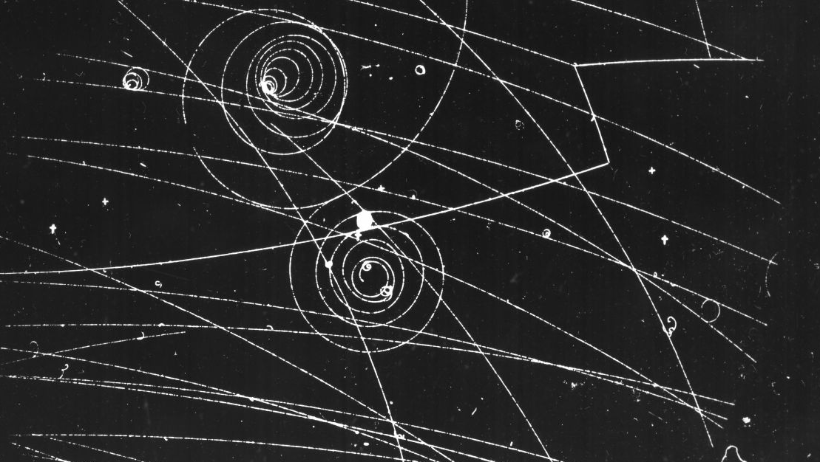
Welcome to the Machester Particle Physics Group!
Elena Gramellini, Michaela Queitsch-Maitland (Experiment)
Christopher Englert (Theory)
25th September 2025

Slide 2
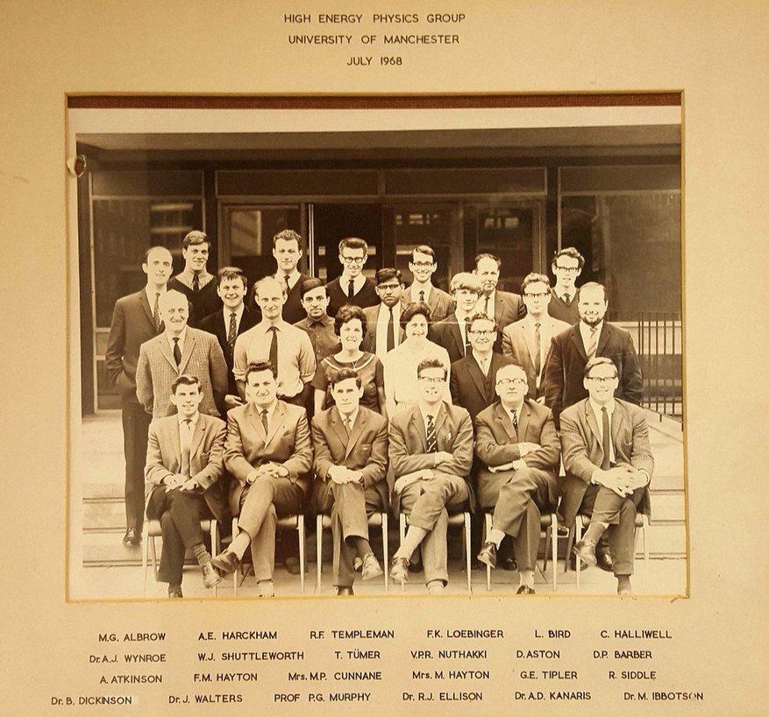
Welcome to the Particle Physics Group!
The group in 1968…

Slide 3
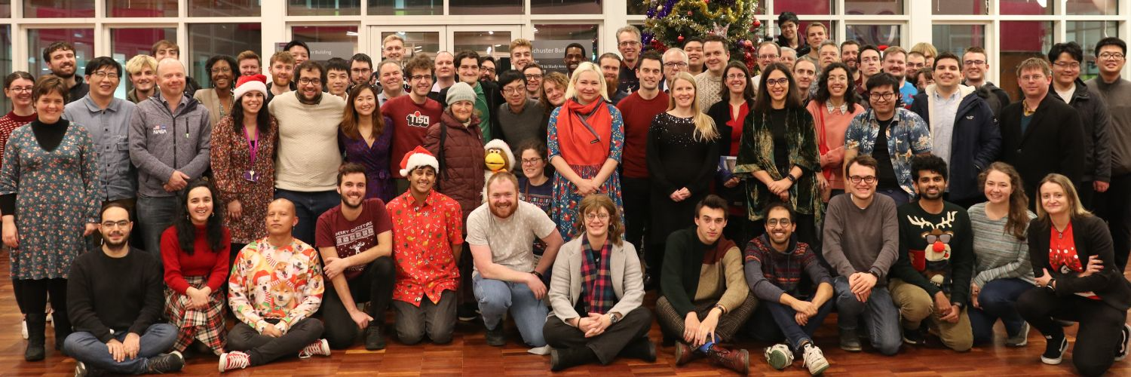

Welcome to the Particle Physics Group!
… the group today(ish)
Christmas 2022

Slide 4
Welcome to the Particle Physics Group!
Big and social group: over 140 researchers, technicians, engineers
Joint theory + experimental research group
Experiments span LHCb (CERN), ATLAS (CERN), FASER (CERN), DUNE/ short-baseline neutrino experiments (Fermilab/USA), NEXT (Spain), Mu2e/g-2 (Fermilab/USA), SuperNEMO (France/Italy), BES-III (China), Darkside-50/20k (Italy), and detector development
Close links with accelerator physics, astrophysics, and nuclear groups.

Slide 5


Coffee and Cake
Good place to speak to other students and staff about your and their work — share ideas!
6th floor coffee area
  Coffee/tea club
    Modest payment per semester/year — get in touch with Ben Wilson [post doc]
  Cake / international treats!
  Tradition to bring back something from travels,
  or for birthdays, including bake-off events
    Coffee time typically 15:30 – but send an email!

Slide 6
Supervisory team
You will have a “supervisory team”
  Supervisor(s) / Co-supervisor
  Advisor
Main supervisors linked directly to your project and are the primary people guiding your PhD research.
Co-supervisor may or may not be involved in your research area (depends on project) and acts as a second point of contact.
Advisor is generally from another research area.

Slide 7

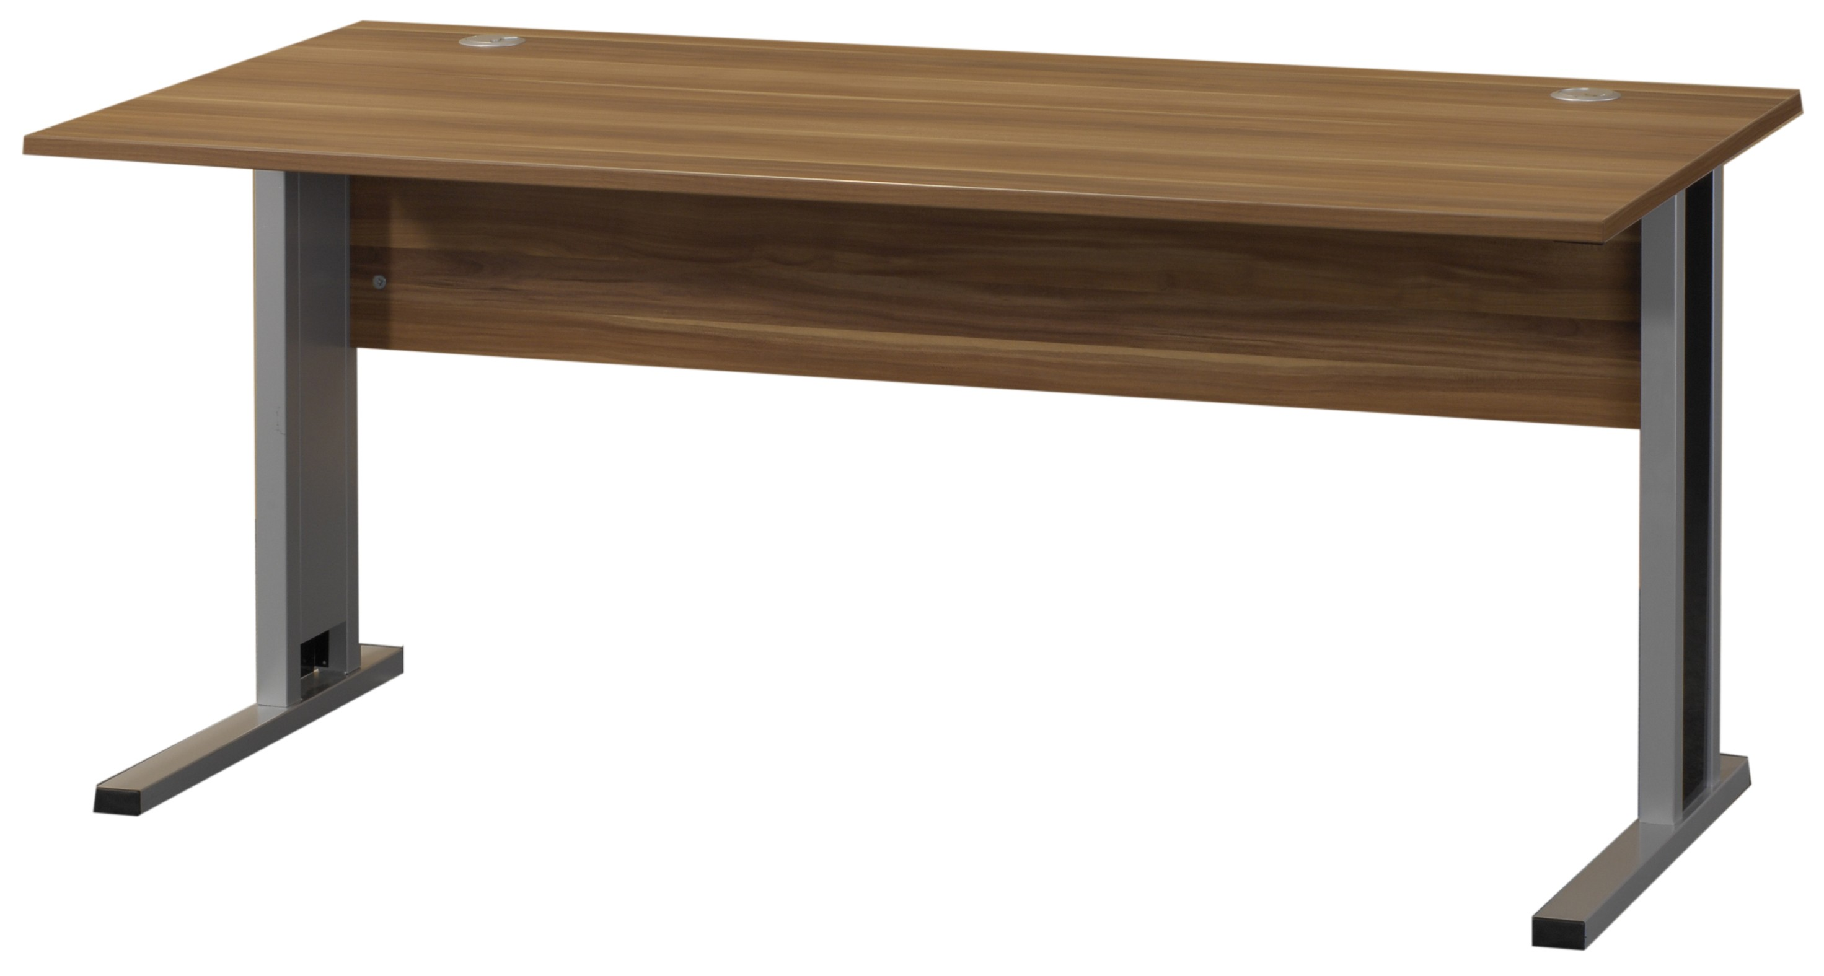
Admin
Laptop/computing:
  You will be provided with a laptop / desktop computer for your use during your PhD/MScR programme (keep in contact with your supervisor about this)
Office/desk:
  PhD students will be placed in an office on the 1st/6th floor
  (speak to your supervisor about where)
  MScR students have allocated desks in the 3rd floor Annexe
  (unless there is space in a PhD office)

Slide 8


Expectations I
Treat your PhD as you would a job.
Be available during normal working hours
  Working from home sometimes fine but discuss with your supervisor.
Keep in regular contact with your supervisor/team
  Most projects rely on teamwork, joining meetings, contributing to discussions, interactions with colleagues…

Slide 9


Expectations II
Be respectful of others
  Follow the University code of conduct.
  We are a friendly group, but a professional environment should be maintained.
Holidays
  You are entitled to them, please take them!
  Discuss early with your supervisor, give plenty of notice.

Slide 10

Travel
PhD students have access to modest travel funds within the group.
As a rough guide, this can approximately cover:
  a national conference,
  an international conference, and
  occasional visits to international labs during your PhD.
Discuss first with your supervisor.
Book well in advance, do price comparisons, apply for external funding where possible.

Slide 11

Travel
All travel/accommodation has to be booked via Phys-Ops
  Must be pre-authorised, ask ASAP
  Check with Phys-ops/supervisor if unsure what documents are needed
Keep receipts for all eligible expenses to claim back after travel
  Typically covers: transport, subsistence (food/drink — not alcohol!), accommodation, registration fees.

Slide 12


Long Term Attachments (LTA)
Long Term Attachments (~1 yr placement) on site is possible, but needs to be applied for separately
  Done via us/STFC (Q1 of 2026)
Typically this is to visit experimental site (CERN/Fermilab/etc.) to undertake detector upgrades or operations (e.g. shifts).
  Expectation is that you fully engage in the on-site activities while you are there.
LTA is not guaranteed and should be well justified
  Discuss with your supervisor in the first instance.

Slide 13

Christmas meeting
Annual full group meeting will be in late December with a dinner planned for one evening (email will be sent closer to the time)
  Dates TBC, but expected to be Mon/Tue after teaching finished (22nd/23rd Dec 2025)
  Format TBC, last year there are overview talks on all areas of the group.
  Likely all new students will be asked to introduce themselves and their PhD project, plans for the future (~5 min).
  Opportunity to meet more members of the group, learn about different areas, ask questions, get experience presenting.

Slide 14
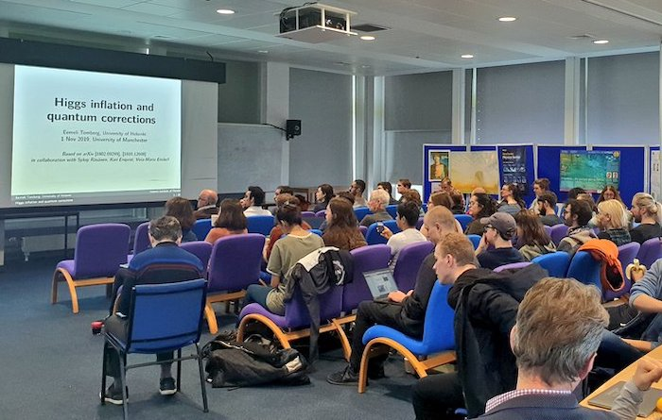
Additional training
Niels Bohr seminars Fridays 13:00 in term-time
  https://indico.cern.ch/category/12688/ Starts 3rd Oct
  Part of your broader education – everyone should attend
  Students are encouraged to ask questions!
Physics Colloquia: should also definitely attend!
  More infrequent, few a term, on Wednesdays (look out for emails)
HEP journal clubs (experiment/theory)
Can attend lectures (FPP1, QFT, Gravitation, FPP2, Gauge Theories, Early Universe, Adv. QM…) check with your supervisor!
Graduate training: postgraduate-researchers-development-programme
Experiment-specific training (workshops, meetings)
Discussing with people from the group and the labs (CERN, Fermilab etc.)
STFC Summer School / BUSSTEPP at the end of your first year
Public engagement (can take many forms) / policy internships

Slide 15
Graduate Teaching Assistant (GTA)
Help support of the teaching and learning in Physics & Astronomy.
  Covers laboratory, computing classes, making examinations.
  Paid hourly (https://documents.manchester.ac.uk/DocuInfo.aspx?DocID=30037)
Opportunity to gain teaching experience and broaden the scope of your CV.
Applications can be made at https://gta.manchester.ac.uk/application/
  Always consult with your supervisor before applying!

Slide 16
PhD first year structure
No taught requirements for the PhD programme at Manchester — get stuck into training/research straight away!
December: Introduction and presentation to the group (~5 mins)
~February: application for Long Term Attachment (will be submitted by your supervisor, but discuss expectations with them)
~June: First year transfer report: 20 page write-up and “mini-viva”
~Aug/Sept*: STFC Particle Physics Summer School (2 weeks) / BUSSTEPP
*Dates may be modified

Slide 17

Issues/questions? I
General route to escalate problems:
  Talk with Supervisor(s)→Advisor→Anyone else! (inside or outside group)
  Communication is critical, tackle them early and don’t let them snowball
Student support team in School and at University-level
Bullying / harassment: reporting mechanisms available / student support

Slide 18
Issues/questions? II
Administrative questions:
  Physics-Operations: PHYS-OPS@manchester.ac.uk
  Can help you with travel bookings, documents you might need etc.
Computing questions
  Related to local computing or for Tier-2 computing/GPU cluster send mails to: blackett-support@listserv.manchester.ac.uk
Postgraduate Handbooks
On Blackboard and eProg (through MyManchester http://my.manchester.ac.uk/ )
If in doubt about who to speak to, raise with your supervisor in first instance, or don’t hesitate to ask us!

Slide 19

Any other questions?

