Slide 1
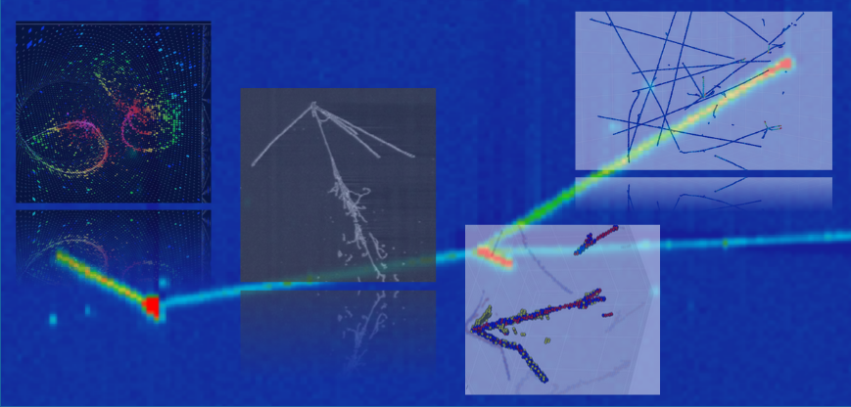
Neutrino Physics and Machine Learning
NPML Summary @ UC Irvine
Kazuhiro Terao (SLAC)

Slide 2
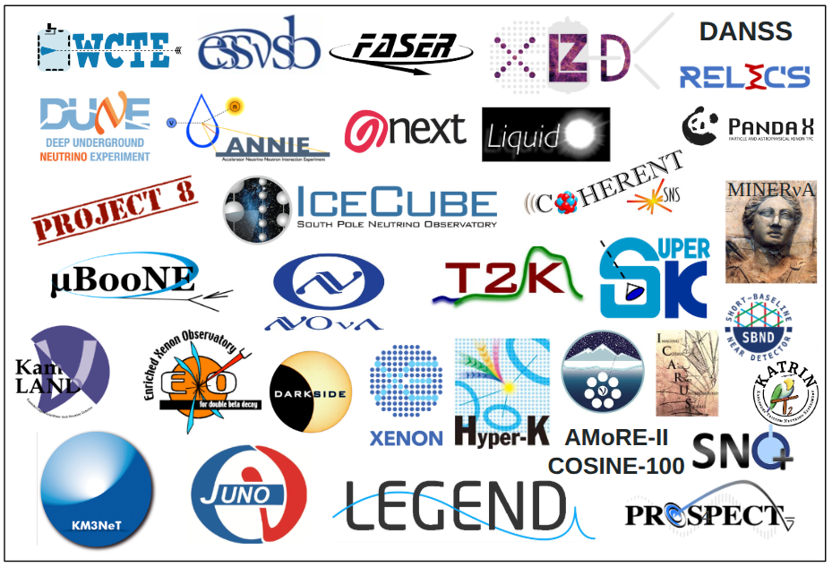
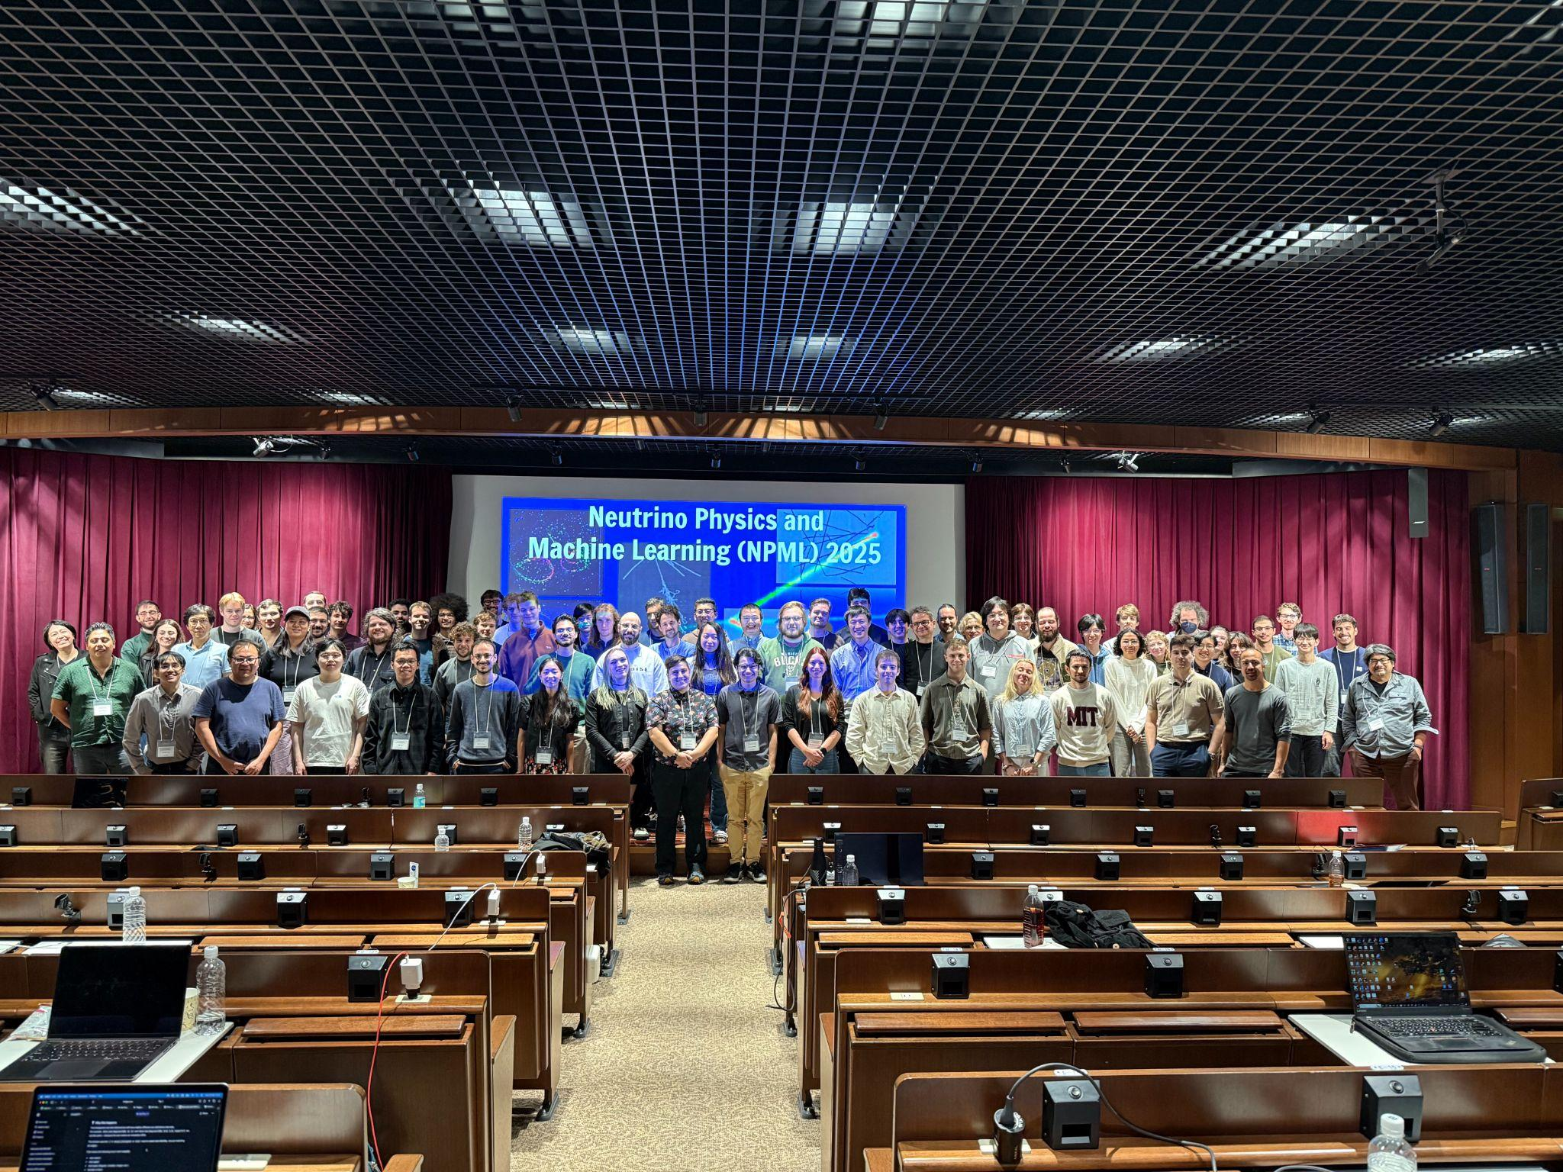
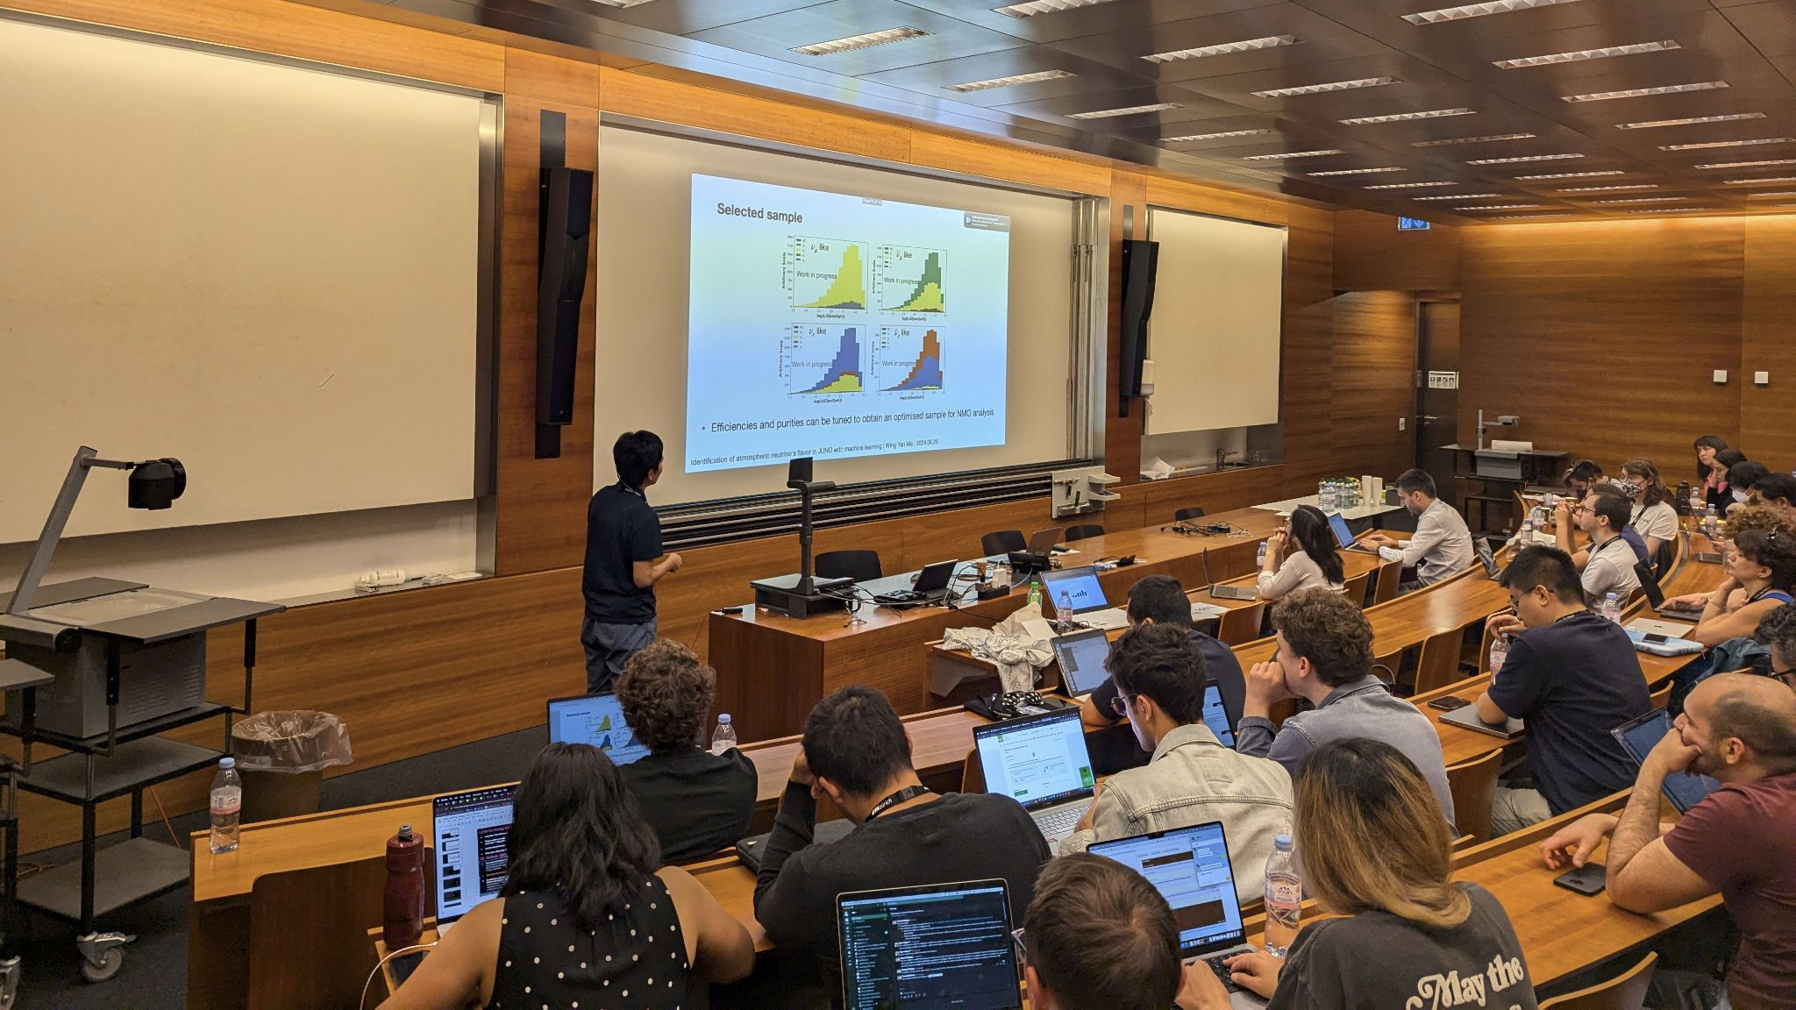
NPML Conference Series
Goal: a venue for technical (AI-focused) research progress, specialized in neutrino physics and data
Started as a virtual satellite event in 2020
2023 @ Tufts
2024 @ ETH (satellite of Neutrino 2024)
2025 @ U-Tokyo
2026 @ UC Irvine (satellite of Neutrino 2026)

Slide 3
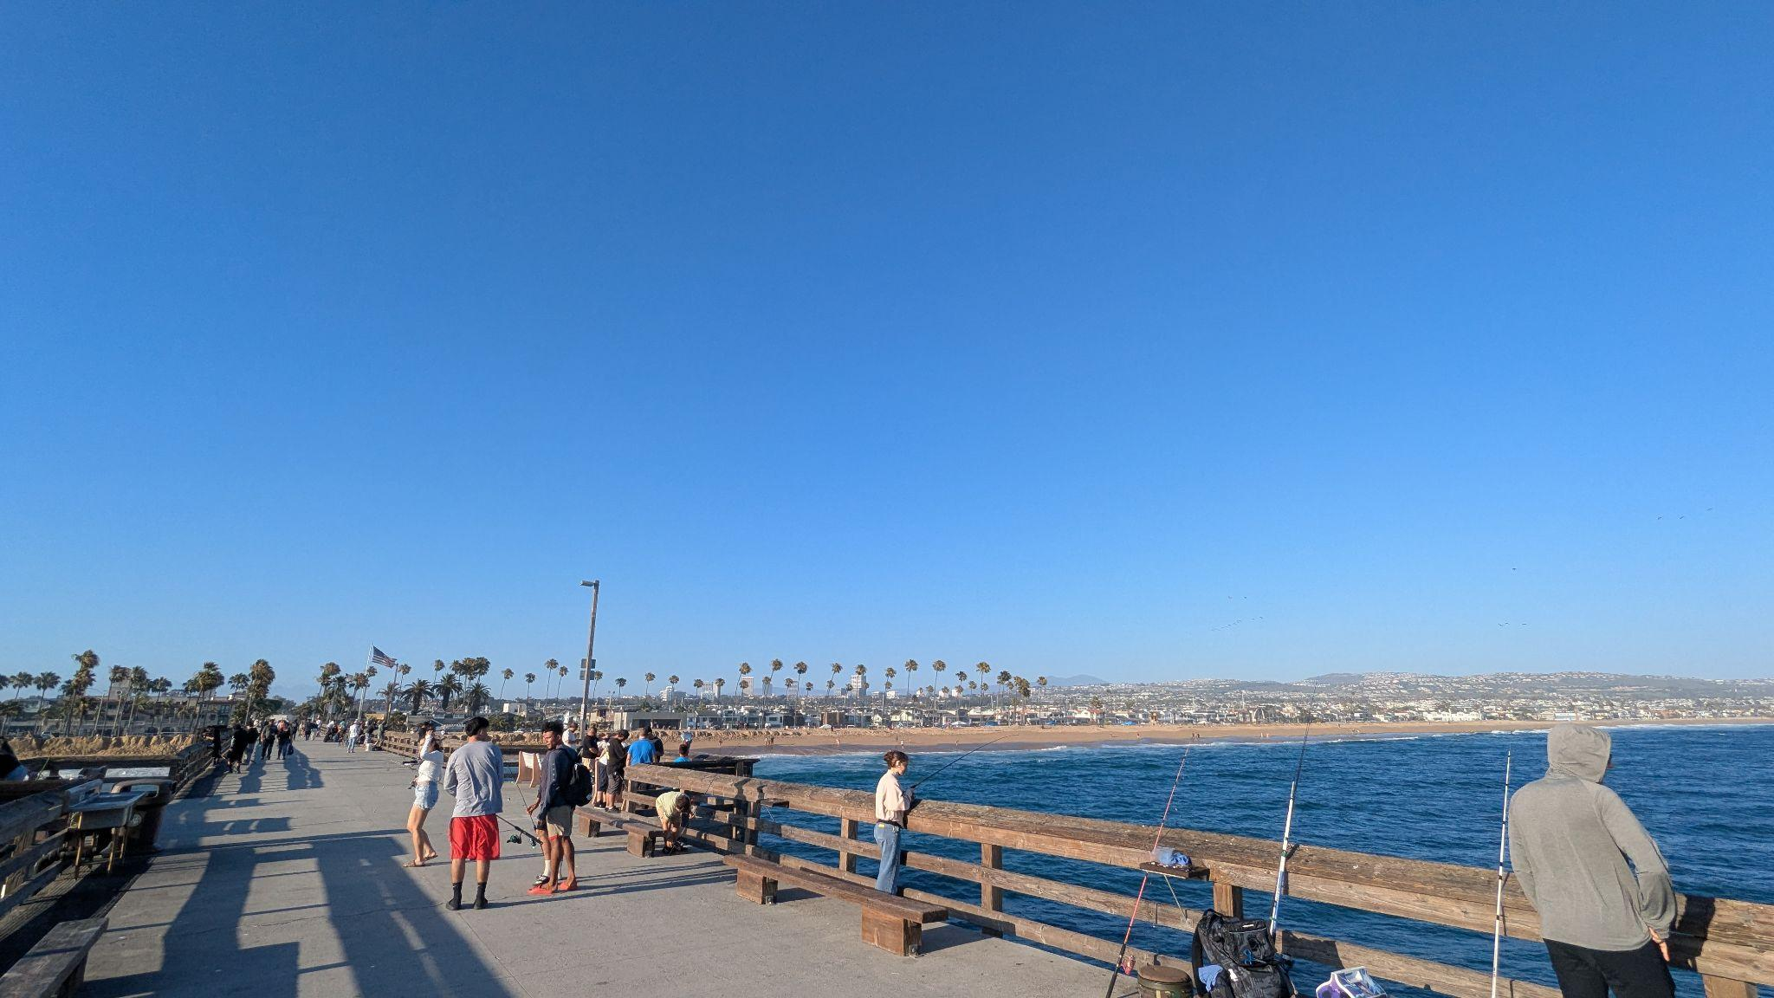
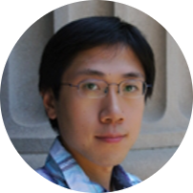

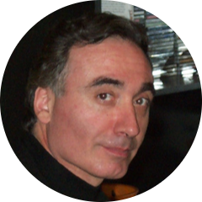
NPML 2026
June 15-19 @ UC Irvine
90 registered for in-person
  10 virtual, 10 withdrawn (visa)
60 talks, 40 posters
  Many presented both
Jianming Bian
(Host)
Aaron Higuera
(Fin. Support, DUNE-TECH)
Pierre Baldi
(Fin. Support, AISI)

Slide 4
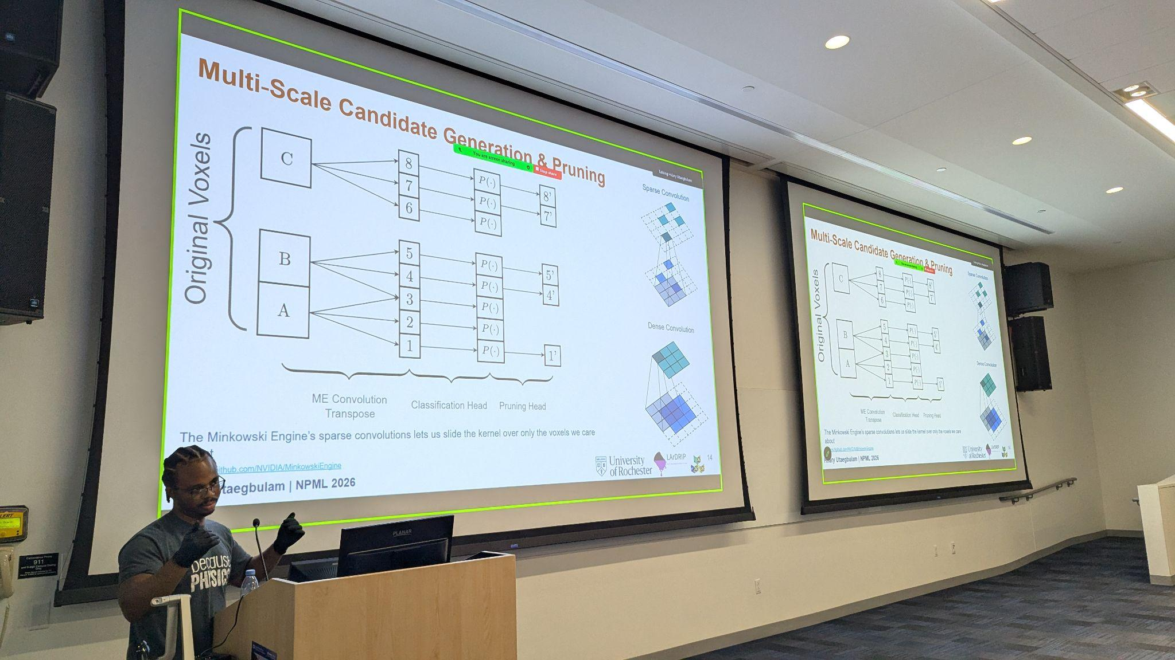
Topics Covered
A: AI Applications in Neutrino Experiments
  A1: Particle & Event Classification
  A2: Energy, Direction & Kinematic Reconstruction
  A3: Detector Calibrations & Systematic Uncertainties
  A4: Signal Processing and Physics Inference
  A5: AI/ML Ecosystem and Scientific Automation
B: Fundamental AI Methods R&D
  B1: Novel Architectures for Detector Geometries
  B2: Self-supervised Learning & Foundation Models
  B3: Generative & Advanced Reconstruction Methods
C: Sharable AI Tools Across Experiments
  C1: Cross-Experiment Reconstruction Tools
  C2: Generator & Cross-Detector Methods
D: Novel Computational Methods
  D1: Advanced Sim & Reco Infrastructure
E: Public Datasets and Open Data Challenge

Slide 5
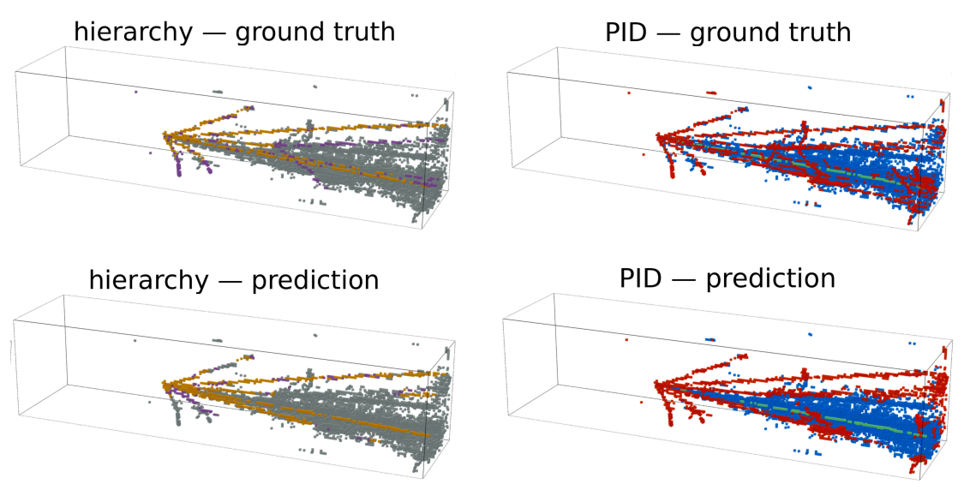
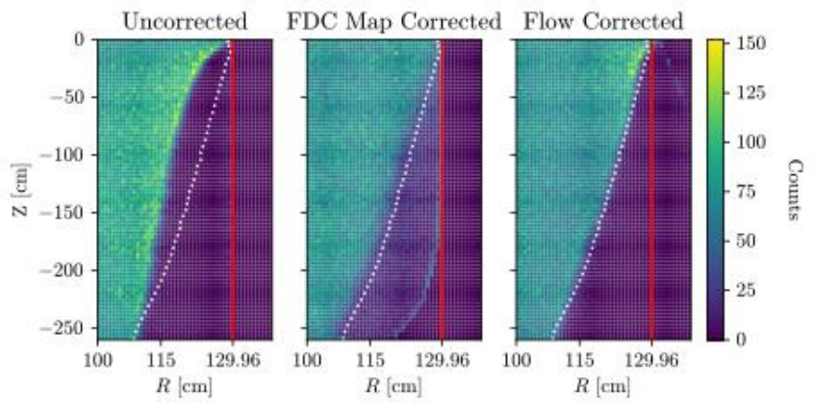
AI Applications for Experiments
Applications
Reco in DUNE, IceCube, FASERCal, MicroBooNE, T2K
  Clustering, particle ID, etc. Many improvements, some solves what was impossible. Common benchmarks would help to understand the impact.
Calibration: LXeTPC E-field and denoising, photons in Eos/SNO+, ICARUS
  Surrogates (flows, implicit neural reps.), simulation-based inference to learn E-field, detector physics parameters, and estimating systematics
Talk link
Talk link

Slide 6
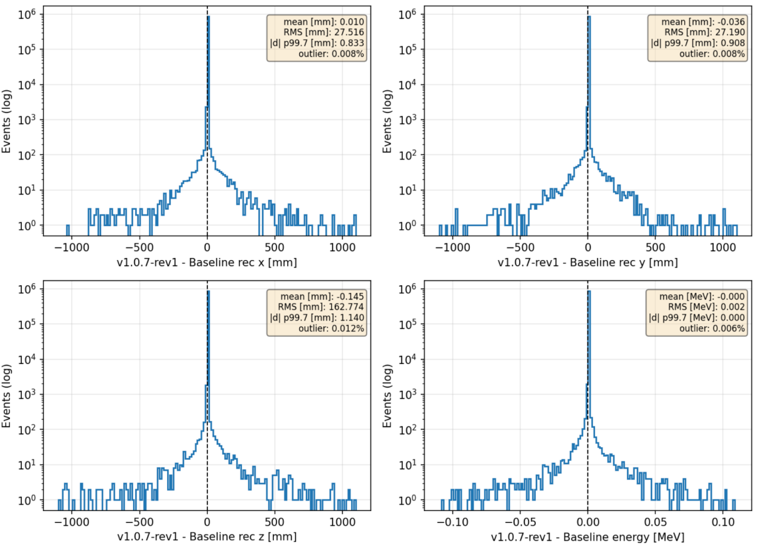
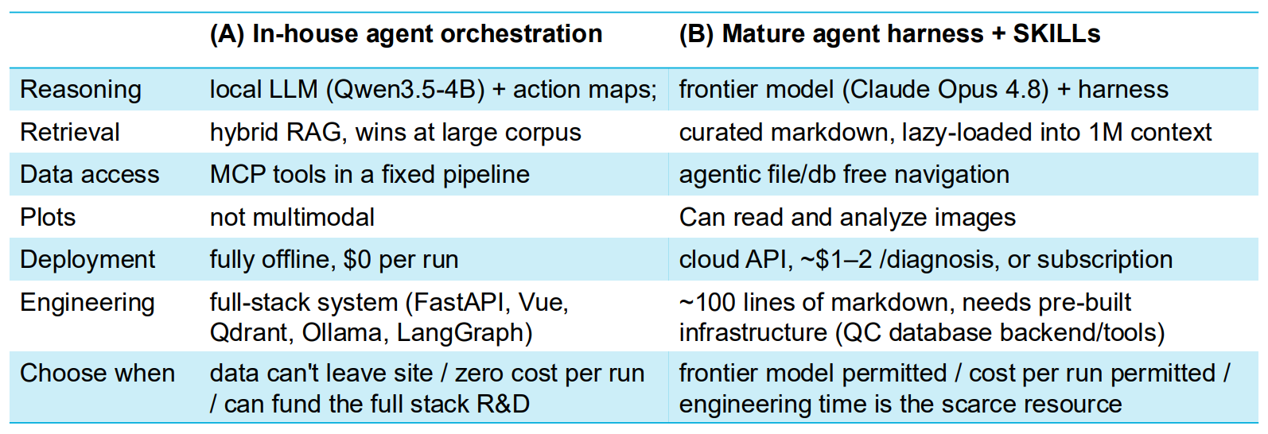
AI Applications for Experiments
Applications
Analysis: SNe (detection and direction), CP violation search in Hyper-K, event-level energy in NOvA, atm. Nus in JUNO, neutron detection in LArTPC
Scientific Automation: quality control in DUNE, analysis automation in JUNO
  Factors speed-up through automation. Analysis/Experts validation steps.
  Comparison of a home-brewed solution (RAG/MCP) vs. Claude agentic workflow
Talk link
Talk link

Slide 7
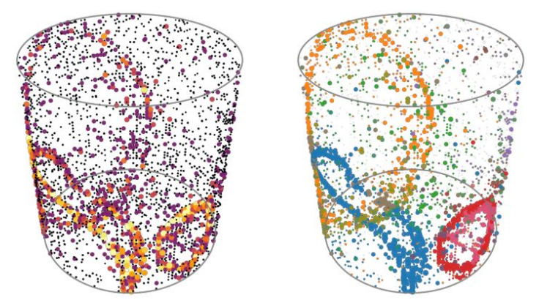
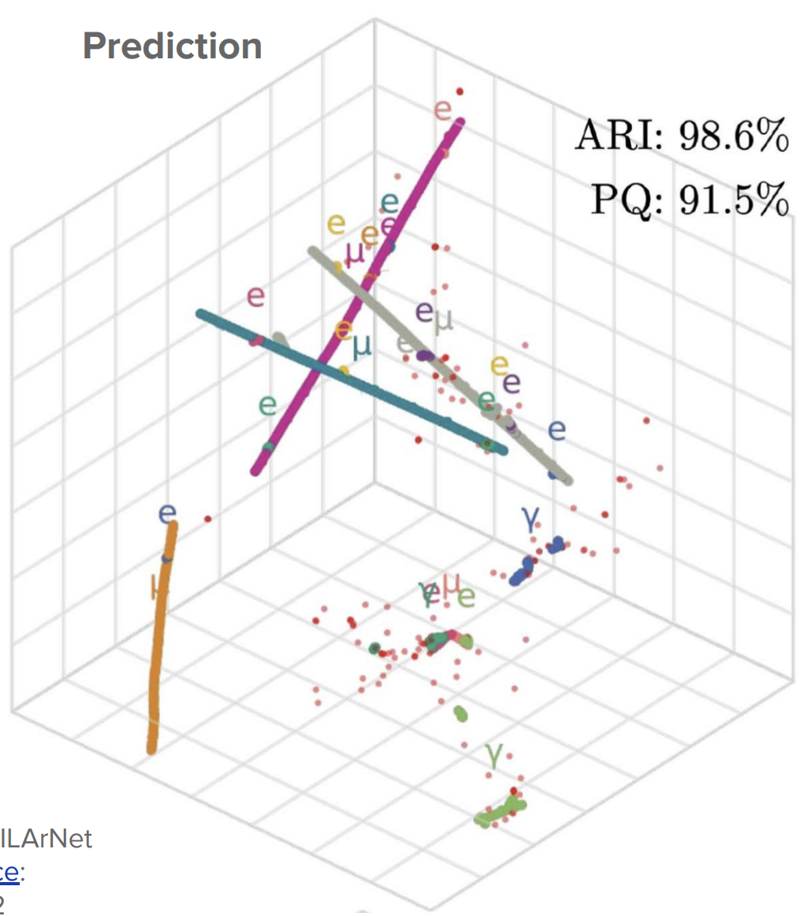
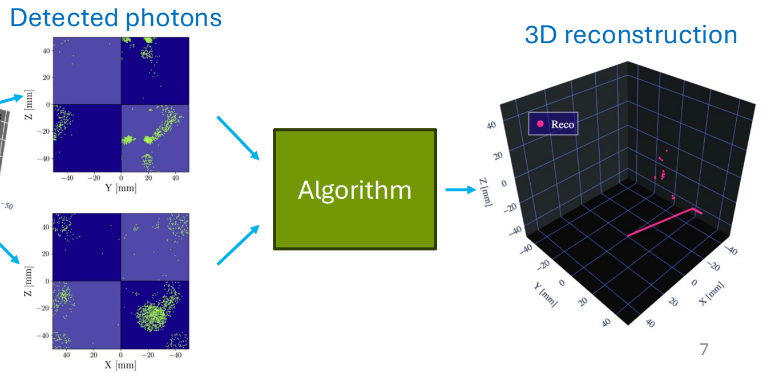
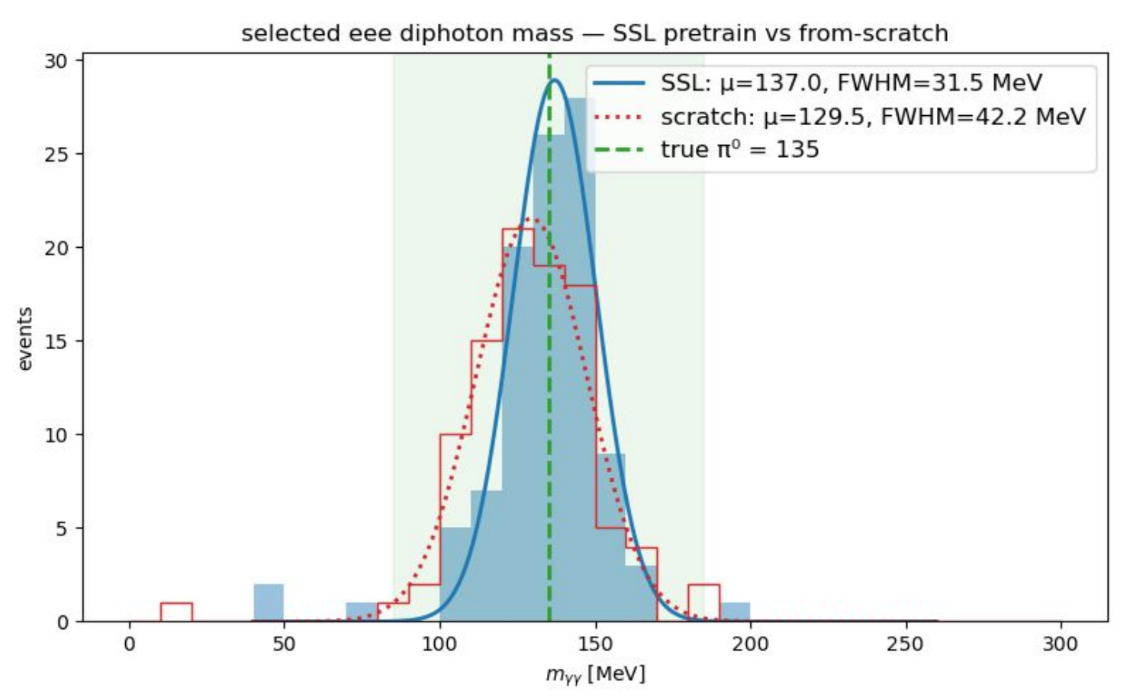
AI Methods R&D
Optical Physics Modeling
Optical detectors: inverse imaging, photon direction, timing, and waveform
Advanced Reconstruction / Generative Models
SPINE++, NuGraph3, latent diffusion, filling module gaps, nu-N modeling
Foundation Models
Cross-modalities (detectors, sensors, input data) and reusable models

Slide 8
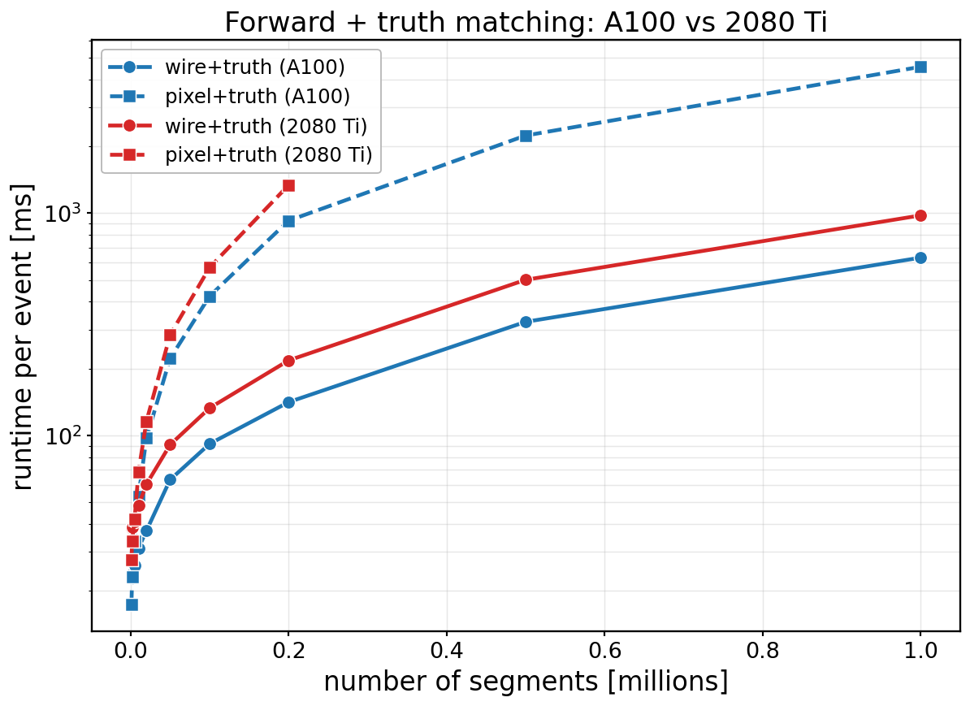
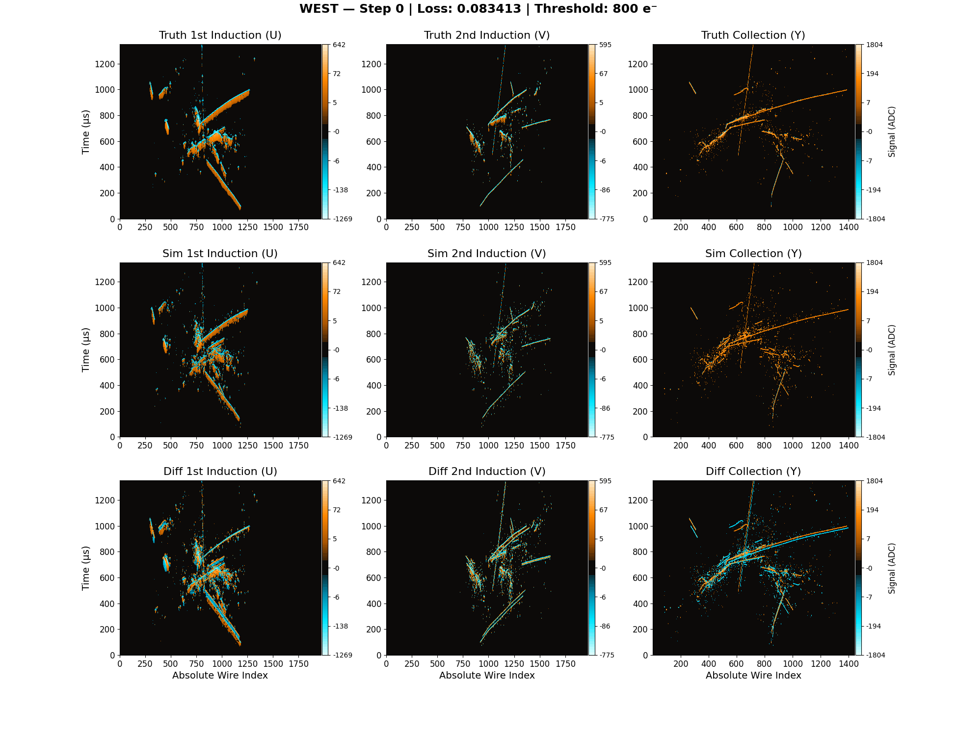
Novel Computational / Sharable Techniques
GPU-enabled, Scalable Simulation Tools
TPC simulator JAXTPC / Tred, optical tracking Symphony, differentiable LADS
Sharable tools
DINO for Wire-Cell, LoRA for FMs, optimal transport for PID, SBI for generators
Xformer event-reweighting, ATLAS-MINERvA shared FM, x-detector track matching

Slide 9
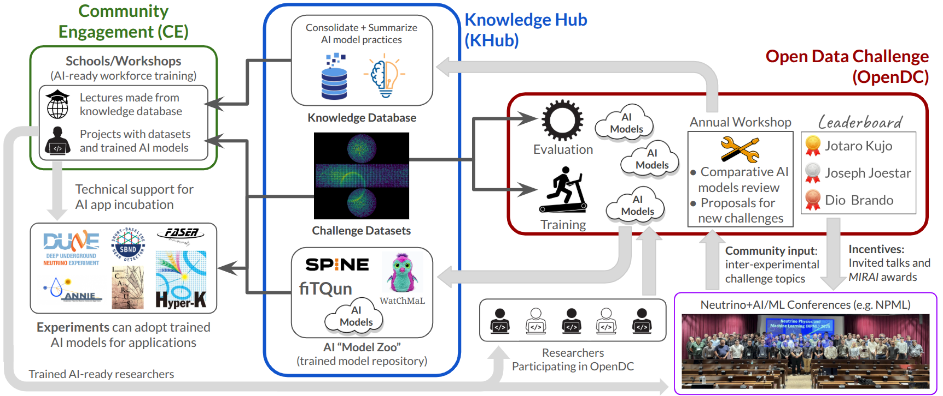
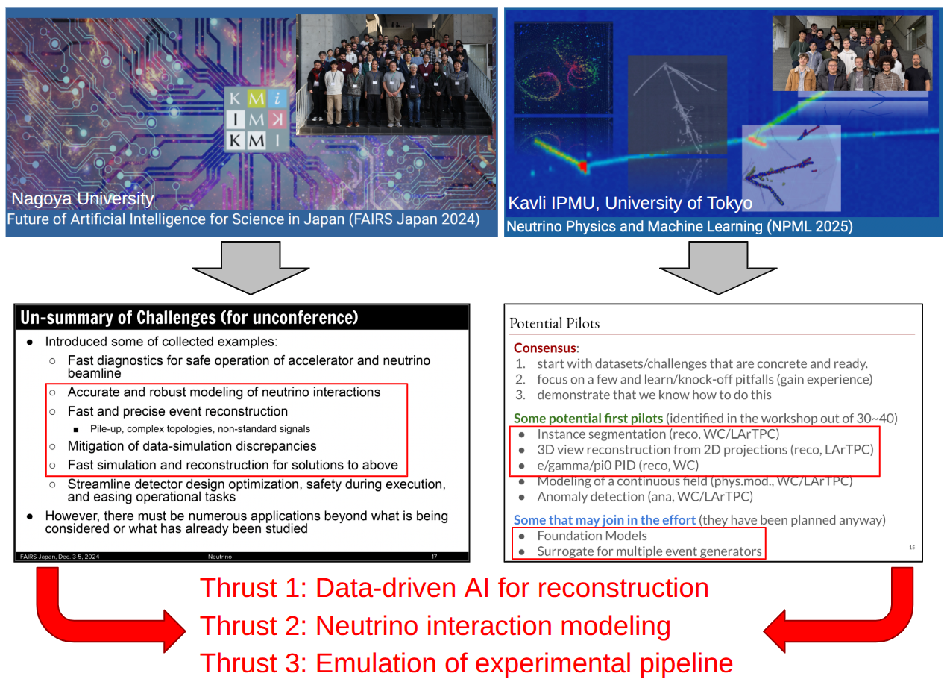
Public Datasets and Data Challenges
Open datasets
MicroBooNE is expanding (waveforms, 3D point clouds, detector variations, nus). WAND: simulated water Cherenkov data for AI R&D (e.g. Foundation Models)
Ecosystem with open datasets
GhostHunter: open data challenge since 2019
Doraemon: an anticipated new US-Japan project to build an ecosystem with public dataset + data challenge + “ML review” (ala PDG) + education/training
  Work with/within Genesis Mission, AI R&D ecosystem building for neutrino

Slide 10
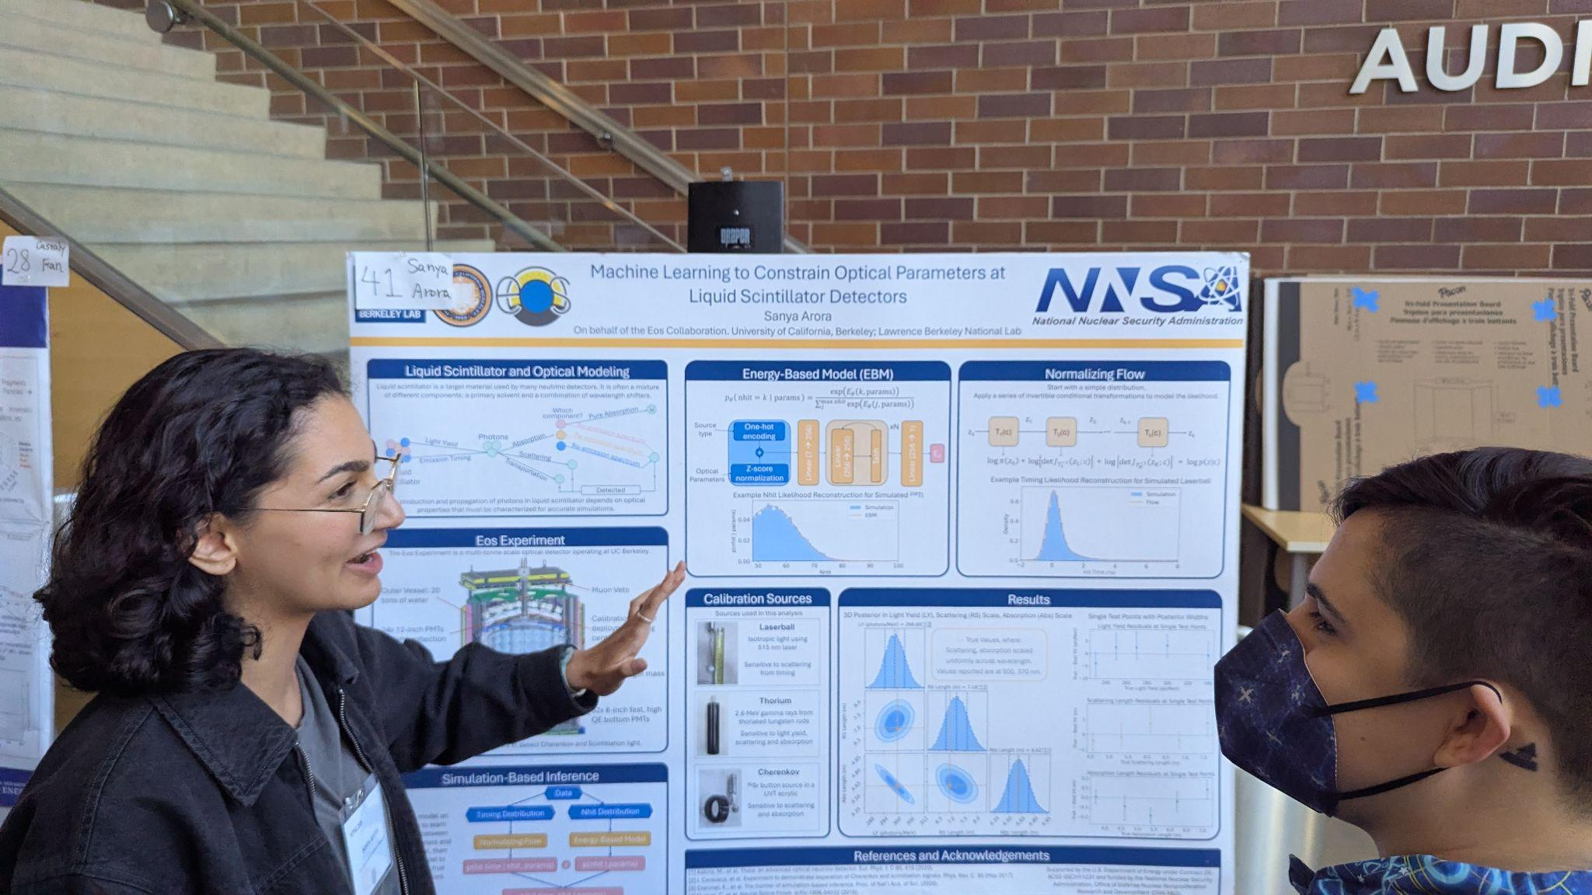
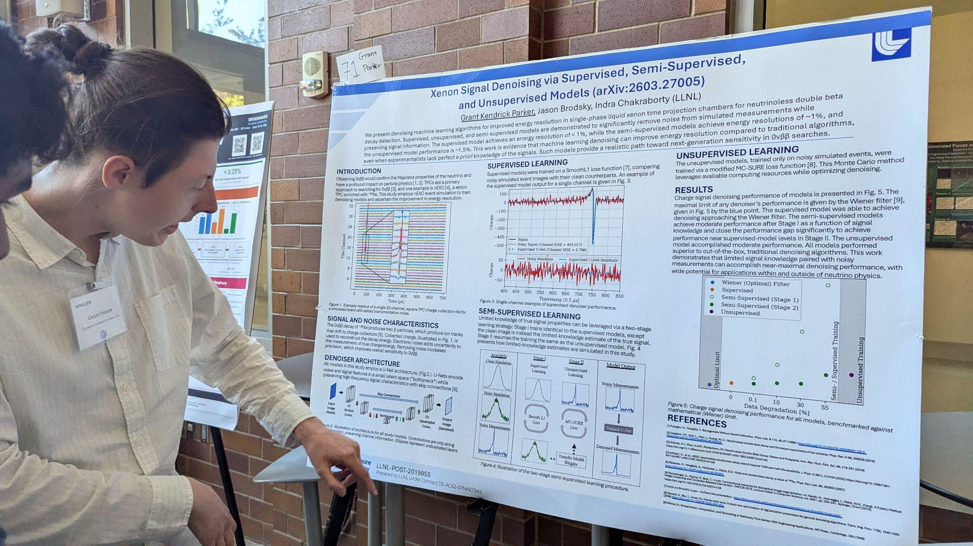
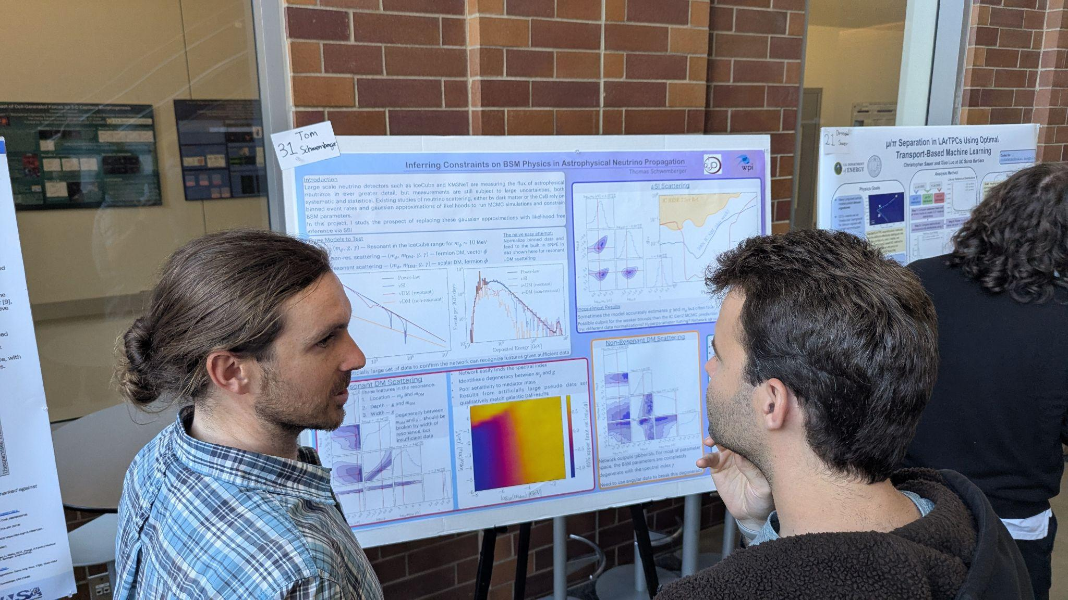
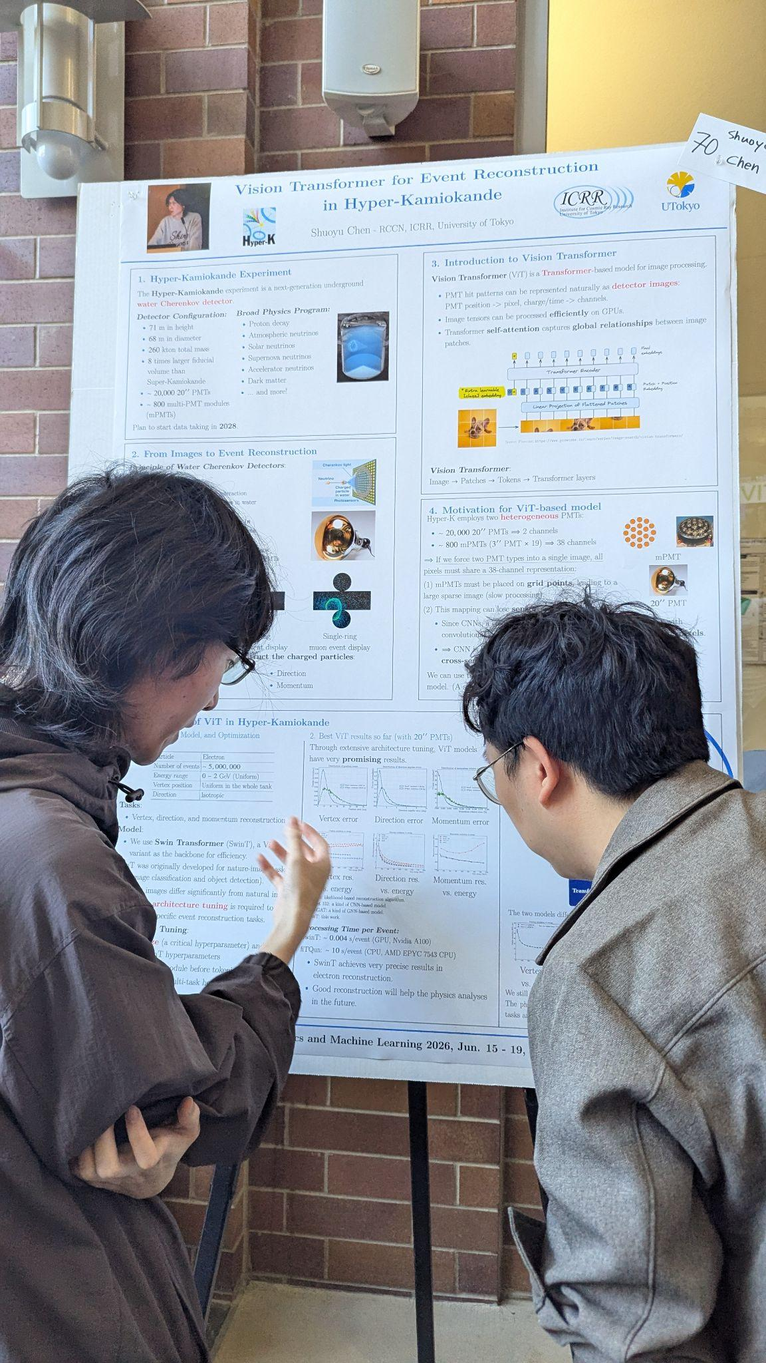
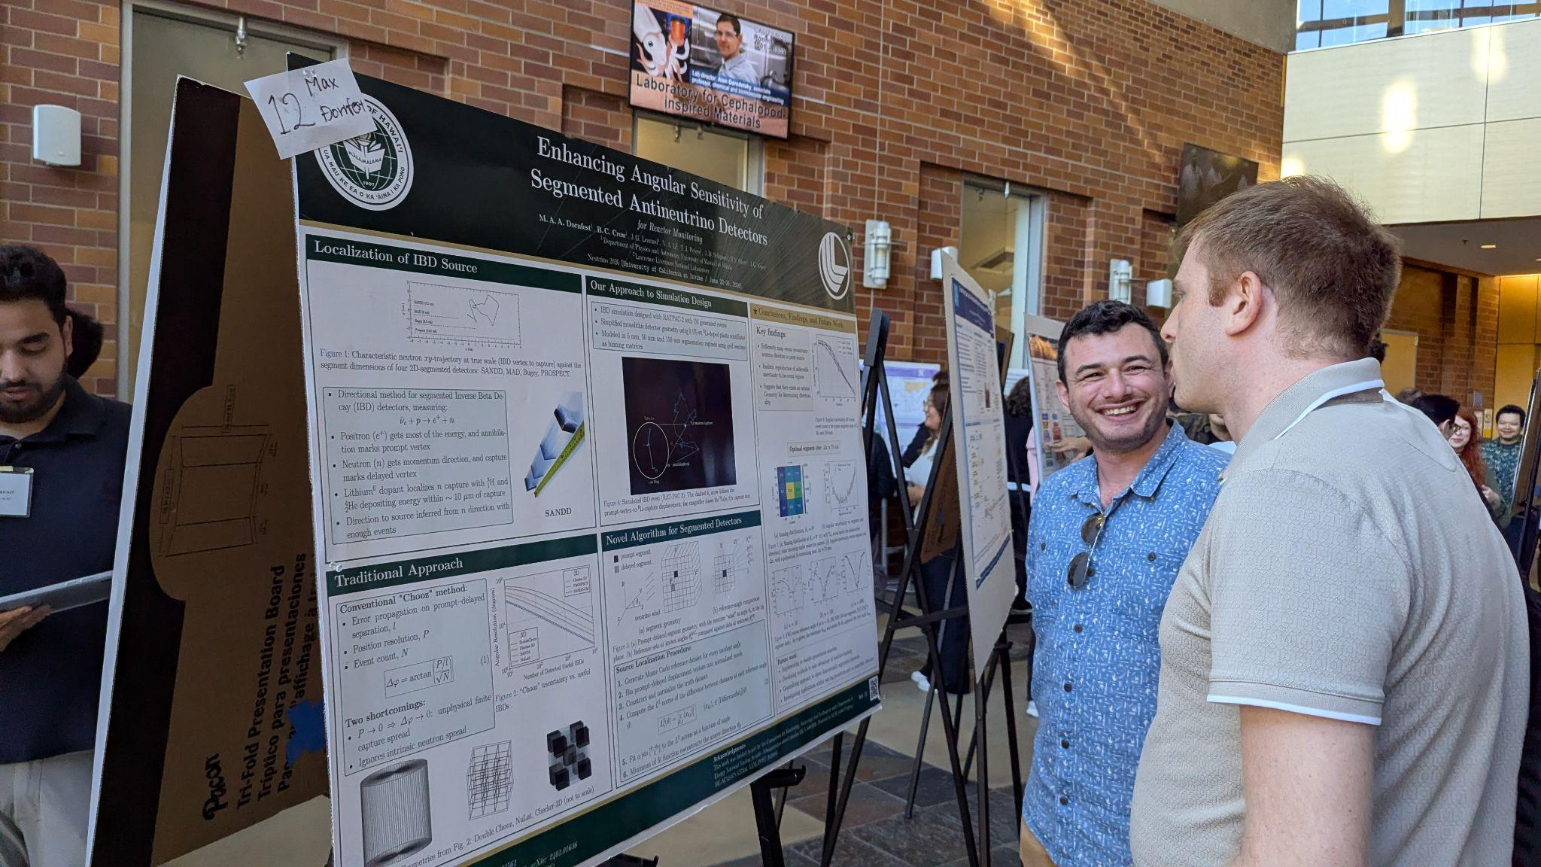
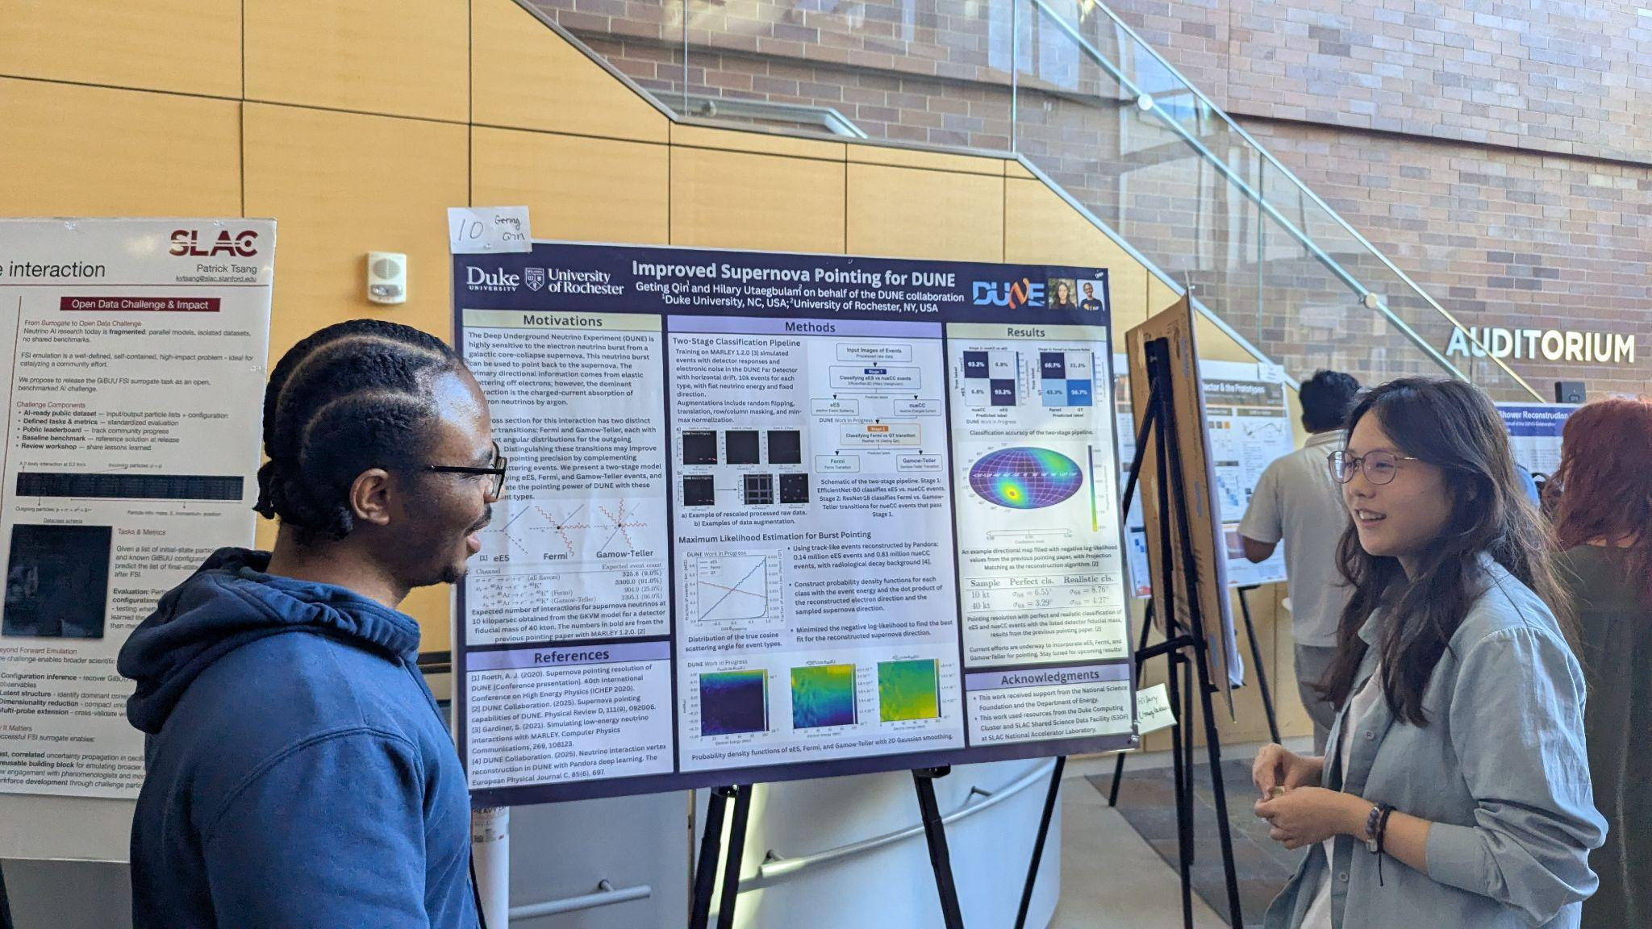
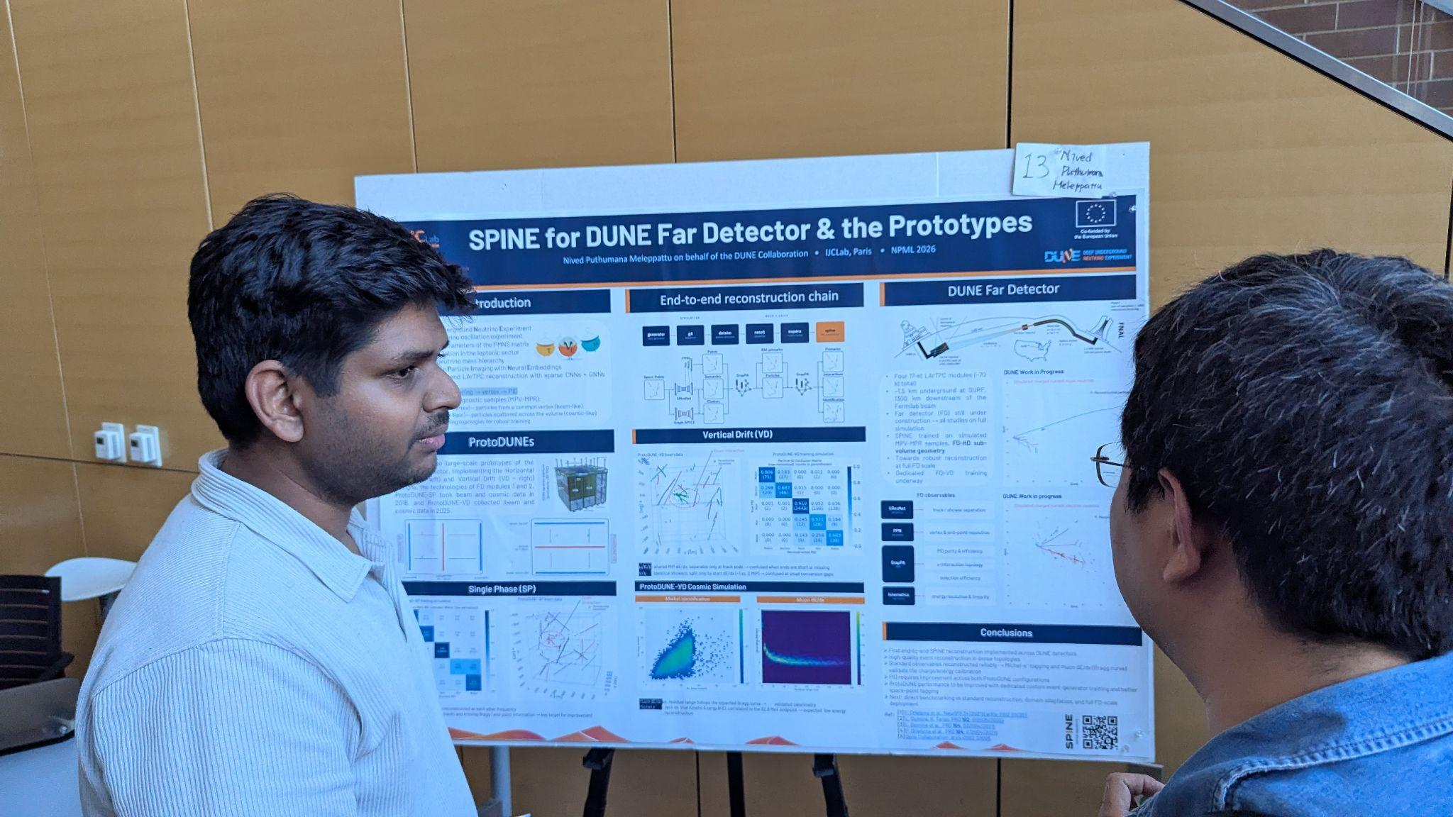
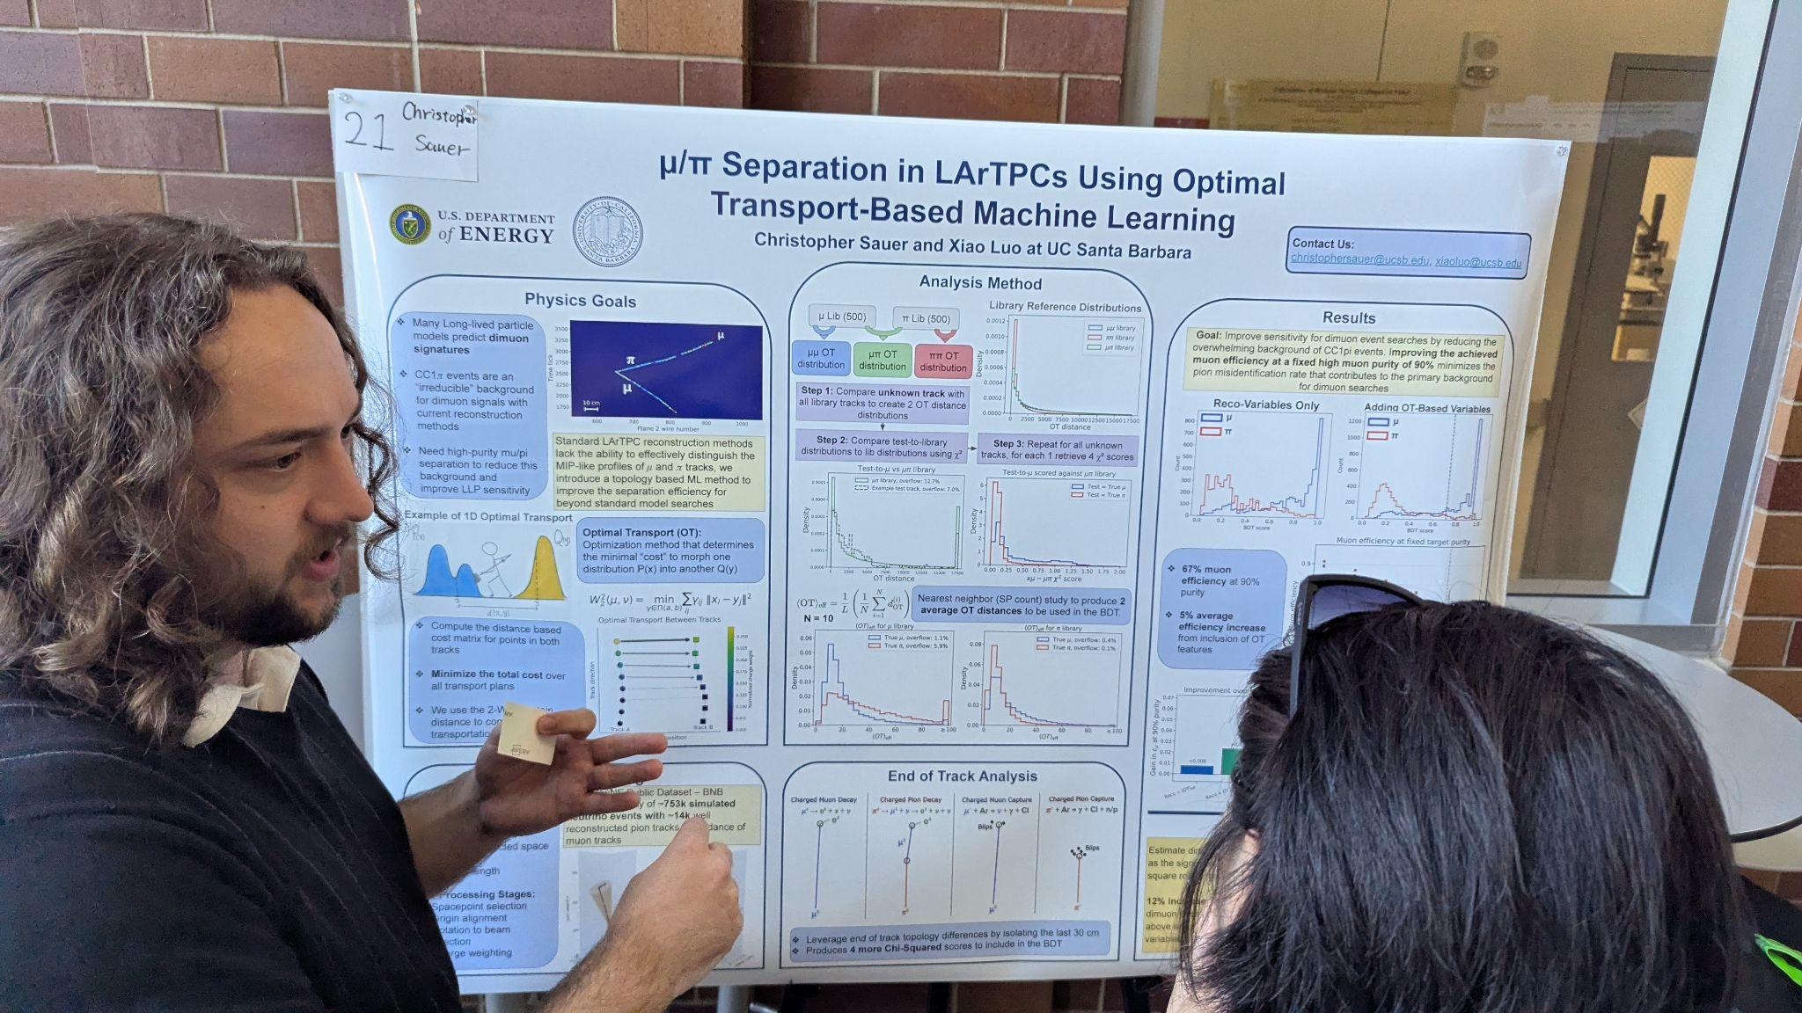
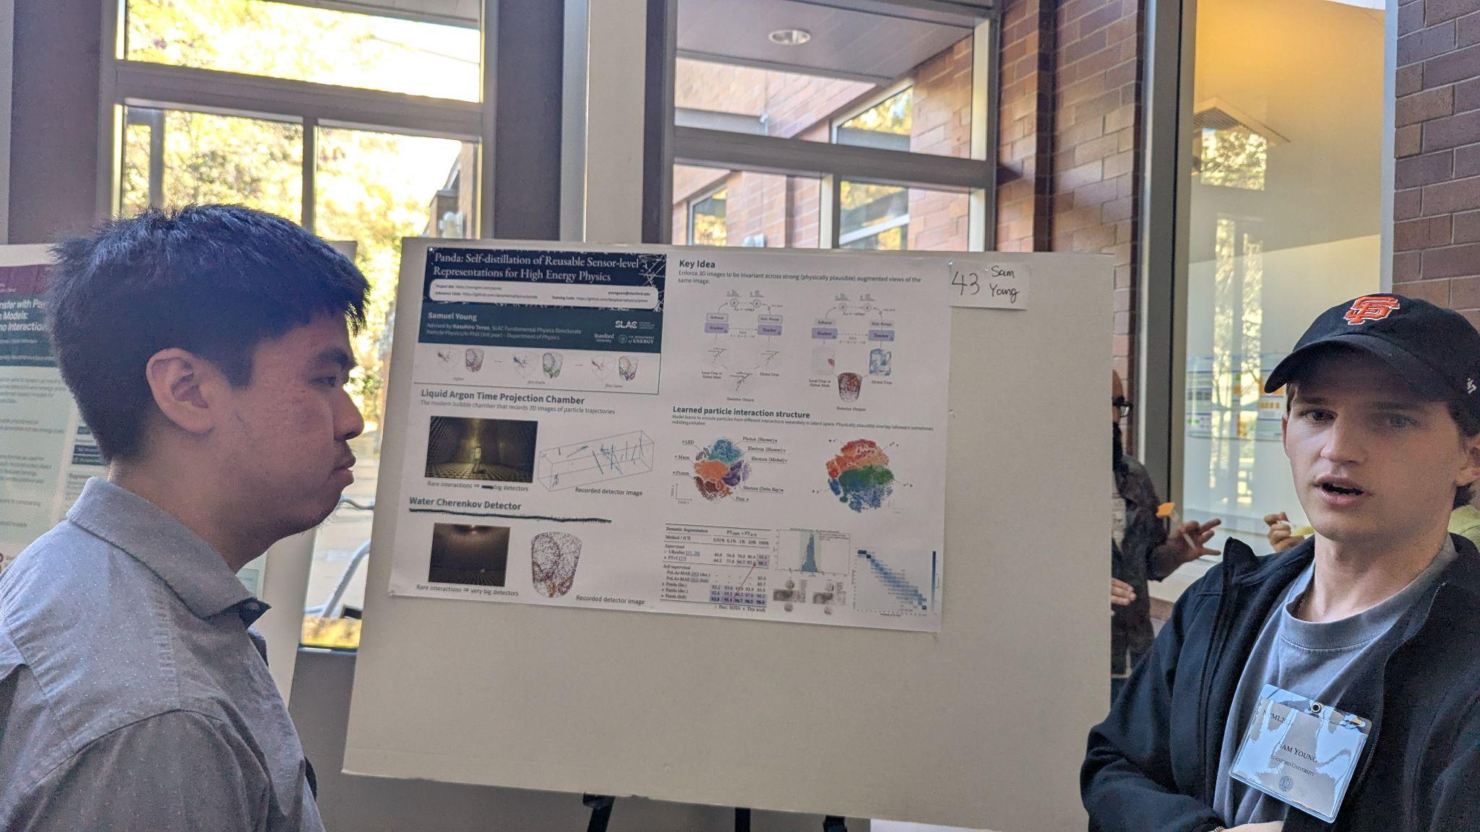
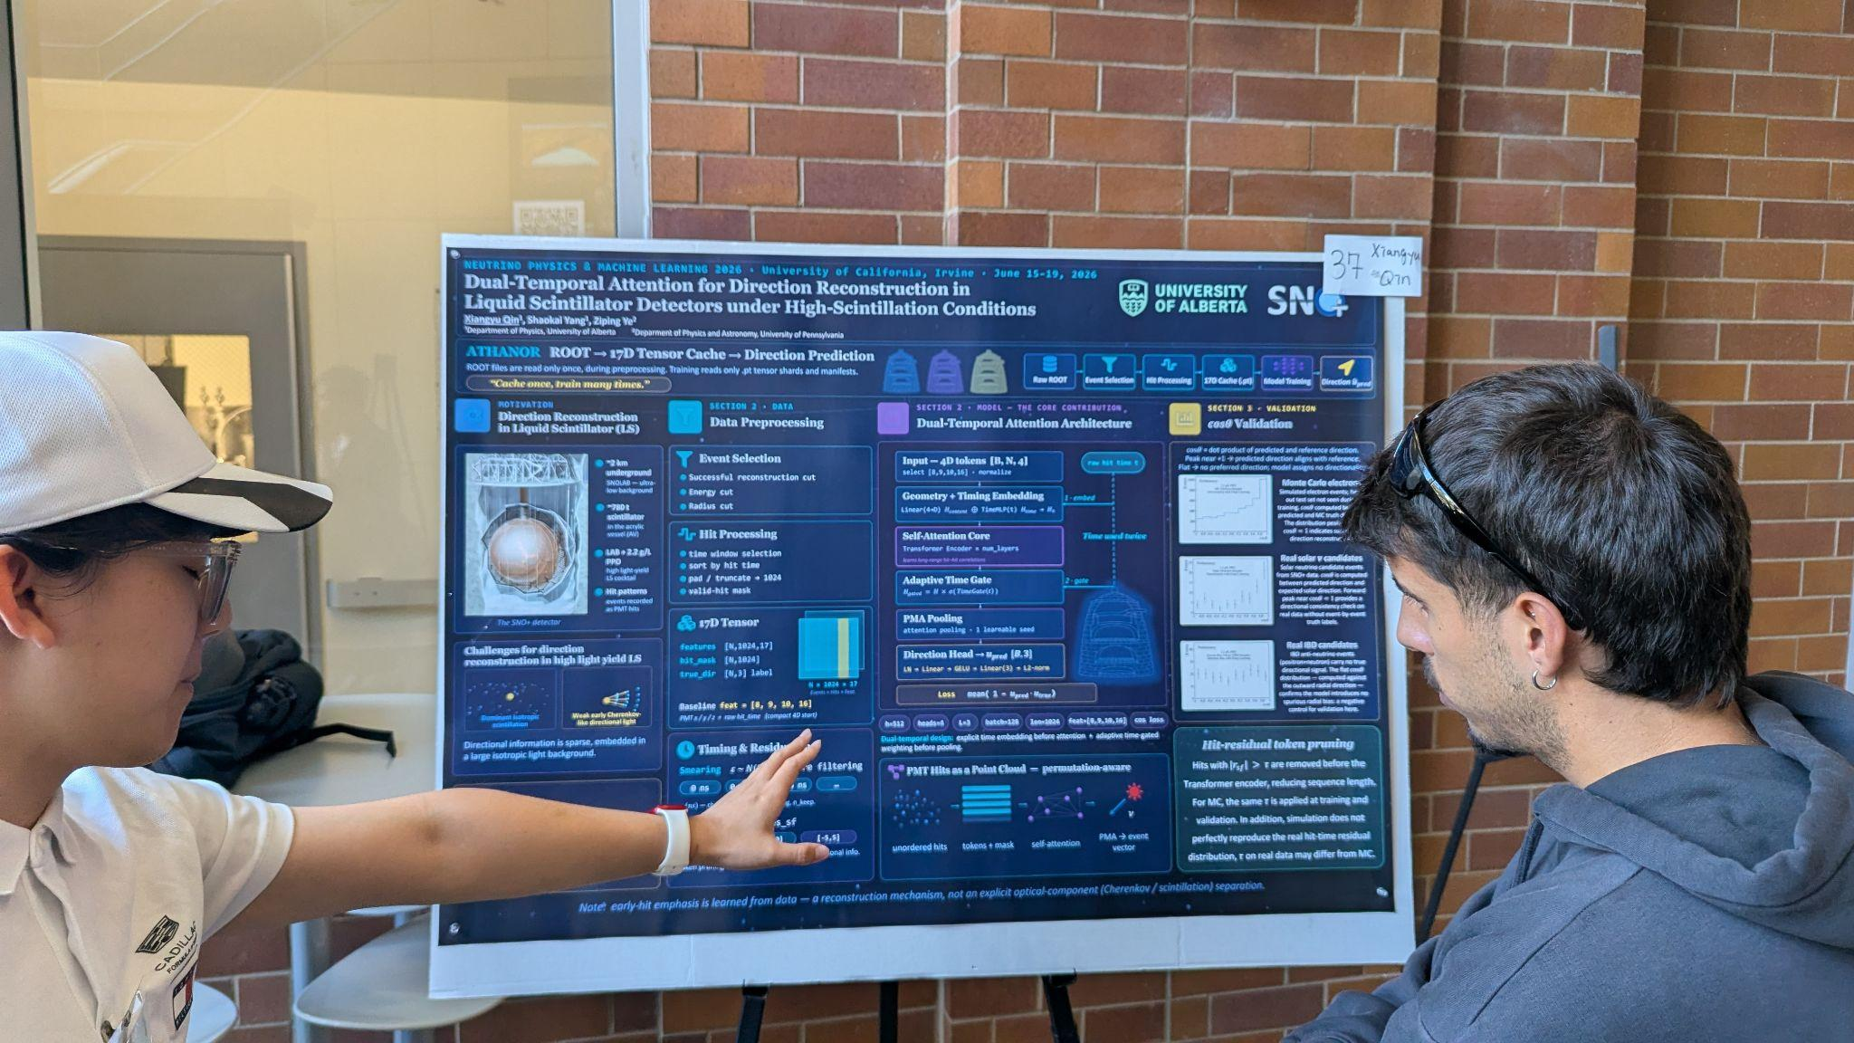
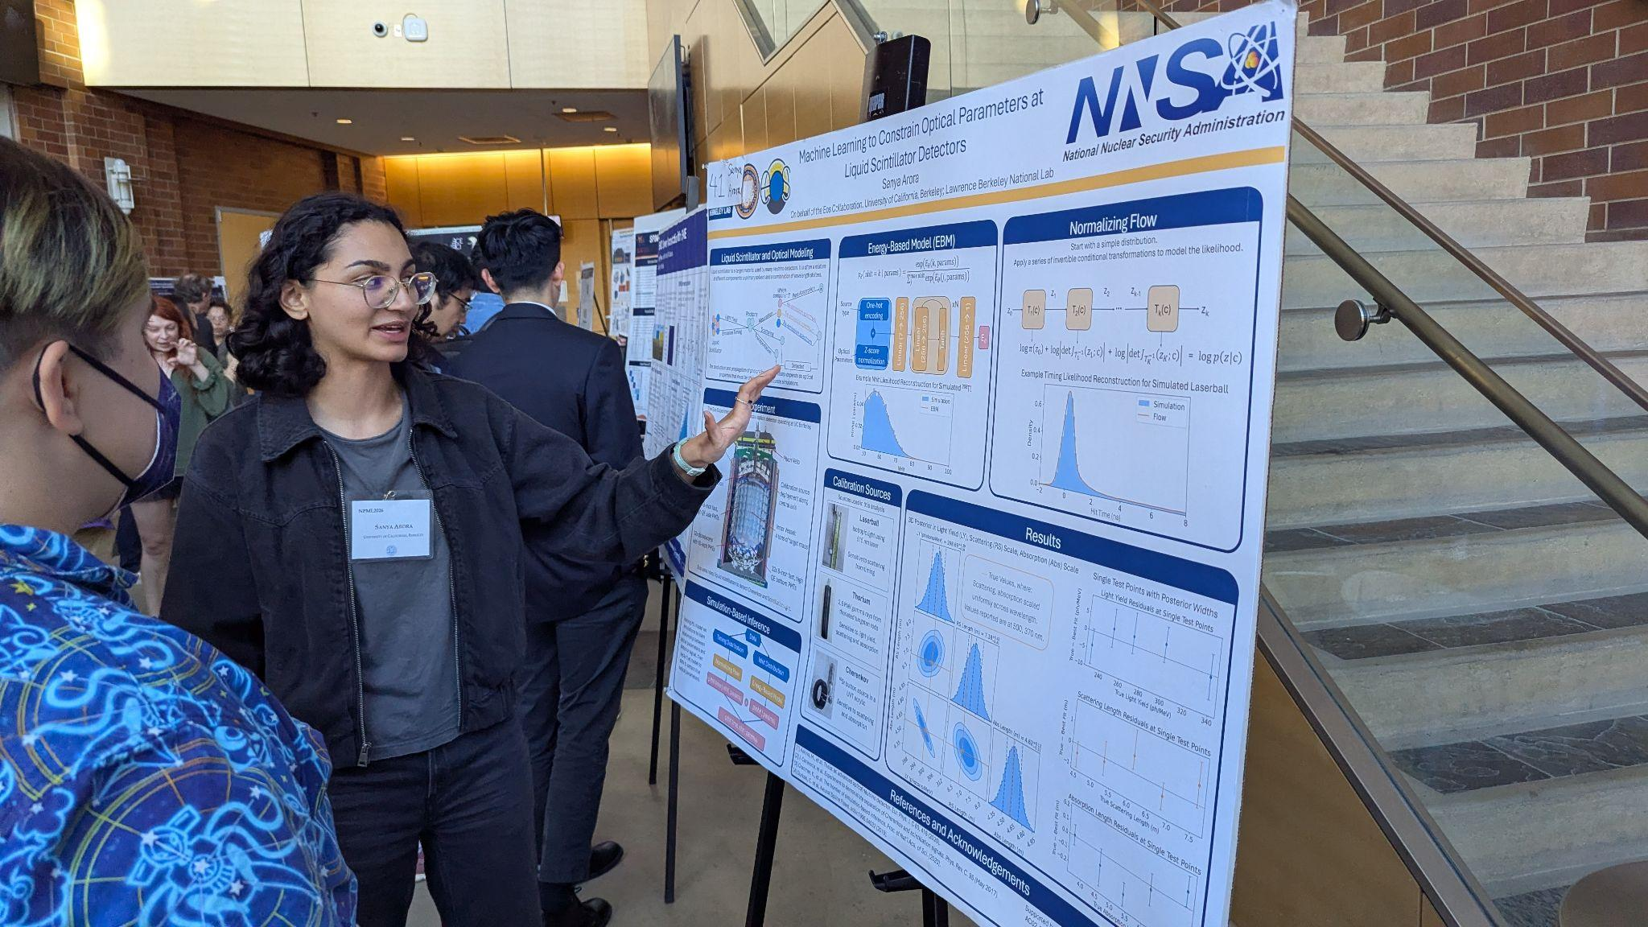
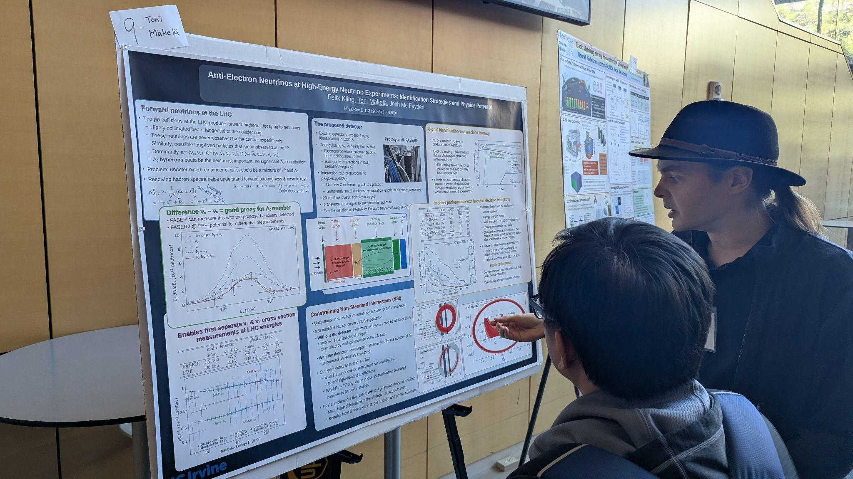
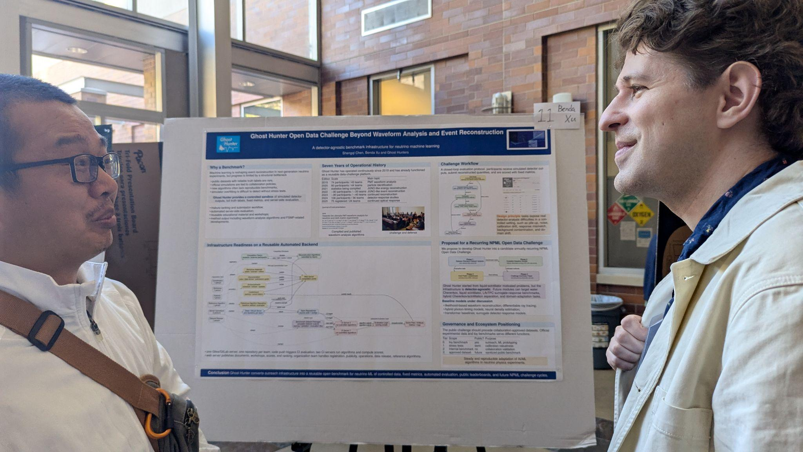
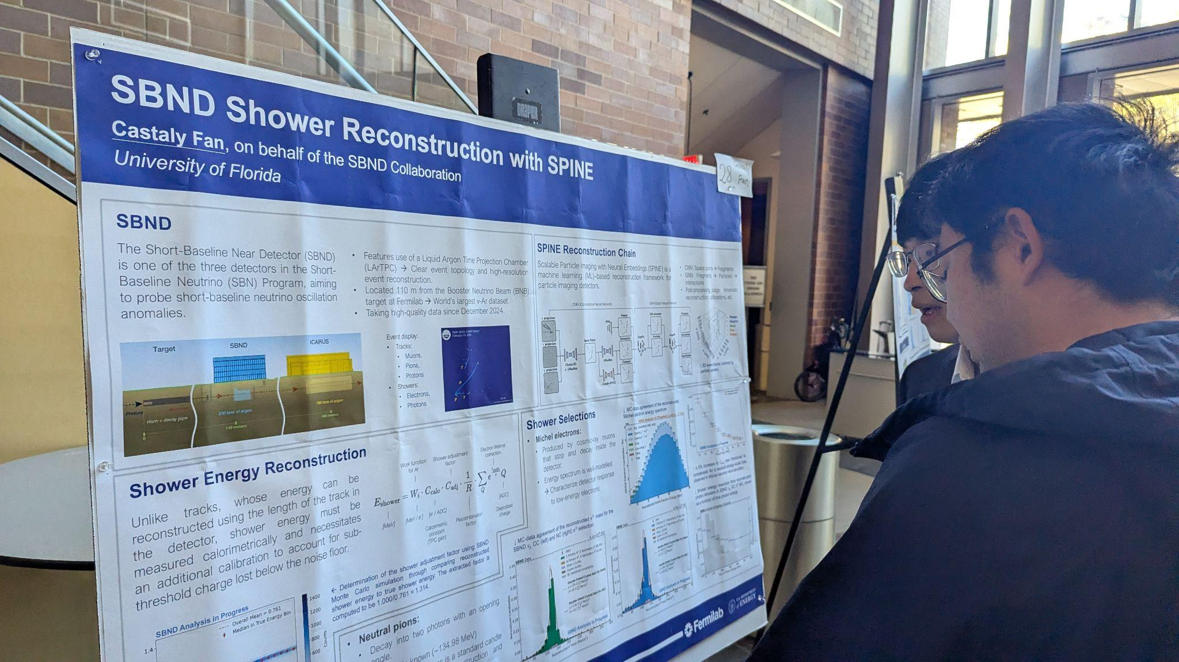
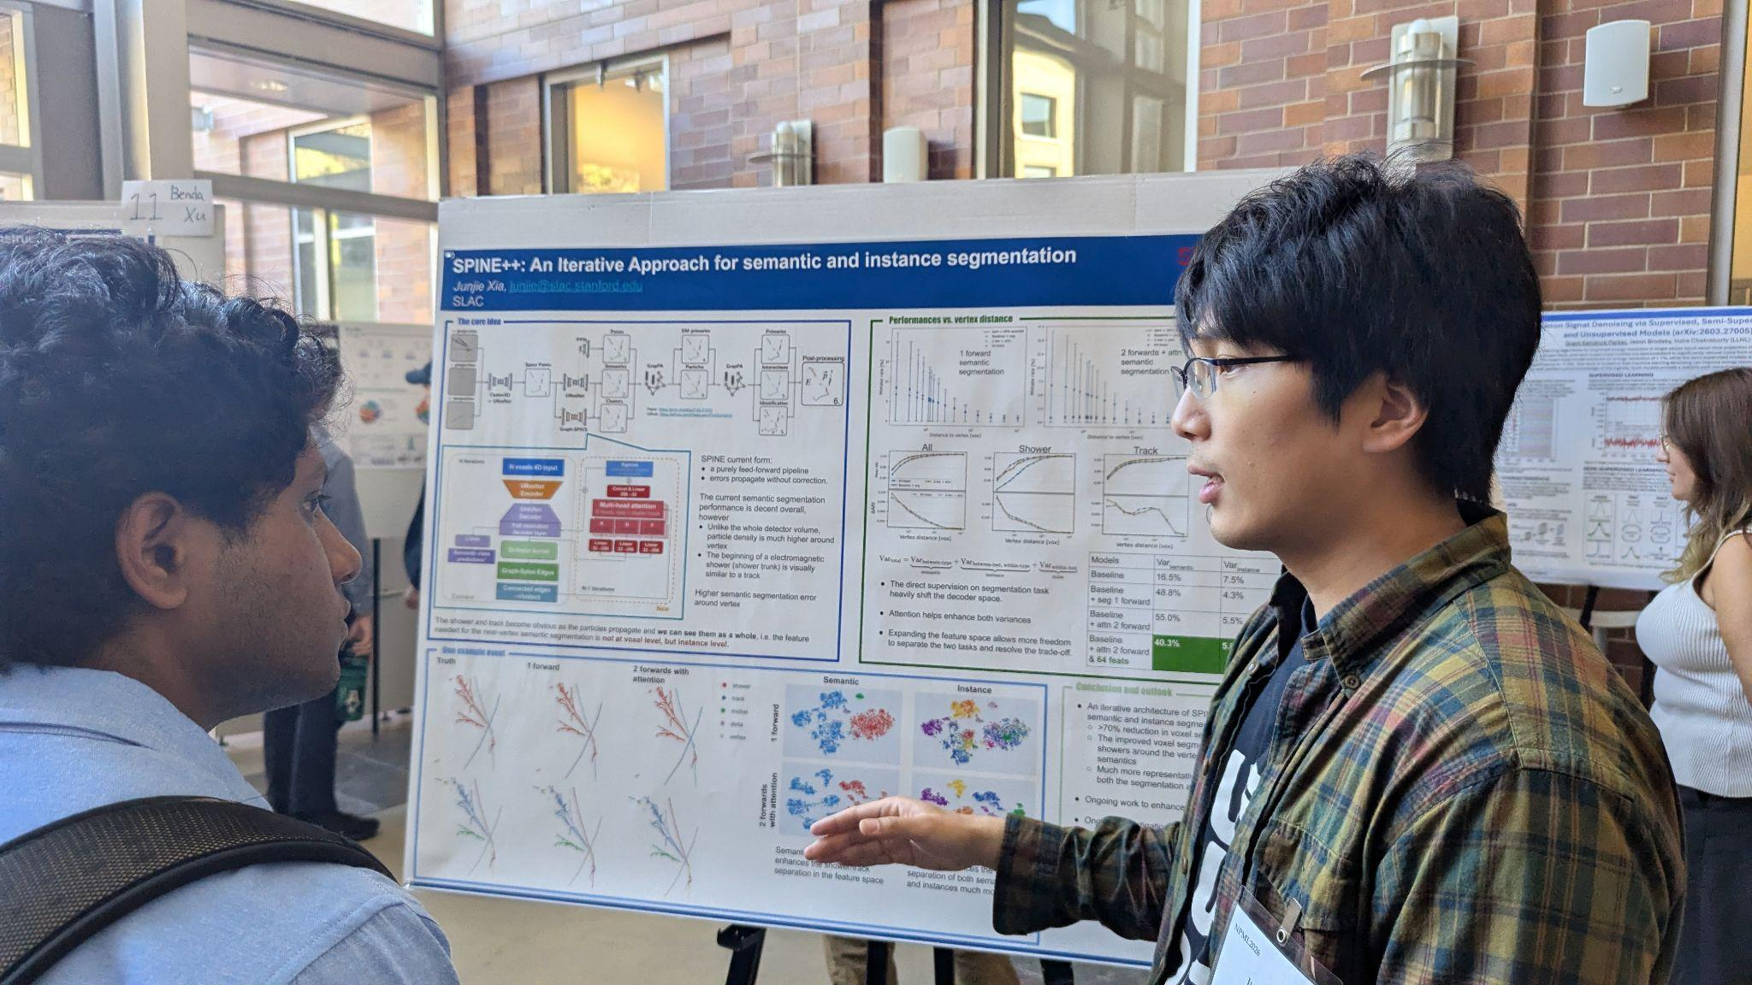
Posters @ NPML
Poster @ NPML 2026

Slide 11
Poster Awards
“Presentation/Visual”, “AI Insights”, “Science Impact”, and “Overall”
6 votes/person (2 votes per category), 280 votes casted, 7 winners!
  Sanya Arora (Berkeley)
    ML to constrain optical parameters at liquid scintillator detectors
  Geting Qin (Duke) / Hilary Utaegbulam (Rochester)
    Improved supernova pointing for DUNE
Sci. impact
Sci. impact

Slide 12
Poster Awards
“Presentation/Visual”, “AI Insights”, “Science Impact”, and “Overall”
6 votes/person (2 votes per category), 280 votes casted, 7 winners!
  Sanya Arora (Berkeley)
    ML to constrain optical parameters at liquid scintillator detectors
  Geting Qin (Duke) / Hilary Utaegbulam (Rochester)
    Improved supernova pointing for DUNE
  Veronika Shalamova (UC Riverside)
    Real-time supernova neutrino triggers for DarkSide-20K
  Xiangyu Qin (Alberta)
    Dual-temporal attention for direction reconstruction in liquid scintillator
Sci. impact
Sci. impact
Presentation
Presentation

Slide 13
Poster Awards
“Presentation/Visual”, “AI Insights”, “Science Impact”, and “Overall”
6 votes/person (2 votes per category), 280 votes casted, 7 winners!
  Sanya Arora (Berkeley)
    ML to constrain optical parameters at liquid scintillator detectors
  Geting Qin (Duke) / Hilary Utaegbulam (Rochester)
    Improved supernova pointing for DUNE
  Veronika Shalamova (UC Riverside)
    Real-time supernova neutrino triggers for DarkSide-20K
  Xiangyu Qin (Alberta)
    Dual-temporal attention for direction reconstruction in liquid scintillator
  Samuel Young (Stanford)
    Panda: self-distillation of reusable sensor-level representations for HEP
  Omar Alterkait (Tufts)
    JAXTPC: fast differentiable simulation of time projection chambers
Sci. impact
Sci. impact
Presentation
Presentation
AI insights
Sci. impact
AI insights
Sci. impact

Slide 14
Poster Awards
“Presentation/Visual”, “AI Insights”, “Science Impact”, and “Overall”
6 votes/person (2 votes per category), 280 votes casted, 7 winners!
  Sanya Arora (Berkeley)
    ML to constrain optical parameters at liquid scintillator detectors
  Geting Qin (Duke) / Hilary Utaegbulam (Rochester)
    Improved supernova pointing for DUNE
  Veronika Shalamova (UC Riverside)
    Real-time supernova neutrino triggers for DarkSide-20K
  Xiangyu Qin (Alberta)
    Dual-temporal attention for direction reconstruction in liquid scintillator
  Samuel Young (Stanford)
    Panda: self-distillation of reusable sensor-level representations for HEP
  Omar Alterkait (Tufts)
    JAXTPC: fast differentiable simulation of time projection chambers
Sci. impact
Sci. impact
Presentation
Overall
Presentation
AI insights
Sci. impact
AI insights
Sci. impact
Overall

Slide 15
NPML 2026: Successful Completion
AI/ML exploitation is accelerating in neutrino physiscs
Self-supervision and foundation models
Simulation-based inference applications
Scalable, fast, and differentiable physics modeling softwares
HUGE thanks to the UC Irvine local team!
  Jianming Bian (host/lead)
  Department Staff: Jan Strudwick
  Postdocs and Students: Jiaxi Liu, Natalie Ma, Dikshant Sagar, Zhengyang Chen, Kaiwen Yu, Larry Zhao, Tianqi Wang, Lawson McCoy, Zhongyi Wu, Boyan Pan

Slide 16
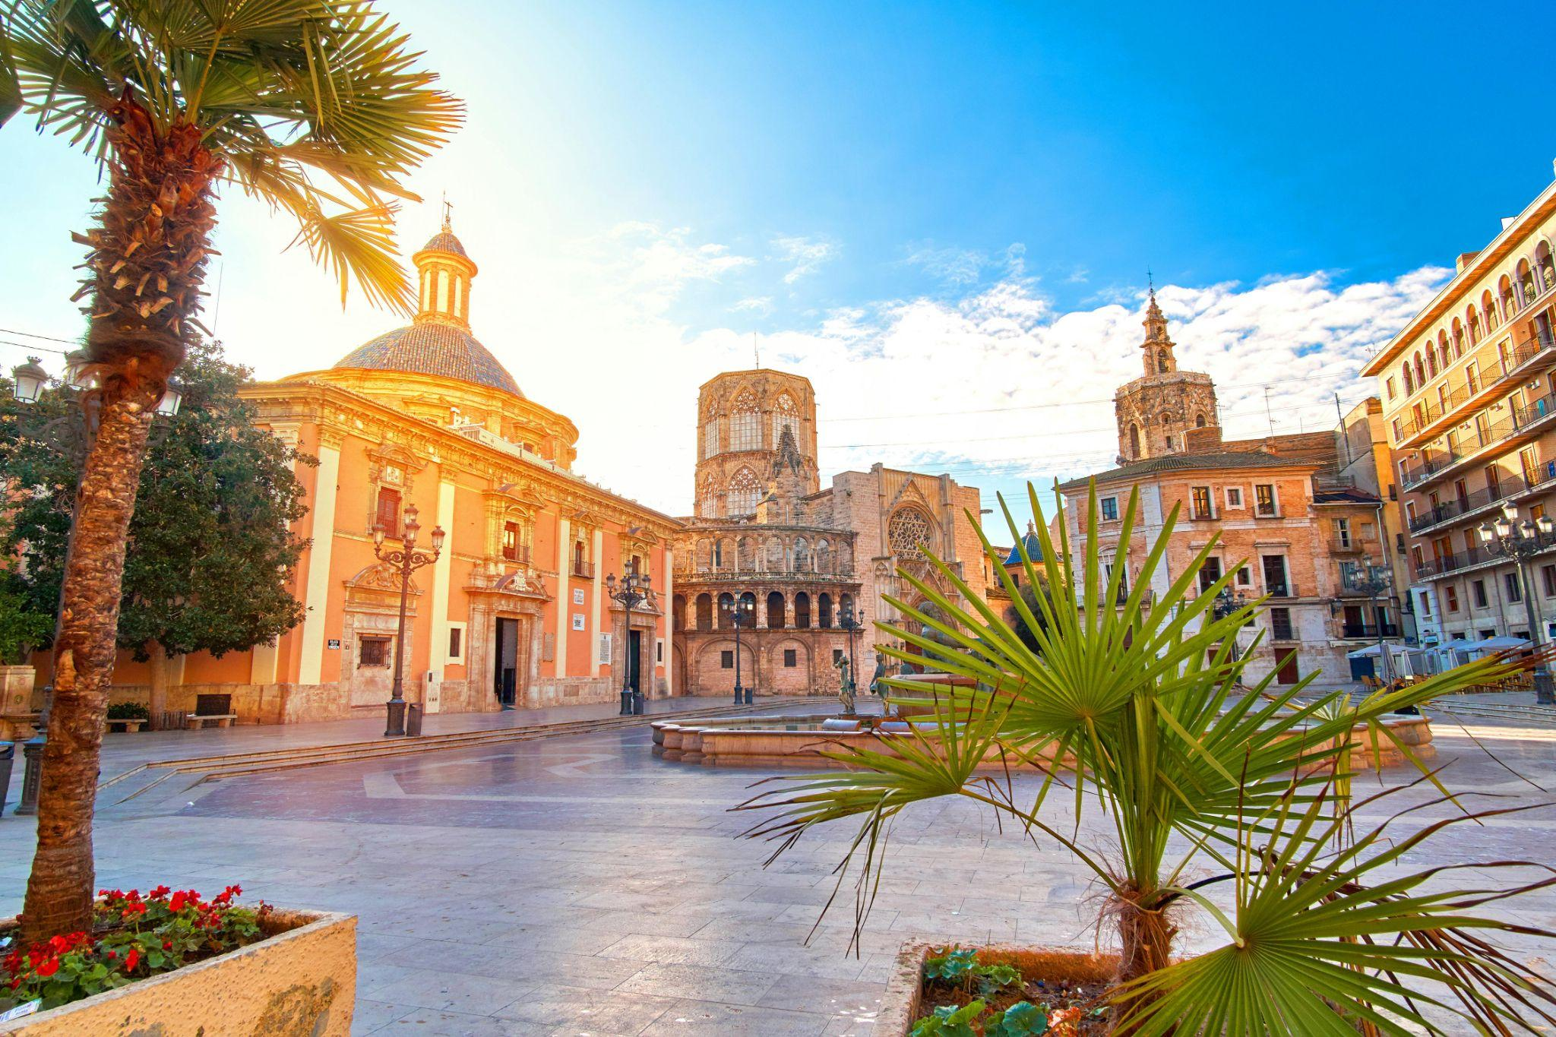
NPML 2027
Location: IFIC (Valencia, Spain), hosted by Pau Novella
When: early summer (~about the same time)
How:
  30min talks: 2-3 pages write-up and review (like ML conference)
  10min flash talks: same title/abstract submissions
  Satellite events: schools, data challenge reviews (e.g., Doraemon)

Slide 17
done!

