Slide 1
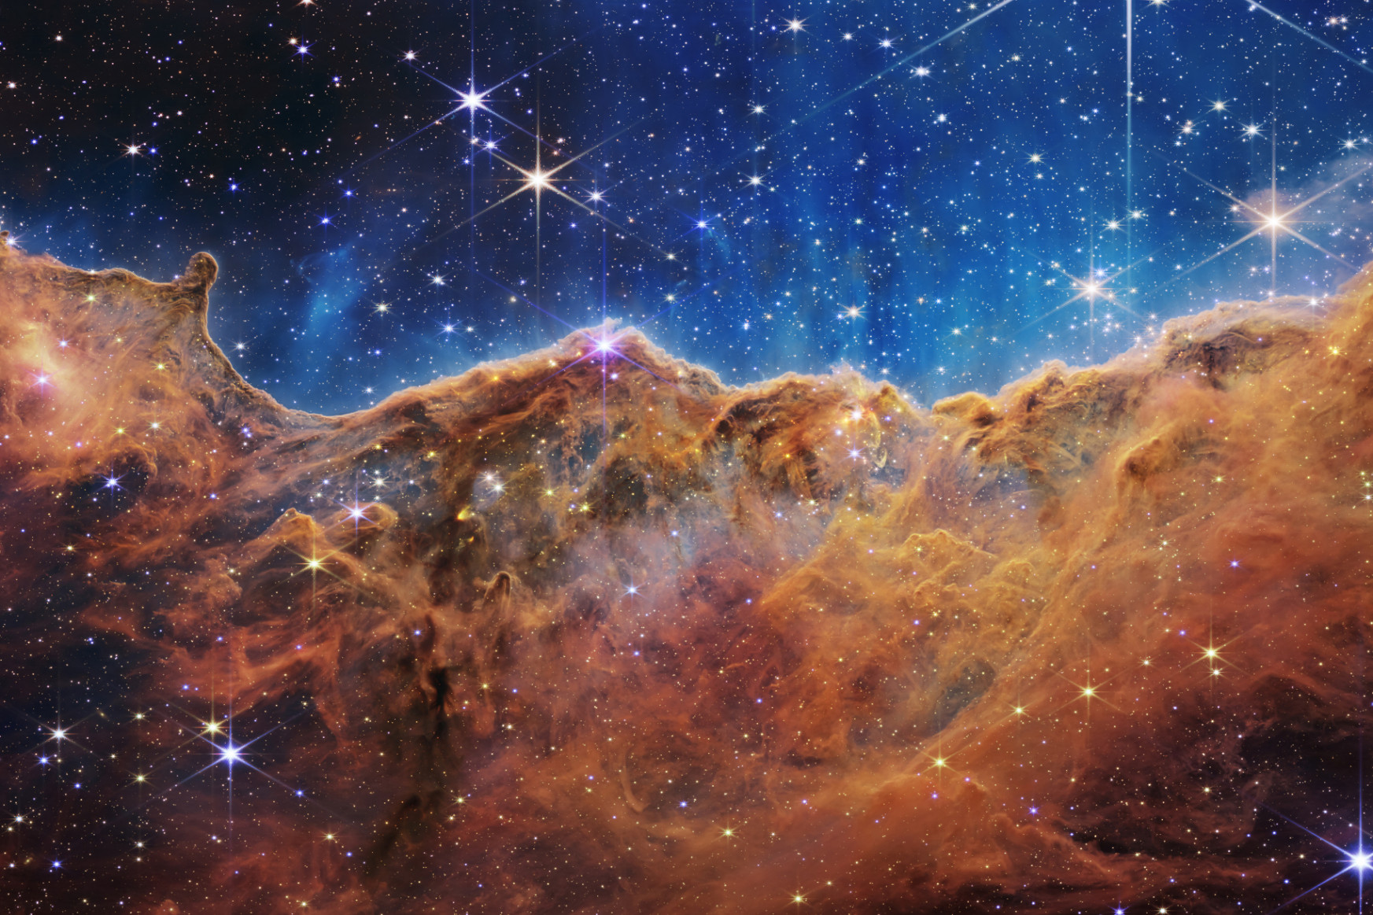

Paving the way for
thermal relic neutrino detection and the neutrino mass measurement with PTOLEMY
Chris Tully (Princeton University)
On Behalf of the PTOLEMY Collaboration
June 25, 2026
Neutrino 2026
Irvine, California, USA

Slide 2
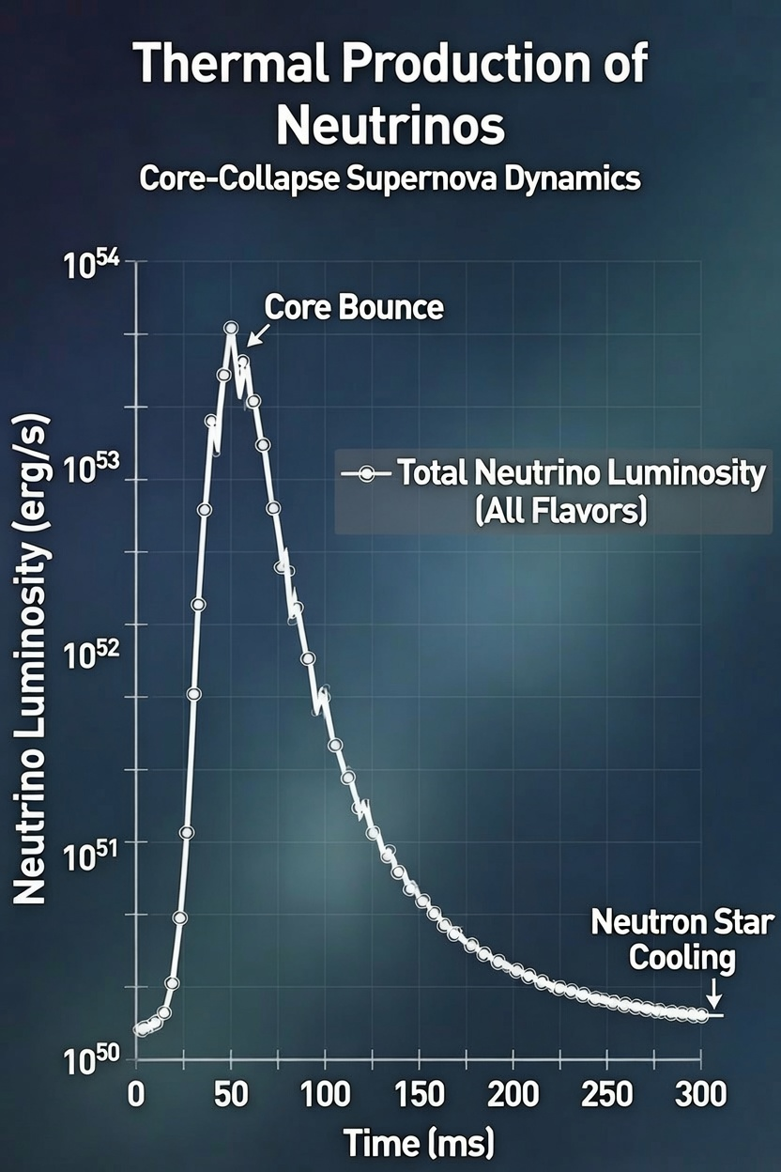
Thermal Production of Neutrinos
Two areas of study seek these neutrinos
  Core-Collapse Supernova
  Big Bang Neutrinos, aka “relic” neutrinos
Both depend on absolute neutrino mass(es)
  CCSN: Arrival time/reshaping of flavor composition
  Relics: Separation power in neutrino capture experiments (PTOLEMY)

Slide 3
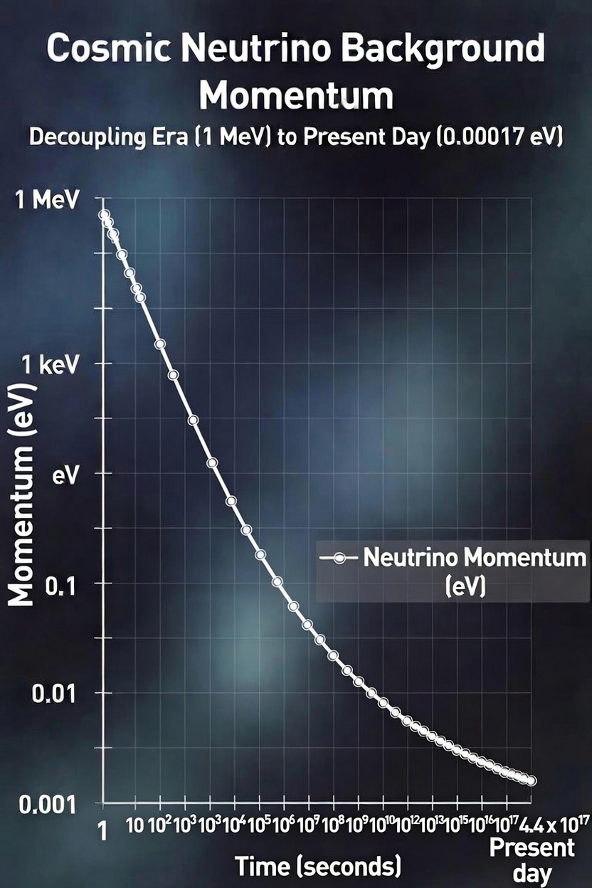
Neutrino Mass Observable
Hubble expansion cooling of the relic neutrino thermal momentum leaves very little kinetic energy
  Relative to masses of 0.01eV and higher
As the absolute neutrino mass measurement pushes below 0.2eV
  Atomic scales can dominate direct measurement techniques
PTOLEMY proposes a new “window” for neutrino mass(es) in the range 0.02-0.2eV
http://ptolemy.lngs.infn.it

Slide 4
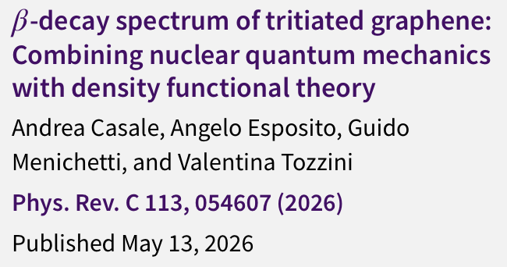
Tritiated-Graphene
Quantum “window” of substrate excitations predicts a potential low state density region of 0.02-0.2eV
Compare with ro-vibrational T₂ that is fully opaque below ~0.3eV
APS Viewpoint on “A Solid-State Pathway to Neutrino Mass”
(May, 2026)
https://physics.aps.org/articles/v19/67

Slide 5
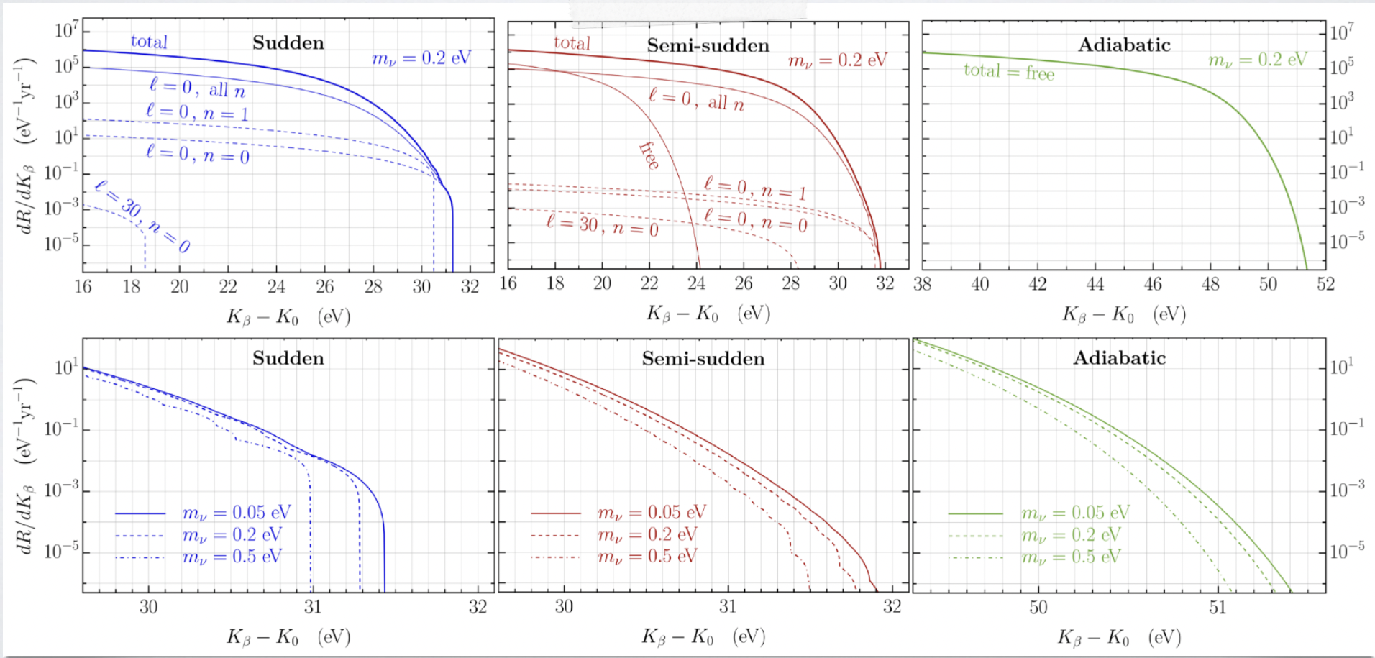
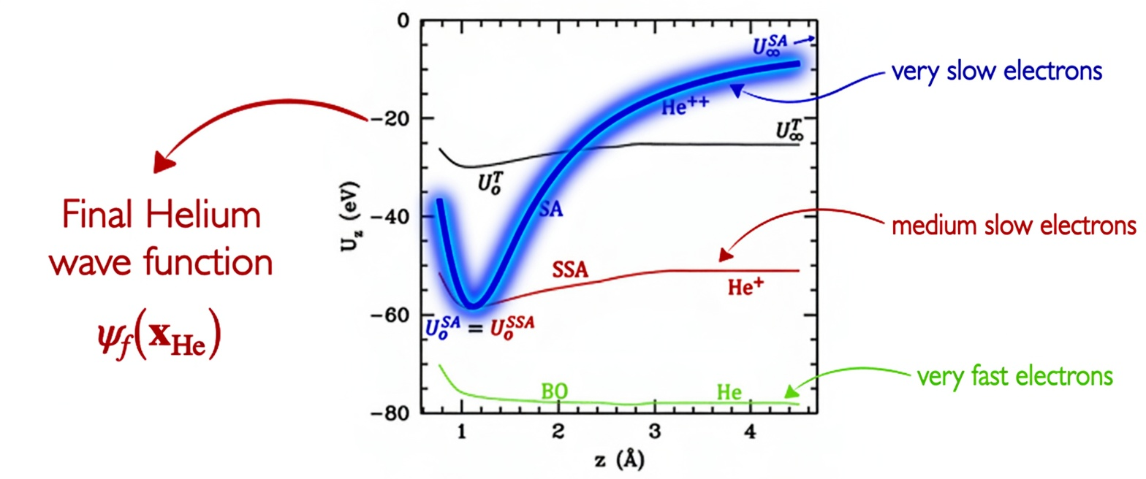
Mystery of Timescales
“Sudden” Approximation (SA)
Phys. Rev. C 113, 054607 (2026)

Slide 6
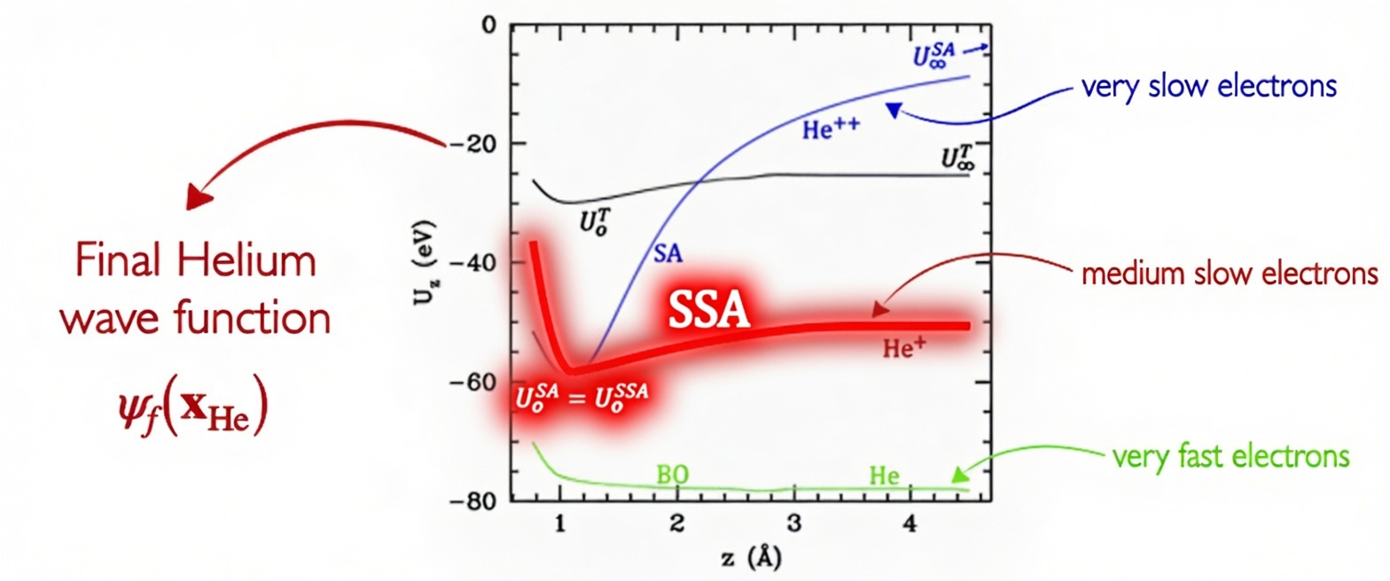
Mystery of Timescales
“Semi-Sudden” Approximation (SSA)
→ at least Graphene allows for quantum engineering of material properties
Phys. Rev. C 113, 054607 (2026)

Slide 7
PTOLEMY Approach
Ultra-High Resolution
  Push down to 10meV where optical transitions can be resolved
  Achievable with an Electrostatic Hemispherical Spectrometer
Effective Reduction in Tritium Mass Requirements
  Neutrino Mass Observable appears on every excitation threshold, repeated through the endpoint spectrum
  No longer required to go to absolute endpoint to have neutrino mass sensitivity (sensitivity paper in progress)

Slide 8
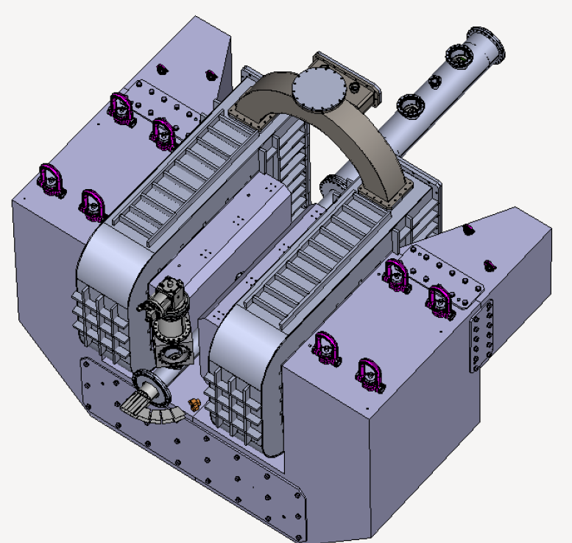
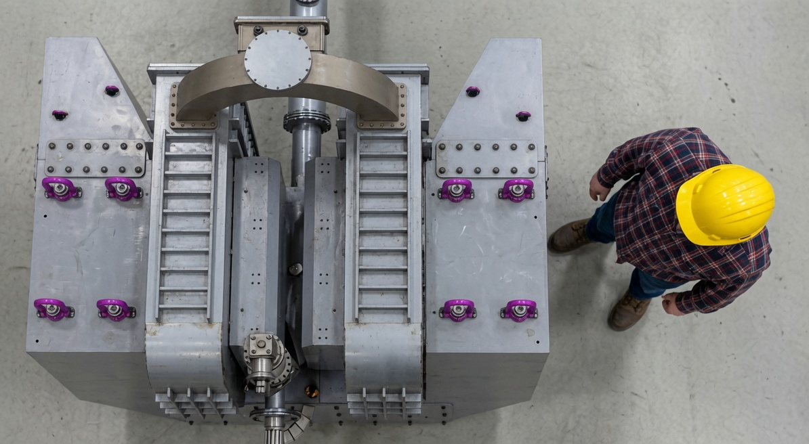
ASG Superconductors/Suprasys MgB₂ Magnet for LNGS
PTOLEMY Magnet
  New approach to electro-magnetic spectrometer
  Electrons from tritium drift transverse to magnetic field
Rendered/Reference Size

Slide 9
Alfredo Cocco (LNGS)
Marcello Messina (LNGS)
Flavio Gatti (Genova)

Slide 10
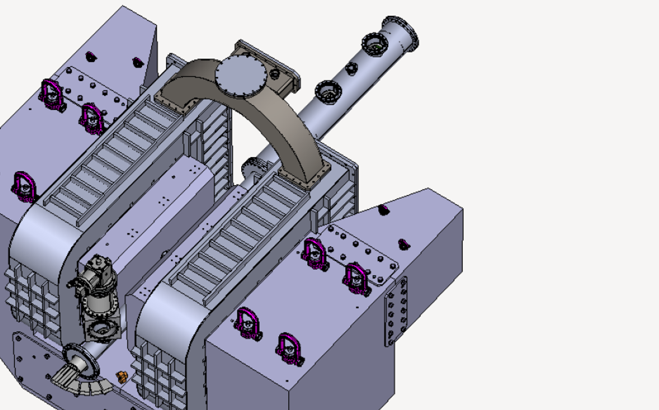
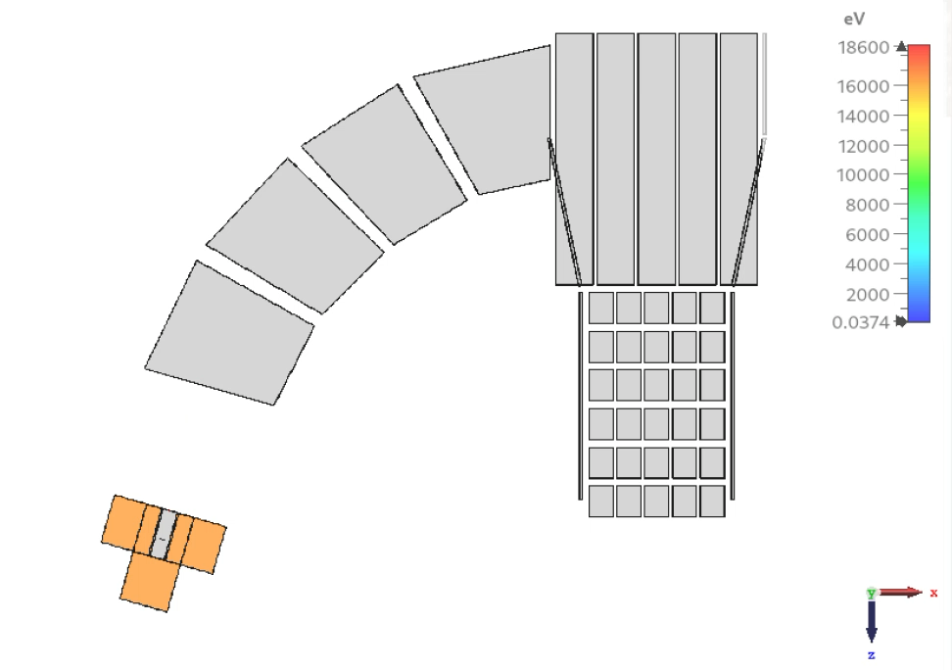
Tritium Endpoint Electron Injection
Mark Farino (Princeton)
Martina Chirico (Sapienza)
Francesca Pofi (GSSI)
Mustafa Anaam (Radboud)

Slide 11
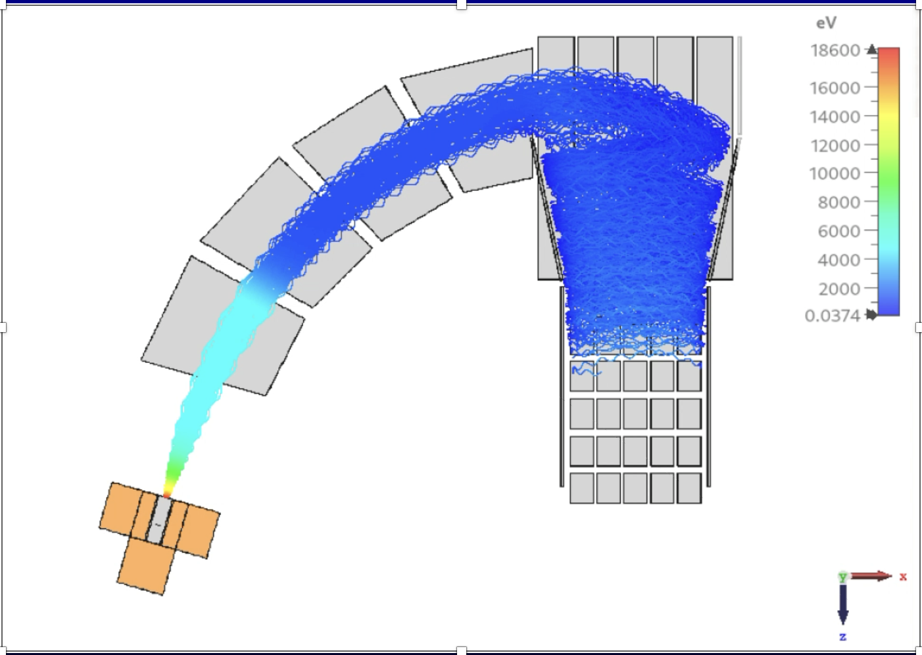
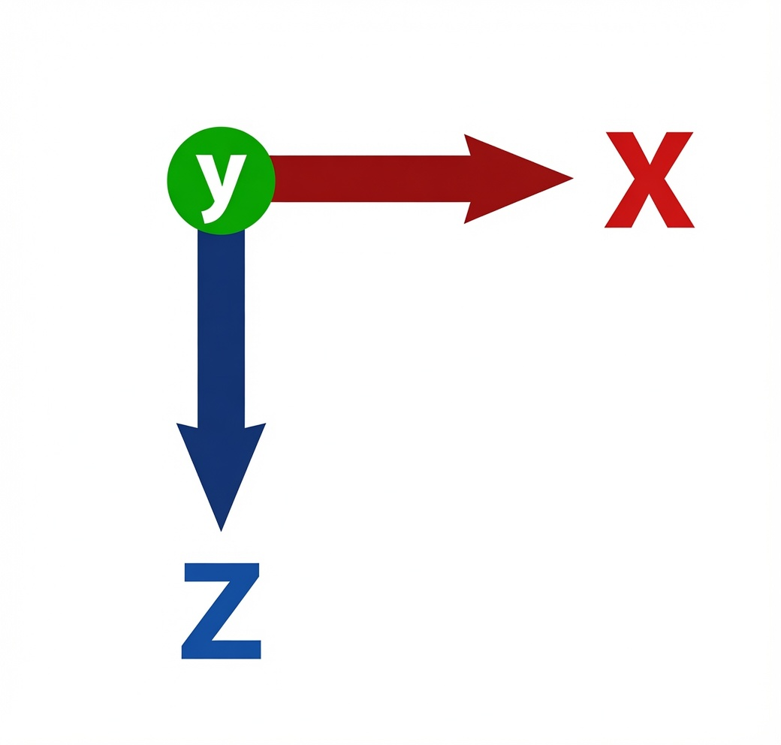
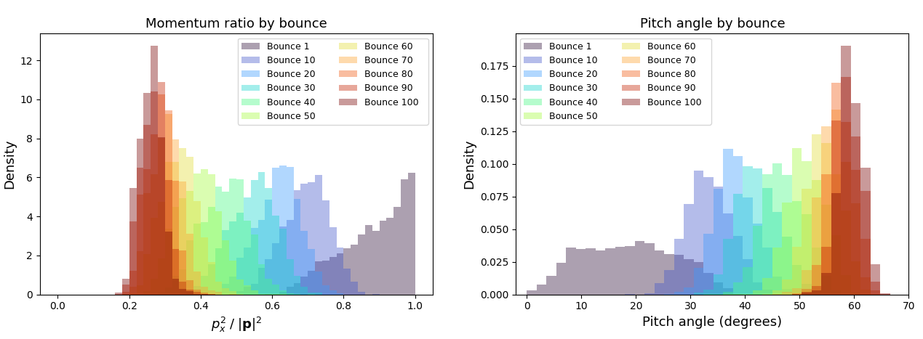
Pitch Angle Compression
Parallel/Total Kinetic Energy ratio by bounce
Pitch angle (degrees) by bounce

Slide 12
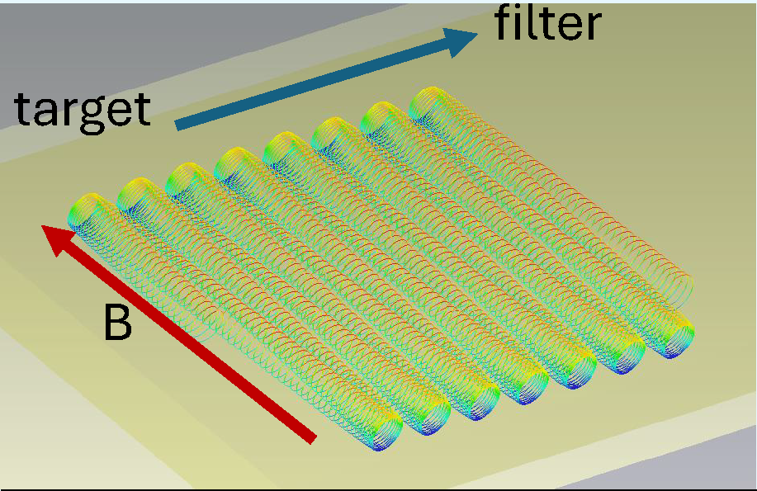
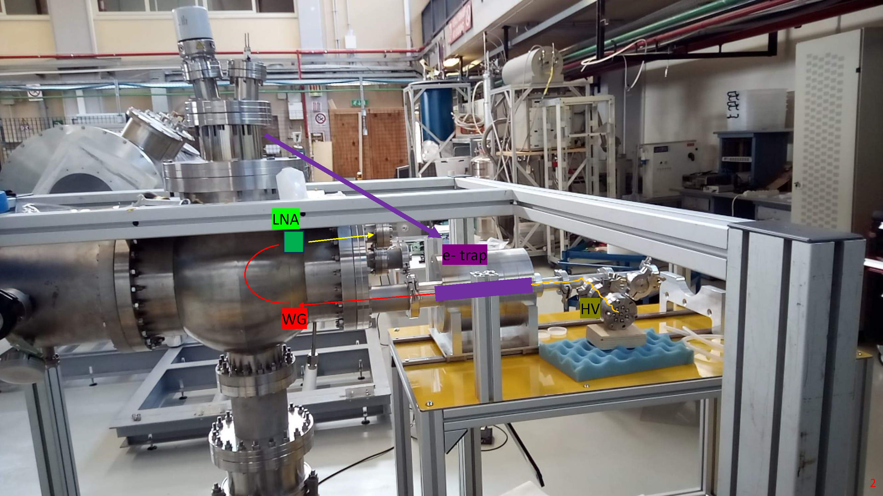
RF Measurements
Non-Destructive Electron Tag
Federico Virzi (L’Aquila/LNGS)
Tagging electrons in flight!
using Project 8 methods
Notes:
The need to suppress background led us to consider the semi-relativistic cyclotron motion of an electron in magnetic field. A new, non-destructive technique for tagging electrons, developed by the Project 8 collaboration, could be used to tag the electron between the graphene and the micro-calorimeter to reduce backgrounds. Here we show the bouncing motion of an endpoint electron in magnetic field as it drifts between the target and micro-calorimeter. These electrons will emit microwave radiation – like in your microwave, but much lower power.

Slide 13
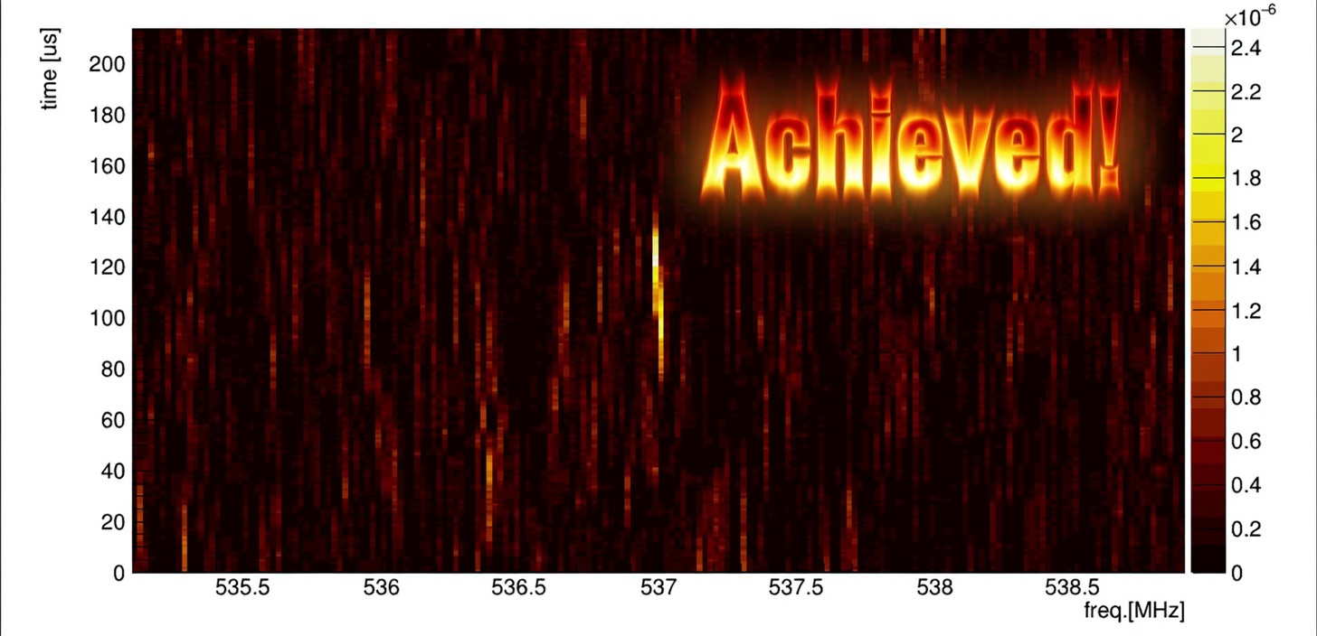
RF Measurements
Non-Destructive Electron Tag
Tagging electrons in flight!
using Project 8 methods
Federico Virzi (L’Aquila/LNGS)
Notes:
The need to suppress background led us to consider the semi-relativistic cyclotron motion of an electron in magnetic field. A new, non-destructive technique for tagging electrons, developed by the Project 8 collaboration, could be used to tag the electron between the graphene and the micro-calorimeter to reduce backgrounds. Here we show the bouncing motion of an endpoint electron in magnetic field as it drifts between the target and micro-calorimeter. These electrons will emit microwave radiation – like in your microwave, but much lower power.

Slide 14
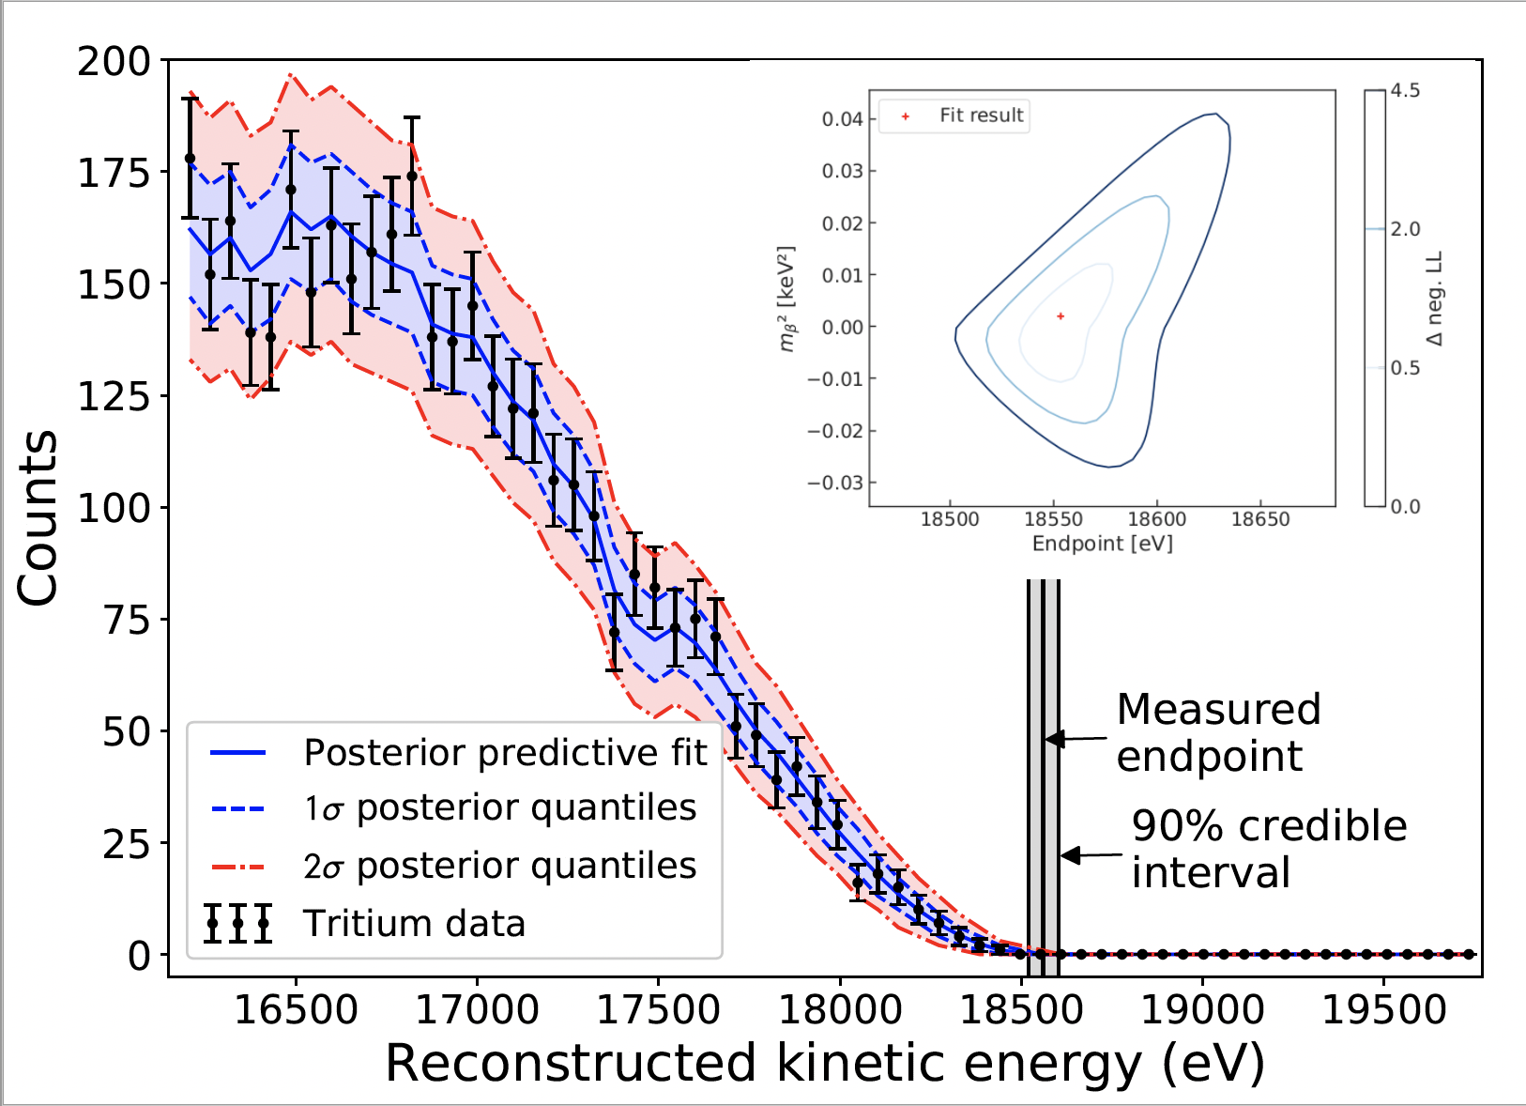
RF Measurement with 10eV Resolution on Total Energy
Highly suppresses backgrounds registered coincident on final measurement system
→ Except non-tritium electrons from source
Project 8 Tritium RF Measurement
No events observed above endpoint,
Setting upper limit on background rate
< 3x10⁻¹⁰ /eV/s (90% CL)
Background Rate
< 1 event per eV in 100 years!
https://arxiv.org/abs/2203.07349
14
Notes:
The Project 8 collaboration uses the relativistic shift of the cyclotron motion to derive the energy values of electrons measured this way and have measured the tritium endpoint spectrum. The background suppression is amazing. They saw the equivalent of less than 1 event per eV in 100 years at the endpoint. This is what we want, but for a drifting geometry.

Slide 15
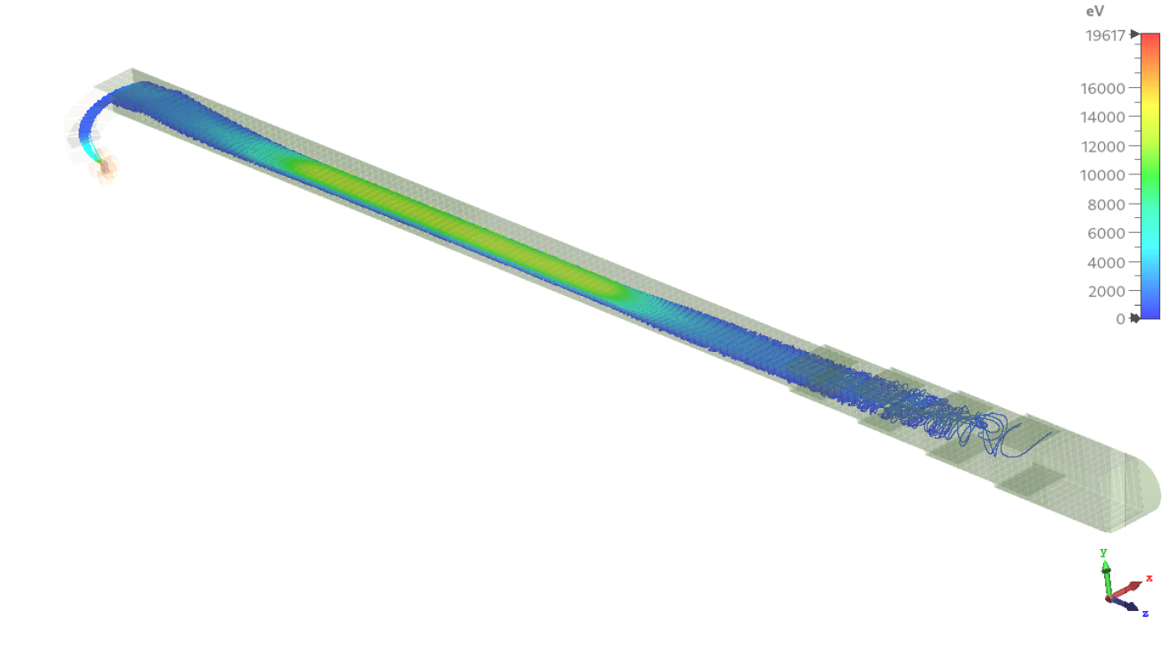
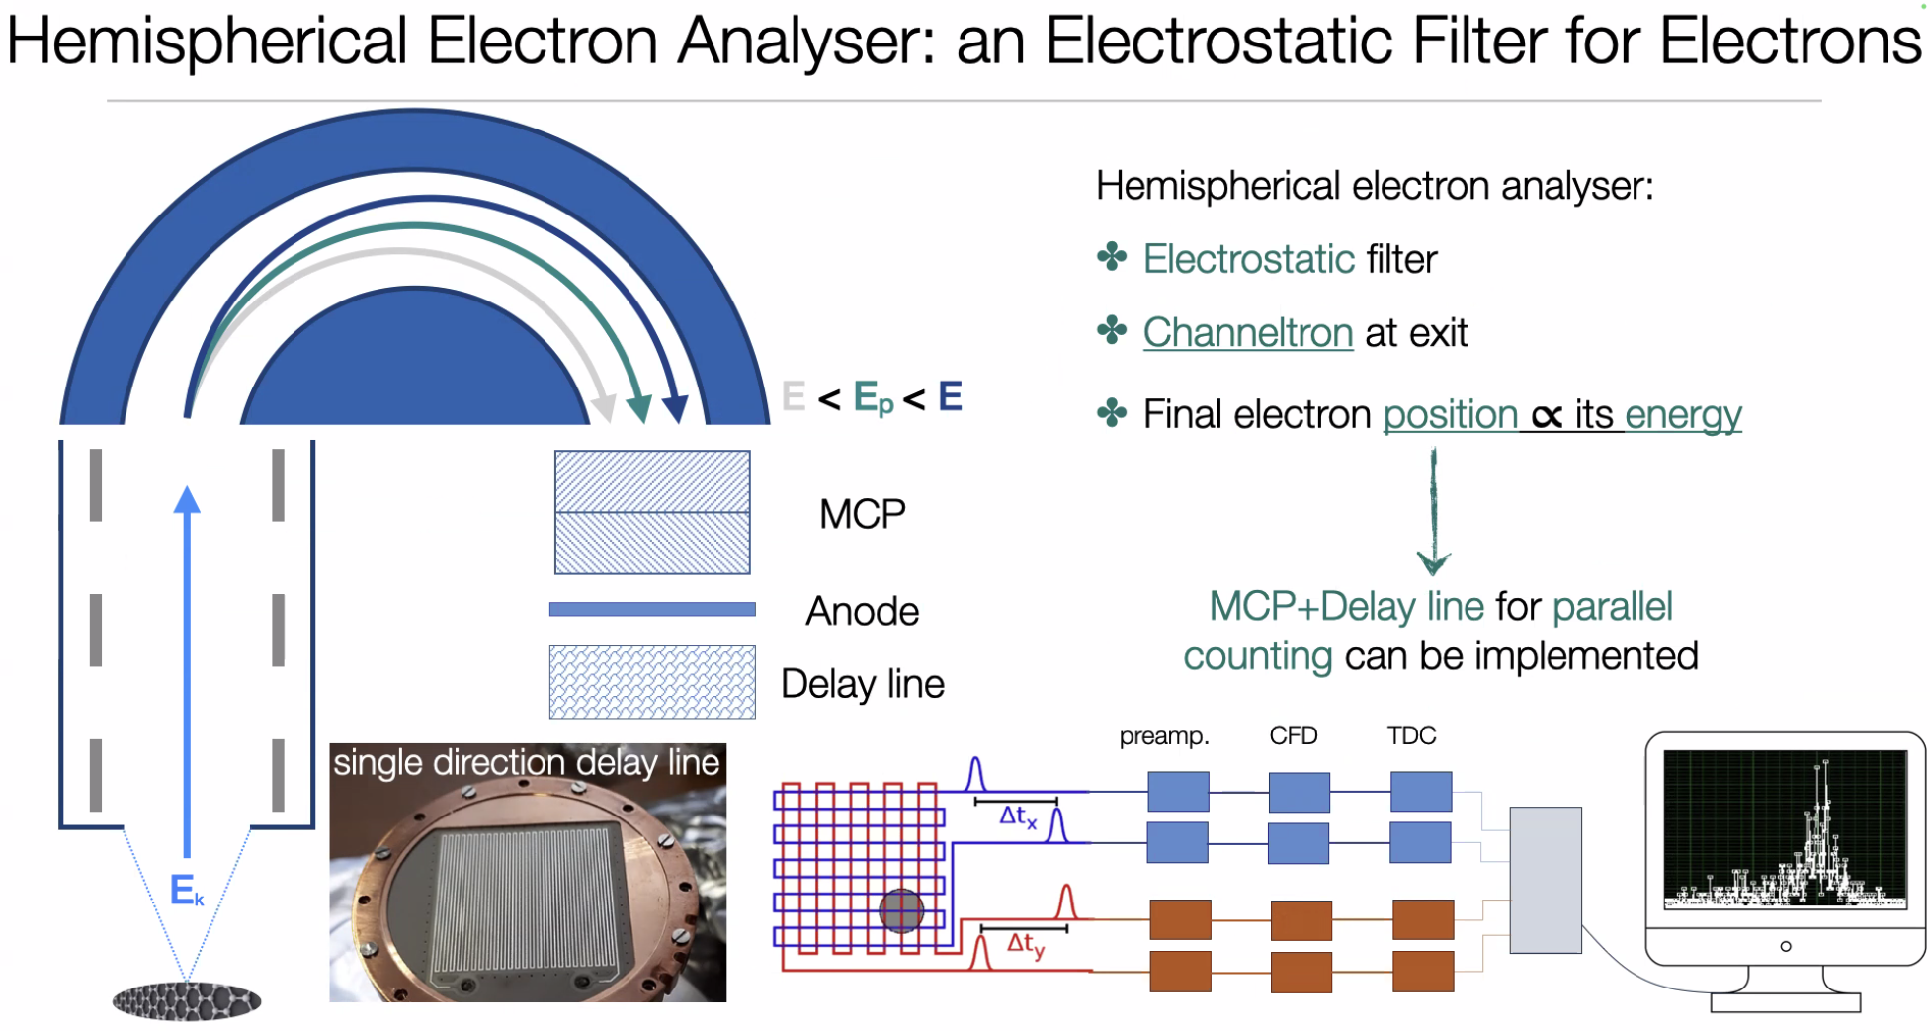
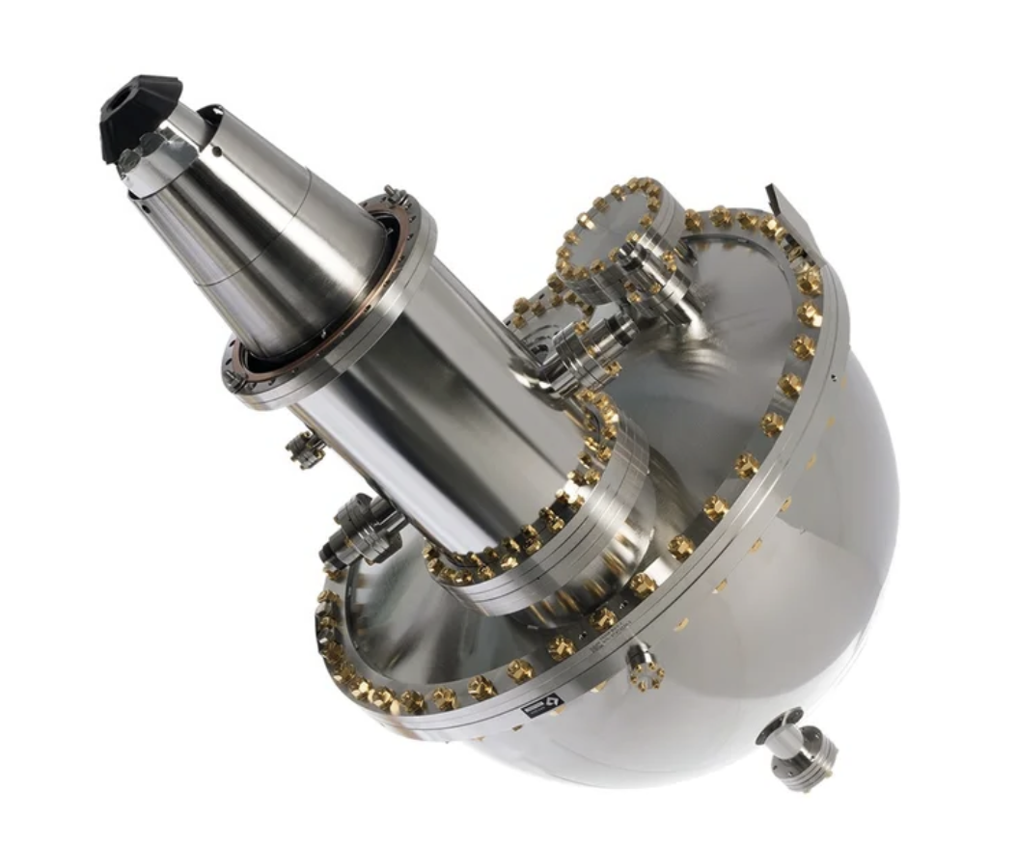
Final Kinetic Energy Measurement
High B-Field
RF Region
Goal for Electrostatic
Hemispherical
Analyzer: 10meV@10eV
Injection from Target
Filter
Zero B-Field
Kinetic Energy
Measurement
Alice Apponi (INFN/Roma)
Also developing
TES microcal
(50meV)

Slide 16
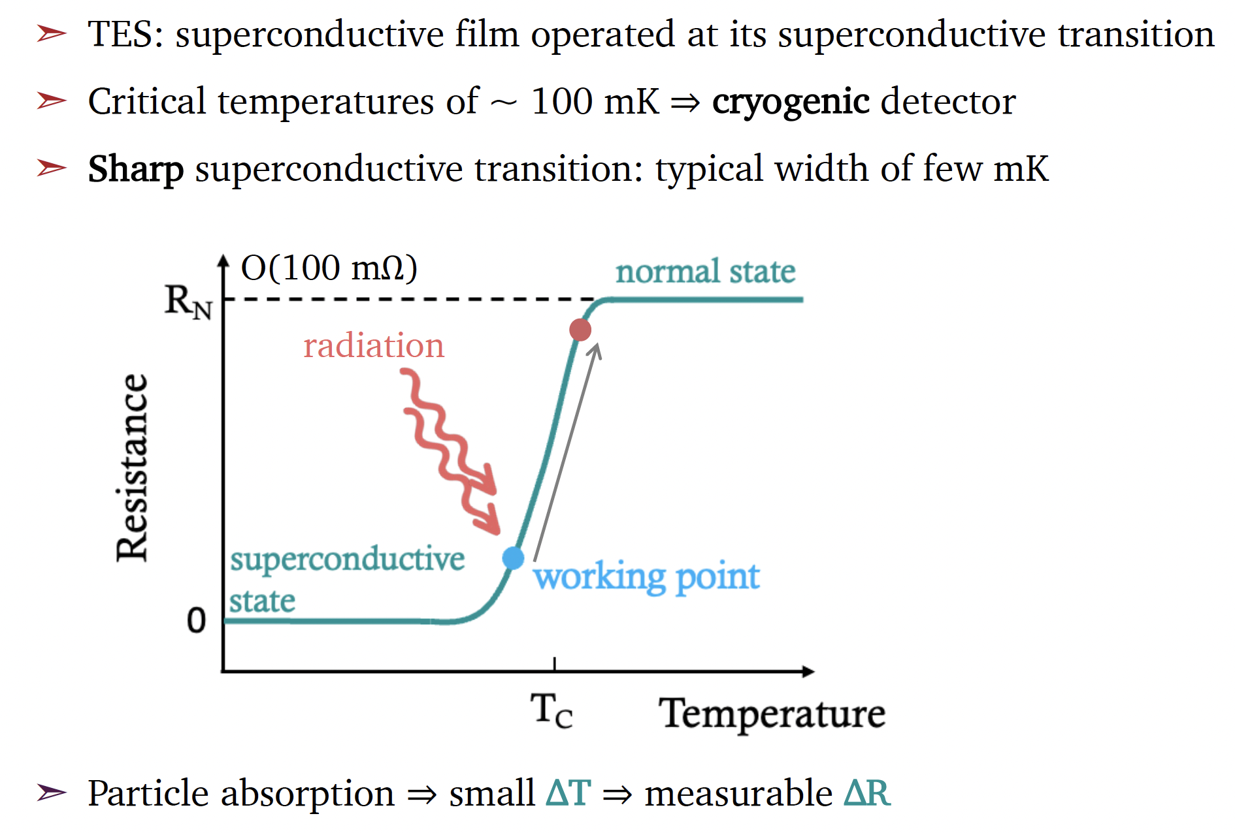
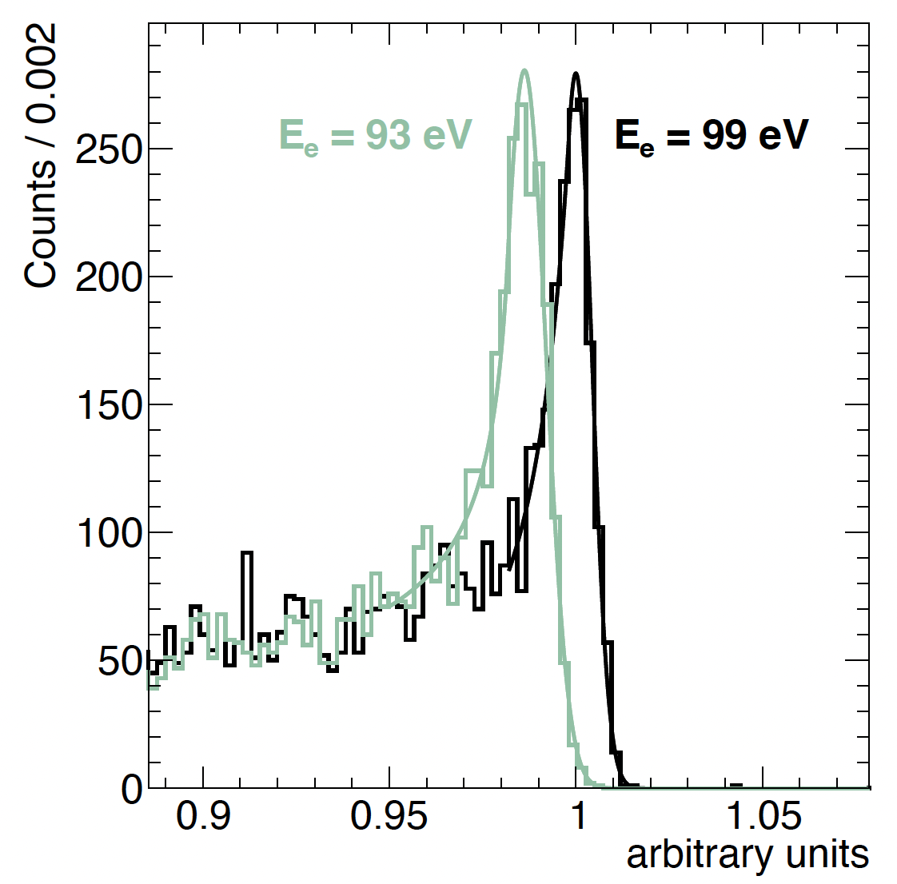
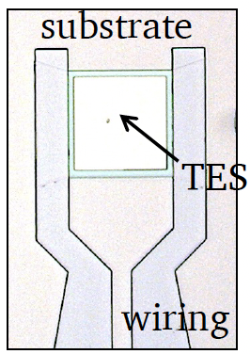
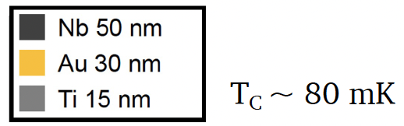

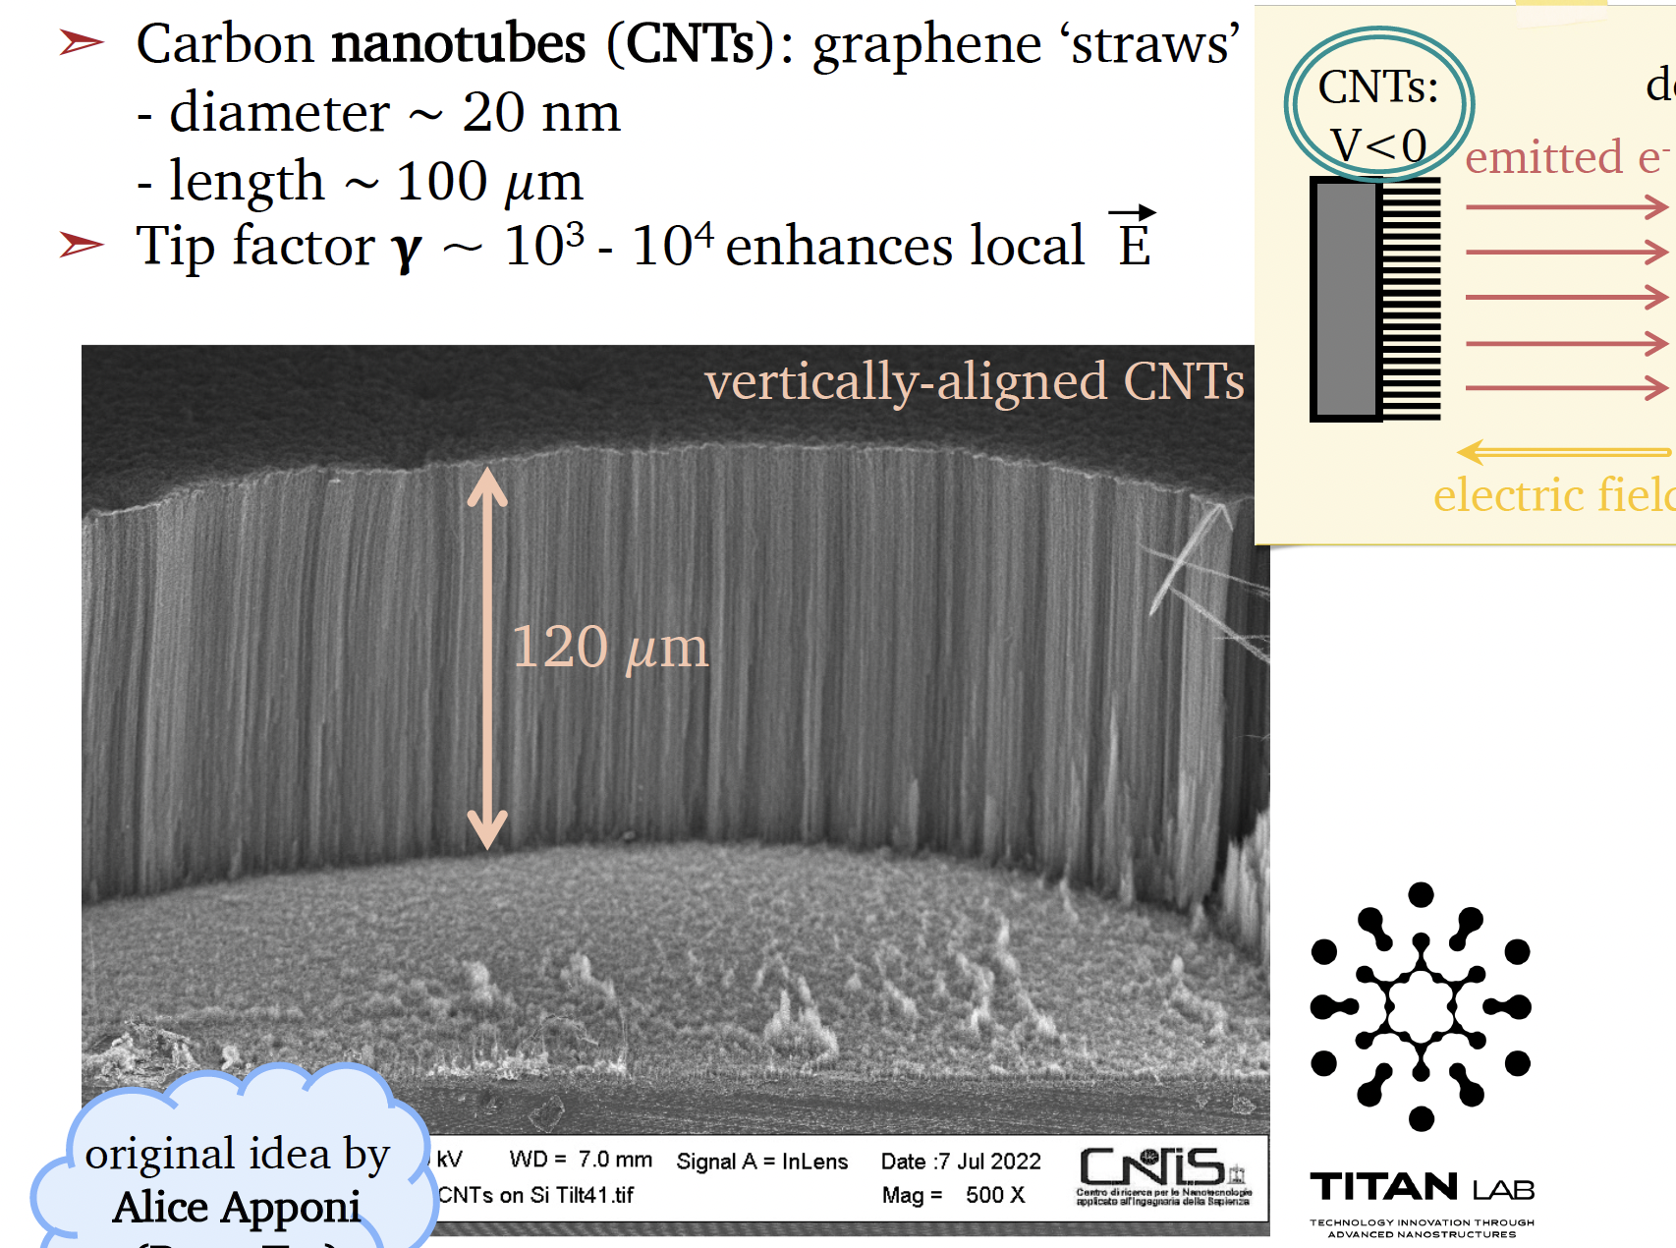
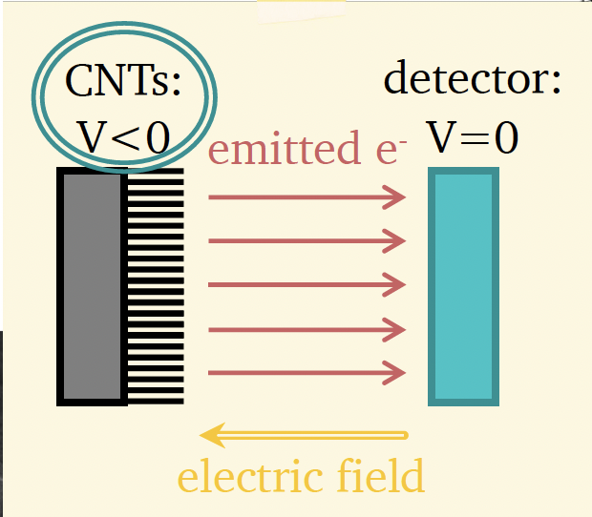
Transition-Edge Sensor μCal
Carlo Pepe (Barcelona,IMB-CNM-CSIC)
Benedetta Corcione (Sapienza)
Francesco Pandolfi (INFN/Roma)
Achieved: 0.5eV@100eV
Alice Apponi (INFN/Roma)
Next Step: 0.05eV@10eV

Slide 17
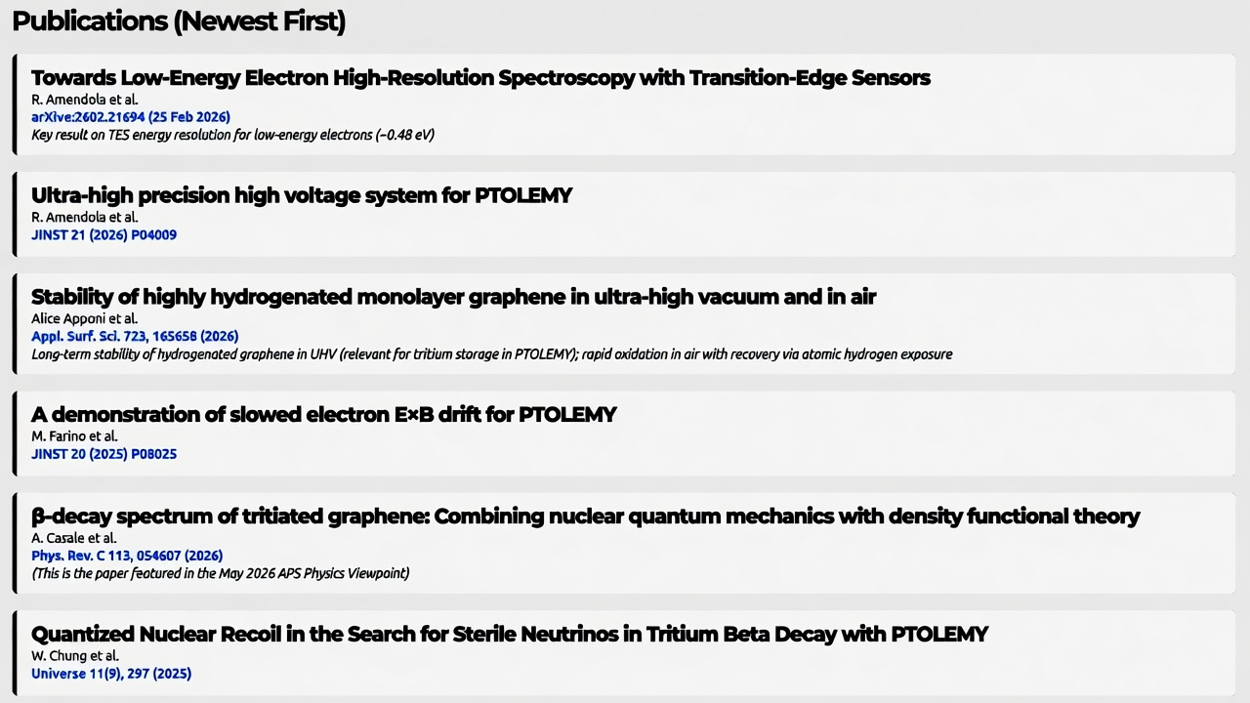
Period of Rapid Progress
Benedetta Corcione (Sapienza)
Soon to come
  Mass Sensitivity
  Mini-Filter with Halbach Magnet
Nicola Rossi (LNGS)
Alice Apponi (INFN/Roma)
Mark Farino (Princeton), Andi Tan (Princeton)
Andrea Casale (Columbia), Angelo Esposito (Sapienza)
Guido Menichetti (Pisa), Valentina Tozzini (Pisa)
Wonyong Chung (Princeton)

Slide 18
Future of Tritium for Relics
Depends on physics studies with tritiated graphene:
If the sudden approximation holds with a deep potential for the He daughter, there may be substrates where the transition into the ground state is significant.
Phys. Rev. C 113, 054607 (2026)
Alternatively, if the binding of atomic T is weak, estimated to be 0.1meV on the surface of liquid Helium, then a shallow potential may be more favorable.
coherent neutrino scattering
S. A. Lyon, Kyle Castoria, Ethan Kleinbaum, Zhihao Qin, Arun Persaud, Thomas Schenkel, and Kathryn M. Zurek. Single phonon detection for dark matter via quantum evaporation and sensing of ³He. Phys. Rev. D, 109:023010, 2024.

Slide 19

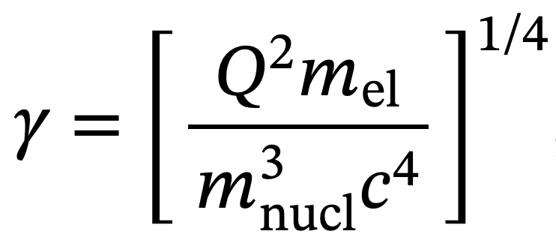
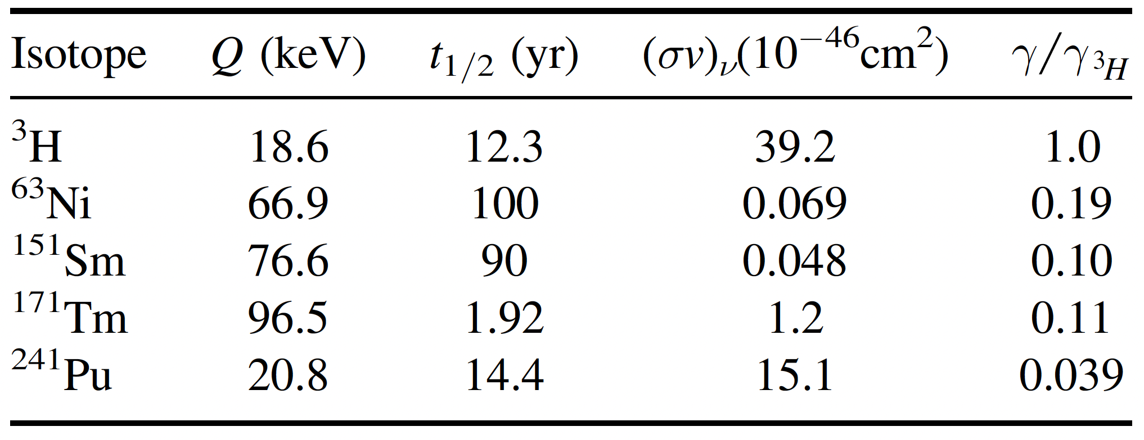
Heavy Targets for Neutrino Capture
Idea first promoted here:
(Cheipesh Yevheniia, Cheianov V and Boyarsky A 2021 Phys. Rev. D 104 116004)
“Goodness⁻¹” Dimensionless Parameter
Case for ²⁴¹Pu (N. De Groot, J. Phys. G: Nucl. Part. Phys. 50 (2023) 055106)
²⁴¹Pu produced in large quantities for fission reactor fuel
Continuous flow chemical separation methods to remove daughter isotopes ( ²⁴¹Am, ²³⁷U /PUREX + γ/α veto)
Excellent

Slide 20
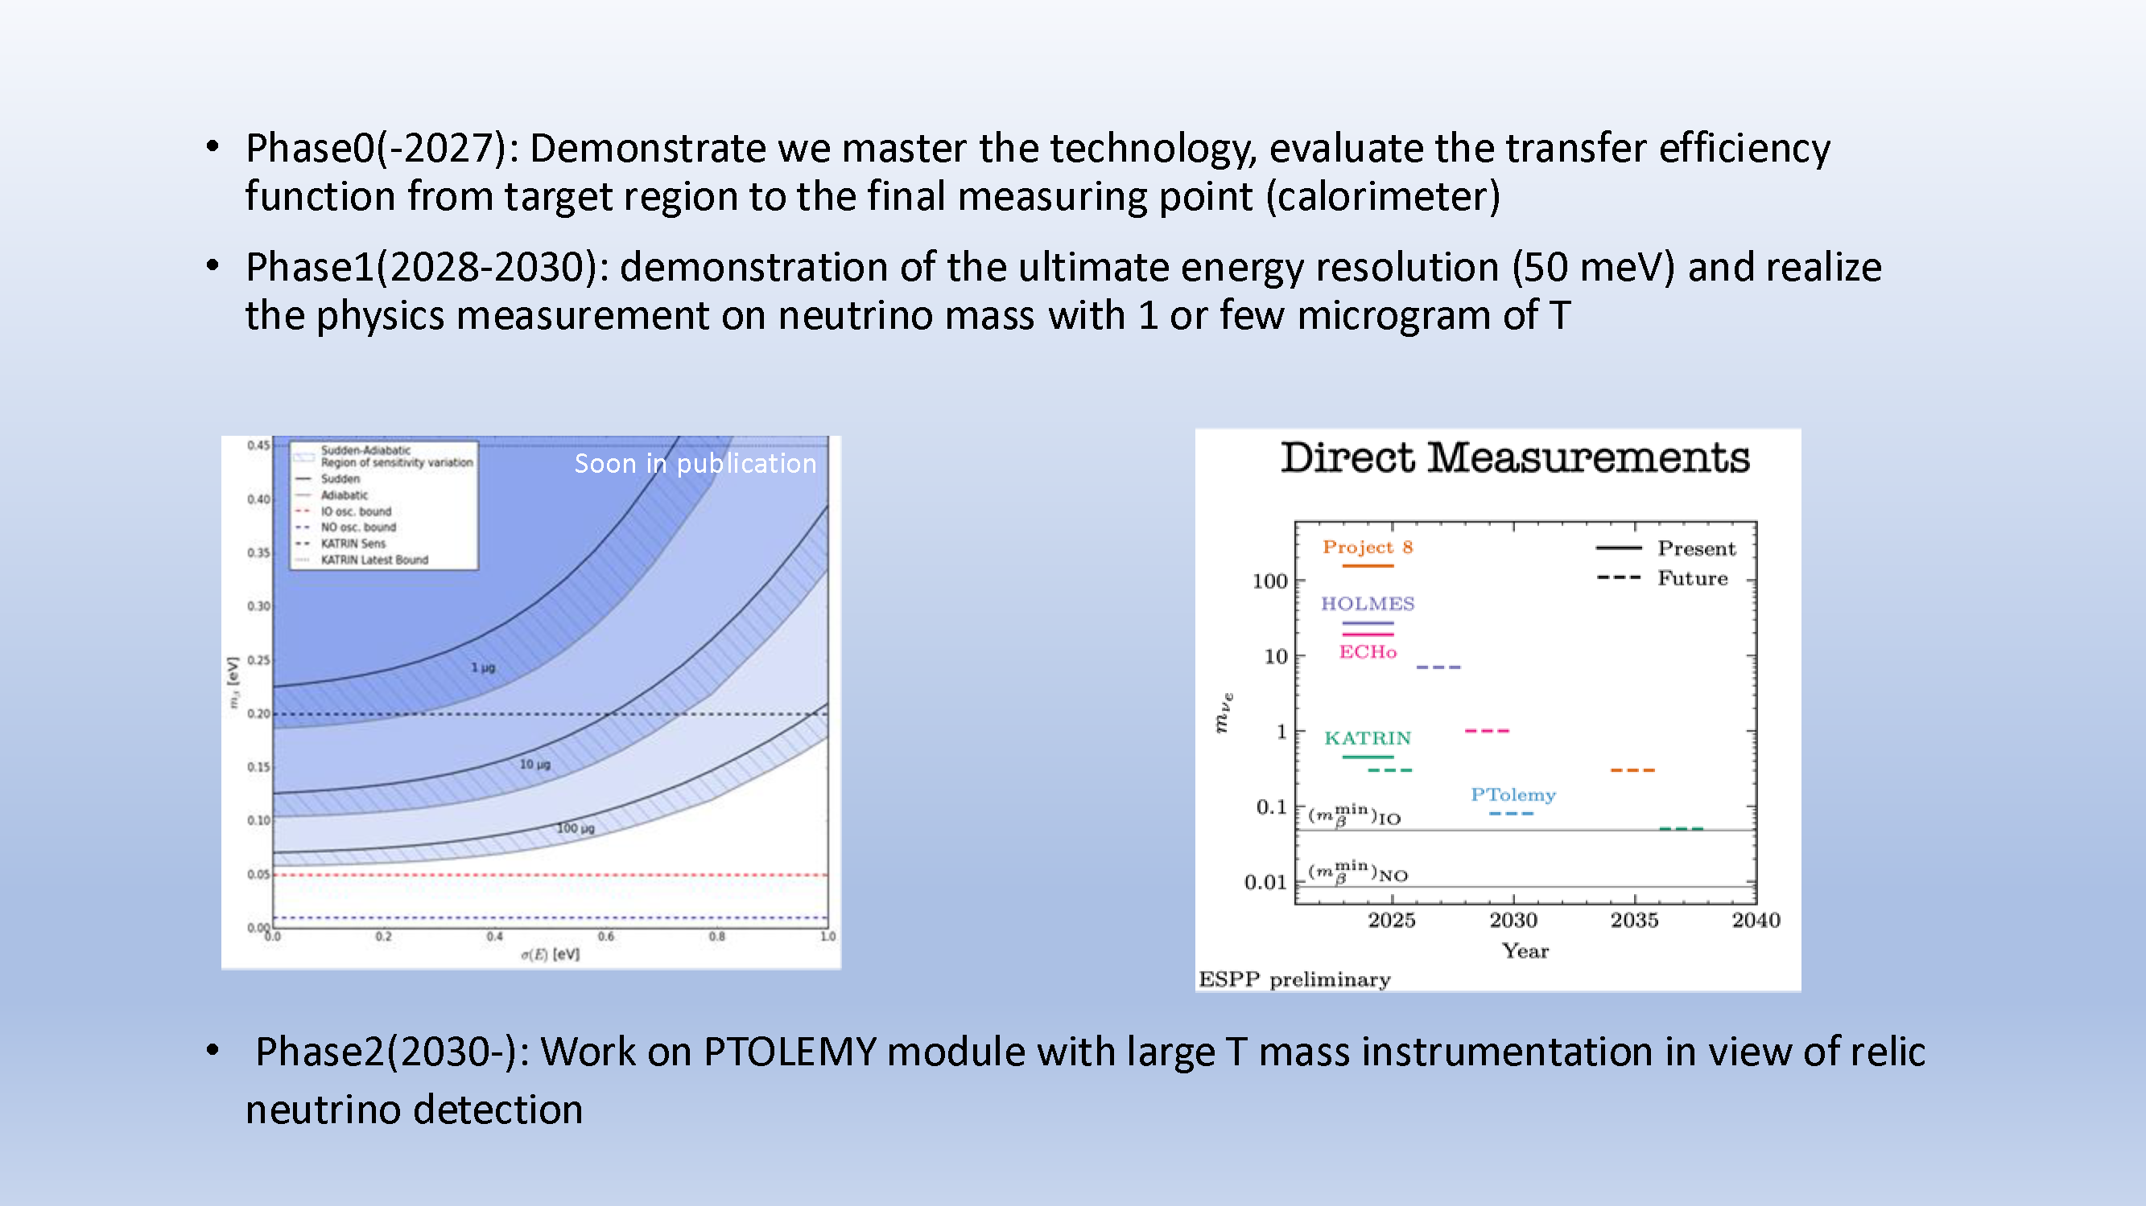
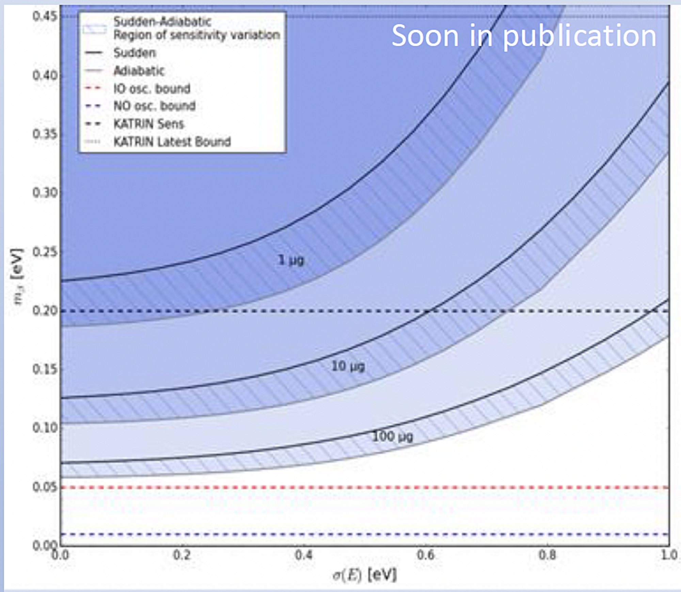
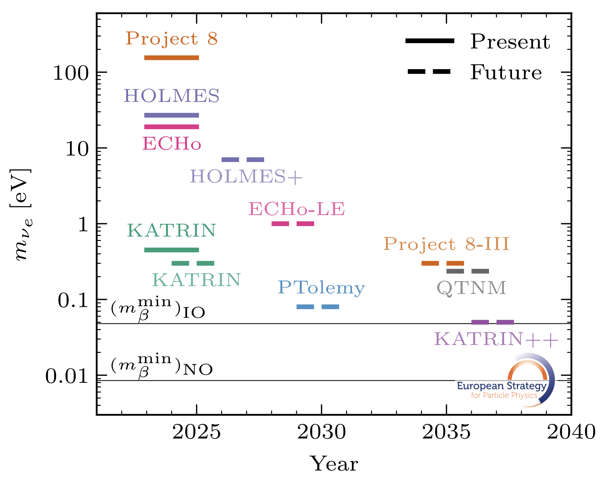
Outlook: Mass Sensitivity
https://arxiv.org/pdf/2511.03883

Slide 21
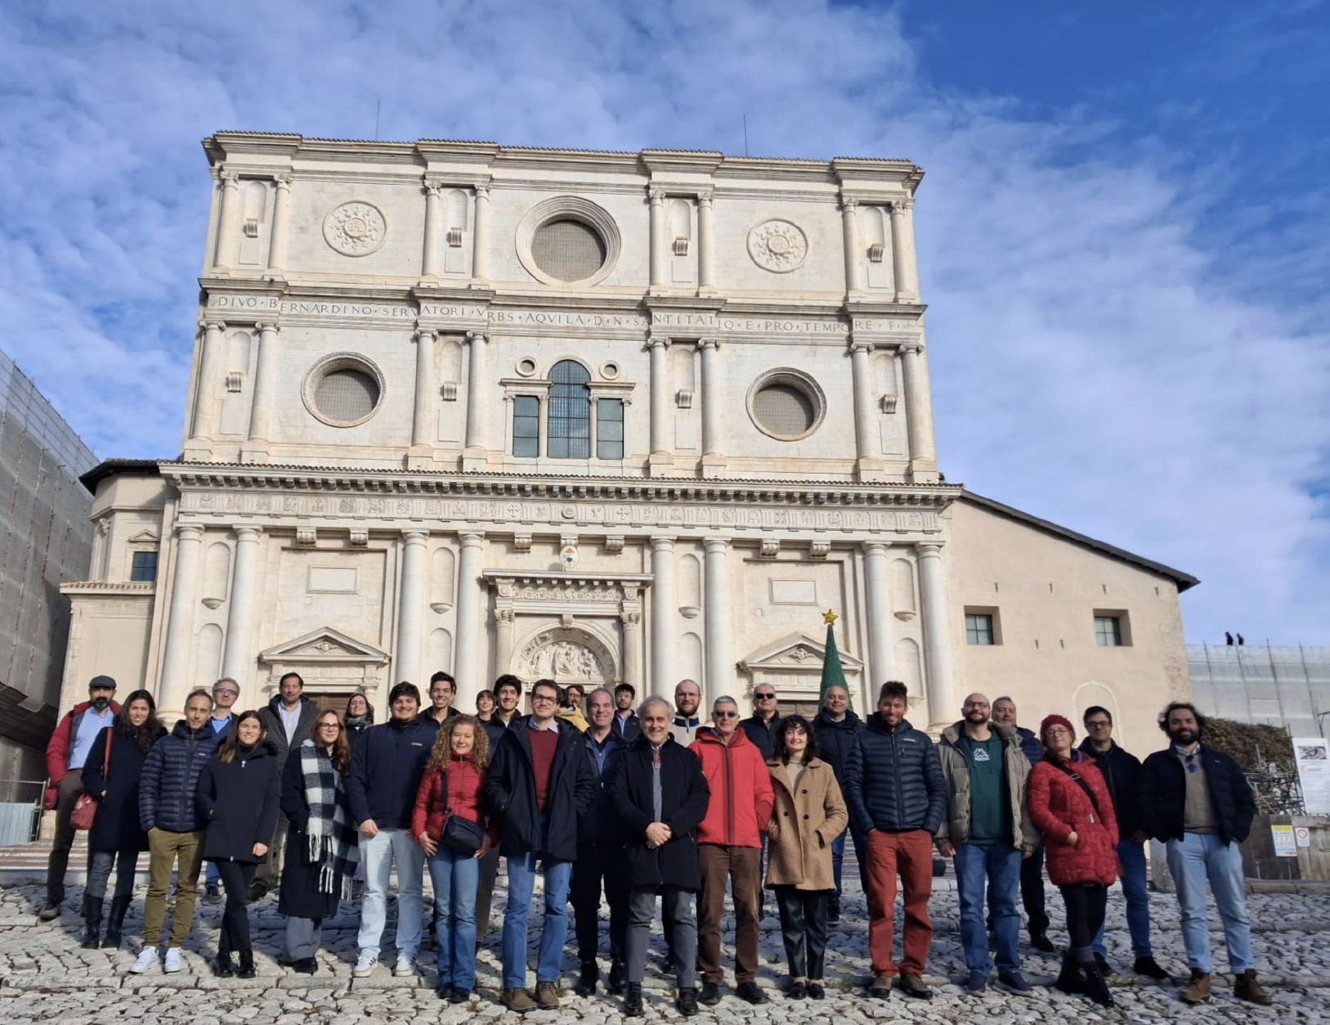

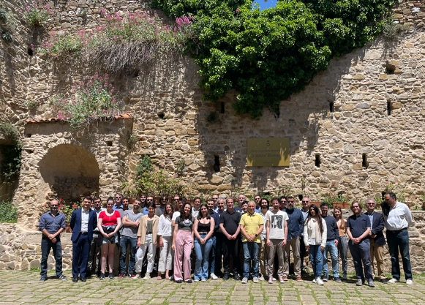
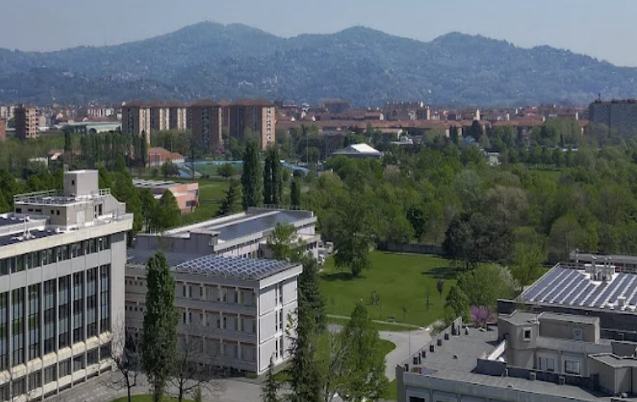
Work In Progress
Next month
@INRiM

Slide 22
Backup

Slide 23
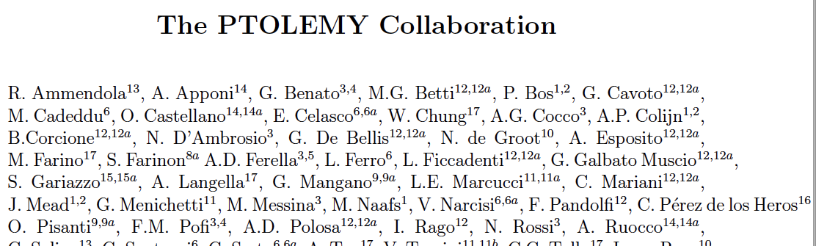
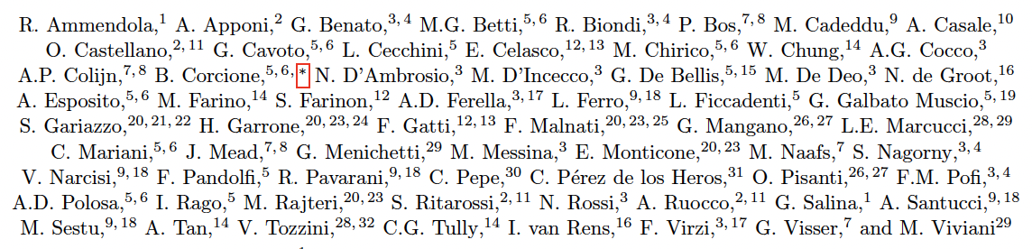
conclusion
PTOLEMY’s goal is to eventually detect the cosmic neutrino background
The detector prototype will be ready at LNGS by the end of this year
Ultimate goals of the Demonstrator: instrumented mass ~ tens of 𝜇g, energy resolution ~ 50 meV
“Intermediate” physics program of Demonstrator: neutrino mass measurements (or limits) striving to go beyond what has been achieved by all previous experiments.
Notes:
In conclusion, …read.

Slide 24
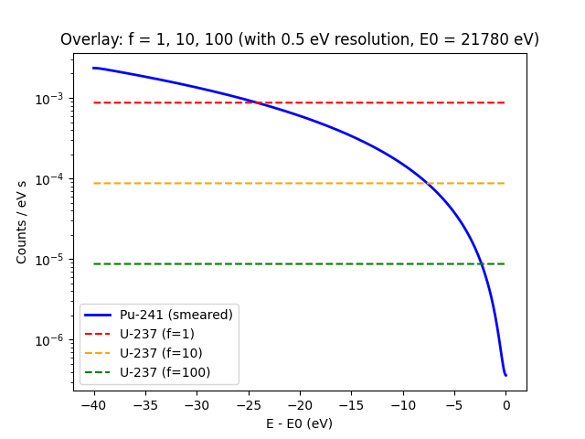
Active Purification of ²⁴¹Pu
”It may not be that hopeless.” [N. de Groot, 2026]

Slide 25
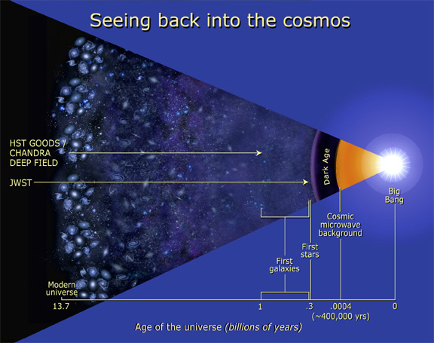
Notes:
When we look back as far as we can see with photons using the Webb telescope (JWST), then the farther we look, the more uniform we see the matter distribution of the universe. Gravitational instability is nominally a late universe effect and driven by free fall timescale over large distances. Stellar black holes are formed when stars run out of fuel to burn and collapse under gravitational pressure. That makes it strange for JWST to observe so many galaxies with supermassive black hole core at a time when we only expect to see the first stars. This is a great mystery and grows with every new observation.

Slide 26
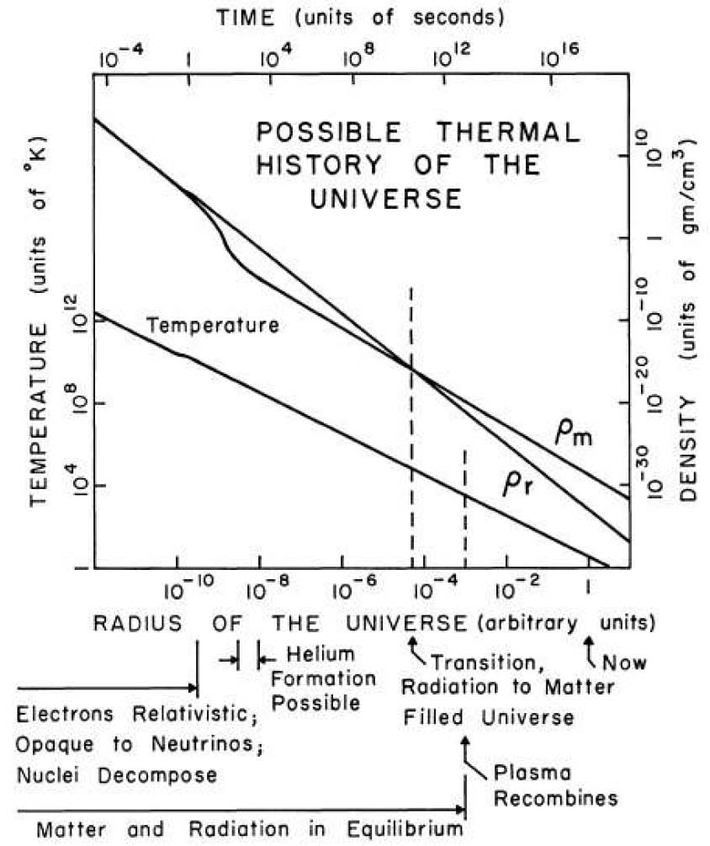
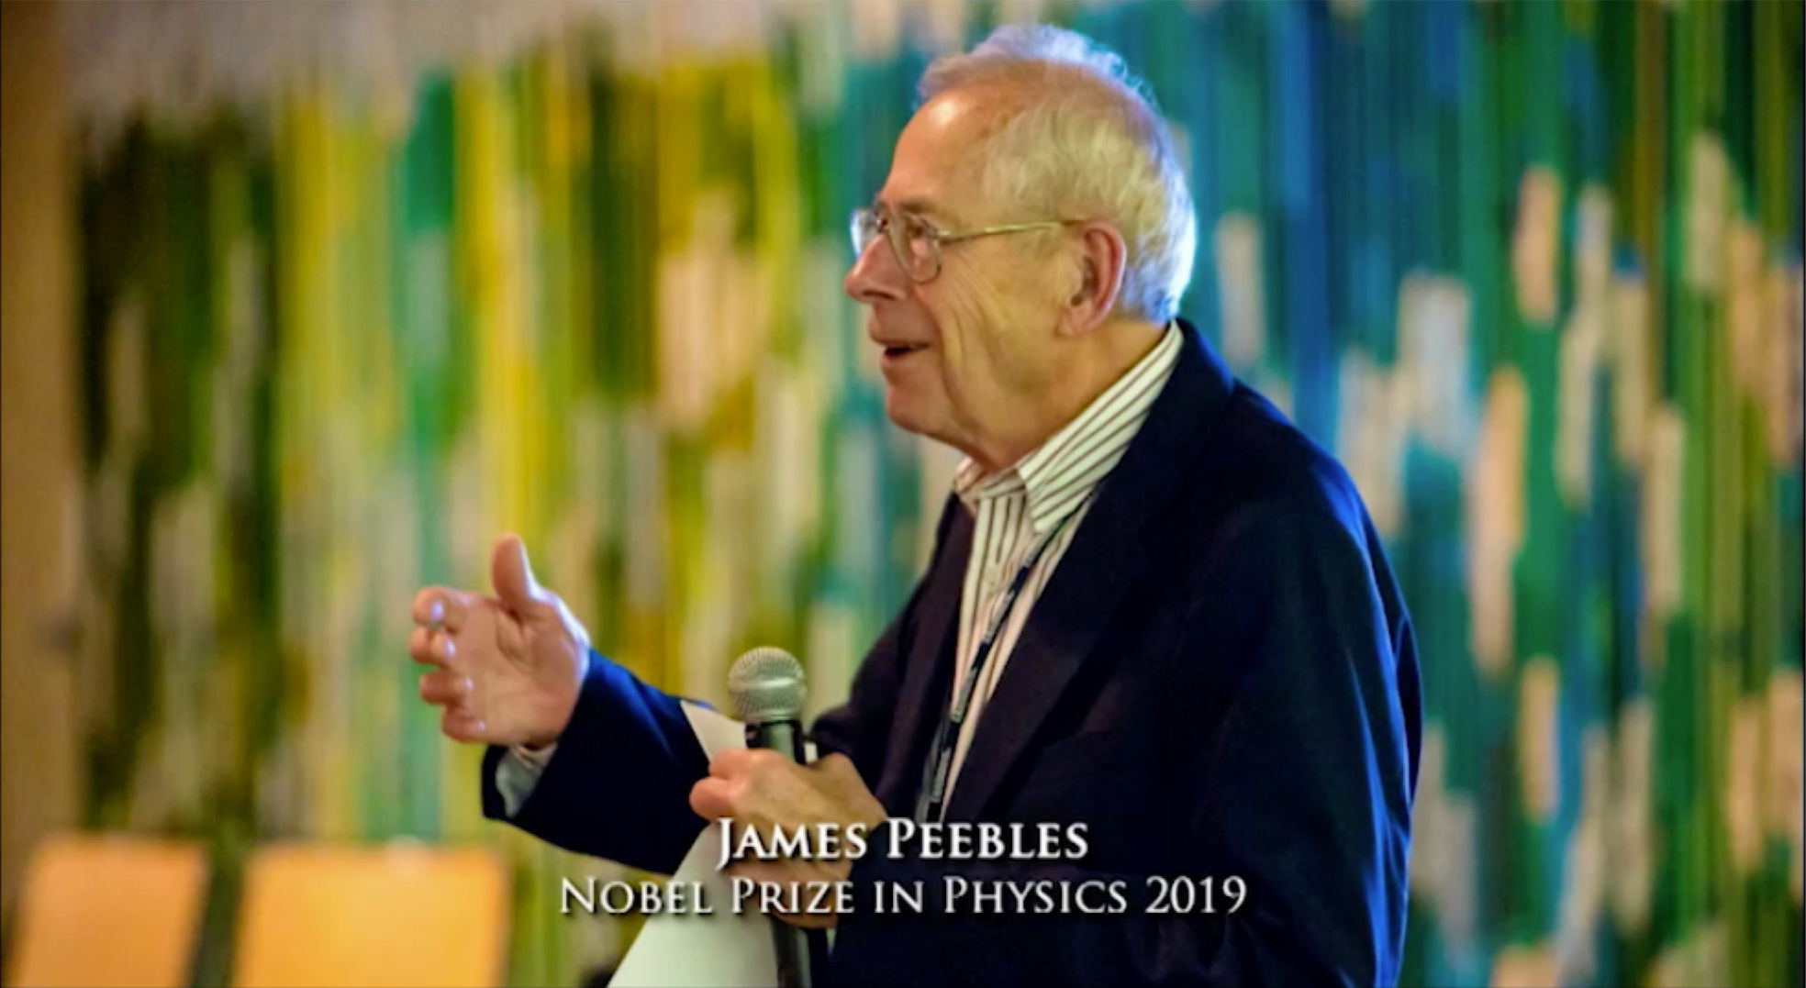
Cosmic Neutrino Background
Number density:
1 sec
n_{ν} = 112/cm³
Temperature:
Radiation ~1/a⁴
T_{ν} ~ 1.95K
Time of decoupling:
Matter
~1/a³
t_{ν} ~ 1 second
~50% of the Total Energy Density
of the Universe @ 1 sec
    neutron/proton ratio
    @start of nucleosynthesis
⁴He
²H
(³He)
⁷Li
Dicke, Peebles*, Roll, Wilkinson (1965)
Cosmology's Century (2020)
*
Notes:
We have an immensely successful thermal model of the early Universe, here shown from a paper published in 1965 that predicted that the sphere shown in the previous slide could one day be observed, not in the optical when it was formed at roughly 3000K, but over a thousand times lower, now measured to be 2.7K due to the expansion of the Universe predicted by Einstein’s equations. This theory predicted the acoustical waves that give rise to the large scale structure we see in the late Universe and that there was a time when the Universe was so hot and dense that the not only photons, but the light, neutral particles known as neutrinos dominate the total energy density of the Universe. At one second after the Big Bang when the neutrinos are nearly half the total energy density of the Universe, the Universe becomes transparent to neutrinos and they begin traveling in straight lines like photons travel through transparent material. From detecting the CMB, we know many properties of the relic neutrinos. Their presence is immensely important as it sets the scale for the cooling of the Universe which enabled the light elements to be fabricated in just enough time, within the first 3 minutes, to give us the neutrons as the fundamental nuclear ingredient to the rich range of atomic elements we have today.

Slide 27
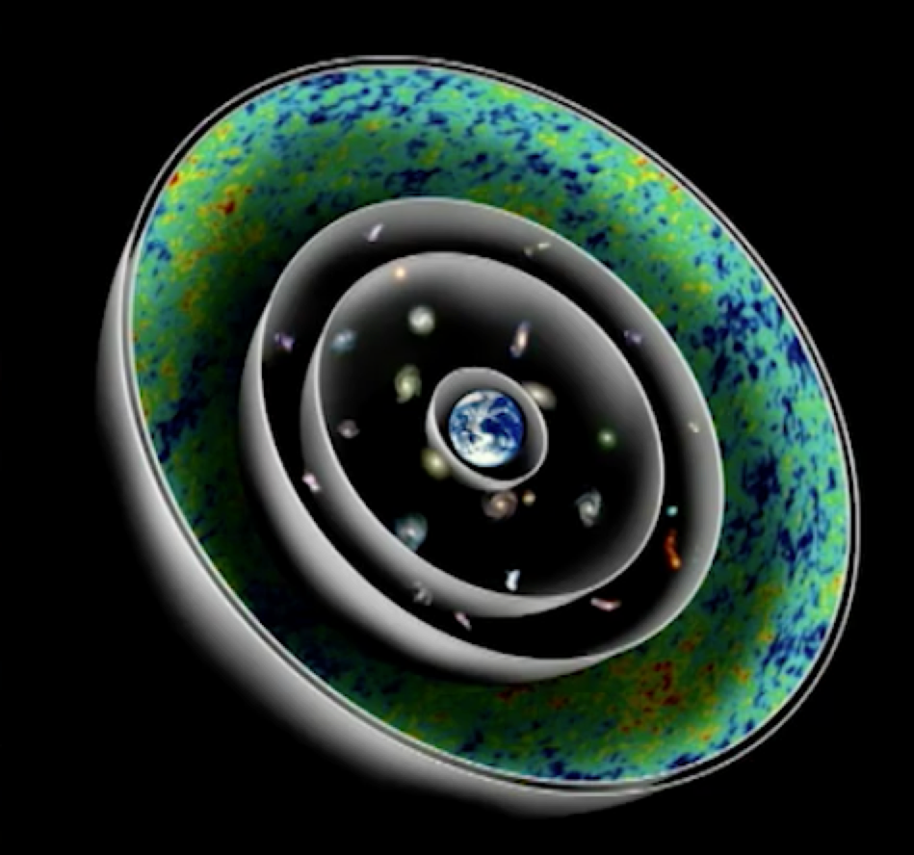
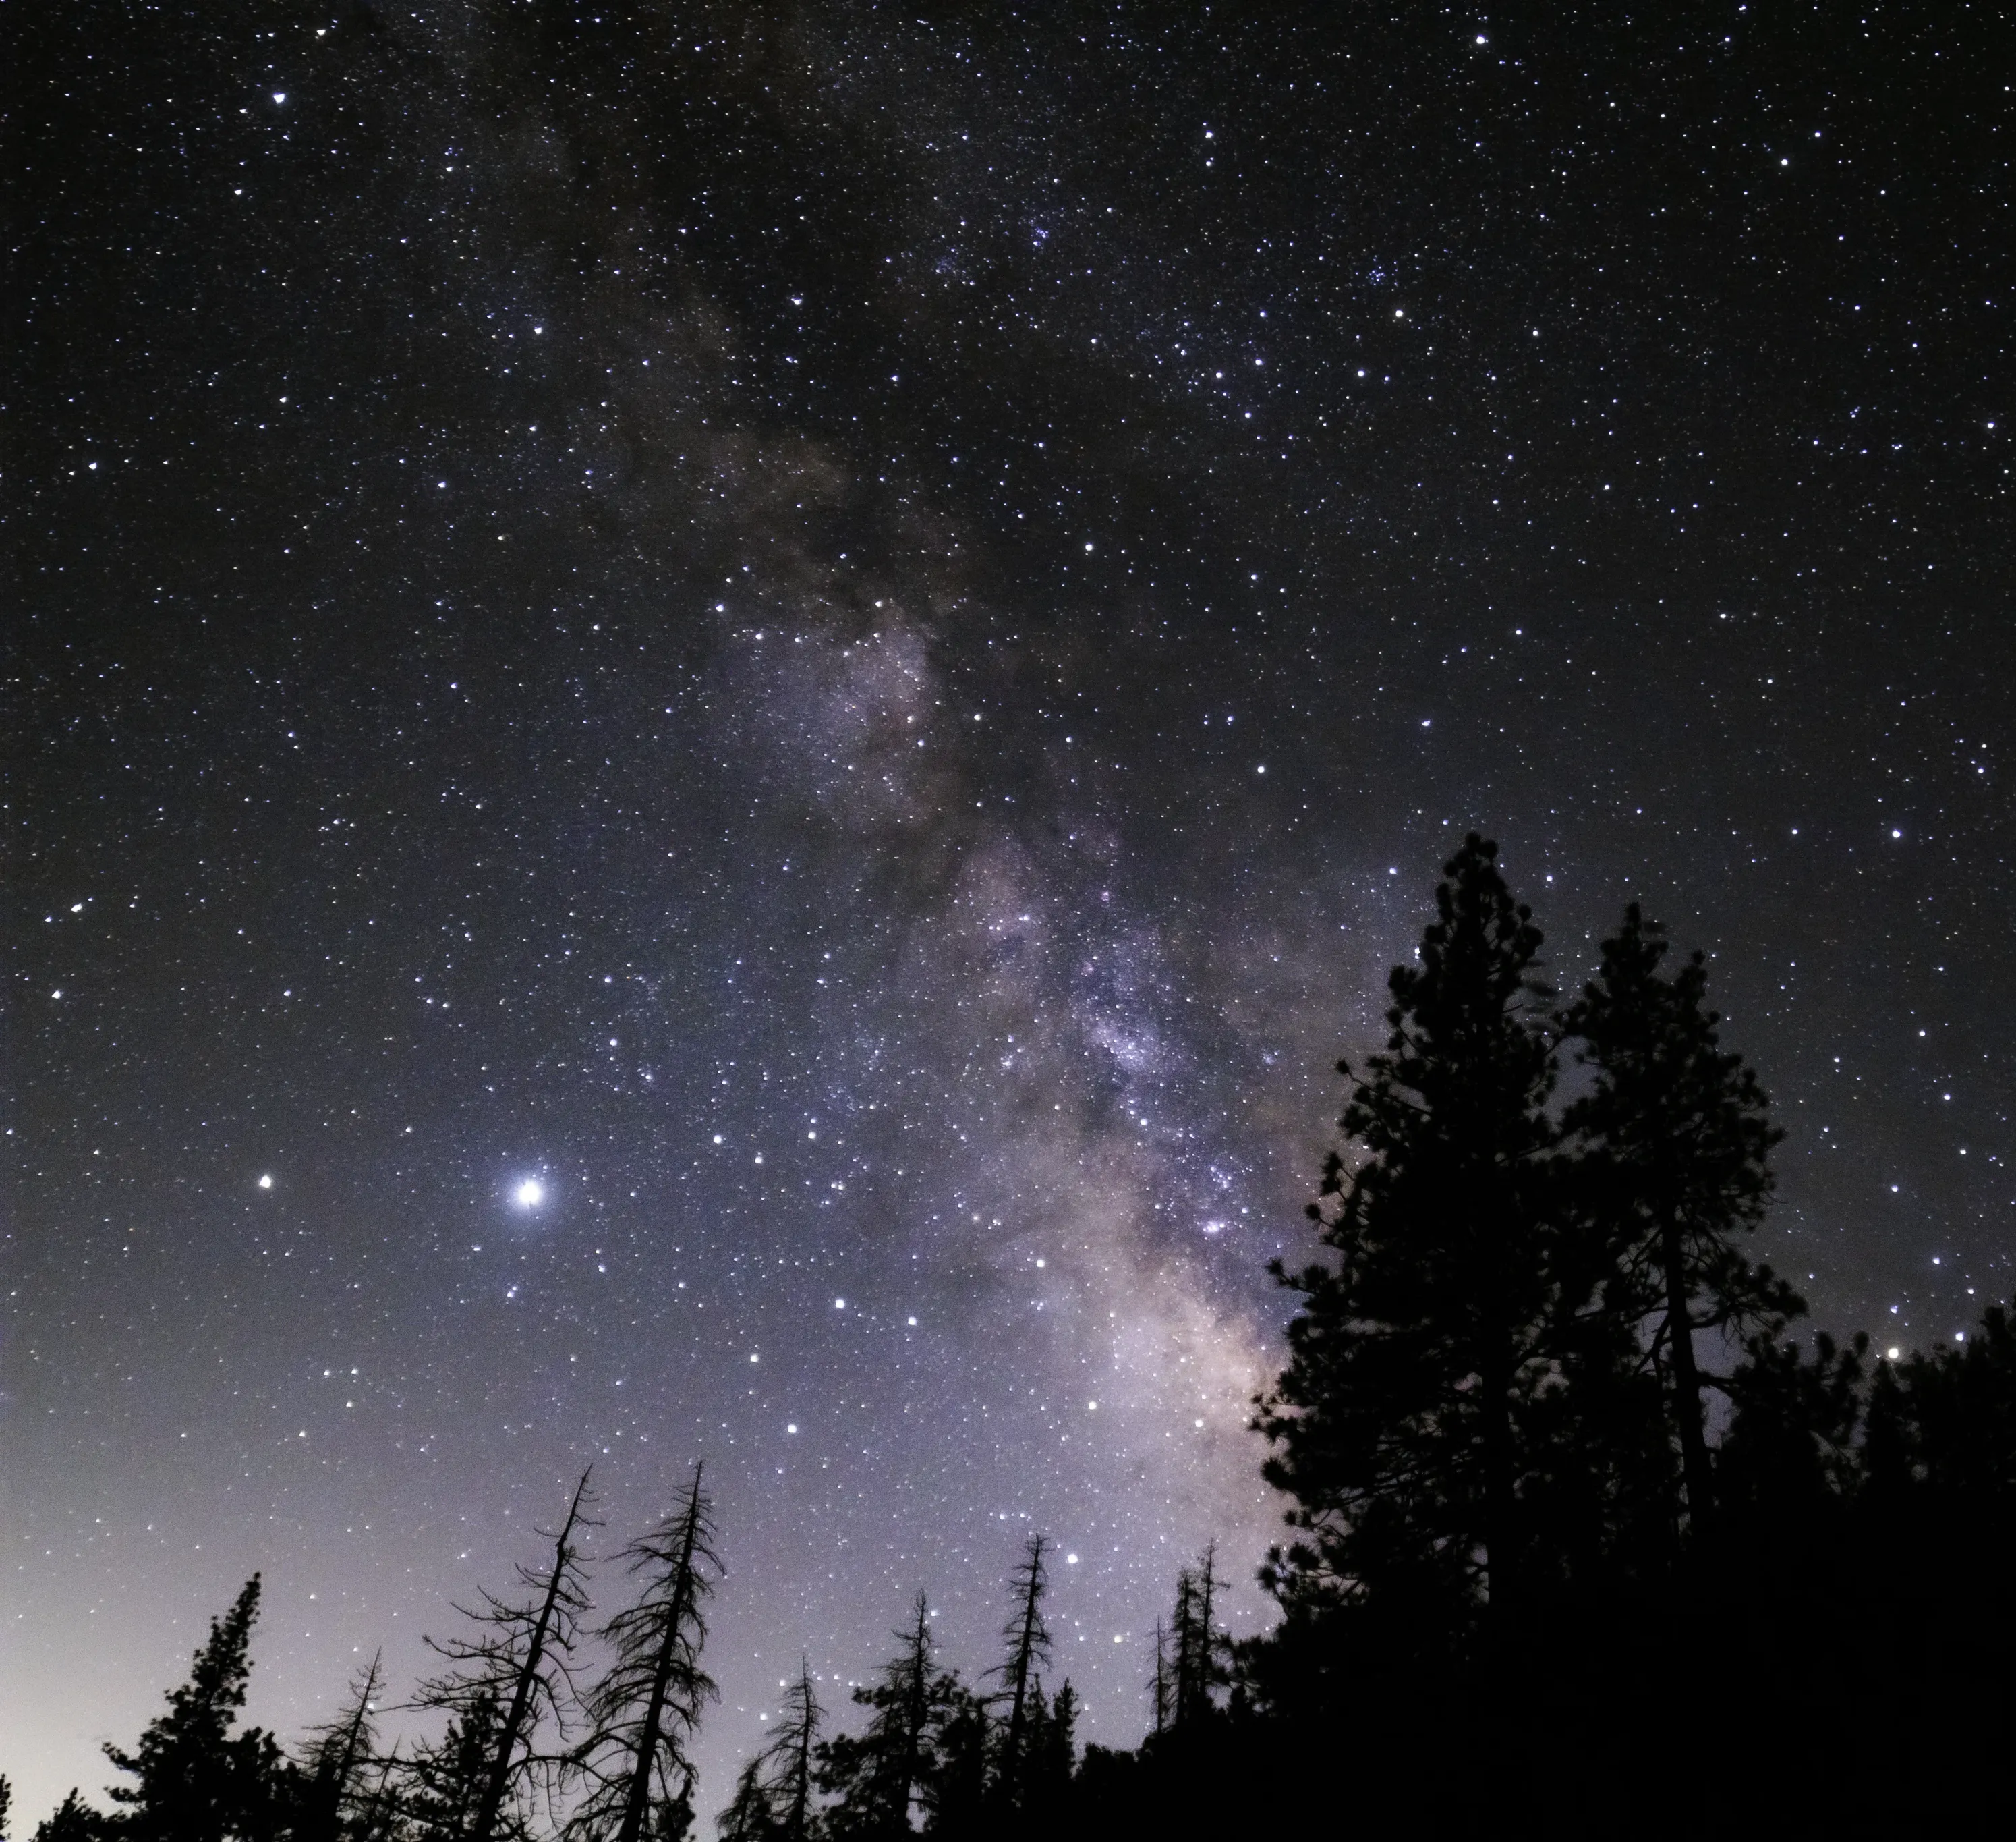
Looking Back in Time with Photons
Emission Time
-13.8x10⁹ years
-4x10⁹ years
-200x10⁶ years
-2x10⁶ years
All of this light arrives at the same time (t=0)
Notes:
When we look up a the night sky, we see a wave of coincident photons, the CMB photons emitted 13.8 billion years ago and now stretched in the microwave, but as they travel to us, they see the Universe aging and are joined by emissions along the way, for instance, of stars born 4 billion years ago, and star clusters and nebula 200 million light years away and the Andromeda galaxy 2 million light years away. That is what we see in the night’s sky - a mélange of many different time periods all at once.
What would the neutrinos see along their way to Earth over their journey starting one second after the Big Bang? You’d think they would see even farther away, but that would only be true if they were massless, we know that at least two of the three neutrinos have mass. When I was a student in the late 80’s, one of the first measurements we made at the LEP collider was to count the number of light neutrinos in Z boson decay. This created great certainty for what to expect in cosmology. I see the neutrino mass in the same way. The more we constrain with lab experiments, the more we can learn from cosmological observables.

Slide 28
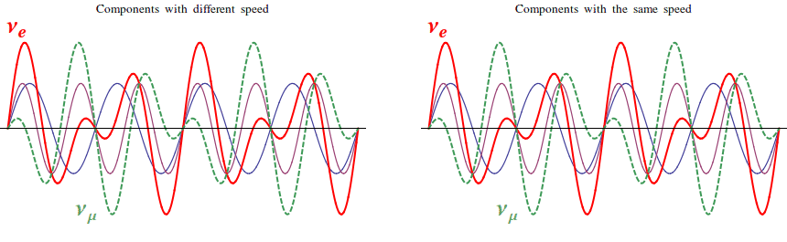
Neutrino Masses from Oscillations
Theory developed by
Bruno Pontecorvo
≈(0.05eV)²
??
3 mass eigenstates
X
3 flavors
(electron, muon, tau)
0
Notes:
It is known that some neutrino masses are non-zero from the theory developed by Bruno Pontecorvo who applied quantum mechanics to the production of neutrinos from processes that are so short in time that the energy uncertainty of the process spans the range of neutrinos masses. In those conditions, nature does not force the choice of one specific neutrino mass eigenstate, but necessarily allows all possible states to propagate coherently over long distances until only one gets projected out at the time of measurement. These states oscillate between each other.

Slide 29
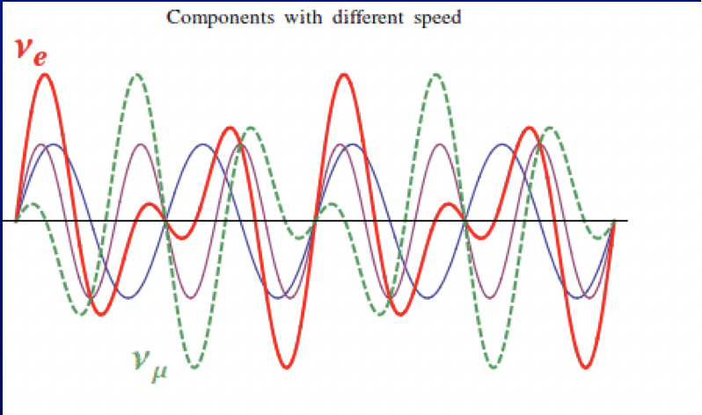
Neutrino Masses from Oscillations
Theory developed by
Bruno Pontecorvo
≈(0.05eV)²
??
3 mass eigenstates
X
3 flavors
(electron, muon, tau)
0
Notes:
It is known that some neutrino masses are non-zero from the theory developed by Bruno Pontecorvo who applied quantum mechanics to the production of neutrinos from processes that are so short in time that the energy uncertainty of the process spans the range of neutrinos masses. In those conditions, nature does not force the choice of one specific neutrino mass eigenstate, but necessarily allows all possible states to propagate coherently over long distances until only one gets projected out at the time of measurement. These states oscillate between each other.

Slide 30
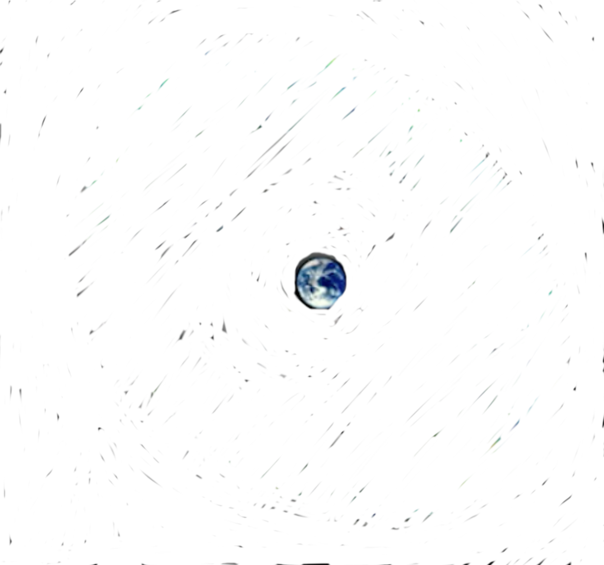
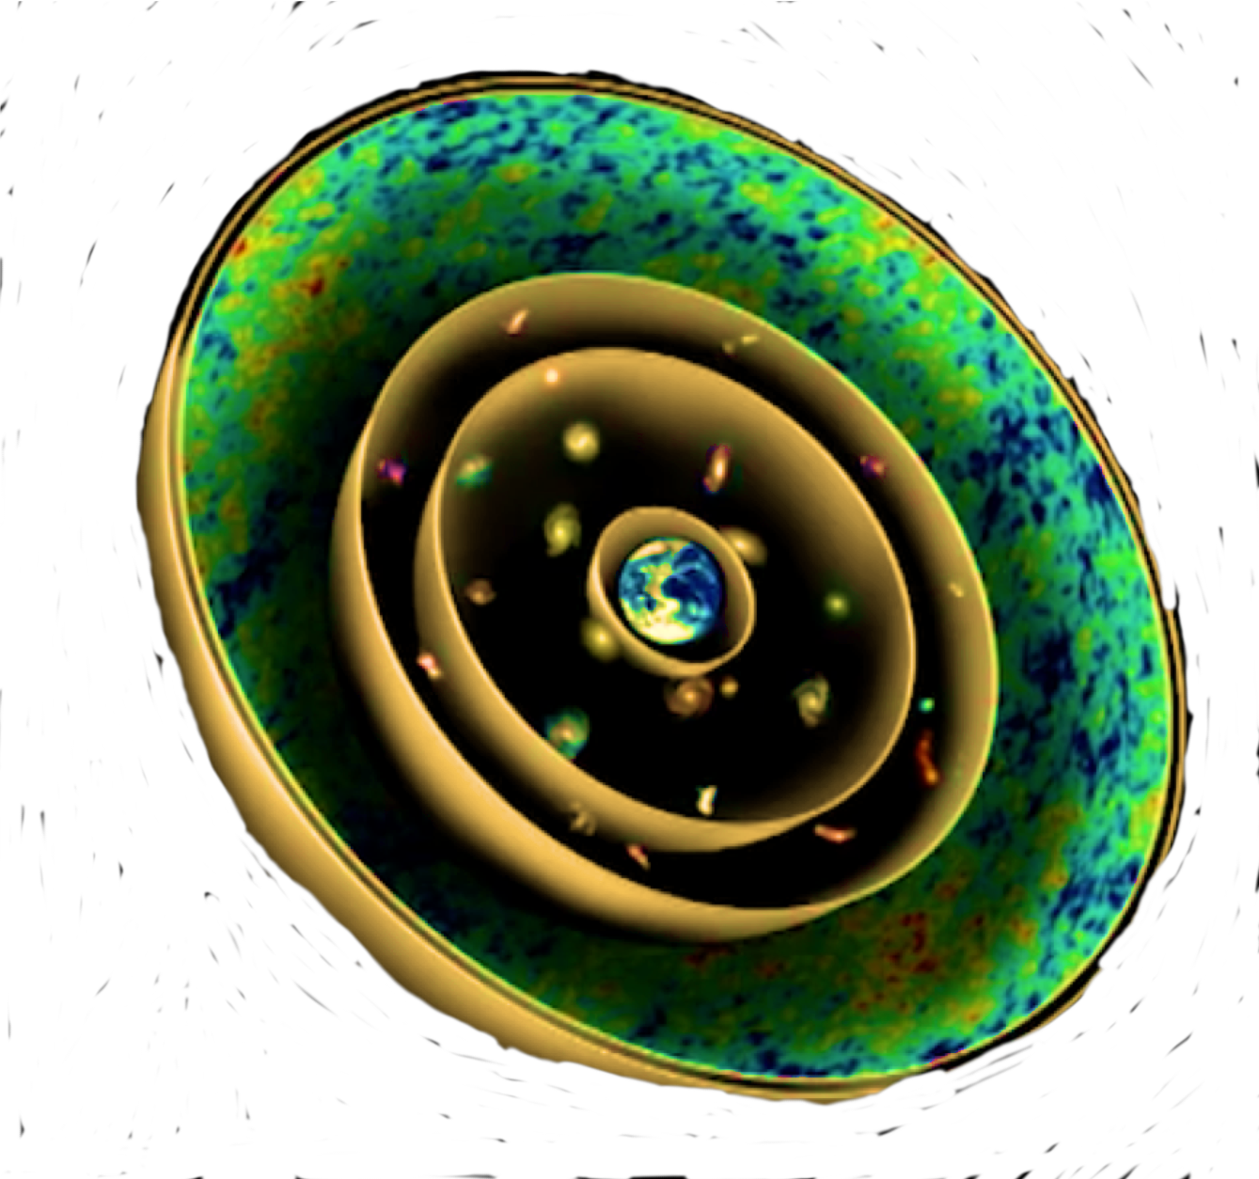
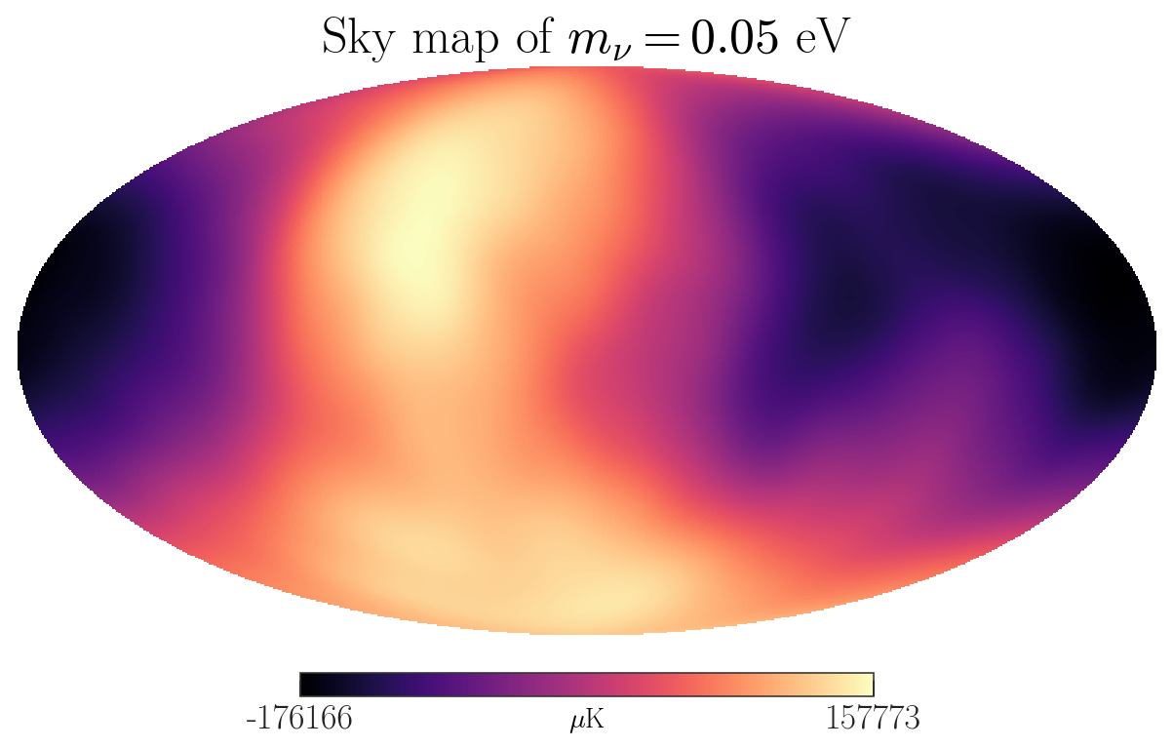
Massive Neutrino Timeline
Emission Time
-13.8x10⁹ years
(1 second after Big Bang)
No comparable flux from other sources
Starting radius more spread out due to mass
Neutrino Sky
Notes:
What does the Universe look like from the point of view of a massive neutrino? Neutrinos start out traveling at nearly the speed of light, but as the Universe expands, they slow down. They see the Universe aging as they travel, but at distances an order of magnitude closer to us than the photons. That means that we can see optically a much older version of the Universe than what the neutrinos experienced. If we spot a supermassive black hole in the path in the way of the neutrino from the Big Bang, then those neutrinos may have been captured or deflected by those black holes.

Slide 31
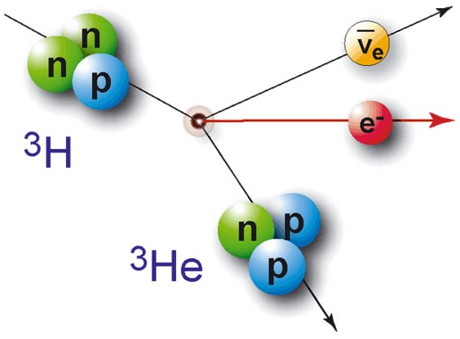



ptolemy - relic neutrino detection
PonTecorvo Observatory for Light Early-universe Massive-neutrino Yield
Beta-Decay
Neutrino Capture
Rev. Mod. Phys. 92, 45006 (2020)
DOI: 10.1088/1475-7516/2007/06/015
Signature of CνB
KM3
Neutrino Mass Effect on Endpoint
Predicted by Enrico Fermi
Notes:
How do we detect neutrinos? We do so through a nuclear transformation where we can convert a light element, in this case, tritium, into a helium-3 atom by the capture of a neutrino from the Big Bang. The mass of the neutrino, for which we don’t know it’s absolute value, would separate the relic neutrino capture signal to be a narrow peak of high kinetic energy electrons. Similarly, tritium, which is unstable to beta-decay, would produce a lower energy spectrum of electrons whose spectrum drops off near its endpoint because of the neutrino mass stealing away what would otherwise be available kinetic energy. Enrico Fermi predicted this effect. This, in turn, predicts a gap with a spacing of twice the neutrino mass between relic neutrino capture and maximal energy beta-decay electrons. I’ve included the world’s highest energy neutrino event from KM3.

Slide 32


Idea of Enrico FErmi
91 year anniversary!
Fermi, E. Versuch einer Theorie der β-Strahlen. I. Z. Physik 88, 161–177 (1934).
https://doi.org/10.1007/BF01351864
The neutrino masses are so tiny, their effects are smaller than atomic transitions in normal materials.
(There is a reason that there are no units on this plot.)
Notes:
The effect on the beta spectrum predicted by Enrico Fermi 91 years ago gives a tell-tale signature for finite neutrino mass. Here you can see the shape for heavy, light and massless neutrinos. However, in Fermi’s time, there was no mass scale known for the neutrino – there is a reason why there are no units on this plot. In practice, the neutrino mess is limited by lab experiments to less than 0.45 eV and oscillations tell us that at least one is heavier than 0.05 eV. Those scales are smaller than atomic binding energies, so when we hold tritium with chemical bonds, the neutrino mass effect from Fermi appears subdominant to atomic effects and as we will see, the threshold effects appear multiple times.

Slide 33





ptolemy: 2D Material - GrapheNE
Graphene w/Tritium
Quantum Steps
$$φ$$
~0.2eV
steps
Other graphene structures also under study
$$φ≡$$
“Atomic” work function
Notes:
The PTOLEMY experiment studies Graphene, a novel 2D material made only from Carbon atoms, as way of holding tritium against vacuum. This allows emitted electrons to pass directly into vacuum to avoid scattering effects. This material will capture the final state helium-3 element in some cases and these atoms fall into a spectrum of excited states that appear like steps in the energy spectrum of the endpoint electrons. And in some cases, the helium-3 clears the Graphene surface as a kind of “atomic” work function.

Slide 34
ptolemy: 2D Material - GrapheNE
Graphene w/Tritium
Quantum Steps
$$φ$$
~0.2eV
steps
Other graphene structures also under study
$$φ≡$$
“Atomic” work function
Notes:
The effect of Fermi appears every time there is a new energy threshold and as excited states grow in numbers with each step, the Fermi effect is a percentage effect on each step and in the much larger atomic work function threshold. This discovery allows us to measure neutrino mass effects across the spectrum and requires much less tritium than having to go to the extreme upper tip and collect events there. The atomic work function and steps introduce an endpoint shape that has more structure than Fermi predicted from neutrino mass alone. One wonders whether previous neutrino mass experiments that measure unphysical negative mass squared preferred values are in fact not accounting for atomic steps in their data, and it could be that our measurements will help with the re-analysis of that data. An important take-away from this talk is that the neutrino mass measurement for these systems for these tiny masses is equally a condensed matter experiment. PTOLEMY will have an energy resolution high enough to measure these steps directly.

Slide 35

Fabrication of a Tritiated-Graphene Target/Source
Hydrogen and Deuterium loading on graphene at Roma1 and Roma3
atomic H as a tool to ‘pinch’ the sp² bonds towards a sp³ configuration
while maintaining the planar nature of graphene
H on Nanoporous Graphene (NPG):
sp³ C-H bond
T-chamber in Rome side view:
Betti et all, Nano Lett. 22, 2971 (2022)
UKAEA’s Active Gas Handling System (tritium for JET, EU Tokamak) for feasibility study & design requirement of a new T loading chamber
Notes:
35
Hydrogen and deuterium loading of nano-porous graphene has been achieved by the Roma and RomaTre groups using a special capillary cracker and loading setup, custom built in Italy. This is the world record for hydrogen loading on Graphene with more than 9 of every 10 carbon atoms attached to hydrogen. We are working on developing this chamber for use in a tritium facility.

Slide 36





ptolemy: the idea
JINST 17 (2022) 05, P05021
A new electromagnetic filter idea based on RF detection and dynamic E setting
𝜟V known to 1 ppm precision
ETot=q(VTES-Vsource)+ETES
collimate and slow down
first measurement of the energy via cyclotron RF emission
($∼10μ\text{s}$)
enter if within $∼10\text{eV}$ from endpoint
By A. Esposito
Notes:
The remaining kinetic energy/momentum of the electrons referenced to a precise voltage difference between target and detector are then measured to resolutions comparable to the neutrino mass. A special feature of the PTOLEMY magnetic geometry is that not only are we able to leverage zero-field TES, an electrostatic spectrometer is also possible for the precision energy measurement.

Slide 37














Precision energy measurement
from Condensed Matter/ARPES
Electostatic analyser
Electron optic basic equation
Helmholtz – Lagrange law
Electrostatic lenses
$$x_{t}θ_{t}\sqrt{E_{k}}=x_{a}θ_{a}\sqrt{E_{p}}$$
$$x_{t}$$
$$θ_{a}$$
$$x_{a}$$
E_{p} + δE
$$θ_{t}$$
E_{p}
Two concentric hemispheres
for the energy selection
$$E_{k}$$
$$E_{p}$$
$$M_{θ}M_{l}$$
E_{p}- δE
Energy resolution
(bandpass energy):
Ptolemy e.m. filter
Delay Line
MCP
$$\frac{∆E}{E_{p}}=\frac{x}{2R_{0}}+\frac{θ^{2}}{4}$$
Position sensitive detector (MCP+delay line)
allows parallel acquisition
ΔE: energy resolution
E_{p} : pass energy
x: slit width
R₀: mean radius
θ: accepted angle
preamp.
CFD
TDC
Anode
Specs Phoibos 225
~few meV energy resolution
Notes:
One great synergy between particle physics and condensed matter physics is in the possibility of using a spherical electrostatic spectrometer for the final electron momentum measurement, as one would use to probe the band structure in condensed matter physics using ARPES-like methods. We are able to time-multiplex the anode to achieve position sensitive detection with an MCP, expanding the phase space of the device. This phase space is very much like photoelectrons coming off a 3 inch photocathode – a familiar problem for KM3.

Slide 38


Detailed simulation of the PTOLEMY filter
Magnet 1 T field
RF region
Filter region
RF Measurement
Micro-Cal
Target
Wonyong C. Princeton University
Geometry relying on modularity approach to increase instrumented
target mass
Micro-calorimeter region
with focusing system to match beam and calorimeter array
Zero B Field FOCUSING
with Einzel lens (90 degress)
Microcalorimeter
Notes:
This is a full end-to-end simulation of this process. We see the target location and electron path into the high field magnet, the RF measurement region and then the electrodes guiding the electrons to the microcalorimeter. At the current stage of the project where we will be commissioning the filter transport, a novel new approach is being developed for electron analysis with Fermilab. A pixelated CCD/Skipper readout system with a GEM-like pre-accelerator on the surface will provide a momentum spectrometer with a silicon-based Faraday cup micro-array with a noise level that is a small fraction of one elementary charge.

Slide 39



demonstrator MagneT
Being built and will be installed at the LNGS
Key element to realize the PTOLEMY Experiment
Construction ASG/Suprasys consortium of a SC dipole with
special attention to the fringe field
Under construction in Genova → Shipment to CERN → LNGS
Simulated B-map
Low Power MgB₂ Superconducting
Conduction-cooled Coils
Vacuum System
< 200 cm
Zero B field saddle point key feature of the field map
Notes:
The most important part of the experiment is being fabricated currently in Genova. This is a new generation of superconducting magnet using MgB2 coils that are conduction cooled. It’s highly energy efficient and produces through iron pole face shaping all the regions we need for the target, RF and a zero field region where we can shield and place the micro-calorimeter/electrostatic spectrometer - which need zero magnetic field to operate. Here we also show the vacuum system under development at LNGS.

Slide 40

The PTOLEMY Collaboration
Notes:
PTOLEMY is a collaboration of people from all over with a common dream of measuring the youngest Universe.

