Slide 1




Future Long-baseline accelerator neutrino experiments (including ESSnuSB) - Beyond DUNE, HK
Budimir Kliček
On behalf of the ESSnuSB+ project
Ruđer Bošković Institute, Zagreb, Croatia

Slide 2




Why need for future LBL experiments?
Precise measurement of neutrino osc. parameters in laboratory conditions (PMNS matrix, delta-m-squares) in all osc. channels
  strive towards the precision of the CKM matrix
Some of the things we can check:
  Unitarity of PMNS
  Mass ordering (recheck)
  Consistency of oscillation channels
These could have far-reaching consequences
  Leptogenesis in the early Universe
  Check CP, T, and CPT consistency
  Extra neutrino flavours
  Unexpected new physics
T
$$ν_{μ}→ν_{e}$$
$$ν_{e}→ν_{μ}$$
CP
CPT
CP
$${\overline{ν}}_{μ}→{\overline{ν}}_{e}$$
$${\overline{ν}}_{e}→{\overline{ν}}_{μ}$$
T

Slide 3
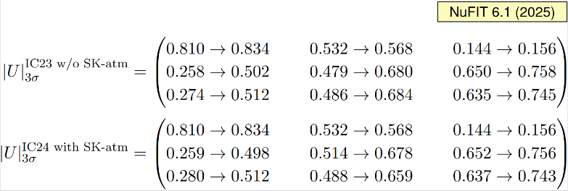
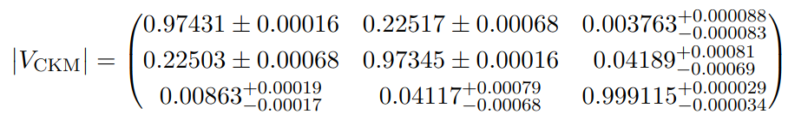
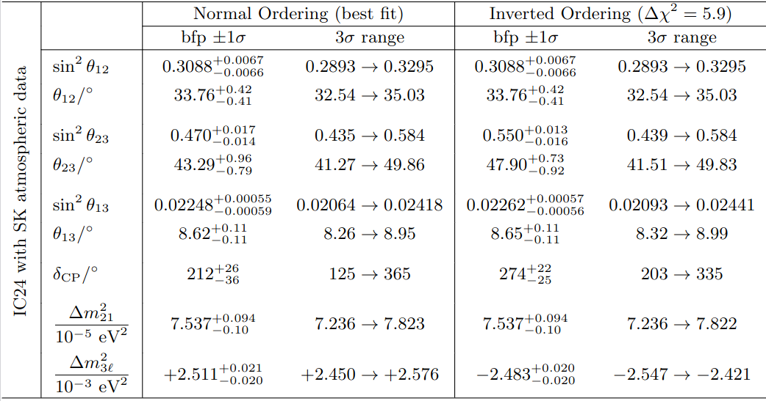

CKM vs. PMNS measured values
Quarks
Neutrinos
CKM parameters
F. Takahashi et al. (Particle Data Group), to be published in Int. J. Mod. Phys. A 41, 2630011 (2026)
JHEP 12 (2024) 216 [arXiv:2410.05380]
and NuFIT 6.1 (2025), www.nu-fit.org.

Slide 4

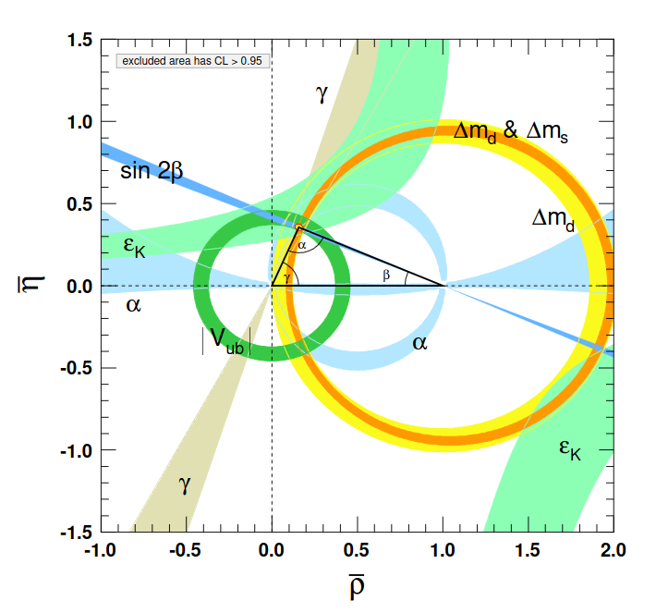
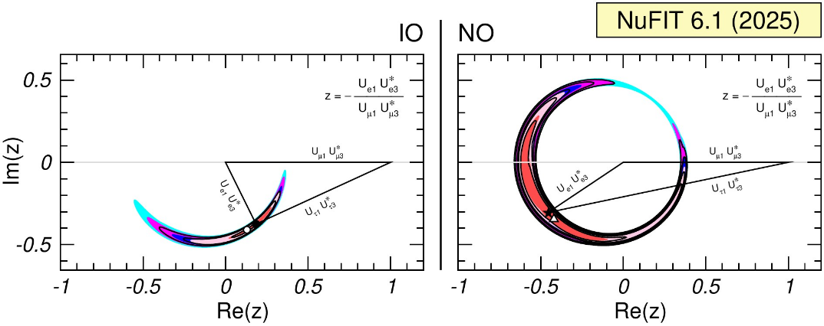
Unitarity triangle CKM vs. PMNS
Quarks
Neutrinos
PMNS
JHEP 12 (2024) 216 [arXiv:2410.05380] and NuFIT 6.1 (2025), www.nu-fit.org.
F. Takahashi et al. (Particle Data Group), to be published in Int. J. Mod. Phys. A 41, 2630011 (2026)
CKM
We’ve got some measuring to do.

Slide 5
Future Long-baseline accelerator neutrino experiments (including ESSnuSB) - Beyond DUNE, HK
What fits this description?
  ESSnuSB
  P2O
  Beta beams
  Neutrino factory
  Tau beams
  Other ideas?
  HyperKK (proposed parallel with HK)

Slide 6
ESSnuSB
A design study for a next-to-next generation experiment to precisely measure CP violation amplitude using the 2nd neutrino oscillation maximum.

Slide 7

CP violation in ESSnuSB
(and HyperK and DUNE)
We will study ν_{e} and ν_{e} appearance in ν_{μ} and ν_{μ} beam, respectively
The plan:
Run with ν_{μ} and look at ν_{e} appearance, then
Run with ν_{μ} and look at ν_{e} appearance

Slide 8
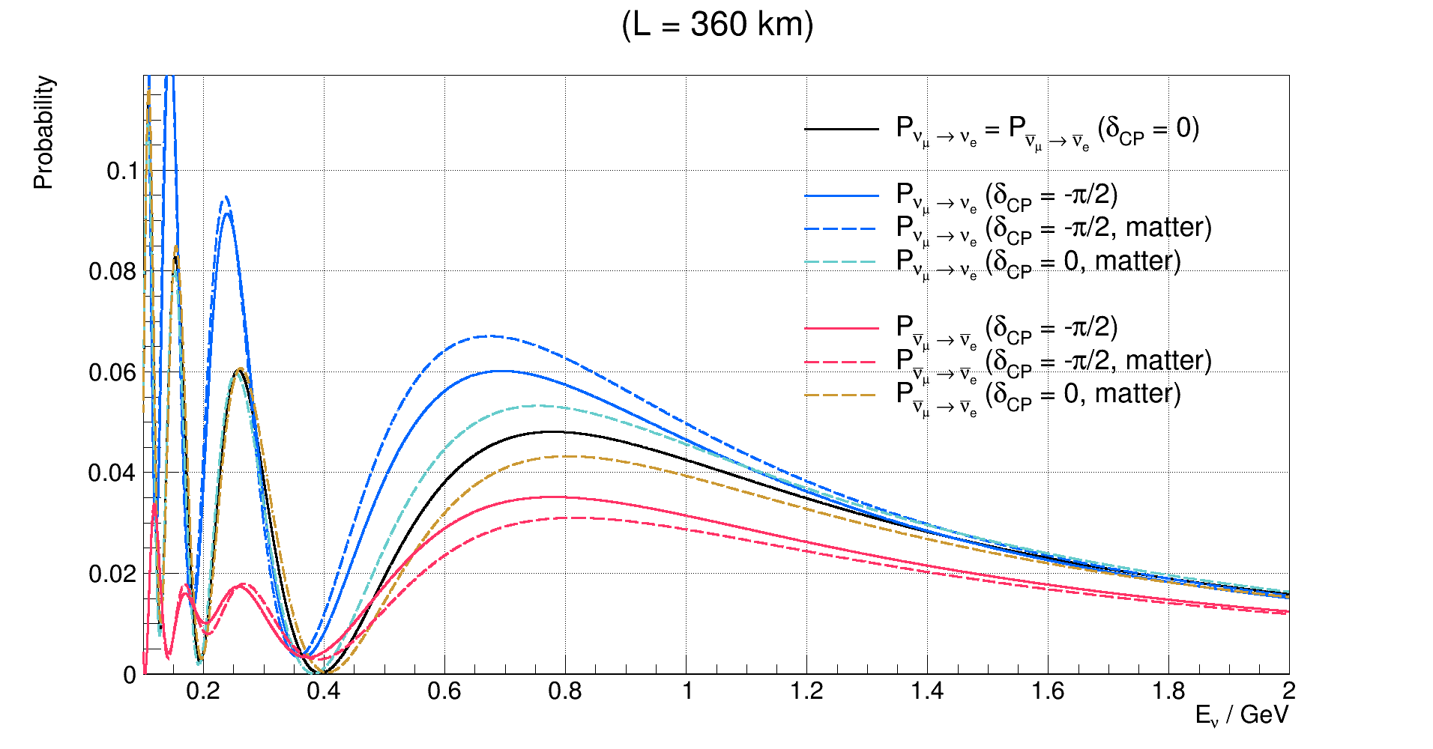

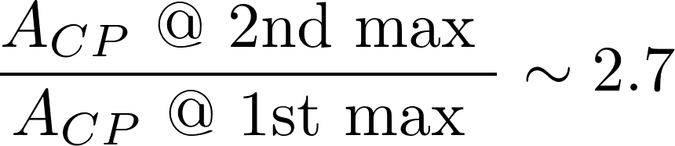
Oscillation pattern at 1st and 2nd maximum
2nd maximum
larger sensitivity to δ_{CP}
matter doesn’t matter
1st maximum
smaller sensitivity to δ_{CP}
matter can mimic CP violation
Does not depend on PMNS matrix elements
Depends only on mass splittings

Slide 9
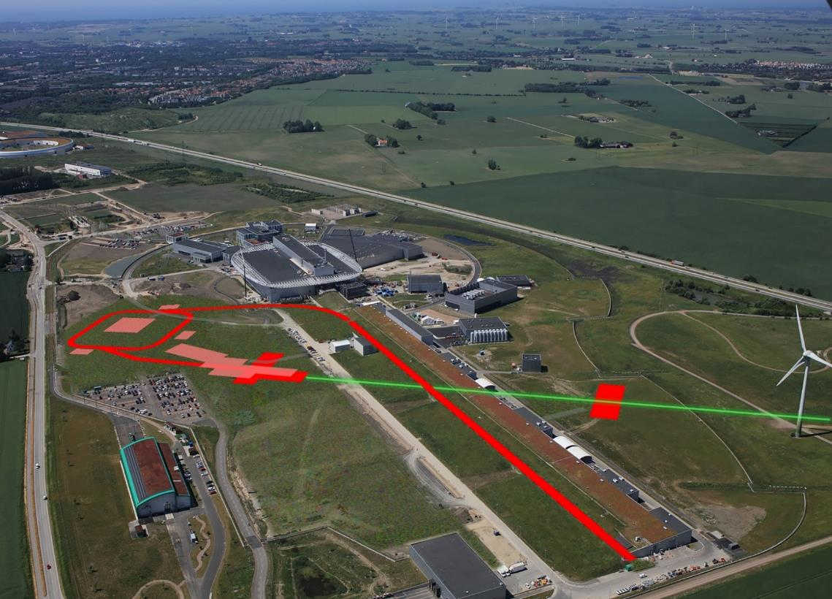

The European Spallation Source (ESS)
The ESS will be a copious source of spallation neutrons.
5 MW average beam power.
125 MW peak power.
14 Hz repetition rate (2.86 ms pulse duration, 10¹⁵ protons).
Duty cycle 4%.
2.0 GeV kinetic energy protons
  up to 3.5 GeV with linac upgrades
>2.7x10²³ p.o.t/year.
Lund
Target
Monolith
Exp. Hall
E01
Central Utility
Building
Linac
First beam on dump in 2025.
450 mg of protons/year
at 95% speed of light!

Slide 10
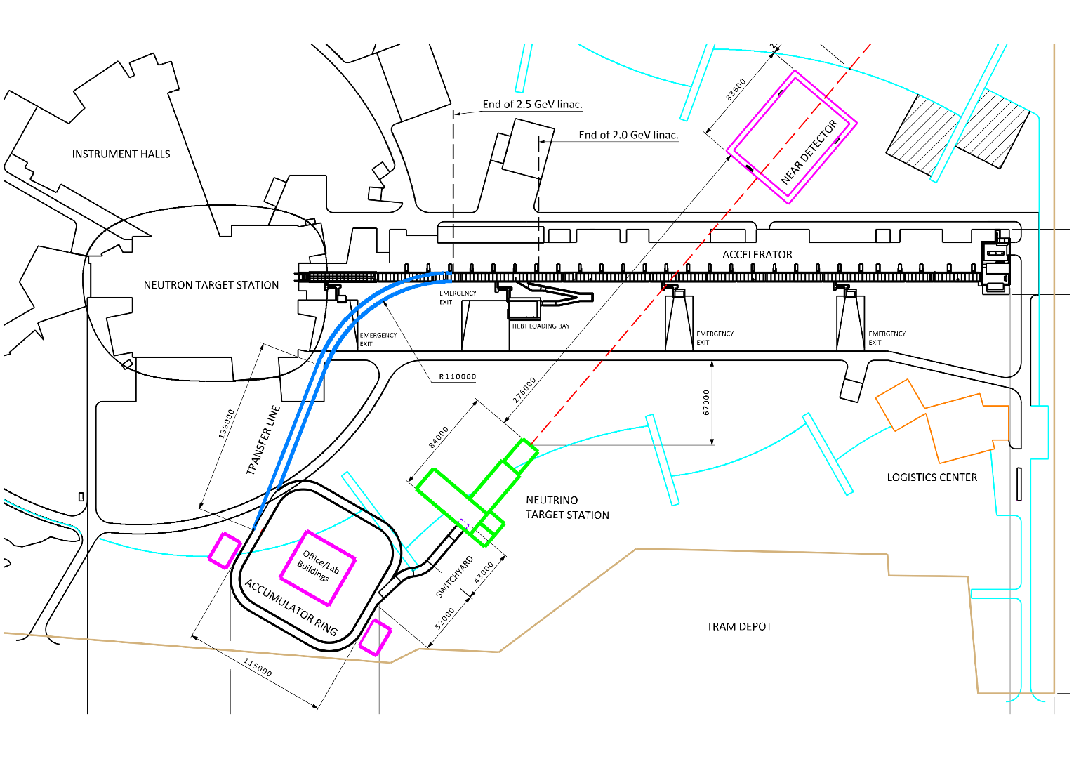
Upgrades to ESS

Slide 11
Upgrades to ESS
Upgrade of the accelerator
14 Hz to 28 Hz
use H⁻ instead of protons in ESSnuSB cycles
increase energy to 2.5 GeV kinetic

Slide 12
Upgrades to ESS
Upgrade of the accelerator
14 Hz to 28 Hz
use H⁻ instead of protons in ESSnuSB cycles
increase energy to 2.5 GeV kinetic
Build an accumulator ring
shorten ESS pulses from 2.86 ms to ≈ 1.2 μs

Slide 13
Upgrades to ESS
Upgrade of the accelerator
14 Hz to 28 Hz
use H⁻ instead of protons in ESSnuSB cycles
increase energy to 2.5 GeV kinetic
Build an accumulator ring
shorten ESS pulses from 2.86 ms to ≈ 1.2 μs
Build a neutrino target station
4 identical targets and horns
need switchyard

Slide 14
Upgrades to ESS
Build a near detector site
water Cherenkov detector
fine grained scintillator
emulsion detector
Upgrade of the accelerator
14 Hz to 28 Hz
use H⁻ instead of protons in ESSnuSB cycles
increase energy to 2.5 GeV kinetic
Build an accumulator ring
shorten ESS pulses from 2.86 ms to ≈ 1.2 μs
Build a neutrino target station
4 identical targets and horns
need switchyard

Slide 15
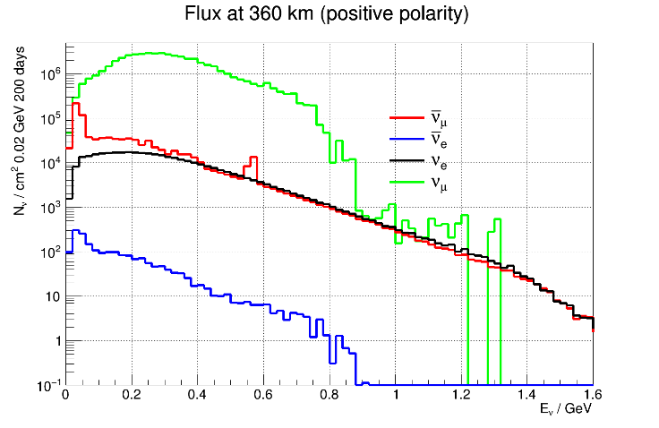
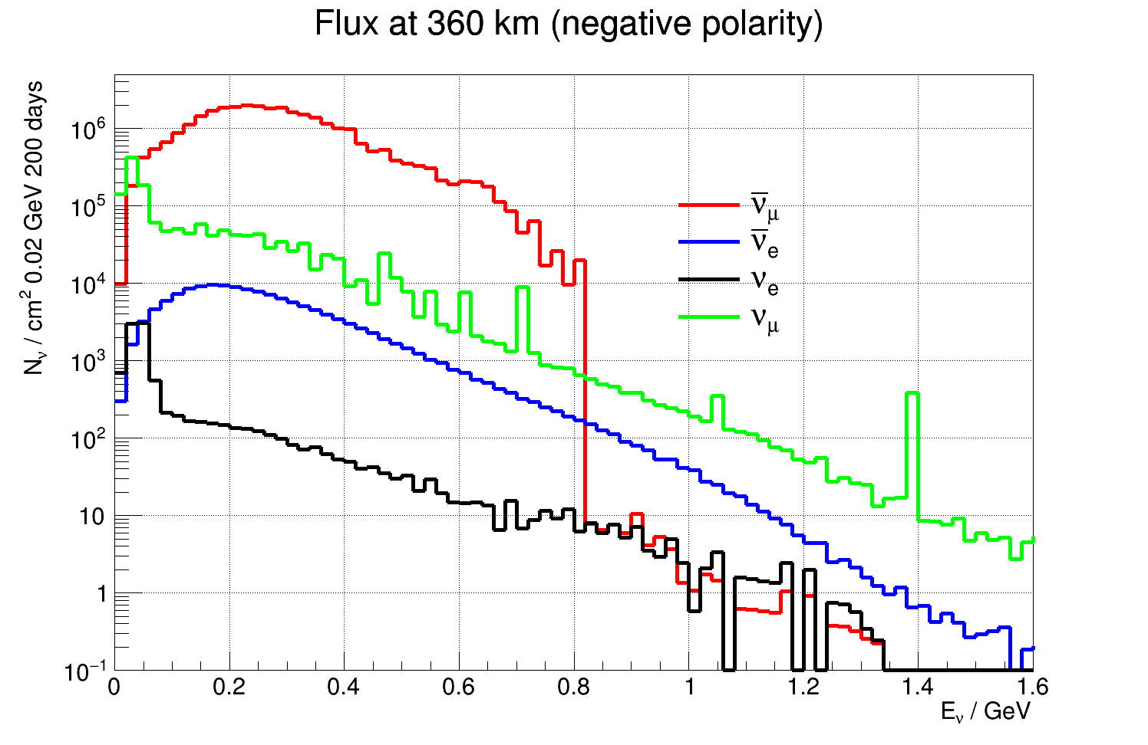
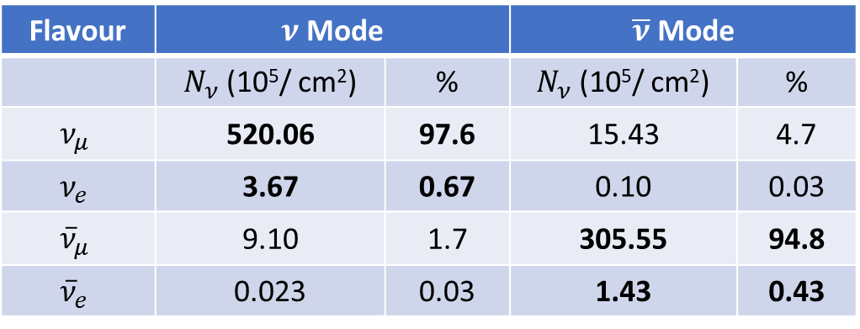
ESSνSB ν energy distribution
(after optimisation)
almost pure ν_{μ} beam
small ν_{e} contamination which will be used to measure ν_{e} cross-sections in a near detector
Flavour | $ν$ Mode |  | $\overline{ν}$ Mode
 | $N_{ν}$ (10⁵/ cm²) | % | $N_{ν}$ (10⁵/ cm²) | %
$$ν_{μ}$$ | 520.06 | 97.6 | 15.43 | 4.7
$$ν_{e}$$ | 3.67 | 0.67 | 0.10 | 0.03
$${\overline{ν}}_{μ}$$ | 9.10 | 1.7 | 305.55 | 94.8
$${\overline{ν}}_{e}$$ | 0.023 | 0.03 | 1.43 | 0.43
at 360 km from the target and per year (in absence of oscillations)

Slide 16
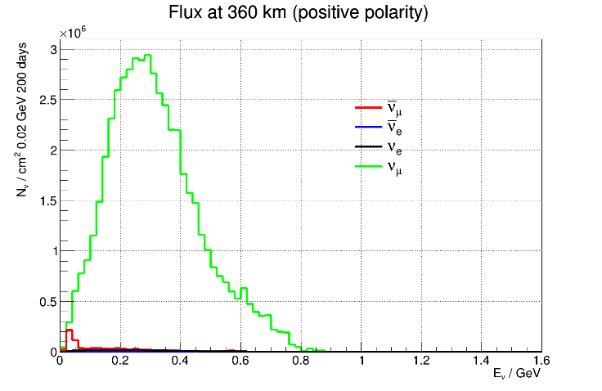
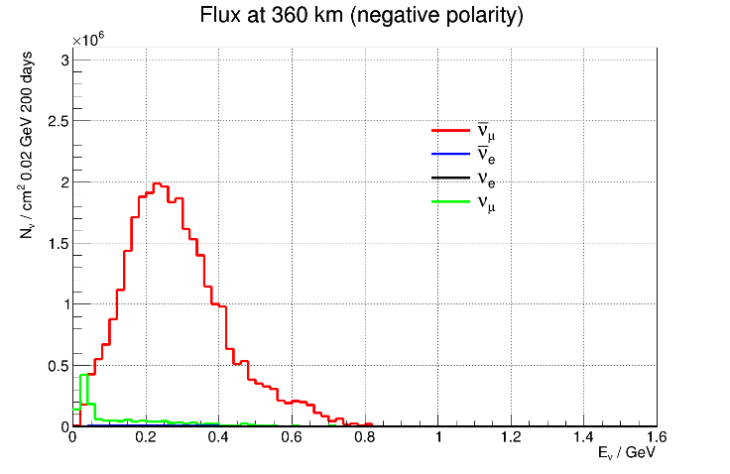
ESSνSB ν energy distribution
(after optimisation)
almost pure ν_{μ} beam
small ν_{e} contamination which will be used to measure ν_{e} cross-sections in a near detector
Flavour | $ν$ Mode |  | $\overline{ν}$ Mode
 | $N_{ν}$ (10⁵/ cm²) | % | $N_{ν}$ (10⁵/ cm²) | %
$$ν_{μ}$$ | 520.06 | 97.6 | 15.43 | 4.7
$$ν_{e}$$ | 3.67 | 0.67 | 0.10 | 0.03
$${\overline{ν}}_{μ}$$ | 9.10 | 1.7 | 305.55 | 94.8
$${\overline{ν}}_{e}$$ | 0.023 | 0.03 | 1.43 | 0.43
at 360 km from the target and per year (in absence of oscillations)

Slide 17
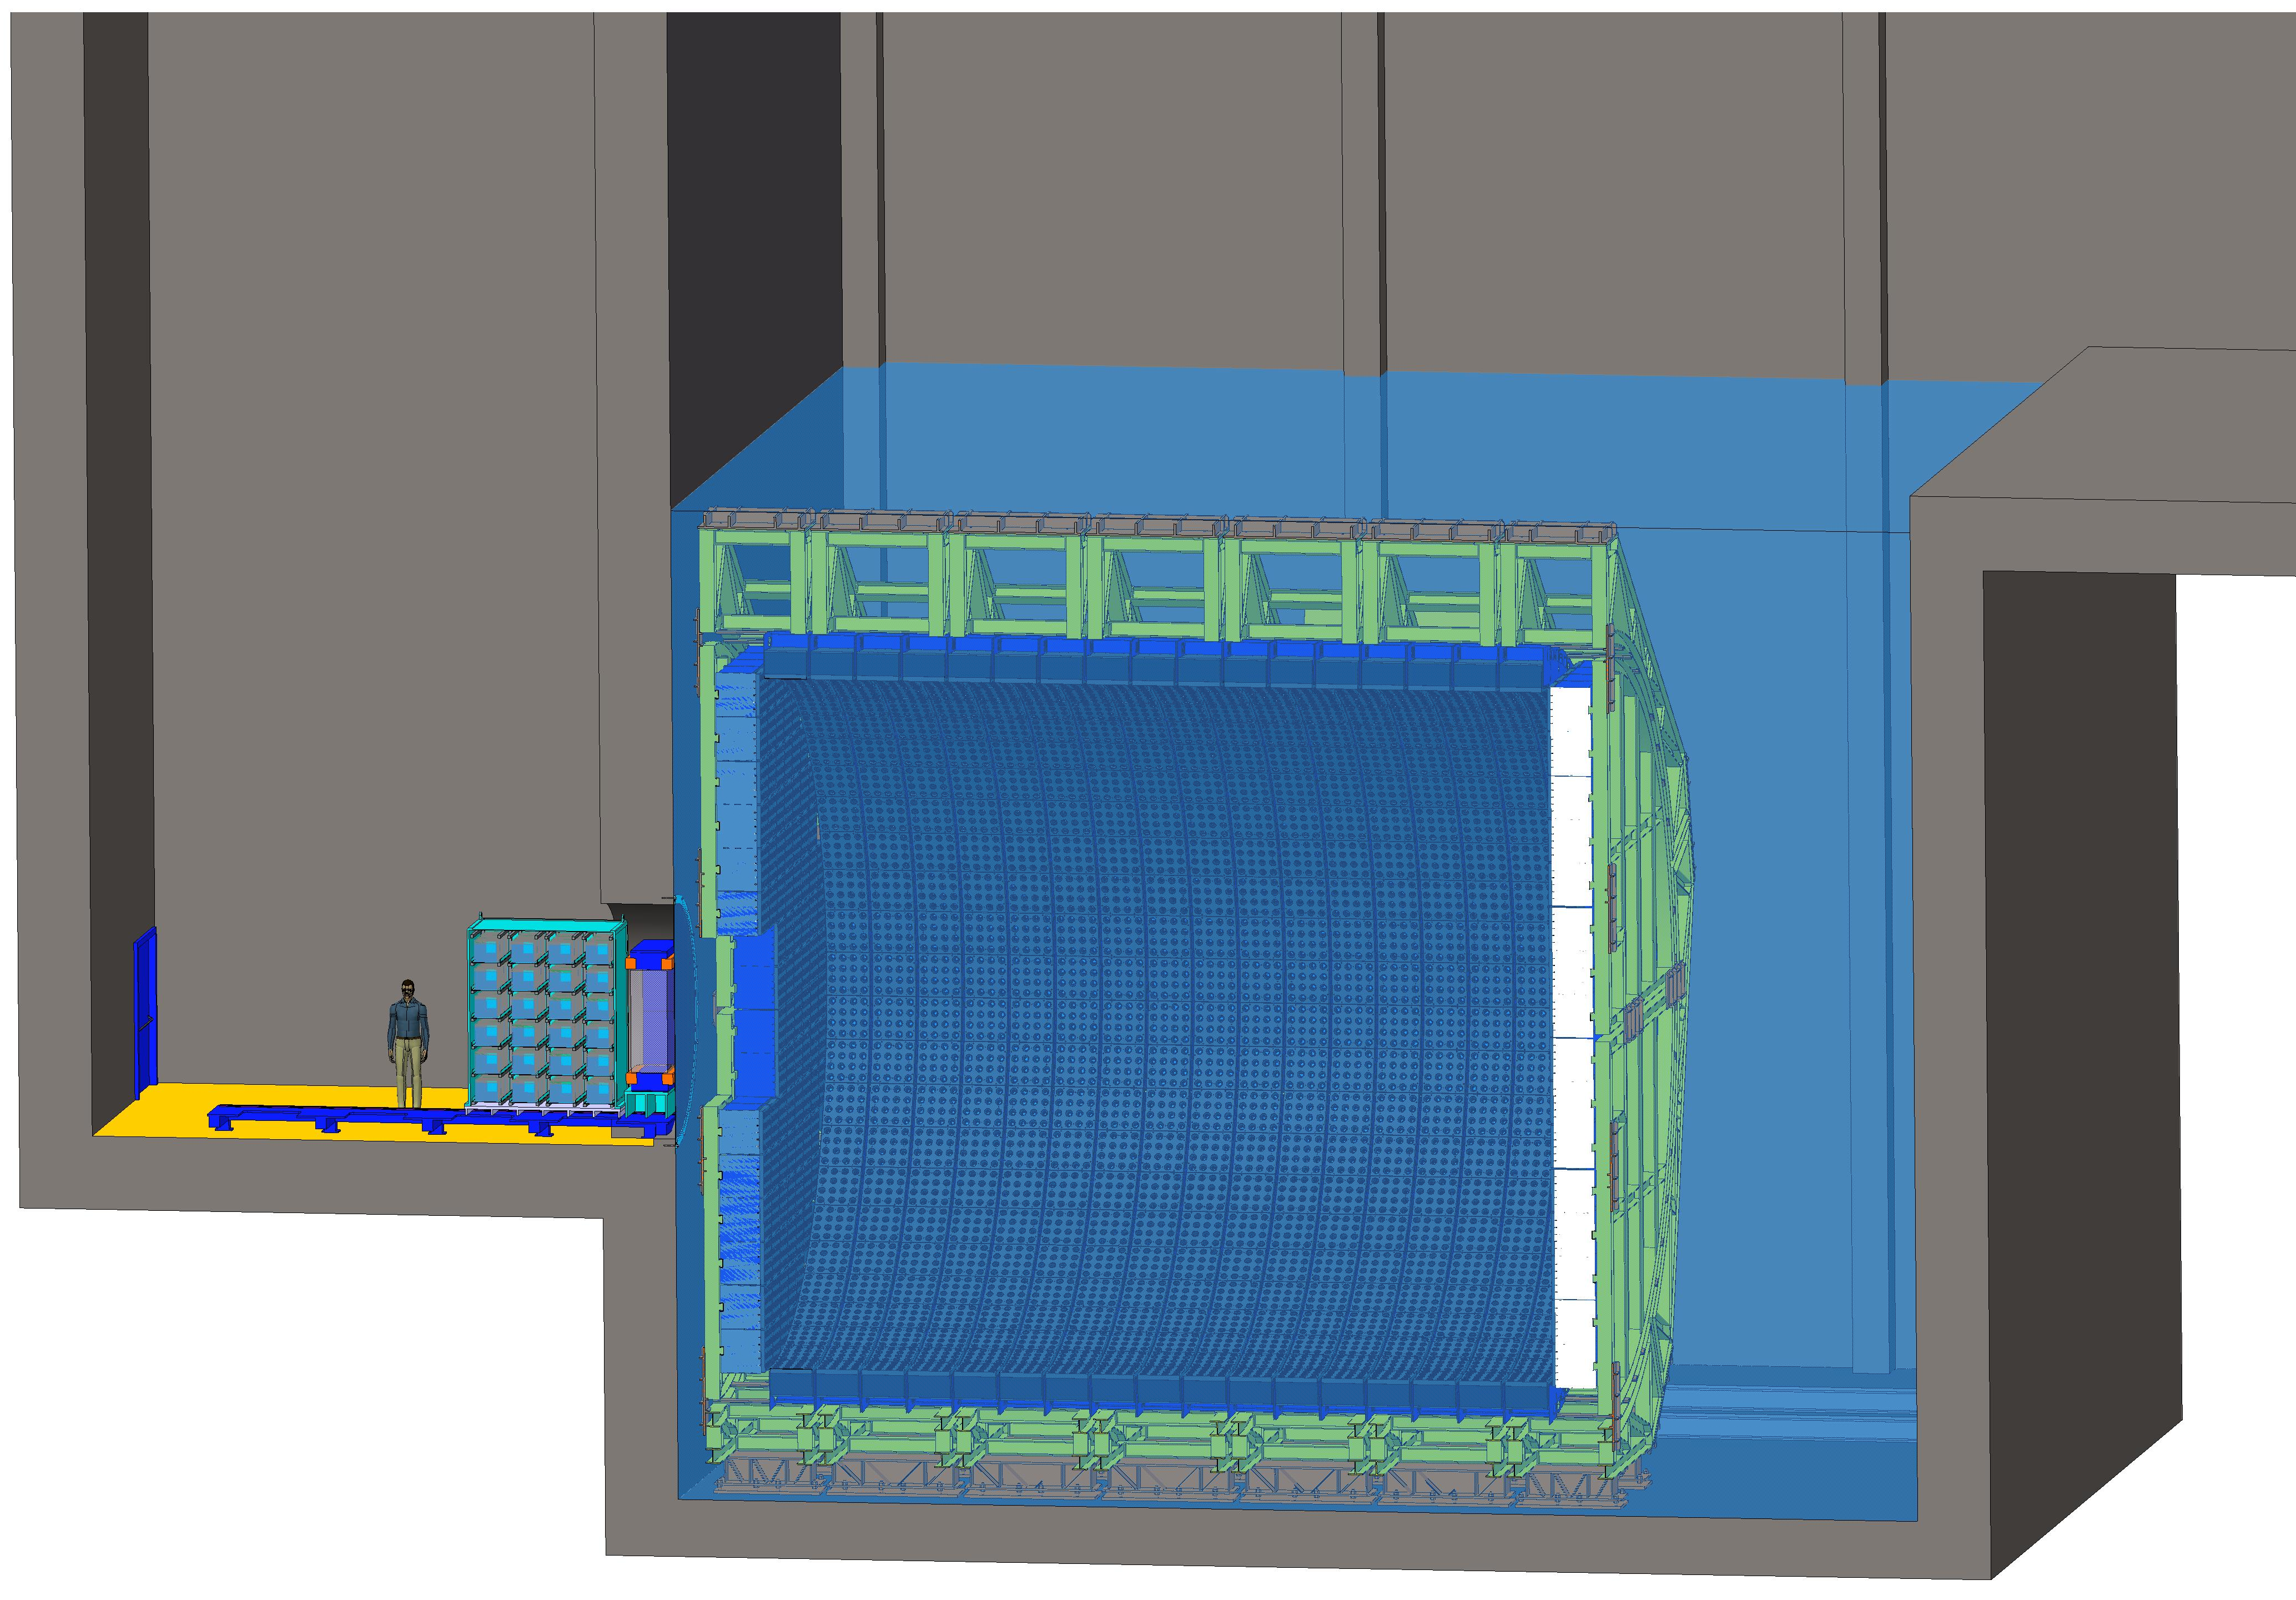
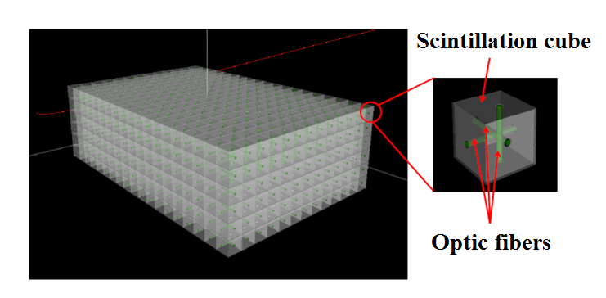
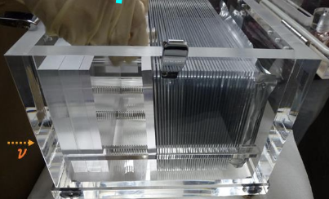
Near detectors
NINJA-like water-emulsion detector (1 t fiducial)
Code name: νIKING
Super-FGD like detector
(1 t fiducial)
ν beam
Near Water Cherenkov detector (0.420 kt fiducial)

Slide 18
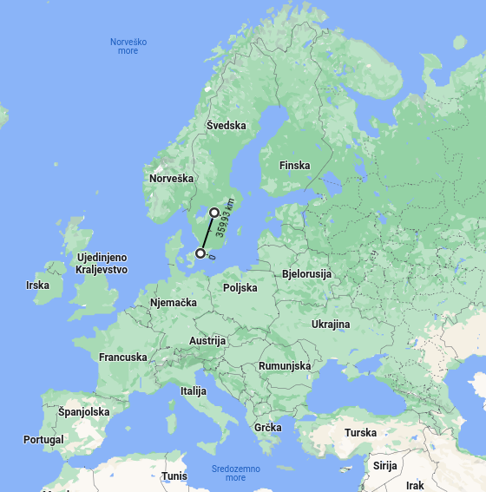
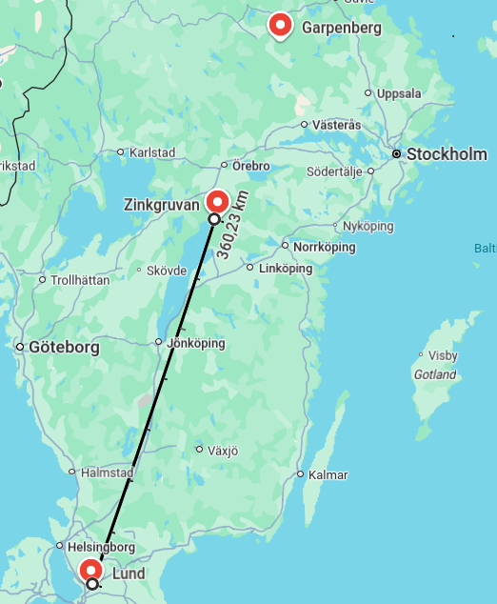
ESSnuSB neutrino baseline
Zinkgruvan mine, 360 km from the source, partly covering 1st and 2nd maximum

Slide 19
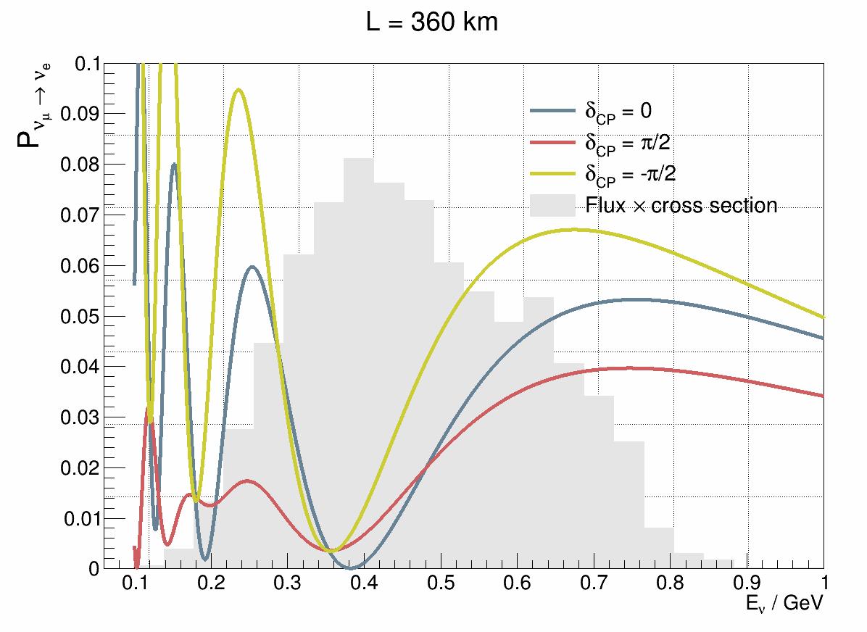
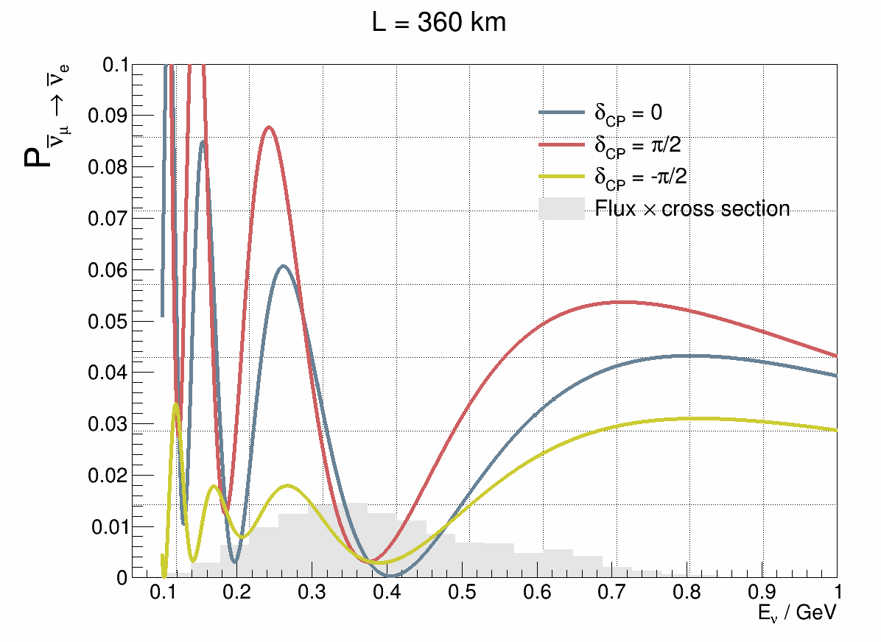
Oscillation coverage
Neutrino
Antineutrino

Slide 20


Oscillation coverage
Going from Zinkgruvan to Garpenberg
Neutrino
Antineutrino
Number of events at the 2nd maximum stays the same at both locations.

Slide 21
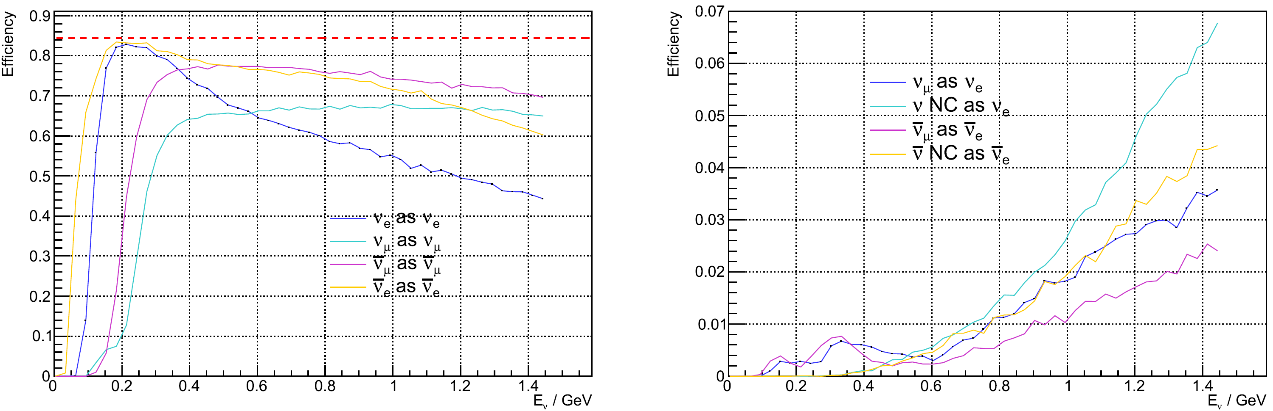
ESSnuSB Far Detector
Detector Specifications
Baseline 360 km
Detector diameter 74.0 m (Internal)
Detector height 74.0 m (Internal)
Depth (w.r.t.) ground level : 1000 m
ESSnuSB Particle selection efficiency
fiducial cut
Detector Design
Water Cherenkov detector
2 x 270 kt fiducial volume (~20x SuperK)
Readout: 2 x 38k 20” PMTs
30% optical coverage
Detector Performance
Detector efficiency for correctly identifying neutrinos > 85%.
Flavour misidentification probability < 1%.
74 m
74 m
Eur. Phys. J. Spec. Top. 231, (2022) 3779–3955

Slide 22
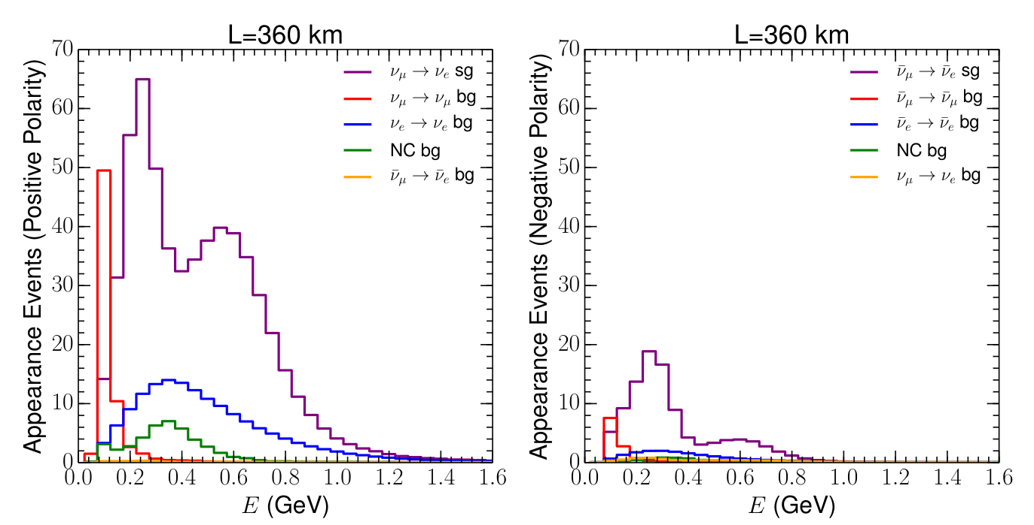


Expected event spectra
From the ESSnuSB CDR: https://doi.org/10.1140/epjs/s11734-022-00664-w & https://arxiv.org/abs/2203.08803
$$δ_{CP}=0$$
$$δ_{CP}=0$$
1 y data taking
1 y data taking

Slide 23

ESSnuSB conceptual design report
Most up to date evaluation of the CPV discovery potential
  arXiv version includes costing
Alekou, A., Baussan, E., Bhattacharyya, A.K. et al. “The European Spallation Source neutrino super-beam conceptual design report”. Eur. Phys. J. Spec. Top. (2022). https://doi.org/10.1140/epjs/s11734-022-00664-w
arXiv: https://arxiv.org/abs/2203.08803 (includes costing)

Slide 24
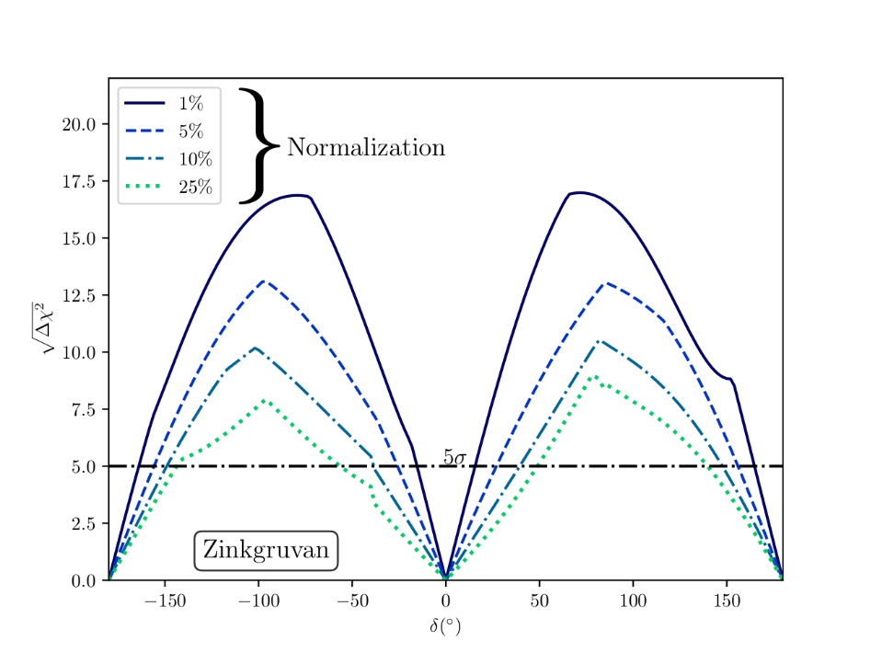
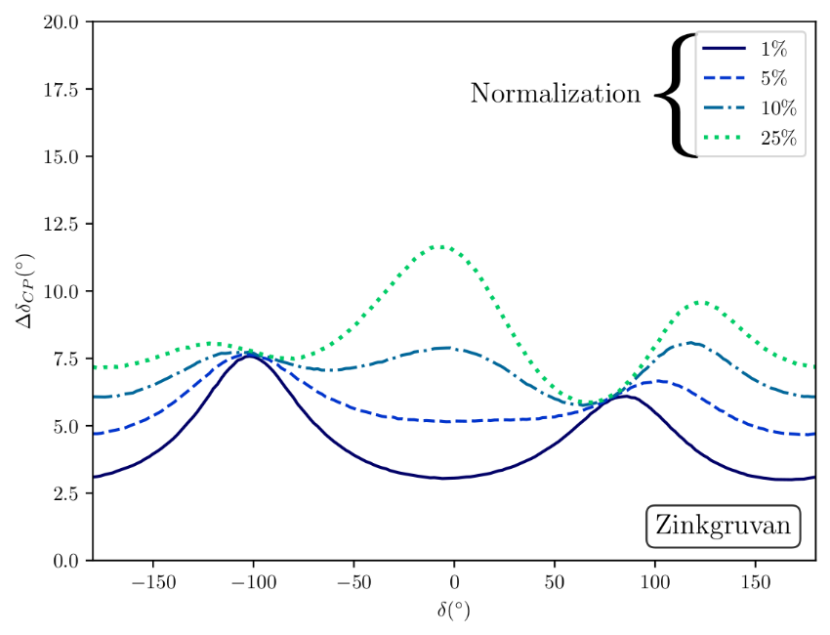
CPV sensitivity and precision
Sensitivity
Precision
From the ESSnuSB CDR: https://doi.org/10.1140/epjs/s11734-022-00664-w & https://arxiv.org/abs/2203.08803

Slide 25

CPV sensitivity and precision
Precision
From the ESSnuSB CDR: https://doi.org/10.1140/epjs/s11734-022-00664-w & https://arxiv.org/abs/2203.08803

Slide 26
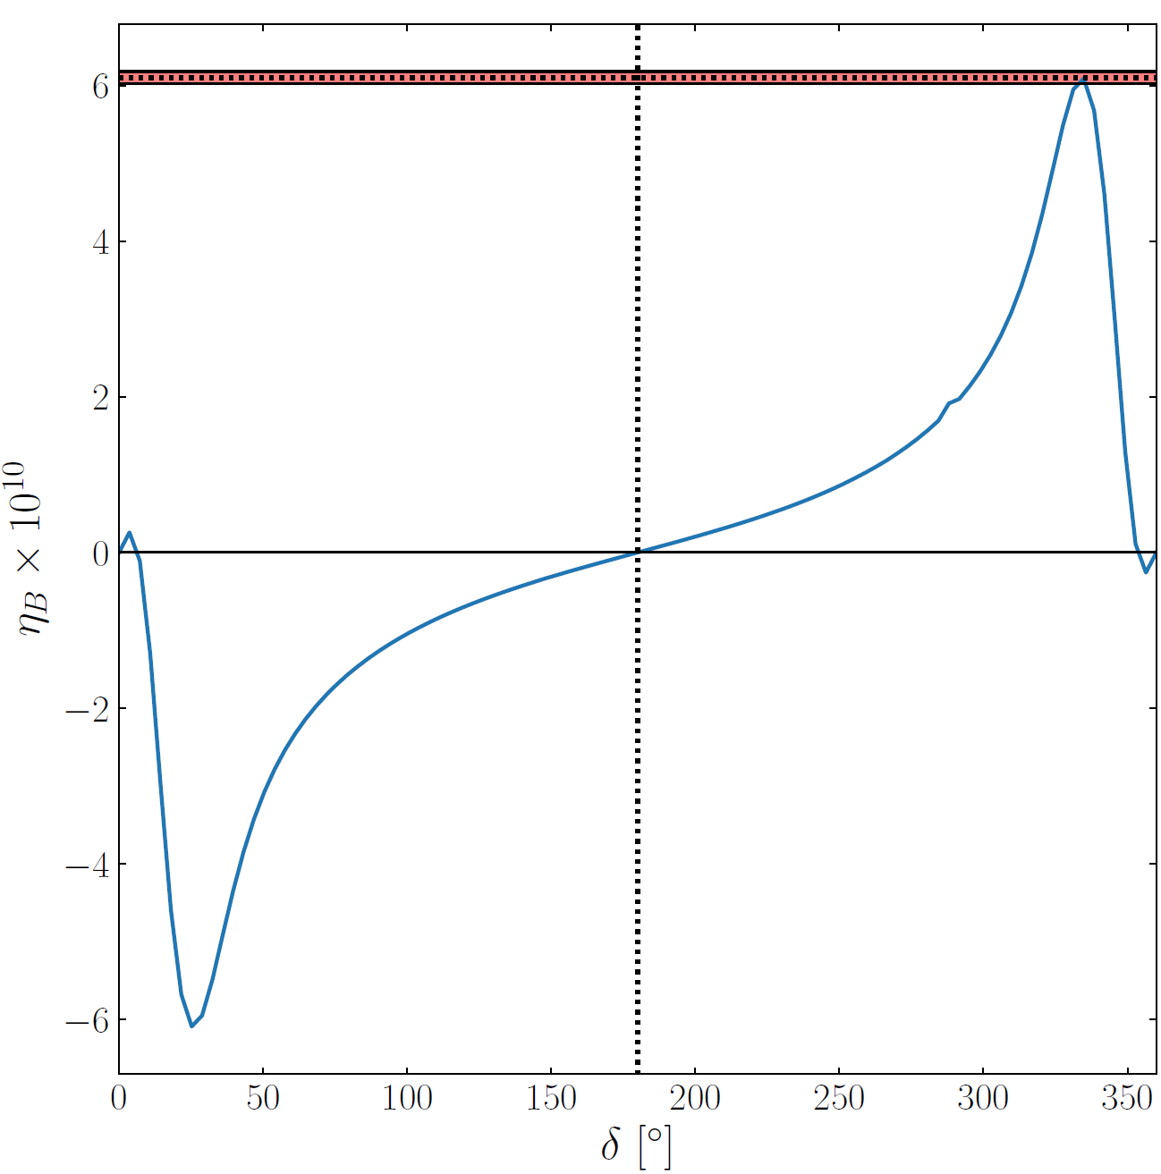
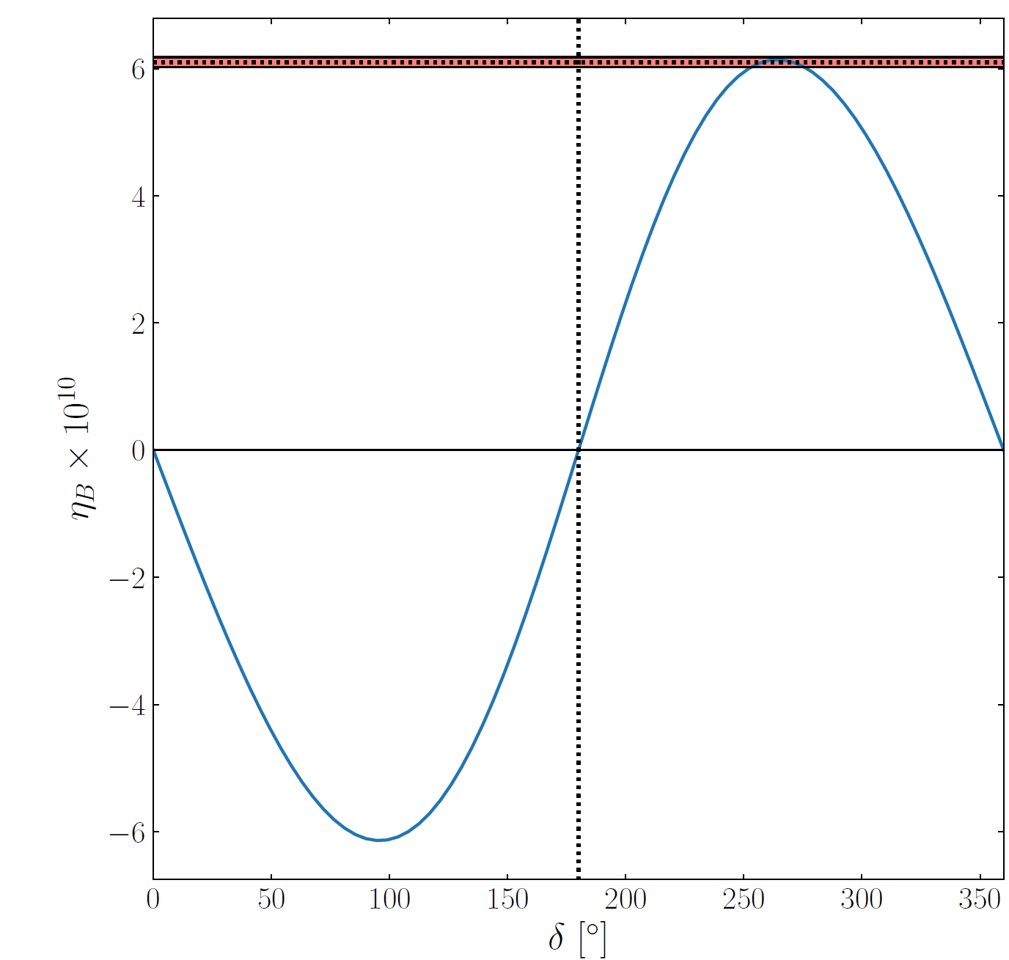
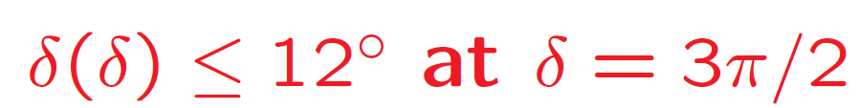
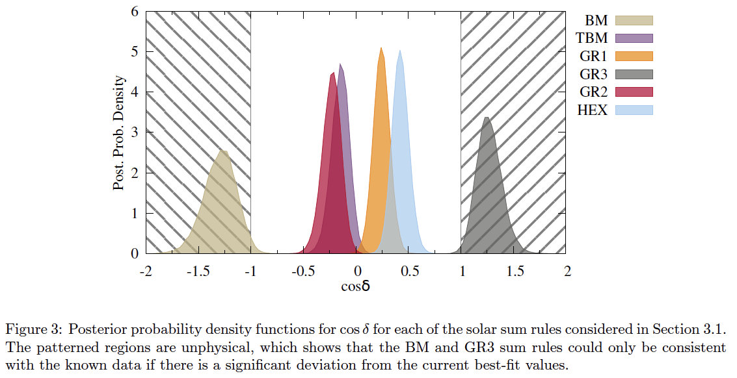
Why precision on CPV?
Leptogenesis Theories
Low mass flavor regime Intermediate mass flavor regime
M₁ (GeV) < 10⁹ 10⁹ < M₁ (GeV) < 10¹²
K. Moffat et al., arXiv:1809.08251 (2019)
Why not?
Discriminate between different leptogenesis and different flavour models
δ_{CP} ~ 340°
δ_{CP} ~ 260°
P. Ballett et al., JHEP12 (2014) 122
Flavour Theories
four different symmetry forms of the neutrino mixing matrix
Desired precision
bimaximal
tri-bimaximal
golden ratio 1/A
golden ratio 3
(S.T. Petcov, NPB 2024, IAS, HKUST, Hong Kong 20/02/2024)
golden ratio 2/B
hexagonal

Slide 27

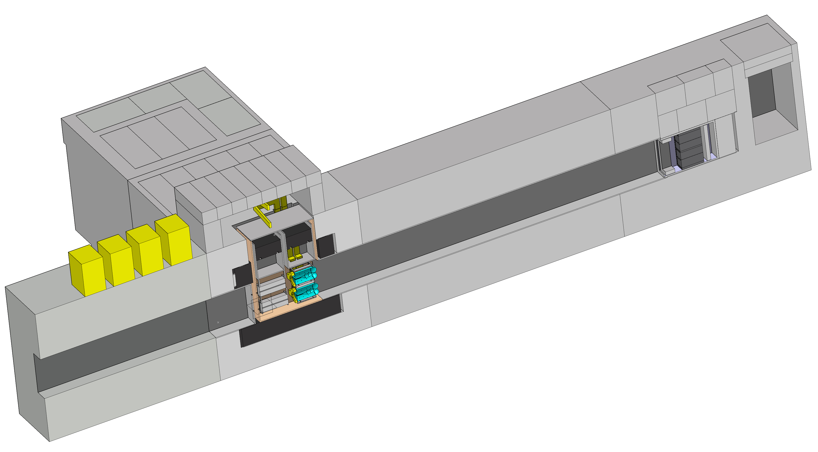

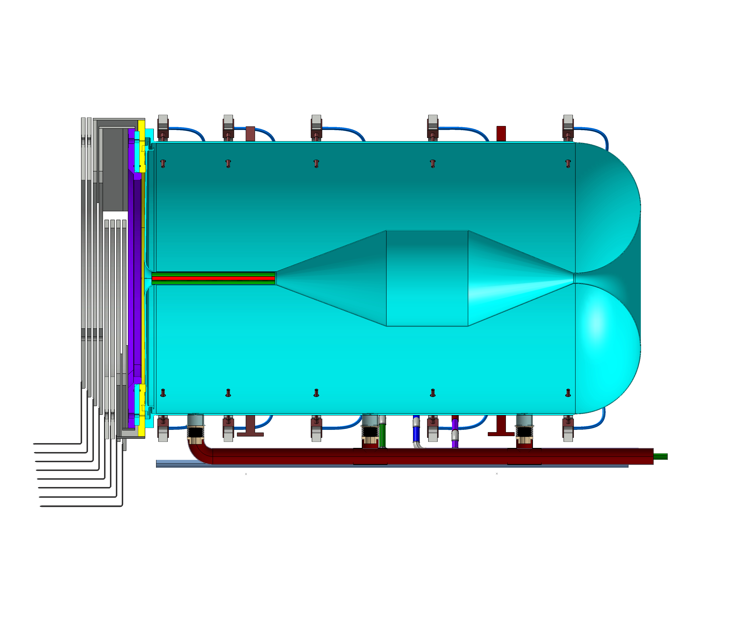

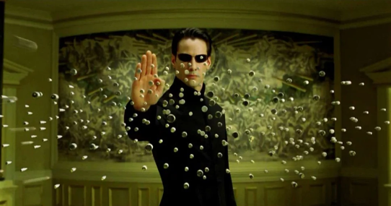
So, we’re all good?
Powerful proton gun
Cool target station
=
Lots of neutrinos, good physics
+
Cross-section uncertainties
Not so fast

Slide 28
The ESSnuSB+ project
Start with the civil engineering and infrastructure development
Design prototyping facilities at ESS
Explore additional physics opportunities offered by ESSnuSB with addition of LEnuSTORM and LEMNB
Design facilities for precise neutrino cross-section measurement:
  low energy nuSTORM (LEnuSTORM) and monitored beam (LEMNB)
Study non-beam physics with far detectors
  Atmospheric neutrinos, supernova neutrinos, solar neutrinos, galactic neutrinos, geoneutrinos, proton decay ...

Slide 29
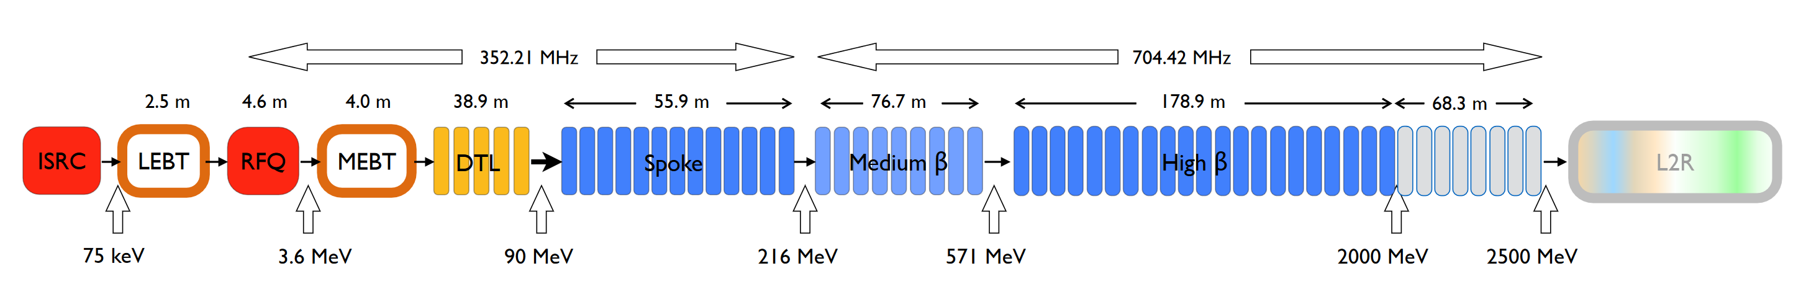
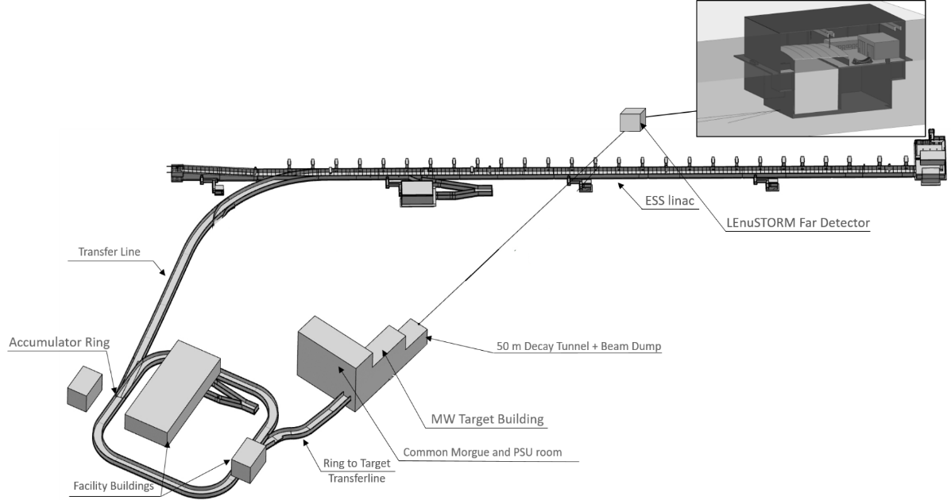
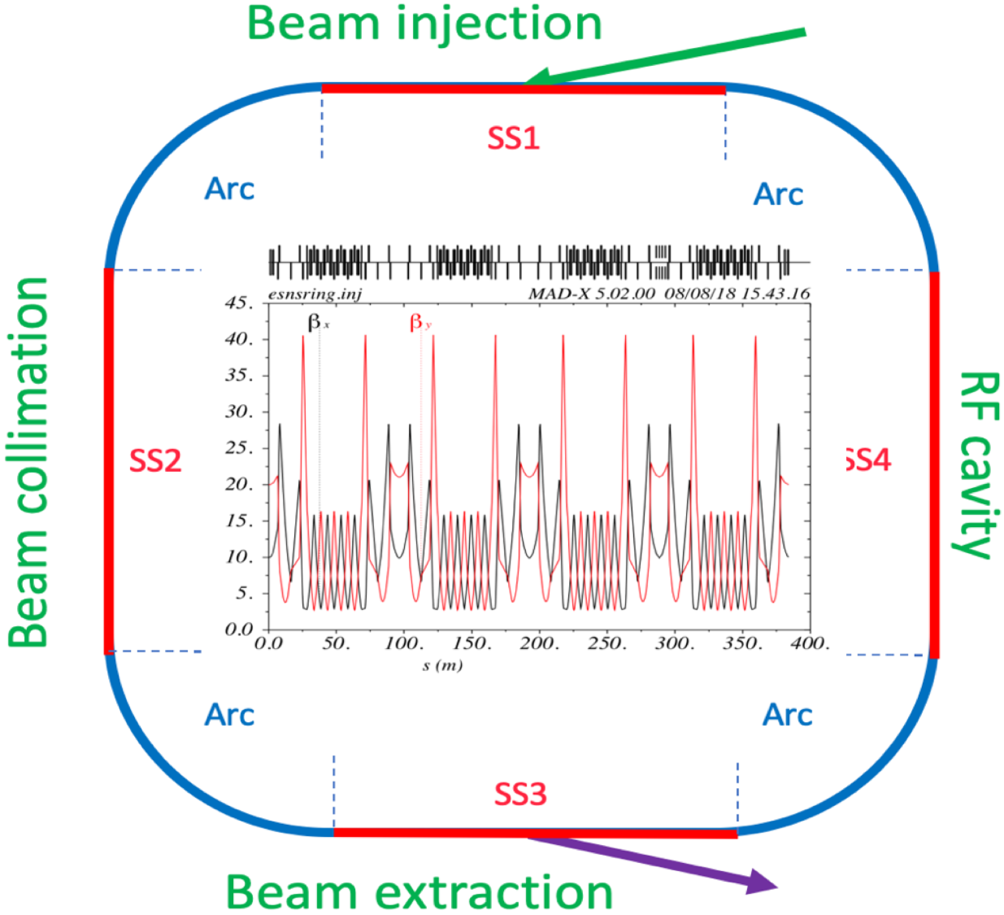
ESS upgrades to host the ESSnuSB+
ESS linac
ESSnuSB Near Detector
ESSnuSB Near Detector
Accumulator Ring
Target Station
One horn-target system

Slide 30

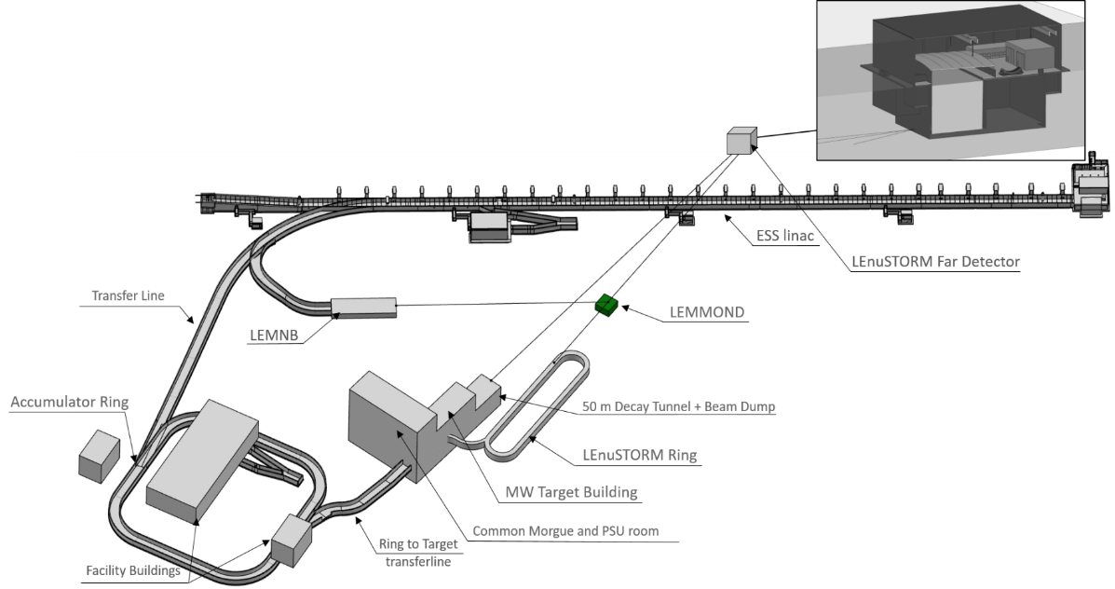
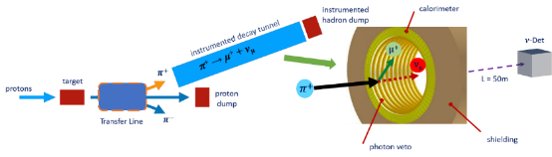
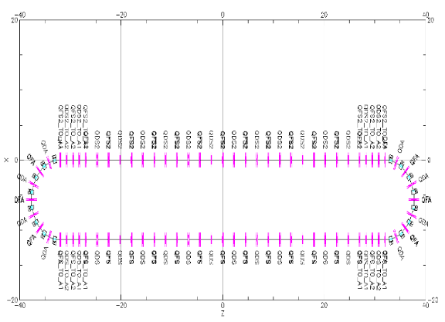
ESS upgrades to host the ESSnuSB+
ESS linac
ESSnuSB Near Detector
LEMNB
ESSnuSB Near Detector
Low Energy Monitored neutrino Beam
( )
π⁺⁽⁻⁾ → μ⁺⁽⁻⁾ + ν_{μ}
LEnuSTORM
Low energy neutrino from STORed Muons
Accumulator Ring
Target Station
( )
μ⁺⁽⁻⁾ → e⁺⁽⁻⁾ + ν_{μ}+ ν_{e}
One horn-target system

Slide 31
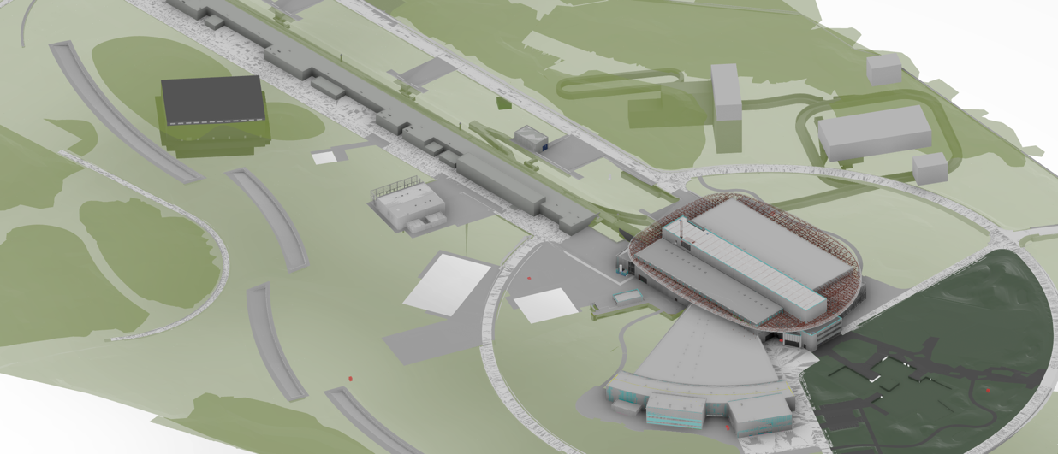
ESS Upgrades to Host the ESSnuSB+
ESS linac
MW target station
LEnuSTORM
LEMMOND
Accumulator ring
LEMNB
END
ESS neutron target monolith

Slide 32

Possible implementation scenario
2018
2022
2026
2030
2033
Interference with ESS
Phase | Stage I | Stage II | Stage III
Construction | 2034-2036 (2y) | 2034-2038 (4y) | 2036-2041 (5y)
Installation | 2036-2039 (3y) | 2038-2041(45) (3y-7y) | 2041-2046 (FD: 5y)
Switch | - | 2045-2046 (2y) | 2052-2055 (1y cool-down + 2y)
Operation | 2039-2045 (1y comm + 5y) | 2046-2052 (2y comm + 5y) | 2055-2075 (0.5y comm + 20y)
ESSnuSB
LBLν exp
ESSnuSB+
LEMNB
LEνSTORM
EC projects
Far Detector Eng
ESS site Eng
Discussion
Funding Agencies
Approval
Beam commissioning (1y)
CDR
CDR
pTDR
2035
2036
Env. Study – Permission
Assumes initial permission for Stage I in 2y
Assumes initial permission for Stage I in 2y
Tech. Design
ESS Linac Mods to 28MHz, LEMNB, LEMMOND
2039
2045
CE: extraction from ESS Linac, TL, LEMNB target, LEMMOND cavern
Inst : includes ESS linac modifications to 28 Hz
Two interruptions to ESS: for CE and Linac modifications
Stage I
CE
Inst
Physics
Tech. Design
ESS Linac Mods H-, RFQ, L2A, Acc, L2T, TCC, T2R, LEnuSTORM, ND
2038
2047
2052
CE: L2A, Accumulator, L2T, TCC, LEnuSTORM, ND
Inst : includes ESS linac modifications to 28 Hz + H-
Note: installation can finish earlier but needs to wait for the completion of Stage I
Interruption to ESS to connect and commission the H- source
Stage II
CE
Inst
Physics
Tech. Design
TCC, ND, FD
2041
2046
2054
2055
Inst : includes 2y to switch from previous stage
Stage III
2075
CE-FD
2065
Low-energy ν_{μ} ν_{e} cross-section results
Inst - FD
Phys
CP-violation in leptonic sector precision measurements
Inst
Physics

Slide 33
Possible implementation scenario
2018
2022
2026
2030
2033
Interference with ESS
Phase | Stage I | Stage II | Stage III
Construction | 2034-2036 (2y) | 2034-2038 (4y) | 2036-2041 (5y)
Installation | 2036-2039 (3y) | 2038-2041(45) (3y-7y) | 2041-2046 (FD: 5y)
Switch | - | 2045-2046 (2y) | 2052-2055 (1y cool-down + 2y)
Operation | 2039-2045 (1y comm + 5y) | 2046-2052 (2y comm + 5y) | 2055-2075 (0.5y comm + 20y)
ESSnuSB
LBLν exp
ESSnuSB+
LEMNB
LEνSTORM
EC projects
Far Detector Eng
ESS site Eng
Discussion
Funding Agencies
Approval
Beam commissioning (1y)
HK 10y run
CDR
CDR
pTDR
2035
2036
Env. Study – Permission
Assumes initial permission for Stage I in 2y
Assumes initial permission for Stage I in 2y
Tech. Design
ESS Linac Mods to 28MHz, LEMNB, LEMMOND
2039
2045
CE: extraction from ESS Linac, TL, LEMNB target, LEMMOND cavern
Inst : includes ESS linac modifications to 28 Hz
Two interruptions to ESS: for CE and Linac modifications
Stage I
CE
Inst
Physics
Tech. Design
ESS Linac Mods H-, RFQ, L2A, Acc, L2T, TCC, T2R, LEnuSTORM, ND
2038
2047
2052
CE: L2A, Accumulator, L2T, TCC, LEnuSTORM, ND
Inst : includes ESS linac modifications to 28 Hz + H-
Note: installation can finish earlier but needs to wait for the completion of Stage I
Interruption to ESS to connect and commission the H- source
Stage II
CE
Inst
Physics
Room to optimize
Tech. Design
TCC, ND, FD
2041
2046
2054
2055
Inst : includes 2y to switch from previous stage
Stage III
2075
CE-FD
2065
Low-energy ν_{μ} ν_{e} cross-section results
Inst - FD
Phys
CP-violation in leptonic sector precision measurements
Inst
Physics

Slide 34

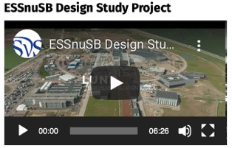



ESSnuSB EU support programmes
COST Action EuroNuNet (CA15139): 2016 - 2020
  https://euronunet.in2p3.fr
  video for scientists: https://www.youtube.com/watch?v=PwzNzLQh-Dw
EU-H2020 Design Study ESSνSB: 2018 - 2023
  https://essnusb.eu
  video for general public: https://www.youtube.com/watch?v=qAnvft0nAlg
EU-Horizon Europe Design Study ESSνSB+: 2023-2026
  ongoing
0.3 M€ from COST
Total 4.7 MEUR
(3 M€ from EU)
Total 5 MEUR
(3 M€ from EU)

Slide 35
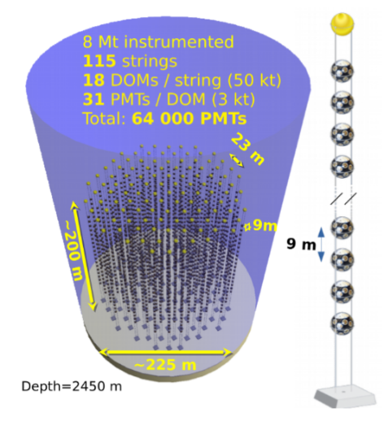
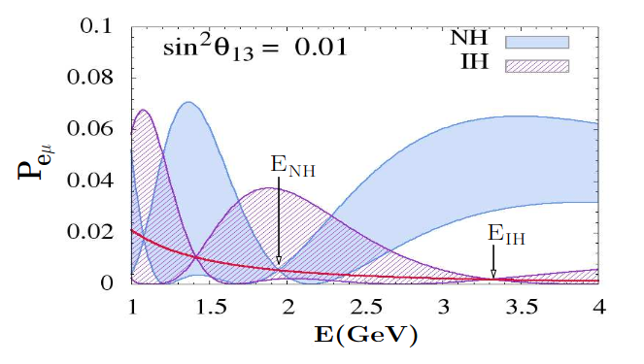
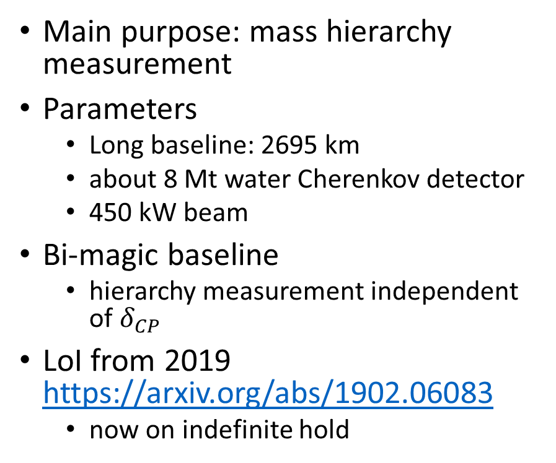
P2O (Protvino to Orca)
Main purpose: mass hierarchy measurement
Parameters
  Long baseline: 2695 km
  about 8 Mt water Cherenkov detector
  450 kW beam
Bi-magic baseline
  hierarchy measurement independent of $δ_{CP}$
LoI from 2019 https://arxiv.org/abs/1902.06083
  now on indefinite hold
https://arxiv.org/pdf/1009.1093

Slide 36
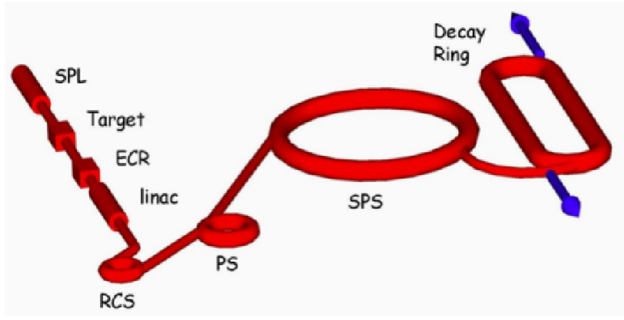
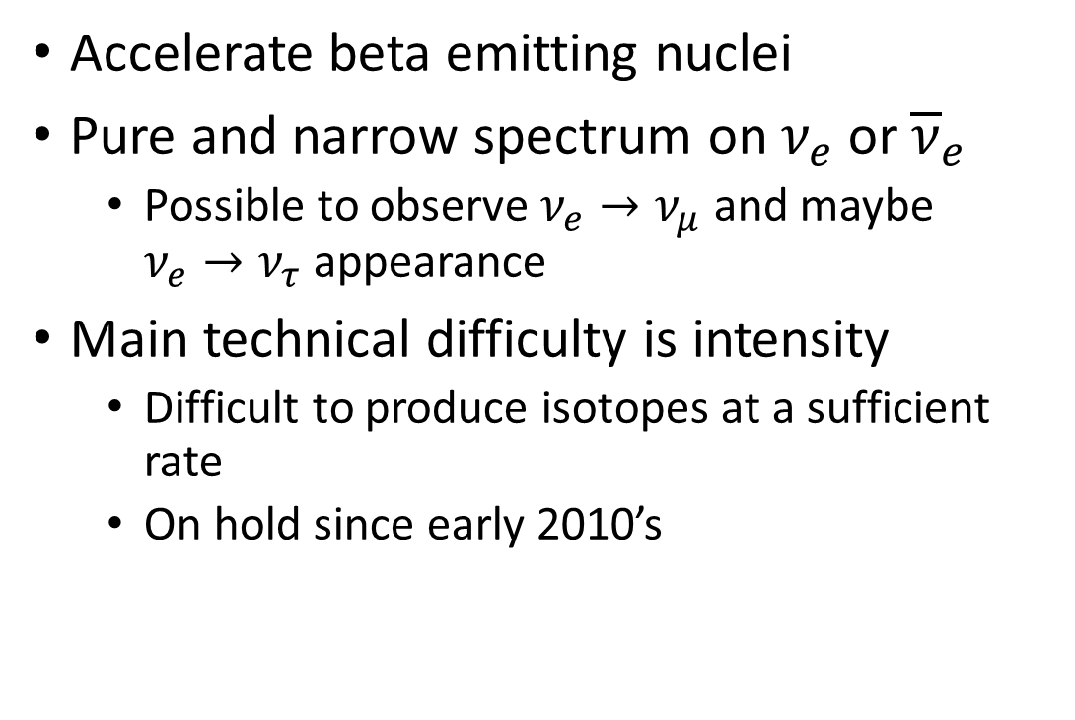
Beta beams
Accelerate beta emitting nuclei
Pure and narrow spectrum on $ν_{e}$ or ${\overline{ν}}_{e}$
  Possible to observe $ν_{e}→ν_{μ}$ and maybe $ν_{e}→ν_{τ}$ appearance
Main technical difficulty is intensity
  Difficult to produce isotopes at a sufficient rate
  On hold since early 2010’s
EURISOL scenario at CERN
https://doi.org/10.1016/j.nuclphysbps.2012.09.037

Slide 37
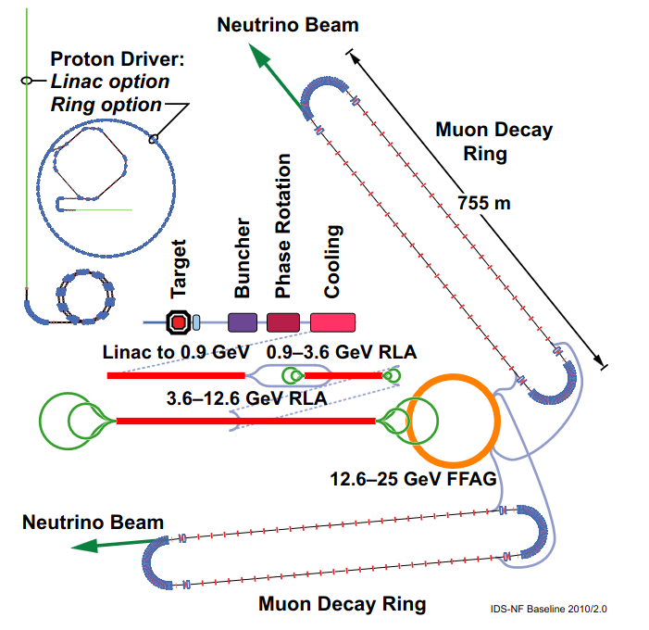

Neutrino factory
Accelerate muons and put them in a storage ring
  nuSTORM just stores the muons, SBL only
Controlled and intense source of $ν_{e}$ and${ \overline{ν}}_{μ}$ (or ${\overline{ν}}_{e}$ and $ν_{μ}$)
Main technical difficulties
  accelerating muons
  magnetized far detector
Proposed sites: CERN, RAL, Fermilab, ..
Progress slowed down at the beginning of 2010s
  Large $θ_{13}$ made CPV (and other) measurements accessible to conventional beams
Interesting new possibilities:
  nu factory at ESS (backup slide)
    Low energy nuSTORM could be a step forward
  nu factory at Fermilab with DUNE as far detectors
    https://arxiv.org/abs/2407.02572
Generic nu fact design from 2011
https://arxiv.org/abs/1112.2853

Slide 38



Tau neutrino beams?
Produced by shooting protons on thick target and sweep/stop anything other than D_{S}
  about 3% neutrinos are $ν_{τ}$
  currently only SBL (DONUT, SHiP)
DsTau (NA65): a running experiment at CERN to measure $ν_{τ}$ production
  To reduce systematics for past and future $ν_{τ}$ experiments
Maybe LBL in future?
  Perhaps via oscillations?
DONUT beamline https://arxiv.org/abs/0711.0728
https://arxiv.org/abs/1906.03487

Slide 39
Conclusions
Long baseline neutrino experiments let us study neutrino oscillations in detail in laboratory conditions (we control both source and detector)
  After next generation of neutrino experiments we expect to have a good estimation of all oscillation parameters
  However, we need precise measurements and cross-checks using different osc. channels: new physics can hide in the details!
Several proposed ideas for LBL experiments after HyperK and DUNE
  ESSnuSB, P2O, Beta beams, Neutrino factory
ESSnuSB is currently the most active, practical and feasible
  Allows very precise leptonic CP violation measurement at the second oscillation maximum

Slide 40

Thank you for your attention
Possible scenario of new physics hiding in the details.

Slide 41

Precision comparison with current projects
precision
ESSνSB

Slide 42


Optimization for precision
Supposing that value of δ_{CP} is roughly known at ESSnuSB time
Precision for different neutrino (antineutrino) run times
Optimal precision for known δ_{CP}
From the ESSnuSB CDR: https://doi.org/10.1140/epjs/s11734-022-00664-w & https://arxiv.org/abs/2203.08803

Slide 43



ESSnuSB in the international context – CPV discovery
ESSnuSB March 2022 with 5% normalization error
DUNE Snowmass March 2022
Hyper-Kamiokande Snowmass March 2022

Slide 44
ESSνSB and (R&D) synergies
Dedicated series of workshops is organized
https://indico.cern.ch/event/849674/
Super Beam
nuSTORM
+Decay At Rest and Coherent scat.
(with short pulses)
Neutrino Factory
Muon Collider

Slide 45
Crazy ideas
Put a neutrino detector in a geostationary orbit (A.L.)
Long baseline tagged beam (L.M.)
Use LHC in FCC era to produce high-energy neutrino beam
Make a tau neutrino beam

Slide 46

ESSνSB+ at the European level
A Horizon Europe Design Study (Call HORIZON-INFRA-2022-DEV-01)
Title of Proposal: Study of the use of the ESS facility to accurately measure the neutrino cross-sections for ESSnuSB leptonic CP violation measurements and to perform sterile neutrino searches and astroparticle physics
Duration: 4 years
Total cost: 5 M€
Requested budget: 3 M€
20 participating institutes, including CERN and ESS
6 Work Packages
Approved August 2022

Slide 47



Neutrino beam production
Hot Cell
Able to manipulate/repair hadronic collector
Work under Radioactive Environment
Morgue
To Store radioactive wastes
Beam dump
Neutrino Beam
Power Supply Unit
16 modules (350 kA, 1.3 μs)
Located above the switchyard
Outside of radioactive part of Facility
Decay tunnel
Pions decay in-flight here
Beam Switchyard
Tunnel
Proton Beam
(Ep=2.5 GeV, 14 Hz) 4 x 1.25 MW
Hadronic Collector

Slide 48


Effect of energy calibration uncertainty on CPV measurements
Sensitivity
Precision
From the ESSnuSB CDR: https://doi.org/10.1140/epjs/s11734-022-00664-w & https://arxiv.org/abs/2203.08803

Slide 49


Effect of bin-to-bin uncorrelated uncertainty on CPV measurements
Sensitivity
Precision
From the ESSnuSB CDR: https://doi.org/10.1140/epjs/s11734-022-00664-w & https://arxiv.org/abs/2203.08803

Slide 50


Hierarchy and octant determination
From: DOI:10.1140/epjc/s10052-021-09845-8, arXiv:2107.07585
10 y of data taking
NH, IH under analysis
NH

Slide 51

ESSνSB at the European level
A H2020 EU Design Study (Call INFRADEV-01-2017)
Title of Proposal: Discovery and measurement of leptonic CP violation using an intensive neutrino Super Beam generated with the exceptionally powerful ESS linear accelerator
Duration: 4 years
Total cost: 4.7 M€
Requested budget: 3 M€
15 participating institutes from
11 European countries including CERN and ESS
6 Work Packages
Approved end of August 2017
ESSνSB
BENE (2004-2008)
ISS (2005-2007)
EUROν (2008-2012)
LAGUNA (2008-2010)
LAGUNA-LBNO (2010-2014)
COST Action CA15139 (2015-2019)

Slide 52





Hot Cell
Able to manipulate/repair hadronic collector
Work under Radioactive Environment
Granular Target Concept
Target made of 3 mm titanium spheres cooled by transverse helium gas cooling
Morgue
To Store radioactive wastes
Beam dump
Power Supply Unit
16 modules (350 kA)
Located above the switchyard
Outside of radioactive part of Facility
Decay tunnel
Beam Switchyard
Tunnel
Proton Beam
(Ep=2.5 GeV, 14 Hz) 4 x 1.25 MW
Hadronic Collector
Beam Switchyard
Share the beam over
Four packed bed targets
MiniBoone Like Horn
Shape optimized with genetic algorithm

Slide 53


Zinkgruvan mine
Potential location in Site 2
Site 2 is considered as best considering access to main transport infrastructure and located in an area less disturbed by mining activities

Slide 54


Slide 55



CP violation in ESSnuSB
2nd maximum
Does not depend on J, i.e. PMNS matrix elements
Depends only on mass splittings
1st maximum
Vacuum

Slide 56
ESSnuSB Implementation Approach
Staged Implementation
Stage 1
LEMNB
  Proton beam from ESS linac, up to 2.86 ms pulses, long-pulses up to 10¹⁴ protons/pulse,
  ~300kW target station, pion capture using conventional magnets, instrumented decay tunnel
  Beam to near detector LEMMOND at ~40-50 m from the target
Stage 2
LENUSTORM
  H⁻ source, and transfer line to accumulator
  Accumulator ring, 1.25 MW target station, horn for pion capture, transfer line and injection to LEnuSTORM ring
  LENUSTORM ring, beam to near detector LEMMOND at ~10-15 m from ring, and to END at 290 m from target
Stage 3
ESSnuSB CPV LBL
  H⁻ source, and transfer line to accumulator
  Accumulator ring, 5MW target station, horn for pion capture
  Decay tunnel, beam to END at 290 m from target and FD

