Slide 1
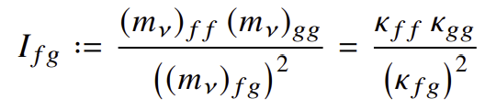
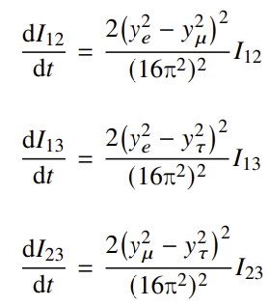
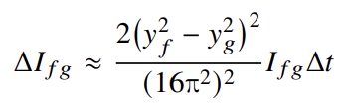
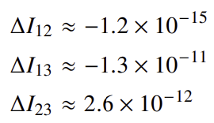
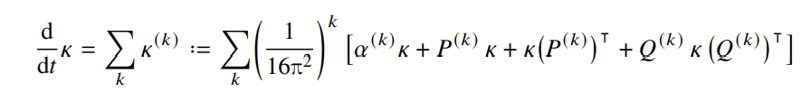







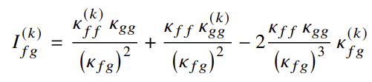



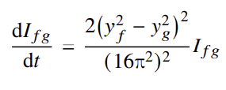
Scale-independent Relations between Neutrino Mass Parameters
Advisors: Mu-Chun Chen, Michael Ratz; Presenter: Shaheed Perez
Department of Physics and Astronomy, University of California, Irvine
Introduction
The neutrino flavor sector is still considered one of the most promising paths to discover physics beyond the Standard Model (BSM) [1].
The origins of neutrino masses and mixing is still not fully understood in the Standard Model (SM) [1].
Neutrino flavor model building seeks to answer these questions and gain a better understanding of the mass hierarchy and flavor mixing in the quark and lepton sectors [1].
Models built from modular flavor symmetries have shown much promise and provide the context for where the invariants (in this discussion) were defined [2].
Interestingly, the ingredients for these invariants were first discovered in top-down models [3].
Invariants
In the basis chosen for the Yukawa couplings, the invariants are defined to be [2]
Significance
The invariants can be entirely expressed in terms of the flavor parameters.
They are also complex, which implies that unless there are degeneracies, 6 independent linear combinations out of the 9 flavor parameters are described by them.
In the framework of modular flavor symmetries, they have important properties. For example, in the Feruglio model [3], I₁₂ = -2 and I₁₃I₂₃ = -32.
Results and Benchmark Values
(To the left) The results show the following [4]:
If the invariants vanish at some scale, it will stay zero at all scales (applies to both the real and imaginary parts).
Corrections to I₁₂ are more suppressed than I₁₃ and I₂₃ .
Generally, y_{τ} ~ 10⁻² , so for practical purposes, the invariants are also invariant under the renormalization group or similarly insensitive to the flavor scale.
(To the right) We estimate benchmark values to the quantum corrections choosing
y_{e} = 2 x 10⁻⁶ , y_{μ} = 5 x 10⁻⁴ , y_{τ} = 7 x 10⁻³ and μ = 10³ GeV – 10⁶ GeV
(for the real part) I₁₂ = -35, I₁₃ = -10, and I₂₃ = 2 [6]
Research Question: How sensitive are these invariants to the flavor scale, specifically, what do their quantum corrections look like at the scale of our experiments?
Neutrino Mass Model
The model considered proposes that neutrino masses are described by the Weinberg operator.
Lepton masses in the SM amended by Weinberg operator [4]:
Lepton doublets:
Right-handed charged lepton:
SM Higgs:
Charged lepton Yukawa couplings:
Effective neutrino mass (Weinberg) operator:
Specific to the neutrino flavor sector
Neutrino mass matrix:
9 flavor parameters:
Renormalization Group Equations
Since the Weinberg operator is symmetric, one possible form of writing its renormalization group equation would be [4]
In similar fashion, we can write the loop expansion of the invariants as [4]
and then expressing the renormalized invariants up to two loop [5], we find the expression on the bottom right.
Conclusion
We have studied the stability of the invariants (from modular flavor symmetries) under the renormalization group symmetries. We further show that up to two-loop, the quantum corrections at the flavor scale are at most on the order 10⁻¹⁰ [4], and thus, the invariants can be considered RG invariant.
Acknowledgements
We acknowledge Michael Schmidt for help with the REAP package, and Shaheed Perez acknowledges support from the APS Bridge Program and the GAANN fellowship from the U.S. Department of Education.
References
[1] Y. Almumin, M.-C. Chen, M. Cheng, V. Knapp-Perez, Y. Li, A. Mondol, S. Ramos-Sánchez, M. Ratz, and S. Shukla, “Neutrino Flavor Model Building and the Origins of Flavor and 𝐶𝑃 Violation: A Snowmass White Paper,” in Snowmass 2021. 4, 2022. arXiv:2204.08668 [hep-ph]
[2] M.-C. Chen, X. Li, X.-G. Liu, O. Medina, and M. Ratz, “Modular invariant holomorphic observables,” Phys. Lett. B 852 (2024) 138600, arXiv:2401.04738 [hep-ph]
[3] F. Feruglio, Are neutrino masses modular forms?, pp. 227–266. 2019. arXiv:1706.08749 [hep-ph]
[4] M.-C. Chen, S. Perez, and M. Ratz, “Scale-independent relations between neutrino mass parameters,”2026. https://arxiv.org/abs/2511.03974
[5] A. Ibarra, N. Leister, and D. Zhang, “Complete two-loop renormalization group equation of the Weinberg operator,” JHEP 03 (2025) 214, arXiv:2411.08011 [hep-ph]
[6] S. Antusch, J. Kersten, M. Lindner, M. Ratz, and M. A. Schmidt, “Running neutrino mass parameters in see-saw scenarios,” JHEP 03 (2005) 024, arXiv:hep-ph/0501272

