Slide 1
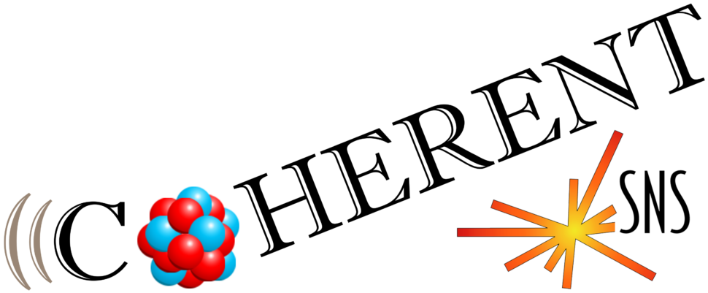


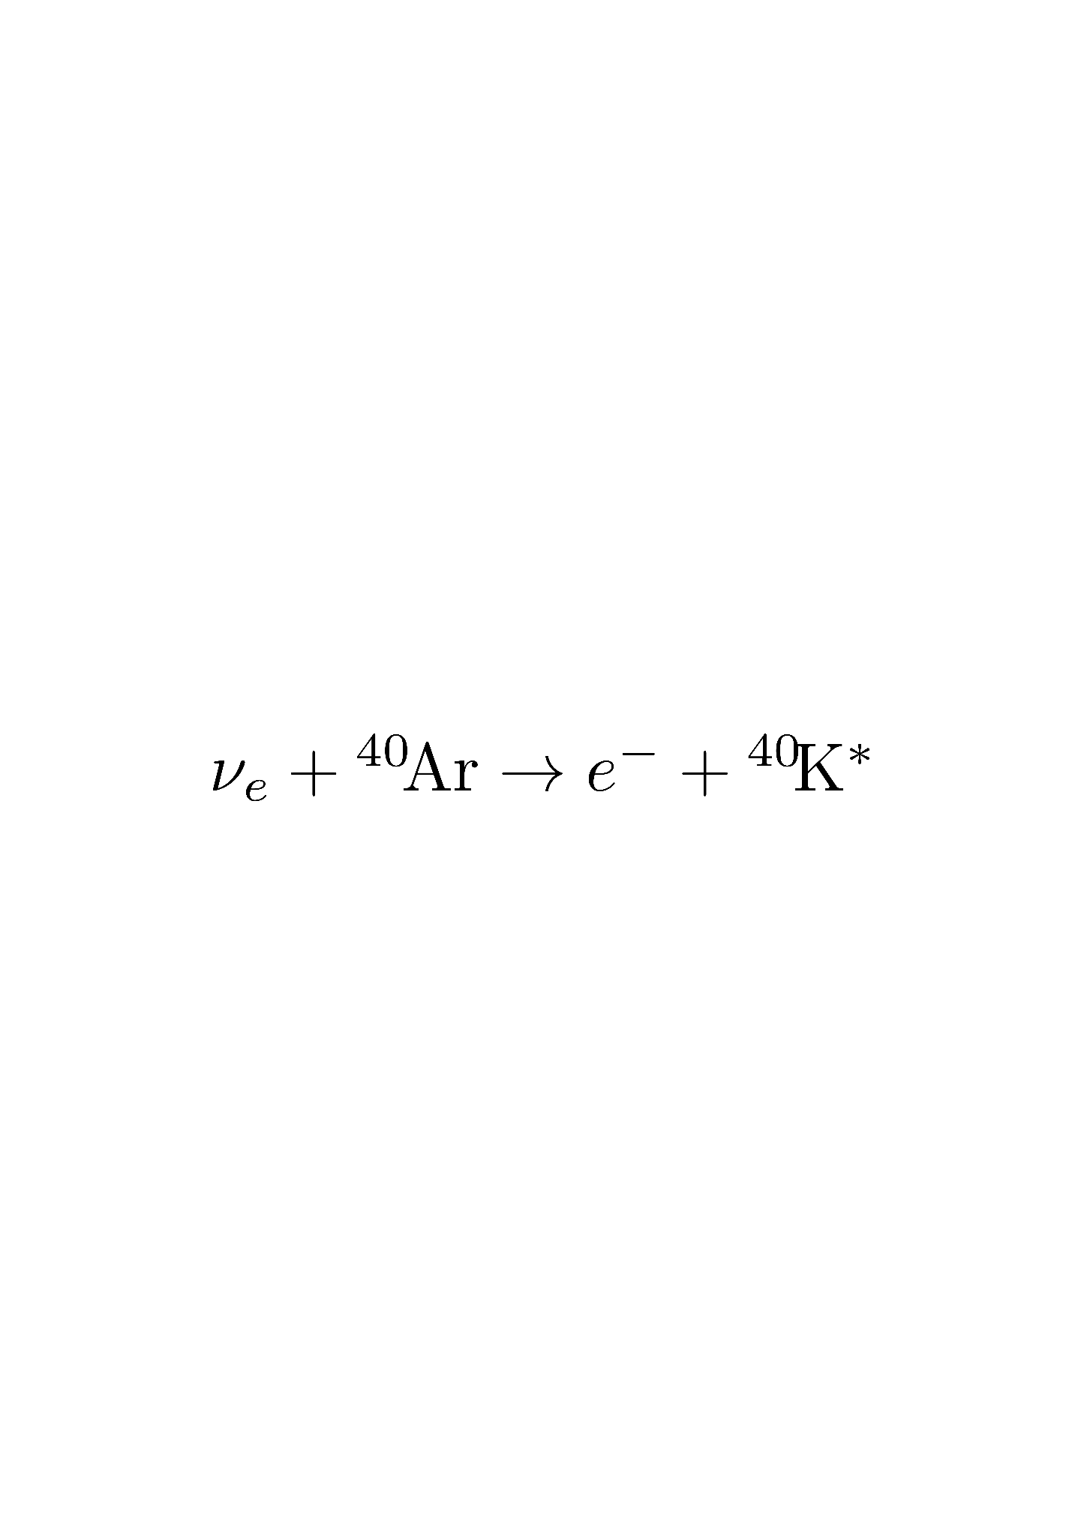
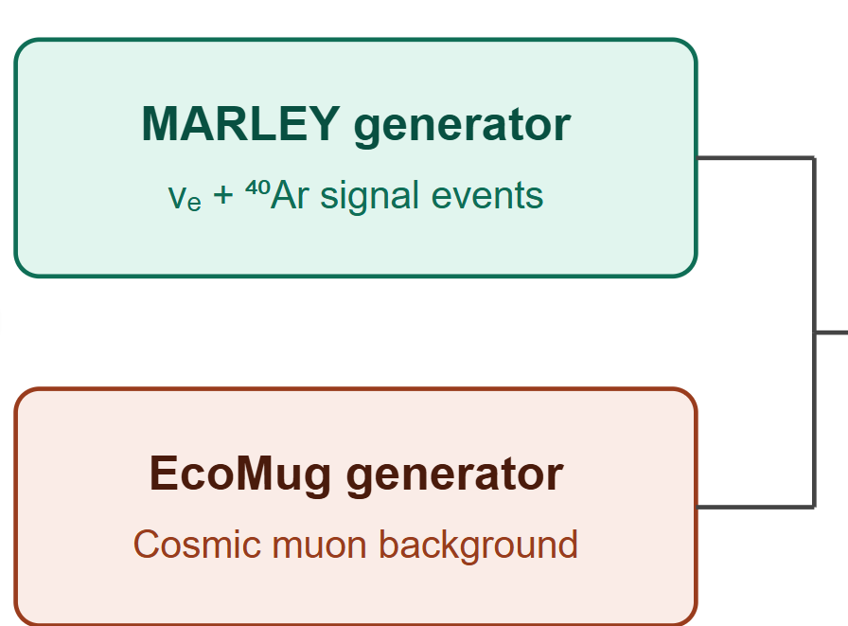
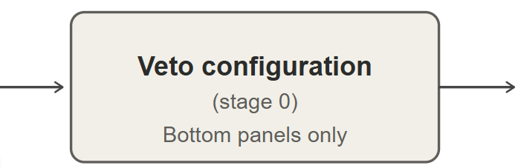
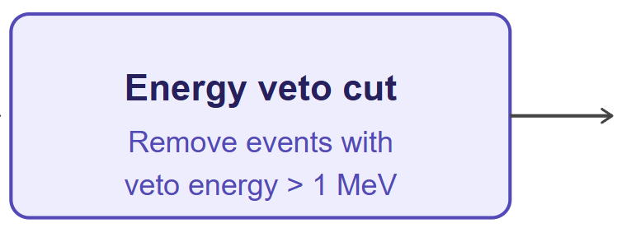
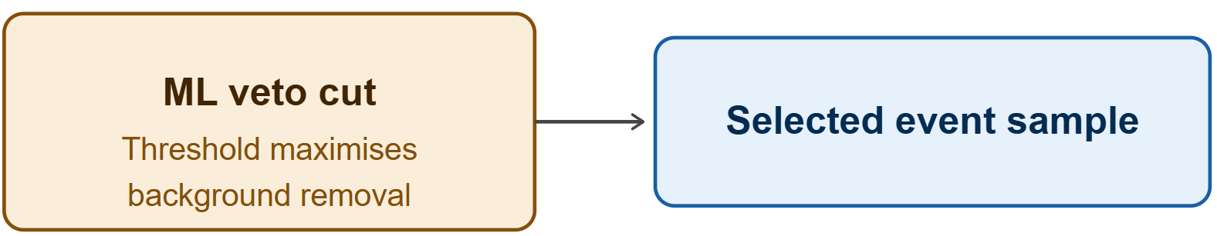
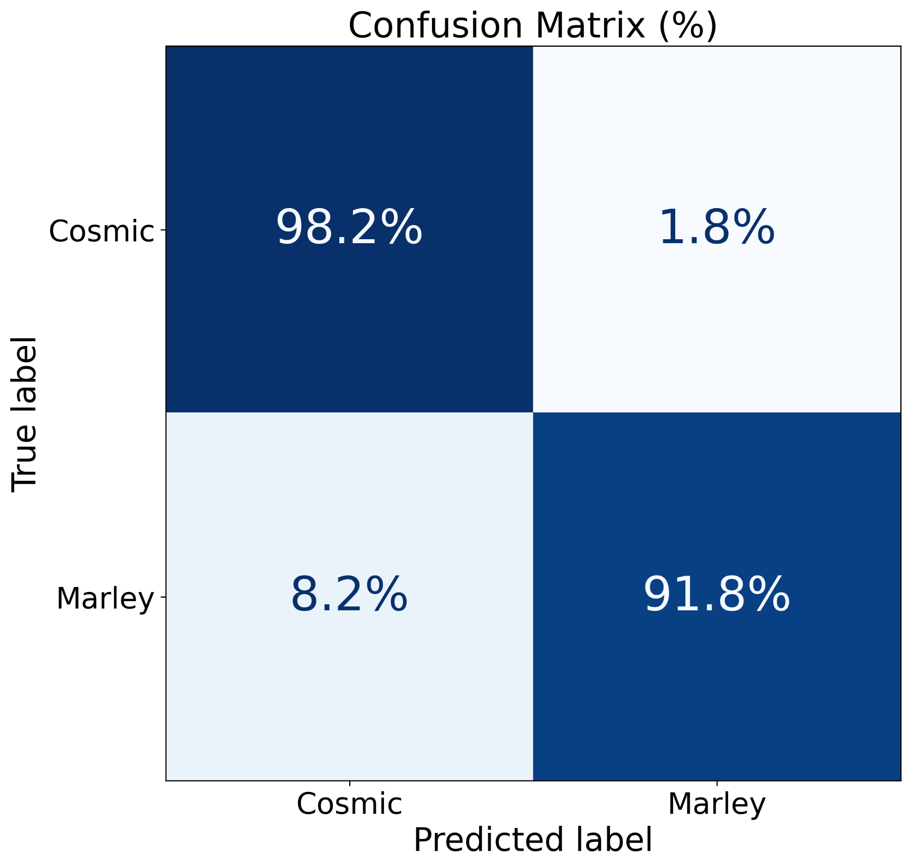
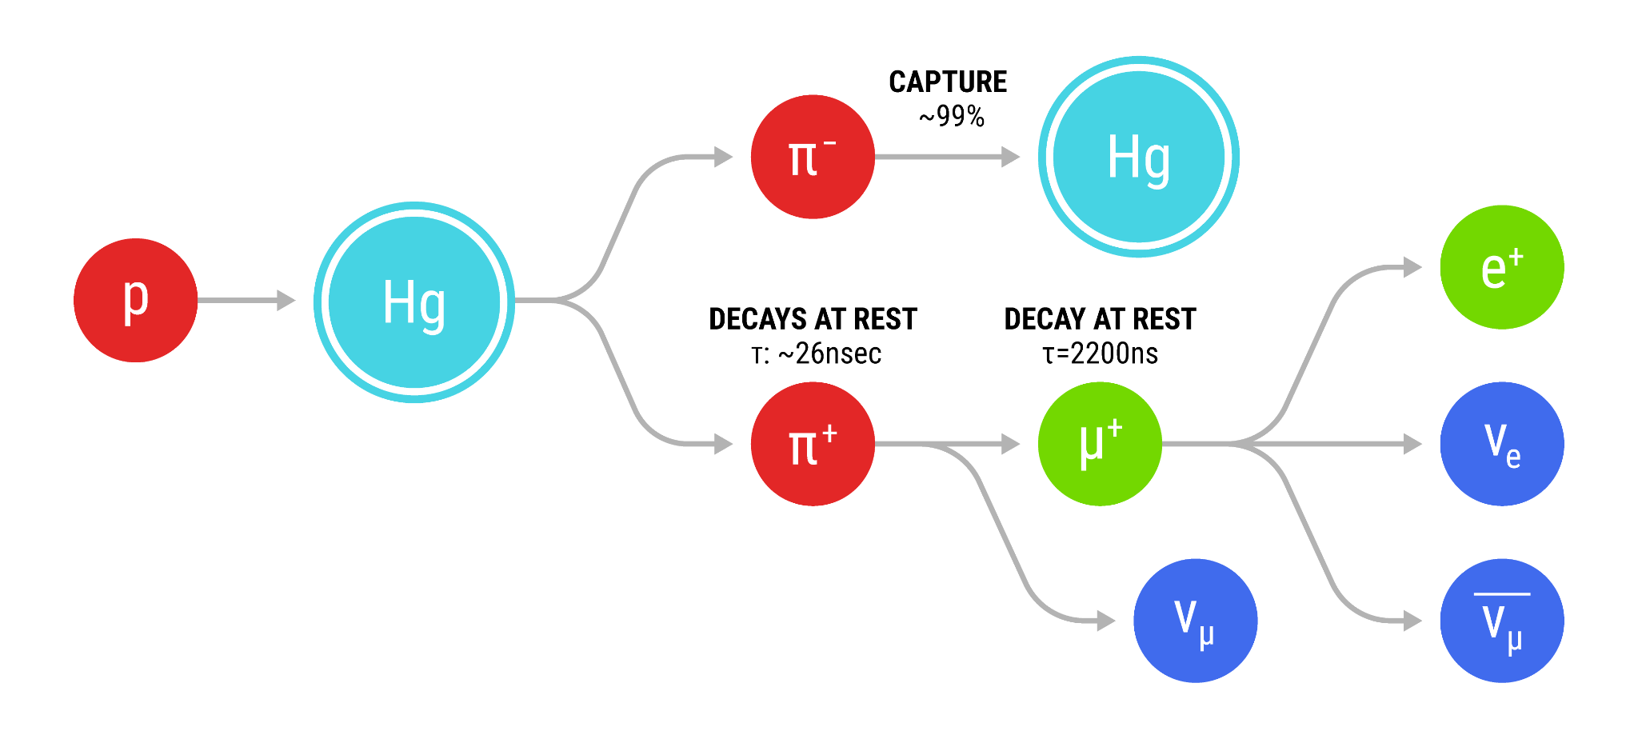
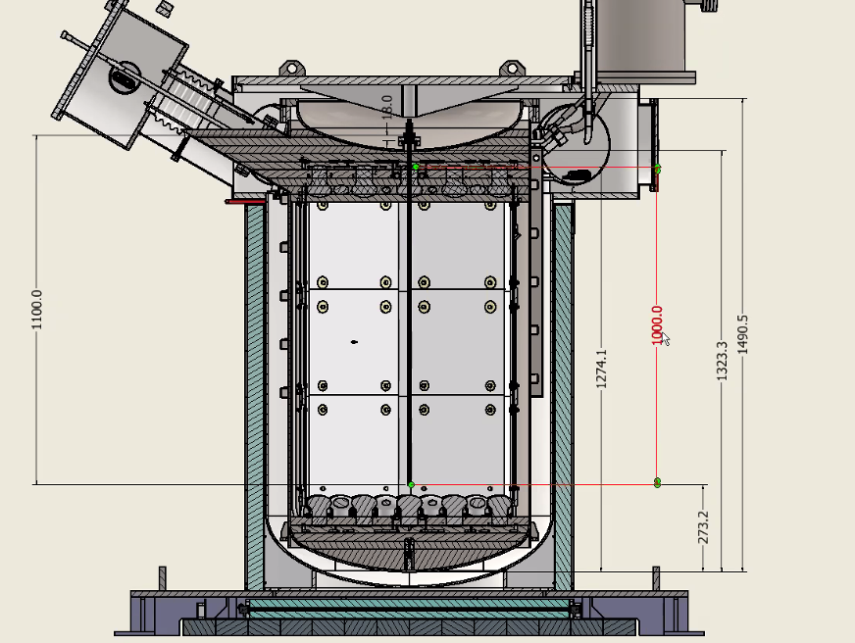
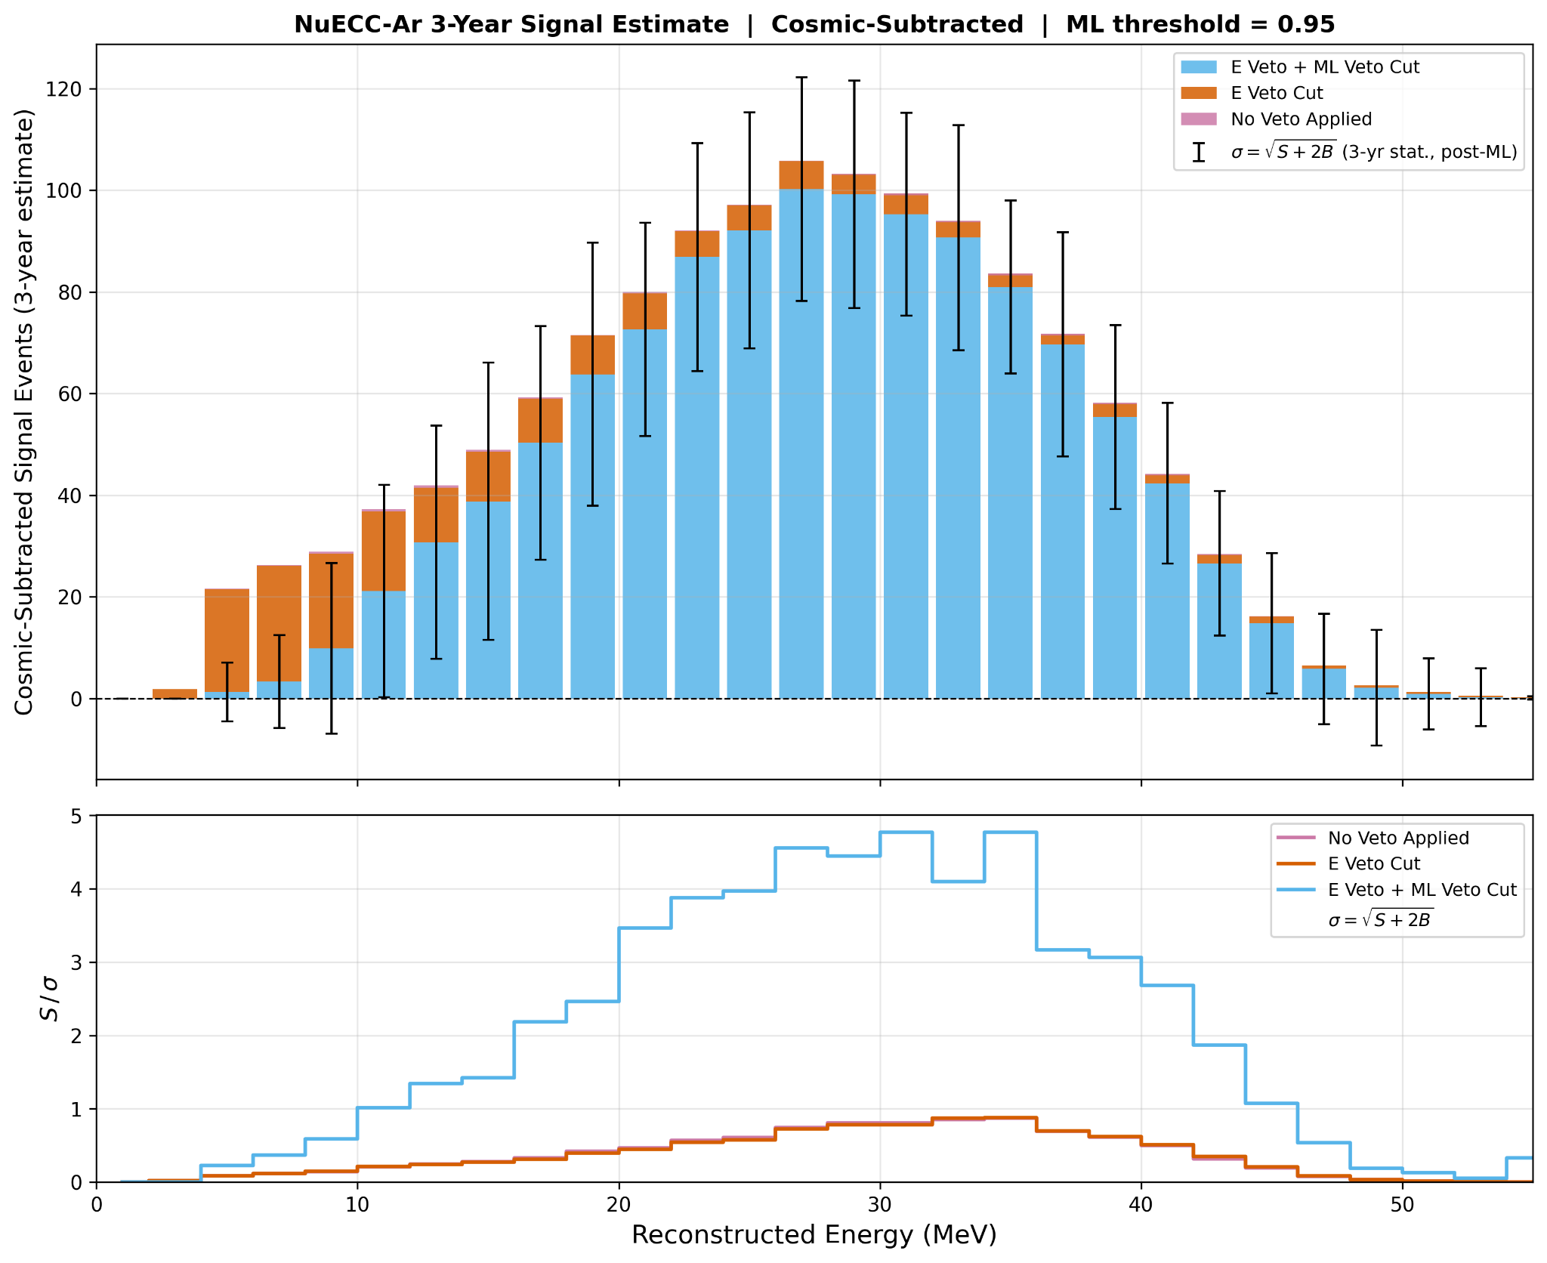
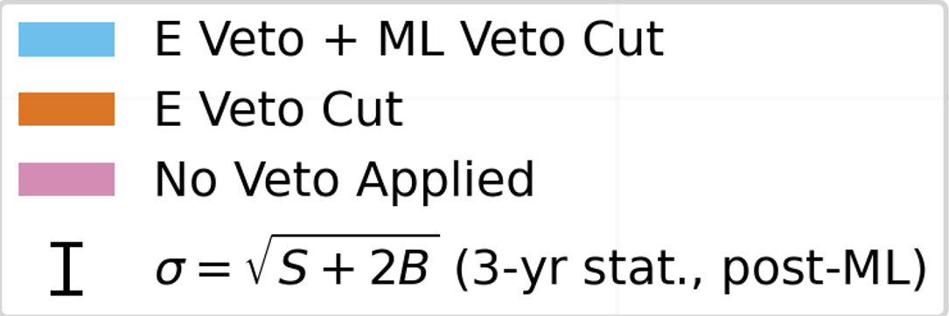
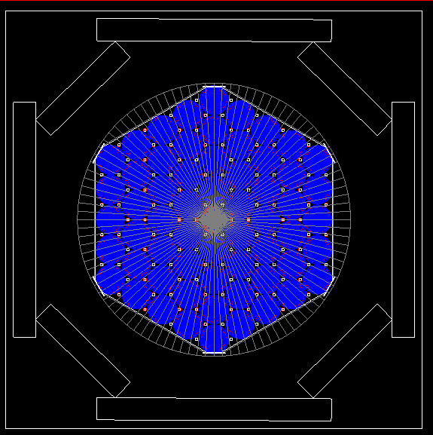
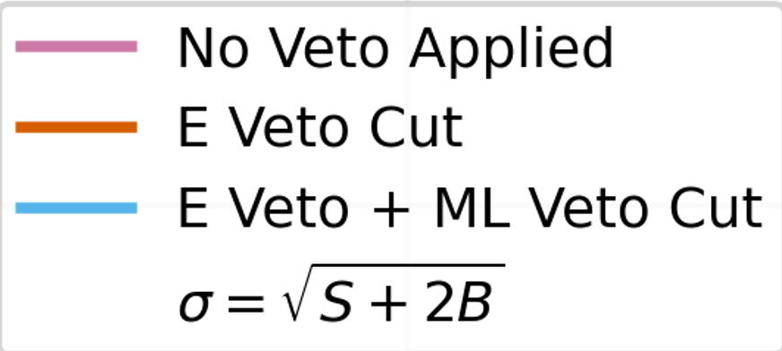



Measuring Neutrino-Argon CC Interactions at 10-50 MeV with the COHERENT 750 kg Detector
Vinicius Da Silva
Tufts University, COHERENT Collaboration
Vinicius.Da_Silva@tufts.edu
Background and Motivation
Simulation Study of Inelastic Events
We have yet to see a measurement of inelastic charged-current electron neutrino interactions ( CC) that covers full 10-50 MeV range
Tens of MeV Neutrino-Argon CC cross section measurements are relevant for ongoing theoretical work on weak axial current gA quenching in Gamow-Teller nuclear transitions
This also corresponds to the energy region of interest expected of supernova neutrino detection at the DUNE experiment
Cosmic background reduction is an important challenge in making this measurement and the focus of our study
Machine Learning Based Veto
Goal : To distinguish Marley neutrino signal events from cosmic background using individual PMT hit patterns.
Neutrino Argon Charge Current Inelastic Interaction
Input Features were selected to provide model with pulse energy, geometry, timing, and shape information
Model was trained in 2 steps:
  Masked autoencoder learned embeddings without labels (self supervised)
  Binary classifier was trained to classify events as cosmic ray (background) vs. neutrino (signal)
Model can maintain above 90% accuracy in Neutrino classification
Neutrino Production with the SNS Beam
Spallation Neutron Source (SNS) is located at Oak Ridge National Laboratory’s neutrino alley
High flux of pulsed neutrinos: 4.3 ⨯ 10⁷ neutrinos/cm²/s at 20 meter
A stopped pion provides tens of MeV neutrino source
Figure 1:SNS Neutrino Production
Figure 4: Confusion Matrix Result for Binary Classifier with threshold that maximizes cosmic removal
Coherent LAr-750 Neutrino Detector and Veto System
NueCC-Ar Expected 3 Year Signal Estimate with Bottom Veto Panel
Single phase liquid argon scintillation detector
122 photomultiplier tubes (PMTs)
750 kg liquid argon cryostat & 610 kg of fiducial volume
27.5m from Hg target
Veto system consists of plastic scintillators equipped with silicon photomultipliers (SiPMs)
We expect to observe a signal in the ~14–46 MeV range after 3 years of running
The energy veto alone provides limited background reduction, motivating a full detector veto system
The ML veto demonstrates meaningful additional rejection power beyond the energy cut, improving S/σ across the signal region
Full detector veto is anticipated to be in place before the full 3-year exposure, the results shown here are conservative
References & Acknowledgements
Bottom Veto Panels
Figure 2: LAr-750 Detector Diagram with Bottom Veto Panels
A. Abed Abud et al., (DUNE collaboration), Impact of cross-section uncertainties on supernova neutrino spectral parameter fitting in the Deep Underground Neutrino Experiment, Phys. Rev. D 107 (2023) 112012 [arXiv:2303.17007].
K. He, X. Chen, S. Xie, Y. Li, P. Dollár, and R. Girshick. Masked autoencoders are scalable vision learners. Proc. IEEE/CVF Conf. Comput. Vis. Pattern Recognit. (CVPR), pages 16000–16009, Jun 2022. arXiv:2111.06377, doi:10.1109/CVPR52688.2022.01553.
S. Gardiner. Simulating low-energy neutrino interactions with MARLEY. Comput. Phys. Commun., 269:108123, Aug 2021. arXiv:2101.11867, doi:10.1016/j.cpc.2021.108123
Veto Panels will be placed in aluminum enclosures
Stage 0: Bottom veto panels only (Figure 2)
Stage 1: Add bottom, side, and top veto panels (Figure 3)
Side panels are arranged octagonally to prevent gaps
Figure 3: Top View of cryostat in simulation with octagonal side panel arrangement
DE-SC0019032
Figure 5: Three year background subtracted signal prediction

