Slide 1
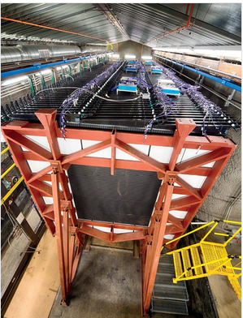

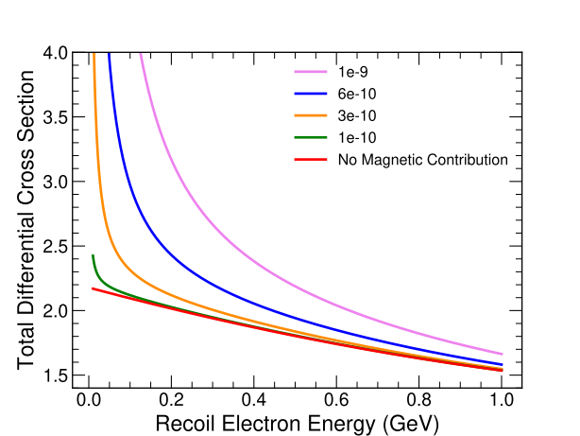
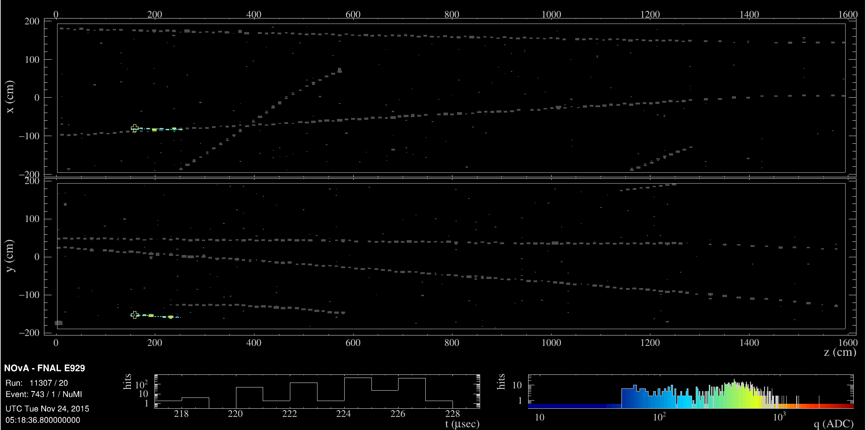
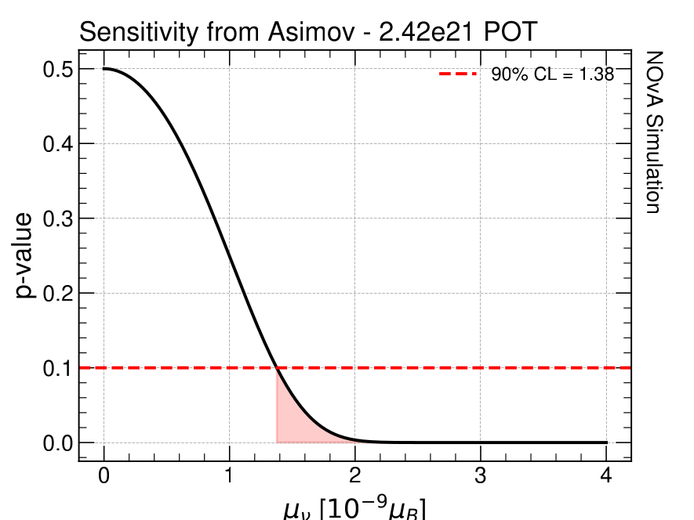
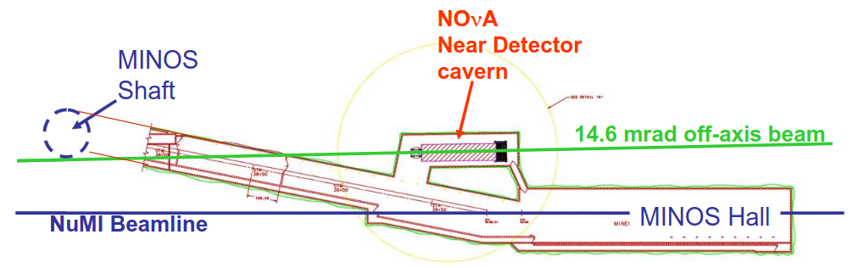
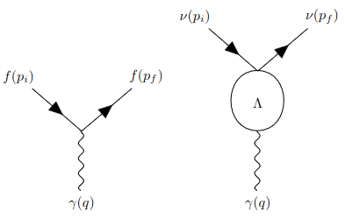
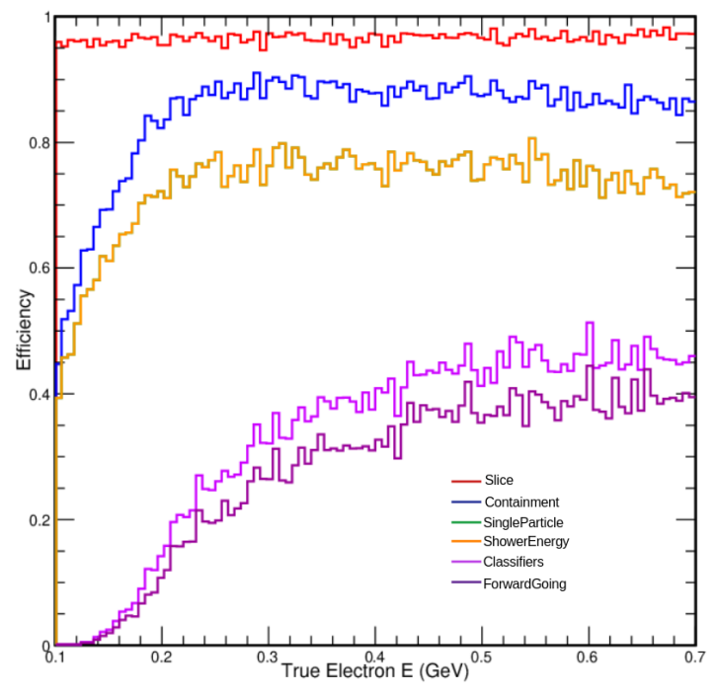
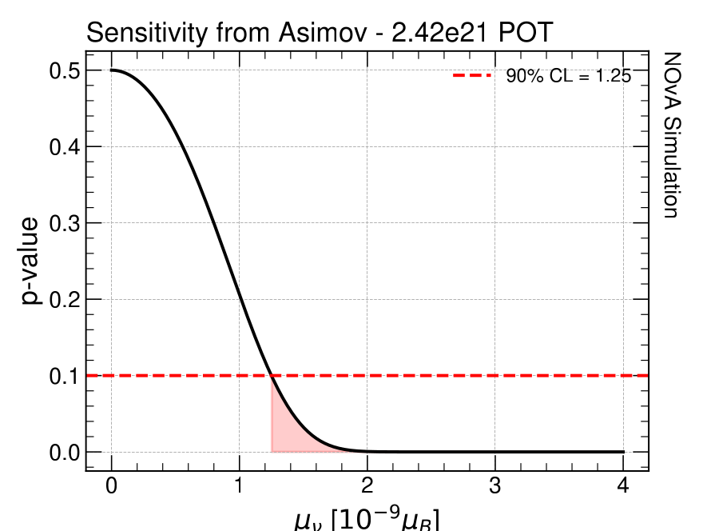
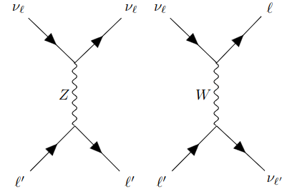
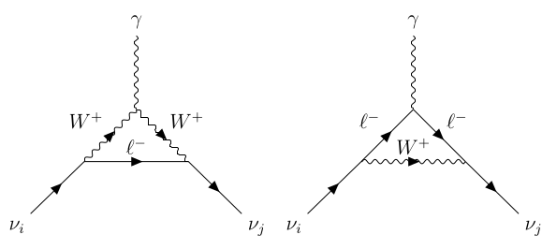
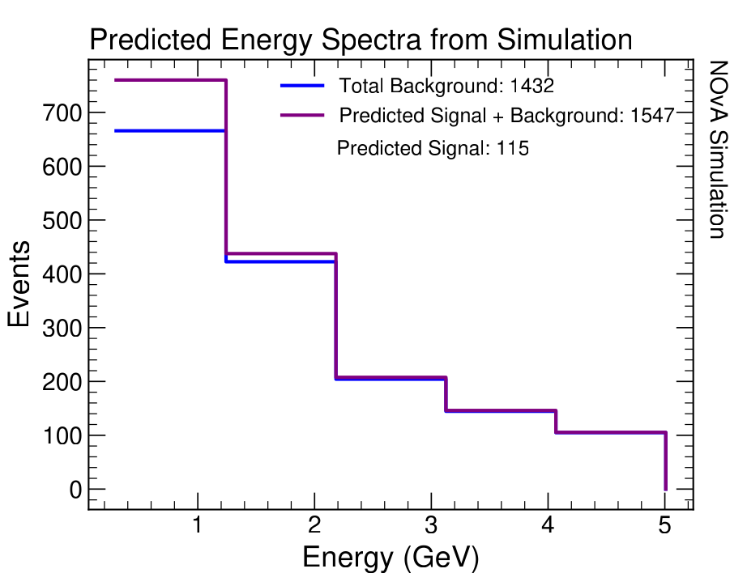
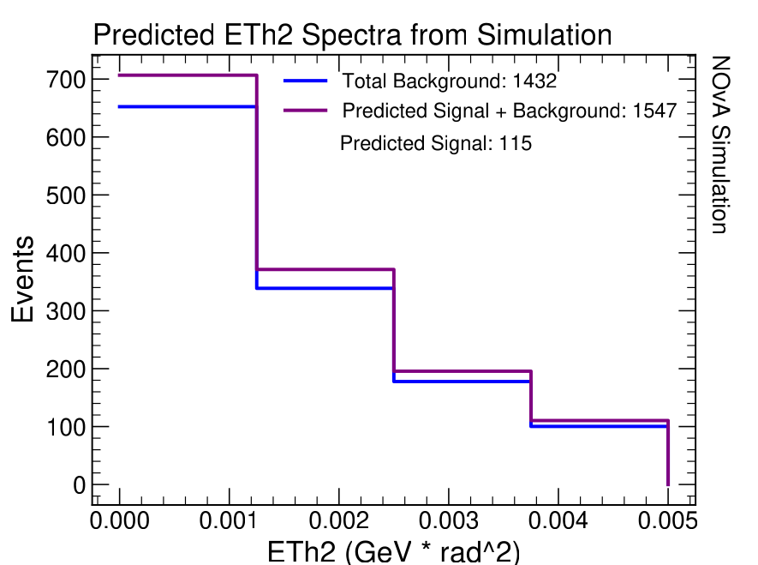


Study of the Neutrino Magnetic Moment with the NOvA Near Detector
Jane Nachtman (Speaker), Sarah Choate FERMILAB-POSTER-26-0127-V
University of Iowa
The NuMI Off-Axis ν_{e} Appearance (NOvA) Experiment
Analysis Process: ν-on-e Scattering
90% CL Sensitivity Predictions
ν-on-e scattering is the most sensitive and widely used process for studying the neutrino magnetic moment because of the differential cross section dependencies and it is purely leptonic [2]
Experiment | Year | 90% CL Result (x 10⁻⁹ μ_{B})
MiniBooNE | 2008 | < 1.27
CHARM II | 1995 | < 3.0
LSND | 1993 | < 0.68
BNL-E-0734 | 1990 | < 0.85
Table 2: Prior direct measurements for the nuMM. μ_{B} = eℏ / 2m_{e} is the Bohr magneton.
The main science goal of NOvA is to observe the oscillation of ν_{μ} to ν_{e} which leads to goals such as:
Precision measurements for θ₂₃ and Δm²₃₂
Place constraints on δ_{CP}
Place constraints on neutrino mass ordering
Study other exotic processes
[1]
Equation 1: Components for the differential cross section for ν-on-e scattering to one loop corrections.T_{e} is the recoil kinetic energy of the scattered electron [2].
To predict NOvA sensitivity for analysis of 2.42E21 POT of FHC data:
Utilize an Asimov
Approximate spectra as Gaussian and assume no signal events observed
NOvA is a long baseline experiment with a Near Detector (ND) and Far Detector (FD). This work exclusively uses the ND located 1 km downstream from the NuMI target.
NOvA Simulation
Figure 11: Sensitivity predictions for full range of electron energy (0.3 to 5 GeV). The p-value at 0.1 correlates to the nuMM value prediction at 90% confidence level (CL).
Figure 1: Beam-eye view of the NOvA Near Detector (Image credit: Fermilab Visual Media Services)
Figure 2: Top-down view of the ND in relation to the NuMI beamline and MINOS hall. The ND is about 1 km from the NuMI target and receives a nearly pure ν_{μ} beam [1].
Figure 6: Differential cross section for ν-on-e scattering with respect to T_{e} and for different values for the neutrino magnetic moment. The red, flat like represents the SM contribution only and the other lines include SM + MAG contributions.
Figure 7: Sample simulation event display for a ν-on-e scattering event.
The prediction for the upper bound on NOvA’s sensitivity is <1.38 x 10⁻⁹ μ_{B}.
Neutrino Magnetic Moment (nuMM)
Signal is observed as an excess of events (particularly at low recoil electron energy) which deviates from SM predictions
Neutrinos are observed to be electrically neutral which aligns with Standard Model (SM) predictions
It is known that some extension to the SM is required by the existence of neutrino masses
Application of higher order perturbative effects to a minimal extension on the SM allows neutrinos to acquire non-zero electromagnetic properties
  Occurs through effective coupling with a photon
Event Selection Method
Next we split the electron spectrum into a signal and sideband region, optimizing the shower energy using the expected 90% CL sensitivity. The new signal region requires 0.3 GeV < E_{shower} < 1.43 GeV, with a sideband at 1.43 GeV < E_{shower} < 5.0 GeV
Our signal is an enhancement over the SM prediction for ν-on-e scattering
Nominal signal is single electron energy 0.5 to 5 GeV
  Select well-contained and well -reconstructed showers
  Nothing else in event
  Focus on low energy where most magnetic moment enhancement appears
    Reduced lower bound on electron energy from 0.5 to 0.3 GeV
Main (irreducible) background is from SM ν-on-e scattering
  Consider additional backgrounds from 2p2h and ν_{e}CC QE events (small compared to SM ν-on-e )
Cutflow Method:
Preselection
NOvA Simulation
Volume Constraint
Figure 12: Sensitivity predictions applying the update signal region energy requirement (0.3 to 1.43 GeV). The p-value at 0.1 correlates to the nuMM value prediction at 90% confidence level (CL).
Figure 3: Diagram for first order coupling of a fermion directly with a photon (left) compared to higher order effective coupling to one loop between a neutrino and photon (right). Λ represents the vertex function which contains the interaction information for the blob [2].
Single Particle
Limit Energy
Apply Neural Network
The prediction for the upper bound on NOvA’s sensitivity is now <1.25 x 10⁻⁹ μ_{B}.
Forward Going
Figure 8: Simulation-based efficiency study to determine an appropriate lower bound energy value to validate down to.
Figure 4: Example lowest order Feynman diagrams for SM ν-on-e scattering. ℓ’ in this process would be the electron [4].
Detector Uncertainty | +8.2% / -10.3%
Flux Uncertainty | +/- 8.1%
Statistical Uncertainty | +/- 2.6%
Total Background Prediction | 1432 +/- 38 (stat) +118/-147 (det) +/- 116 (flux)
Table 1: Uncertainties affecting the background prediction and the total background prediction with the associated uncertainties. Only the shift up in uncertainty matters for the nuMM prediction, as we are looking for an observed excess.
Figure 5: Example Feynman diagrams for higher order ν-on-e scattering resulting in a nuMM. The process can vary depending on the theoretical framework utilized, these were used in [3].
Continuing Work
D. S. Ayres et al. The NovA Technical Design Report. 10 2007.
Carlo Giunti and Alexander Studenikin. Neutrino electromagnetic interactions: a window to new physics. Rev. Mod. Phys. 87,531 2015
Robert E. Shrock. Electromagnetic Properties and Decays of Dirac and Majorana Neutrinos in a General Class of Gauge Theories. Nuclear Physics C, 206(3):359-379, 1982.
Oleksandr Tomalak and Richard J. Hill. Theory of elastic neutrino-electron scattering. Physical Review D, 101(3), feb 2020.
Wenjie Wu and Yiwen Xiao. Neutron-Electron Elastic Scattering in the NOvA Near Detector - Technote. Nova technical note, NOvA Document 56383, October 2023.
Note: Eθ² is defined by the reconstructed electron energy and the angle of the electron with respect to the beam -- it describes the forward-going nature of the signal.
Signal region validation studies have been performed with 10% of the available data, reviewed by collaboration
Analysis of full dataset coming soon!
Future work focuses on improving low energy reconstruction to try to improve efficiency in the region where this signal is most accessible
References
This work is supported by DOE Grant No. DE-SC0010113
This document was prepared by NOvA using the resources of the Fermi National Accelerator Laboratory (Fermilab), a U.S. Department of Energy, Office of Science, Office of High Energy Physics HEP User Facility. Fermilab is managed by Fermi Forward Discovery Group, LLC, acting under Contract No. 89243024CSC000002.
Figure 9: Predicted electron energy for signal + background and background only spectra from NOvA simulations
Figure 10: Predicted signal + background and background only spectra with respect to Eθ² using NOvA simulations

