Slide 1

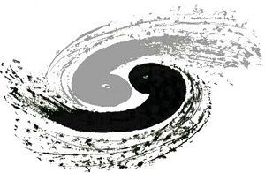
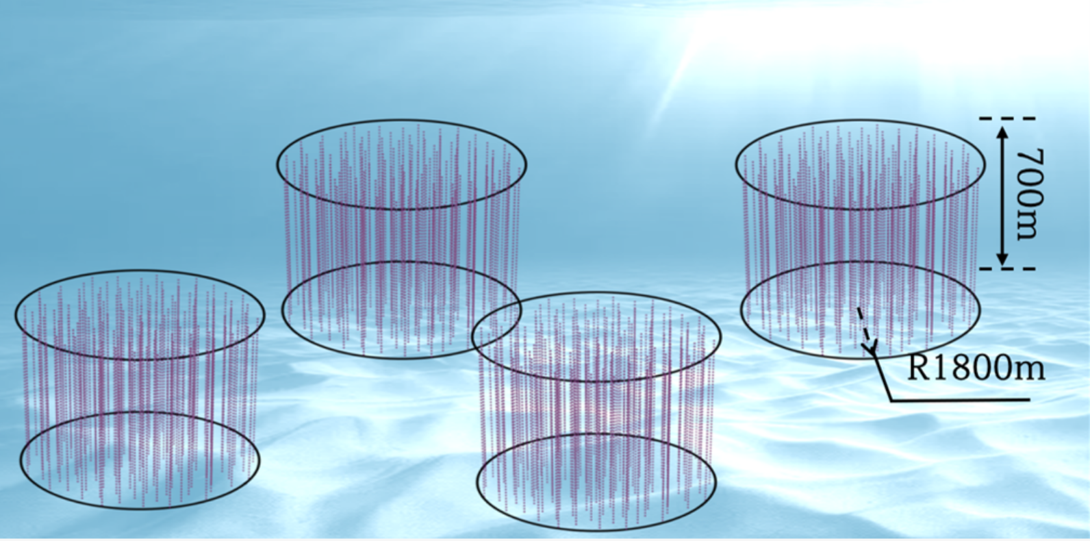
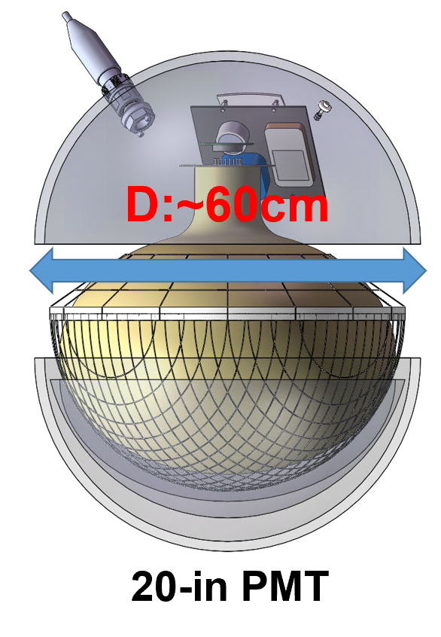
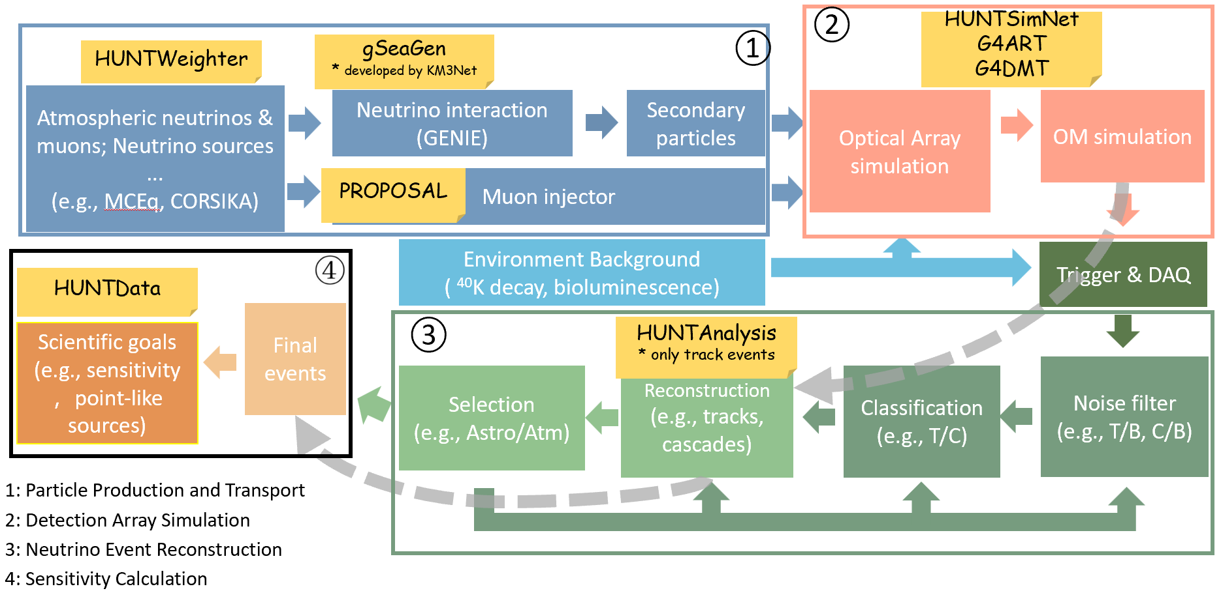
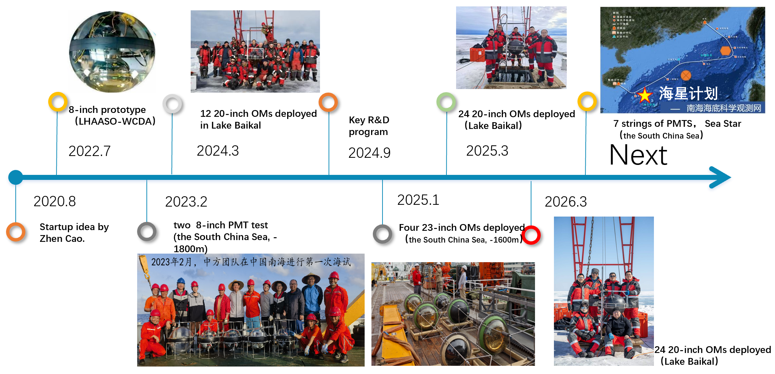
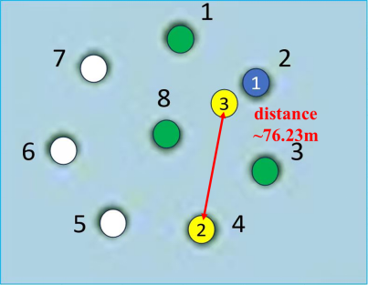
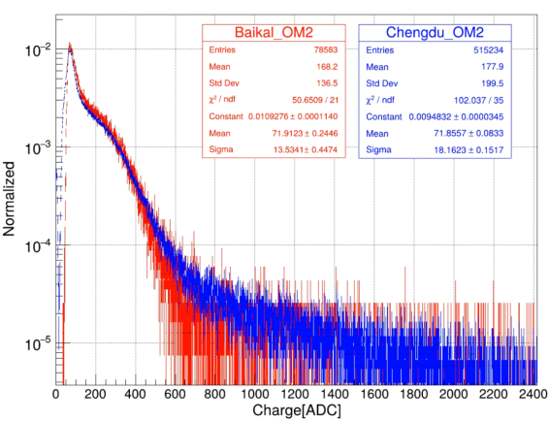
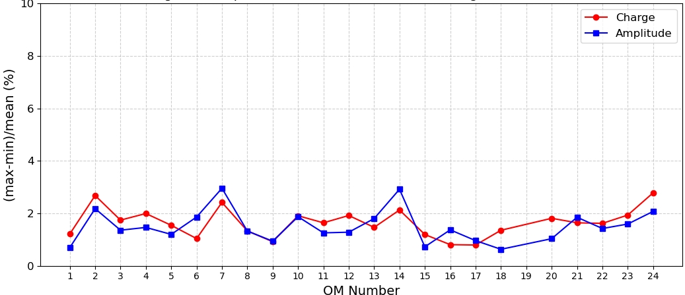
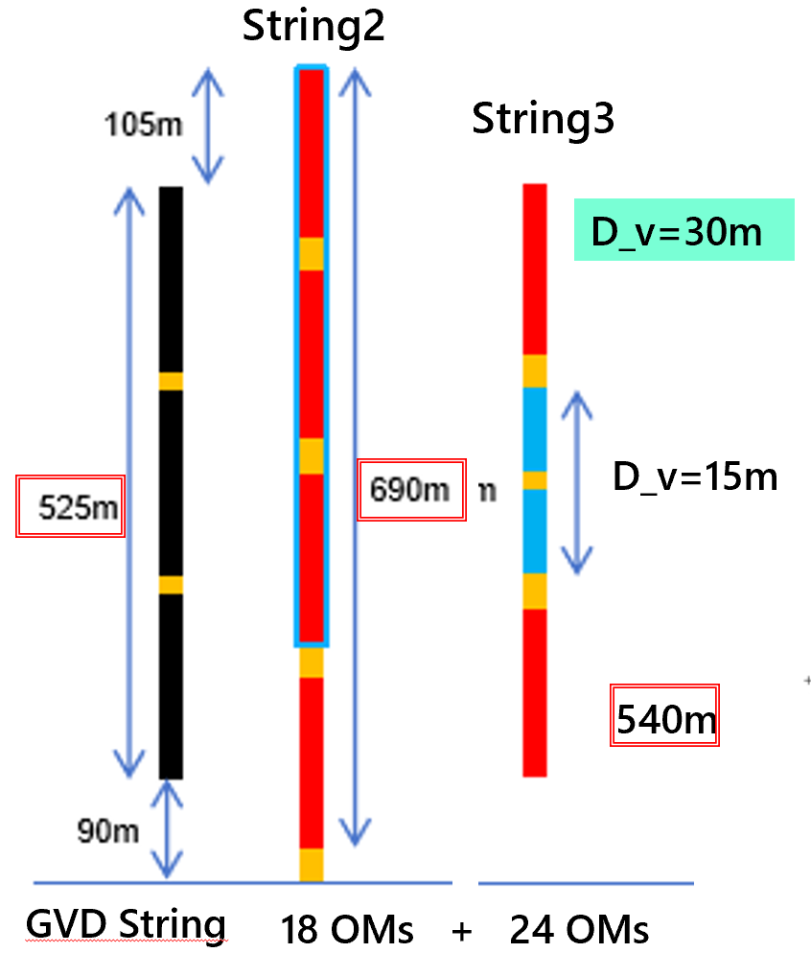
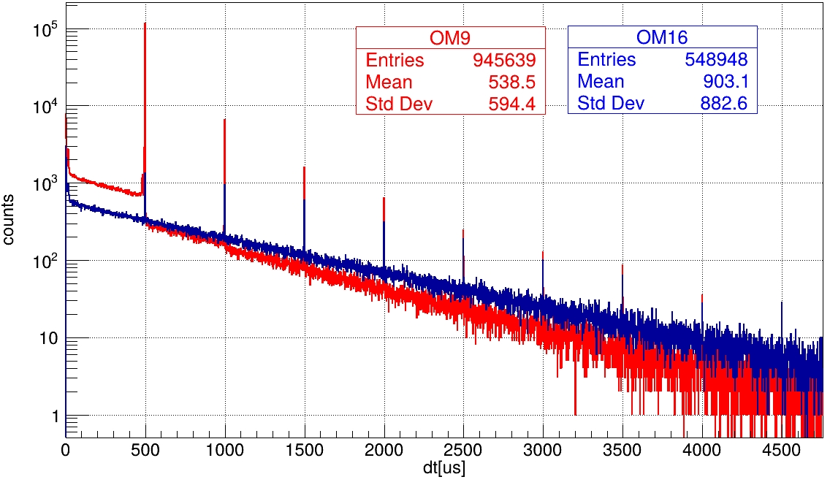
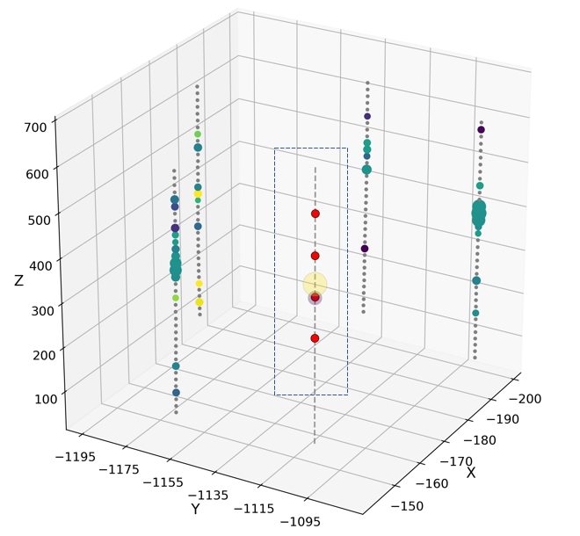
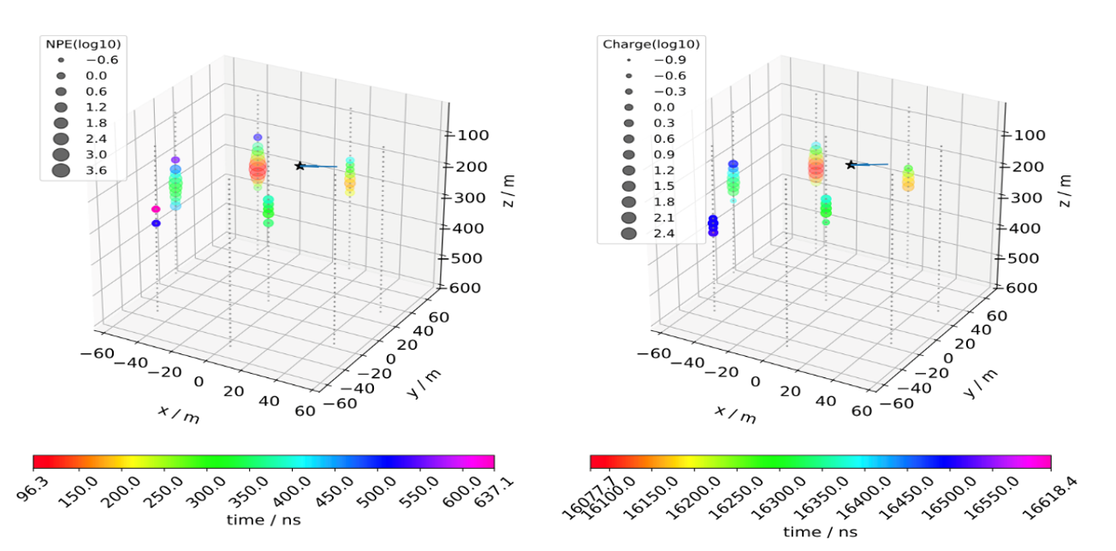
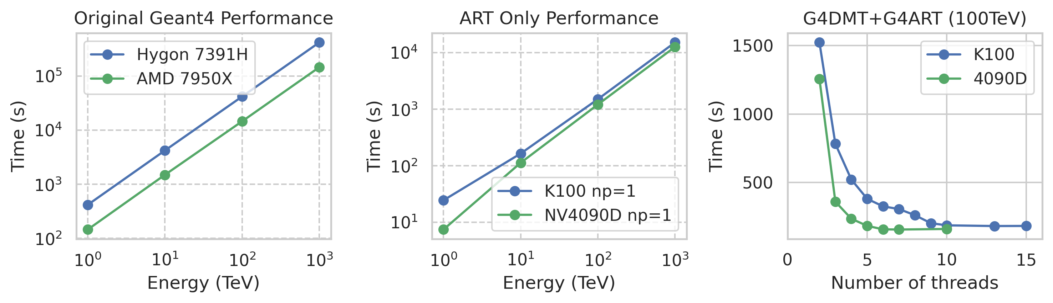
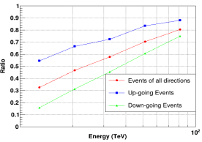
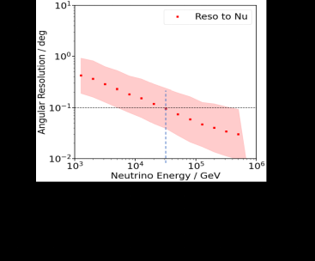
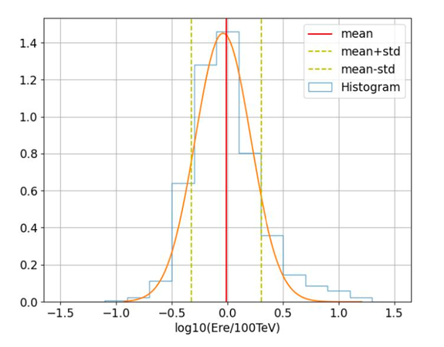
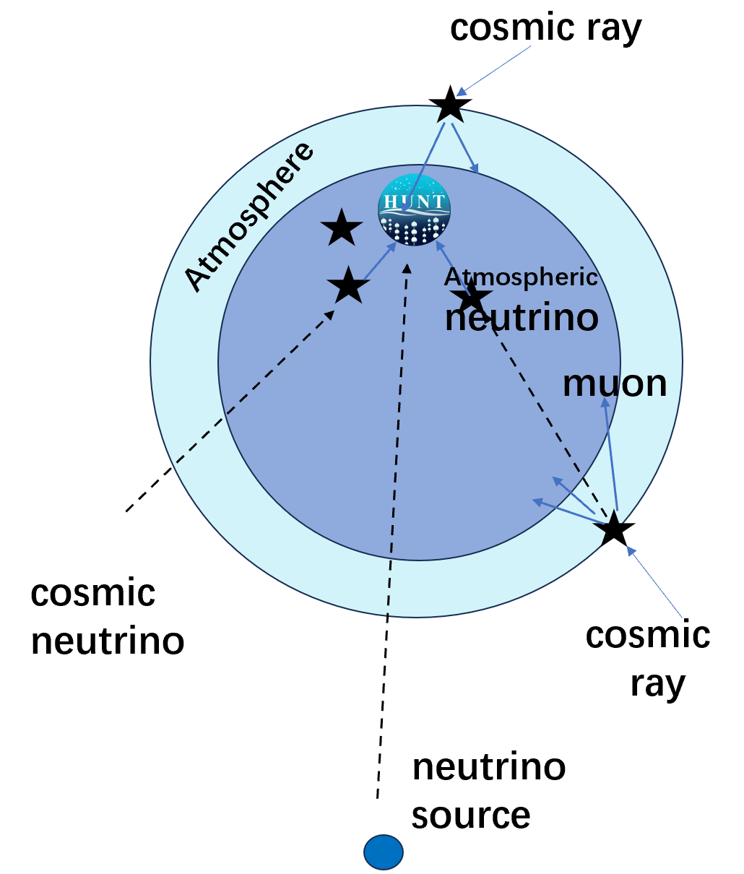
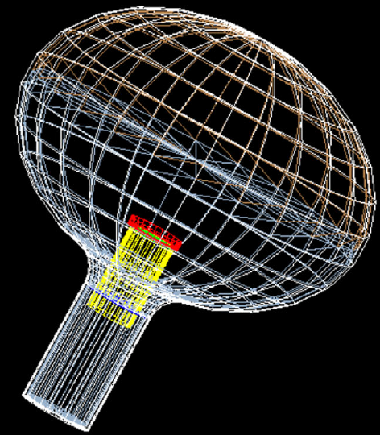
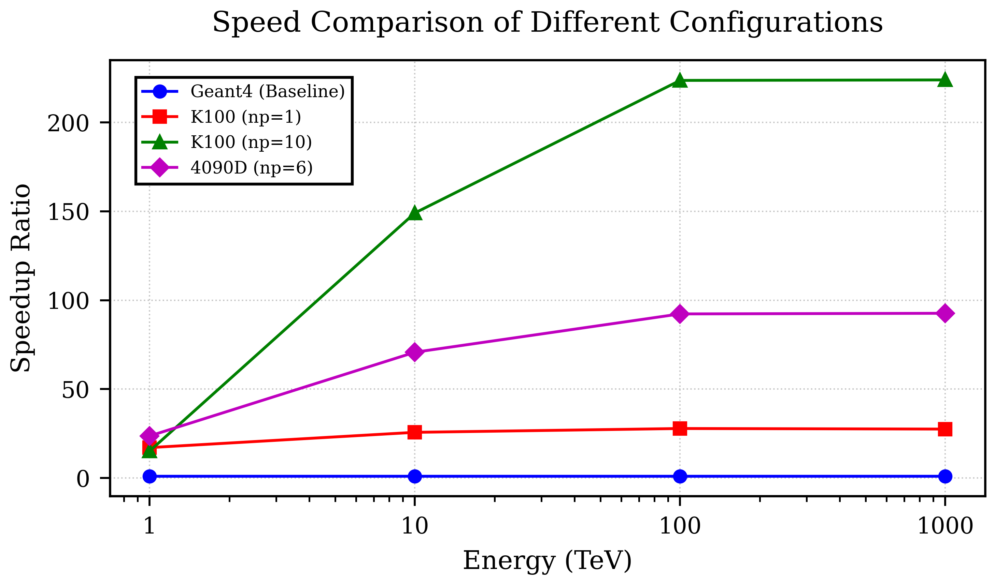
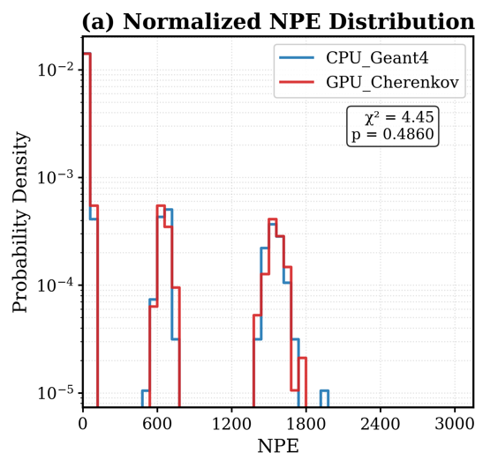
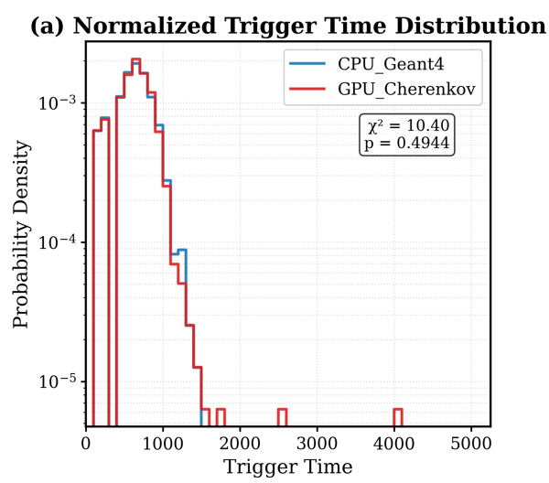
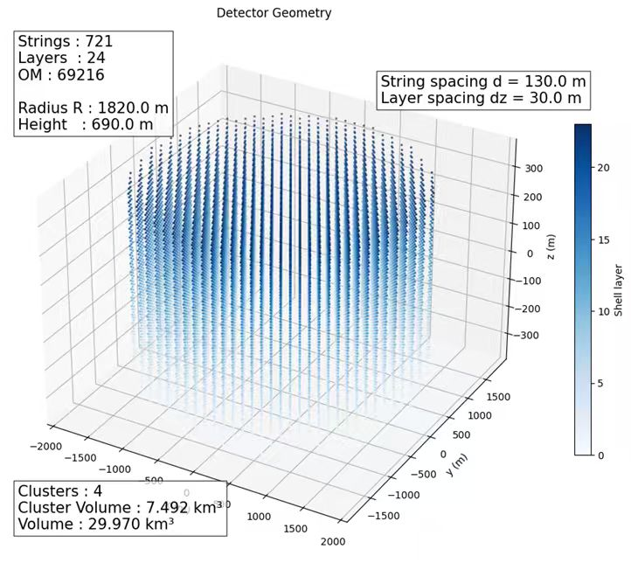
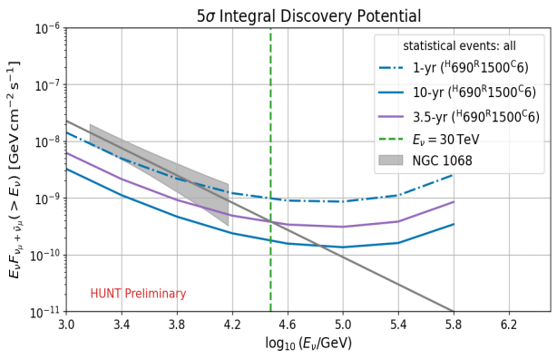
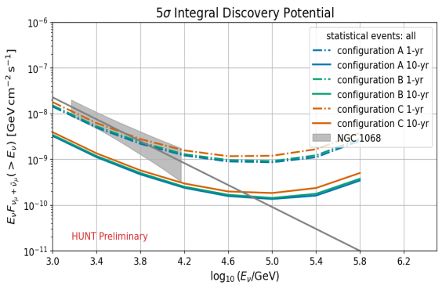
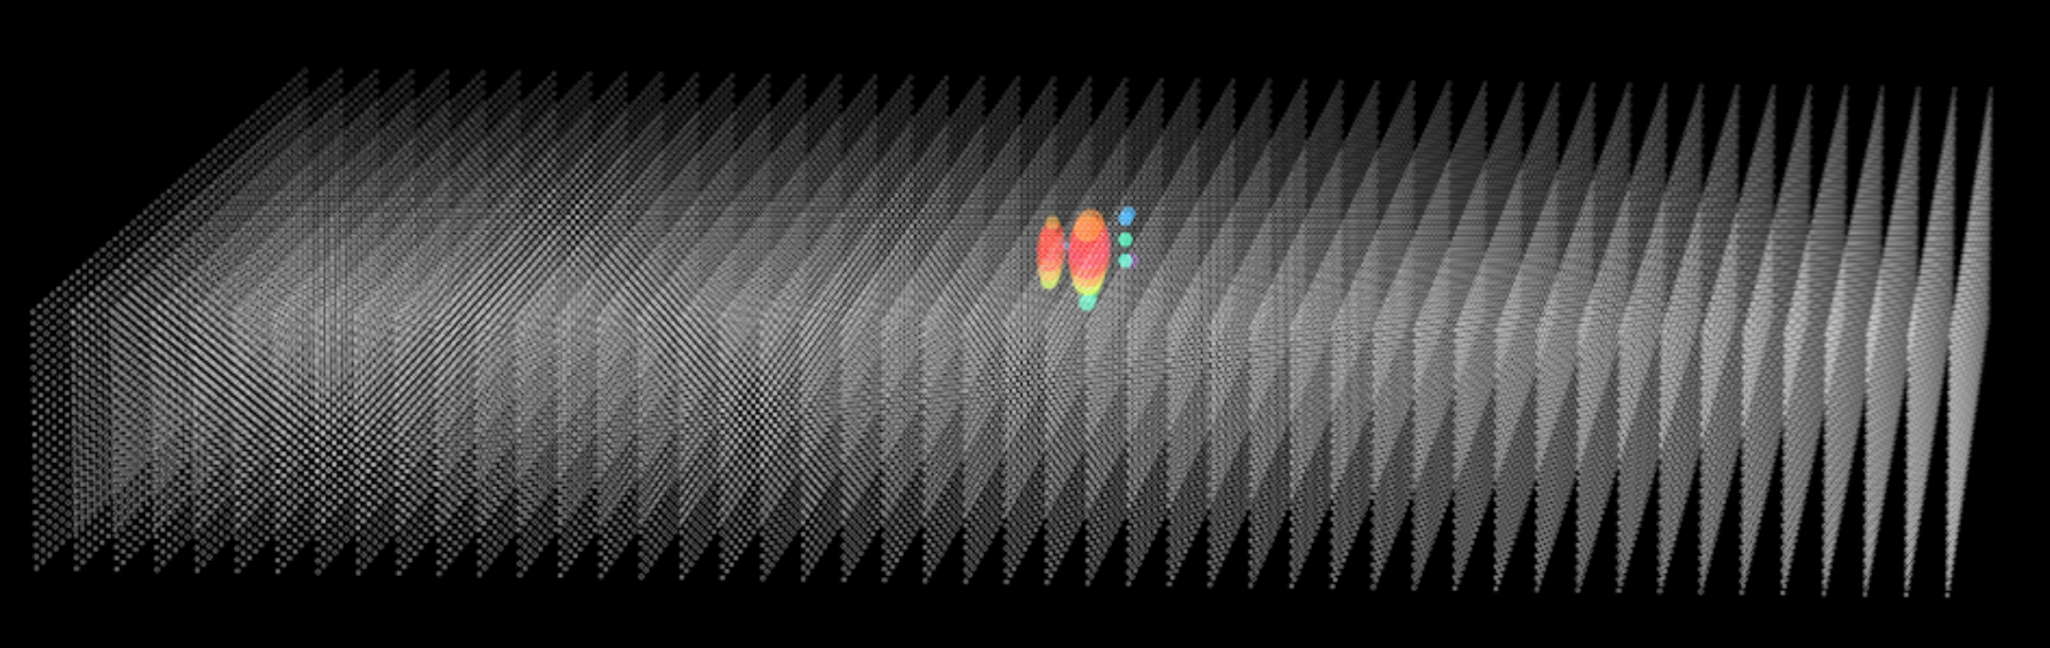
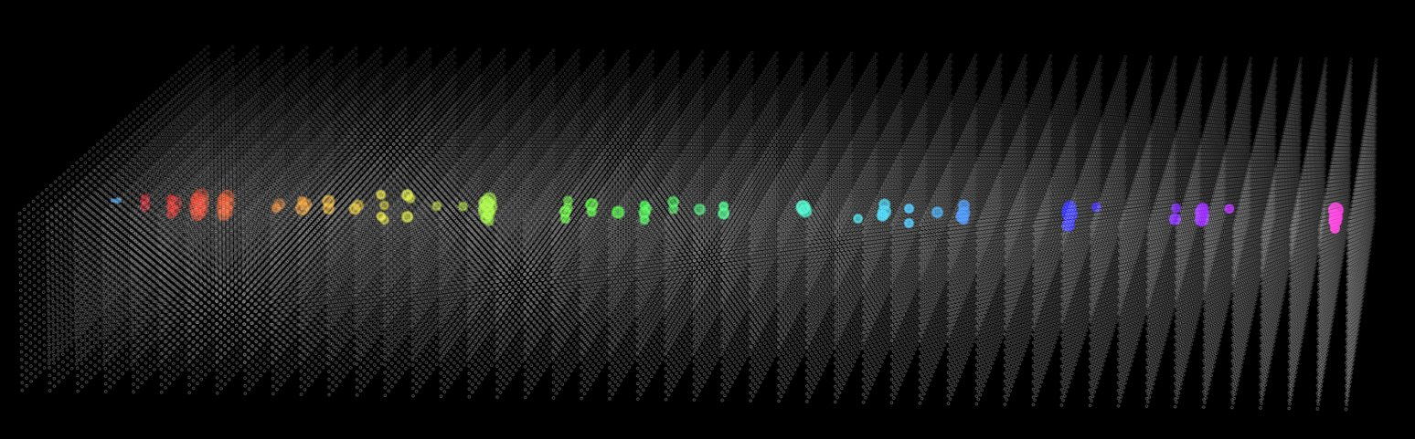
Geometry Optimization and Simulation of BAIKAL-HUNT
Xiurong Li
(on behalf of the BAIKAL-HUNT Collaboration)
Institute of High Energy Physics, Chinese Academy of Science
1 – Introduction
  BAIKAL-HUNT: A next-generation deep-water neutrino telescope for Galactic and extragalactic high-energy neutrino detection
  Primary Goals: Identifying hadronic PeVatrons ；Resolving neutrino sky；Understanding propagation of cosmic-rays , new physics
  Location: The candidate site is Lake Baikal, which has a water depth of 1365 m
  Detector Volume: 30 km³ of 20-inch PMT array, (may be divided into 4 or 6 clusters)
  PMT distance in one volume: Vertical distance 30m and horizontal distance at most 130m
2 – Experimental Progress
3 – Prototype analysis
4 – Simulation framework
  Three strings of PMT prototypes were installed in Lake-Bakail
  Twice of prototype tests were done in South China Sea
  Seven prototype strings will be installed in South China Sea this year
  The SPE、beta、stability、 LED signals and muon signals of PMT prototype are analyzed， with good performance
  Realized the joint analysis between HUNT prototypes and GVD array
  The total simulation and analysis framework of BAIKAL-HUNT is below:.
Charge of SPE
Fluctuation of SPE peak
LED signal vs time
Red: HUNT string;
Green: GVD array
Time (us)
5 – Simulation details
6 – Geant4 speed up
7 – Performance and preliminary sensitivity
gSeagen：simulate the neutrino events with given flux and random angles
Proposal： simulate atmospheric muon backgrouds
Geant4: simulating particle interactions inside the array
CRMC: hadronic interactions above 100 TeV
G4ART and G4DMT, are developed to accelerate the Geant4 simulation
G4DMT：Geant4 Distributed Multiple Threads，with cpu parallelization
G4ART：Geant4 Accelerated Ray Tracing， with GPU or DCU parallelization
The trigger efficiency of neutrino events are estimated
Track-like and cascade-like ν events are reconstructed.
The sensitivity of neutrino sources are estimated (ν only; no atmospheric μ, bioluminescence, radioactive background, dark noise, etc.)
Trigger efficiency of ν_{u} CC Evts
Angle resolution of ν_{u} CC
Energy resolution of ν_{u} CC
NGC 1068
Track events
different arrays
Left is the Geant4 simulation, right
is one event of GVD real data

