Slide 1

PSAS2026 Welcome
Eberhard Widmann, Savely Karshenboim
Vienna, 18.5.2026

Slide 2
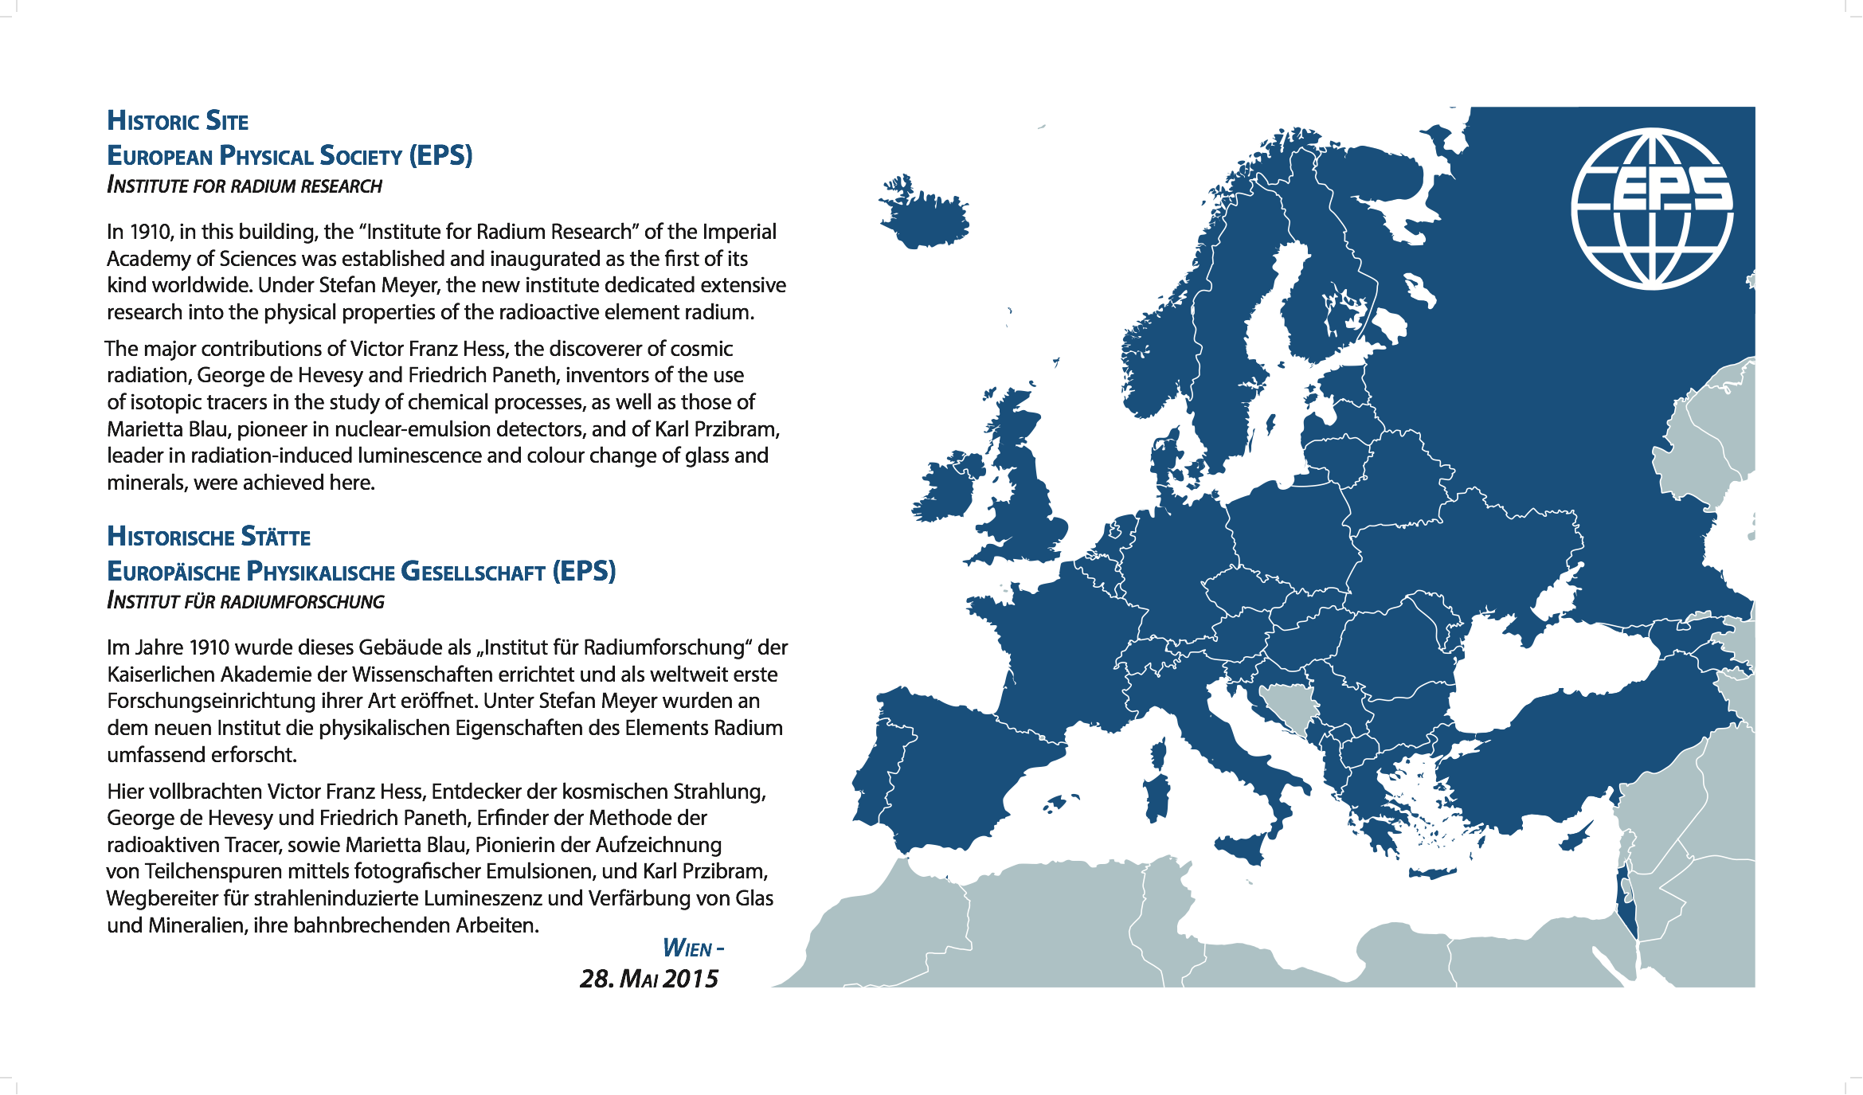
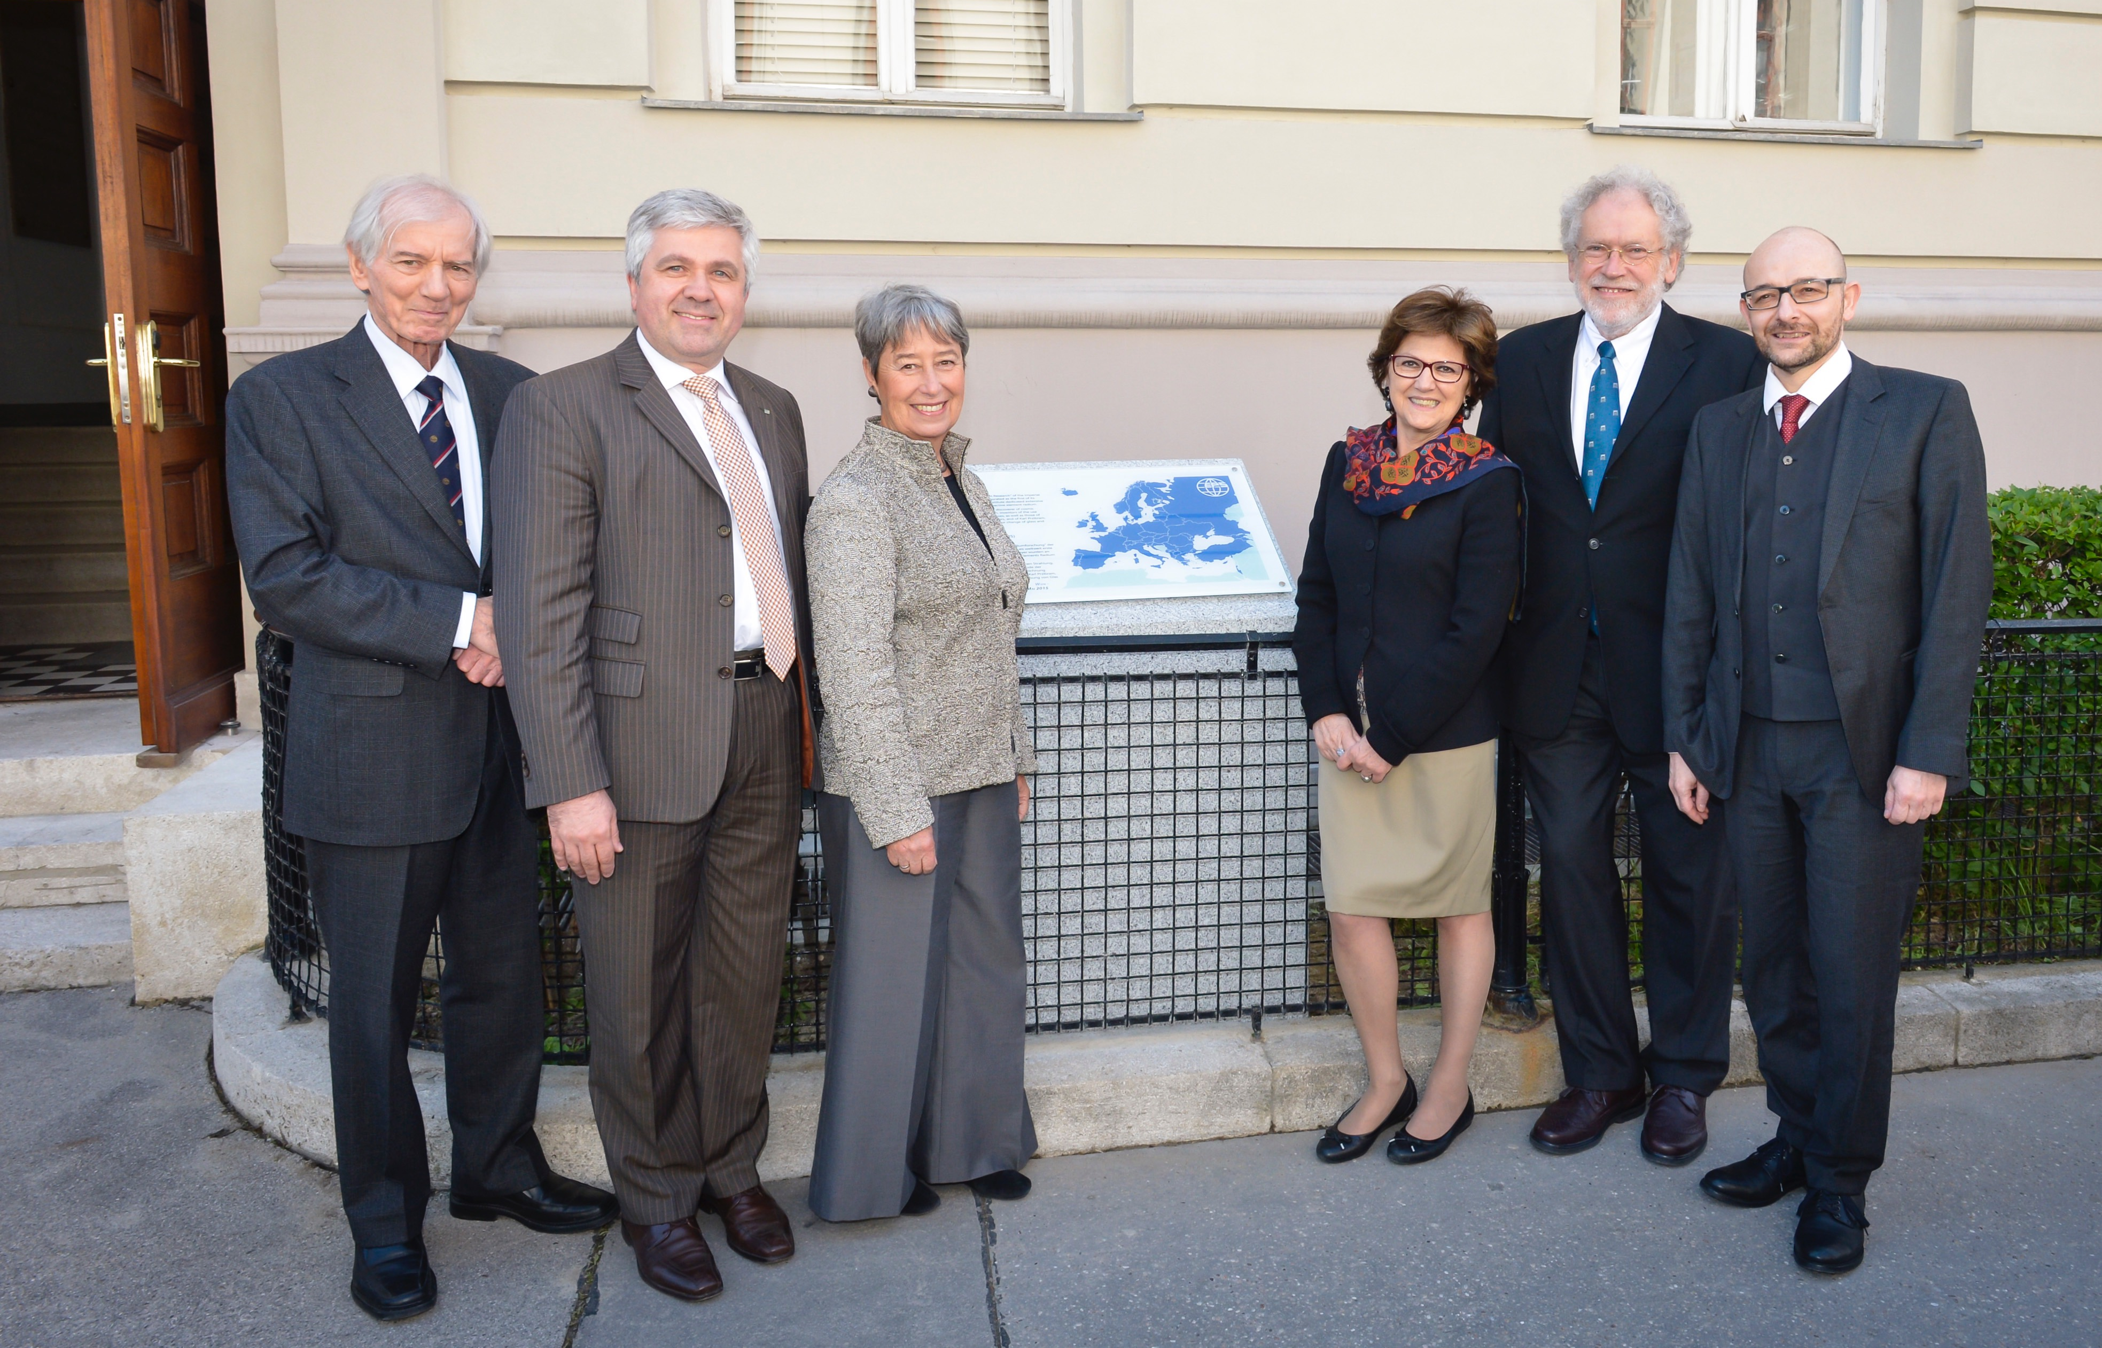


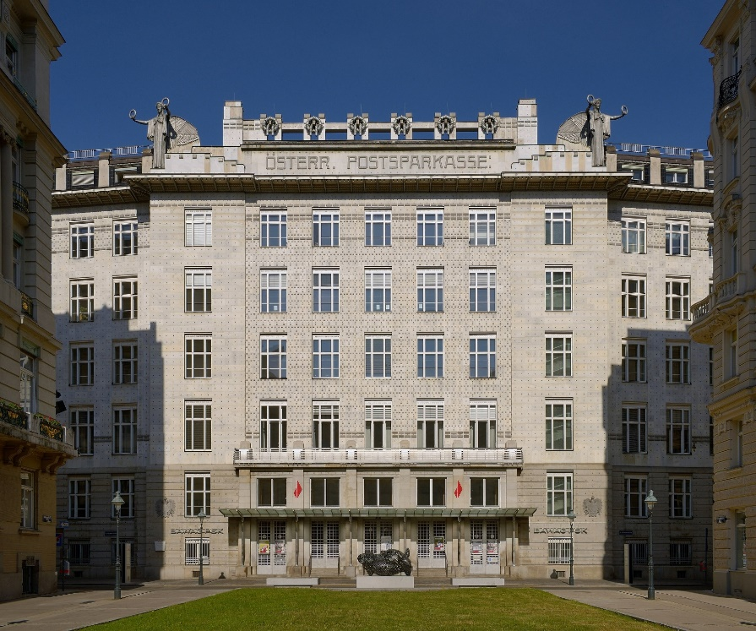

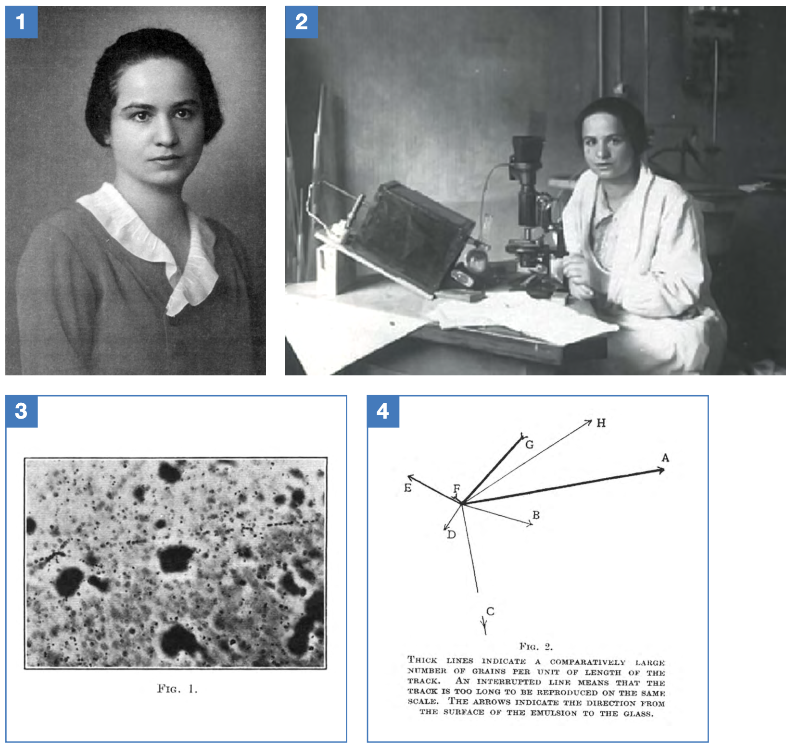
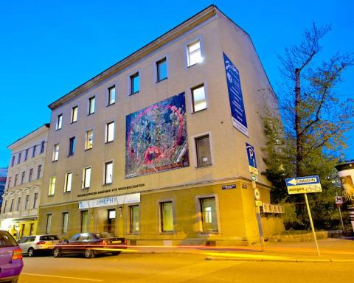

Marietta Blau Institute for Particle Physics
Institute for Radium Research → Stefan Meyer Institute for subatomic Physics → Marietta Blau Institute for Particle Physics
1910 2004 2025
Institute of High Energy Physics
1966

Slide 3


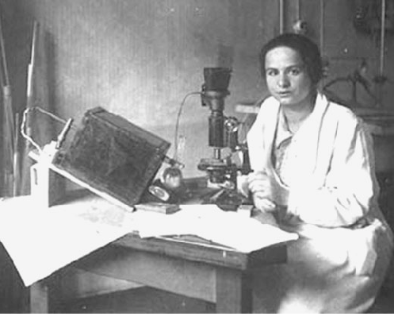
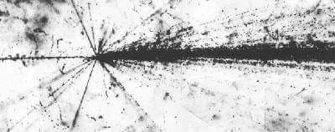
MBI – emerging from HEPHY & SMI
Institute of High Energy Physics
CMS
Belle-II
Rare Event Searches
MagLev
Gravitational Waves
Machine Learning
Detector Development
Theory
Stefan Meyer Institute for Subatomic Physics
ALICE
Exotic Atoms
Antimatter
Located in Postsparkasse, 5 min from Academy headquarters
Austria‘s largest non-university research institute focusing on experimental and theoretical particle physics
https://www.oeaw.ac.at/mbi
Total staff of ~120 persons
nuclear disintegration stars (Zertrümmerungsterne)
Source: https://www.furche.at/chancen/pionierinnen-der-forschung-schau-schau-eine-frau-12416891
https://www.google.com/url?sa=i&url=https%3A%2F%2Fwww.facebook.com%2FPhysicsToday%2Fposts%2Fits-the-birthday-of-marietta-blau-who-was-born-in-1894-in-vienna-blau-studied-ph%2F10155541107900164%2F&psig=AOvVaw1tVXiJfmZaTWJfipfbN-kk&ust=1758700267268000&source=images&cd=vfe&opi=89978449&ved=2ahUKEwiQleyWs-6PAxUT7AIHHWSbHW4QjRx6BAgAEBo

Slide 4
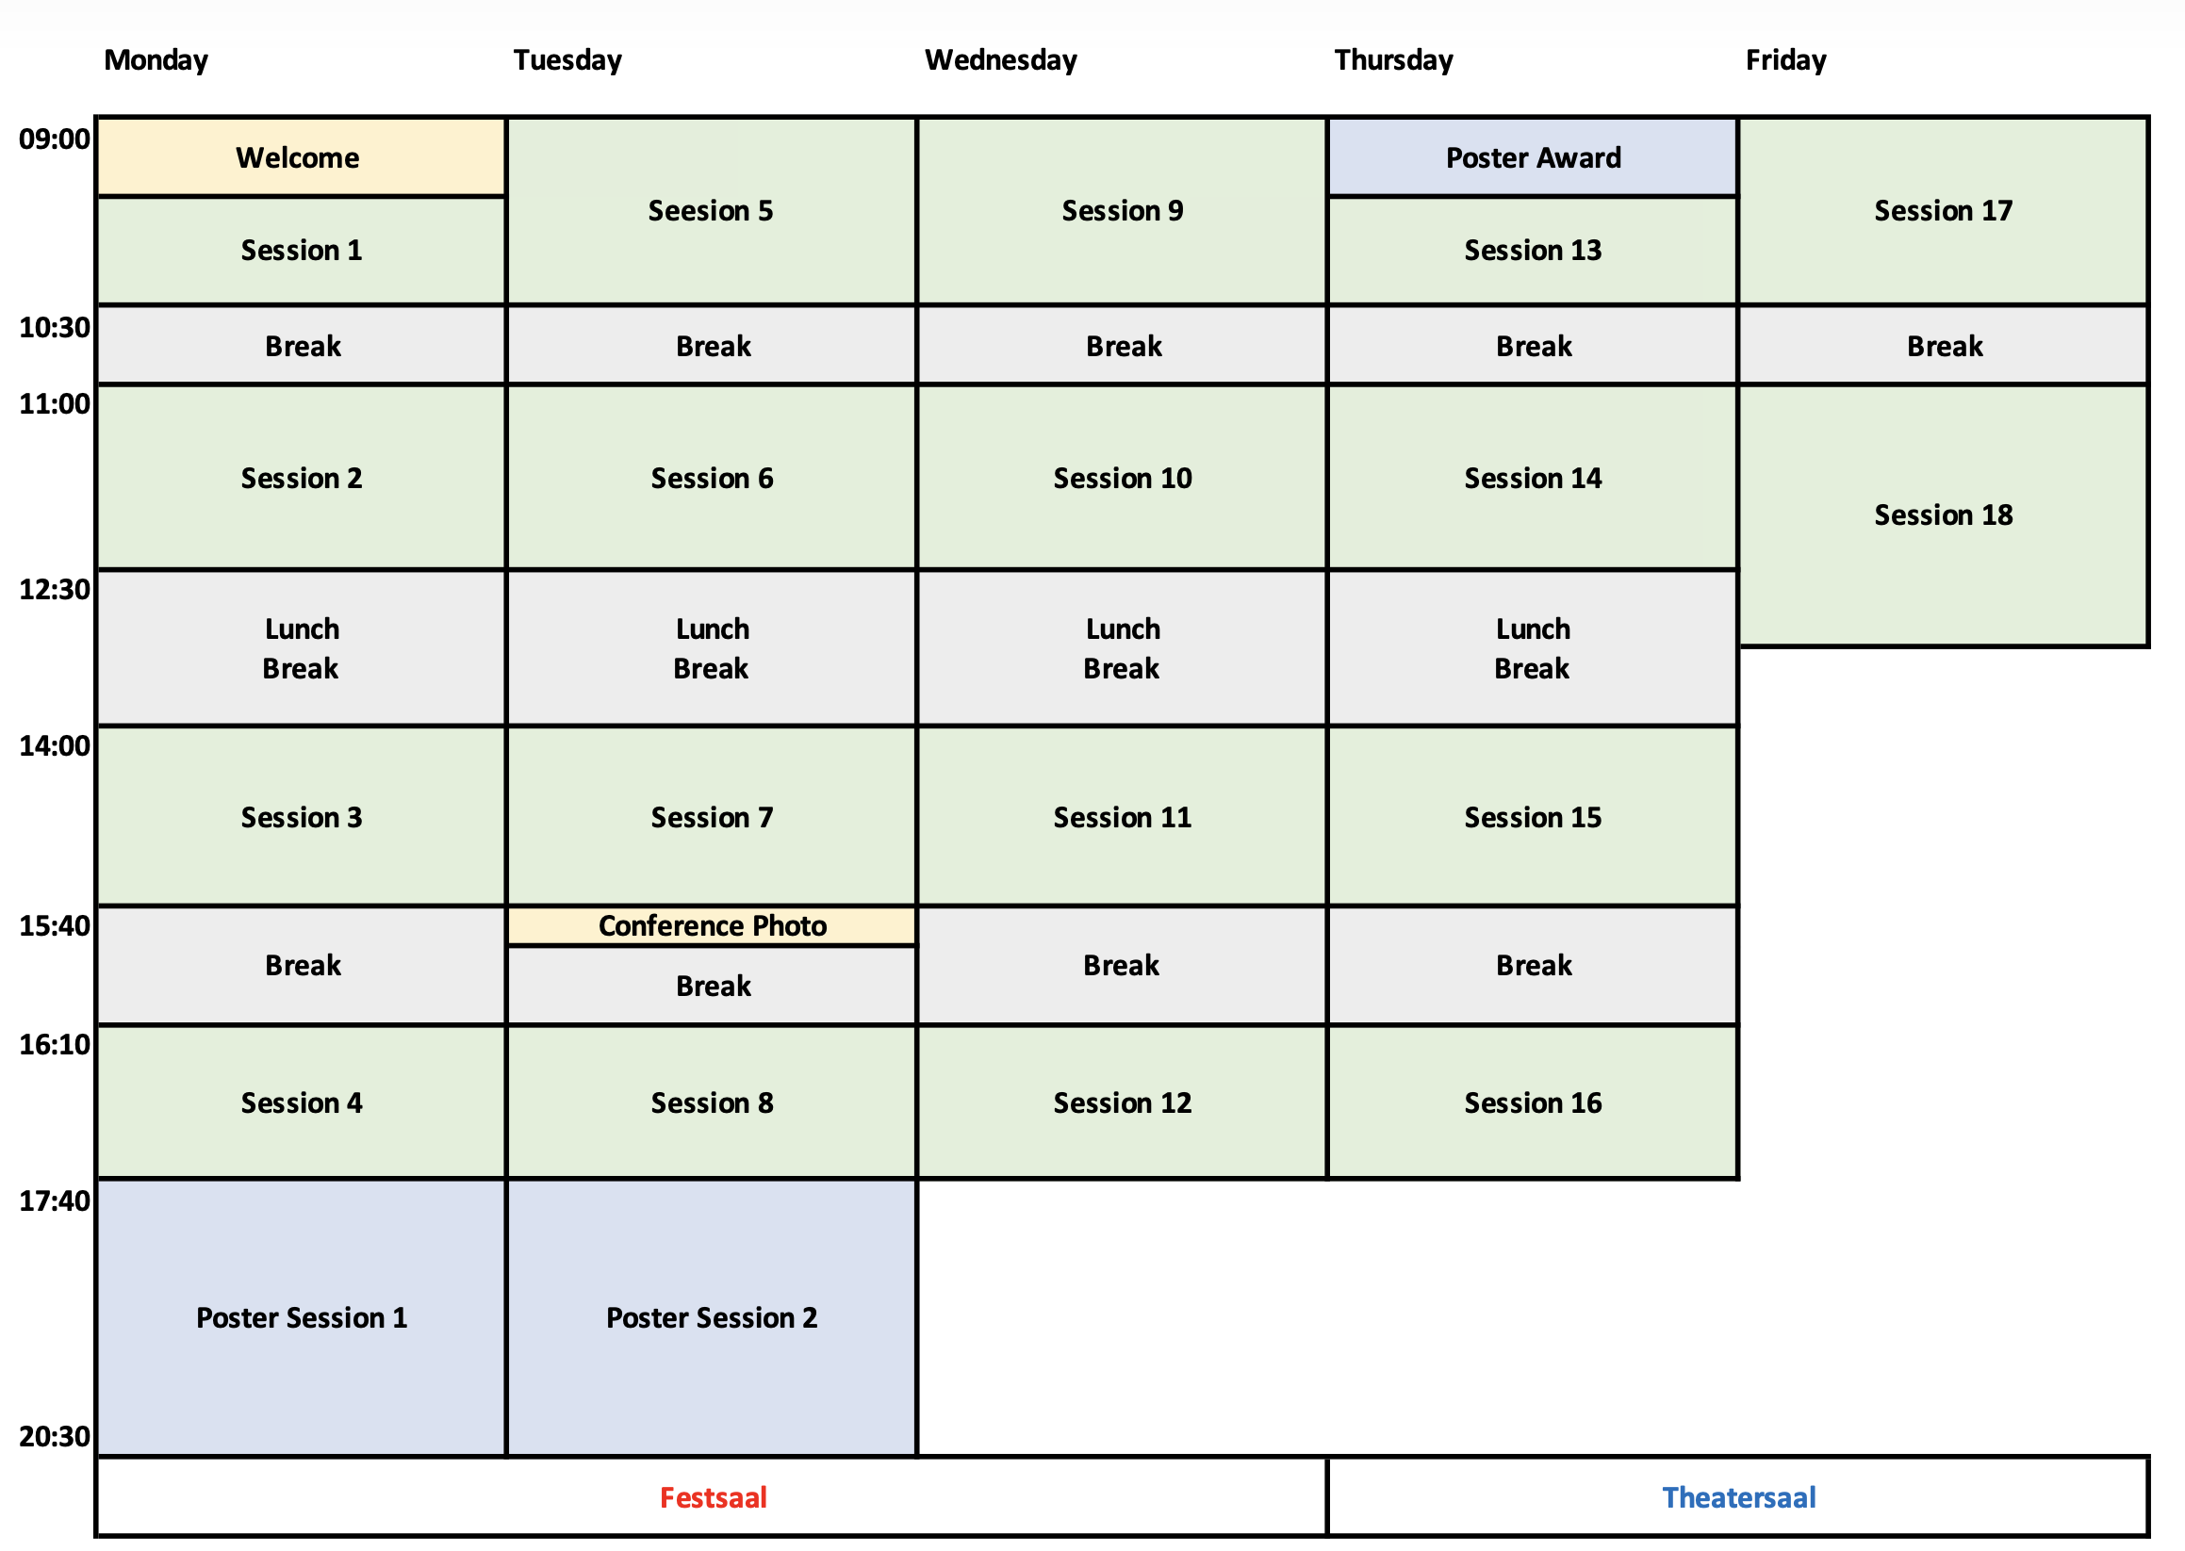
PSAS2026
  13th version of the conference
    >120 participants registered
    47 posters
    PSAS2018, FFK2023 organised in Vienna
  Program
    Mo – We in Festsaal
    Thu, Fri in Theatersaal (Sonnenfelsgasse 2nd floor)
  Poster sessions
    Mo, Tu 17:40 – 20:20, Aula (1st floor)
    With refreshments
    Poster prize award Thu 9:00
  Conference Photo
    Tu 15:40 before afternoon coffee break
  Photos will be taken during poster sessions.

Slide 5
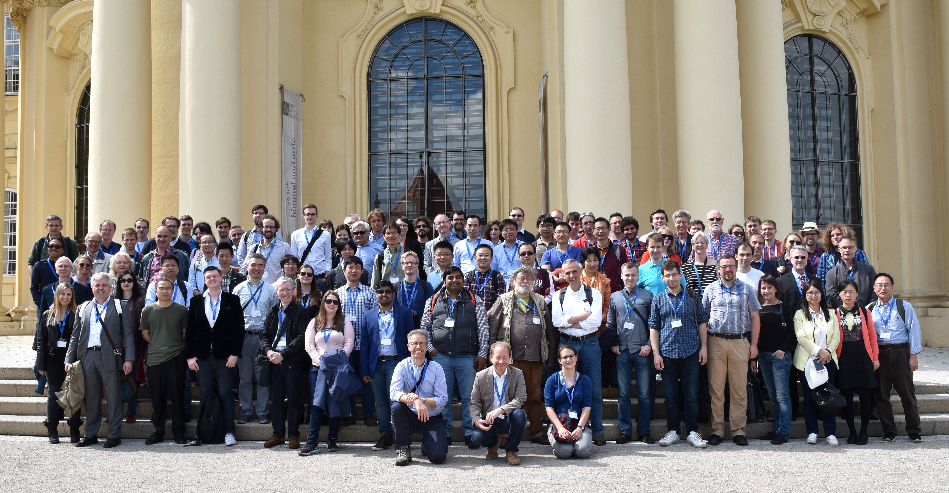

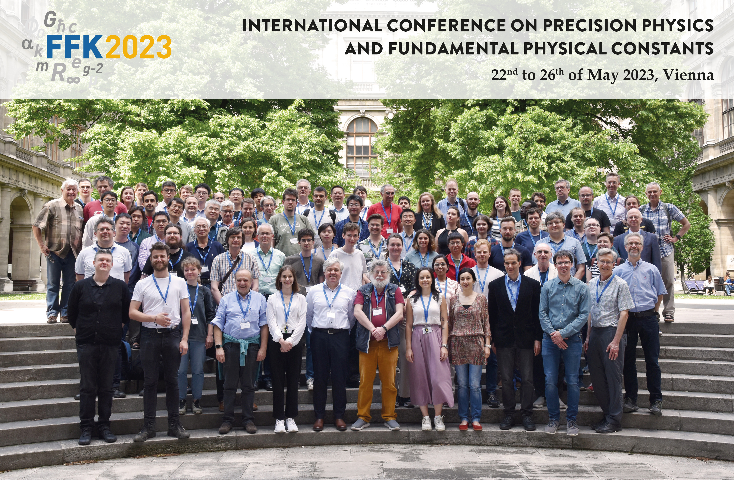
PSAS2026 Organisation
  Program
    On indico, talks should be uploaded
    https://indico.global/e/psas2026
  Conference desk & cloak
    Mo – We main building
    Thu, Fri Sonnenfelsgasse 1st floor
  Coffee breaks
    Mo – We Aula (ground floor)
    Thu, Fri Sonnenfelsgasse ground floor
  Lunch
    List of restaurants and cafes on indico
  Questions ➝ conference desk

