Slide 1
Multipole blackbody radiation shift
in Rydberg states of hydrogen
Robert Potvliege
Physics Department, Durham University, UK
arXiv preprint 2605.16100

Slide 2
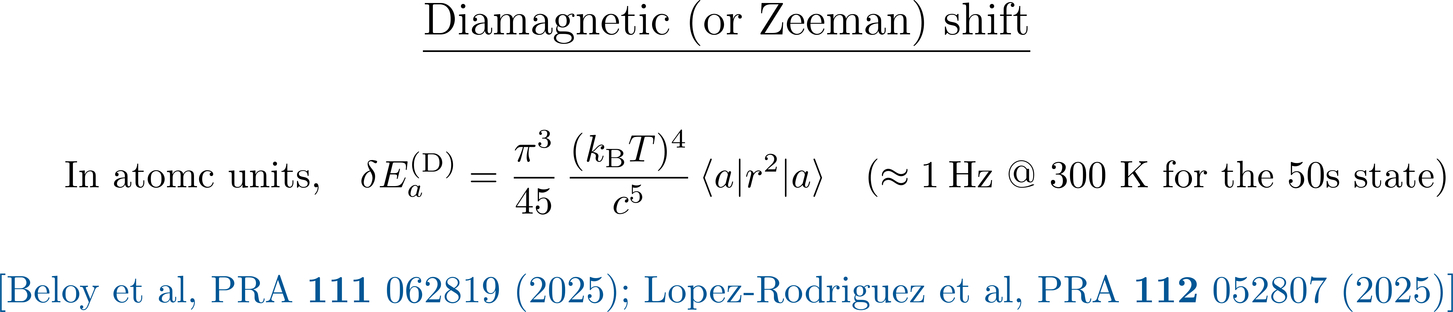
BBR shift beyond the electric dipole approximation

Slide 3
BBR shift beyond the electric dipole approximation

Slide 4
Farley and Wing (1981)
Jentschura and Haas (2008) “Reexamining blackbody shifts for hydrogenlike ions”
  Phys. Rev. A 78 042504
Amit et al (2026) “Control of the blackbody radiation shift in hydrogen and hydrogen-like optical computable clocks using a magic temperature”
  Metrologia 63 025009

Slide 5
Farley and Wing (1981)
Jentschura and Haas (2008) “Reexamining blackbody shifts for hydrogenlike ions”
  Phys. Rev. A 78 042504
Amit et al (2026) “Control of the blackbody radiation shift in hydrogen and hydrogen-like optical computable clocks using a magic temperature”
  Metrologia 63 025009
Zalialiutdinov, Anikin and Soloviev (2022) “Thermally induced Stark shifts of highly excited states of hydrogen atom”
  JETP 135 605

Slide 6
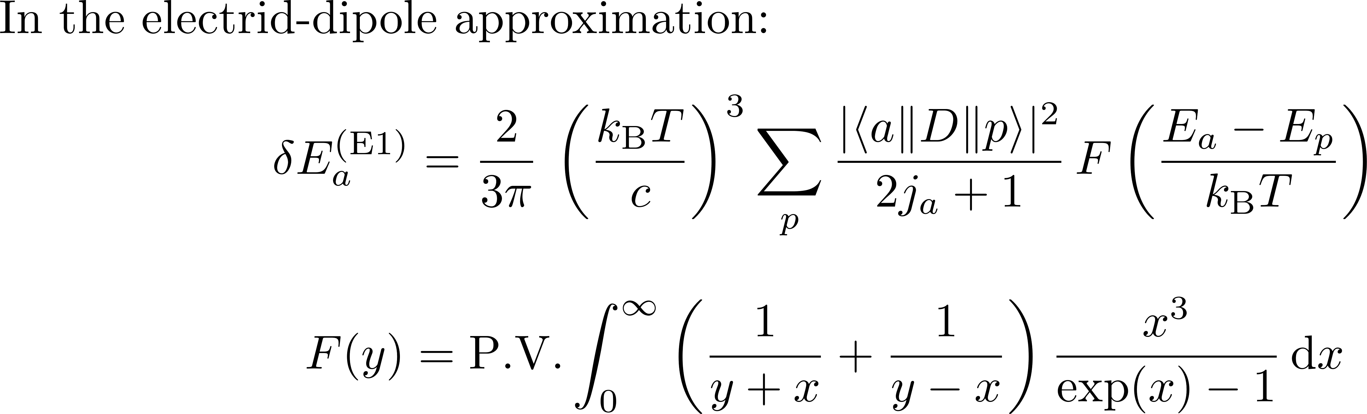
Farley and Wing (1981)

Slide 7
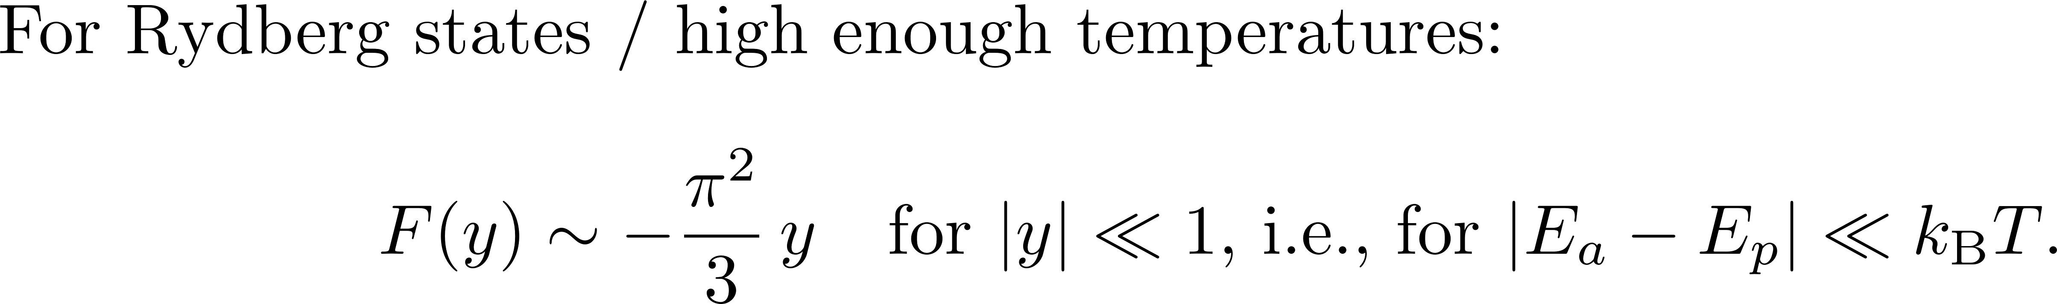
Farley and Wing (1981)

Slide 8
Farley and Wing (1981)

Slide 9
Farley and Wing (1981)

Slide 10
Farley and Wing (1981)

Slide 11
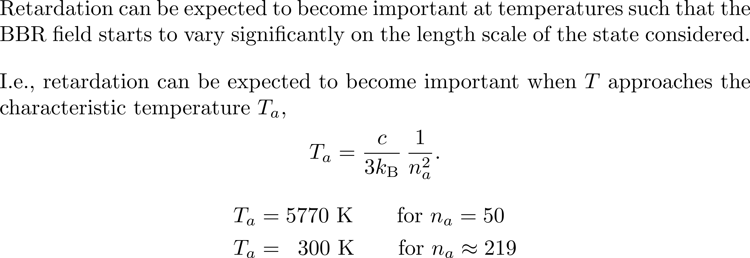
Farley and Wing (1981)

Slide 12
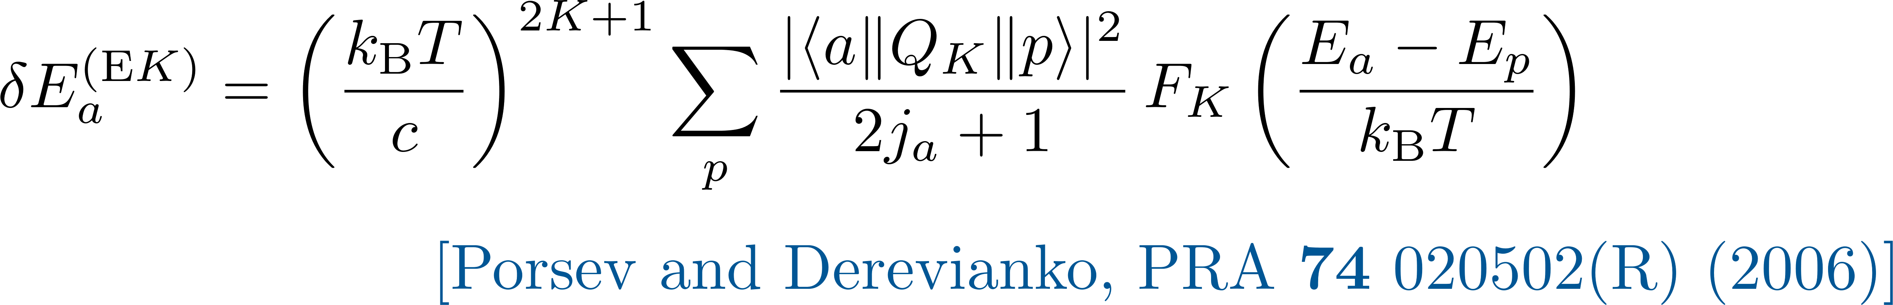
Calculation of electric multipole shifts

Slide 13
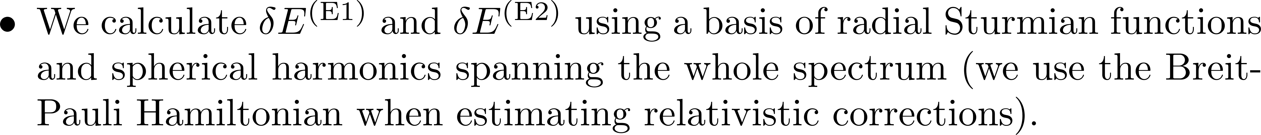
Calculation of electric multipole shifts

Slide 14
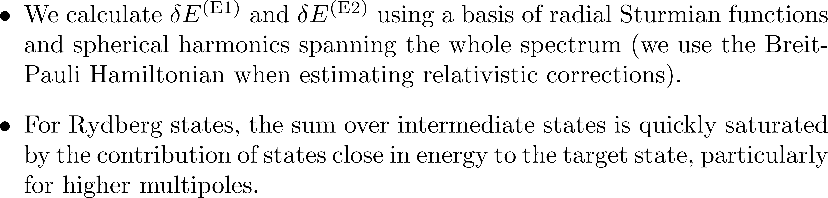
Calculation of electric multipole shifts

Slide 15
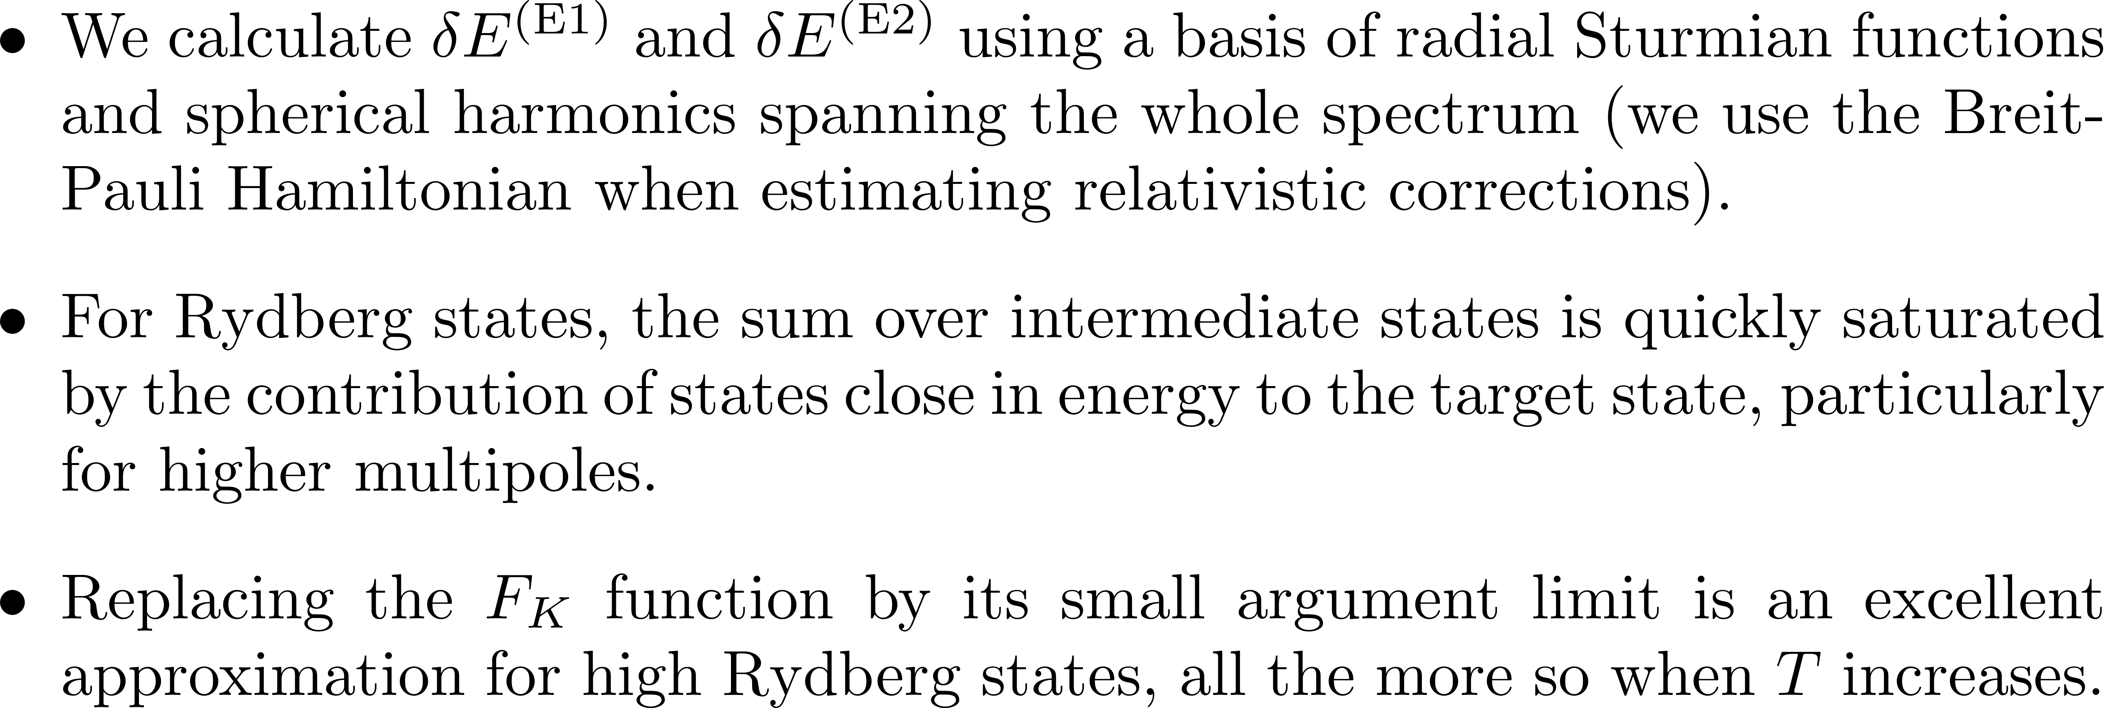
Calculation of electric multipole shifts

Slide 16
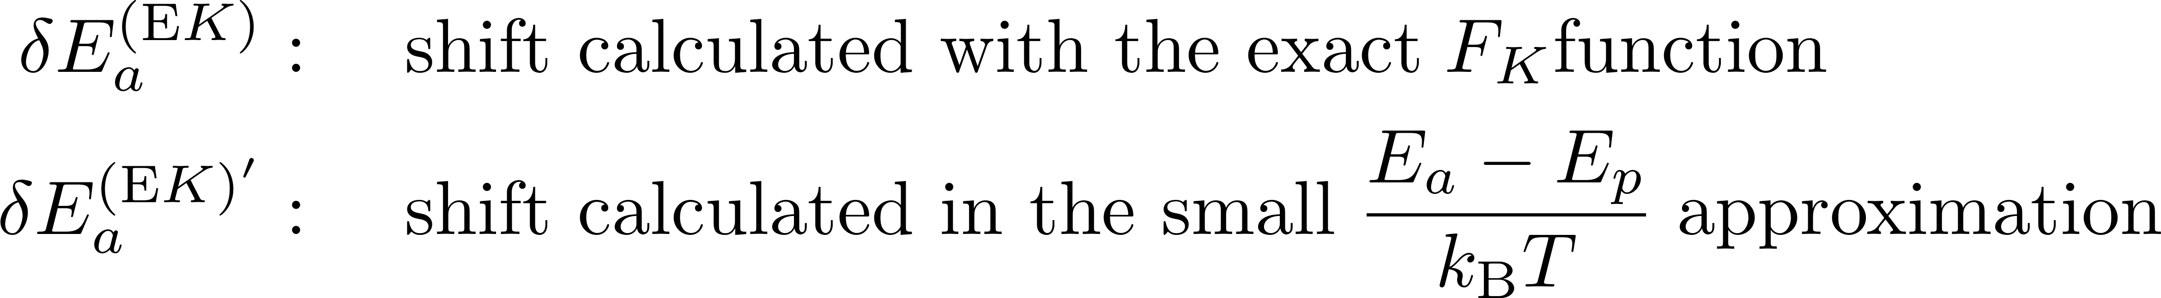
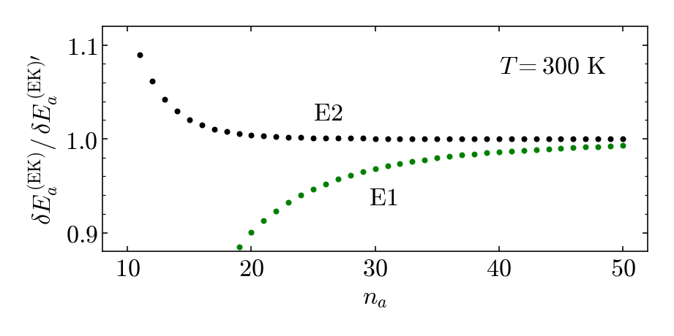
Large n approximation

Slide 17
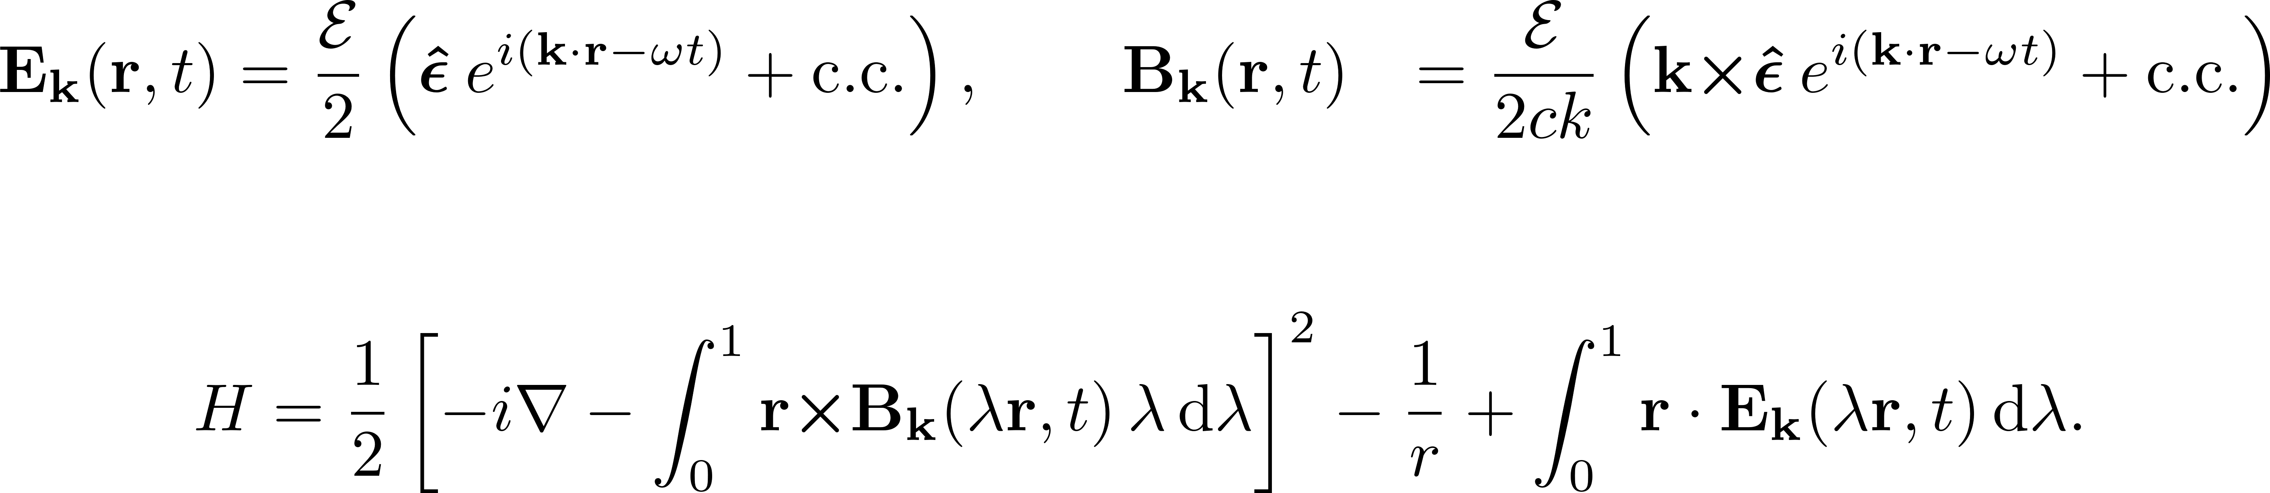
Calculations in the Power-Zienau-Woolley gauge

Slide 18

Calculations in the Power-Zienau-Woolley gauge
Electric shift
Paramagnetic shift
Diamagnetic shift

Slide 19
Calculations in the Power-Zienau-Woolley gauge
Electric shift
Paramagnetic shift
Diamagnetic shift

Slide 20
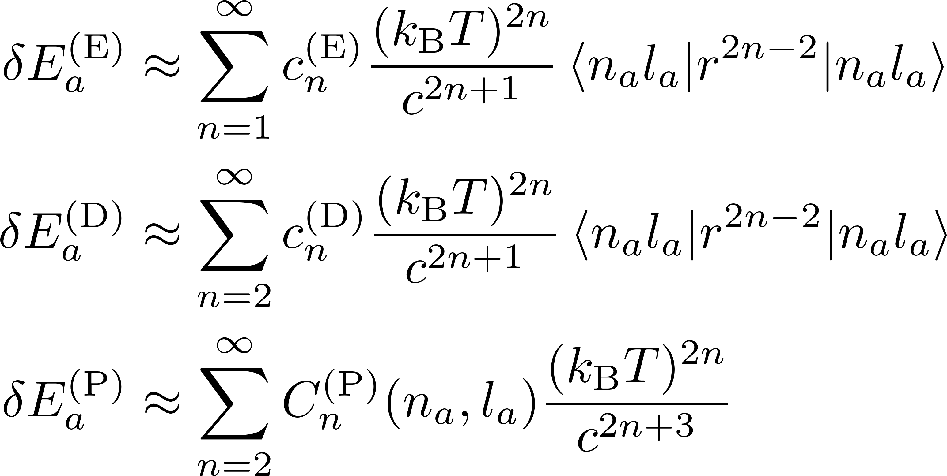
Results

Slide 21
Results

Slide 22
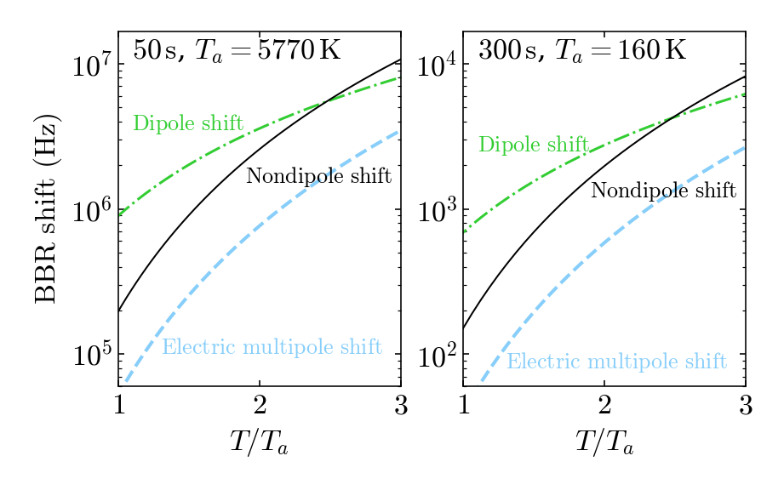
Results

Slide 23
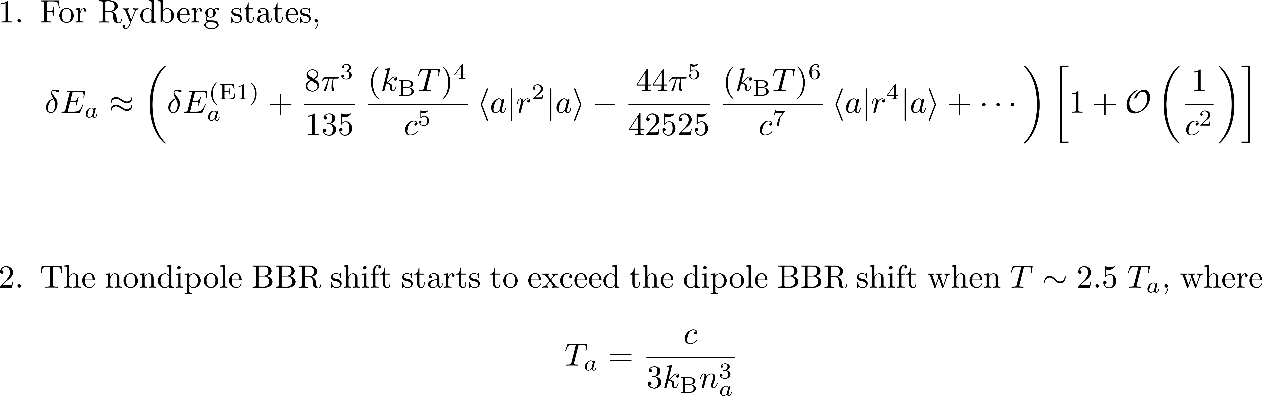
Conclusions
arXiv preprint 2605.16100

Slide 24
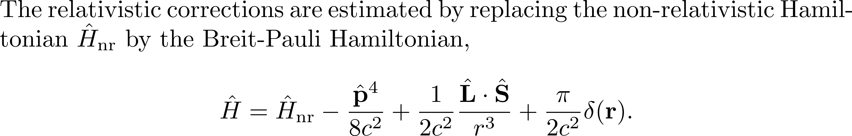
Relativistic corrections

Slide 25
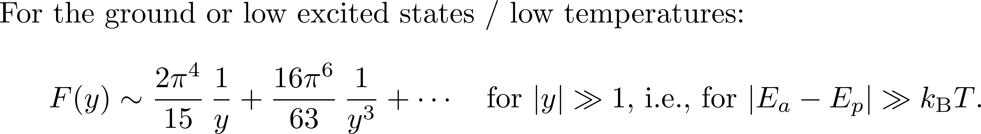
Farley and Wing (1981)

Slide 26

Farley and Wing (1981)

