Slide 1
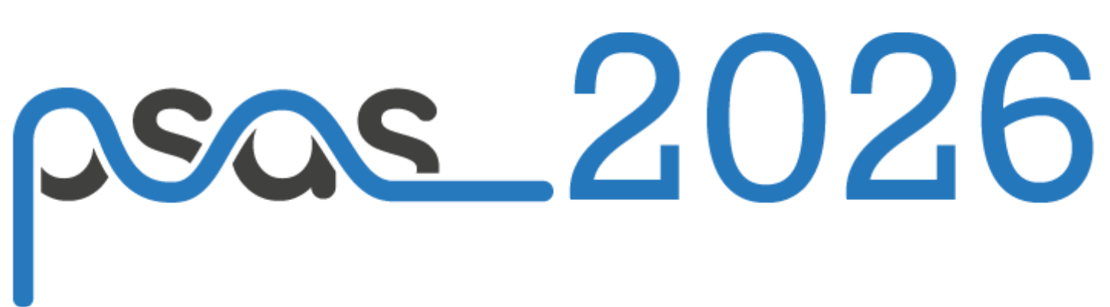

Molecular deceleration via vibrational coherent bichromatic force
Meng-Yi Yu, Cun-Feng Cheng, Shui-Ming Hu
Hefei National Research Center for Physical Sciences at the Microscale
University of Science and Technology of China
Hefei 230026, China
2026.05.21

Slide 2
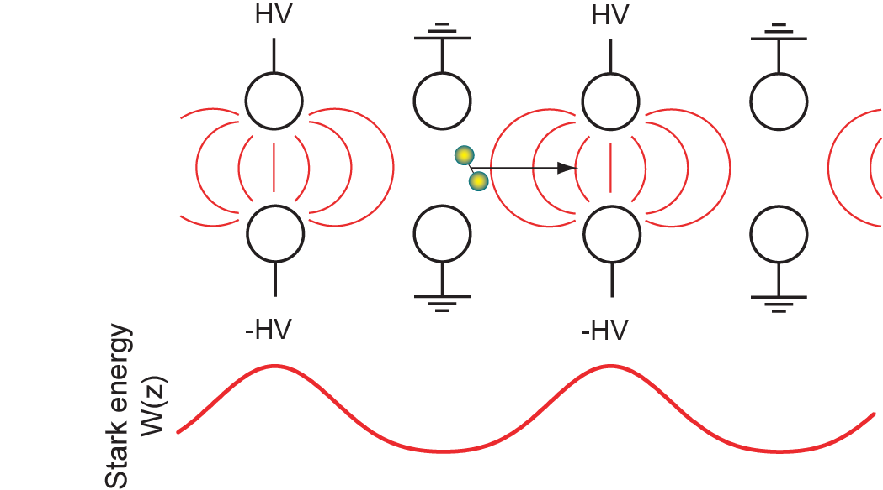
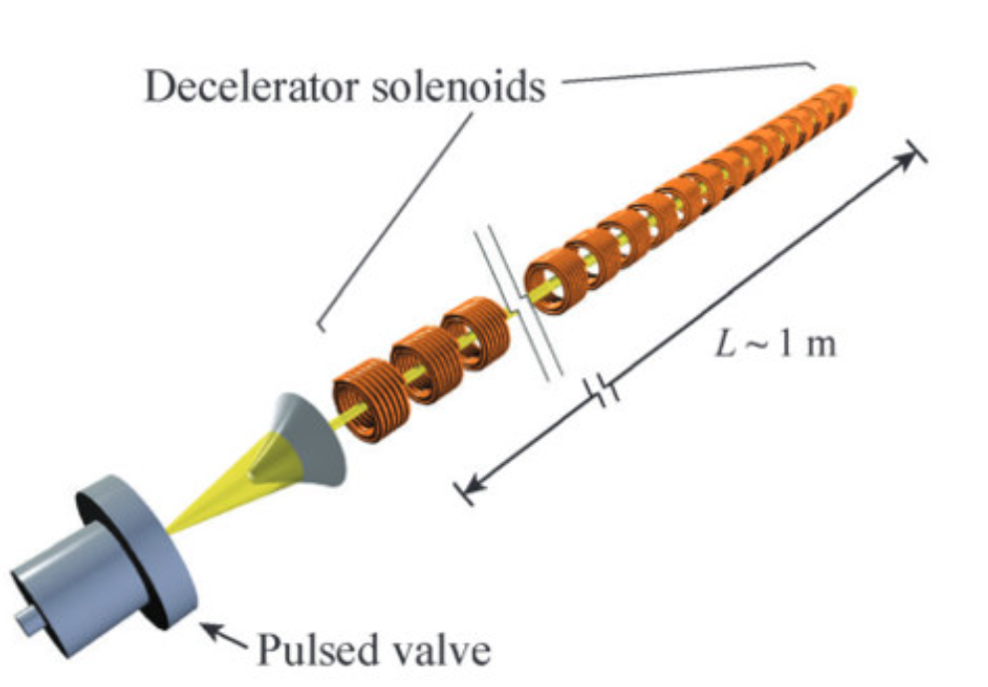
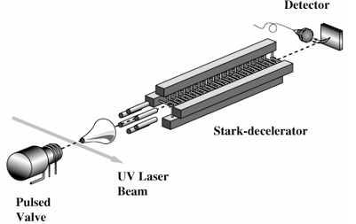
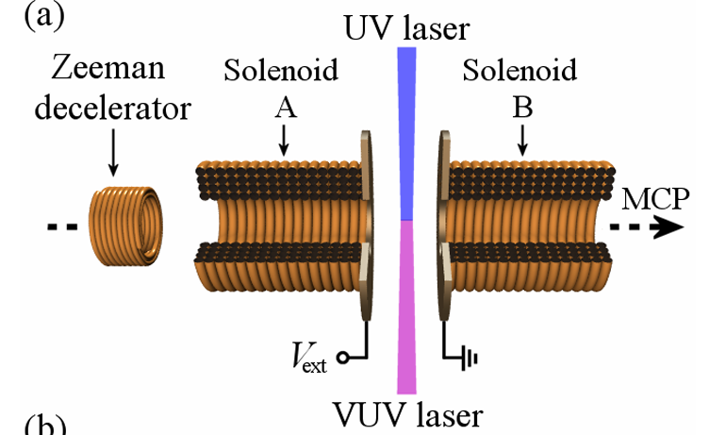
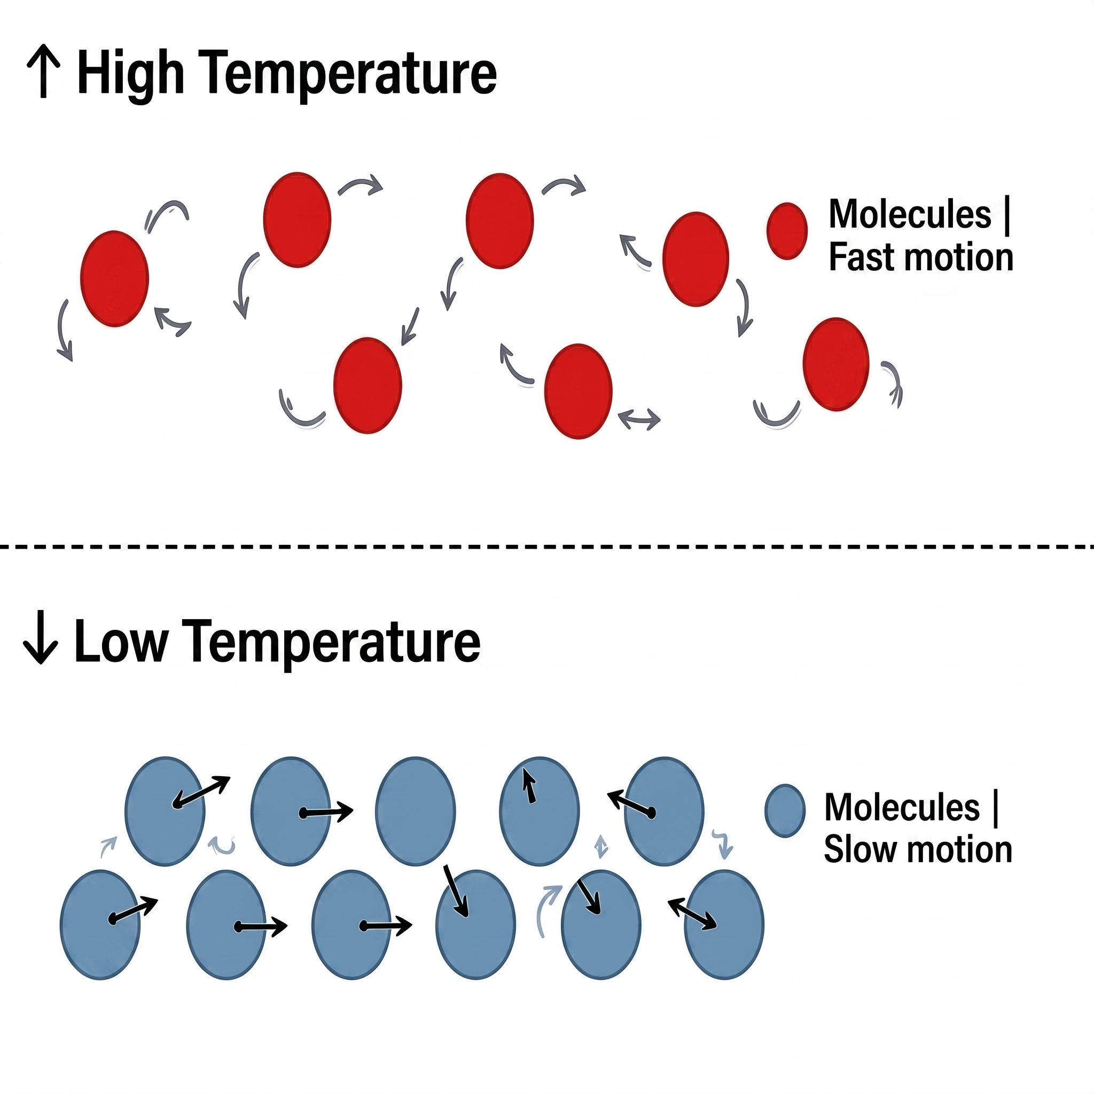
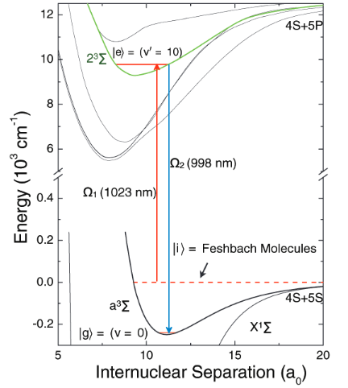
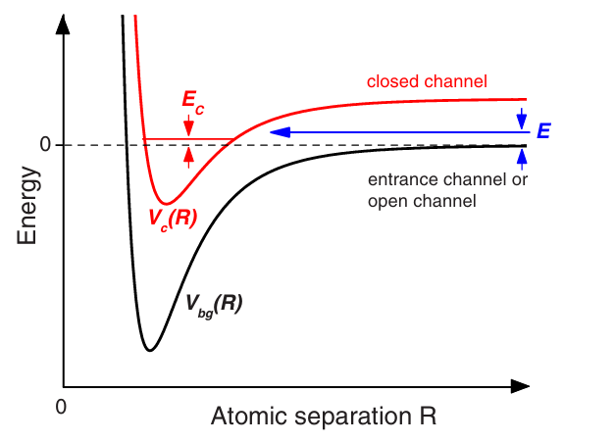
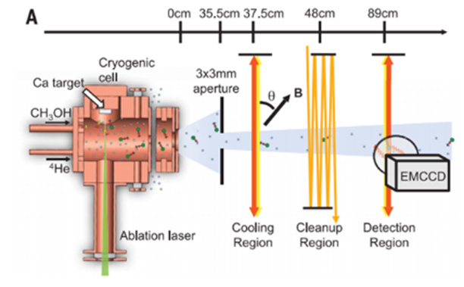
The generation of Cold molecules
Stark deceleration
Zeeman deceleration
Phys. Rev. Lett. 83, 1558-1561 (1999)
Phys. Rev. Lett. 101, 143001 (2008)
Feshbach Resonances
Direct Laser Cooling
Science 322.5899:231-235 (2008)
Reviews of Modern Physics, 82(2), 1225-1286(2010)
Science 369.6509: 1366-1369(2020)

Slide 3

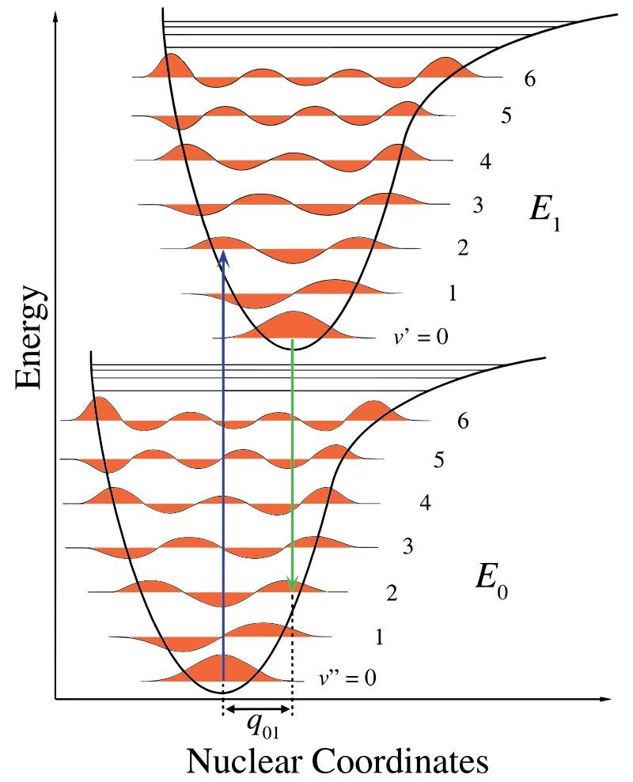
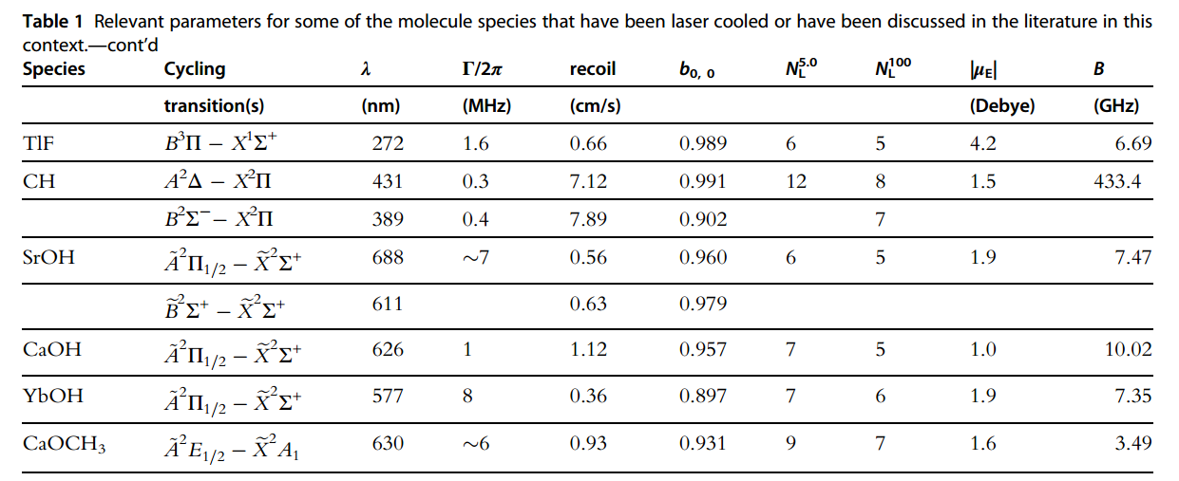
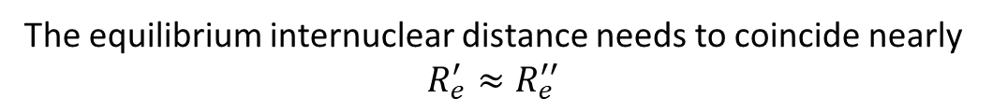
The FCFs Limitation
The core requirement: Quasi-closed optical cycling transition
The equilibrium internuclear distance needs to coincide nearly $R_{e}^{′}≈R_{e}^{′′}$
Number of the Repump Lasers
Advances in Atomic, Molecular, and Optical Physics, 71, 1–86(2021).
How to break this Intrinsic Limitation ?

Slide 4
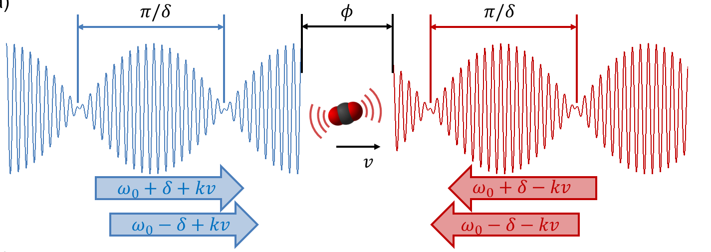
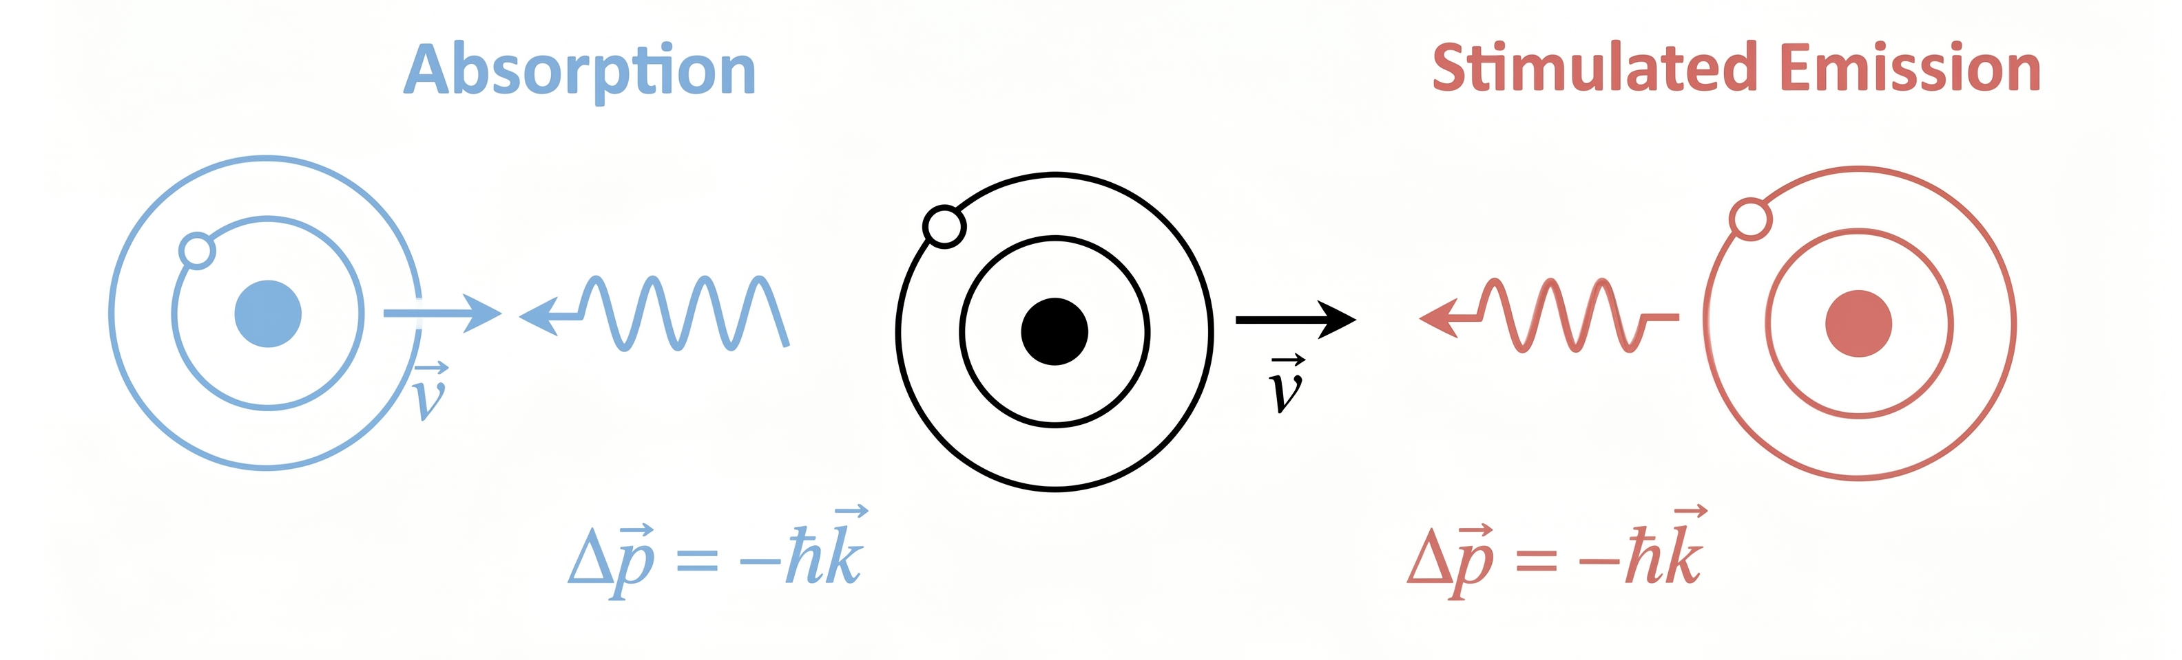
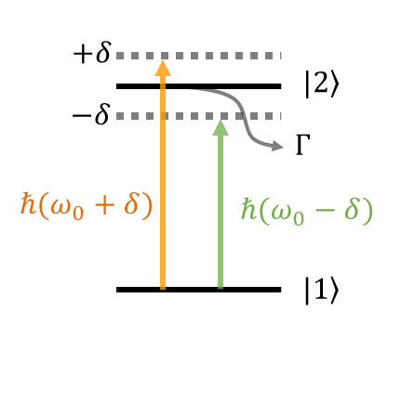



Momentum Transfer in Non-Dissipative Systems
Bichromatic Force (BCF)
Controllable momentum transfer
Key Factors:$φ=\frac{π}{2}, Ω_{0}=\sqrt{3/2} δ$
Vibrational Transition
VBCF : $\sqrt{Γ_{a}^{2}+Γ_{c}^{2}}≪Ω_{12}$
Demonstration: ¹³CO₂
Decoherence rate: ∼10$−$10² s⁻¹
R(0) (00011)–(00001)
A: 125.7 s⁻¹
k: 2284.261644 cm⁻¹ (4377nm)
Non-Dissipative Process

Slide 5

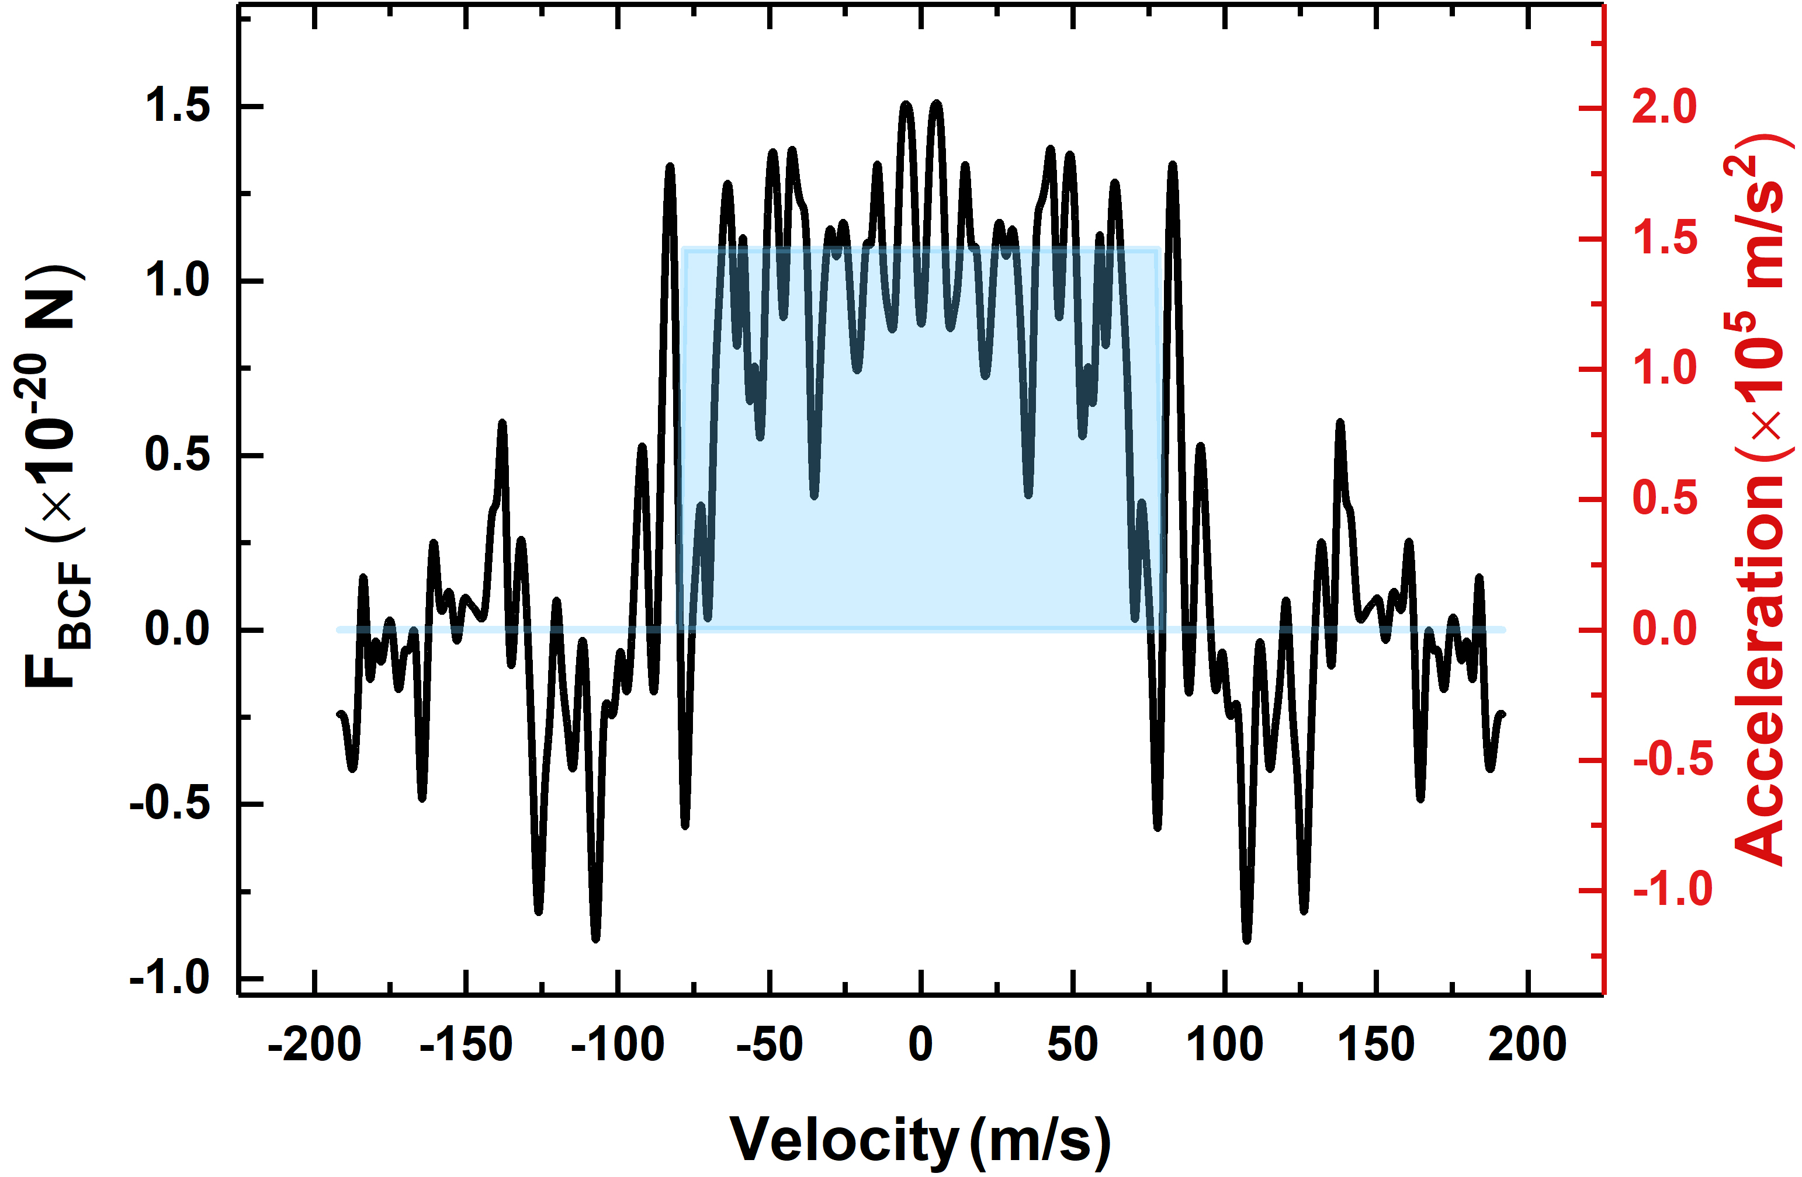




Action of the VBCF
The Optical Bloch Evolution of VBCF
Expected VBCF Profile
$$F_{BCF}=\frac{ℏkδ}{π}$$
$${Δv}_{c}=δ/k$$
Periodic momentum accumulation
Peak Acceleration: $\sim 1.45×{10}^{5} {m/s}^{2}$
Capture Range: -65 to 65 $m/s$
Unexpected VBCF Profiles
How to maintain the robustness ?

Slide 6
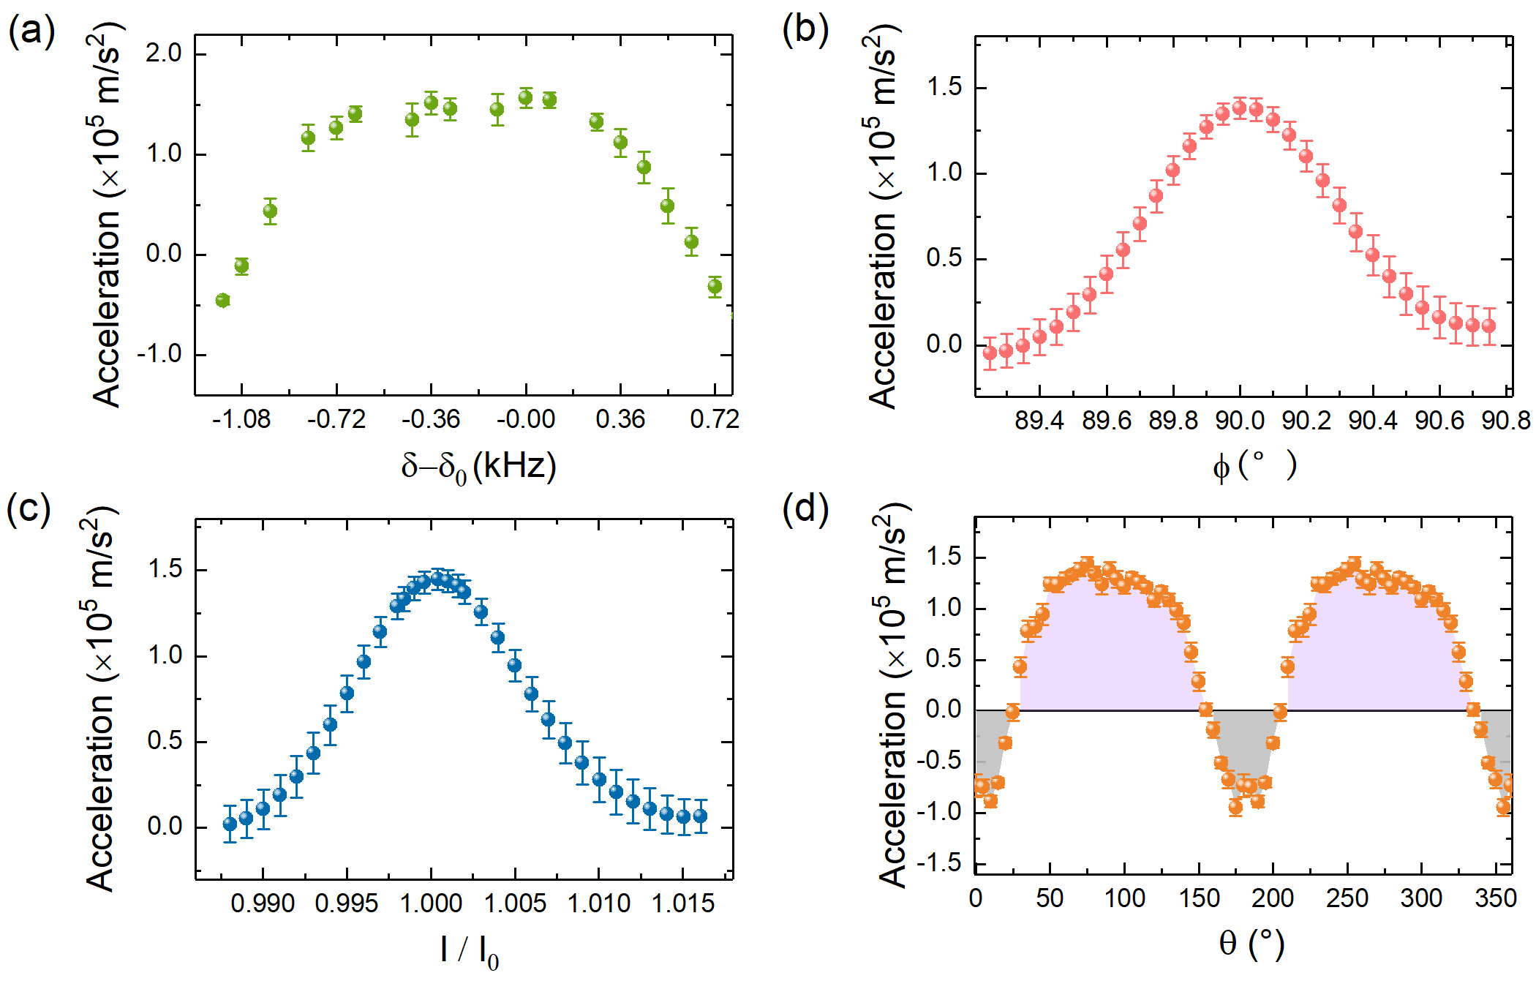










Robustness of the VBCF
$$Ω_{ij}=4Ω_{ij}^{0}(\cos\left(kz\right)\cos\left(δt+θ\right)\cos\left(φ/4\right)+isin\left(kz\right)\sin\left(δt+θ\right)sin⁡\left(φ/4\right)$$
$$δ$$
$$φ$$
$$δ_{0}=2π×36 MHz$$
Deviation control range: $Δφ<0.4°$
Deviation control range: $Δδ<1.3 kHz$
Equivalent path deviation: $ΔL<2.3mm$
$$I_{0}=302.8 W/{cm}^{2}$$
$$Ω_{ij}^{0}∝\sqrt{I_{0}}$$
$$θ$$
297𝑚𝑊 laser
Focus to 0.5mm diameter
Expected proportion
Deviation control range: ${ΔI/I}_{0}<1\%$
Equivalent contribution: 2/3 population
Notes:
(297$mW$ laser & 0.5mm diameter）

Slide 7
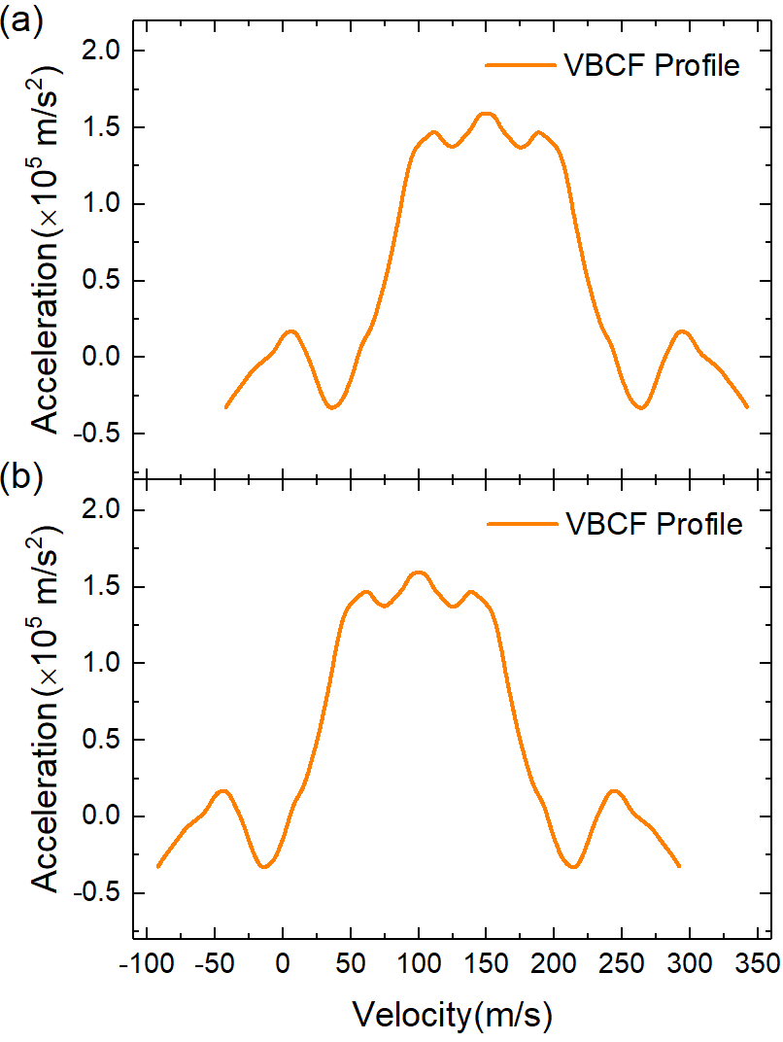
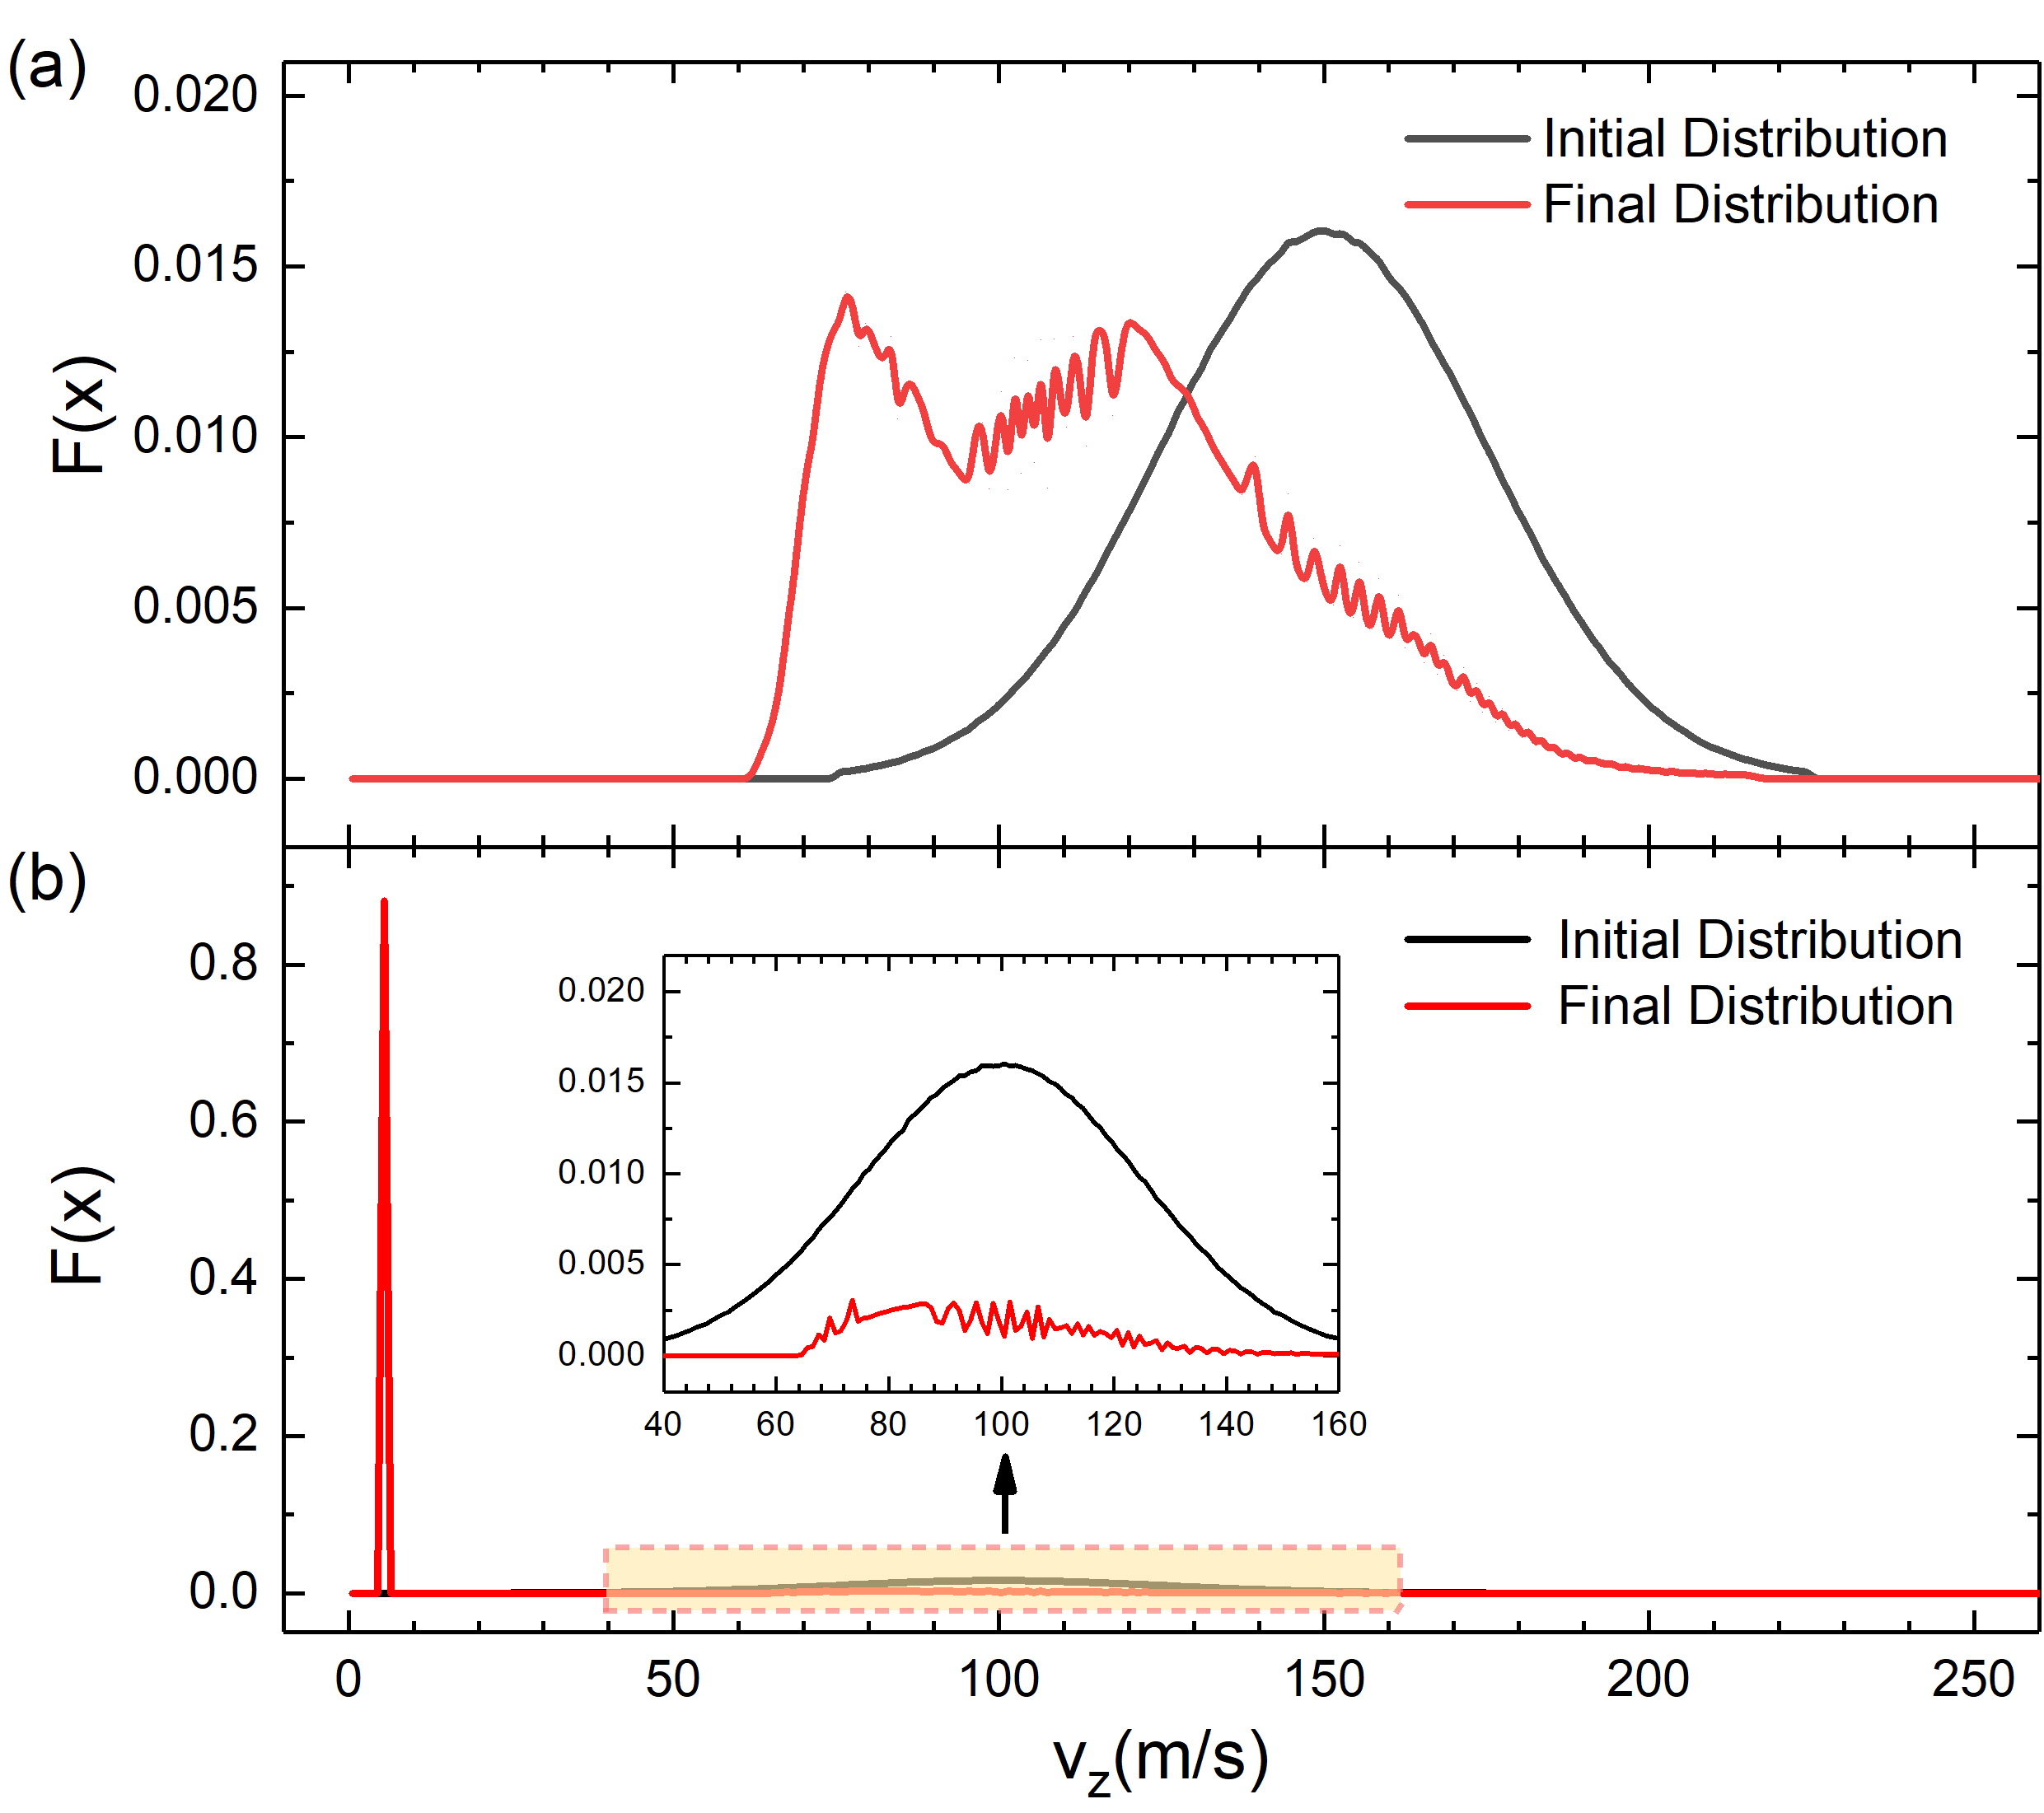
Effectiveness of VBCF
Averaged VBCF Profile
Longitudinal direction vz simulation
77m/s
150m/s
Deceleration
Distance: 28mm
Velocity Bunching
55 m/s to 245 m/s
5.7m/s
100m/s
5 m/s to 195 m/s

Slide 8
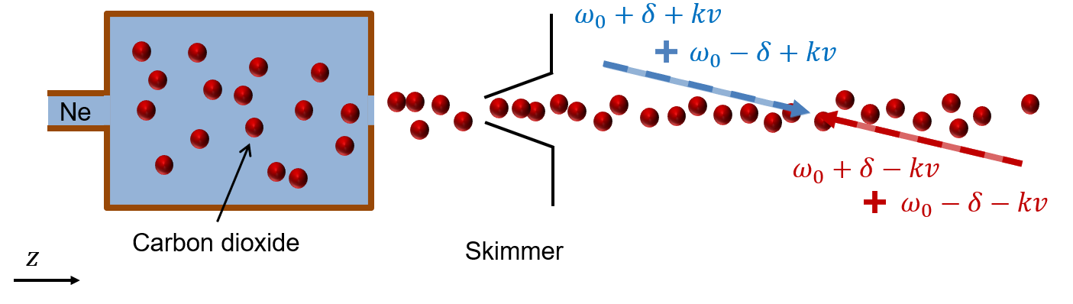
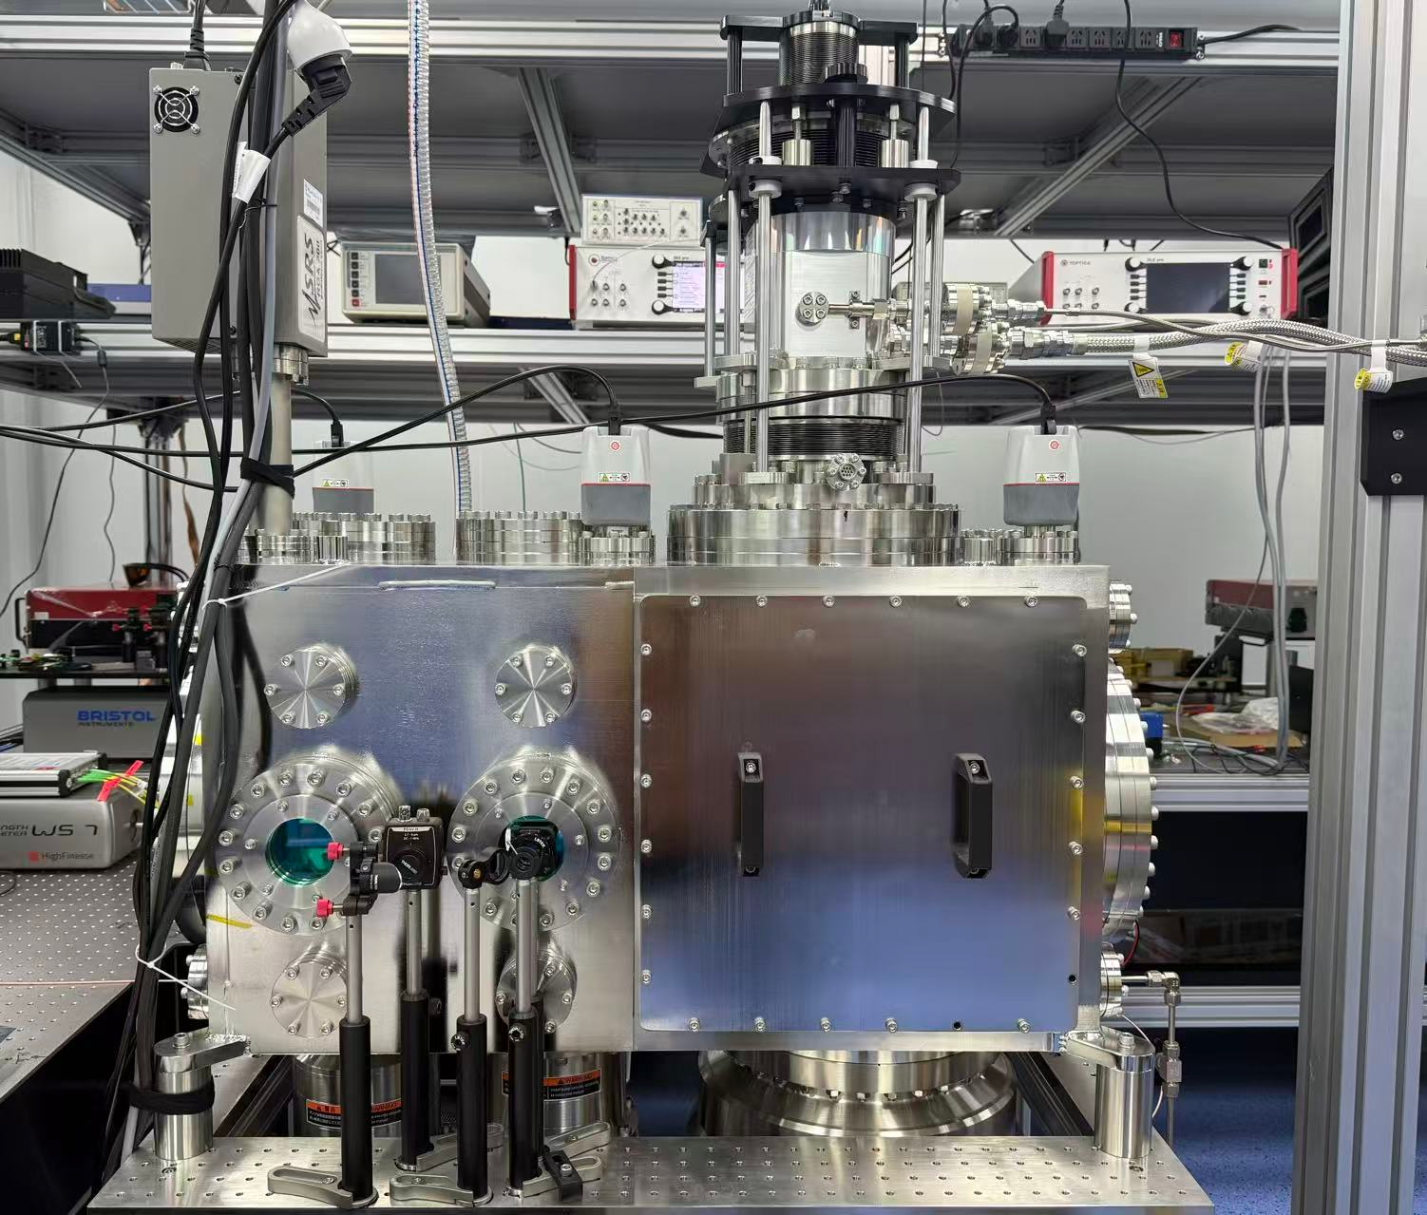
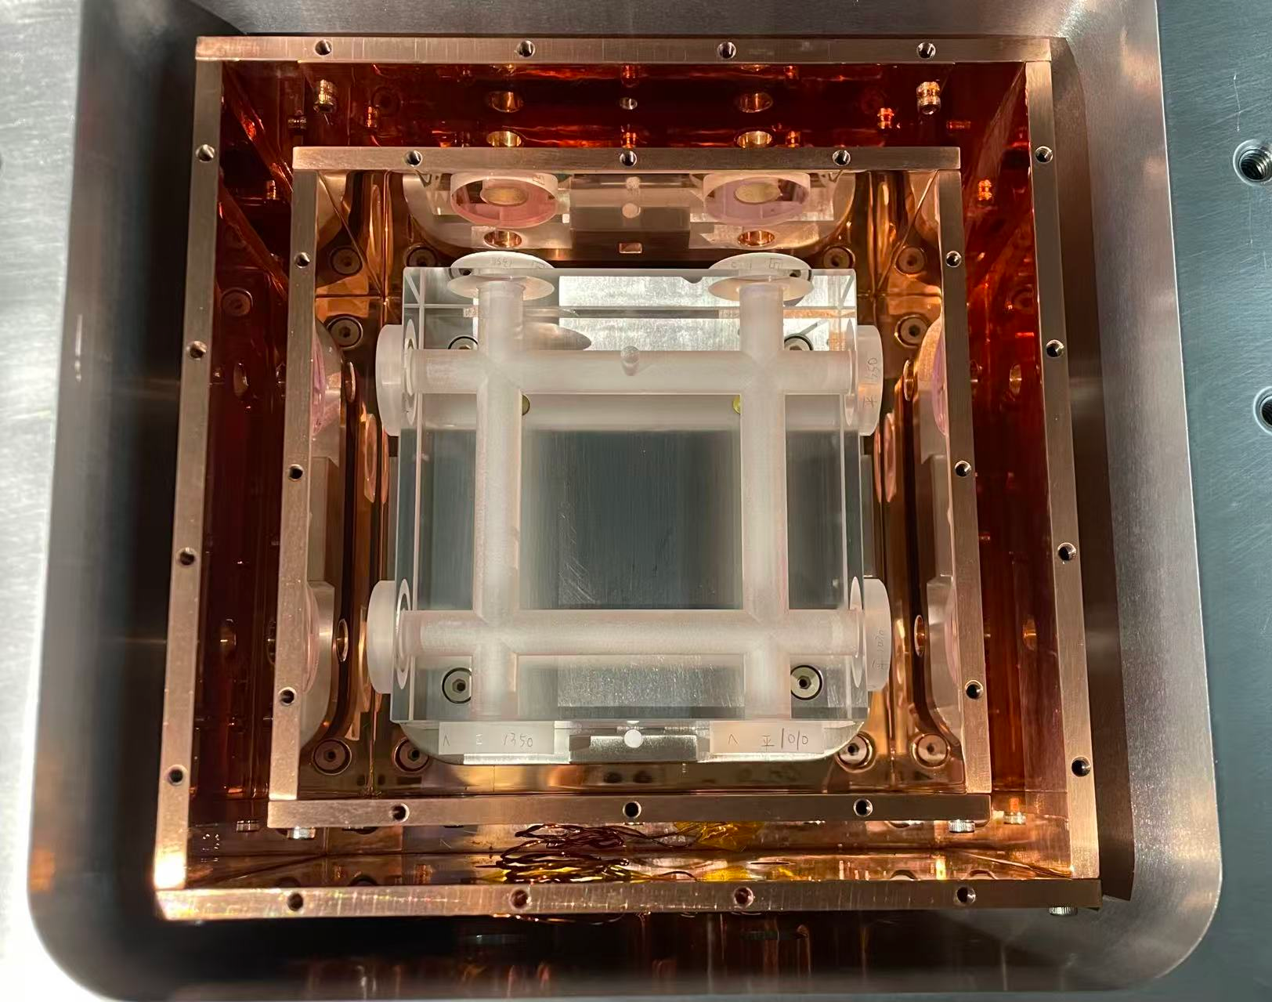
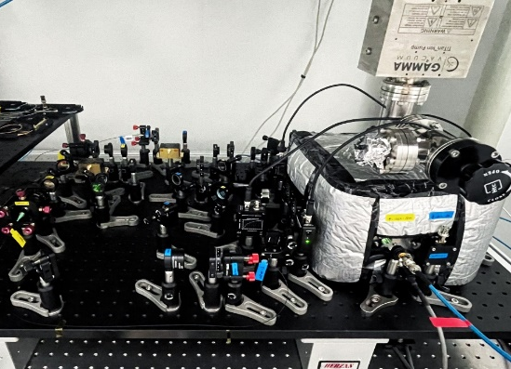
Experimental Concept
Experimental schematic of the VBCF deceleration
1°
Deceleration Distance: 28mm
Beam Source
Deceleration Region
Experimental apparatus
Laser stabilization system
ULE Cavity
PDH Lock
Beam source inside
Multiple laser beams locked simultaneously

Slide 9
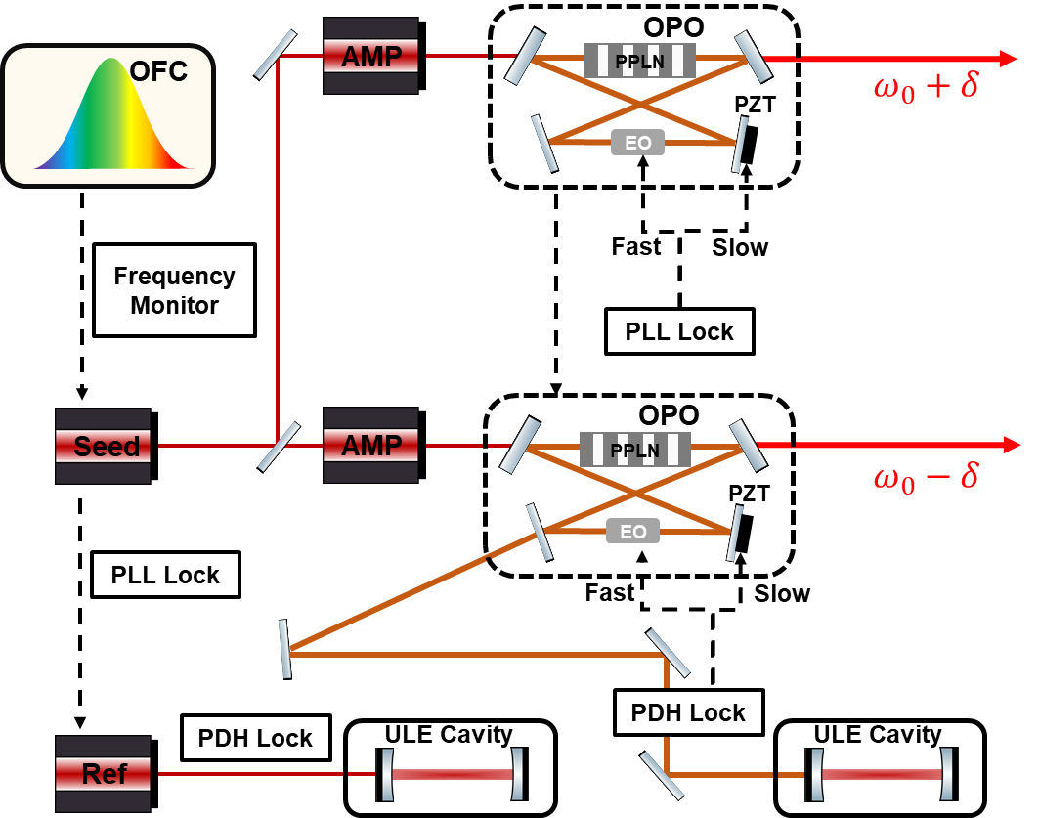



High-performance Light Source: CW-OPO
Homemade Continuous-Wave Optical Parametric Oscillator (CW-OPO)
Optical design for VBCF beat note
High-precision Phase Lock
Performance Test
Wavelength coverage: $2.6−4.4 μm$
Piezoelectric transducer (PZT): ~10 kHz
Long-term stabilization
Output power: 0.1$−2 W$
Intra-cavity Electro-optic (EO) crystal: ~5 MHz
Phase corrections
Linewidth: $<10 kHz$

Slide 10
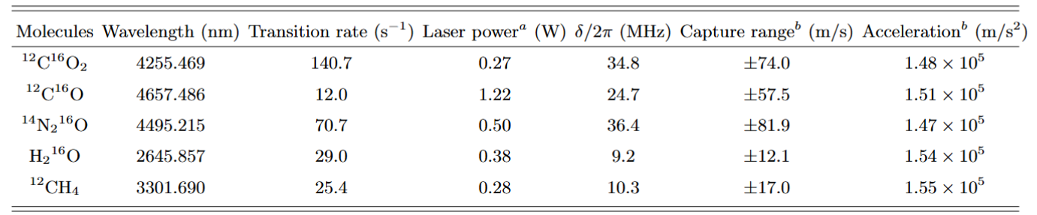
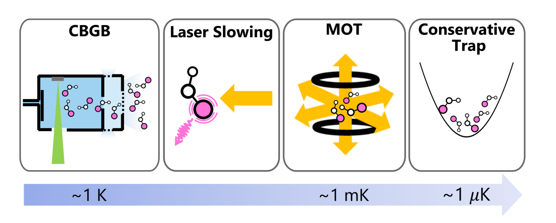
The Advantages of VBCF
(A). Break the limitations of FCFs
The spontaneous emission rate (∼10$−$10² s⁻¹ ) $≪$the VBCF cycling rate (∼10⁷ $−$10⁸ s⁻¹ )
Negligible population leakage over ∼10000 cycles
(B). Applicable to various molecular species
TABLE I. Calculated VBCF amplitude and acceleration of molecules and the laser power needed.
a. The laser power refers to the power of each beam, and the focusing diameter is set to 0.5 mm.
b. Estimated with the classical formulas.
(C). Possible to combine with other cold molecule technologies
ArXiv:
https://arxiv.org/abs/2605.19626

Slide 11
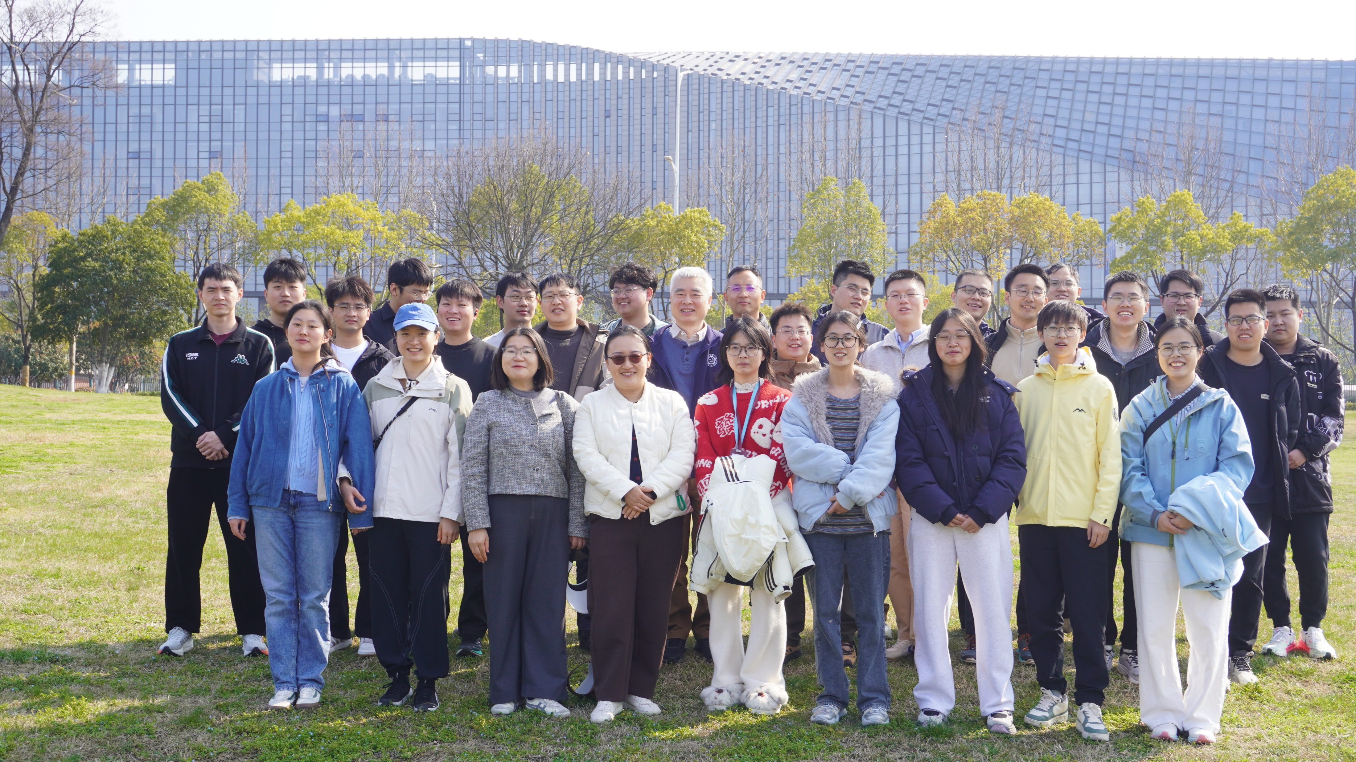


Thanks for your attention
Laser Laboratory for Trace Analysis and Precision Measurements
Collaboration: VU (Amsterdam, NL)
Wim Ubachs w.m.g.ubachs@vu.nl
Rick Bethlem h.l.bethlem@vu.nl
USTC (Hefei, China)
Shui-Ming Hu smhu@ustc.edu.cn
Cun-Feng Cheng cfcheng@ustc.edu.cn
Meng-Yi Yu myyu@mail.ustc.edu.cn
https://atta.ustc.edu.cn/zh-cn/index.html
THE CHINESE ACADEMY OF SCIENCES
NATIONAL NATURAL SCIENCE FOUNDATION OF CHINA

Slide 13
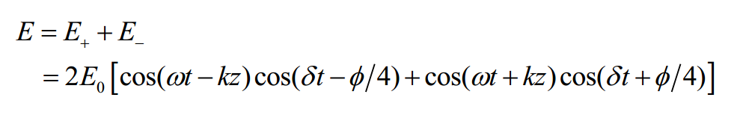
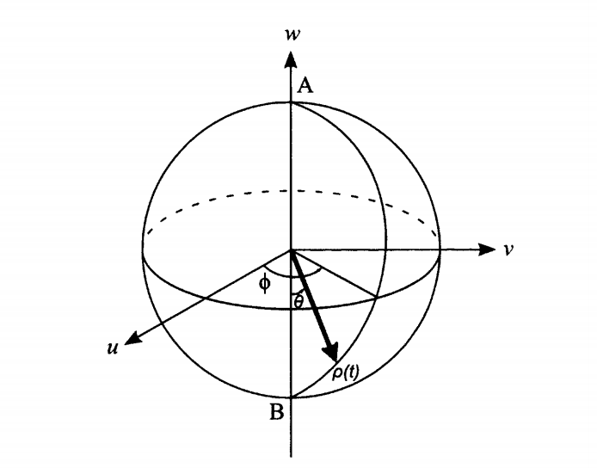
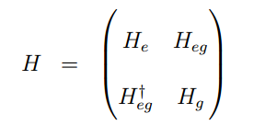
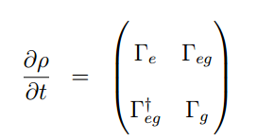

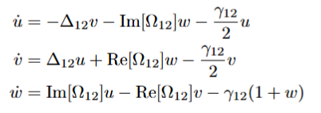



Numerical Calculation
Vibrational Bichromatic Force (VBCF)
Demonstration: ¹³CO₂
R(0) (00011)–(00001)
A: 125.7 s⁻¹
k: 2284.261644 cm⁻¹
Key Factors :$Ω_{0}=\sqrt{3/2} δ ; φ=π/2$
The Optical Bloch Equations (OBEs)
$π$ Pulse:
$$θ\left(t\right)=\int_{−π/2δ}^{+π/2δ}{2Ω_{r}\cos\left(δt\right)dt=π}$$
Numerical solution with OBEs:
$$F_{BCF}=\frac{ℏkδ}{π}$$

Slide 14
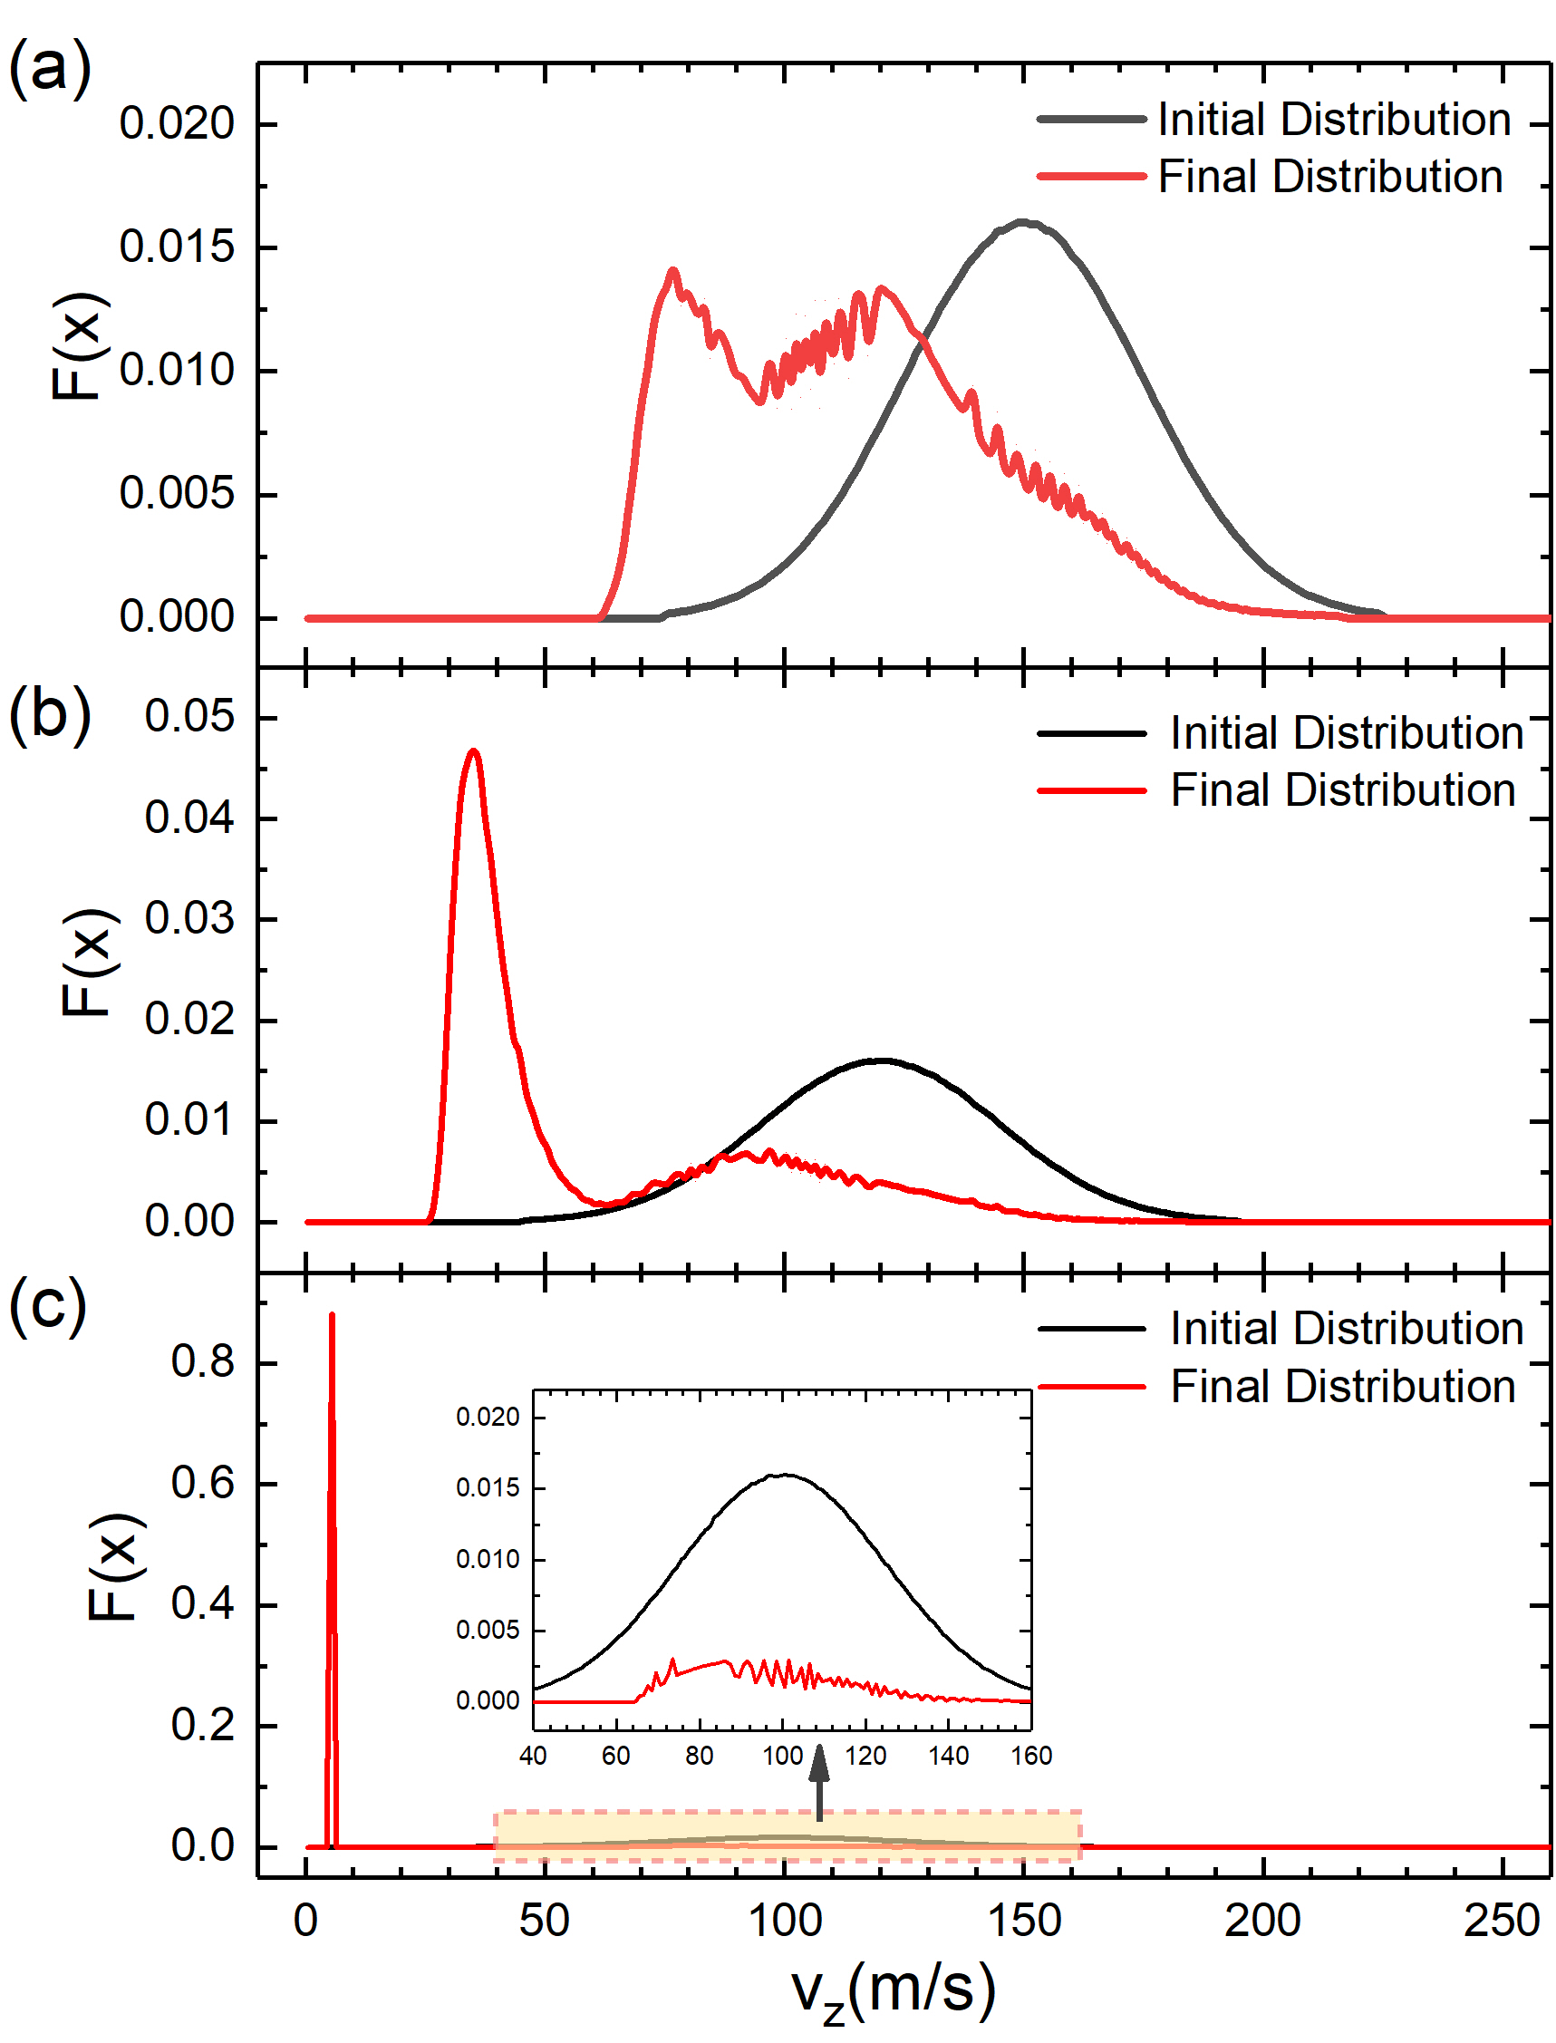
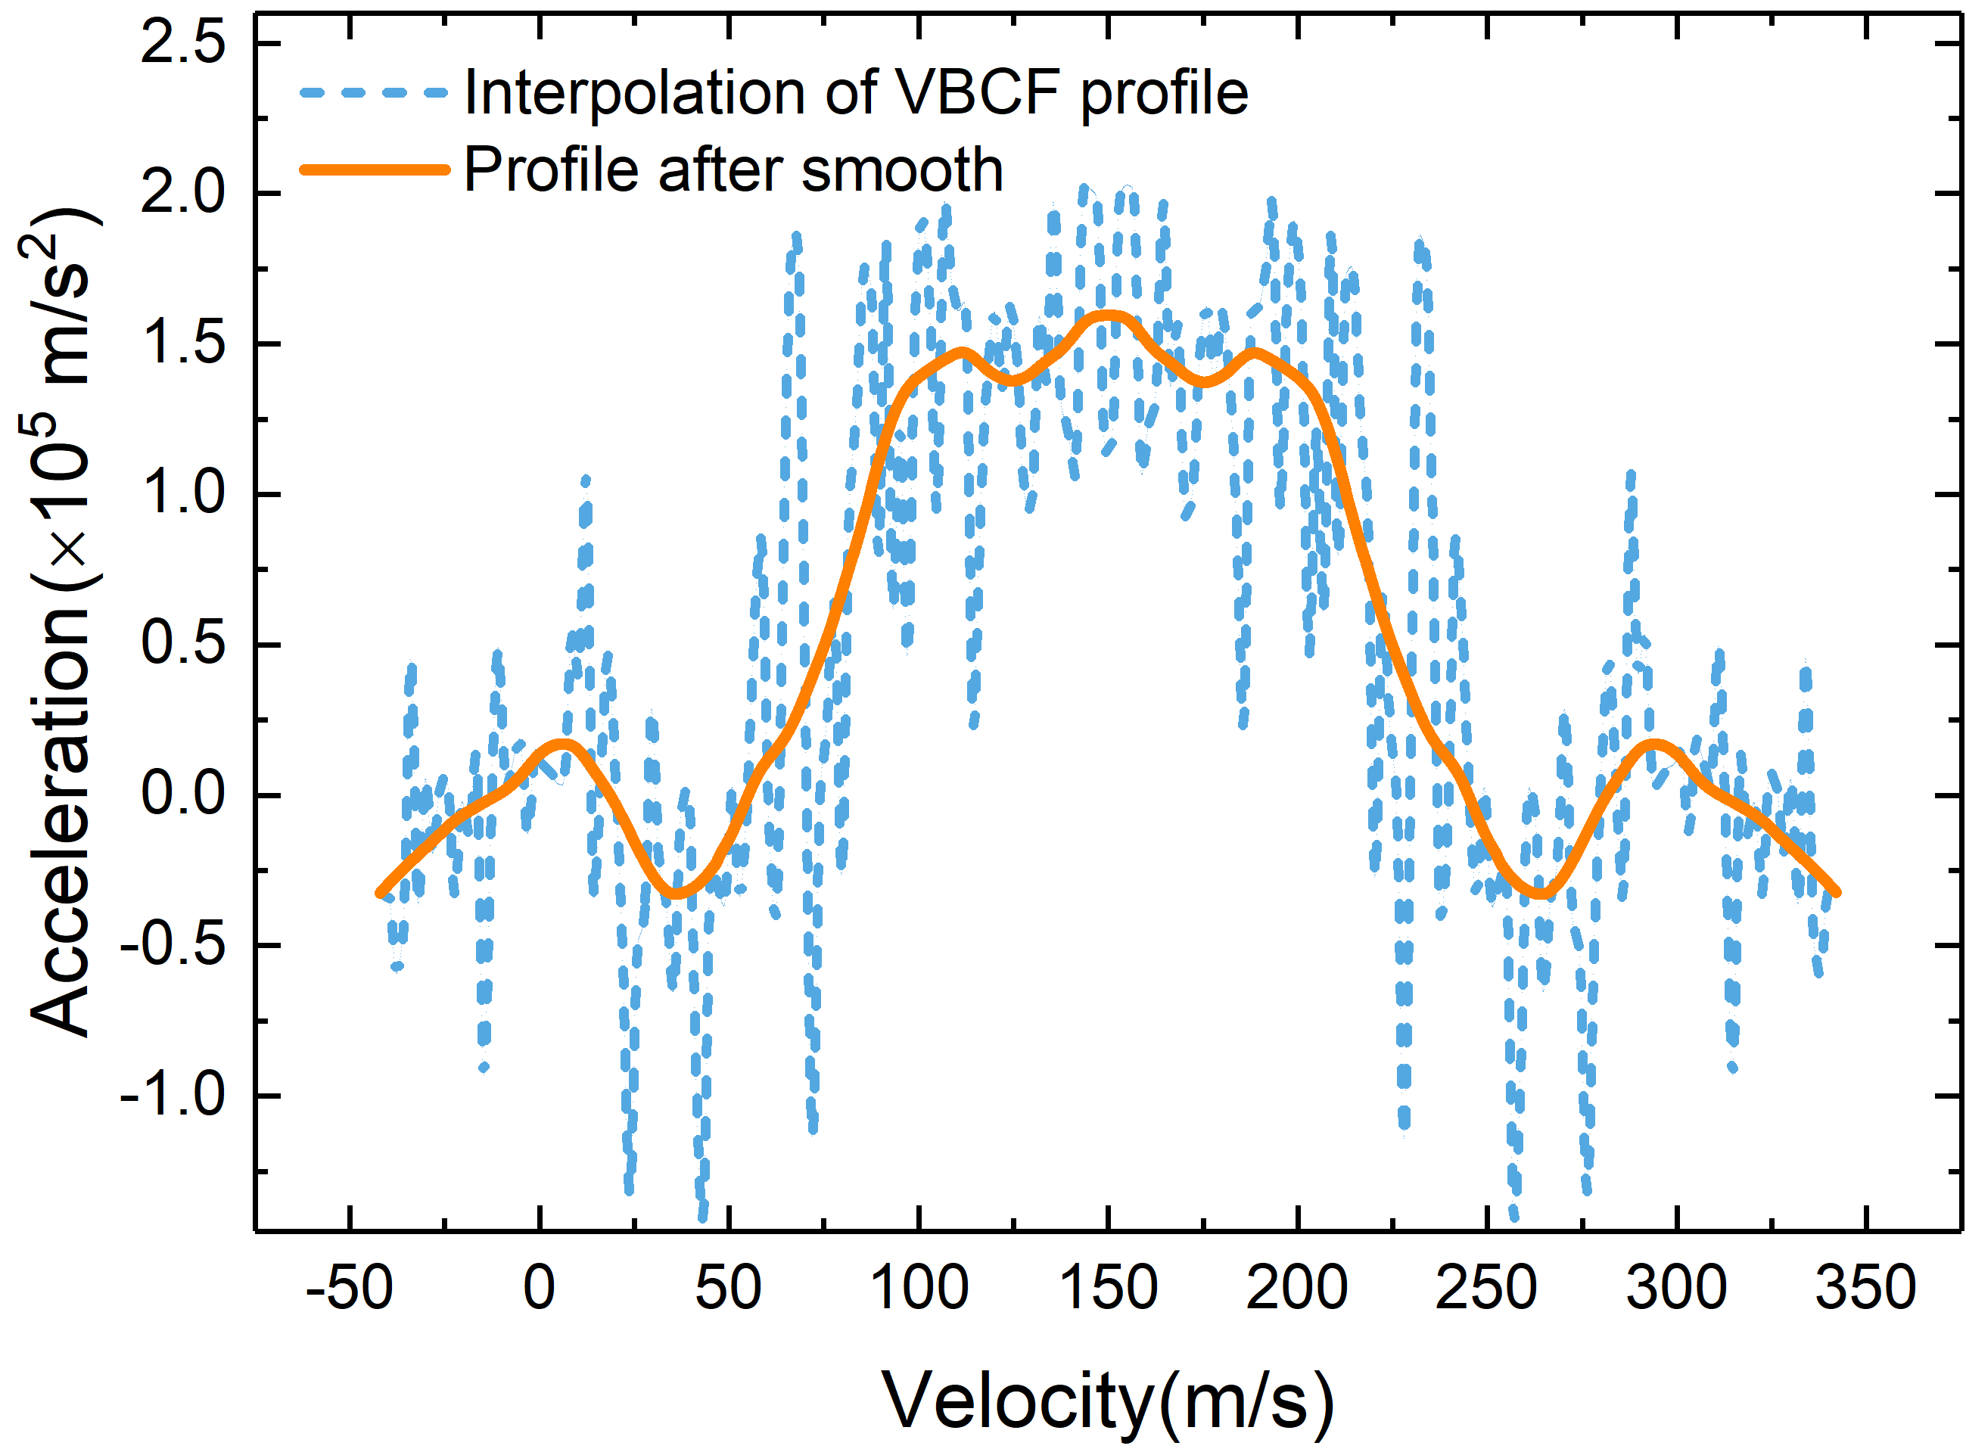


One-dimensional simulation
Simulation Parameters
Molecular number: $\sim 5 million$
Interaction region: $\sim 2$8.6mm
Initial velocities range: ±75 m/s
Numerical OBEs result input
Iteration: Acceleration vs Velocity
Time domain subintervals: ∆t = 20 π/δ

Slide 15
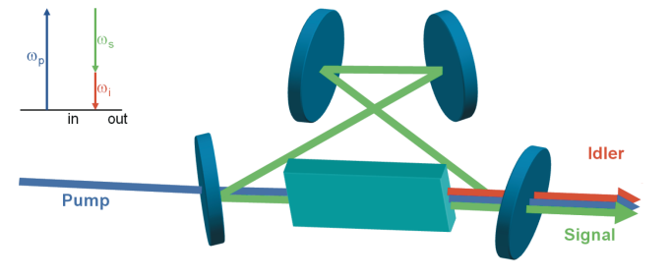
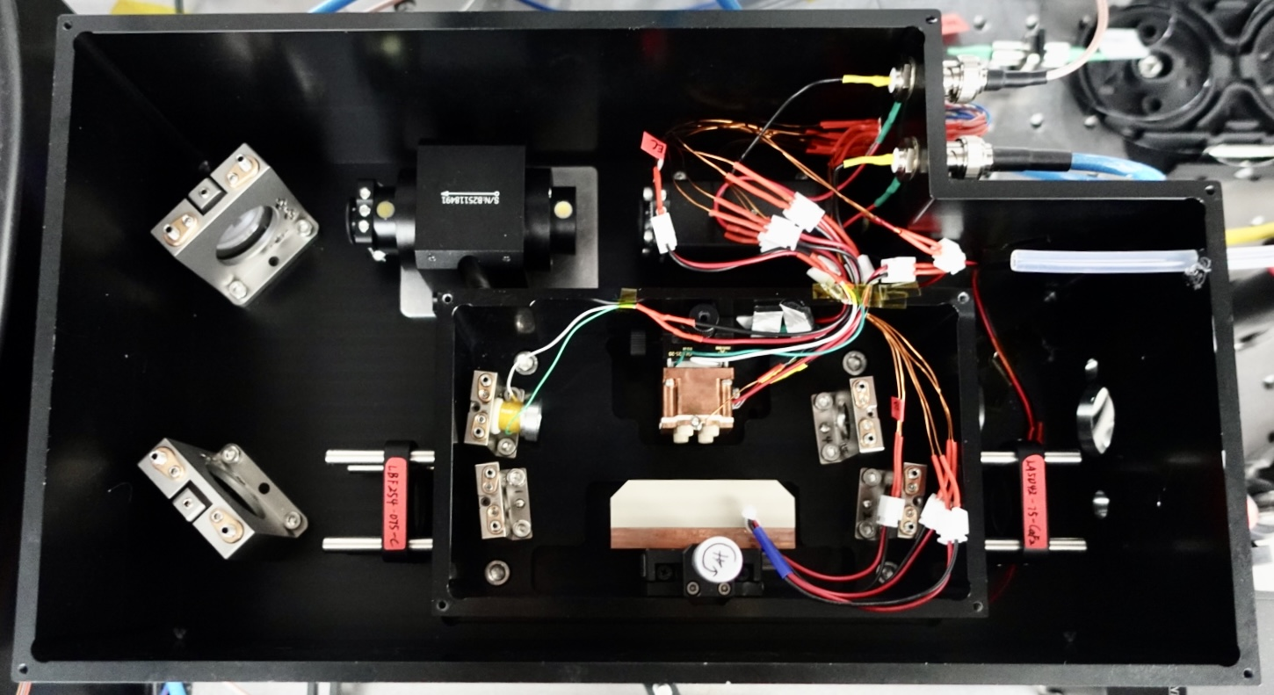


Continuous-Wave Optical Parametric Oscillator (CW-OPO)
Schematic diagram
FWHM and Frequency Stability Test
$$hν_{p}=hν_{s}+hν_{i}$$
$$∆k=\vec{k_{p}}−\vec{k_{s}}−\vec{k_{i}}$$
Homemade CW-OPO
Frequency Drift: 0.23 Hz/s

Slide 16
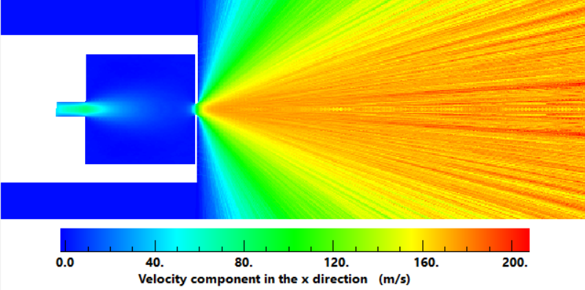

Buffer Gas Simulation
Density: $5×{10}^{12}{/cm}^{3}$（at 10mm after the nozzle）
Simulation Conditions
Gas flow: 30 SCCM
Nozzle diameter: 3 mm
Ne + CO₂ : 5% CO₂
Chamber size: $3$0$×30×3$0 mm

Slide 17
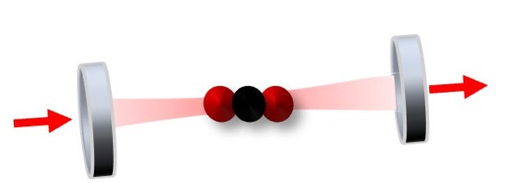
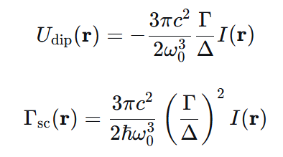

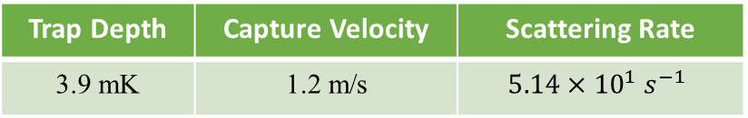


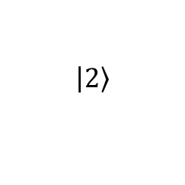

Dipole force
➢ Fundamental vibrational transition
$$\left.\left|2\right.\right\rangle$$
High Finesse Optical Cavity
$$\left|δ\right|$$
$$Γ$$
$$ℏω_{1}$$
$$\left.\left|1\right.\right\rangle$$
High intra-cavity power
¹³CO₂ R(0): 4377nm
➢ Dipole force
Calculation parameters
Detuning: 200MHz
Laser power:10W
Laser beam diameter: 0.5mm
Trap Depth | Capture Velocity | Scattering Rate
3.9 mK | 1.2 m/s | $${5.14×10}^{1}{ s}^{−1}$$

