Slide 1










The ASACUSA Antihydrogen beam
Ross Sheldon for the ASACUSA Collaboration
PSAS 2026, Vienna
Notes:
More logos

Slide 2
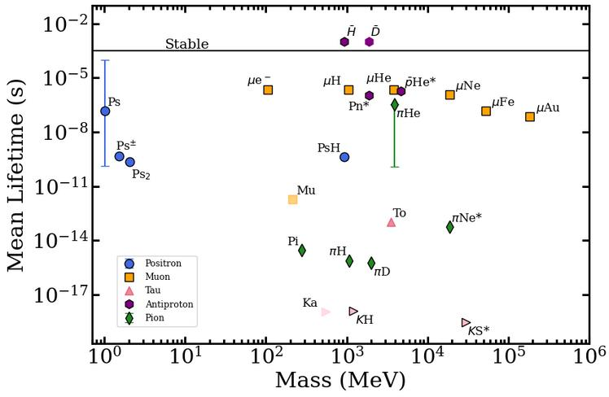
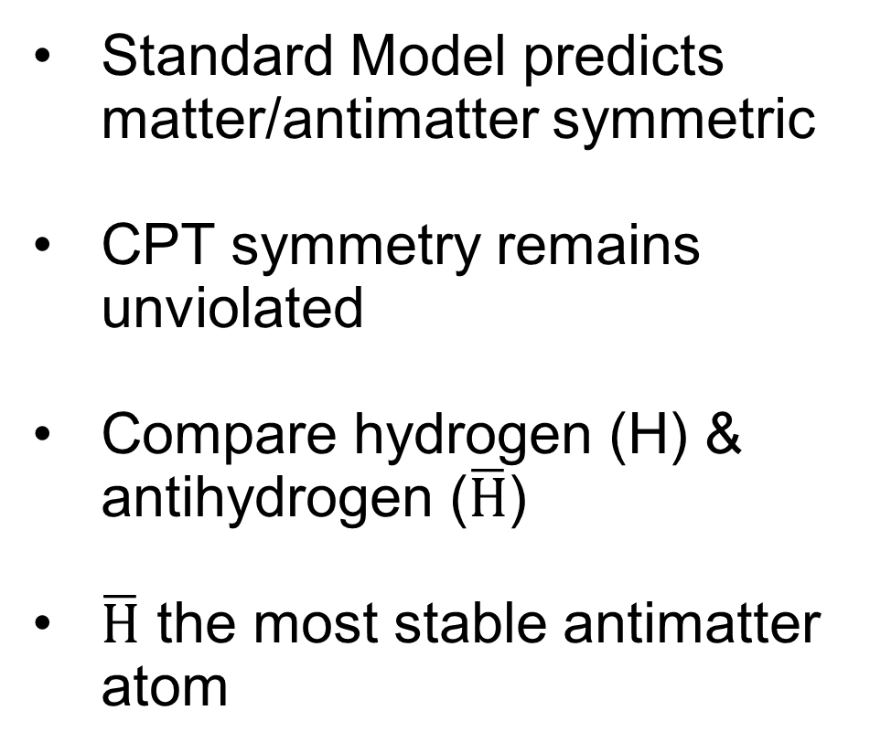
Where is all the antimatter?
Standard Model predicts matter/antimatter symmetric
CPT symmetry remains unviolated
Compare hydrogen (H) & antihydrogen ($\overline{H}$)
$\overline{H}$ the most stable antimatter atom

Slide 3
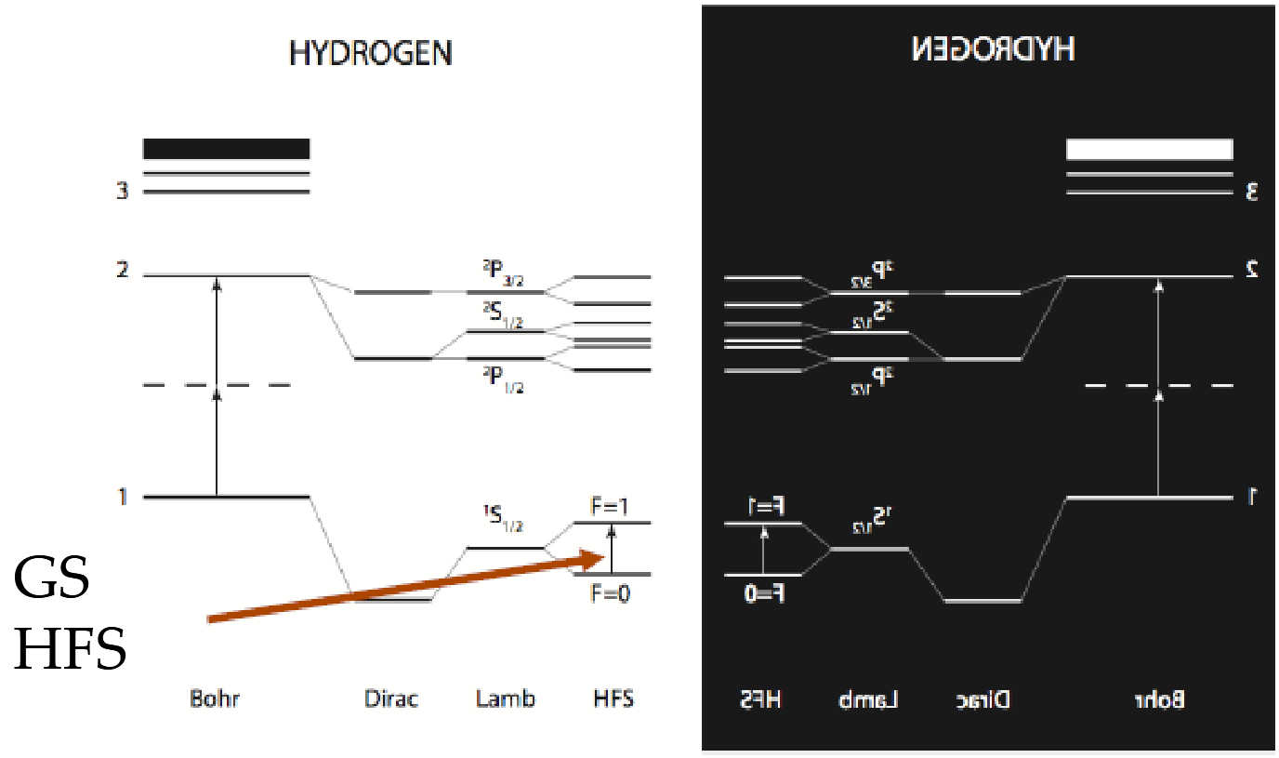
Ground State Hyperfine Structure
ν_{hfs}: ¹S_{1/2}(F=0) → ¹S_{1/2}(F=1)
F = total spin quantum number

Slide 4
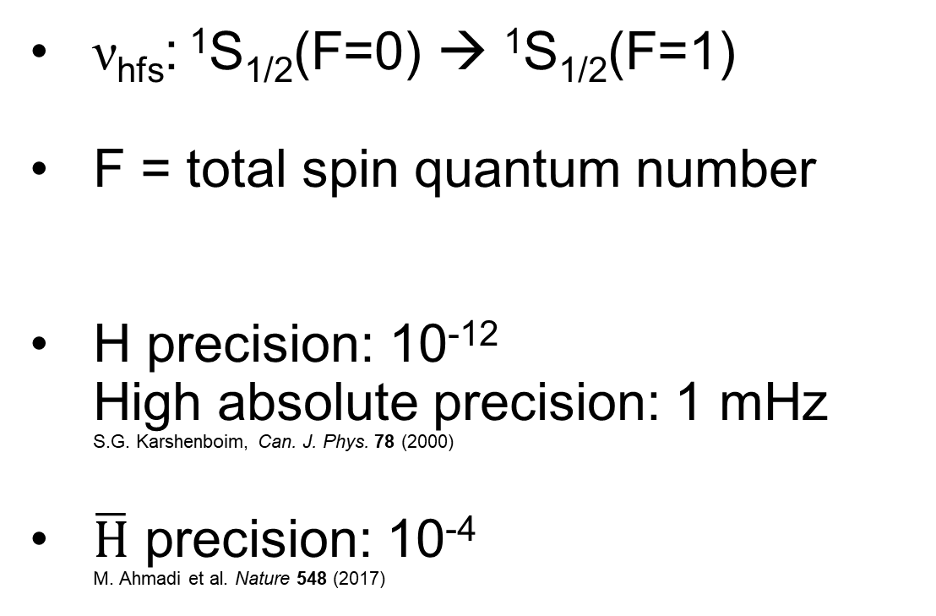
Ground State Hyperfine Structure
ν_{hfs}: ¹S_{1/2}(F=0) → ¹S_{1/2}(F=1)
F = total spin quantum number
H precision: 10⁻¹²
High absolute precision: 1 mHz
S.G. Karshenboim, Can. J. Phys. 78 (2000)
$\overline{H}$ precision: 10⁻⁴
M. Ahmadi et al. Nature 548 (2017)
GOAL
10⁻⁶

Slide 5
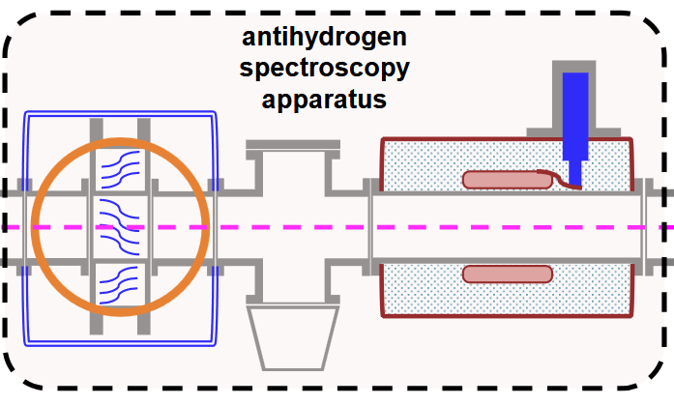
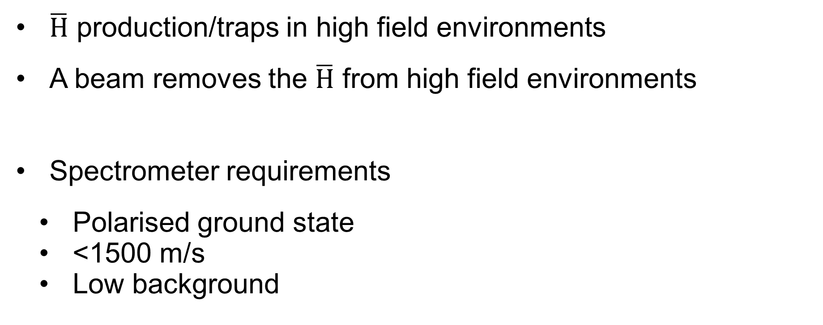
Antihydrogen beam
$\overline{H}$ production/traps in high field environments
A beam removes the $\overline{H}$ from high field environments
Spectrometer requirements
  Polarised ground state
  <1500 m/s
  Low background
F=0
F=0
F=1
C. Malbrunot et al. NIM Phys. Res. Sect. A 935 (2019)

Slide 6
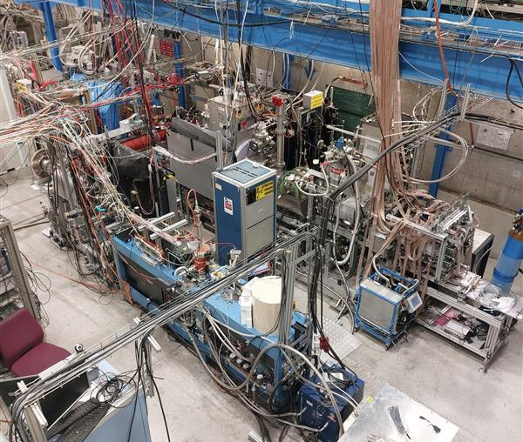
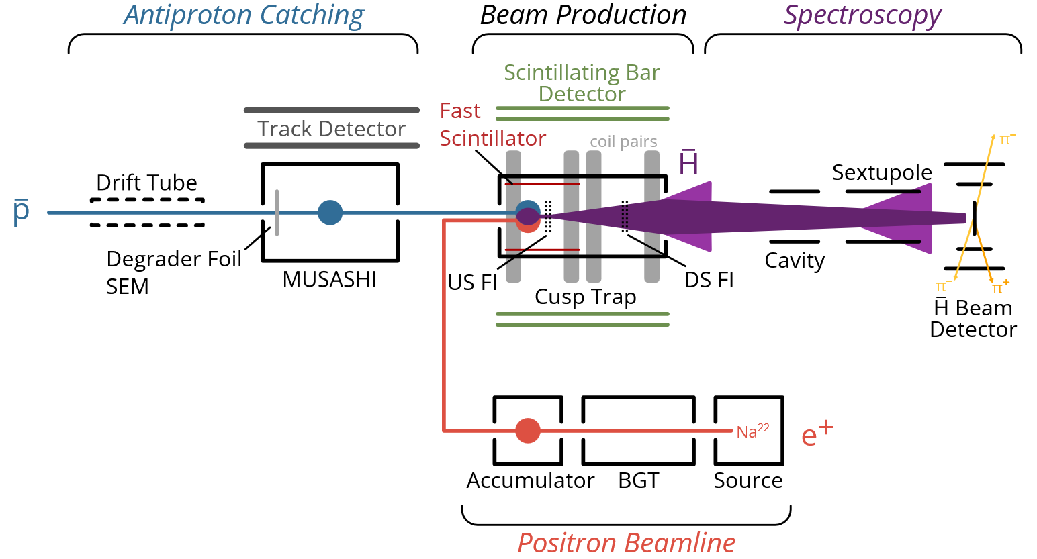
ASACUSA Experiment
MUSASHI
Cusp
Trap
ASACUSA SPSC Report for 2025, SPSC-SR-377
Spectroscopy
Line
Positron
Beamline

Slide 7
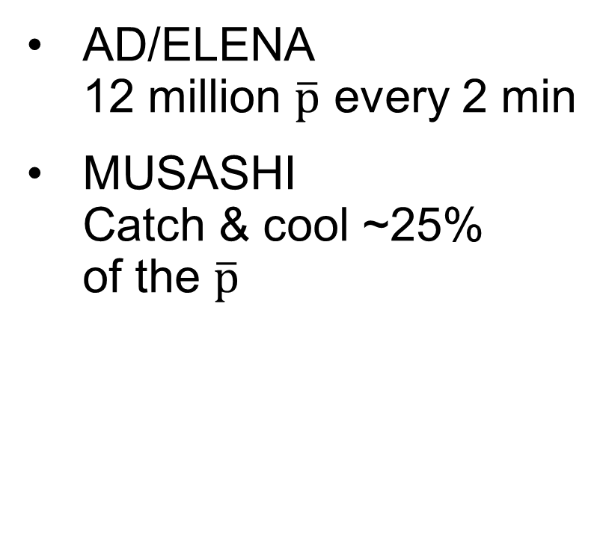
Experiment - Particles
ASACUSA SPSC Report for 2025, SPSC-SR-377
AD/ELENA
12 million $\overline{p}$ every 2 min
MUSASHI
Catch & cool ~25%
of the $\overline{p}$
²²Na positron beam
21 million positrons every 2 min

Slide 8
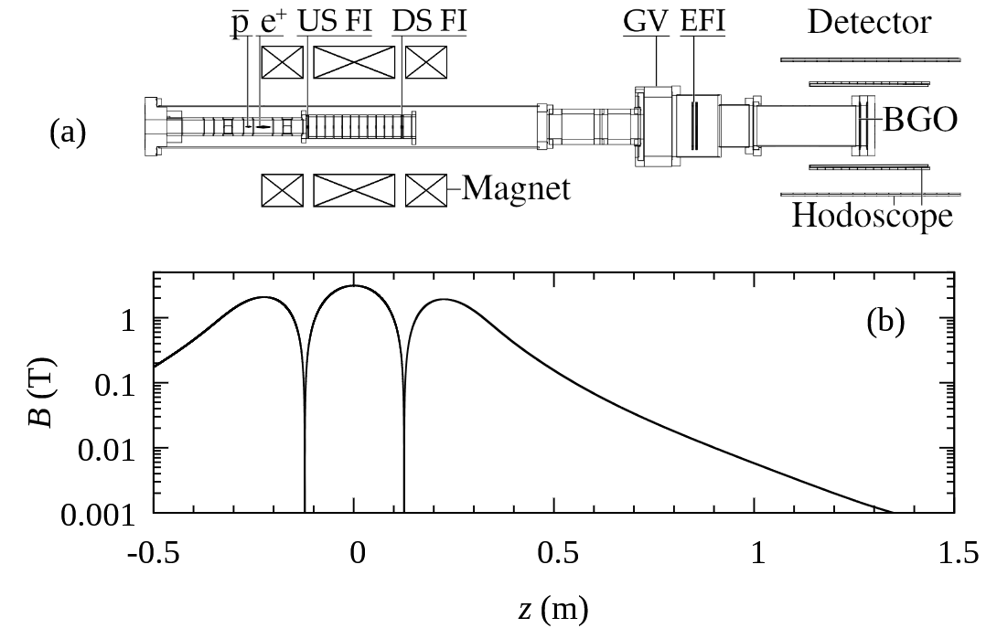




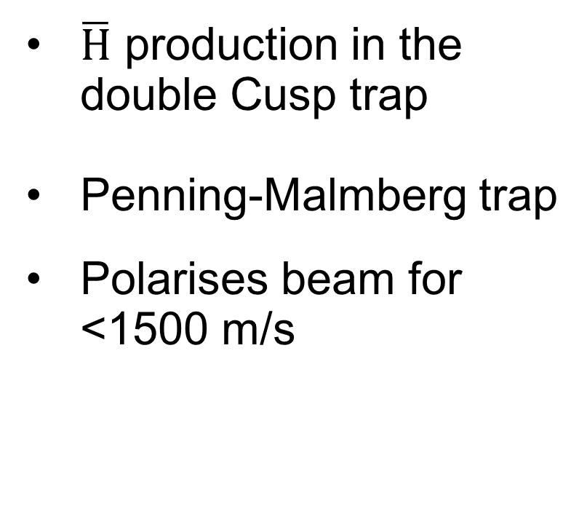

Experiment - $\overline{H}$ production
$$HFS \overline{H}$$
$\overline{H}$ production in the double Cusp trap
Penning-Malmberg trap
Polarises beam for <1500 m/s
$$\overline{p}$$
$$LFS \overline{H}$$
e⁺
$$HFS \overline{H}$$
E. D. Hunter et al. Phys. Plasmas 33 (2026)
Notes:
Hbar arrow

Slide 9
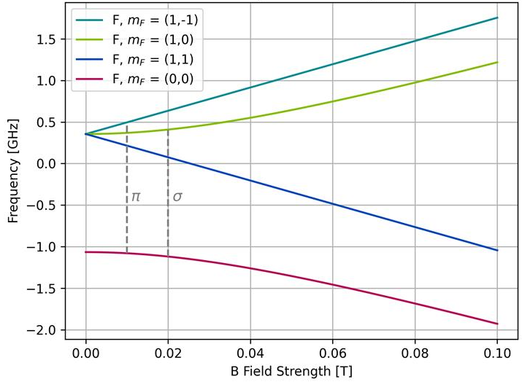



Experiment - $\overline{H}$ production
E. D. Hunter et al. Phys. Plasmas 33 (2026)
$$HFS \overline{H}$$
$$\overline{p}$$
e⁺
$$LFS \overline{H}$$
$$HFS \overline{H}$$
Low field seeker (LFS)
Magnetic moment anti-align to B
High field seeker (HFS)
Magnetic moment align to B
Polarisation LFS:HFS better for lower velocity
~60:40 for 1500 m/s
~80:20 for 1000 m/s
LFS
HFS
Notes:
Hbar arrow

Slide 10
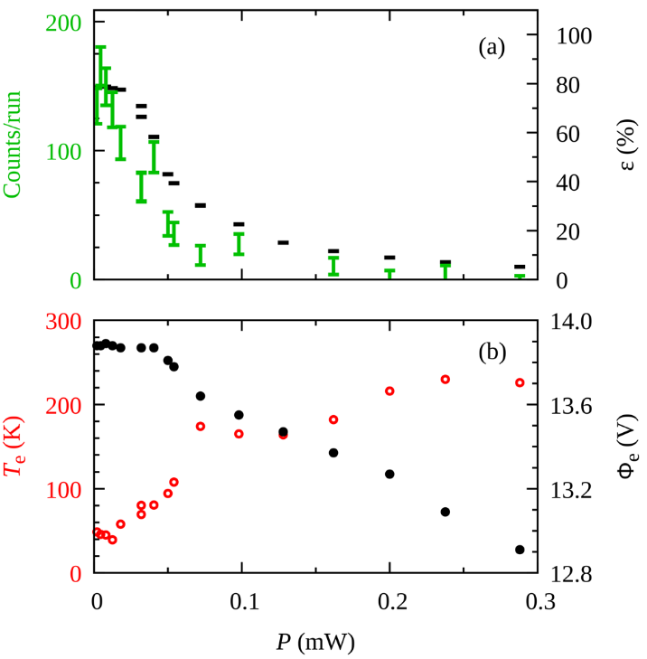


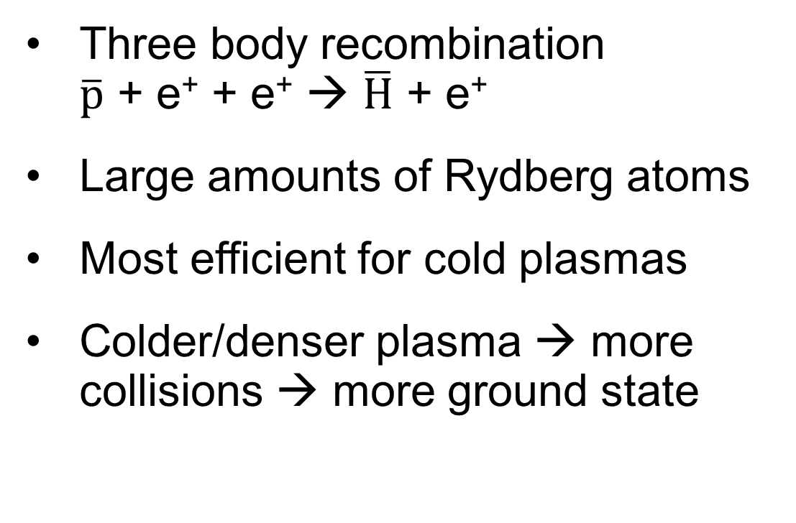
Experiment - $\overline{H}$ production
e⁺
e⁺
Three body recombination
$\overline{p}$ + e⁺ + e⁺ → $\overline{H}$ + e⁺
Large amounts of Rydberg atoms
Most efficient for cold plasmas
Colder/denser plasma → more collisions → more ground state
$\overline{p}$
$\overline{H}$
e⁺
E. D. Hunter et al. Phys. Plasmas 33 (2026)
Notes:
Used to be direct injection

Slide 11
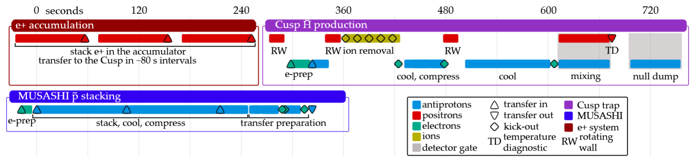
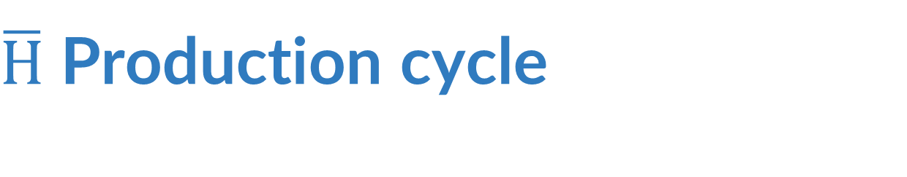

$\overline{H}$ Production cycle
$\overline{H}$ production cycles takes ~15min
Key part of this is plasma preparation in the Cusp trap
Remove electrons from $\overline{p}$ & positive ions from positrons
Compress & cool using strong-drive regime evaporative cooling
ASACUSA SPSC Report for 2024, SPSC-SR-358

Slide 12
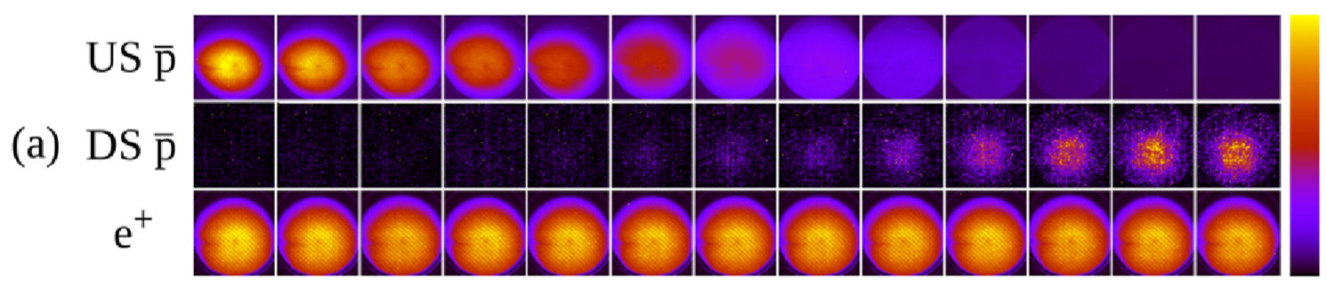
Plasma properties
E. D. Hunter et al. Phys. Plasmas 33 (2026)
 | Number (x10⁶) | Temperature (K) | Density* (x10⁸ cm⁻¹)
Antiprotons | 2.89 ± 0.04 | 1700 ± 200 | 0.8 ± 0.1
Positrons | 100 ± 2 | 50 ± 20 | 2.0 ± 0.5
*numerical solver
Antiprotons
Positrons

Slide 13
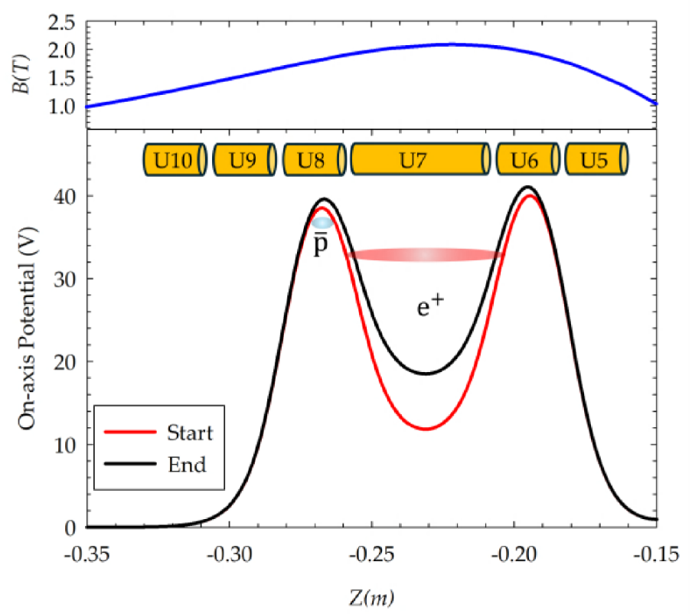
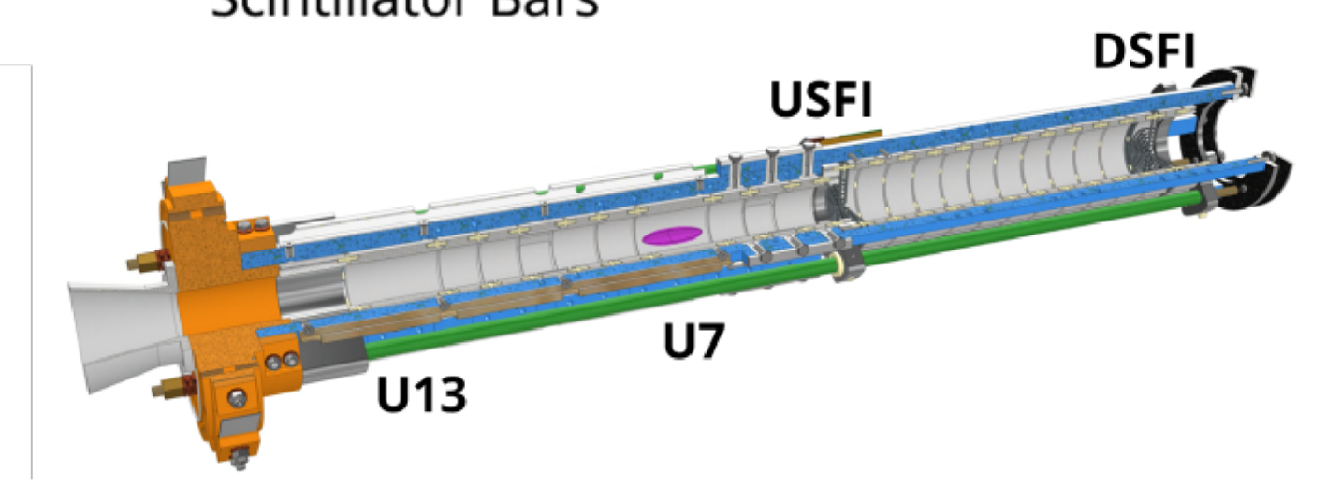

Antihydrogen production
ASACUSA SPSC Report for 2024, SPSC-SR-358
Slow merge mixing over 60s
Production efficiency ~80%
$$\overline{H}$$
Notes:
Used to be direct injection

Slide 14
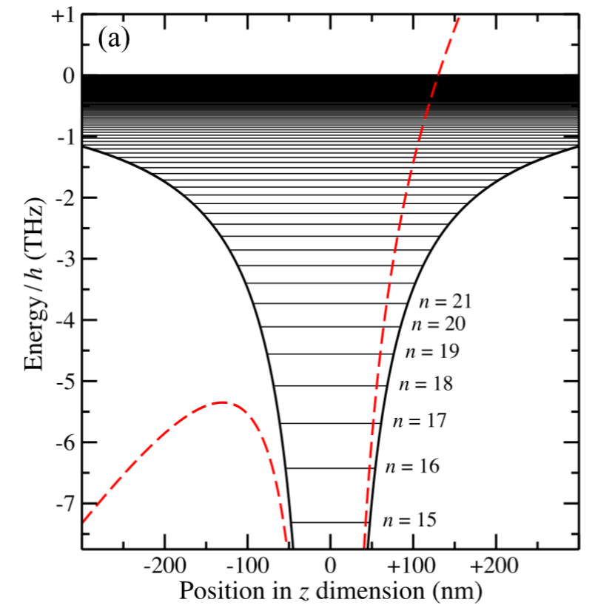
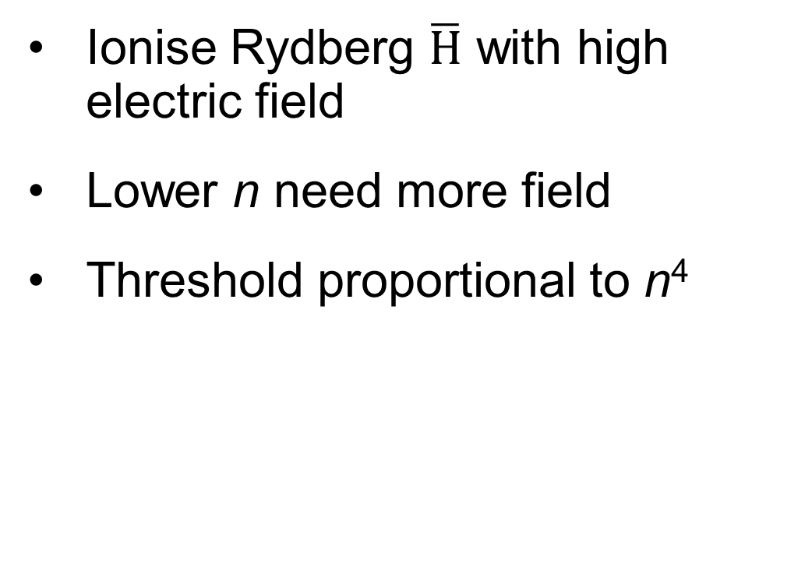

Field ionisers
A. M. Alonso et al. PRA 98 (2018)
Ionise Rydberg $\overline{H}$ with high electric field
Lower n need more field
Threshold proportional to n⁴
2h (THz)
x2 (nm)
$$\overline{H}$$
ASACUSA SPSC Report 2025
Notes:
FI diagram and waveform

Slide 15

Field ionisers
https://arxiv.org/pdf/2509.02583
Two meshes mm apart
One grounded, one biased
Upstream field ioniser - Chopper
Pulsed from 0-800 V at 240 Hz during mixing
Downstream field ioniser – Filter
DC on or off throughout mixing
$$\overline{H}$$
Bias
Time
Notes:
FI diagram and waveform

Slide 16
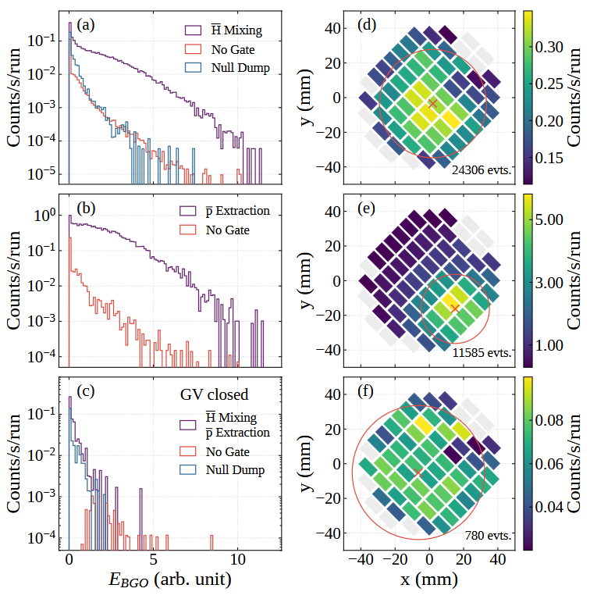

Beam detector
Detect $\overline{p}$ annihilation of $\overline{H}$
Pixelated central BGO scintillator calorimeter
Coincidence with 2-layer hodoscope
Notes:
Mention fast scint

Slide 17
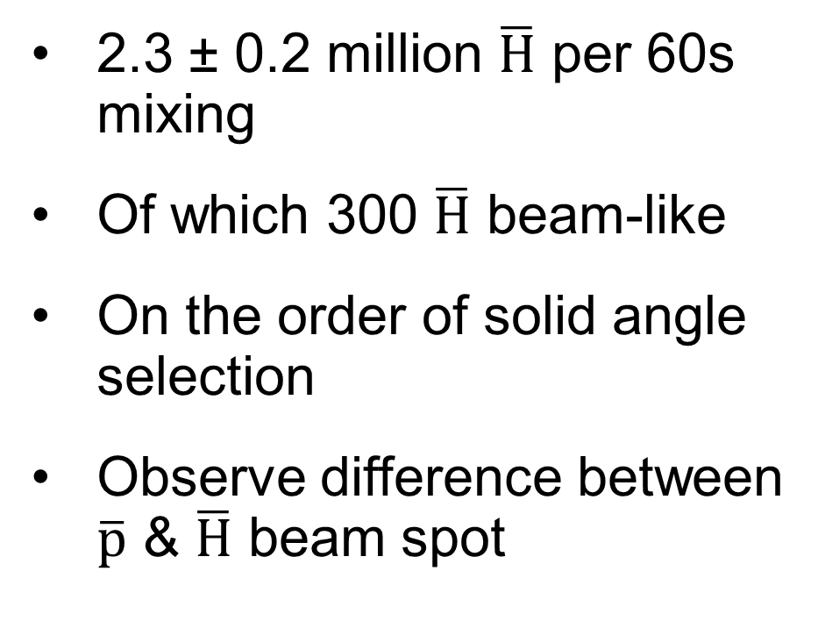
Beam intensity
2.3 ± 0.2 million $\overline{H}$ per 60s mixing
Of which 300 $\overline{H}$ beam-like
On the order of solid angle
selection
Observe difference between $\overline{p}$ & $\overline{H}$ beam spot
E. D. Hunter et al. In Preparation
Notes:
Numbers for size, fractional SA 2.1x10^-4

Slide 18
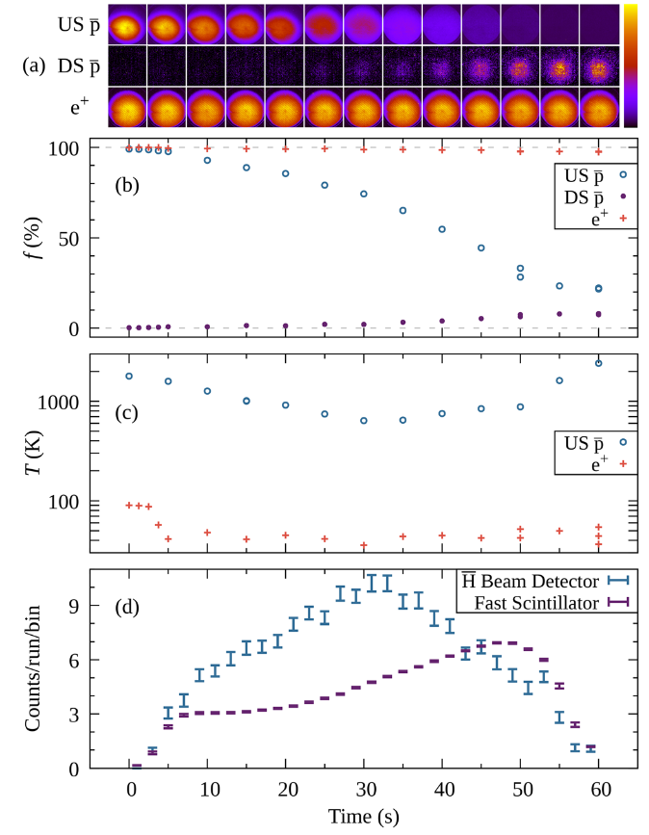
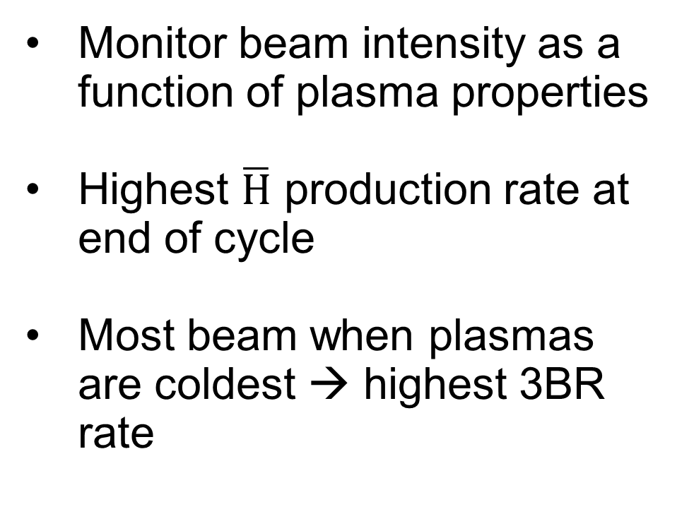
Beam intensity
E. D. Hunter et al. Phys. Plasmas 33 (2026)
Monitor beam intensity as a
function of plasma properties
Highest $\overline{H}$ production rate at end of cycle
Most beam when plasmas are coldest → highest 3BR rate
*
*divided by 1000
Notes:
Highest production due to more pbar entering e+

Slide 19
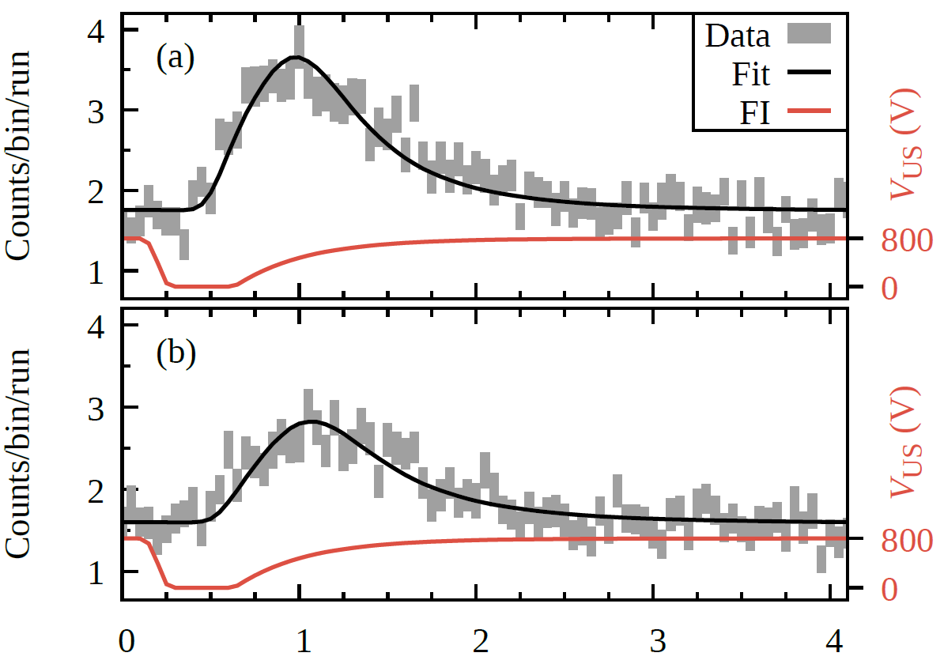

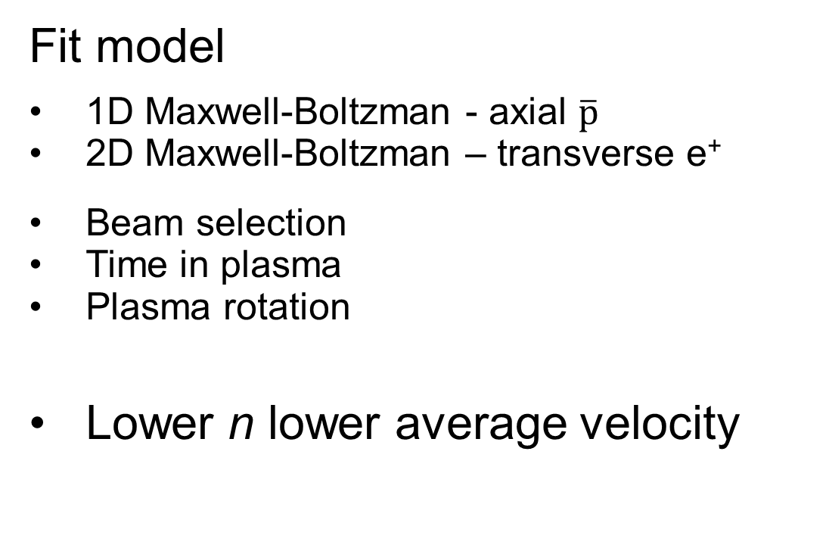
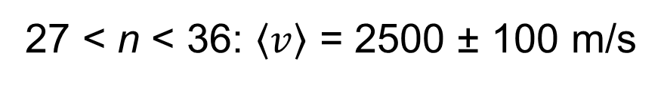
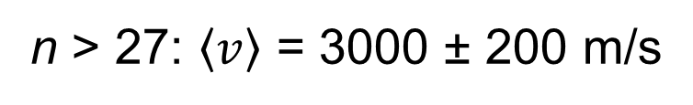
Beam velocity
E. D. Hunter et al. In Preparation
n > 27: $\left\langle v\right\rangle$ = 3000 ± 200 m/s
Fit model
1D Maxwell-Boltzman - axial $\overline{p}$
2D Maxwell-Boltzman – transverse e⁺
Beam selection
Time in plasma
Plasma rotation
Lower n lower average velocity
PRELIMINARY
27 < n < 36: $\left\langle v\right\rangle$ = 2500 ± 100 m/s

Slide 20
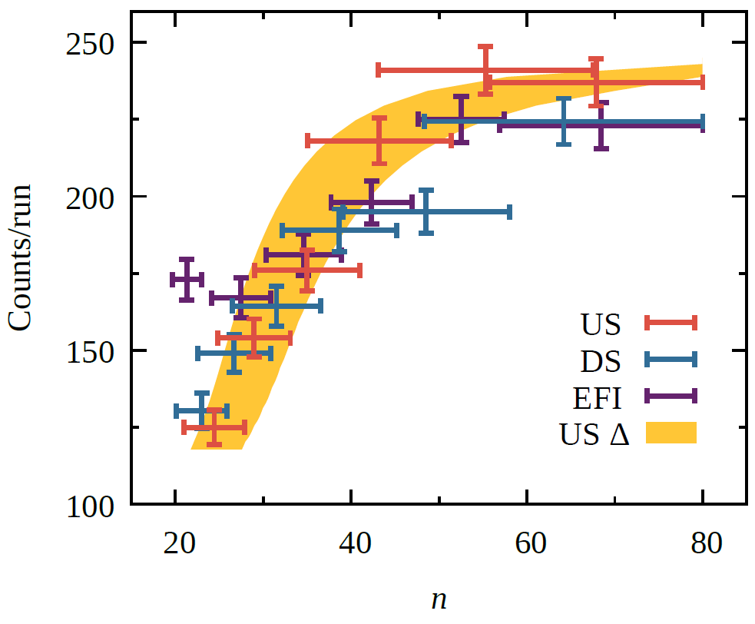
Quantum number distribution
Approximately 66% in n > 20
n < 15 will fluoresce during flight
Estimate > 10% ground state fraction
Polarisation uncertain
Significant background
E. D. Hunter et al. In Preparation
PRELIMINARY

Slide 21
Spectroscopy Line Installation
New
2025
ASACUSA SPSC Report for 2025, SPSC-SR-377
Stripline cavity at ~1.4 GHz
Sextupole → focuses LFS and defocuses HFS
Spin flip would show as decrease in signal at detector

Slide 22
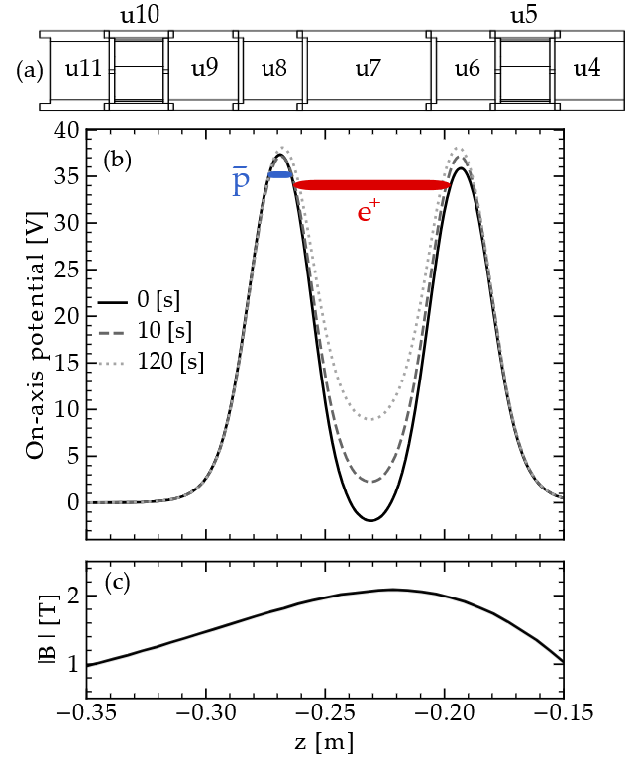
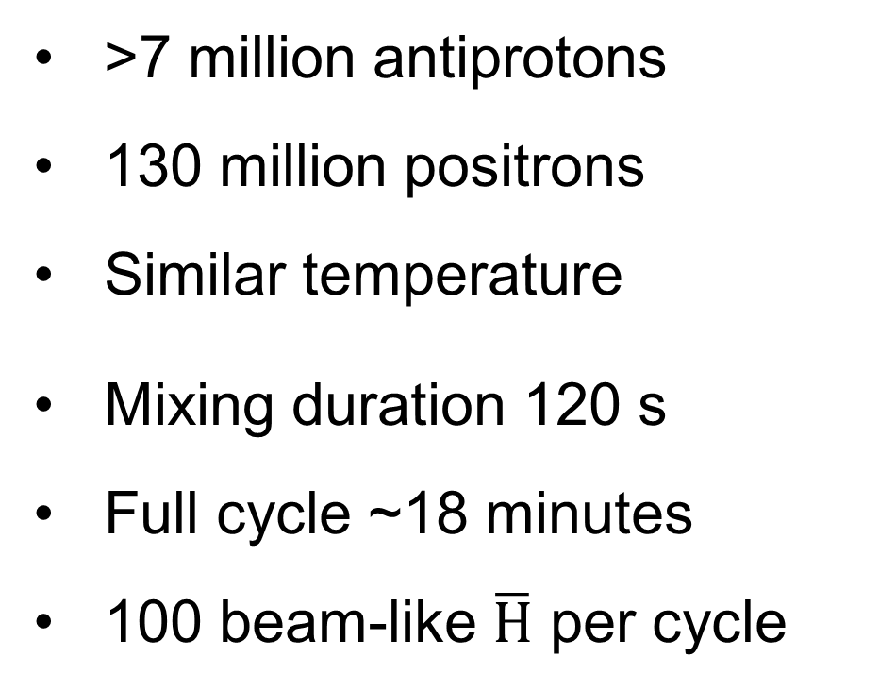
2025 Mixing
New
2025
ASACUSA SPSC Report for 2025, SPSC-SR-377
>7 million antiprotons
130 million positrons
Similar temperature
Mixing duration 120 s
Full cycle ~18 minutes
100 beam-like $\overline{H}$ per cycle

Slide 23
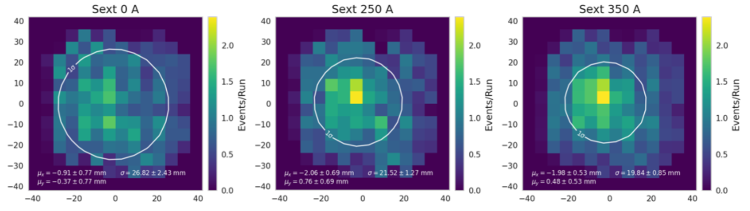
Sextupole Focusing
New
2025
ASACUSA SPSC Report for 2025, SPSC-SR-377
Sextupole Off
Focusing with sextupole observed (~2 T)
26 ± 7% reduction in beam spot size
No reduction in beam intensity
High Rydberg contribution
On axis atoms not focussed
PRELIMINARY
y (mm)
x (mm)
Sextupole On
PRELIMINARY
y (mm)
ASACUSA SPSC Report 2026
x (mm)

Slide 24
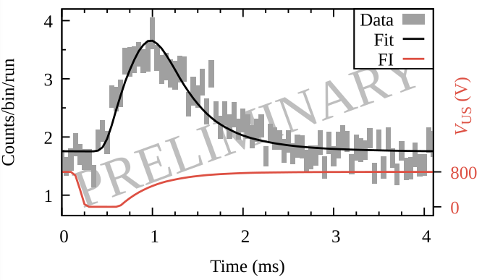
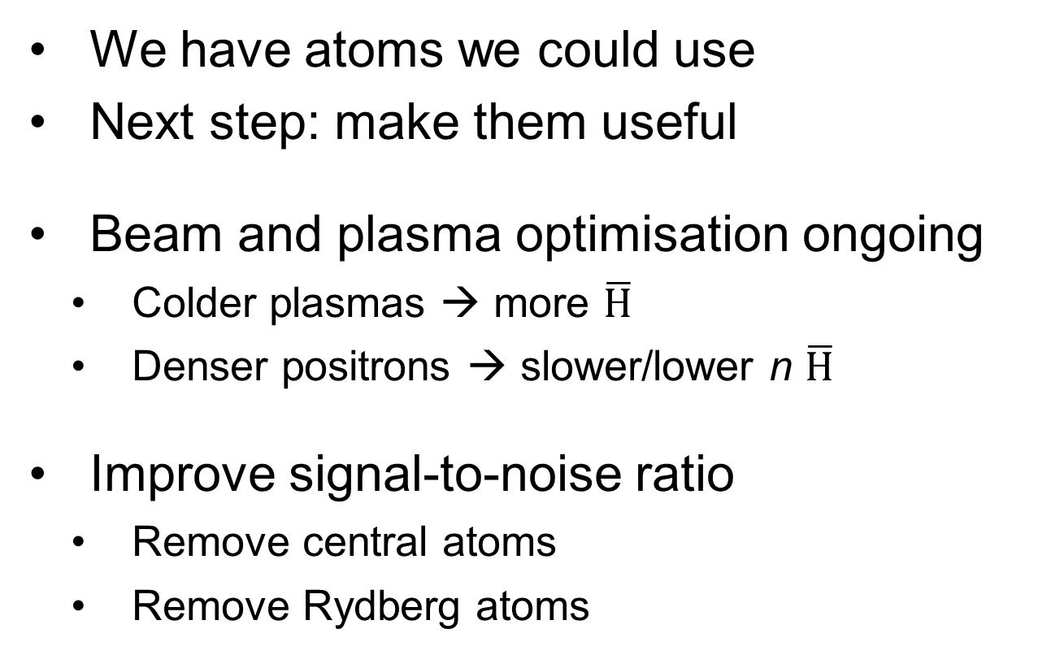
Conclusions
Sextupole On
We have atoms we could use
Next step: make them useful
Beam and plasma optimisation ongoing
  Colder plasmas → more $\overline{H}$
  Denser positrons → slower/lower n $\overline{H}$
Improve signal-to-noise ratio
  Remove central atoms
  Remove Rydberg atoms
y (mm)
PRELIMINARY
x (mm)

Slide 25
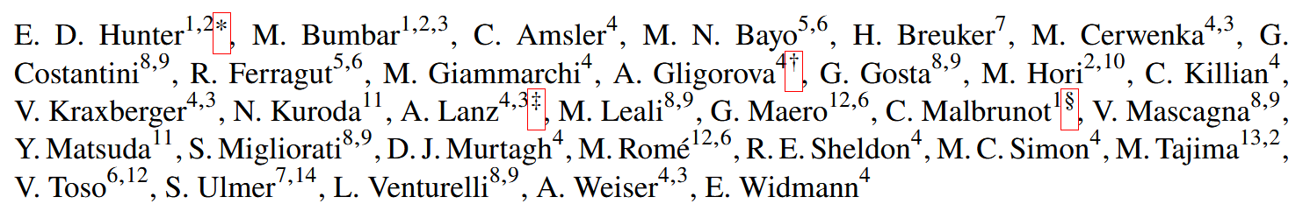
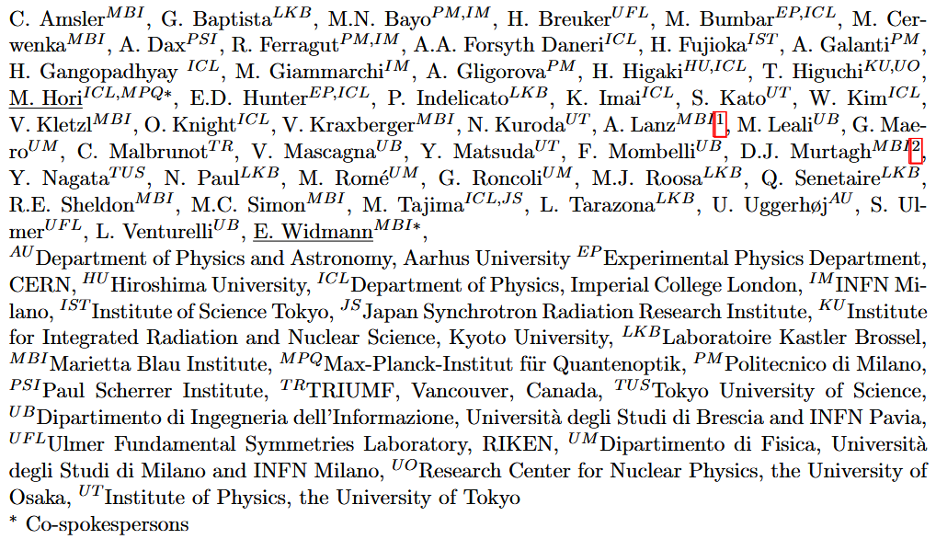

Acknowledgements
, S. Kato, H. Higaki, T. Higuchi

Slide 27
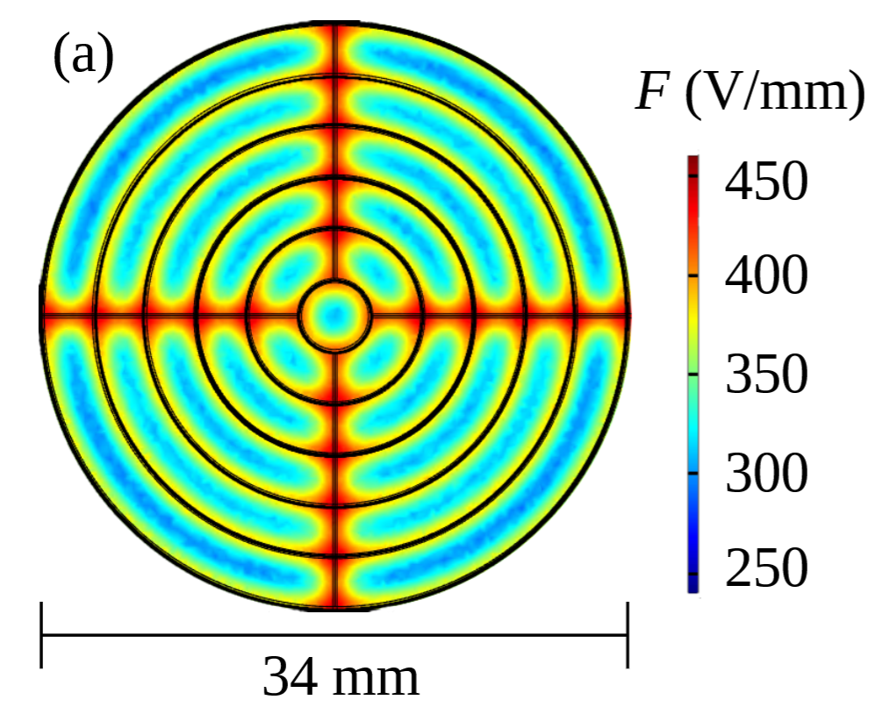
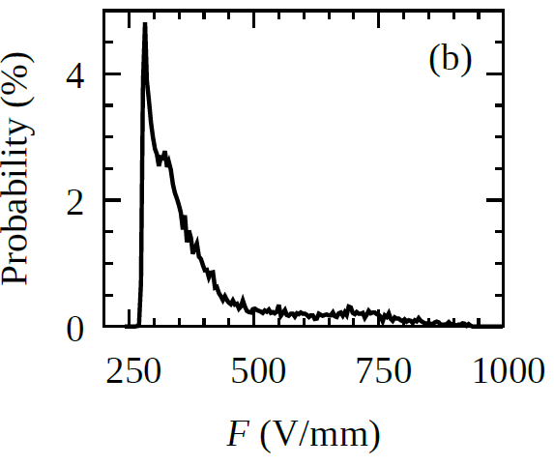
Bonus – FI bias to n conversion
FI has uneven spatial distribution
Simulations and modelling converts field distribution to probability of ionising one n
Simulations classical but agree with approximation
Quantum state distribution & residual B accounted for

Slide 28
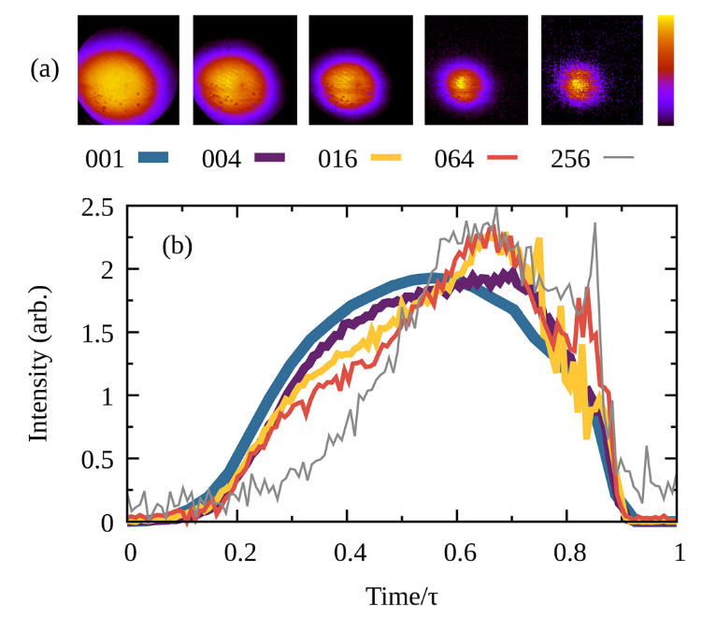
Bonus – Slow Extraction
Repeat mixing routine but extract antiprotons to MCP instead of into positrons to see how plasma evolves
Most come out at the end in tight spot

Slide 29
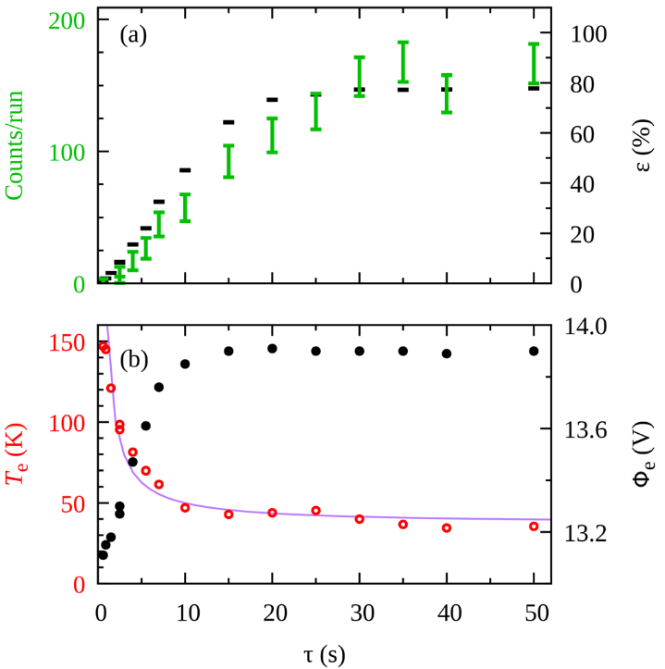
Bonus – Mixing Duration
The longer we mix the more antihydrogen we make up to a certain limit
Merging fast allows plasma to hollow out
Plasma is stable for slower merging

