Slide 1
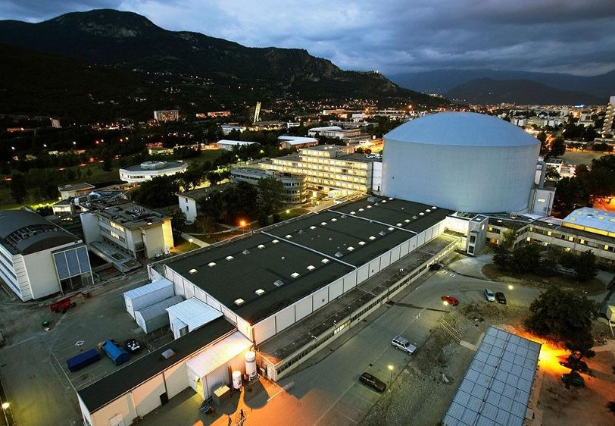

Gravitational and other shifts of whispering-gallery and gravitational state interference patterns of light neutral particles.
PSAS-2026, 18-22 May, Vienna

Slide 2
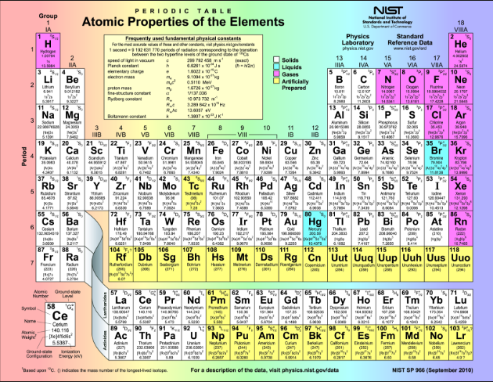
⁰n
Precision Physics of Simple Atomic Systems (PSAS):
“Austrian definition”
of Simple Atomic Systems (Helmut Rauch), including the neutron

Slide 3


This talk is totally based on our recent publication
V.V. Nesvizhevsky, J.A. Pioquinto, K. Schreiner, S. Baeβler, P. Crivelli, F. Nez, S. Reynaud, P. Yzombard, S.A. Vasiliev, and E. Widmann, Gravitational and other shifts of whispering-gallery and gravitational state interference patterns of light neutral particles, New Journal of Physics, accepted, 2026.
Gravitational, optical and hyperfine spectroscopy and interferometry with the lightest neutral particles/atoms (neutrons, atoms, antiatoms, positronium, muonium) at lowest kinetic energies
Spectroscopy of gravitational quantum states of ultracold neutrons
AMADEUS grant
20.05.26
V.V. Nesvizhevsky

Slide 4
More details are given in several articles (to be submitted soon) as well as in the talks and posters at PSAS-2026:
J.A. Pioquinto, et al, Search for a new spin-dependent short-range interaction at the nanometer scale using whispering gallery states of neutrons (to be submitted)
K. Schreiner, et al, Observation of a magnetic shift in neutron whispering-gallery states (to be submitted)
C. Killian, et al, GRASIAN: First observation of quantum reflection of atomic hydrogen from a silicon mirror on the journey toward the first demonstration of gravitational quantum states of atoms, PSAS-2026, Talk, Session 10
S. Vasiliev, et al, Cold sources of atomic hydrogen and its isotopes, PSAS-2026, Poster Session 2
K. Schreiner, et al, Design and construction of a whispering gallery spectrometer for cold atomic hydrogen, PSAS-2026, Poster Session 1
E. Bera, et al, A Zeeman decelerator, for enhancing the creation of GQSs, PSAS-2026, Poster Session 2
20.05.26
V.V. Nesvizhevsky

Slide 5
Whispering Gallery States (WGS) and Gravitational Quantum States (GQS) of light neutral particles
Short history of this long investigation:
The idea of a “quantum bouncer” [G. Breit, Phys. Rev. 32 (1928) 273]
Several unsuccessful attempts to observe this phenomenon
Observation of gravitational quantum states (GQS) of neutrons [V. Nesvizhevsky et al, Nature 297 (2002) 415]
Observation of whispering gallery states of neutrons (WGS) [V. Nesvizhevsky et al, Nature Phys. 6 (2010) 114]
Realization of resonant transitions between GQS of neutrons [T. Jenke et al, Nature Phys. 7 (2011) 468]
Observation of WGS of electrons [G. Reecht et al, Phys. Rev. Lett. 110 (2013) 056802]
GRASIAN collaboration: Towards observation of GQS and WGS of atoms [C. Killian et al, Europ. Phys. J. D 78 (2024) 132]
20.05.26
20.05.26
V.V. Nesvizhevsky

Slide 6
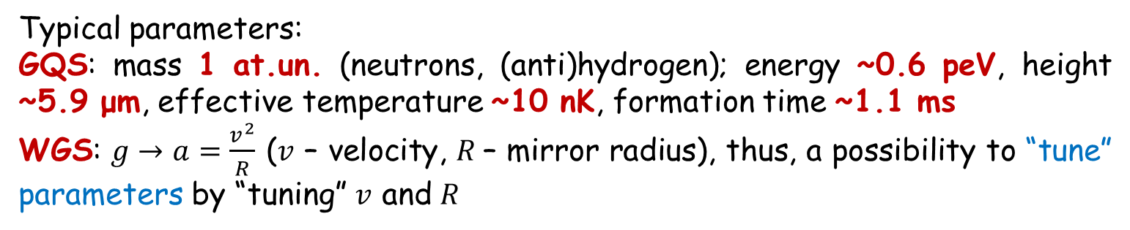
Whispering Gallery States and Gravitational Quantum States of light neutral particles
Typical parameters:
GQS: mass 1 at.un. (neutrons, (anti)hydrogen); energy ~0.6 peV, height ~5.9 μm, effective temperature ~10 nK, formation time ~1.1 ms
WGS: $g→a=\frac{v^{2}}{R}$ ($v$ – velocity, $R$– mirror radius), thus, a possibility to “tune” parameters by “tuning” $v$ and 𝑅
WGS
GQS
20.05.26
20.05.26
V.V. Nesvizhevsky

Slide 7
Experimental and theoretical status, limitations and advantages
Experimental methods for producing and measuring WGS and GQS are well developed. In particular, several collaborations are (were, will be) measuring GQS of neutrons using different methods: qBounce, Tokyo, GRANIT, ALSUN etc. GRASIAN is measuring GQS of atoms. GBAR considers measuring GQS of antiatoms.
The accuracy of theoretical description of such states can be high. The “theoretical uncertainties” are mainly of the “experimental” origin; they are related to the accuracy to which we know parameters of concrete systems.
GQS of Neutrons. Limitations: observation times ~10⁻²-10⁻³ s are not much shorter then the formation time ~10⁻³ s. So, precision spectroscopy is hard. Advantages: “easy” experiments. GQS of Atoms and Antiatoms. Limitations: The magnetic moment is a factor of thousand larger than the neutron magnetic moment, therefore the control of electromagnetic false effects is harder. Advantages: Atoms promise much higher statistics and observation times. Antiatoms are an efficient method to measure precisely gravitational properties of antimatter (if ultracold).
20.05.26
20.05.26
V.V. Nesvizhevsky

Slide 8

General features of all WGS and GQS
For all experiments with GQS and WGS of all particles,
there are certain conditions and constraints, in particular:
The surface reflects neutrons, atoms, antiatoms, positronium,
muonium, etc, elastically due to the condition l₀>>1Å (a typical
size of the quantum state is much larger than an interatomic
distance). It means that the thermal motions of individual
nuclei/atoms in the surface are effectively averaged out, and
specularly, provided the surface is well-polished and
homogeneous (on the spatial scale of the order of l₀) – a condition “easier” to satisfy for GQS and more difficult for WGS.
- A characteristic range of raising the potential should be <<l₀ (the condition of sharpness of the reflecting potential). Otherwise, the raising part of potential modifies GQS/WGS, and this modification has to be known precisely.
20.05.26
20.05.26
V.V. Nesvizhevsky

Slide 9
A new general approach and a first test
In [V.V. Nesvizhevsky, J.A. Pioquinto, K. Schreiner, S. Baeβler, P. Crivelli, F. Nez, S. Reynaud, P. Yzombard, S.A. Vasiliev, and E. Widmann, Gravitational and other shifts of whispering-gallery and gravitational state
interference patterns of light neutral particles,
New Journal of Physics, accepted, 2026],
we develop a new method of measuring small
shifts of WGS and GQS interference patterns,
in [K. Schreiner, et al, Observation of a
magnetic shift in neutron whispering-gallery
states (to be submitted)] we performed its test,
and in [J.A. Pioquinto, et al, Search for a new
spin-dependent short-range interaction at the
nanometer scale using whispering gallery states
of neutrons (to be submitted)] we improved
constraints on extra interactions.
The experimental test: to add an additional force first in the direction of the mirror surface, then in the direction away from the surface; measure the interference pattern in both cases and compare them.
20.05.26
20.05.26
V.V. Nesvizhevsky

Slide 10
The general approach (applied to WGS and GQS of neutrons, hydrogen, antihydrogen, positronium, muonium and other light neutral particles)
Let’s start from known parameters of neutron (hydrogen, antihydrogen) GQS :
acceleration
characteristic state energy
characteristic state size
characteristic state formation time
To resolve neutron GQS, the observation time should be, say:
or, for a typical mirror length of
the maximum neutron velocity is limited to
Thus, for neutrons, we are limited to ultracold neutrons (UCN) and, even then, the accuracy is strongly limited by their available velocity
20.05.26
20.05.26
V.V. Nesvizhevsky

Slide 11
The general approach (applied to WGS and GQS of neutrons, hydrogen, antihydrogen, positronium, muonium and other light neutral particles)
Still, we could measure interference of neutron GQS with the existing neutron beams, neutron optics and detectors
Simulation, the experiment is scheduled in September 2026.
Comparable in precision to the existing neutron GQS experiments and projects but it’s much easier to realize !
20.05.26
20.05.26
V.V. Nesvizhevsky

Slide 12
The general approach (applied to WGS and GQS of neutrons, hydrogen, antihydrogen, positronium, muonium and other light neutral particles)
GQS of hydrogen atoms ? – nearly the same experimental scheme
Simulation
This would be the first demonstration of GQS of atoms. Ongoing experiment, see the talk by Carina Killian.
20.05.26
20.05.26
V.V. Nesvizhevsky

Slide 13
The general approach (applied to WGS and GQS of neutrons, hydrogen, antihydrogen, positronium, muonium and other light neutral particles)
The characteristic values of acceleration, energy, size and time can be “tuned” by choosing particle mass, velocity as well as mirror radius and inclination (see formulas in slide 10)
We will consider particular applications of this approach
A motivation to use neutron WGS : until you reach the critical energy (neutron-nuclei optical potential, Fermi potential)
a slight modification for atoms, antiatoms, positronium, muonium: we will define effective critical energy as follows: , in the low energy limit you need to calculate only the effective scattering length. It’s sufficient for planning experiments. For the precision analysis, you have to do more sophisticated calculations.
What follows from these very simple arguments?
20.05.26
20.05.26
V.V. Nesvizhevsky

Slide 14
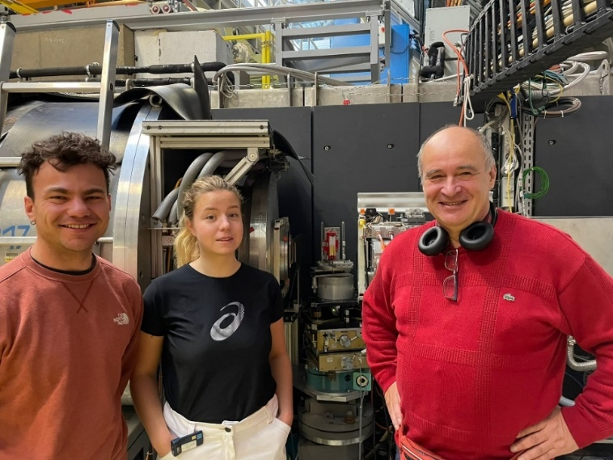
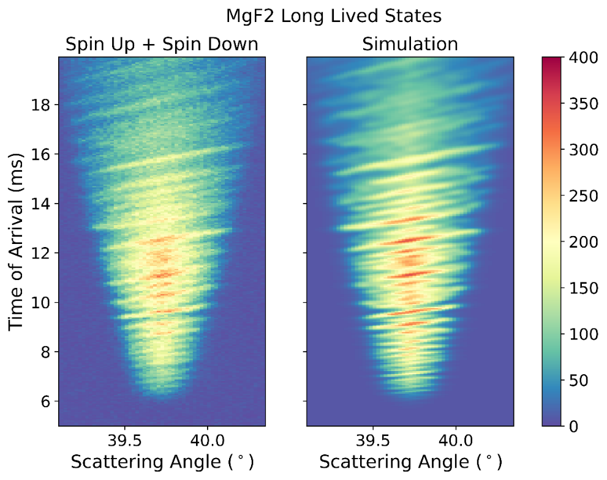
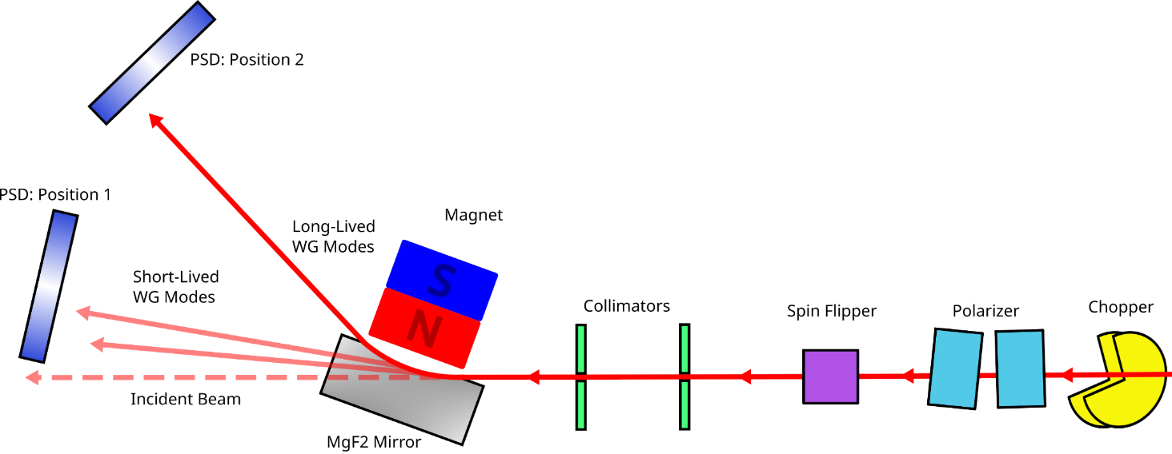
The general approach (applied to WGS and GQS of neutrons, hydrogen, antihydrogen, positronium, muonium and other light neutral particles)
What follows from these very simple arguments?
Very detailed interference patterns measured at
standard ILL instruments (D17, PF1B, etc)
K. Schreiner PhD, first measurement of a magnetic
shift of neutron WGS, the proof of principle for
measuring small shifts of ~10⁻⁶-10⁻⁵.
J. Pioquinto PhD, more than an order of
magnitude improvement of constraints on
extra fundamental interactions
major improvements are possible !!
20.05.26
20.05.26
V.V. Nesvizhevsky

Slide 15
The general approach (applied to WGS and GQS of neutrons, hydrogen, antihydrogen, positronium, muonium and other light neutral particles)
The characteristic values of acceleration, energy, size and time can be “tuned” by choosing particle mass, velocity and mirror radius
A motivation to decrease the acceleration value:
Such an experiment can be built and installed at the PF2/UCN facility at the ILL, or at another UCN facility. It’s a long-term project requiring significant efforts; therefore, it might be realized in steps. However, it promises exceptionally high sensitivity !
Very conservative estimations of its sensitivity:
A factor of >10 improvement for neutron electric charge
10⁻⁴ G sensitivity for the gravitational constant
20.05.26
20.05.26
V.V. Nesvizhevsky

Slide 16
The general approach (applied to WGS and GQS of neutrons, hydrogen, antihydrogen, positronium, muonium and other light neutral particles)
Optimum conditions to measure WGS of hydrogen atoms.
The main difference between atoms and neutrons is much a lower effective potential
Therefore, we select
The lightest atom (hydrogen), thus the most efficient quantum reflection (QR);
Mirror materials with high effective potential (silica);
Motivations: unprecedented sensitivity and
accuracy of QR measurements; constraints
on extra fundamental interactions, etc
20.05.26
V.V. Nesvizhevsky

Slide 17
The general approach (applied to WGS and GQS of neutrons, hydrogen, antihydrogen, positronium, muonium and other light neutral particles)
Optimum conditions to measure WGS of hydrogen atoms.
Many quasi-classical bounces and quantum states
Thus, a short time of formation of WGS
and a huge gravitational shift
To use the same experimental setup as that for H GQS :
Then and
20.05.26
V.V. Nesvizhevsky

Slide 18
The general approach (applied to WGS and GQS of neutrons, hydrogen, antihydrogen, positronium, muonium and other light neutral particles)
To discuss the feasibility and experimental details, please, see the Poster presented by K. Schreiner
Depending on the spatial resolution of the detector and the time resolution of the chopper, we can choose the slit size between the mirror and the absorber/scatterer, and thus the complexity of the interference pattern.
20.05.26
V.V. Nesvizhevsky

Slide 19
The general approach (applied to WGS and GQS of neutrons, hydrogen, antihydrogen, positronium, muonium and other light neutral particles)
Acceptable conditions to measure WGS of antihydrogen atoms.
You have just seen a scheme of an “easy” experiment with WGS of hydrogen atoms and a huge gravitational shift. What is the maximum velocity of hydrogen and antihydrogen which still allows to measure a gravitational shift?
A very large mirror
A very large mirror radius
To increase the effective critical energy we limit the number of quasi-classical bounces and select
For these parameters of the quantum states:
And the gravitational shift is
20.05.26
V.V. Nesvizhevsky

Slide 20
The general approach (applied to WGS and GQS of neutrons, hydrogen, antihydrogen, positronium, muonium and other light neutral particles)
Acceptable conditions to measure WGS of antihydrogen atoms.
Acceptable conditions to measure WGS of antihydrogen atoms.
In contrast to measurements with hydrogen, here we measure the point of annihilation of antihydrogen atom in the mirror; even for the extreme case of largest antihydrogen velocities (simulation on the right) requirements for the spatial resolution of the detector could be easily met
20.05.26
V.V. Nesvizhevsky

Slide 21
The general approach (applied to WGS and GQS of neutrons, hydrogen, antihydrogen, positronium, muonium and other light neutral particles)
Muonium ?
A limitation – its short lifetime
But !! Low velocity and sufficient monochromaticity
Moreover, due to a smaller mass a largely improved efficiency of QR and a significantly larger critical energy
We can perform our standard optimization
procedure and get
WGS measurements are feasible
Gravitational shift is challenging
A detection scheme
to be developed
20.05.26
V.V. Nesvizhevsky

Slide 22
The general approach (applied to WGS and GQS of neutrons, hydrogen, antihydrogen, positronium, muonium and other light neutral particles)
Positronium ?
Lifetimes of highly excited states are sufficiently long
Available velocities are close to acceptable
Due to the much smaller mass, the QR is very efficient
For a gravitational shift is and
A scheme is the same as for antihydrogen
Promising! A “fine tuning” of parameters
is still needed
20.05.26
V.V. Nesvizhevsky

Slide 23
Conclusion
We developed a simple method of optimizing experiments that rely on various shifts of interference patterns formed by whispering-gallery and gravitational quantum states of various particles and atoms;
We propose parameters which allow the observation of whispering gallery states of muonium and positronium;
Proposed neutron interferometers can be used to improve constraints on neutron electric charge and measure the gravitational constant;
The proposed atomic WGS experiments promise unprecedented sensitivity and accuracy in studies of quantum reflection;
Measurement of a gravitational shift are possible with antihydrogen atoms of up to ~10⁴ m/s;
Measurements of a gravitational shift might be possible with available positronium sources, however, an optimization of such an experiment is still to be done;
A major further progress is possible in constraining extra fundamental interactions in various realizations discussed in this talk (in particular with neutrons and hydrogen)
20.05.26
V.V. Nesvizhevsky

