Slide 1
Towards XUV Frequency Comb Spectroscopy of the 1s-2s Transition in He⁺
Jorge Moreno
PSAS 2026, ÖAW Vienna
Florian Egli
Muhammad Thariq
Erdem Yilmaz
Johannes Weitenberg
Theodor W. Hänsch
Thomas Udem
Akira Ozawa

Slide 2
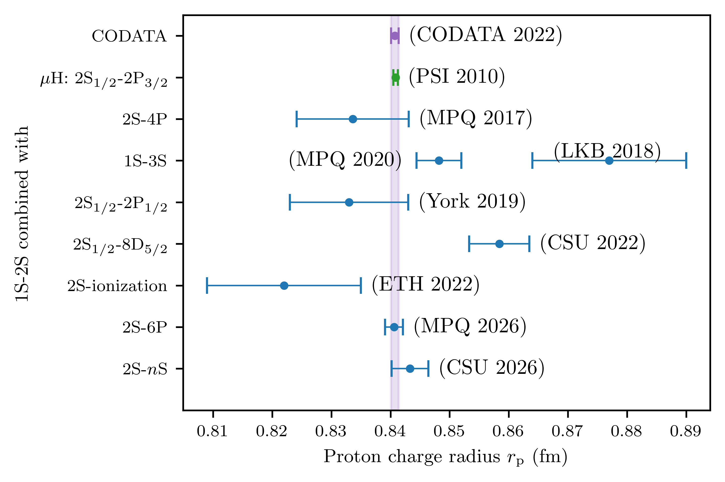
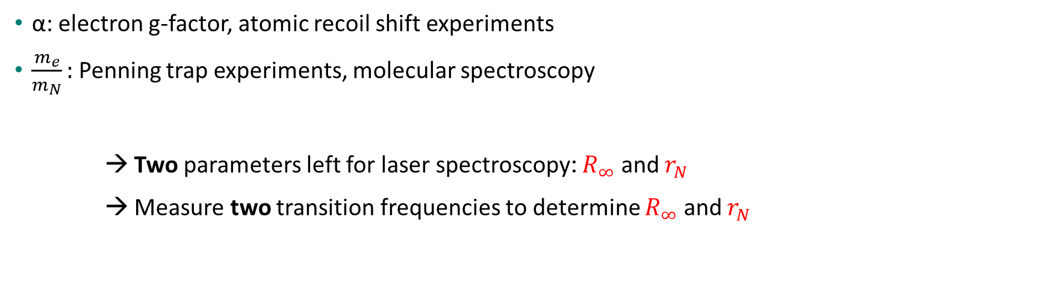
Testing QED by precision spectroscopy of Hydrogen-like systems
Rydberg constant
Fine structure constant
Electron/nucleus mass ratio
Nuclear charge radius
α: electron g-factor, atomic recoil shift experiments
$\frac{m_{e}}{m_{N}}:$ Penning trap experiments, molecular spectroscopy
→ Two parameters left for laser spectroscopy: $R_{∞}$ and $r_{N}$
→ Measure two transition frequencies to determine $R_{∞}$ and $r_{N}$
E. Tiesinga et al., Rev. Mod. Phys. 93, 025010 (2021)
D. Hanneke et al., Phys. Rev. Lett. 100, 120801 (2008)
L. Morel et al., Nature 588, 61 (2020)
S. Alighanbari et al., Nature 644, 69–75 (2025)

Slide 3
Target: 1s-2s Transition in He+
Independent QED test (in combination with µHe+ measurements)
Sensitive to higher order QED corrections (∝ Z⁵⁻⁷)
Trapped and cooled target → small systematics
2s
Γ ≈ 2π × 84 Hz
2 x 61 nm
1s
J. Moreno et al., Eur. Phys. J. D 77, 67 (2023)
J.J. Krauth et al., Nature 589, 527–531 (2021)
3

Slide 4
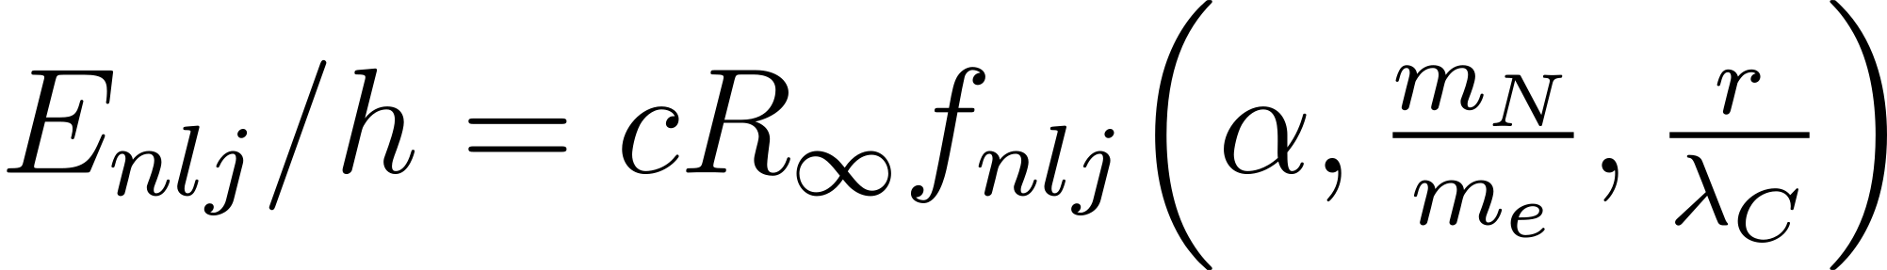
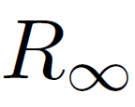



Scanning Range
Expected observational linewidth: 1 kHz
Parameters | Contribution to Uncertainty (He⁺ 1s-2s)
Rydberg constant
Hydrogen spectroscopy
μ-H + H (1s-2s), CODATA2022
1x10⁻¹² (10 kHz)
Nuclear charge radius
7x10⁻¹² (74 kHz)
μ-He spectroscopy [1, 2]
Nucleus/electron mass
5x10⁻¹⁵ (45 Hz)
Mass ratio measurements
in Penning traps
Fine structure constant
2x10⁻¹⁴ (166 Hz)
Atomic recoil (atom interferometer)
g-2 measurement
Uncertainty from He⁺ QED: 4x10⁻¹² (36 kHz)
[1] J.J. Krauth et al., Nature 589, 527–531 (2021)
[2] S. S. Li Muli et al., Phys. Rev. Lett. 134, 032502 (2025)

Slide 5
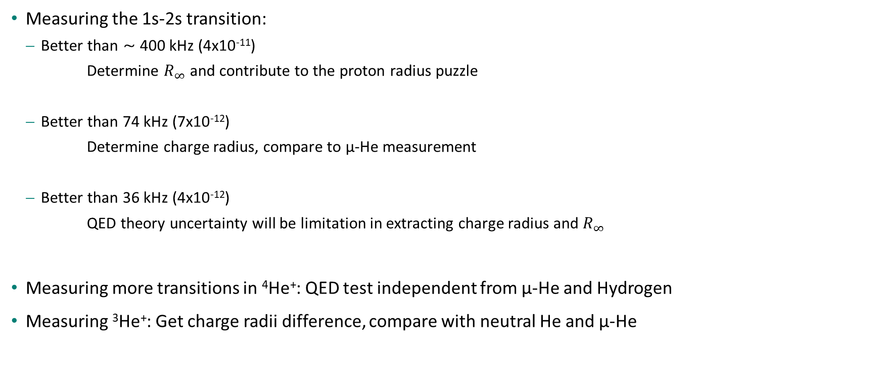
He+ Spectroscopy for Testing QED
Measuring the 1s-2s transition:
  Better than ⁓ 400 kHz (4x10⁻¹¹)
  Determine $R_{∞}$ and contribute to the proton radius puzzle
  Better than 74 kHz (7x10⁻¹²)
  Determine charge radius, compare to µ-He measurement
  Better than 36 kHz (4x10⁻¹²)
  QED theory uncertainty will be limitation in extracting charge radius and $R_{∞}$
Measuring more transitions in ⁴He⁺: QED test independent from µ-He and Hydrogen
Measuring ³He⁺: Get charge radii difference, compare with neutral He and µ-He
Sun, Y. R. and Hu, S.-M., National Science Review 7, 1818–1827 (2020)
The CREMA Collaboration, arXiv.2305.11679 (2023)

Slide 6



Direct Frequency Comb Spectroscopy
Line width of a single comb mode
Efficient nonlinear frequency conversion due to high peak power of pulsed laser
As efficient as CW laser of same average power
Spectroscopy signal: He²⁺
< 91 nm
2S
XUV comb at 61nm
2 x 61 nm
1S
He⁺
6

Slide 7
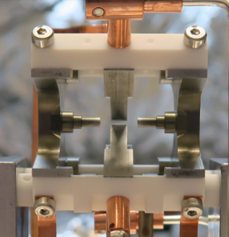
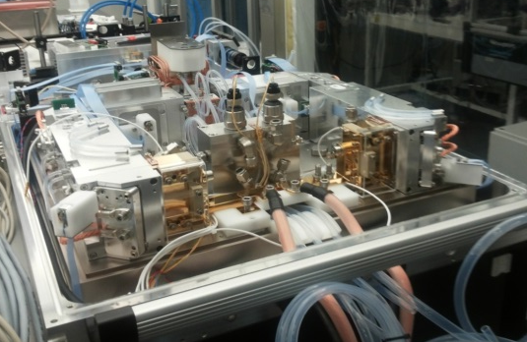
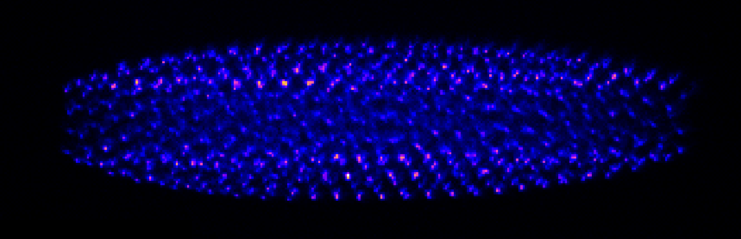
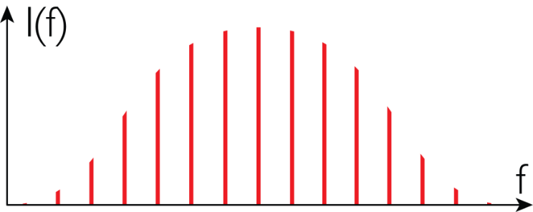
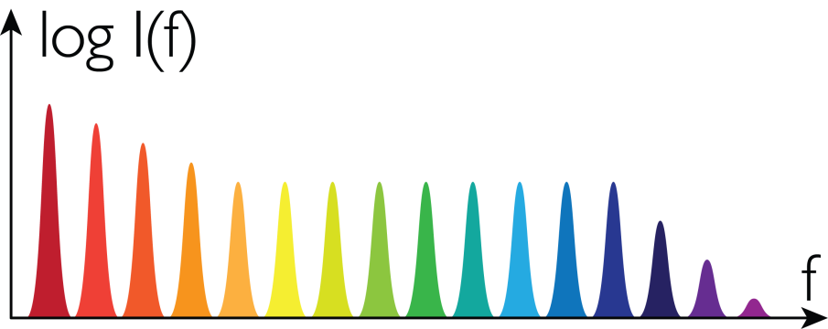
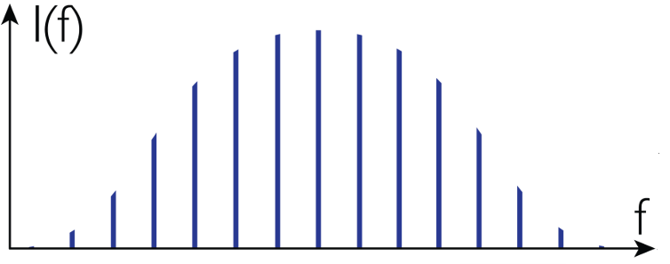
He⁺ spectroscopy setup: overview
High-power IR
frequency comb
Frequency comb
at 61 nm
Trapped He⁺ ions
Yb:KYW laser + amplifiers
@1030 nm
Intracavity
high-harmonic generation
17th harmonic
300 W Innoslab amplifier
(Fraunhofer ILT)
HHG
High-harmonic generation
17th harmonic
IR frequency comb
1030 nm
Odd-order harmonics
XUV frequency comb
61 nm

Slide 8

61 nm laser system
Yb:KYW oscillator (frequency comb)
Seed laser
f
40 MHz, 10 mW, λ = 1030 nm
Yb:LuAG preamplifier x2
Yb:YAG amplifier (Innoslab)
Multi-pass-cell spectral broadening
Amplification
&
compression
(+ double-pulse generation)
(two stages)
2.7 W
Δλ = 2.3 nm
270 W, Δλ = 1.6 nm, 𝜏 = 1.1 ps
230 W , 1010 - 1060 nm, 59 fs
Intracavity high-harmonic generation
(non-collinear geometry)
XUV comb
generation
XUV comb
to He⁺ trap
HHG
$\sim$30 µW at 61 nm
5 kW, < 100 fs

Slide 9
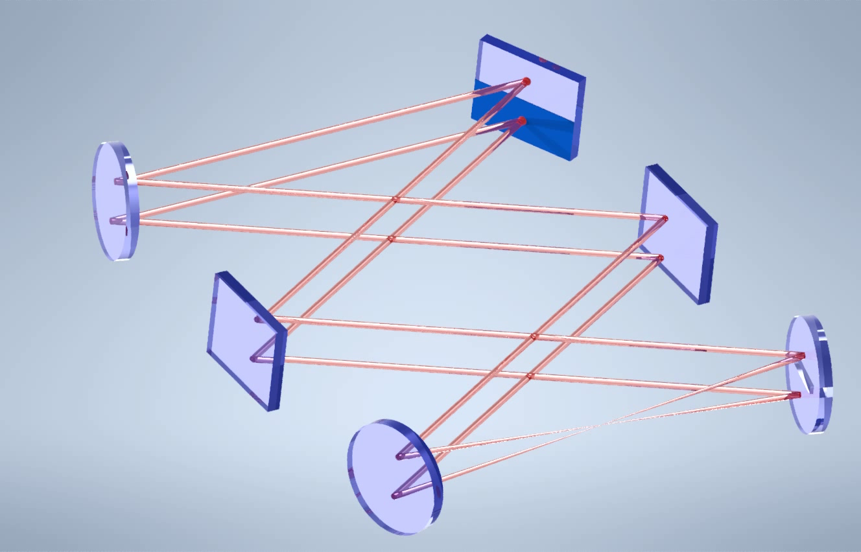
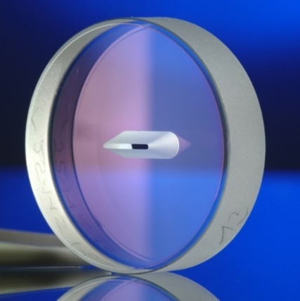
Enhancement Resonator for HHG
Comb f_{rep} = 40 MHz
Segmented input coupler
Cavity FSR = 20 MHz
Mirror with slit
Wedge mirror
frequency comb
at 61 nm
Side view
Xe gas for HHG
9
Wissenberg, S. H. et al., Phys. Rev. Res. 7, 023071 (2025)

Slide 10
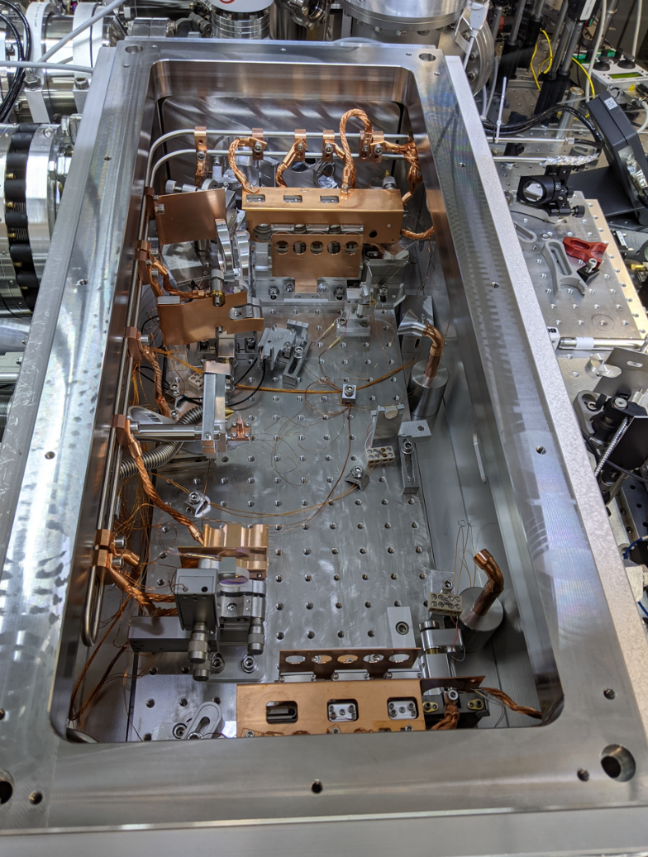
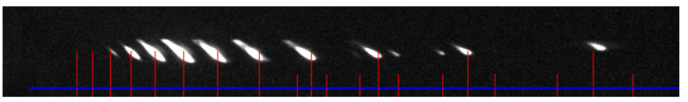
Optical frequency comb at 61 nm
H23
H19
H25
41nm
H21
H17
61nm
H15
H13
H11
H9
115nm
~30 µW at 61 nm
~ 0.1 Hz signal rate (ionization)

Slide 11
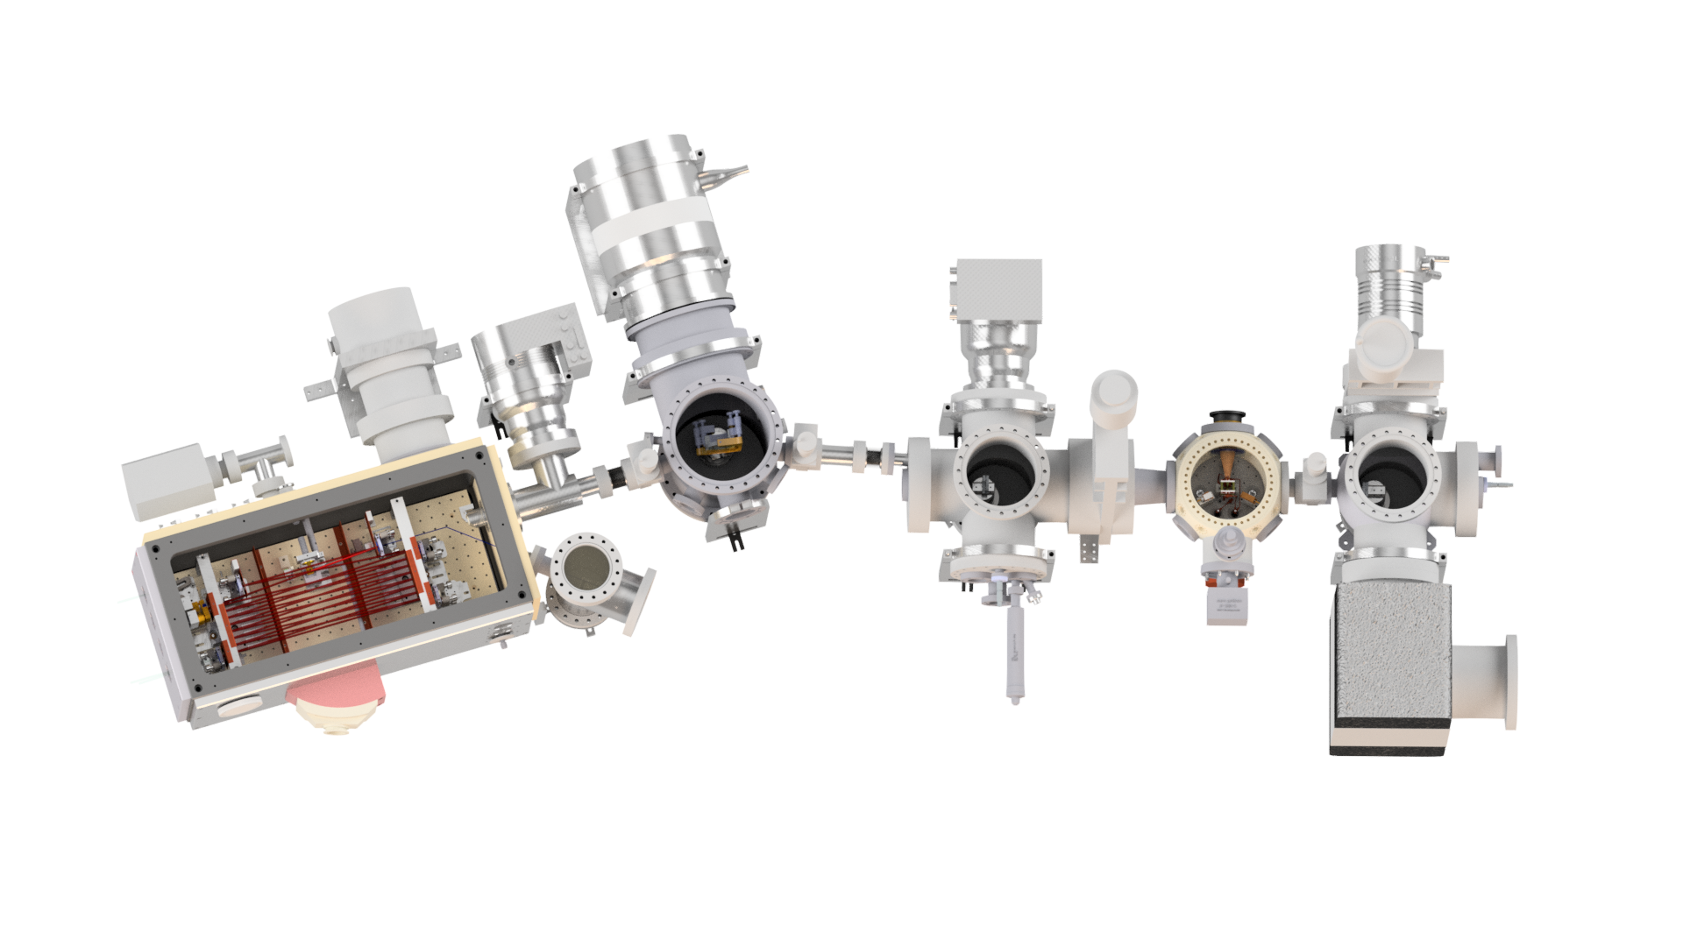

XUV beam delivery to trapped He+
recoil- and Doppler-free
Anti-collinear excitation
Ion trap
HHG chamber
XUV grazing incidence mirror
(R=70% @ 61 nm)
XUV focusing mirrors
(R=30% @ 61 nm)
11

Slide 12
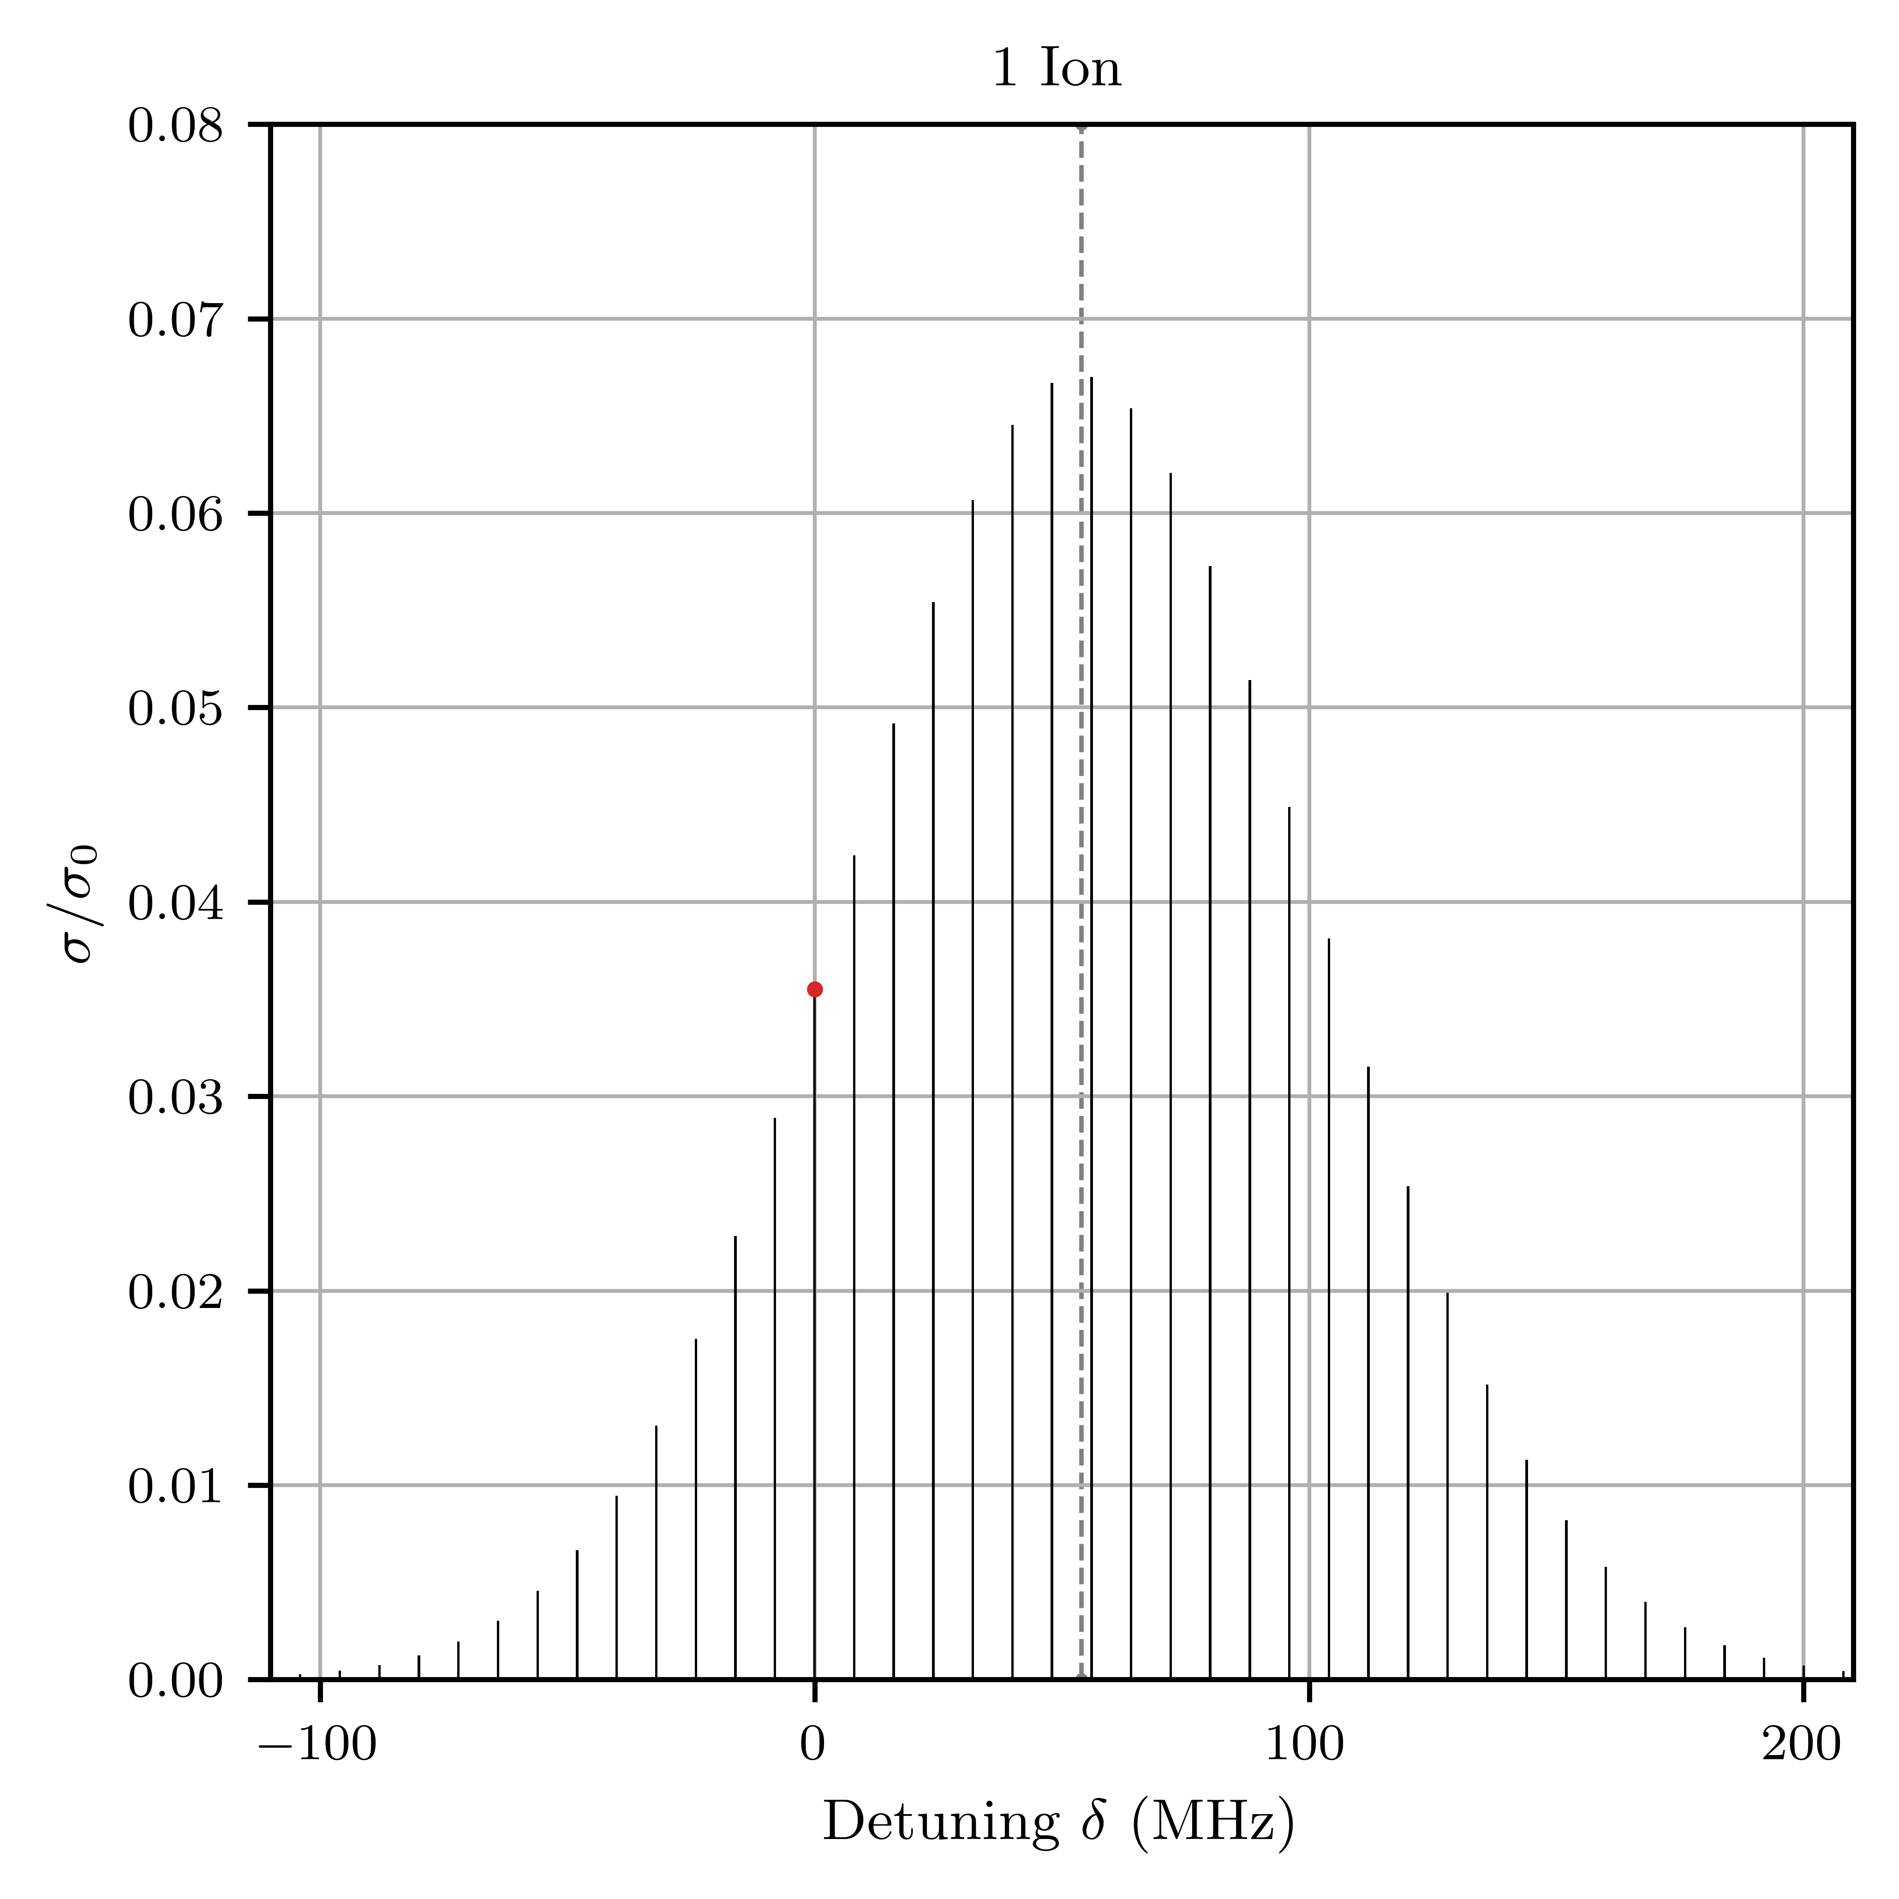
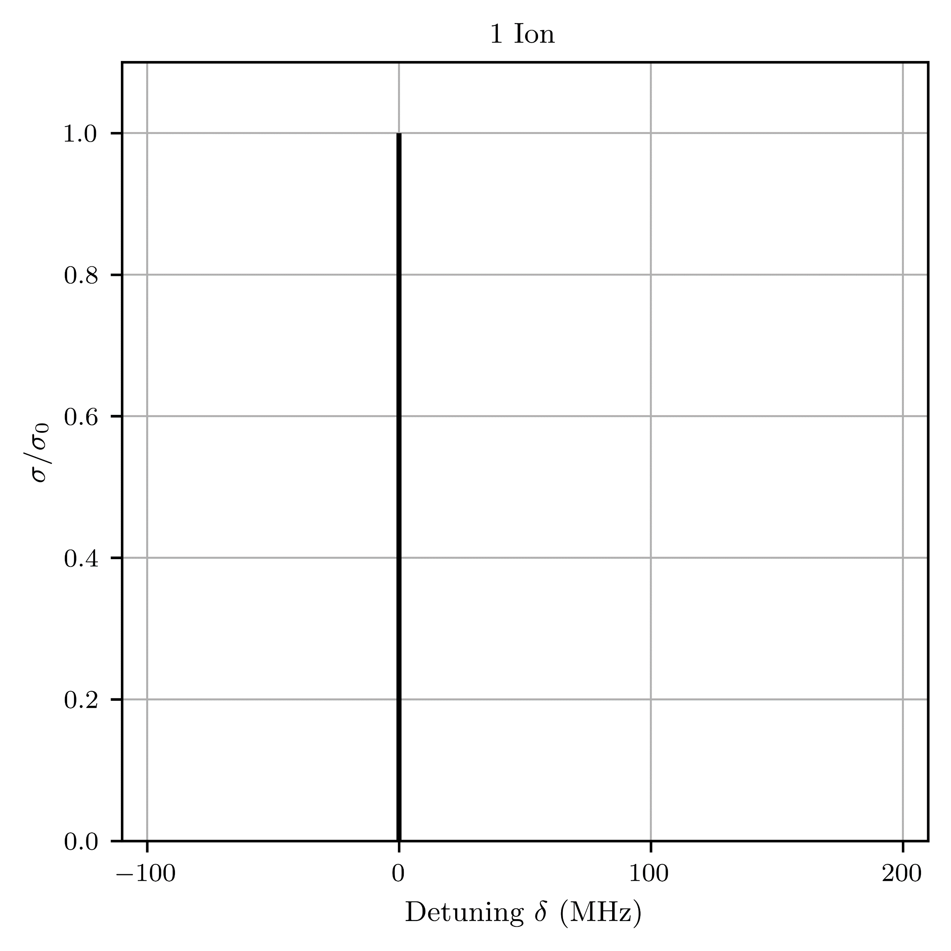
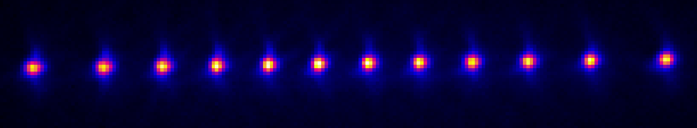
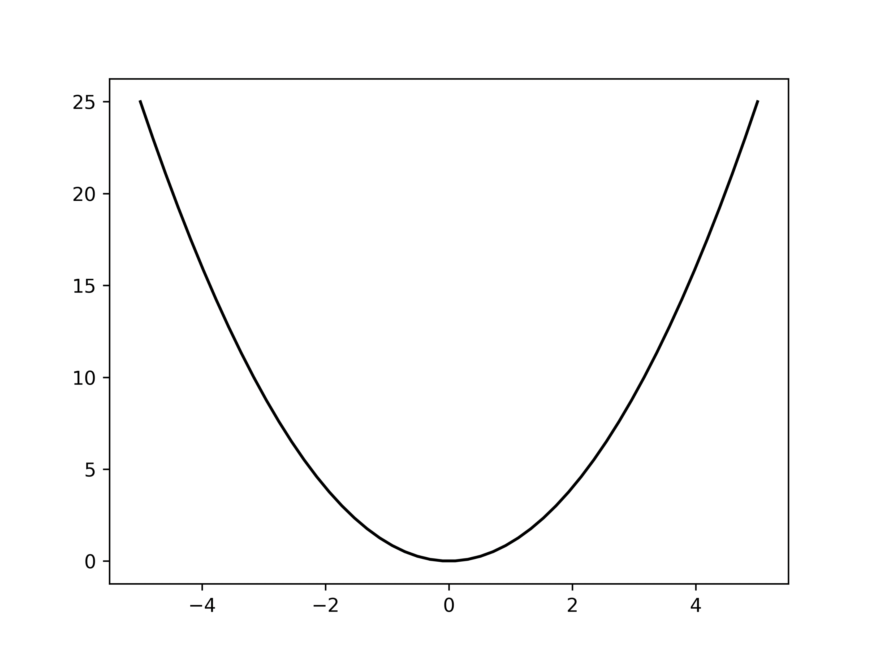



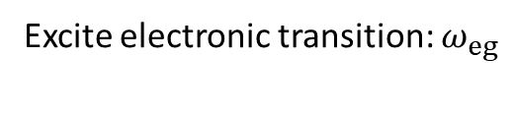


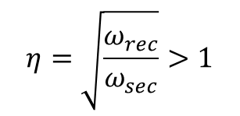

Single Ion Laser Excitation in Harmonic Oscillator
Laser
Laser
$$ω_{rec}$$
$$|e⟩$$
Excite electronic transition: $ω_{eg}$
$$|g⟩$$
carrier
$$ω_{sec}$$
$$ω_{sec}$$
$$ω_{rec}=\frac{{ℏk}^{2}}{2m}≥ω_{sec, ax}$$
$$η=\sqrt{\frac{ω_{rec}}{ω_{sec}}}>1$$
F. Egli et al., arXiv:2605.07942 (2026)

Slide 13

Spatial and Temporal Alignment of the XUV Beam
Harmonics + IR leak
IR (1030 nm)
SHG
Linear chain of Be⁺
Linear chain of Be⁺
➤ Drive Raman transition in Be⁺ with 515 nm pulses

Slide 14




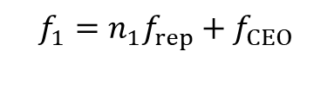

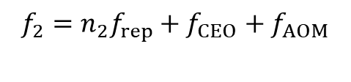

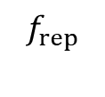

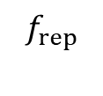

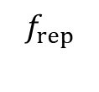



Pulse Overlap: Raman Transitions in Be⁺ ground state HFS
$${f_{1}=n_{1}f}_{rep}+f_{CEO}$$
Virtual state
$$f_{CEO}$$
$$f_{rep}$$
515 nm
Comb 2
$$f$$
$$f_{rep}$$
AOM
$$f_{rep}$$
$${f_{2}=n_{2}f}_{rep}+f_{CEO}+f_{AOM}$$
Comb 1
$$f_{1}$$
$$f_{2}$$
F=1
$$f$$
$$f$$
$$f_{CEO}$$
$Δ=1.25$ GHz
$$f_{CEO}+f_{AOM}$$
F=2
$${|f}_{1}−f_{2}|=Δ$$
$f_{1}−f_{2}=\left(n_{1}−n_{2}\right)f_{rep}+f_{AOM}$
$$Δn$$
1.25 GHz
40 MHz
87 MHz
29
Paschke, A.-G. et al., Phys. Rev. Lett. 122, 123606 (2019)

Slide 15
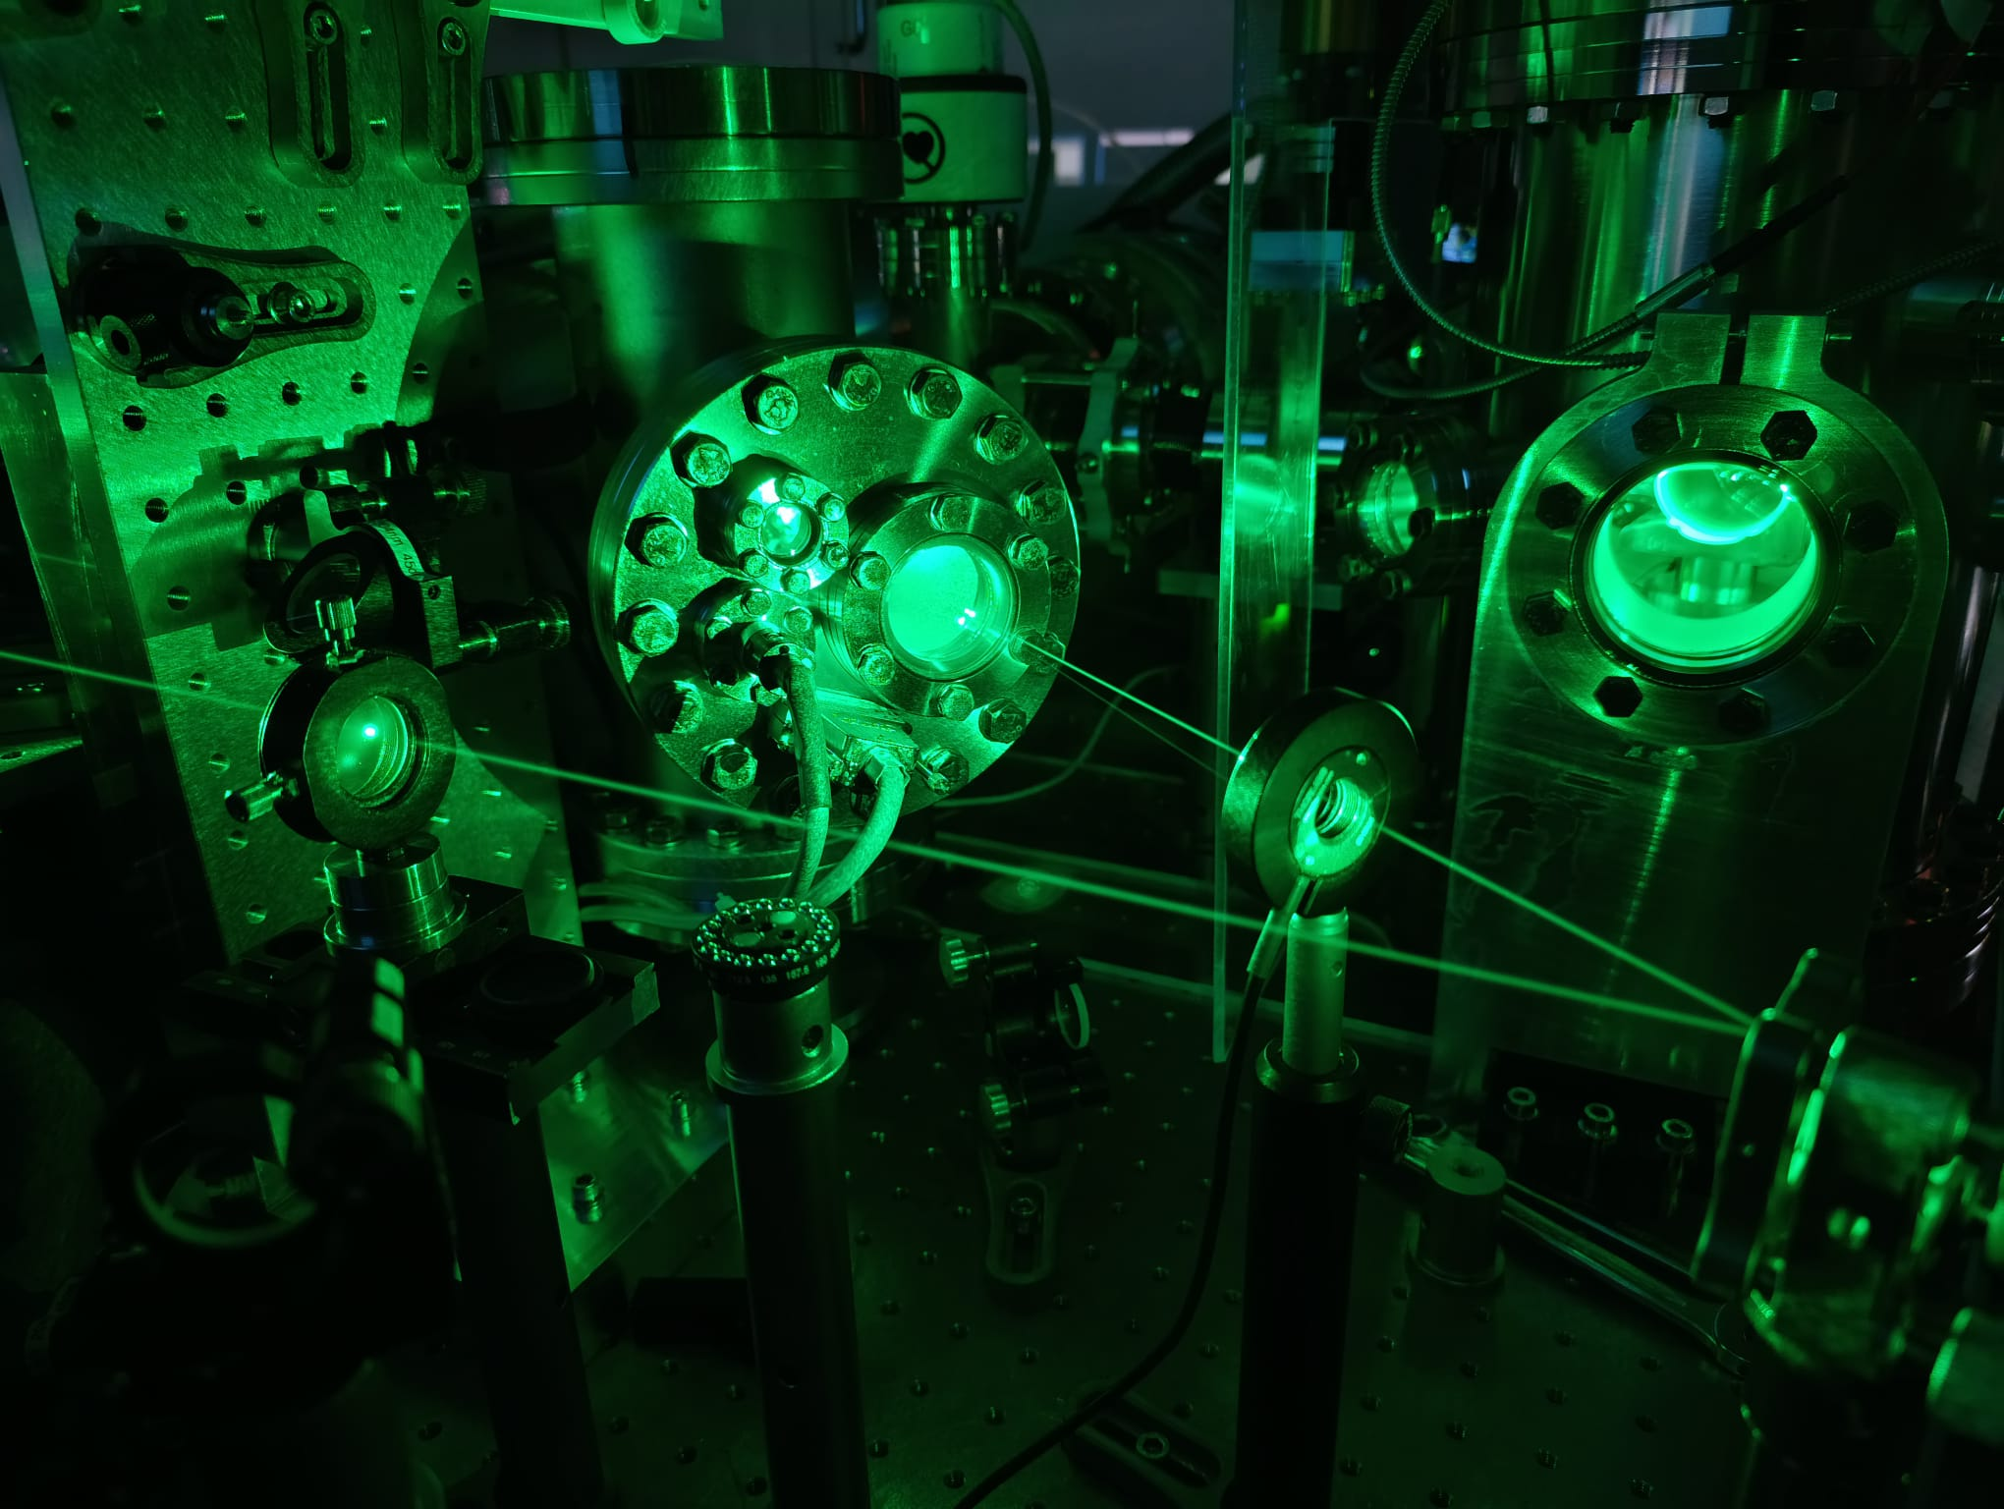
Pulse Overlap: Raman Transitions in Be⁺ ground state HFS
Beam Switcher
(rotational stage with mirrors)
Grazing Incidence Plate (GIP)
Ion trap
HHG chamber
Achieved:
- Comb at 515 nm with ⁓ 4W (SHG from IR)
- Double pass AOM setup
SHG
515 nm
XUV focusing mirrors
(R=50% @ 515 nm)
XUV Spectrometer
1030 nm
After losses: Power @ ions ~300 mW
Estimated π-time ~250 ms

Slide 16
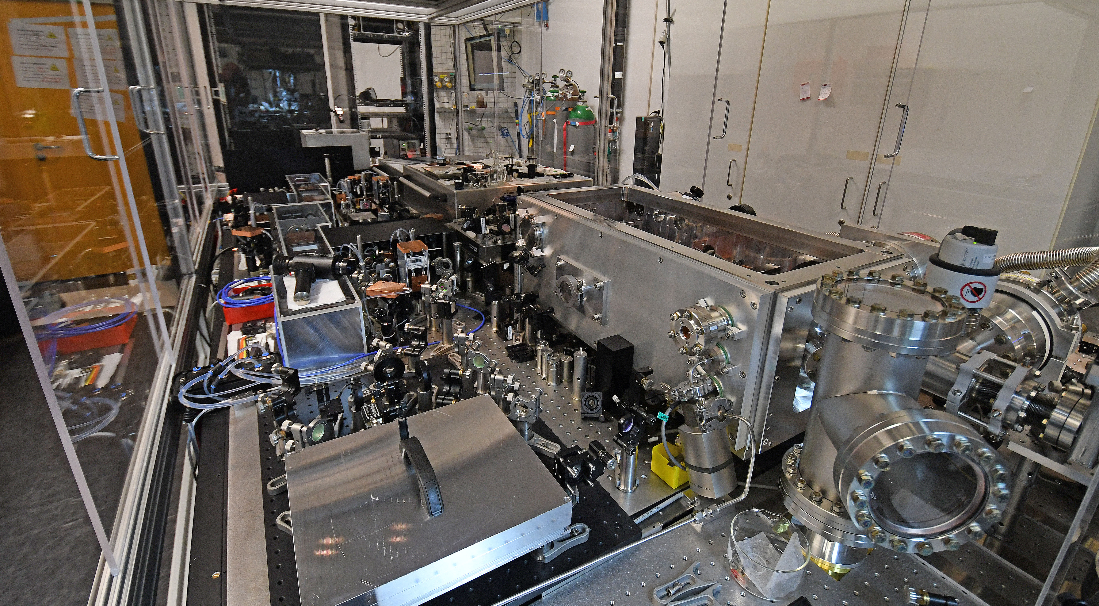
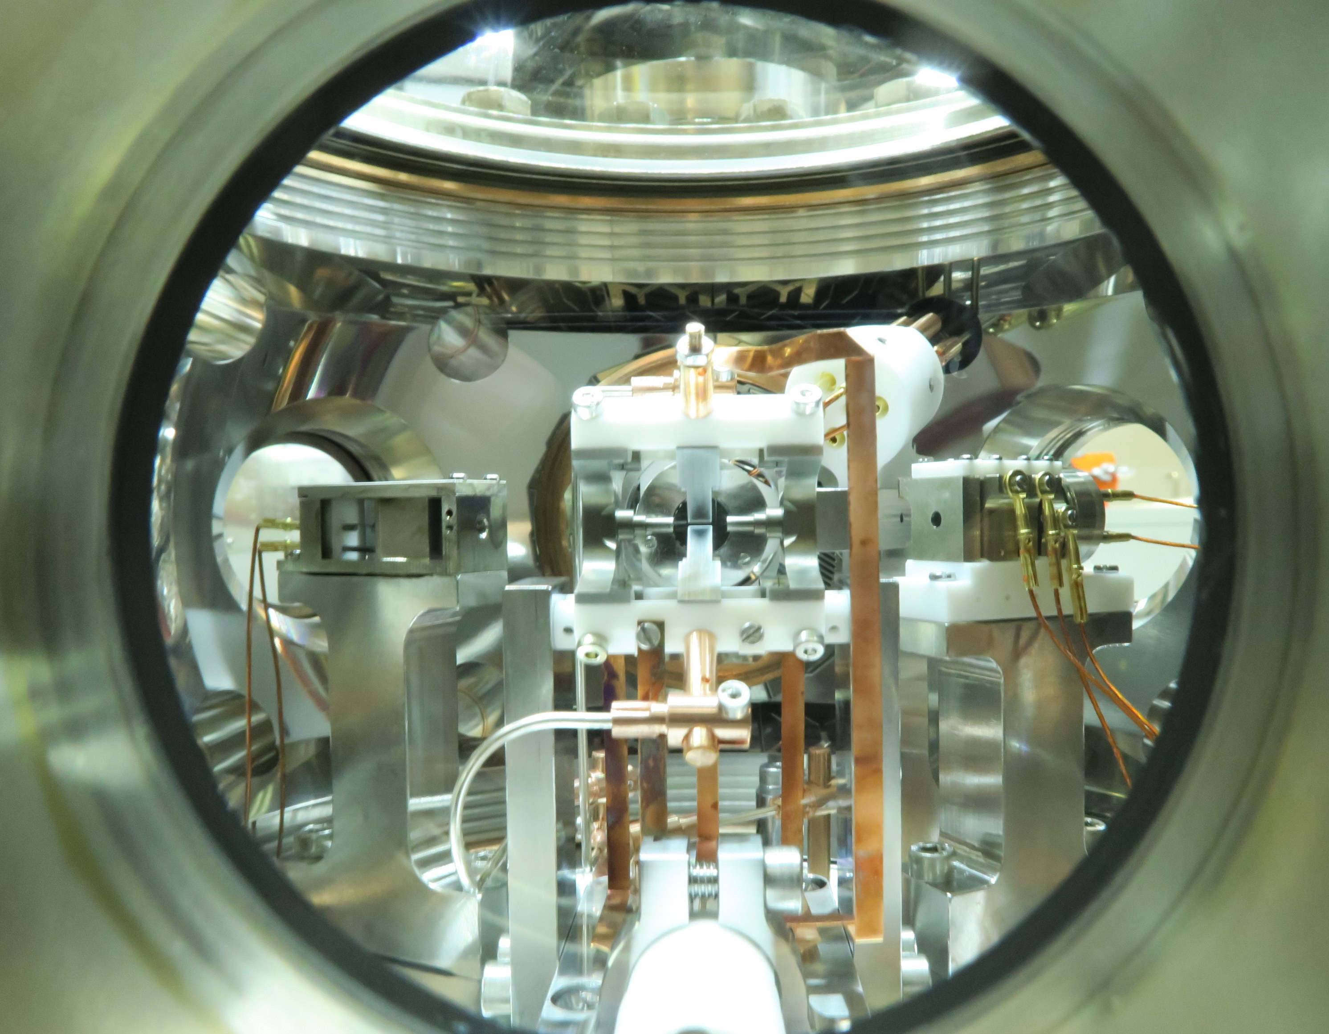
XUV frequency comb source
Ion trap

Slide 17
Single Ion Laser Excitation in Harmonic Oscillator
Laser
$$ω_{rec}$$
$$|e⟩$$
Excite electronic transition: $ω_{eg}$
$$|g⟩$$
carrier
$$ω_{sec}$$
$$ω_{sec}$$
$$ω_{rec}=\frac{{ℏk}^{2}}{2m}≥ω_{sec, ax}$$
$$η=\sqrt{\frac{ω_{rec}}{ω_{sec}}}>1$$
F. Egli et al., arXiv:2605.07942 (2026)

Slide 18
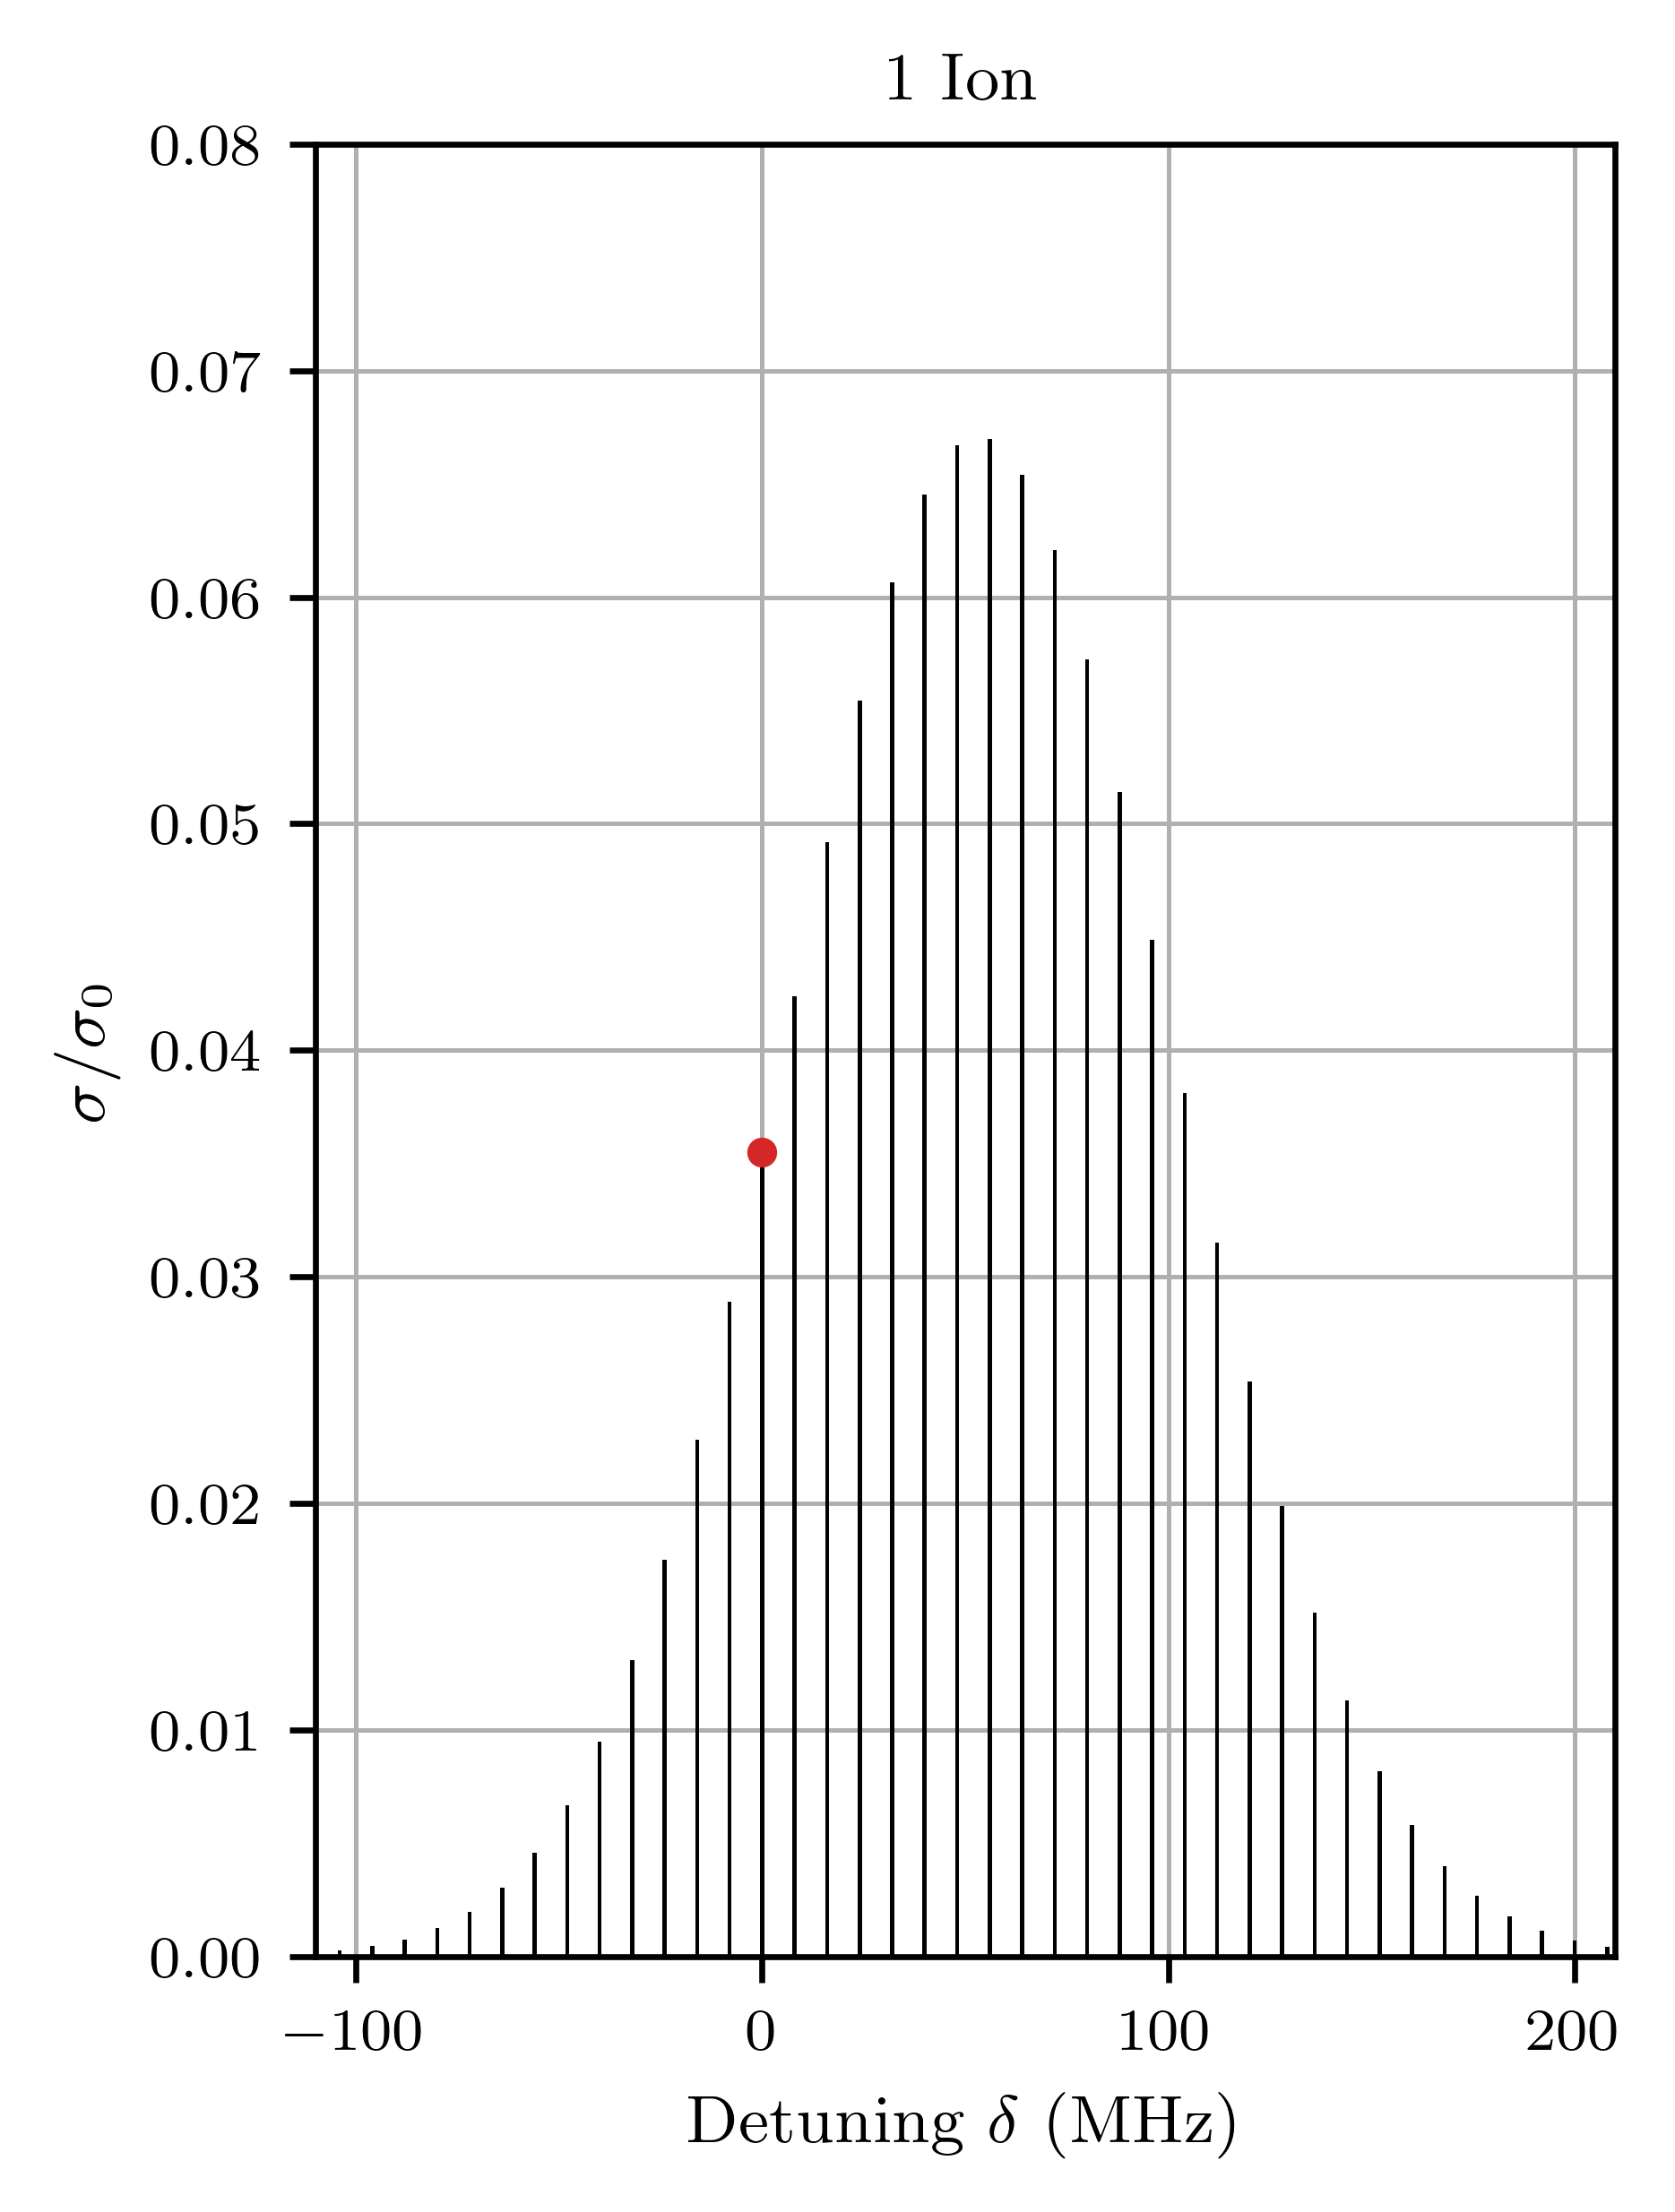
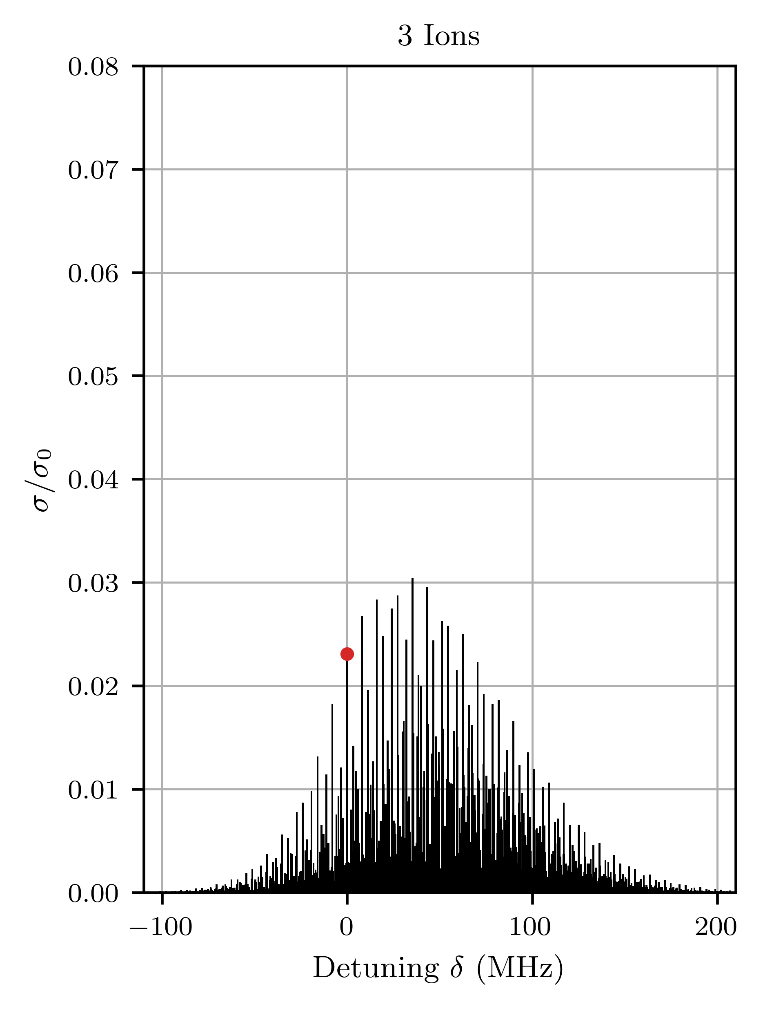
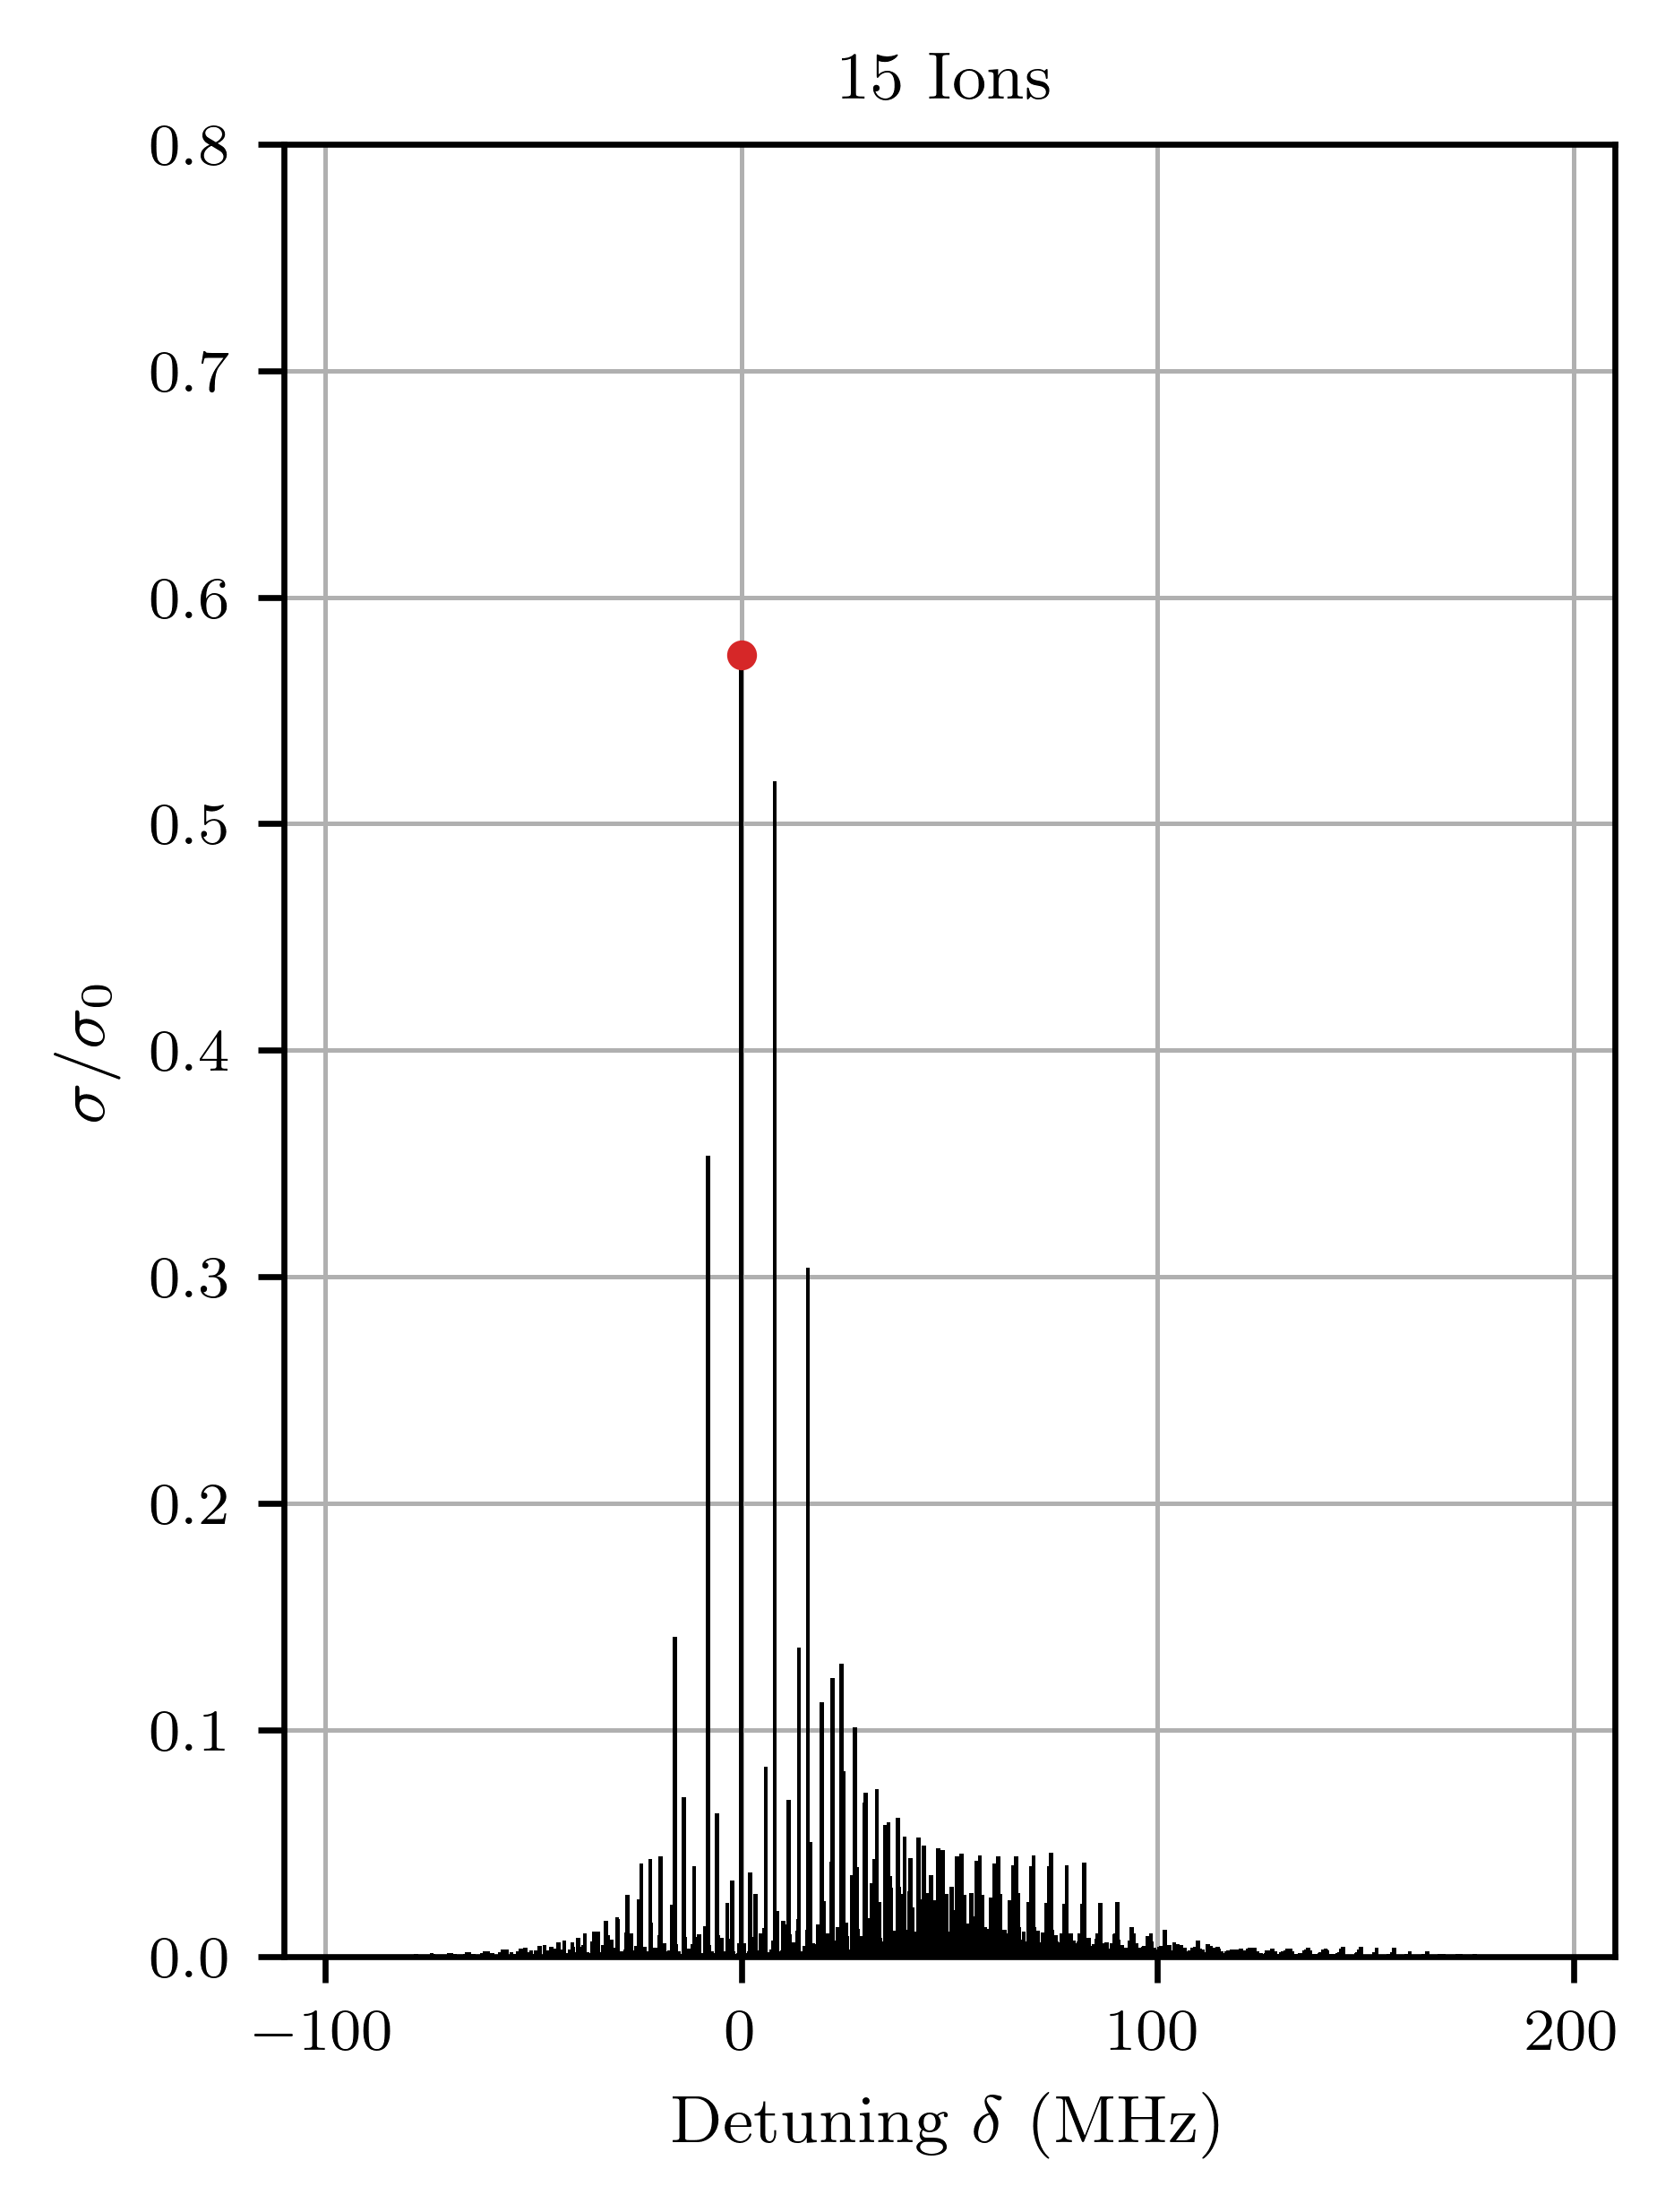
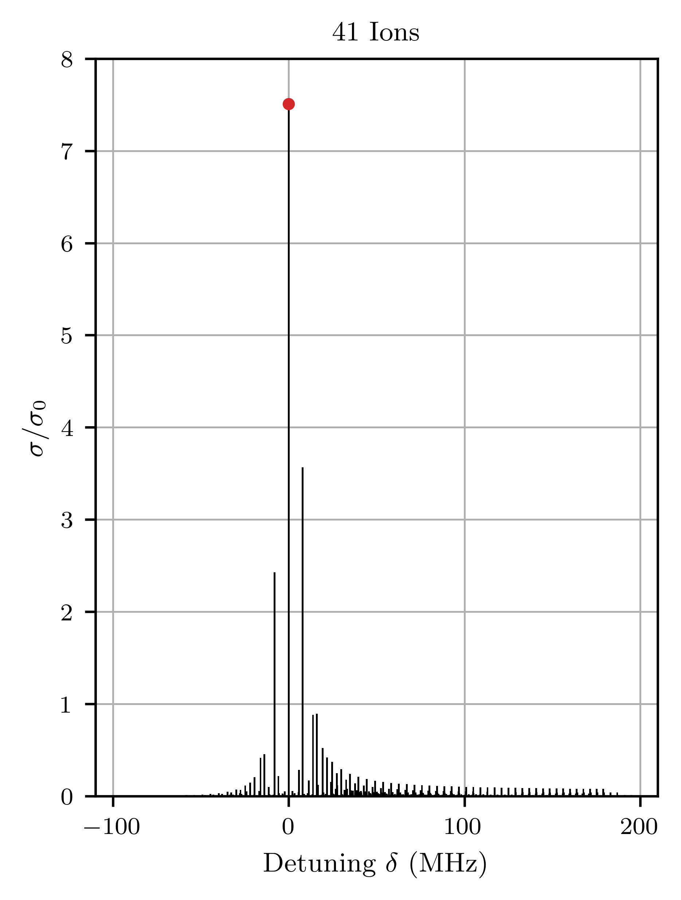

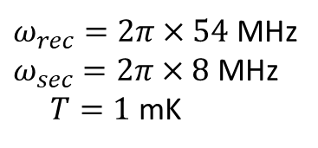
Carrier Revival in Linear Ion Chains
Sidebands $Δn=\left(Δn_{1},…,Δn_{N}\right)$
detuning $δ=\sum_{α}{Δn_{α}ω_{α}}$
$ω_{rec}=2π×54$ MHz
$ω_{sec}=2π×8$ MHz
$T=1$ mK
F. Egli et al., arXiv:2605.07942 (2026)

Slide 19

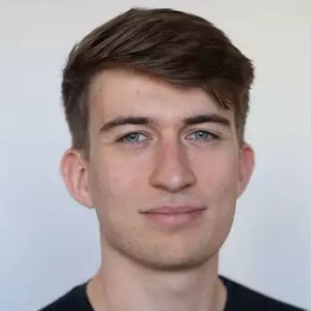


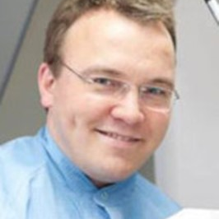
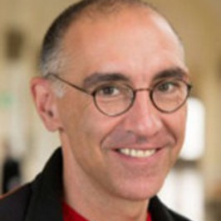
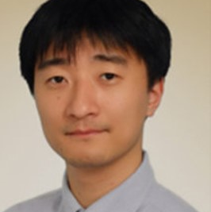
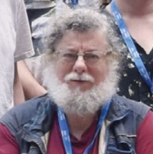
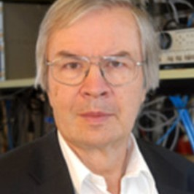
The He⁺ team
Jorge Moreno
Florian Egli
Muhammad Thariq
Erdem
Yilmaz
Johannes Weitenberg
Thomas Udem
Akira
Ozawa
Savely Karshenboim
Theodor W. Hänsch

Slide 20
Uncertainty due to QED theory for He⁺ 1s-2s transition
[1] Yerokhin A. and Shabaev V. M , Phys. Rev. A 93, 062514 (2016)
[2] Pachucki K. and Moro A. M, Phys. Rev. A 75, 032521 (2007)
[3] Karshenboim S. G et al. , Physics Letters B 795, 432–437 (2019)
[4] Karshenboim S. G et al. , Phys. Rev. A 100, 032515 (2019)
[5] Karshenboim S. G et al. , Phys. Rev. A 98, 022522 (2018)
[6] V. Yerokhin et al. , Annalen der Physik 531, 1800324 (2019)
[7] A.Czarnecki et al. , Phys. Rev. A 94, 060501 (2016)
[8] S. Laporta, Physics Letters B 800, 135137 (2020)
[9] Karshenboim S. G and Shelyuto V. A. , Phys. Rev. A 100, 032513 (2019)
Contribution | Uncertainty (in kHz)
Relativistic Recoil | 0
Nuclear Polarizability | 3
Self Energy | 0
Vacuum Polarization | 1
Two Loop Corrections | 32
Three Loop Corrections | 9.5
Four Loop Corrections | 0
Nuclear Size Correction to Self Energy | 0
Nuclear Size Correction to Vacuum Polarization | 0
Radiative Recoil | 12
Nuclear Self Energy | 0.6
Total | ~36 kHz
[1]
[2]
[3-7]
[3,4]
[8]
[9]
Total QED uncertainty : 36 kHz (4x10⁻¹²) (preliminary)

Slide 21
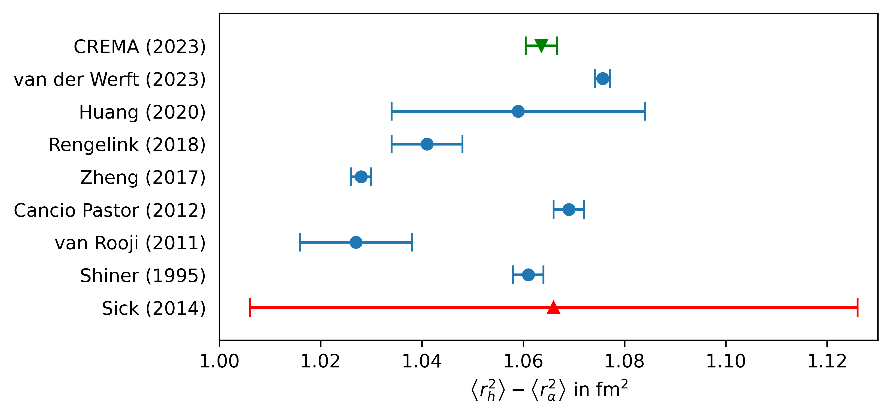
Helium: Difference of Squared Charge Radii
Sun, Y. R. and Hu, S.-M., National Science Review 7, 1818–1827 (2020)
The CREMA Collaboration, arXiv.2305.11679 (2023)

Slide 22
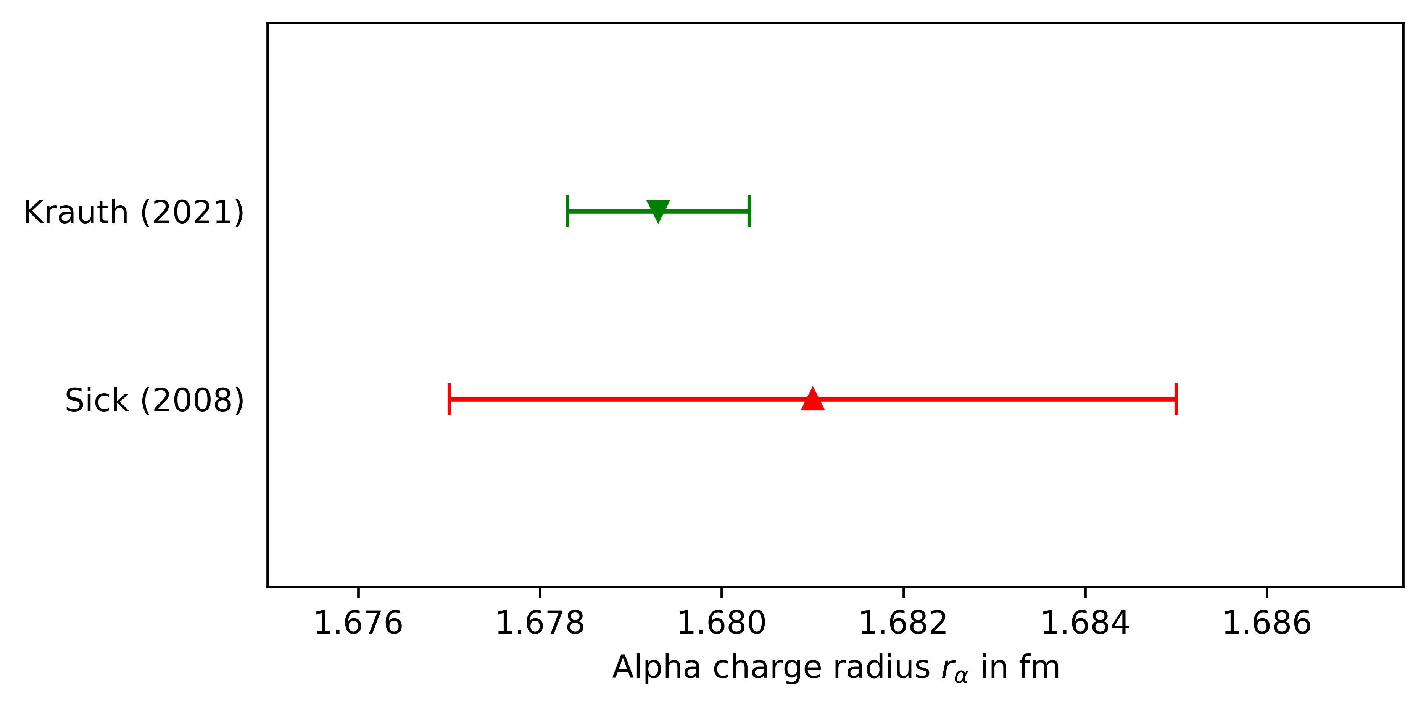

Helium Ions: Alpha Charge Radius
µHe + $R_{∞}$
e⁻ scattering
Krauth et al., Nature 589, 527–531 (2021).

Slide 23
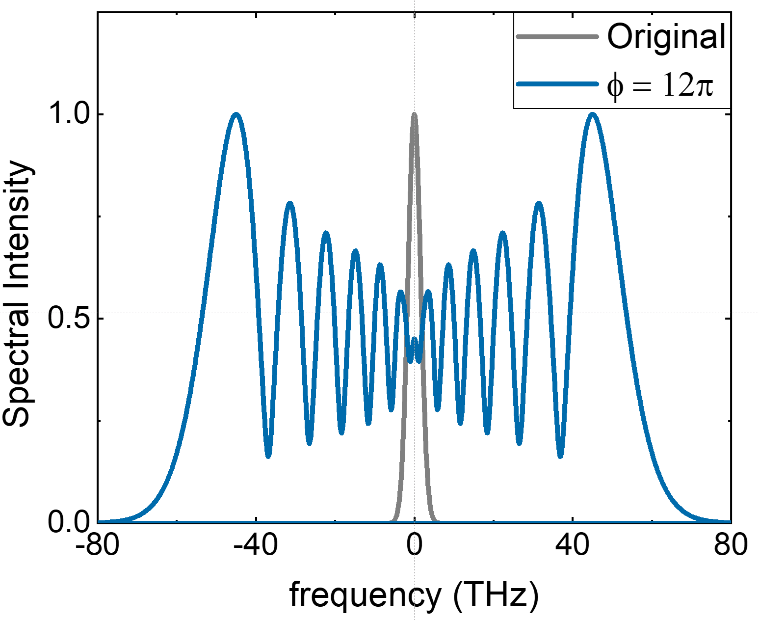
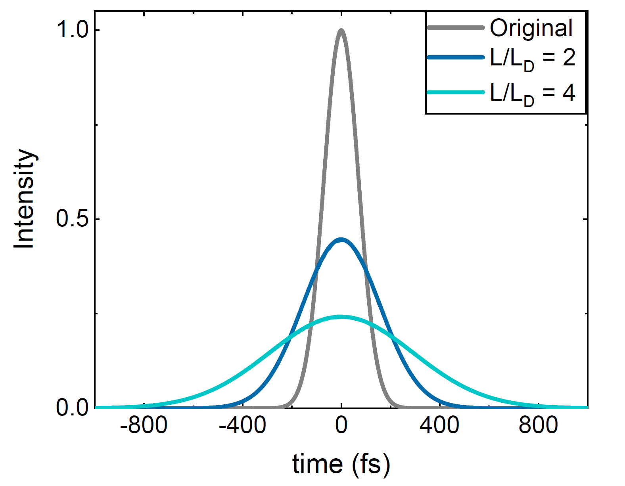
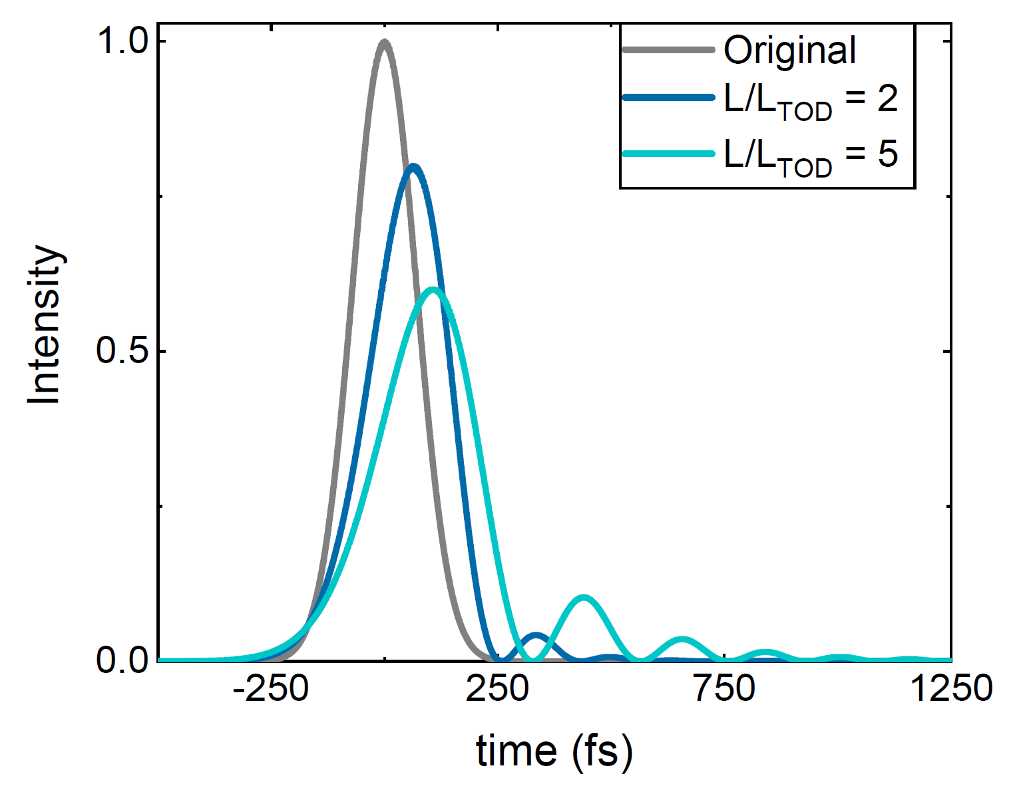
Understanding spectral broadening
SPM
Self-phase modulation
GDD
Second-order dispersion
TOD
Third-order dispersion
Not considering self-steepening, intrapulse Raman scattering…
Notes:
To understand and simulate spectral broadening, one needs to consider mainly two effects. The most important, self-phase modulation, is an intensity and time dependant phase in time domain, that causes modulation and broadening in frequency domain. But also chromatic dispersion or chirp play an important role, mainly through its leading term: the second order dispersion or GDD. This modulates the pulse amplitude in time domain by adding a frequency dependant phase in frequency domain. And one can also consider the next leading term in dispersion, which is the third order dispersion or TOD, which is the first term that introduces asymmetries in the pulses. In principle one can think that SPM affects only the spectral amplitude and dispersion affects only the pulse shape in time domain, but when acting together, they all affect the properties of the pulses both in time and frequency domains.

Slide 24
Simulating multi-pass cell spectral broadening
GDD
GDD+SPM
GDD
Simulation of MPCSB
GDD + SPM act together in Split-step Fourier method
Asymmetry only explained with strong TOD = − 0.5 ps³ present before MPCSB!
Agrawal, G. Nonlinear Fiber Optics. (Elsevier Inc, Cambridge, 2019)
Notes:
In order to calculate the spectral broadening, we can assume Gaussian pulses come into the MPCs and propagate such that they accumulate GDD in the focusing mirrors, and GDD and SPM simultaneosuly in the nonlinear element. This can be simulated via the Split-step Fourier method, where you split the propagating medium in small distance steps and you apply GDD to your pulses in frequency domain, then perform a Fourier transform to time-domain, apply your SPM phase and Fourier transform back. Then move to the next distance step and repeat this process until you have propagated your pulses through the whole medium. In principle, these MPCs are designed with specific values for GDD and SPM in mind, but when simulating the spectral broadening, we see that the asymmetry of the spectrum cannot be reproduced with these effects only. One could also include the TOD from the propagation in the nonlinear element, but this contribution is actually quite small. In order to reproduce this asymmetry, I had to make the initial pulses non-gaussian, with a very strong third order phase corresponding to a TOD of -0.5 ps3. We can then reproduce the spectrum quite well. We believe that this strong TOD contribution comes from the very strong gain narrowing in the previous amplification stages, but this is something that still needs to be studied in more detail.

Slide 25



XUV Spectrometer
Response function obtained from He⁺ lamp spectroscopy
(second order diffraction of 1s – 2p emission at 30.4 nm)
resolution 0.18 nm
repeatability 0.0015 nm

Slide 26



Comb stabilization
Cavity-stabilized cw laser (ECDL)
Fixed point (depends on noise source)
Comb mode locked at $f_{1S−2S}/34$
Yb:KYW oscillator
f
f
Noise cancelled by two-photon excitation

