Slide 1

Precision Spectroscopy Single HD⁺ Ions in a Penning Trap
Matthew Bohman

Slide 2
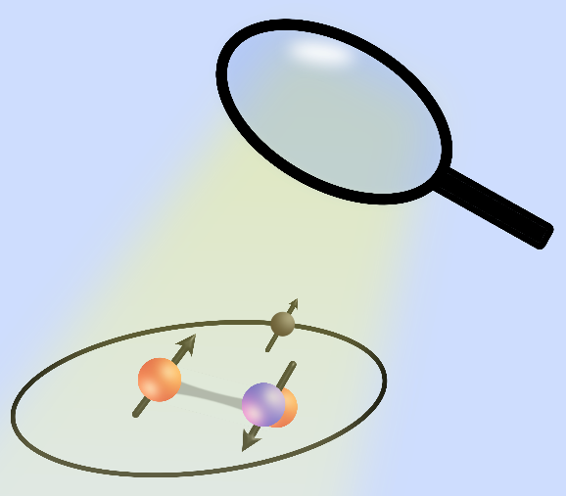
The Simplest Molecules
Highly calculable with bound state quantum electrodynamics (QED)
Determination of fundamental constants
High precision tests of the Standard Model
e
p
d
Simple molecules let us investigate the properties of fundamental particles and how they interact

Slide 3
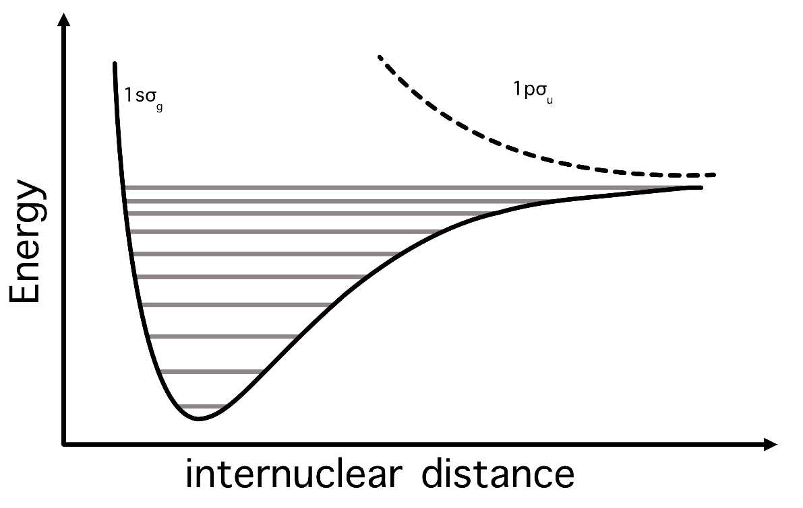
Diatomic MHI Observables
Single, bound electronic energy level
Hundreds of unique rotational, vibrational energy levels
Each level has unique hyperfine structure (HFS)

Slide 4
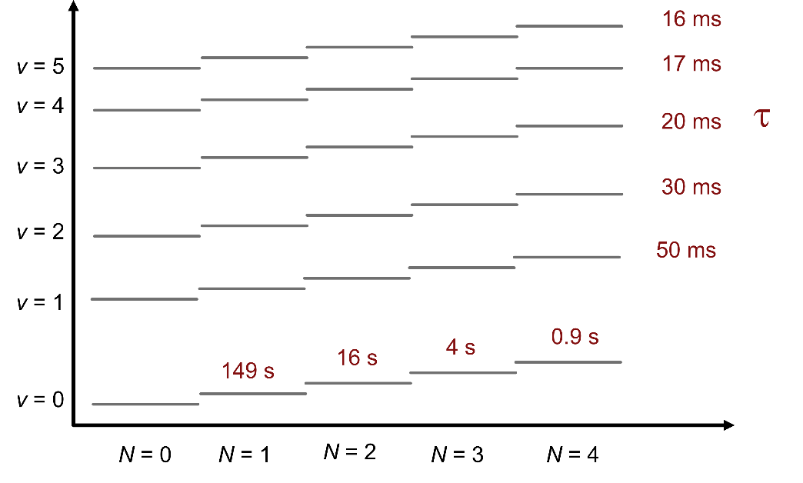
Diatomic MHI Observables

Slide 5
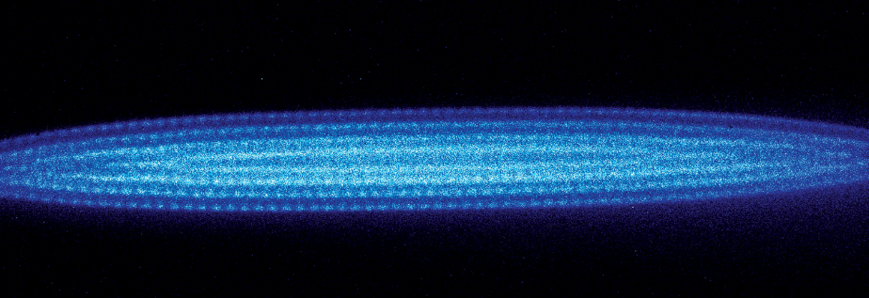
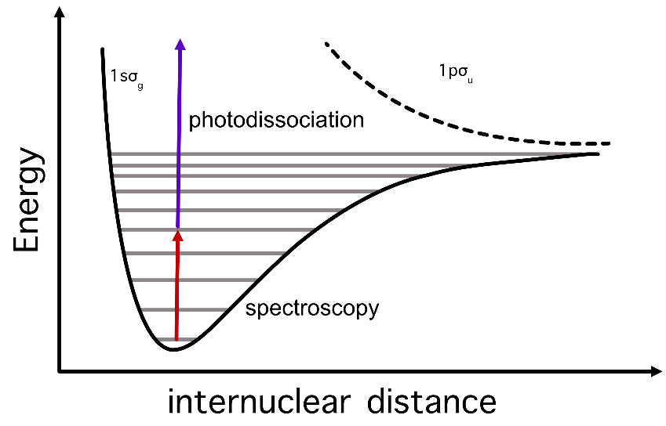
Status of MHI Experiments
Coulomb Crystal Experiments
  HHU Düsseldorf
  VU Amsterdam
  LKB Paris
  Wuhan
Science 2020
In RF traps, a small number MHI (<100) is trapped in a Coulomb crystal of laser cooled Be+ ions
Detection via photodissociation -> discrete drop in fluorescence

Slide 6
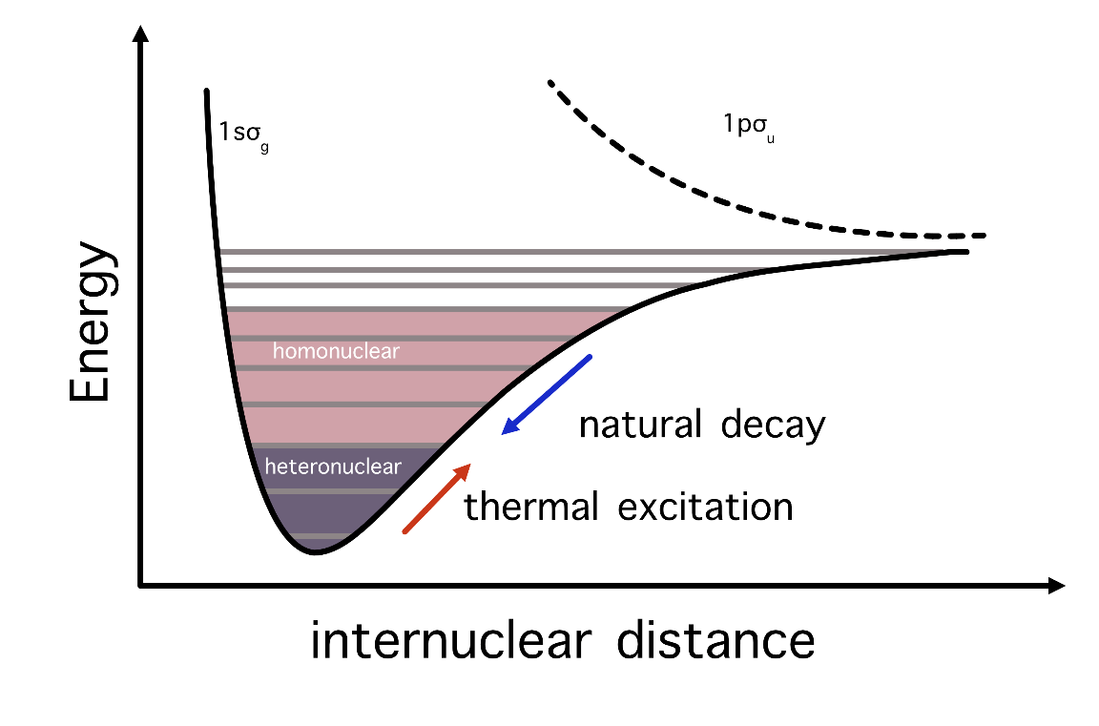
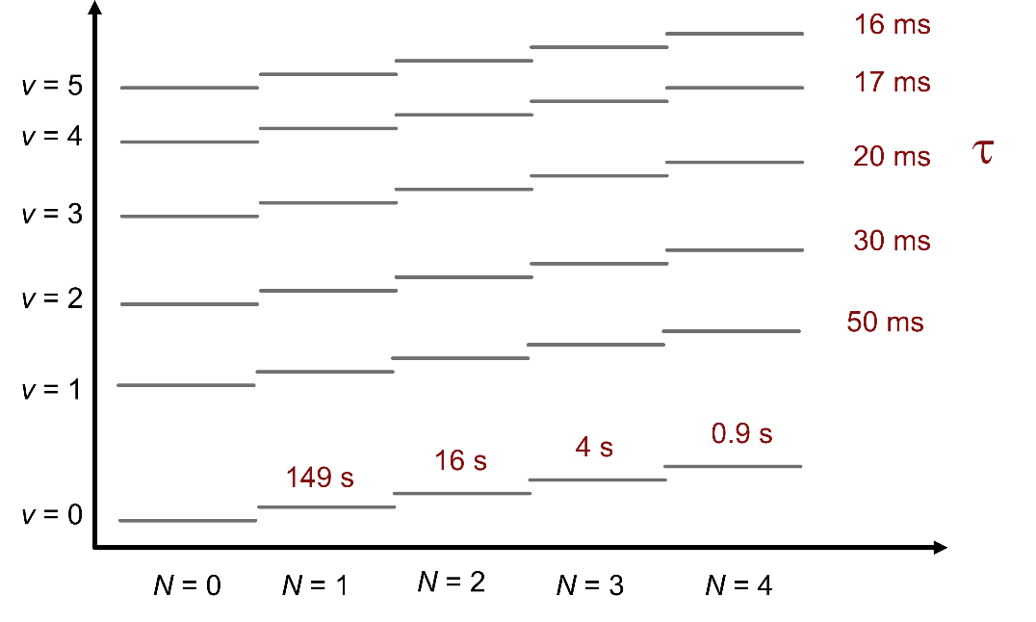
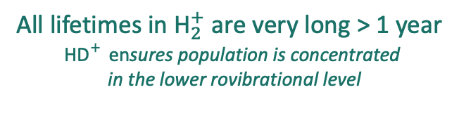

${\text{H}\text{D}}_{}^{+}$ vs. ${\text{H}}_{2}^{+}$
All lifetimes in ${\text{H}}_{2}^{+}$ are very long > 1 year
${\text{H}\text{D}}_{}^{+}$ ensures population is concentrated
in the lower rovibrational level
$${\text{H}\text{D}}_{}^{+}$$

Slide 7
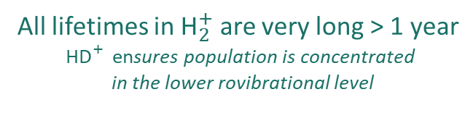
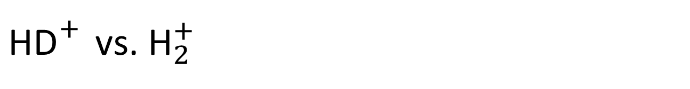
${\text{H}\text{D}}_{}^{+}$ vs. ${\text{H}}_{2}^{+}$
Multi-ion thermal distribution
Single ion
All lifetimes in ${\text{H}}_{2}^{+}$ are very long > 1 year
${\text{H}\text{D}}_{}^{+}$ ensures population is concentrated
in the lower rovibrational level
$${\text{H}\text{D}}_{}^{+}$$

Slide 8
${\text{H}\text{D}}_{}^{+}$ vs. ${\text{H}}_{2}^{+}$
Single ion
All lifetimes in ${\text{H}}_{2}^{+}$ are very long > 1 year
${\text{H}\text{D}}_{}^{+}$ ensures population is concentrated
in the lower rovibrational level
$${\text{H}\text{D}}_{}^{+}$$

Slide 9
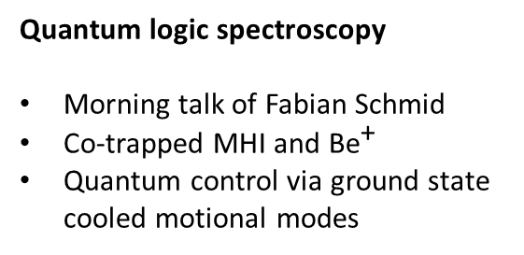

New approaches
Quantum state control dramatically changes the experimental landscape
and require new experimental approaches
Quantum logic spectroscopy
Morning talk of Fabian Schmid
Co-trapped MHI and $\text{B}{\text{e}}^{\text{+}}$
Quantum control via ground state cooled motional modes
Penning traps
MPIK in collaboration with HHU Düsseldorf
“Exotic ion” approach using species independent state detection
Extension in the future to antimatter ${\overline{\text{H}}}_{\text{2}}^{\text{−}}$

Slide 10
Penning trap approach
Techniques of precision Penning trap experiments, namely, g-factor measurements of highly charged ions or antimatter enable optical spectroscopy at the highest levels of precision.
MHI Campaign at ALPHATRAP
Goals
External injection and capture of MHI, long-term ion storage (months+)
Quantum control of single MHI
Employ quantum control for precision measurement
Flagship measurement:
laser spectroscopy of the $\left(v,N\right)=\left(0,0\right)→(5,1)$ transition with sub-kHz precision

Slide 11
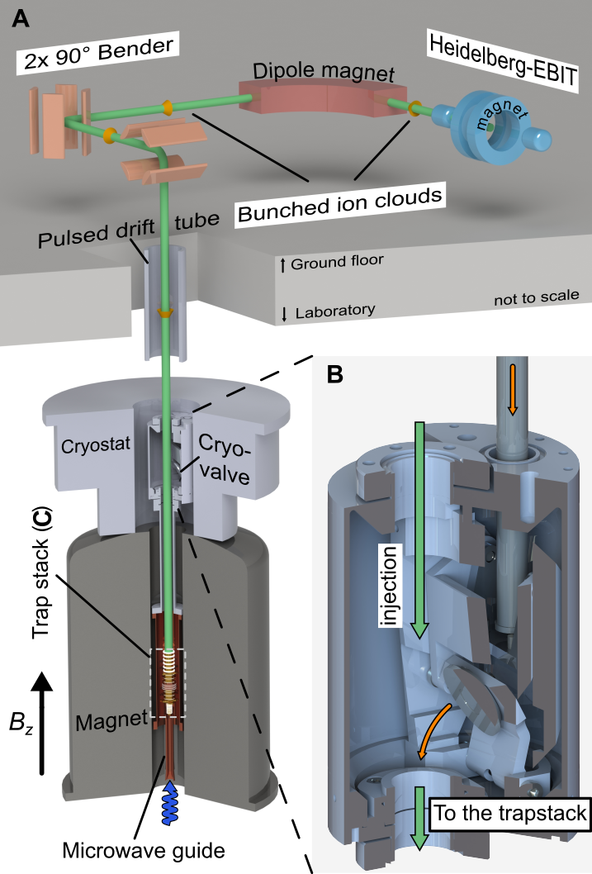
ALPHATRAP Experiment
Ions from electron beam ion traps (EBITs)
Designed for precision measurements of highly-exotic heavy hydrogen-like ions
Monday talk from Anton Gramberg
Isolated, cryogenic environment for weeks-long storage of Sn⁴⁹⁺
Optical access for millimeter wave (MW) electron spin-flip excitations
4 K image current detectors for species-independent cooling and detection
B = 4 T
Notes:
So the first order of business for performing our measurements is producing these ions. Because highly charged ions have such high binding energies we need dedicated ion sources to produce them. Our experiment is located the Max Planck Institute for Nuclear Physics in Heidelberg Germany and we have several ion sources that are able to deliver these ions for us.
We have what we call, a mini-EBIT for producing hydrogen-like ions up to around Z = 14. This requires that we produce an electron beam with a few keV energy and this can be done in a compact, table top sized device. We also have access to larger ion source that’s takes up a whole room that is capable of producing electron beams with tens of keV energies. We’ve recently kind of pushed this device to its limits and were able to produce hydrogen like tin which has Z = 50 and an ionization energy of around 35 keV and we’re currently building up a new ion source that should let us explore the rest of the periodic table.
So whichever ion source we use, we then guide the ions through a set of ion optics and inject them into a cryogenic Penning trap that is inside a superconducting magnet. Because highly charged ions would pick up extra electrons if they were to collide with any residual gas in our vacuum chamber we have to close off the cryogenic vacuum section with a cryogenic valve so no gas can get in. We’re then able to trap these ions for long periods of time – more or less indefinitely for some of the lighter species and up to a few weeks for the heavier one.

Slide 12
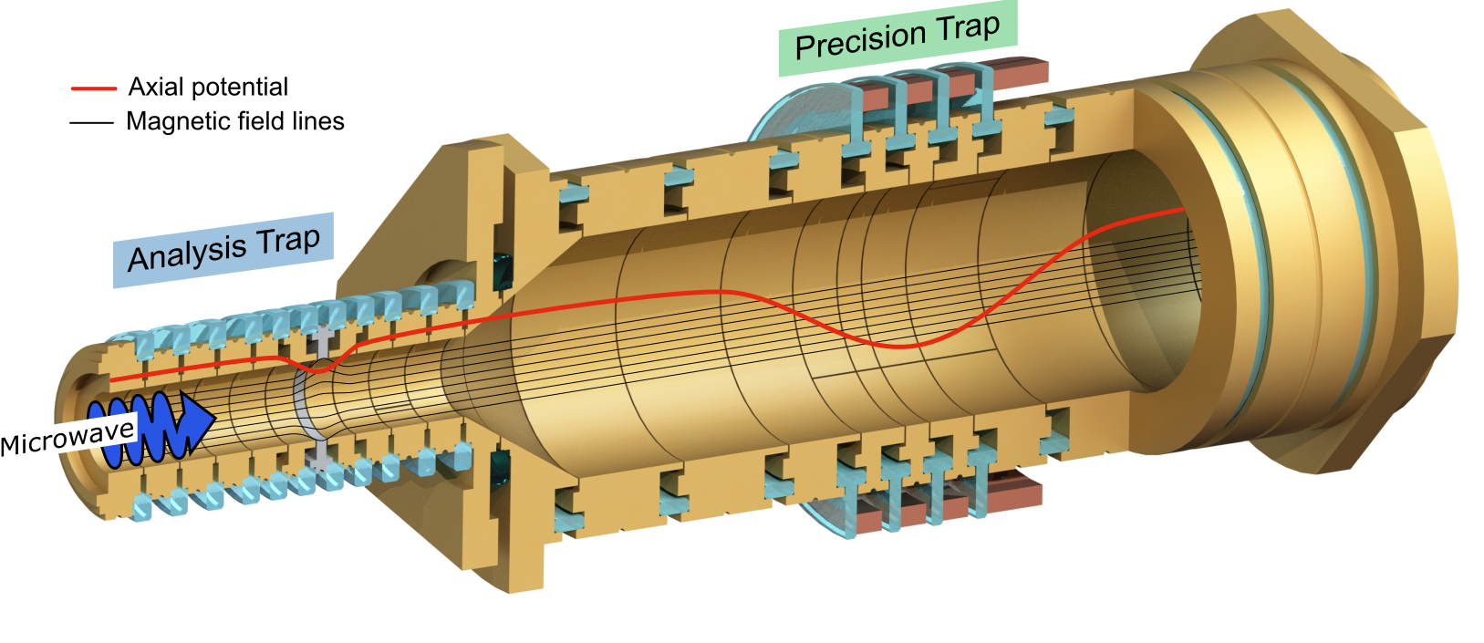
ALPHATRAP Penning trap
Precision Trap (PT)
Highly harmonic, homogeneous
trap for precision spectroscopy
Analysis Trap (AT)
Magnetic bottle for spin state detection
Notes:
So the first order of business for performing our measurements is producing these ions. Because highly charged ions have such high binding energies we need dedicated ion sources to produce them. Our experiment is located the Max Planck Institute for Nuclear Physics in Heidelberg Germany and we have several ion sources that are able to deliver these ions for us.
We have what we call, a mini-EBIT for producing hydrogen-like ions up to around Z = 14. This requires that we produce an electron beam with a few keV energy and this can be done in a compact, table top sized device. We also have access to larger ion source that’s takes up a whole room that is capable of producing electron beams with tens of keV energies. We’ve recently kind of pushed this device to its limits and were able to produce hydrogen like tin which has Z = 50 and an ionization energy of around 35 keV and we’re currently building up a new ion source that should let us explore the rest of the periodic table.
So whichever ion source we use, we then guide the ions through a set of ion optics and inject them into a cryogenic Penning trap that is inside a superconducting magnet. Because highly charged ions would pick up extra electrons if they were to collide with any residual gas in our vacuum chamber we have to close off the cryogenic vacuum section with a cryogenic valve so no gas can get in. We’re then able to trap these ions for long periods of time – more or less indefinitely for some of the lighter species and up to a few weeks for the heavier one.

Slide 13
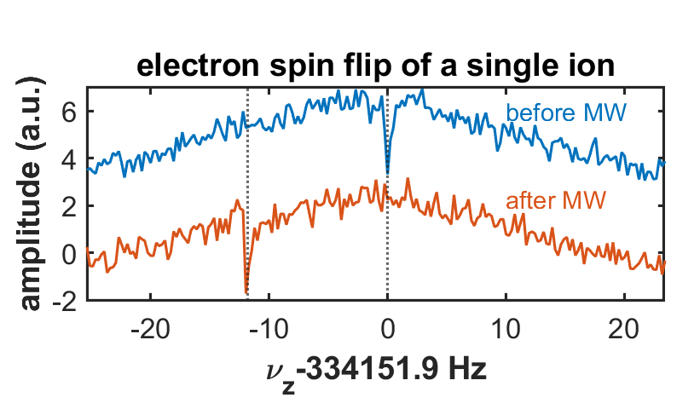
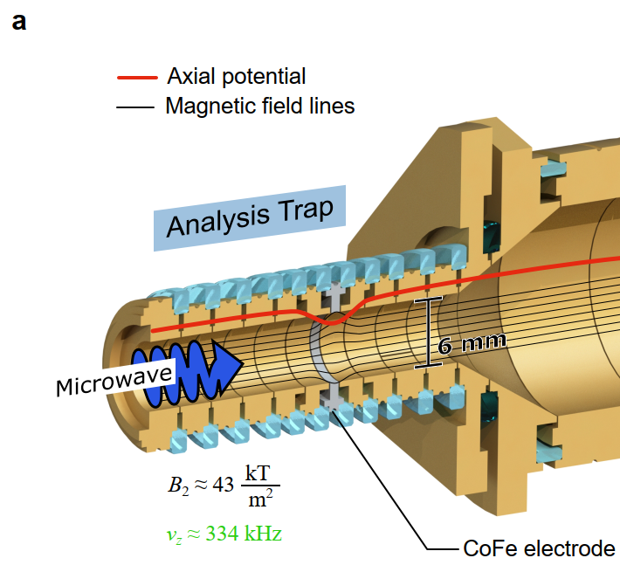
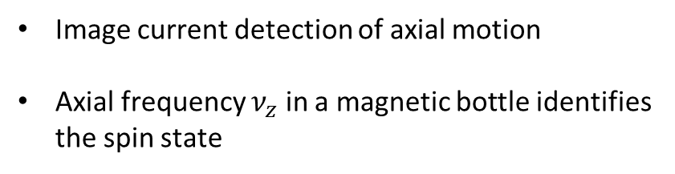
Quantum state detection
Image current detection of axial motion
Axial frequency $ν_{z}$ in a magnetic bottle identifies the spin state
Notes:
Now to measure the Larmor frequency we need to drive electron spin transitions which we can do with microwaves that are injected along the axis of the trap. Now to measure the spin state, or whether we’ve successfully flipped the spin or not, we play a similar trick to the one we use to measure the radial frequencies. We put the ion in a dedicated trap with a strong magnetic field gradient that couples the spin of the ion or the electron to the axial motion, which than then be picked up by our image current detection systems.
One way to think about this is that one of the spin state is a high field seeker so the while the other is a low field seeker so the ion will be either more or less tightly bound by the axial potential and the axial frequency will shift accordingly.

Slide 14
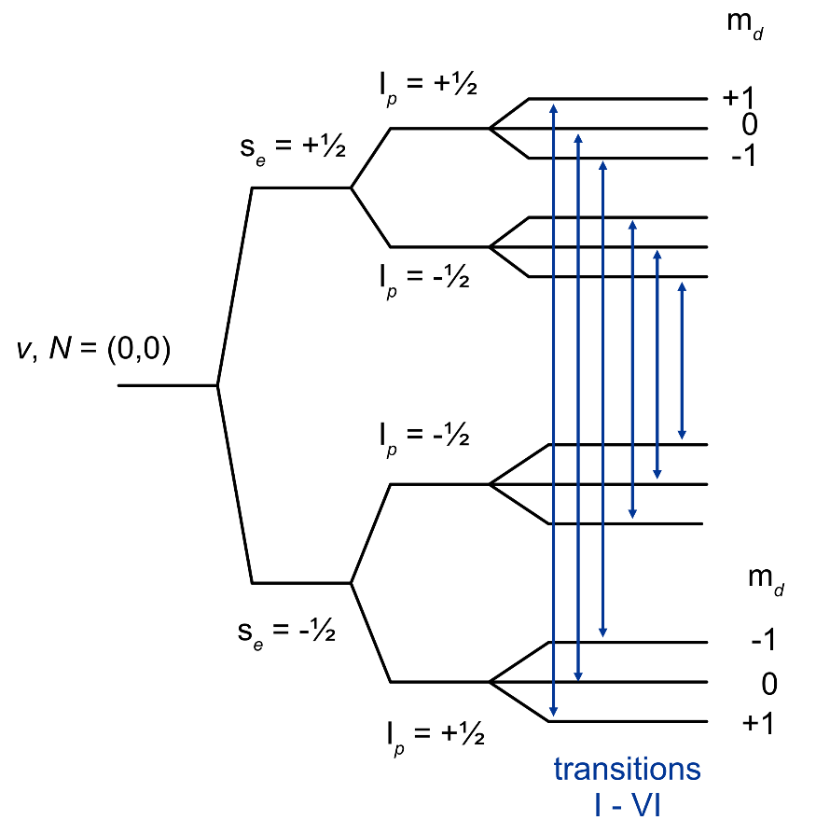
Ground state HFS of HD⁺
Ability to drive electron spin flips uniquely, and non-destructively, determines the quantum state

Slide 15
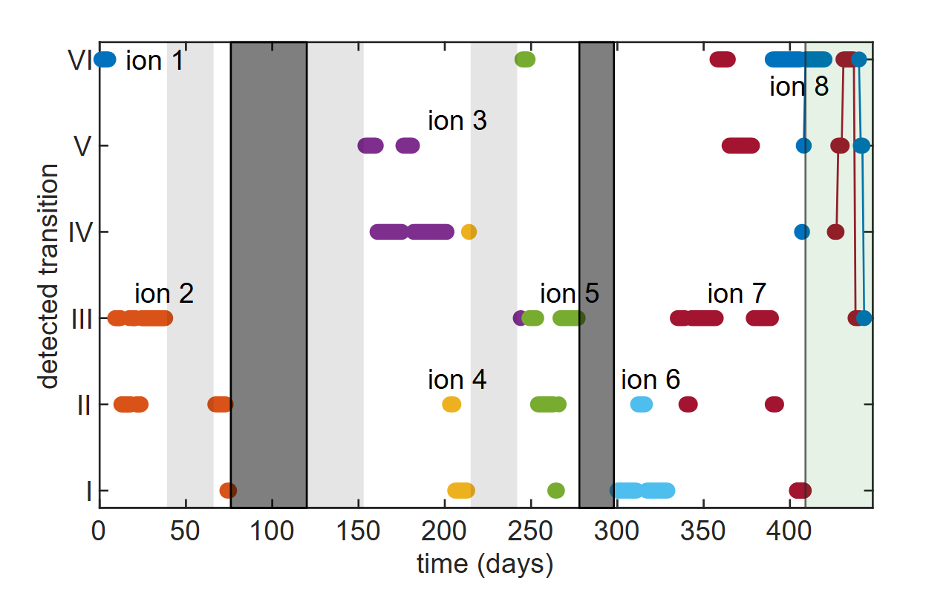
Trapping and quantum state preparation of single HD+ ions
External injection and capture of HD+
Months-long storage
König et al. PRL 134, 163001

Slide 16
Ground state HFS of HD⁺
Ability to drive electron spin flips uniquely, and non-destructively, determines the quantum state

Slide 17
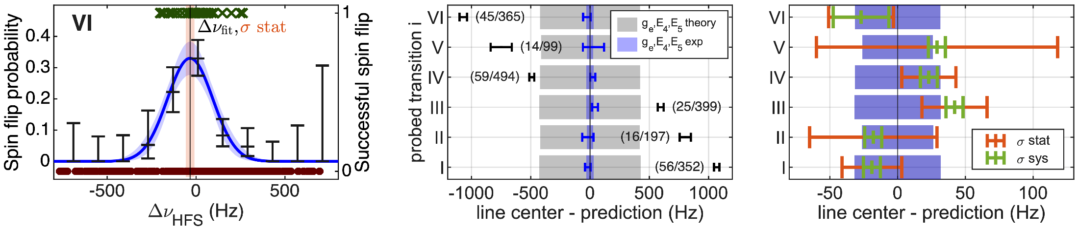
Precision measurement of the ground state HFS
König et al. PRL 136, 143002

Slide 18
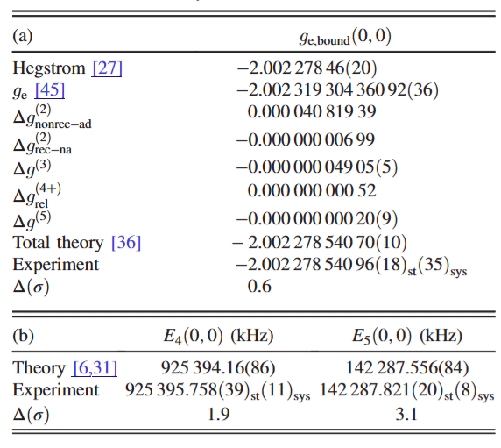
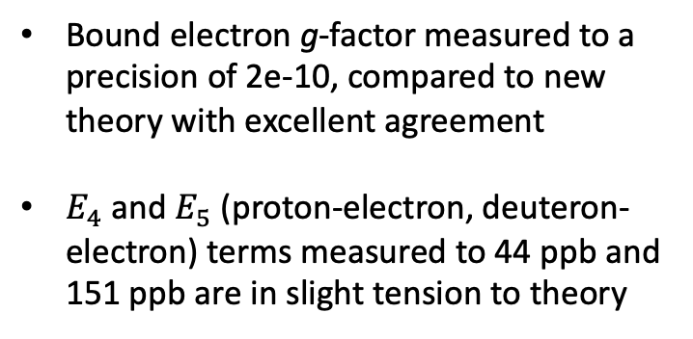
Precision measurement of the ground state HFS
Bound electron g-factor measured to a precision of 2e-10, compared to new theory with excellent agreement
$E_{4}$and $E_{5}$ (proton-electron, deuteron-electron) terms measured to 44 ppb and 151 ppb are in slight tension to theory

Slide 19
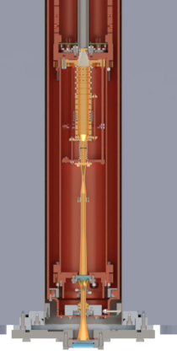
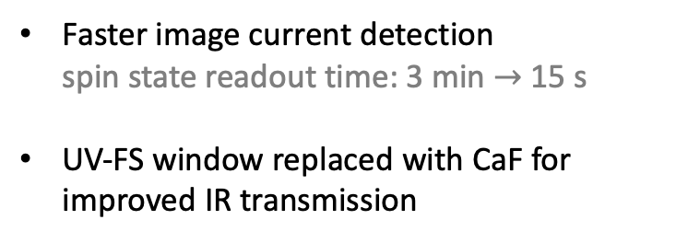
Preparation for laser spectroscopy
Faster image current detection
spin state readout time: 3 min $→$ 15 s
UV-FS window replaced with CaF for improved IR transmission
cryogenic waveguide

Slide 20
Checking spin flip probability
?
?
MW Pulse

Slide 21
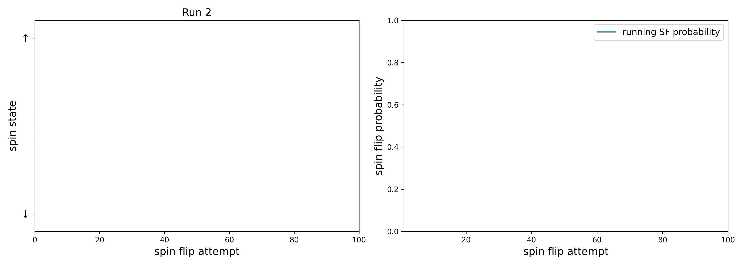
Checking spin flip probability

Slide 22
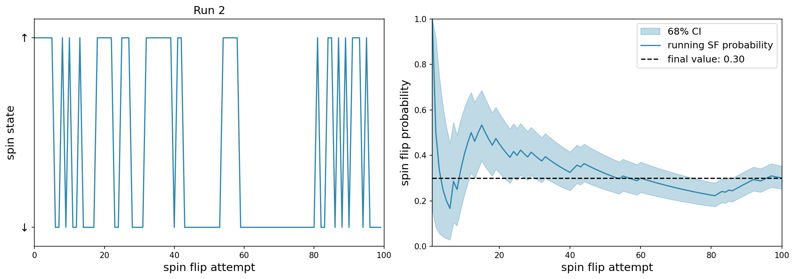
Checking spin flip probability
Not very!
0.08 %
How likely is it that we measure 0 spin flips in 20 trials with 30% spin flip probability?

Slide 23
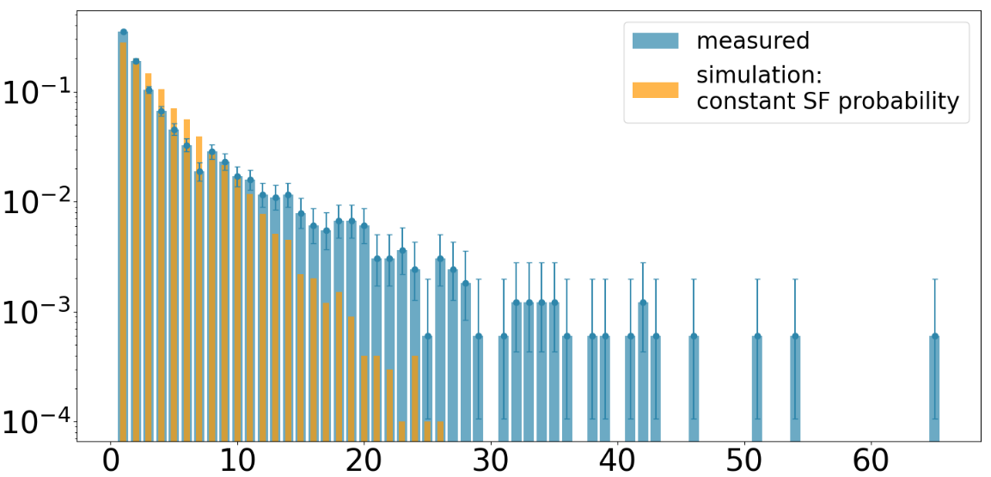
Further analysis
Calculate average excitations required to drive a spin flip
Compare to simulation
probability
Conclusion:
A model of constant spin flip probability is not a good fit to the data!
trials for SF

Slide 24
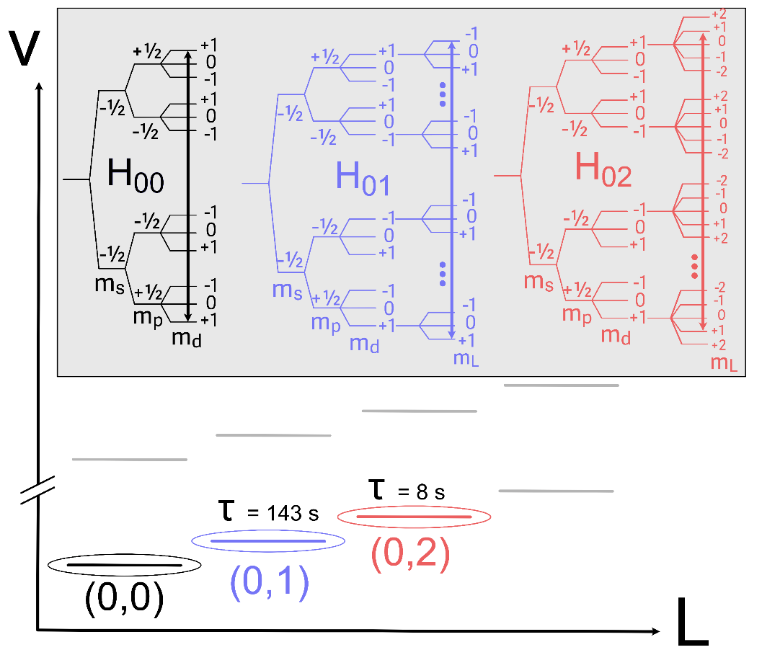
Explanation
Hamiltonian for (0,1) also well known – we can drive ESR transitions there as well!
“dark” periods correspond to population in excited rotational states
analogous to electron shelving

Slide 25
Preparation for laser spectroscopy
apparatus
modifications
cryogenic waveguide

Slide 26
Checking spin flip probability
?
?
MW Pulse

Slide 27
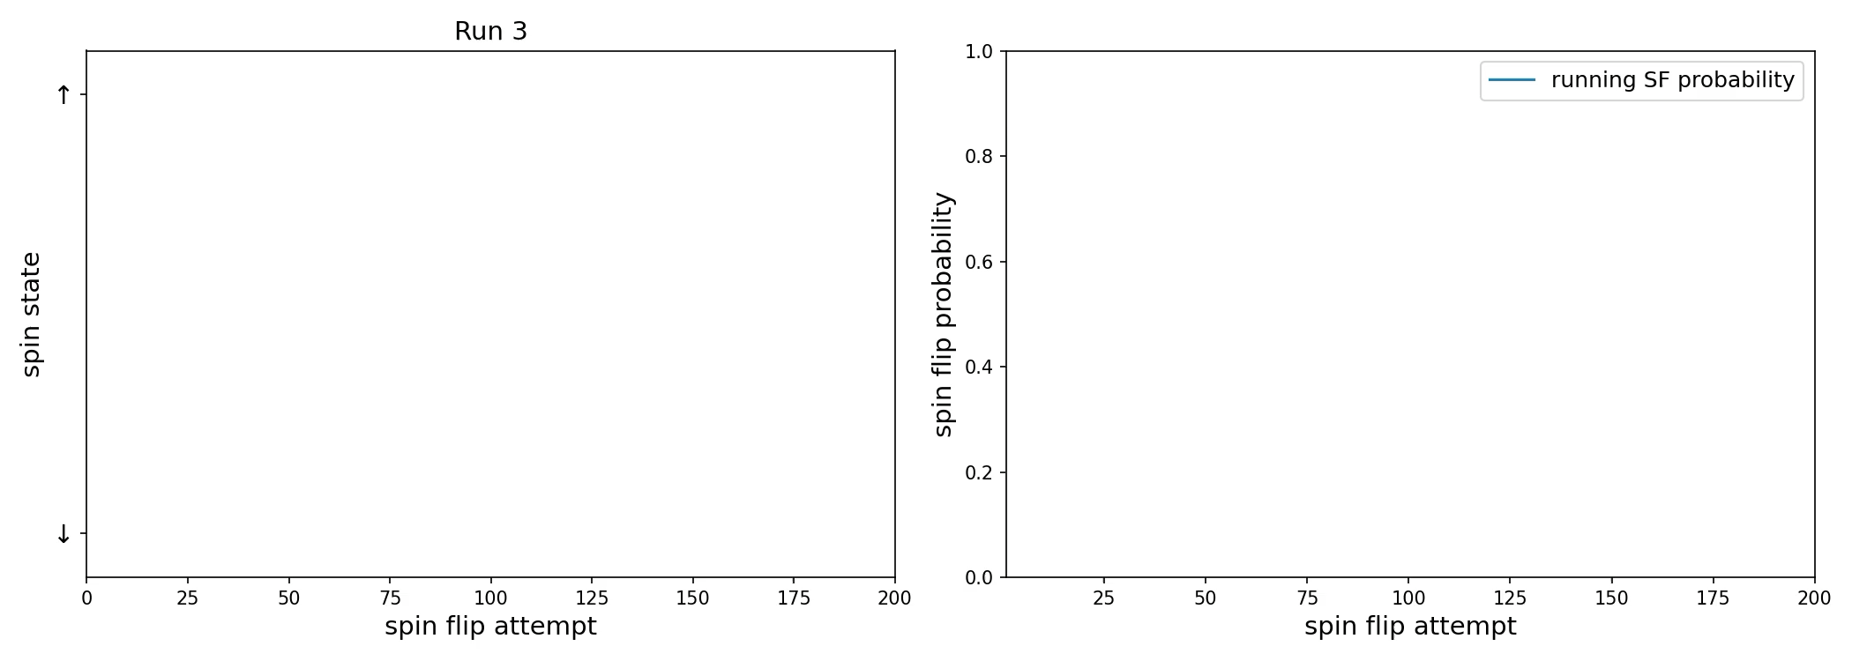
Revisiting spin flip probability

Slide 28
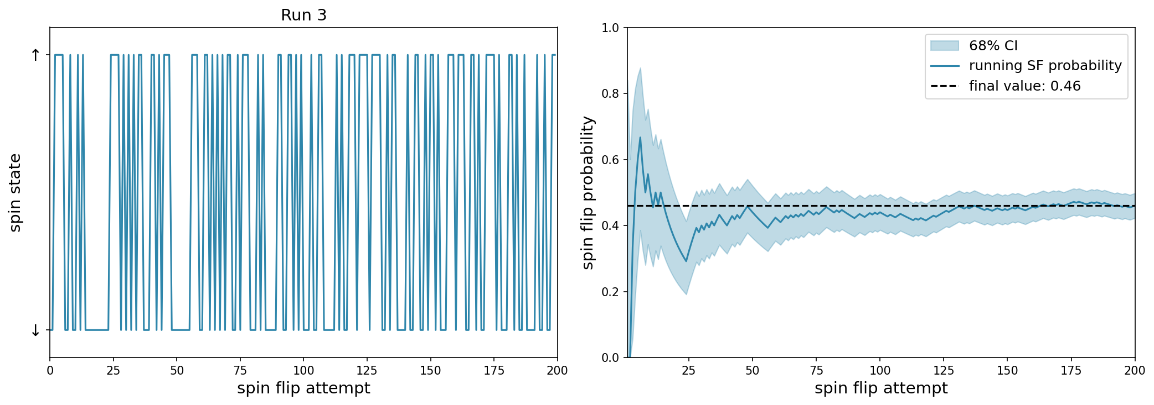
Revisiting spin flip probability

Slide 29
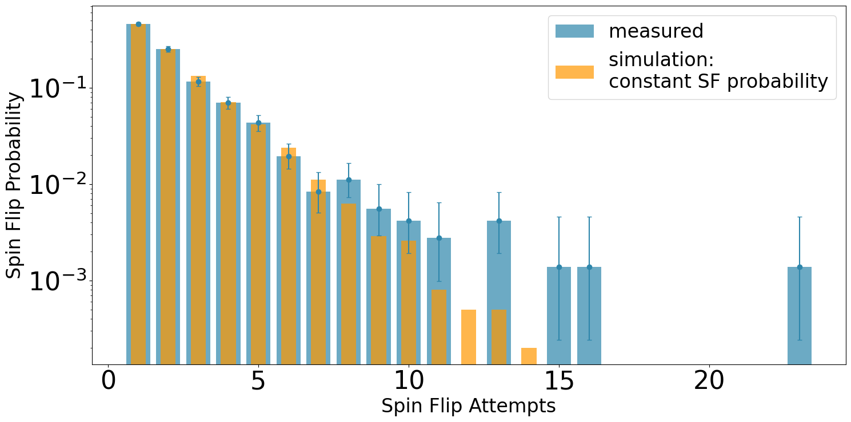
Revisiting spin flip probability
Thermal radiation brings population into rotationally excited states
Careful design of cryogenic environment is important
Ingredients in place for laser spectroscopy
probability
trials for SF

Slide 30
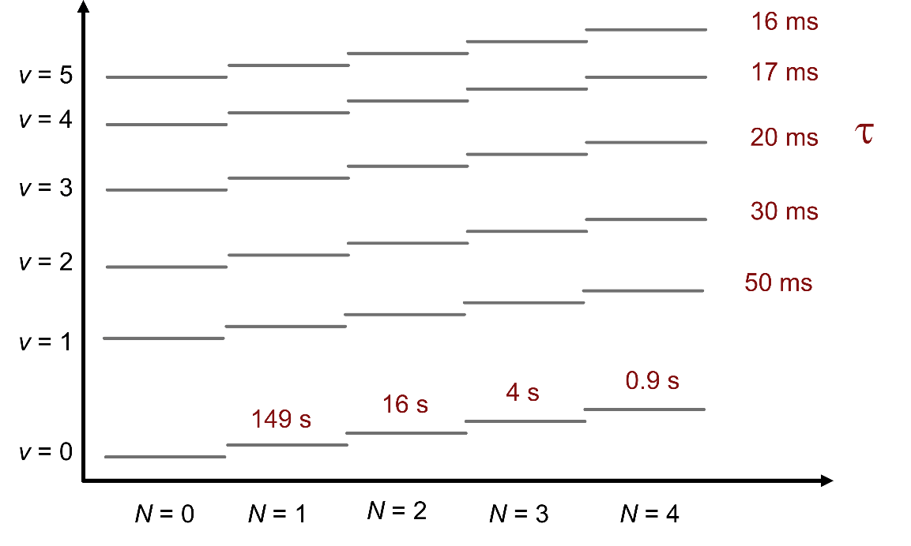
Laser Spectroscopy - scheme
Prepare ion in (0,0)

Slide 31

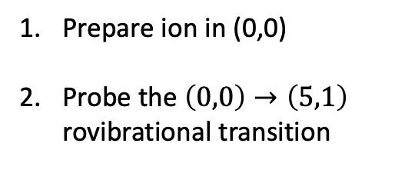
Laser Spectroscopy - scheme
successful
unsuccessful
Prepare ion in (0,0)
Probe the $\left(0,0\right)→\left(5,1\right)$ rovibrational transition
$λ≈1154$ nm

Slide 32
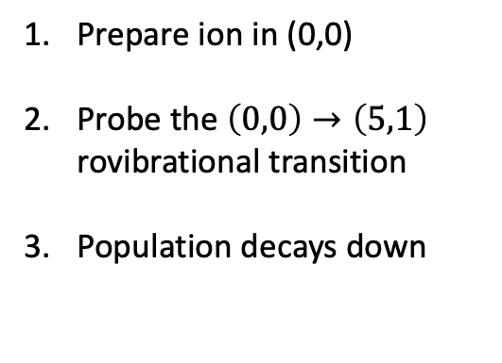
Laser Spectroscopy - scheme
successful
unsuccessful
Prepare ion in (0,0)
Probe the $\left(0,0\right)→\left(5,1\right)$ rovibrational transition
Population decays down

Slide 33
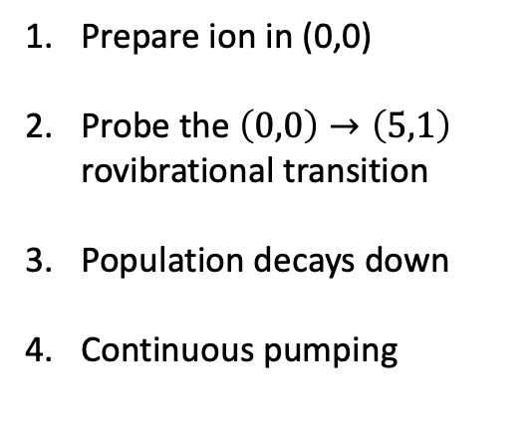
Laser Spectroscopy - scheme
successful
unsuccessful
Prepare ion in (0,0)
Probe the $\left(0,0\right)→\left(5,1\right)$ rovibrational transition
Population decays down
Continuous pumping

Slide 34
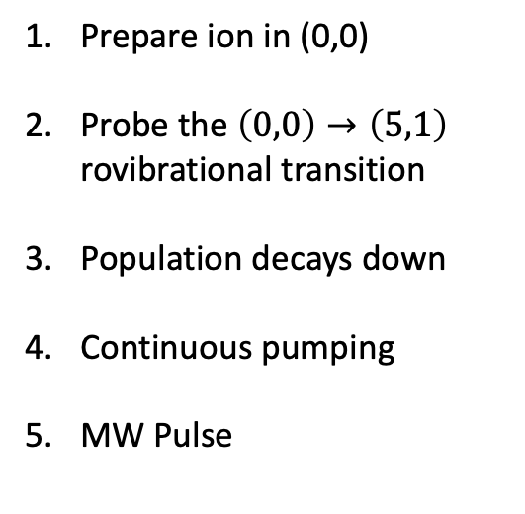
Laser Spectroscopy - scheme
successful
unsuccessful
Prepare ion in (0,0)
Probe the $\left(0,0\right)→\left(5,1\right)$ rovibrational transition
Population decays down
Continuous pumping
MW Pulse
MW

Slide 35
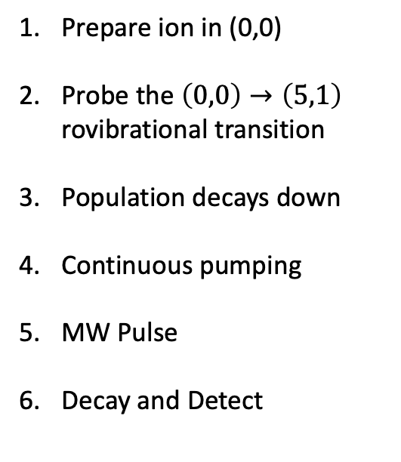
Laser Spectroscopy - scheme
successful
unsuccessful
Prepare ion in (0,0)
Probe the $\left(0,0\right)→\left(5,1\right)$ rovibrational transition
Population decays down
Continuous pumping
MW Pulse
Decay and Detect

Slide 36
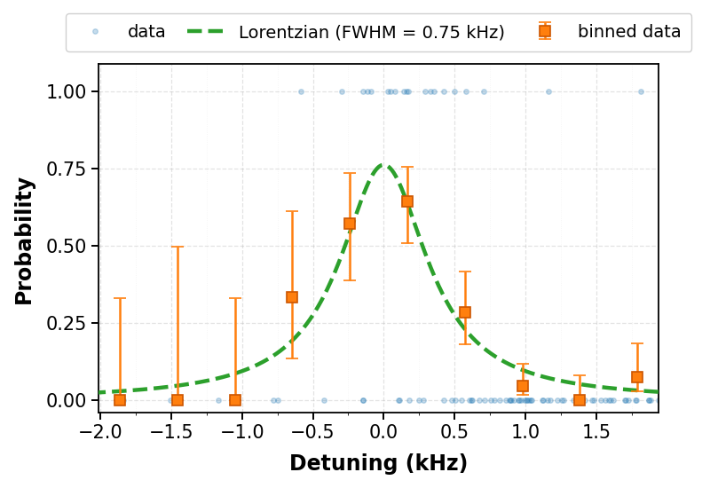
Laser Spectroscopy - results
Achievable resonance linewidths < 1 kHz
Statistical uncertainty
< 100 Hz
10⁻¹³ level statistical precision – narrowest measured line in HD⁺

Slide 37
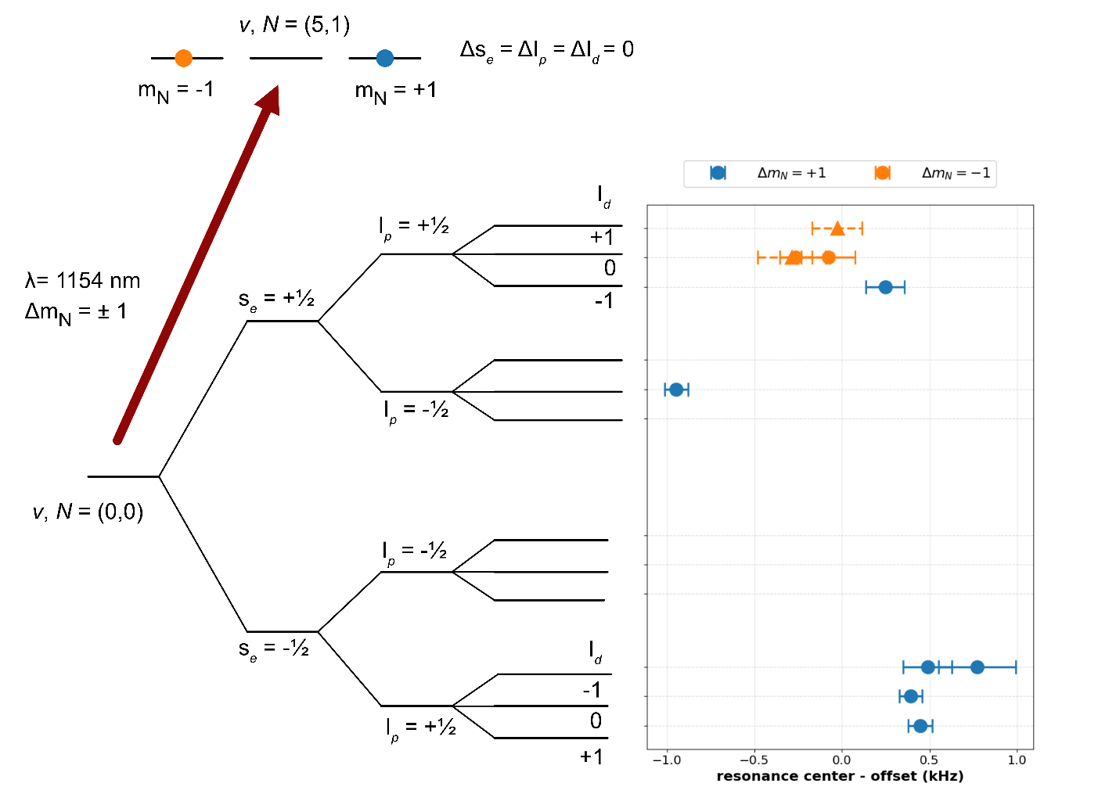
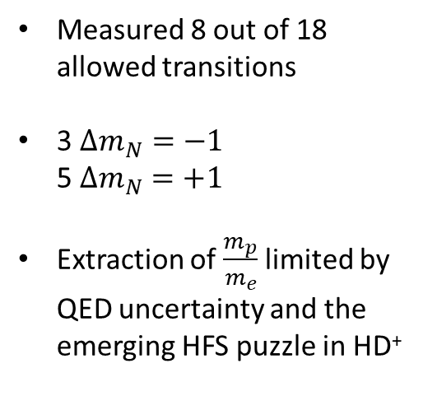
Laser Spectroscopy
- results
Measured 8 out of 18 allowed transitions
3 $Δm_{N}=−1$
5 $Δm_{N}=+1$
Extraction of $\frac{m_{p}}{m_{e}}$ limited by QED uncertainty and the emerging HFS puzzle in HD⁺

Slide 38
Acknowledgements
Alphatrap team
Group leader
Sven Sturm
Division Leader:
Klaus Blaum
Ground state HFS lead
Charlotte König
Additional members
Fabian Heisse, Jonathan Morgner,
Anton Gramberg, Philipp Justus
HHU Düsseldorf Team
Group leader
Stephan Schiller
Laser development and maintenance
Ivan Kortunov, Victor Vogt
Theory Collaborators
Dimitar Bakalov
Bulgarian Academy of Sciences
Hugo Nogueira, Jean-Philippe Karr
LKB Paris
Ossama Kullie
University of Kassel

Slide 39
