Slide 1



Towards the determination of the fine structure constant α
Probing the spatial distribution of k-vectors in situ with Bose-Einstein condensates
Samuel Gaudout
Metrology of simple system and fundamental test group
Rayan Si-Ahmed, Clément Debavelaere, Menno Door, Pierre Cladé and Saïda Guellati-Khelifa

Slide 2
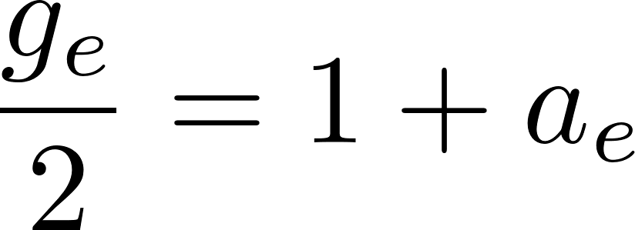
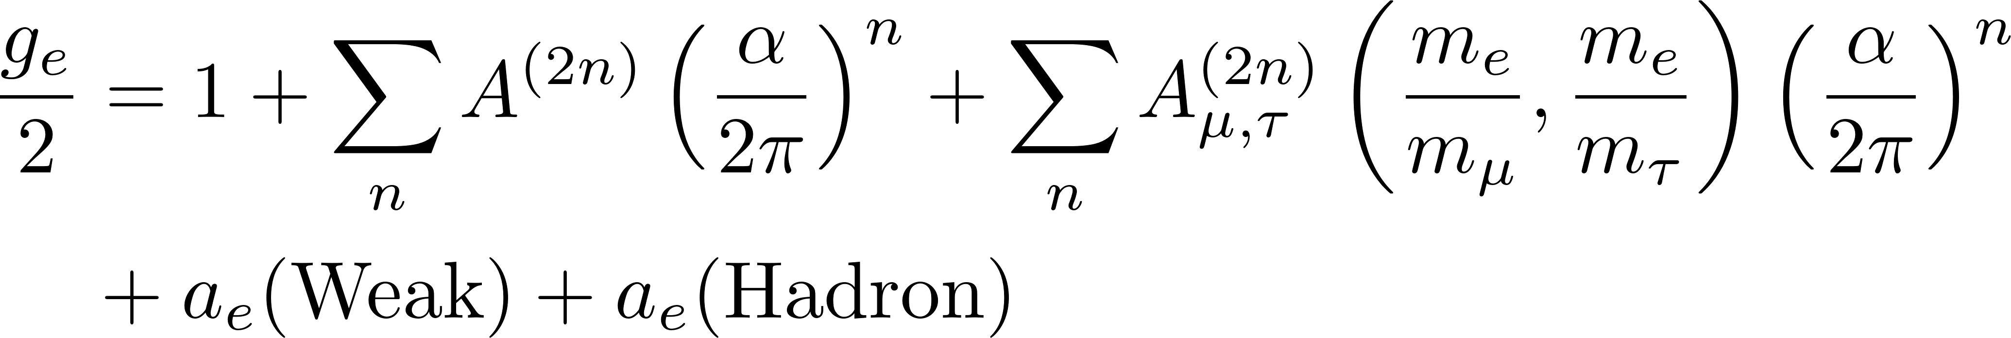
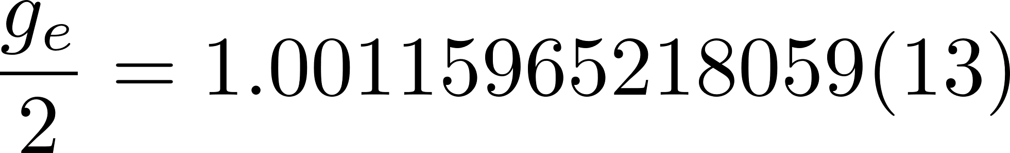
Test of Standard model at low energy scales
Measurement
Theoritical predictions
Comparaison
Electron magnetic moment
Direct measurement
X. Fan, et al., Phys. Rev. Lett. 130, 071801 (2023)
Standard Model prediction
Depends on the fine structure constant α via QED term
Comparaison between the value calculated with α and the direct measurement of a_{e}

Slide 3
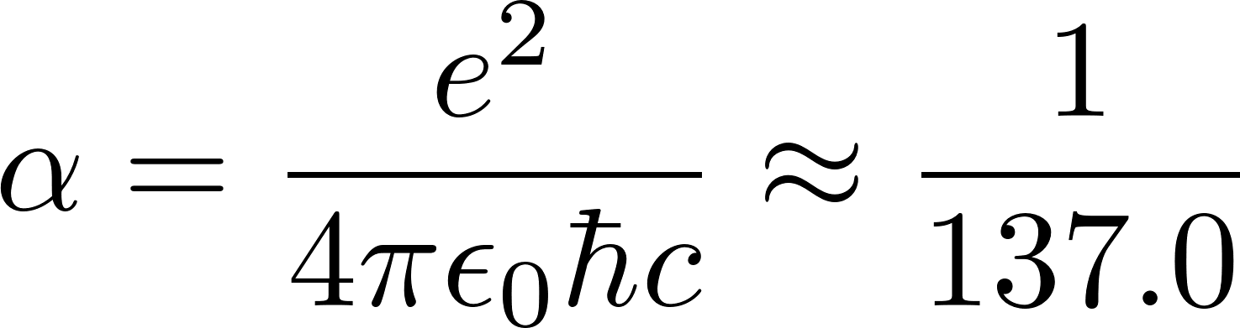
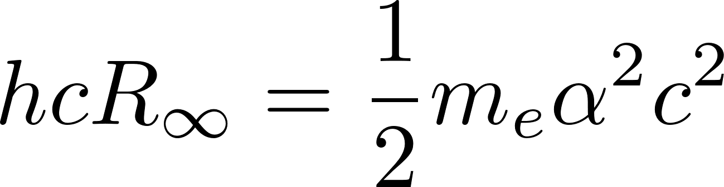
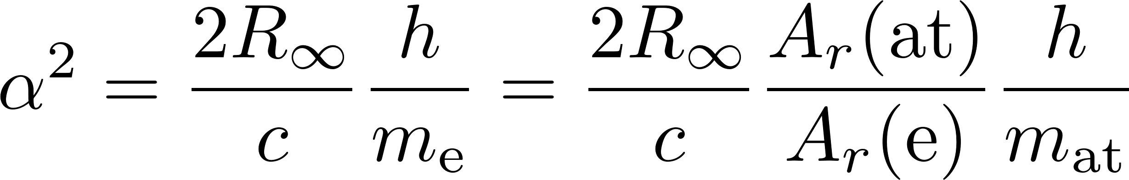

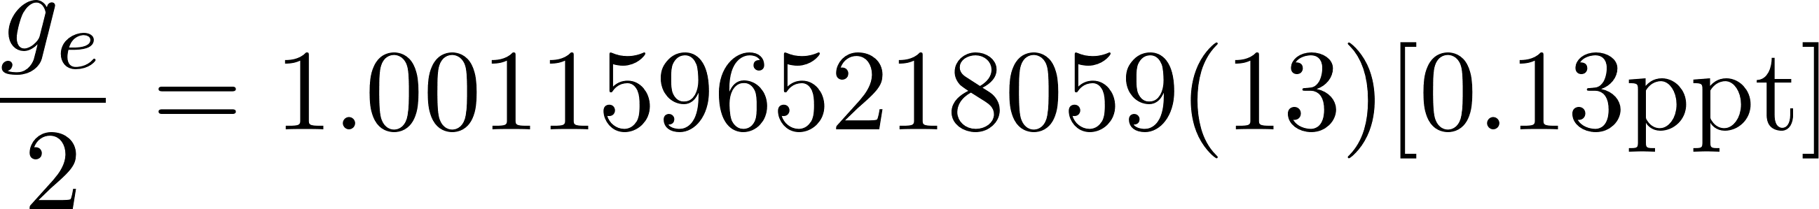
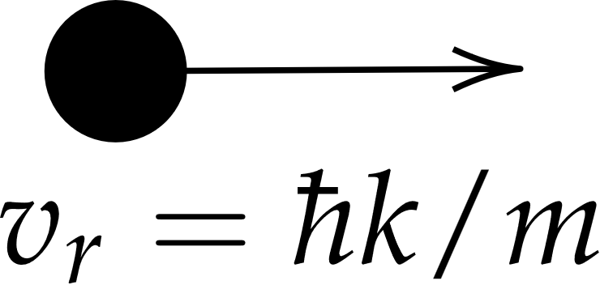
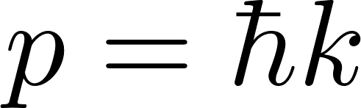

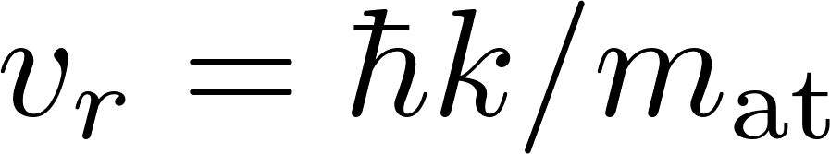
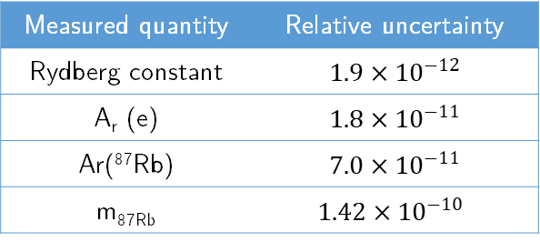
Determination of α from atomic recoil measurement
Fine structure constant
Hydrogen spectroscopy
Measured quantity | Relative uncertainty
Rydberg constant | $$1.9×{10}^{−12}$$
A_{r} (e) | $$1.8×{10}^{−11}$$
Ar(⁸⁷Rb) | $$7.0×{10}^{−11}$$
m_{87Rb} | $$1.42×{10}^{−10}$$
Limiting factor
Recoil velocity measurement
G. Audi et al., 2014 Nuclear Data Sheets 120, 1-5 (2014)
S. Sturm et al. Nature 506, 476-470 (2014),
E. Tiesinga et al., Rev. Mod. Phys. 93, 025010 (2021)
L. Morel et al, Nature 588, 6660 (2020)
Notes:
h set by the syst international units

Slide 4
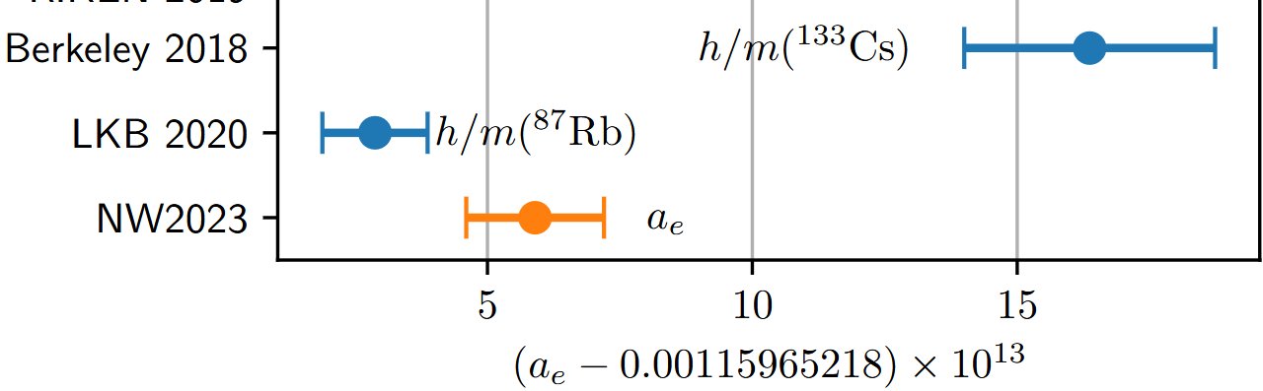

Determination of a_{e} from atomic recoil measurement
Testing Standard Model at current precision of the electron measurement requires that this Cs/Rb discrepancy be resolved.
L.Morel, Z. Yao, P. Cladé and S. Guellati-Khelifa Nature 588, 6660 (2020)
R.Parker, C.Yu, W.Zhong, B.Estey , H.Müller Science 360, 6385 (2018)
X. Fan, T. G. Myers, B. A. D. Sukra, G. Gabrielse Phys. Rev. Lett. 130, 071801 (2023)

Slide 5

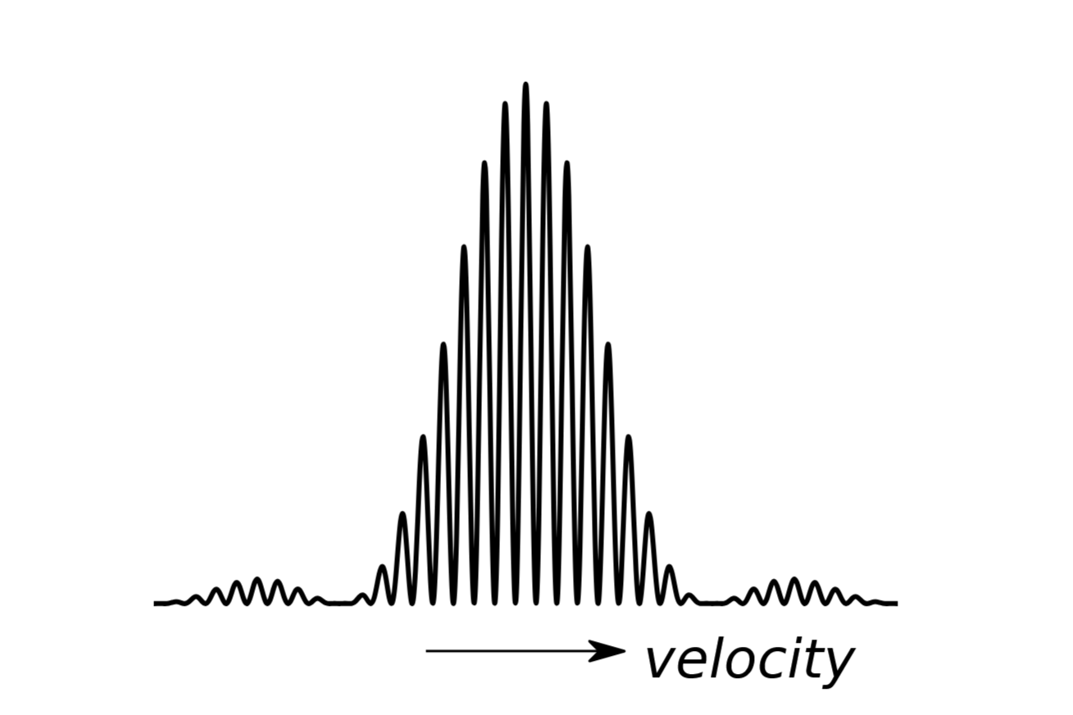
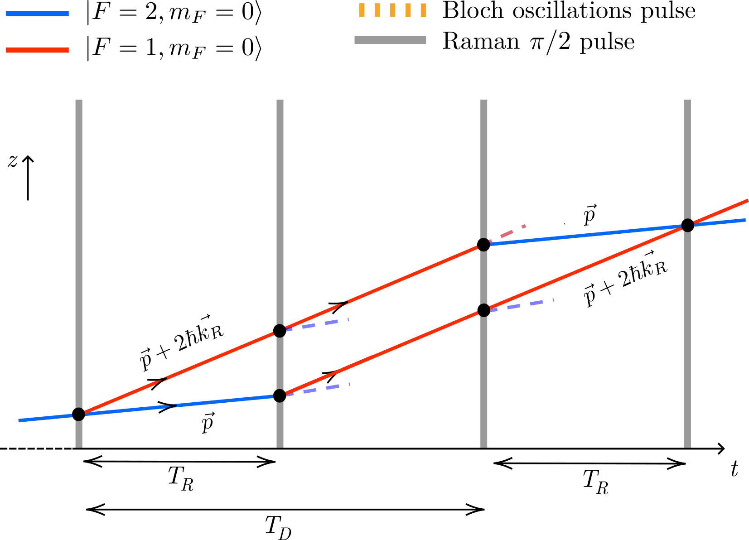

Measuring the recoil velocity using an atom interferometer
Phase difference between the two arms
Atom interferometry
Superposition travelling along 2 different paths
Differential phase accumulated. When recombined → interferences
Notes:
Transition 1 photon : Spontaneous emission

Slide 6
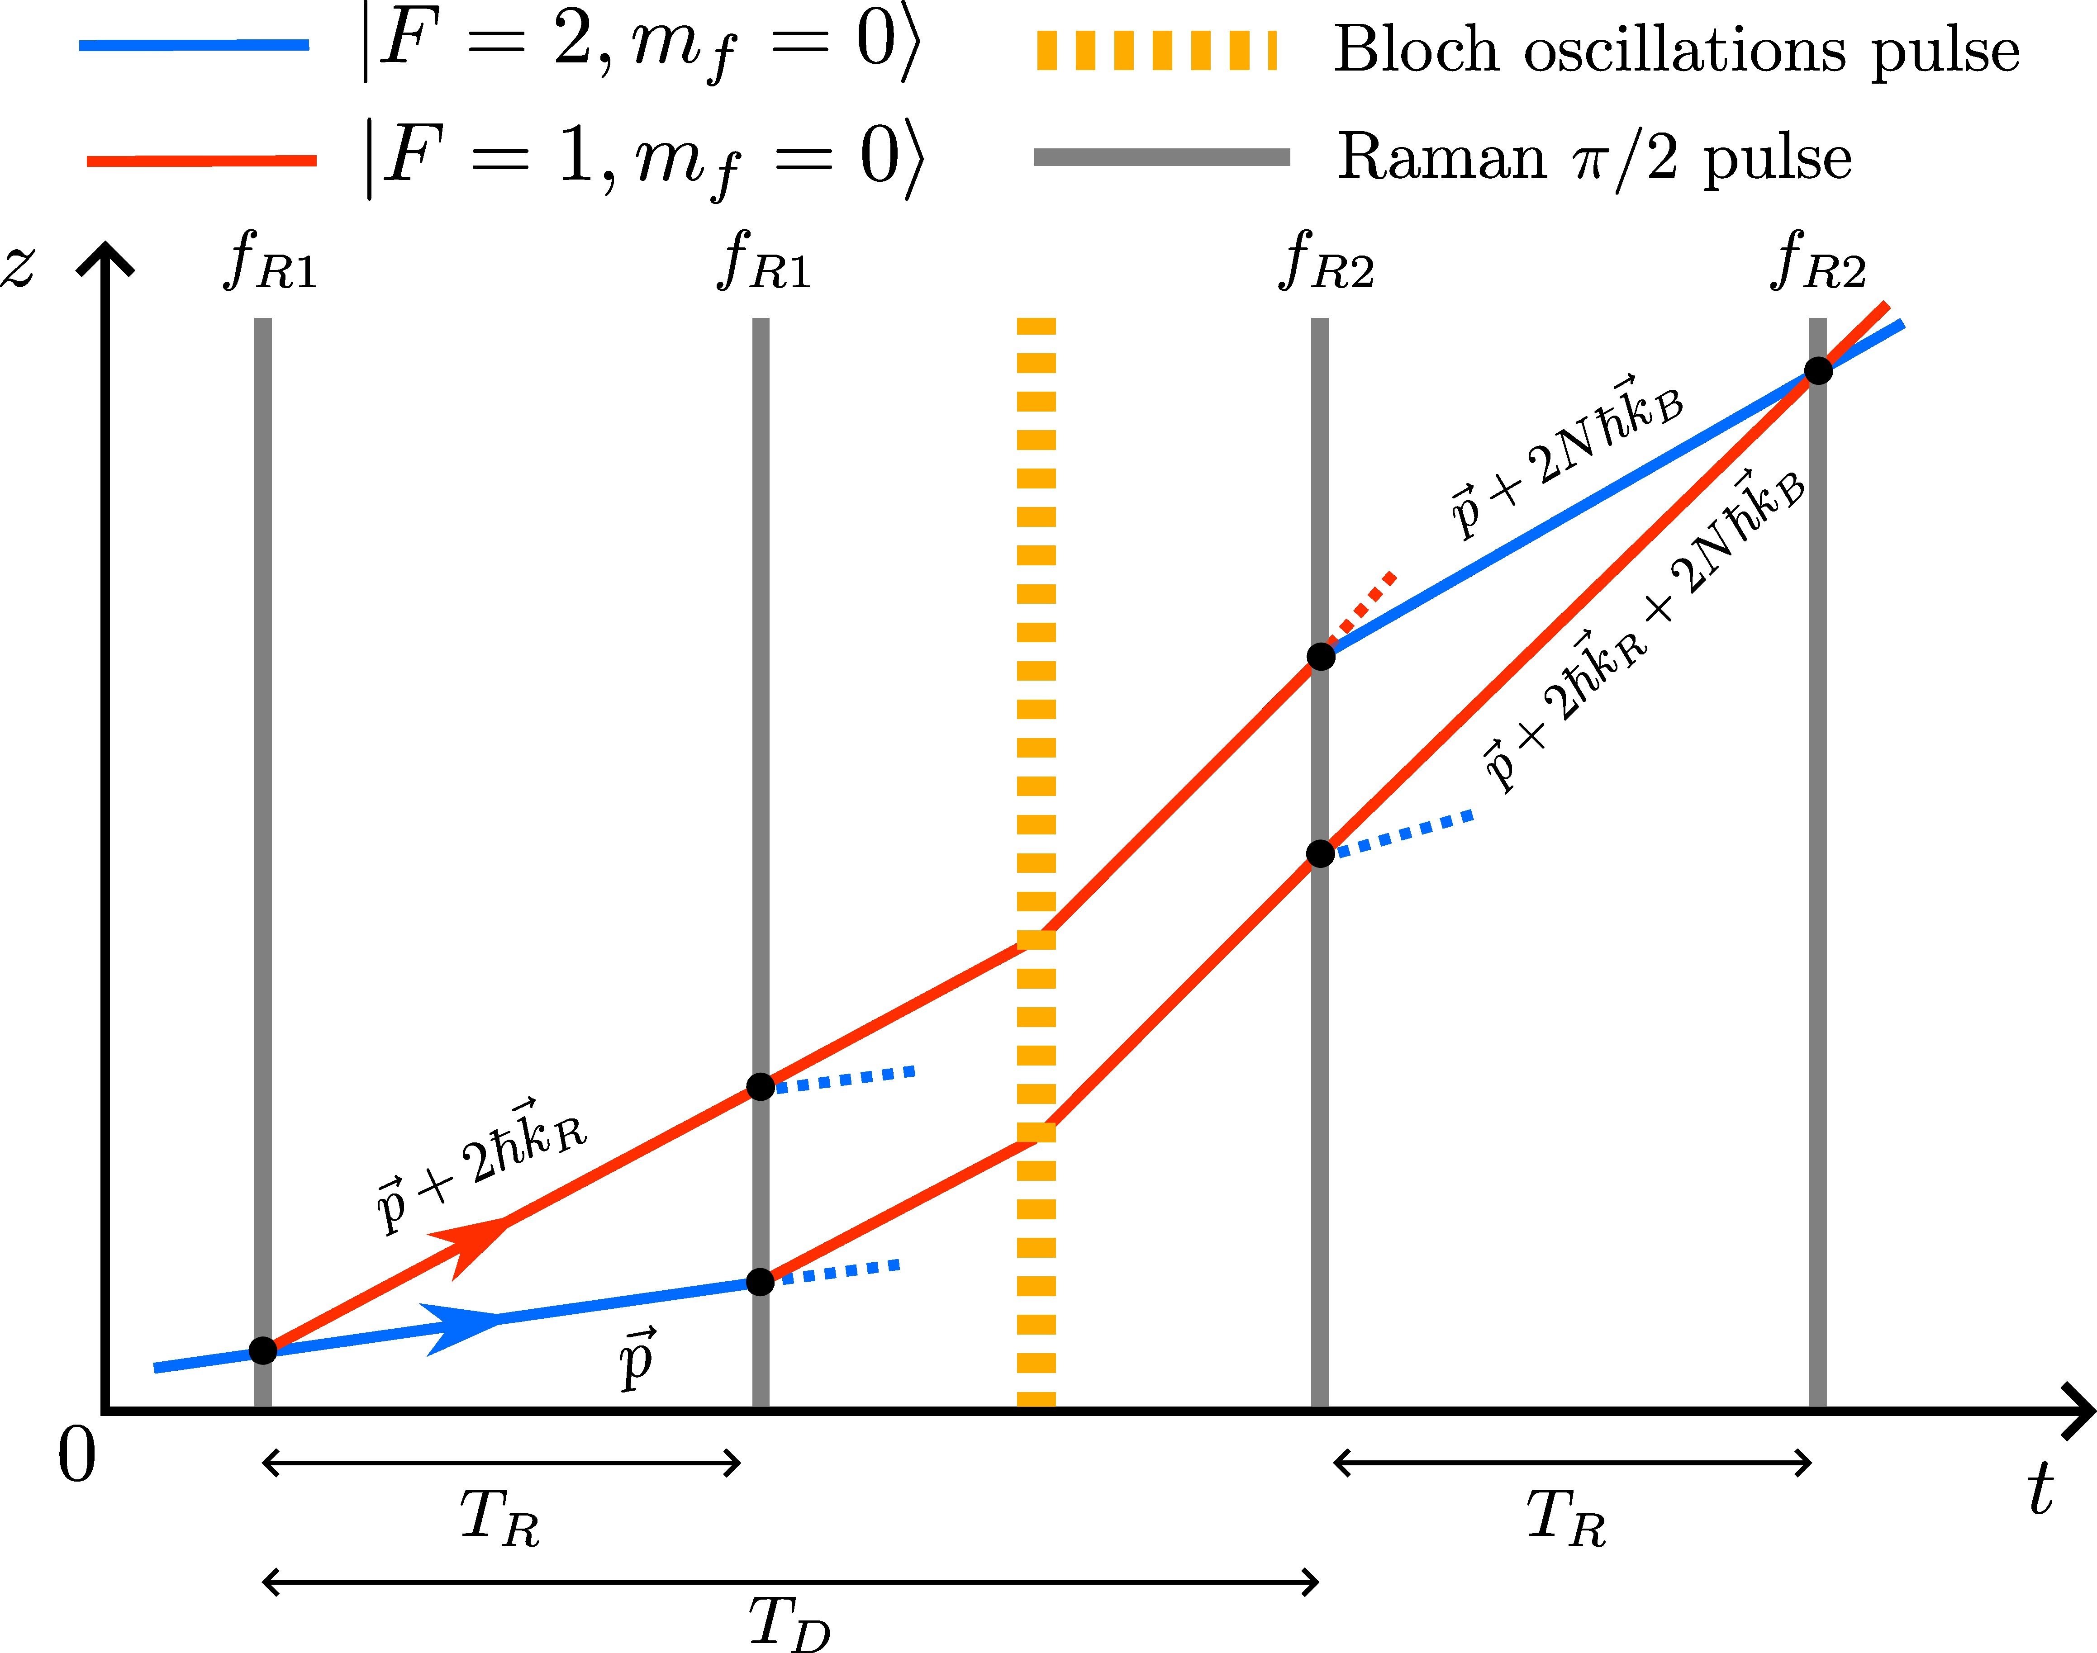
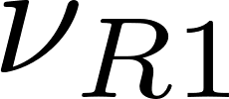
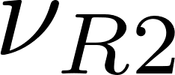
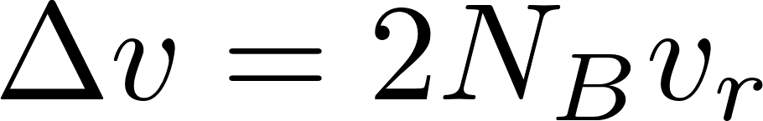
Measuring the recoil velocity using an atom interferometer
+ acceleration
Phase difference between the two arms
Doppler
Bloch oscillations
Measurement of the Doppler effect induced : measurement of the recoil velocity
In the experiment : 2×N_{B}=1000 recoil velocities (6 m/s)
Notes:
Transition 1 photon : Spontaneous emission

Slide 7
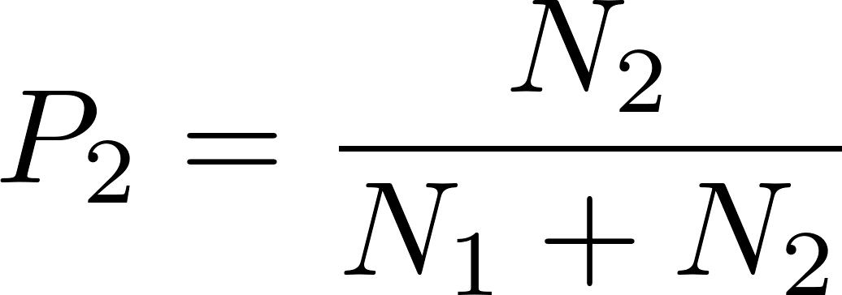
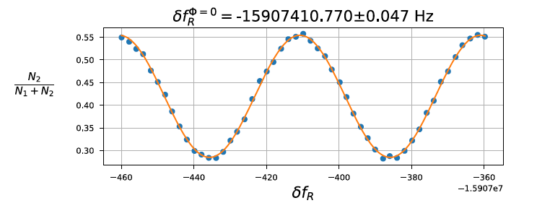
Measuring the recoil velocity using an atom interferometer
Scan the frequency of the last two Raman pulses, measure the Doppler effect
Measure relative population in the two states
Atomic interferometer sensitive to recoil velocity
Notes:
Transition 1 photon : Spontaneous emission

Slide 8

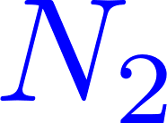

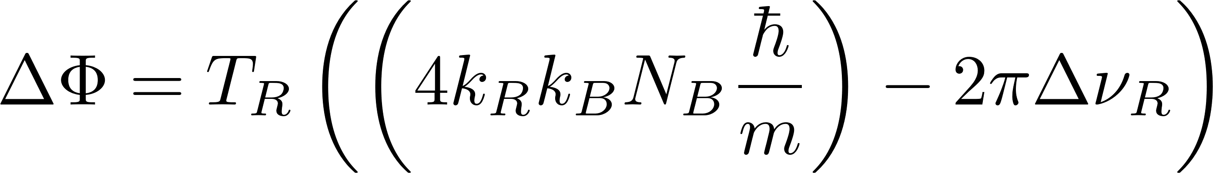
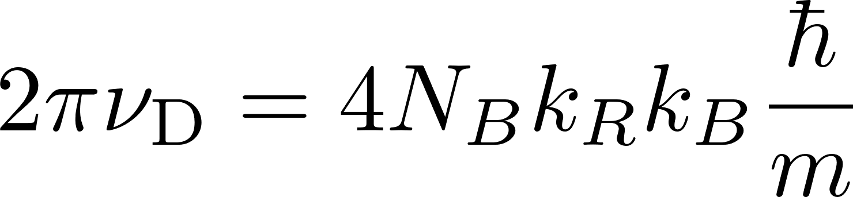
Measuring the recoil velocity using an atom interferometer
Scan the frequency of the last two Raman pulses, measure the Doppler effect
Measure relative population in the two states
Atomic interferometer sensitive to recoil velocity
Notes:
Transition 1 photon : Spontaneous emission

Slide 9
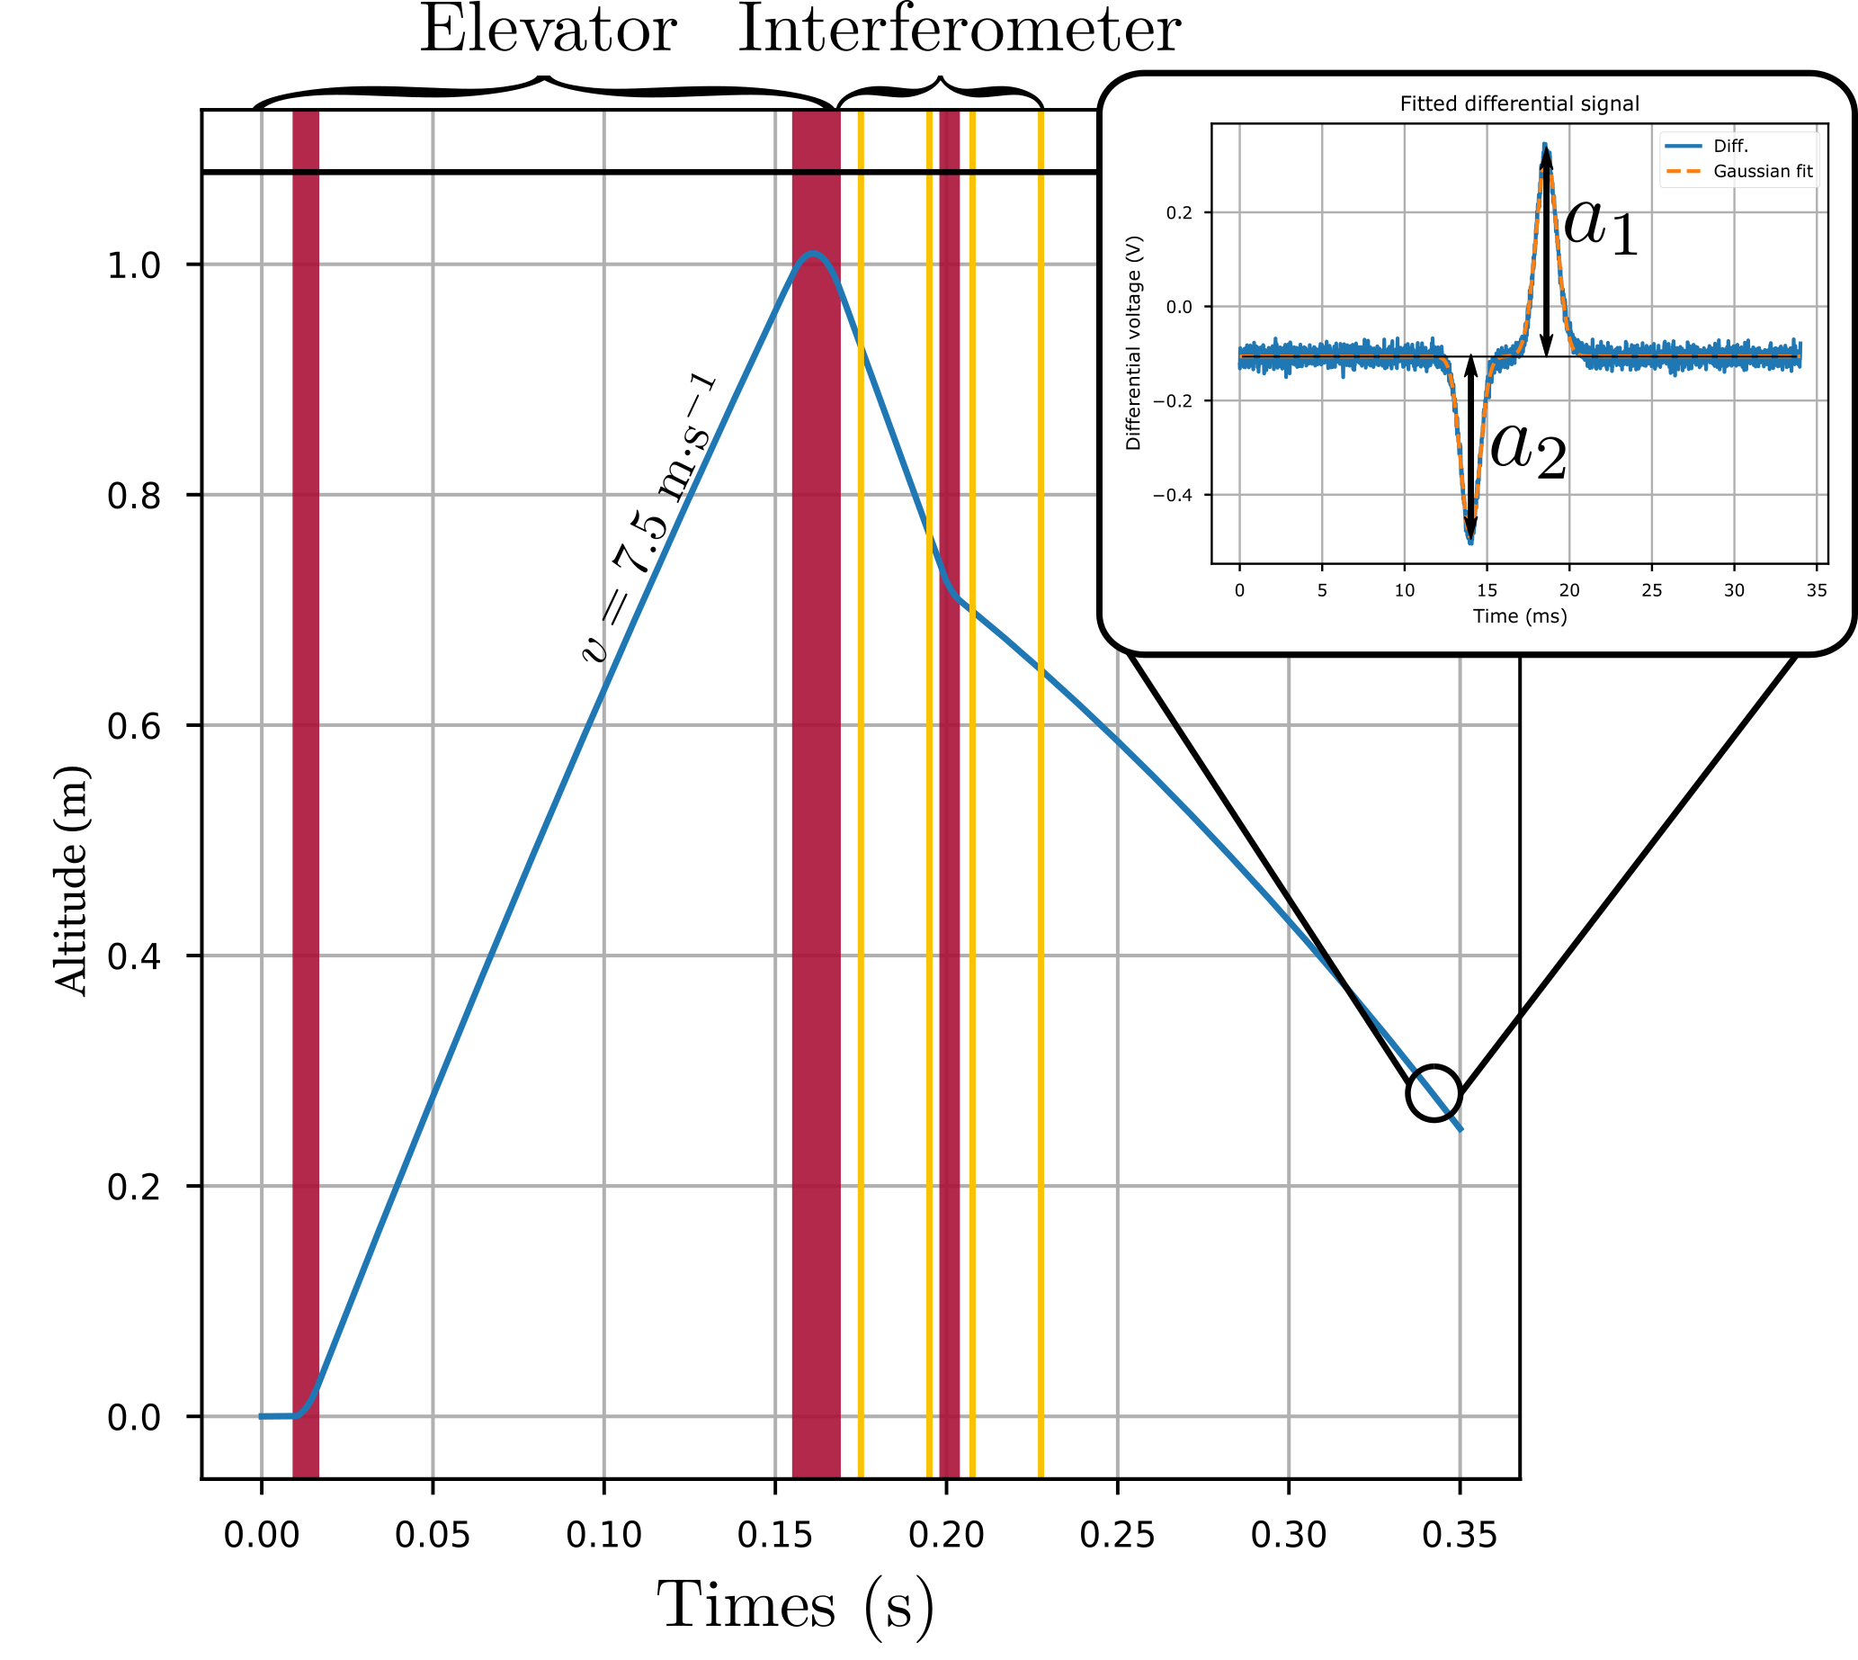
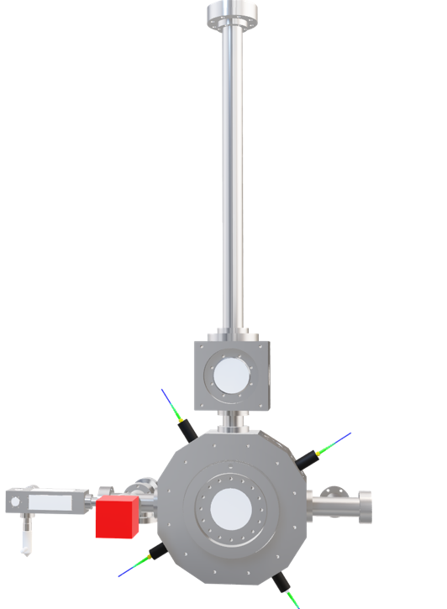
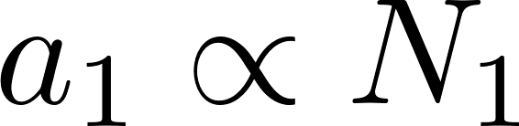
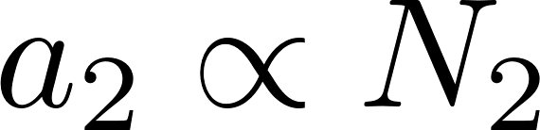
h/m experiment – temporal sequence
fluorescence
Controlled magnetic field
⁓ 1 point per 3 seconds → 50 points per spectra (⁓ 3minutes)
Detection zone
T_{Ramsey} = 20 ms
Number of recoil 2×N = 1000
One photon momentum: ⁓15 kHz
→ 1000 photon momenta: 15 MHz
Notes:
We measure the relative population in the two states, FLUORESCENCE imaging

Slide 10
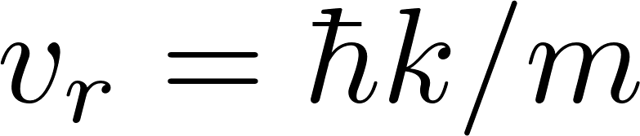
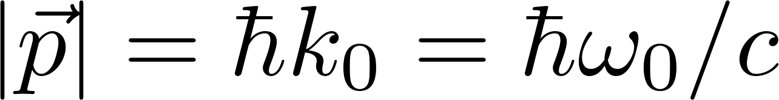
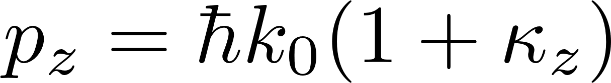
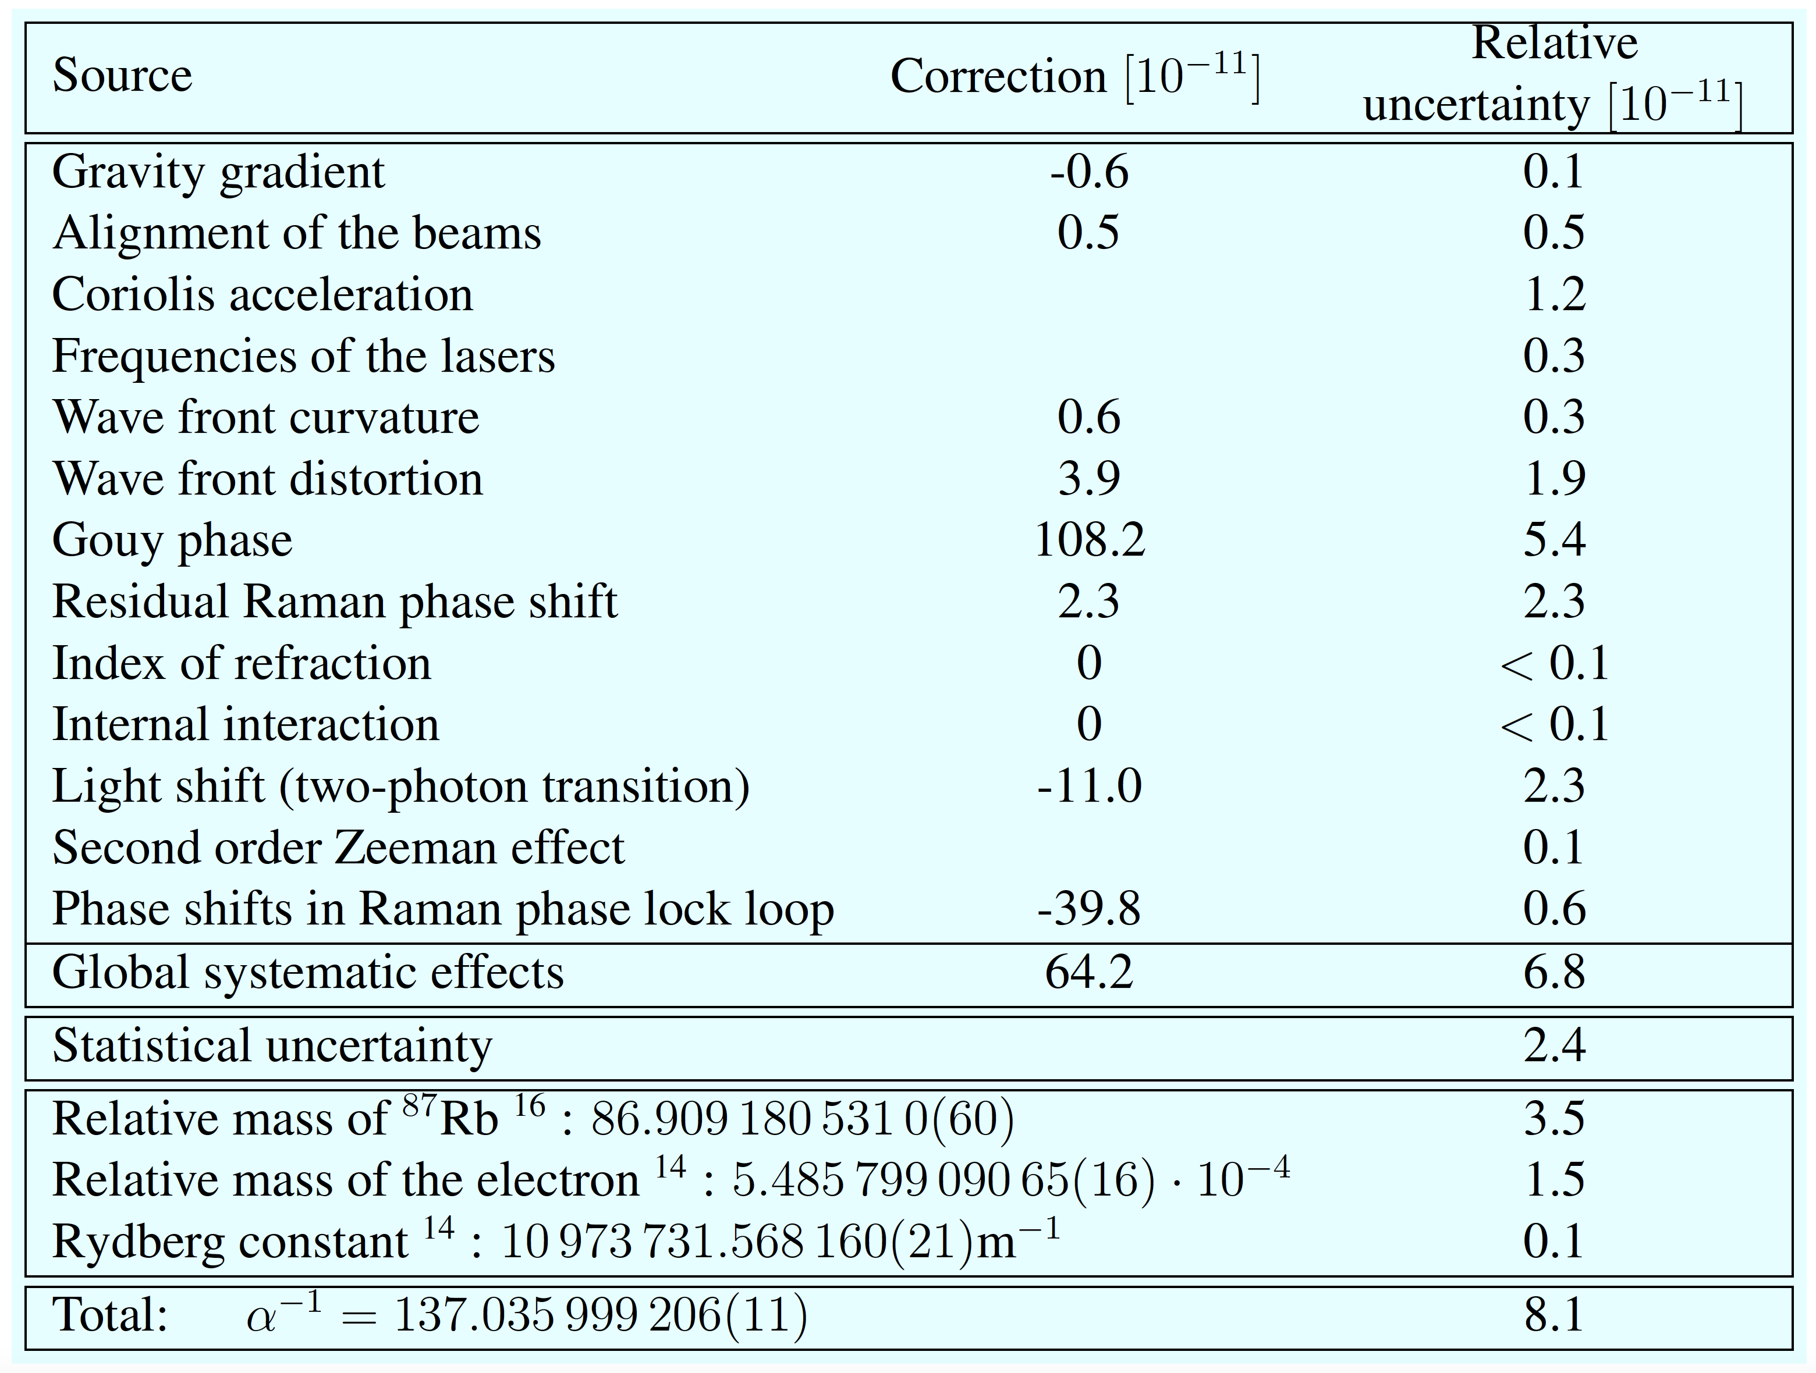
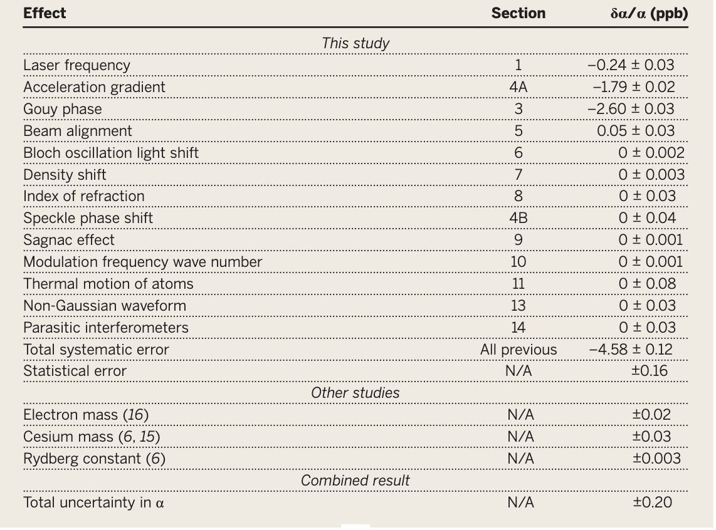
Error budgets of the last measurements
For a plane wave
Correction to the plane wave model
?
L.Morel et al, Nature 588, 6660 (2020)
R.H. Parker et al, Science 2018, 360, 191–195.

Slide 11
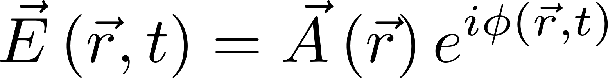
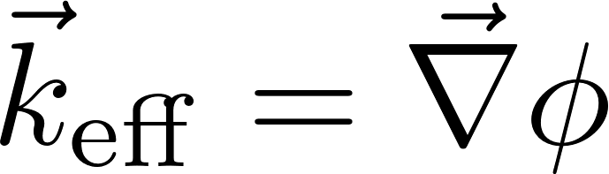
Effective wavevector in a distorted beam
Momentum carried by the photon :
Description with an electric field :

Slide 12
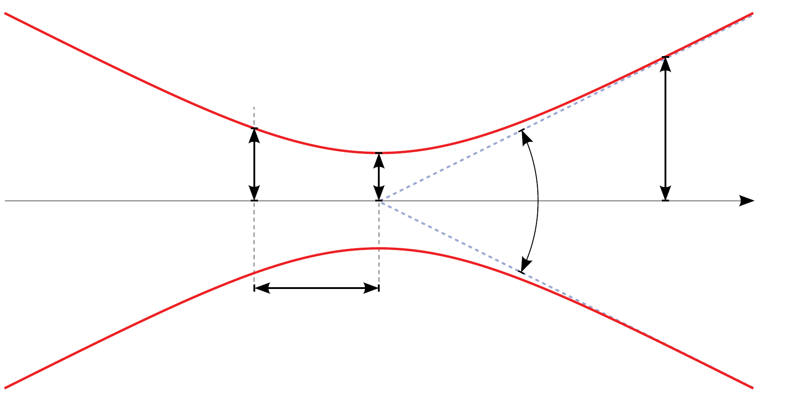
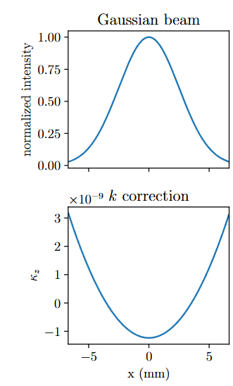
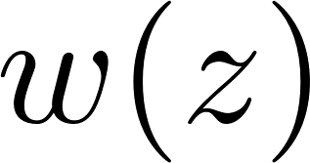
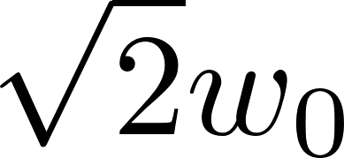


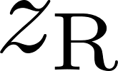
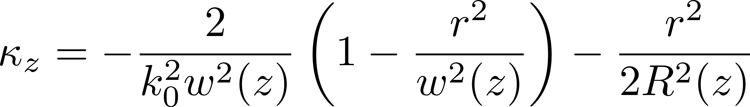

Effective wavevector in a distorted beam
Momentum carried by the photon :
Description with an electric field :
Correction of k-vector
Systematic effect on $α$
Effect of the Gouy phase
$$(108.2±5.4)×{10}^{−11}$$
for w = 5 mm

Slide 13
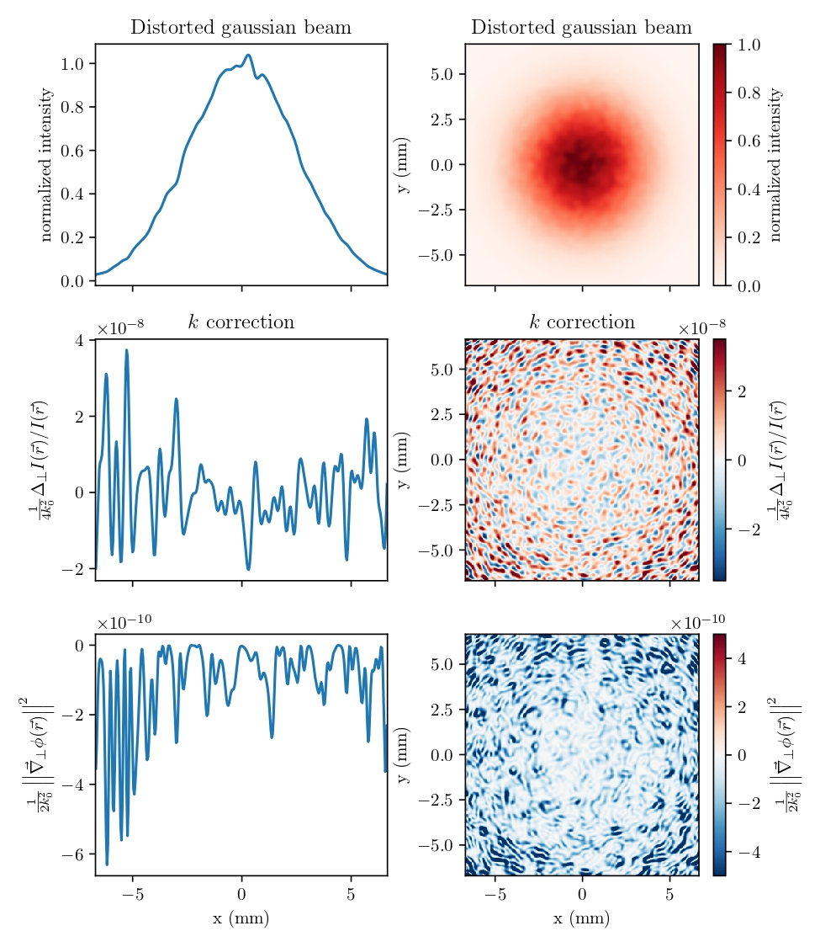
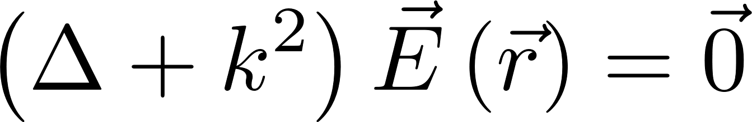
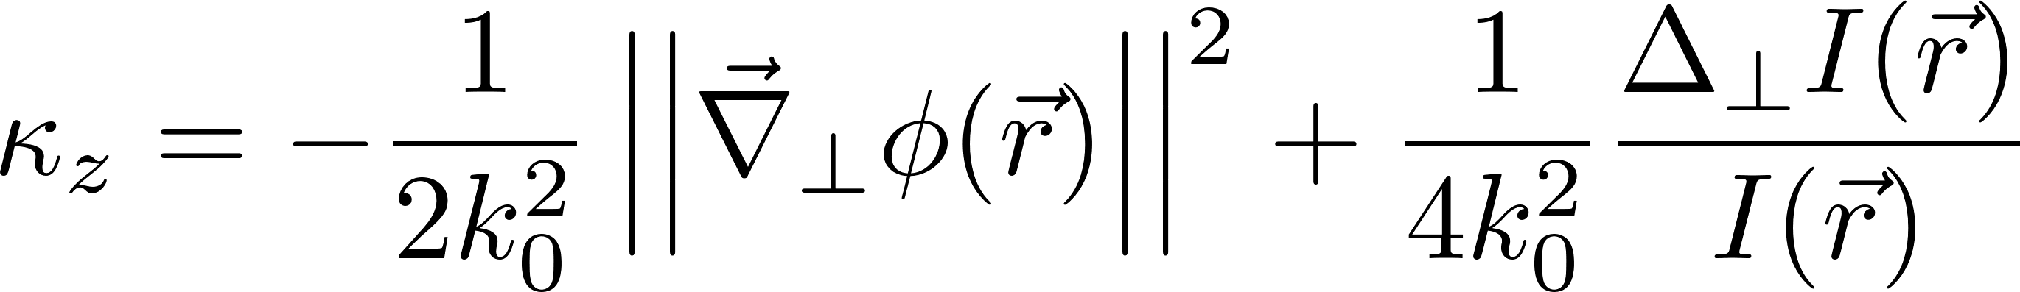
Effective wavevector in a distorted beam
Helmholtz equation :
First term : (local distortion of the wavefront) negligible respect to the second.
Second term : intensity variations, correction to momentum even in the case of a plane wavefront
Berry, M. V. (2009). Optical currents. Journal of Optics A: Pure and Applied Optics, 11(9), 094001.
Bade et al. « Observation of Extra Photon Recoil in a Distorted Optical Field ». Physical Review Letters 121.7 (2018)

Slide 14
Effective wavevector in a distorted wavefront
Helmholtz equation :
First term : (local distortion of the wavefront) negligible respect to the second.
Second term : intensity variations, correction to momentum even in the case of a plane wavefront
Probe local effective k-vector with the atoms:
Small and cold atomic source
Reconstruct intensity profile of laser beam
Map the k-vector distribution with atomic interferometry
Berry, M. V. (2009). Optical currents. Journal of Optics A: Pure and Applied Optics, 11(9), 094001.
Bade et al. « Observation of Extra Photon Recoil in a Distorted Optical Field ». Physical Review Letters 121.7 (2018)
Notes:
The first term is related to the phase gradient and describes the local distortion of the wavefront. This term has been found negligible respect to the second.
The second term depends on intensity variations and gives a correction to momentum even in the case of a plane wavefront

Slide 15
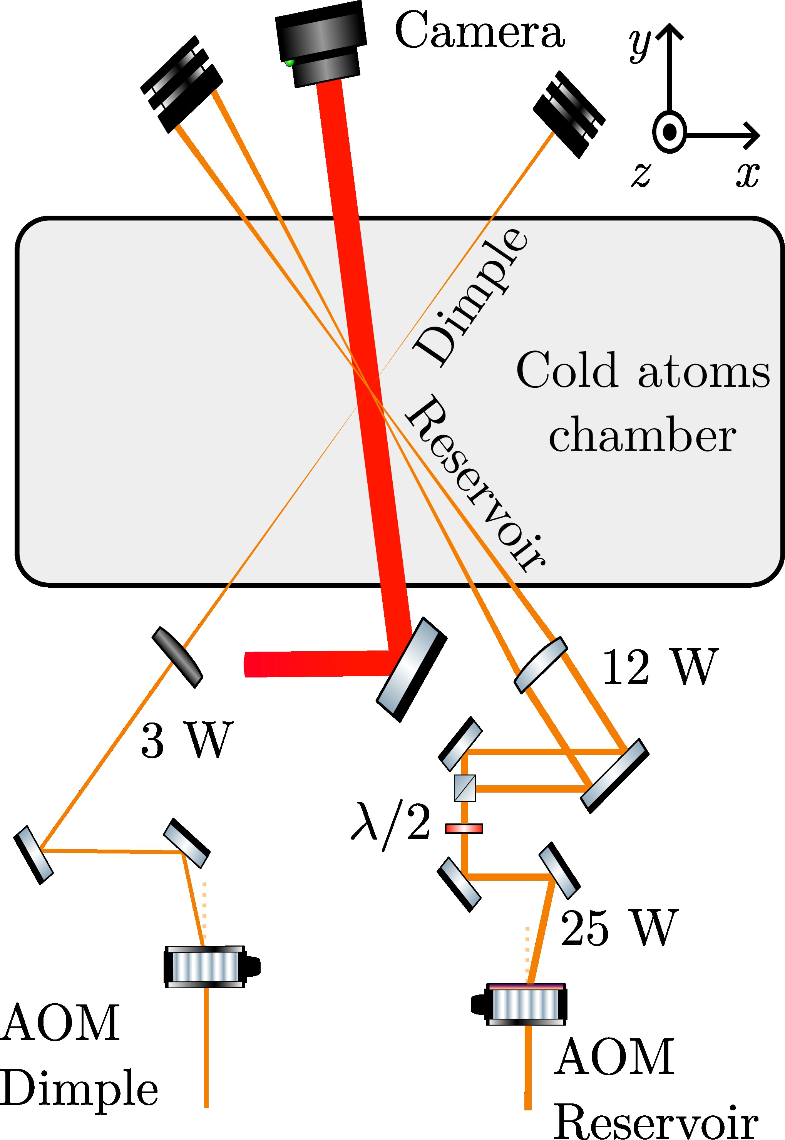
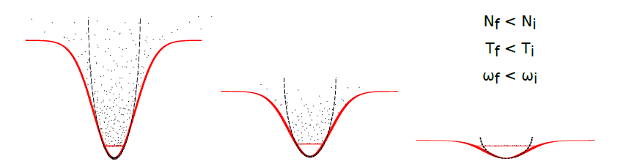
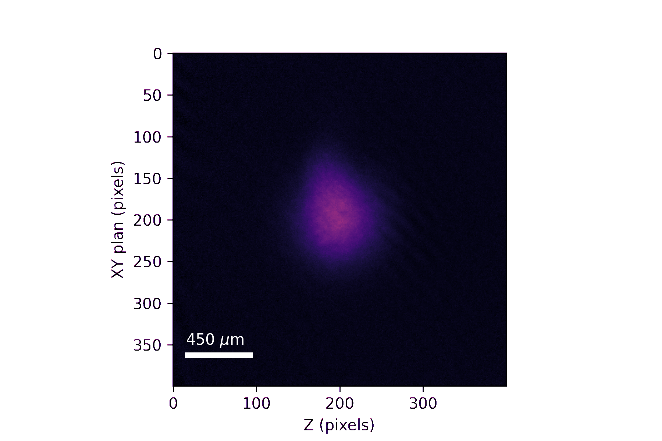
Bose Einstein condensate
To probe local effects of the laser → cold and compact atomic cloud.
We produce a Bose-Einstein condensate (BEC) using evaporative cooling with a 50 W laser at 1070 nm.
Images took during different stages of the evaporation and at the end we have :
200K atoms at 100nK
Size of the BEC during the interferometer : ~ 350 μm
Size of the molasses during the interferometer : ~ 3 mm

Slide 16
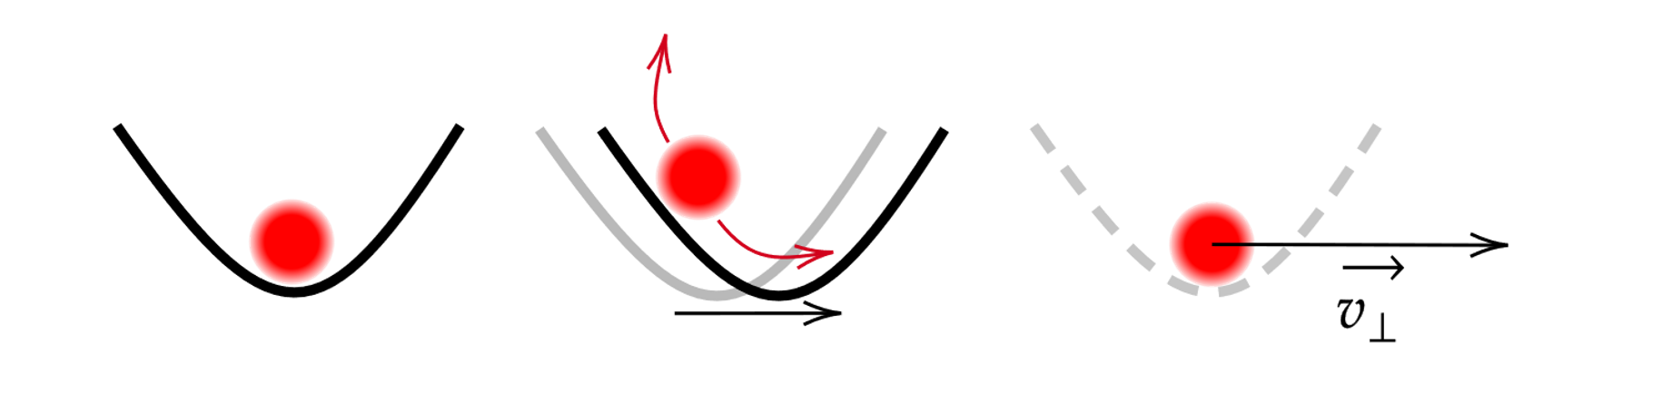
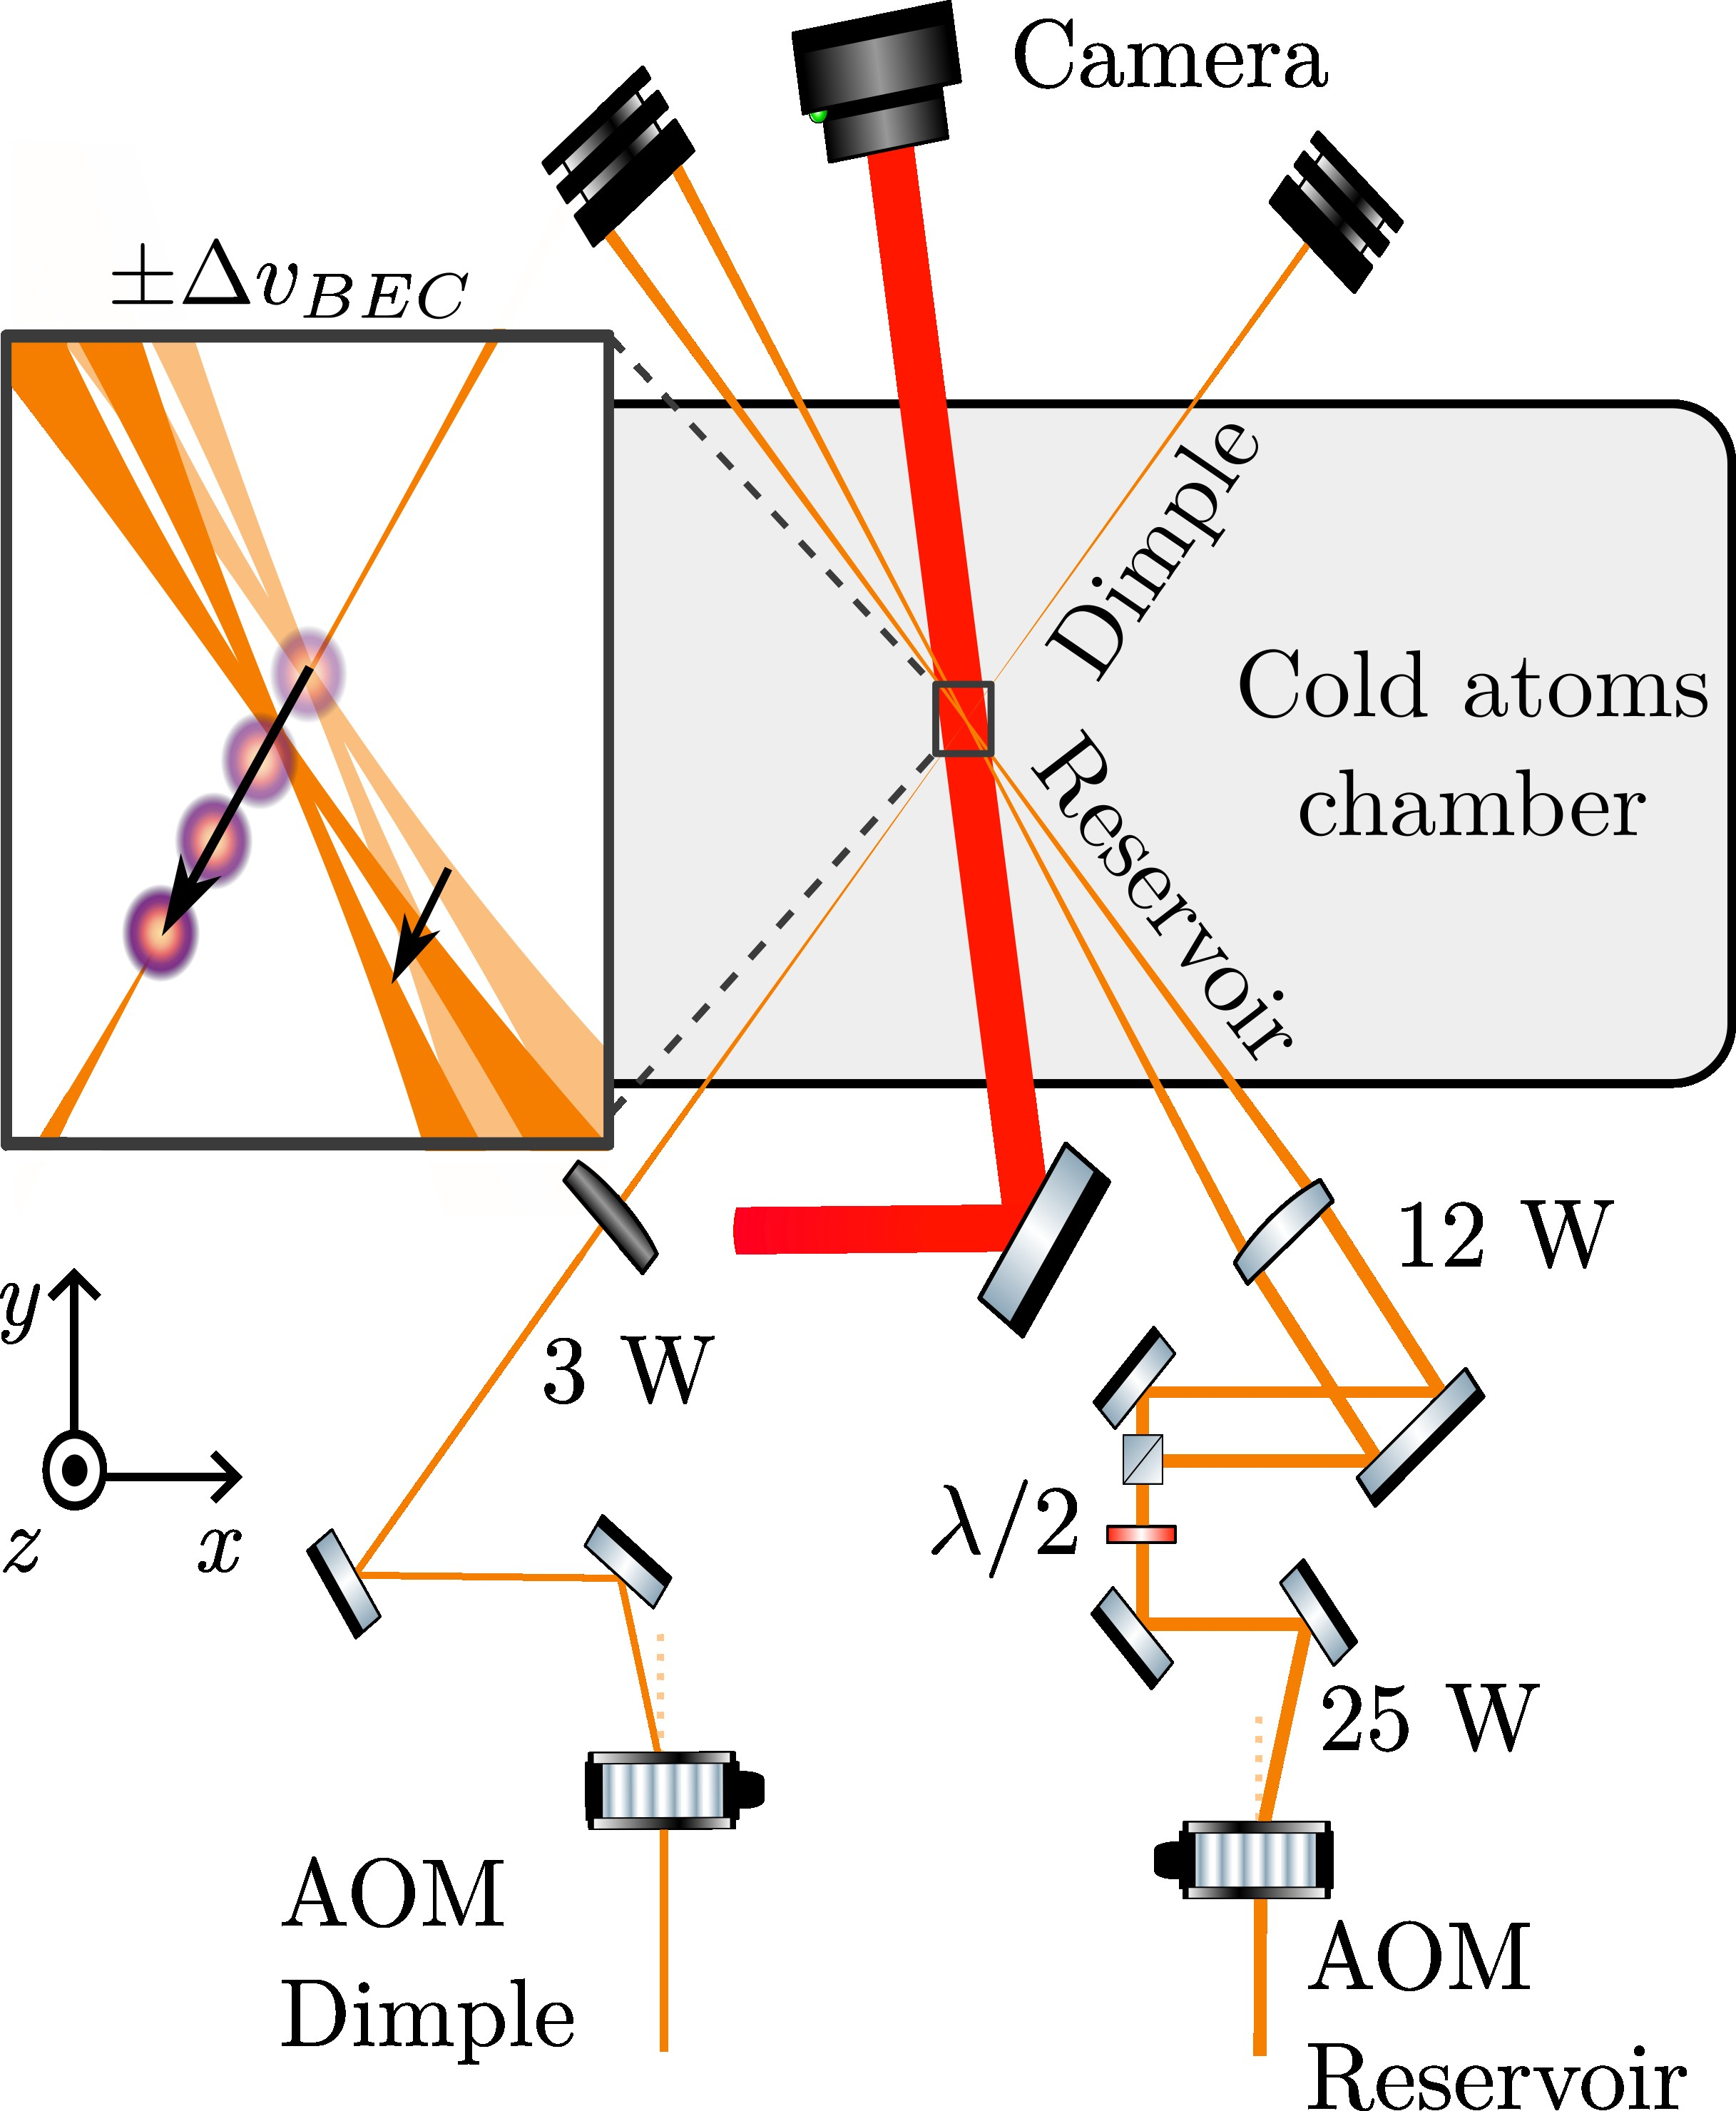
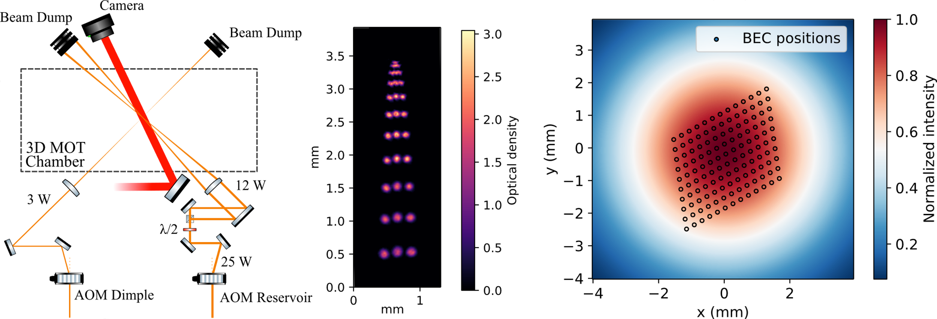

Bose Einstein condensate
Displace the BEC to probe various regions of the beam
Give an initial transverse velocity : shift the frequency of the dimple/reservoir AOMs.
Maximum transverse velocity : 10 mm/s
RMS fluctuation 0,075 mm/s, negligible compared to cloud’s velocity spread (⁓1,8 mm/s)

Slide 17
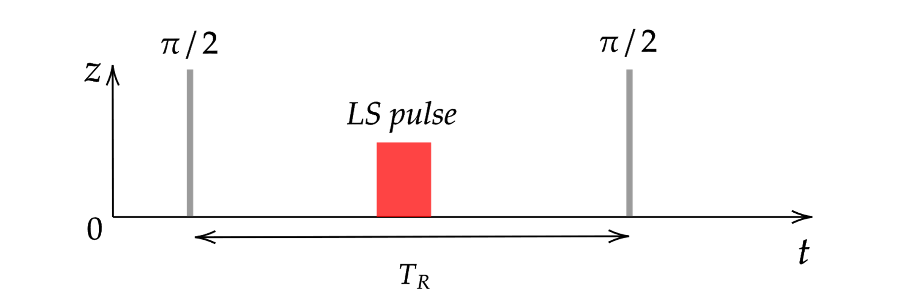
Local intensity probe of the beam in-situ
Clock sequence with a « light shift pulse » in between the two π/2 pulses
  Light shift pulse : single laser beam at 50 GHz of detuning from D2 line applied on the atoms with a duration of few ms
Differential light shift proportionnal to the intensity
Notes:
Example with a 4 pi phase shift, so a displacement of the fringes of 2 periods

Slide 18
Local intensity probe of the beam in-situ
Clock sequence with a « light shift pulse » in between the two π/2 pulses
  Light shift pulse : single laser beam at 50 GHz of detuning from D2 line applied on the atoms with a duration of few ms
Differential light shift proportionnal to the intensity
Notes:
Example with a 4 pi phase shift, so a displacement of the fringes of 2 periods

Slide 19




Caracterisation of the method
Clipped beam with an iris with an aperture of 4 mm → Fringes pattern
J. M. Cervantes, J. Opt. Soc. Am. A, 41(5):881891, (2024)

Slide 20



Laplacian calculation
Convolution of the intensity map with the Laplacian kernel
Account for the spatial arrangement of the positions
Notes:
Extra photon recoil in the center of the donut

Slide 21
Laplacian calculation
Convolution of the intensity map with the Laplacian kernel
Account for the spatial arrangement of the positions
Notes:
Extra photon recoil in the center of the donut

Slide 22


Local extra photon recoil measurement
Reverses sign across beam profile
    → Laplacian-dependent local momentum transfer
Extra photon recoil observed: momentum transfer exceeds nominal value hν/c
→ Superoscillations concentrate near intensity minima
M V Berry. Superoscillations for monochromatic standing waves. Journal of Physics A:Mathematical and Theoretical, 53(22):225201, June 2020.
Dennis M R, Hamilton A C and Courtial J 2008 Superoscillation in speckle patterns Opt. Lett. 33 2976–8
Bade et al. « Observation of Extra Photon Recoil in a Distorted Optical Field ». Physical Review Letters 121.7 (2018)
Gaudout et al, “Probing the spatial distribution of 𝑘-vectors in situ with Bose-Einstein condensates”. Phys. Rev. A 112, L061301 (2025)
Notes:
Any light field can be decomposed as a superposition of plane waves. The precise interference between these components creates local oscillations faster than the fastest Fourier component, particularly near intensity minima—this is the superoscillation effect.

Slide 23





Systematic effect correction
Typical uncertainty on $ν_{D}$ is 80 mHz $\left(2.8×{10}^{−9}\right)$
Each data point represents an average 7 such measurements statistical uncertainty of $⁓1.5×{10}^{−9}$ on $κ$
Full data were acquired over 20 hours, using BEC and optical molasses alternately.
We use as reference value the average of 18 values with optical molasses ($σ_{r}=4.3×{10}^{−10}$with $χ^{2}=1.2$)

Slide 24

Summary and outlook
New method for measuring the spatial distribution of k-vectors and the laser intensity profile
Measurement of a local extra photon recoil
Statistical uncertainty is limited by the time required to scan the full beam profile.
Gaudout et al, “Probing the spatial distribution of 𝑘-vectors in situ with Bose-Einstein condensates”. Phys. Rev. A 112, L061301 (2025)
Advanced Beam Profiling:
  Use Spatial Light Modulator (SLM) to improve beam profile after determining it with BEC atoms, enabling feedback and correction.
Efficient Measurement Techniques:
  Implement a 2D lattice of BECs for simultaneous measurements, avoiding the need to move a single BEC.
  Using imaging techniques with a optical molasses
K. Stolzenberg et al. « Multi-Axis Inertial Sensing with 2D Matter-Wave Arrays ». Phys. Rev. Lett. 134, 143601 (2025)
A. Trimeche, M. Langlois, S. Merlet, and F. Pereira Dos Santos, Physical Review Applied 7, 034016 (2017)
J. Junca, J. Kitching and W. McGehee Phys. Rev. Lett. 136, 143402 (2026)
R. Karcher, A. Imanaliev, S. Merlet, and F. P. D. Santos, New Journal of Physics 20, 113041 (2018)

Slide 25










Thank you for your attention
O. Boucher
Pierre Louis Premoli
Mona Ghazal

Slide 26




How we reconstruct the spatial distribution of k-vectors
Measurement of frequency $ν_{D}$ directly provides the correction $κ_{z}$
Notes:
Transition 1 photon : Spontaneous emission

Slide 27







Atomic splitter using Raman transitions
Create an atomic superposition by performing a π/2 light pulse
Two photons transition : Raman transition
Contra-propagating beams :
Notes:
Transition 1 photon : Spontaneous emission

Slide 28



Experimental implementation
Four science lasers (NKT laser or diode at 1560 nm doubled and amplified by EDFA + doubling Muquans)
Frequency locked on an ultra stable freq comb
(200MHz repetition frequency)
Bloch lasers
Raman lasers

Slide 29
Experimental implementation
Four science lasers (NKT laser or diode at 1560 nm doubled and amplified by EDFA + doubling Muquans)
Bloch lasers
Raman lasers

Slide 30
Experimental implementation
Four science lasers (NKT laser or diode at 1560 nm doubled and amplified by EDFA + doubling Muquans)
Bloch lasers
Raman lasers

Slide 31






Phase of the interferometer
Phase determination of the interferometer : fit the positions of the fringes
Bloch oscillations up/down and Raman transitions up/down.
Phase determined at the end of the measurement to return the h/m value
By summing the four fringes positions δω_{c} we determine the h/m value

Slide 32



Laplacian calculation
Convolution of the intensity map with the Laplacian kernel
Intensity map
Laplacian map
Notes:
Extra photon recoil in the center of the donut

Slide 33





Laplacian details

Slide 34

Comparaison impact on κ
First term : (local distortion of the wavefront) negligible respect to the second.
Second term : intensity variations, correction to momentum even in the case of a plane wavefront and important fluctuations
Notes:
Extra photon recoil in the center of the donut

Slide 35


Effect of finite atomic cloud size on κ
Convolving the optical field with the atomic density distribution
Notes:
Extra photon recoil in the center of the donut

Slide 36

Local intensity probe of the beam in-situ
Ramsey sequence with a « light shift pulse » in between the two π/2 pulses
  Light shift pulse : single laser beam at 50 GHz of detuning from D2 line applied on the atoms with a duration of few ms
Differential light shift proportionnal to the intensity
Notes:
Example with a 4 pi phase shift, so a displacement of the fringes of 2 periods

Slide 37

Displacement of the BEC
Displace the BEC to probe various regions of the beam
Give an initial transverse velocity : changing the frequency of the dimple/reservoir AOMs.
Z (mm)
Maximum transverse velocity : 10 mm/s
RMS fluctuation 0,075 mm/s, negligible compared to cloud’s veocity spread (⁓1,8 mm/s)
Notes:
Max Displacement during AI : 0,5 mm

Slide 38





New collimators
A spot of size will diffract with
an angle of
Caracteristic length
Attenuation of the fluctuations when the diffraction spot size is larger than the waist
Waist of the laser
Notes:
Sigma = spatial fluctuations scale as along the propagation

Slide 39



Toolbox for FPGA programmation (coming soon)
Odeon python package : toolbox for digital signal processing on FPGA platforms
Leverage MyHDL for hardware description (converts to Verilog)
Use familiar Python tools and practices
Can simulate the hardware description language (HDL)
Examples of applications develloped :
  Lock-in amplifiers
  Digital signal processing
  Weveform generation
  Data acquisition …

