Slide 1


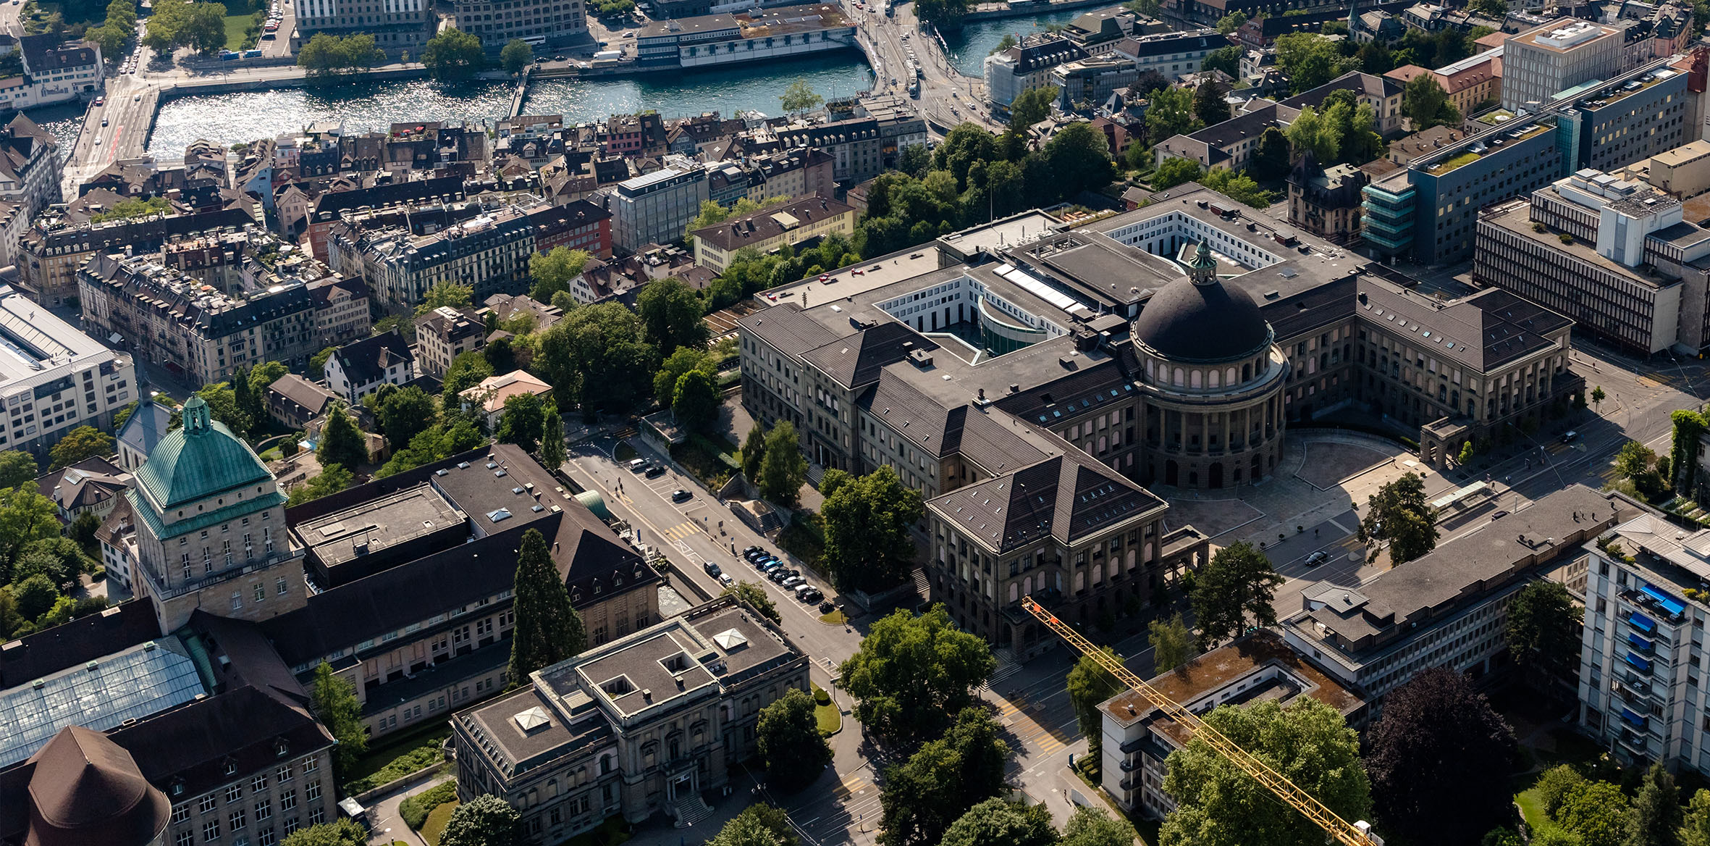
Precision CW spectroscopy of the 1S-2S transition of Positronium and Muonium
Ted Thorpe-Woods,
on behalf of the Crivelli group
Ted Thorpe-Woods
on behalf of the Exotic Matter group at ETH Zurich

Slide 2
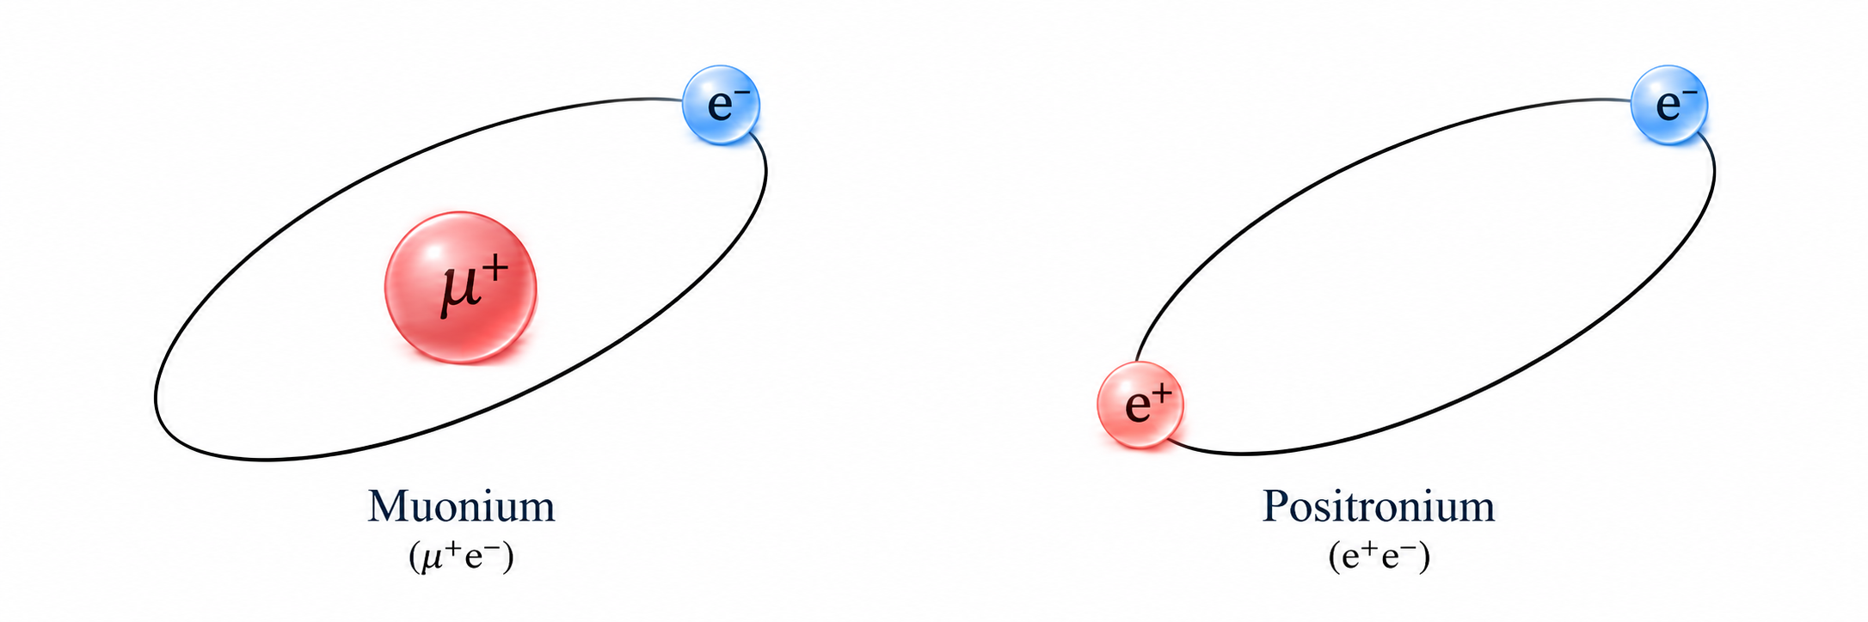
Ted Thorpe-Woods; PSAS 2026
Leptonic atoms
(Mu)
(Ps)
Lifetime of ~ 2.2µs
1/9 mass of Hydrogen
p-Ps lifetime of 125ps (↑↓)
o-Ps lifetime of 142ns (↑↑)
1/918 mass of hydrogen
Devoid of internal structure

Slide 3
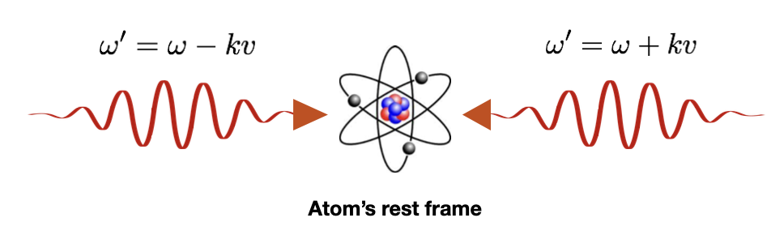
Ted Thorpe-Woods; PSAS 2026
The 1S-2S transition
The gold standard for precision spectroscopy
  Meta-stable (0.12s)
  Doppler free to first order
Fundamental constants (muon mass)
Fundamental symmetries and searches for new physics
2S
244nm (Mu)
488nm (Ps)
244nm (Mu)
488nm (Ps)
1S

Slide 4

1. Mu-MASS
Ted Thorpe-Woods; PSAS 2026
See Marcus’ poster for more details of 1S-2S of Mu
See Iren’s Poster for discussion of Microwave spectroscopy of Mu

Slide 5
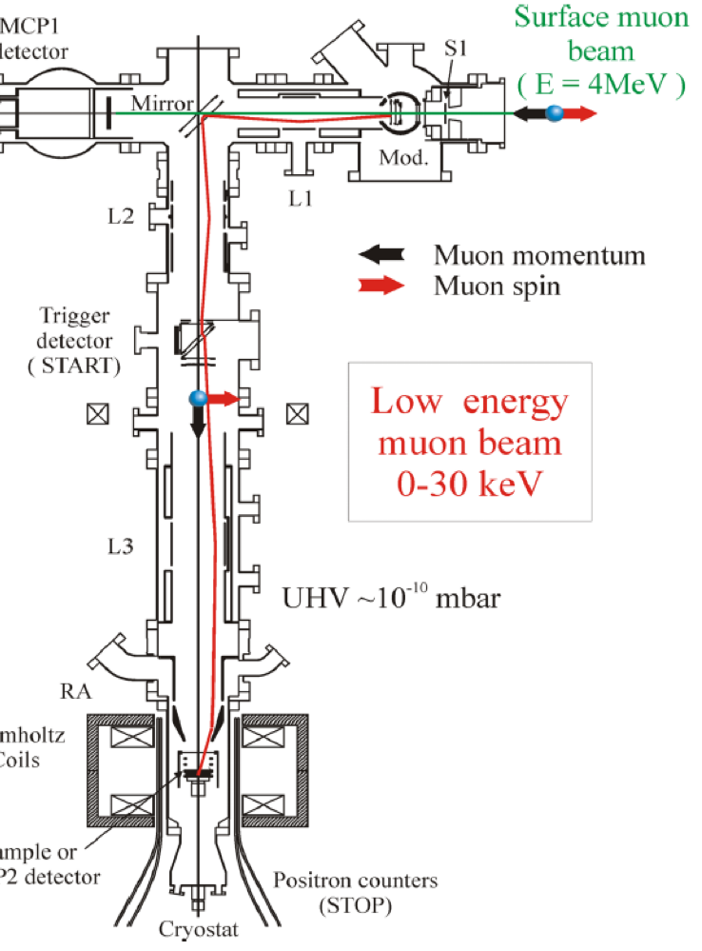
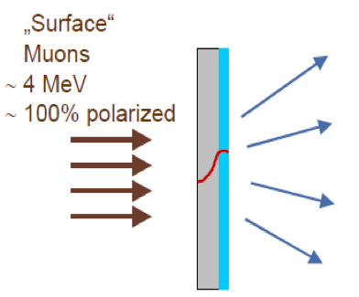

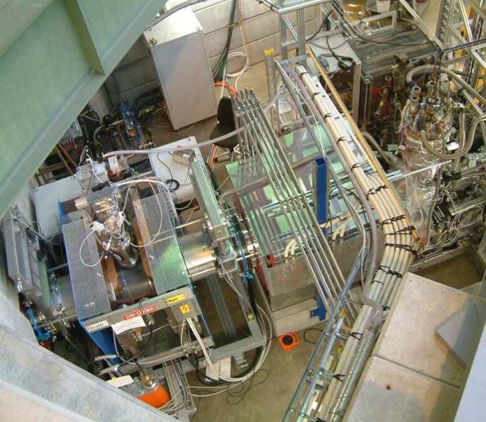
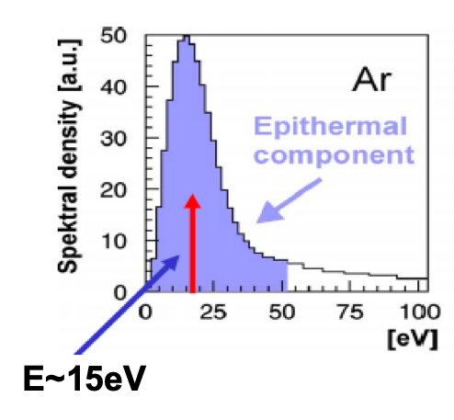
Ted Thorpe-Woods; PSAS 2026
The PSI low energy muon beam (LEM)
Solid Ne/Ar
500 nm film
https://www.psi.ch/en/low-energy-muons
Up to 5x10³ μ⁺/s
Helmholtz coil
TARGET

Slide 6
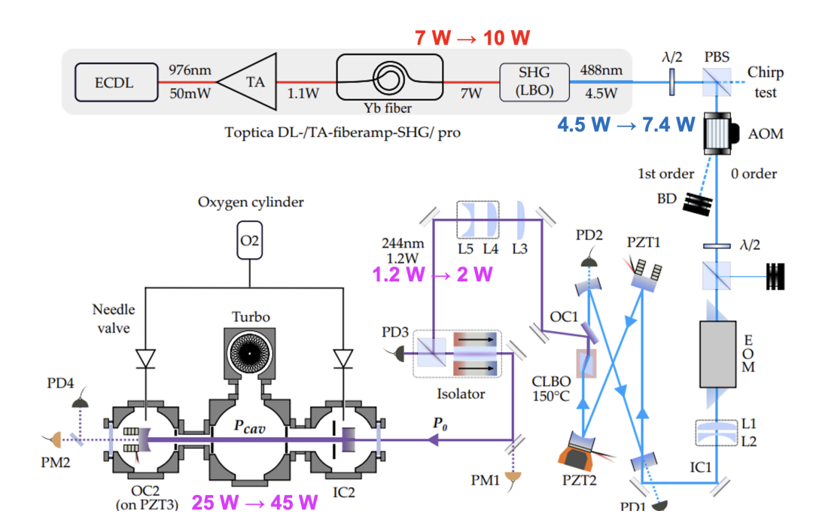
Ted Thorpe-Woods; PSAS 2026
Upgraded 244nm laser system
976nm light amplified to 10W via sequential TA and FA
Frequency doubled to 7W of 488nm
Second frequency doubling to ~2W of 244nm within custom made cavity with CLBO
Enhanced to 45W within MuMASS
N Zhadnov et al, Optics Express 31, 17(2023)

Slide 7
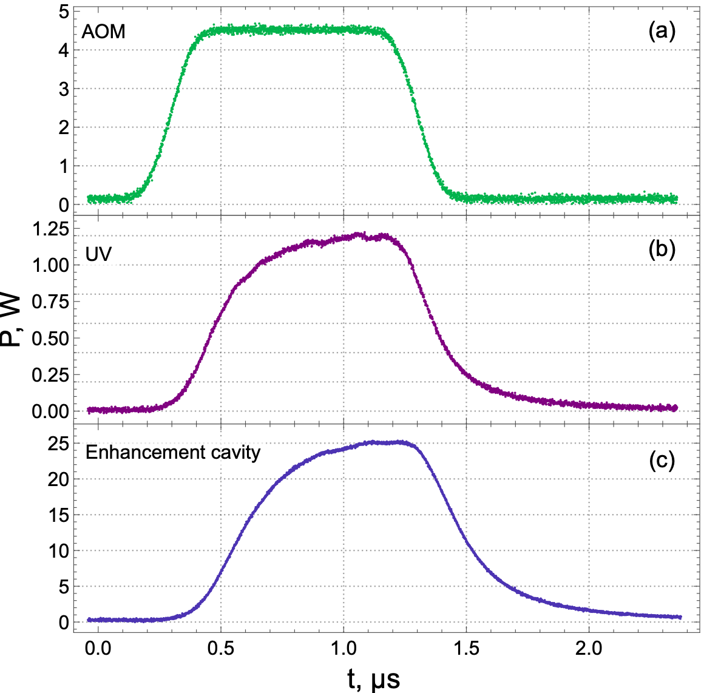
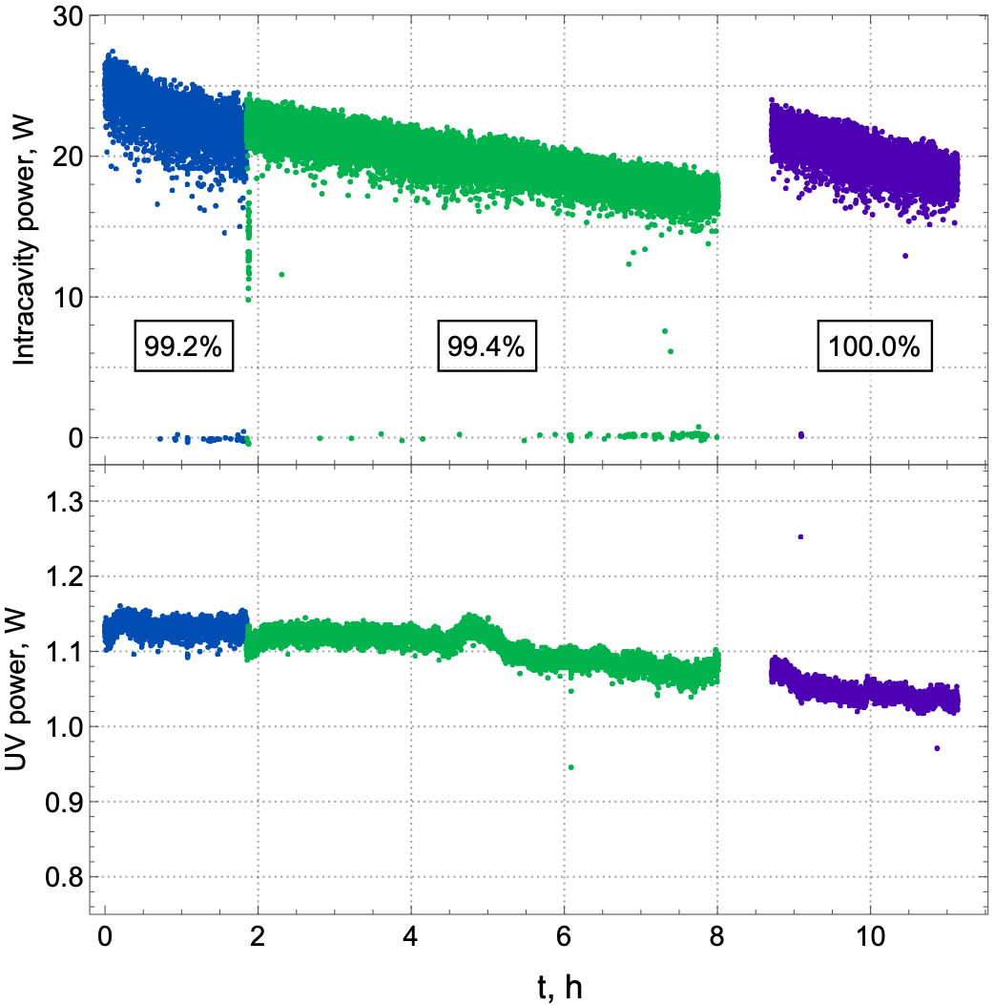
Ted Thorpe-Woods; PSAS 2026
Upgraded 244nm laser system
976nm light amplified to 10W via sequential TA and FA
Frequency doubled to 7W of 488nm
Second frequency doubling to ~2W of 244nm within custom made cavity with CLBO
Enhanced to 45W within MuMASS
Pulsed-CW method to avoid degradation
AOM has been replaced with a Pockles cell for faster pulsing
N Zhadnov et al, Optics Express 31, 17(2023)

Slide 8
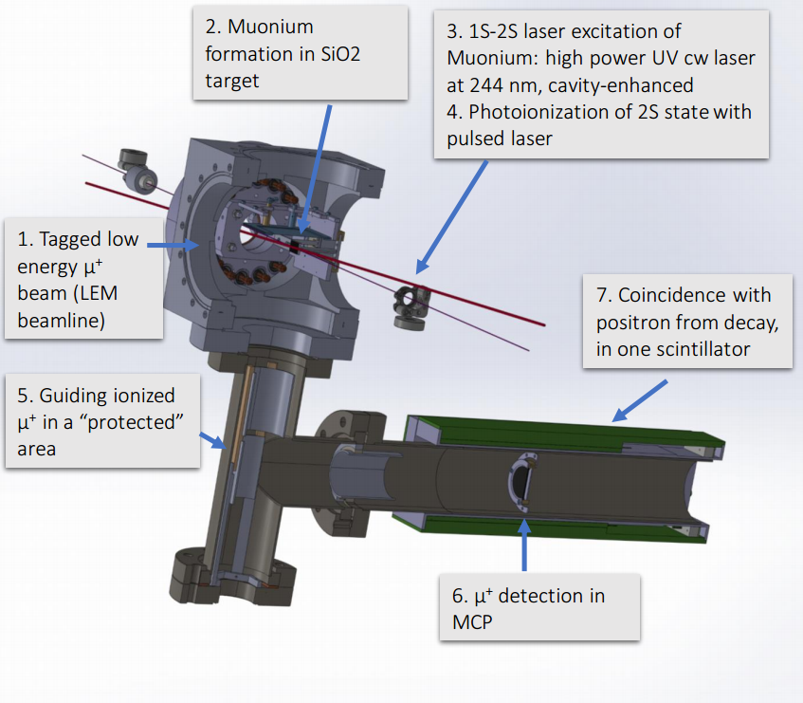
Ted Thorpe-Woods; PSAS 2026
Mu-Mass experimental setup
Zoom on Laser & target
I. Cortinovis, PC, et al., EPJD 77 (2023)
244nm (100mW)
SiO2 target
Internal State of M
continuum
2S
1S

Slide 9

Ted Thorpe-Woods; PSAS 2026
Mu-Mass experimental setup
Zoom on Laser & target
I. Cortinovis, PC, et al., EPJD 77 (2023)
$$μ^{+}$$
244nm (100mW)
SiO2 target
Internal State of M
continuum
2S
1S

Slide 10

Ted Thorpe-Woods; PSAS 2026
Mu-Mass experimental setup
Zoom on Laser & target
I. Cortinovis, PC, et al., EPJD 77 (2023)
$$M$$
244nm (100mW)
SiO2 target
Internal State of M
continuum
2S
1S

Slide 11
Ted Thorpe-Woods; PSAS 2026
Mu-Mass experimental setup
Zoom on Laser & target
I. Cortinovis, PC, et al., EPJD 77 (2023)
$$M$$
244nm (30W)
SiO2 target
Internal State of M
continuum
2S
244nm
244nm
1S

Slide 12


Ted Thorpe-Woods; PSAS 2026
Mu-Mass experimental setup
Zoom on Laser & target
I. Cortinovis, PC, et al., EPJD 77 (2023)
$$μ^{+}$$
$$M$$
$$e^{−}$$
244nm (30W)
355nm (~1mJ)
SiO2 target
Internal State of M
continuum
355nm
2S
244nm
244nm
1S

Slide 13
Ted Thorpe-Woods; PSAS 2026
Mu-Mass experimental setup
Zoom on Laser & target
I. Cortinovis, PC, et al., EPJD 77 (2023)
$$μ^{+}$$
$$M$$
$$e^{−}$$
244nm (100mW)
SiO2 target
Internal State of M
continuum
355nm
2S
244nm
244nm
1S

Slide 14
Ted Thorpe-Woods; PSAS 2026
Mu-Mass experimental setup
Zoom on Laser & target
I. Cortinovis, PC, et al., EPJD 77 (2023)
$$μ^{+}$$
$$M$$
$$e^{−}$$
244nm (100mW)
SiO2 target
Internal State of M
continuum
355nm
2S
244nm
244nm
1S

Slide 15
Ted Thorpe-Woods; PSAS 2026
Mu-Mass experimental setup
Zoom on Laser & target
I. Cortinovis, PC, et al., EPJD 77 (2023)
$$μ^{+}$$
$$M$$
$$e^{−}$$
244nm (100mW)
SiO2 target
Internal State of M
continuum
355nm
2S
244nm
244nm
1S

Slide 16
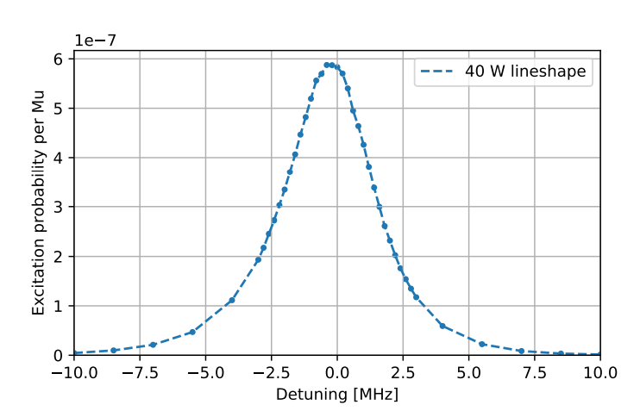
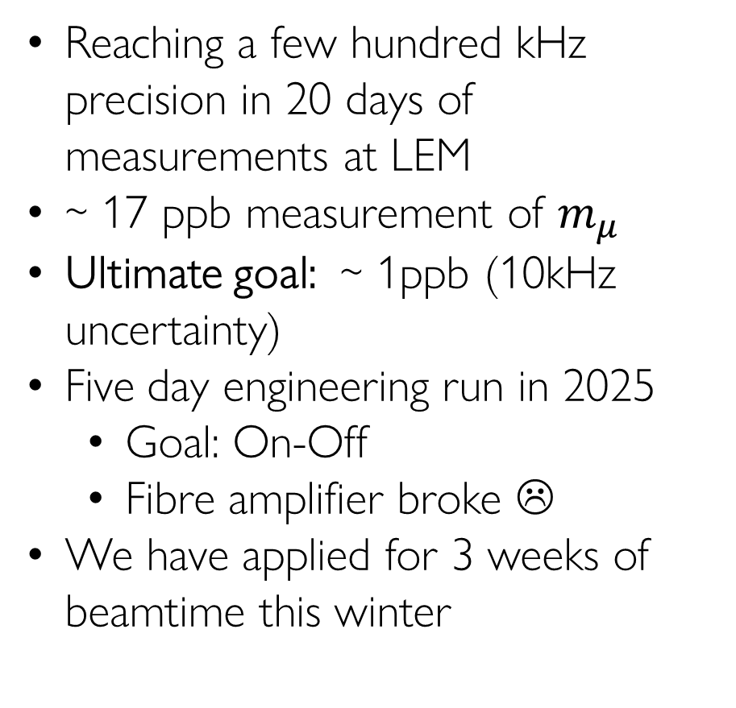
Ted Thorpe-Woods; PSAS 2026
Expected result
Reaching a few hundred kHz precision in 20 days of measurements at LEM
~ 17 ppb measurement of $m_{μ}$
Ultimate goal: ~ 1ppb (10kHz uncertainty)
Five day engineering run in 2025
  Goal: On-Off
  Fibre amplifier broke ☹
We have applied for 3 weeks of beamtime this winter

Slide 17
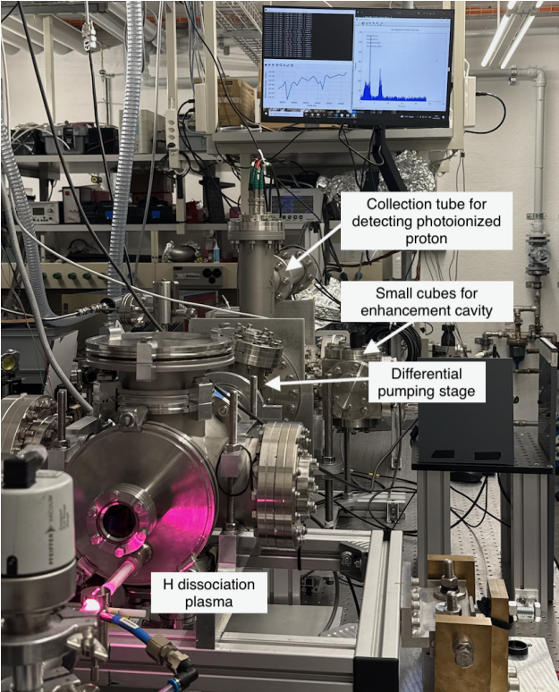
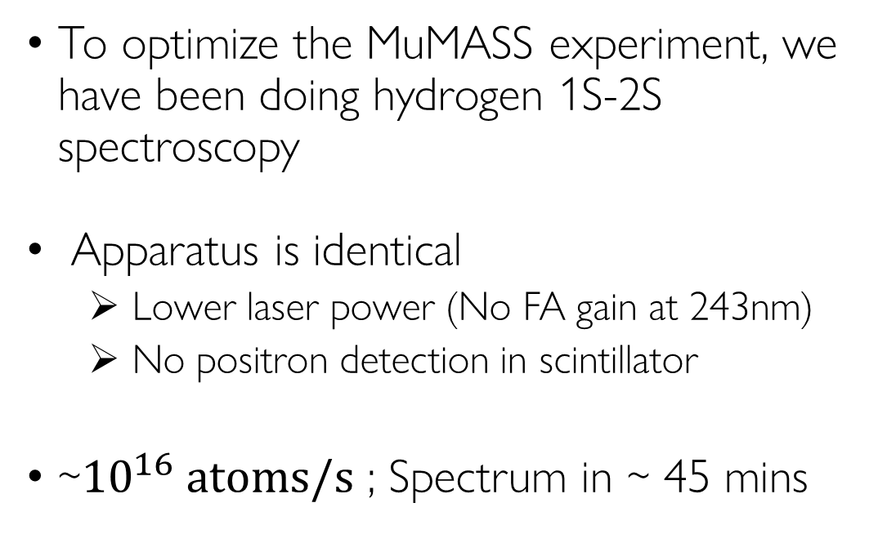
Ted Thorpe-Woods; PSAS 2026
Commissioning with Hydrogen
To optimize the MuMASS experiment, we have been doing hydrogen 1S-2S spectroscopy
Apparatus is identical
  Lower laser power (No FA gain at 243nm)
  No positron detection in scintillator
~$10^{16} atoms/s$ ; Spectrum in ~ 45 mins

Slide 18
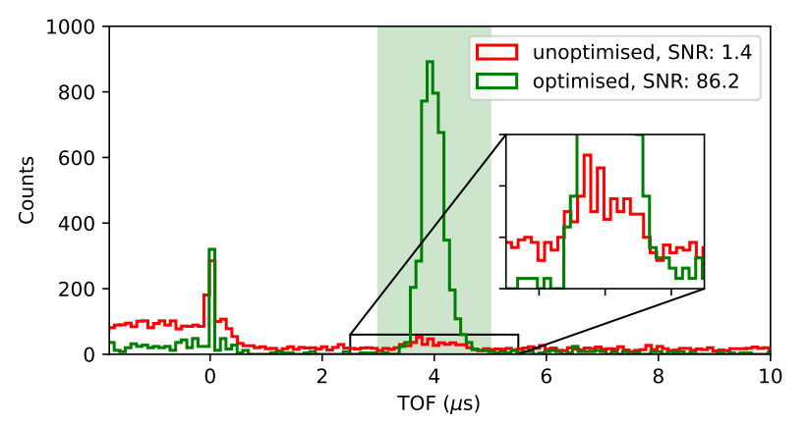
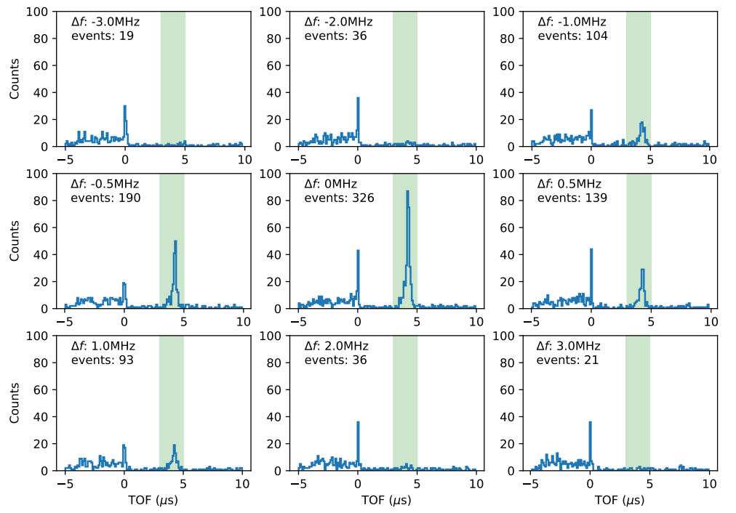
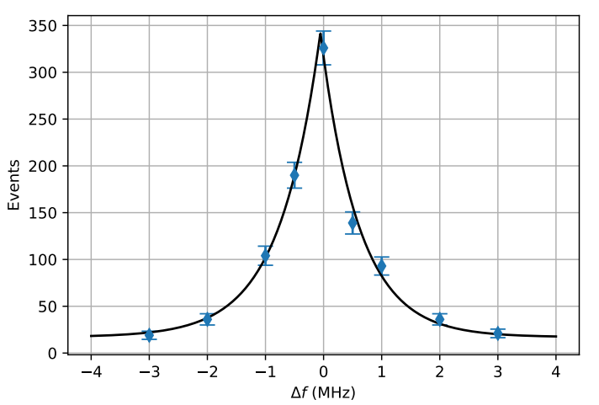
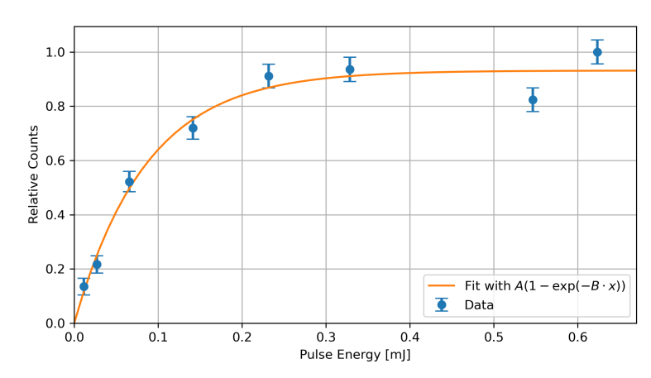
Ted Thorpe-Woods; PSAS 2026
Commissioning with Hydrogen
Scan/Optimise experimental parameters
Compare to Simion Simulations
Select optimum parameters for muonium
Measured
in 45 mins

Slide 19
2. Positronium 1S-2S
Ted Thorpe-Woods; PSAS 2026
See Evan’s Poster for more details!

Slide 20
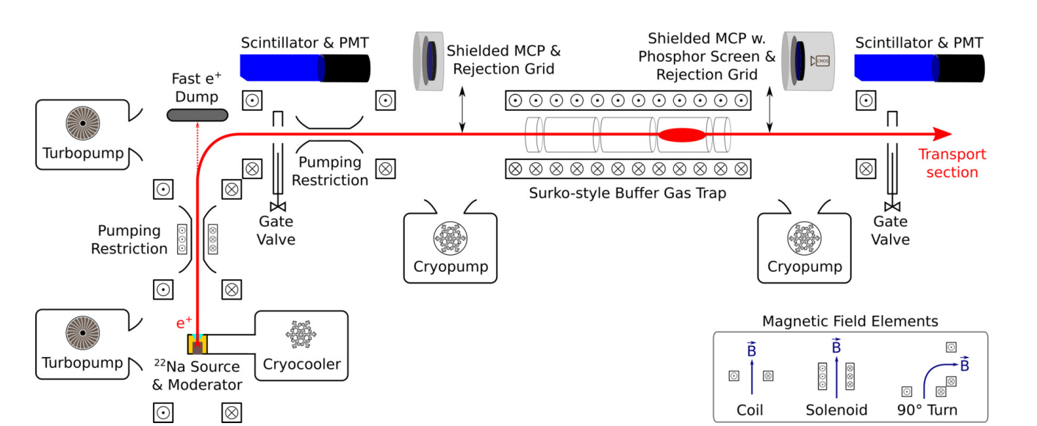

Ted Thorpe-Woods; PSAS 2026
Pulsed $e^{+}$ beam
Spectroscopy chamber

Slide 21
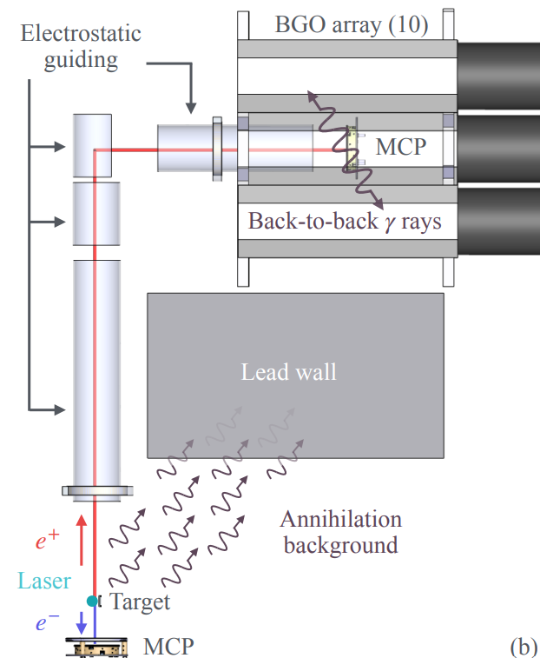

Ted Thorpe-Woods; PSAS 2026
Ps 1S-2S experimental setup
CW experiment on the pulsed $e^{+}$ beam at ETH Zurich:
continuum
2S
1S
a)
Porus silica
target
486nm
~500W
Ps internal state
Zoom on laser & target
Cross section of experiment
b)
c)

Slide 22
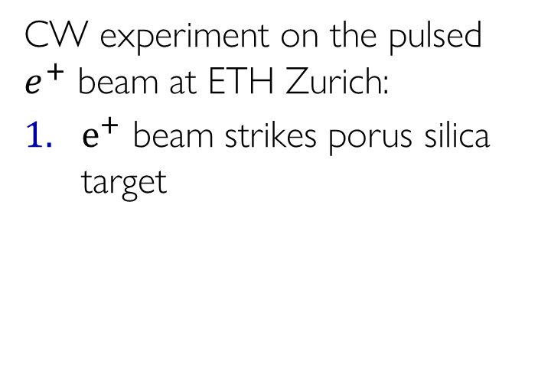

Ted Thorpe-Woods; PSAS 2026
Ps 1S-2S experimental setup
CW experiment on the pulsed $e^{+}$ beam at ETH Zurich:
$e^{+}$ beam strikes porus silica target
continuum
2S
1S
a)
Porus silica
target
$e^{+}$
486nm
~500W
Ps internal state
Zoom on laser & target
Cross section of experiment
b)
c)

Slide 23

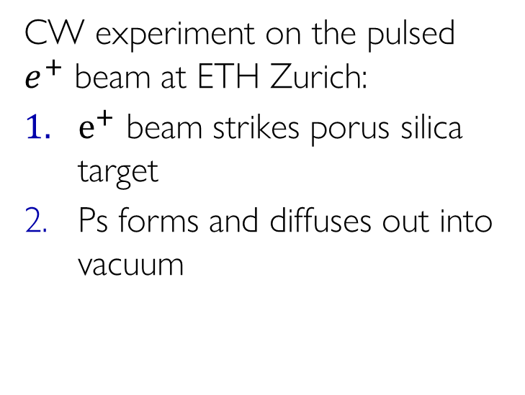
Ted Thorpe-Woods; PSAS 2026
Ps 1S-2S experimental setup
CW experiment on the pulsed $e^{+}$ beam at ETH Zurich:
$e^{+}$ beam strikes porus silica target
Ps forms and diffuses out into vacuum
continuum
2S
1S
a)
Porus silica
target
$$Ps$$
486nm
~500W
Ps internal state
Zoom on laser & target
Cross section of experiment
b)
c)

Slide 24
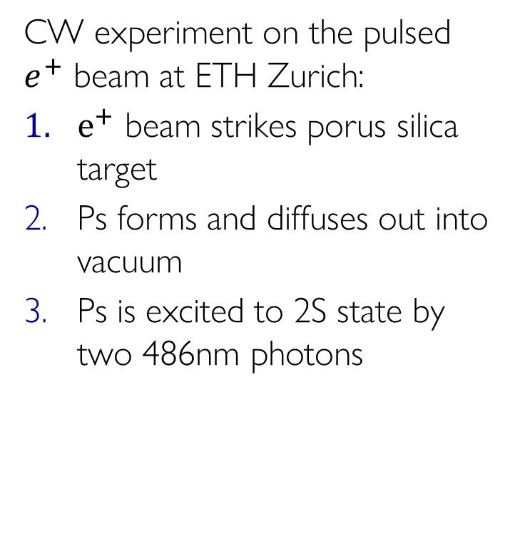
Ted Thorpe-Woods; PSAS 2026
Ps 1S-2S experimental setup
CW experiment on the pulsed $e^{+}$ beam at ETH Zurich:
$e^{+}$ beam strikes porus silica target
Ps forms and diffuses out into vacuum
Ps is excited to 2S state by two 486nm photons
continuum
2S
1S
a)
Porus silica
target
$$Ps$$
486nm
~500W
Ps internal state
Zoom on laser & target
Cross section of experiment
b)
c)

Slide 25


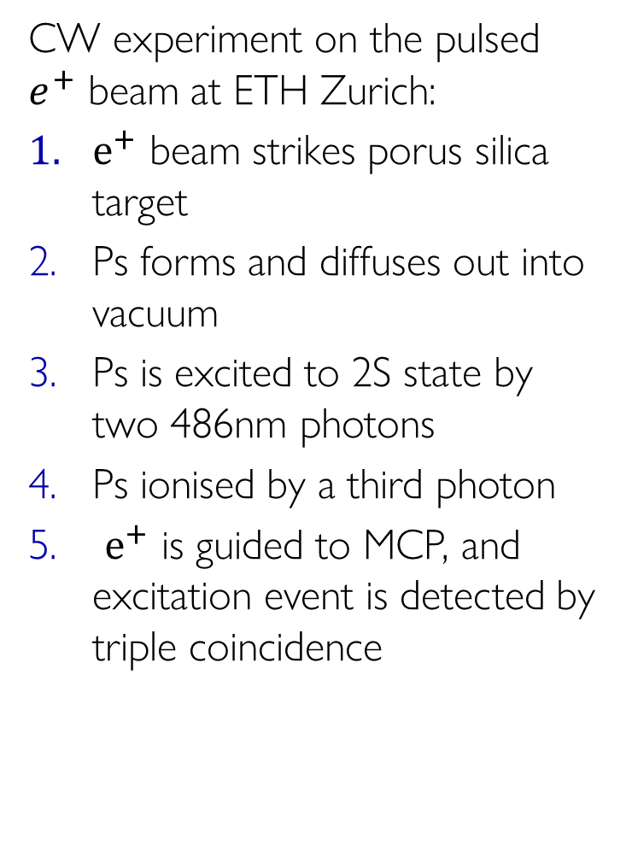
Ted Thorpe-Woods; PSAS 2026
Ps 1S-2S experimental setup
CW experiment on the pulsed $e^{+}$ beam at ETH Zurich:
$e^{+}$ beam strikes porus silica target
Ps forms and diffuses out into vacuum
Ps is excited to 2S state by two 486nm photons
Ps ionised by a third photon
$e^{+}$ is guided to MCP, and excitation event is detected by triple coincidence
continuum
2S
1S
a)
Porus silica
target
$e^{+}$
$e^{−}$
486nm
~500W
Ps internal state
Zoom on laser & target
Cross section of experiment
b)
c)

Slide 26
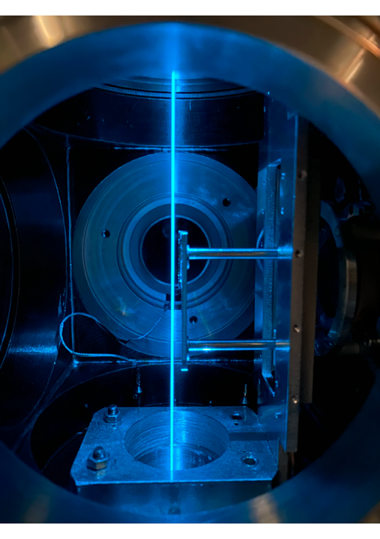
Ted Thorpe-Woods; PSAS 2026
Ps 1S-2S experimental setup
CW experiment on the pulsed $e^{+}$ beam at ETH Zurich:
$e^{+}$ beam strikes porus silica target
Ps forms and diffuses out into vacuum
Ps is excited to 2S state by two 486nm photons
Ps ionised by a third photon
$e^{+}$ is guided to MCP, and excitation event is detected by triple coincidence
continuum
2S
1S
a)
guiding
target
b)
c)

Slide 27
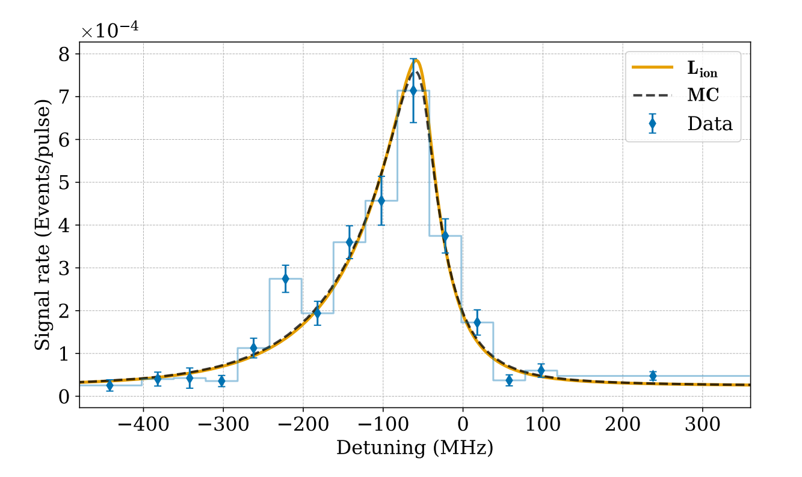
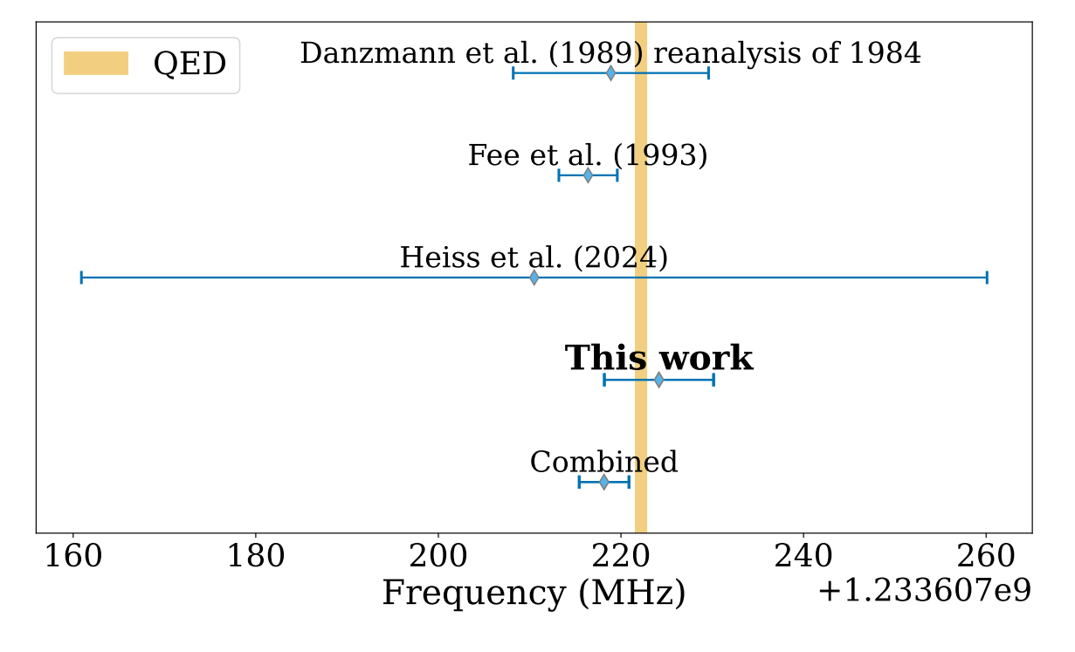
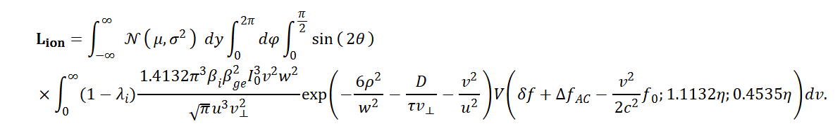
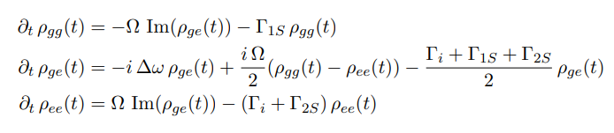
Ted Thorpe-Woods; PSAS 2026
Results
(2025)
Experiment: 1 233 607 224.1 ± 6 MHz.
Theory : 1 233 607 222.2 ± 0.6 MHz.
L. de Sousa Borges et al., PRA. 113, (2026)
G. S. Adkins et al., Phys. Rep. 975, (2022).

Slide 28
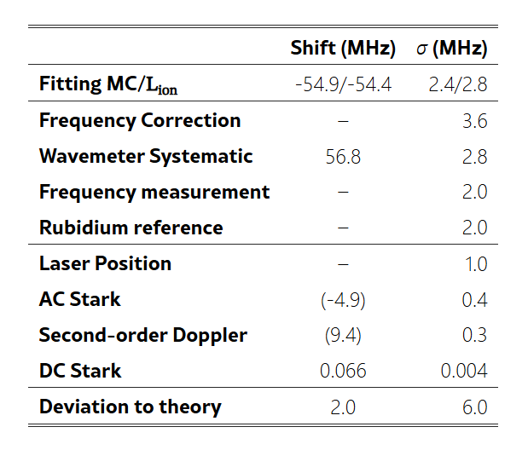
Ted Thorpe-Woods; PSAS 2026
Doing Better

Slide 29
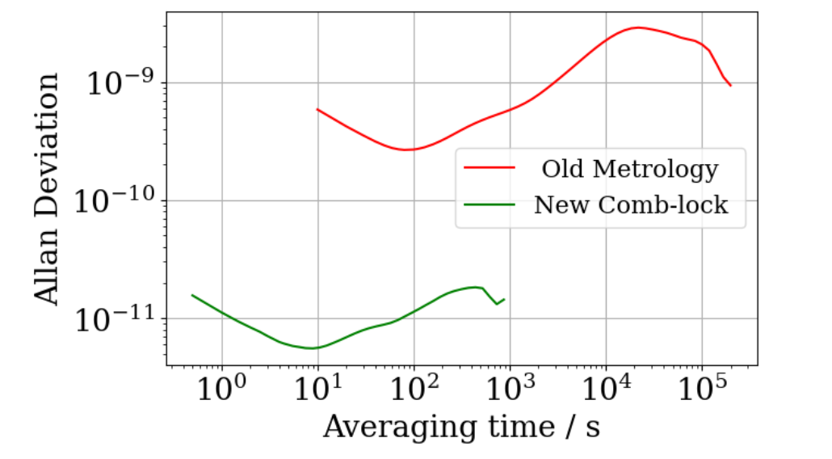



Ted Thorpe-Woods; PSAS 2026
Doing Better
$$\frac{λ}{4}$$
Over an order of magnitude better frequency stability
CW
leak
ECDL
grating
AOM
Comb
light
B
D
U
$$÷$$
$$×$$
PID
U. Schünemann et al. Rev. Sci. Instrum. 70, 242–243 (1999)

Slide 30
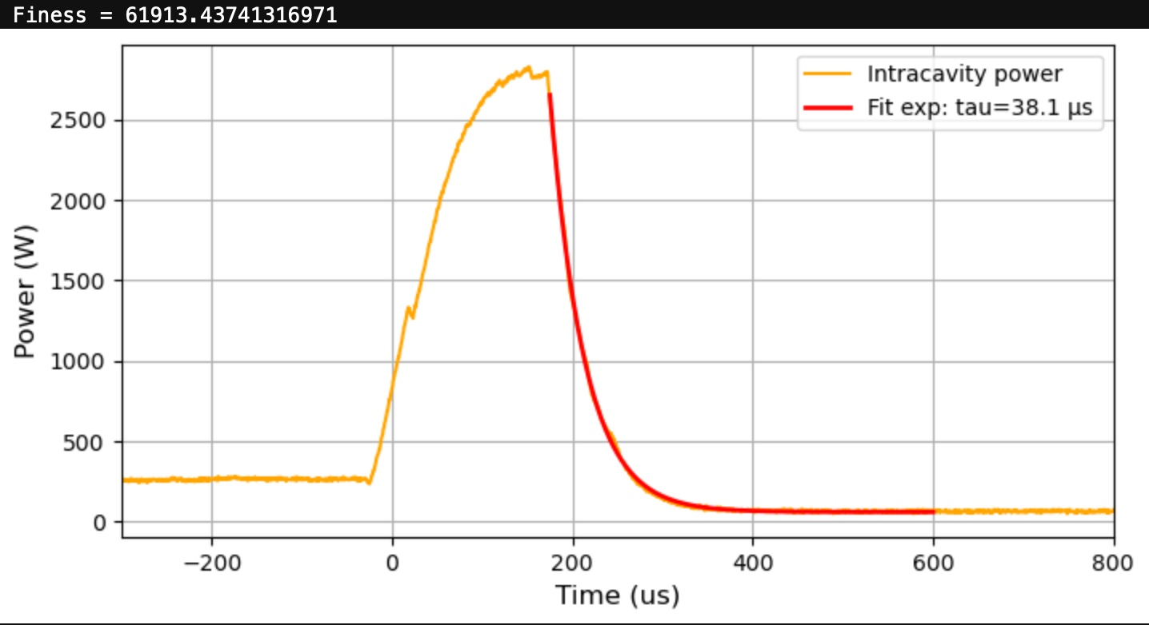

Ted Thorpe-Woods; PSAS 2026
Doing Better
2024 power
We can now operate stably with 5 times more power via Pulsed-CW methods
Experimental signal ∝ $P^{3}$
Route to investigate AC Stark systematic

Slide 31
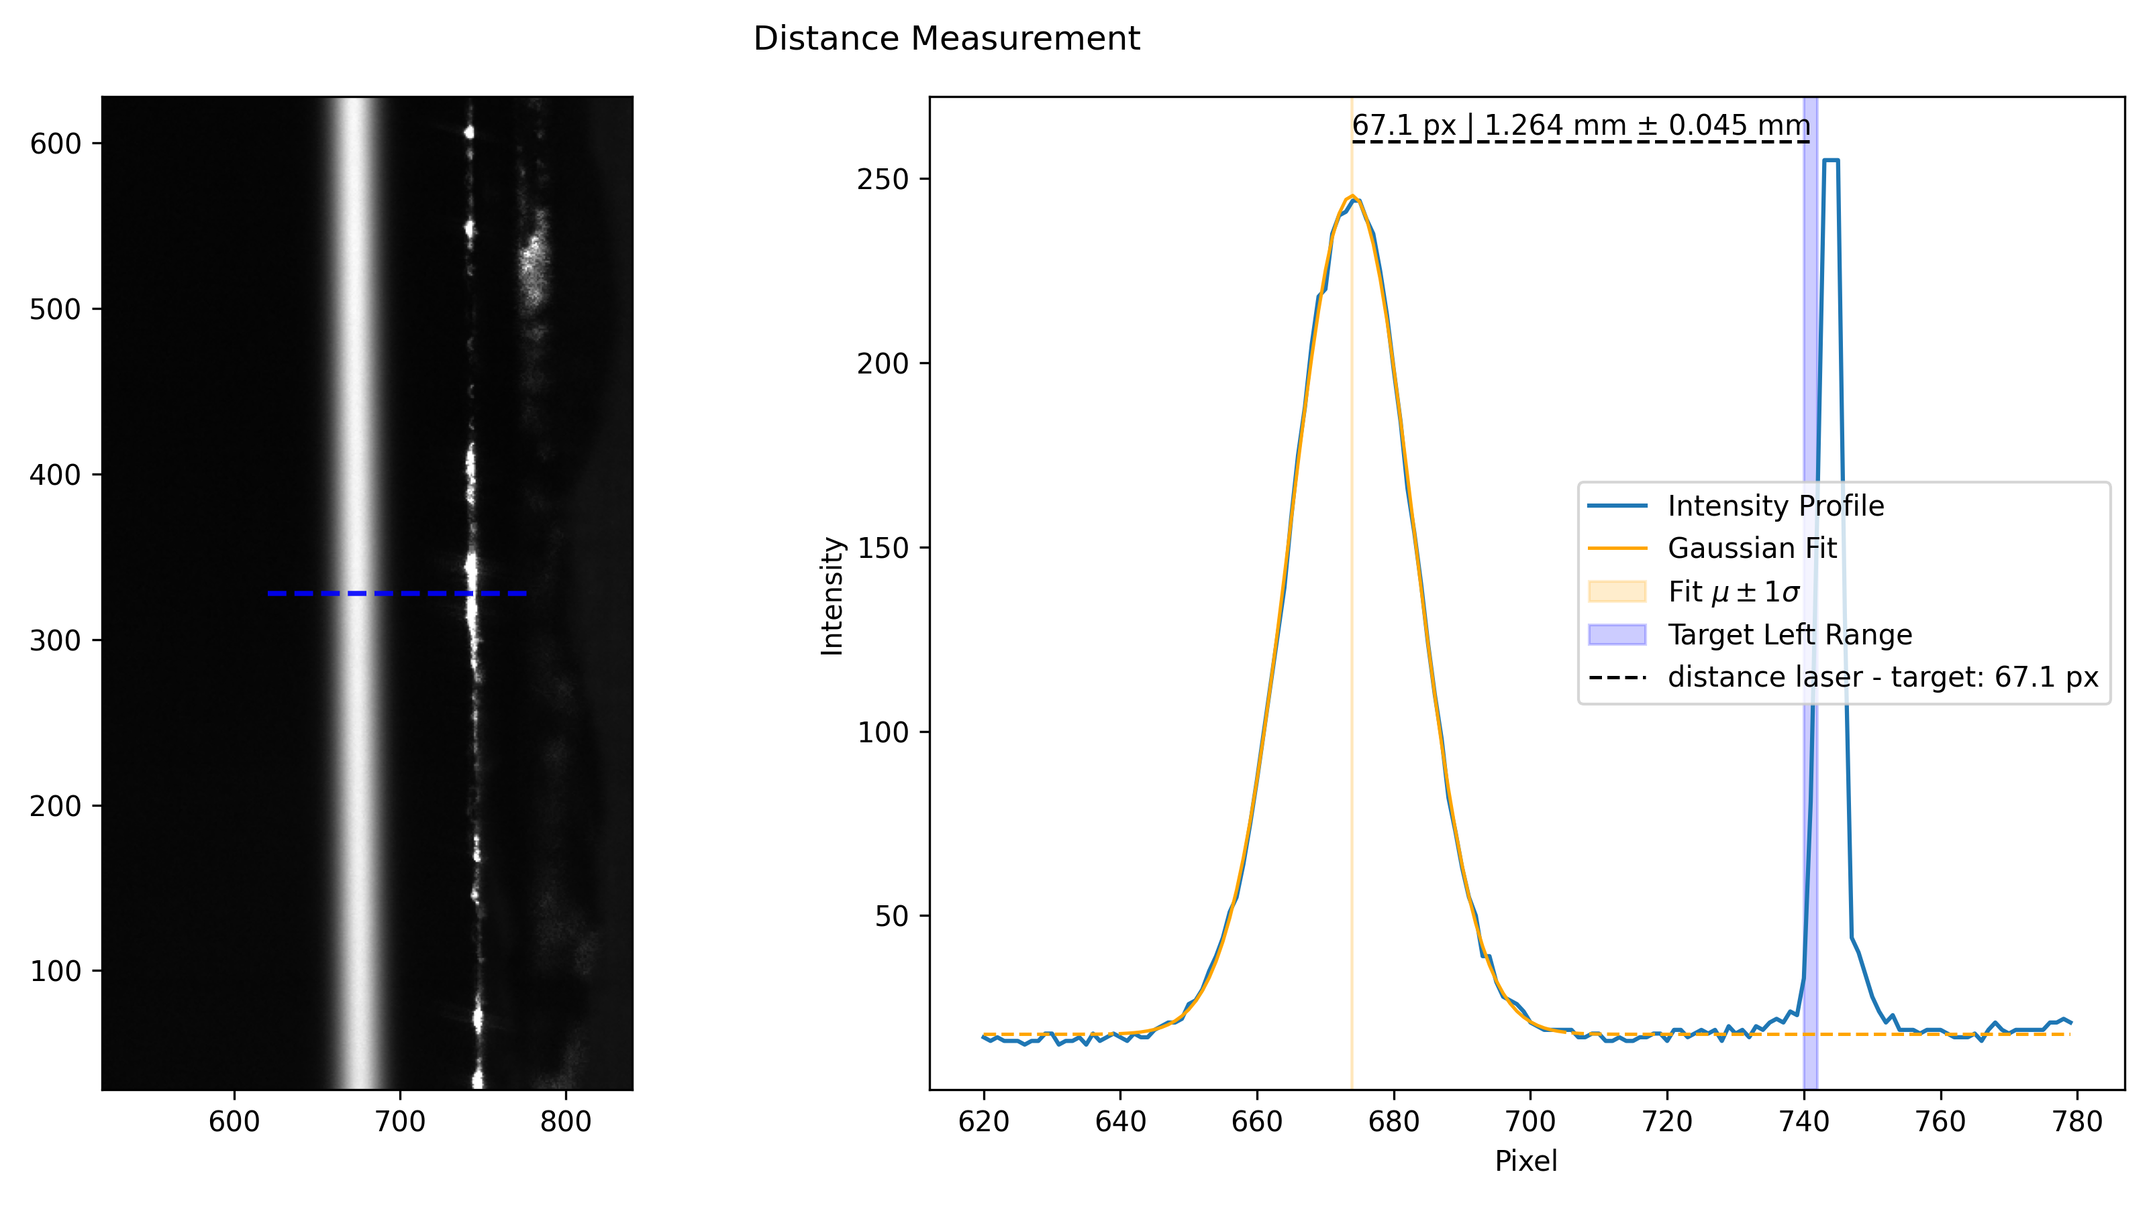
Ted Thorpe-Woods; PSAS 2026
Doing Better
Calibrated CCD to measure laser-target displacement (45um resolution)
Significant improvement upon previous measurements (500um resolution)

Slide 32
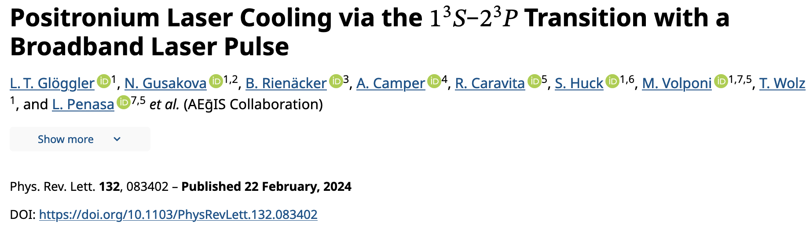
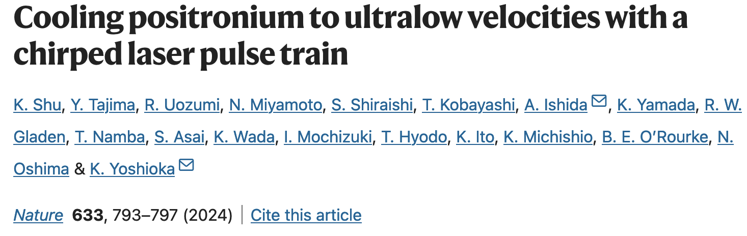
Ted Thorpe-Woods; PSAS 2026
But how do we do even better??
The incredibly light mass of Ps makes 1S-2S spectroscopy tricky
Natural linewidth ~ 1.2MHz
Substantial velocities even at room temperature
  Huge transit time broadening ~ 100MHz
  2nd Order doppler shift is substantial
  Large laser powers required (AC Stark shift)
How do we get around this limitation?
  First demonstration of laser cooled Ps
  Or…

Slide 33
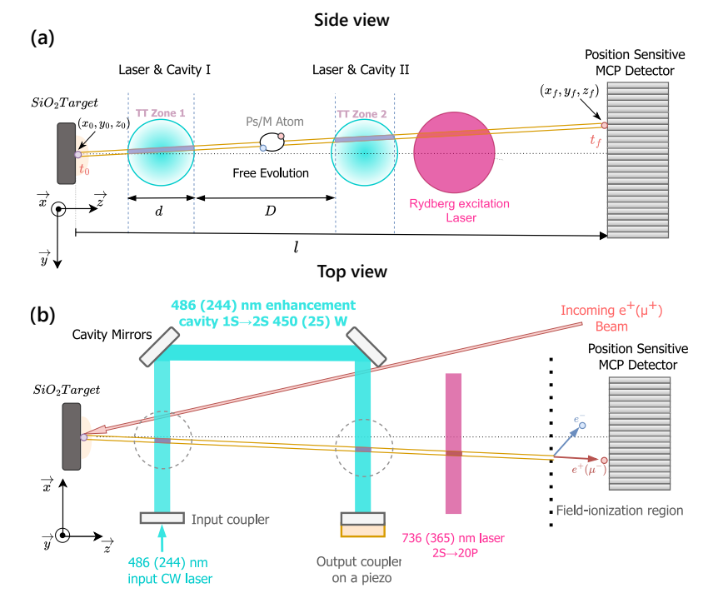
Ted Thorpe-Woods; PSAS 2026
Ramsey-Doppler Spectroscopy
Appling Ramsey spectroscopy to the 1S-2S transition
  Has been done for hydrogen
Position sensitive detection which measures TOF
  Uses 2nd Order Doppler as detuning mechanism
Reduces transit time broadening, 2nd Order Doppler and AC stark shift
Huber, A et al. Phys. Rev. A 58, (1998)
Javary, E., Thorpe-Woods, E., Cortinovis, I. et al. Eur. Phys. J. D 79, 15 (2025).

Slide 34
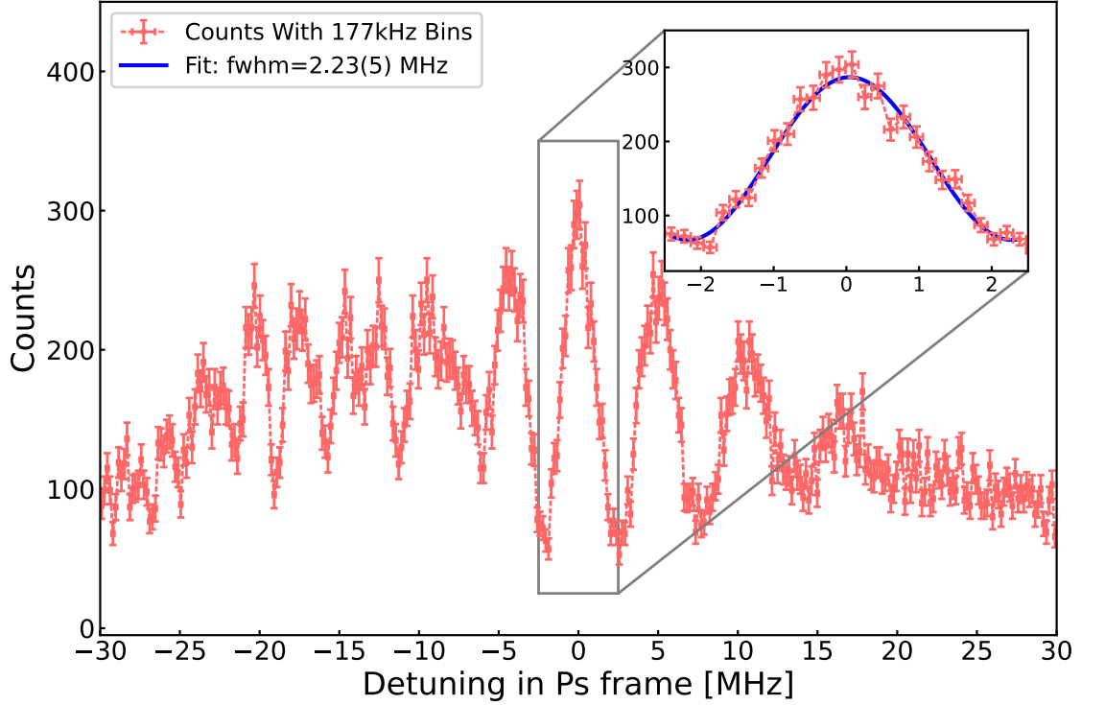
Ted Thorpe-Woods; PSAS 2026
Ramsey-Doppler Spectroscopy
Appling Ramsey spectroscopy to the 1S-2S transition
  Has been done for hydrogen
Position sensitive detection which measures TOF
  Uses 2nd Order Doppler as detuning mechanism
Reduces transit time broadening, 2nd Order Doppler and AC stark shift
Uncertainty | Approximate size | Comment
Statistical | ≈ 20 kHz (10 days) | Uncertainty in fit
AC Stark | < 10kHz (450 ± 45W) | Suppressed by Ramsey technique
2nd order Doppler | ≈ 18kHz | TOF corrected
Laser stability | < 2kHz | Laser frequency measured by comb
Huber, A et al. Phys. Rev. A 58, (1998)
Javary, E., Thorpe-Woods, E., Cortinovis, I. et al. Eur. Phys. J. D 79, 15 (2025).

Slide 35
Ted Thorpe-Woods; PSAS 2026
Summary
Spectroscopy of leptonic atoms provides a precision test of QED
We are in the process of commissioning MuMASS using hydrogen
CW 1S-2S measurement of Ps with similar precision to state-of-the-art
Ongoing upgrades to current setup expected to result in sub-MHz resolution on Ps 1S-2S spectroscopy
Ramsey-Doppler offers a route to measuring 1S-2S with tens-of-kHz precision

Slide 36
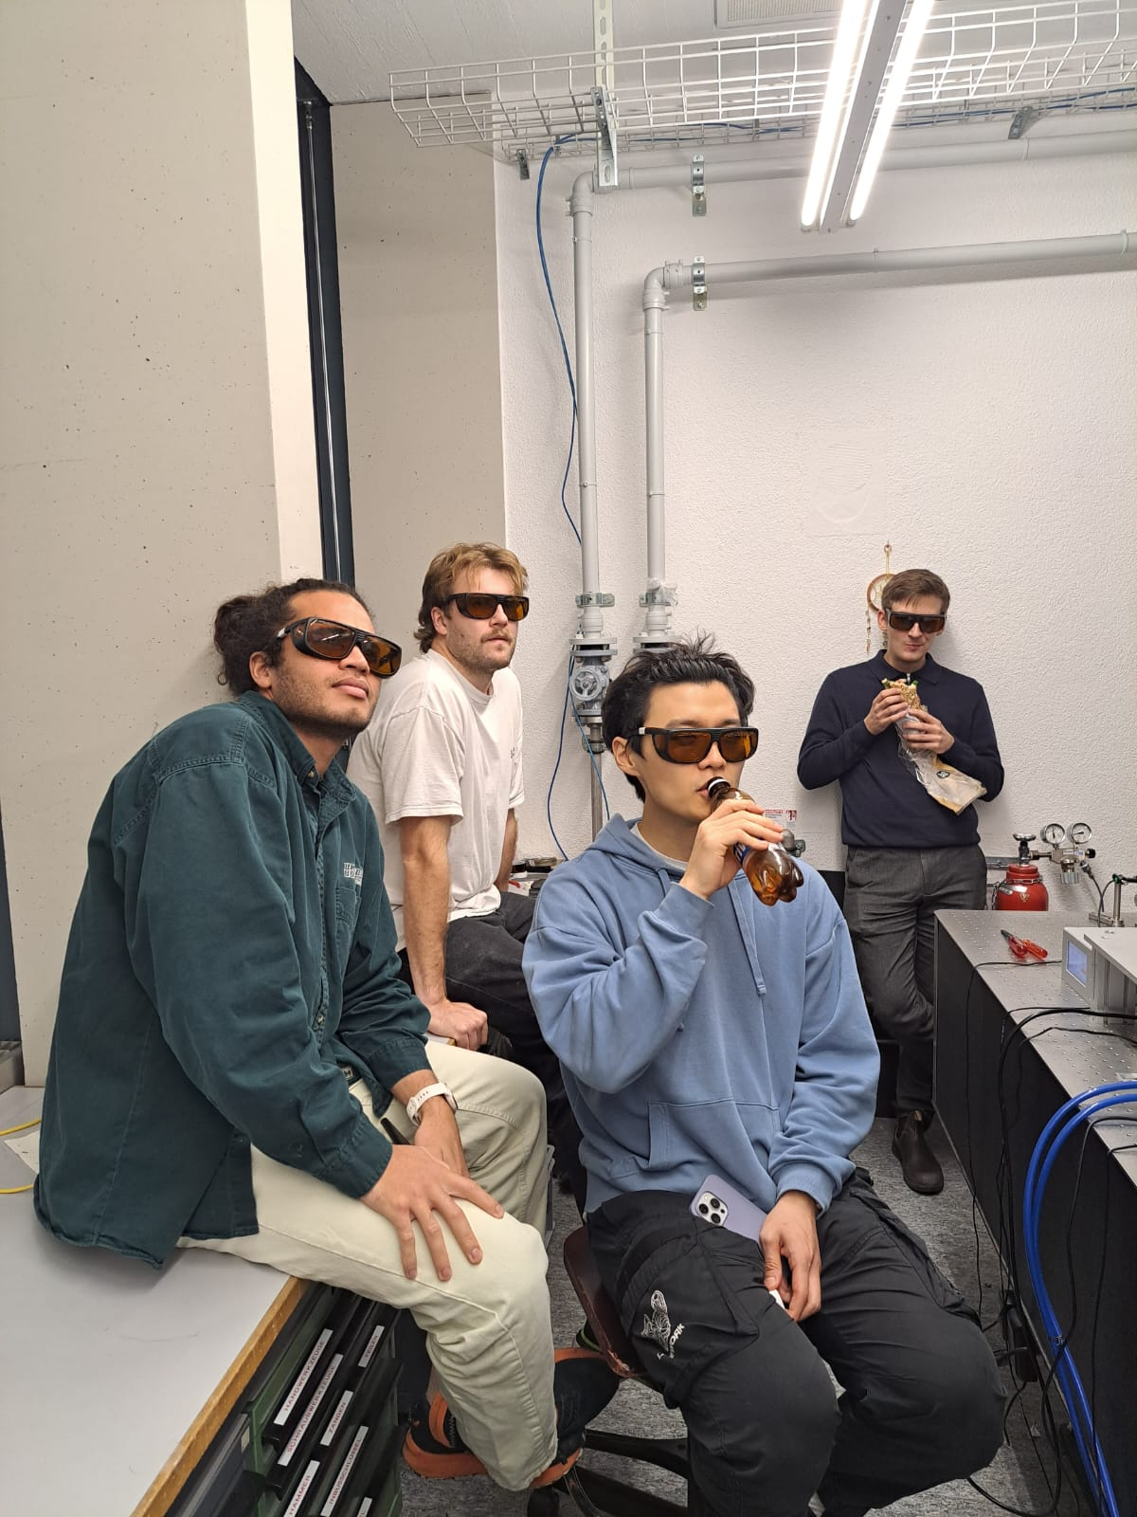
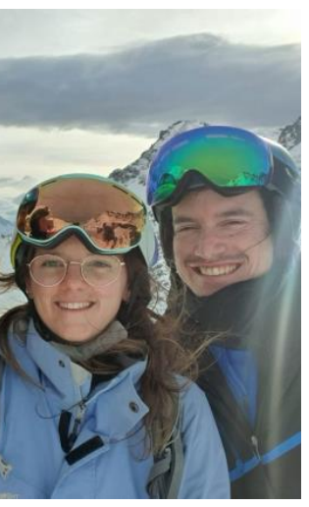
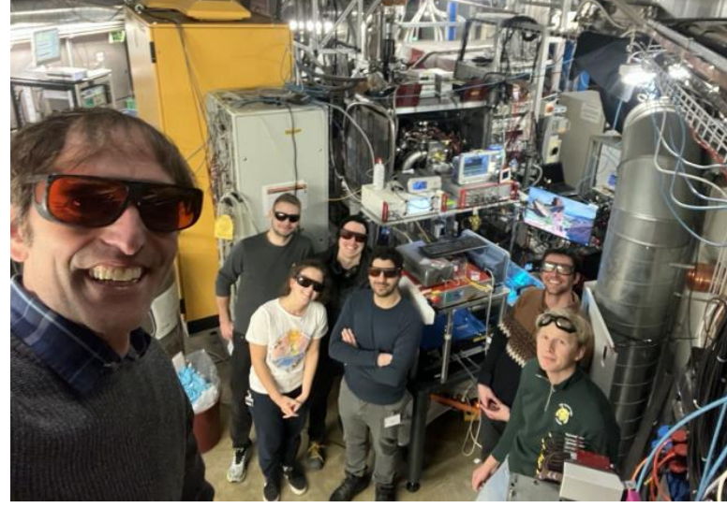



Ted Thorpe-Woods; PSAS 2026
Thank you for listening!
PART OF THIS WORK IS SUPPORTED BY an ERC consolidator grant
(818053 -Mu-MASS) and by the Swiss National Foundation under the grants 197346
219485.

Slide 37
Extra Slides
Ted Thorpe-Woods; PSAS 2026

Slide 38
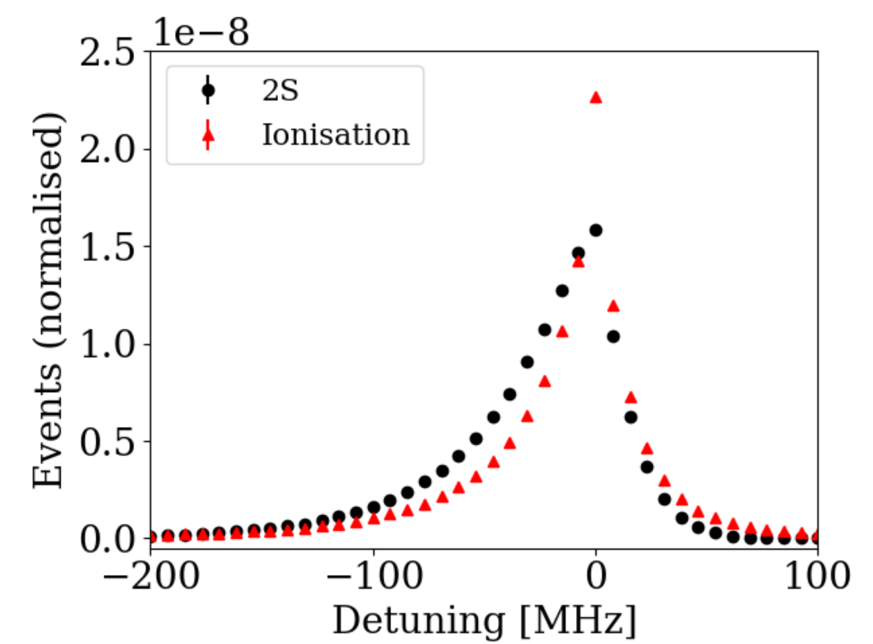
Edward Thorpe-Woods; FFK 2025
Semi-analytic lineshape
Simulated Data
To analyse the spectrum we can use Monte-Carlo Simulations
  “Black box”
We have a semi-analytic function which agrees with simulated results

Slide 39
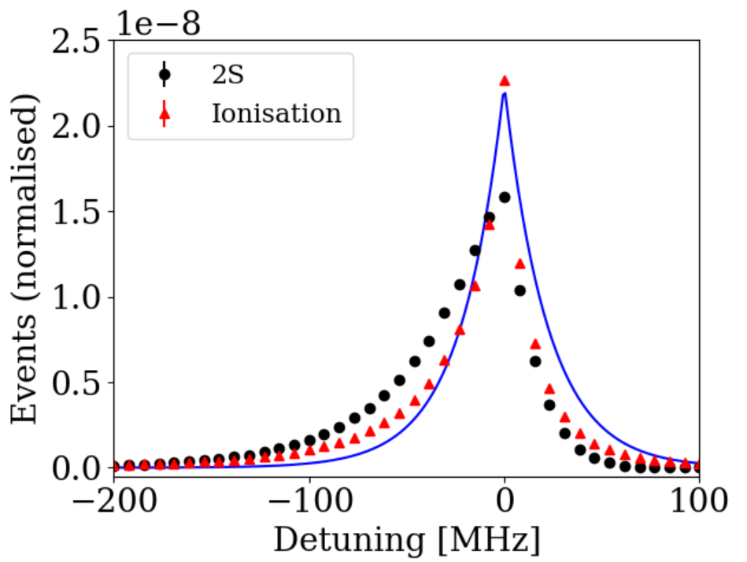




Edward Thorpe-Woods; FFK 2025
Semi-analytic lineshape
Simulated Data
To analyse the spectrum we can use Monte-Carlo Simulations
  “Black box”
We have a semi-analytic function which agrees with simulated results
$${P_{2S}∝\int{ }}_{0}^{∞} dv_{⊥}exp\left(−{\left[\frac{2πw\left(f_{L}−f_{0}\right)}{v_{⊥}}\right]}^{2}−\frac{v_{⊥}^{2}}{u^{2}}\right)$$
From [1]
$f_{0} :$resonance frequency ;
$f_{L} :$laser frequency ;
$v_{⊥}^{ }:$perpendicular velocity
[1] F. Biraben, M. Bassini, B. Cagnac. Journal de Physique, 1979, 40 (5)
$w_{ }^{ }:$laser waist ; $D_{ }^{ }:$laser displacement ; $τ_{ }^{ }:$Ps lifetime; $u_{ }^{ }:$thermal velocity

Slide 40
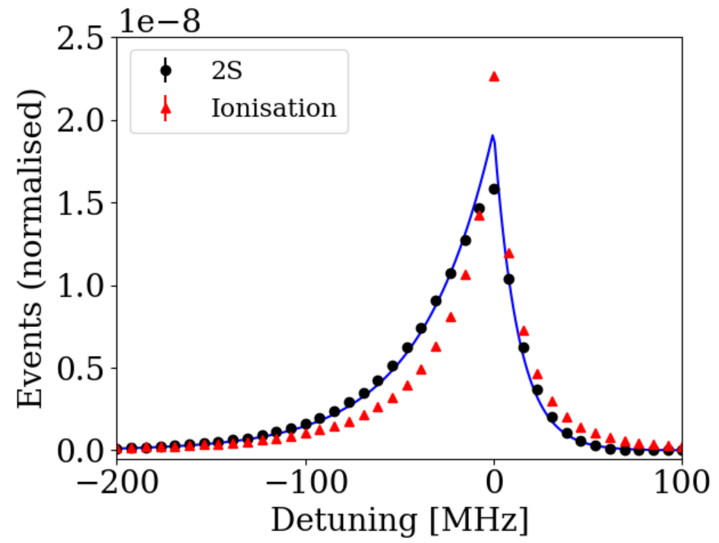
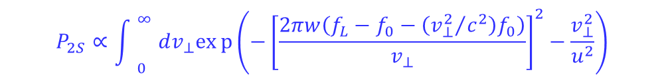
Edward Thorpe-Woods; FFK 2025
Semi-analytic lineshape
Simulated Data
To analyse the spectrum we can use Monte-Carlo Simulations
  “Black box”
We have a semi-analytic function which agrees with simulated results
2nd order Dop
$${P_{2S}∝\int{ }}_{0}^{∞} dv_{⊥}exp\left(−{\left[\frac{2πw\left(f_{L}−f_{0}−\left({v_{⊥}^{2}}/{c^{2}}\right)f_{0}\right)}{v_{⊥}}\right]}^{2}−\frac{v_{⊥}^{2}}{u^{2}}\right)$$
$f_{0} :$resonance frequency ;
$f_{L} :$laser frequency ;
$v_{⊥}^{ }:$perpendicular velocity
F. Biraben, M. Bassini, B. Cagnac. Journal de Physique, 1979, 40 (5)
$w_{ }^{ }:$laser waist ; $D_{ }^{ }:$laser displacement ; $τ_{ }^{ }:$Ps lifetime; $u_{ }^{ }:$thermal velocity

Slide 41
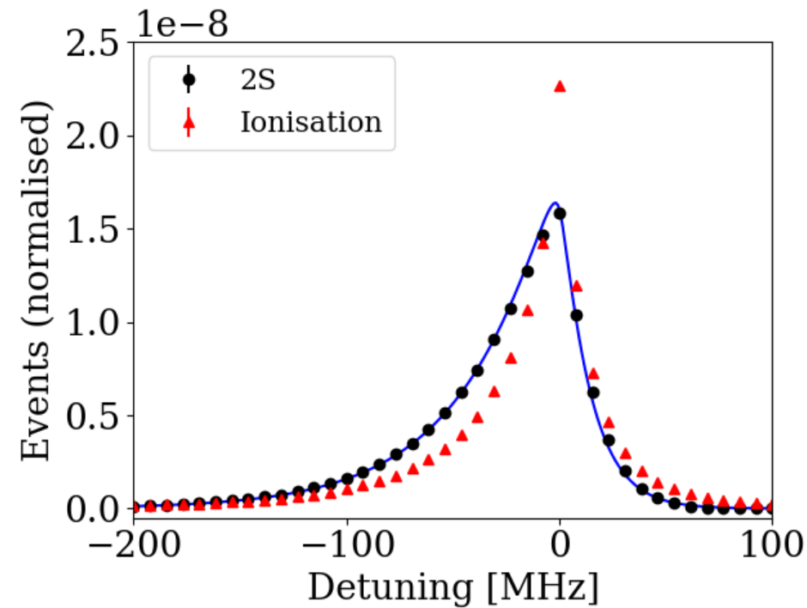
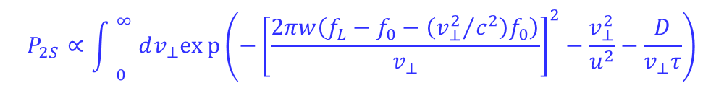
Edward Thorpe-Woods; FFK 2025
Semi-analytic lineshape
Simulated Data
To analyse the spectrum we can use Monte-Carlo Simulations
  “Black box”
We have a semi-analytic function which agrees with simulated results
2nd order Dop
$${P_{2S}∝\int{ }}_{0}^{∞} dv_{⊥}exp\left(−{\left[\frac{2πw\left(f_{L}−f_{0}−\left({v_{⊥}^{2}}/{c^{2}}\right)f_{0}\right)}{v_{⊥}}\right]}^{2}−\frac{v_{⊥}^{2}}{u^{2}}−\frac{D}{v_{⊥}τ}\right)$$
Finite lifetime
$f_{0} :$resonance frequency ;
$f_{L} :$laser frequency ;
$v_{⊥}^{ }:$perpendicular velocity
[1] F. Biraben, M. Bassini, B. Cagnac. Journal de Physique, 1979, 40 (5)
$w_{ }^{ }:$laser waist ; $D_{ }^{ }:$laser displacement ; $τ_{ }^{ }:$Ps lifetime; $u_{ }^{ }:$thermal velocity

Slide 42
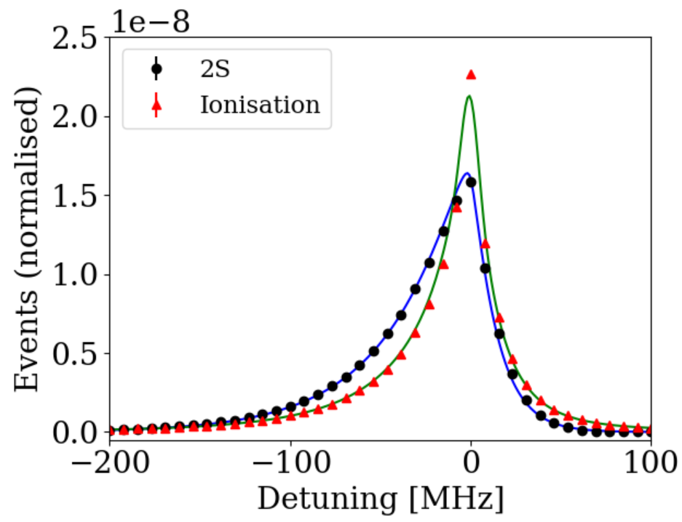


Edward Thorpe-Woods; FFK 2025
Semi-analytic lineshape
Simulated Data
To analyse the spectrum we can use Monte-Carlo Simulations
  “Black box”
We have a semi-analytic function which agrees with simulated results
2nd order Dop
$${P_{2S}∝\int{ }}_{0}^{∞} dv_{⊥}exp\left(−{\left[\frac{2πw\left(f_{L}−f_{0}−\left({v_{⊥}^{2}}/{c^{2}}\right)f_{0}\right)}{v_{⊥}}\right]}^{2}−\frac{v_{⊥}^{2}}{u^{2}}−\frac{D}{v_{⊥}τ}\right)$$
Voight function due to photoionisation
Finite lifetime
$${P_{I}∝\int{ }}_{0}^{∞} dv_{⊥} V\left(f_{L}−f_{0}−\frac{v_{⊥}^{2}}{c^{2}}f_{0};\frac{0.55 v}{\sqrt{2}w};\frac{0.28 v}{\sqrt{2}w}\right)∙exp\left(−\frac{v_{⊥}^{2}}{u^{2}}−\frac{D}{v_{⊥}τ}\right)$$
$f_{0} :$resonance frequency ;
$f_{L} :$laser frequency ;
$v_{⊥}^{ }:$perpendicular velocity
[1] F. Biraben, M. Bassini, B. Cagnac. Journal de Physique, 1979, 40 (5)
$w_{ }^{ }:$laser waist ; $D_{ }^{ }:$laser displacement ; $τ_{ }^{ }:$Ps lifetime; $u_{ }^{ }:$thermal velocity

Slide 43

Edward Thorpe-Woods; Mainz 2025
Muon-electron mass ratio from Muonium 1S-2S
How does the uncertainty of $r$ extracted from the 1S-2S transition frequency scale with the precision of the spectroscopy?
Again, we can use logarithmic sensitivities:
$$ν_{1S−2S}^{Mu}∝\frac{r}{1+r}R_{∞}c×\left[1+Δ_{QED}+⋯\right]$$
$$S_{r}^{\left(1S−2S\right)}≡\frac{∂\ln{{(ν}_{1S−2S})}}{∂\ln{r}}=\frac{1}{1+r}$$
Using this to map uncertainty in 1S-2S transition frequency
$$\frac{σ_{r}(r)}{r}=\left(1+r\right)\frac{σ_{υ}}{ν}≈208\frac{σ_{υ}}{ν}$$
A 10kHz uncertainty in the 1S-2S frequency translated into $\frac{σ_{r}(r)}{r} ≈$ 0.85ppb

