Slide 1
Nuclear laser spectroscopy
of ²²⁹Thorium in CaF₂ crystals
Thorsten SCHUMM
TU Wien, Atominstitut
PSAS2026 18.05.2026
Notes:
15 s → 0:15

Slide 2
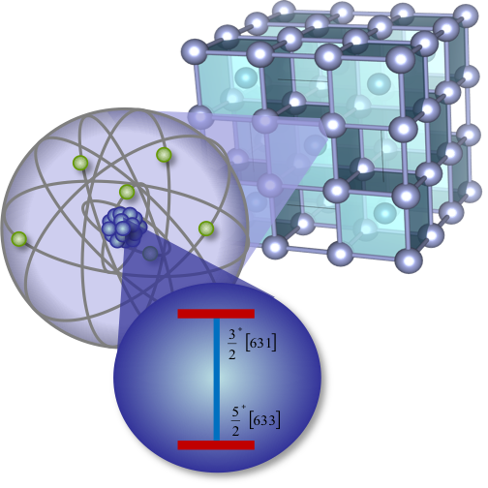
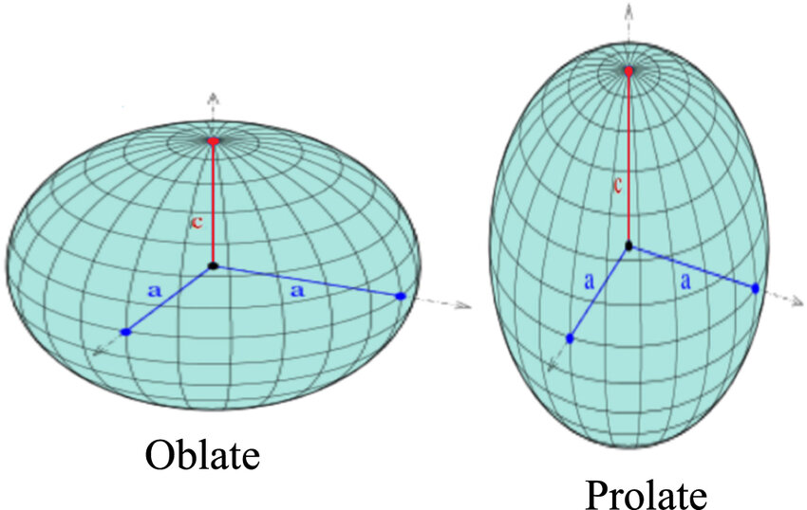
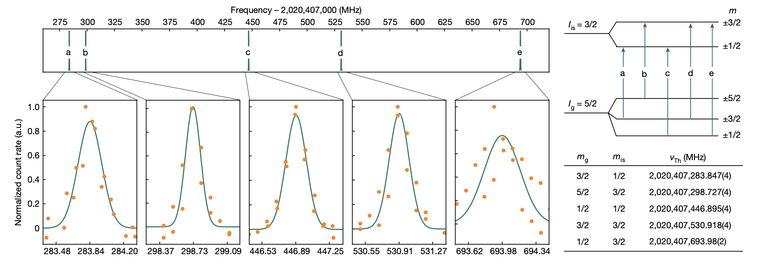
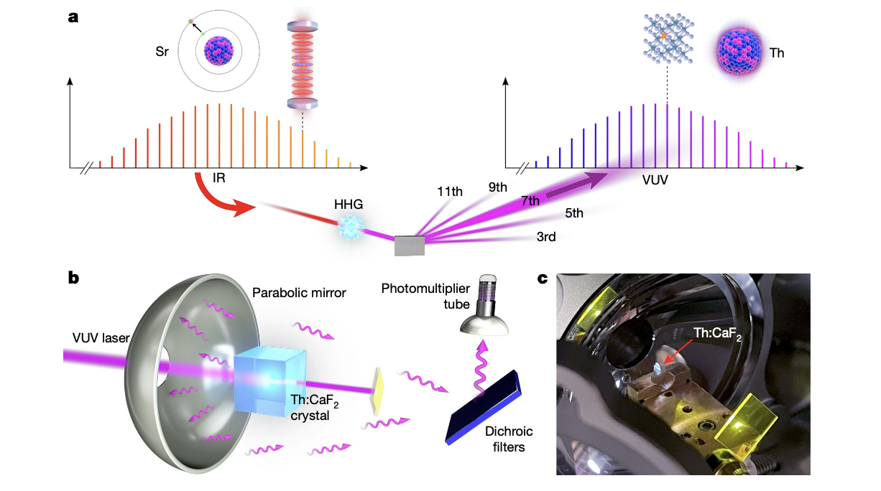

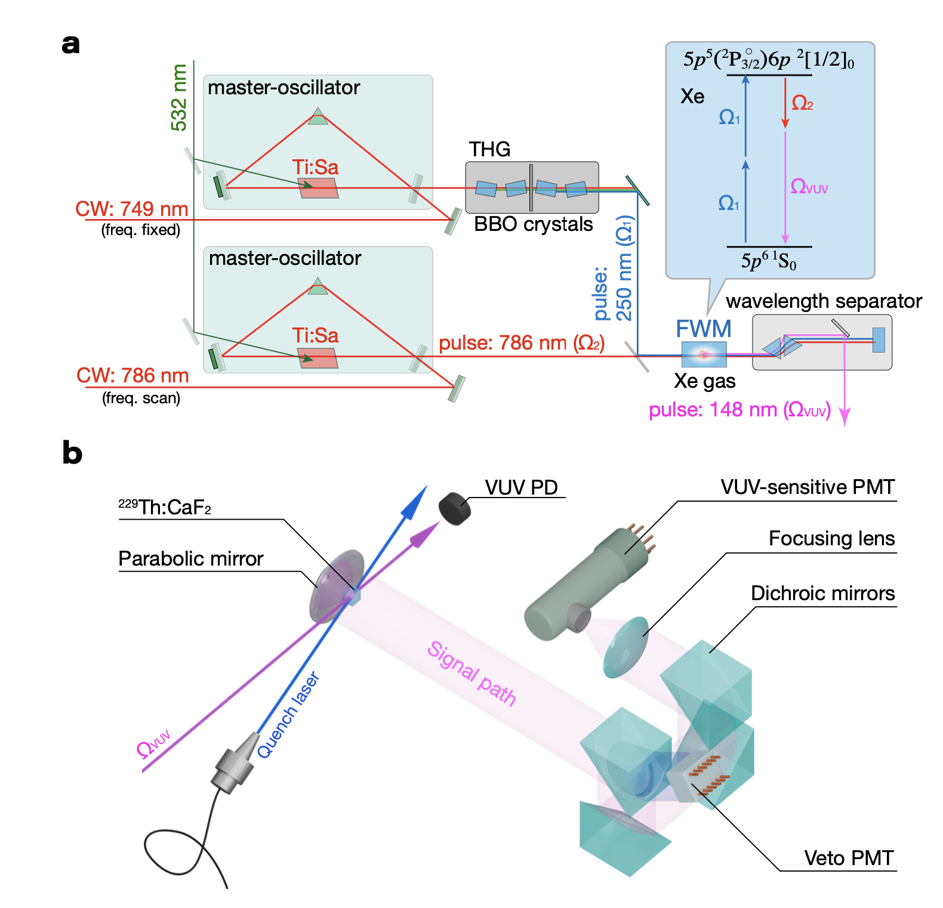

OUTLINE
The „solid state approach“ to ²²⁹Th nuclear spectroscopy
Basic concept and implementation
Nuclear quadrupole structure
Nuclear – solid coupling
Separating nuclear properties and material parameters
JILA experiment
Absolute Mössbauer spectroscopy
Temperature depencence
Towards a solid-state nuclear clock
OKAYAMA experiment
Multiple defect centers
Site-dependent properties
Notes:
40 s → 0:55

Slide 3

…any questions?…any time!
or contact:
thorsten.schumm@tuwien.ac.at
Notes:
85 s → 3:30

Slide 4
Concept: Nuclear laser excitation
discrete energy levels
Atomic quantum state manipulation
laser spectroscopy
atomic clocks, quantum sensing
quantum computation, communication
many-body physics (BEC…)
fundamental physics
eV
excited
states
1.0
0
ground
state
10⁻¹⁰ m
Notes:
40 s → 0:55

Slide 5
Concept: Nuclear laser excitation
discrete energy levels
Atomic quantum state manipulation
laser spectroscopy
atomic clocks, quantum sensing
quantum computation, communication
many-body physics (BEC…)
fundamental physics
eV
excited
states
1.0
0
ground
state
MeV
Nuclear quantum state manipulation?
laser spectroscopy???
material science
fundamental physics
…
excited
states
1.0
0
ground
state
10⁻¹⁵ m
Notes:
40 s → 0:55

Slide 6
Concept: ²²⁹Th nuclear laser excitation
²²⁹Th isomer state
M1 transition
ΔE ≈ 8 eV (150 nm)
τ ≈ min. – h.
²²⁹Th ground state
10⁻¹⁵ m
Notes:
A valence Neutron!
Possible material for a nuclear clock
Enhanced robustness
40 s → 0:55

Slide 7
Concept: ²²⁹Th nuclear laser excitation
²²⁹Th isomer state
M1 transition
ΔE ≈ 8 eV (150 nm)
τ ≈ min. – h.
laser excitation???
²²⁹Th ground state
10⁻¹⁵ m
Notes:
40 s → 0:55

Slide 8
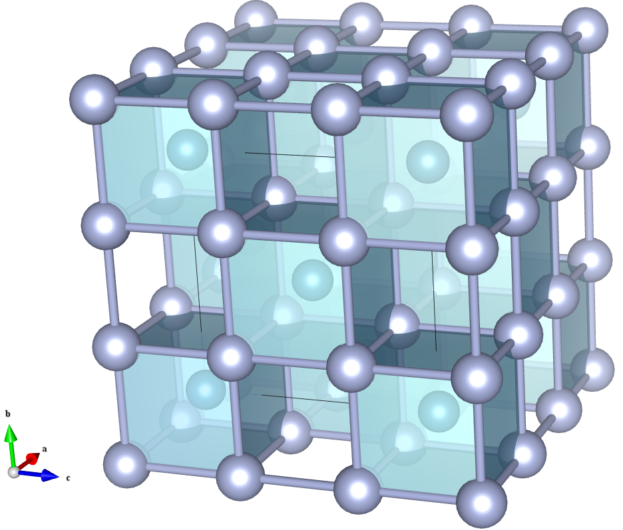
Concept: ²²⁹Th nuclear laser excitation in CaF₂
The „solid state approach“:
Th nuclei inside VUV transparent material
large band (~10 eV) gap → fluoride crystals
doping, implantation, diffusion…
control of electronic environment: [Rn]
a solid-state optical nuclear clock?
²²⁹Th isomer state
M1 transition
ΔE ≈ 8 eV (150 nm)
τ ≈ min. – h.
laser excitation???
²²⁹Th ground state
10⁻¹⁵ m
Notes:
40 s → 0:55

Slide 9
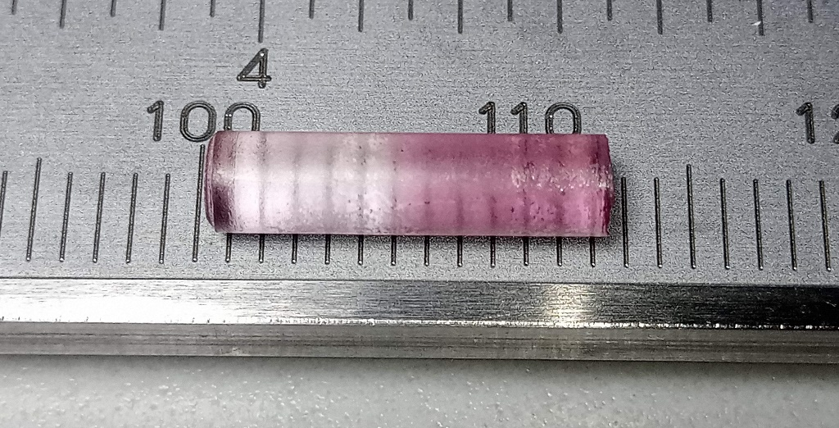
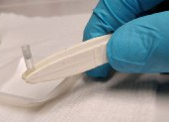
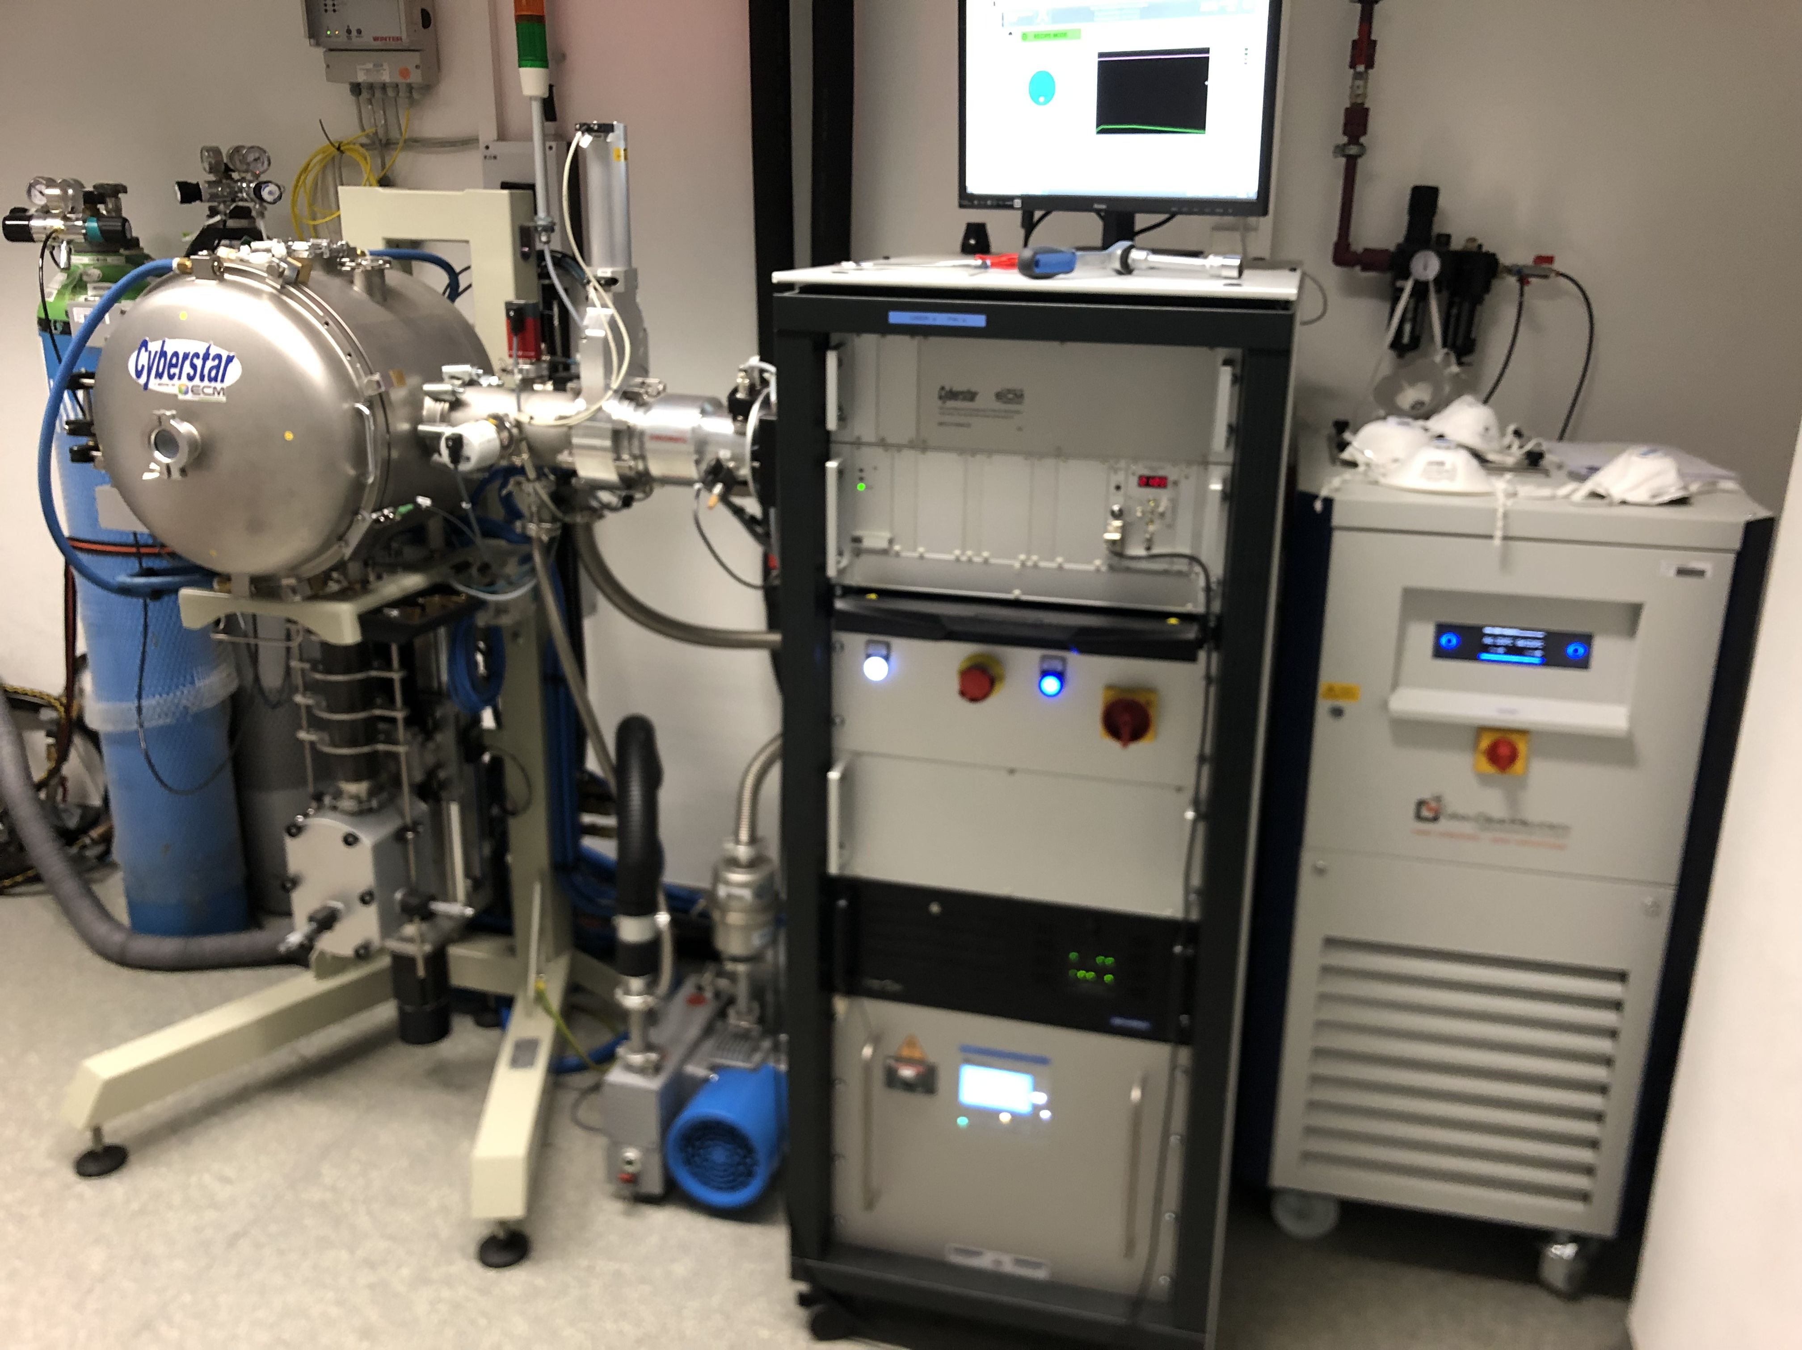
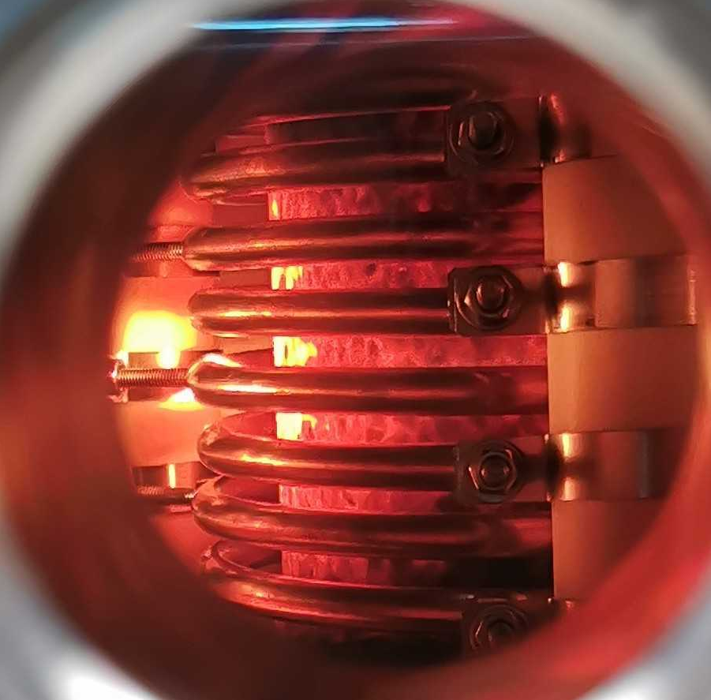
Fabrication of Th:CaF₂ in Vienna
> 10 years of painful method development…
dedicated lab for growth of
radioactive dopants (only one in Europe)
miniaturized crystal growth to
increase doping concentration
fluorine annealing to reduce defects
in-house cutting + polishing
characterization (optical, radiological)
1 crystal (attempt) takes 5 days
currently working on:
pulling single crystal fibers
growing bulk ThF₄ crystals
Notes:
40 s → 0:55

Slide 10
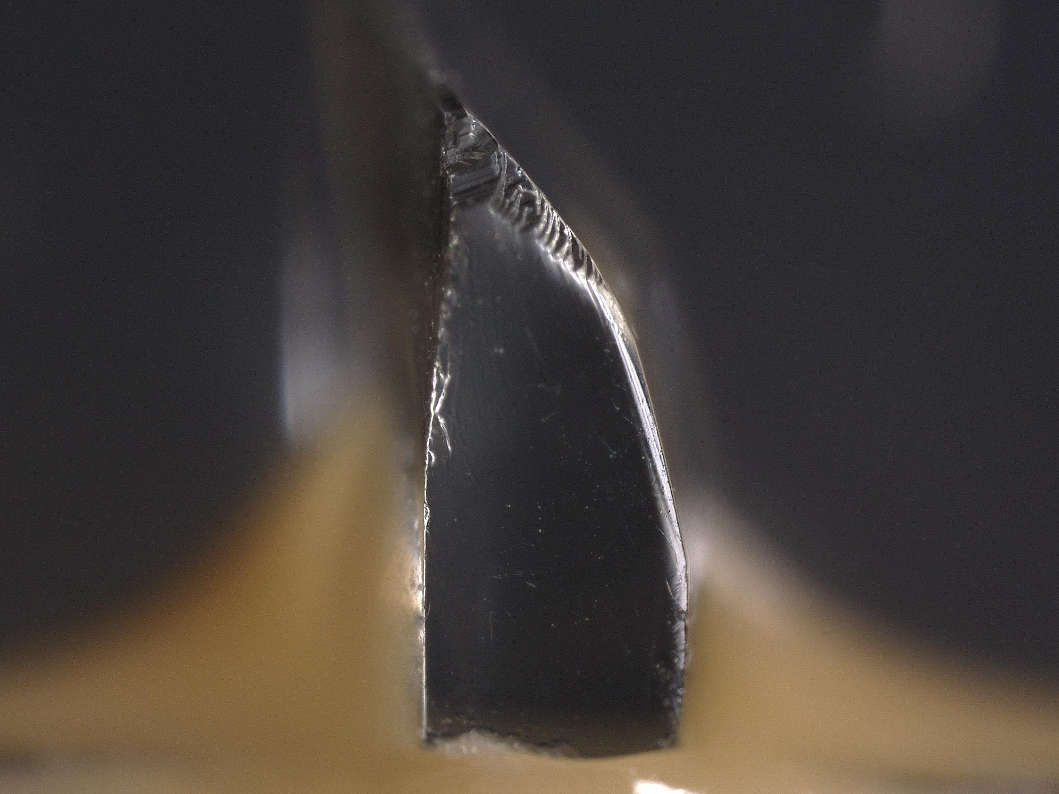
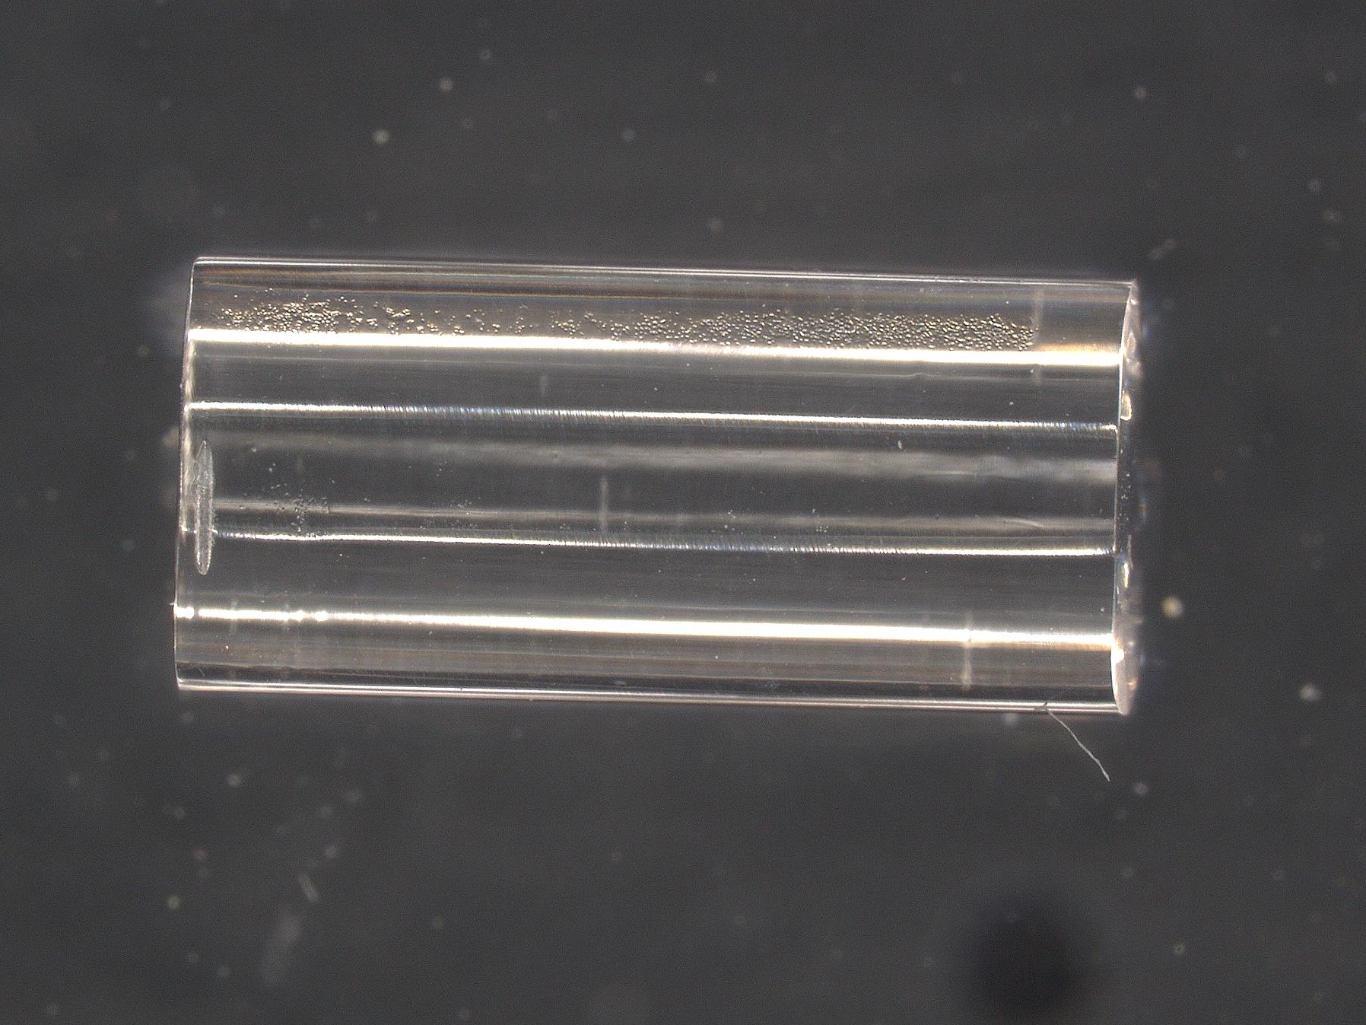
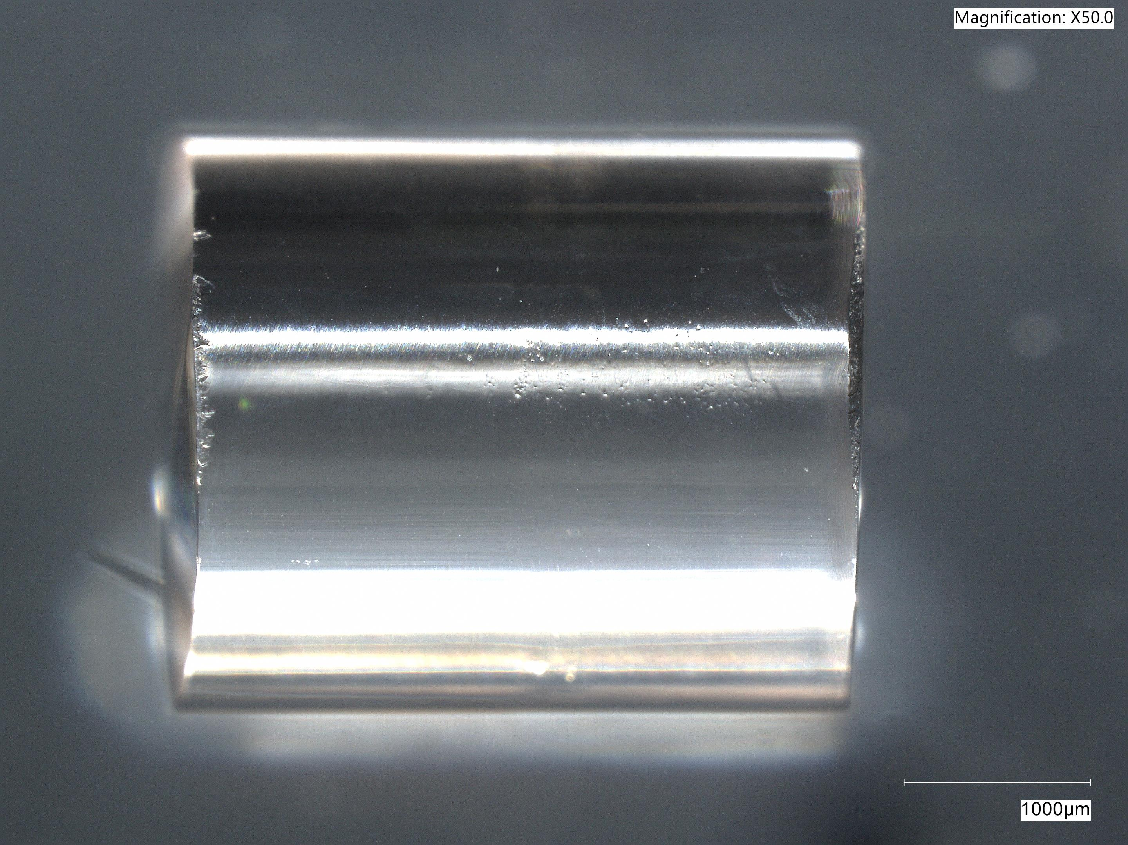
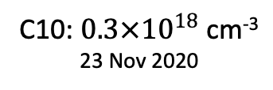
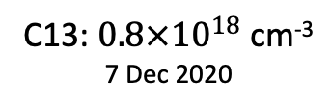
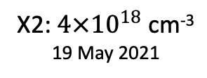
Fabrication of Th:CaF₂ in Vienna
3 crystals from Vienna with different „history“ and concentration
X2: $4×{10}^{18}$ cm⁻³
19 May 2021
C13: $0.8×{10}^{18}$ cm⁻³
7 Dec 2020
C10: $0.3×{10}^{18}$ cm⁻³
23 Nov 2020
1 mm
3 mm
…will be used in ALL experiments shown today
* apart from the UCLA experiment on slide 4
Notes:
40 s → 0:55

Slide 11
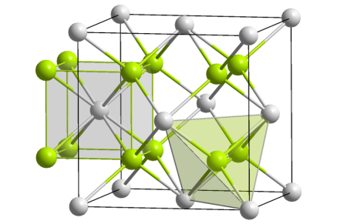
Simulation of Th:CaF₂ in Vienna
CaF₂ crystal structure
Th⁴⁺ replaces Ca²⁺
low doping limit >0.1% (no interactions between Th?)
Ionic crystal → 2+ charge compensation ([Rn] config.)
  2 extra (interstitial) fluorines (several spatial arrangements)
  1 Ca vacancy (nearest neighbor)
  …?
put ²²⁹Th here!
F
F
F
F
Ca
e⁻
F
Th
Th
F
F
F
F
F
F
F
F
e⁻
Ca
F
Ca
F
F
F
F
Notes:
40 s → 0:55

Slide 12
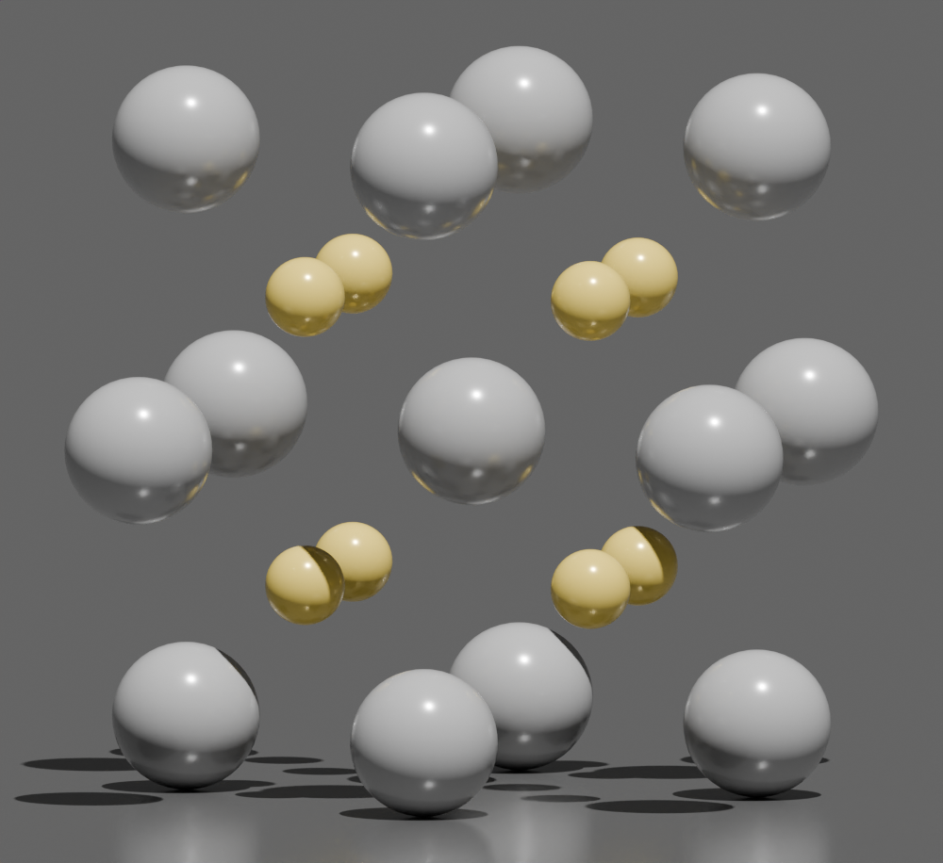
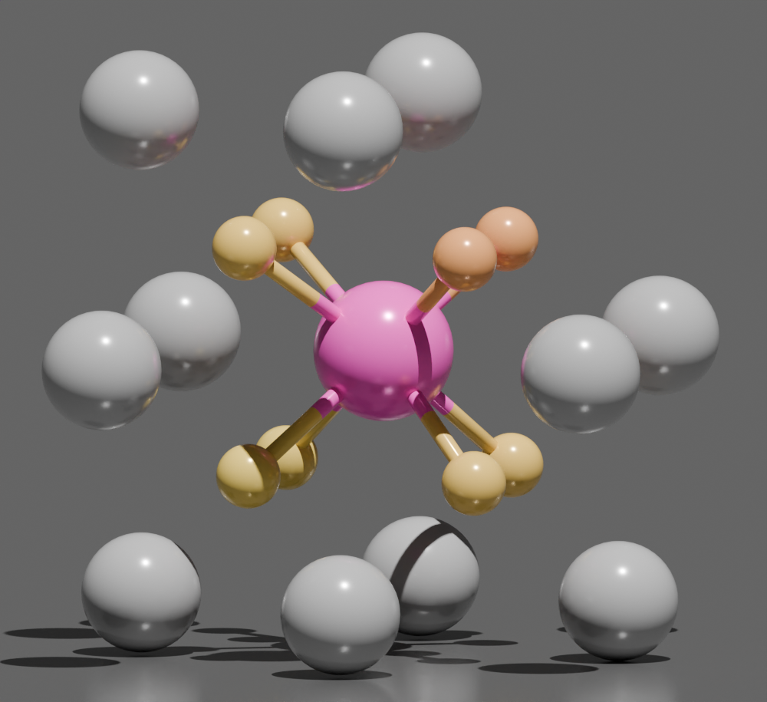
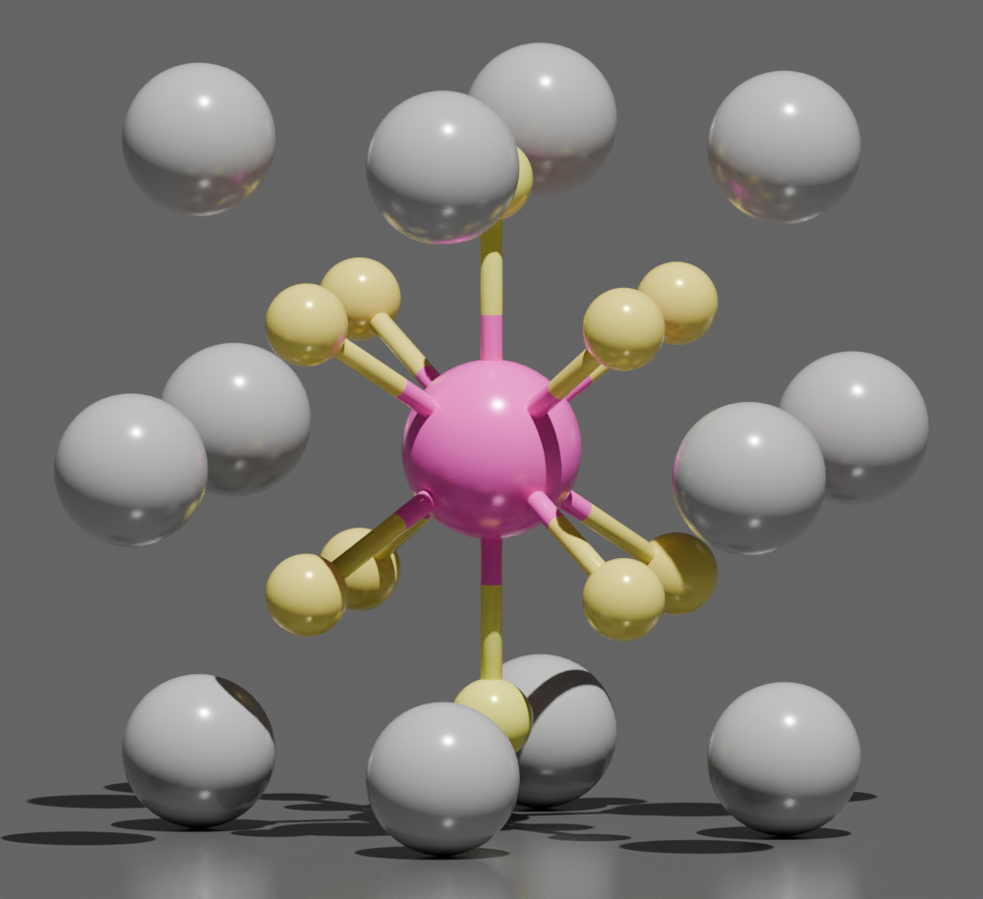
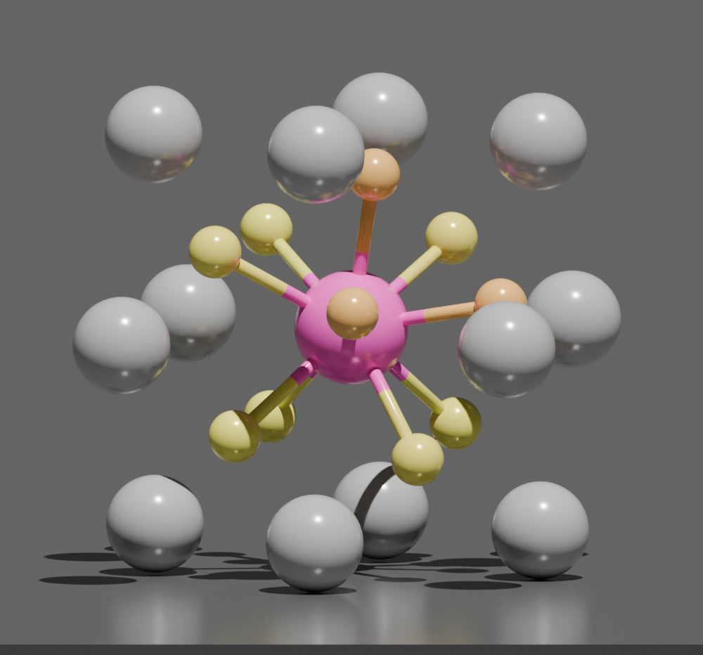
Simulation of Th:CaF₂ in Vienna
CaF₂ crystal structure
Th⁴⁺ replaces Ca²⁺
low doping limit >0.1% (no interactions between Th?)
Ionic crystal → 2+ charge compensation ([Rn] config.)
  2 extra (interstitial) fluorines (several spatial arrangements)
  1 Ca vacancy (nearest neighbor)
  …?
put ²²⁹Th here!
F
F
F
F
Vienna is the „Mekka“ of density functional theory…
Ca
e⁻
F
Th
Th
F
F
F
F
F
F
F
F
e⁻
Ca
F
Ca
F
F
F
F
pristine CaF₂
Ca vacancy
2F interstitials
2F interstitials
Notes:
40 s → 0:55

Slide 13
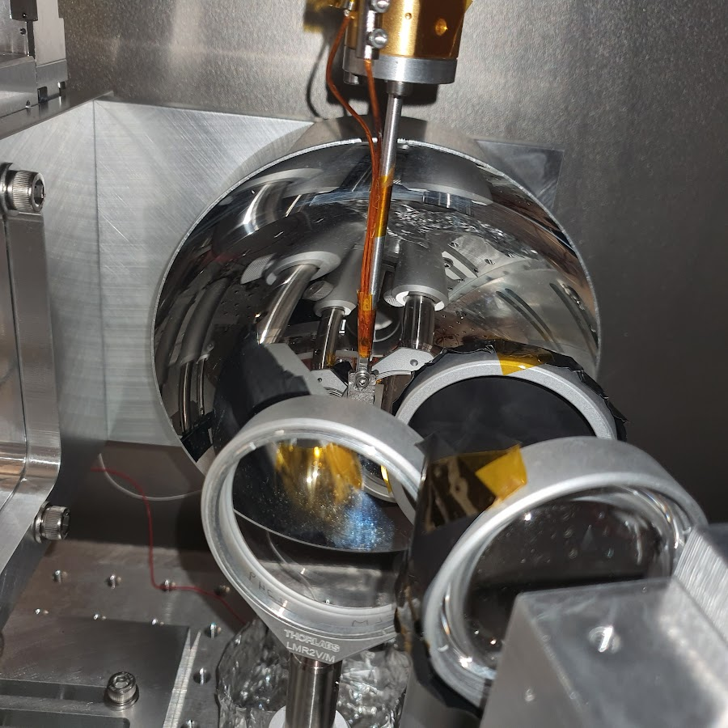
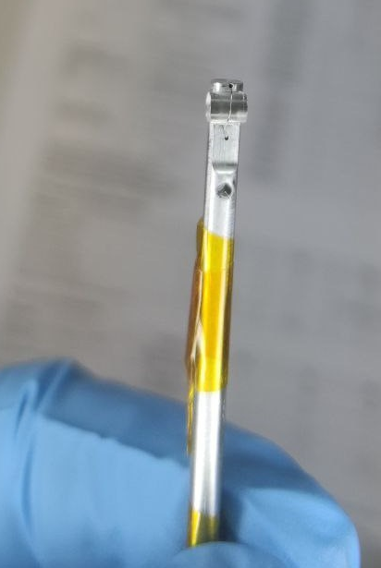
First laser excitation of ²²⁹Th in 2024
PTB Experiment
Notes:
40 s → 0:55

Slide 14
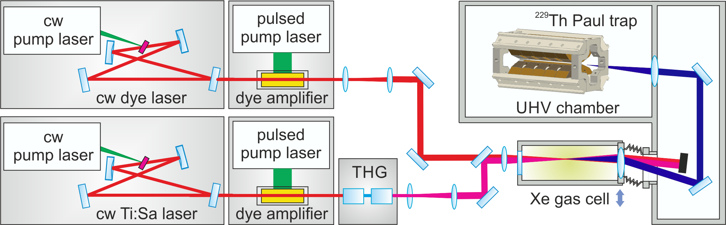
First laser excitation of ²²⁹Th in 2024
PTB Experiment
Notes:
40 s → 0:55

Slide 15
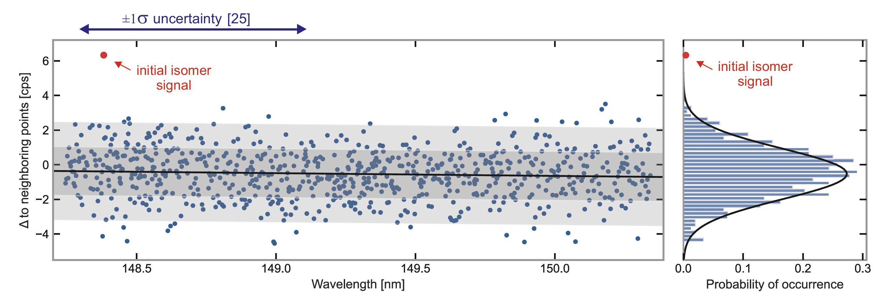
First laser excitation of ²²⁹Th in 2024
PTB Experiment
scanning for almost a year…
Notes:
40 s → 0:55

Slide 16
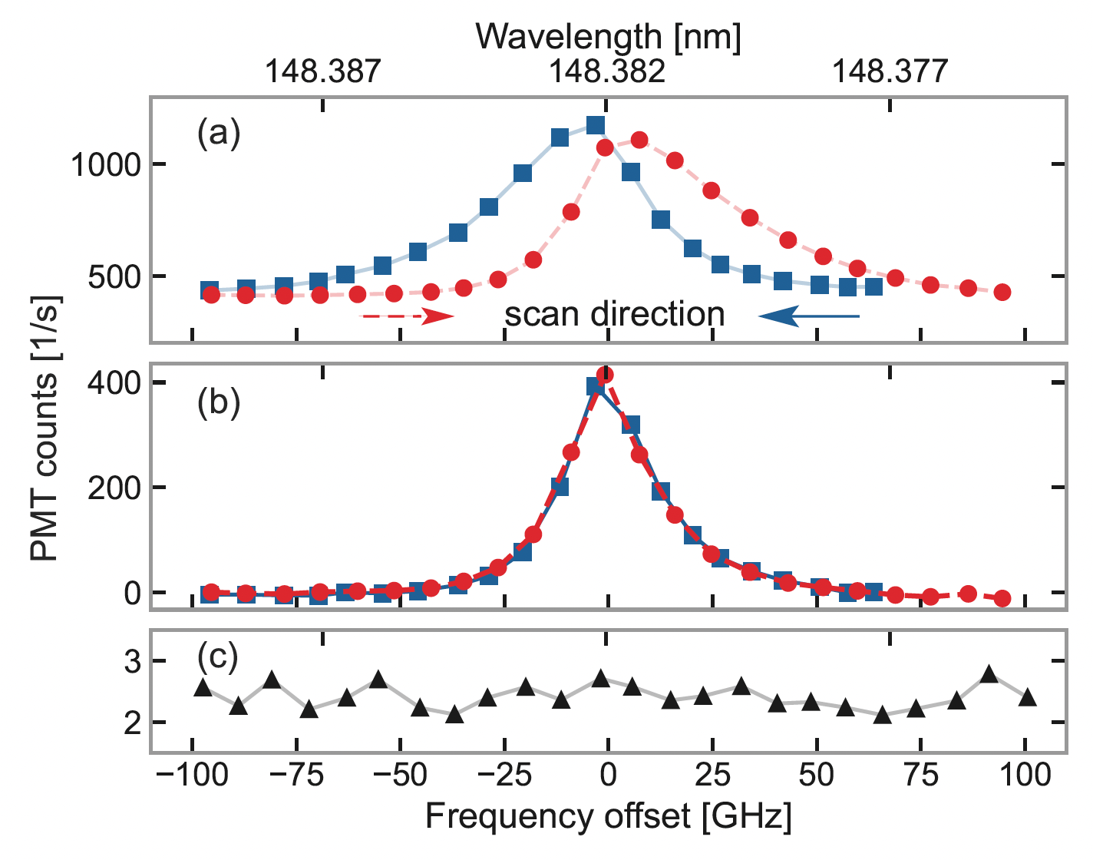
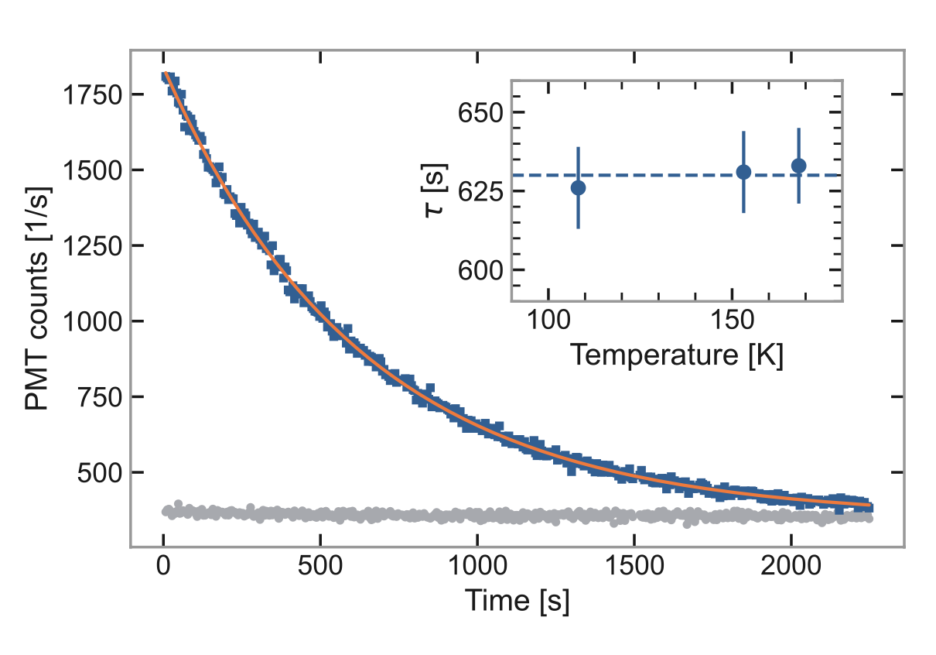


First laser excitation of ²²⁹Th in 2024
PTB Experiment
$ν_{isomer}$= 2020.409(7) THz
$τ_{\frac{1}{2}}=$670(102) s (in crystal)
laser linewidth limited
Notes:
40 s → 0:55

Slide 17
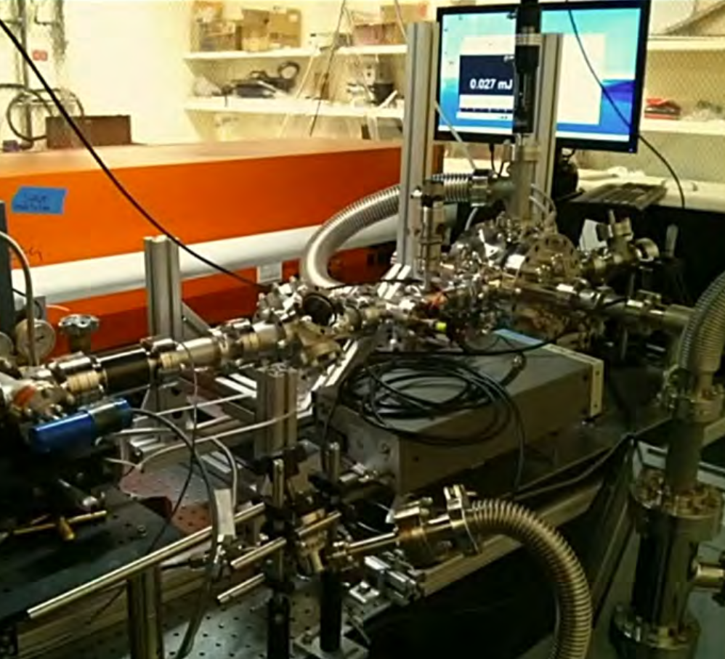
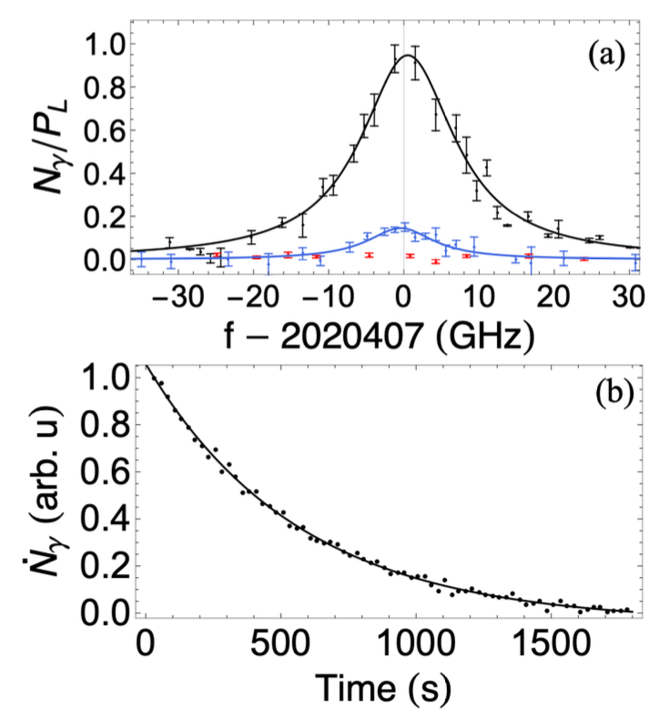
First laser excitation of ²²⁹Th in 2024
PTB Experiment
UCLA Experiment
Host: CaF₂
Host: LiSrAlF₆
Notes:
40 s → 0:55

Slide 18
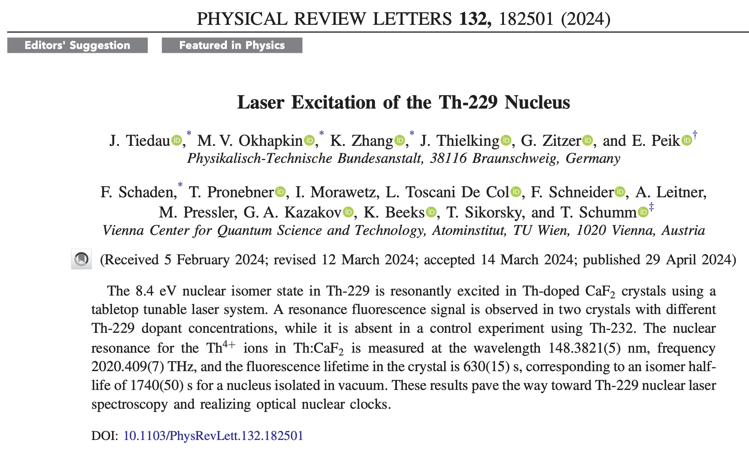
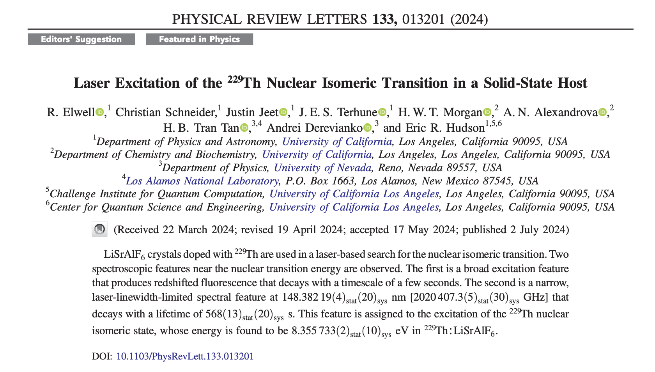
First laser excitation of ²²⁹Th in 2024
PTB Experiment
UCLA Experiment
Host: CaF₂
Host: LiSrAlF₆
Isomer energy:
8.338(24) eV or 148.71(42) nm
Isomer lifetime:
670(102) s (in crystal)
Isomer energy:
148.38219(4)stat (20)sys nm
Isomer lifetime:
568(13)stat (20)sys s (in crystal)
April 2024
July 2024
Notes:
40 s → 0:55

Slide 19
…any questions?…any time!
or contact:
thorsten.schumm@tuwien.ac.at
Notes:
85 s → 3:30

Slide 20
OUTLINE
The „solid state approach“ to ²²⁹Th nuclear spectroscopy
Basic concept and implementation
Nuclear quadrupole structure
Nuclear – solid coupling
Separating nuclear properties and material parameters
JILA experiment
Absolute Mössbauer spectroscopy
Temperature depencence
Towards a solid-state nuclear clock
OKAYAMA experiment
Multiple defect centers
Site-dependent properties
Notes:
40 s → 0:55

Slide 21
Nuclear quadrupole structure in ²²⁹Th:CaF₂
What about interactions between crystal and nuclear levels?
²²⁹Th isomer state
????
M1 transition
ΔE ≈ 8 eV
τ ≈ min. – h.
²²⁹Th ground state
Notes:
40 s → 0:55

Slide 22
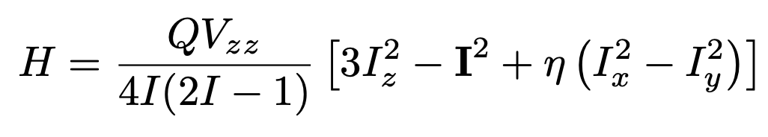
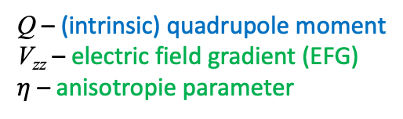
Nuclear quadrupole structure in ²²⁹Th:CaF₂
Quadrupole structure determined by nuclear and material parameters
Q – (intrinsic) quadrupole moment
V_{zz} – electric field gradient (EFG)
$η$ – anisotropie parameter
„universal“
host-specific
Notes:
40 s → 0:55

Slide 23
Nuclear quadrupole structure in ²²⁹Th:CaF₂
Quadrupole structure determined by nuclear and material parameters
Q – (intrinsic) quadrupole moment
V_{zz} – electric field gradient (EFG)
$η$ – anisotropie parameter
„universal“
host-specific
can we see these quadrupole levels…?
Notes:
40 s → 0:55

Slide 24
OUTLINE
The „solid state approach“ to a Th-229 nuclear clock
Basic concept and implementation
Nuclear quadrupole structure
Nuclear – solid coupling
Separating nuclear properties and material parameters
JILA experiment
Absolute Mössbauer spectroscopy
Temperature depencence
The EFG “mystery“
OKAYAMA experiment
Multiple defect centers
Site-dependent properties
Notes:
40 s → 0:55

Slide 25
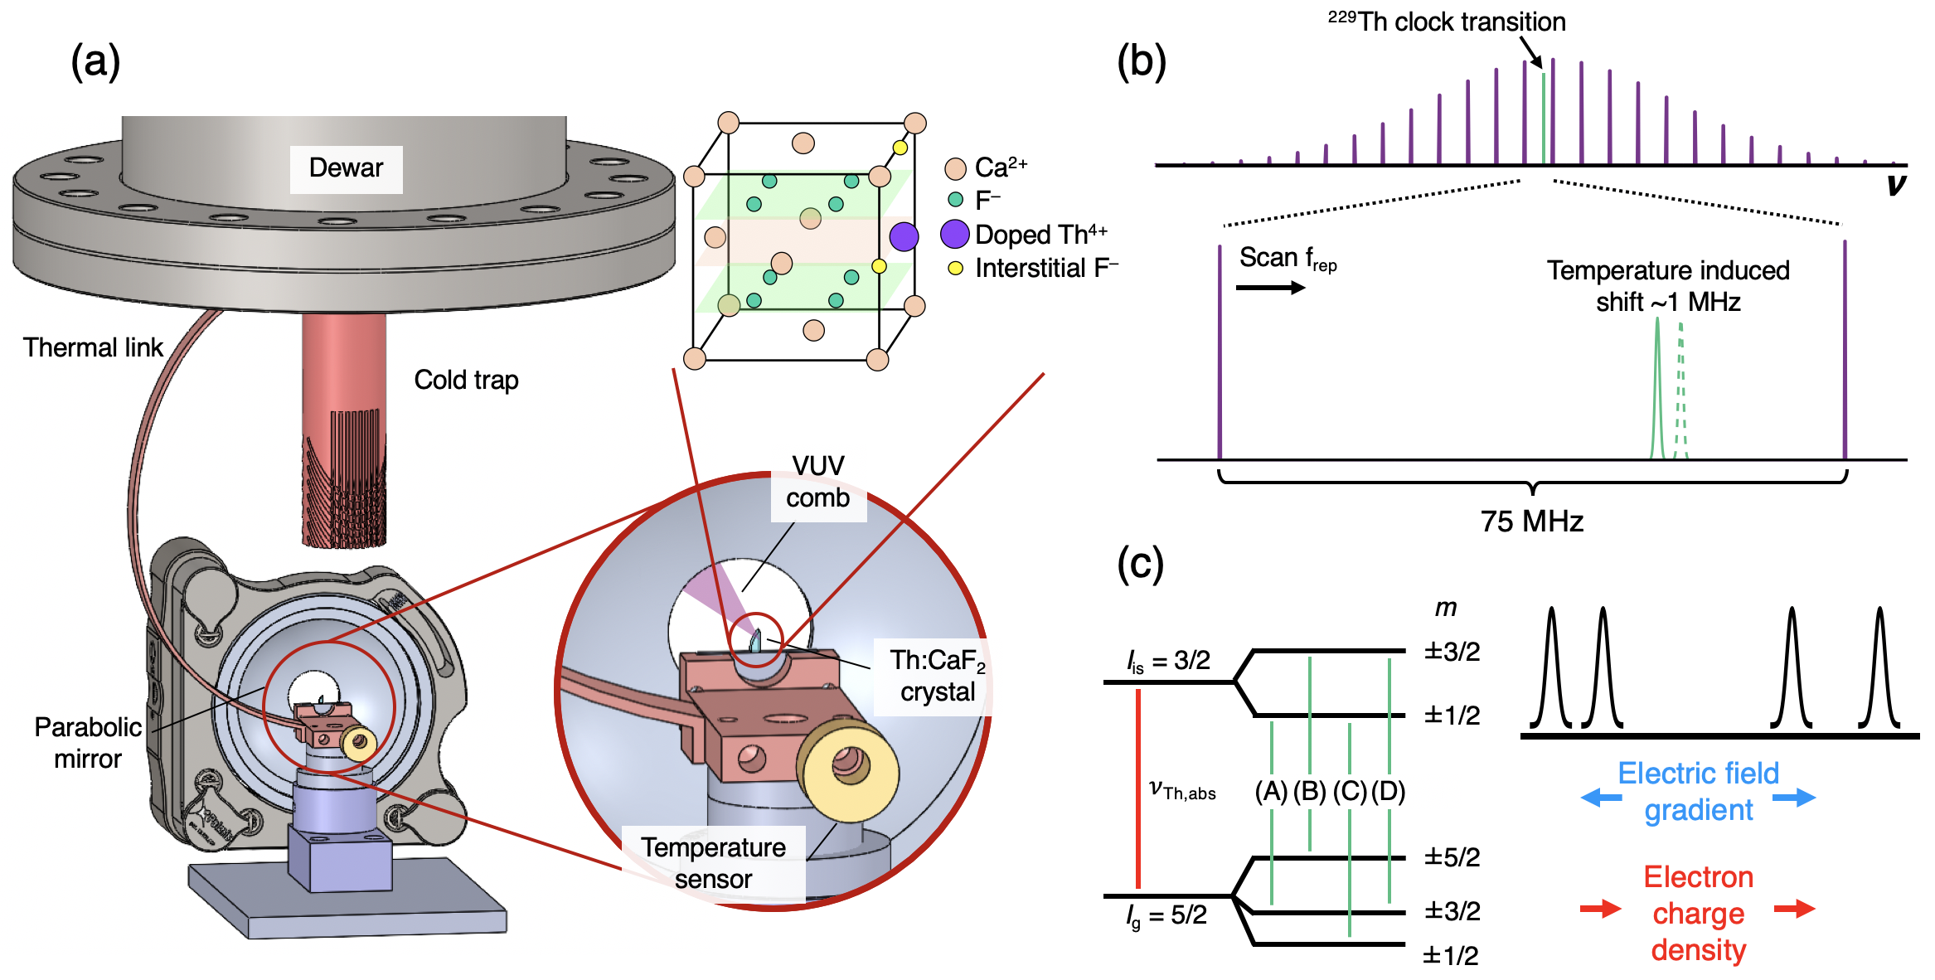
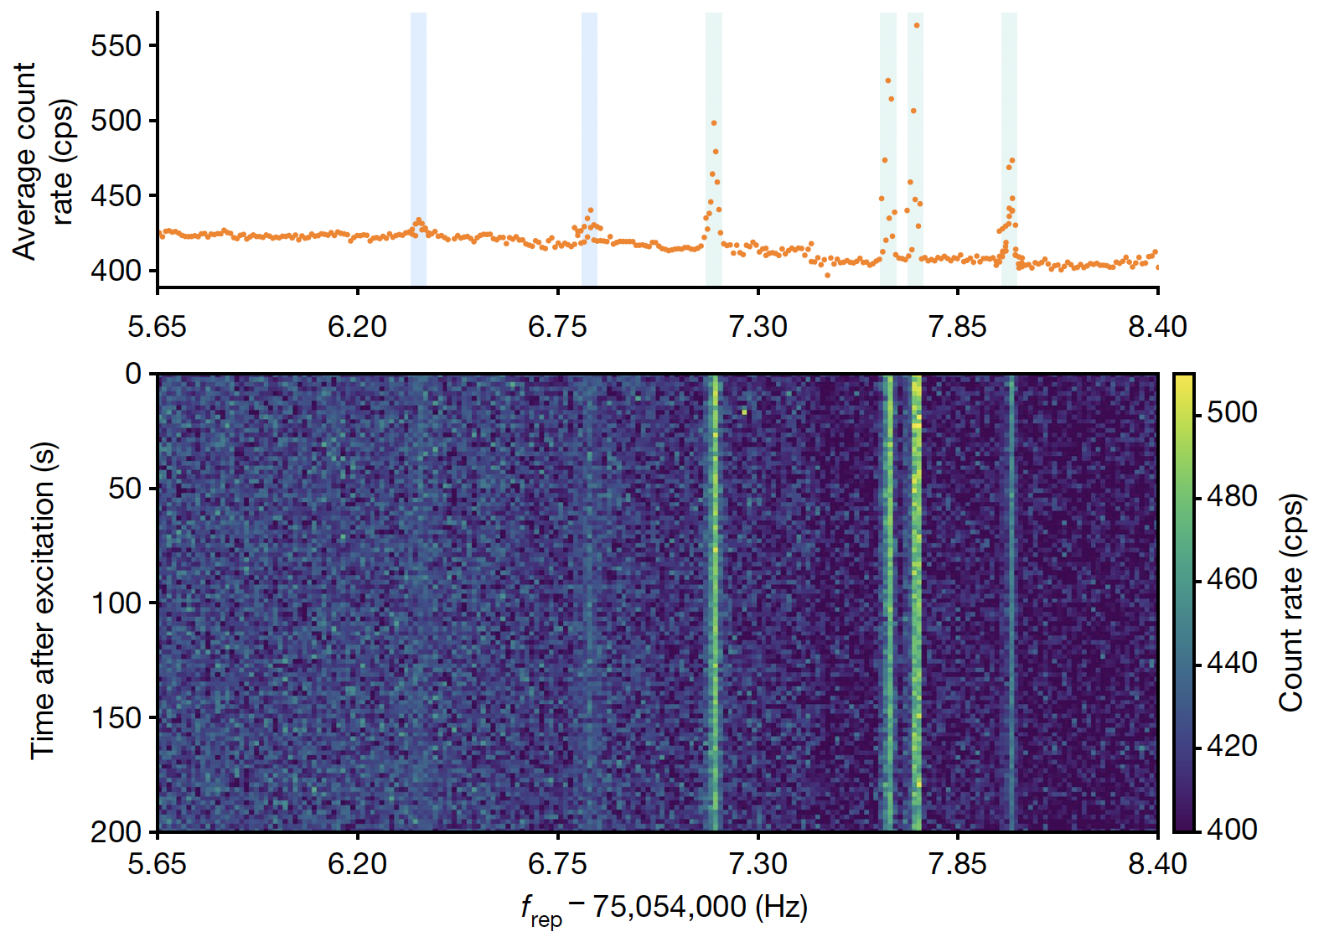
VUV frequency comb precision spectroscopy
JILA experiment
4 strong, 2 weak lines observed
absolute frequency determination with reference to Sr clock
Notes:
40 s → 0:55

Slide 26
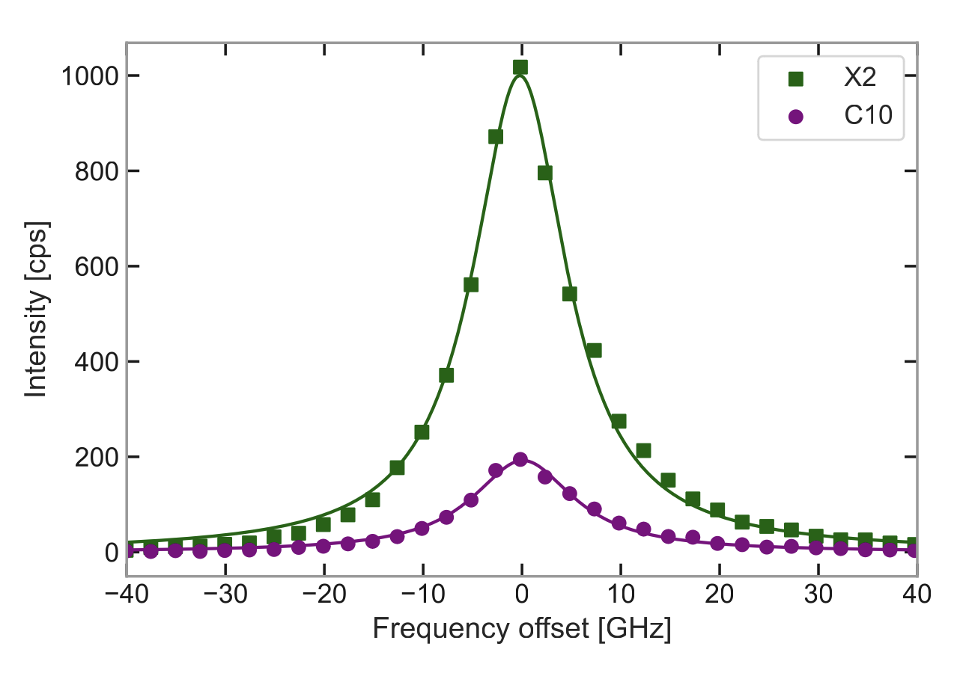

VUV frequency comb precision spectroscopy
JILA experiment vs. PTB/UCLA
PTB/TUW spectra
~ 7 GHz
JILA lines
covering 400 MHz
individual lines ~ 30 kHz
accuracy ~1 kHz
$ν_{isomer}$= 2 020 407 384 335(2) kHz
Notes:
40 s → 0:55

Slide 27
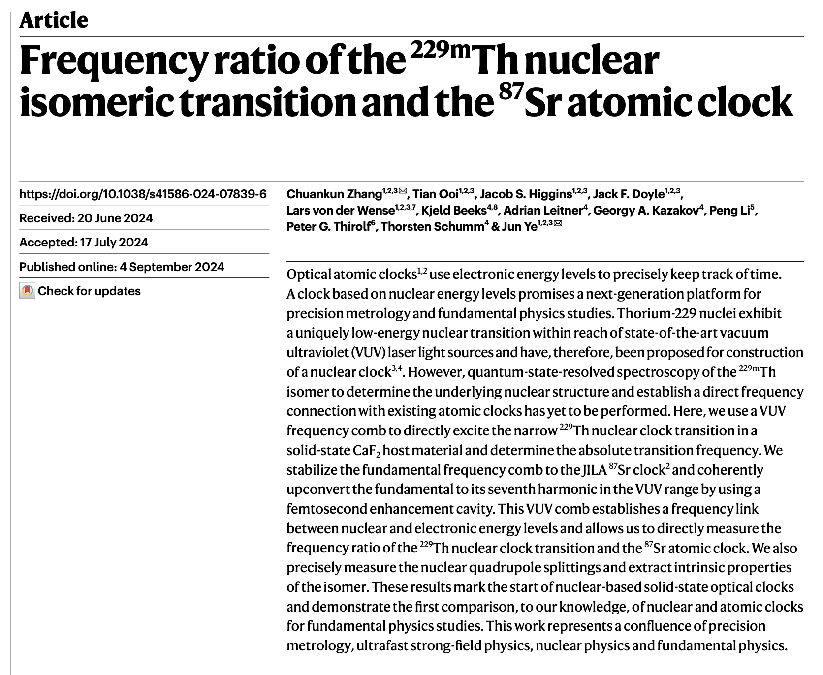
VUV frequency comb precision spectroscopy
JILA experiment vs. PTB/UCLA
same crystals X2 and C10 used at PTB and JILA
PTB/TUW spectra
~ 7 GHz
JILA lines
covering 400 MHz
individual lines ~ 30 kHz
accuracy ~1 kHz
September 2024
$ν_{isomer}$= 2 020 407 384 335(2) kHz
Notes:
40 s → 0:55

Slide 28
Nuclear quadrupole structure in ²²⁹Th:CaF2
JILA experiment
4 strong + 1 additional line observed → asignement to nuclear quadrupole structure
absolute frequency determination
(let‘s not totally forget about the 2 weak lines)
Notes:
40 s → 0:55

Slide 29
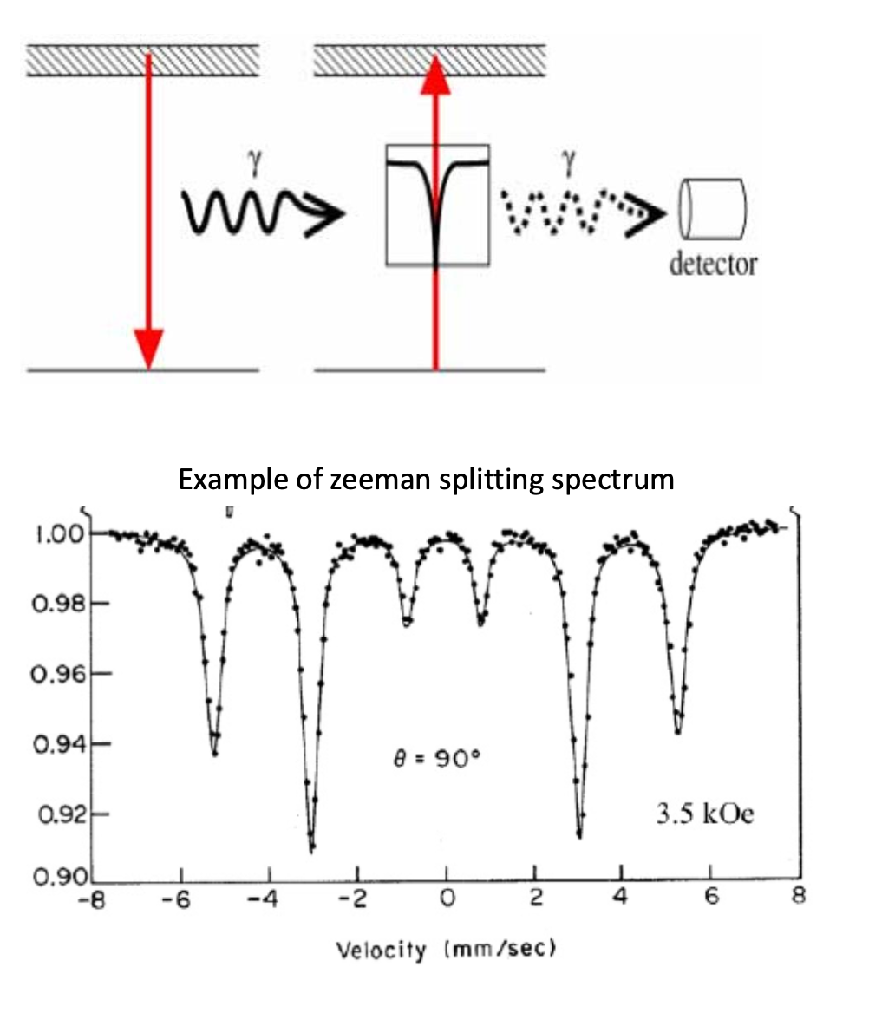
Nuclear quadrupole structure in ²²⁹Th:CaF2
JILA experiment
„traditional“ Mössbauer spectroscopy
4 strong + 1 additional line observed → asignement to nuclear quadrupole structure
absolute frequency determination
(let‘s not totally forget about the 2 weak lines)
Notes:
40 s → 0:55

Slide 30
Nuclear quadrupole structure in ²²⁹Th:CaF2
JILA experiment
„traditional“ Mössbauer spectroscopy
VUV
laser
4 strong + 1 additional line observed → asignement to nuclear quadrupole structure
absolute frequency determination
(let‘s not totally forget about the 2 weak lines)
Notes:
40 s → 0:55

Slide 31
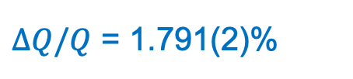
Nuclear quadrupole structure in ²²⁹Th:CaF₂
Quadrupole structure determined by nuclear and material parameters
Q – (intrinsic) quadrupole moment
V_{zz} – electric field gradient (EFG)
$η$ – anisotropie parameter
„universal“
host-specific
change in quadrupole moment…
$∆Q/Q$ = 1.791(2)%
Notes:
40 s → 0:55

Slide 32
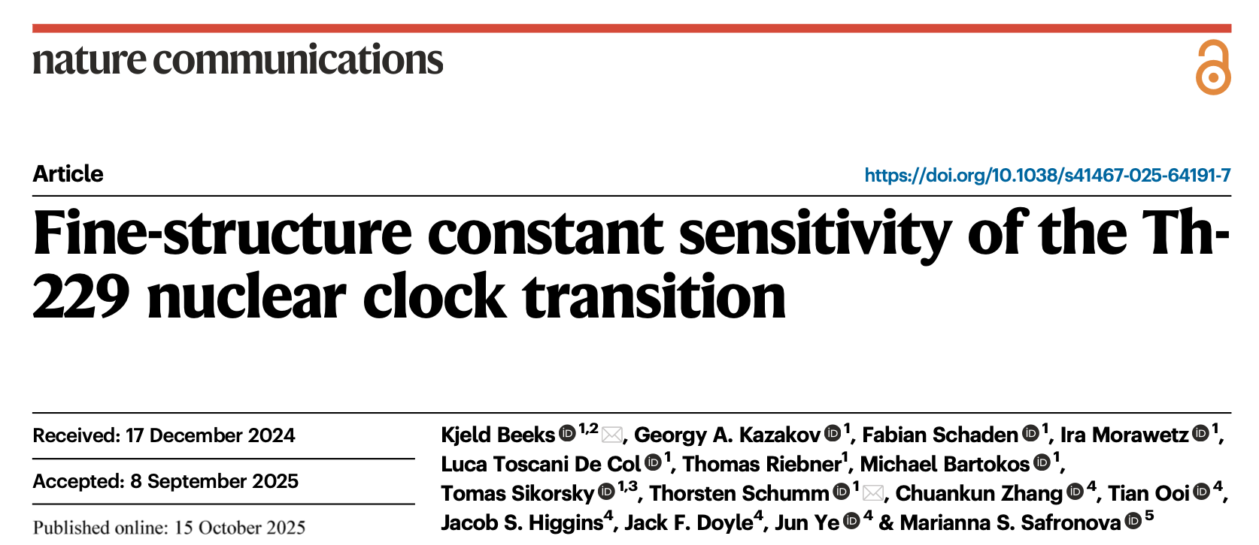
Nuclear quadrupole structure in ²²⁹Th:CaF₂
Quadrupole structure determined by nuclear and material parameters
Q – (intrinsic) quadrupole moment
V_{zz} – electric field gradient (EFG)
$η$ – anisotropie parameter
„universal“
host-specific
change in quadrupole moment…
$∆Q/Q$ = 1.791(2)%
Notes:
40 s → 0:55

Slide 33
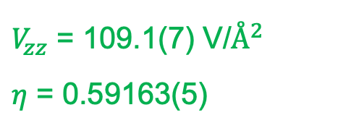
Nuclear quadrupole structure in ²²⁹Th:CaF₂
Quadrupole structure determined by nuclear and material parameters
Q – (intrinsic) quadrupole moment
V_{zz} – electric field gradient (EFG)
$η$ – anisotropie parameter
„universal“
host-specific
change in quadrupole moment…
Extracted electrical field gradient (EFG)
$V_{zz}$ = 109.1(7) V/$Å^{2}$
$η$ = 0.59163(5)
$∆Q/Q$ = 1.791(2)%
extremely well reproduced over 3 different crystals
Notes:
40 s → 0:55

Slide 34
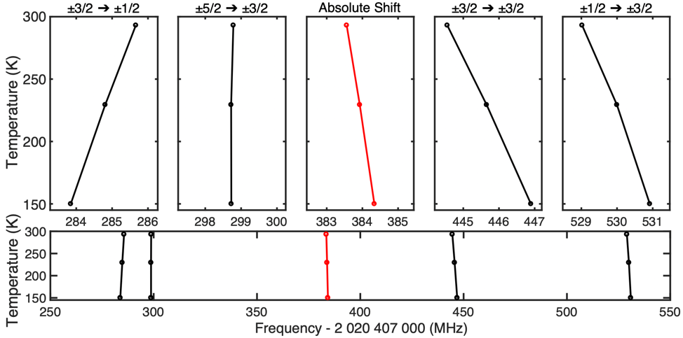
Temperature dependence of spectroscopy lines
JILA experiment
tracing 4 strongest lines over temperature
EFG and eta parameter „well behaved“
compatible with thermal expansion
interesting cancellellation in (B) transition (clock?)
strong eta indicates breaking of lattice symmetry
transitions now clearly depend on
host material and temperature (CaF₂, LiSaF₆…)
Notes:
40 s → 0:55

Slide 35
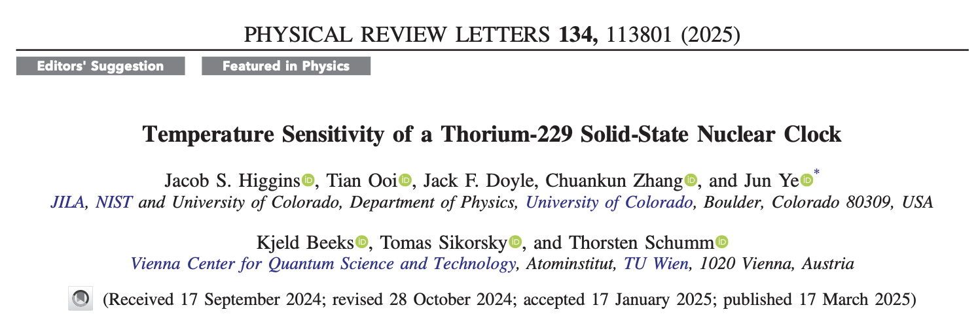
Temperature dependence of spectroscopy lines
JILA experiment
tracing 4 strongest lines over temperature
EFG and eta parameter „well behaved“
compatible with thermal expansion
interesting cancellellation in (B) transition (clock?)
strong eta indicated breaking of lattice symmetry
transitions clearly depend on
host material and temperature
Notes:
40 s → 0:55

Slide 36
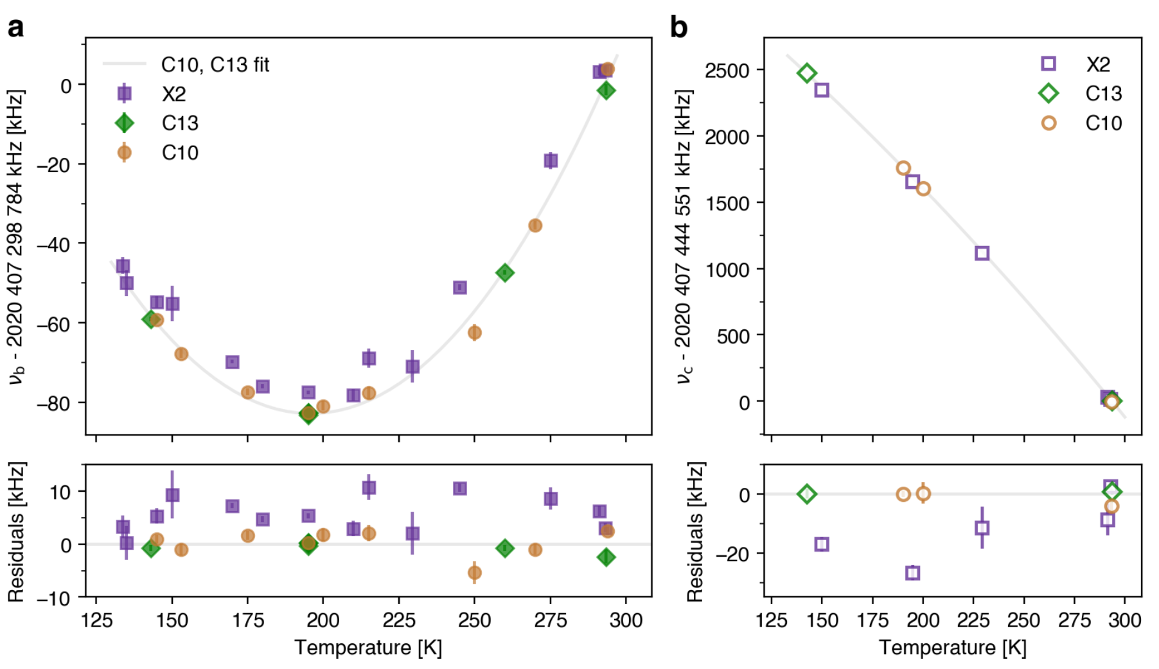
Towards a ²²⁹Th:CaF₂ solid-state nuclear clock
JILA experiment
(B) transition
(C) transition
vanishing T dependence
line for
thermometry
transition frequencies consistent within ~kHz over different crystals
linewidth 10-100 kHz, scaling with concentration („micro-strain“)
Continuous interrogation at fixed T (over 1 year) within 1 kHz
Notes:
40 s → 0:55

Slide 37
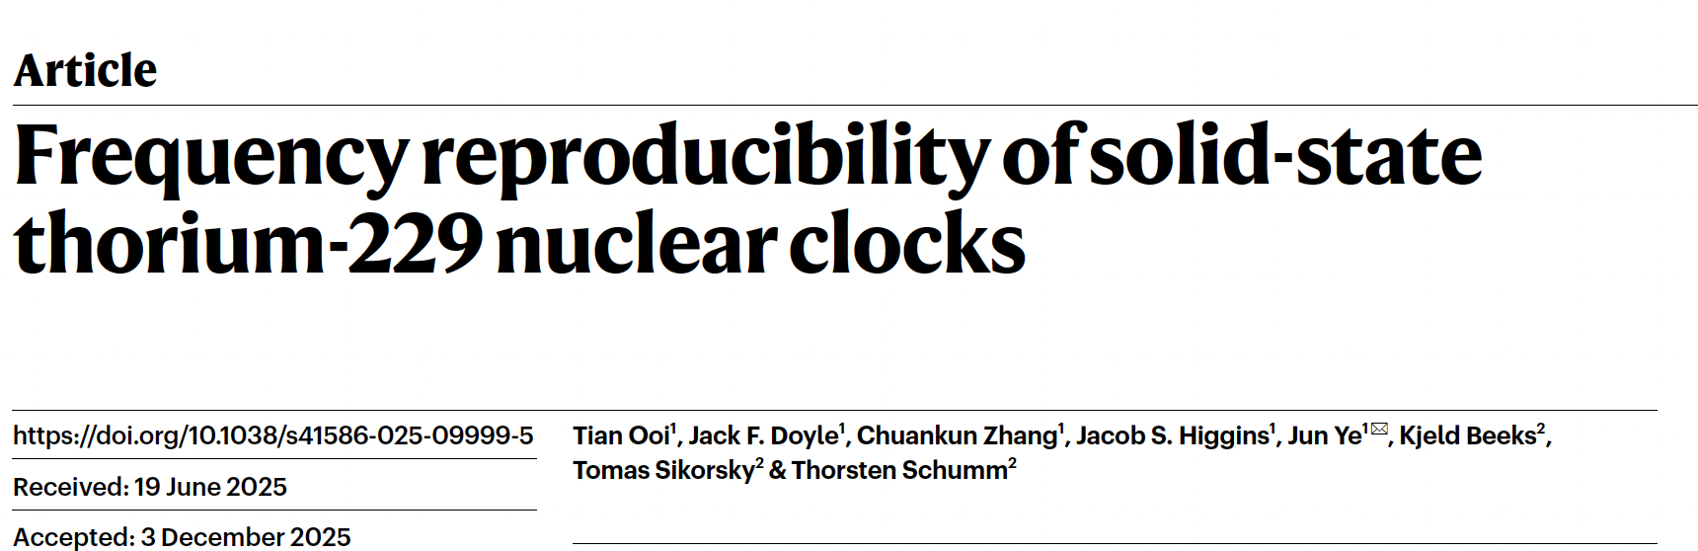
Towards a ²²⁹Th:CaF₂ solid-state nuclear clock
JILA experiment
(B) transition
(C) transition
vanishing T dependence
line for
thermometry
transition frequencies consistent within ~kHz over different crystals
linewidth 10-100 kHz, scaling with concentration („micro-strain“)
Continuous interrogation at fixed T (over 1 year) within 1 kHz
Notes:
40 s → 0:55

Slide 38
…any questions?…any time!
or contact:
thorsten.schumm@tuwien.ac.at
Notes:
85 s → 3:30

Slide 39
OUTLINE
The „solid state approach“ to a Th-229 nuclear clock
Basic concept and implementation
Nuclear quadrupole structure
Nuclear – solid coupling
Separating nuclear properties and material parameters
JILA experiment
Absolute Mössbauer spectroscopy
Temperature depencence
Towards a solid-state nuclear clock
OKAYAMA experiment
Multiple defect centers
Site-dependent properties
Notes:
40 s → 0:55

Slide 40
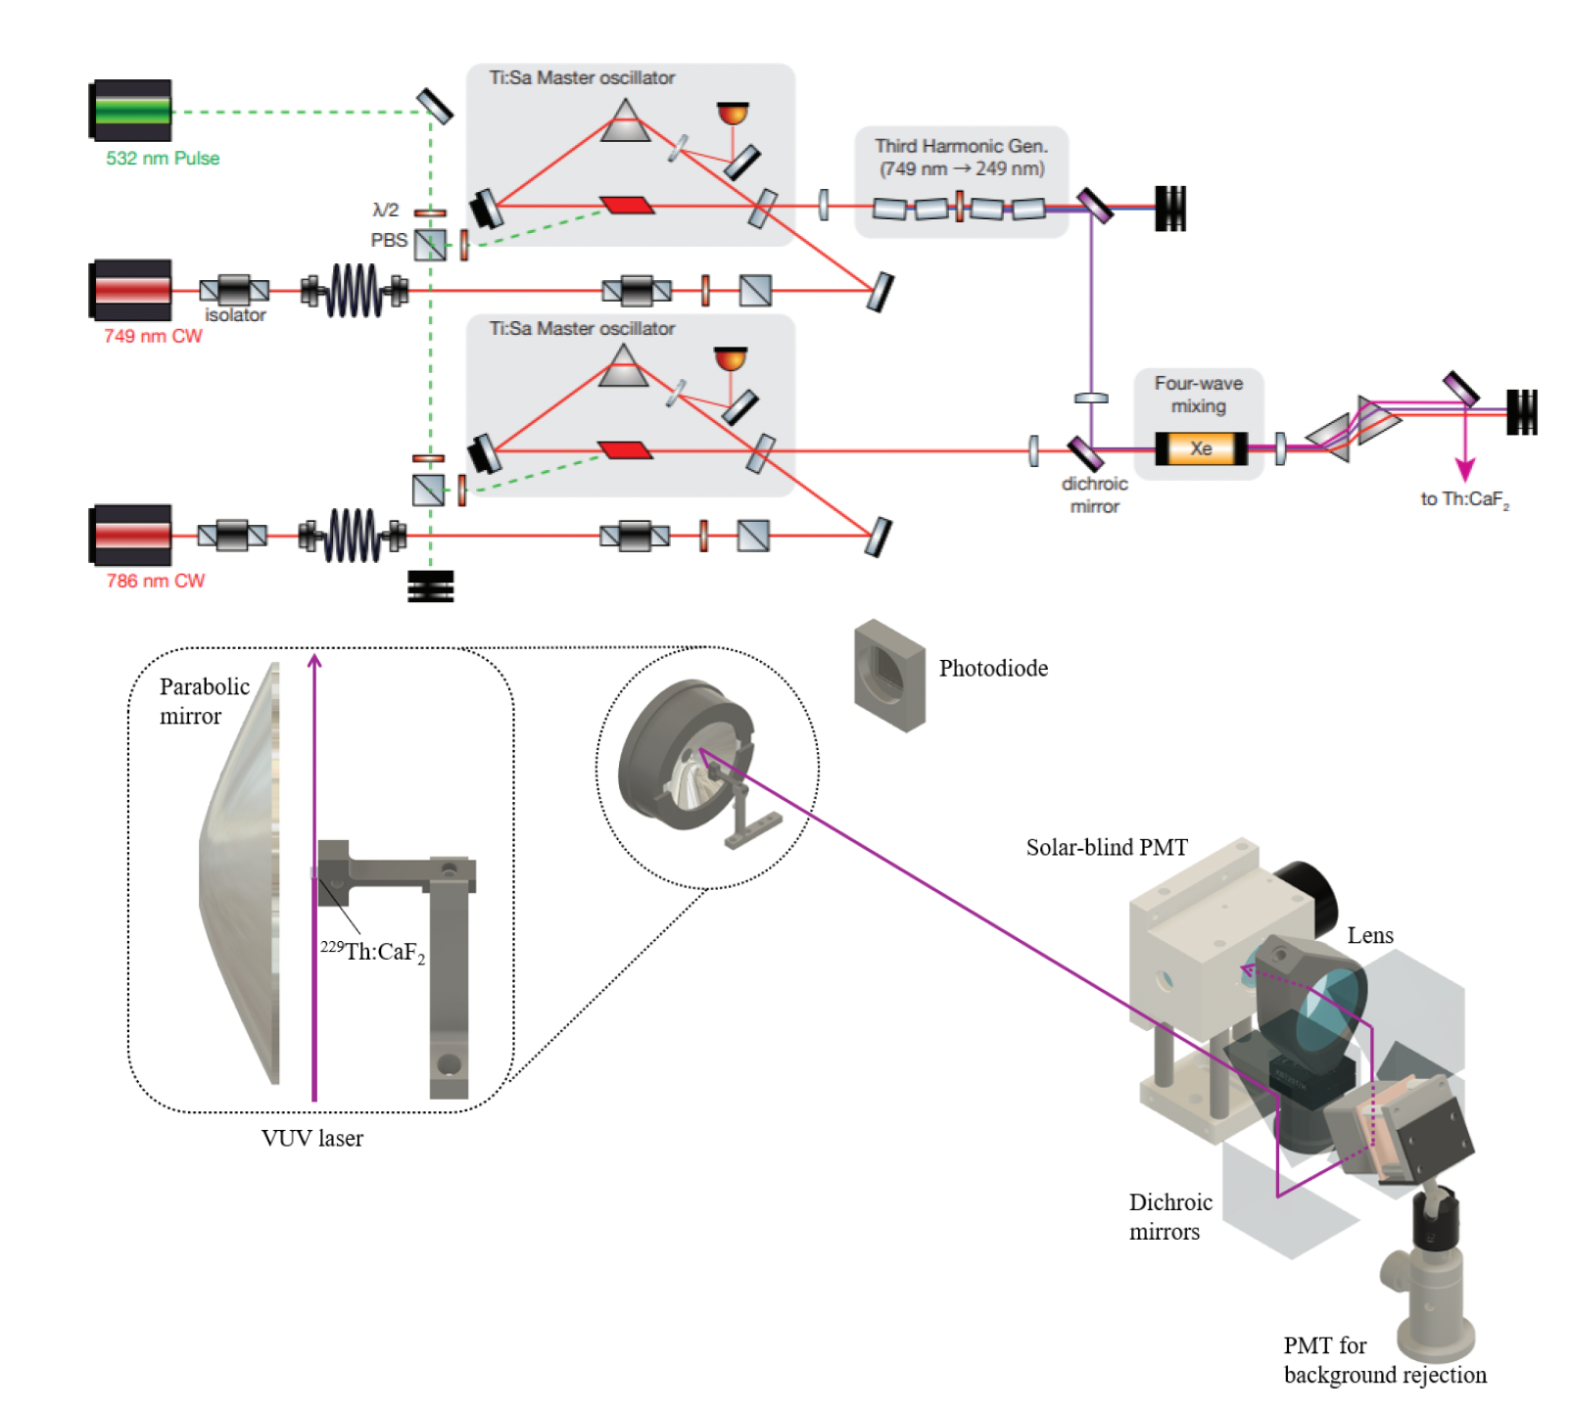
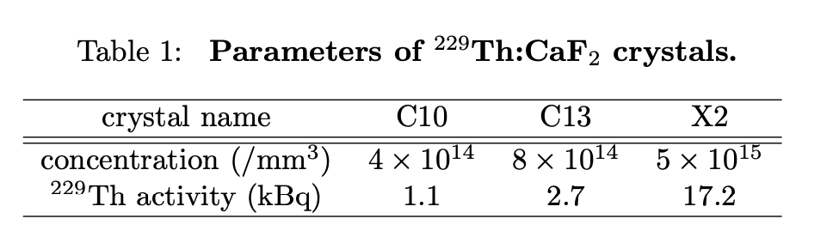
Multiple doping sites in a single crystal
Okayama experiment
4-wave mixing laser similar to PTB/UCLA
linewidth 30 MHz → resolve Q-structure
factor 50 higher excitation rate than JILA
detection system taken from SPring-8
3 crystals from Vienna (always the same)
Notes:
40 s → 0:55

Slide 41
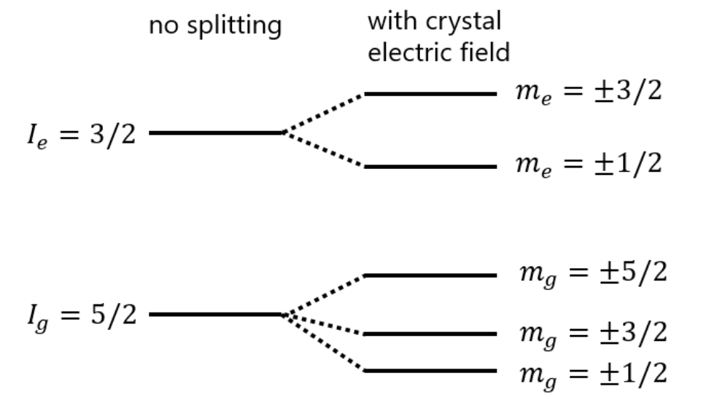
Multiple doping sites in a single crystal
Okayama experiment
?
?
at least 4 different Th sites identified in all 3 crystals
one of them is „JILA site“ (site 2)
missing 6th line of „JILA site“ observed
Relative occurences of sites changes with concentration
Notes:
40 s → 0:55

Slide 42
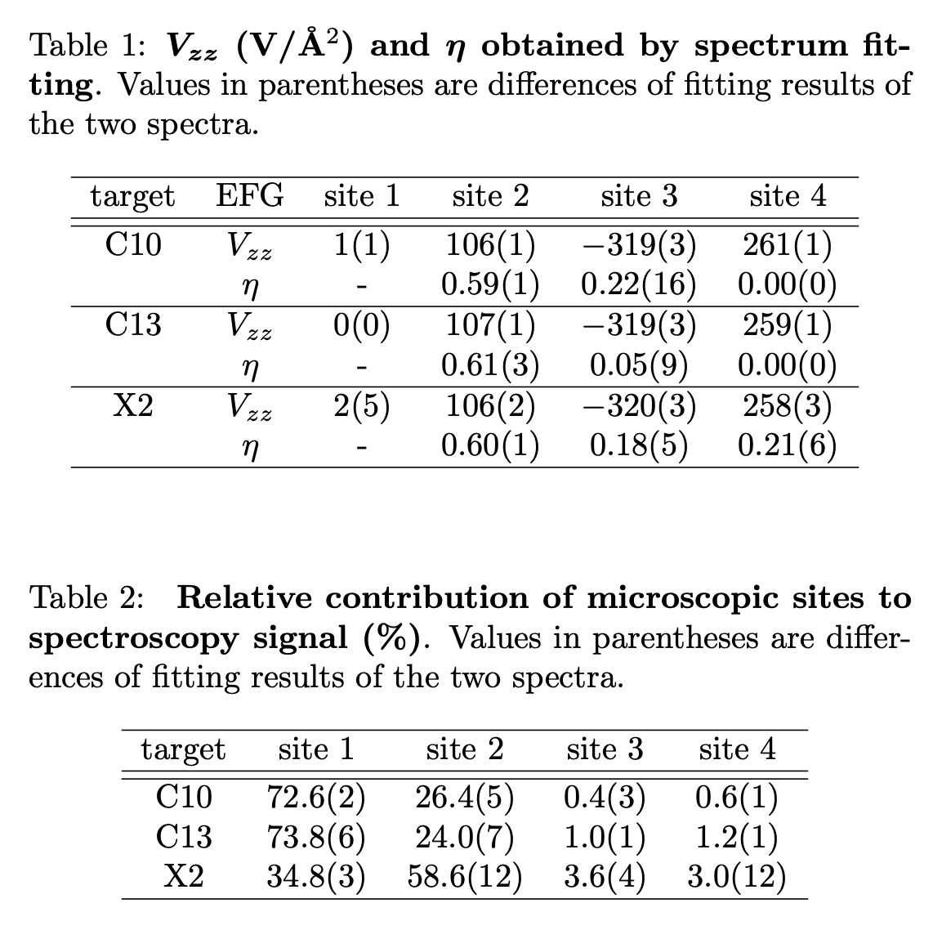
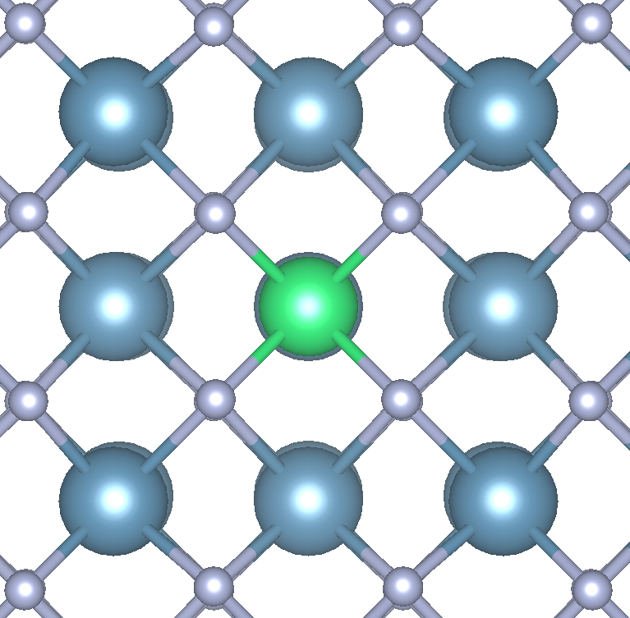

Multiple doping sites in a single crystal
Okayama experiment
0 EFG!
JILA site
tentative assignement: single Th and 2Th cluster without local charge compensation
Notes:
40 s → 0:55

Slide 43
Multiple doping sites in a single crystal
Okayama experiment
0 EFG!
JILA site
>90%
Notes:
40 s → 0:55

Slide 44
Multiple doping sites in a single crystal
Okayama experiment
0 EFG!
JILA site
selective laser excitation of nuclei in specific sites in the crystal
“…beyond Mössbauer“
>90%
Notes:
40 s → 0:55

Slide 45

Multiple doping sites in a single crystal
Okayama experiment
isomer lifetime DOES NOT seem to depend (much) on Th doping site
(all measurements at room temperature)
Notes:
40 s → 0:55

Slide 46
Multiple doping sites in a single crystal
Okayama experiment
isomer lifetime DOES NOT seem to depend (much) on Th doping site
(all measurements at room temperature)
isomer laser quenching DOES depend on Th doping site
(all measurements at room temperature)
405 nm CW 10 mW quenching laser
Notes:
40 s → 0:55

Slide 47

Multiple doping sites in a single crystal
Okayama experiment
isomer lifetime DOES NOT seem to depend (much) on Th doping site
(all measurements at room temperature)
isomer laser quenchin DOES depend on Th doping site
(all measurements at room temperature)
405 nm CW 10 mW quenching laser
arXiv:2509.00041v1
Notes:
40 s → 0:55

Slide 48
…any questions?…last Chance!
or contact:
thorsten.schumm@tuwien.ac.at
Notes:
85 s → 3:30

Slide 49
Credits (most probably incomplete, I apologize!)
ISOLDE-CERN measurements
S. Kraemer, J. Moens, S. Bara, P. Chhetri, A. Claessens, T. Cocolios, KU Leuven
S. Geldhof, L. Pareire, S. Sels, A. Vantomme, M. Verlinde, P.v. Duppen
M. Athanasakis-Kaklamanakis, K. Chrysalidis, R. Henke CERN
K. Beeks, N. Hosseini, T. S. TU Wien
PTB measurements
J. Tidau, J. Thielking, G. Zitzer K. Zhang, M. Okhapkin, E. Peik PTB Braunschweig
F. Schaden, K. Beeks, T. Pronebner, I. Morawetz, T. Sikorsky, T. S. TU Wien
SPring-8/Okayama measurements
T. Masuda, A. Yoshimi, A. Fujieda, H. Hara, T. Hiraki, H. Kaino, Y. Miyamoto, Okayama University
K. Okai, S. Okubo, N. Sasao, S. Uetake, M. Yoshimura, K. Yoshimura, K. Suzuki
H. Fujimoto, T. Watanabe AIST Tsukuba
H. Haba, A. Yamaguchi, T. Yokokita, K. Tamasaku RIKEN
Y Kasamatsu, Y. Yasuda, Y. Shigekawa Osaka University
S. Kitao, M. Seto Kyoto University
K. Konashi, M. Watanabe Institute f. Material res. Tohoku
S. Stellmer, K. Beeks, F. Schaden, T. Sikorsky, T. S. TU Wien
JILA measurements
C. Zhang, T. Ooi, J. Doyle, J. Higgins, J. Ye JILA
K. Beeks, F. Schaden, A. Leitner, T. Sikorsky, G. Kazakov, T. S. TU Wien
Notes:
40 s → 0:55

Slide 50
THE END
Notes:
40 s → 0:55

