Slide 1
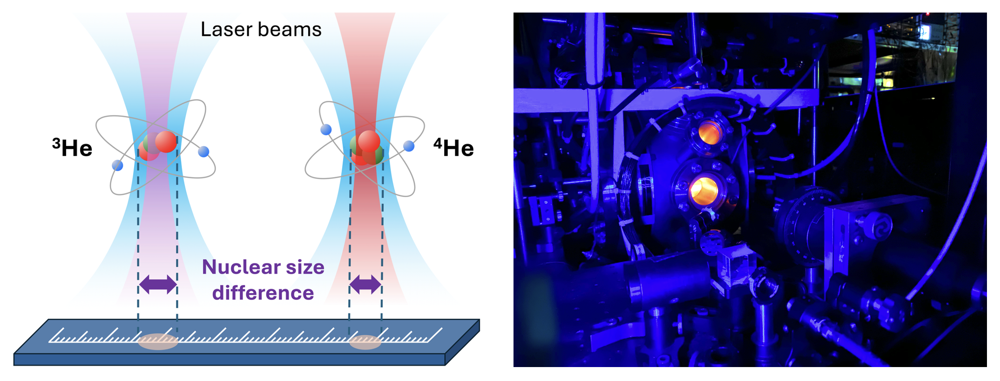


Precision determination of the alpha–helion particle charge radius difference with ultracold helium
Kees Steinebach,
Haoyuan Li
Yuri van der Werf,
Raphael Jannin,
Jeroen Koelemeij,
Hendrick Bethlem,
Kjeld Eikema
LaserLaB,
Vrije Universiteit,
Amsterdam, The Netherlands
Funding:
PSAS Vienna 2026
ETHZ 24 May 2024

Slide 2
Outline
  Introduction precision measurements for fundamental tests & charge radii
  Targets: He and He⁺
  Isotope shift measurement in ultra-cold ³He and ⁴He: nuclear size difference
  Quantum differences: cooling, trapping and spectroscopy of ³He and ⁴He
  Previously published results: ³He - Science 388, 850-853 (2025).
  New results ⁴He (accepted by PRL May 2026)
  Outlook
  Summary
2

Slide 3
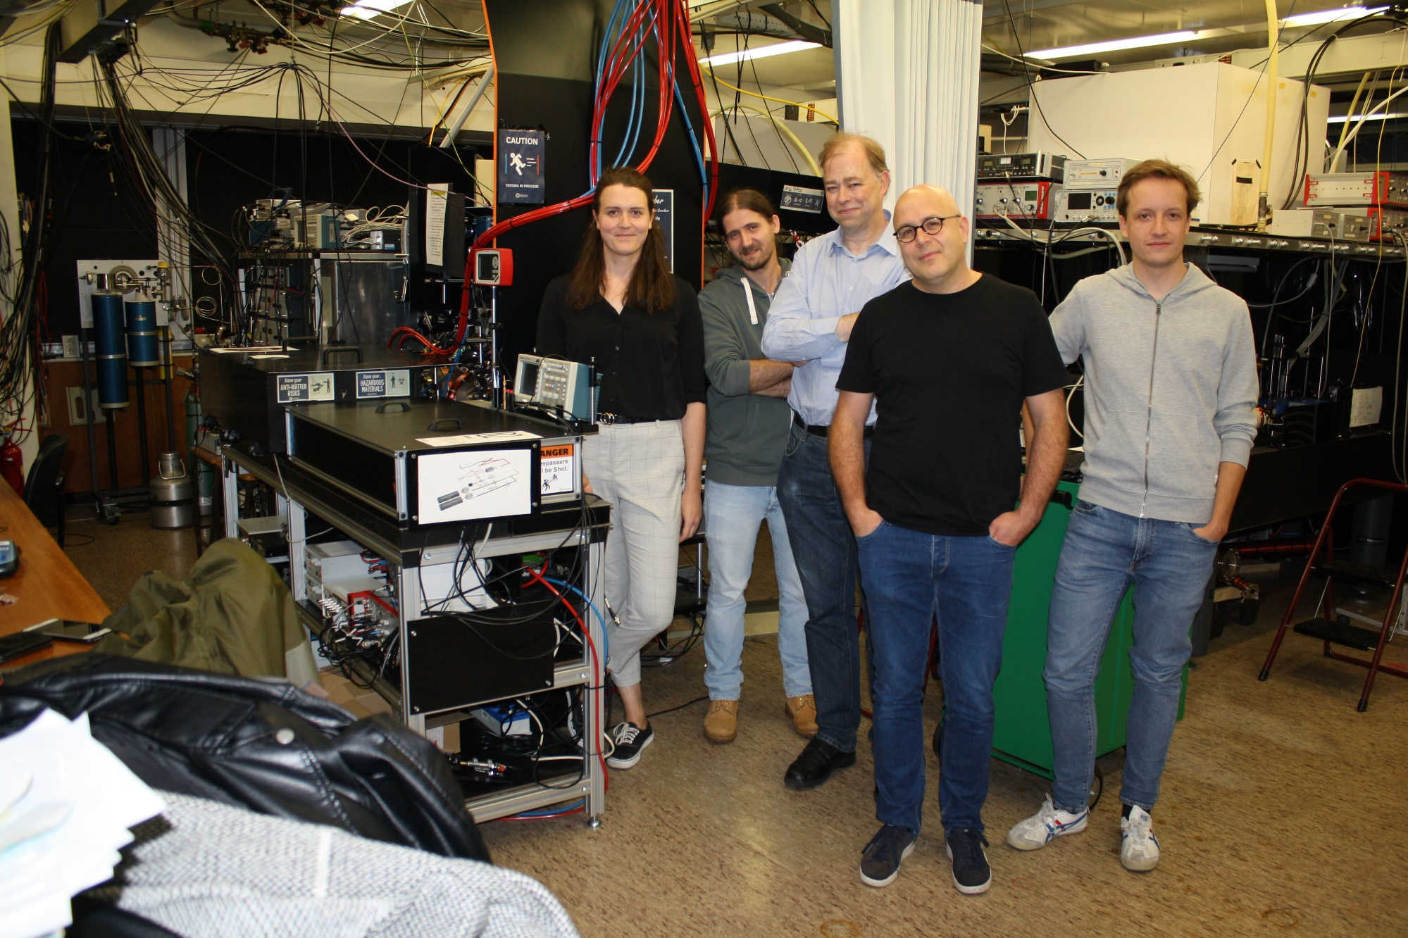

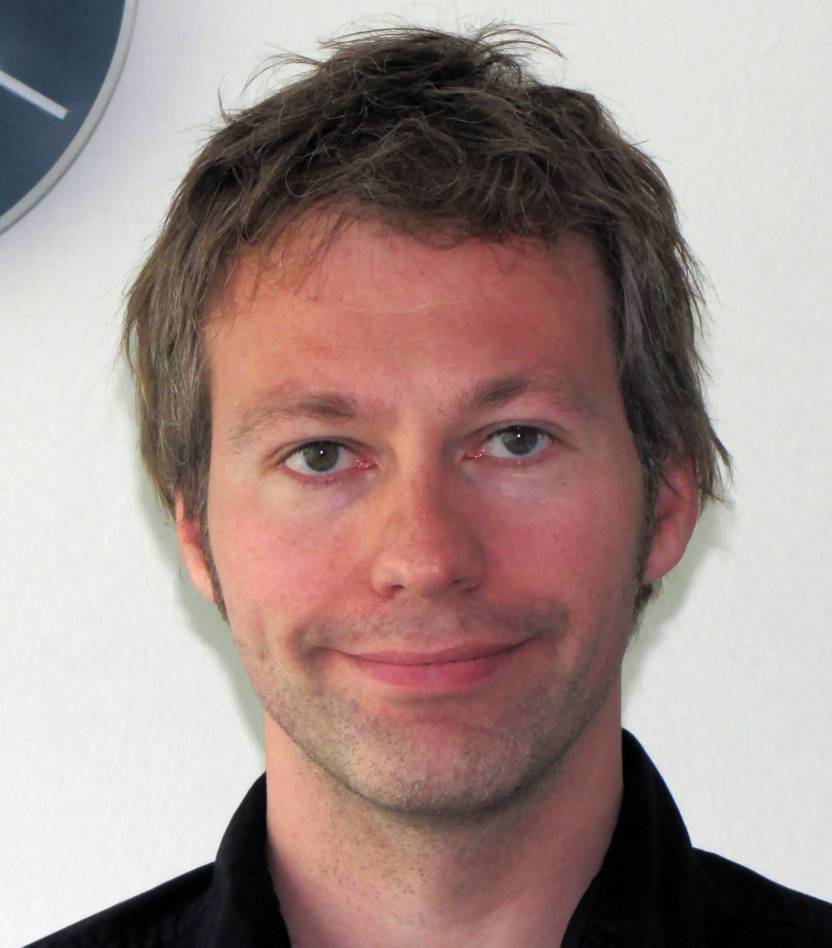
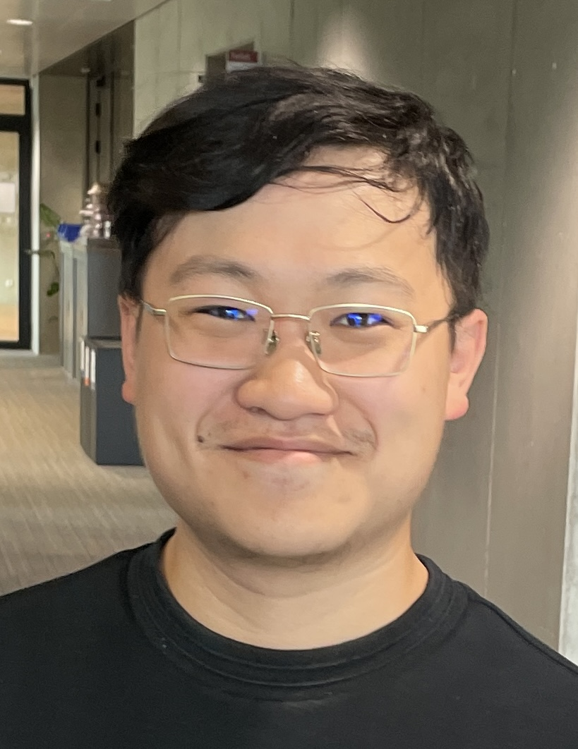
The Helium 2 ³S₁ – 2 ¹S₀ team
Kjeld
Eikema
He* team:
Kees Steinebach
Haoyuan Li
Yuri van der Werf
Raphael Jannin
Jeroen Koelemeij
Hendrick Bethlem
Kjeld Eikema (PI)
Technical support:
Rob Kortekaas
Joanne Slijper
Ronald Buijs
Lex van der Gracht
Raphael
Jannin
Kees
Steinebach
*
Yuri van
der Werf
Haoyuan
Li
Original PI:
Wim Vassen
† 11-2-2019
Jeroen
Koelemeij
Hendrick
Bethlem
3

Slide 4
Linked spectroscopy targets: He and He⁺
Goal: nuclear charge radius² difference
between ³He and ⁴He
³He
⁴He

Slide 5
Linked spectroscopy targets: He and He⁺
Goal: nuclear charge radius² difference
between ³He and ⁴He
³He
⁴He
170 Hz (10⁻¹²)
48 Hz (3*10⁻¹³)
Isotope measurement on the
doubly-forbidden 2 ³S – 2 ¹S transition at 1557 nm
5

Slide 6
Linked spectroscopy targets: He and He⁺
Goal: nuclear charge radius² difference
between ³He and ⁴He
Goal: absolute nuclear charge radius of ⁴He⁺,
or test of QED or Rydberg constant
³He
⁴He
⁴He⁺
170 Hz (10⁻¹²)
48 Hz (3*10⁻¹³)
target 1 kHz (10⁻¹³)
Isotope measurement on the
doubly-forbidden 2 ³S – 2 ¹S transition at 1557 nm
Ramsey-comb spectroscopy of the
two-photon 1S-2S transition with 32 nm + 790 nm
6

Slide 7
Linked spectroscopy targets: He and He⁺
Goal: nuclear charge radius² difference
between ³He and ⁴He
Goal: absolute nuclear charge radius of ⁴He⁺,
or test of QED or Rydberg constant
³He
⁴He
⁴He⁺
170 Hz (10⁻¹²)
48 Hz (3*10⁻¹³)
target 1 kHz (10⁻¹³)
Isotope measurement on the
doubly-forbidden 2 ³S – 2 ¹S transition at 1557 nm
Required: ultra-cold ³He and ⁴He
& trapping in magic wavelength trap
Ramsey-comb spectroscopy of the
two-photon 1S-2S transition with 32 nm + 790 nm
Required: single trapped & cooled He⁺,
enough power at 32 nm, and a whole lot more!
7

Slide 8
Charge radius² difference from isotope shift
Goal: nuclear charge radius² difference
between ³He and ⁴He
Recipe for determining charge radius² difference:
³He
⁴He
Measure the isotope shift
Subtract the theory isotope shift for point nuclei
Convert the difference to a value for the charge
radius² difference based on theory
FERMION
BOSON
170 Hz (10⁻¹²)
48 Hz (3*10⁻¹³)
Isotope measurement on the
doubly-forbidden 2 ³S – 2 ¹S transition at 1557 nm
Required: ultra-cold ³He and ⁴He
& trapping in magic wavelength trap

Slide 9
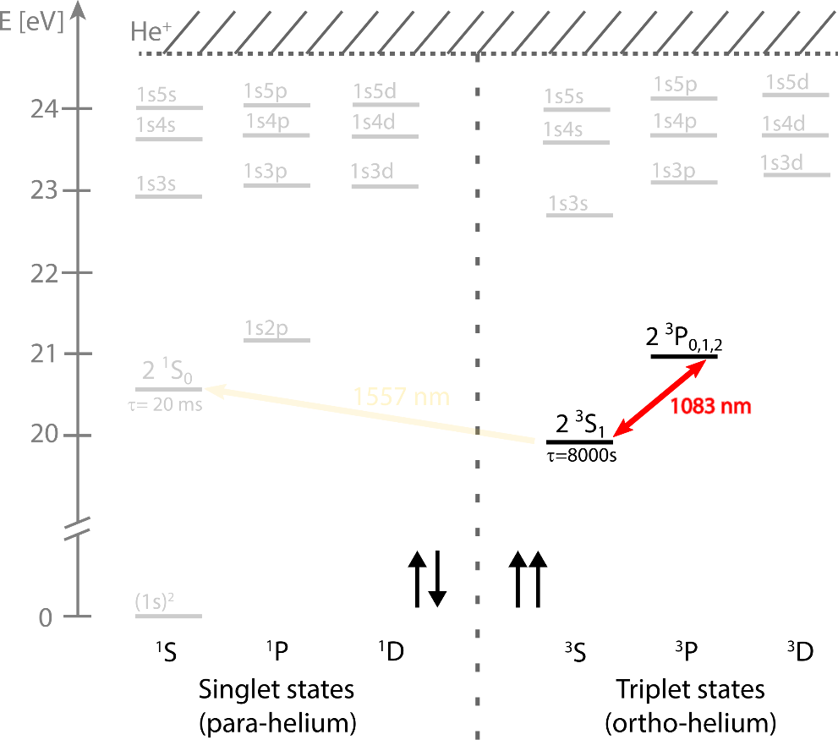
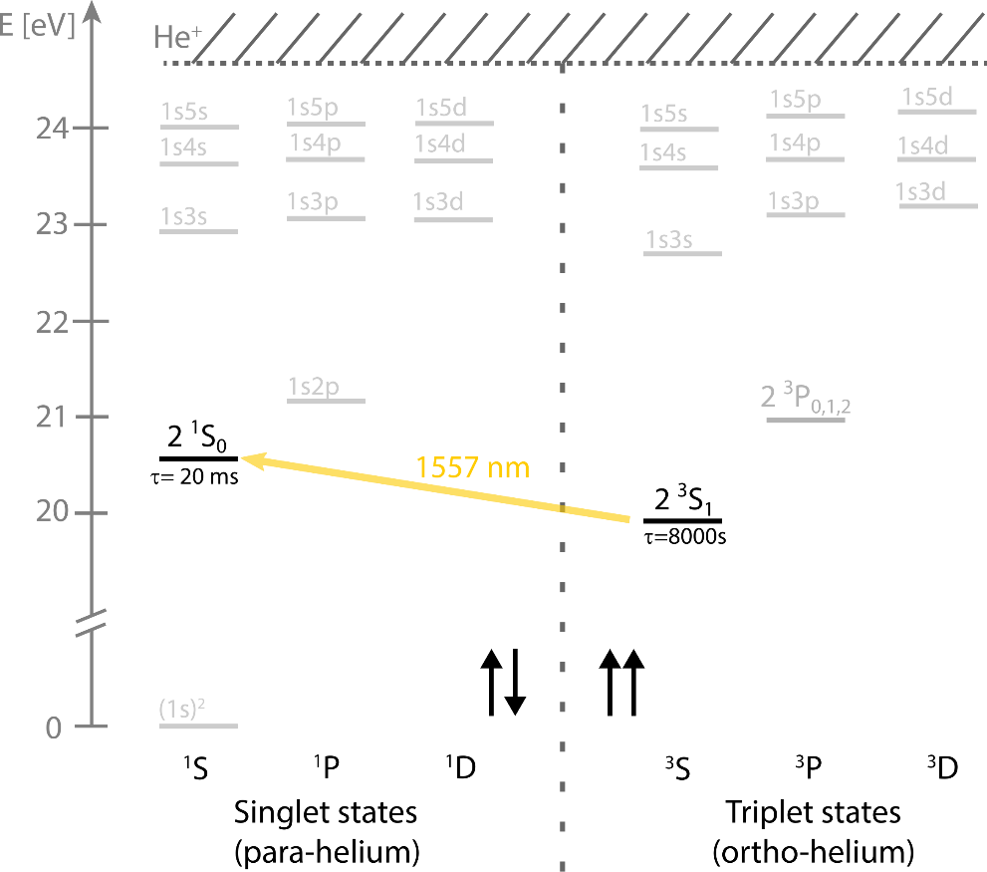
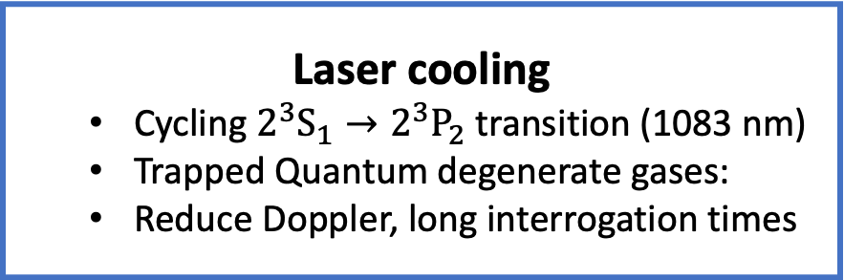

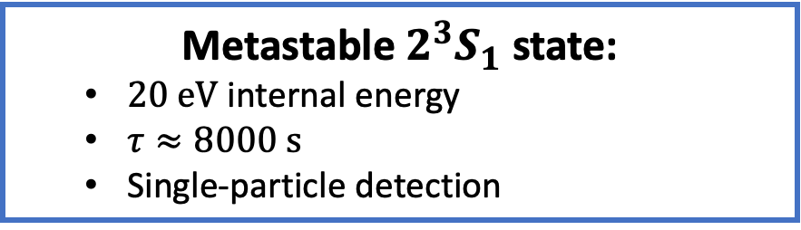
Metastable helium (He*)
Helium
Metastable $2^{3}S_{1}$ state:
  $20 eV$ internal energy
  $τ≈8000 s$
  Single-particle detection
Accessible narrow transition:
  Doubly forbidden $2^{3}S_{1}→2^{1}S_{0}$ (1557 nm)
  $8 Hz$ natural linewidth
  Einstein A coefficient $\sim 9.8⋅{10}^{−8}$ / s
Laser cooling
  Cycling $2^{3}S_{1}→2^{3}P_{2}$transition (1083 nm)
  Trapped Quantum degenerate gases:
  Reduce Doppler, long interrogation times
ab initio calculations
  Two-electron correlations
  Measure ⁴He – ³He isotope shift
  Derive ‘fundamental constant’
  (differential) nuclear charge radius²
9

Slide 10
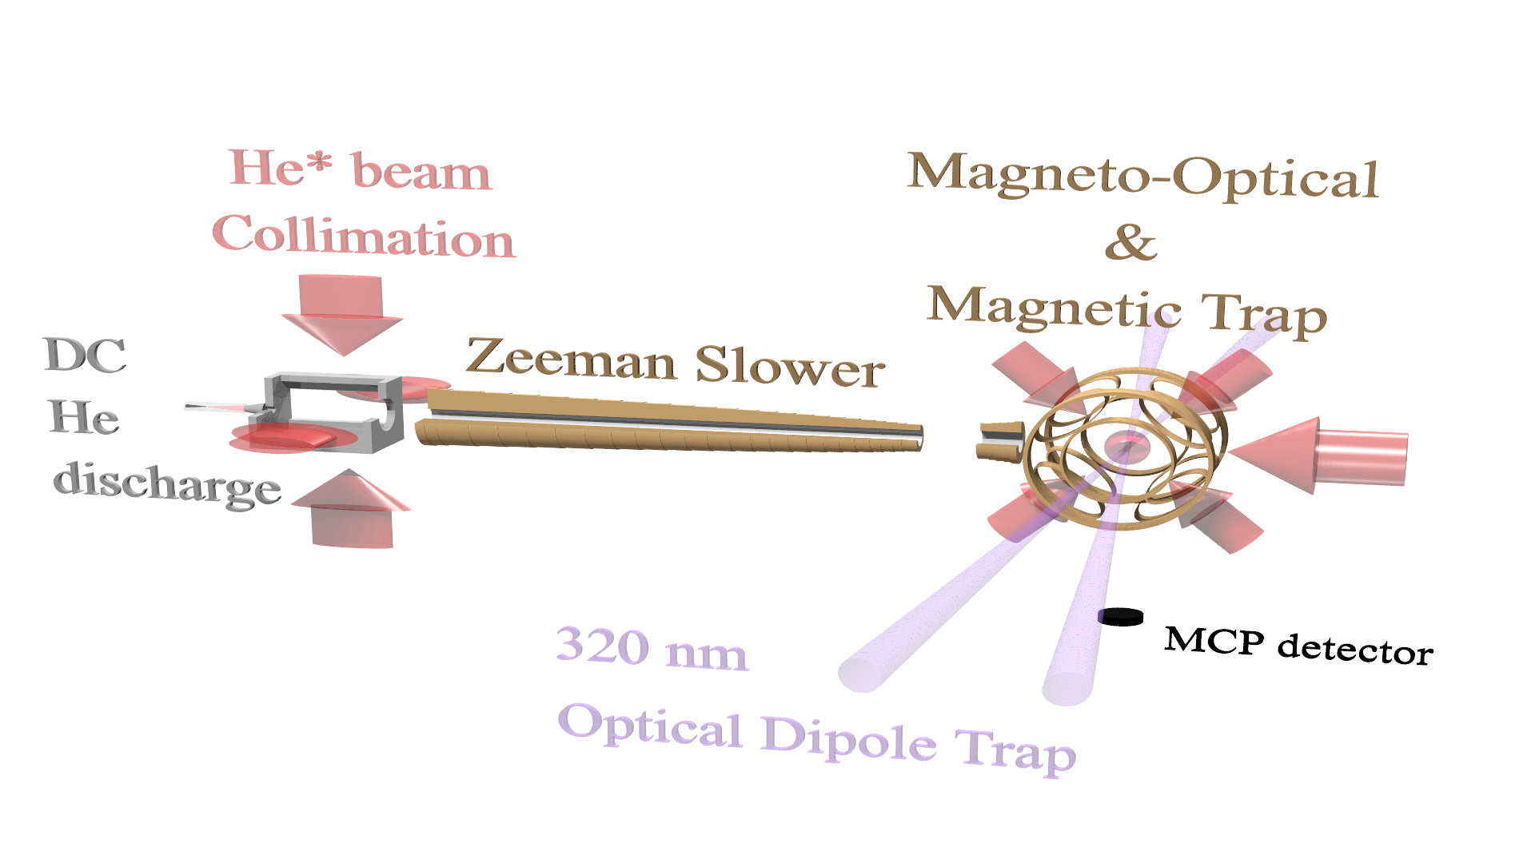
Making quantum degenerate He*
10

Slide 11
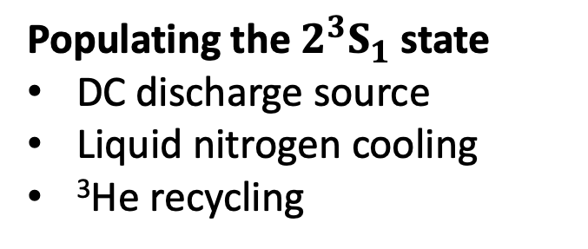



Making quantum degenerate He*
Populating the $2^{3}S_{1}$ state
DC discharge source
Liquid nitrogen cooling
³He recycling
$$2^{3}P_{2}$$
1083 nm
$$2^{3}S_{1}$$
20 eV
$$1^{1}S_{0}$$
11

Slide 12
Initial trapping of He* and cooling to degeneracy
Further steps
Laser cooling/collimation 1083 nm
12

Slide 13
Initial trapping of He* and cooling to degeneracy
Further steps
Laser cooling/collimation 1083 nm
Zeeman slower: detuning compensated with magnetic field
13

Slide 14
Initial trapping of He* and cooling to degeneracy
Further steps
Laser cooling/collimation 1083 nm
Zeeman slower: detuning compensated with magnetic field
Magneto-optical trap: 0.5 mK
Magnetic trapping
Penning ionization:
He* + He* → He + He⁺ + e⁻
14

Slide 15
Initial trapping of He* and cooling to degeneracy
Further steps
Laser cooling/collimation 1083 nm
Zeeman slower: detuning compensated with magnetic field
Magneto-optical trap: 0.5 mK
Magnetic trapping
Suppression Penning ionization
by spin polarization: max |m_{J}|
Level energy
m_{J}=+1
Penning ionization:
He* + He* → He + He⁺ + e⁻
⁴He 2 ³S₁
J=1
m_{J}=0
m_{J}=−1
B magnetic field
15

Slide 16
Initial trapping of He* and cooling to degeneracy
Further steps
Laser cooling/collimation 1083 nm
Zeeman slower: detuning compensated with magnetic field
Magneto-optical trap: 0.5 mK
Magnetic trapping
Suppression Penning ionization
by spin polarization: max |m_{J}|
1-D Doppler to 120 μK
Level energy
m_{J}=+1
Penning ionization:
He* + He* → He + He⁺ + e⁻
⁴He 2 ³S₁
J=1
m_{J}=0
m_{J}=−1
B magnetic field
16

Slide 17
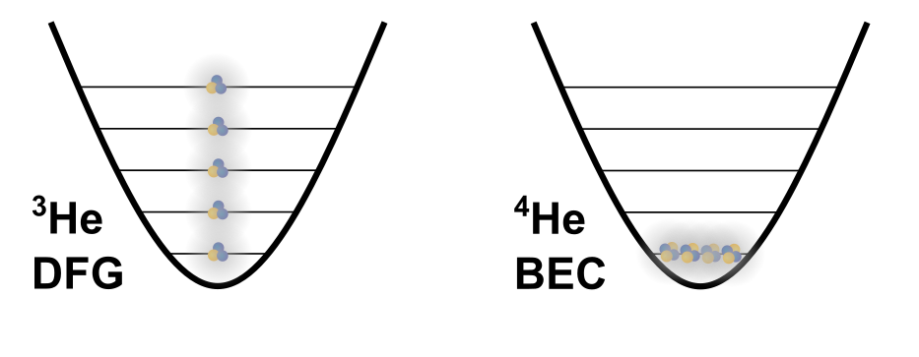
Fermions and Bosons: very different behaviour
Evaporative cooling to quantum degeneracy
⁴He collides, re-thermalizes
and forms a Bose condensate
³He does not collide at μK temperatures;
only S-wave collisions, which is forbidden
for fermions. Solution mix ³He and ⁴He
Level energy
m_{J}=+1
⁴He 2 ³S₁
J=1
m_{J}=0
m_{J}=−1
B magnetic field
³He and ⁴He in a trapping potential
17

Slide 18
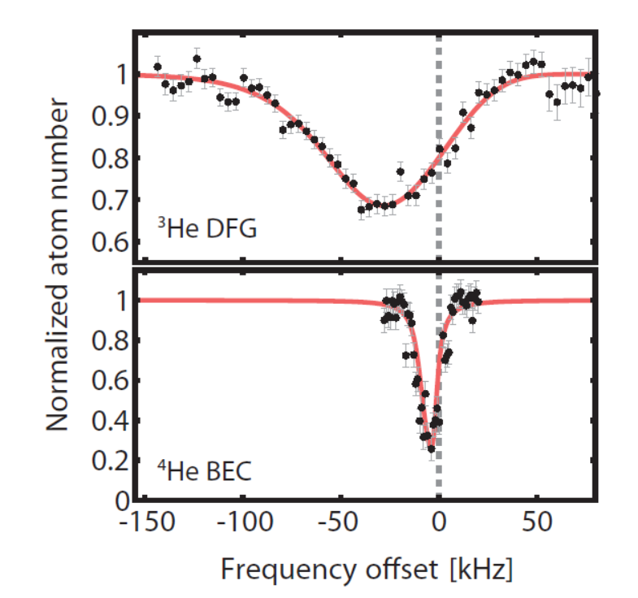

Fermions and Bosons: very different spectroscopy
Trapped bosonic ⁴He: all atoms in ground state
No Doppler, but ’mean field’ shift & broadening
Trapped fermionic ³He: Fermi-Dirac distribution
  Many motional states in the trap occupied
  Doppler broadening ($T_{F}∼1 μK$)
From 2016:
Spectroscopy 2 ¹S - 2 ³S @ 1557 nm
in a 1557.3 nm dipole trap
PRL 117, 213001 (2016)
⁴He in a trapping potential
18

Slide 19

Fermions and Bosons: very different spectroscopy
Trapped bosonic ⁴He: all atoms in ground state
No Doppler, but ’mean field’ shift & broadening
Trapped fermionic ³He: Fermi-Dirac distribution
  Many motional states in the trap occupied
  Doppler broadening ($T_{F}∼1 μK$)
From 2016:
Spectroscopy 2 ¹S - 2 ³S @ 1557 nm
in a 1557.3 nm dipole trap
PRL 117, 213001 (2016)
³He and ⁴He in a trapping potential
19

Slide 20
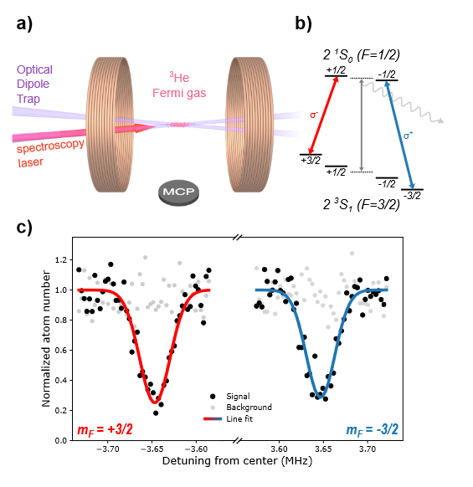
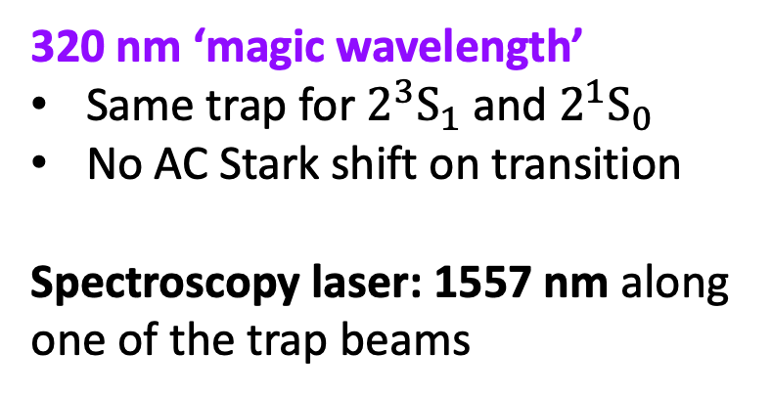
Magnetic substates and dipole trap: ³He
Cancel magnetic field influence:
switch between opposite m states
Required: magnetic state independent trapping
Solution: optical dipole trap
³He
320 nm ‘magic wavelength’
Same trap for $2^{3}S_{1}$ and $2^{1}S_{0}$
No AC Stark shift on transition
Spectroscopy laser: 1557 nm along one of the trap beams
20

Slide 21
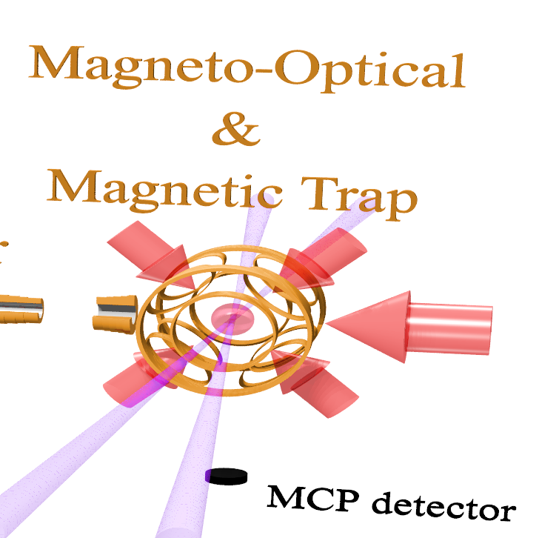
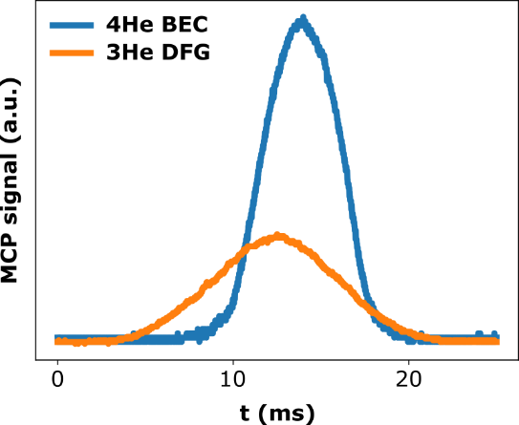
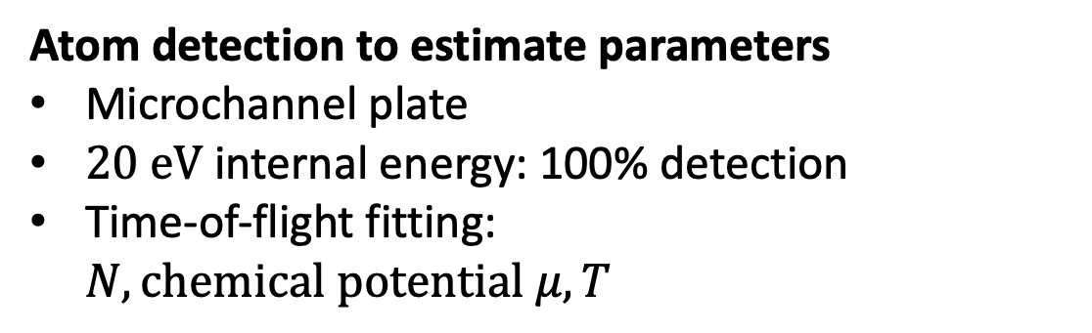
Detection and trapping parameters
Atom detection to estimate parameters
Microchannel plate
$20 eV$ internal energy: 100% detection
Time-of-flight fitting:
$N,chemical potential μ,T$
21

Slide 22
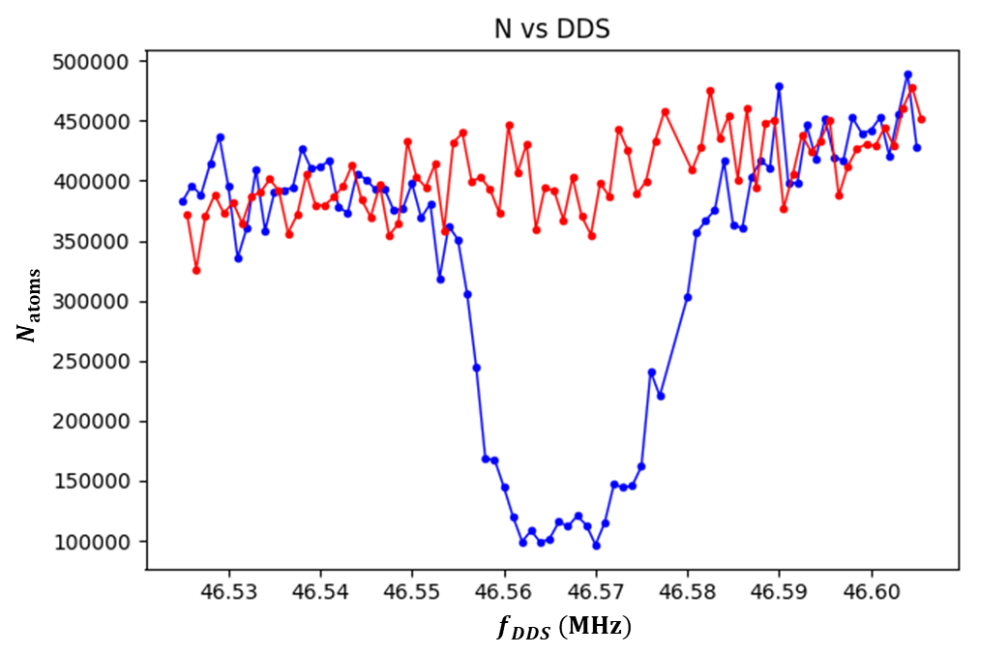
Detection and measuring the spectrum for ³He
Atom detection to estimate parameters
Microchannel plate
$20 eV$ internal energy: 100% detection
Time-of-flight fitting:
$N,chemical potential μ,T$
³He: measuring the 2 ³S₁ – 2 ¹S₀ at 1557 nm
Sample preparation
Set laser, 3s exposure
Signal: measure remaining atoms
Alternate with background shots
22

Slide 23
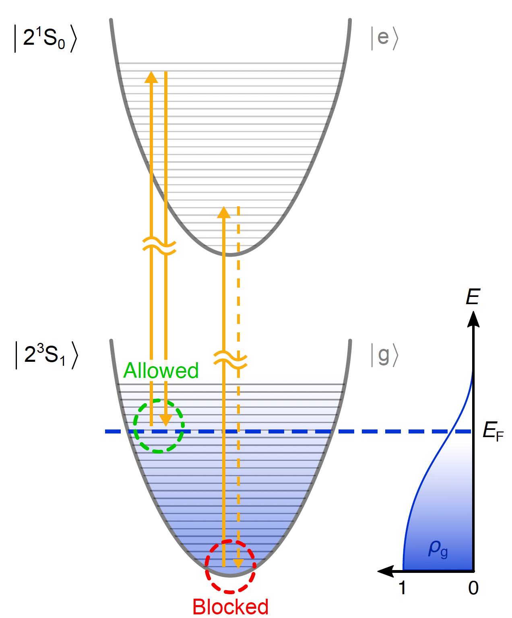
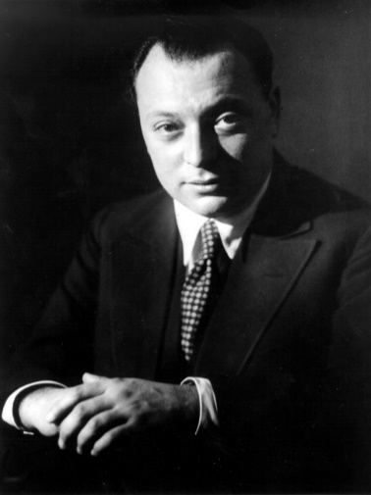
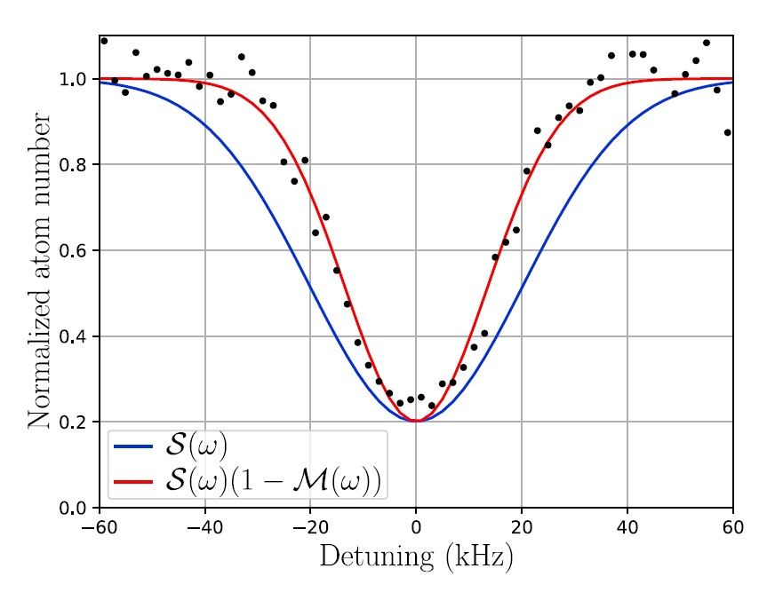
³He quantum effect: Pauli blocking
Pauli-blocking of stimulated emission
R. Jannin et al., Nat. Comm. 13, 6479 (2022)
Modeling by
Raphaël Jannin
W. Pauli
— Doppler
— Pauli
3 papers for spontaneous emission all in same issue of Science 374 (2021):
A. Deb et al. on page 972, Margalit et al. on page 976, and Sanner et al. on page 979,
23

Slide 24
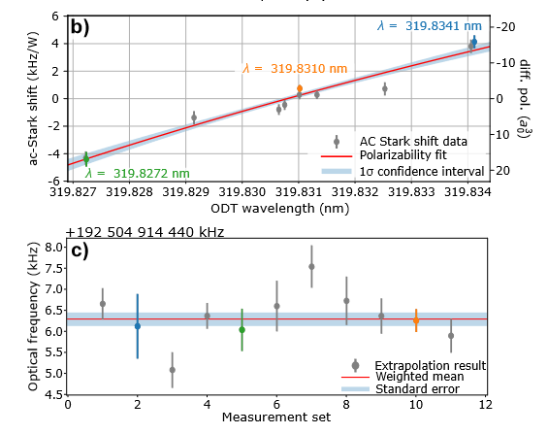
³He spectroscopy result and δr² determination
Frequency comb calibration
Locking to <2Hz ultra-stable laser (1542 nm)
Standard commercial Cs clock reference + GPS
³He 2 ³S₁ – 2 ¹S₀ frequency with 170 Hz accuracy:
192 504 914 418.96(17)kHz (10x better)
Before corrections
24

Slide 25
³He spectroscopy result and δr² determination
Frequency comb calibration
Locking to <2Hz ultra-stable laser (1542 nm)
Standard commercial Cs clock reference + GPS
³He 2 ³S₁ – 2 ¹S₀ frequency with 170 Hz accuracy:
192 504 914 418.96(17)kHz (10x better)
⁴He previous measurement (200 Hz accuracy):
R. Rengelink et al., Nat. Phys. 14, 1132 (2018)
Theory:
K. Pachucki et al., PRA 95, 062510 (2017)
Before corrections
25

Slide 26
³He spectroscopy result and δr² determination
Frequency comb calibration
Locking to <2Hz ultra-stable laser (1542 nm)
Standard commercial Cs clock reference + GPS
³He 2 ³S₁ – 2 ¹S₀ frequency with 170 Hz accuracy:
192 504 914 418.96(17)kHz (10x better)
⁴He previous measurement:
R. Rengelink et al., Nat. Phys. 14, 1132 (2018)
Theory:
K. Pachucki et al., PRA 95, 062510 (2017)
Before corrections
Resulting δr² = r²_{h} − r²_{α} calculated in 2023:
1.0757(12)_{exp}(9)_{theo} fm²
26

Slide 27
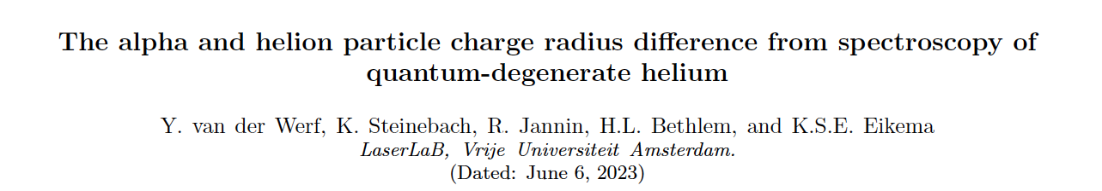
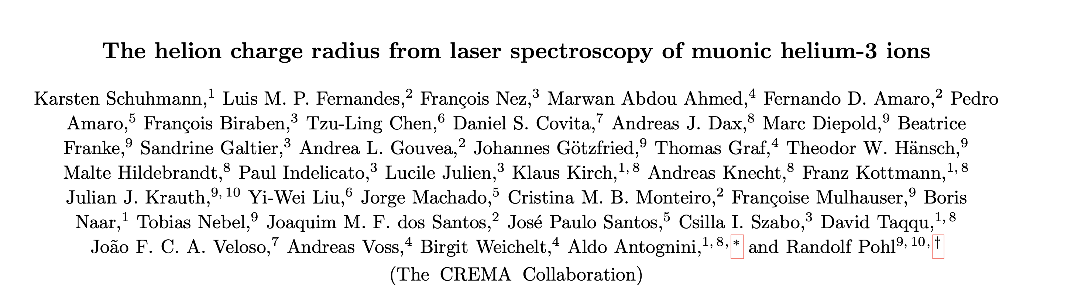
Alpha and helion charge radius² measurements
Submitted 2023 to Science & arXiv
Amsterdam
³He
arXiv: 2305.02333v1
CREMA
μ³He⁺
arXiv: 2305.11679v2
27

Slide 28
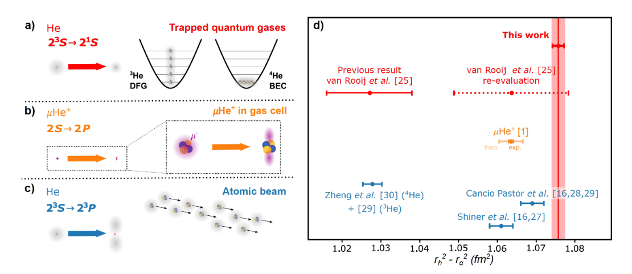
Helion-alpha particle charge radius² difference
Situation 2023
2011
CREMA
28

Slide 29
3.6σ difference?
3.6 σ difference
Situation 2023
2011
CREMA
29

Slide 30
Inspiring to improve theory
Improved theory nuclear structure confirmed discrepancy: (sumitted January 2024)
S. Salvatore Li Muli, Thomas R. Richardson, Sonia Bacca, Phys. Rev. Lett. 134, 032502 (2025)
New calculation of hyperfine effect in ³He, 14 September 2024 on arXiv
Xiao-Qiu Qi et al., Phys. Rev. Research 7, L022020 (2025)
Correction −1.37 kHz, leading to r²_{h} − r²_{α} = 1.0693(12)_{exp}(9)_{theo} fm².
Full second-order hyperfine calculation:
K. Pachucki et al., Phys. Rev. A 110, 062806 (2024), published 9 December 2024
Correction −1.77 kHz, leading to r²_{h} − r²_{α} = 1.0678(12)_{exp}(7)_{theo} fm² (combined error 0.014 fm²)
Based on Pachucki et al. 2024, our measurement of r²_{h} − r²_{α} agreed within 1.2σ with the value of CREMA
VU: ³He*: Y. van der Werf et al., Science 388, 850-853 (2025).
CREMA: μ³He⁺: K. Schumann et al., Science 388, 854-858 (2025): r²_{h} − r²_{α} = 1.0636(6)_{exp}(30)_{theo} fm².
30

Slide 31
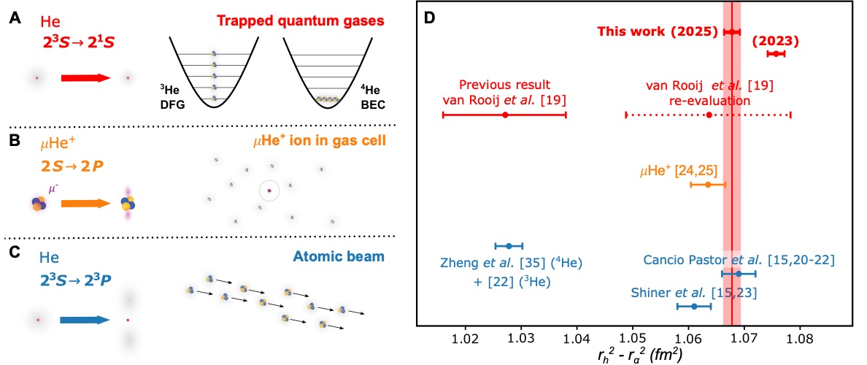
Helion-alpha particle charge radius² difference
VU: ³He*: Y. van der Werf et al., Science 388, 850-853 (2025).
CREMA: μ³He⁺: K. Schumann et al., Science 388, 854-858 (2025).
Agreement with μHe⁺ within 1.2 σ
31

Slide 32
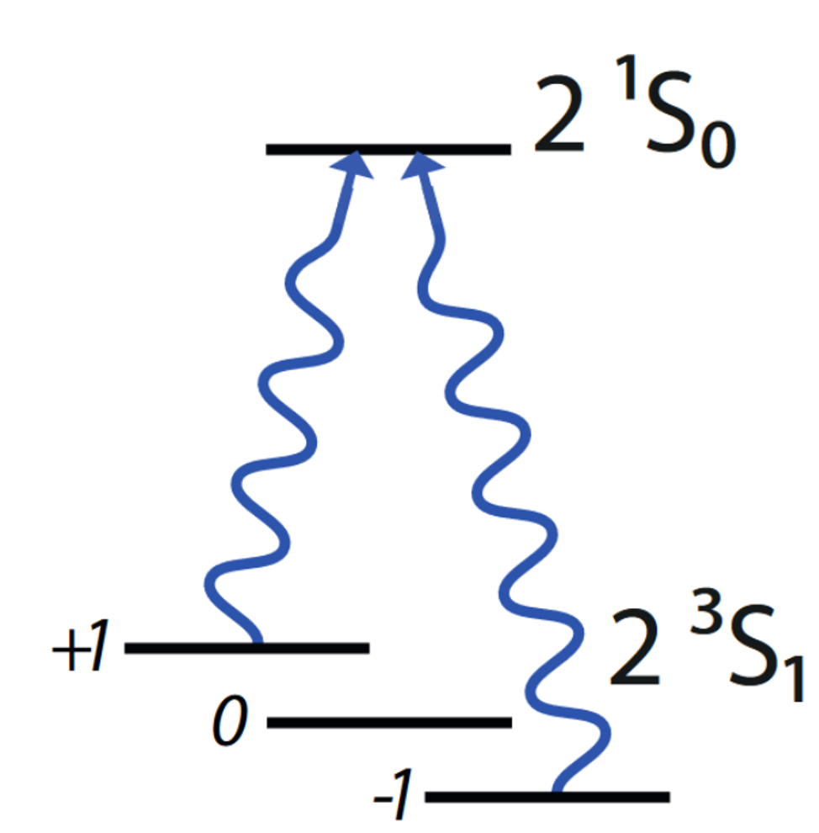
New ⁴He results
Improvements for ⁴He:
1. Signal detection: ions from Penning ionization
2. Time-to-digital detection of He ion signal
3. Reduced linewidth of 2 kHz
Increased stability of the ODT,
removed AC-magnetic field sources
Laser linewidth from few kHz to 300 Hz
4. Measurement cycle faster by factor 5
5. Link to H-maser VSL via White Rabbit link
6. Stabilization of magnetic field
Previous jumps of 2-3mG; now stabilized to 100 μG
⁴He
Kees Steinebach
32

Slide 33

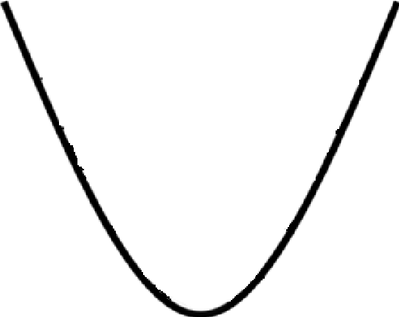
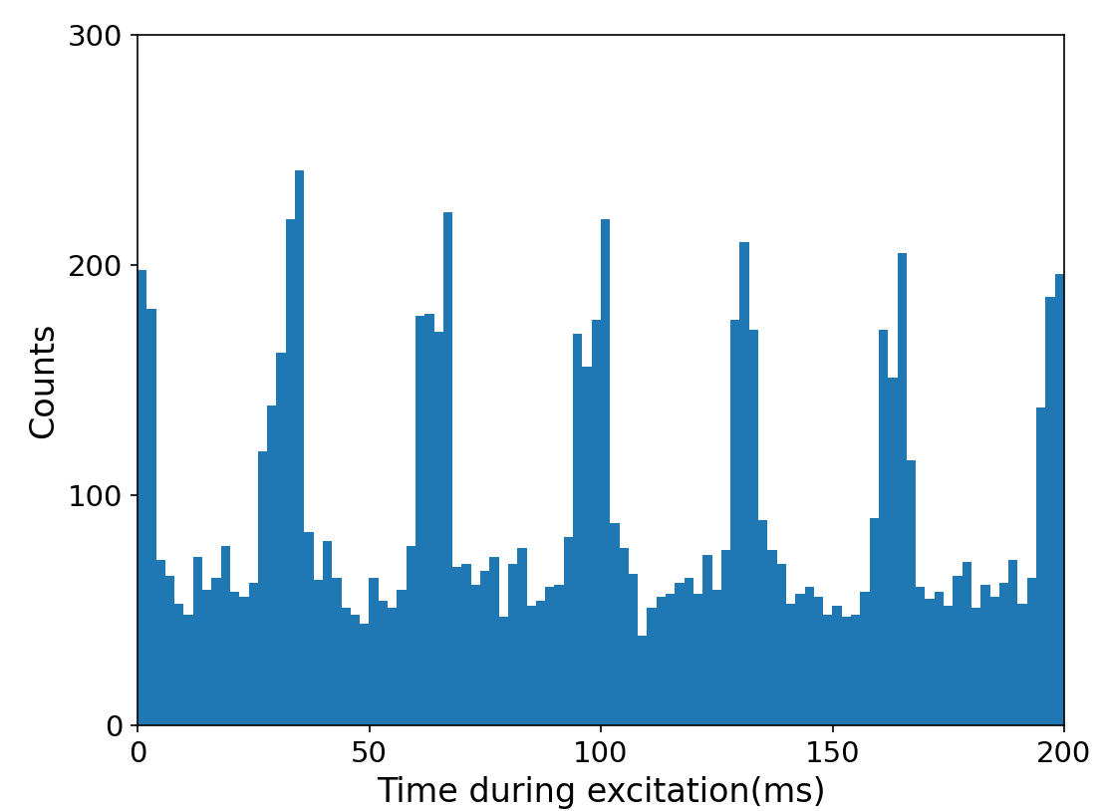
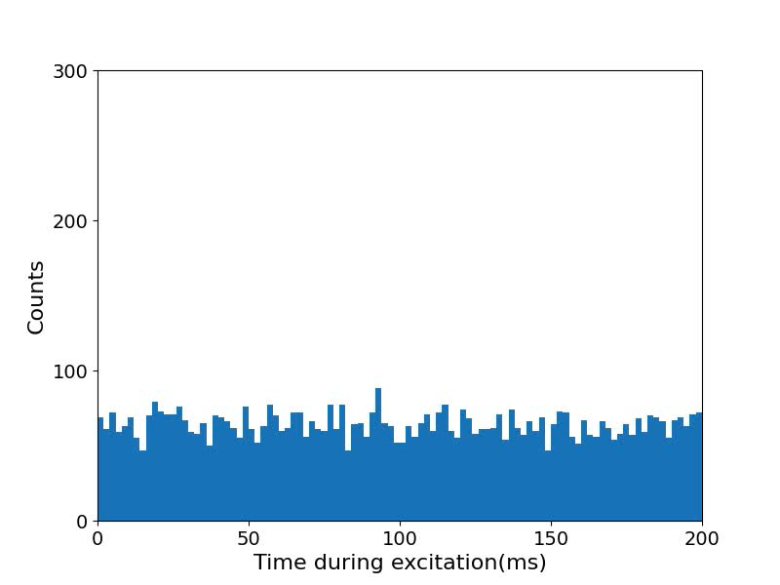
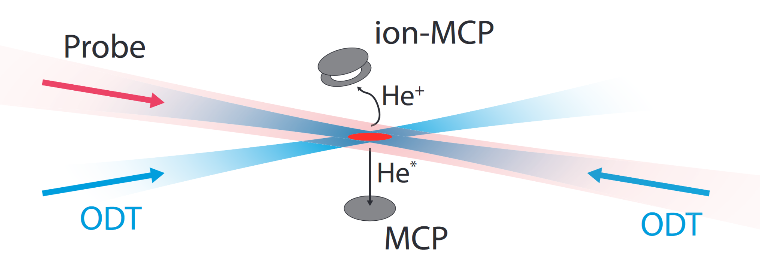
Trap oscillations visible by TDC detection for ⁴He
BEC
Time to digital converter
Spectro Laser
Discriminator
33

Slide 34
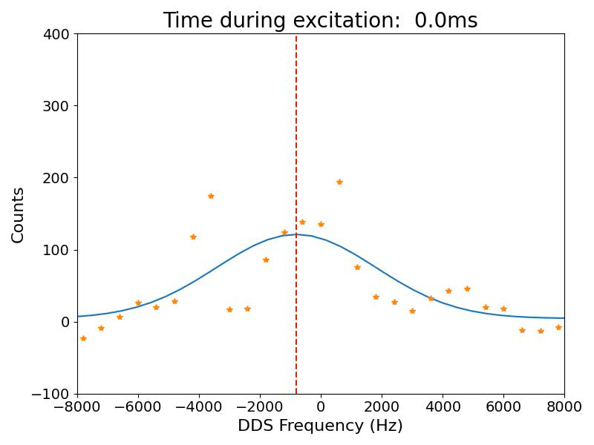
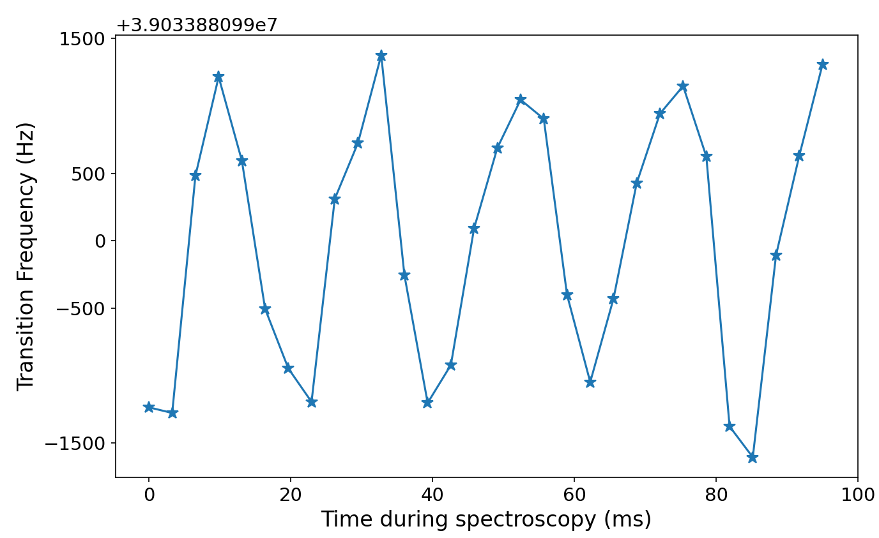
Systematic movement could give systematic error
Transition frequency
v= 2mm/s
∆x = 7µm
Oscillations have a well-defined phase with respect to the experimental sequence:
For ³He, the spectroscopy time was of 3s >> oscillation time: negligible shift
For ⁴He, the spectroscopy time < 100 ms: could lead to systematic shift
34

Slide 35
Suppression of Doppler effect in two stages
Step 1: Choose spectroscopy time to be equal to trap oscillation period
Requires stable trap frequencies over a
measurement day (~16 hours)
→ Rebuilt ODT for more stability and control
→ Excitation through the symmetry axis
→ Active stabilization and control of the UV
ODT power (0.1mW, 0.3%)
→ Motion reduction: temporary ODT depth
lowering
35

Slide 36
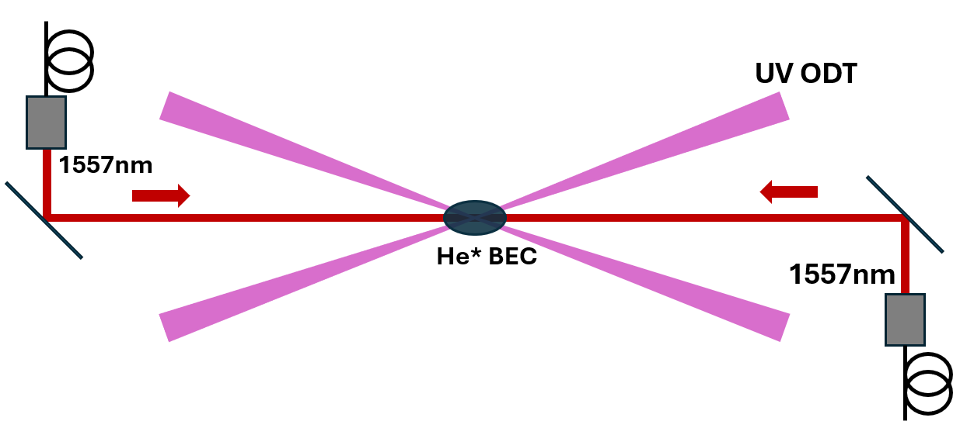
Suppression of Doppler effect in two stages
Step 2: Measure from opposite sides
Excitation measured for each side
separately (after each other)
Oscillation period varies
due to drifting ODT laser alignment
Measure over a 1 full oscillation for each side
and afterwards combine the measurements.
36

Slide 37
Suppression of Doppler effect in two stages
Step 2: Measure from opposite sides
Left excitation
Right excitation
37

Slide 38
Suppression of Doppler effect in two stages
Step 2: Measure from opposite sides
Left excitation
Right excitation
Left-right difference is 9(53) Hz
38

Slide 39
Varying other parameters: ⁴He collective fit
We vary chemical potential, spectroscopy laser power & ODT power.
We measure 2x2 spectra:
m_{j}=+1 and m_{j}=-1 → take average to cancel magnetic field.
Spectro laser from left side and right & full-period average to suppress residual Doppler
39

Slide 40
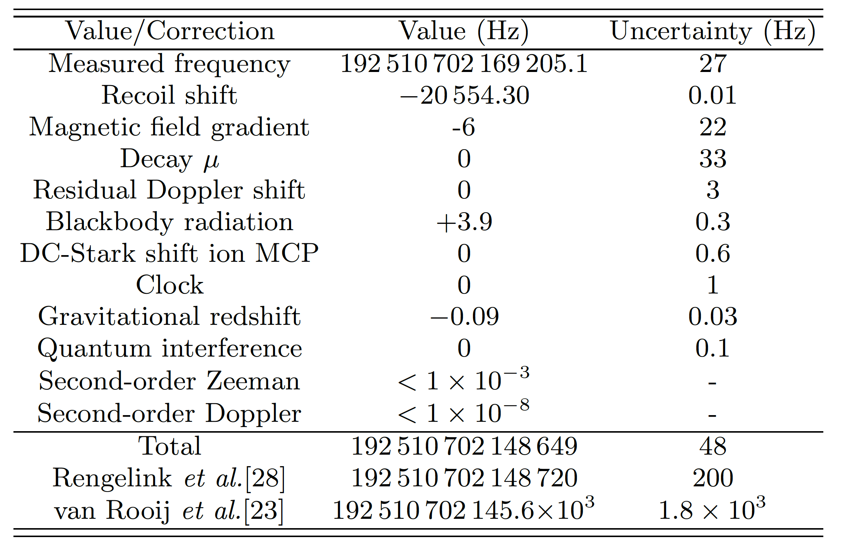
Spectroscopy results ⁴He
2 ³S₁ – 2 ¹S₀ transition of ⁴He
Paper accepted:
Steinebach et al., PRL 2026

Slide 41
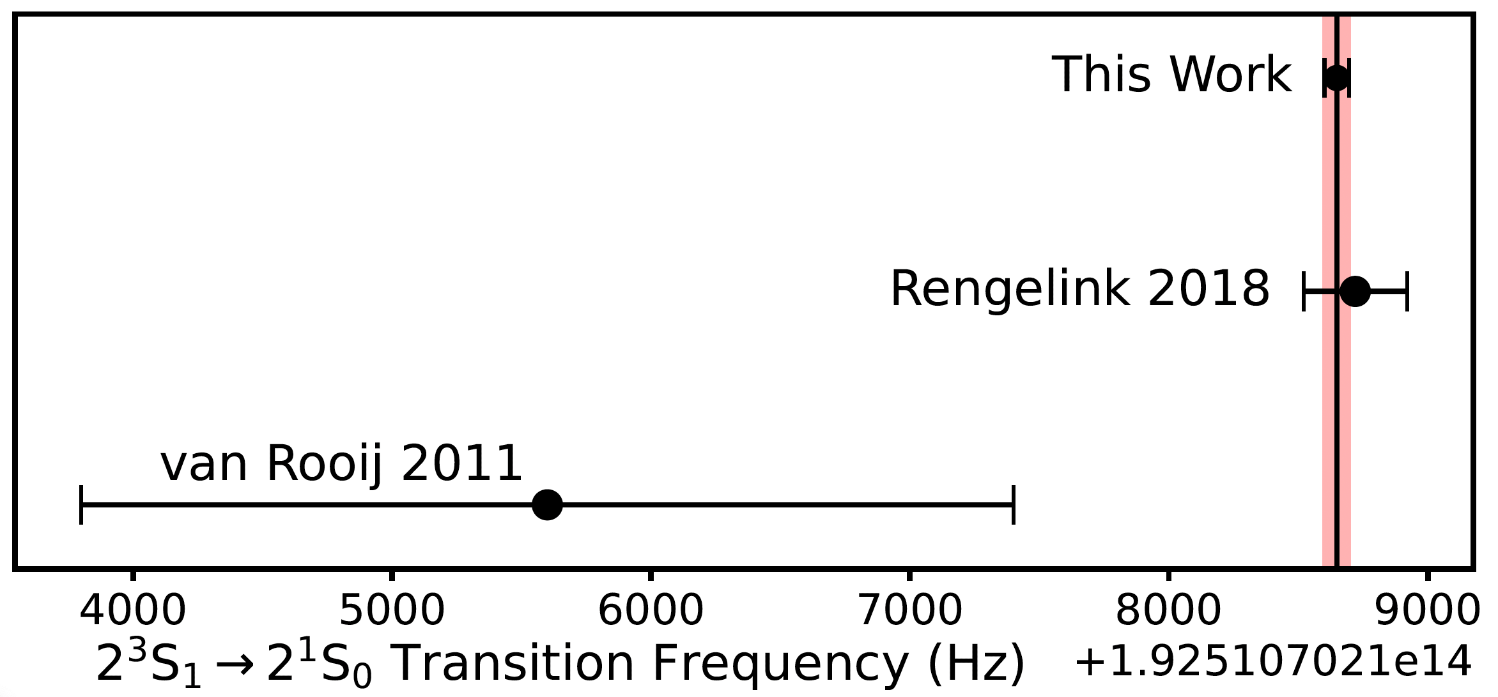
Spectroscopy results ⁴He
Magic wavelength:
319.81602(4) nm
2 ³S₁ – 2 ¹S₀ transition in ⁴He
48 Hz: 4x better than before
4 times better than before
41

Slide 42
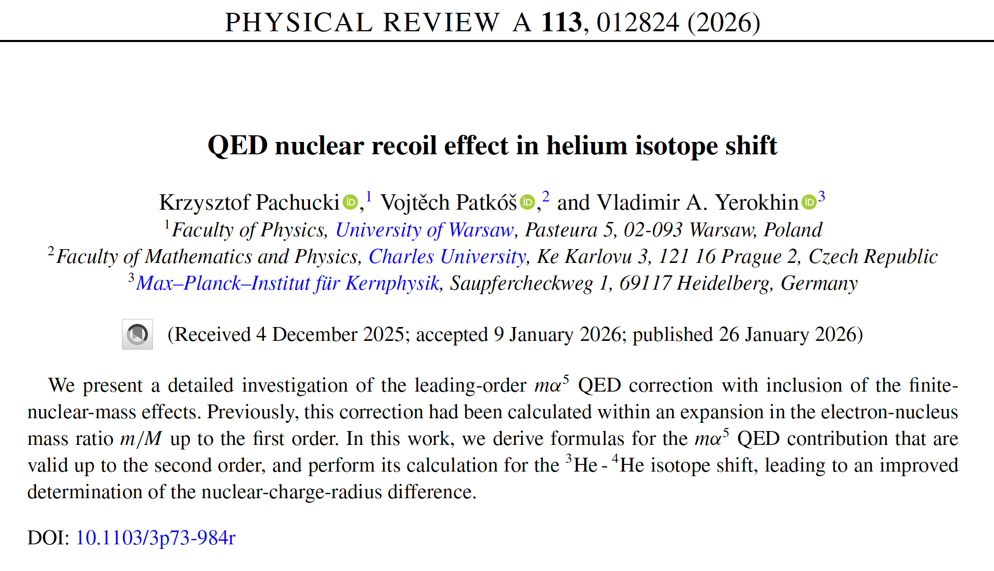
Latest theory evaluation helium isotope shift

Slide 43
Overview h-α radius² difference determinations
This work
δr² = r²_{h} – r²_{α} = 1.0676(10) fm²
~1.4x better than previous
2026
Agreement with CREMA μHe⁺
confirmed at 1.2σ
combined uncertainy
Also agreement with ETH (F. Merkt)
based on ^{3,4}He 2 ³S₁
ionization potental difference
43

Slide 44
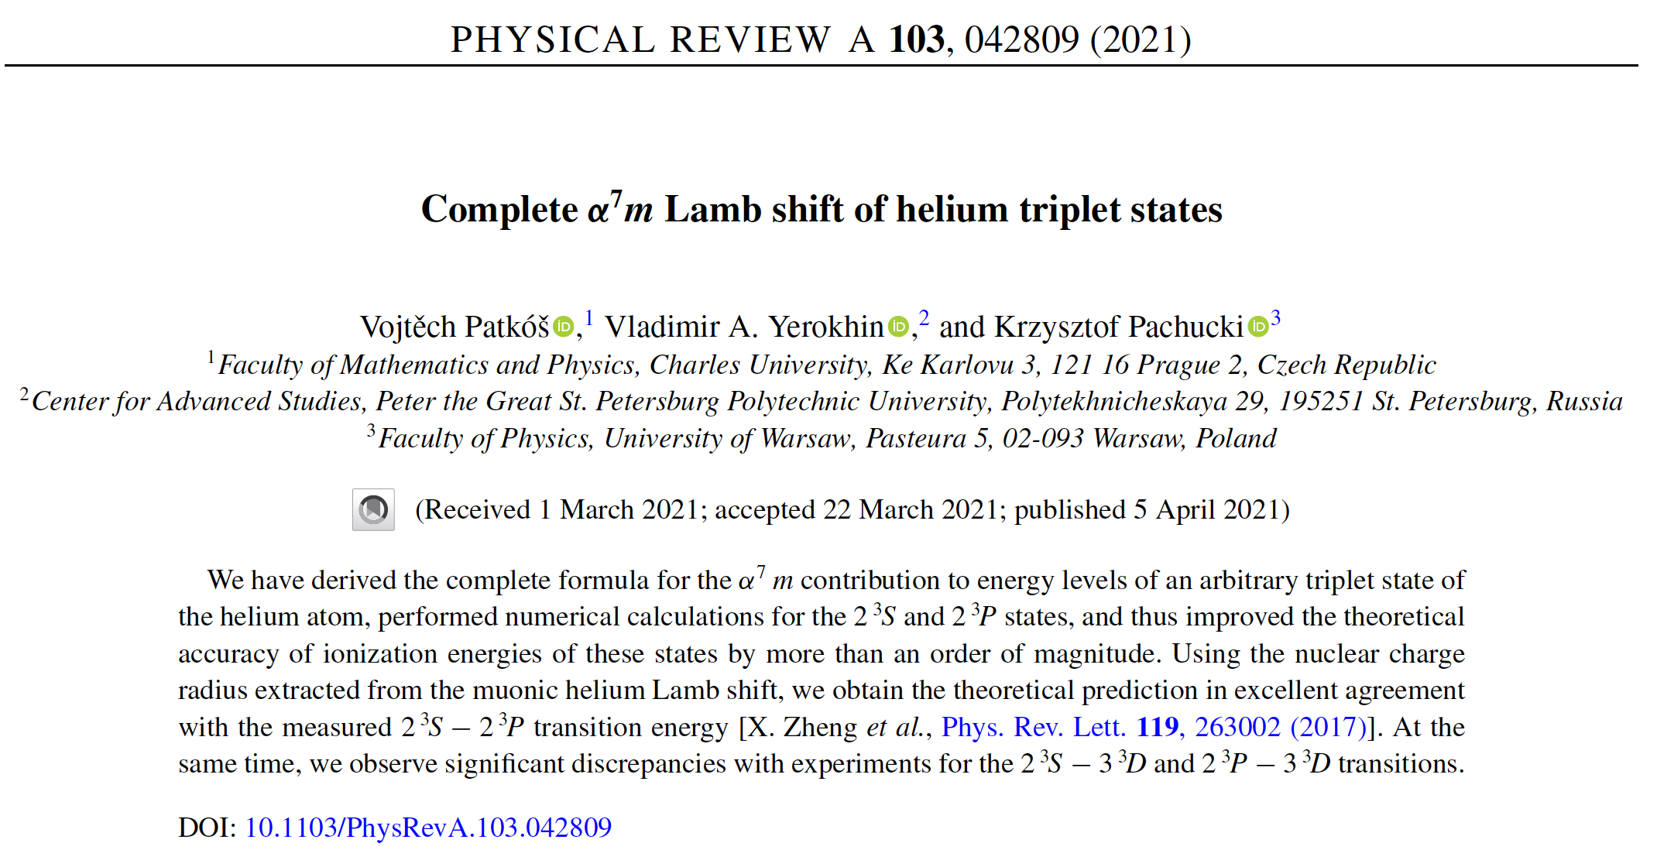
Ionization potential conundrum vs isotope shift

Slide 45
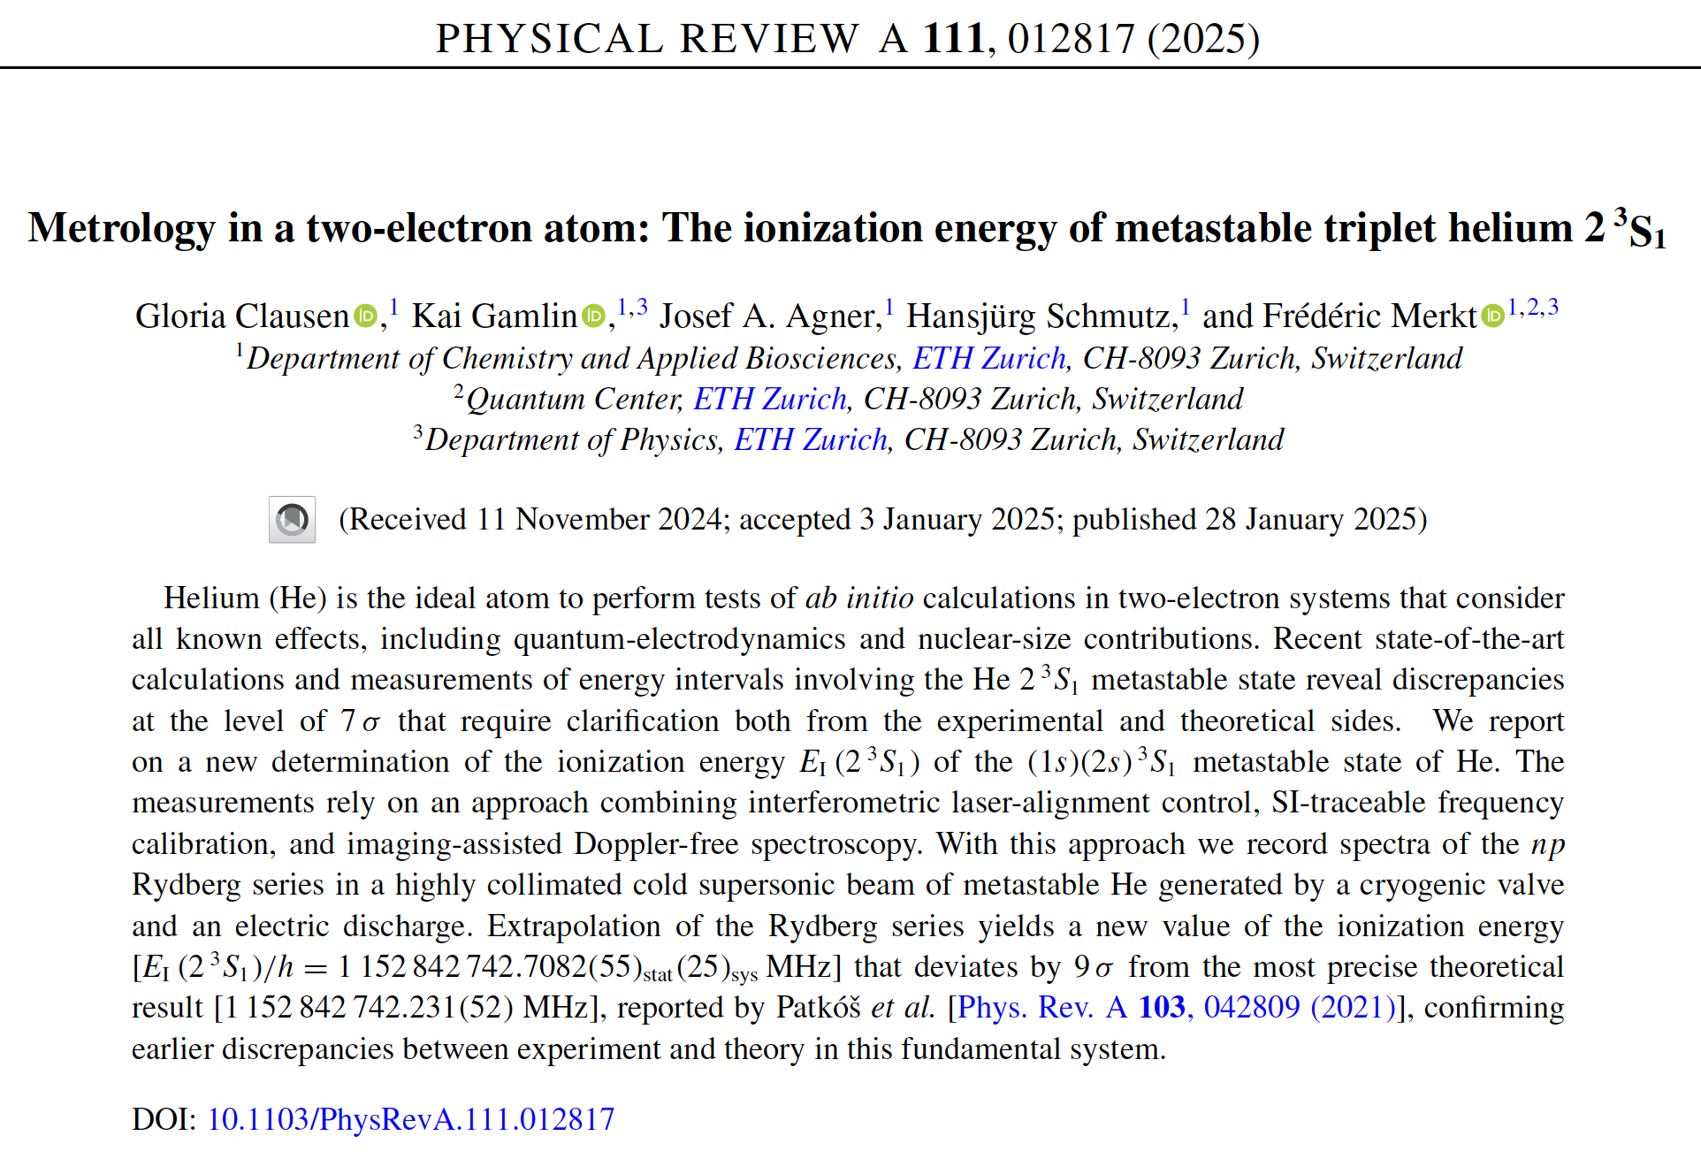
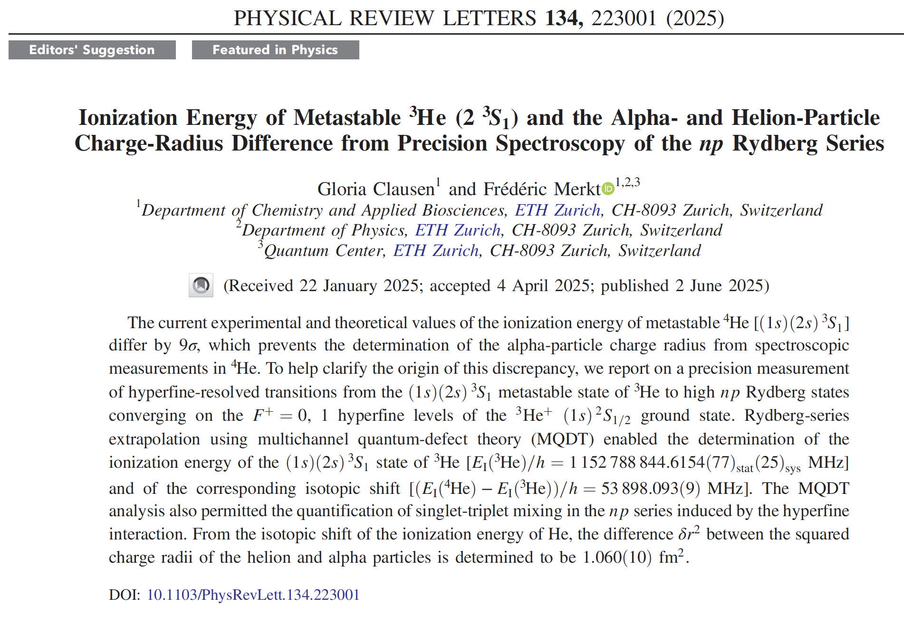
Ionization potential conundrum … vs isotope shift
⁴He
³He
Ionization potential ⁴He 2³S₁ shows 9σ deviation
with theory of Patkos et al. PRA 103, 042809 (2021)
But δr² is in agreement with others!

Slide 46
Outlook for He and He⁺
Goal: nuclear charge radius² difference
between ³He and ⁴He
³He
⁴He
170 Hz (10⁻¹²)
48 Hz (3*10⁻¹³)
Isotope measurement on the
doubly-forbidden 2 ³S – 2 ¹S transition at 1557 nm
Required: ultra-cold ³He and ⁴He
& trapping in magic wavelength trap
46

Slide 47
Outlook for He and He⁺
Goal: nuclear charge radius² difference
between ³He and ⁴He
³He
⁴He
170 Hz (10⁻¹²)
48 Hz (3*10⁻¹³)
Improve ³He also to 50 Hz
Then accuracy δr² improves by factor ~1.6 (up to 3)
How:
- Laser-ionization detection instead of loss of atoms
- Active hydrogen maser (VSL) calibration via WR
47

Slide 48
Outlook for He and He⁺
Goal: nuclear charge radius² difference
between ³He and ⁴He
Goal: absolute nuclear charge radius of ⁴He⁺,
or test of QED or Rydberg constant
³He
⁴He
⁴He⁺
170 Hz (10⁻¹²)
48 Hz (3*10⁻¹³)
target 1 kHz (10⁻¹³)
Improve ³He also to 50 Hz
Then accuracy δr² improves by factor ~1.6 (up to 3)
How:
- Laser-ionization detection instead of loss of atoms
- Active hydrogen maser (VSL) calibration via WR
48

Slide 49
Outlook for He and He⁺
Goal: nuclear charge radius² difference
between ³He and ⁴He
Goal: absolute nuclear charge radius of ⁴He⁺,
or test of QED or Rydberg constant
³He
⁴He
⁴He⁺
170 Hz (10⁻¹²)
48 Hz (3*10⁻¹³)
target 1 kHz (10⁻¹³)
Improve ³He also to 50 Hz
Then accuracy δr² improves by factor ~1.6 (up to 3)
How:
- Laser-ionization detection instead of loss of atoms
- Active hydrogen maser (VSL) calibration via WR
Do first Ramsey-comb spectroscopy 1S-2S He⁺
Initial aim for accuracy 10 kHz, later 1 kHz
How:
- Implement new idea; disclosed in the future …
- Install the ion trap, and finally do it!
49

Slide 50
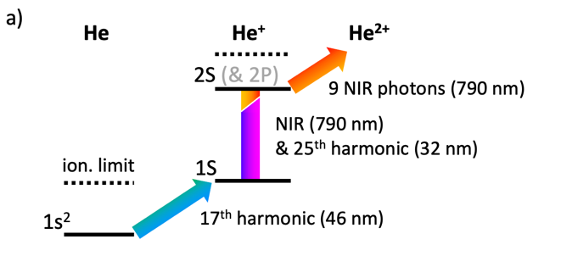
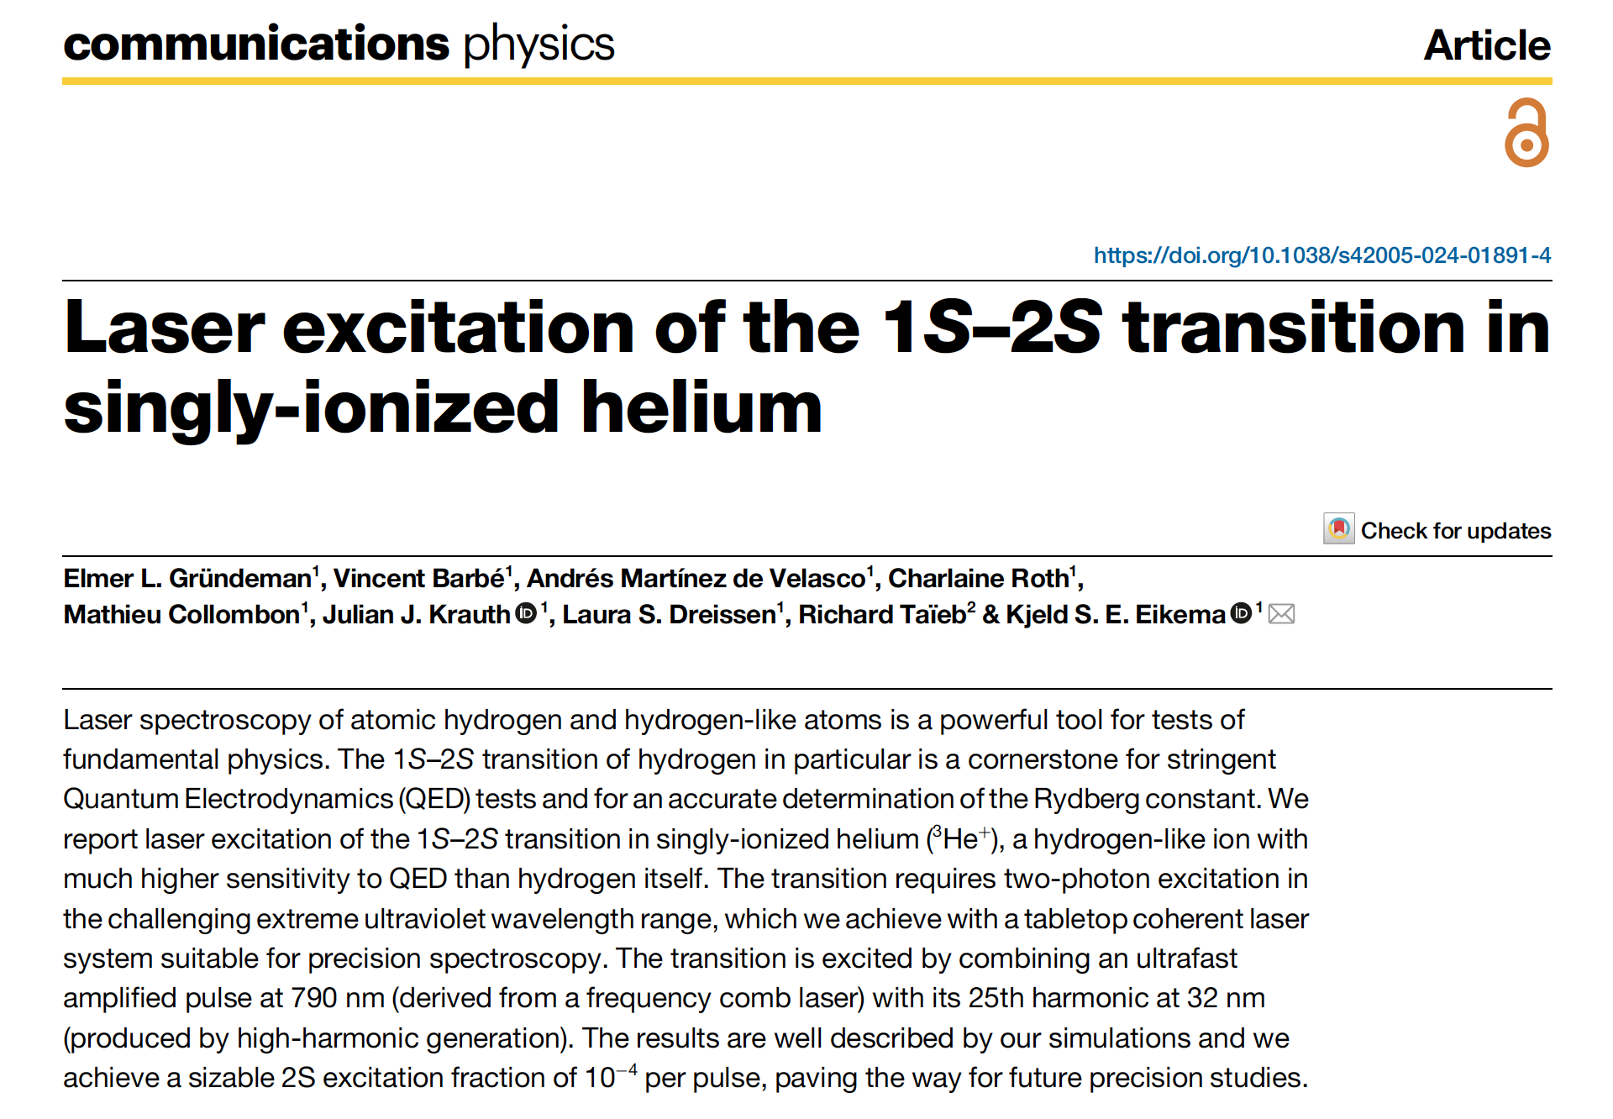
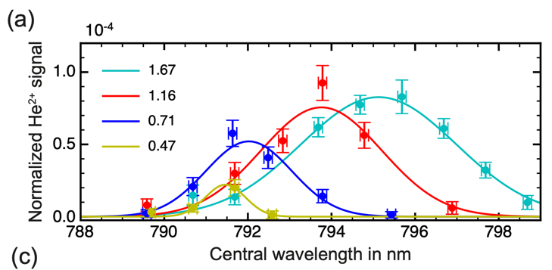
1S-2S excitation in He⁺
Comm. Phys. 7, 414 (2024)
Wavelengths based on HHG of 790 nm
1S-2S excitation in He⁺
10¹⁴ W/cm²
NIR
50

Slide 51
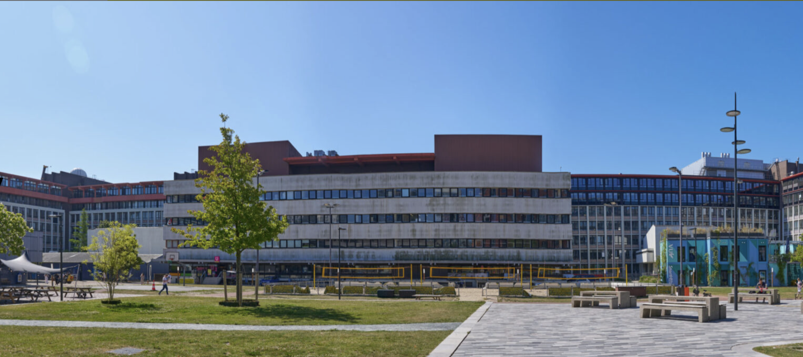
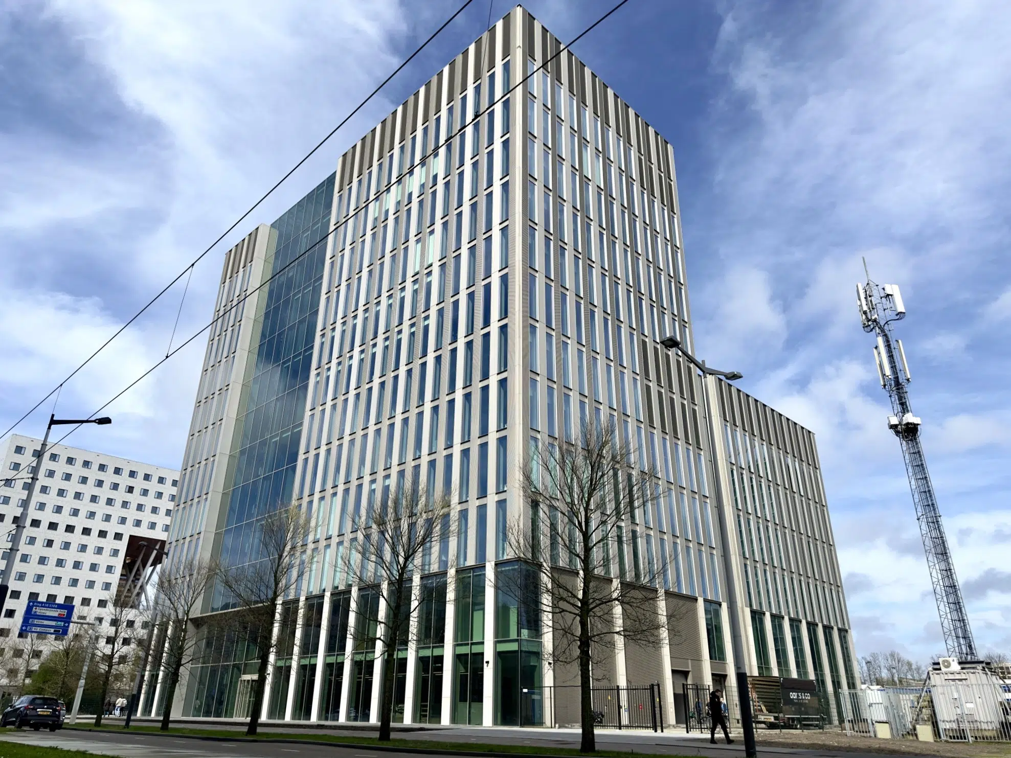
New research building in 2025 - the move
The old “W&N” building
The new Research Building
Early 2025
51

Slide 52
New research building in 2025 - the move
The old “W&N” building
The new Research Building
Early 2025
52

Slide 53

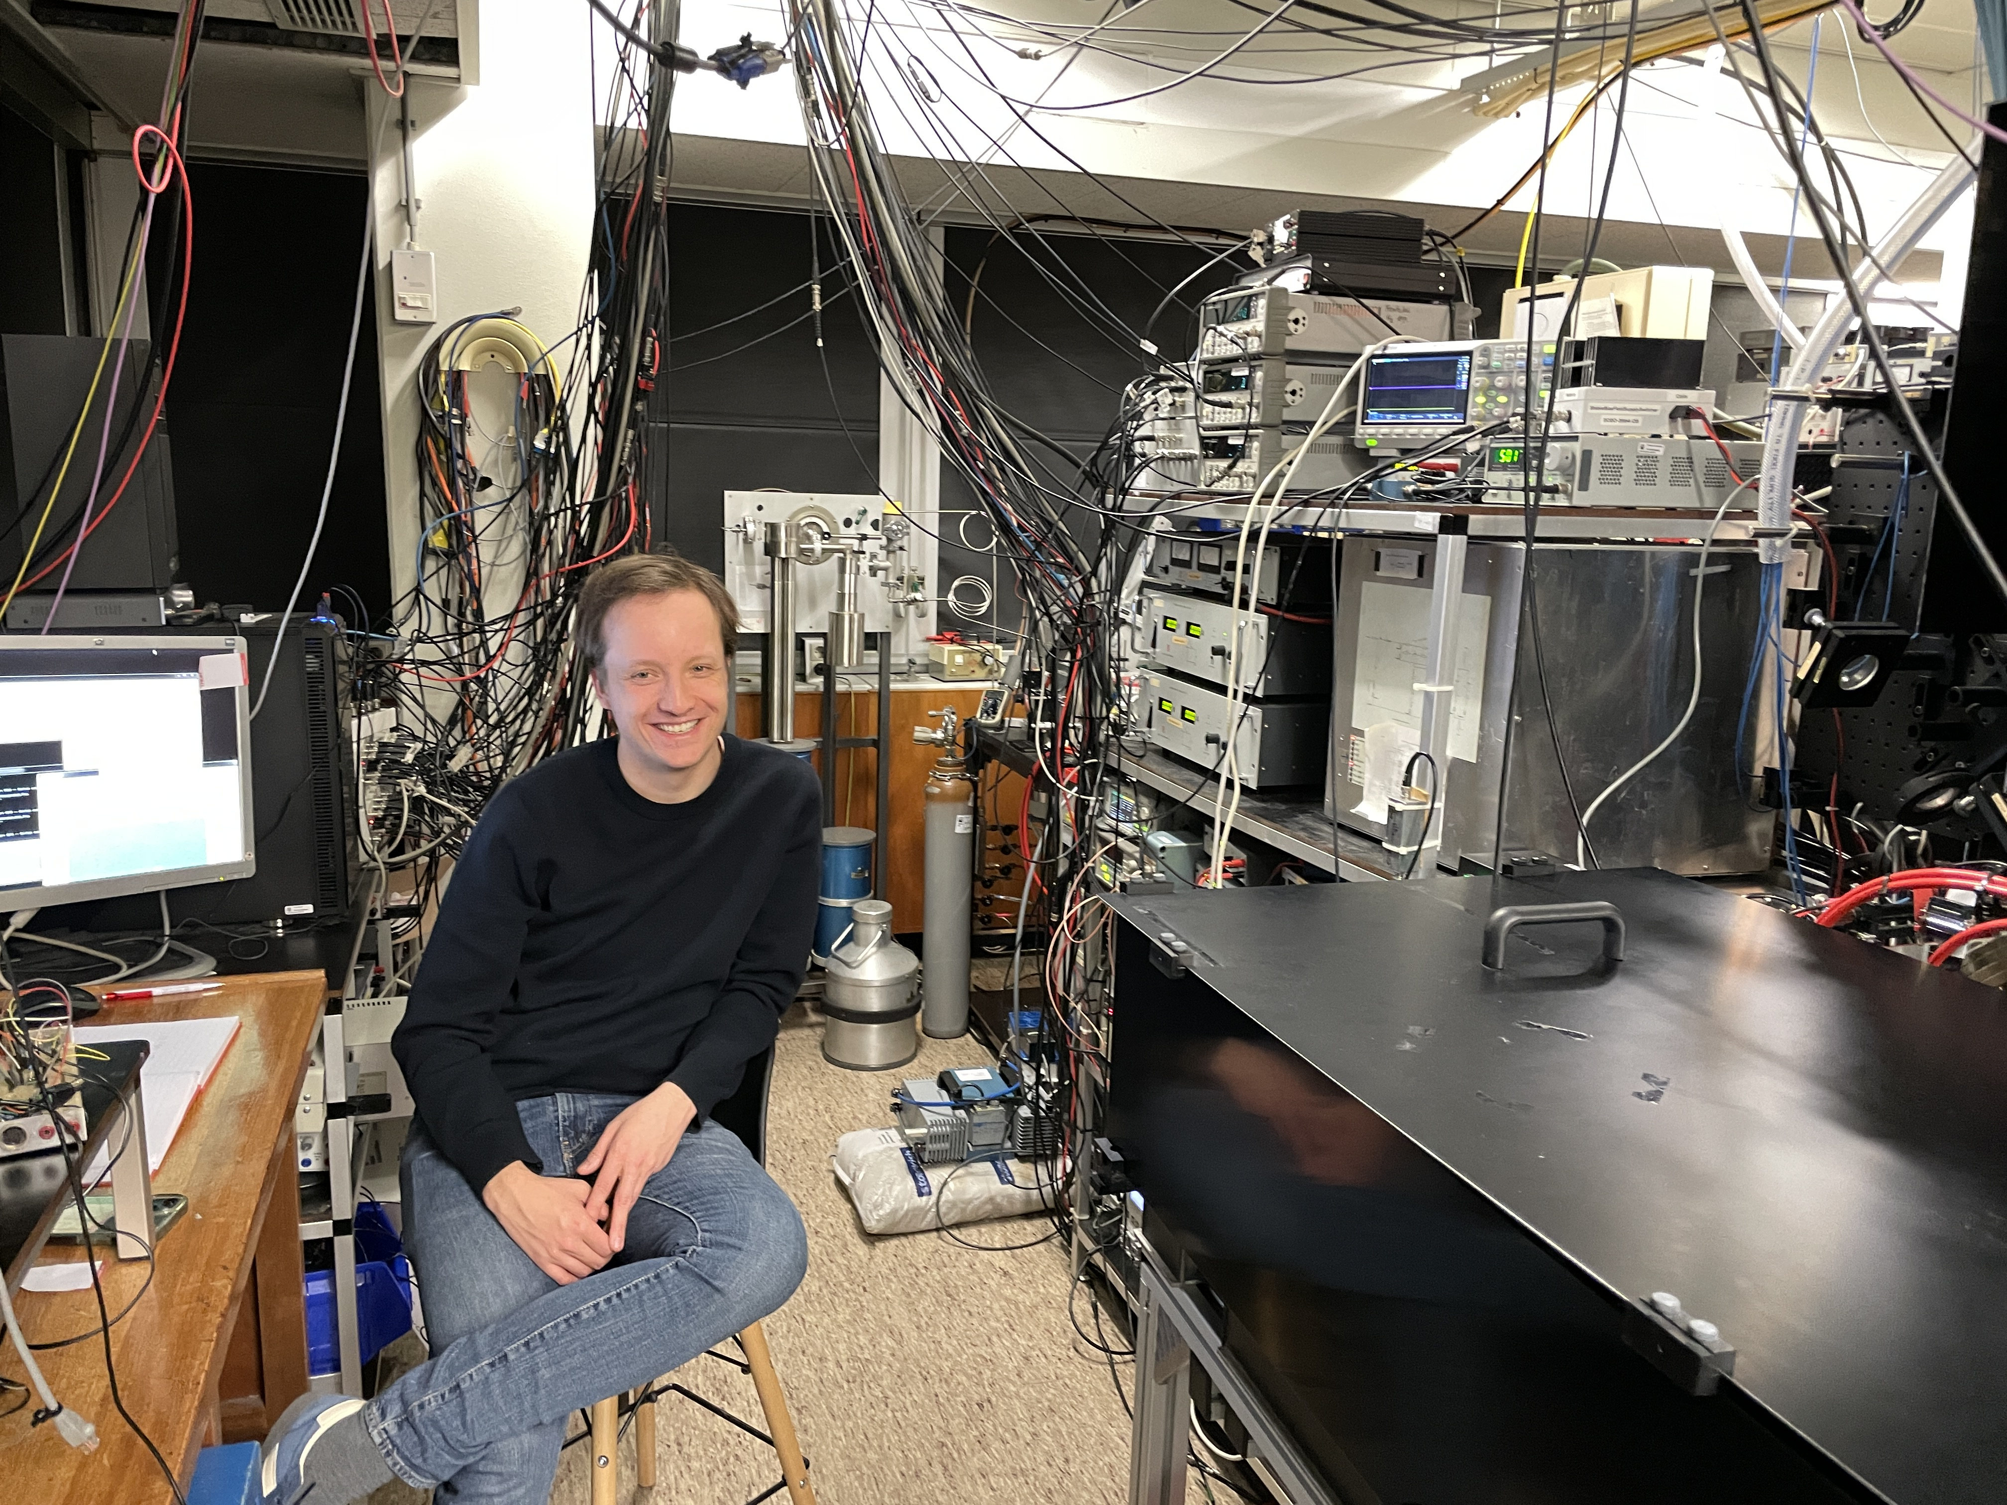
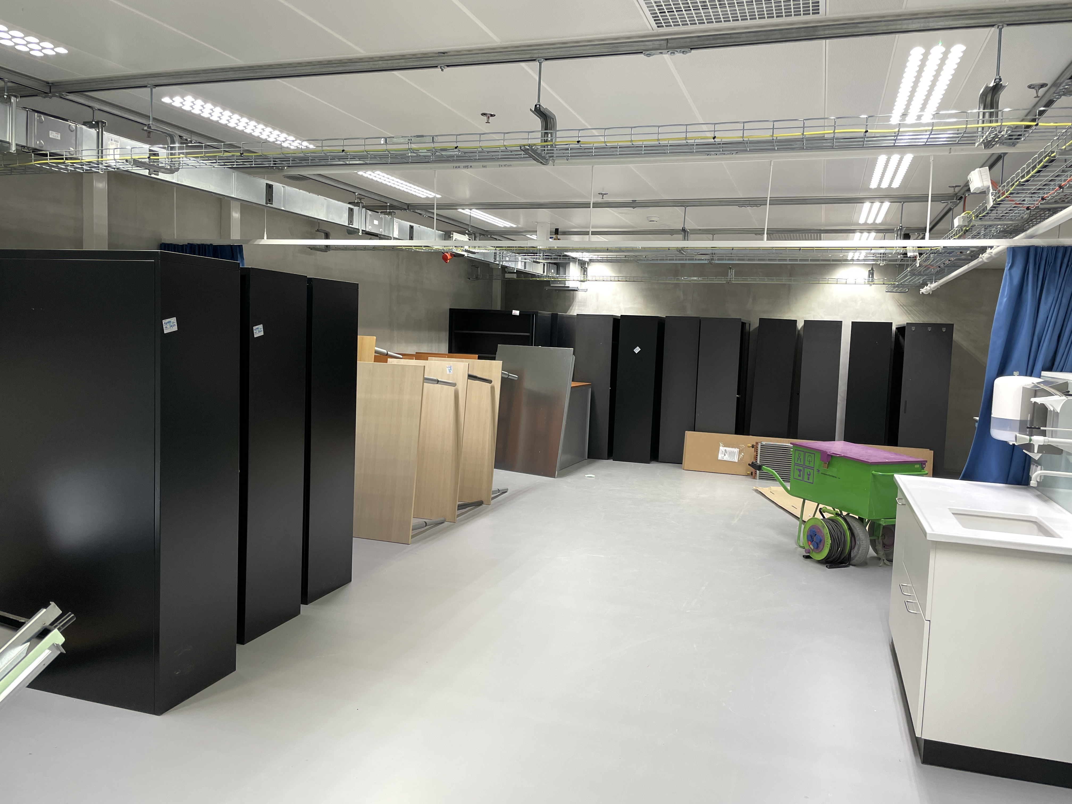
Before and after
The old “W&N” building
The new Research Building
The helium experiment with Kees Steinebach
And the new lab initially …
The move
53

Slide 54


Past year: rebuilding everything again
Repairing leak in the He setup a month ago,
With Kees and Joanne (technician)
The nearly-working He experiment right now…
54

Slide 55



Still (re)building after 1.5 years, He⁺ setup
He⁺ ion trap mounting
and chamber
with Alejandra Dias (PhD)
He+ / Be+ laser cooling:
Ruth Zwemer (MSc student)
& Kees Steinebach
2 of 3 optical tables of the He⁺ setup (10 m long)
55

Slide 56
Summary
The 2 ³S₁ – 2 ¹S₀ transition in ³He and ⁴He measured with record accuracy of
170 Hz and 48 Hz respectively
Most accurate r²_{h} − r²_{α} determination, initial 3.6σ difference with μHe⁺ resolved in 2024
improved ³He 2025: r²_{h} − r²_{α} = 1.0678(14) fm² 1.2σ agreeement – Science paper
improved ⁴He 2026: r²_{h} − r²_{α} = 1.0676(10) fm² still 1.2σ agreeement – PRL accepted
Agreement is special: broad range of physics involved
and discrepancy in the ionization potential of excited He!
Next steps:
Improve ³He to <50 Hz: potentially 3x improved r²_{h} − r²_{α}
But then we need improved theory!
Precision Ramsey comb spectroscopy of He⁺ 1S-2S
Kees Steinebach & Haoyuan Li are presenting a poster this evening about r²_{h} − r²_{α}
56

Slide 57
The End

Slide 58

Plan for He⁺ 1S-2S: Ramsey-comb excitation in a trap
2S
2P
790 nm
32 nm
He⁺
He⁺
Be⁺
1S
32 nm +
790 nm
32 nm +
790 nm
58

Slide 59

Possibilities ⁴He⁺ 1S-2S combined with H and μ⁴He⁺
⁴He⁺
2S
2P
With r_{α} from μ⁴He⁺ and
Karshenboim PLB795 (2019)
Yerokin Ann. Phys. 531 (2019)
With r_{α} from μ⁴He⁺
With current R♾ and slightly improved QED
λ = 30 nm
(XUV)
Ry. test at 24 kHz
r_{α} test at 60 kHz
QED test 41 kHz
1S
Experimental target 1S-2S in He⁺ is < 1 kHz
See: Krauth, J.J., Schuhmann, K., Ahmed, M.A. et al. Nature 589, 527–531 (2021)
59

Slide 60



The Ramsey-comb laser → power & precision
Δφ phase measurement
Cs
clock
upconversion & spectroscopy
532 nm
two amplified FC pulses (5mJ)
pulse length fs – ps range
easy wavelength selection
av. phase constant at ~ 1 mrad
phase noise ~50 mrad for BBO,
and 15 mrad expected for LBO
Nat. Phys. 10, 30-33 (2014)
PRA 89, 052510 (2014)
PRL 117, 173201 (2016)
PRL 120, 043204 (2018)
PRL 123, 143001 (2019)
Mol. Phys. Accepted (2023)
LBO-based OPA
60
60

Slide 61

Ramsey-comb spectroscopy – the principle
nano or microsecond delay: N T_{rep}
|e>
}
= ΔE
|g>
2nd
1st
Ramsey fringe recording
Excitation probability
0
Δt = NΔT + δt →

Slide 62
Ramsey-comb spectroscopy – the principle
nano or microsecond delay: N T_{rep}
|e>
}
= ΔE
|g>
2nd
1st
Phase evolution
e^{i 2π ΔE Δt /h}
|e>
Ramsey fringe recording
} A² = p
|g>
2nd
1st
Excitation probability
p
0
Δt = NΔT + δt →

Slide 63
Ramsey-comb spectroscopy – the principle
nano or microsecond delay: N T_{rep}
|e>
}
= ΔE
|g>
Signal ~ 1+ cos (2π f_{trans} Δt + Δφ)
2nd
1st
Phase evolution
e^{i 2π ΔE Δt /h}
|e>
Ramsey fringe recording
} A² = p
|g>
2nd
1st
|e>
|g>
} (2A)² = 4p
Excitation probability
2nd
Δt = NΔT + δt →

Slide 64
Ramsey-comb spectroscopy – the principle
nano or microsecond delay: N T_{rep}
|e>
}
= ΔE
|g>
Signal ~ 1+ cos (2π f_{trans} Δt + Δφ)
2nd
1st
Phase evolution
e^{i 2π ΔE Δt /h}
|e>
Ramsey fringe recording
} A² = p
|g>
4p
2nd
1st
|e>
|g>
} (4A)² = 4p
Excitation probability
2nd
attosecond micro-delay
by adjusting f_{rep}
δt
|e>
|g>
} A² = 0
2nd
Δt = NΔT + δt →

Slide 65

Ramsey-comb spectroscopy – the principle
Transition frequency
Excitation probability after 2 identical pulses*:
tr
τ_{p} = pulse length (square pulses)
Ω_{R} = Rabi frequency (depends on intensity)
b = Rabi frequency with detunig taken into account
Δf = detunig center of pulse spectrum
* see PRA 89, 052510 (2014)

Slide 66
Ramsey-comb spectroscopy – the principle
Transition frequency
Excitation probability after 2 identical pulses*:
tr
τ_{p} = pulse length (square pulses)
Ω_{R} = Rabi frequency (depends on intensity)
b = Rabi frequency with detunig taken into account
Δf = detunig center of pulse spectrum
* see PRA 89, 052510 (2014)

Slide 67
Ramsey-comb spectroscopy – the principle
Transition frequency
Excitation probability after 2 identical pulses*:
tr
τ_{p} = pulse length (square pulses)
Ω_{R} = Rabi frequency (depends on intensity)
b = Rabi frequency with detunig taken into account
Δf = detunig center of pulse spectrum
* see PRA 89, 052510 (2014)

