Slide 1
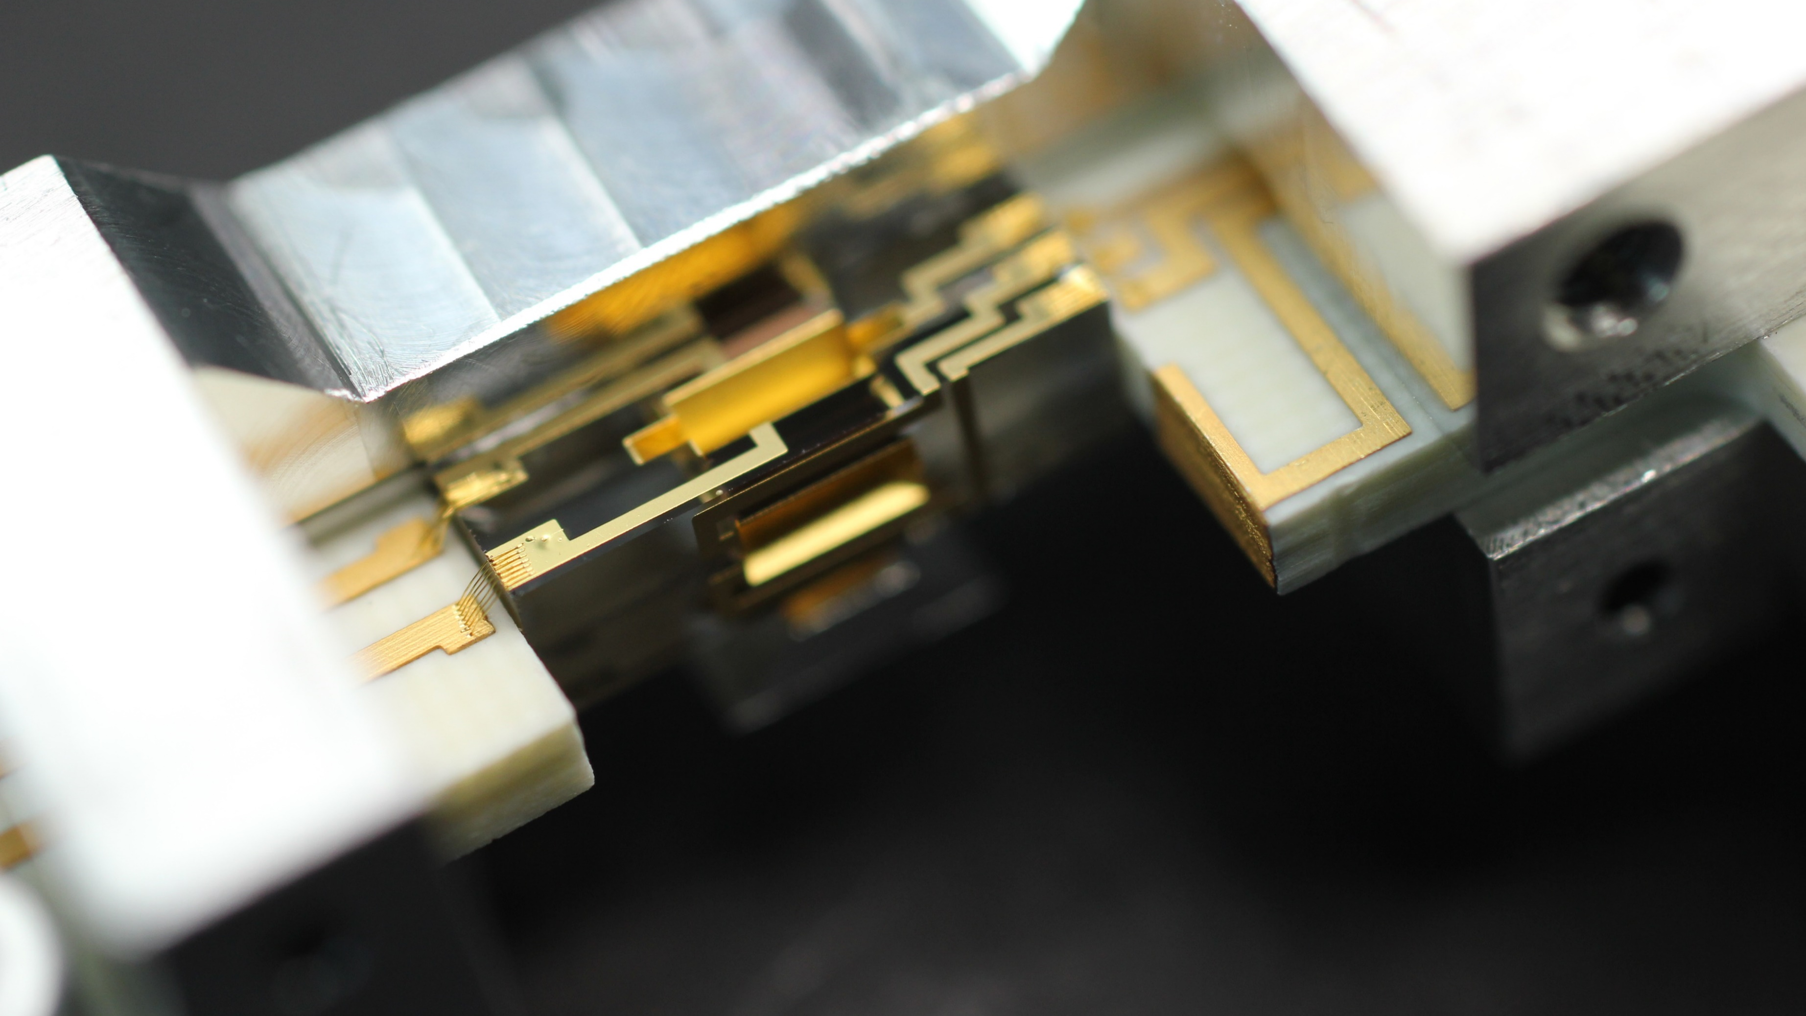
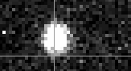

Quantum logic spectroscopy of the hydrogen molecular ion
Be⁺
H₂⁺
F. Schmid, D. Holzapfel, Q. He, H. J. Kim, F. Vouzinas, N. Zischka, N. Schwegler, M. Stadler, A. Ferk, J. P. Home, D. Kienzler
Trapped Ion Quantum Information Group
21.05.2026
PSAS 2026

Slide 2
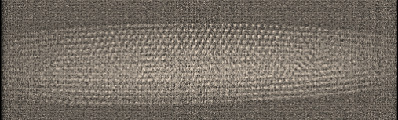
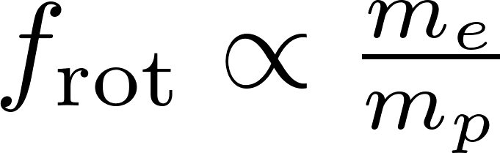
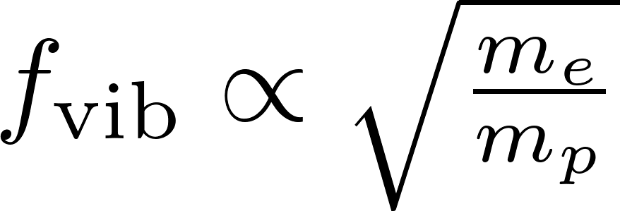
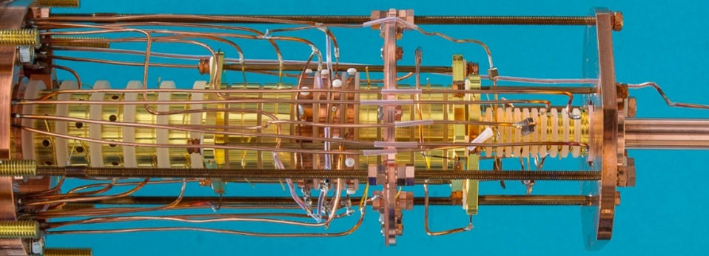

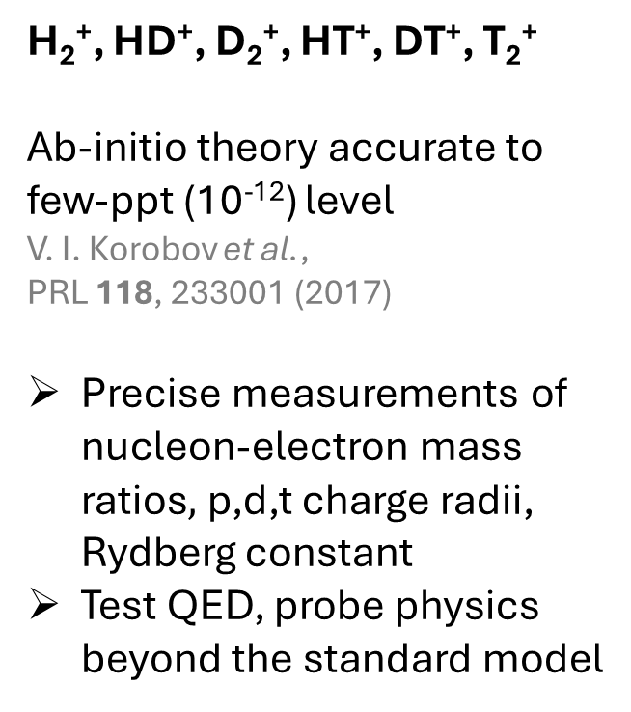
Hydrogen molecular ions
Düsseldorf, Schiller group
H₂⁺, HD⁺, D₂⁺, HT⁺, DT⁺, T₂⁺
Ab-initio theory accurate to few-ppt (10⁻¹²) level
V. I. Korobov et al.,
PRL 118, 233001 (2017)
Precise measurements of nucleon-electron mass ratios$,$p,d,t charge radii, Rydberg constant
Test QED, probe physics beyond the standard model
Ensembles - Paul traps
Düsseldorf, Amsterdam, Paris, Wuhan
Destructive state detection
Single-ion - Penning trap
MPIK Heidelberg + Düsseldorf
Spin orientation detection
Single-ion - Paul trap
ETH Zürich
+
-
+
MPIK, Sturm/Blaum groups
Be⁺
H₂⁺

Slide 3
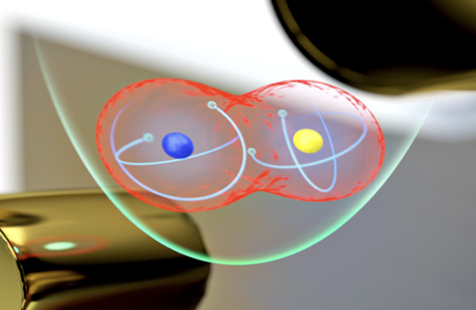
QLS - Quantum logic spectroscopy
H₂⁺
H₂⁺
cannot scatter photons
Single (Paul-)trapped-ion control
Laser cooling
State preparation (optical pumping)
Non-destructive readout
QLS - Quantum logic spectroscopy
Al⁺: P. O. Schmidt et al., Science 309, 749 (2005)
Al⁺: M. C. Marshall et al., PRL 135, 033201 (2025)
Al⁺ clock syst. uncertainty: 5.5 × 10⁻¹⁹
Highly charged ions (PTB, MPIK)
QLS of Molecules
MgH⁺: F. Wolf et al., Nature 530, 457 (2016)
CaH⁺: C.-W. Chou et al., Nature 545, 203 (2017)
N₂⁺: M. Sinhal et al., Science 367, 6483 (2020)
H₂⁺: D. Holzapfel et al., PRX 15, 031009 (2025)
H₂⁺ projected uncertainty with QLS: 10⁻¹⁷
S. Schiller et al., PRL 113, 023004 (2014)
J.-P. Karr et al., J. Phys. Conf. Ser. 723, 012048 (2016)
✗
Be⁺
Mg⁺
Al⁺
S. Burrows/JILA

Slide 4
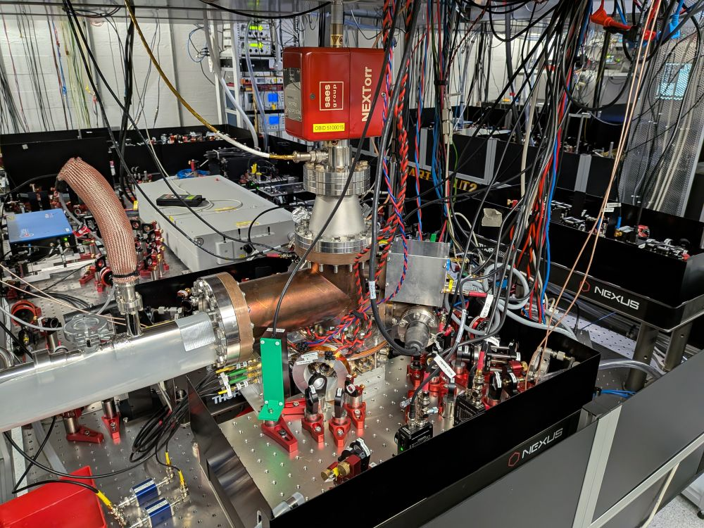
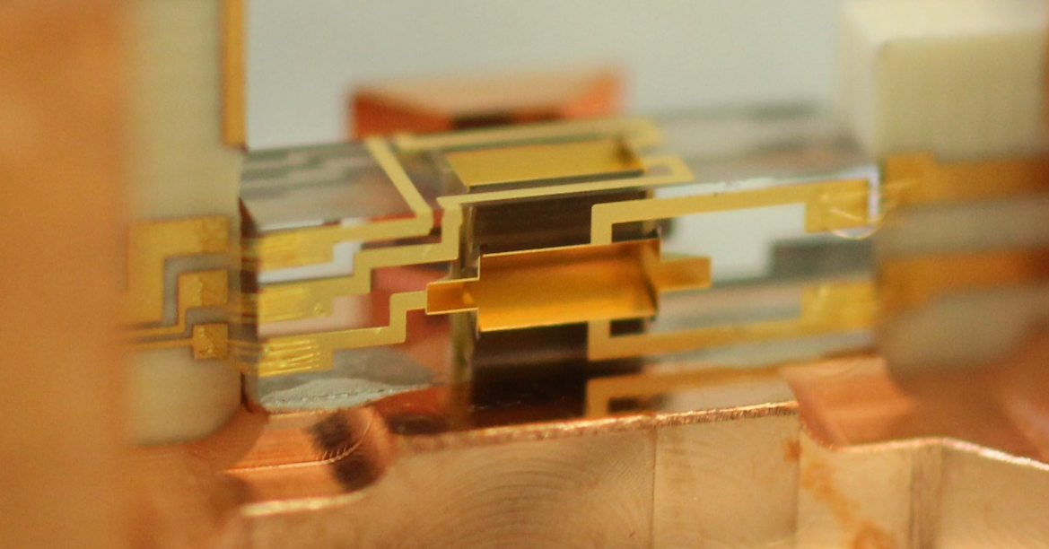
Apparatus
Tabletop experiment (~few m³)
Linear Paul trap
particle motion: harmonic oscillator with frequency O(1 MHz)
Loading procedure
Trap single Be⁺ (photo-ionization)
Electron impact ionization or multiphoton ionization of background H₂
Cryostat + UHV:
Prevent H₂⁺ reaction to H₃⁺
H₂ partial pressure ~10⁻¹⁵ mbar
N. Schwegler et al., PRL 131, 133003 (2023)
High-precision micro-fabricated ion trap
2.5 mm
H₂
Be⁺
H₂⁺
Be⁺
H₂⁺

Slide 5
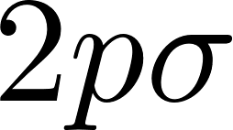
H₂⁺
E
+
-
+
Vibration
Rotation
…
…
microwave
Raman 1050 nm
…
Hyperfine structure
(18 levels)
~1.4 GHz
66 THz
5 THz
Ortho
(I = 1)
Para
(I = 0)
R

Slide 6
Electron gun ionization + buffer gas cooling
E
Be⁺
H₂⁺
He
T = 15 K
Vibration
Buffer gas cooling
A. K. Hansen et al., Nature 508, 76 (2014)
S. Schiller et al., Phys. Rev. A 95, 043411 (2017)
Rotation
…
…
…
General tool, cheap.
Slow (~10 min)
Not ortho-para selective
66 THz
5 THz
Ortho
(I = 1)
Para
(I = 0)
R

Slide 7
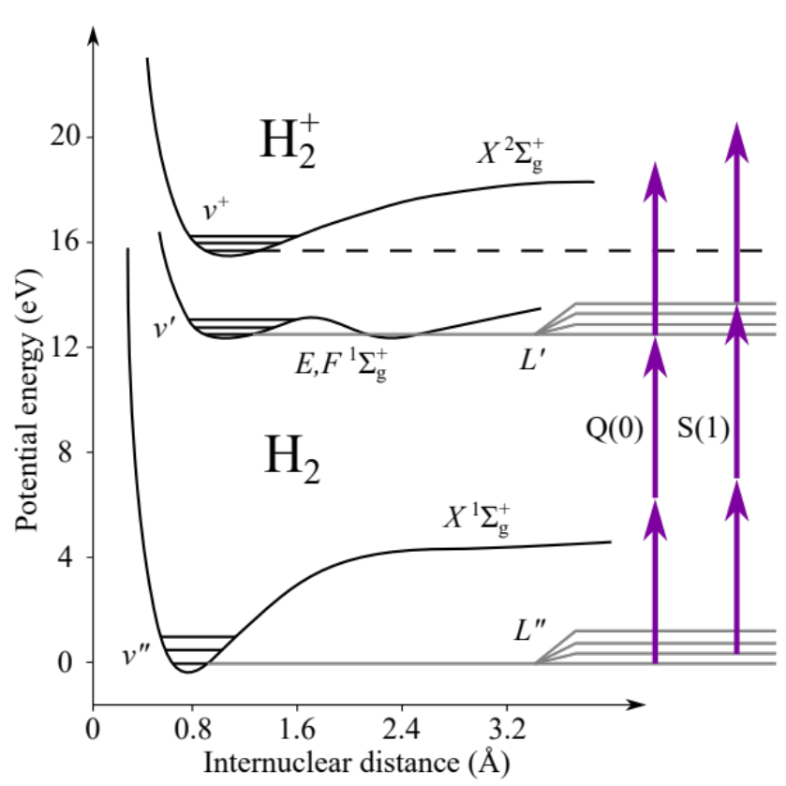
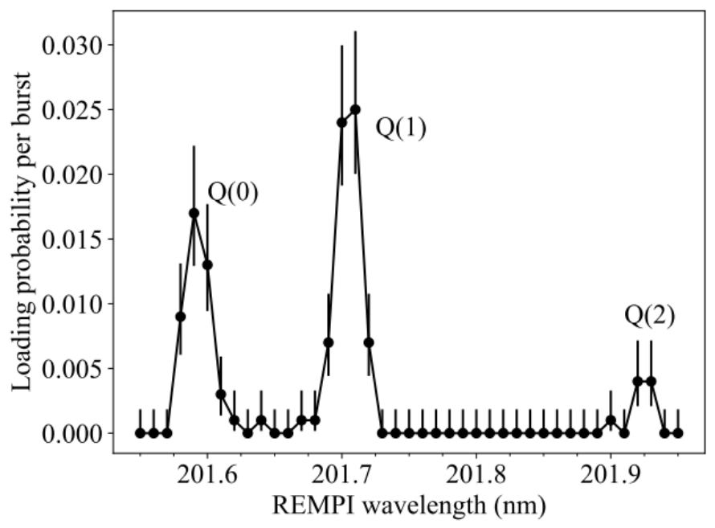
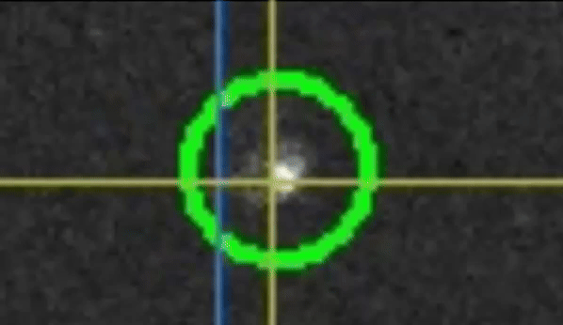
State selective REMPI loading
Not to scale
1050 nm
Master student:
Ho June Kim
202 nm
Pulsed OPO:
3 ns, 0.2 mJ, 50 Hz
H₂⁺
⁹Be⁺
313 nm
202 nm
“Cold” H₂ (L’’ = 0): raise cryostat temperature
“Warm” H₂ (L’’ > 0): leak valve
QLS L = 1:
85(6)% success
Theory: ~84%
Loading protocol
Burst of 50 REMPI laser pulses
Check Be⁺ ion position
Repeat
QLS L = 2:
Lifetime > 1 day
(no collisional quenching)
H. J. Kim et al., PRA 113, 043119 (2026)

Slide 8


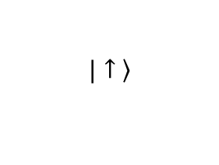
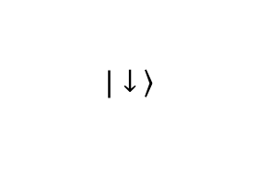
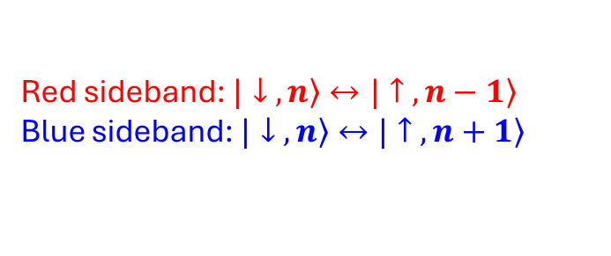
Axial motion: ground state cooling
Trap axis
in-phase mode
@ 1.3 MHz
out-of-phase mode
@ 3.4 MHz
$$\left.|↑ \right\rangle$$
…
2
$$\left.|↓ \right\rangle$$
1
n = 0
Be⁺ state-dependent fluorescence
Red sideband: $\left.|↓ ,n\right\rangle ↔\left.|↑ ,n−1\right\rangle$
Blue sideband: $\left.|↓ ,n\right\rangle ↔\left.|↑ ,n+1\right\rangle$
N. Schwegler et al., PRL 131, 133003 (2023)

Slide 9
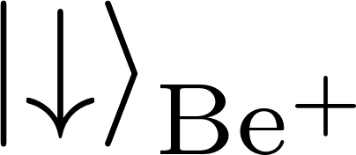
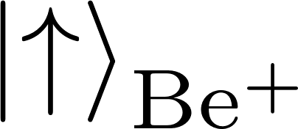


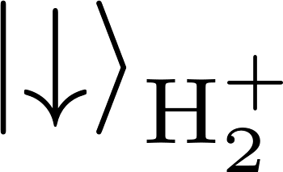


Quantum logic state detection
State-dependent
fluorescence
& pumping
Detect
1050 nm
313 nm
Laser pulse maps internal state of H₂⁺ onto shared motion
Laser pulse maps motional state onto internal state of Be⁺
Repump
P. O. Schmidt et al., Science 309, 749 (2005)

Slide 10
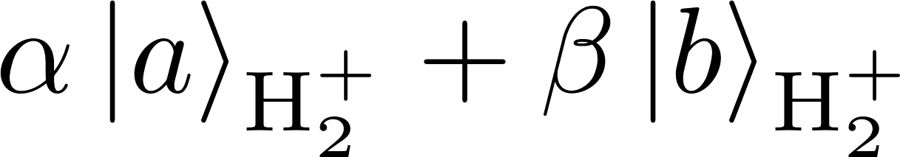
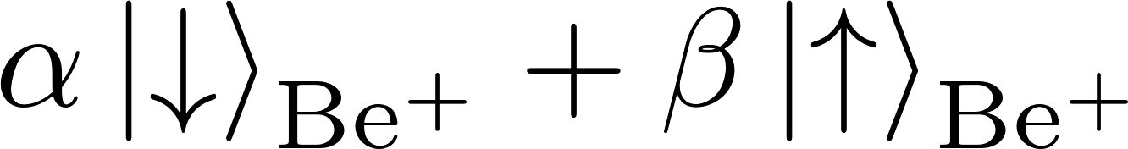

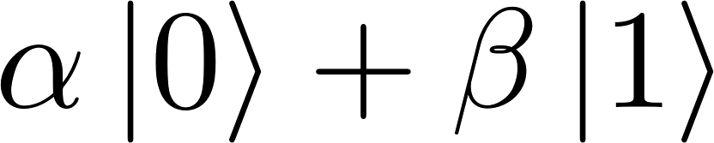
QLS detection
QLS
Collisions with He change hyperfine state
QLS
D. Holzapfel et al., PRX 15, 031009 (2025)

Slide 11
H₂⁺ state preparation
Quantum logic pumping
with Raman to combine populations
Microwave transitions
to connect to all states
Continue until state is prepared
QLS
D. Holzapfel et al., PRX 15, 031009 (2025)

Slide 12
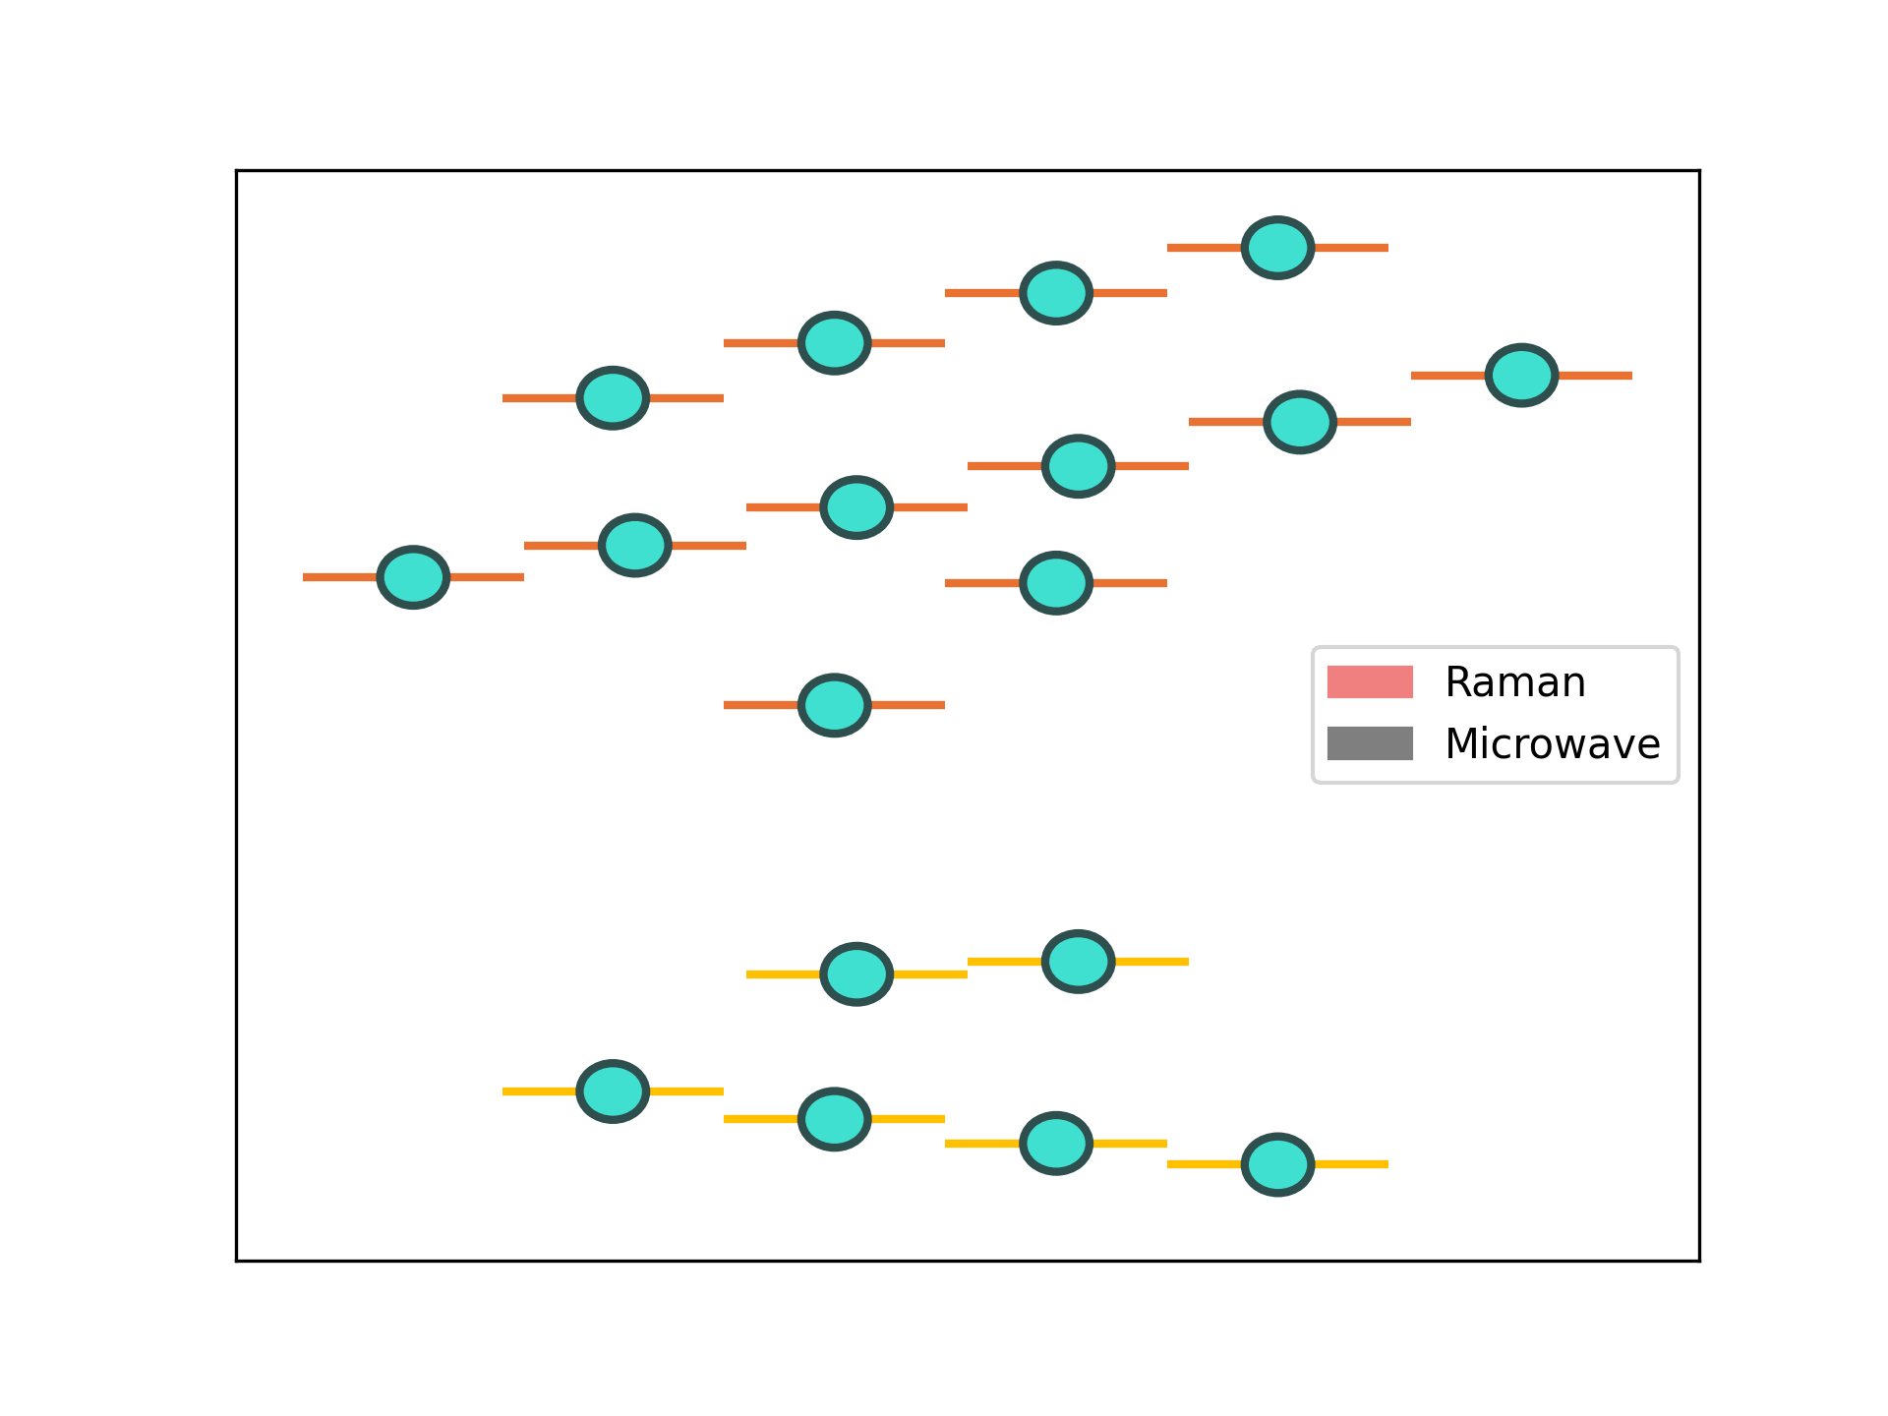
H₂⁺ state preparation
Quantum logic pumping
with Raman to combine populations
Microwave transitions
to connect to all states
Continue until state is prepared
D. Holzapfel et al., PRX 15, 031009 (2025)

Slide 13
Quantum logic spectroscopy – Raman sideband
No post processing!
scan
QLS
?
D. Holzapfel et al., PRX 15, 031009 (2025)

Slide 14
Quantum logic spectroscopy - microwave
?
scan
probe
QLS
D. Holzapfel et al., PRX 15, 031009 (2025)

Slide 15
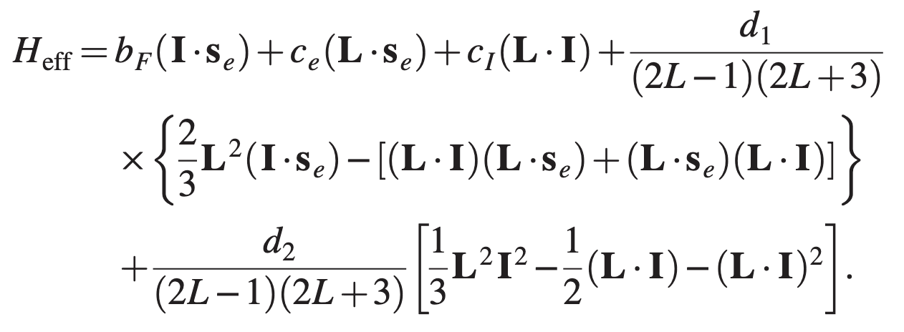
Hyperfine spectroscopy
Collaboration with J.-Ph. Karr (LKB, Paris)
proton-proton spin interaction
p
p
?
Test new physics, 5th force:
Additional spin-dependent proton-proton interaction
In H₂: N. F. Ramsey, Physica 96A, 285 (1979)
Review: L. Cong et al., RMP 97, 025005 (2025)

Slide 16
Hyperfine spectroscopy
H₂⁺ has large Zeeman shifts…
Use magnetic field insensitive transitions (0 – 1 mT range)
Be⁺ as in-situ magnetic field sensor
Collaboration with J.-Ph. Karr (LKB, Paris)
788 µT
468 µT
489 µT
45 µT
202 µT
458 µT
510 µT
764 µT
332 µT
15 µT
278 µT
233 µT
0.8 Hz
600 µT
539 µT
198 µT
175 µT
15 mHz precision in 90 min
Be⁺ Hyperfine & Zeeman constants: N. Shiga et al., PRA 84, 012510 (2011)

Slide 17
Hyperfine spectroscopy - systematics
Trap RF amplitude
Trap RF-induced AC Zeeman shift
Preliminary uncertainty budget
Ro-vib. transition
 | Shift | Uncertainty
Trap RF AC Zeeman | (0 - 2) Hz | ~50 mHz
Magnetic field fluctuations | 0 | < 10 mHz
Quadrupole shift | (0-0.3) Hz | ?
Micromotion Stark shift | ~ mHz | ~ mHz
2nd order Doppler shift | ~ μHz | ~ μHz
Shift | Uncertainty
≅ | ≅
≅ | ≅
≅ | ≅
≅ | ≅
≲ 0.2 Hz | ≲ 0.2 Hz
Up to few Hz | < Hz
?
Probe laser AC Stark
Quadrupole theory: D. Bakalov and S. Schiller, Appl. Phys. B 114, 213; 116, 777 (2014)

Slide 18


Outlook: H₂⁺
Microwave hyperfine spectroscopy L = 1
Test of theory
Probe New Physics
…
Rovibrational single-photon transitions
Rotational Raman transitions
L: 0-2, 1-3 (5, 8 THz)
ν,L: 0,0-3,2: 1576 nm quadrupole transition
J.-Ph. Karr et al., J. Phys.: Conf. Ser. 723, 012048 (2016)
ν,L: 0,0-3,1: 1600 nm ortho-para (dipole) transition
V. I. Korobov and D. Bakalov, PRA 107, 022812 (2023)
C.-W. Chou et al., Science 367, 1458 (2020),
A. L. Collopy et al., PRL 130, 223201 (2023),
K. H. Leung et al., PRX 13, 011047 (2023)
Fundamental constants, probe New Physics

Slide 19
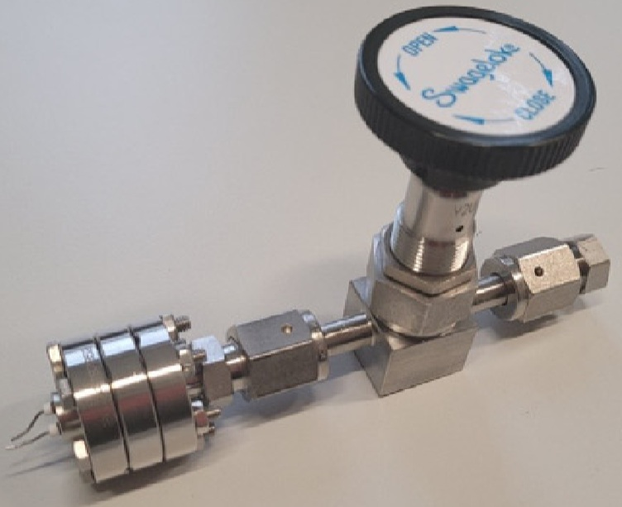
Outlook: Other light molecules
Order-of-magnitude improvement of triton charge radius, check m_{t}/m_{e}
J.-Ph. Karr et al.,
PRA 112, 022809 (2025)
Benchmark quantum chemistry calculations
Hyperfine structure theory:
G. Avila et al.,
PRL 135, 043003 (2025)
Deuteron quadrupole moment
Be⁺
D₂⁺/T₂⁺
Be⁺
H₃⁺
HeH⁺
He₂⁺
…
F. Schmid
D. Kienzler
PhD & PostDoc position available
daniel.kienzler@phys.ethz.ch
tiqi.ethz.ch
Tritium Laboratory Karlsruhe:
10⁻² mbar*l of T₂ (1 GBq) at VU Amsterdam
We load H₂⁺ from 10⁻⁷ mbar*l…
V. Hermann, …, W. Ubachs, M. Schlösser, Vacuum 230, 113708 (2024)

Slide 20
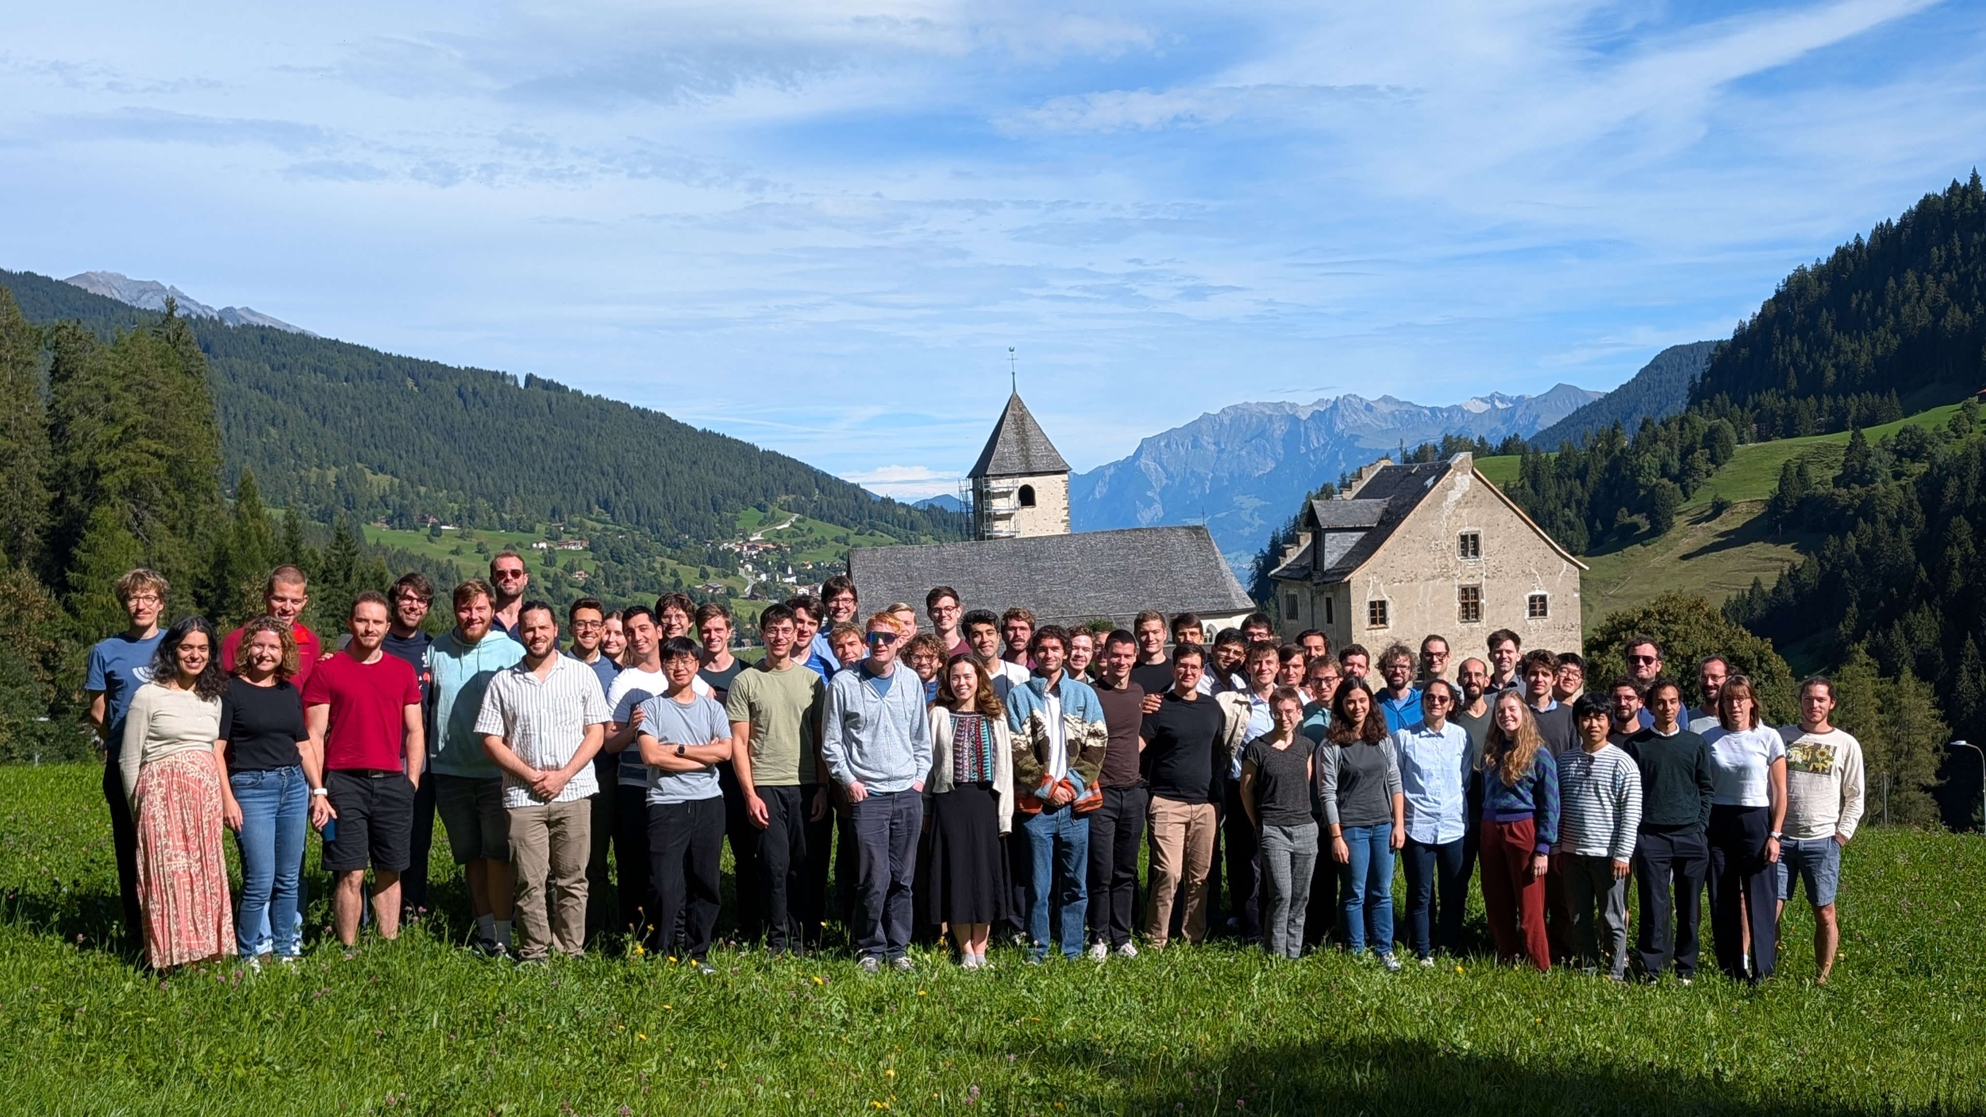

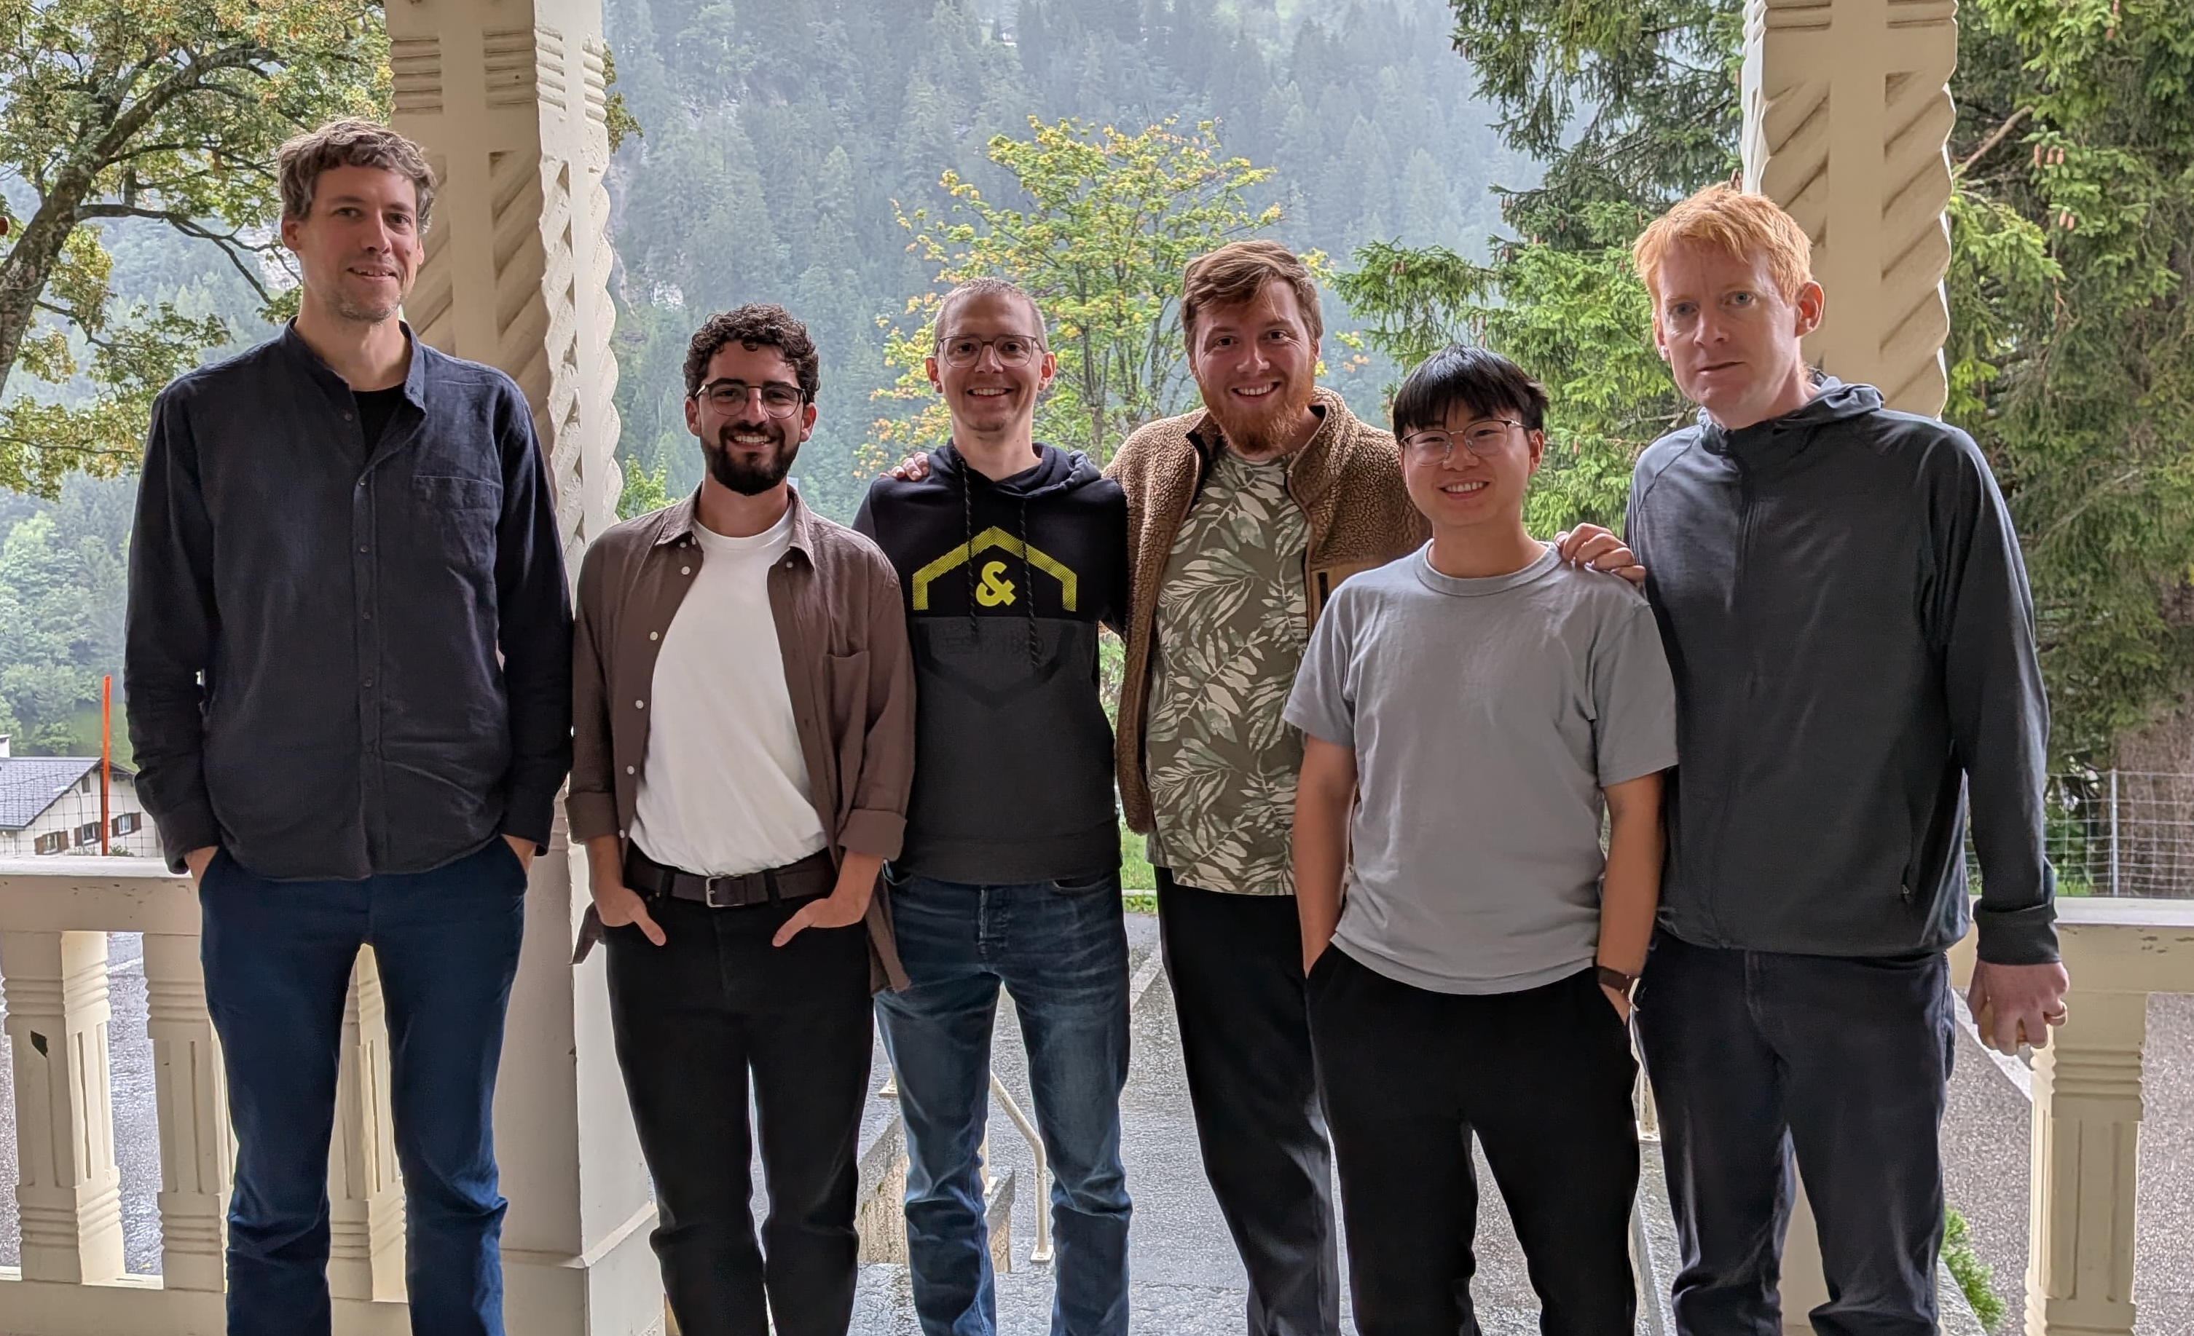

Jonathan Home
David Holzapfel
Niklas Zischka
Daniel Kienzler
Foivos Vouzinas
Qianlong He
tiqi.ethz.ch
Trapped Ion Quantum Information Group

Slide 21
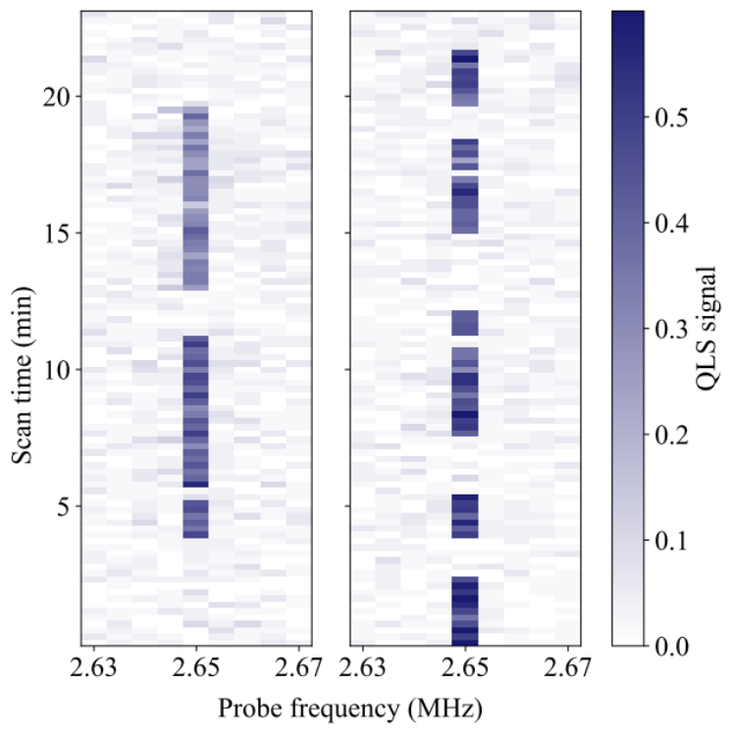
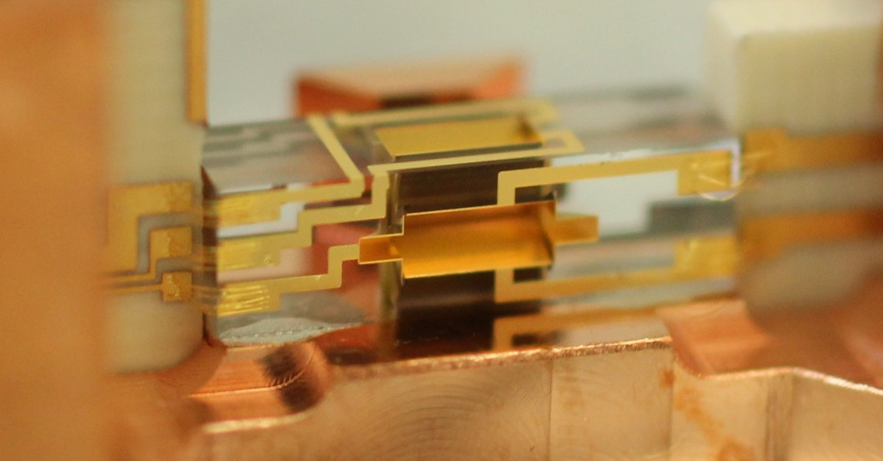
Thank you for your attention
N. Schwegler et al., PRL 131, 133003 (2023)
D. Holzapfel et al., PRX 15, 031009 (2025)
H. J. Kim et al., PRA 113, 043119 (2026)
Be⁺
H₂⁺
0.8 Hz

