Slide 1
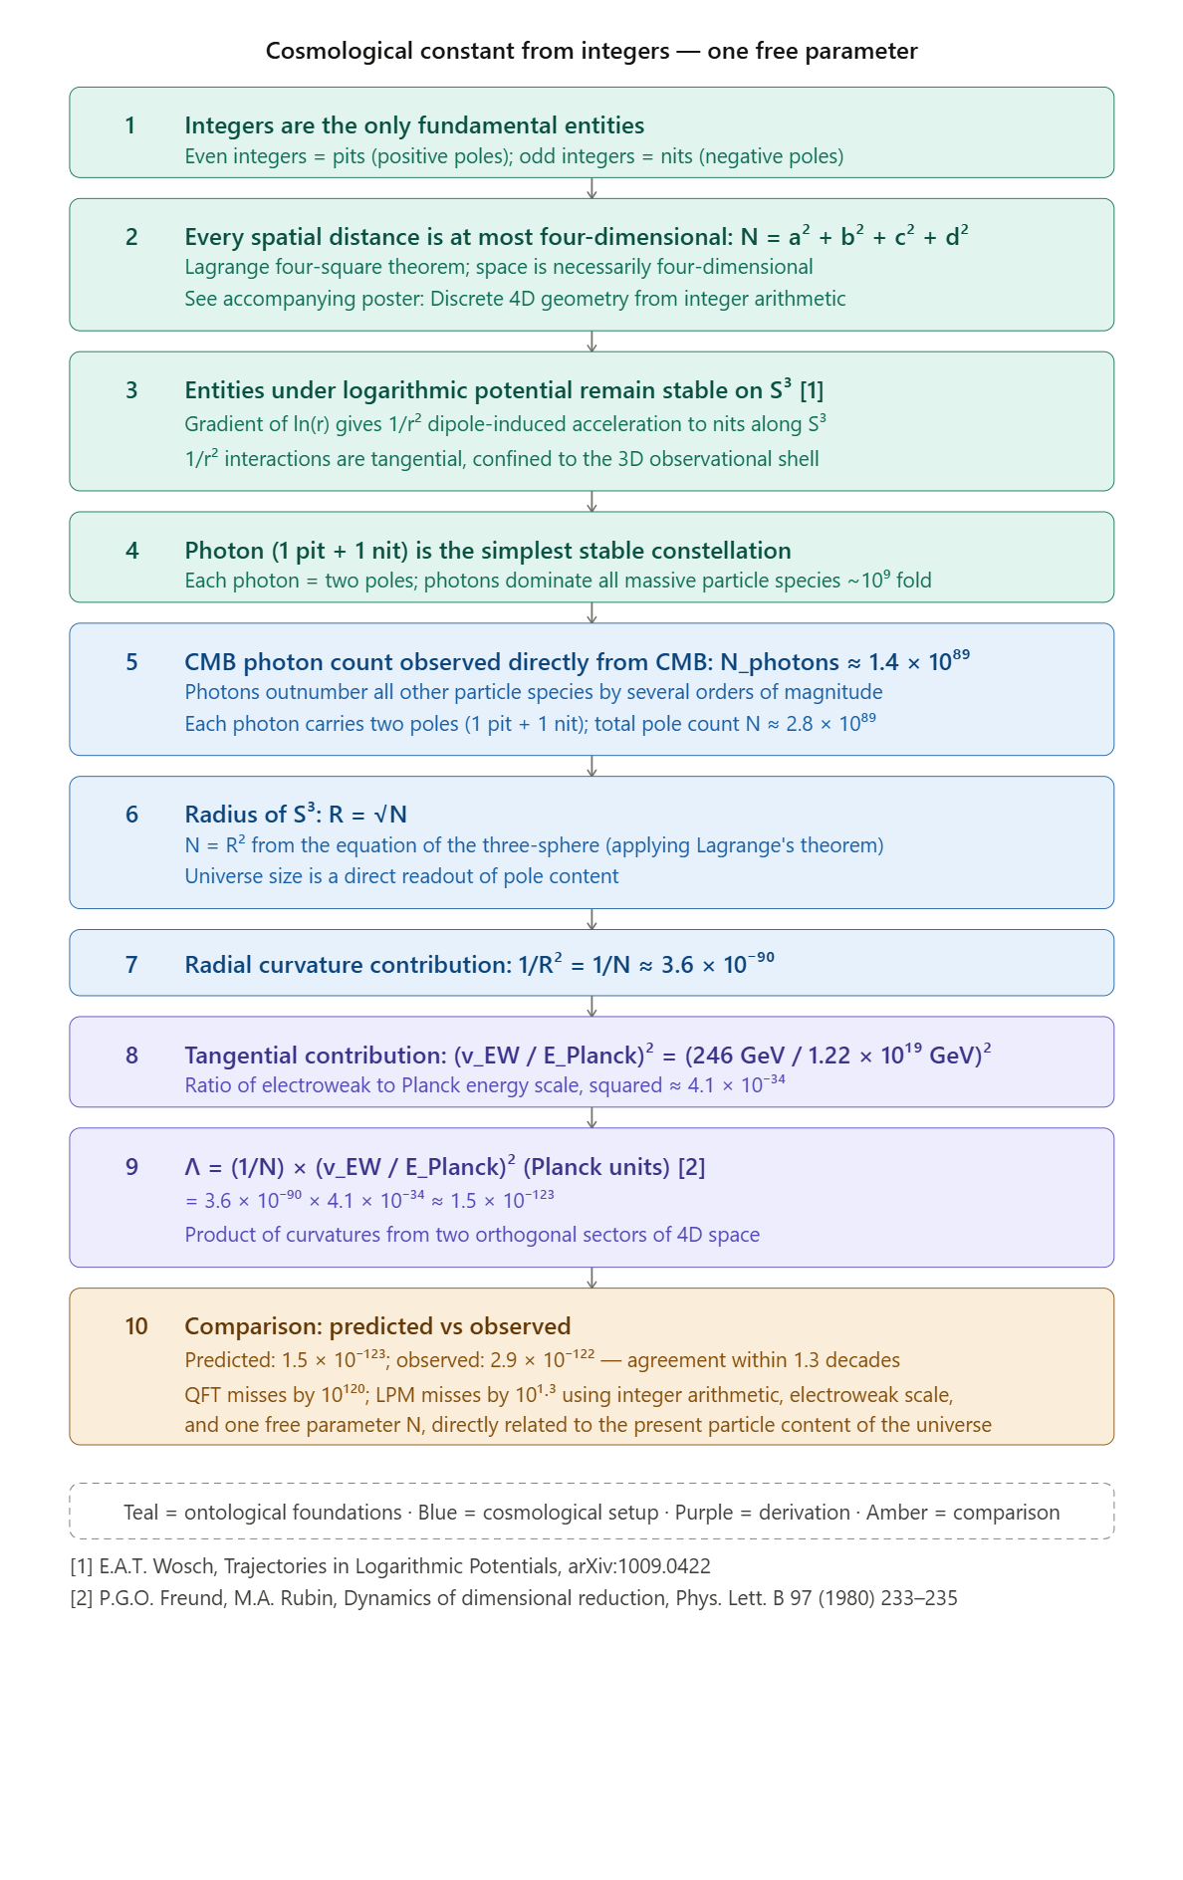
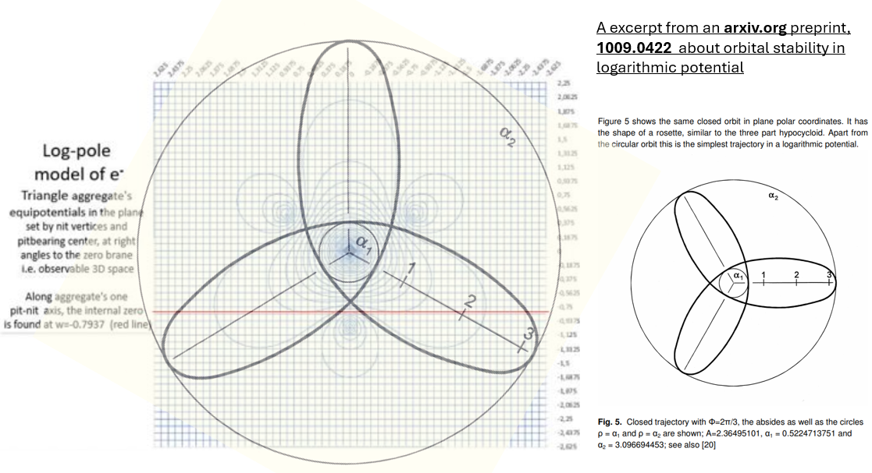
The cosmological constant
from two curvature components in a discrete arithmetic cosmos
Petri Muinonen Vantaa, Finland natpole@petrimuinonen.eu
independent researcher
Abstract
I show that the observed value of the cosmological constant, Λ ≈ 10⁻¹²² in Planck units, follows from two independently meaningful and empirically known values, with no free parameters and no fine-tuning.
The derivation is built on a discrete arithmetic framework of N constituents, Logarithmic Pole Model, presented in the companion poster. The major contributor to its N≈2.8*10⁸⁹ constituents are the CMB photons. Under LPM, the space is a 3-sphere with a radius R = N^{1/2}, thus giving a radial curvature ≈3.6*10⁻⁹⁰
The tangential curvature, along the observable part of the 3D shell is based on the ratio of the electroweak scale to the Planck scale (see derivation → )
The two contributions together produce the lambda to nearly within an order of magnitude across the 122 orders of magnitude.
Please contact me if you see opportunities for:
a seminar visit to your university/institute to let me tell more about the Logarithmic Pole Model
doctorate thesis supervision & an affiliation
a PhD thesis-work position in Europe (I have readiness to relocate by the end of 2026)
co-publishing of the present work and related results
Notes about the approach
Multiplying curvature contributions from orthogonal submanifolds of a product space is standard procedure in dimensional reduction, established in the context of spontaneous compactification by Freund and Rubin [2].
The cosmological constant is the product of two independent geometric curvature contributions from orthogonal sectors embedded into 4D space: the radial S³ curvature and the tangential electroweak-scale curvature in 3D (along 3-sphere).
Under Logarithmic Pole Model the radial sector arises from the integer arithmetic, the tangential one is based on a fundamental 3D length, the electroweak scale. I anticipate a paper under preparation that grounds the electroweak scale on the LPM pole composition of the Higgs boson — 6 pits and 7 nits — yielding the ratio of the electroweak scale to the Planck length from first principles.
Below: An example of the pole composition of a Standard Model particle.
To the right, a diagram of closed orbits under logarithmic potential from [1];
To the left, the orbit diagram superimposed on the equipotential diagram of an electron, composed of 3 pits and 3 nits into asymmetrical constellation by their reciprocal interactions as described in the Logarithmic Pole Model.
[1]
Upcoming presentations of Logarithmic Pole Model
Talk accepted to the Eighth Spacetime Conference, Albena, Bulgaria in September 2026. It includes, for example, a derivation of supernova 1987A neutrino signal from first principles under LPM, to within an order of magnitude across 58 orders in absolute scale.
.

