Slide 1




Clustered Unified Dark Sector Cosmology
Mahmoud Hashim
Centre for Theoretical Physics, The British University in Egypt
Physicum, Tartu University, 29 January 2026

Slide 2
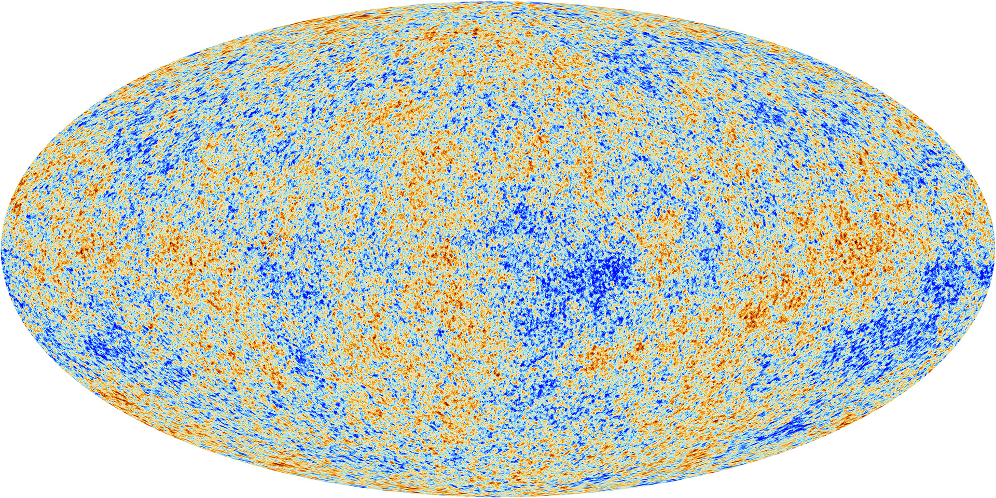
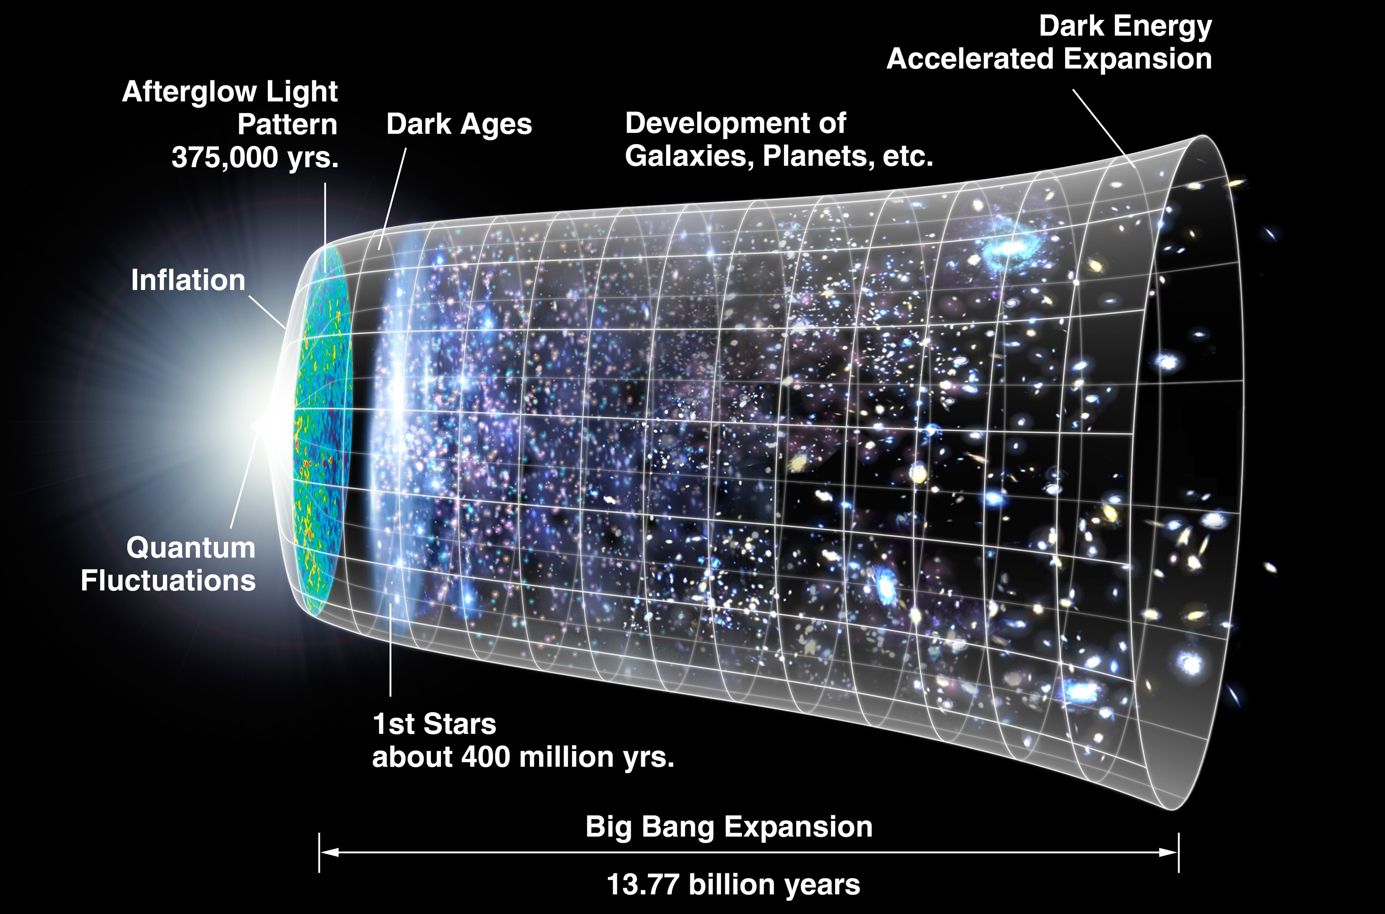
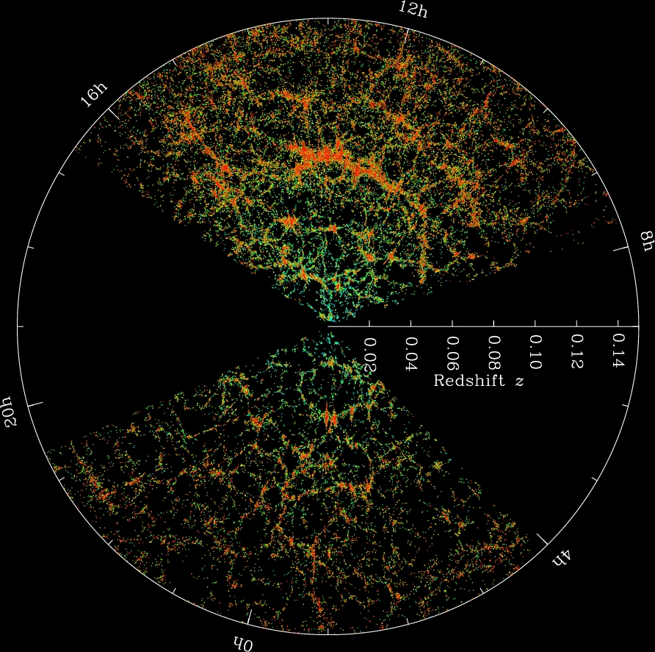
Cosmic Expansion History
GeomGravX: 10 Years of Geometric Foundations of Gravity and eXtensions
Tartu University, 29 June - 3 July 2026

Slide 3
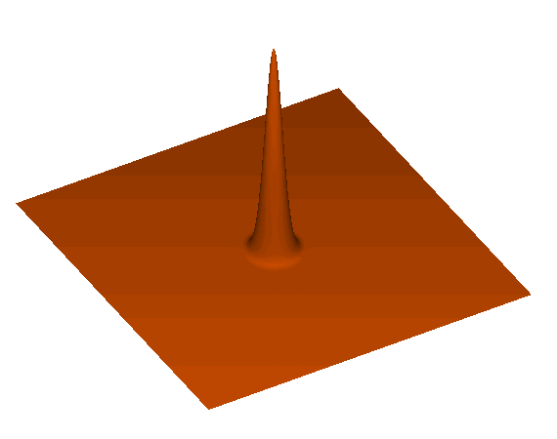
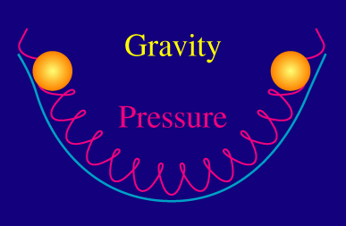
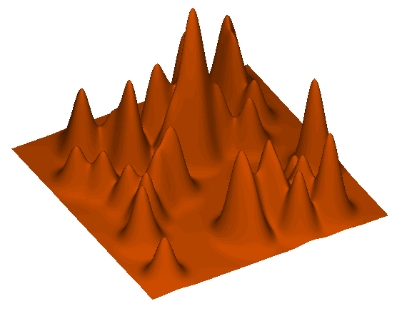

Baryon Acoustic Oscillations
Baryon Acoustic Oscillations (BAO) are "fossilized" sound waves from the early universe that now serve as a critical tool for measuring the cosmos.
Origin in the Early Plasma: In the first Mega years after the Big Bang, the universe was a hot, dense plasma of photons, electrons, and baryons (protons and neutrons).
The "Cosmic Tug-of-War": Inside this plasma, gravity pulled matter inward toward regions of higher density, while intense radiation pressure from photons pushed it back out. This competition created pressure waves that traveled outward, much like sound waves moving through air.
Freezing at Recombination: When the universe cooled enough for neutral atoms to form (the epoch of recombination), the photons escaped as light (seen today as the Cosmic Microwave Background), and the pressure waves "froze" in place.
GeomGravX: 10 Years of Geometric Foundations of Gravity and eXtensions
Tartu University, 29 June - 3 July 2026

Slide 4
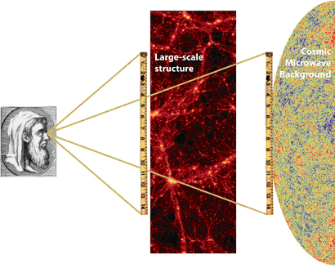
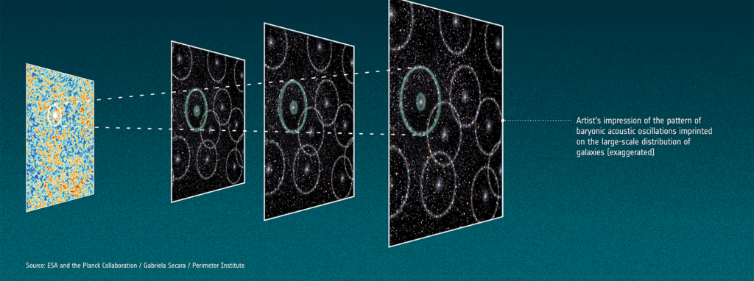

Baryon Acoustic Oscillations: cont
Imprint on Galaxies: These frozen waves left behind shells of slightly higher matter density. Today, billions of years later, galaxies are statistically more likely to be separated by the radius of these original shells, which is approximately 150 megaparsecs (roughly 500 million light-years).
Standard Ruler: Because the size of these waves is determined by well-known early universe physics, astronomers use this 150-Mpc separation as a "standard ruler" to measure the expansion history of the universe and study dark energy.
GeomGravX: 10 Years of Geometric Foundations of Gravity and eXtensions
Tartu University, 29 June - 3 July 2026

Slide 5
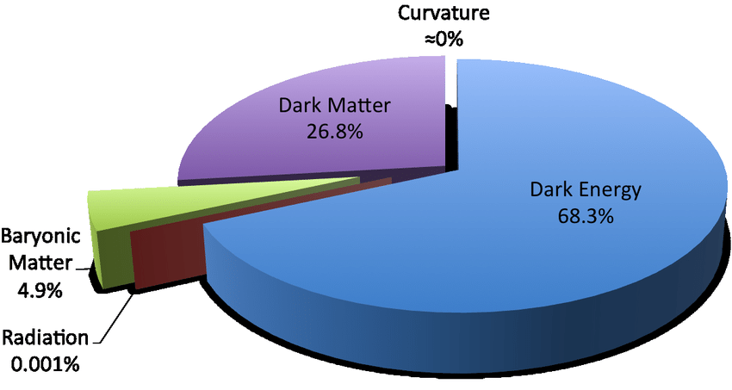

Standard $Λ$CDM Cosmological Model
The standard cosmological model, known as the ΛCDM model, is the prevailing scientific framework for the origin and evolution of the universe. The model is built on several key pillars:
The Big Bang & Inflation: The universe began about 13.8 billion years ago as an extremely hot, dense point (the Big Bang) and underwent a fraction-of-a-second period of exponential growth called cosmic inflation.
Three Main Components:
  Dark Energy (Λ): Comprises roughly 68% of the universe. It is a repulsive force that drives the current accelerated expansion.
  Cold Dark Matter (CDM): Makes up about 27%. It is "cold" (slow-moving) and "dark" (invisible), providing the gravitational "scaffold" for galaxies to form.
  Ordinary Matter: Only about 5% of the universe is composed of the atoms that make up stars, planets, and humans.
The Cosmological Principle: The model assumes that on a sufficiently large scale, the universe is homogeneous (uniform in density) and isotropic (looks the same in every direction).
General Relativity: It uses Einstein’s theory of gravity to describe the large-scale interactions between matter, energy, and the curvature of spacetime.
According to recent data, the model remains highly successful but faces significant challenges known as "tensions". The most prominent is the Hubble Tension, a persistent discrepancy between different measurements of the universe's expansion rate. Additionally, data from the Dark Energy Spectroscopic Instrument (DESI) has introduced hints that dark energy may not be a constant but could evolve over time.
GeomGravX: 10 Years of Geometric Foundations of Gravity and eXtensions
Tartu University, 29 June - 3 July 2026

Slide 6
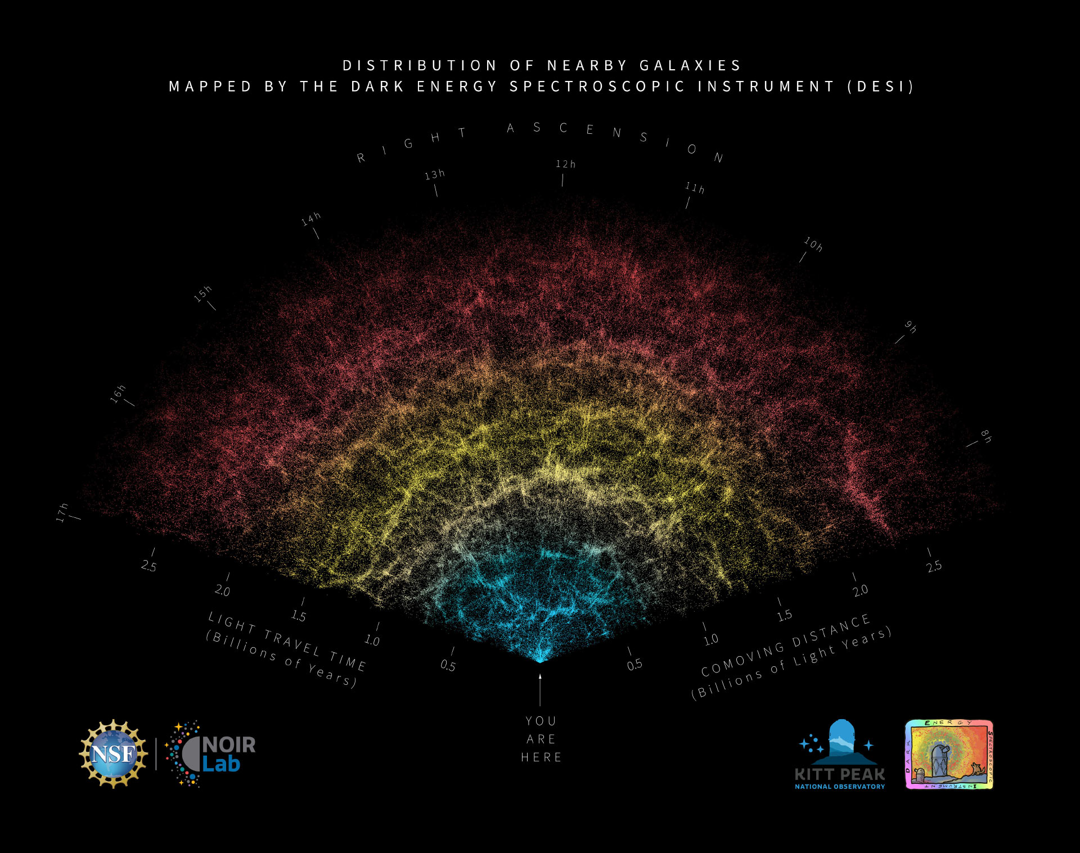
BAO measurements from DESI
Recently the Dark Energy Spectroscopic Instrument (DESI) has provided the most precise map of the universe's expansion history to date. Based on the Data Release 2 (DR2), the key features are:
Unprecedented Precision: DESI has measured over 30 million galaxy and quasar redshifts, with 14 million used for clustering analysis. This achieved an isotropic BAO scale precision of 0.24%–0.30%, roughly twice as precise as previous surveys.
Expansion Over 11 Billion Years: Measurements span from the local universe to redshift 4.16, covering roughly 11 billion years of cosmic history. This includes the most precise measurement of the BAO scale at high redshifts (z>2) using the Lyman-alpha forest.
Hints of Evolving Dark Energy: While consistent with the standard ΛCDM model on its own, when DESI data is combined with Cosmic Microwave Background (CMB) and supernova data, it shows a 2.5σ
to 4.2σ preference for a time-varying dark energy equation of state.
Tension with Planck: DESI results exhibit a mild 2.3σ tension with the parameters predicted by the Planck CMB mission, suggesting potential new physics or unknown systematics in current cosmological models.
GeomGravX: 10 Years of Geometric Foundations of Gravity and eXtensions
Tartu University, 29 June - 3 July 2026

Slide 7
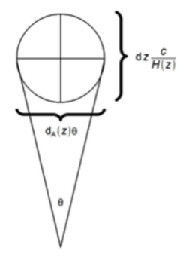
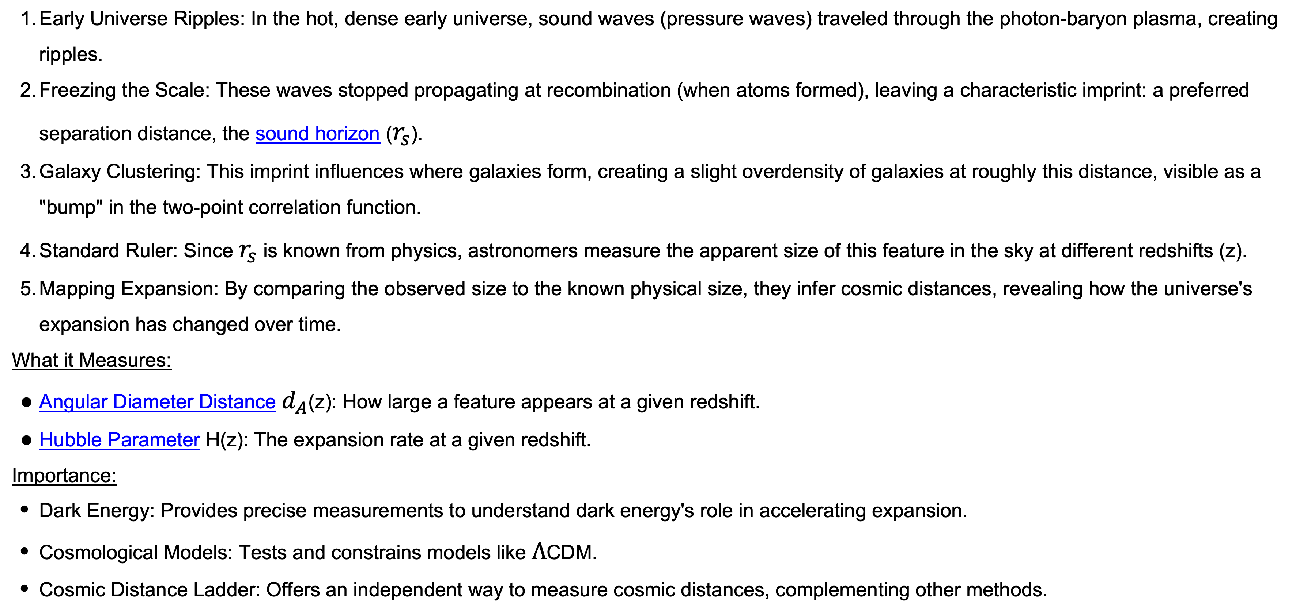
BAO distance measurement
BAO distance measurement uses the fixed scale of primordial sound waves in the early universe as a cosmic "standard ruler" to map the expansion history of the universe, determining distances to galaxies at different redshifts by observing the slight preference for galaxies to be separated by this known scale (~150 Mpc). This technique helps constrain cosmological parameters like dark energy, measuring the angular diameter distance ($d_{A}$) and the Hubble parameter ($H(z)$).
Early Universe Ripples: In the hot, dense early universe, sound waves (pressure waves) traveled through the photon-baryon plasma, creating ripples.
Freezing the Scale: These waves stopped propagating at recombination (when atoms formed), leaving a characteristic imprint: a preferred separation distance, the sound horizon ($r_{s}$).
Galaxy Clustering: This imprint influences where galaxies form, creating a slight overdensity of galaxies at roughly this distance, visible as a "bump" in the two-point correlation function.
Standard Ruler: Since $r_{s}$ is known from physics, astronomers measure the apparent size of this feature in the sky at different redshifts (z).
Mapping Expansion: By comparing the observed size to the known physical size, they infer cosmic distances, revealing how the universe's expansion has changed over time.
What it Measures:
Angular Diameter Distance $d_{A}$(z): How large a feature appears at a given redshift.
Hubble Parameter H(z): The expansion rate at a given redshift.
Importance:
Dark Energy: Provides precise measurements to understand dark energy's role in accelerating expansion.
Cosmological Models: Tests and constrains models like $Λ$CDM.
Cosmic Distance Ladder: Offers an independent way to measure cosmic distances, complementing other methods.
GeomGravX: 10 Years of Geometric Foundations of Gravity and eXtensions
Tartu University, 29 June - 3 July 2026

Slide 8
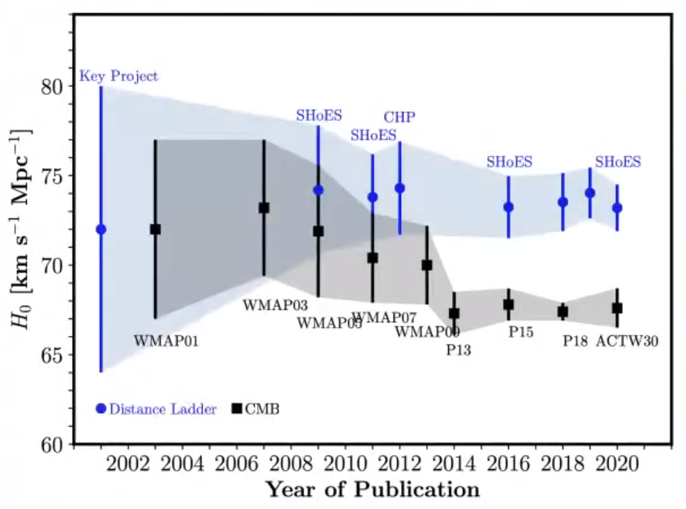
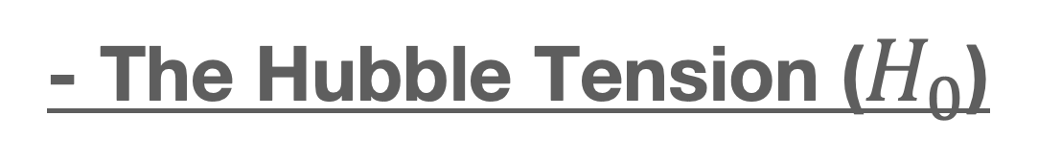
Cosmological Hubble tension:
Referred to as high-precision observational data have revealed persistent, statistically significant discrepancies between different measurement methods.
- The Hubble Tension ($H_{0}$)
The Hubble constant (H0 ) describes the current expansion rate of the universe. The tension arises from a persistent mismatch between two independent ways of measuring this value:
Early-Universe Measurements: By observing the Cosmic Microwave Background (CMB) and using the ΛCDM model to extrapolate forward in time, the expansion rate of approximately 67–68 km/s/Mpc.
Late-Universe Measurements: By using a "distance ladder" (calibrating the brightness of Cepheid variable stars and Type Ia supernovae) to directly measure the recession velocity of nearby galaxies, the expansion rate is found to be of approximately 73–74 km/s/Mpc.
arXiv:2403.18902
The gap between these values has reached a statistical significance level often cited as greater than 5$σ$
GeomGravX: 10 Years of Geometric Foundations of Gravity and eXtensions
Tartu University, 29 June - 3 July 2026

Slide 9
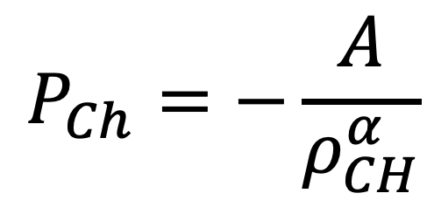
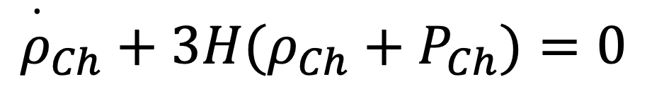
Clustered Chaplygin Gas
Cosmological observations may require dark energy, as well as dark matter, to be added to the cosmic budget.
The possibility that a single fluid may represent both constituents was proposed, as It is also realisable, in principle, in the form of a fluid endowed with negative pressure p that vanishes with increasing density ρ.
Early on, when the universe is dense, the cosmological fluid would behave as pressureless dark matter, and as the universe expands it ultimately behaves as dark energy.
The generalized Chaplygin gas equation of state, relating the pressure and density, is given by:
$$P_{Ch}=−\frac{A}{ρ_{CH}^{α}}$$
Where A and α are positive constants that represents a fluid endowed with a negative pressure that decreases in magnitude with increasing density.
In a cosmological context, a homogeneous Chaplygin gas obeys the conservation equation
$${\overset{·}{ρ}}_{Ch}+3H(ρ_{Ch}+P_{Ch})=0$$
Hashim, M. and El-Zant, A. 2025 (arXiv:2502.01751)
GeomGravX: 10 Years of Geometric Foundations of Gravity and eXtensions
Tartu University, 29 June - 3 July 2026

Slide 10
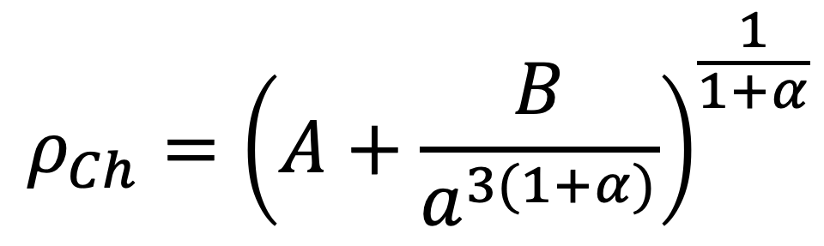
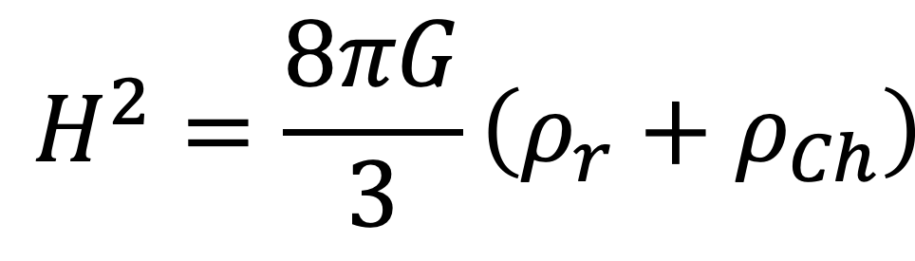
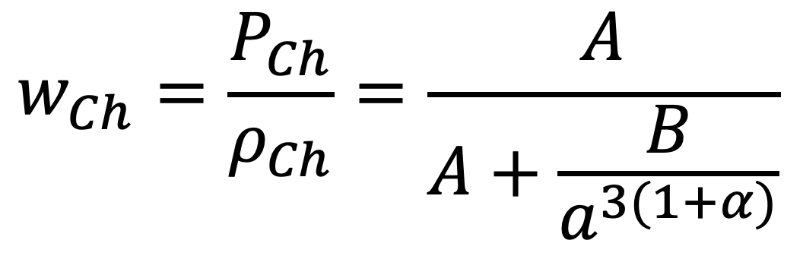
Clustered Chaplygin Gas: cont
This leads to a background density evolution given by
$$ρ_{Ch}={\left(A+\frac{B}{a^{3(1+α)}}\right)}^{\frac{1}{1+α}}$$
In general, the Chaplygin gas equation of state parameter $w_{Ch}$ is given by
$$w_{Ch}=\frac{P_{Ch}}{ρ_{Ch}}=\frac{A}{A+\frac{B}{a^{3(1+α)}}}$$
The Hubble expansion rate function is given by (assuming flatness)
$$H^{2}=\frac{8πG}{3}\left(ρ_{r}+ρ_{Ch}\right)$$
GeomGravX: 10 Years of Geometric Foundations of Gravity and eXtensions
Tartu University, 29 June - 3 July 2026

Slide 11
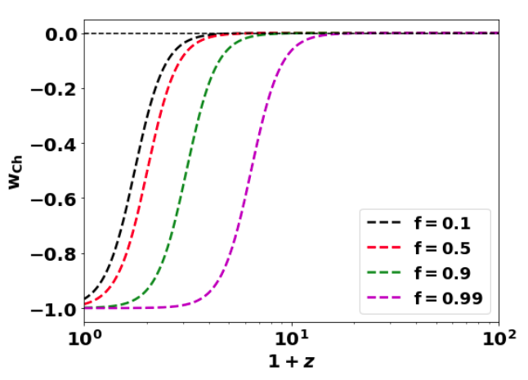
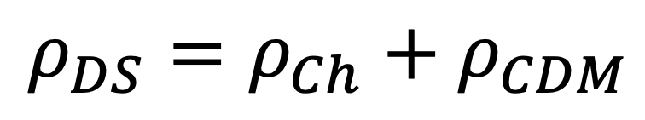
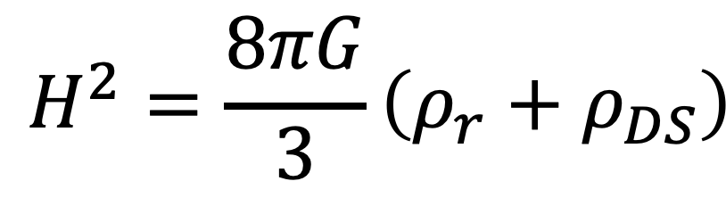

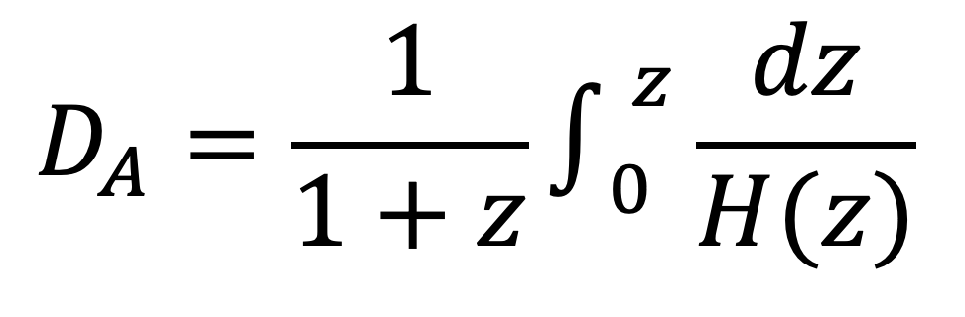
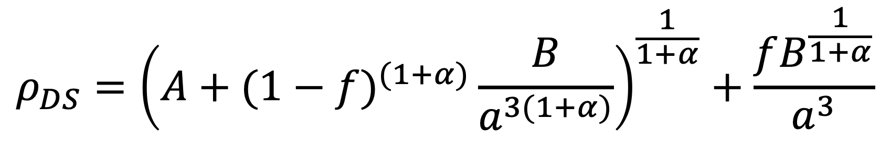
Clustered Chaplygin Gas: cont
In a clustered Chaplygin fluid one assumes that a fraction f of its energy density may nonlinearly grow into self gravitating structures, eventually forming halos akin to those in the standard cosmology
$$ρ_{DS}=ρ_{Ch}+ρ_{CDM}$$
$$ρ_{DS}={\left(A+(1−f)^{(1+α)}\frac{B}{a^{3(1+α)}}\right)}^{\frac{1}{1+α}}+\frac{fB^{\frac{1}{1+α}}}{a^{3}}$$
where the subscript DS refers to the total dark sector density, We take the special case $α$ =1.
The Hubble function is then equals:
$$H^{2}=\frac{8πG}{3}\left(ρ_{r}+ρ_{DS}\right)$$
The angular diameter distance is given by:
$$D_{A}=\frac{1}{1+z}∫_{0}^{z}\frac{dz}{H(z)}$$
GeomGravX: 10 Years of Geometric Foundations of Gravity and eXtensions
Tartu University, 29 June - 3 July 2026

Slide 12
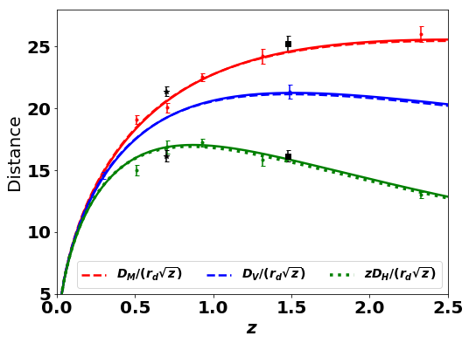
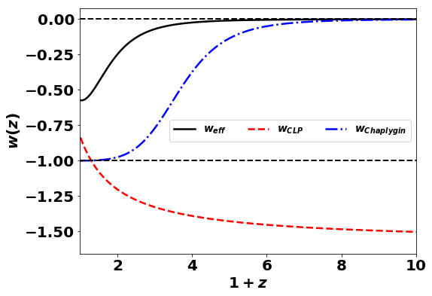
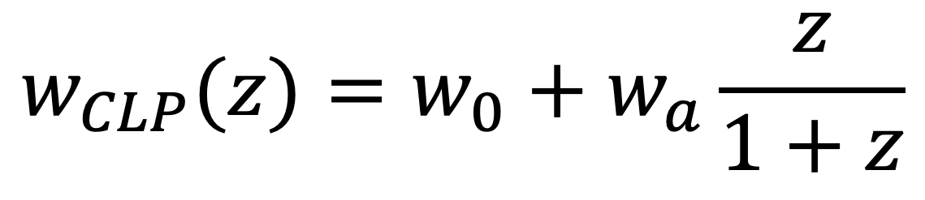
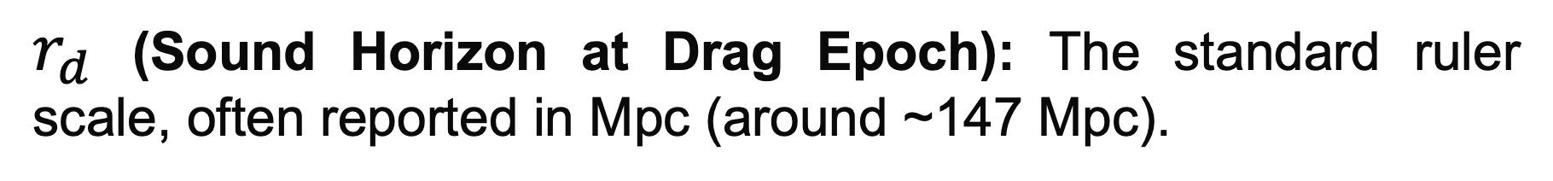
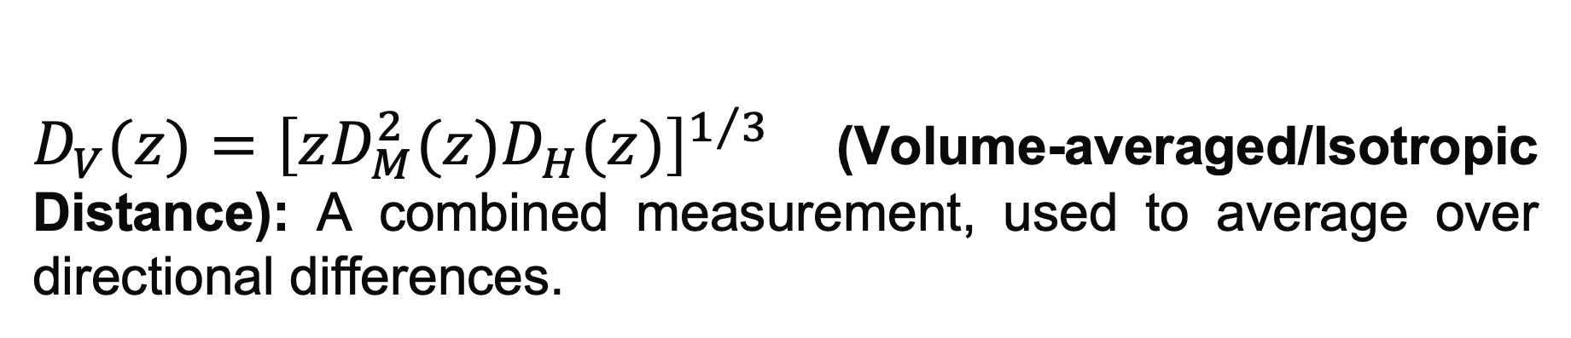
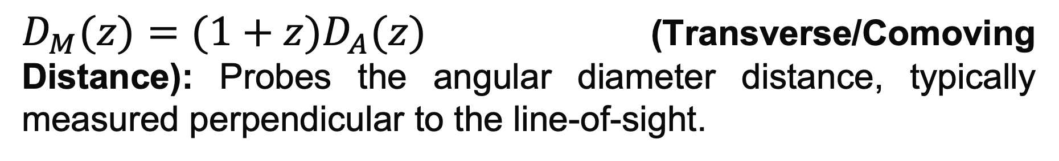
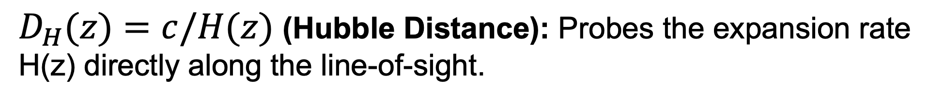
Clustered Chaplygin Gas: Observational constrains from BAO
The Chevallier-Linder-Polarski (CLP) parameterization is one of the most widely used mathematical models to describe evolving (dynamical) dark energy.
$$w_{CLP}(z)=w_{0}+w_{a}\frac{z}{1+z}$$
$D_{H}(z)=c/H(z)$ (Hubble Distance): Probes the expansion rate
H(z) directly along the line-of-sight.
$D_{M}(z)=(1+z)D_{A}(z)$ (Transverse/Comoving Distance): Probes the angular diameter distance, typically measured perpendicular to the line-of-sight.
$D_{V}(z)={\left[zD_{M}^{2}(z)D_{H}(z)\right]}^{1/3}$(Volume-averaged/Isotropic Distance): A combined measurement, used to average over directional differences.
$r_{d}$ (Sound Horizon at Drag Epoch): The standard ruler scale, often reported in Mpc (around ~147 Mpc).
GeomGravX: 10 Years of Geometric Foundations of Gravity and eXtensions
Tartu University, 29 June - 3 July 2026

Slide 13
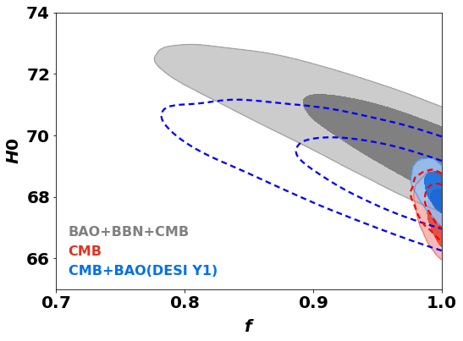
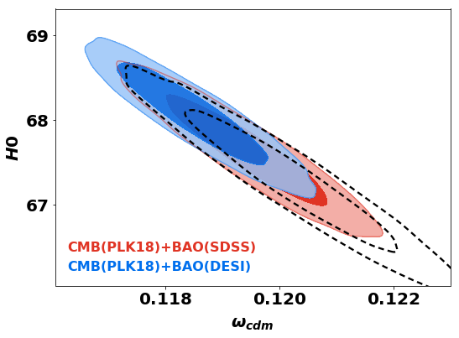


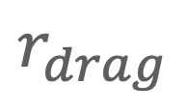
Clustered Chaplygin Gas: Observational constrains from BAO
DESI BAO constraints $H_{0}$ with higher values than previous SDSS measurements
$$r_{drag}$$
Clustered matter fraction has a degeneracy with the Hubble constant $H_{0}$
GeomGravX: 10 Years of Geometric Foundations of Gravity and eXtensions
Tartu University, 29 June - 3 July 2026

Slide 14
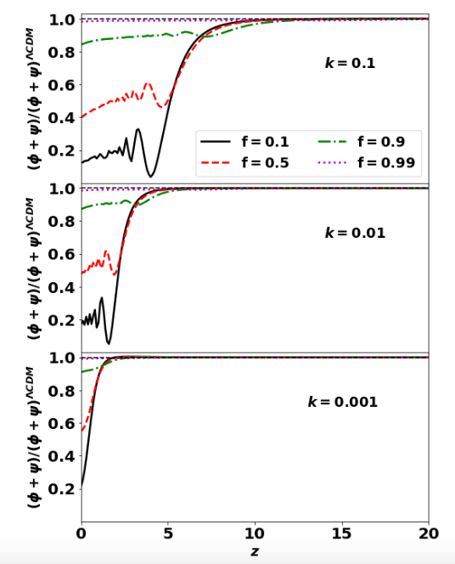

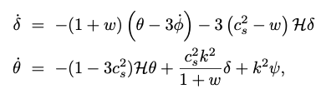



Clustered Chaplygin Gas: Perturbations
We consider adiabatic perturbations of a perfect fluid in the Newtonian gauge of a flat Friedmann Robertson Walker metric
With fluid perturbation equations
Relativistic Poisson Equation
GeomGravX: 10 Years of Geometric Foundations of Gravity and eXtensions
Tartu University, 29 June - 3 July 2026

Slide 15
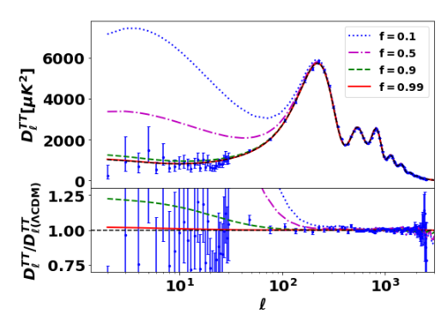
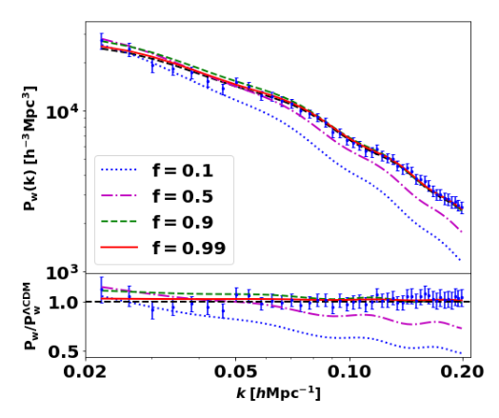

Clustered Chaplygin Gas: results
Late Integrated Sachs-Wolfe
As dark energy accelerates cosmic expansion, the expanding space smooths out superclusters and voids, weakening their gravitational influence. Because the wells are flattening, a CMB photon exits a shallower well than it entered, resulting in a net energy gain (blueshift) or loss (redshift)
GeomGravX: 10 Years of Geometric Foundations of Gravity and eXtensions
Tartu University, 29 June - 3 July 2026

Slide 16
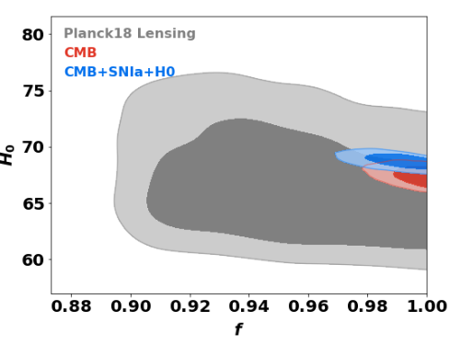
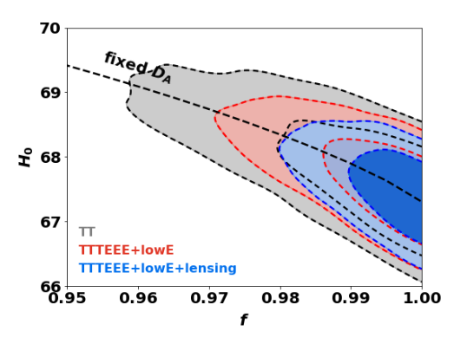
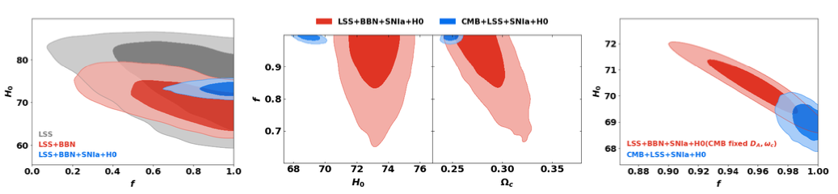
Clustered Chaplygin Gas: results
GeomGravX: 10 Years of Geometric Foundations of Gravity and eXtensions
Tartu University, 29 June - 3 July 2026

Slide 17
Conclusions
BAO measurements from DESI suggest that dark energy may be evolving over cosmic time rather than being a constant..
Despite the success of the standard cosmological model in explaining observational cosmology, it faces tensions with recent precise data from BAO and the local measurements of the Hubble expansion rate.
An alternative unified dark sector model (clustered Chaplygin gas) tends to resolving these tensions.
Clustered Chaplygin gas could model both dynamical dark energy and clustered dark matter in one unified fluid.

