Slide 1
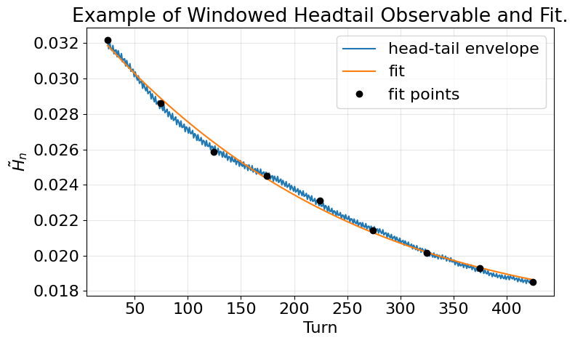
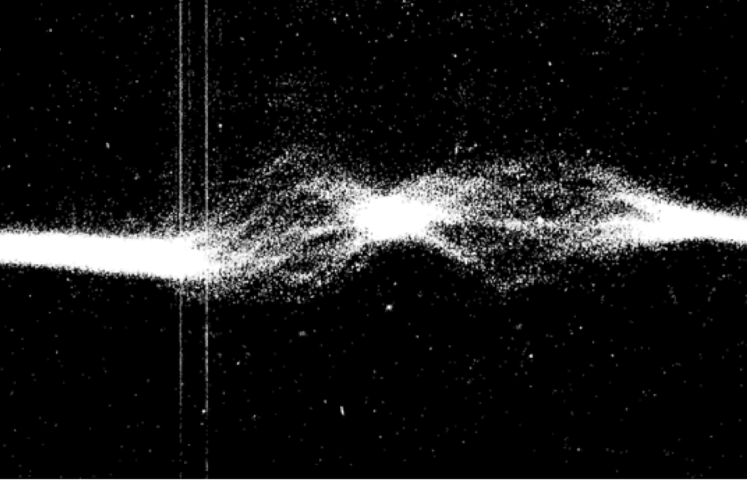
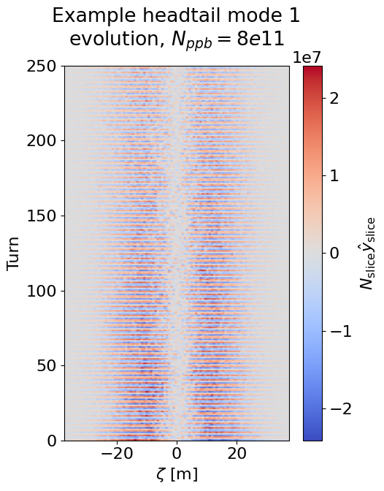
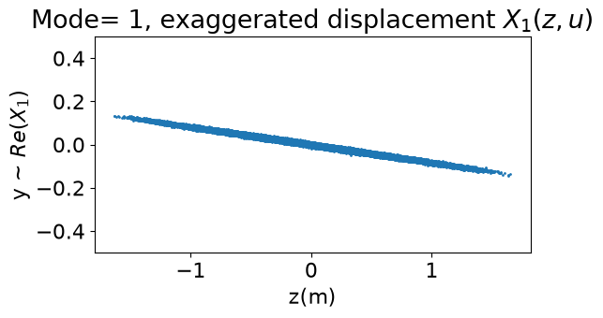
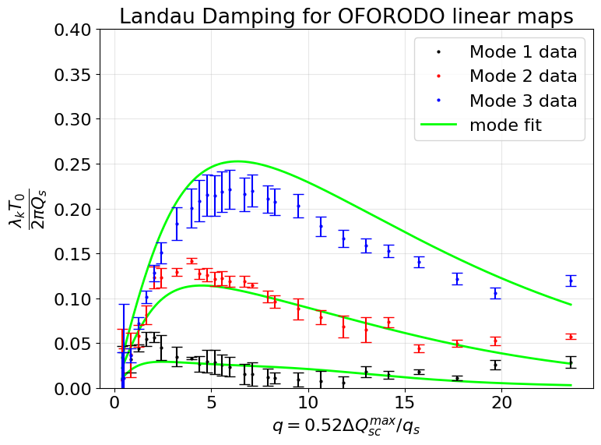
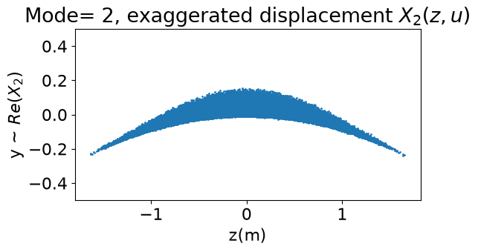
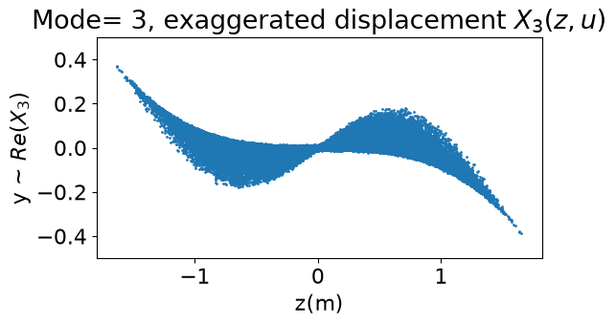


Simulations of Landau Damping on the ISIS RCS
Simulate head-tail modes to measure their landau damping
Fit the decay of the head-tail signal over turns.
Perform intensity scan for different space charge regimes
3
ISIS RCS experiences head-tail instabilities.
2
4
5
Track bunch turn-by-turn with Xsuite.
1
Francesco Straniero, francesco.straniero@physics.ox.ac.uk
Contribution to SC26, Oxford 30th September 2026

