Slide 1
Oxford, Space Charge 2026, Sept. 29 – Oct. 26
A Historical View on Research in Space Charge for Particle Accelerators
Ingo Hofmann retired, GSI / Goethe University Frankfurt
MURA (Midwestern Universities Research Association) – an early cradle of accelerator physics *)
Political circumstances 1950s /1960s
HIF (Heavy Ion Inertial Fusion) driven by ion linear accelerators from 1975 – 98 / exploring limits by coherent space charge instabilities.
From 2000 onwards High Intensity Linacs like SNS/US, J-PARC/Japan, ESS/EU, CSNS/China, ADS /China and others are dealing with „real world“ linac space charge challenges
Acknowledgments:
*) Francis Cole „Oh Camelot!“ (MURA)
Images: Lawrence Jones (U Michigan)

Slide 2
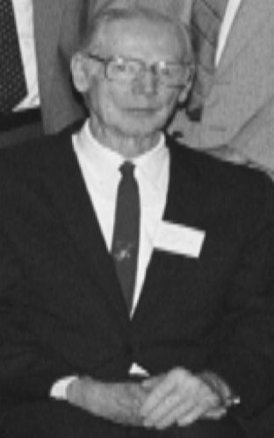
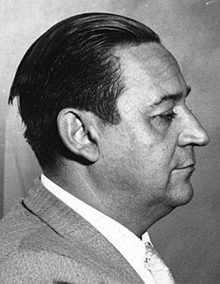
The 1940‘s – a beginning
In 1941 Donald Kerst (University of Illinois) started first discussion of space-charge effects in accelerators + detuning of transverse oscillations (Phys. Rev.)
He also built a betatron (Nature, 1946)
In 1949 Greek engineer Nicholas Christofilos patented “alternating gradient (strong) focusing” – at first ignored
In 1953 meeting (BNL) about the “newly” re-invented “Strong Focusing” from 1952 Courant and Snyder paper (Courant afterwards published “credit”)
Donald Kerst (1989)
Nicholas Christofilos
Notes:
space charge is not just „Laslett tune shift Lloyd Smith - amateur invention – raised in Greece – 1956 to LLL and worked on fusion - Courant afterwards wrote a paper to recognize Christofilos – Lloyd Smith: left patent (US+Greece) in a drawer
some called him cold war physicist

Slide 3
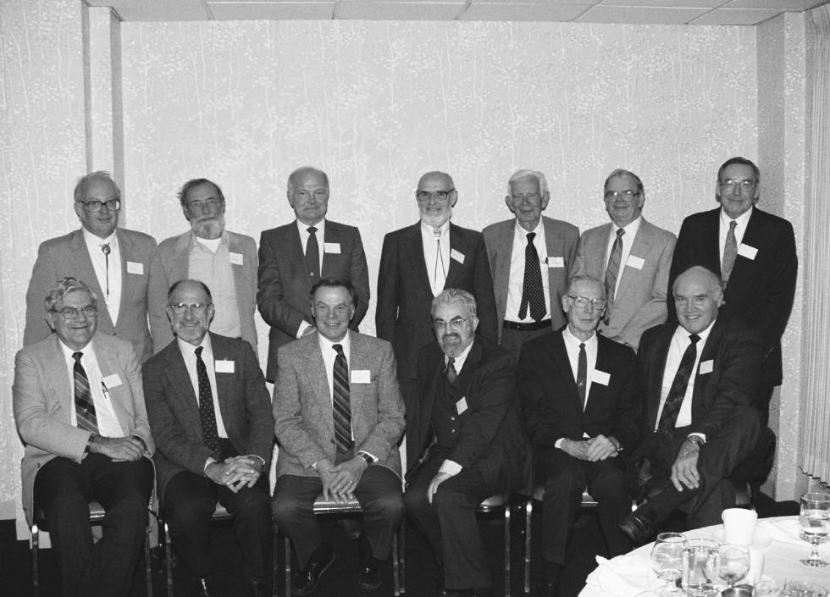
The MURA era
An accelerator think tank - born from US-rivalries in 1950‘s
Big lab competition – Fermilab (Tevatron), Argonne (ZGS), Brookhaven (AGS) and Berkeley (Bevatron)
A „brain drain“ fear in the US-Midwest / Chicago area: 1953 number of physicists met -> MURA was born
lasted “only” 10 years
MURA alumni in 1989:
L-R back: Don Swenson, E. Rowe, D. Young, Keith Symon, H.R. Crane, C. Pruett, and Francis Cole;
L‐R front: Fred Mills, Andy Sessler, L. Jones, Earnest Courant, Donald Kerst, and W. Wallenmeyer.
Notes:
amateur invention – raised in Greece – 1956 to LLL and worked on fusion - Courant afterwards wrote a paper to recognize Christofilos – Lloyd Smith: left patent (US+Greece) in a drawer
some called him cold war physicist

Slide 4
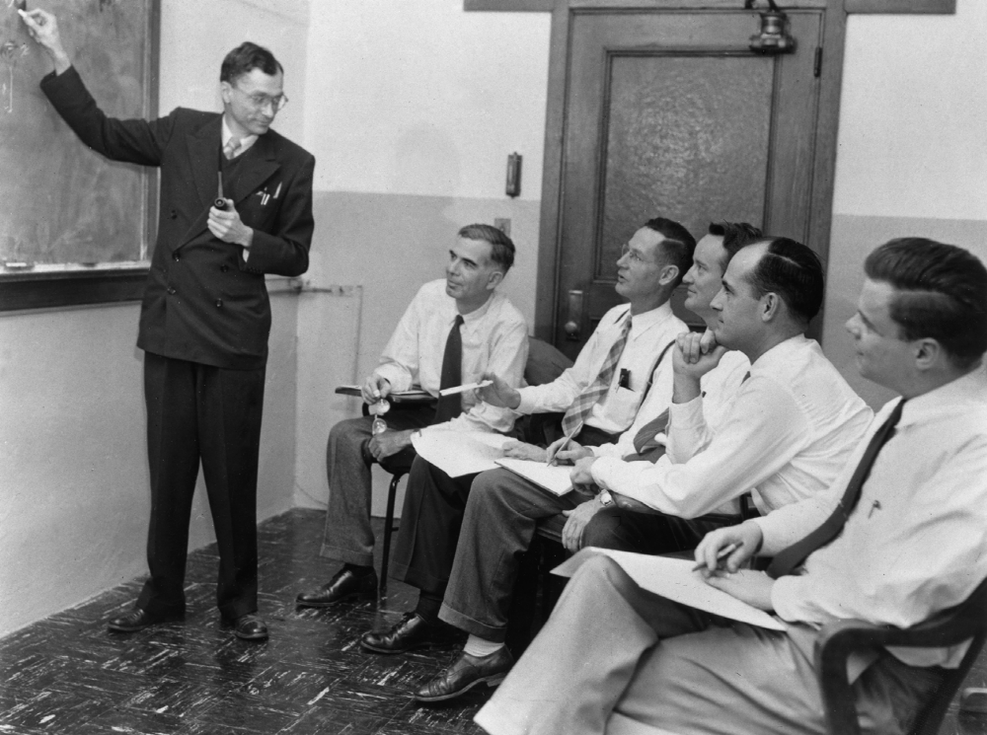
The Michigan study group
Initiated in 1954
D. Kerst
J. Laslett
Michigan study group; L. Jackson Laslett, Dick Crane, Donald Kerst, Kent Terwilliger, Keith Symon, & Larry (Lawrence Jones)
Notes:
Donald Kerst originator of spiral sector

Slide 5
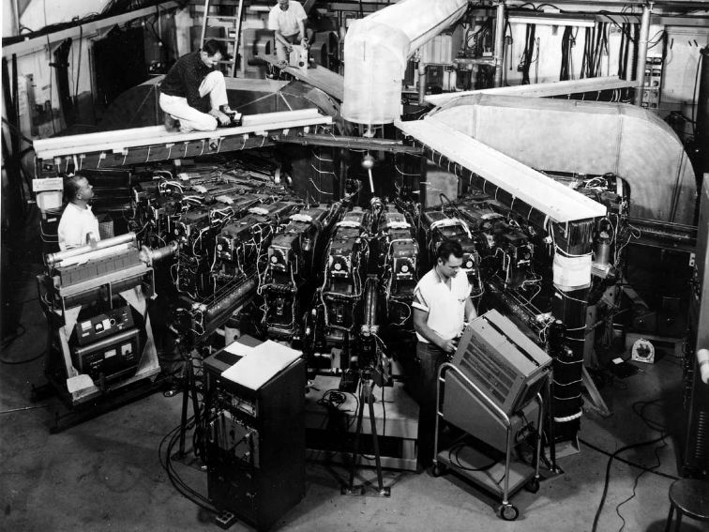
Some highlights
Several smaller electron FFA(G)s were built – and great hopes established. In 1960 a 50 MeV electron FFA was built in Madison for space charge studies & rf issues etc.
1956: Storage ring invention by D. Lichtenberg et al. from MURA group – advantages over FFA:
- have long straights for detectors
- dc magnets less complex/cheaper
1959: Negative mass instability discovered + Landau damping by
C. Nielsen, A. Sessler & K. Symon
Madison: FFA 50 MeV electrons
Notes:
neg. mass 1959 Intern. Conf.on High-Energy Accelerators, CERN, Geneva, (1959), p.239

Slide 6
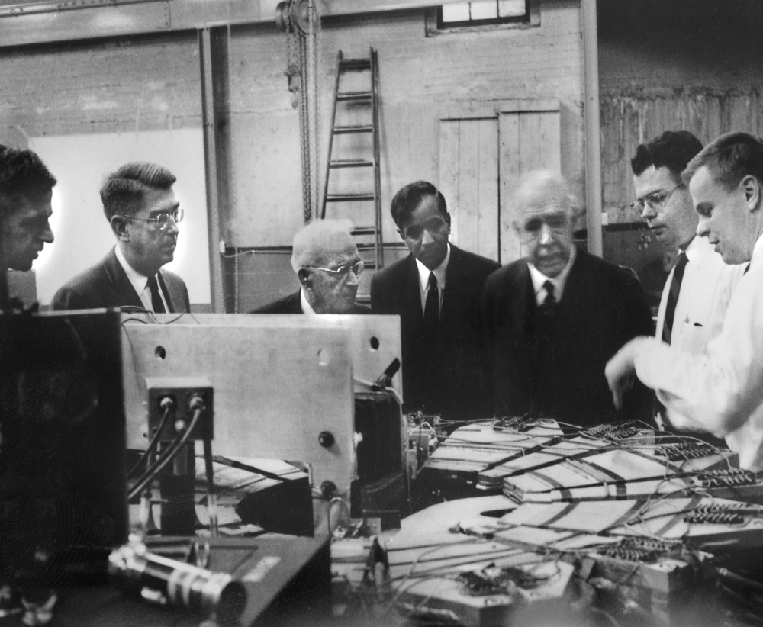
Prominent visitors to MURA
Niels Bohr
1958 visit to MURA lab; L‐R: Bob Haxby, Ragner Rollefson, Harrison Randall, Subramanyan Chandrasekhar, Niels Bohr, Charles Pruett, and Larry Jones

Slide 7
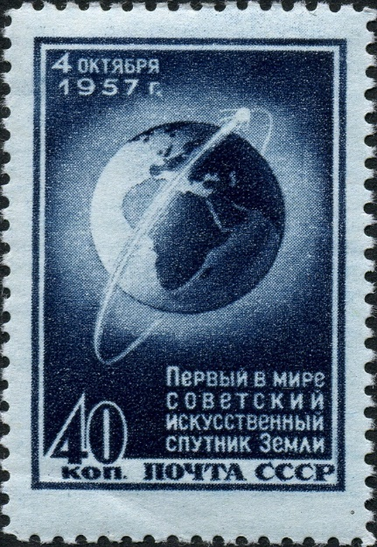
The Sputnik Crisis a political & cultural shock of the 1957
October 4, 1957: The Soviet Sputnik 1, the world's first artificial satellite
Triggered the Cold War Space Race between superpowers in research – also accelerators – to catch up (Linacs, cyclotrons and synchrotrons already existed)
AEC wanted a 12 GeV p accelerator very quickly at Argonne to compete with a Soviet 10-GeV p accelerator at Dubna
Competition put pressure on US and MURA
Notes:
The Commission(AEC) wanted to build an 12 GeV proton accelerator very quickly at Argonne, because the Soviet Union would soon have a 10-GeV accelerator at Dubna

Slide 8
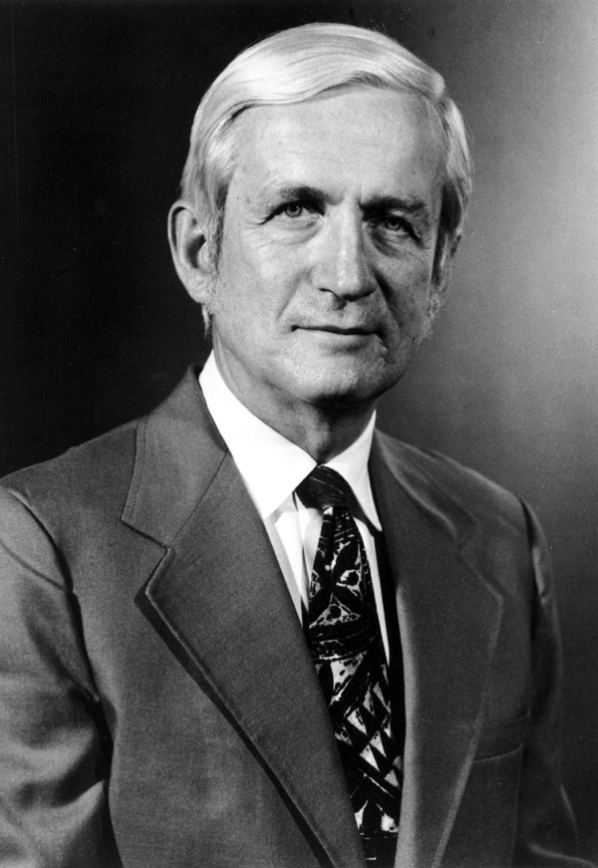
Further politics: The Ramsey Panel
The beginning of the „end“ of MURA and its big FFAG plans
1962, Ramsey Panel: Supported the Berkeley 200 GeV proposal as 1st priority + later a 1000 GeV for BNL - and supported a high intensity MURA 12.5 GeV FFAG only as 2nd priority.
The MURA university presidents: political effort to try to save MURA - visited President Johnson in the White House in 1964.
Considerable criticism of MURA by Berkeley & BNL of political action to introduce politics into physics.
Mura was over
Not really: Revival much later on (see, for example, “Scaling FFAG Accelerators …”, Shinji Machida, Phys. Rev. Lett. 119, 2017)
Norman Ramsey, Nobel Laureate of 1989
Notes:
1989 nobel price – in Interferometry kennedy assassinated 1963 - Cole: big labs. senators came and visited them, so they didn‘t have to go to White House

Slide 9
A glimpse on Laslett‘s further work in this period
On Space Charge: In 1963, detailed calculation of space-charge effects & presence of conducting walls and dc magnets. The name "Laslett tune shifts“ appeared
On “chaos” (1957): The Runge-Kutta method in use for orbit studies didn’t conserve phase space exactly → roundoff and truncation errors
→ Symon and Laslett developed a symplectic algebraic transformation
-> In a MURA report of 1957: Laslett demonstrated a real physical basis to chaos
Notes:
other work of laslett – astronomy?

Slide 10
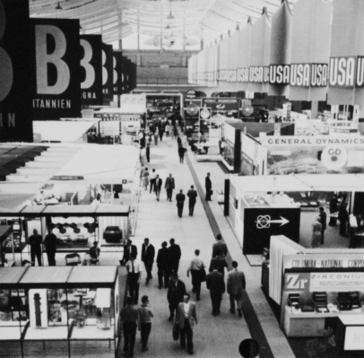
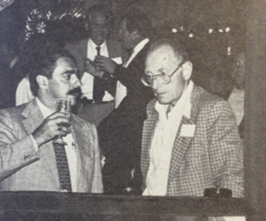
A switch: „Atoms for Peace“ / energy problem a parallel development of relevance
1958 in Geneva: 2nd UN-conference on Peaceful Uses of Atomic Energy lifted Cold War military secrecy around thermonuclear fusion. Soviet Lev Artsimovich (inventor of Tokamak): most important is “… the further development of the international cooperation“
1975: Al Maschke, BNL: Proton/ion accelerators a new path to drive inertial fusion – instead of a laser
Maschke later: „board was immediately wiped off and meeting declared as “classified “
Notes:
Linac Conference – our paper on HIF with Target on indirect drive on Christmas eve

Slide 11
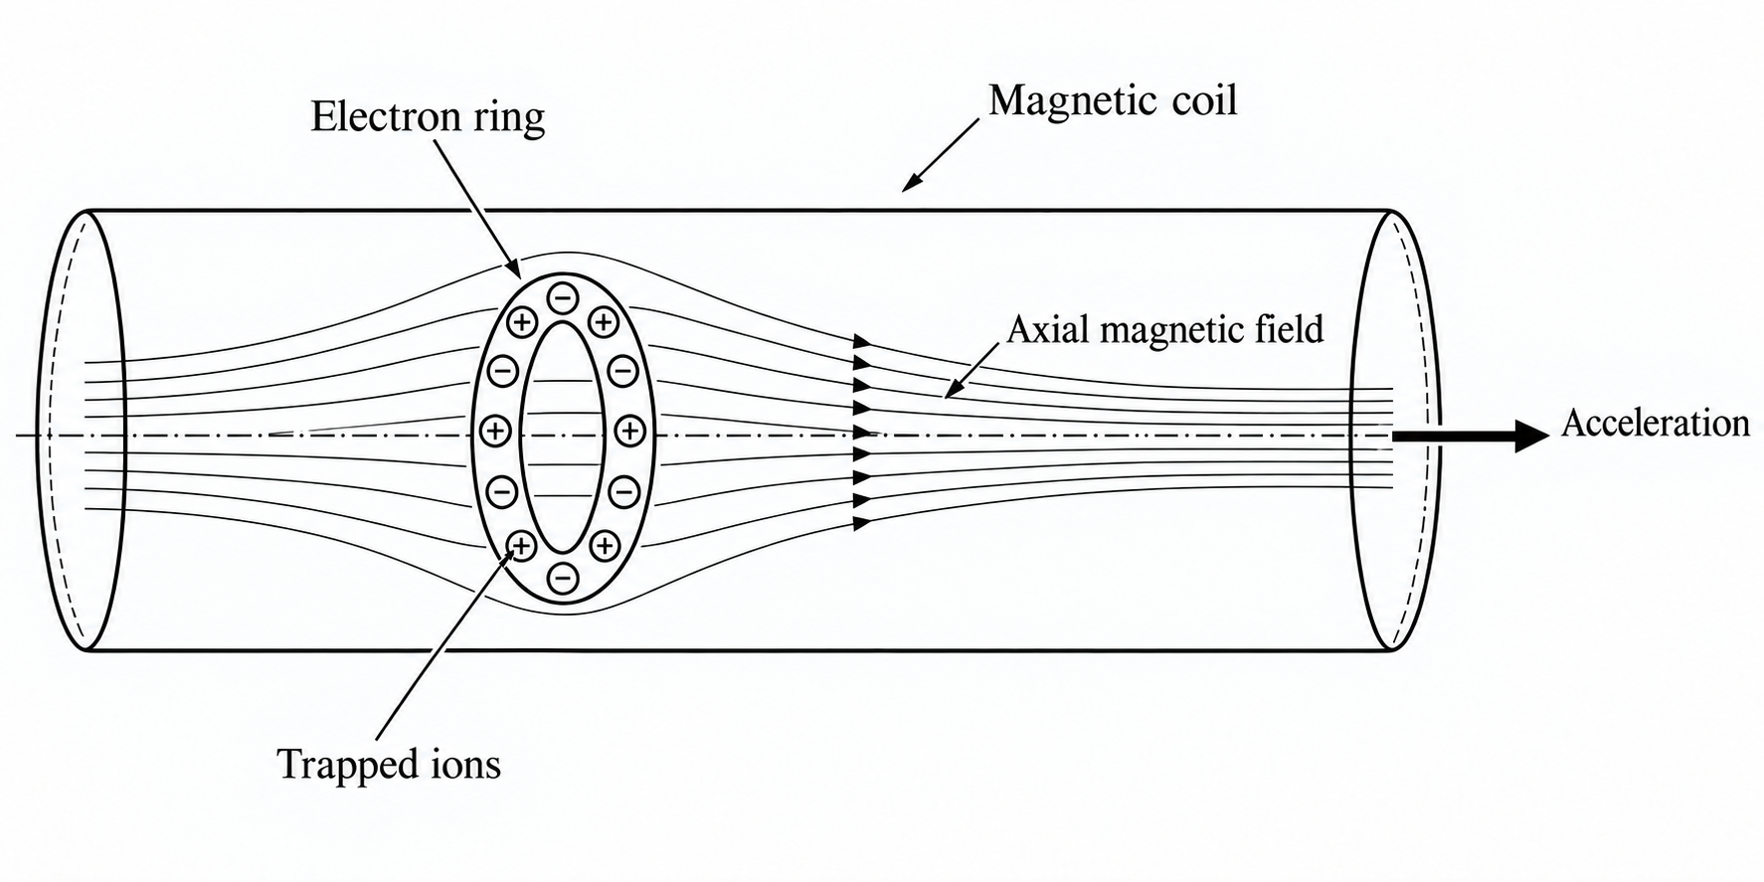
Berkeley group - after 1963
Several MURA people had gone to LBNL and/or LLNL after 1963
Worked first on the „Electron Ring Accelerator“(ERA) collective acceleration (plasma ring) project – a forerunner to two-beam accelerators, invented by Academician Veksler / SU
LBNL was leading in the West - against Dubna/SU. Martin Reiser at U Maryland; Germany started an ERA project at IPP Munich - my first job in accelerator theory!
Most people gave up after a decade -frustrated by unexpected resonances and instabilities
1975: after Maschke‘s proposal
  the LBNL group switched to HIF,
  hoping for more political support

Slide 12
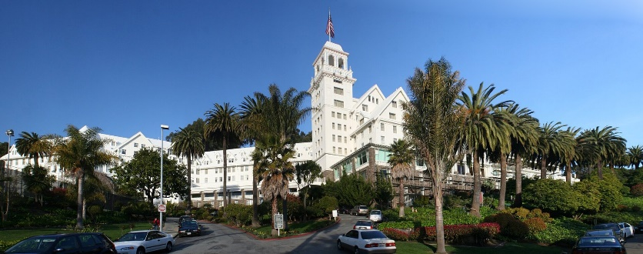
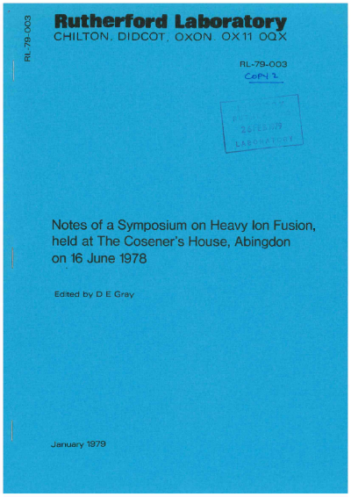
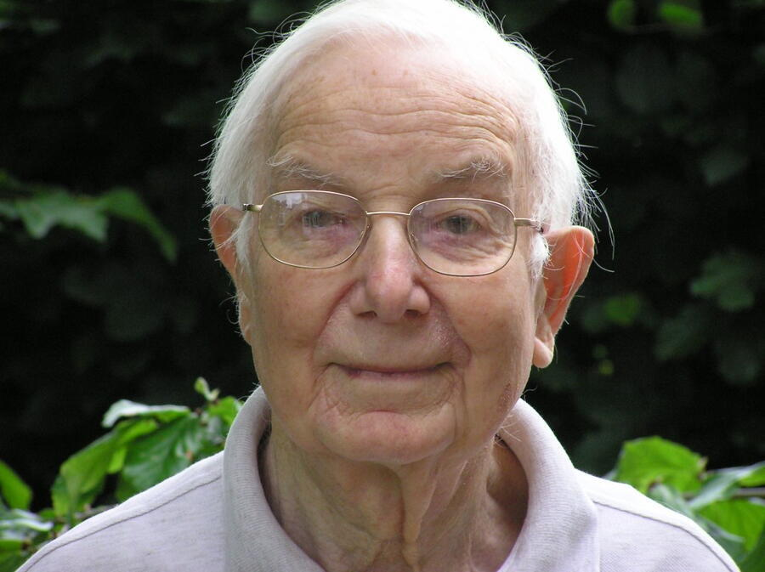
International Meeting: Heavy Ion Fusion“ HIF
Sparks jumped over to many Labs
1976: LBNL organized 1st HIF workshop at Claremont/Berkeley
wide participation from many US-labs & universities as well as from Canada, CERN, GSI, RAL, Saclay, Japan …
In summer 1978 John Lawson (1957: Lawson criterion for fusion burn) in a meeting at Cosener‘s House, Abingdon: „Problems in HIF“ (RAL-report)

Slide 13
John Lawson
David Gray, RAL, in 1978: “This symposium on
heavy ion fusion was held to inform the relevant
university departments and other interested
organisations of the developments and prospects
in this field, and to encourage them to take up
problems relevant to their own research fields.”
John Lawson, 1978: ”It is now possible to see the
  broad outline of a concept involving heavy ion accelerators, target, reactive vessel and steam plant … to identify problems which it would be profitable to study in the UK at the present time …”
  He listed many issues, from charge exchange of the ions in storage rings to transport problems in the reactor chamber etc.
Notes:
abstract from D. Gray – rest Lawson

Slide 14
Berkeley group HIF project
→ Single bunch induction linear accelerator – to handle extreme transverse space charge tune depression - Fusion required: highest intensity and brilliance of beam – accelerator seemed superior to laser (that time)
Laslett and others were uncertain about beam instabilities at such high space charge level
My chance: in 1977/78 got invited to take part in their analytical theory - using Vlasov‘s equation (my PHD background); hardly used in accelerator work – different from plasma physics
  practically no PIC codes in accelerator community

Slide 15
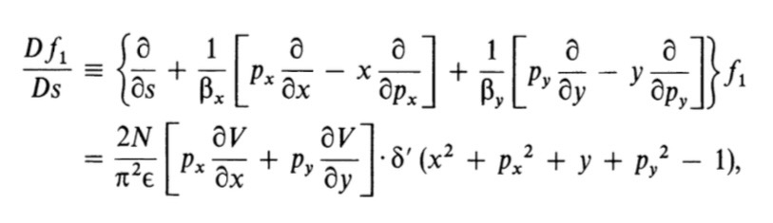
Initially: it was „all theory only“ 0
Solving linearized Vlasov‘s equation (collisionless Liouville equation) in 2d for a round beam in a periodic lattice was new!
(f = f₀ + f₁)
0
0

Slide 16
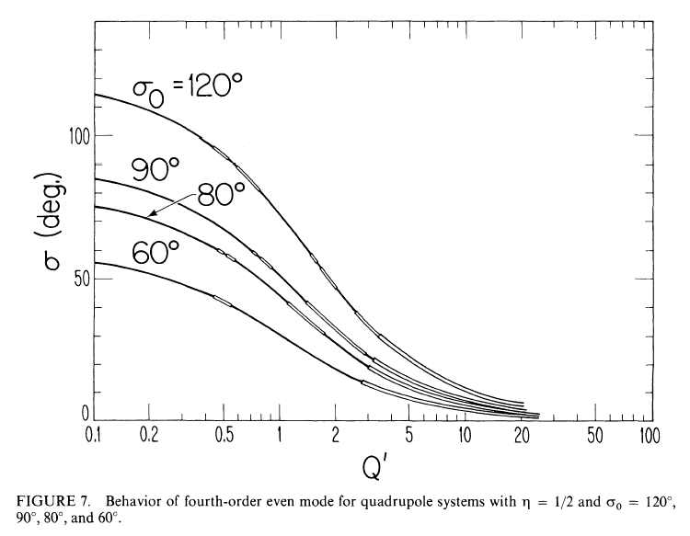
Initially: it was „all theory only“
Found „Parametric Instabilities“ in each order - growing from noise - example 4th order „octupolar“ mode ----->
LBNL leadership advised: we cannot publish this pessimistic result - work harder and study non-KV!

Slide 17
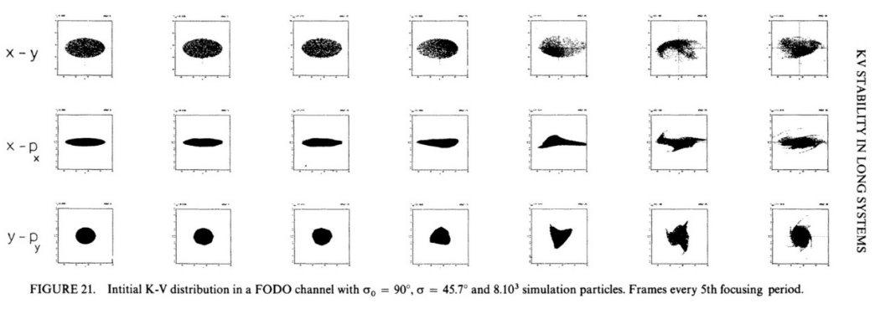
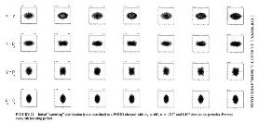

Computer simulation „saved us“
Our tool was one of the first accelerator PIC simulations
The KV beam grew in 4d
4d-Waterbag was ok! Absent in Gaussian, („Landau damping“) and we could publish – in 1983! Monotonically decreasing initial distribution functions provided enough Landau damping
I. Hofmann, L.J. Laslett, L. Smith and I. Haber, Stability of the K-V distribution in long periodic transport systems, Part. Accel. 13, p. 145, 1983

Slide 18
What happened next with HIF?
Berkeley project slowly declined in late 1990‘s
  Complexity of design
  Livermore laser advanced more and more
1991 C. Rubbia/CERN, : Let‘s go the European way!
He argued: Accelerator much cheaper, higher rep rate & efficiency & reliability
HIDIF - Heavy Ion Driven Inertial Fusion - was born -> 1995- 98
  People from 9 countries involved, including labs CERN, GSI, KfK, RAL, ENEA-Frascati, ITEP Moscow, Orsay-France and others
  Coordinators: Günther Plass/CERN and Ingo Hofmann/GSI

Slide 19
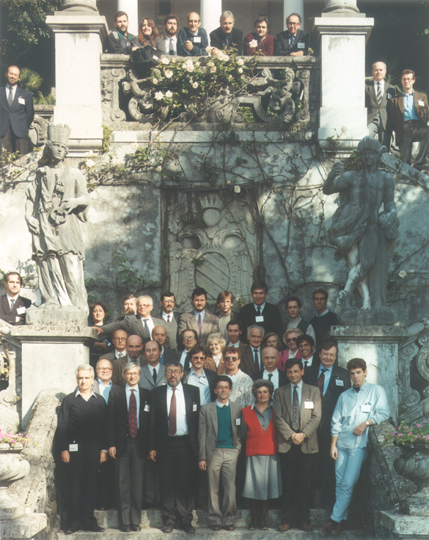
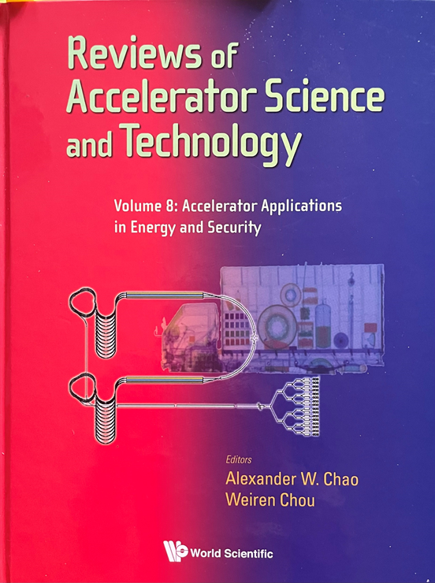
CERN „European initiative“ – began in 1991 and ended in 1998
Review of HIF in 2015 volume
Carlo Rubbia
Final (internal) conclusion:
cost > 10x higher than Rubbia
believed in beginning -> end
Varenna, Italy, 1991, all-European start in HIF
HIF served as a kind of Start-up preparing for
next generation high-intensity projects

Slide 20
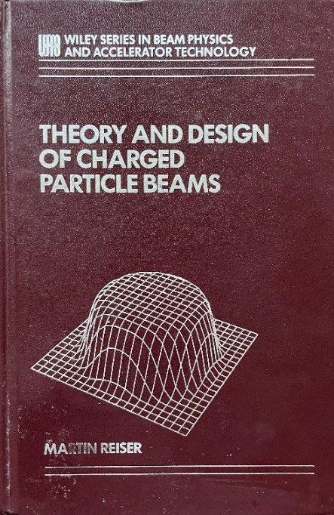
High intensity linac and ring projects for p/ion (Spallation Neutron Sources …
1998: Shelter Island Workshop
1999: BNL Workshop
→ preparing for SNS in theory and practice (construction started end of 1999!)
  Among them was the „equipartitioning“ question in
  linacs - defended in Martin Reiser‘s book on beam dynamics
  Thermodynamic thinking: intense linac bunches naturally go into a state of equipartition - „equal temperatures“ - due to collisional effects → energy transfer from hotter“ direction to „colder“ one.
  But rate was too small!
→ Anisotropy discussion started: resonant coherent space charge instabilities „only“ explanation for transverse emittance growth
First edition, 1994

Slide 21
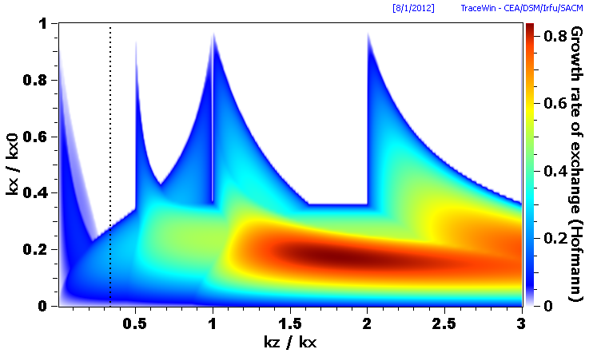
Anisotropy - between x,y and z (linacs) - driven parametric instabilities
  Anisotropy parameter T = E _{z} / E _{x} = ε_{z}k_{z} / ε_{x}k_{x} T with T=1 equipartion
  „Stability Charts“: calculated analytically from Vlasov equation - effort far above our 1983 paper
  I. Hofmann: Stability of anisotropic beams with space charge, Phys. Rev. E 57, 1998
3rd
2k_{z} =2k_{x}
4th
3rd
  Automatic plots on
  TRACEWIN (Saclay group) allowed visualizing coherent mode stopbands on k_{z} /k_{x} plane
  Note: Also incoherent resonances driven by space charge possible in these bands
  Hofmann, Oeftiger, Boine-Frankenheim, PRAB 24(2021)
T=1
ε_{z}/ε_{x}=3
octupolar mode
equipartioned
Notes:
- erwähne dispersion relation 4h order half a page long … for WB parametric similar to KV – with interplay incoherent – paramtric (2017)…

Slide 22
Landau damping in anisotropic beams
x
y
x/y
z
isotropic
anisotropic

Slide 23
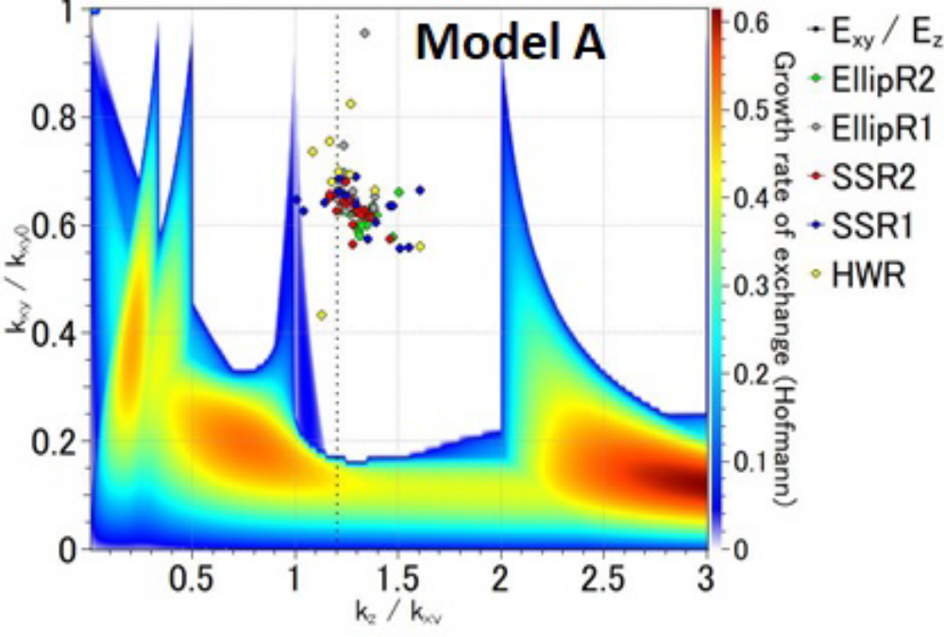
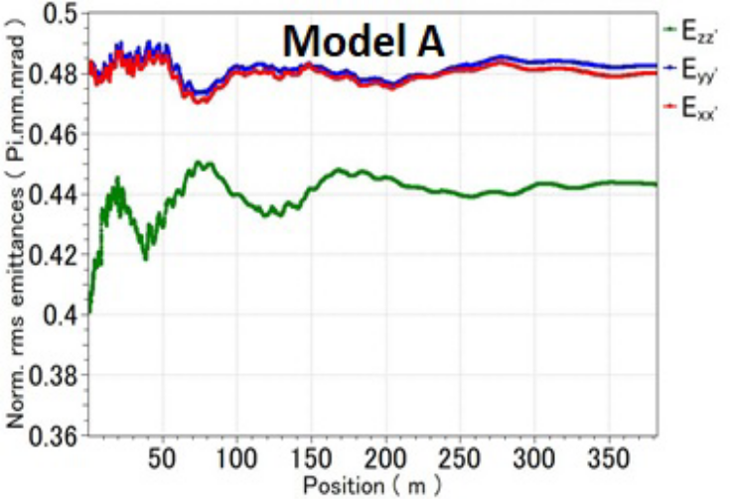
JAEA – ADS: Accelerator Driven Subcritical System s.c . CW proton linac of 30 MW & subcritical nuclear reactor
T=1
A nearly equipartitioned design - no risk
C. Plostinar et al. , Proc. IPAC'13, Shanghai, China
ε_{z}/ε_{x}=.83
ε_{z}/ε_{x}=.83

Slide 24
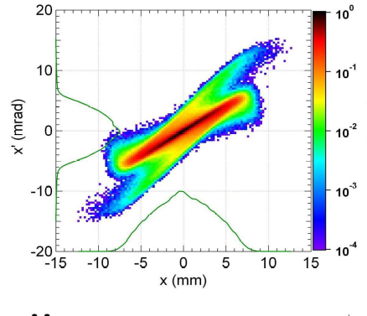

W. Simeoni et al, IPAC’11, San Sebastian, Spain
IFMIF-EVEDA
s.c .Fusion Material Irradiation Facility (F/J)
T=1
3rd
4th
3rd
ε_{z}/ε_{x}=1.5
T~6
“Realistic” x-x’-initial distribution
as input – not Gaussian or WB
What is a realistic distribution?
ν_{z}/ν _{x}
Anisotropy effect: combined response of parametric instability and single-particle resonances
→ Landau damping may be ineffective here due to 3d z- x/y anisotropy - specific to linear accelerators, where it is sometimes overlooked!
Notes:
T initially T = E _{z} / E _{x} = ε_{z}k_{z} / ε_{x}k_{x}

Slide 25
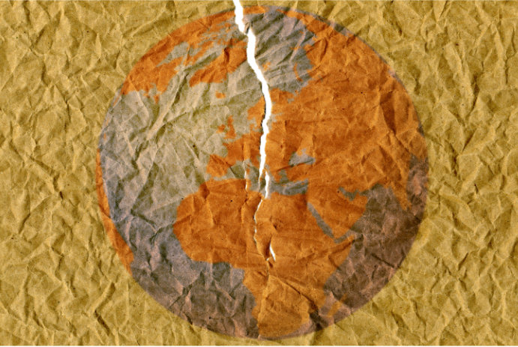
Concluding Remarks
Progress in accelerator science is built on about 70 to 80 years of history – also on politics – after the Cold War now between the two big Supers.
APS Journal Jan/Feb 2026:
The fight to keep science global
(Robbert Dijkgraaf, mathematical physicist and
president-elect of the International Science Council)
““Frontier research infrastructures, such
  as the next generation of particle
  accelerators, space telescopes, or
  gravitational wave detectors …
  all demand world-scale laboratories.”
“Some nations are trying to shut the doors of international collaboration”
“Scientists can keep them open.”
Let us continue to keep the doors open!
Picture from Article

Slide 26
Backups

Slide 27
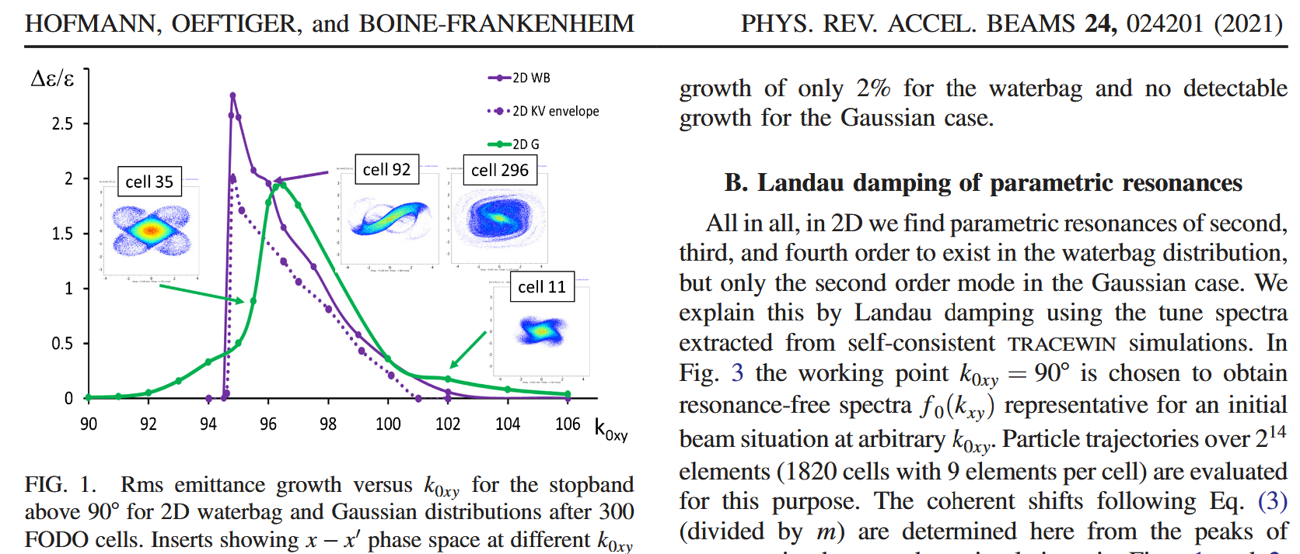
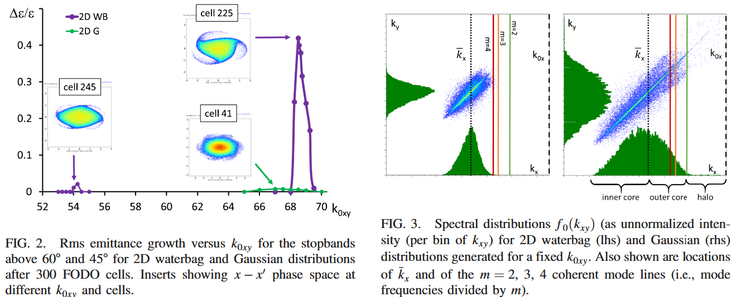
From our PRAB 2021:

Slide 28
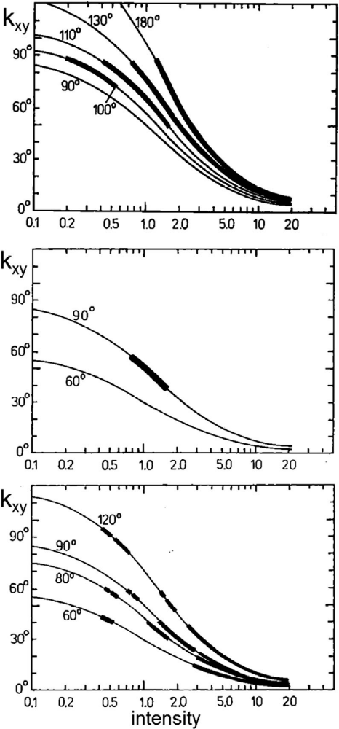
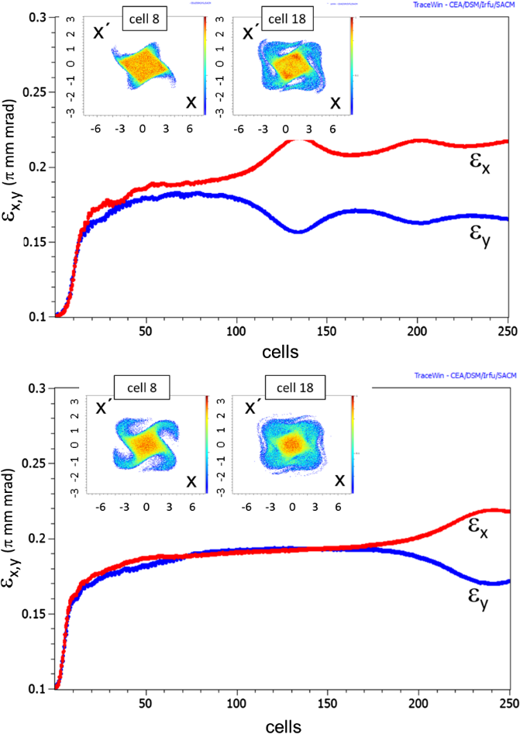
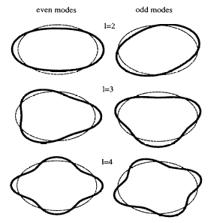
From our PRAB 2017
out at later times). Note that the initial distribution has
strictly uniform transverse density profiles with no space
charge “pseudo-octupole” content, except on the noise
level. Thus, this growth can be attributed only to an integer
(n = 2) parametric resonance ϕ=4k_{0;x;y}−Δk_{4;coh}=360°,
which drives its amplitude to a finite level until saturation.
The existence of this mode is in agreement with the
linearized theory stopband prediction at 90° of Fig. 3.
FIG. 4. rms emittances versus cell number for k0;x;y =120°,
kx;y =80° (inserts showing phase space plots at indicated cells)
for KV beam (top graph) and for waterbag distribution beam
(bottom graph).
(even or odd modes – laslett graph shows only 4th even?)

Slide 29
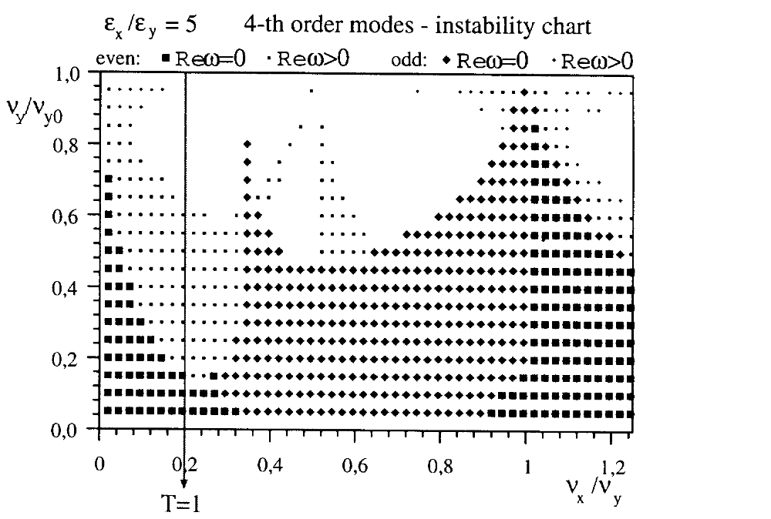
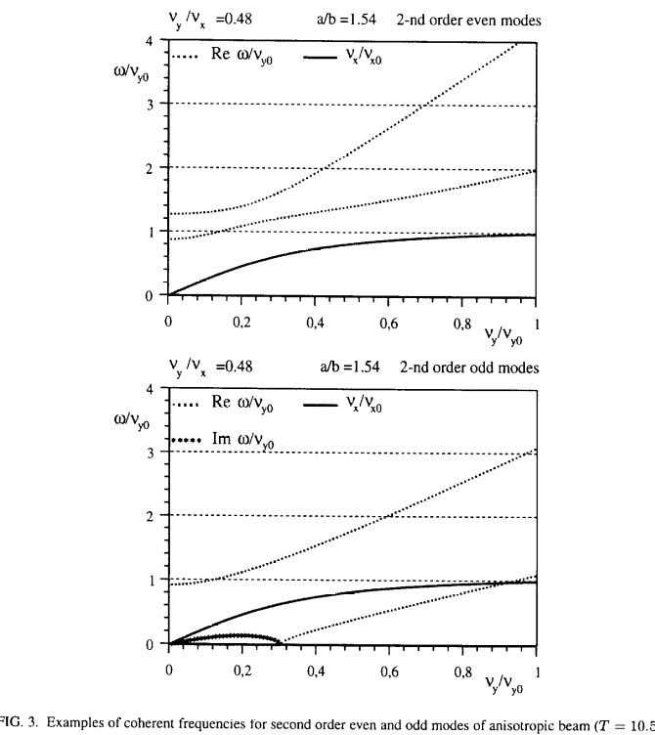
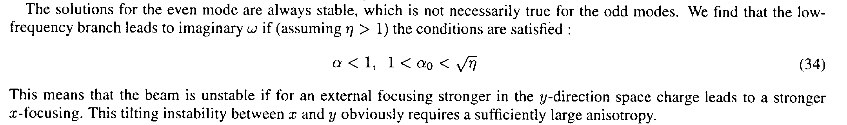
from my 1998 paper (constant focusing!):
odd modes lhs from 1 even. odd rhs – only non-oscillatory (Rew=0) modes considered in final charts
odd mode instability require very strong tune depression in y in this example (in sea)

Slide 30
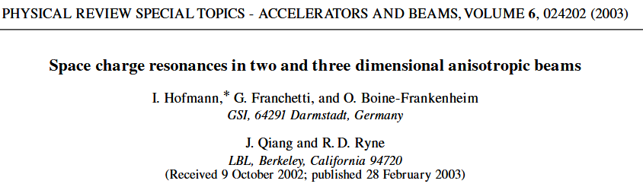
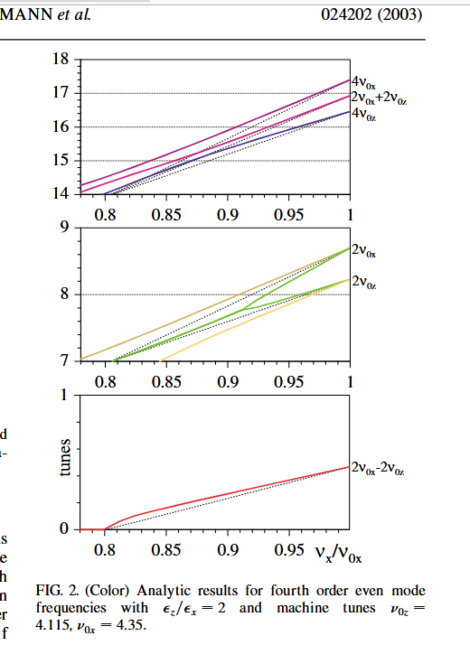
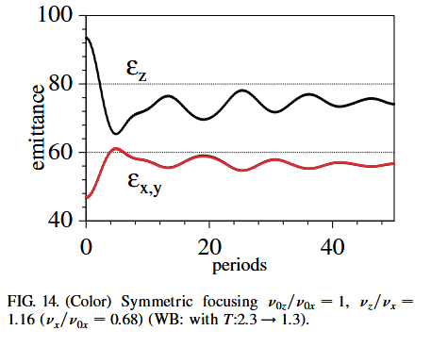
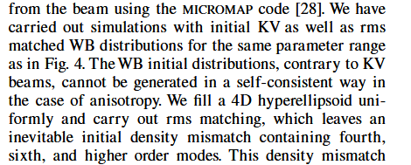
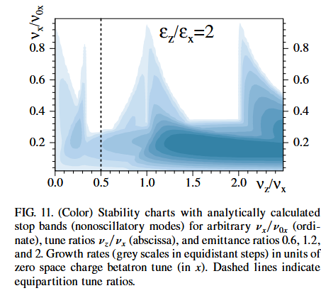
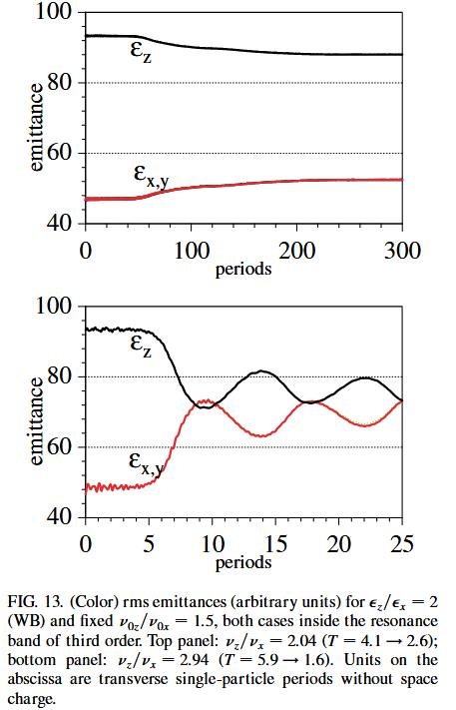
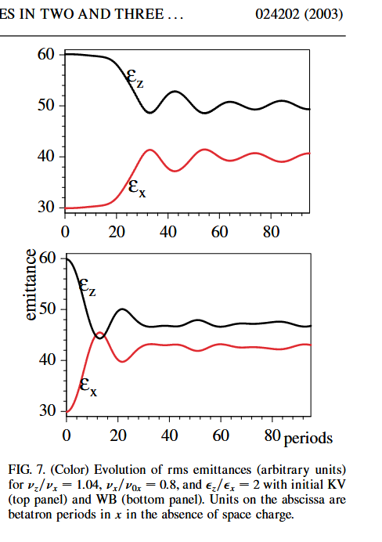


Slide 32
Concluding Remarks
Progress in accelerator science is built on quite on about 70 to 80 years of history
New ideas have been stimulating and driving progress – many never got realized
Analytical efforts are history – computer simulation and AI make the game now!
Mind the gap between idealized simulation and data from realistic input or even measurements (example Landau damping …)
………………………..
continued …
Notes:
Glen Lambertson

Slide 33
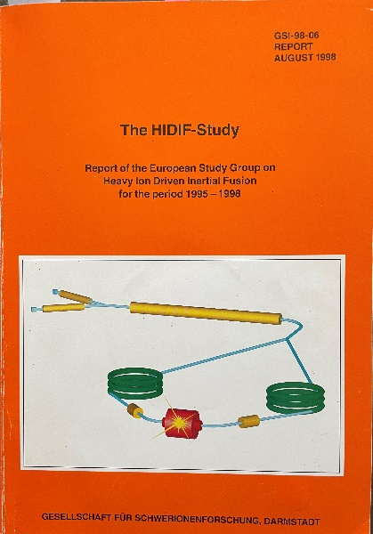
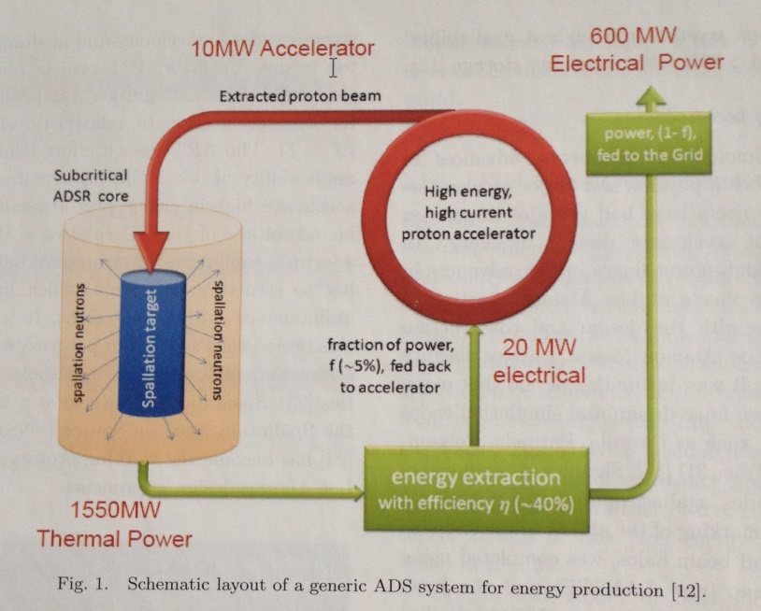
“Accelerator Applications in Energy “ 2015 Review:
Accelerator Driven Systems
are at power frontier:
Nuclear waste transmutation, Subcritical reactors,
Others: …….
HIDIF driver

