Slide 1



Mitigation of Proton Beam Instabilities under
Strong Space Charge
D. W. Posthuma de Boer
Space Charge 2026, 1st October 2026

Slide 2
Contents
Background
Coherent Instability – Impedance Model
Experimental Results
Mitigation
Conclusion

Slide 3
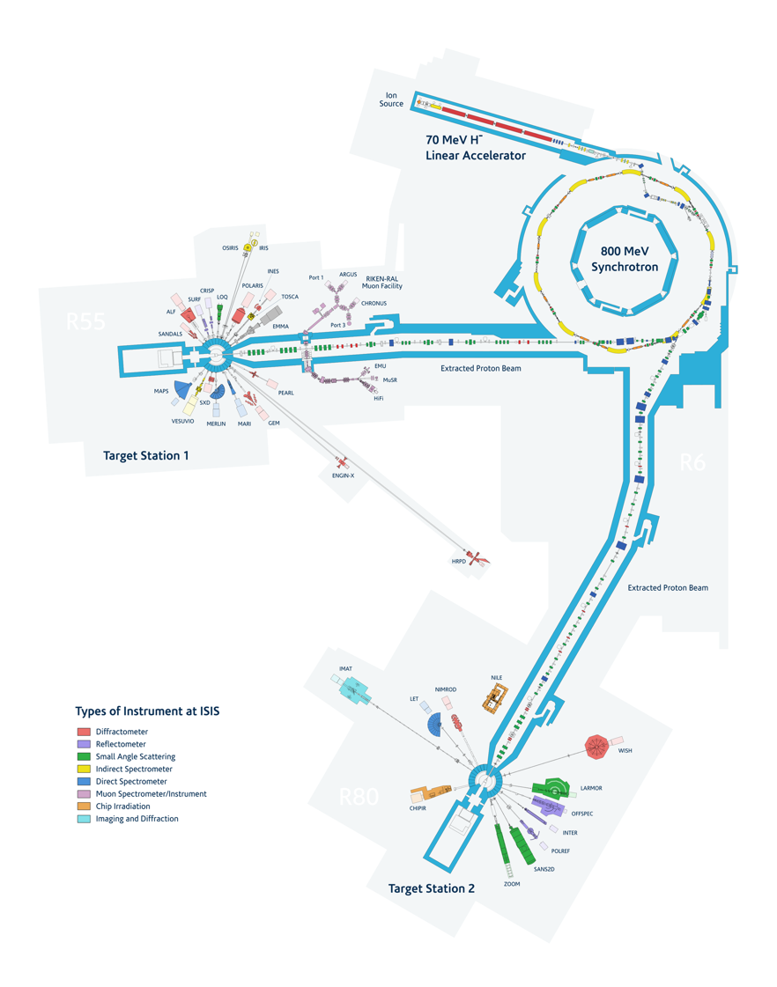
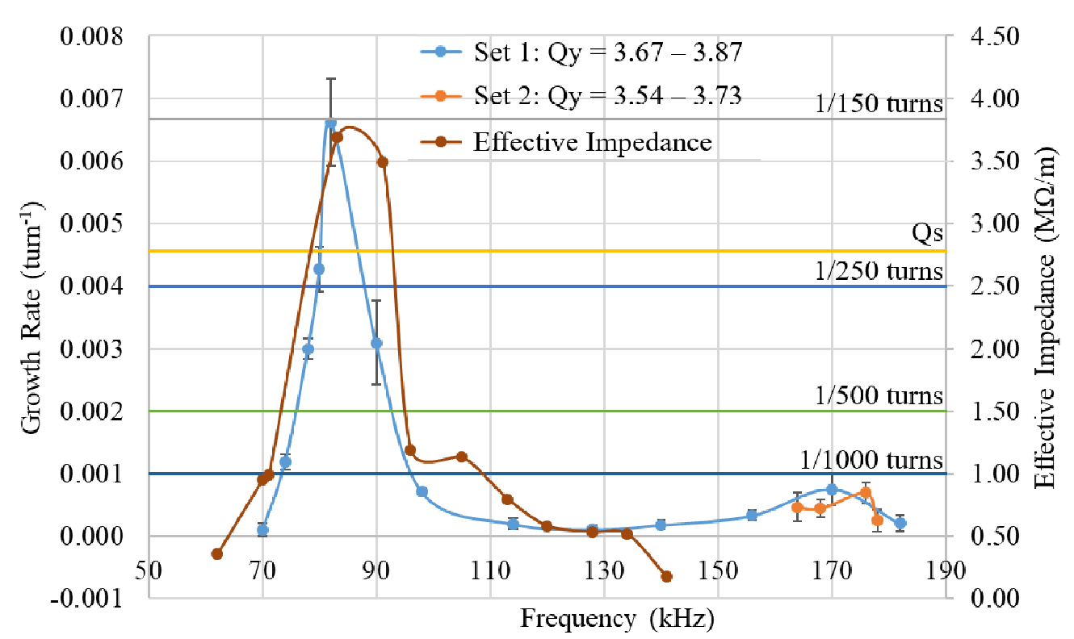
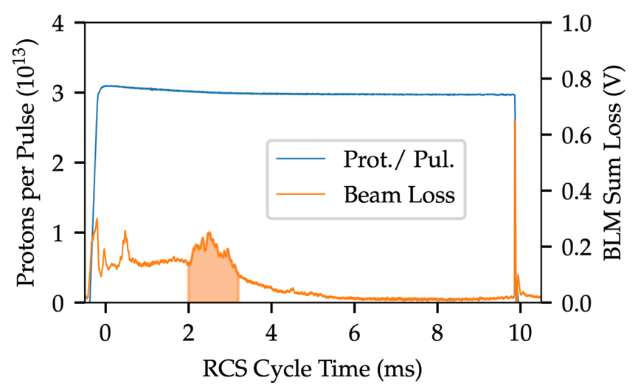
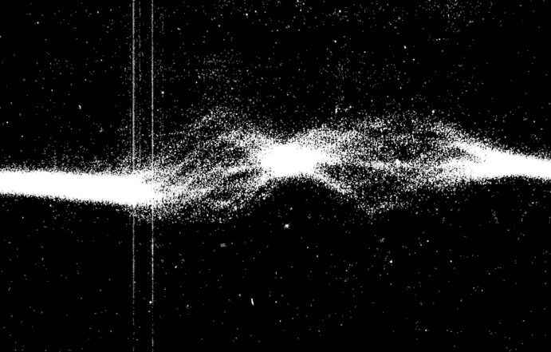
ISIS is the UKs Spallation Neutron and Muon Source
Delivers research across many disciplines (batteries, archeology, healthcare…)
Driven by a Rapid Cycling Synchrotron with a dual-harmonic RF system, which delivers up to 3x10¹³ protons to its fixed targets at 50 Hz [1]
Typical space-charge parameters in operation are ~30 – 50 (strong) [3]
Primary causes of loss include:
  Direct Transverse Space Charge
    C. M. Warsop (Weds), E. Ahmadi (Fri), J. Appleby (Weds)
  Longitudinal Trapping
    B. Kyle (Thurs)
  Coherent Vertical Instability
    D. W. Posthuma de Boer (now), F. Straniero (poster)
ISIS Facility [2]
BPM difference plot [4]
ISIS SRM and BSRM instability results [3]

Slide 4
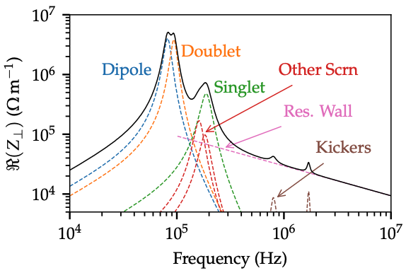
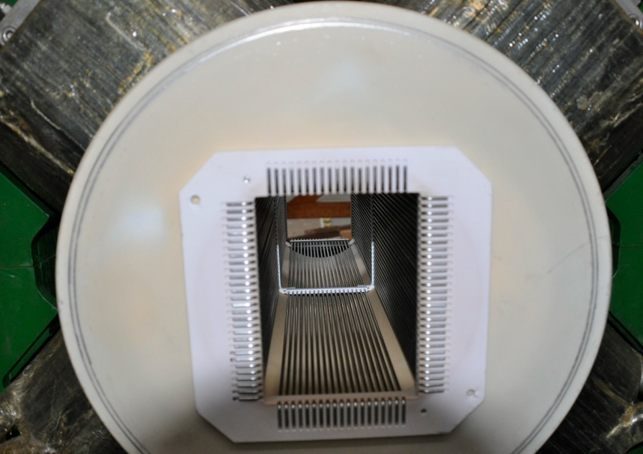
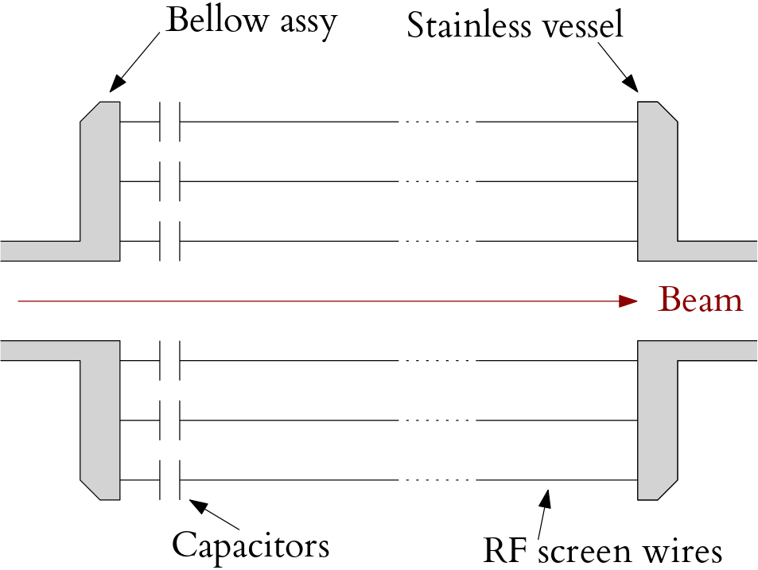
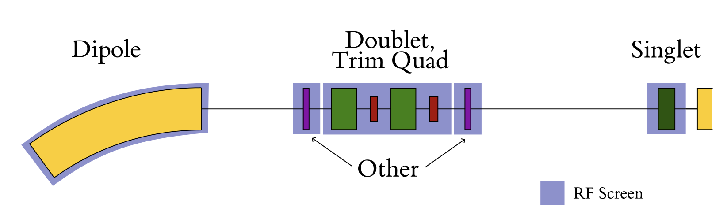
The Vertical Impedance Model
Impedance model is targeted at identifying the driver
of the 2 ms head-tail instability [5].
  Low-frequency, vertical, driving resonator impedances
Includes:
  Resonator from capacitively coupled RF screens
  Thick resistive-wall
  Terminated kicker magnets
  Indirect space-charge
Lowest frequency sideband in early part of acceleration (~100-200 kHz), overlaps with RF screen resonators.
  Dominated by RF screens
Photograph of an RF screen and ceramic vessel.
Schematic of RF screen wire connections.
A typical ISIS superperiod

Slide 5
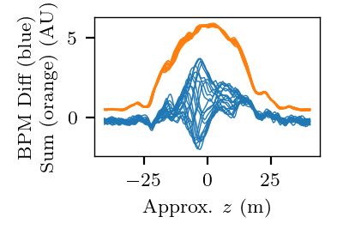
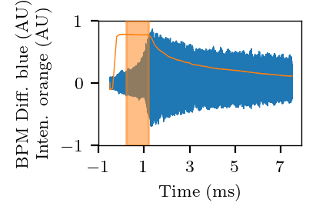
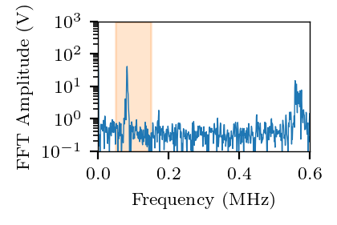
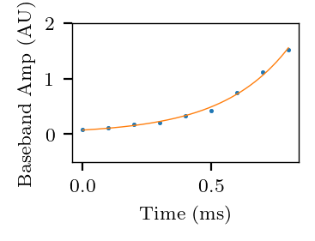
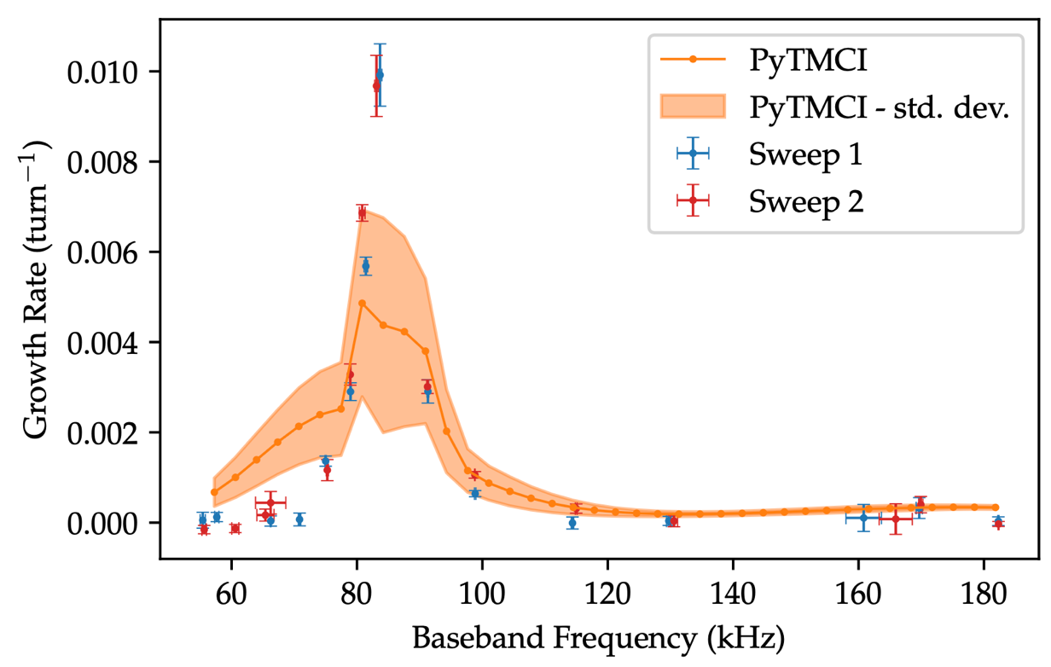
Low-Intensity Experiments
Studies with operational beams challenging, so
Bunched Storage Ring Mode (BSRM) used [3, 5]:
  Beam stored in stationary bucket
  Typically with lower intensity (SC-parameter of ~3-5)
Sweep vertical tune, record instability growth rate.
Benchmark with PyTMCI [6] predictions
  Vlasov solver – no direct space charge
Order of magnitude agreement in growth rate at ~85 kHz
  Driver understood from impedance model as dipole/ doublet RF screens.

Slide 6
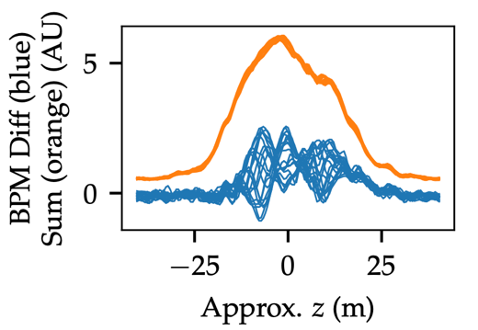
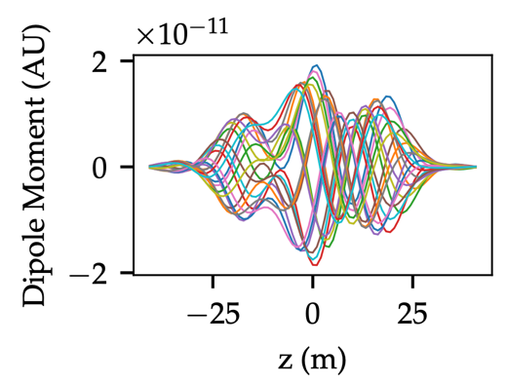
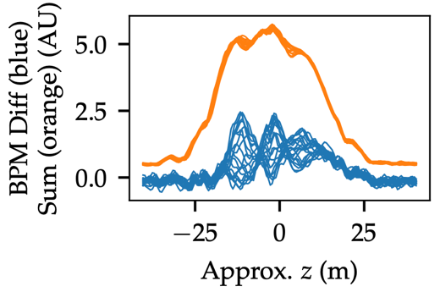
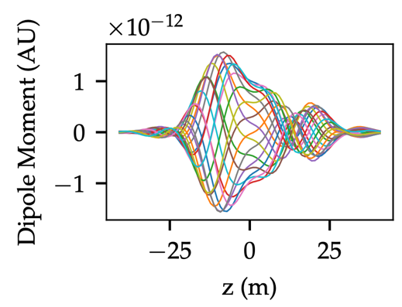
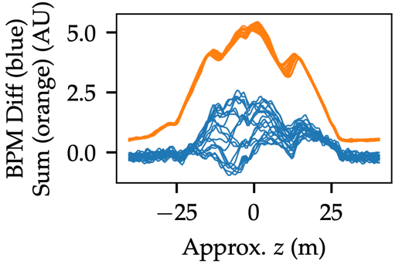
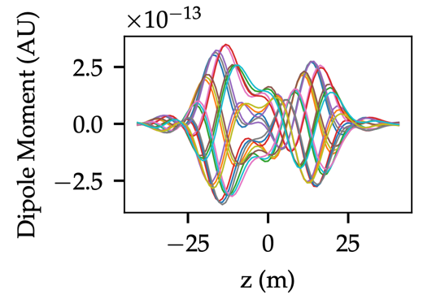
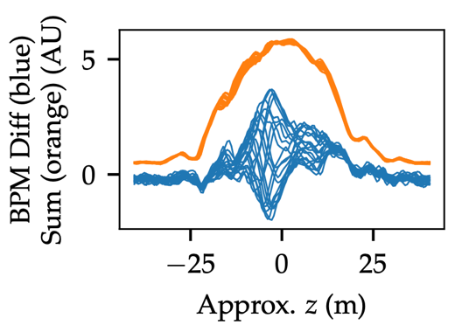
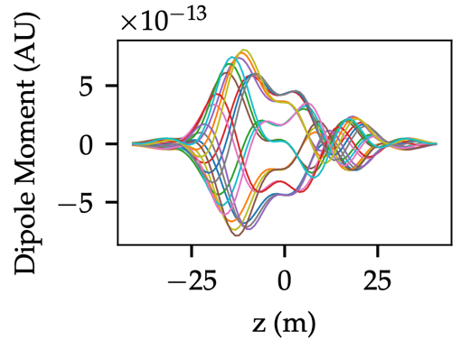
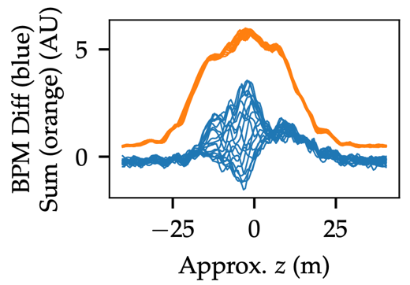
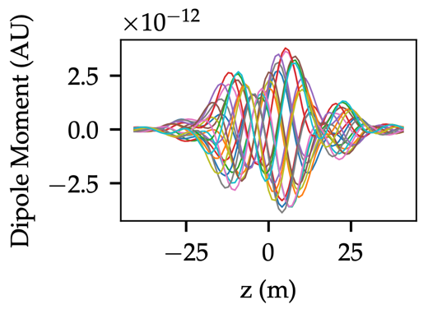
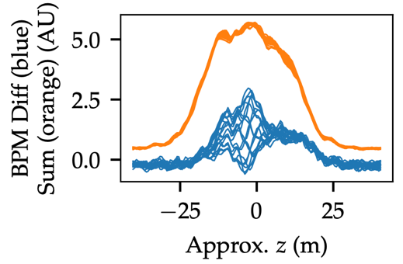
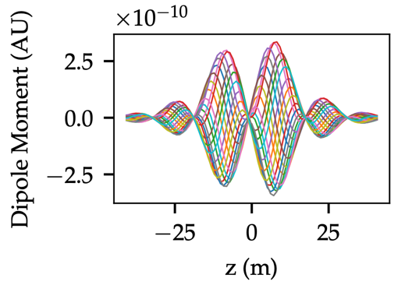
Low-Intensity Experiments - Distribution
3.854
In general, distributions not well predicted by PyTMCI,
but is this because space-charge omitted?
For most unstable setting (3.876), PyTMCI predicts
several modes with similar growth rates.
  If we wait a long time, one will dominate
  Before that time, we’ll see a sum of several modes
Estimate ~3 ms for dominant mode with most unstable setting, but beam loss occurs after ~0.5 ms.
Space-charge definitely important – but challenging anyway.
3.865
3.876
3.879
3.884
3.889

Slide 7
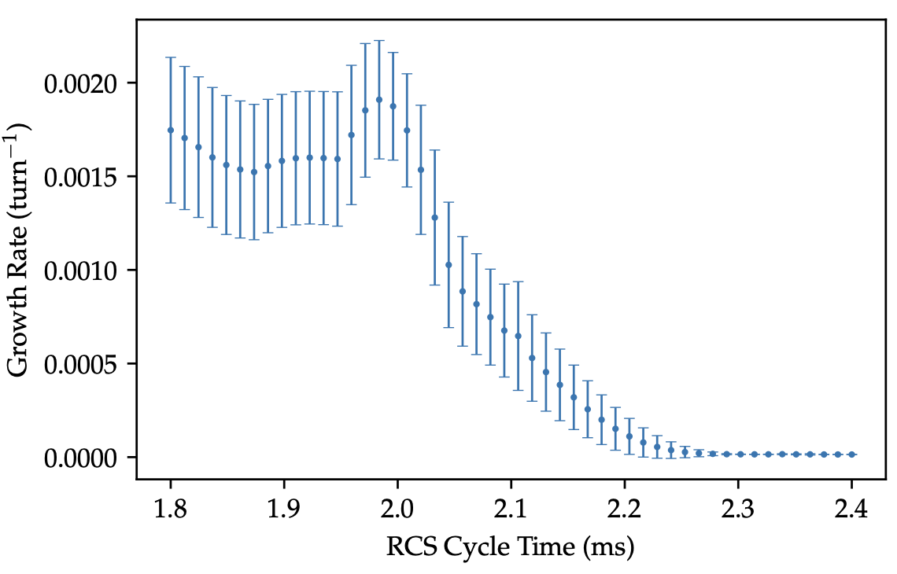
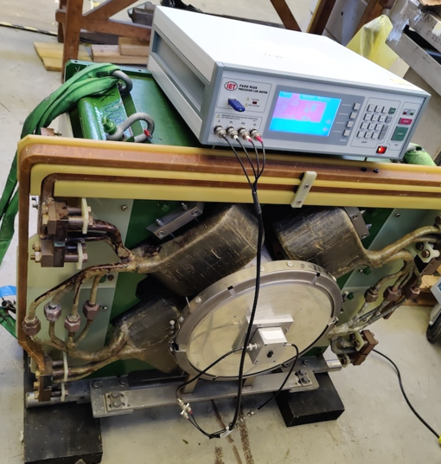
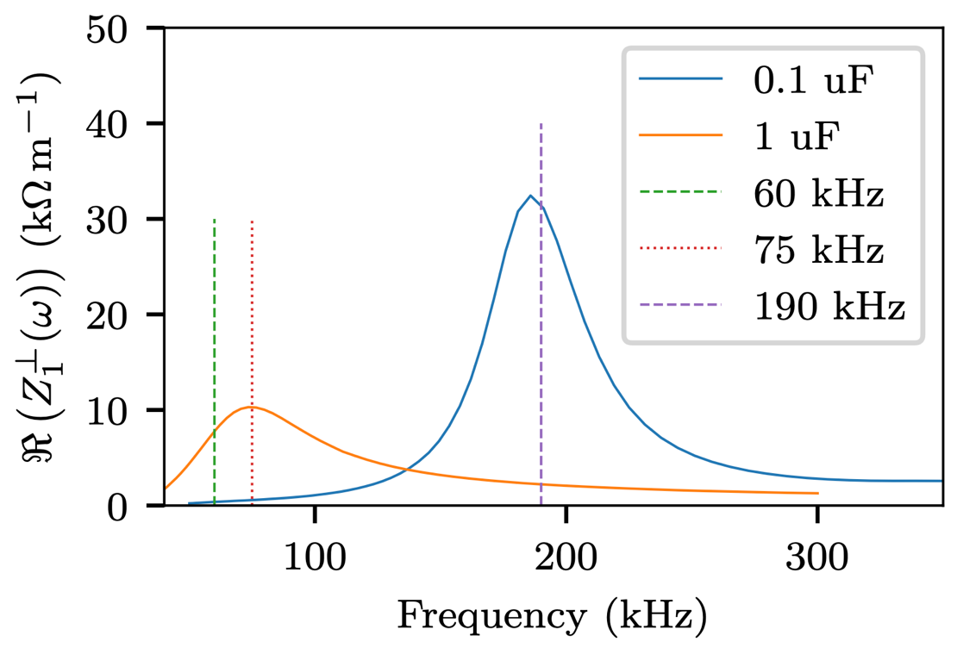
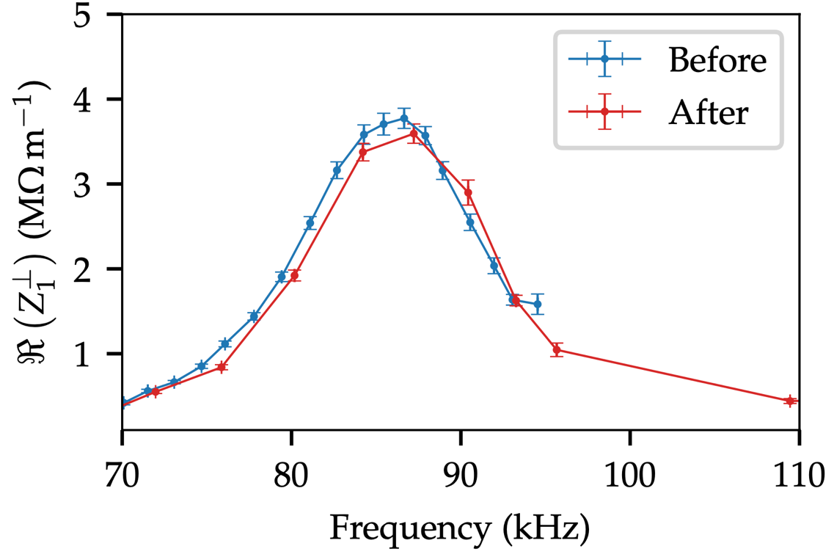
Mitigation under Strong Space-Charge
PyTMCI
PyTMCI also predicts key elements of observed instability
  Growth rate (~0.4 ms predicted, ~0.2– 0.6 ms observed)
  RCS cycle time when the beam will be unstable (~2 ms)
Impedance optimisation is still a fundamental solution.
Verified that resonant frequency follows ~1/√C [7].
  C is the capacitance of rf-screen capacitors
Predicted growth times increase by 2+ orders of
magnitude if all resonant frequencies reduced by factor of 3.
  ~10x increase in capacitance
Trial of operational capacitor replacements ongoing –impact monitored using coasting beams.
  Initial results promising – but more data required.

Slide 8
Conclusions
Instability growth rates reasonably well predicted by PyTMCI without direct SC, despite experimental space-charge parameter of ~3-5.
  Driven by dipole/ doublet RF screens.
Predicting distribution could be challenging on ISIS, even without SC.
PyTMCI also reproduces key observations of an operational beam.
  Driven by RF screens.
Traditional approach to mitigation: impedance optimisation, coasting-beam experiments to monitor progress.
Francesco Straniero combining space-charge with impedance model for ISIS

Slide 9
References
[1] - isis.stfc.ac.uk
[2] - https://doi.org/10.5281/zenodo.21157242
[3] – R. E. Williamson, “Studies of beam instabilities and associated beam-loss on a high-intensity proton synchroton”, DPhil thesis, 2023.
[4] – C. Planner, “Progress to operating at 100-µA on ISIS”, Snowmass88, 1988.
[5] – D. W. Posthuma de Boer, “Studies of beam impedance with related beam stability and loss effects on a high intensity proton synchrotron”, DPhil thesis, 2026.
[6] - https://github.com/stfc/PyTMCI
[7] – D. W. Posthuma de Boer et al, “Low-frequency transverse resonator impedances on the ISIS proton synchrotron”, HB2025.

