Slide 1
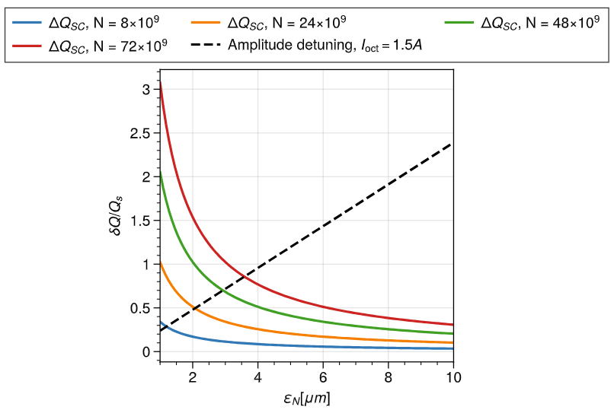
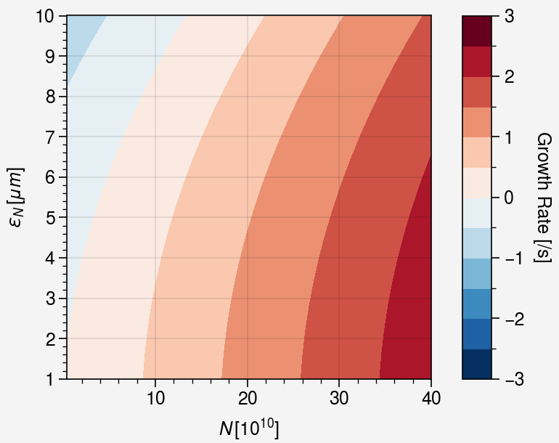
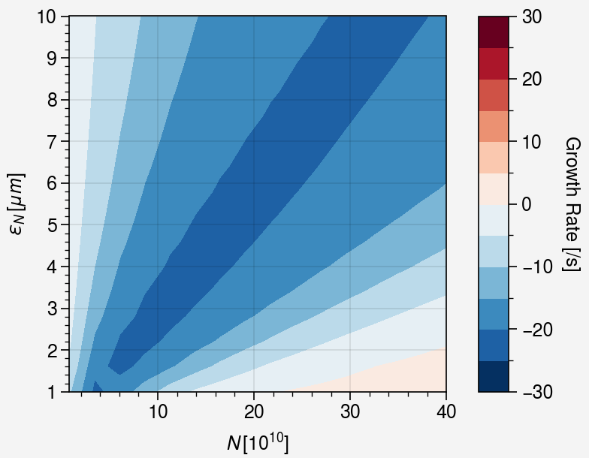
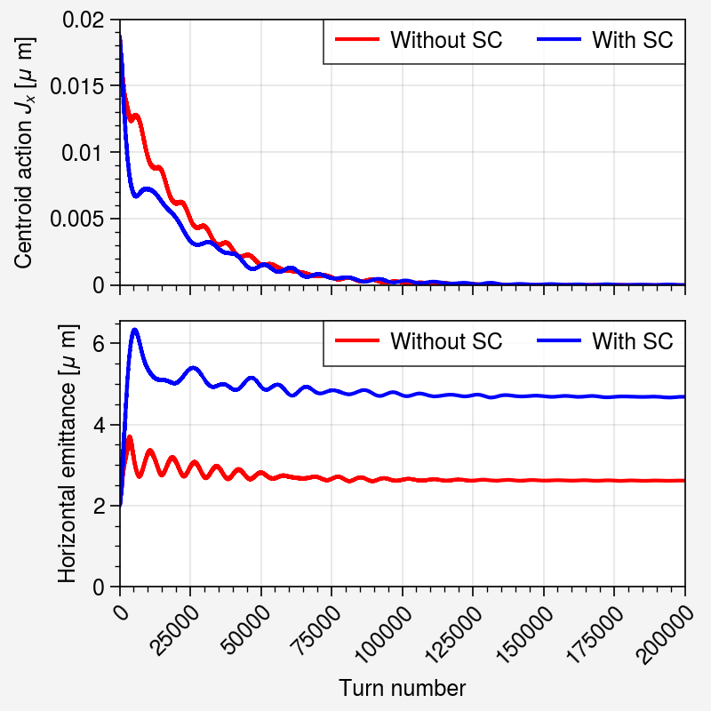
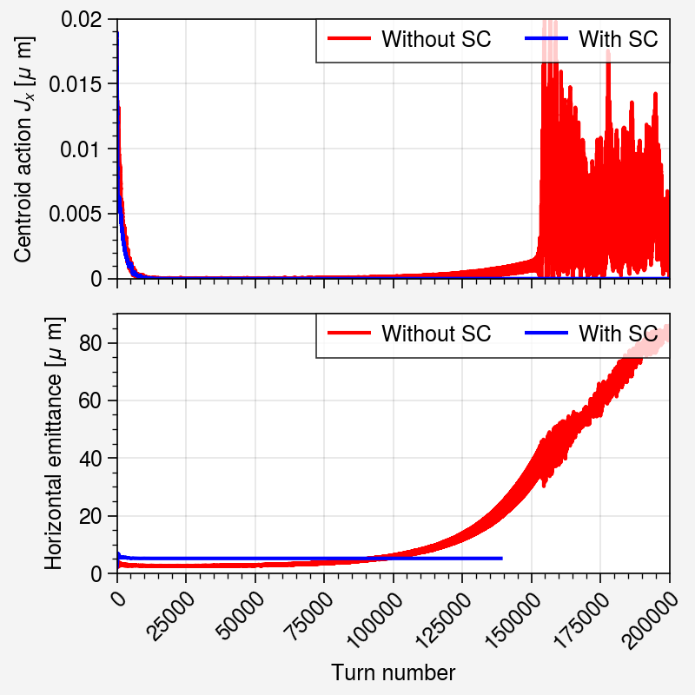
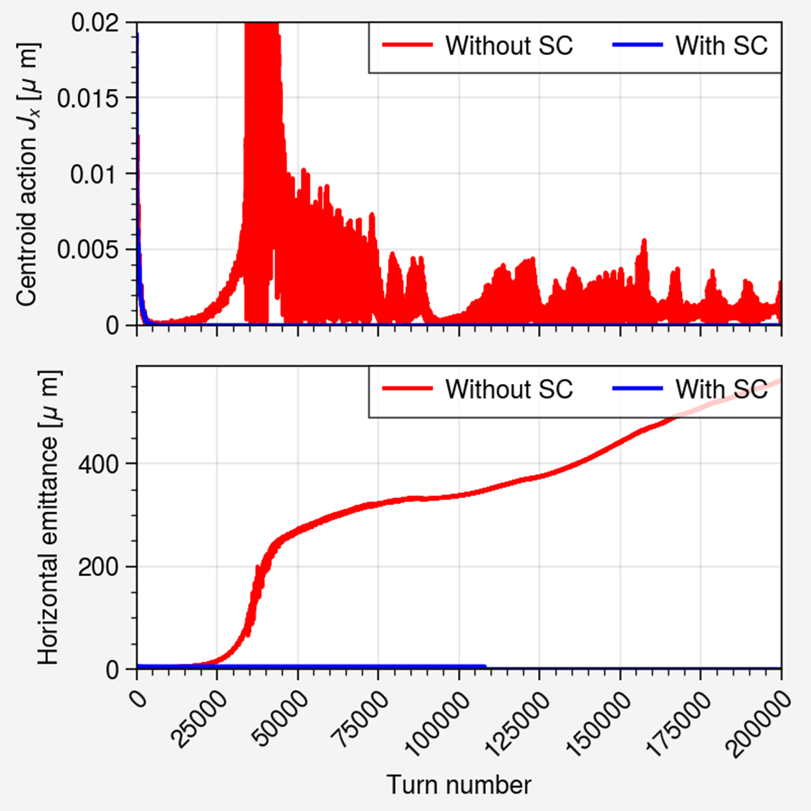



Landau Damping with Space Charge in the LHC
M. E. Topp-Mugglestone*, A. Oeftiger
Idea:
During early LHC commissioning, LHC was operated without Landau octupoles: injection was stable, but an instability occurred during ramp. The reason for this was never fully ascertained.
  Two possible explanations: residual nonlinearities or space charge contribution
For intense beams at small transverse emittance, tune shift from SC can be larger than from external nonlinearities
Without space charge
With space charge
Tune shift measurements at injection were used to estimate residual detuning:
Coefficients combined with formulae from Burov and growth rate simulations to estimate overall stability of LHC at injection without space charge as a function of intensity and emittance
Effect of space charge was incorporated following formulae of Macridin et al
$$N_{B}=8×{10}^{9}$$
$$N_{B}=1×{10}^{11}$$
$$N_{B}=1×{10}^{11}$$
No instability:
Intensity too low to overcome Landau damping from residual nonlinearities
No SC: Slowly growing instability
SC applied: damped instability
No SC: rapid instability growth (order 20k turns)
SC applied: fully damped instability

