Slide 1
Plans for Space Charge Compensation with Electron Lenses at GSI
M. Kirk
GSI Helmholtzzentrum für Schwerionenforschung GmbH
Space Charge 2026, 7th ICFA Beam Dynamics Mini-Workshop, 30th Sept. - 2nd Oct., University of Oxford

Slide 2
Acknowledgements
GSI:
K. Schulte-Urlichs, K. Thoma*, D. Ondreka, P. Spiller, O. Boine-Frankenheim
FNAL:
G. Stancari
CERN:
G. Khatri
Riga TU:
A. Ratkus, G. Pirkus, A. Moisejevs
Goethe University Frankfurt:
O. Meusel, M. Droba, H. Podlech, S. Artikova, K. Thoma*
University of Oxford:
A. Oeftiger
LLNL:
W. Stem

Slide 3
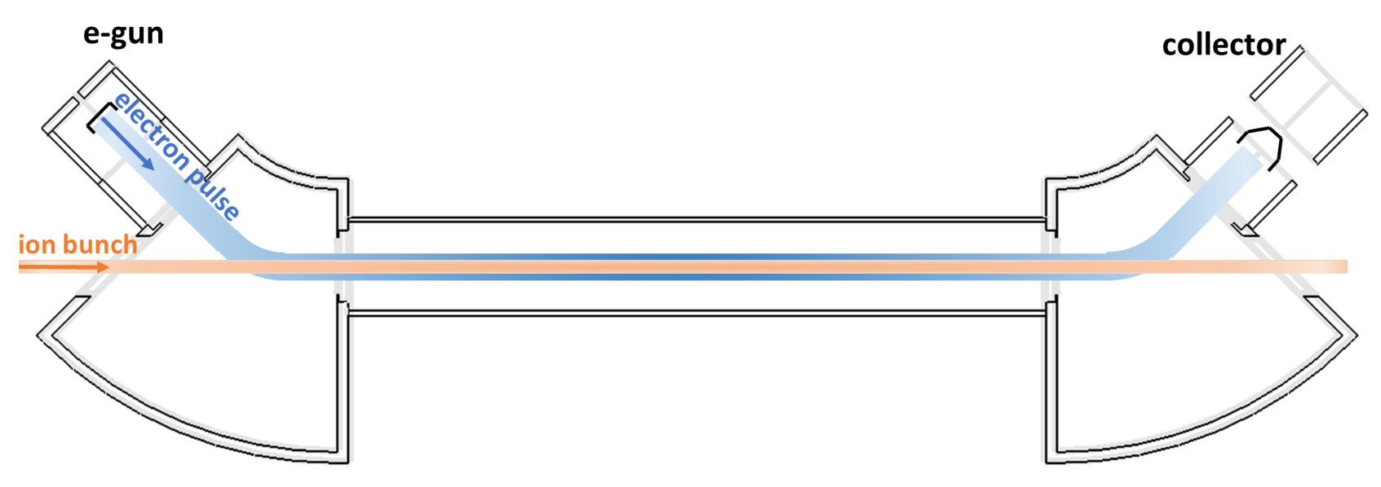
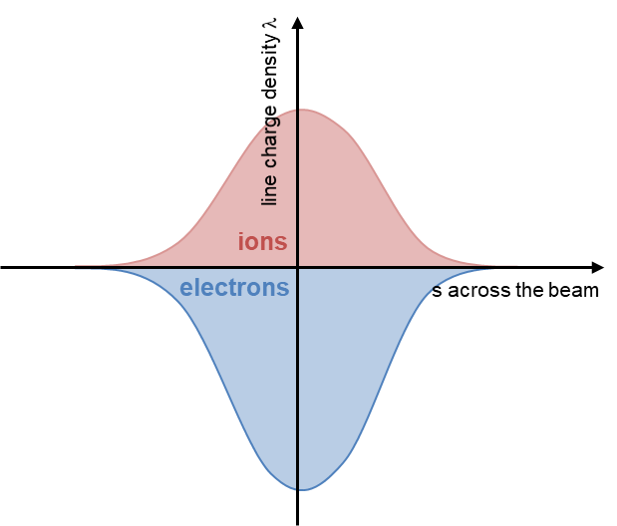
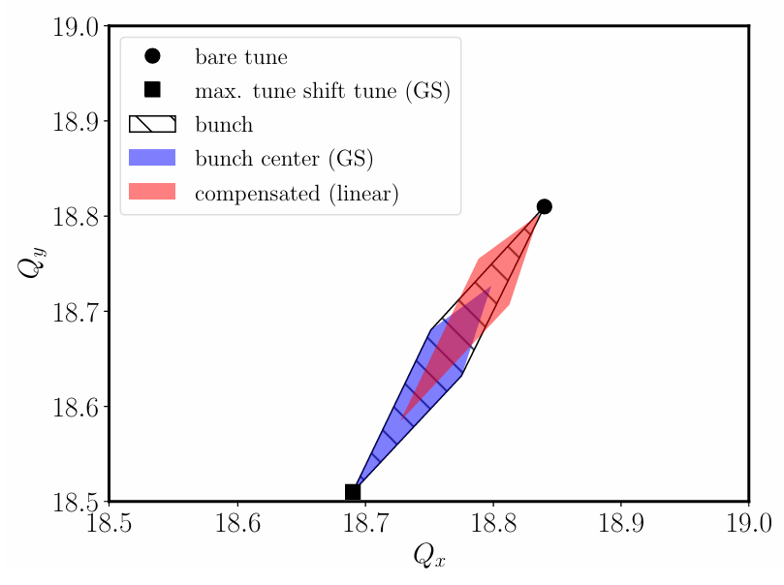
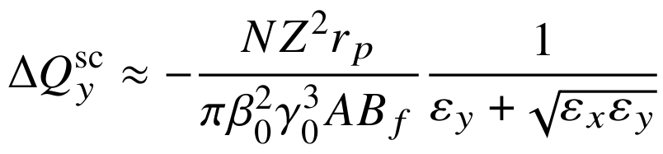
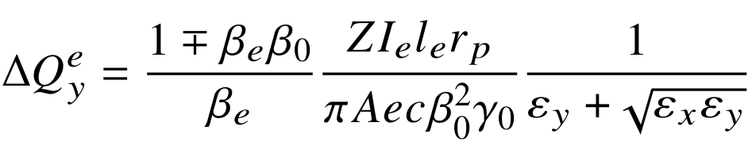
Basic concept of an electron lens
1st publication: Burov et al., FERMILAB-TM-2125, September 2000
Solenoids†
Solenoids
Main (interaction) Solenoid
Primary beam:
'Toroid'
'Toroid'
Just enough ΔE (ion - e⁻) to avoid cooling
the primary beam
Artikova, Boine-Frankenheim et al., 2021:
Modulation to match longitudinal bunch profiles:
Primary beam (ions):
Reduced tune footprint (SIS100):
Compensation by electrons:
† "Gun" and "expansion" solenoid

Slide 4
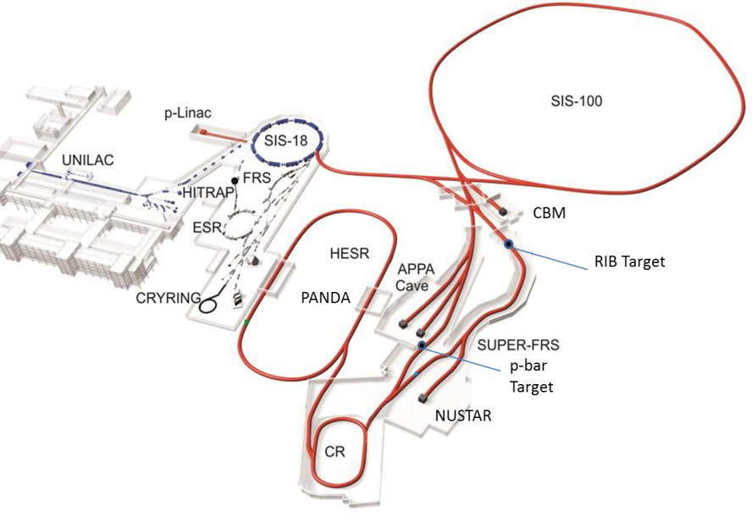
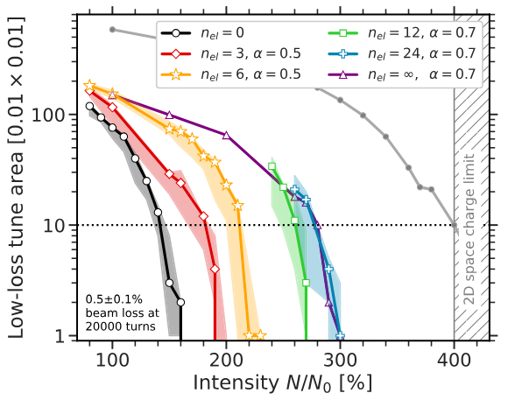
Motivation
GSI facility… as injector for FAIR
FAIR designed to increase intensity limits of GSI:
  Primary beam intensities up by factor 10-100
  Lower charge states to avoid space charge limit
Primary Beam Intensities at GSI and FAIR
 |  | p | Ar | Xe | U
Charge number | GSI | 1 | 18 | 48 | 73
 | FAIR | 1 | 10 | 21 | 28
Energy [GeV/u] | GSI | 4.7 | 1.7 | 1.3 | 1.0
 | FAIR | 28.8 | 6.6 | 4.0 | 2.7
Intensity [Ions/s] | GSI | 10¹¹ | 8·10¹⁰ | 2·10¹⁰ | 4·10⁹
 | FAIR | 10¹³ | 10¹² | 5·10¹¹ | 3·10¹¹
Oeftiger et al., 2024 [1]
Later module (> 2028)
"Numerical studies for SIS100 have shown that a few symmetrically distributed electron lenses could increase the space-charge limit by up to 50%, while a larger number potentially enables increase up to x 2" [1]
[1] A. Oeftiger and O. Boine-Frankenheim, “Pulsed Electron Lenses for Space Charge Mitigation”, Phys. Rev. Lett., vol. 132, p. 175001, 2024, doi: 10.1103/PhysRevLett.132.175001

Slide 5

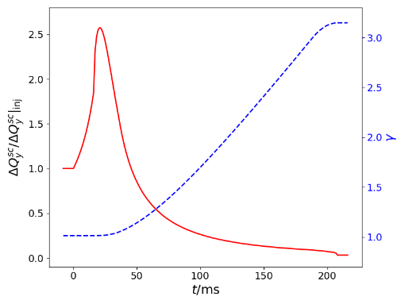
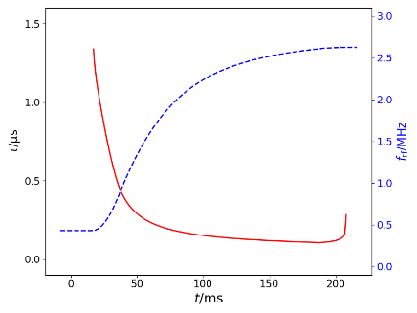
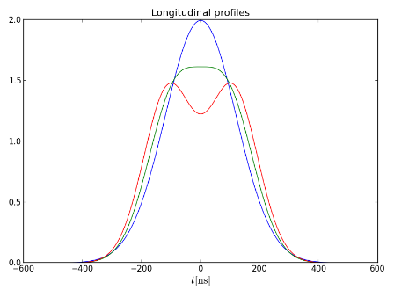
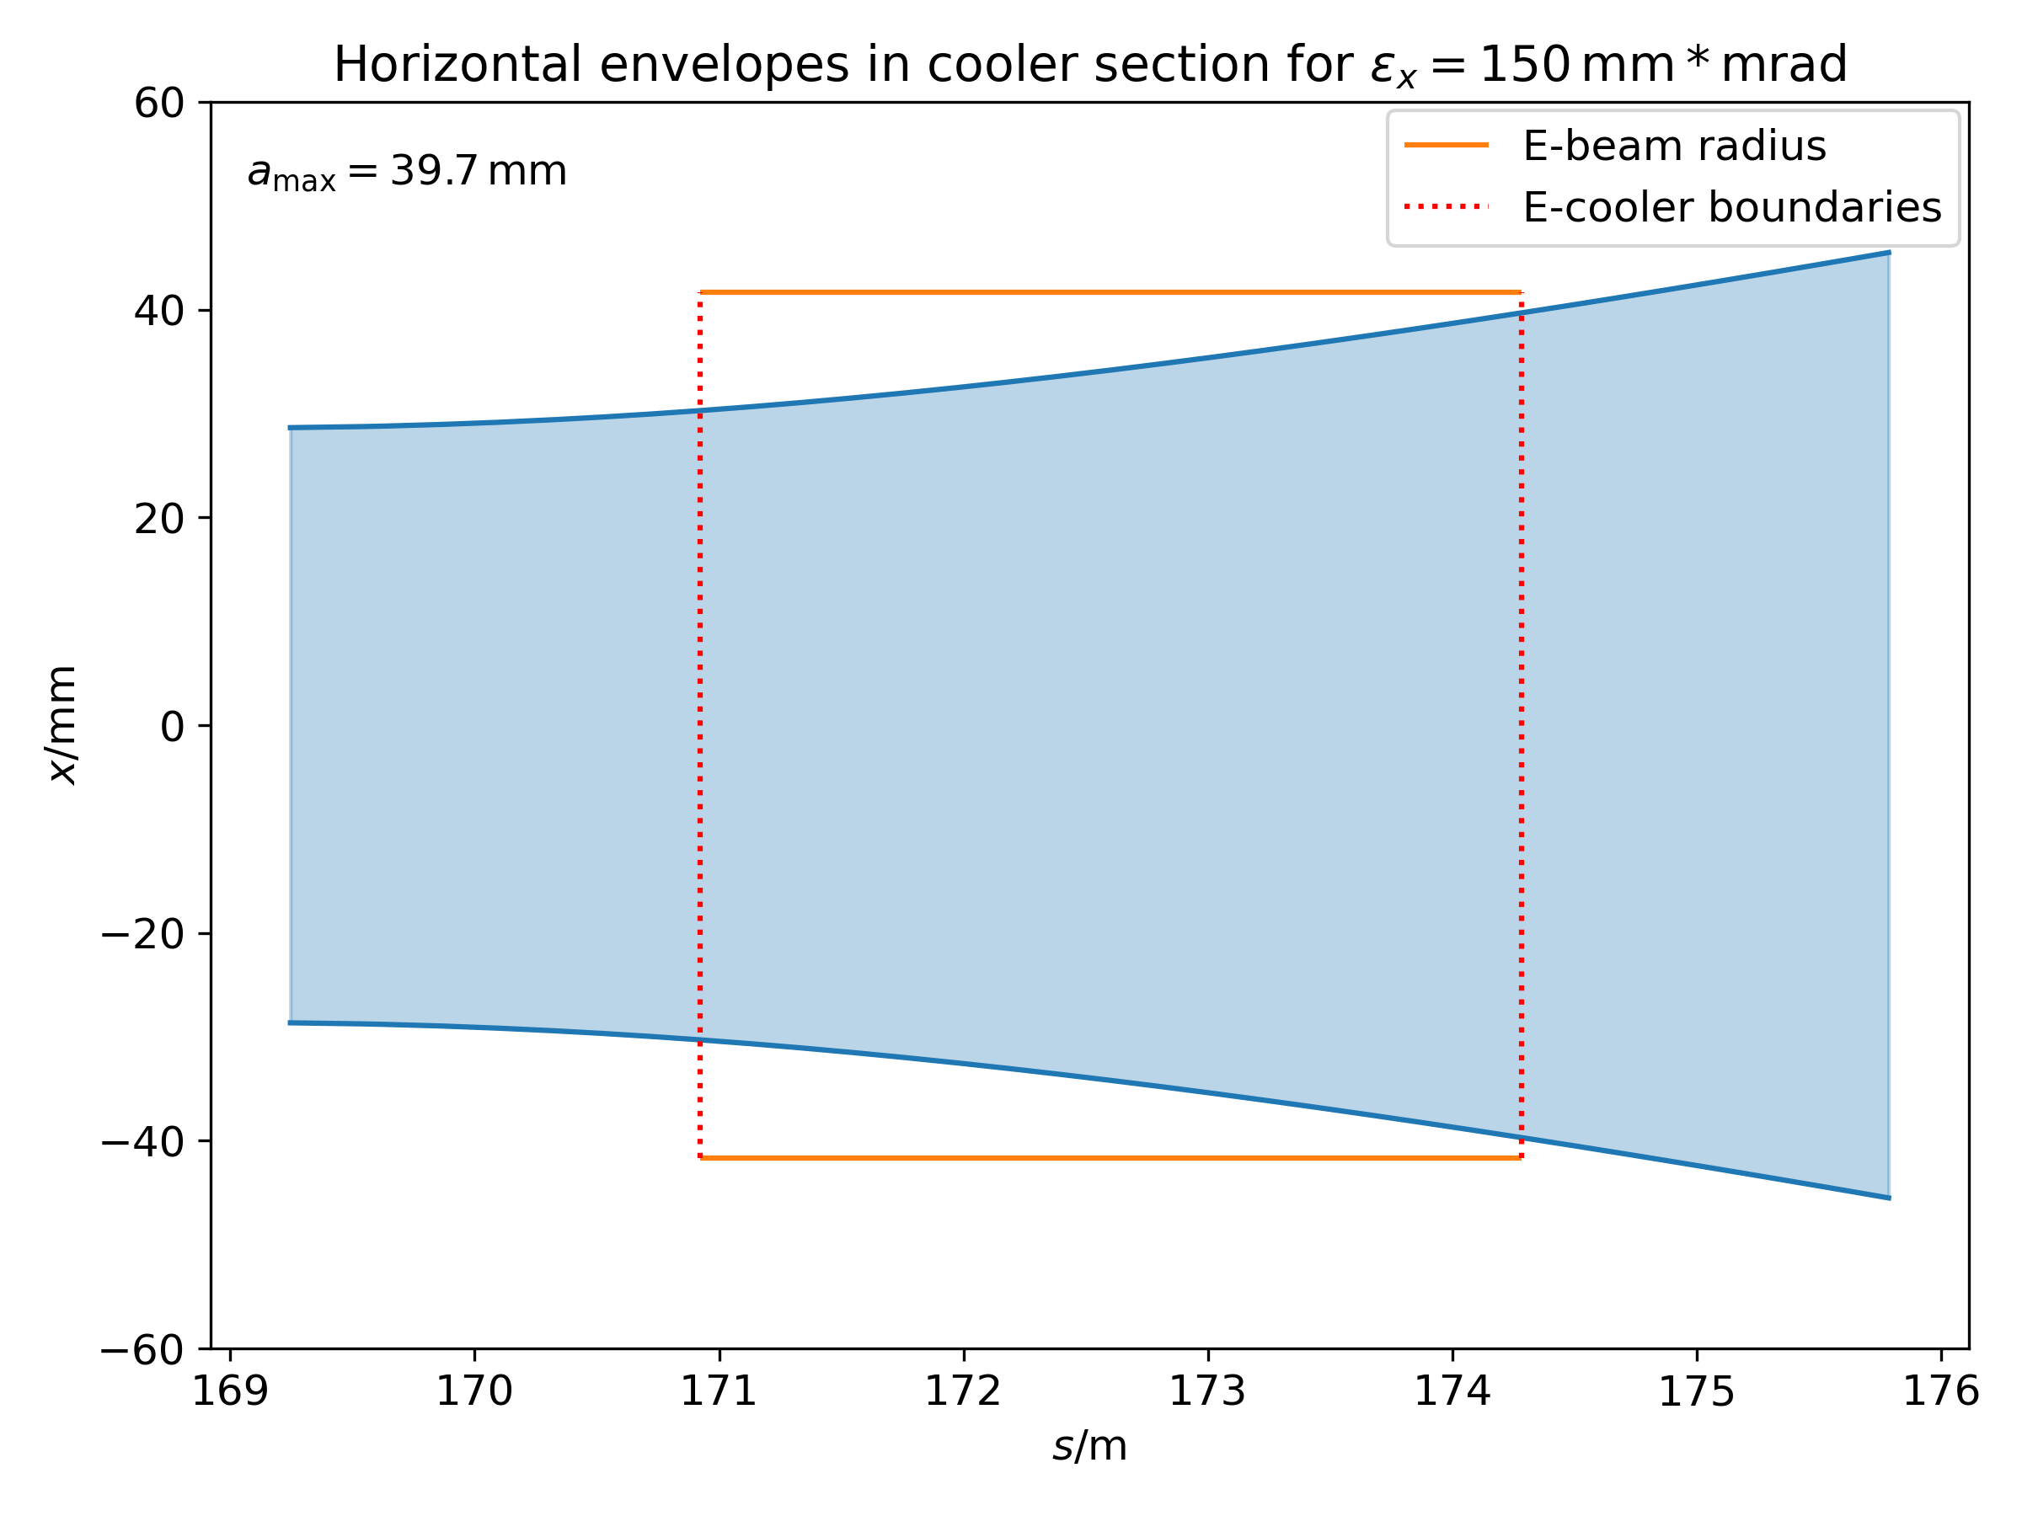
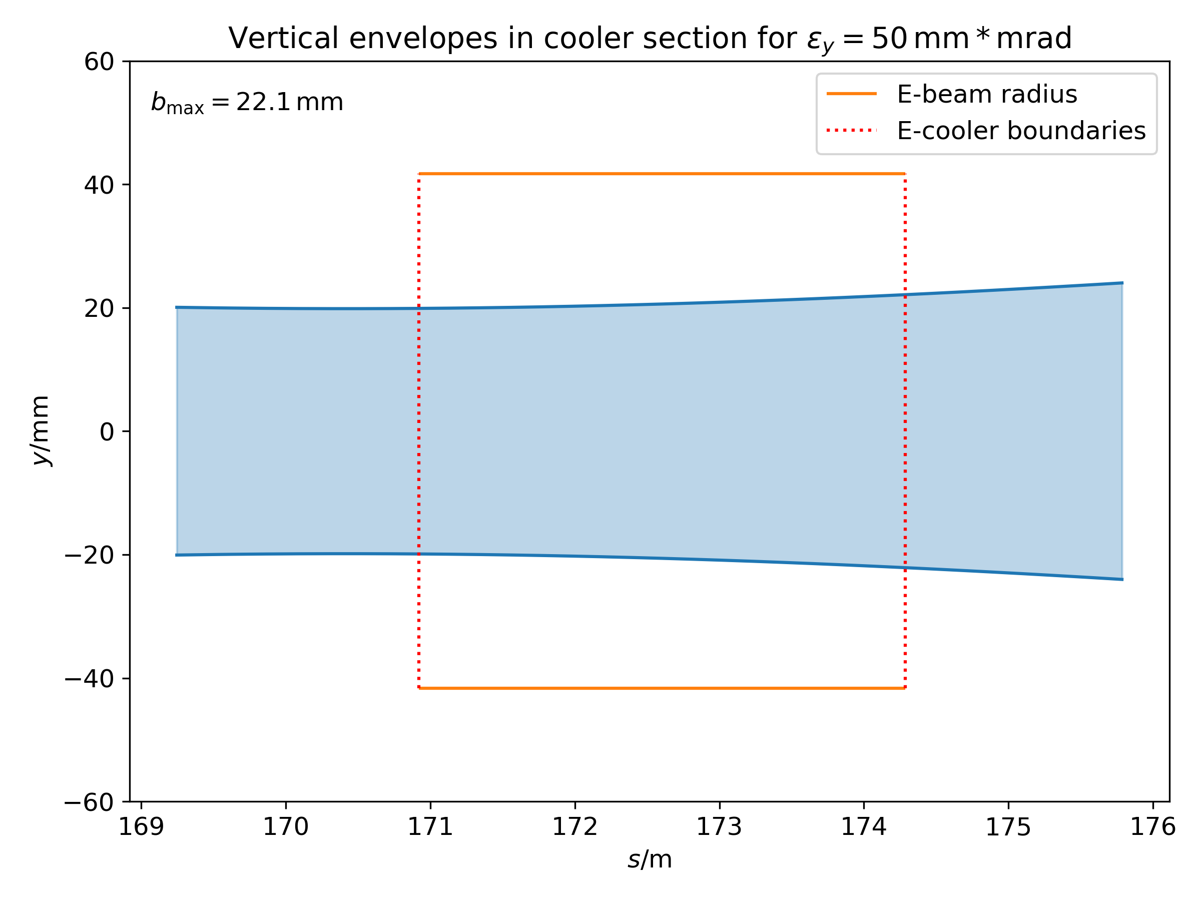

E-Lens Requirements for SIS18
Synchrotron Cycle
  Parameters determining modulation to superimpose ion and e⁻ bunches
    Tune spread peaks shortly after start of ramp
    Cavity RF and ∴ bunch length vary strongly
Electron Lens Design
  RF-modulated e⁻ gun
    Up to 15 A (peak) electron beam current for space charge compensation
    0.4 - 1 MHz to follow longitudinal bunch profile, required bandwidth 10 MHz
    Transverse homogeneous e⁻ beam density with circular cross section
  Collector
    Reduce e⁻ beam power density by deceleration and e⁻ beam expansion in a cusp-form B-field
    Mitigation of secondary electrons
Longitudinal Bunch Structure (time)
Evolution of peak tune spread
Injection
Bunching
Cycle time (t)
Accele-ration
Evolution of bunch length & RF
Longitudinal ion bunch profiles
A
Profiles:
A: Single h RF,
B: dual h RF,
C: Beam blow-up
B
C
Ion beam envelopes in e⁻ lens section (ELEGANT code):
e⁻ beam
e⁻ beam
Solenoid
Solenoid
Electron lens design underway. Demonstration with SIS18 e⁻ cooler to come

Slide 6
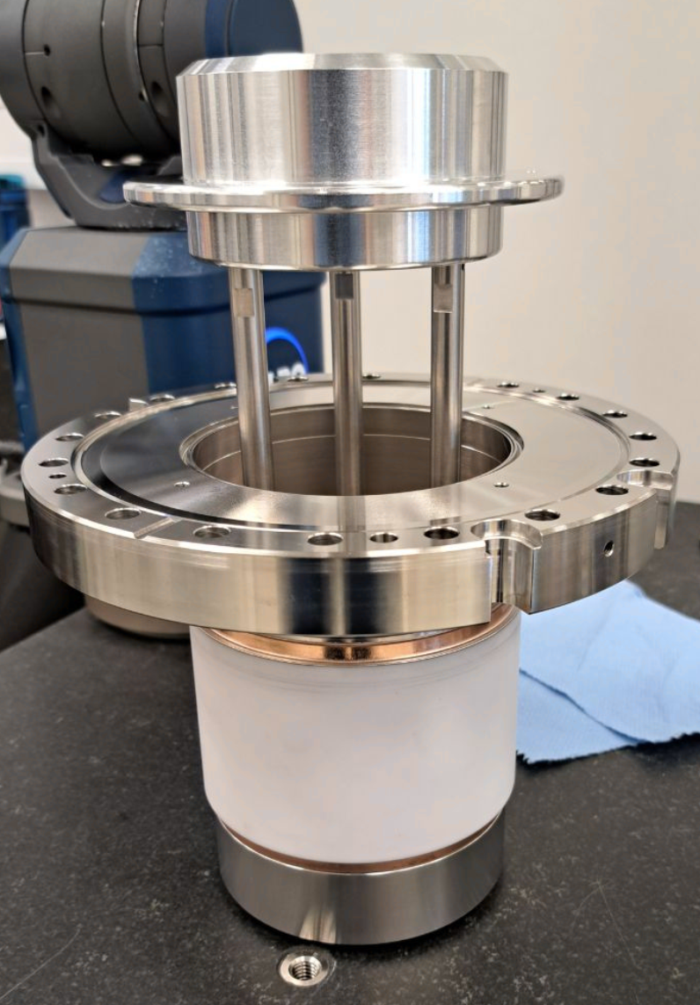
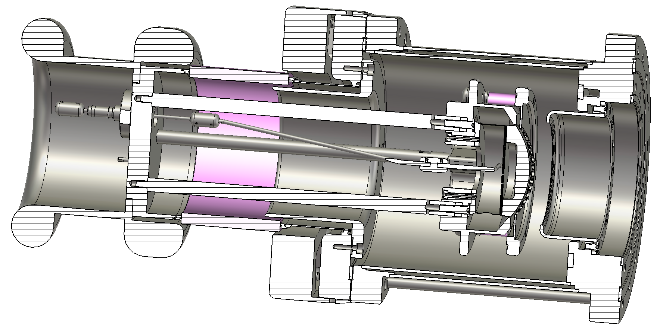
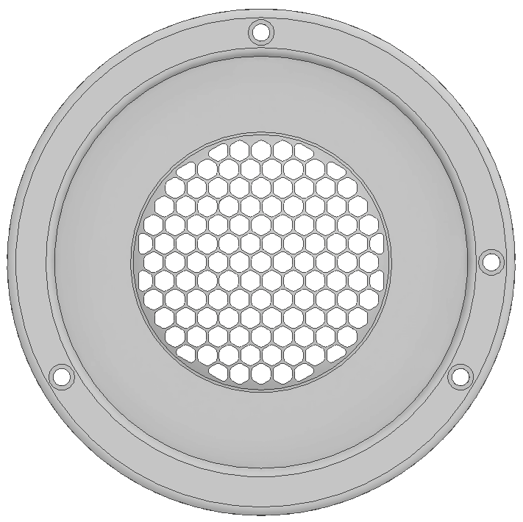
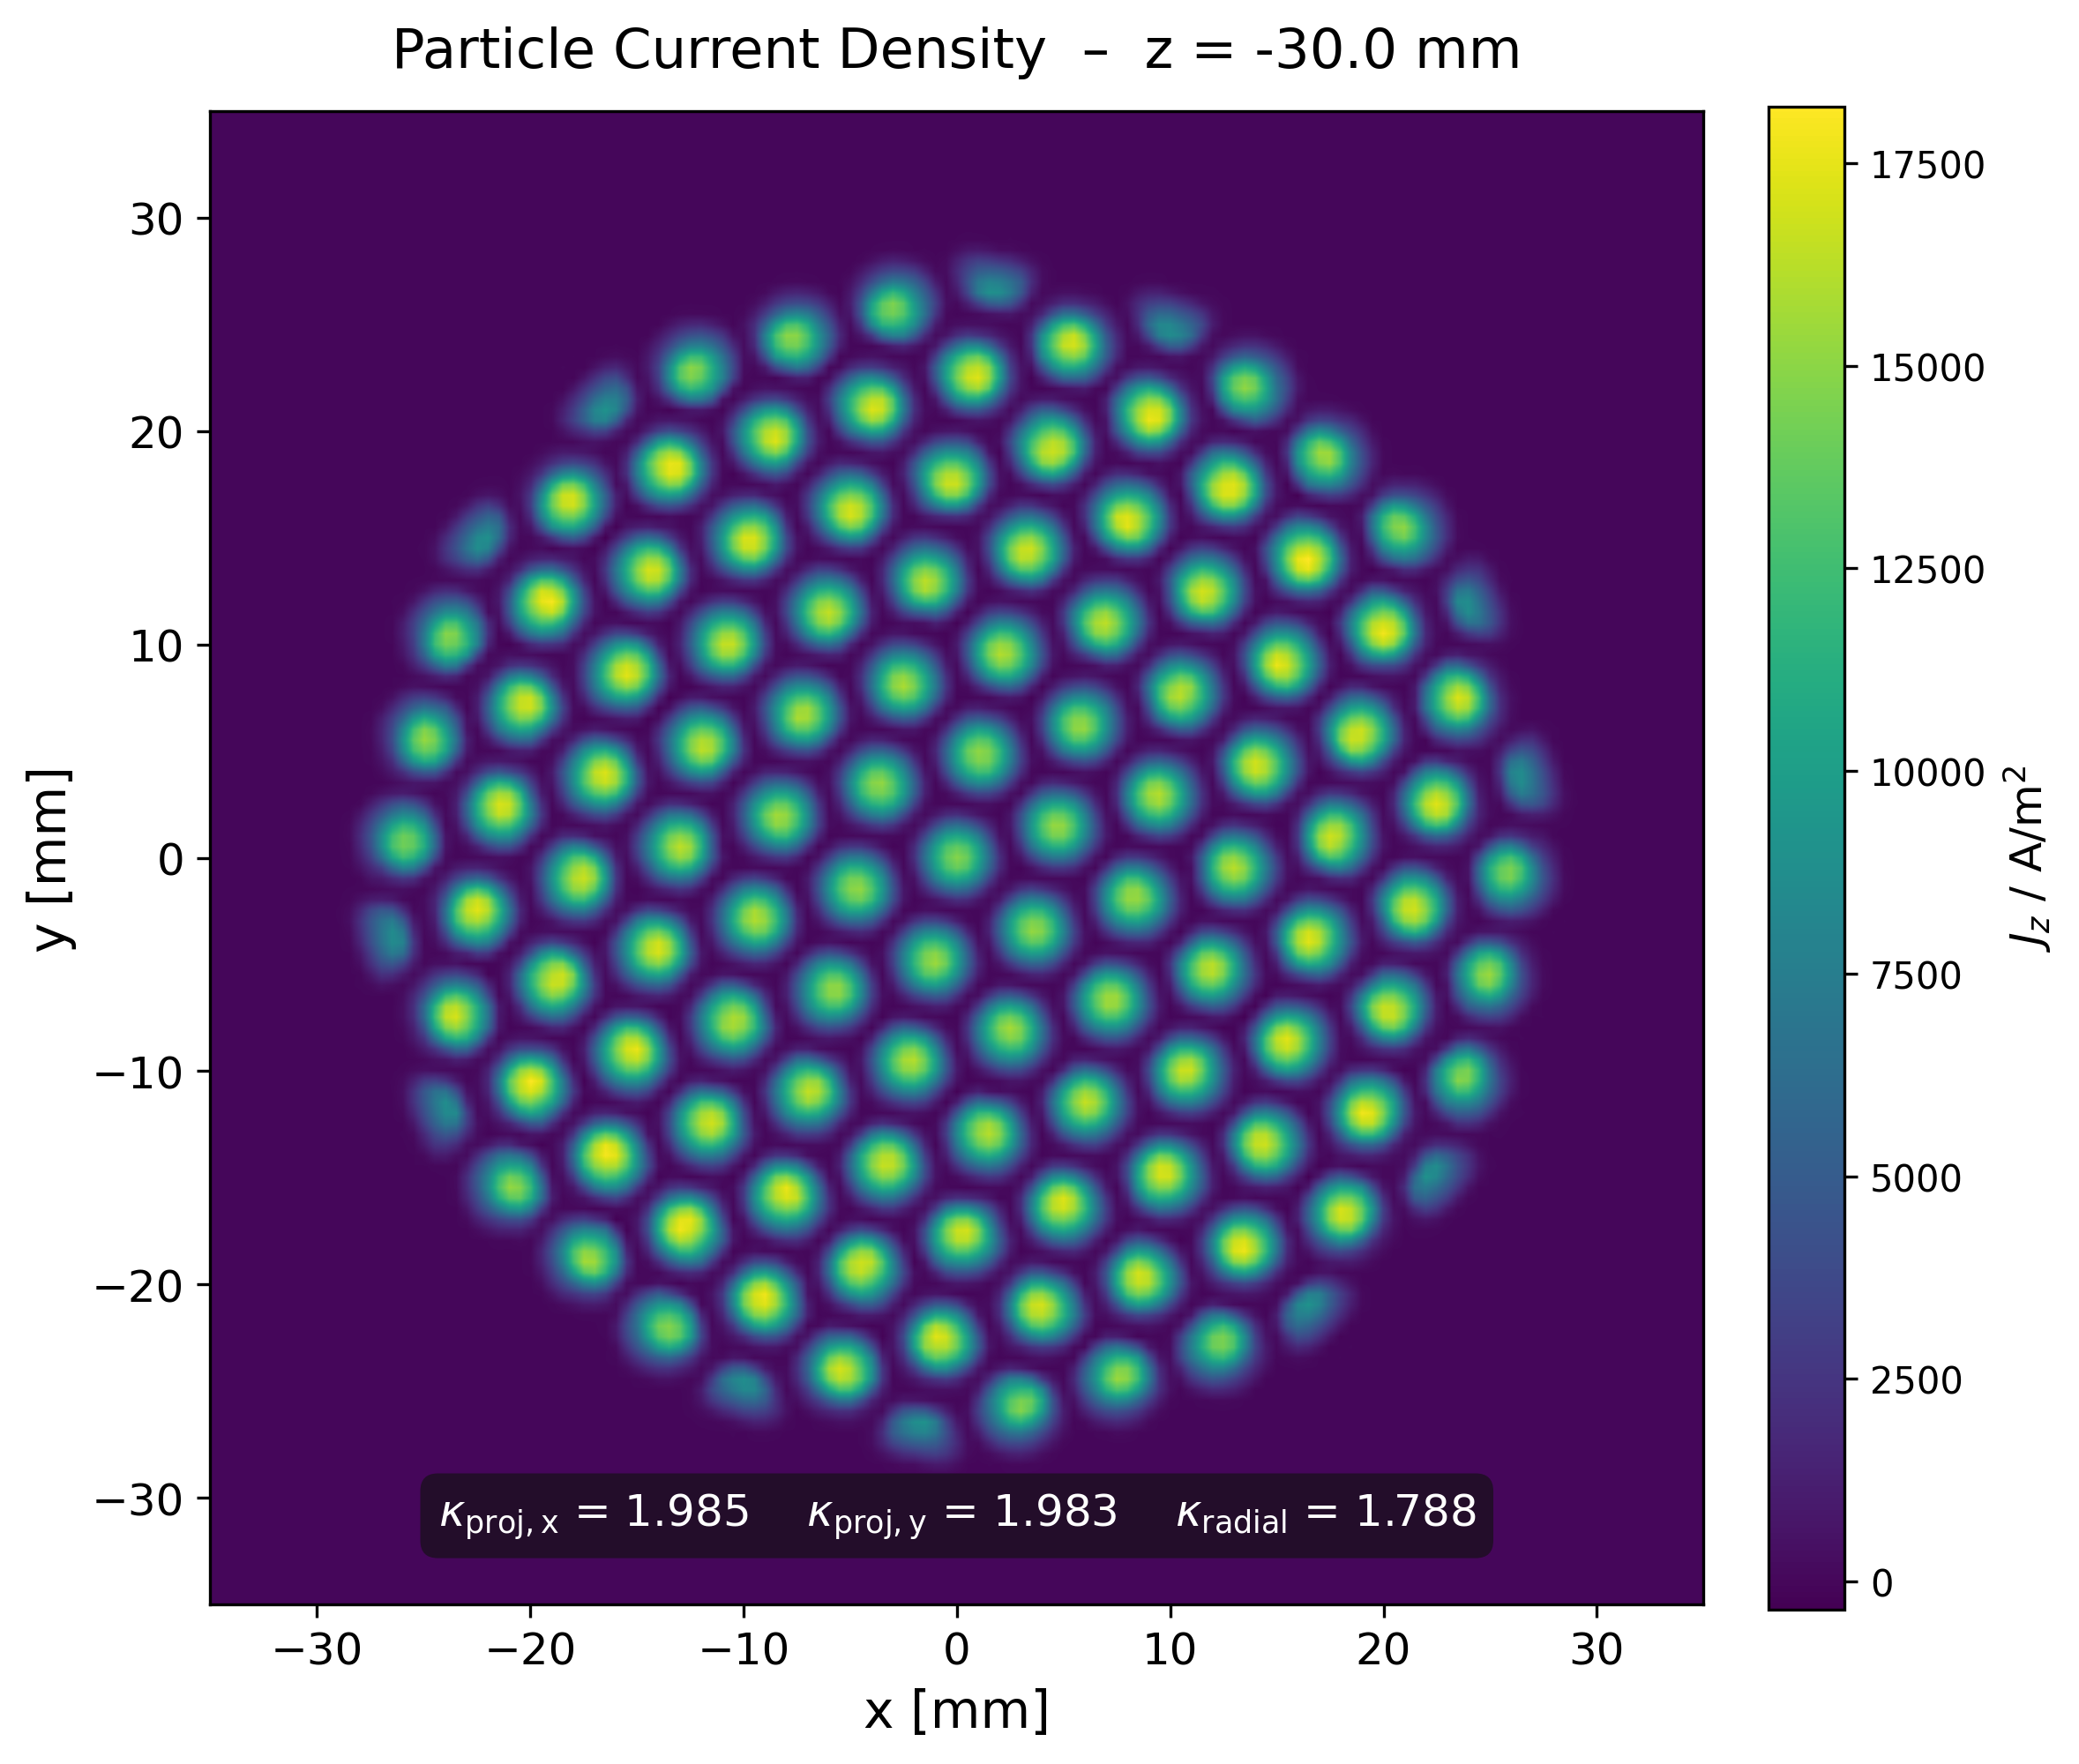

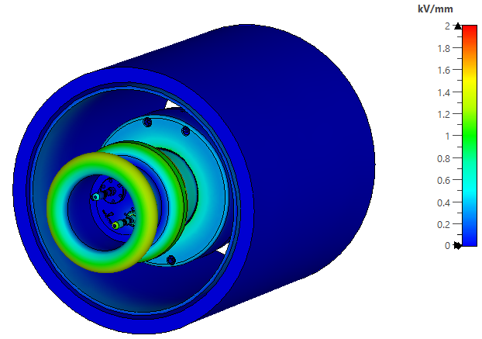
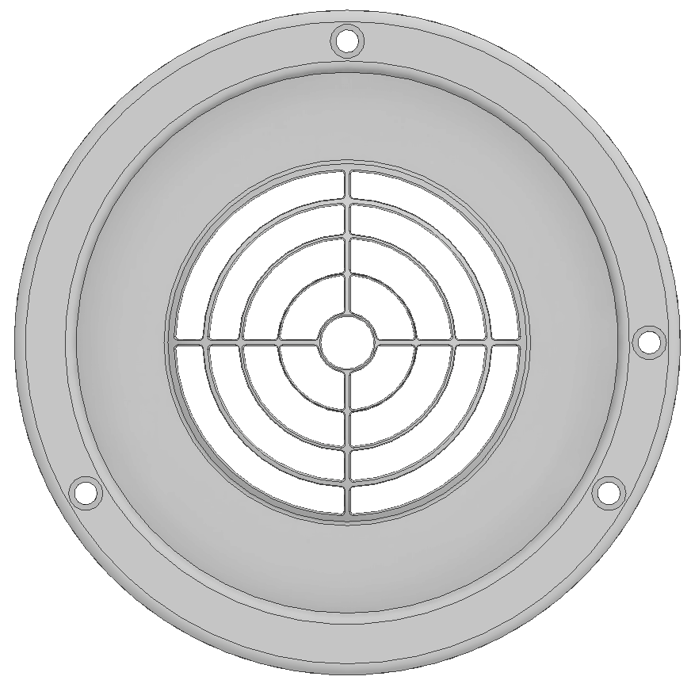
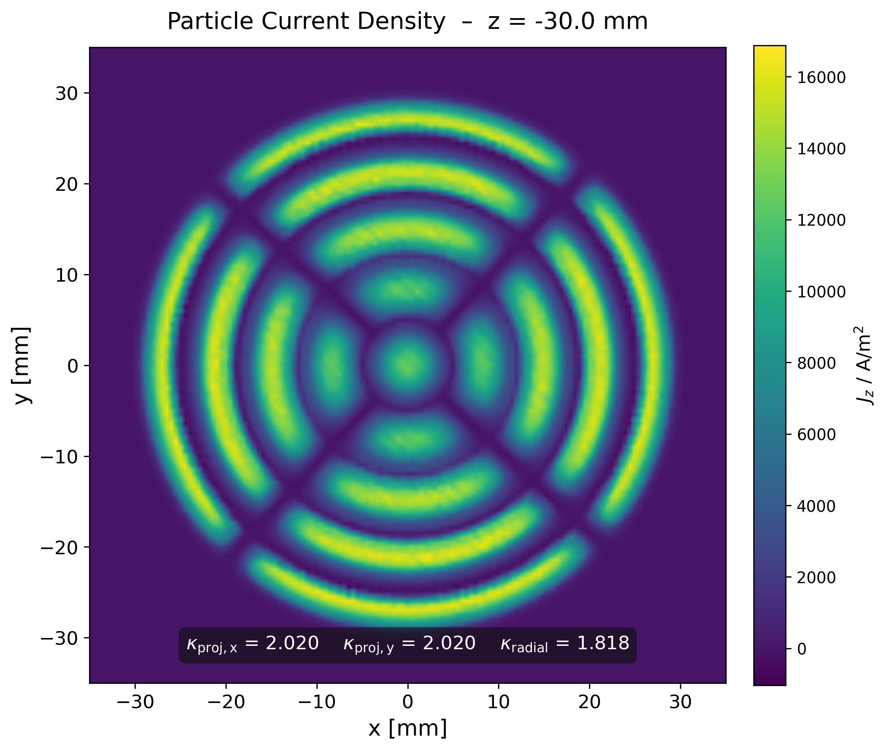

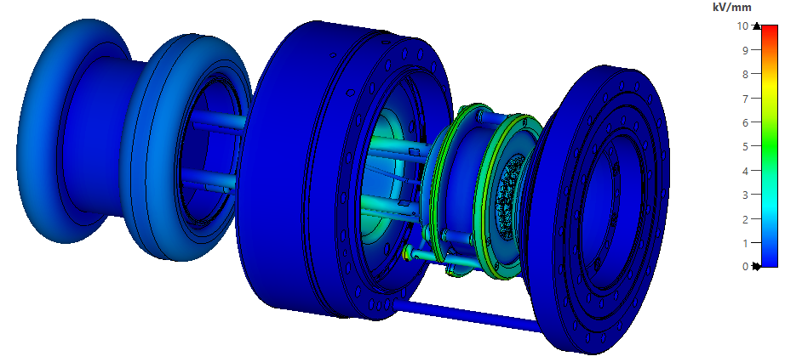
RF-Modulated Electron Gun
Air
Being
assembled
'Honey comb' grid
Electrostatic Analysis:
Max. 1.5 kV / mm air:
1.5 kV / mm
'Target' grid
Gun-Solenoid
Max. 10 kV / mm vacuum:
10 kV / mm
Gun-Solenoid
invisible for illustration

Slide 7


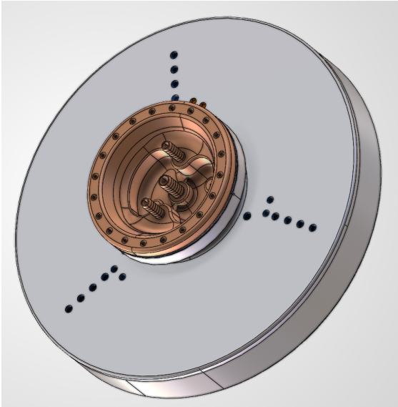
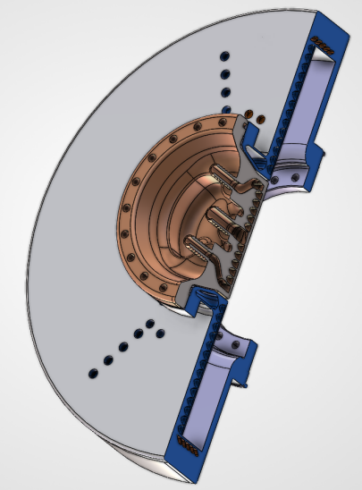
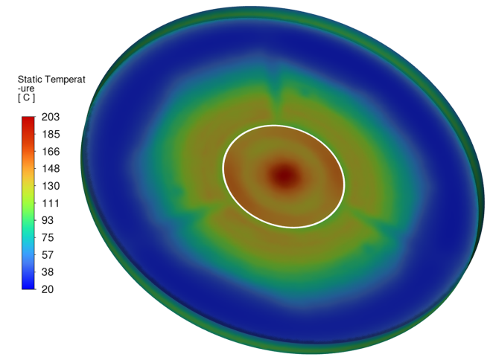
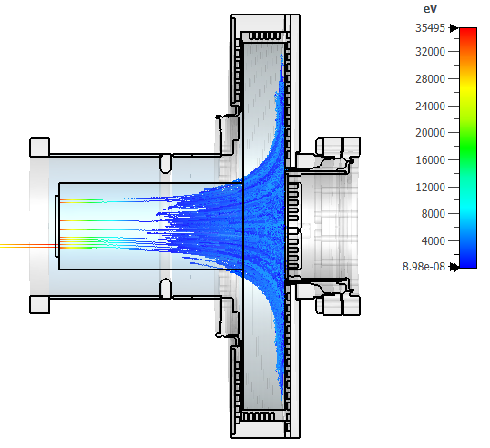
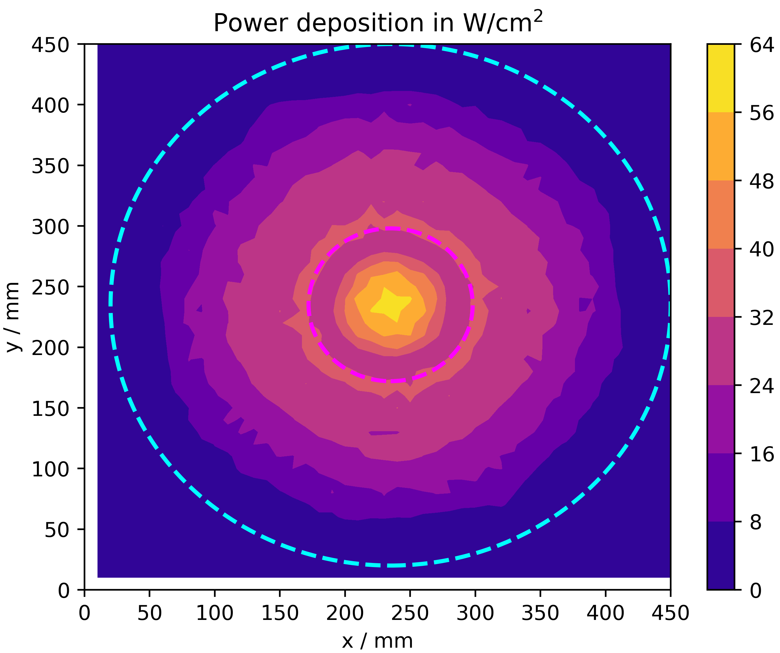
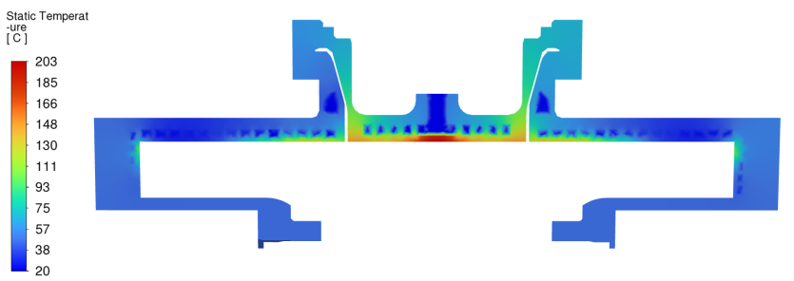
Electron Collector
This project received funding from the European Union’s Horizon Europe Research and Innovation Programme under GA No. 101290927
Additively manufactured
Collector Parameter
electron current, max. | 15 | A
bias potential, max. | -6 | kV
collector area | 1452 | cm²
inner radius , max. | 215 | mm
outer radius, max. | 242 | mm
beam radius | ≥ 215 | mm
DC power deposition, max. | 90 | kW
power deposition within cycle, max. | 30 | kW
chamber height | 66 | mm
weight | >50 | kg
B-field, max. | 0.4 | T
Design by G. Pikurs, A. Ratkus and A. Moisejevs, RTU, 2026
Distribution T °C:
Secondary Electron Mitigation:
Maximum Power Deposition in Cycle:
SE backflow:
11.1 mA
Electrons
35 keV, 15 A
→
0 kV
-29 kV
Efficiency ≈99.8%
E-lens is used at low Bρ of SIS18 cycle thus reducing power deposition by ~0.3

Slide 8
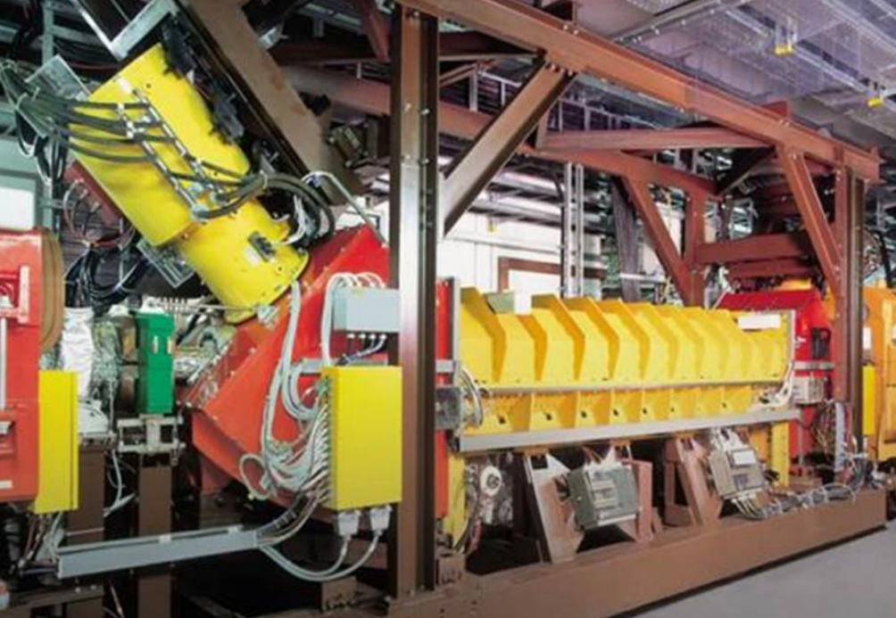
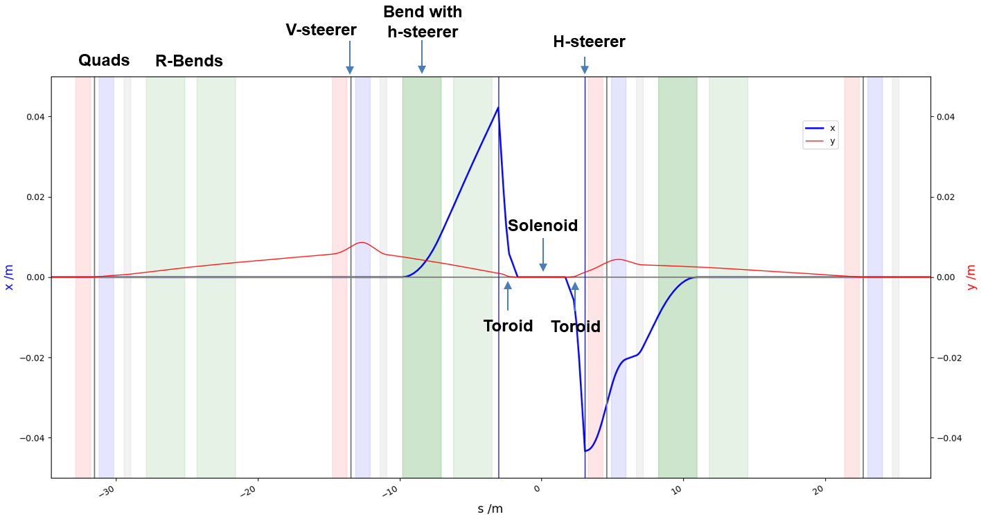
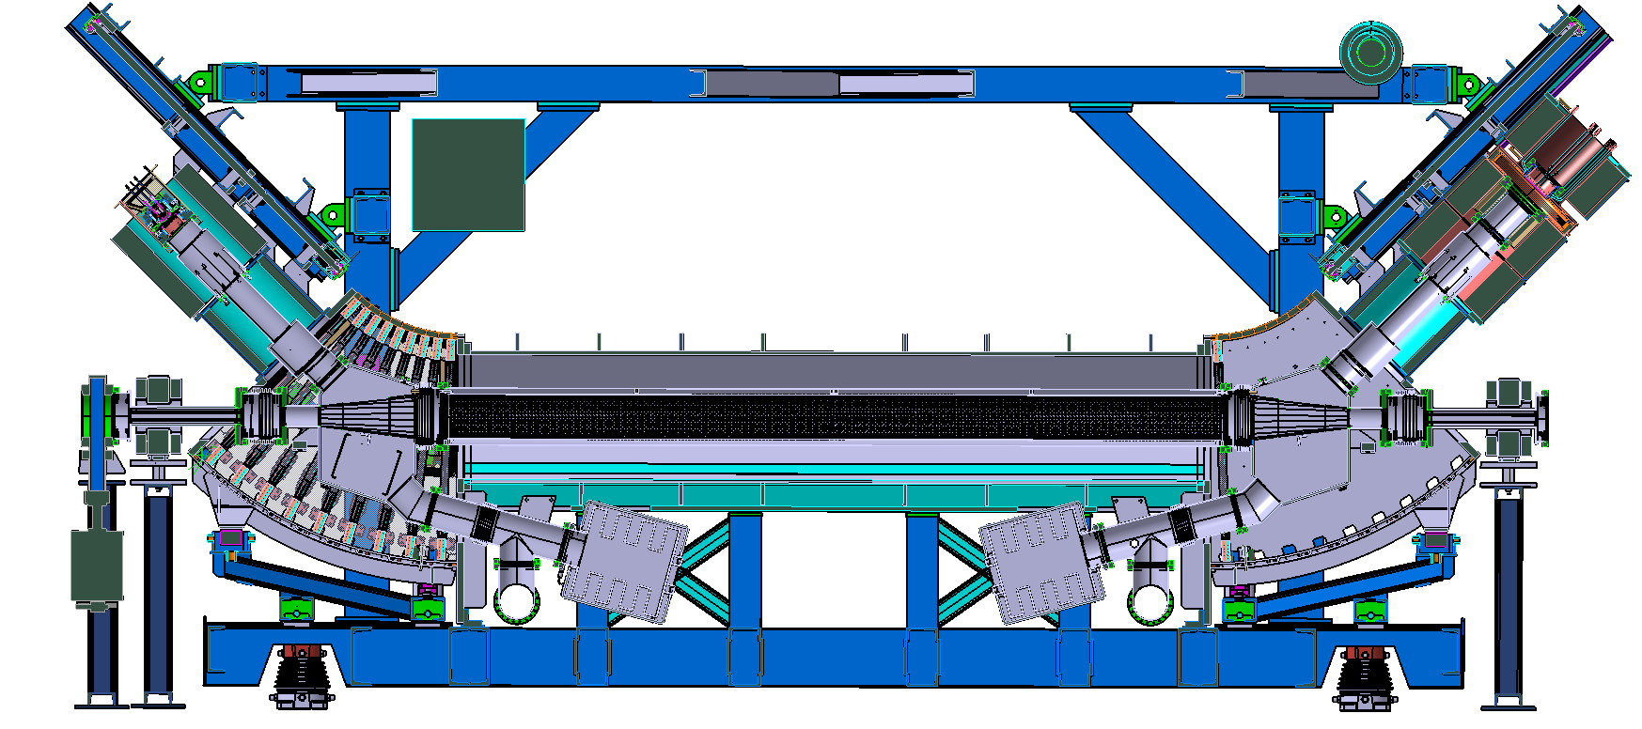
SIS18 e⁻ Cooler as Test-Bed
Modification of SIS18 e-cooler:
Max. B-field: e⁻ & ion-beam region 0.15 T, gun & collector 0.4 T
CO simulation indicates that the 0.15 T is feasable for experiments
Gun and collector designs adapted to e⁻ cooler
Experiments on e⁻ cooler carried out with more to come.
Questions:
  Kicks to particles from toroids
  e⁻ beam‘s influence on ions
  'Gridded' e⁻ beam current density distribution
  Compensation of coupling between transverse planes
  Resonance compensation
SIS18 e-cooler at present:
SIS18 closed orbit at 0.15 T, CST → ELEGANT with FTABLE* element:
Modified SIS18 e⁻ cooler design:
H-Steerer
(HS)
HS
HS
Solenoid
HS
M .Kirk
* Ref. FTABLE: A. Xiao, M. Borland et al., “Tracking particles through a general magnetic field", PAC11

Slide 9
Further Reading
S. Artikova, D. Ondreka, K. Schulte-Urlichs, P. J. Spiller,
“Design and Beam Dynamics of the Electron Lens for Space Charge Compensation in SIS18”,
IPAC'21, pp. 3614–3617
K. Schulte-Urlichs et al.,
“Status of the Electron Lens for Space Charge Compensation in SIS18”,
IPAC'21, pp. 1880–1883
A. Oeftiger and O. Boine-Frankenheim,
“Pulsed Electron Lenses for Space Charge Mitigation”,
Phys. Rev. Lett., vol. 132, p. 175001, 2024,
doi: 10.1103/PhysRevLett.132.175001
A. Xiao, M. Borland et al.,
“Tracking particles through a general magnetic field”,
Conf. Proc. PAC11
I. Lobach, Y. Li,
“Using neural-network Ansatz for the generating function in the Hamilton-Jacobi equation to obtain symplectic transfer maps for elements with any magnetic field configuration”,
IPAC’26

Slide 10
History of Electron Lenses for Space Charge Compensation
The references above are up to about the point when work at GSI began.
A. V. Burov, G. W. Foster, V. D. Shiltsev, “Space-Charge Compensation in High-Intensity Proton Rings,” FERMILAB-TM-2125, September 2000
S. Machida, 2001, KEK PS simulation
Y. Alexahin, “Effects of Space Charge and Magnet Nonlinearities on Beam Dynamics in the Fermilab Booster”, PAC 2007, DOI 10.1109/PAC.2007.4440463
M. Aiba, M. Chanel, U. Dorda, R. Garoby, J.-P. Koutchouk, M. Martini, E. Métral, Y. Papaphilippou, W. Scandale, F. Zimmermann, V. Shiltsev, G. Franchetti, “Space-Charge Compensation Options for the LHC Injector Complex”, Proceedings of PAC'07, Albuquerque, 2007, pp. 3390–3392
M. Aiba, “Benchmark of ACCSIM-ORBIT codes for space charge and electron-lens compensation”, CERN, 2008
Y. Alexahin and V. Kapin, “Study of Possibility of Space Charge Compensation in the Fermilab Booster with Multiple Electron Columns,” Fermilab Beams-doc-3108, June 2008
V. N. Litvinenko and G. Wang, “Compensating Tune Spread Induced by Space Charge in Bunched Beams”, Physical Review Special Topics — Accelerators and Beams 17, 114401 (2014)
O. Boine-Frankenheim and W. D. Stem, “Space charge compensation with pulsed electron lenses for intense ion beams in synchrotrons”, Nuclear Instruments and Methods in Physics Research A 896 (2018), 122–128. DOI: 10.1016/j.nima.2018.04.014
S. Artikova et al., “Pulsed electron lenses for space charge compensation in the FAIR synchrotrons”, 2021 JINST 16 P03044. https://doi.org/10.1088/1748-0221/16/03/P03044
Y. Alexahin and V. V. Kapin, “On possibility of space-charge compensation in the Fermilab Booster with multiple electron columns”, Journal of Instrumentation 16 (2021) P03049. DOI: 10.1088/1748-0221/16/03/P03049

Slide 11
Summary & Outlook
Electron lens is under development
Electron gun will be ready for testing at GSI
Prototype electron lens in SIS18 synchrotron will follow
Symplectic transfer map for e-lens*
Resonance and coupling compensation
* I. Lobach, Y. Li, Using neural-network Ansatz for the generating function in the Hamilton-Jacobi equation to obtain symplectic transfer maps for elements with any magnetic field configuration, IPAC’26

Slide 12
Reserve slides …

Slide 13
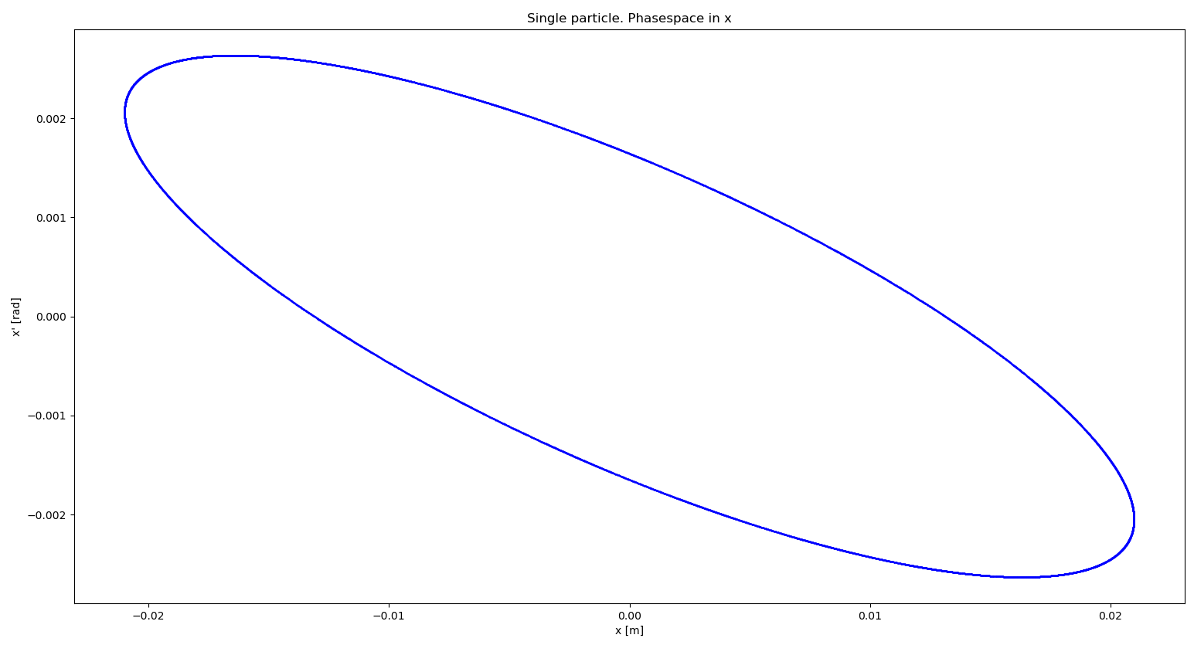
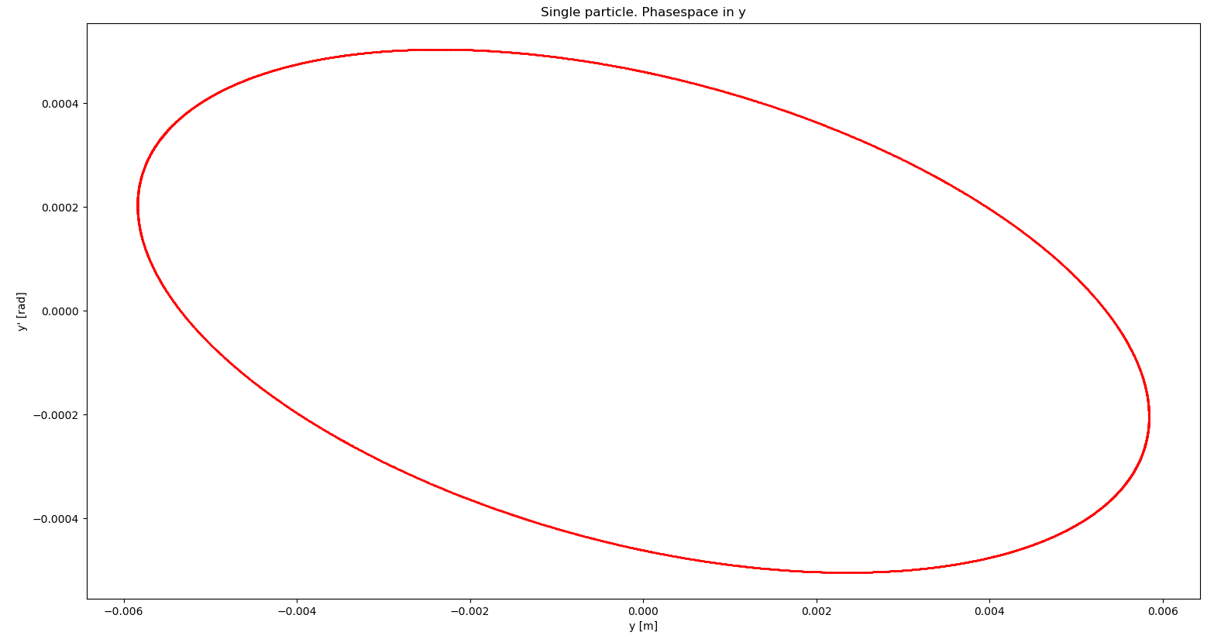
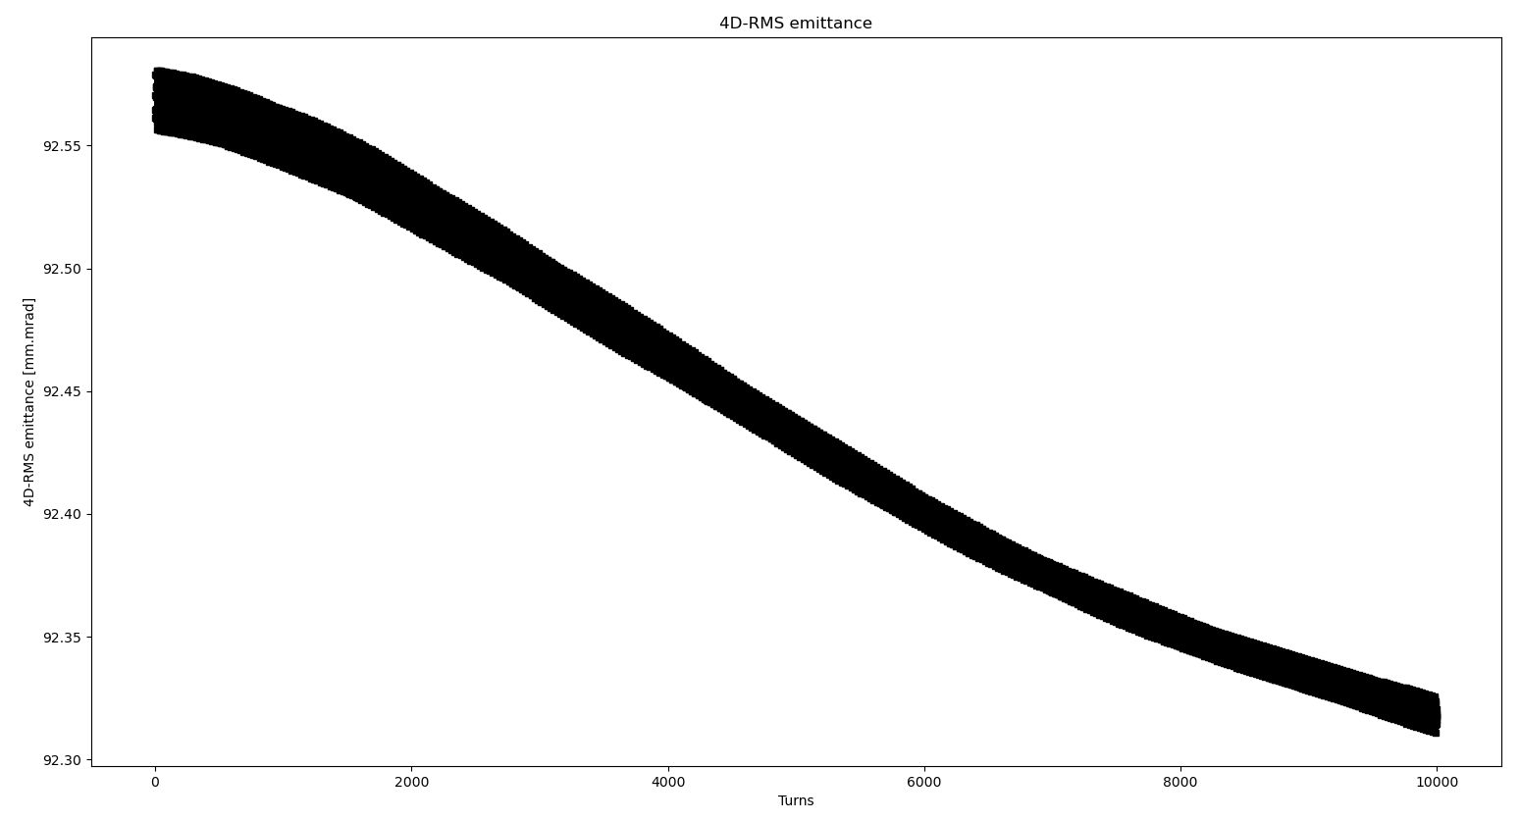
Transport Simulations with ELEGANT
Lattice with EDRIFTs, CSBENDS (EDGE*_EFFECTS = 3), KQUADS. SOLEnoids at 0 mT. Tunes (4.28, 3.3), ¹²C⁶⁺ 11.5 MeV/u
Horizontal
4 mrad
40 mm
Single particle in phase space
tracked for 10k turns
Vertical
8 mrad
12 mm
92.55 μm²
4D RMS emittance vs. turn
1k-ion waterbag tracked for 10k turns
≈0.3% drop in emittance

Slide 14
RF-Modulated Electron Gun – Choice of Materials
Body parts: Stainless steel
Insulators: Alumina
Dispenser cathode: BaO, type 311XM by Spectra-Mat Inc.
Modulation grids: Molybdenum or graphite (SIGRAFINE®)
Focusing electrode: Molybdenum

Slide 15
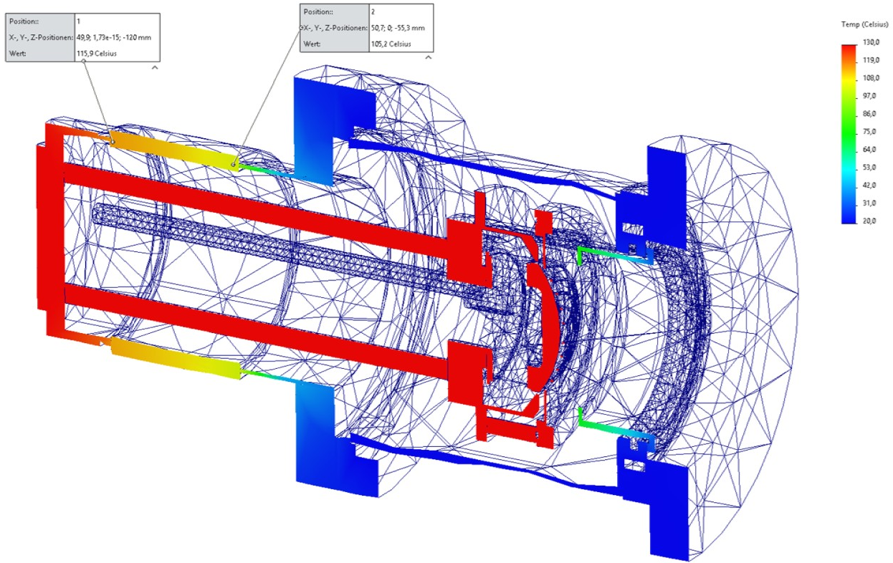
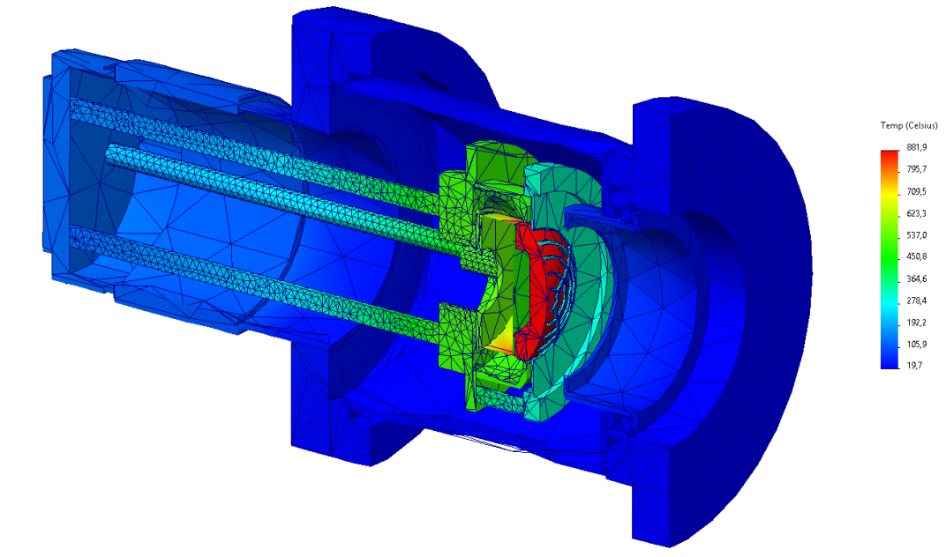

RF-Modulated Electron Gun
Thermomechanical analysis

Slide 16
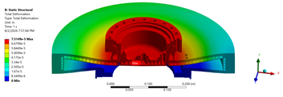
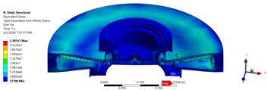
Collector – Stress Distribution
Structural Analysis
Notes:
Top fig. total deformation in mm. 0.07 mm max. (top of color scale)
Bottom fig. equivalent stress in Pascals.
[Artjom CAS]
ANSYS (Riga TU)

Slide 17
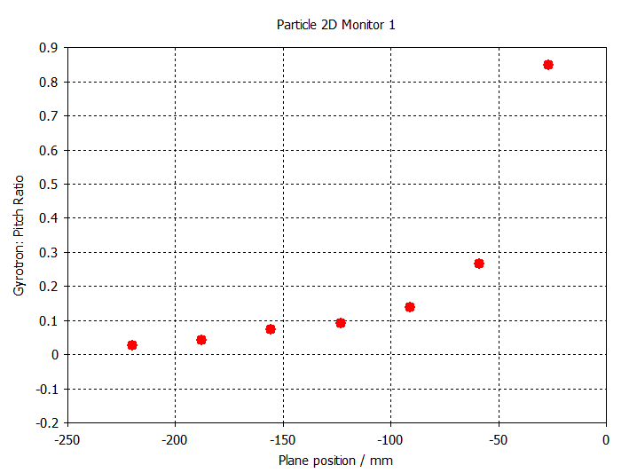
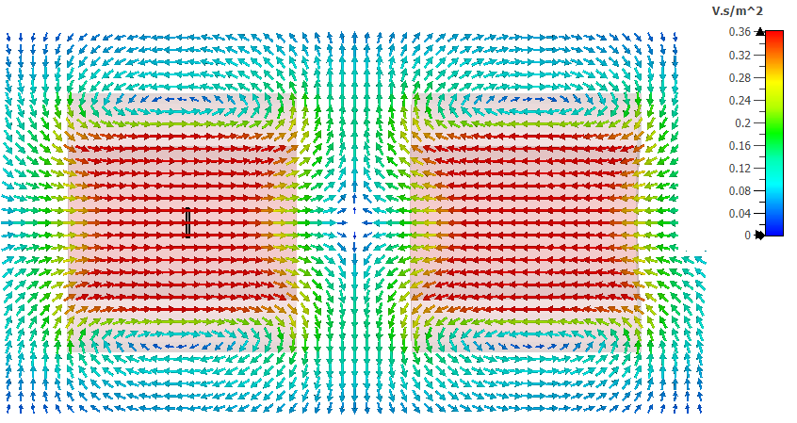

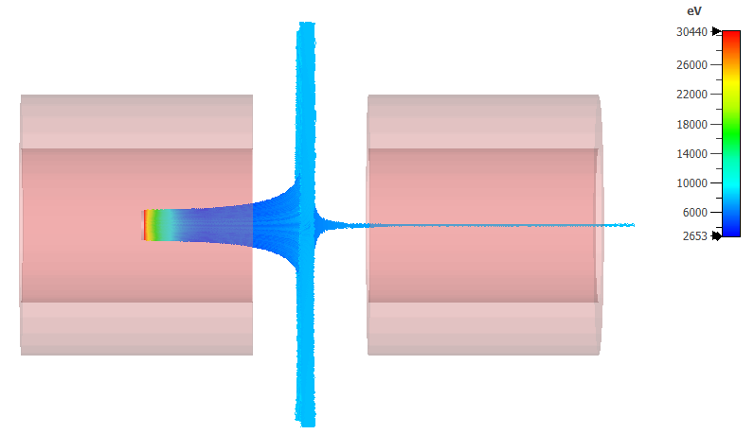
Collector - Cusp Design
Cusp field
transverse velocity vs. longitudinal velocity
Approx. 7% losses

Slide 18
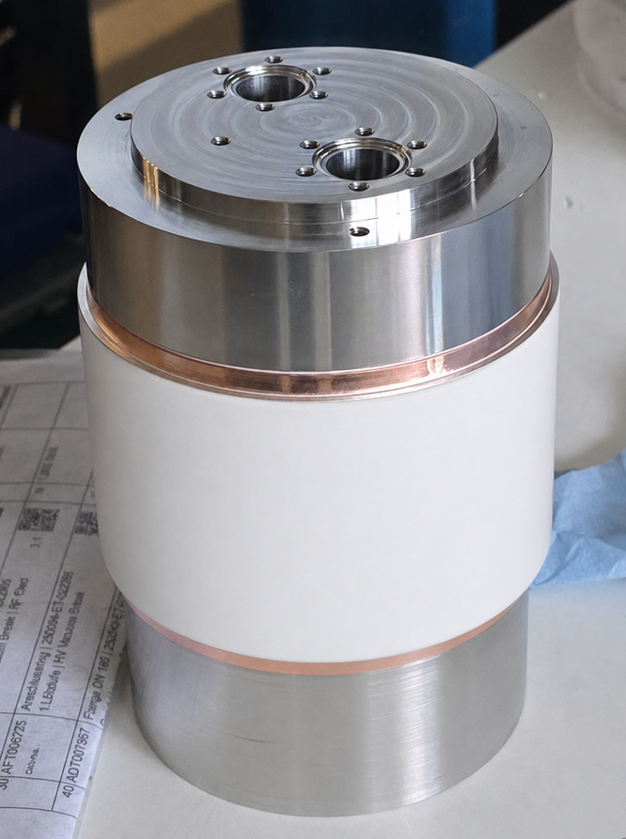
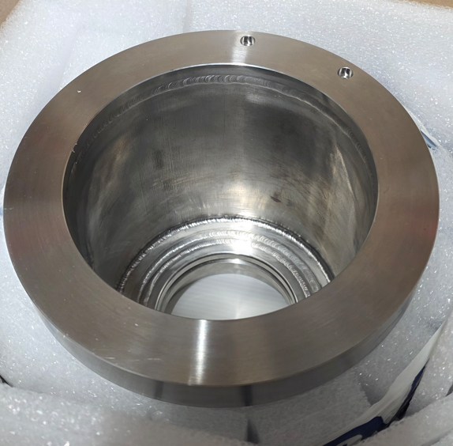
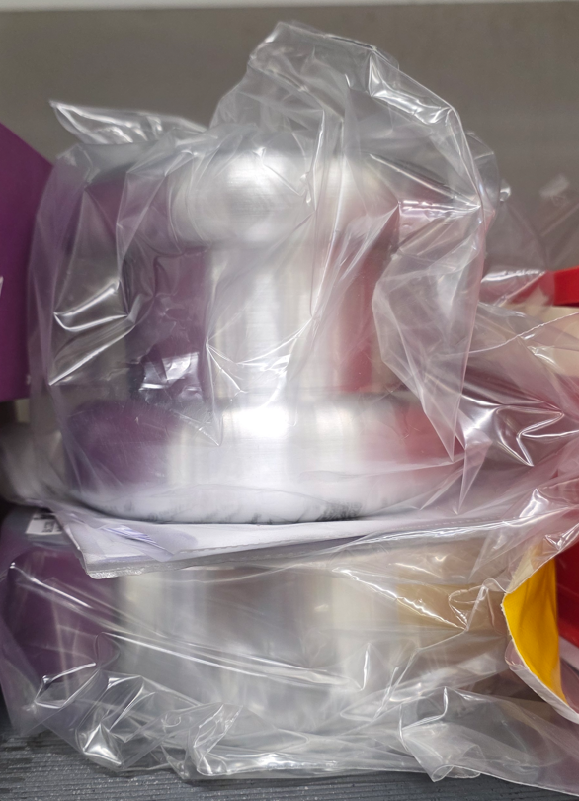
RF-Modulated Electron Gun
Electron gun parts & assembly: NTG GmbH & Co. KG
B
A
A
B

