Slide 1
Plans for Space Charge Compensation with Electron Lenses at GSI
M. Kirk
GSI Helmholtzzentrum für Schwerionenforschung GmbH
Space Charge 2026, 7th ICFA Beam Dynamics Mini-Workshop, 30th Sept. - 2nd Oct., University of Oxford
Notes:
A set of so-called e- lenses for the compensation of the primary beam‘s space charge are planned for the existing and the future synchrotron at GSI.
(9 sec.)
###
KSU:
E-gun slide –be quicker, say less. Do not talk about the materials. can leave the text there about materials or place into ‚back up‘ slide.
Thermo-mechanical simulations –remove.
DO:
1 slide for the gun
1 highlight for the collector: energy deposition.
forget table. say 90 kW DC!

Slide 2
Acknowledgements
GSI: K. Schulte-Urlichs, K. Thoma, D. Ondreka, P. Spiller
CERN: G. Khatri
Riga TU: A. Ratkus, G. Pirkus, A. Moisevjes
Goethe University Frankfurt: O. Meusel, M. Droba, H. Podlech
Notes:
I am here to present on behalf of Kathrin who, in the end, unfortunately could not attend.
The

Slide 3
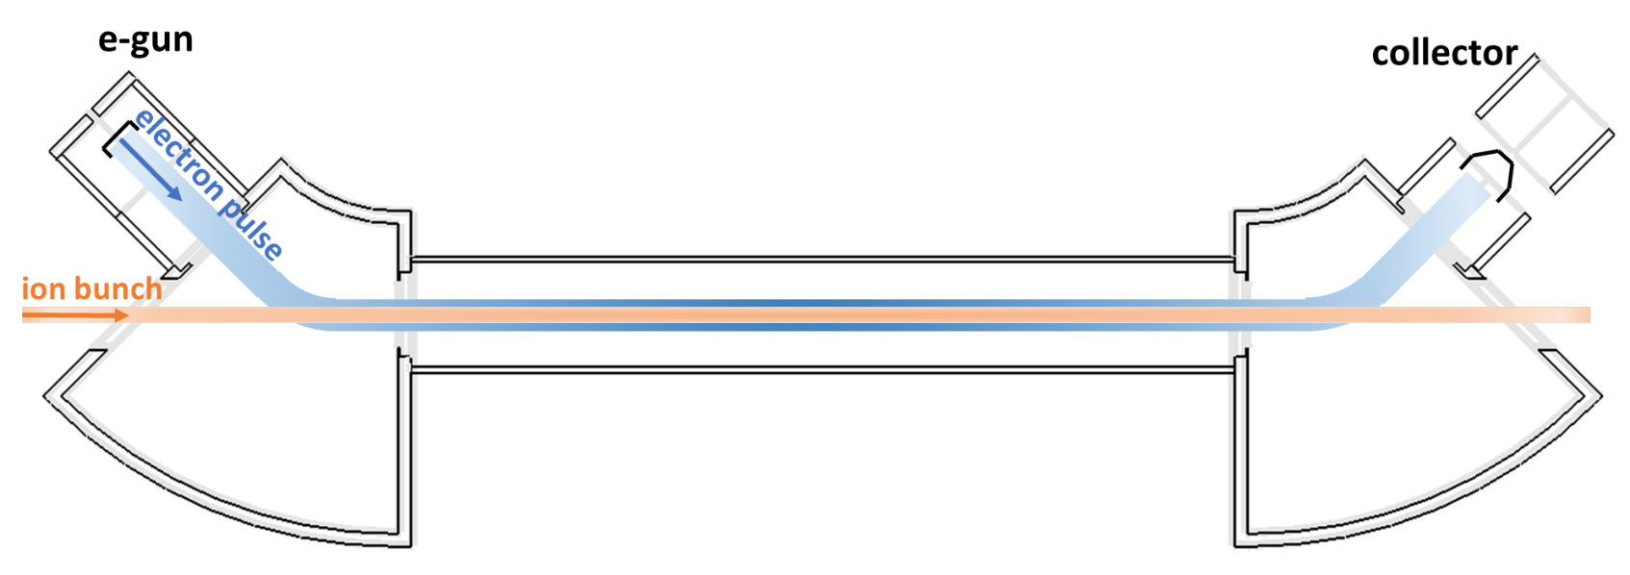
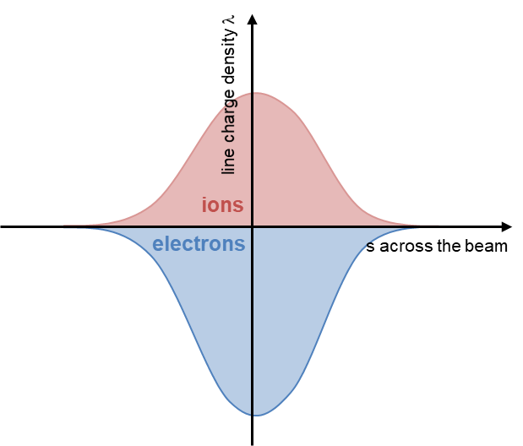
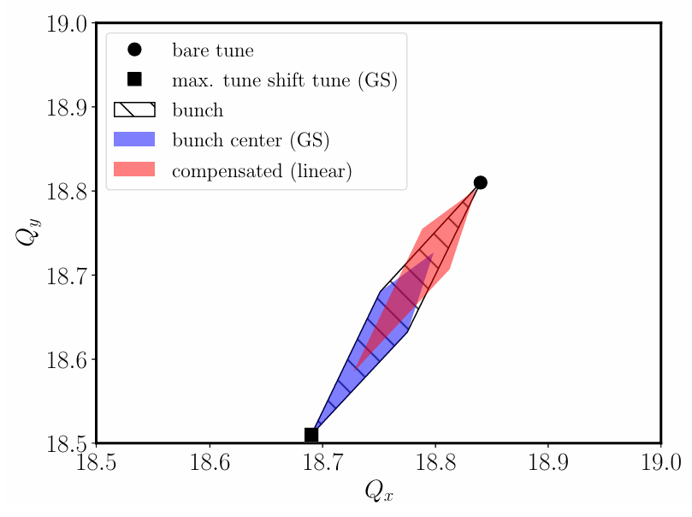
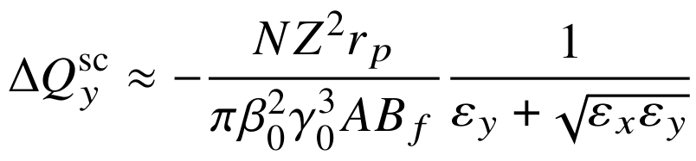
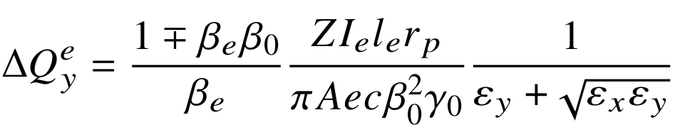
Functional Principle of an Electron Lens
Burov et al., FERMILAB-TM-2125, September 2000 –first publication
Solenoids†
Solenoids
Main (interaction) Solenoid
Primary beam:
'Toroid'
Just enough ΔE (ion - e⁻) to avoid cooling
the primary beam
'Toroid'
Artikova, Boine-Frankenheim et al., 2021:
Modulation to match longitudinal bunch profiles:
Primary beam (ions):
Reduced tune footprint (SIS100)
Compensation by electrons:
† "Gun" and "expansion" solenoid
Notes:
First studies date back to 2000. So far not built for SCC.
Reduce the space charge tune shift by superimposing an electron beam which co-moves with the ion beam.
e- beam current is modulated to follow the ion beam current, thereby maintaining SCC over the ion beam.
###
An electron lens reduces the incoherent space charge tune shifts in the transverse planes as shown in the bottom-right figure by means of counteracting the repulsive electrostatic forces between –in our case– positive ions of the primary beam with oppositely charged particles, namely electrons.
The electron lens has some features also found in an electron cooler.
As illustrated in the figure at the top, electrons interact with the positively charged particles of the primary beam in a solenoid in the middle of the device.
The primary beam circulates in the synchrotron.
A set of current carrying single-wind coils up-stream from the main solenoid creates a toroidal-like B-field which guides the e-beam to the main solenoid.
The main solenoid then guides both the electron and primary particles to a another toroid which guides the electrons to a collector where they are dumped.
The primary beam is deflected by the toroids much less than the electrons are owing to their much lower charge-to-mass ratio and are therefore able to pass through the electron lens.
Steerers up- and down-stream from the electron lens serve to close the orbit in the synchrotron.
When the primary beam is bunched longitudinally, the compensating transverse force from the electrons acting on the primary beam should remain proportional to the force from the primary particles acting on the primary particles themselves (i.e. self field).
That means the longitudinal charge density profile of the electron beam -above all, that in the main solenoid- has to be modulated such that its longitudinal charge density profile is proportional to that of the primary beam‘s, and in phase with it, as depicted in the bottom-left figure.
(2 min. 19 sec.)
###
dQ SC for a K-V
dQ e: -/+ sign in eq.: co-propagating -, counter-propagating +
… SIS-18 we chose to keep the – sign option because we wanted to keep the e- cooler / SCC being capable of cooling when needed.
Perveance: I, V → E e-
Child-Langmuir U**3/2
SC dominated extraction from gun.
? SIS100 apertures small due to cost.
Bunch length > interaction zone
elliptic cross section of e- beam was abandonded. we want not to match transversally. yes costs dQ suppression but then res.correction becomes easier and perhaps possible!

Slide 4
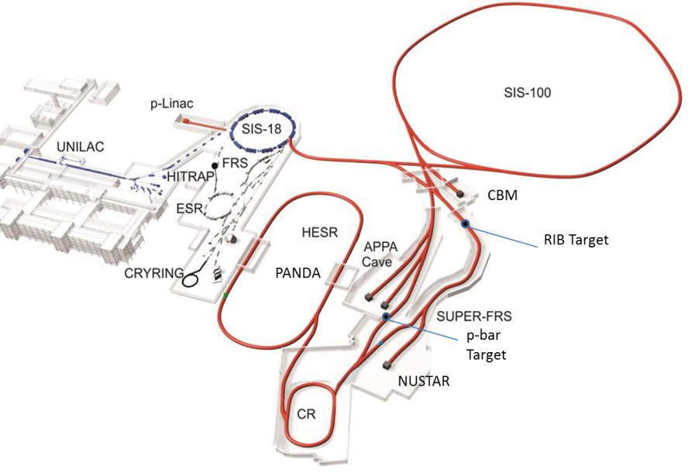
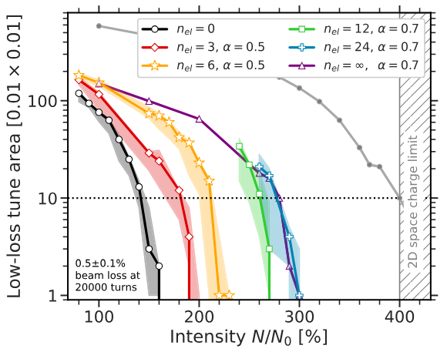
Motivation
GSI facility… as injector for FAIR
FAIR designed to increase intensity limits of GSI:
  Primary beam intensities up by factor 10-100
  Lower charge states to avoid space charge limit
Primary Beam Intensities at GSI and FAIR
 |  | p | Ar | Xe | U
Charge number | GSI | 1 | 18 | 48 | 73
 | FAIR | 1 | 10 | 21 | 28
Energy [GeV/u] | GSI | 4.7 | 1.7 | 1.3 | 1.0
 | FAIR | 28.8 | 6.6 | 4.0 | 2.7
Intensity [Ions/s] | GSI | 10¹¹ | 8·10¹⁰ | 2·10¹⁰ | 4·10⁹
 | FAIR | 10¹³ | 10¹² | 5·10¹¹ | 3·10¹¹
Oeftiger et al., 2024 [1]
Later module (> 2028)
"Numerical studies for SIS100 have shown that a few symmetrically distributed electron lenses could increase the space-charge limit by up to 50%, while a larger number potentially enables increase up to x 2" [1]
[1] A. Oeftiger and O. Boine-Frankenheim, “Pulsed Electron Lenses for Space Charge Mitigation”, Phys. Rev. Lett., vol. 132, p. 175001, 2024, doi: 10.1103/PhysRevLett.132.175001
Notes:
The ambitious intensity goals -shown in the table- of the SIS-100 synchrotron being built at GSI demands new means of mitigating beam losses.
The existing SIS-18 injector synchrotron has undergone various upgrades which shall enable higher beam intensities.
Both synchrotrons would benefit from space charge compensation devices.
It has been shown that in theory we may expect at least 50% increase in the intensity limit dictated by the space charge tune shift by placing 3 such lenses into SIS-100.
###
You can see the sychrotrons in the top left picture which shows the existing and future accelerator complex.
SIS-18, which has been upgraded to deliver higher beam intensity, will inject into SIS-100 which is under construction.
These machines are part of the Facility for Antiproton and Ion Research -FAIR.
Ions with lower charge states are required to avoid particle losses which would otherwise occur due to lattice resonances and the space charge induced ‚shifts‘ in the tunes of the particles.
Thus RF systems have been designed to accelerate these low charge state ions while maintaining the required ramp rates and thereby cycles times.
Beams out of the 100 Tm synchrotron, SIS-100, shall delivery intensities 1 to 2 orders of magnitude above that at present, hence the need to consider devices, namely electron lenses,
for the compensation of the electric field of the primary beam with the electric field from an electron beam. The goal intensities are shown in the table on the right.
PIC code studies on SIS-100 were made resulting in the plot on the right which shows how the low-loss tune area reduces with increasing intensity under several scenarios.
The results are encouraging. It was concluded that just a few lenses distributed symmetrically could increase the space charge limit by 50 % while more of them could even double it.
The electron lenses designed for GSI have considerably high B-field strengths in their main solenoids which cause strong coupling between the transverse planes in the primary beam particle‘s motion.
The local effect of this coupling may be compensated globally through the use of the exsiting skew quadrupoles in the injector synchrotron SIS-18.
( 1 min. 51 sec.)
4 min. 10 sec. used up. 5 min 50 sec to go.. (16 sec per remaining slide.)
###
Not mentioned in the talk:
Vacuum pumping systems had to be designed with sufficient capability which included NEG coating in critical sections along the beamline and cryogenically cooled sections with
the aim to mitigate a negative ‚feedback‘ process whereby residual gas in the UHV would start a desorption induced ‚snow ball‘ effect in the so-called dynamic vacuum process.
PANDA internal target on east side HESR.
HESR e- cooler on west side of HESR.

Slide 5

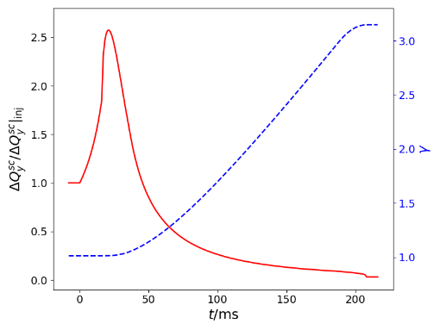
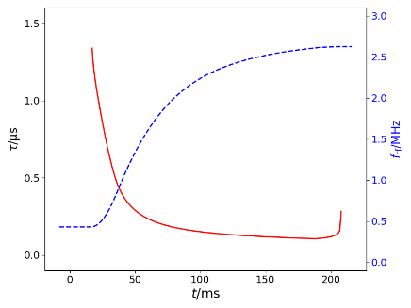
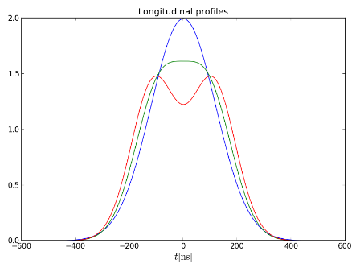
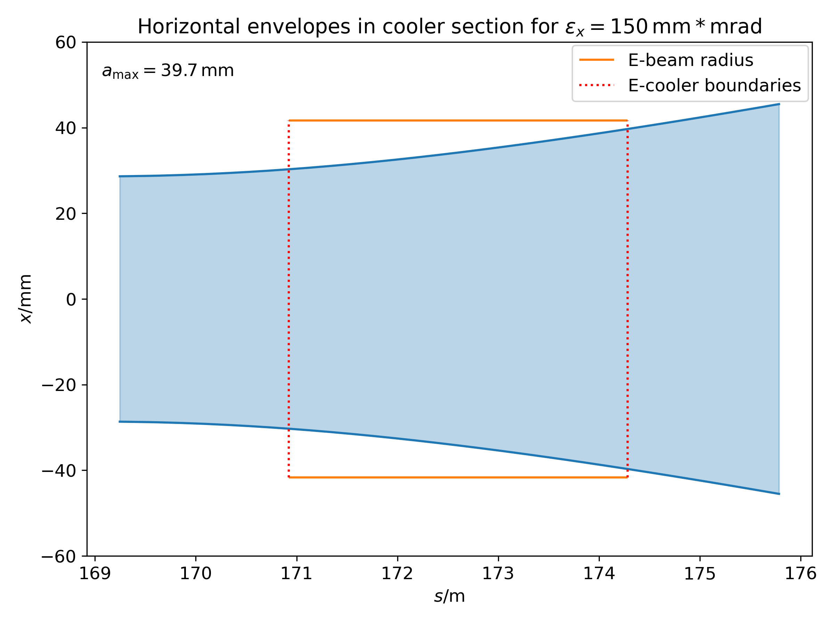
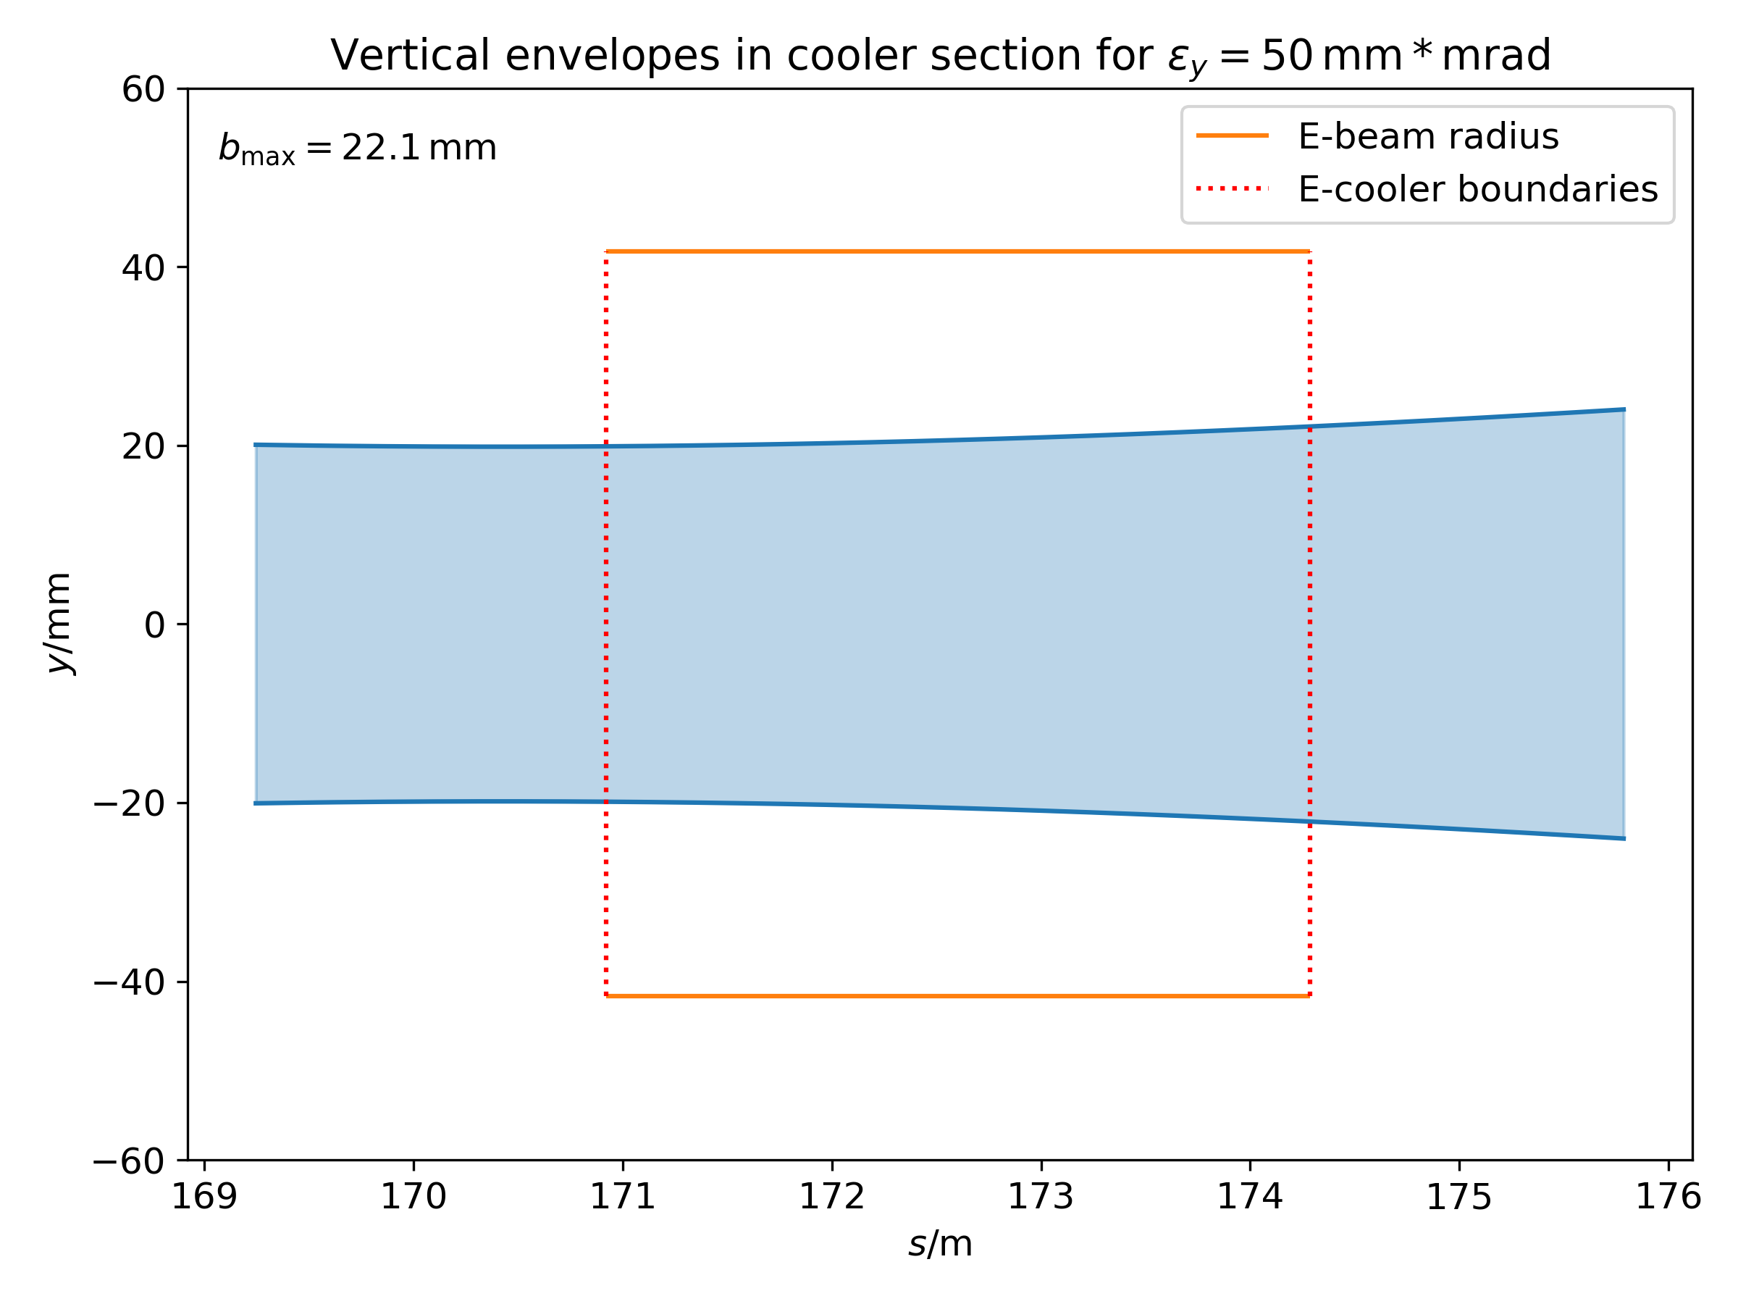

E-Lens Requirements for SIS18
Synchrotron Cycle
  Parameters determining modulation to superimpose ion and e⁻ bunches
    Tune spread peaks shortly after start of ramp
    Cavity RF and ∴ bunch length vary strongly
Electron Lens Design
  RF-modulated e⁻ gun
    Up to 15 A (peak) for space charge compensation
    0.4 - 1 MHz to follow longitudinal bunch profile, required bandwidth 10 MHz
    Transverse homogeneous e⁻ beam density with circular cross section for ‘linear’ compensation
  Collector
    Reduce e⁻ beam power density by deceleration and e⁻ beam expansion in a cusp-form B-field
    Mitigation of secondary electrons
Longitudinal Bunch Structure (time)
Evolution of peak tune spread
Injection
Bunching
Cycle time (t)
Accele-ration
Evolution of bunch length & RF
Longitudinal ion bunch profiles
A
Profiles:
A: Single h RF,
B: dual h RF,
C: Beam blow-up
B
C
Ion beam envelopes in e⁻ lens section (ELEGANT code):
e⁻ beam
e⁻ beam
Solenoid
Solenoid
Electron lens design underway. Demonstration with SIS18 e⁻ cooler to come
Notes:
The injector synchrotron SIS-18 will have 3 lenses with e- beam on for about the 1st third of the machine cycle due to the tune shift becoming sufficiently reduced due to beta & gamma term in the space charge tune shift.
The goal intensity of the synchrotron requires a relatively high e- peak current of 15 A to be able to suppress the tune shift of a bunched ion beam.
Because the RF period and therefore bunch length varies considerably over the cycle we require a modulation of the electron current in the range 0.4 to 1 MHz, and a bandwidth of 10 MHz to be able to compensate over the anticipated bunch profiles shown.
We chose to produce an electron beam in the main solenoid which has a homogeneous density in ist transverse cross section and is circular and which encompasses the ions. This choice makes a successful resonance compensation more likely.
Due to the high electron current which consists of 35 kV electrons in the main solenoid, it has become necessary to not only decelerate the electrons to a dump but to expand the e- beam them too which is done by a B-field which drops to zero at the collection point.
The collector should have a little as possible flow of secondary electrons from the dump back towards the ion beam.
###
The figures in the top row pertain to the machine cycle of SIS18.
Soon after the DC beam is captured the tune shift reaches a maximum.
Thereafter at about 50 ms into the cycle it reduce enough that an e-lens can be switched off which is good for the heat load in the collector.
Because tune spread to be compensated varies, the current from the gun has to be modulated in its amplitude up to a maximum of 15 A.
The cavities‘ RF frequency and therefore bunch length undergo considerable change during the cycle as shown in the left figure in the middle row which determine the range of center frequency of the modulation of the electron current out of the gun which is from 0.4 to 1 MHz.
3 forms of bunch profiles are considered, shown in the figure on the right in the middle row.
Their spectra determine the required bandwidth of the frequency modulation which is 10 MHz.
It was decided to trade off some tune shift compensation in order to reduce the lattice induced tune resonances which is why the transverse e- beam density shall be homogenous and circular in its transverse cross section.
The left figure in the bottom row show the transverse cross section of the ion beam at the entrance to the main solenoid.
The two figures to the right of it show the projection of the ion beam over the main solenoid onto the horizontal and vertical planes together with the extremities of the e-beam which encompasses the ions.
The B-fields will expand the e- beam coming through the gun‘s modulator grid on its way via the gun-solenoid to the main solenoid.
The B-field at the centre of the main solenoid determines, along with other parameters, the rate of coherent e-beam rotation in this solenoid due to the so-called E x B mechanism.
This B-field along the optical axis of the electrons should be sufficiently strong to keep e- beam deviating too much from its ideal orbit.
The dedicated e-lens will have so-called correction dipole magnet coils instead of the steerers which are the steerers closest to the e- cooler.
Each toroids will have a correction dipole.
These correctors help establish the closed orbit bumps in the horizontal caused by the vertical B-field components in the toroids.
The collector has to be capable of receiving the high power e-beam.
The beam is expanded by a B-field directed along the optical axis in the collector branch which has no field at the cusp which is at the point where the e-beam impinges the collection point.
Meanwhile the electrons are decellerated down to just a few (6) kV.
The flow of secondary electrons from the collector‘s anode is heavily reduced.
(2 min. 5 sec.) 3 min. 45 sec. to go..
###
Fig middle right:
Blue is that in single harmonic bucket. Gaussian assumed.
‚Flattened‚ profile is that when using double harmonic RF (h2 = 2 h1)
Double peaked profile (2 gaussians) comes from a Landau damped bunch in a single harmonic bucket with a modulation in RF phase at the synchrotron frequency → resonance.
Figs bottom right:
E-beam between vertical red lines is that in the solenoid 3.3 m
Green horizontal
###
Best explanation by reading „Pulsed electron lenses for space charge compensation in the FAIR synchrotrons”, S. Artikova et al., JINST2021
“electron beam requirements”
Building new e-gun for SCC which has to encompass the 150 um EX
‘Frozen’ e-beam: E x B drift not the most relevant argument at the moment.
Bsol = 150 – 300 mT

Slide 6
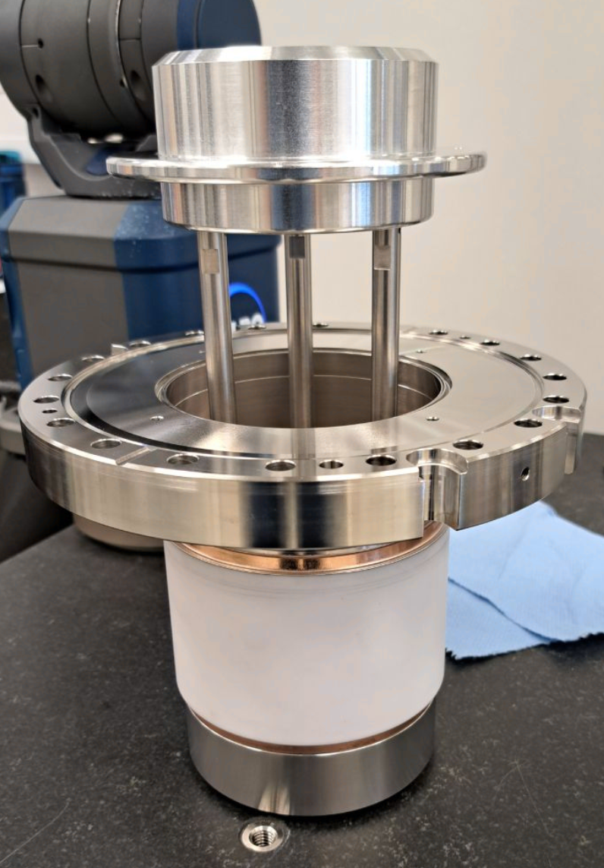
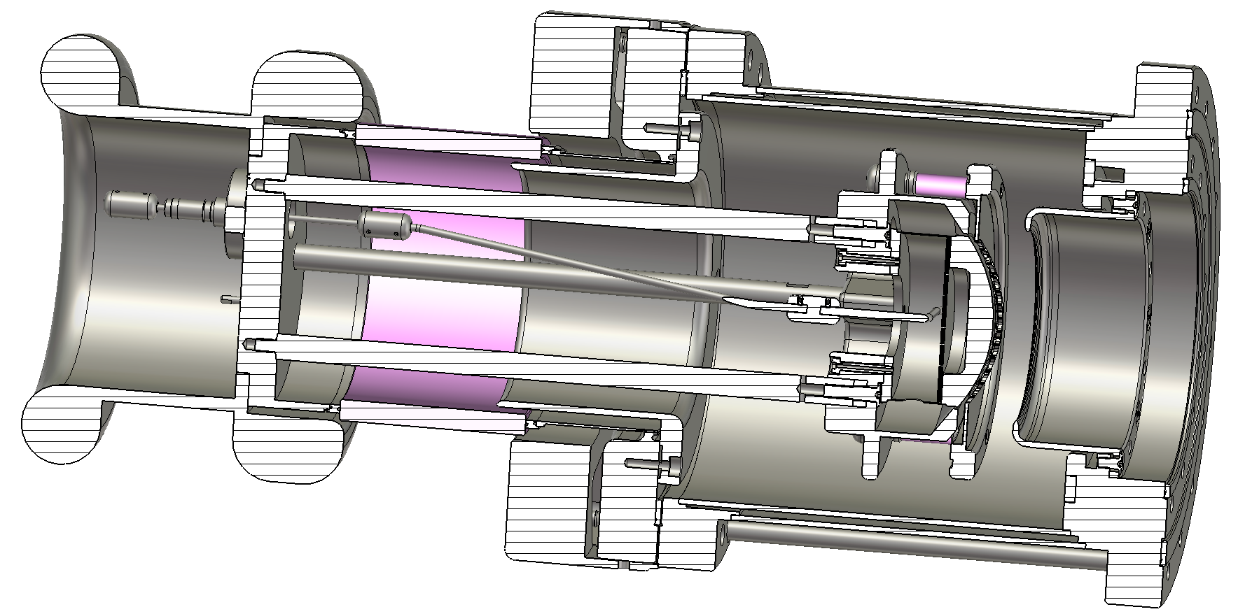
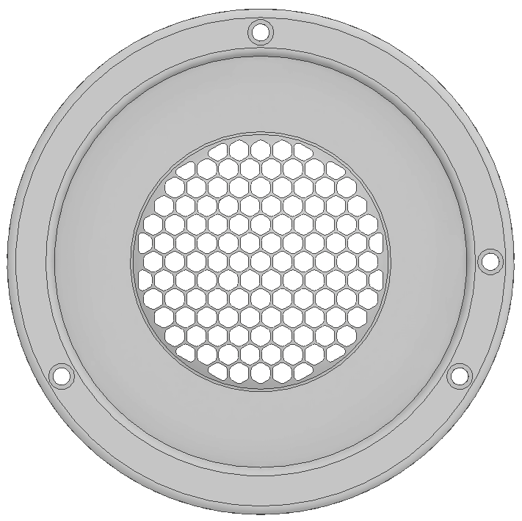
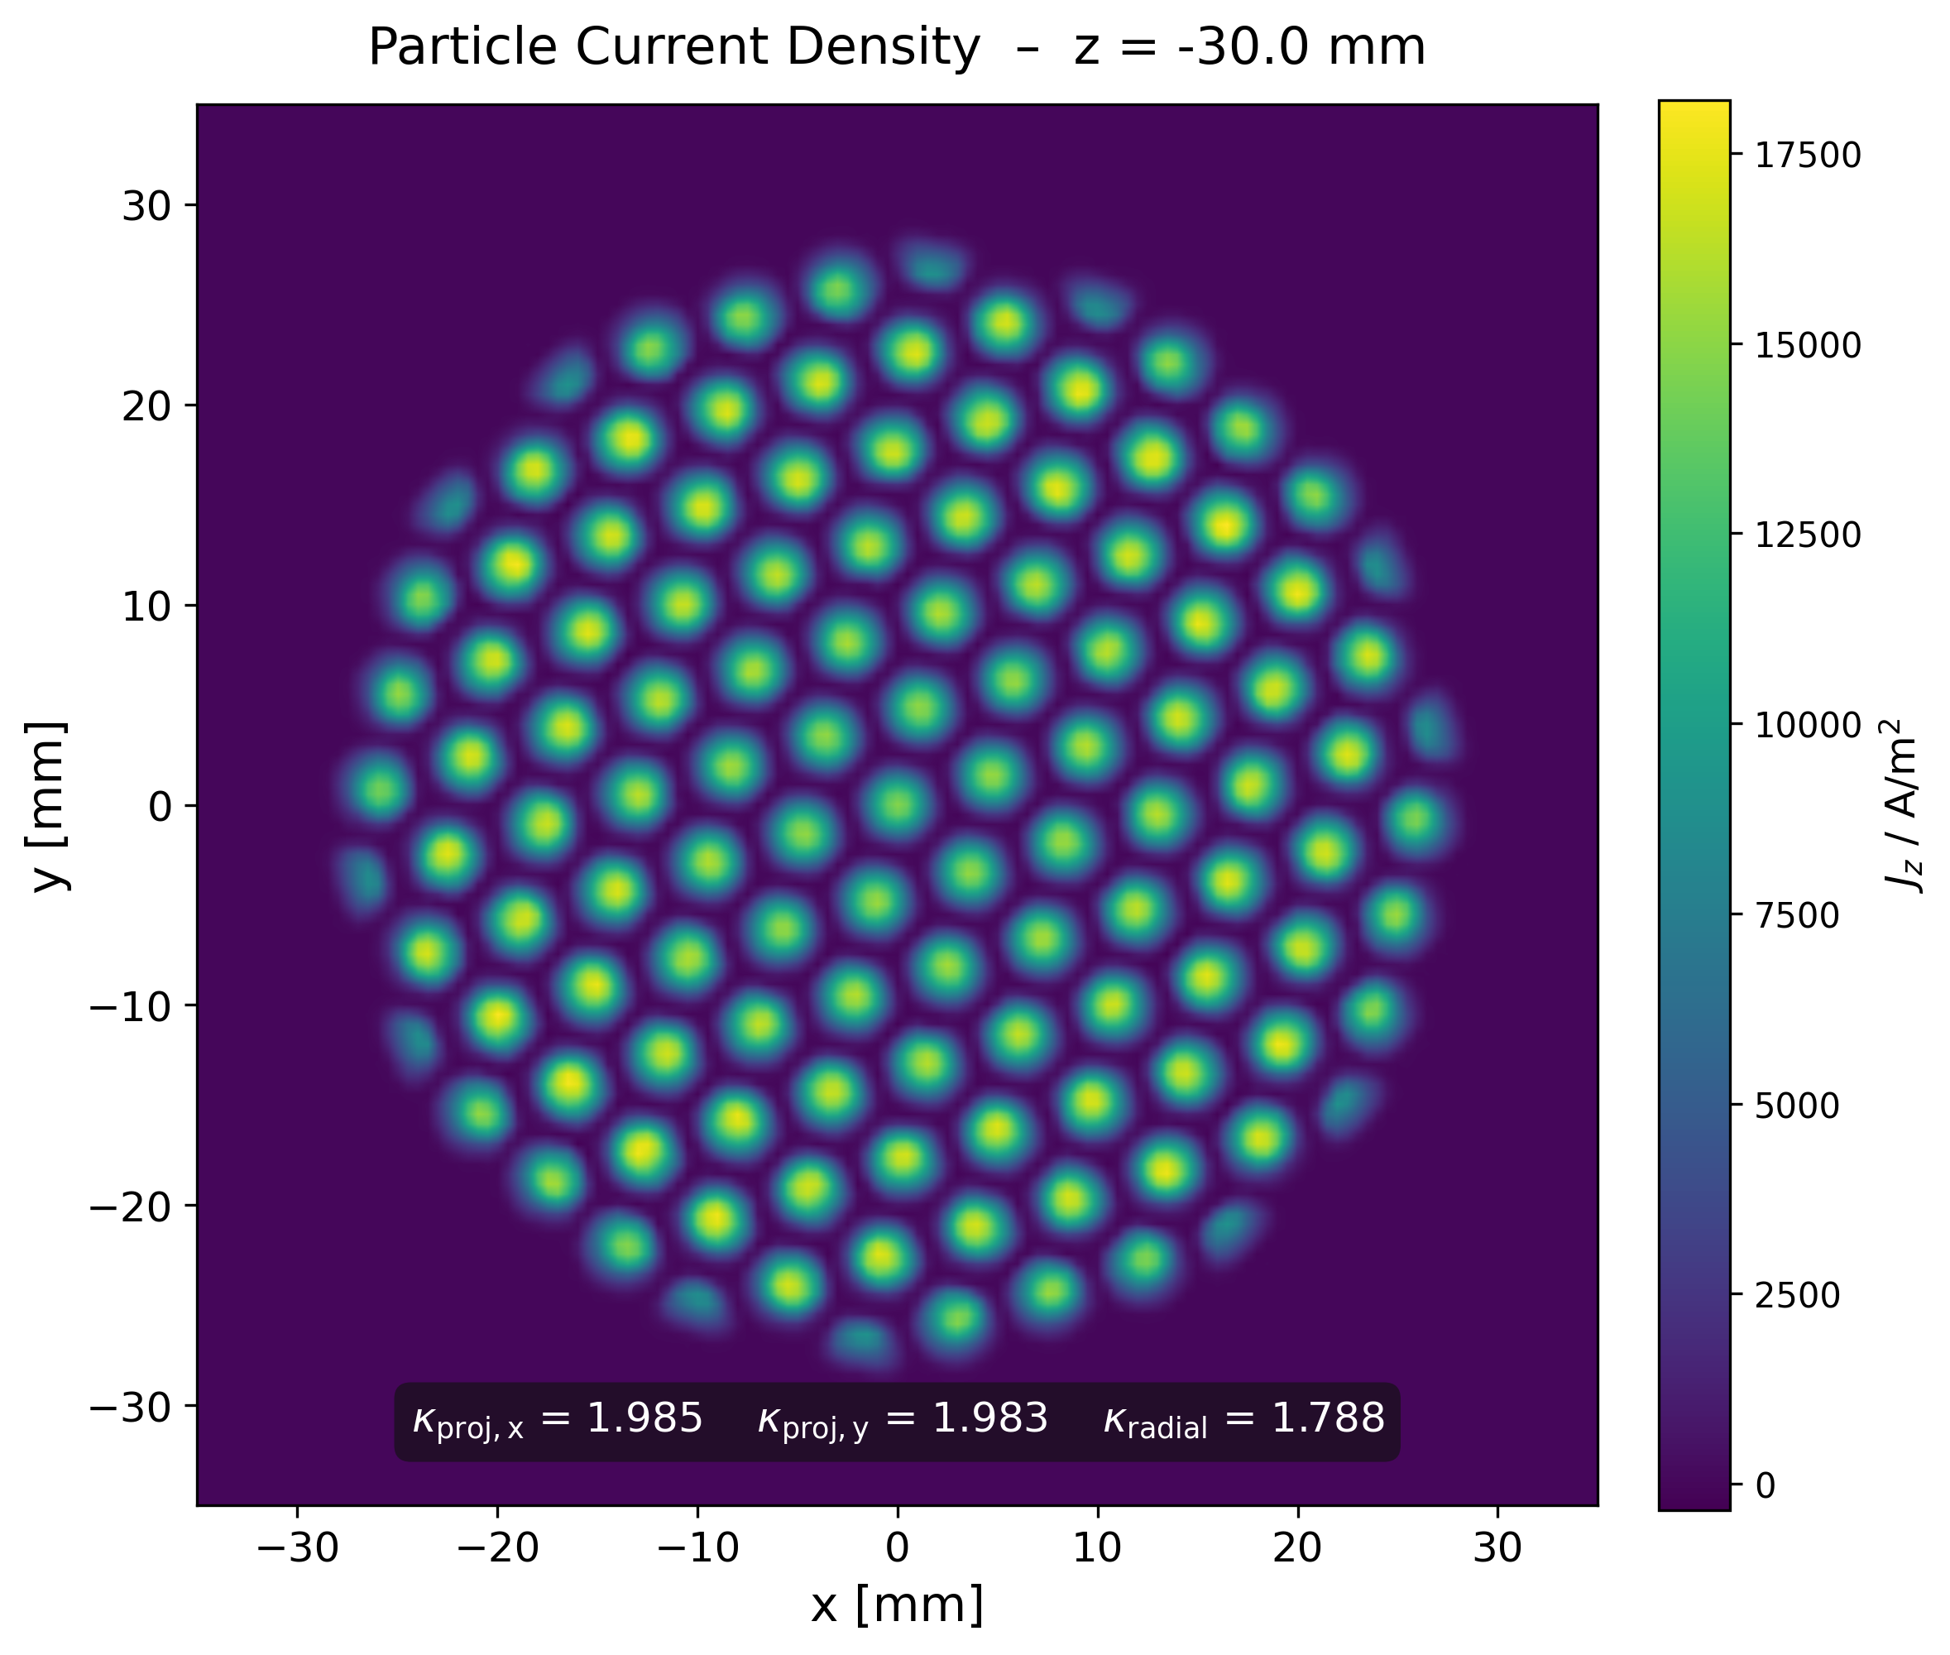

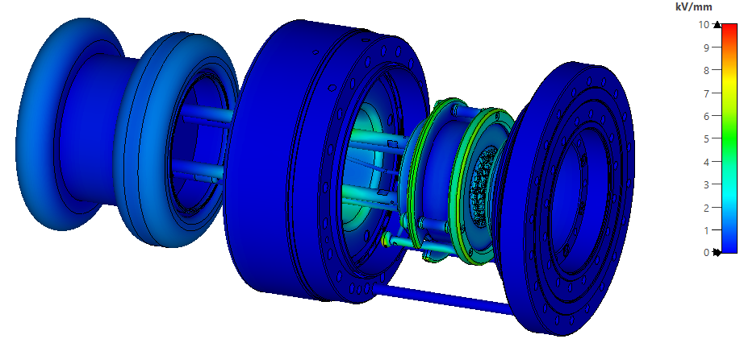
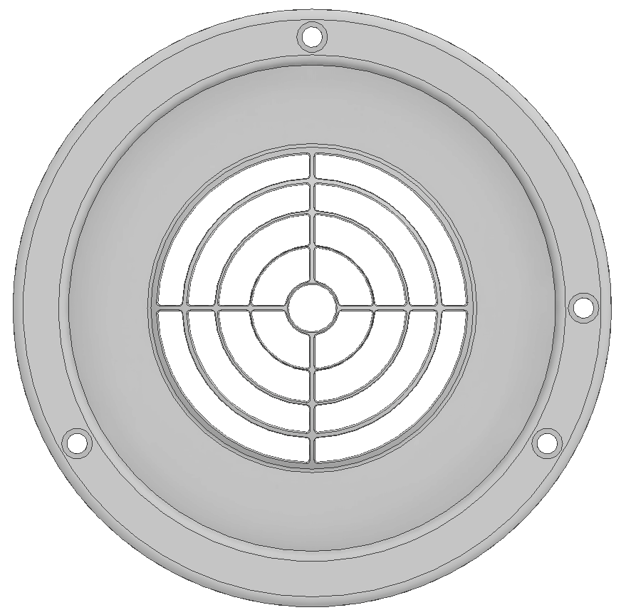
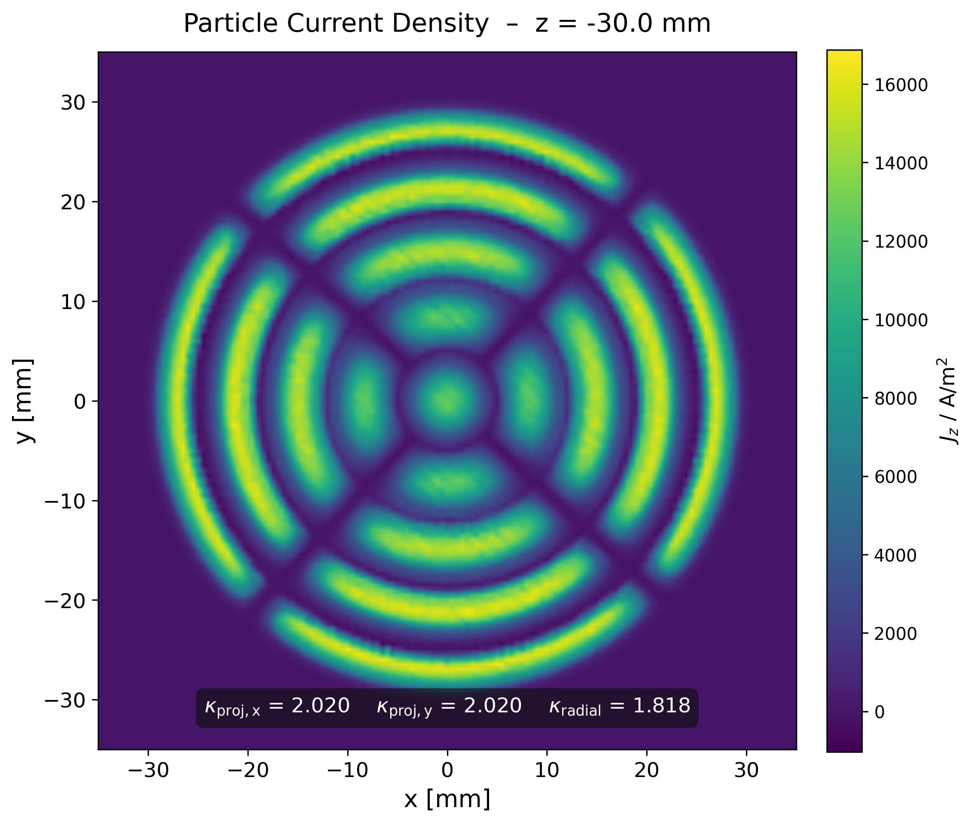

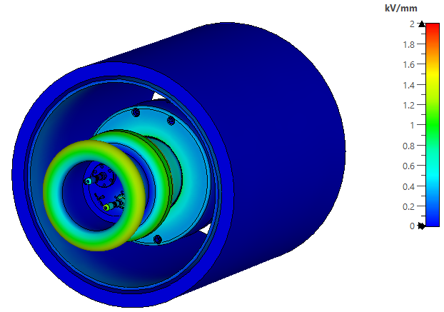
RF-Modulated Electron Gun
'Honey comb' grid
Electrostatic Analysis:
Optimized for max. 10 kV / mm:
'Target' grid
Optimized for max. 1.5 kV / mm:
Solenoid
Notes:
Gun: First stage design by GSI. Design modified by and being manufactured by NTG.
Modulation grid very close to and in front of the cathode which is also curved …in the second half of the top left figure.
Modulation grids: 4 combinations of 2 geometries with 2 materials to compare in SIS-18 runs. Patterns in e- distribution out of the modulator → SCC? … and secondary electrons, and STRUCTURAL stability?
ANSYS: electrostatic FEM of design of gun optimized for up to 10 kV/mm in vacuum and 1.5 kV/mm air.
… also Thermomechanically in the same manner.
###
The electron gun (e-gun) was originally designed by GSI and has since been redesigned and manufactured by NTG.
The top figure shows a cross section of the gun. We see amongst from the other components the electrical feedthroughs, cathode, and a modulation grid which is located close to the cathode.
To match the longitudinal electron-beam profile to the ion-bunch profile, the electron beam is modulated by the modulation grid.
Compared with other modulation techniques, this approach significantly reduces the power load on the modulator.
4 grid designs which are a combination 2 kinds of geometry (‘honey comb’ or ‘target’) and made of molybdenum or graphite are currently being manufactured and will be evaluated in terms of structural stability and secondary electron yield (SEY).
The trade off is between secondary electrons from the grid and the pattern on the electron beam in the main solenoid which should of course be minimal.
Particular attention was paid to the thermal management of the e-gun to minimize the temperature of the alumina insulators and thereby reduce the risk of high-voltage (HV) breakdowns.
Furthermore, the e-gun was optimized to limit the electric-field strength to a maximum of 10 kV/mm in the ultra-high-vacuum (UHV) region and 1.5 kV/mm in air.
1 min. 40 sec.
###
NTG | NTG Neue Technologien

Slide 7


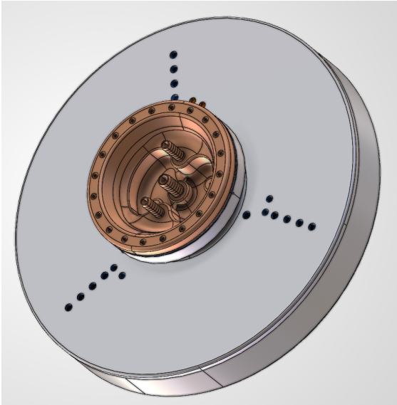
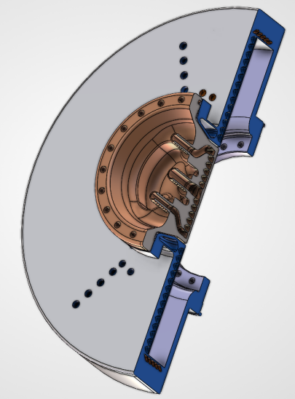
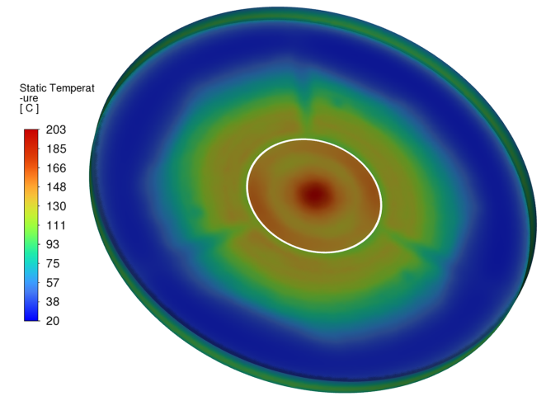
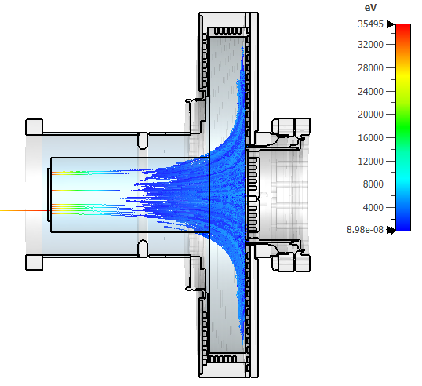
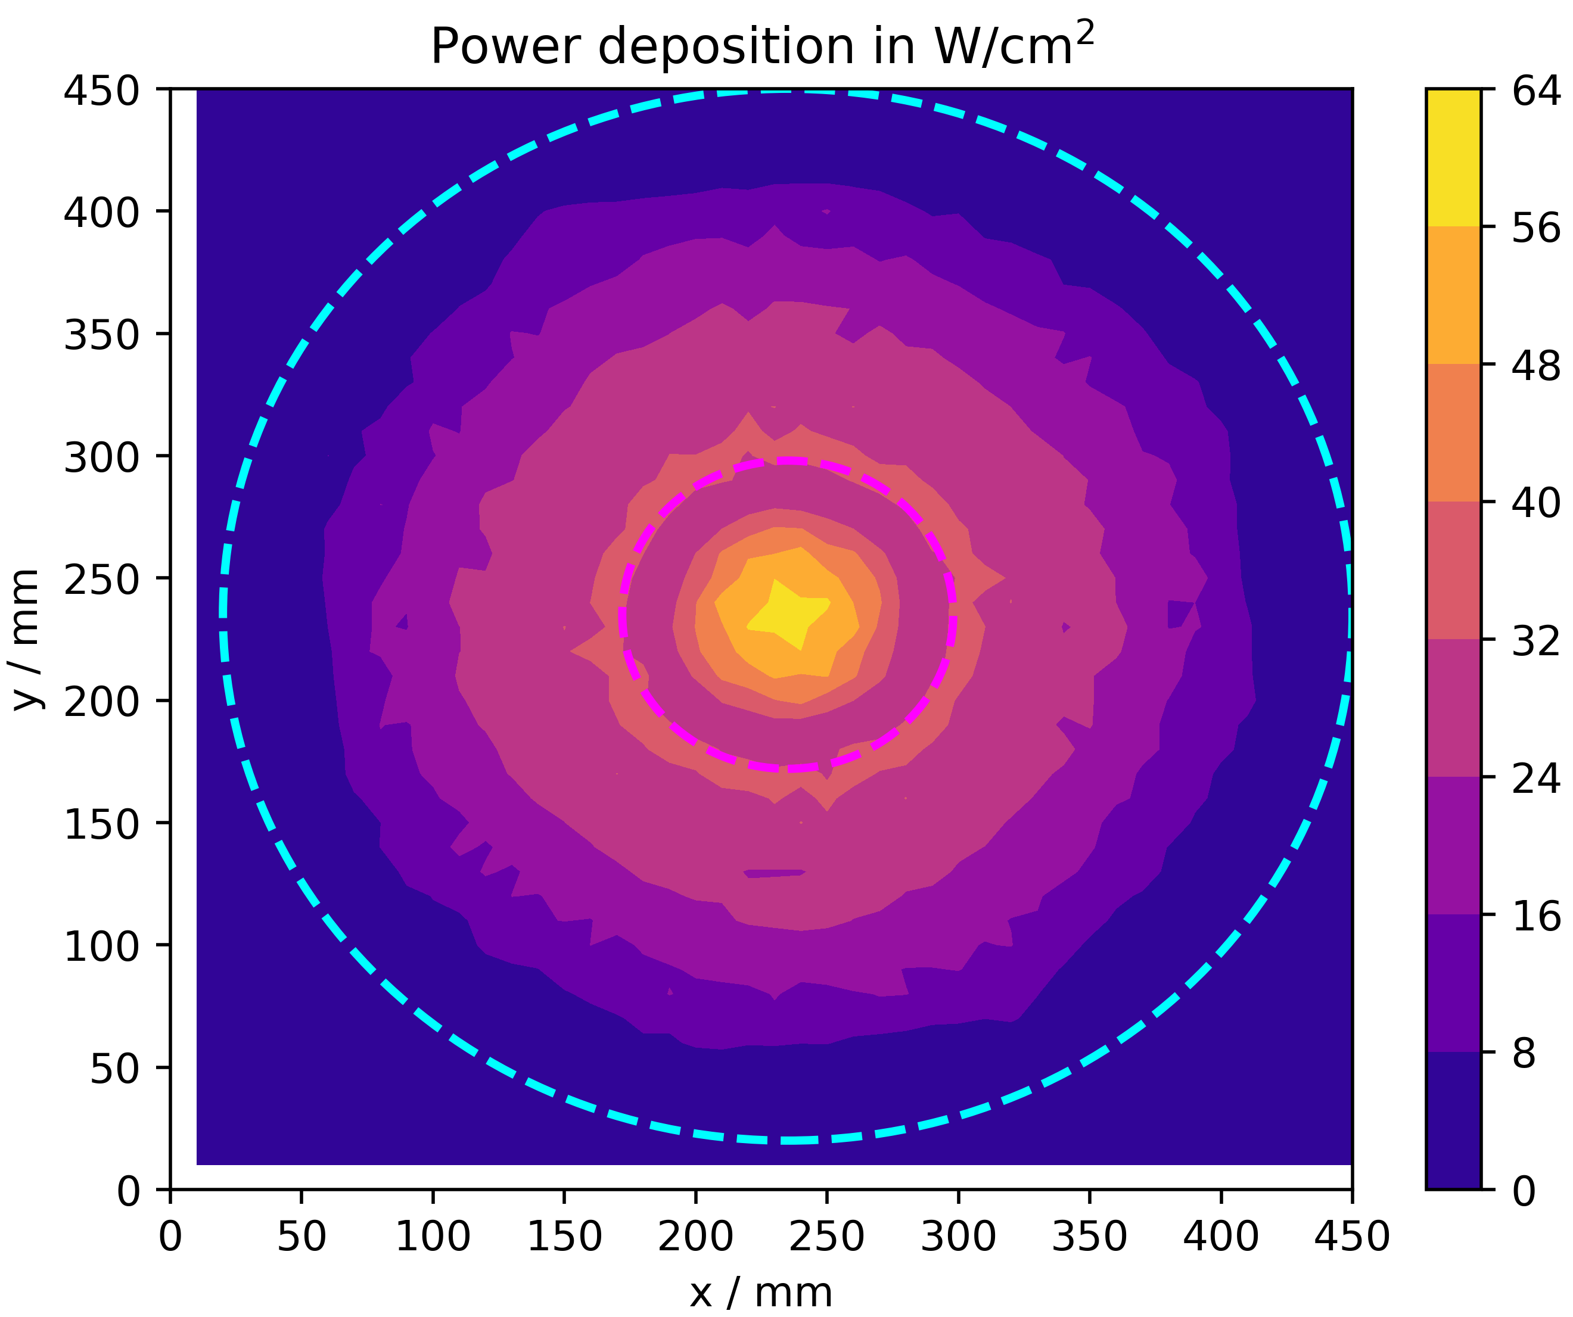
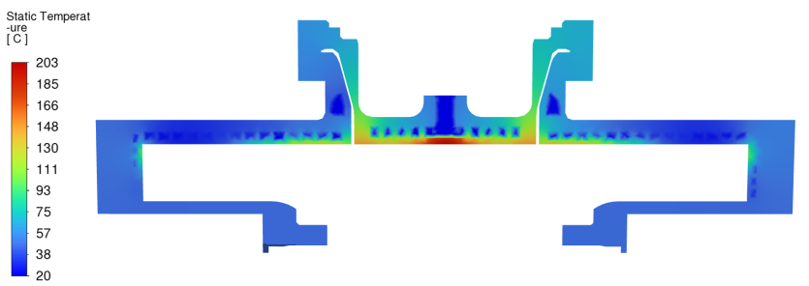
Electron Collector
This project received funding from the European Union’s Horizon Europe Research and Innovation Programme under GA No. 101290927
Additively manufactured
Collector Parameter
electron current, max. | 15 | A
bias potential, max. | -6 | kV
collector area | 1452 | cm²
inner radius , max. | 215 | mm
outer radius, max. | 242 | mm
beam radius | ≥ 215 | mm
DC power deposition, max. | 90 | kW
power deposition within cycle, max. | 30 | kW
chamber height | 66 | mm
weight | >50 | kg
B-field, max. | 0.4 | T
Design by G. Pikurs, A. Ratkus and A. Moisevjes, RTU, 2026
Distribution T °C:
Secondary Electron Mitigation:
Maximum Power Deposition in Cycle:
SE backflow:
11.1 mA
Electrons
35 keV, 15 A
→
0 kV
-29 kV
Efficiency ≈99.8%
E-lens is used at low Bρ of SIS18 cycle thus reducing power deposition by ~0.3
Notes:
Collector in B-field cusp to allow expansion of beam to deposit power over large area AND reduce e- beam SC and so collector bias voltage (peak power.)
Peak power 90 kW for 30% of the cycle → effective 30 kW.
Cooling water temp measured to allow power to be determined.
Complex geometry therefore AM.
Suppressor electrode (insulator) → back flow few mA
###
For beam dumping, a specialized collector design was chosen in which the collector is located within a magnetic cusp field.
This field causes the electron beam to expand rapidly, thereby
(a) reducing the beam’s space-charge potential during deceleration and,
consequently, the required collector bias voltage, which determines the peak power, and
(b) distributing the deposited power over a larger surface area.
Although the peak power in this configuration remains 90 kW, the electron lens is operated only during the initial phase of the SIS18 cycle.
This reduces the effective power deposition by approximately a factor of three (~0.3), to about 30 kW.
The collector is equipped with separate cooling circuits, allowing the power-density distribution to be determined from the cooling-water return temperatures.
Owing to the complex geometry of the cooling channels, Additive Manufacturing (AM) was selected to simplify production.
The manufacture of the cusp collector is now part of Work Package 11 (WP11) of the EPITA project.
The control and mitigation of secondary electrons constituted another important design criterion.
By integrating an additional suppressor electrode into the insulator between the beam pipe and the collector,
simulations indicate that the backflow of secondary electrons can be reduced to a few mA.
1 min. 38 sec.
###

Slide 8
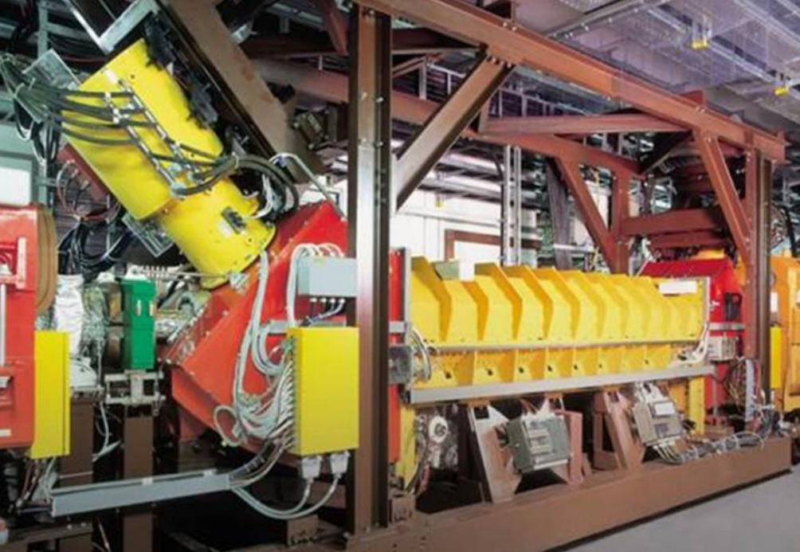
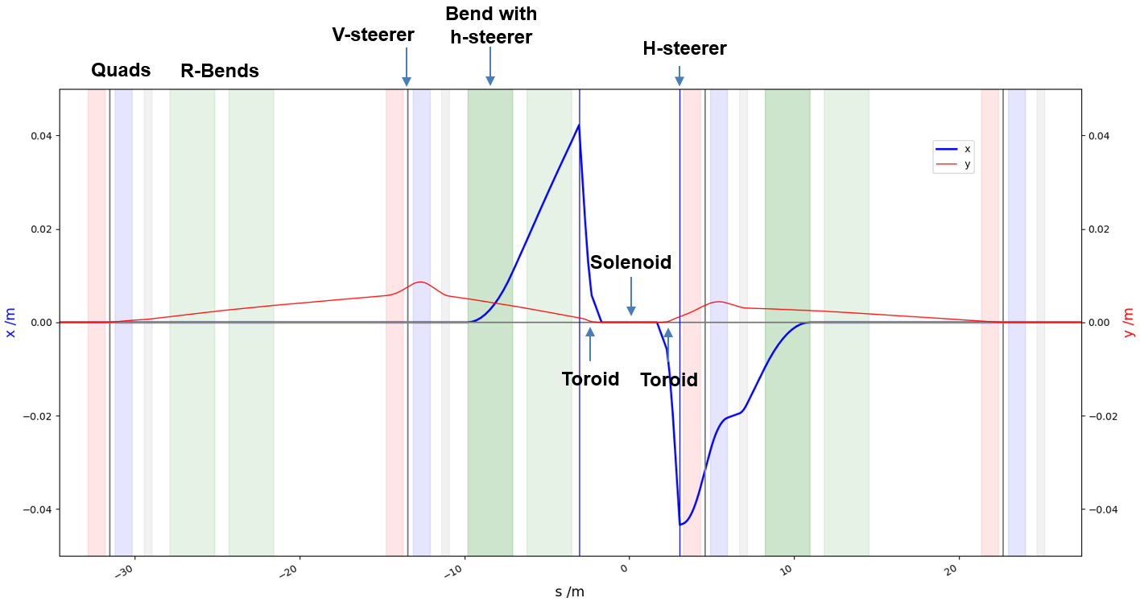
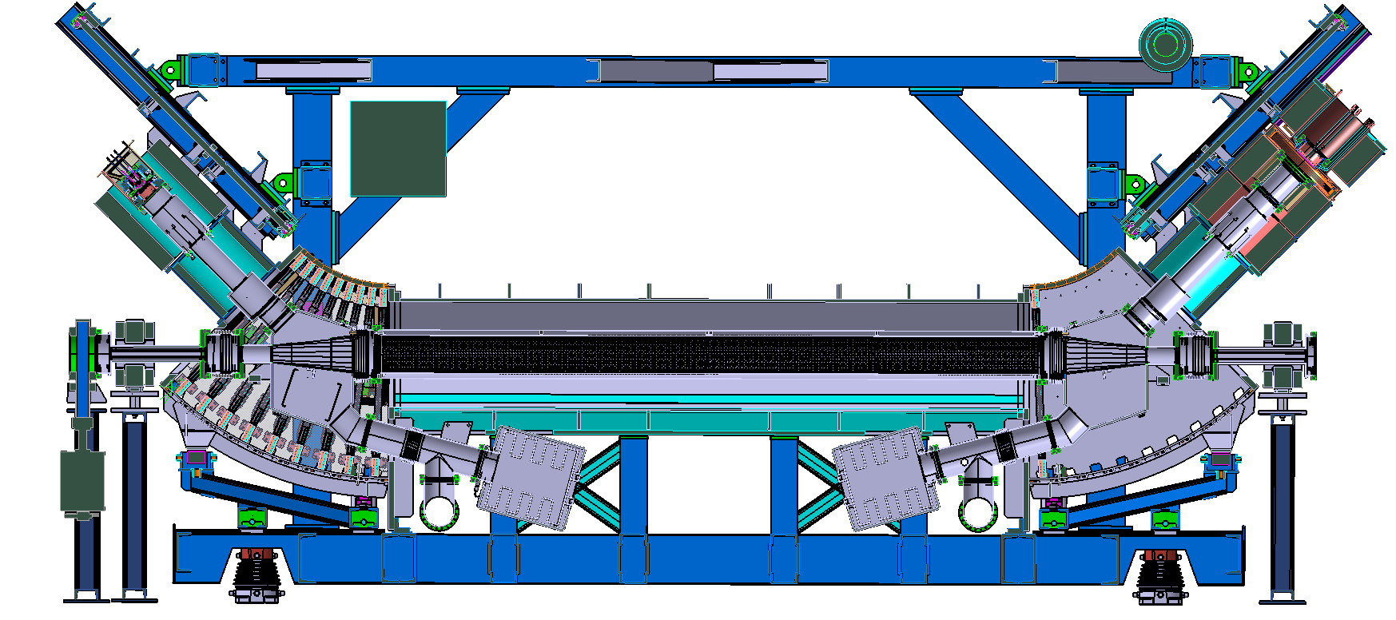
SIS18 e⁻ Cooler as Test-Bed
Modification of SIS18 e-cooler:
Max. B-field: e⁻ & ion-beam region 0.15 T, gun & collector 0.4 T
CO simulation indicates that the 0.15 T is feasable for experiments
Gun and collector designs adapted to e⁻ cooler
Experiments on e⁻ cooler carried out with more to come.
Questions:
  Kicks to particles from toroids
  e⁻ beam‘s influence on ions
  'Gridded' e⁻ beam current density distribution
  Compensation of coupling between transverse planes
  Resonance compensation
SIS18 e-cooler at present:
SIS18 closed orbit at 0.15 T, CST → ELEGANT with FTABLE* element:
Modified SIS18 e-cooler design:
H-Steerer
(HS)
HS
HS
Solenoid
HS
M .Kirk
* Ref. FTABLE: A. Xiao, M. Borland et al., “Tracking particles through a general magnetic field", PAC11
Notes:
Solenoid 150 mT, gun & collector 400 mT
CO correction for both planes due to high B-field
Questions…
###
The electron cooler which has been in operation for decades will be modified for space charge compensation.
The field at the center of the main solenoid will be at 150 mT. Electron cooling is done at 60 mT.
The solenoid directly in front of the gun‘s optics and the B-field of the collector are also both at higher than e- cooling values, namely at 400 mT.
The steerer strengths which produce the closed orbit shown in the bottom right figure were calculated with an iteratively converging optimization algorithm using the code ELEGANT.
The B-field from all sources of the e- cooler were calculated with CST and the field was imported into ELEGANT via the element called FTABLE.
FTABLE is not a symplectic element but for tracking over a single turn of the synchrotron it was sufficiently accurate.
The gun and collector had to be designed to fit to the rest of the electron cooler.
The designs for the other lenses in SIS18 and SIS100 differ in this respect.
Closed orbit correction has been experimentally proven to work at higher than usual field strengths in the e- cooler.
Python script based tune scans of primary beam intensity loss were carried out as an excerise.
More experiments are to come with the aim to address the following questions:
Is the model of the inflence of the toroid coils on the ions over many turns sufficient?
What is the influence of the e- beam on the ions in particular that in the toroids where the e- beam is close to the ion beam but not mixed with it?
What is the effect on the ions of the features in the transverse e- beam density distribution which come from the modulator grid?
Are of course the coupling and resonance compensation schemes have to be worked out.
###
For the dedicated e-cooler, the HS will be absent. Instead the h-steering will be done by correction dipoles in the toroids.
H-steerers in the electron cooler will moved towards the toroids. The CO calculation is based on the layout before they are moved.
FTABLE reference:
A. Xiao, M. Borland, et al., “Tracking particles through a general magnetic field", PAC11
!! → Additional solenoid is provided to adjust the collector system to the length of the beam tube.
The SIS18 ecooler is used to demonstrate the concept of space charge compensation for the first time.
In preparation for demonstration experiments, machine experiments have been performed with the SIS18 e-cooler at the end of 2023 as well as 2025, and
beam dynamic simulations are currently underway to study the effects on the ion bunch introduced by the electron lens.

Slide 9
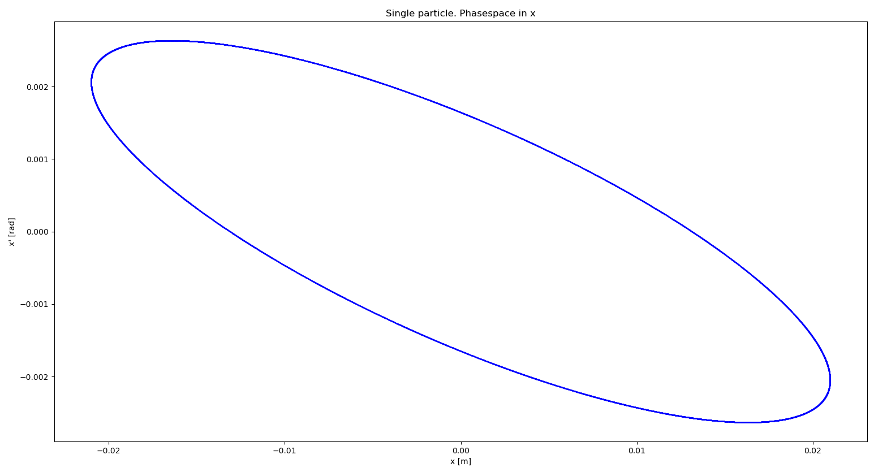
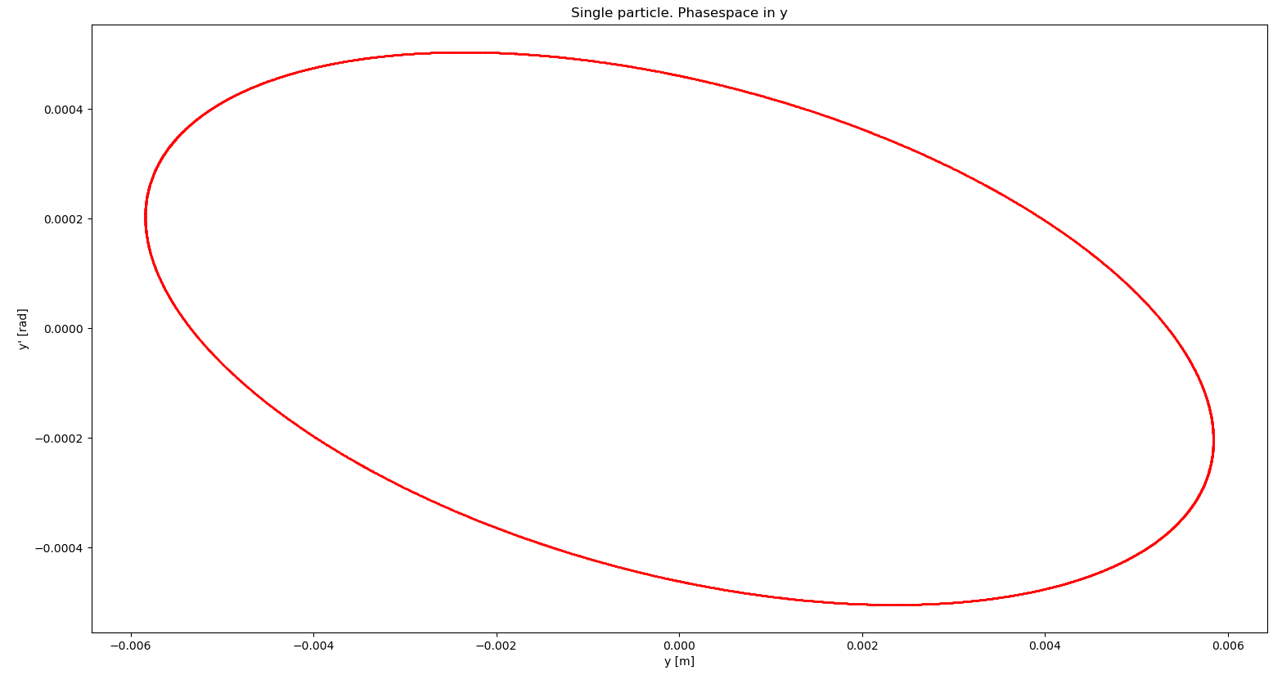
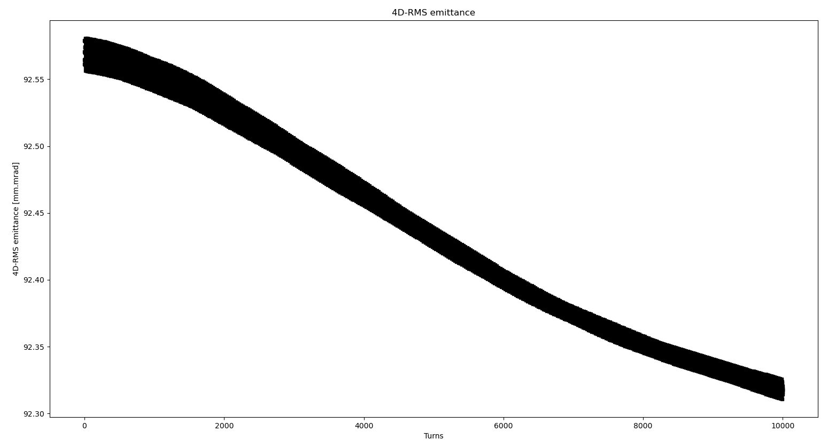
Transport Simulations with ELEGANT
NO SOLEnoids
Horizontal
4 mrad
40 mm
Single particle in phase space
tracked for 10k turns
Vertical
8 mrad
12 mm
92.55 μm²
4D RMS emittance vs. turn
1k-ion waterbag tracked for 10k turns
≈0.3% drop in emittance
Notes:
Tracking over many turns requires a high degree of symplecticity.
Optimized the lattice parameters, to a large part through choice of fringe field model.
Single particle results show apparently a closed motion in phase space over 10 k turns.
Looking closer at the 4D phase space of 1k ions shows a 0.3% drop in RMS emittance over 10k turns.
###
Closed orbit was computed. ELEGANT‘s &correct command tracks a test particle over a single turn per iteration until converged to closed orbit.
However tracking ions in a simulation over many turns around a synchrotron without incurring undersired numerical effects will be an issue.
ELEGANT & FTABLE based simulations have failed well within the simulated time frame of interest, i.e. ~0.2 sec (50k turns). Extreme emittance blow-up towards the end. FTABLE known to be asymplectic.
ELEGANT & SOLEnoid elements instead of FTABLE have been put to the test.
If toroids can be treated symplectically then we can reliably transport ions over many turns.
xsuite & E-Lens element is being looked into.
###
0.3% is too much for symplectic behaviour therefore cf. lattice w/ csbends, kquads and edrifts.
tunes were (4.28 , 3.3)
? TODO: (4.15, 3.3)
EX < 50 um to avoid losses at apertures during exchange.
TODO: sim. w/ 10 mT on main SOLEnoid.
KSU observed trafo loss because of difference resonance → EX EY warning …aperture Y !!

Slide 10
Further Reading
S. Artikova, D. Ondreka, K. Schulte-Urlichs, P. J. Spiller,
“Design and Beam Dynamics of the Electron Lens for Space Charge Compensation in SIS18”,
IPAC'21, pp. 3614–3617
K. Schulte-Urlichs et al.,
“Status of the Electron Lens for Space Charge Compensation in SIS18”,
IPAC'21, pp. 1880–1883
A. Oeftiger and O. Boine-Frankenheim,
“Pulsed Electron Lenses for Space Charge Mitigation”,
Phys. Rev. Lett., vol. 132, p. 175001, 2024,
doi: 10.1103/PhysRevLett.132.175001
A. Xiao, M. Borland et al.,
“Tracking particles through a general magnetic field”,
Conf. Proc. PAC11
I. Lobach, Y. Li,
“Using neural-network Ansatz for the generating function in the Hamilton-Jacobi equation to obtain symplectic transfer maps for elements with any magnetic field configuration”,
IPAC’26

Slide 11
History of Electron Lenses for Space Charge Compensation
The references above are up to about the point when work at GSI began.
A. V. Burov, G. W. Foster, V. D. Shiltsev, “Space-Charge Compensation in High-Intensity Proton Rings,” FERMILAB-TM-2125, September 2000
S. Machida, 2001, KEK PS simulation
Y. Alexahin, “Effects of Space Charge and Magnet Nonlinearities on Beam Dynamics in the Fermilab Booster”, PAC 2007, DOI 10.1109/PAC.2007.4440463
M. Aiba, M. Chanel, U. Dorda, R. Garoby, J.-P. Koutchouk, M. Martini, E. Métral, Y. Papaphilippou, W. Scandale, F. Zimmermann, V. Shiltsev, G. Franchetti, “Space-Charge Compensation Options for the LHC Injector Complex”, Proceedings of PAC'07, Albuquerque, 2007, pp. 3390–3392
M. Aiba, “Benchmark of ACCSIM-ORBIT codes for space charge and electron-lens compensation”, CERN, 2008
Y. Alexahin and V. Kapin, “Study of Possibility of Space Charge Compensation in the Fermilab Booster with Multiple Electron Columns,” Fermilab Beams-doc-3108, June 2008
V. N. Litvinenko and G. Wang, “Compensating Tune Spread Induced by Space Charge in Bunched Beams”, Physical Review Special Topics — Accelerators and Beams 17, 114401 (2014)
O. Boine-Frankenheim and W. D. Stem, “Space charge compensation with pulsed electron lenses for intense ion beams in synchrotrons”, Nuclear Instruments and Methods in Physics Research A 896 (2018), 122–128. DOI: 10.1016/j.nima.2018.04.014
S. Artikova et al., “Pulsed electron lenses for space charge compensation in the FAIR synchrotrons”, 2021 JINST 16 P03044. https://doi.org/10.1088/1748-0221/16/03/P03044
Y. Alexahin and V. V. Kapin, “On possibility of space-charge compensation in the Fermilab Booster with multiple electron columns”, Journal of Instrumentation 16 (2021) P03049. DOI: 10.1088/1748-0221/16/03/P03049
Notes:
GSI is not the first to consider an electron lens for space charge compensation where the e- beam moves with the primary beam.
The references shown are incomplete. Nonetheless, this particular topic dates back to a paper from FermiLab in 2000.
The concept so far has been theoretically shown to work.
(20 sec.)
###

Slide 12
Summary & Outlook
Electron lens is under development
Electron gun will be ready for testing at GSI
Prototype electron lens in SIS18 synchrotron will follow
Symplectic transfer map for e-lens*
Resonance and coupling compensation
* I. Lobach, Y. Li, Using neural-network Ansatz for the generating function in the Hamilton-Jacobi equation to obtain symplectic transfer maps for elements with any magnetic field configuration, IPAC’26
Notes:
Concerning toroid-like fields, SYMPLECTIC transfer maps have been shown to be in principle calculable from ARBITRARY B-fields [Lobach & Li, IPAC’26].
Starting point would be the field of an ideal current density distribution on the surface of a toroid.
###

Slide 13
Reserve slides …

Slide 14
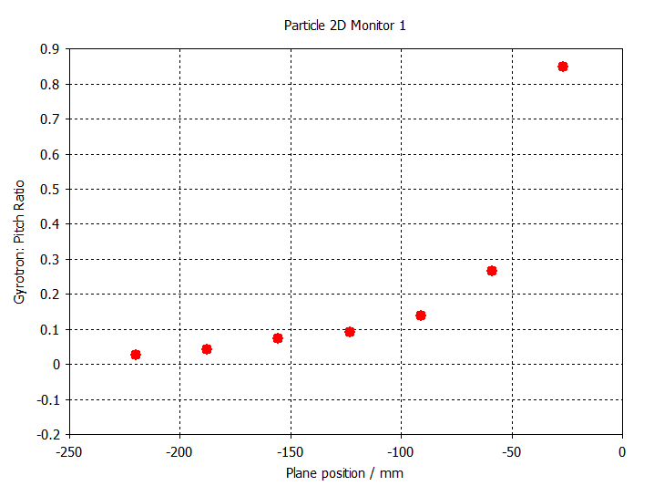
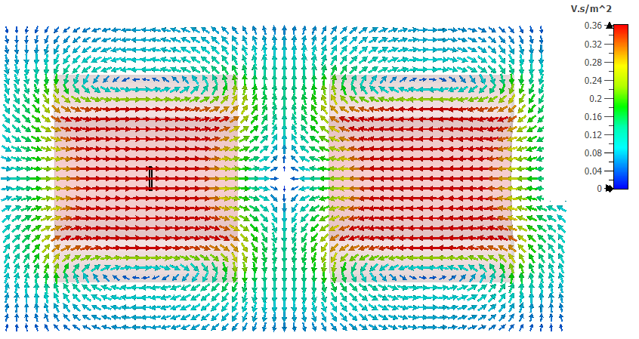

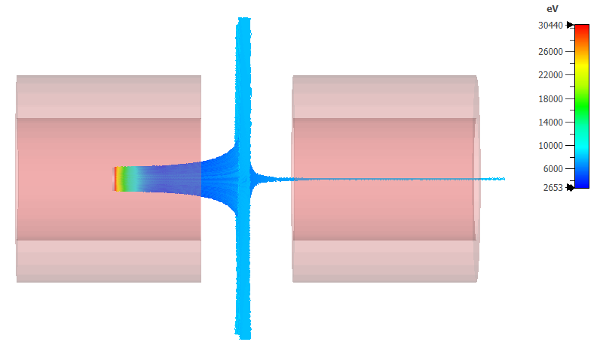
Collector - Cusp Design
Cusp field
transverse velocity vs. longitudinal velocity
Approx. 7% losses

Slide 15
RF-Modulated Electron Gun – Choice of Materials
Body parts: Stainless steel
Insulators: Alumina
Dispenser cathode: BaO, type 311XM by Spectra-Mat Inc.
Modulation grids: Molybdenum or graphite (SIGRAFINE®)
Focusing electrode: Molybdenum
Notes:
The parts for the electron gun are ready and are being assembled at NTG.
On the left in the schematic are the connection points for the HV and the heating of the cathode.
In the middle section labelled A there is the insulator for avoiding electrical breakdown.
The right section B has the chamber inside which there are the electrodes of the cathode and the modulator.
The chamber is actively cooled.
28 sec.
###
Status of the e-gun.
Die Bilder dienen nur zur Info im Vortrag ,um zu zeigen, dass die E-Gun bald fertig produziert ist und ausgeliefert wird.
Dispenser Cathodes for TWTS, Klystrons & Gyrotron - Spectra-Mat
SIGRAFINE® isostatische Graphite | SGL Carbon

Slide 16
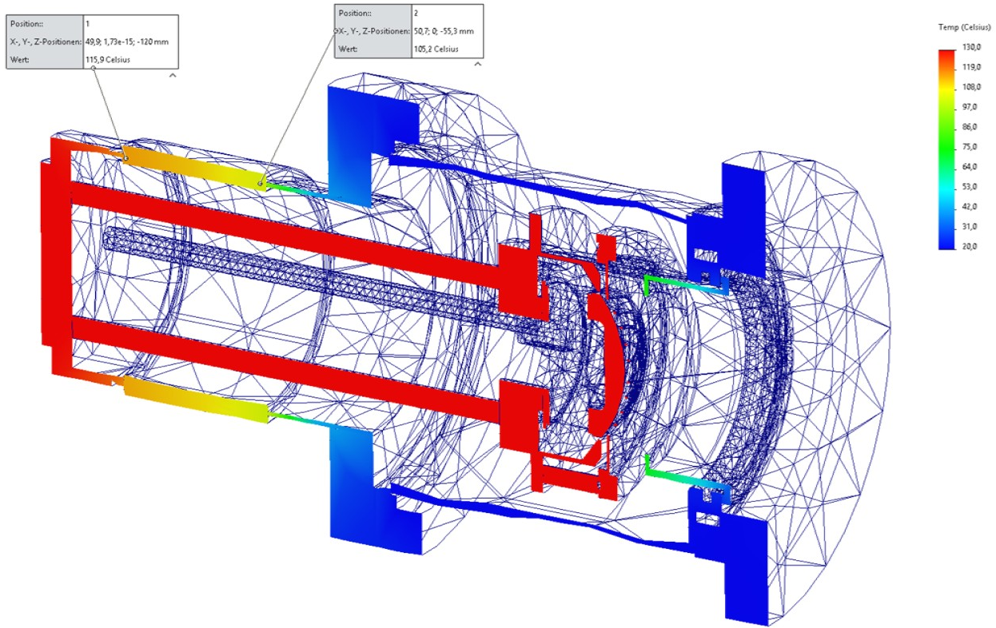
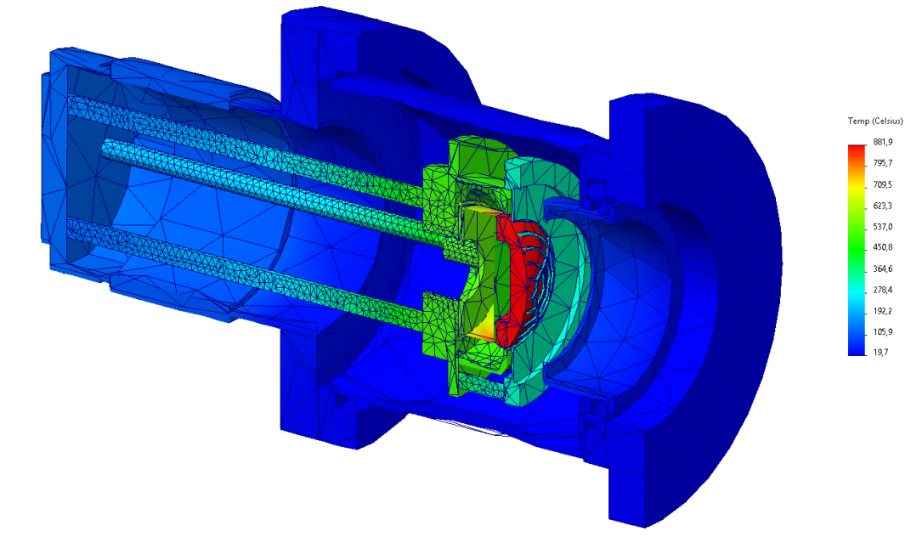

RF-Modulated Electron Gun
Thermomechanical analysis
Notes:
Gun: First stage design by GSI. Design modified by and being manufactured by NTG.
Modulation grid very close to and in front of the cathode which is also curved …in the second half of the top left figure.
Modulation grids: 4 combinations of 2 geometries with 2 materials to compare in SIS-18 runs. Patterns in e- distribution out of the modulator → SCC? … and secondary electrons, and STRUCTURAL stability?
ANSYS: electrostatic FEM of design of gun optimized for up to 10 kV/mm in vacuum and 1.5 kV/mm air.
… also Thermomechanically in the same manner.
###
The electron gun (e-gun) was originally designed by GSI and has since been redesigned and manufactured by NTG.
The top figure shows a cross section of the gun. We see amongst from the other components the electrical feedthroughs, cathode, and a modulation grid which is located close to the cathode.
To match the longitudinal electron-beam profile to the ion-bunch profile, the electron beam is modulated by the modulation grid.
Compared with other modulation techniques, this approach significantly reduces the power load on the modulator.
4 grid designs which are a combination 2 kinds of geometry (‘honey comb’ or ‘target’) and made of molybdenum or graphite are currently being manufactured and will be evaluated in terms of structural stability and secondary electron yield (SEY).
The trade off is between secondary electrons from the grid and the pattern on the electron beam in the main solenoid which should of course be minimal.
Particular attention was paid to the thermal management of the e-gun to minimize the temperature of the alumina insulators and thereby reduce the risk of high-voltage (HV) breakdowns.
Furthermore, the e-gun was optimized to limit the electric-field strength to a maximum of 10 kV/mm in the ultra-high-vacuum (UHV) region and 1.5 kV/mm in air.
1 min. 40 sec.
###
NTG | NTG Neue Technologien

Slide 17
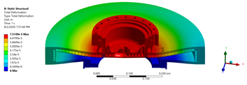
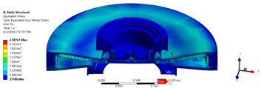
Collector – Stress Distribution
Structural Analysis
Notes:
Top fig. total deformation in mm. 0.07 mm max. (top of color scale)
Bottom fig. equivalent stress in Pascals.
[Artjom CAS]
###

Slide 18
Transport Simulations – undesired numerical effects
Closed orbit was computed. ELEGANT‘s &correct command tracks a test particle over a single turn per iteration until converged to closed orbit.
However tracking ions in a simulation over many turns around a synchrotron without incurring undersired numerical effects will be an issue.
ELEGANT & FTABLE based simulations have failed well within the simulated time frame of interest, i.e. ~0.2 sec (50k turns). Extreme emittance blow-up towards the end. FTABLE known to be asymplectic.
ELEGANT & SOLEnoid elements instead of FTABLE have been put to the test.
If toroids can be treated symplectically then we can reliably transport ions over many turns.
xsuite & E-Lens element is being looked into.
Notes:
###

Slide 19
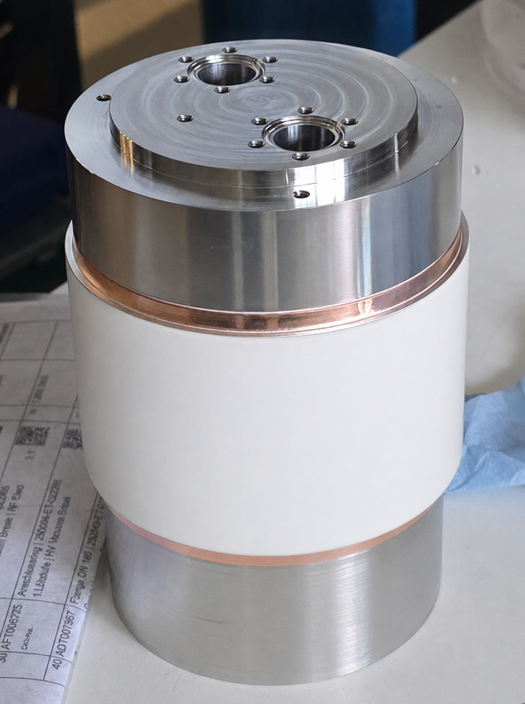
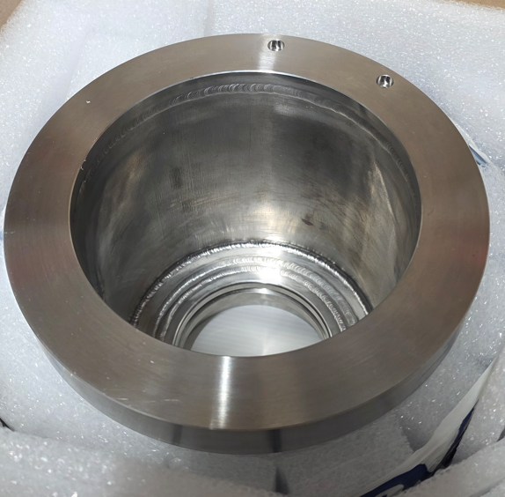
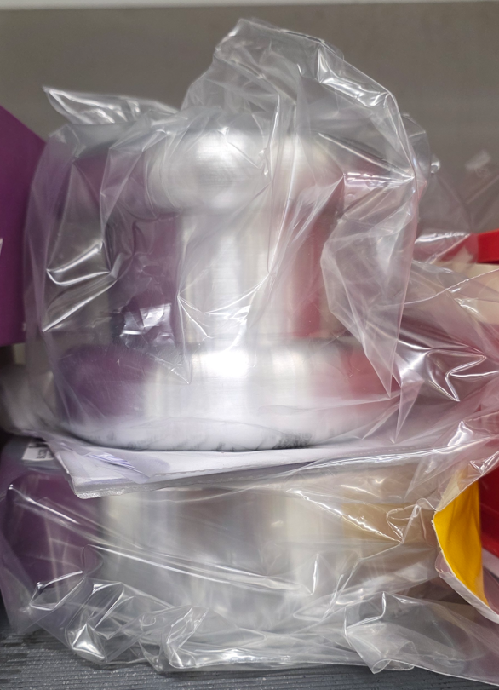
RF-Modulated Electron Gun
Electron gun parts & assembly: NTG GmbH & Co. KG
B
A
A
B
Notes:
Part and assembly NTG
Connection points for HV & heating cathode
Insulator avoid electrical breakdown - A
Cathode and modulator – B
B: chamber actively cooled
###
The parts for the electron gun are ready and are being assembled at NTG.
On the left in the schematic are the connection points for the HV and the heating of the cathode.
In the middle section labelled A there is the insulator for avoiding electrical breakdown.
The right section B has the chamber inside which there are the electrodes of the cathode and the modulator.
The chamber is actively cooled.
(28 sec.)
###
Status of the e-gun.
Left: Anschlusspunkte für die Hochspannung und Heizung der Kathode.
Middle: Abschirmung, zur Vermeidung von elektrischen Überschlägen.
Right: Gekühlte Kammer in der das Elektrodensystem untergebracht wird. You can see two of the holes which are the cooling channels. And the anode at the bottom(?)
Die Bilder dienen nur zur Info im Vortrag ,um zu zeigen, dass die E-Gun bald fertig produziert ist und ausgeliefert wird.
Dispenser Cathodes for TWTS, Klystrons & Gyrotron - Spectra-Mat
SIGRAFINE® isostatische Graphite | SGL Carbon
NTG GmbH & Co. KG
NTG | NTG Neue Technologien

