Slide 1
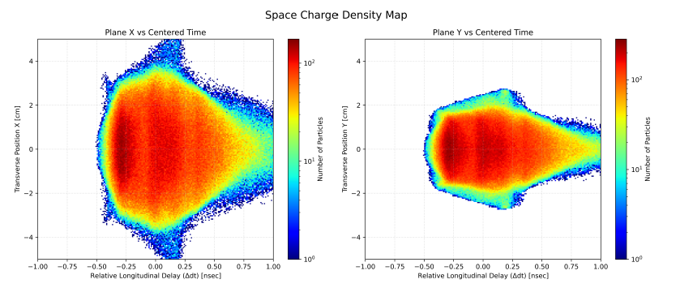
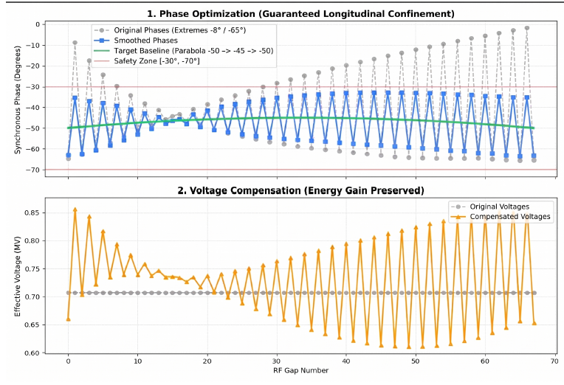
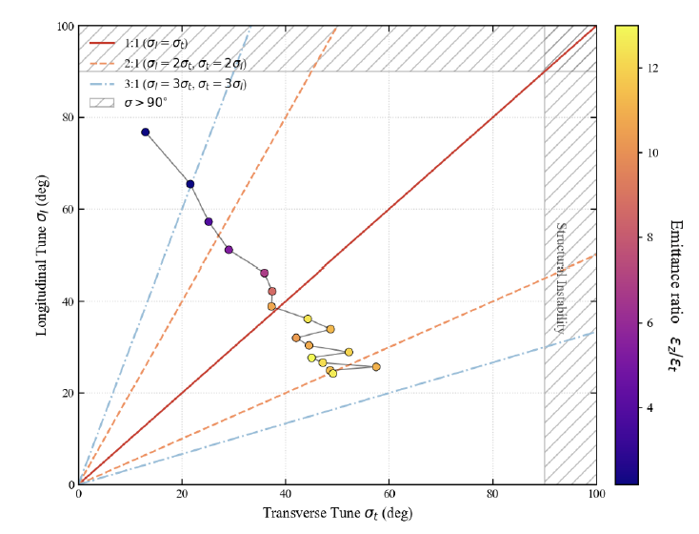
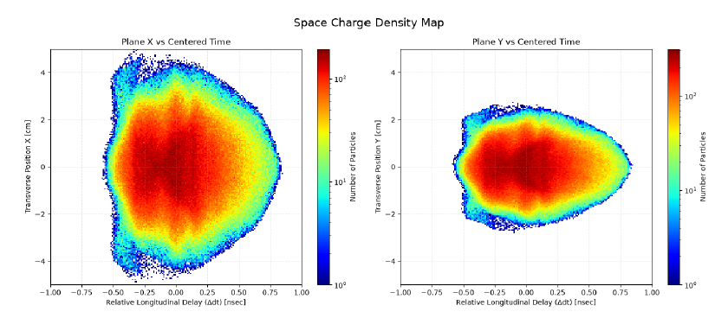
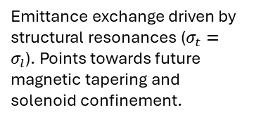
4D Beam Matching, Phase Smoothing, and Resonant Energy Exchange in a 1 Ampere Deuteron LINAC
Lucas Zaïdat ¹, Hiroki Okuno ² , 1École Polytechnique, 2RIKEN Nishina Center
The 1A Space-Charge Challenge
The Solution : Phase Smoothing
At 1A, extreme space-charge forces destroy longitudinal bunching and create a massive transverse halo.
Nelder-Mead 4D Twiss optimization coupled with a tailored parabolic RF phase profile $φ_{s}\left(z\right)$.
1
2
Figure : 2D Density map with the previous design. 0A lattice + 1/β²γ³
Figure : Graph of the phases and voltage profiles
Results : Halo Supression
Resonance Limits
Non-adiabatic transitions mitigated. Longitudinal bunching restored and
halo safely confined
Emittance exchange driven by structural resonances ($σ_{t}=σ_{l}$). Points towards future magnetic tapering and solenoid confinement.
Desiable tune evolution
Figure : 2D Density map with the new design
Figure : Tune stability diagram
3
4
Notes:
🔷 Introduction (40 seconds)
“Good afternoon. My name is Hiroki Okuno from RIKEN. From April to August, Lucas Zaïdat from École Polytechnique worked with me as an intern, and today I am presenting the summary of the work he carried out during his stay.
The title of the poster is 4D beam matching, phase smoothing, and resonance energy exchange in a 1 ampre deuteron LINAC
At the beginning of the project, we started from a lattice originally designed without space‑charge. We then introduced the full 1‑Ampere space‑charge force into the simulations. Space‑charge effects were globally scaled using the conventional 1/(β²γ³) dependence, but even with this scaling, the resulting beam behavior showed poor agreement with what we expected physically. This mismatch motivated us to investigate the underlying beam‑dynamics mechanisms more carefully.
This slide summarizes the challenge, the solution, the results, and the remaining limits. Let me walk you through it from top left to bottom right.”
🔷 1. Left‑Top — The 1A Space‑Charge Challenge (40 seconds)
“Starting from the top‑left, we highlight the fundamental difficulty. At 1 Ampere, the beam behaves like a strongly repulsive plasma. As written here, ‘extreme space‑charge forces destroy longitudinal bunching and create a massive transverse halo.’ The bunching structure collapses, and the transverse halo becomes very large. This severe degradation of beam quality is exactly what we observed when we added the 1A space‑charge force to the originally halo‑free lattice.”
🔷 2. Right‑Top — The Solution: Phase Smoothing (45 seconds)
“Now moving to the top‑right. Our solution combines 4D Twiss optimization with RF phase smoothing. The slide notes: ‘Nelder–Mead 4D Twiss optimization coupled with a tailored parabolic RF phase profile.’ The 4D optimization stabilizes the transverse envelope by selecting the correct initial Twiss parameters. Then, the parabolic synchronous phase profile removes non‑adiabatic phase jumps. As written here, ‘Longitudinal bunching restored and halo safely confined.’ This combined approach was the core of Lucas’s contribution.”
🔷 3. Left‑Bottom — Results: Halo Suppression (40 seconds)
“Next, looking at the bottom‑left, you can see the impact of this approach. The upper figure shows the previous design, where the halo is large and clearly visible. The lower figure shows the new design, where the core is dense and the halo is strongly suppressed. This demonstrates that combining 4D matching with phase smoothing dramatically improves beam confinement and restores longitudinal bunching.”
🔷 4. Right‑Bottom — Resonance Limits (40 seconds)
“Finally, on the bottom‑right, we show the tune stability diagram. Even with improved confinement, the beam still crosses structural resonances—especially σₜ = σₗ. The slide states: ‘Emittance exchange driven by structural resonances… points towards future magnetic tapering and solenoid confinement.’ These resonances cause energy exchange between longitudinal and transverse planes, gradually increasing transverse emittance. This indicates the next step for future design improvements.”
🔷 Closing (20 seconds)
“So in summary, this slide presents the full picture: the 1‑Ampere challenge, the combined solution of 4D matching and phase smoothing, the resulting halo suppression, and the remaining resonance limits. This work represents the main achievements of Lucas’s internship from April to August. Thank you very much.”

