Slide 1
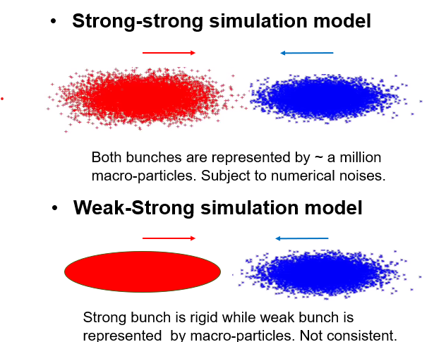
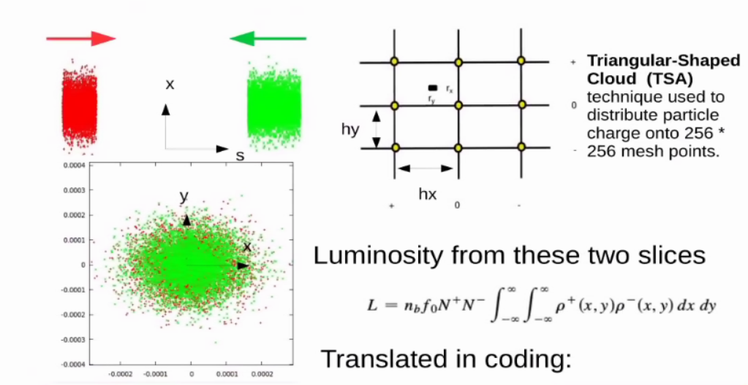
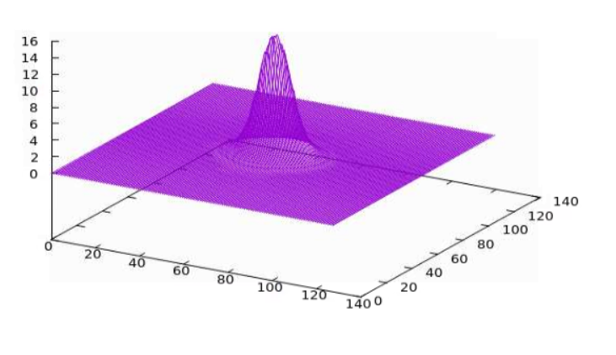
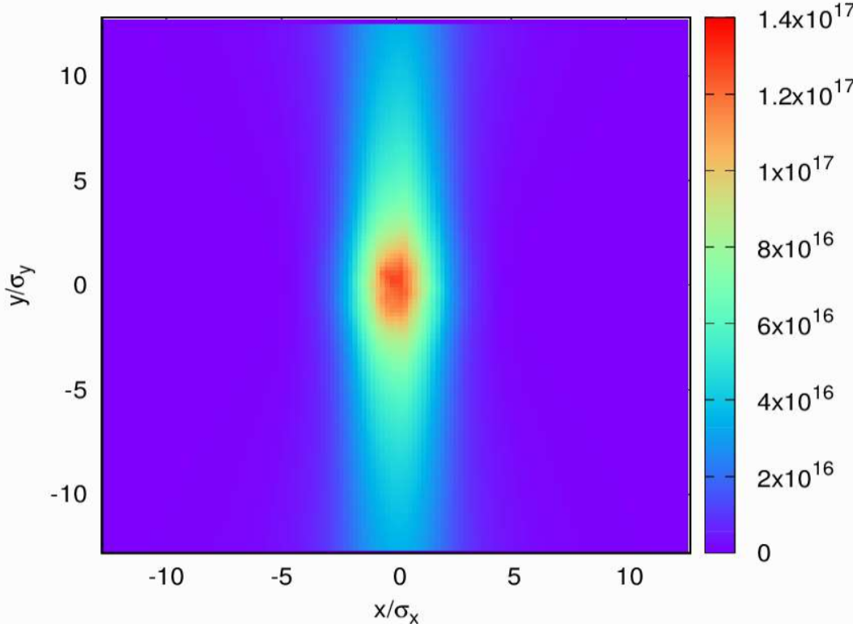
Beam-Beam Simulation Models and Numerical Noises
for Flat-Beam Collisions in the Electron-Ion Collider
Abstract #12
Yum Luo, BNL
Particle-In-Cell (PIC) Poisson solver
Charge density variation on grids
Space charge kick variation on grids

