Slide 1
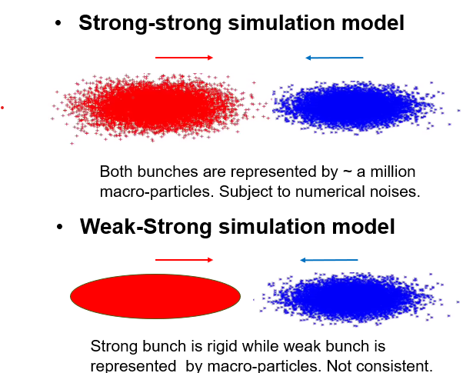
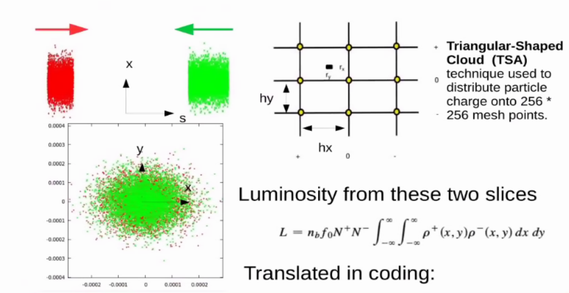
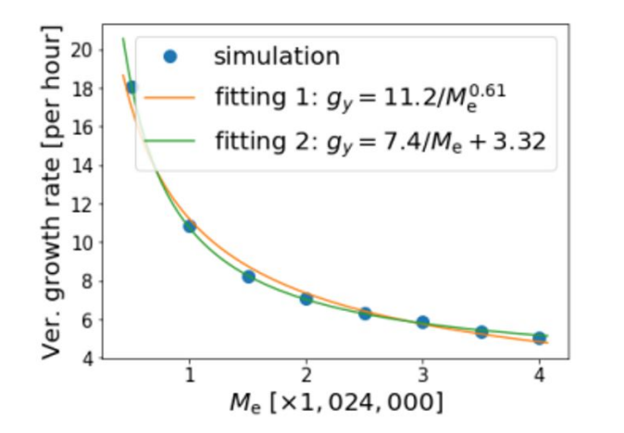
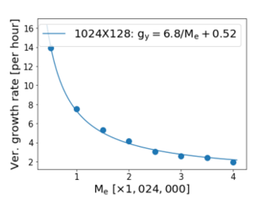
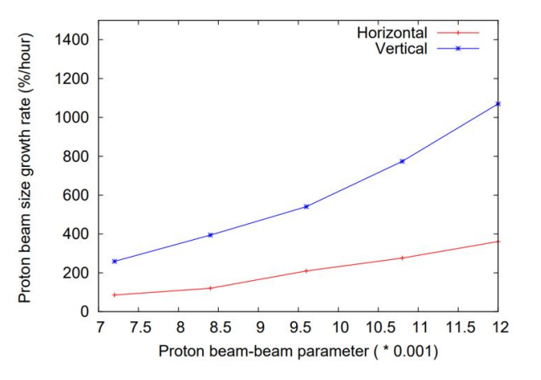
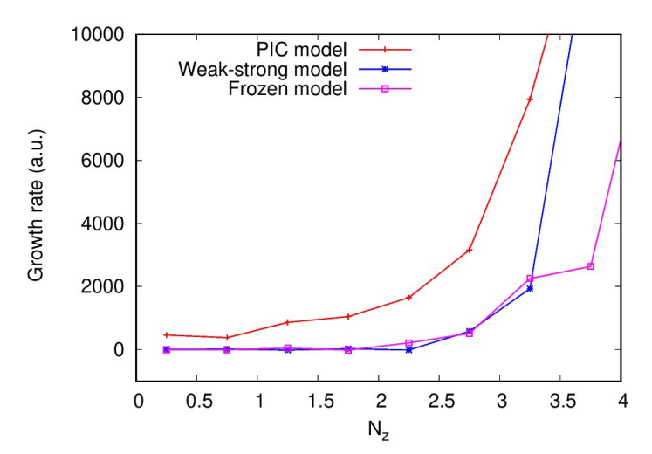
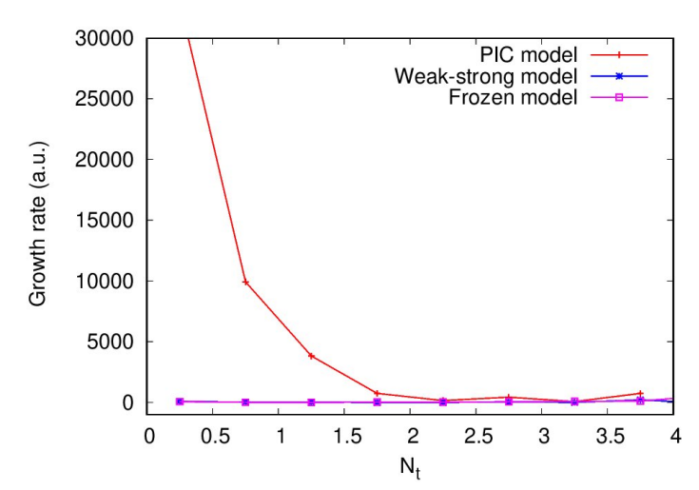
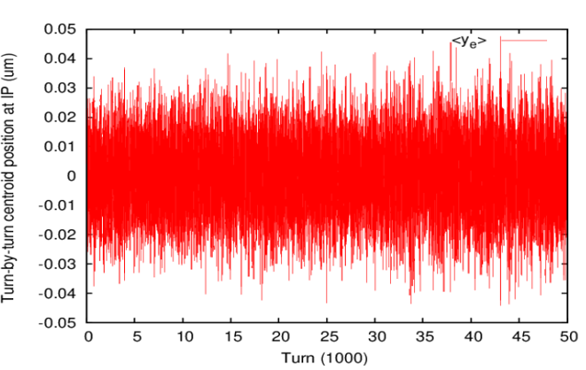
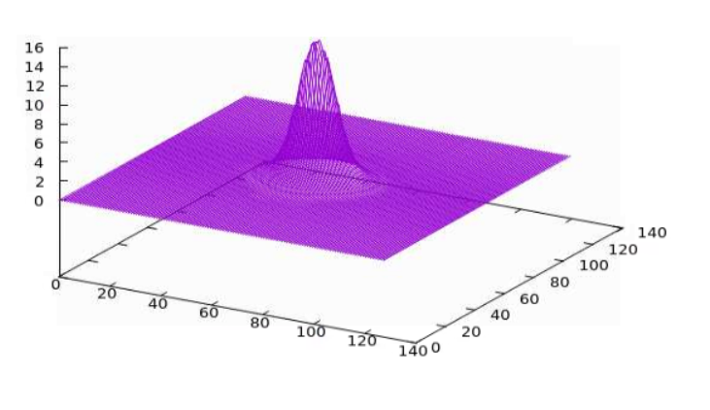
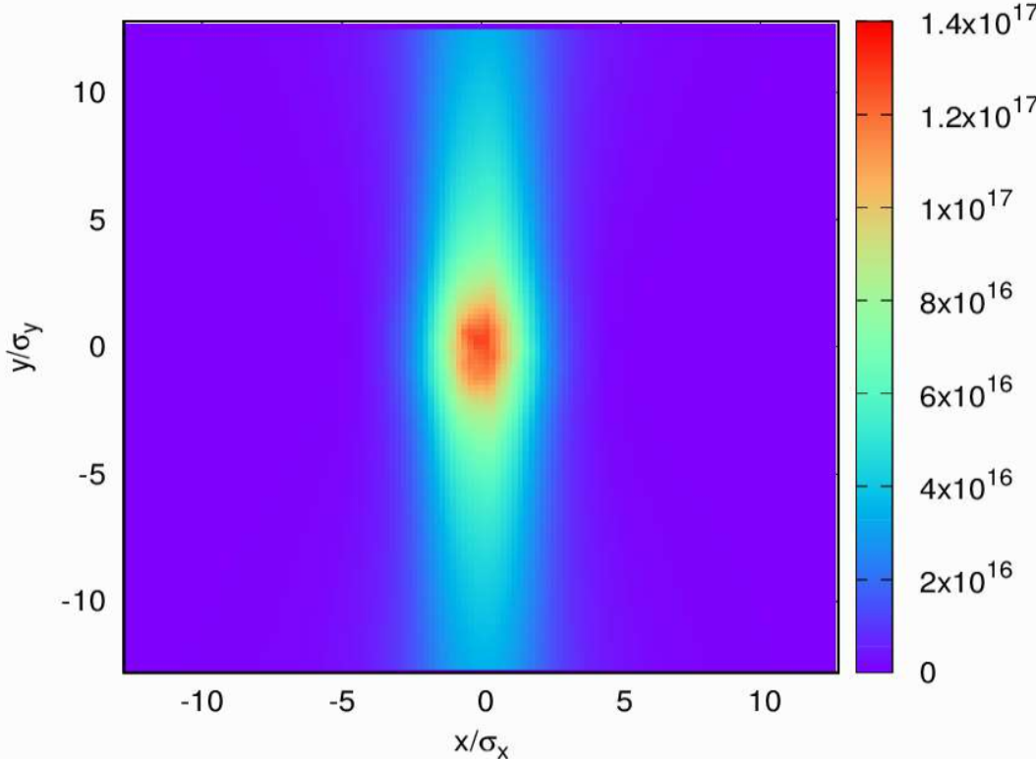
Beam-Beam Simulation Models and Numerical Noises
for Flat-Beam Collisions in the Electron-Ion Collider
Abstract 12
email: yluo@bnl.gov
Yun Luo, D. Xu, Y. Hao, J. Qiang, M. Blaskiewicz, C. Montag, Brookhaven National Laboratory, NY, USA
1. Strong-strong Beam-beam Simulation Models and Particle-In-Cell (PIC) Method
2. Scaling laws of Numerical Noise in S-S Beam-beam Simulation for flat-beam collision
3. Sources of Numerical Noise in Strong-strong Beam-beam Simulation with PIC
TBT <Y> of electron bunch
Emittance growth as function of long. amplitude
Emittance growth as function of trans. amplitude
4. Summary
We observed large artificial emittance growth in strong-strong beam-beam simulation for flat-beam collision in EIC. We attribute this to numerical noise associated with PIC algorithm.
5. References
D. Xu, et al, NAPAC2022, MOYD4.
Y. Luo, et al, IPAC2022, WEPOPT038.
Y. Luo, et al, IPAC2022, WEPOPT040.
Variation of charge density on grids in 1000 turns
Variation of vertical kick on grids in 1000 turns
Y. Luo, et al, IPAC2022, WEPOPT036

