Slide 1



Space-Charge Impedance in Material-Filled Beam Regions for Ionization Cooling in a Future Muon Collider
Space Charge 2026, 7th ICFA BD Mini-workshop
Erik Kvikne*, Elias Métral, Erik Adli
Erik Kvikne · CERN BE-ABP-CEI · University of Oslo
*erik.kvikne@cern.ch
02.10.2026

Slide 2
Space Charge in Matter
Wake Potential and Electromagnetic benchmark
Conclusion and Outlook
Erik Kvikne / Space Charge 2026, 7th ICFA BD Mini-workshop / 02.10.26

Slide 3

From a vacuum to a material-filled beam region
Standard SC geometry
Material-filled SC geometry
a
a
b₁
b₁
PEC
Material: $ε_{1}, μ_{1}, σ_{1}$
Vacuum
Source charge
Erik Kvikne / Space Charge 2026, 7th ICFA BD Mini-workshop / 02.10.26

Slide 4



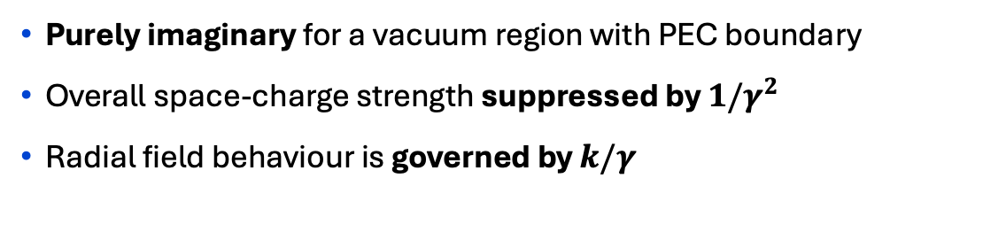
Conventional space-charge: vacuum beam region
Conventional Space-Charge Impedance
[1]
Direct SC
Indirect SC
a
Definitions →
b₁
Purely imaginary for a vacuum region with PEC boundary
Overall space-charge strength suppressed by $1/γ^{2}$
Radial field behaviour is governed by $k/γ$
PEC
Vacuum
Source charge
Erik Kvikne / Space Charge 2026, 7th ICFA BD Mini-workshop / 02.10.26

Slide 5
Conventional space-charge: vacuum beam region
Conventional Space-Charge Impedance
[1]
a
Definitions →
b₁
Purely imaginary for a vacuum region with PEC boundary
Overall space-charge strength suppressed by $1/γ^{2}$
Radial field behaviour is governed by $k/γ$
PEC
Vacuum
Source charge
Erik Kvikne / Space Charge 2026, 7th ICFA BD Mini-workshop / 02.10.26

Slide 6


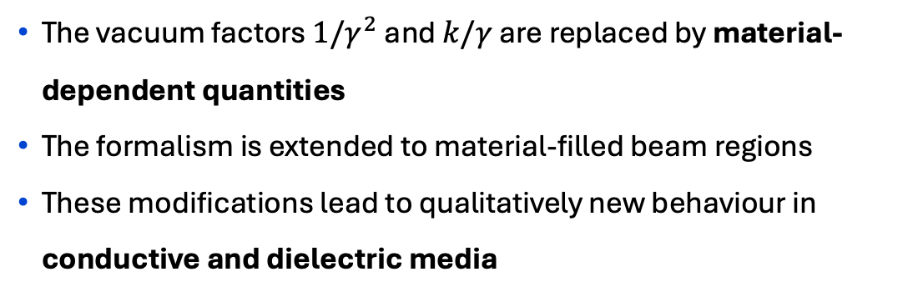
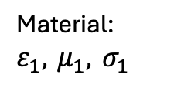
Space-charge in a material-filled beam region
Space-Charge Impedance in Matter
[2]
Definitions →
The vacuum factors $1/γ^{2}$ and $k/γ$ are replaced by material-dependent quantities
The formalism is extended to material-filled beam regions
These modifications lead to qualitatively new behaviour in conductive and dielectric media
a
b₁
PEC
Material:
$$ε_{1}, μ_{1}, σ_{1}$$
Source charge
Erik Kvikne / Space Charge 2026, 7th ICFA BD Mini-workshop / 02.10.26

Slide 7
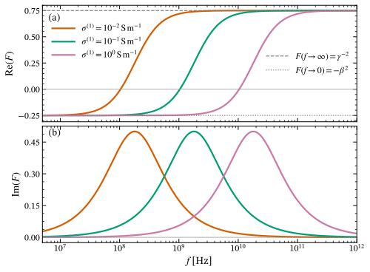




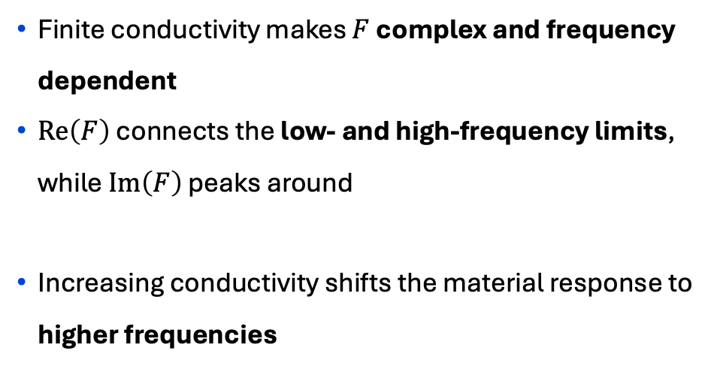
Material response through $F$
Finite conductivity makes $F$ complex and frequency dependent
$Re\left(F\right)$ connects the low- and high-frequency limits, while $Im\left(F\right)$ peaks around
Increasing conductivity shifts the material response to higher frequencies
Erik Kvikne / Space Charge 2026, 7th ICFA BD Mini-workshop / 02.10.26

Slide 8
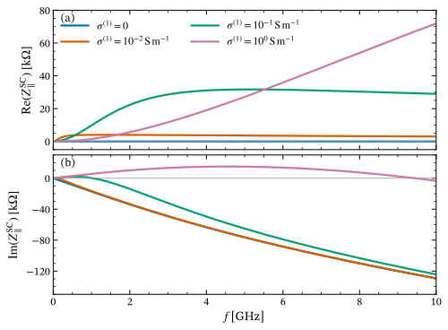


Conductive beam region: impact on longitudinal impedance
Finite conductivity introduces a real part of the impedance
The imaginary part can change sign as the material response changes
Increasing conductivity shifts these effects to higher frequencies
Transverse Impedance →
Erik Kvikne / Space Charge 2026, 7th ICFA BD Mini-workshop / 02.10.26

Slide 9

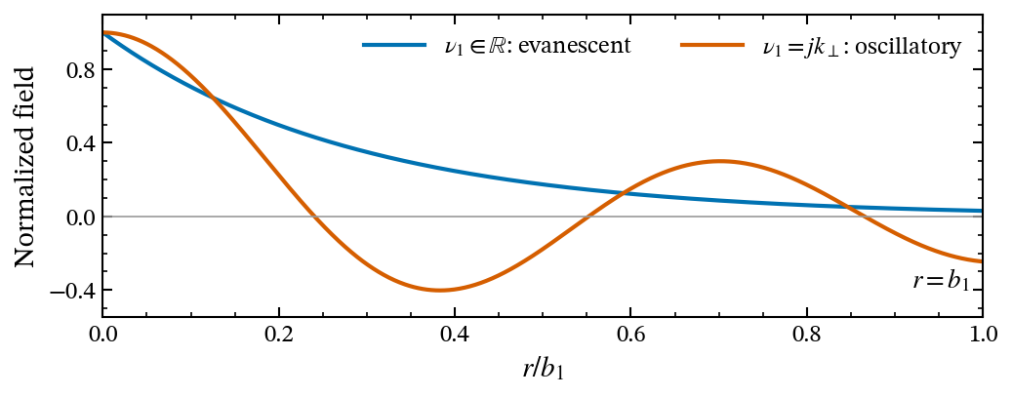

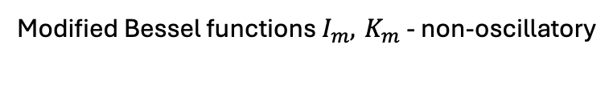
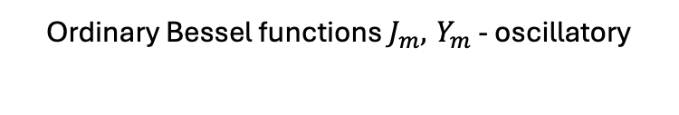
Dielectric media can change the radial field behaviour
Evanescent radial fields
Oscillatory radial fields
Modified Bessel functions $I_{m}, K_{m}$ - non-oscillatory
Ordinary Bessel functions $J_{m}, Y_{m}$ - oscillatory
Schematic radial field behaviour
Equivalent condition
Beam velocity exceeds the electromagnetic phase velocity in the medium
Erik Kvikne / Space Charge 2026, 7th ICFA BD Mini-workshop / 02.10.26

Slide 10
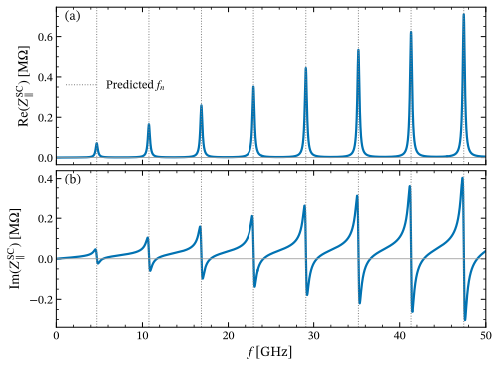


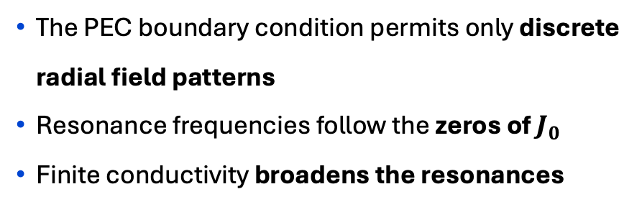
Oscillatory radial fields give rise to resonant modes
Resonance condition
The PEC boundary condition permits only discrete radial field patterns
Resonance frequencies follow the zeros of $J_{0}$
Finite conductivity broadens the resonances
Transverse Impedance →
Erik Kvikne / Space Charge 2026, 7th ICFA BD Mini-workshop / 02.10.26

Slide 11
Space Charge in Matter
Wake Potential and Electromagnetic benchmark
Conclusion and Outlook
Erik Kvikne / Space Charge 2026, 7th ICFA BD Mini-workshop / 02.10.26

Slide 12
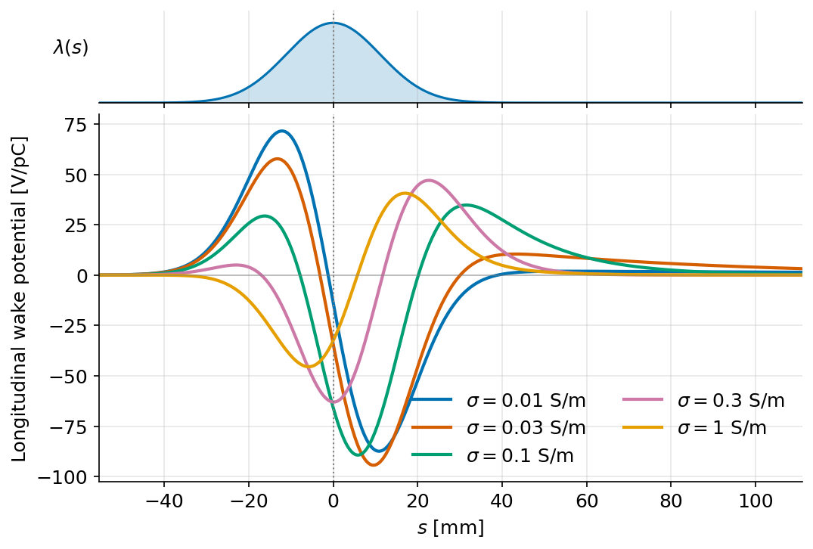


From impedance to wake potential
A finite bunch samples the impedance through its frequency spectrum
Material properties modify the shape and amplitude of the wake potential
The total longitudinal and transverse wake potentials are compared directly with WAKIS [3]
Erik Kvikne / Space Charge 2026, 7th ICFA BD Mini-workshop / 02.10.26

Slide 13
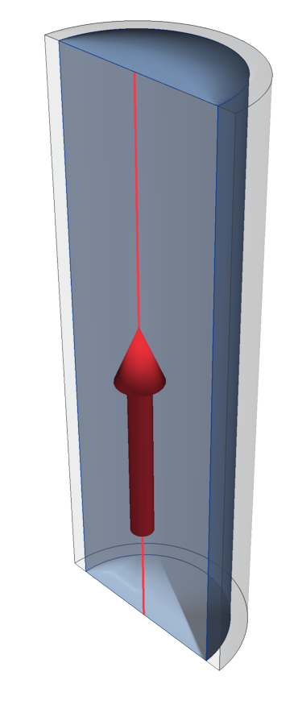
Electromagnetic benchmark with WAKIS
Time-domain electromagnetic simulation of a bunch propagating through the material-filled beam region
The total longitudinal and transverse wake potentials and impedances are obtained from the simulated fields
Results are compared with the corresponding analytical prediction for each simulation case
Erik Kvikne / Space Charge 2026, 7th ICFA BD Mini-workshop / 02.10.26

Slide 14
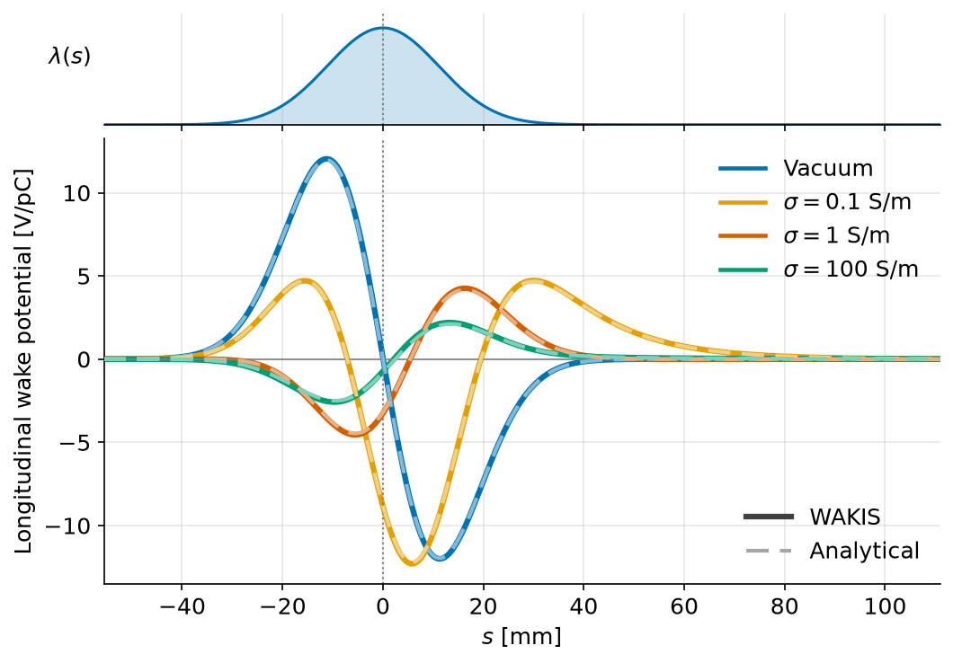

WAKIS benchmark: longitudinal wake potential – resistive beam region
Very good agreement between WAKIS and the analytical prediction over the full wake shape
WAKIS reproduces the conductivity-dependent modification of the longitudinal wake potential
Simulation parameters
Impedance plot →
Erik Kvikne / Space Charge 2026, 7th ICFA BD Mini-workshop / 02.10.26

Slide 15
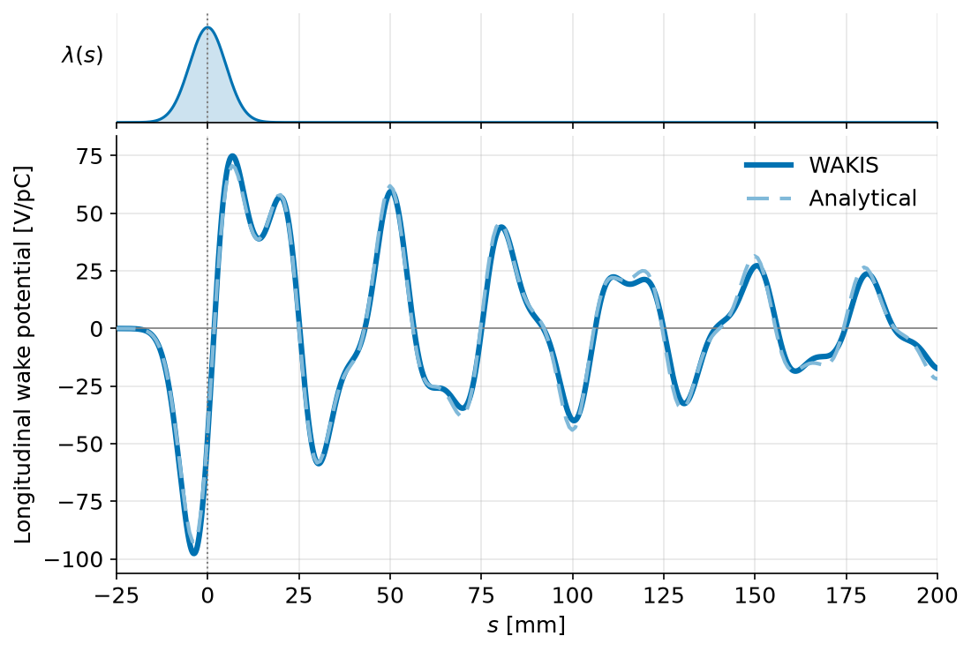

WAKIS benchmark: longitudinal wake potential – dielectric beam region
Very good agreement between WAKIS and the analytical prediction in the dielectric regime
WAKIS reproduces the predicted resonant structure
Simulation parameters
Impedance plot →
Erik Kvikne / Space Charge 2026, 7th ICFA BD Mini-workshop / 02.10.26

Slide 16
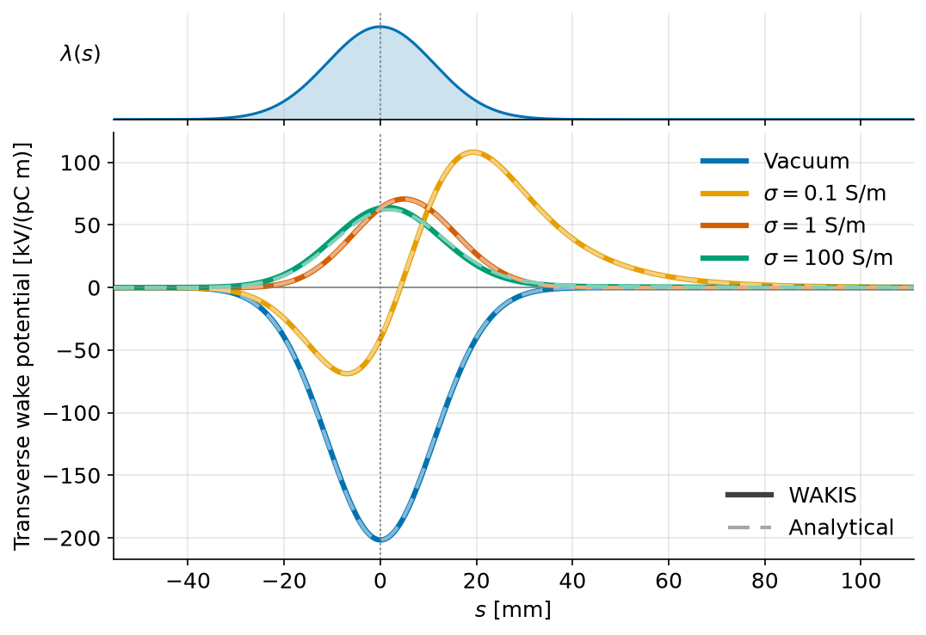
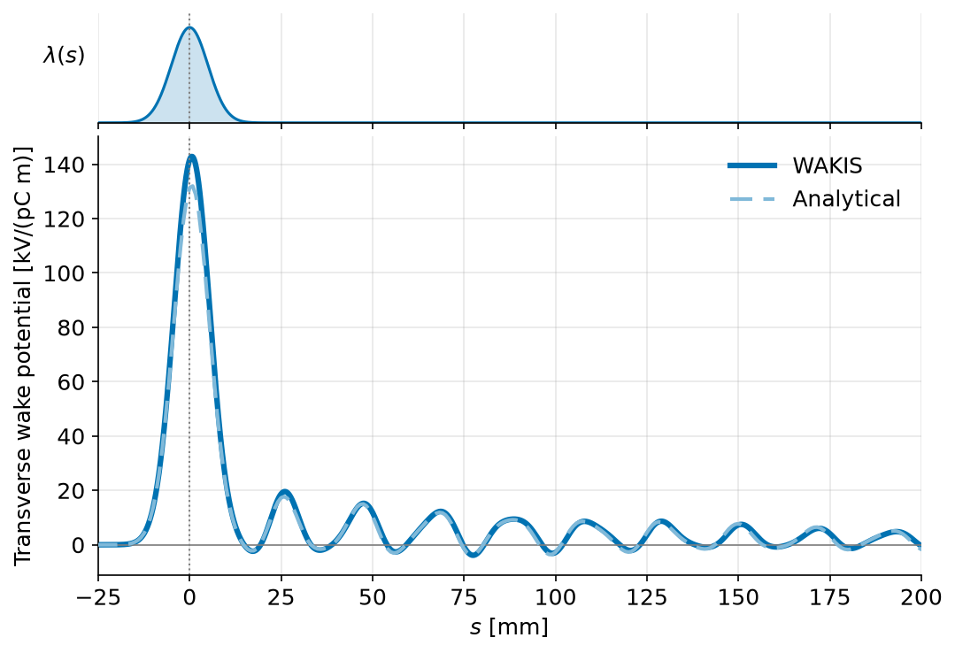


WAKIS benchmark: transverse wake potential
Resistive beam region
Dielectric beam region
Erik Kvikne / Space Charge 2026, 7th ICFA BD Mini-workshop / 02.10.26

Slide 17
Space Charge in Matter
Wake Potential and Electromagnetic benchmark
Conclusion and Outlook
Erik Kvikne / Space Charge 2026, 7th ICFA BD Mini-workshop / 02.10.26

Slide 18
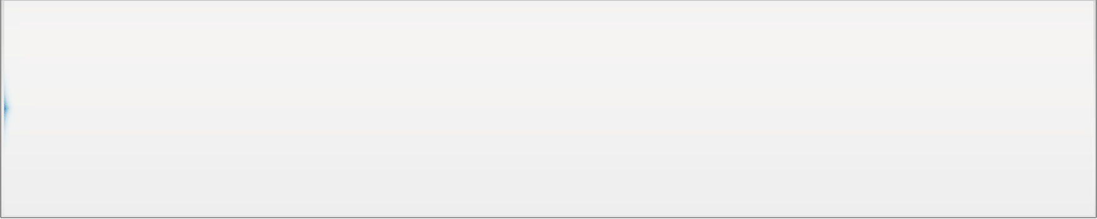
Conclusion and Outlook
Conclusions
Outlook
Space-charge impedance can change qualitatively when the beam region is filled with matter
Conductive media can significantly modify the magnitude, phase and sign of the space-charge impedance, while dielectric media can introduce resonant behaviour
Analytical predictions are reproduced with very good agreement by WAKIS
Extend the benchmark to realistic finite-length absorbers, transitions, materials and geometries
Quantify the resulting effects for representative ionization-cooling stages
Include the resulting impedances/wakes in beam-dynamics simulations to quantify their impact on the cooling channel.
Erik Kvikne / Space Charge 2026, 7th ICFA BD Mini-workshop / 02.10.26
Longitudinal electric field for a beam propagating in a dielectric

Slide 19
Thank you for your attention!
Funded by the European Union (EU). Views and opinions expressed are however those of the author(s) only and do not necessarily reflect those of the EU or European Research Executive Agency (REA). Neither the EU nor the REA can be held responsible for them.
Erik Kvikne / Space Charge 2026, 7th ICFA BD Mini-workshop / 02.10.26

Slide 20
References
[1] R. L. Gluckstern, Analytic Methods for Calculating Coupling Impedances, CERN-2000-011 (2000).
[2] E. Kvikne, E. Métral and E. Adli, “Impedance of multilayer cylindrical structures with a material-filled beam region,” arXiv:2606.16761 (2026).
[3] E. de la Fuente Garcia et al., WAKIS, Zenodo (2025), doi:10.5281/zenodo.15527405.
Erik Kvikne / Space Charge 2026, 7th ICFA BD Mini-workshop / 02.10.26

Slide 21
Backup
Erik Kvikne / Space Charge 2026, 7th ICFA BD Mini-workshop / 02.10.26

Slide 22
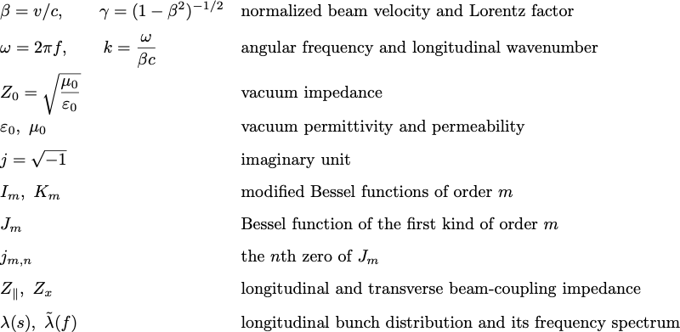
Definitions
Erik Kvikne / Space Charge 2026, 7th ICFA BD Mini-workshop / 02.10.26

Slide 23
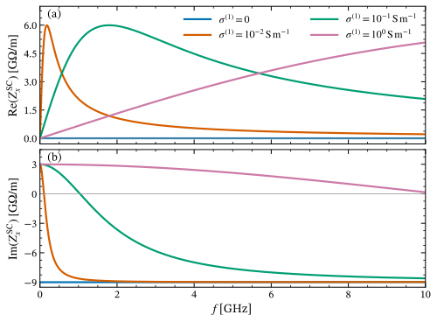
Transverse impedance: resistive beam region
Erik Kvikne / Space Charge 2026, 7th ICFA BD Mini-workshop / 02.10.26

Slide 24
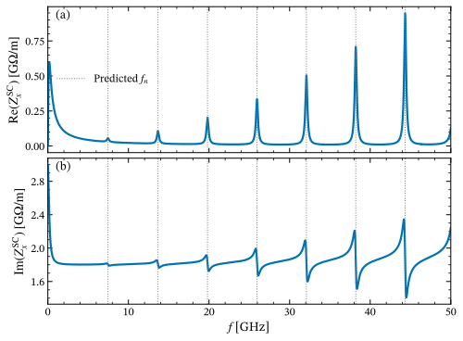
Transverse impedance: dielectric beam region
Erik Kvikne / Space Charge 2026, 7th ICFA BD Mini-workshop / 02.10.26

Slide 25
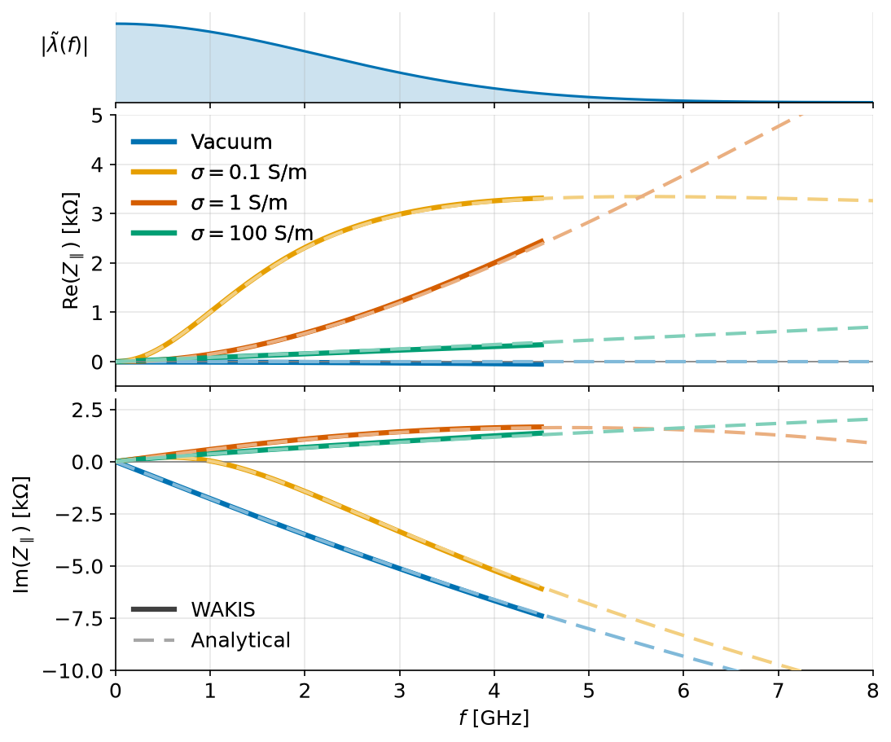
WAKIS longitudinal impedance benchmark: resistive beam region
Erik Kvikne / Space Charge 2026, 7th ICFA BD Mini-workshop / 02.10.26

Slide 26
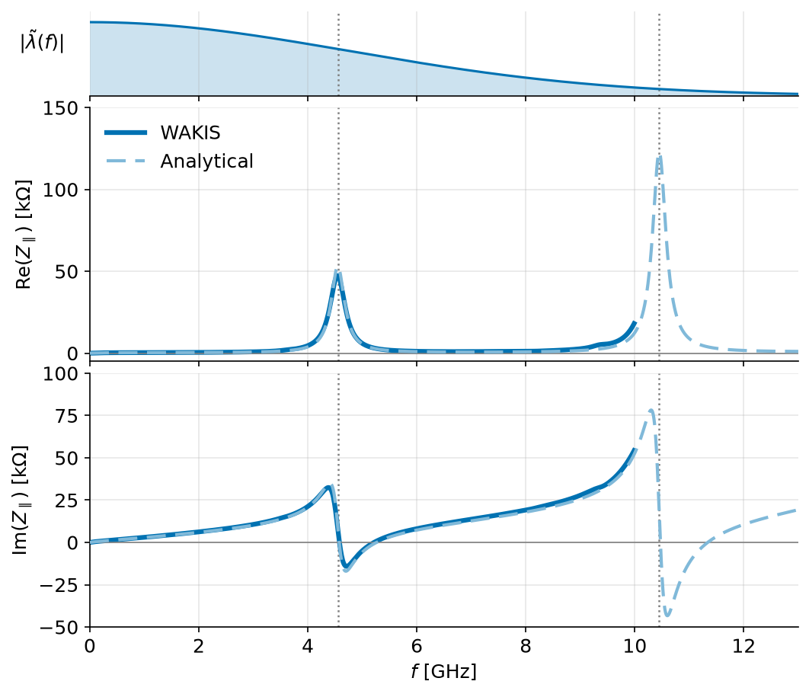
WAKIS longitudinal impedance benchmark: dielectric beam region
Erik Kvikne / Space Charge 2026, 7th ICFA BD Mini-workshop / 02.10.26

