Slide 1
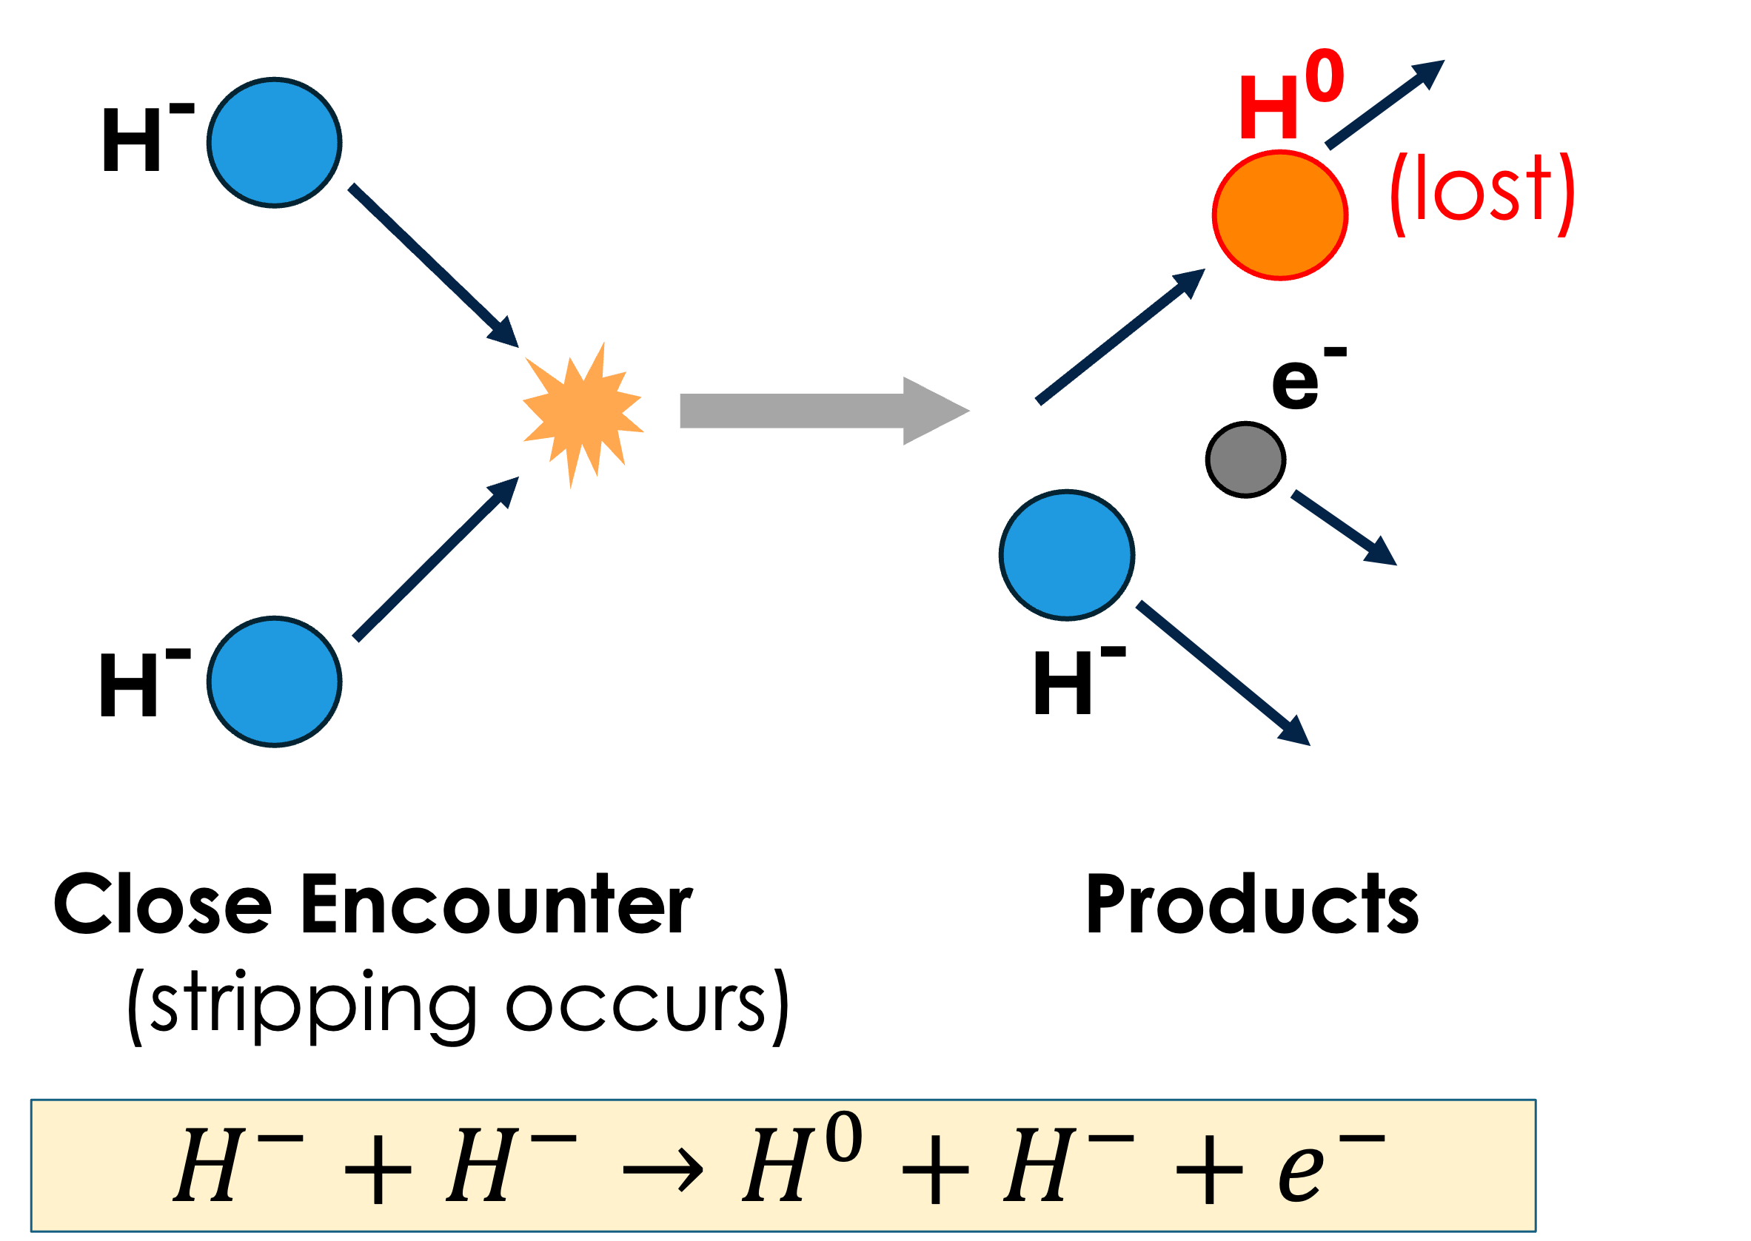
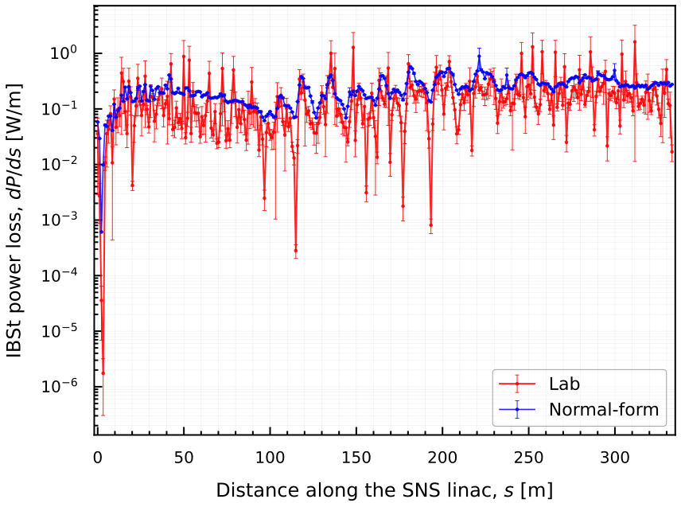
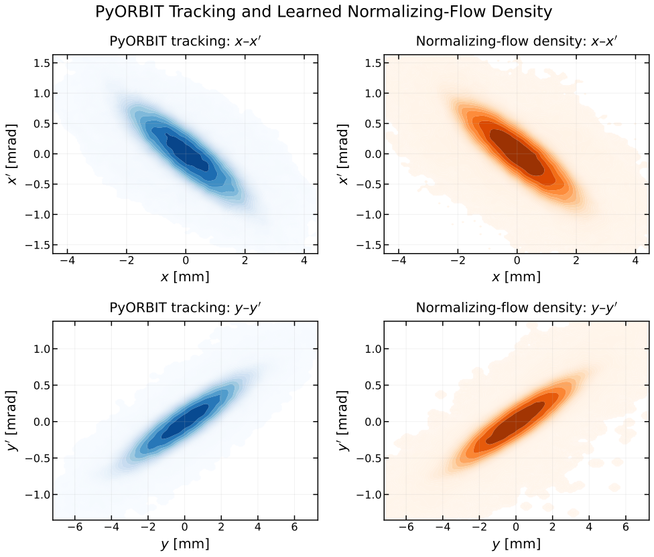
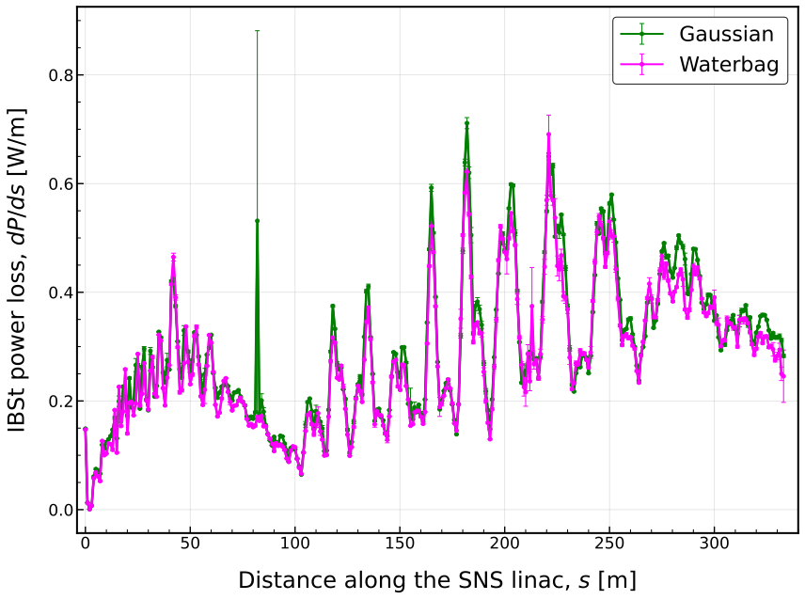
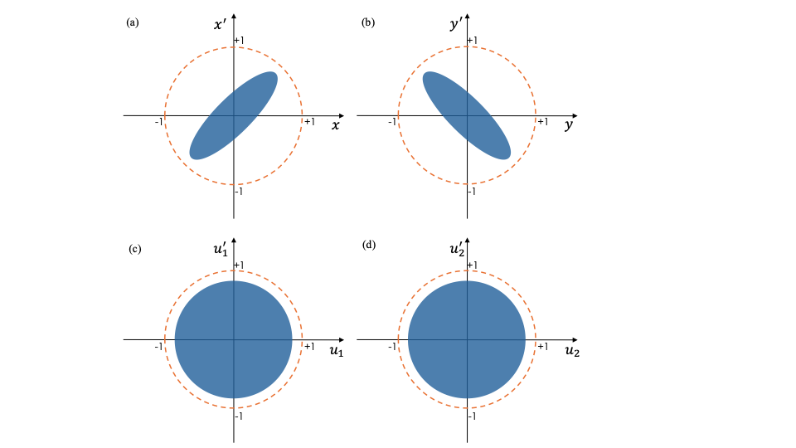
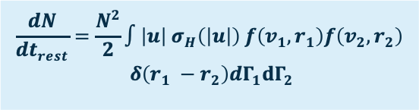
A new way to calculate Intra-Beam Stripping (IBSt) losses
A new way to calculate Intra-Beam Stripping (IBSt) losses
The Problem
Challenges with Monte Carlo Integration
IBSt loss prediction along
the SNS linac
1
2
3
1) Representing the beam distribution
Normalizing Flow
IBSt calculations require evaluating a high-dimensional integral.
2) Efficient Monte Carlo sampling
Normal-Form Coordinates
$$\frac{dN}{dt_{rest}}=\frac{N^{2}}{2}∫\left|u\right| σ_{H}\left(\left|u\right|\right) f\left(v_{1}, r_{1}\right)f\left(v_{2}, r_{2}\right)$$
$$δ\left(r_{1} −r_{2}\right)dΓ_{1}{dΓ}_{2}$$
Shivam Kakkar (ORNL, UTK)
Space Charge Workshop 2026

