Slide 1
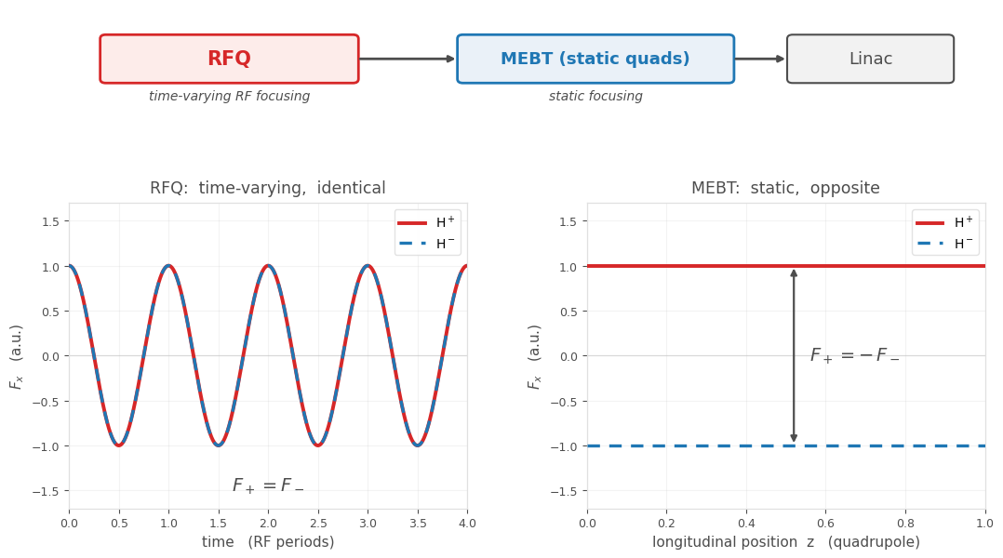
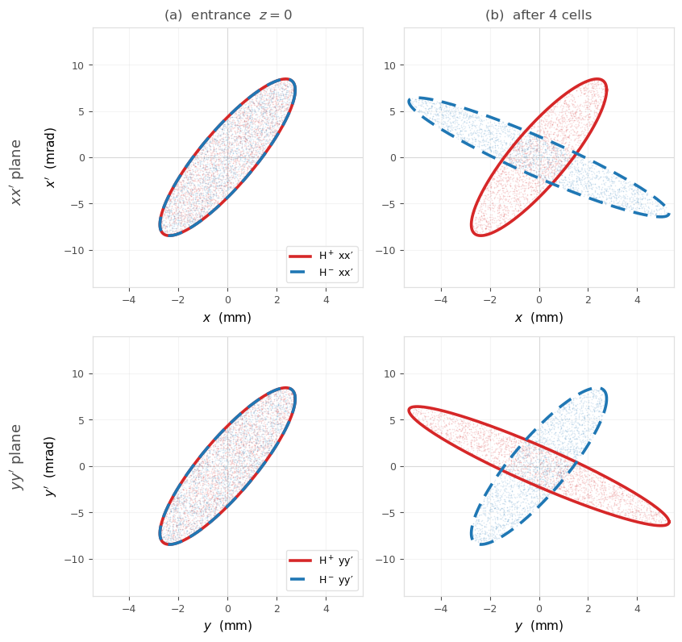

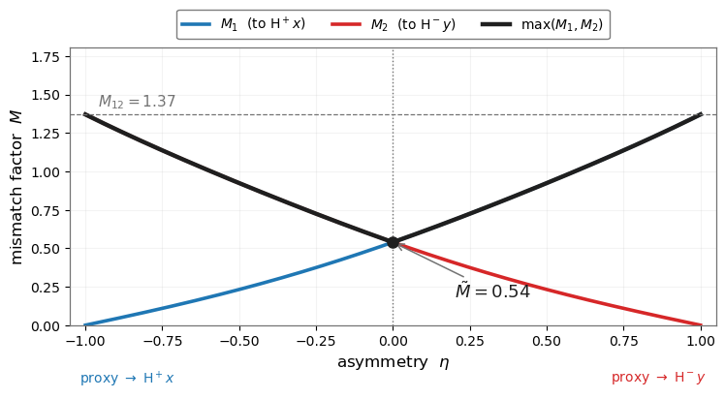
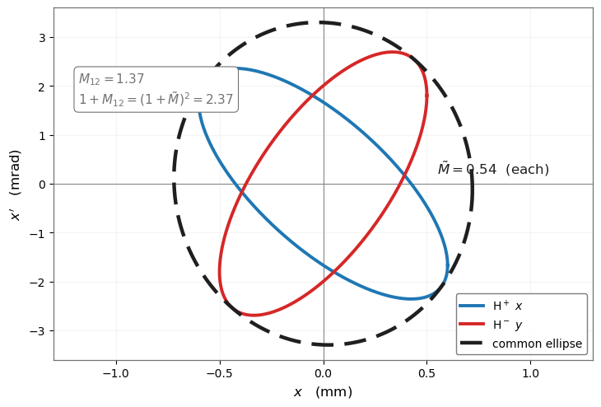
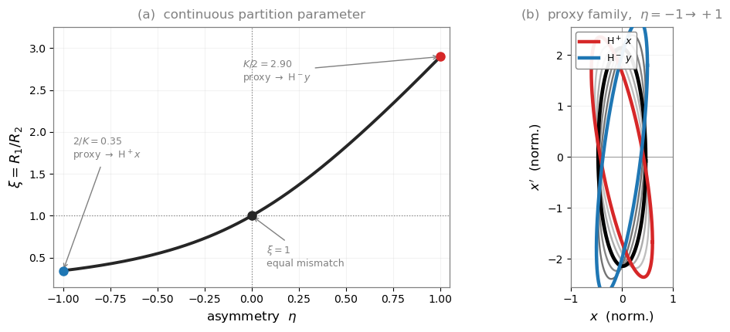


When Mismatch Is Inherent:
Mismatch Partitioning Between H⁺ and H⁻ in Dual-Beam Transport with Strong Space Charge
Yinqi Ji^{1,2,3},Chun Yan Jonathan Wong^{1,2,3},Zhijun Wang^{1,2,3},Yu Du^{1,2,3}
Mismatch is inherent
• One linac, two beams: power doubled, ions neutralize.
• RFQ: same force. MEBT: opposite forces.
• Identical at the RFQ exit but not round: one MEBT setting cannot match both.
Single-particle analytic solution (no space charge)
• Smallest ellipse enclosing both beams, found analytically.
• Mismatch split equally; neither beam is favored.
• Minimize the maximum mismatch.
Space-charge correction
• With space charge, the partition needs a correction.
• One continuous parameter shifts the reference ellipse.
• It acts as a compensation parameter for the space-charge force.
Space Charge 2026, Oxford

