Slide 1
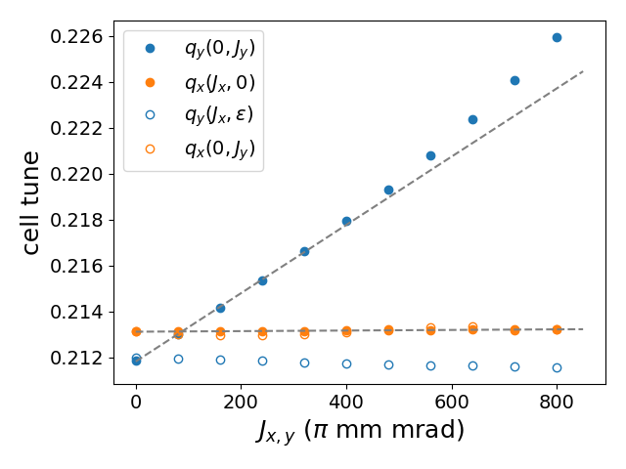
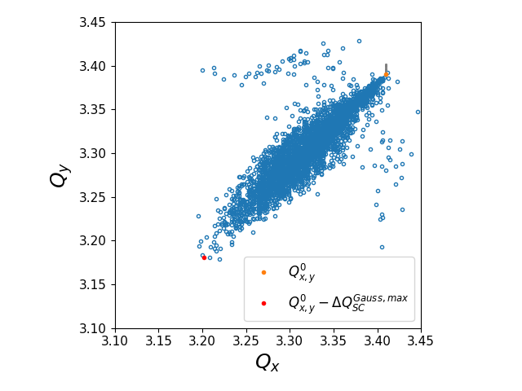
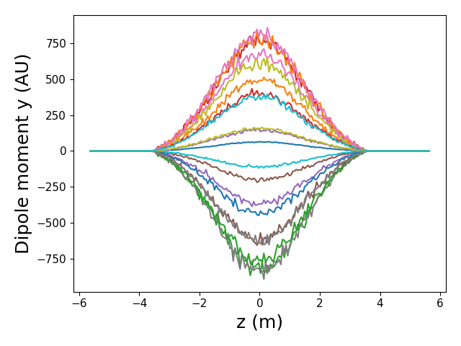
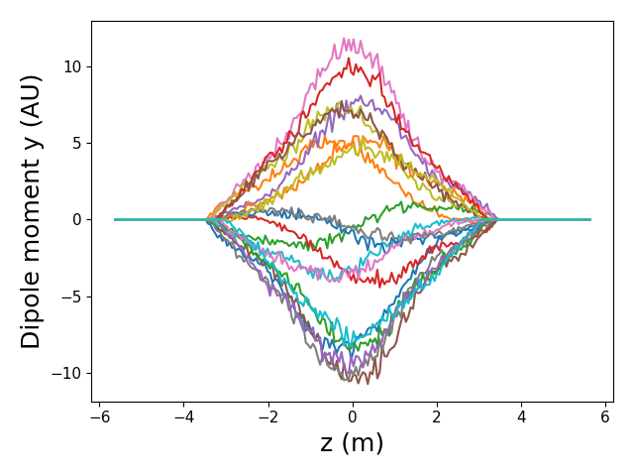
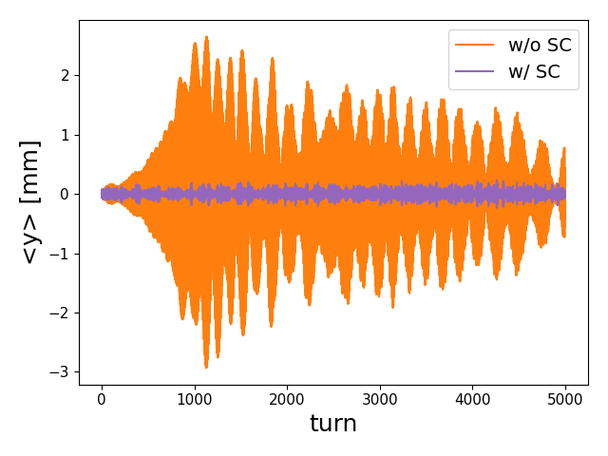
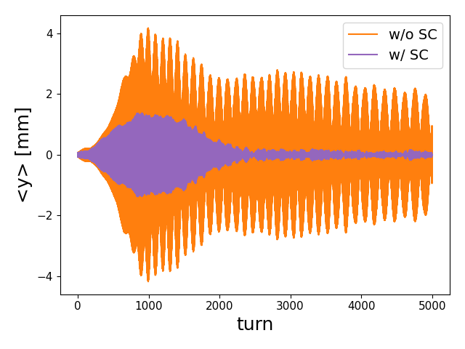
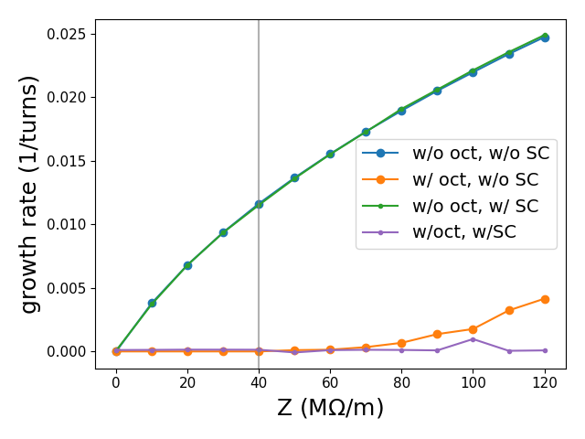

Landau damping from octupolar tune spread and space charge in scaling FFAs
FETS-FFA tune vs amplitude
SC tune spread
w/o octupole
w/ octupole
Rigid mode, m=0
Non-rigid mode, m=0
No damping
Turn-by-turn
Cell-by-cell
(Turn-by-turn tracking)
D. J. Kelliher (ISIS Neutron and Muon source, RAL)

