Slide 1
Space Charge Simulation for the Third Order Resonance Corrections at J-PARC MR
Space Charge 2026, 7th ICFA Mini-workshop
2026/9/30
Susumu Igarashi KEK/J-PARC Center

Slide 2
Contents
Introduction
Third order resonance correction for on-momentum particles
Third order resonance correction for off-momentum particles
Beam optics modulated by space charge effect
Simulation results
Summary

Slide 3
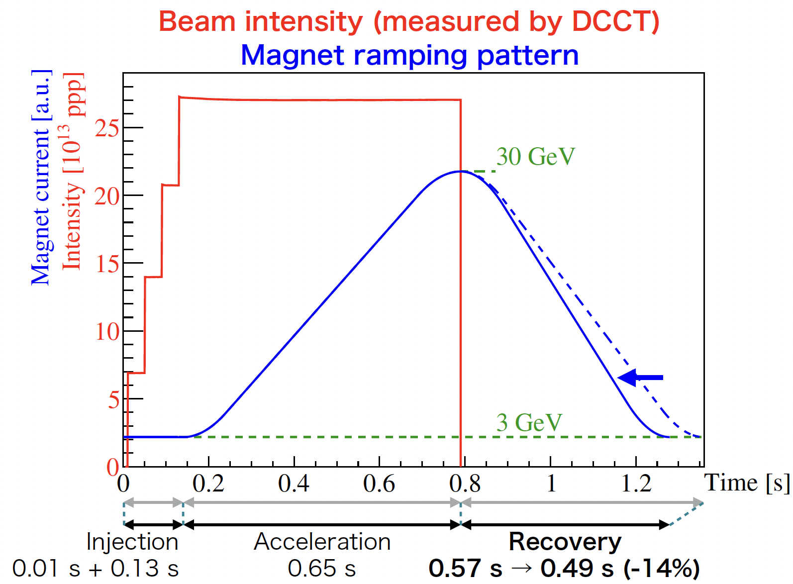
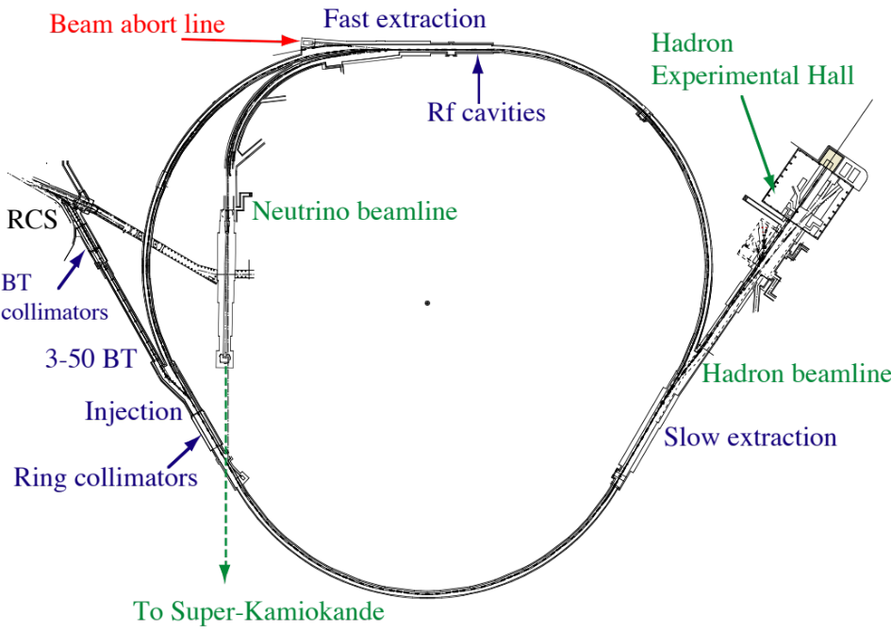
MR Design and Operation Modes
Circumference 1567.5 m
Three-fold symmetry
Target Beam Power: 1.3 MW (for fast extraction)
Fast extraction mode (FX) for the neutrino Facility: 1 turn extraction.
  Cycle : 1.28 s → 1.16 s
  Beam Intensity 2.7×10¹⁴ ppp → 3.3×10¹⁴ ppp
Slow extraction mode (SX) for the hadron hall: 2 s – spill extraction.
  Cycle : 4.24 s

Slide 4
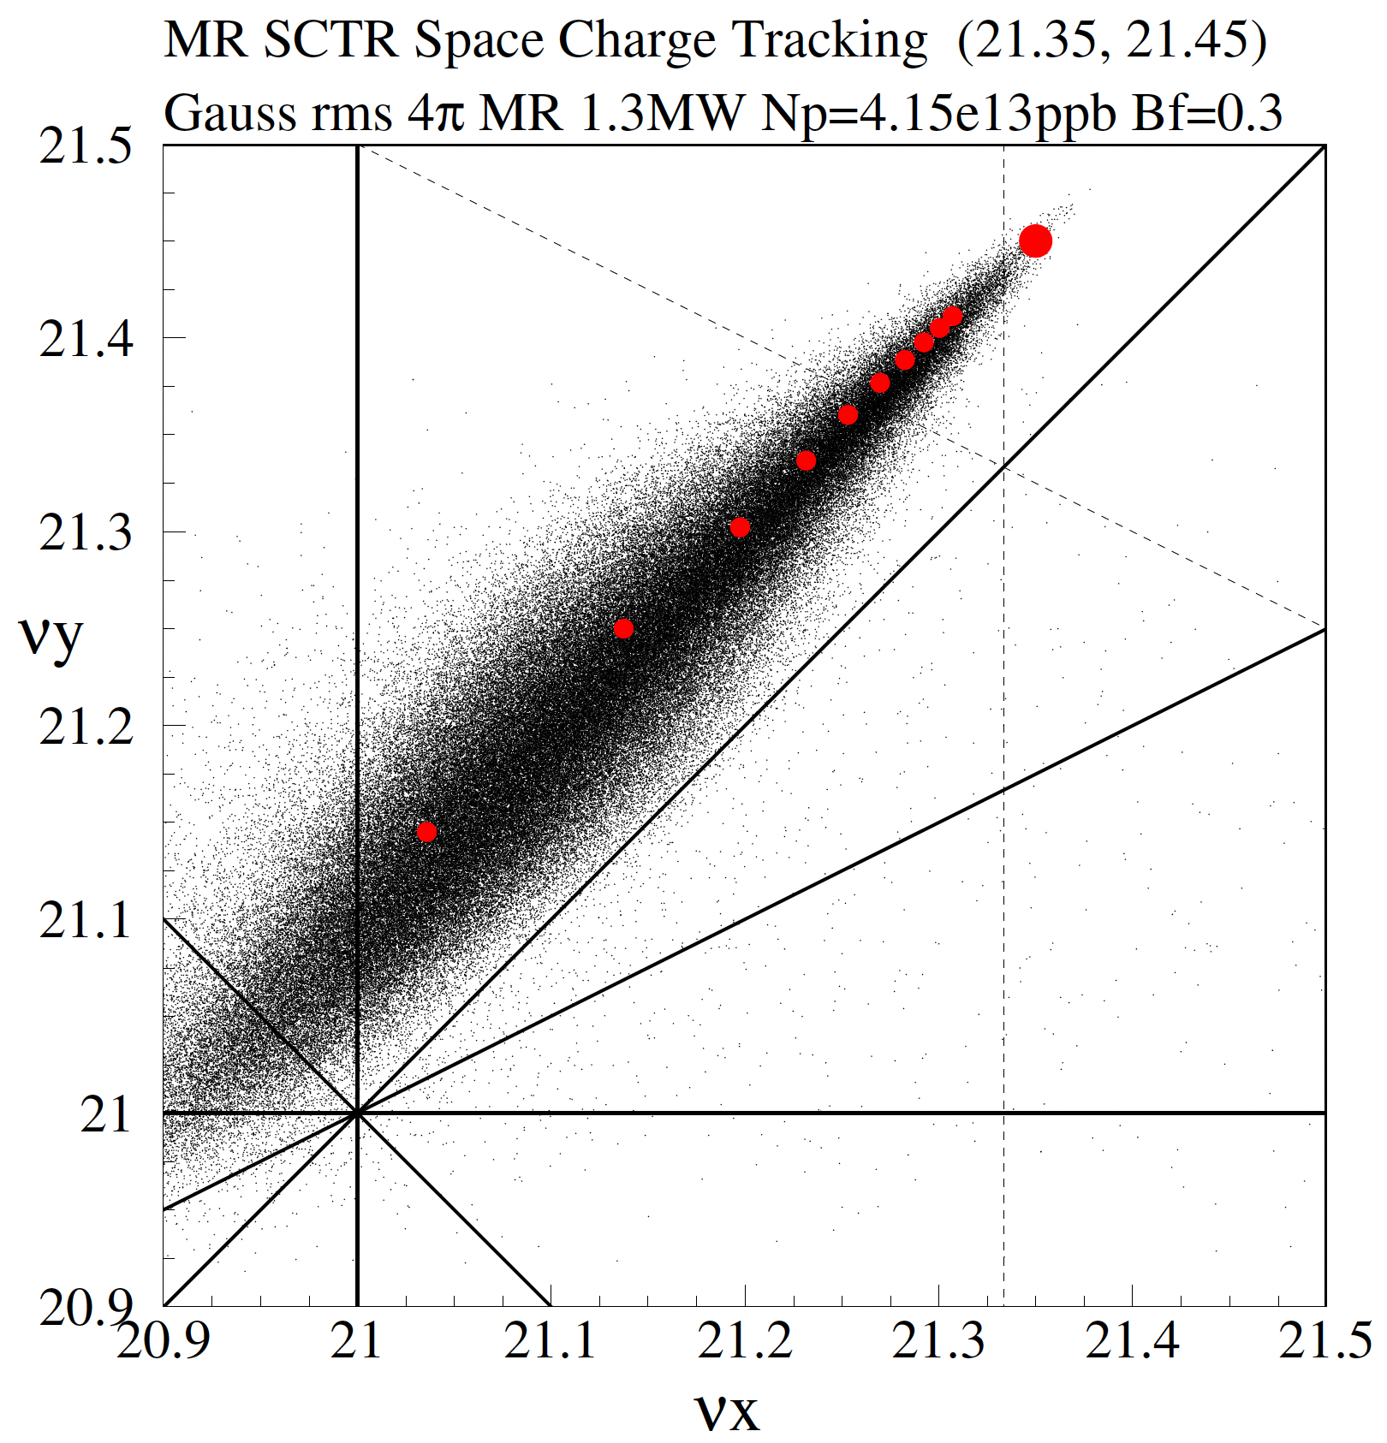
Space Charge Tune Spread and Resonances
MR Power 1.3 MW
Number of protons: 4.15e13 protons per bunch
Typical operation tune : (21.35, 21.45)
Beam loss reduction is necessary for the high intensity operation.
Resonances of
  3νx = 64 and
  νx+2νy = 64
  are corrected for the FX operation.
νx−νy=0
2νy=43
νx−2νy=−21
νx+2νy=64
νy=21
νx+νy=42
3νx=64
νx=21
2νx=43

Slide 5
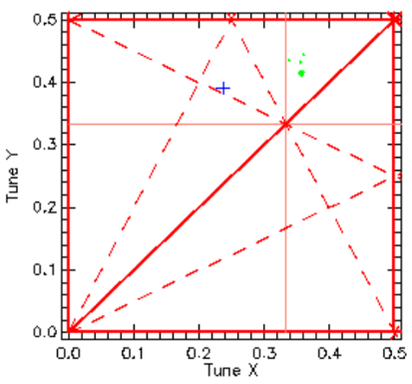
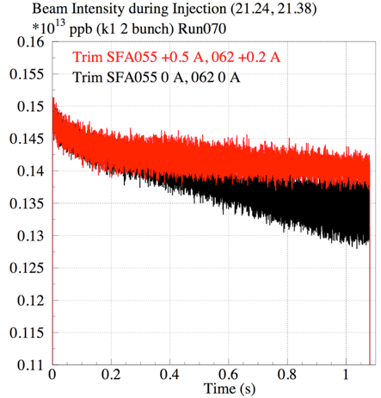
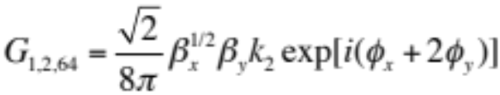
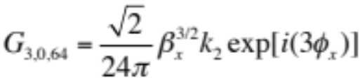
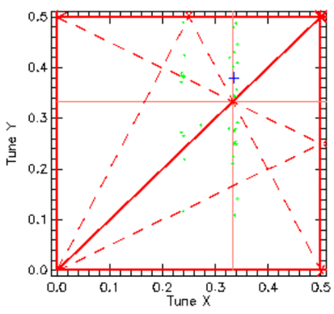
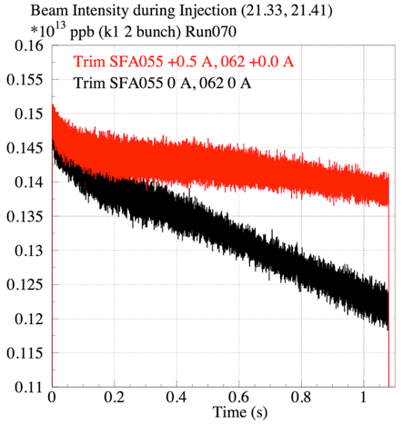
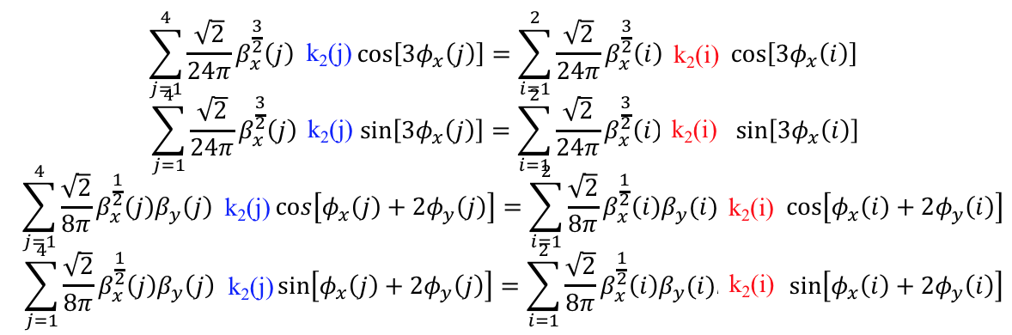
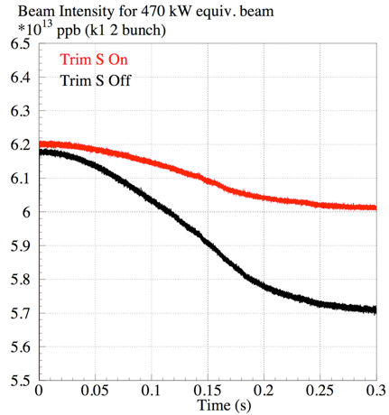
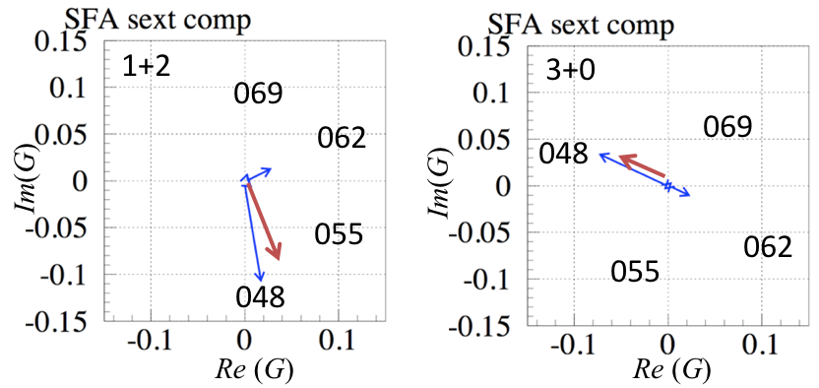
3rd Order Resonances Corrections with
Trim Coils of Sextupole Magnets
ν_{x}+2ν_{y}=64 , (1+2)
Beam survival recovers with SFA048: +0.5 A, SFA055: +0.2 A.
|G| = 0.076
3ν_{x}=64 , (3+0)
Beam survival recovers with SFA048 +0.5 A, SFA055 0.0 A.
|G| = 0.055
Simultaneous equations for 4 sextupole trim coils to correct both resonances.
Injection
Acceleration

Slide 6
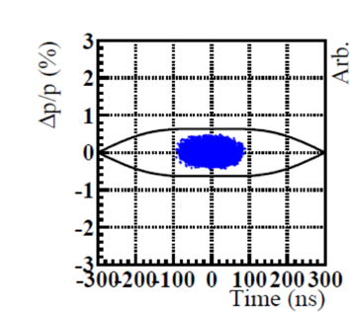
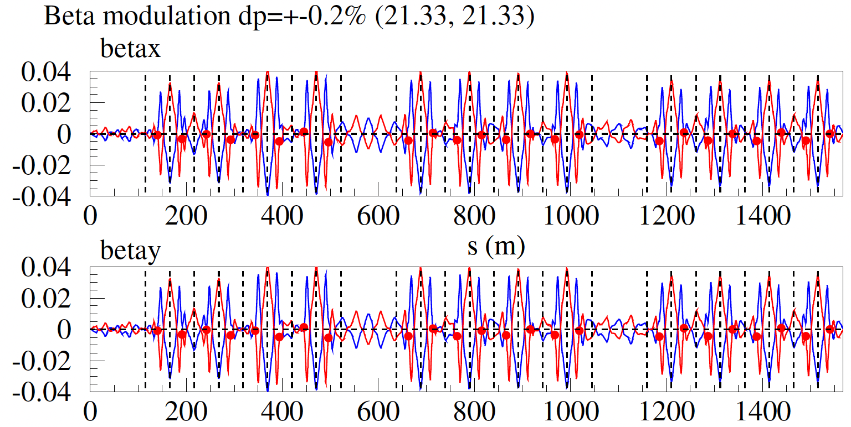
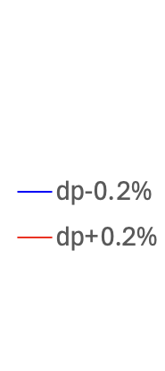
Beam optics for off-momentum particles
Beam optics for the off-momentum particles (dp/p = ±0.2%, ±0.4%,) were calculated with SAD with respect to the optics of on-momentum (dp/p = 0) particle .
(βx(dp=−0.2%)−βx(dp=0))/βx(dp=0)
(βx(dp=+0.2%)−βx(dp=0))/βx(dp=0)
(βy(dp=−0.2%)−βy(dp=0))/βy(dp=0)
(βy(dp=+0.2%)−βy(dp=0))/βy(dp=0)
SFA magnets
group 1
group 2
QDR081
QFR082
group 3
group 4
group 5
group 6
s (m)

Slide 7
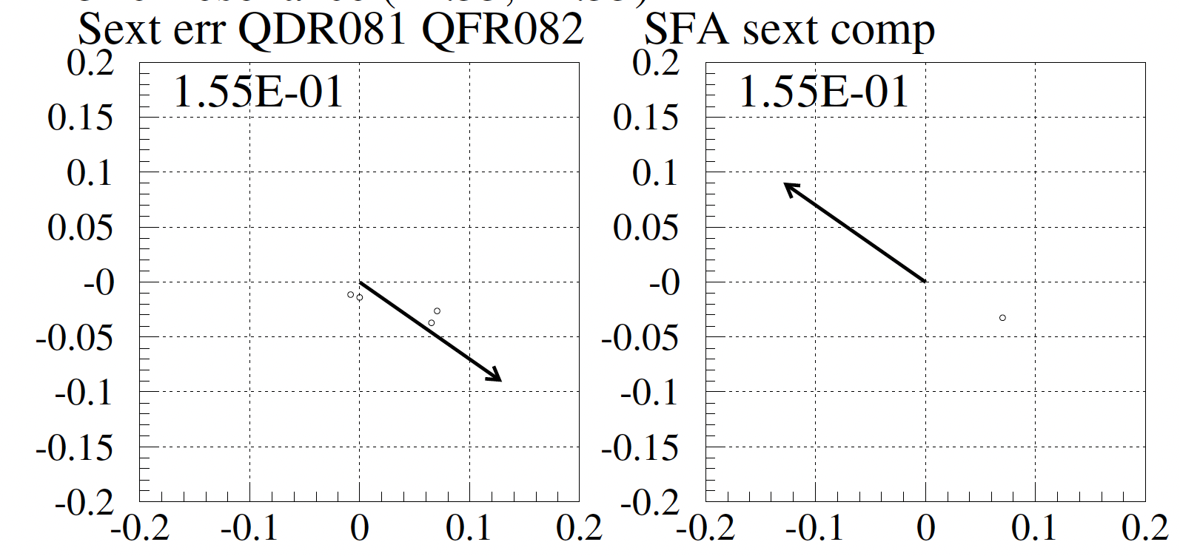
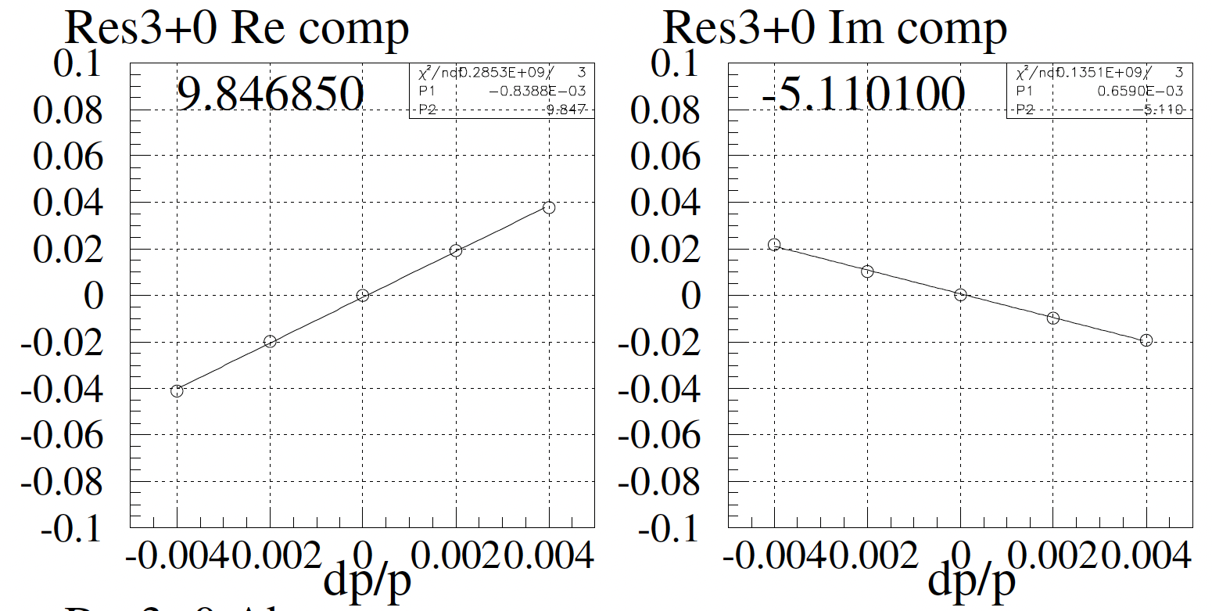
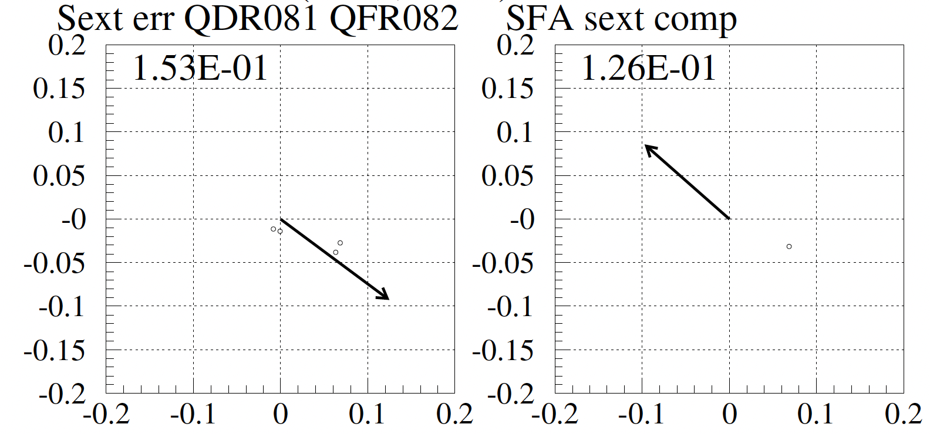
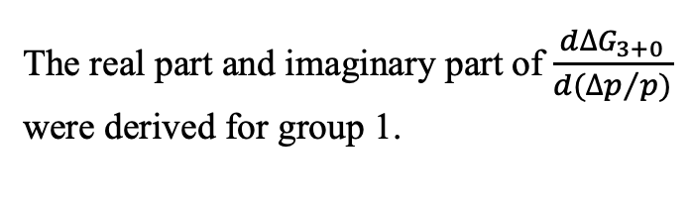
Resonance correction for 3+0 for off-momentum particles
SFA group 1 | Trim Coil Current (A)
020 | −1.6328
027 | +2.8697
034 | −4.7788
041 | +3.2752
Error at QDR081 and QFR082
Resonance correction with trim coils of 4 SFA magnets
Analysis is repeated for the 1+2 resonance.
G_{3,0} for dp = 0
G_{3,0} for dp = +0.2%
The real part and imaginary part of $\frac{d∆G_{3+0}}{d{(∆p}/{p)}}$
were derived for group 1.

Slide 8
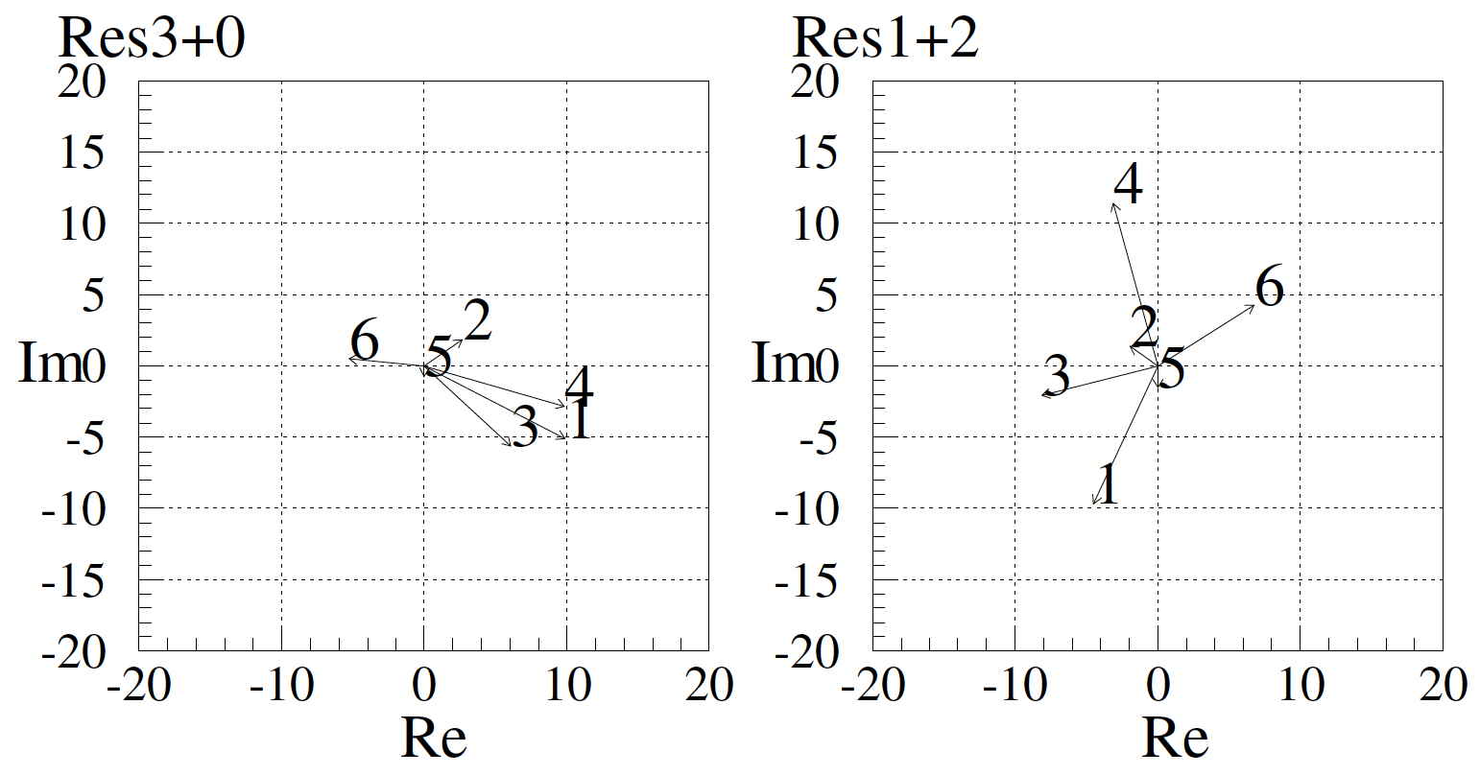
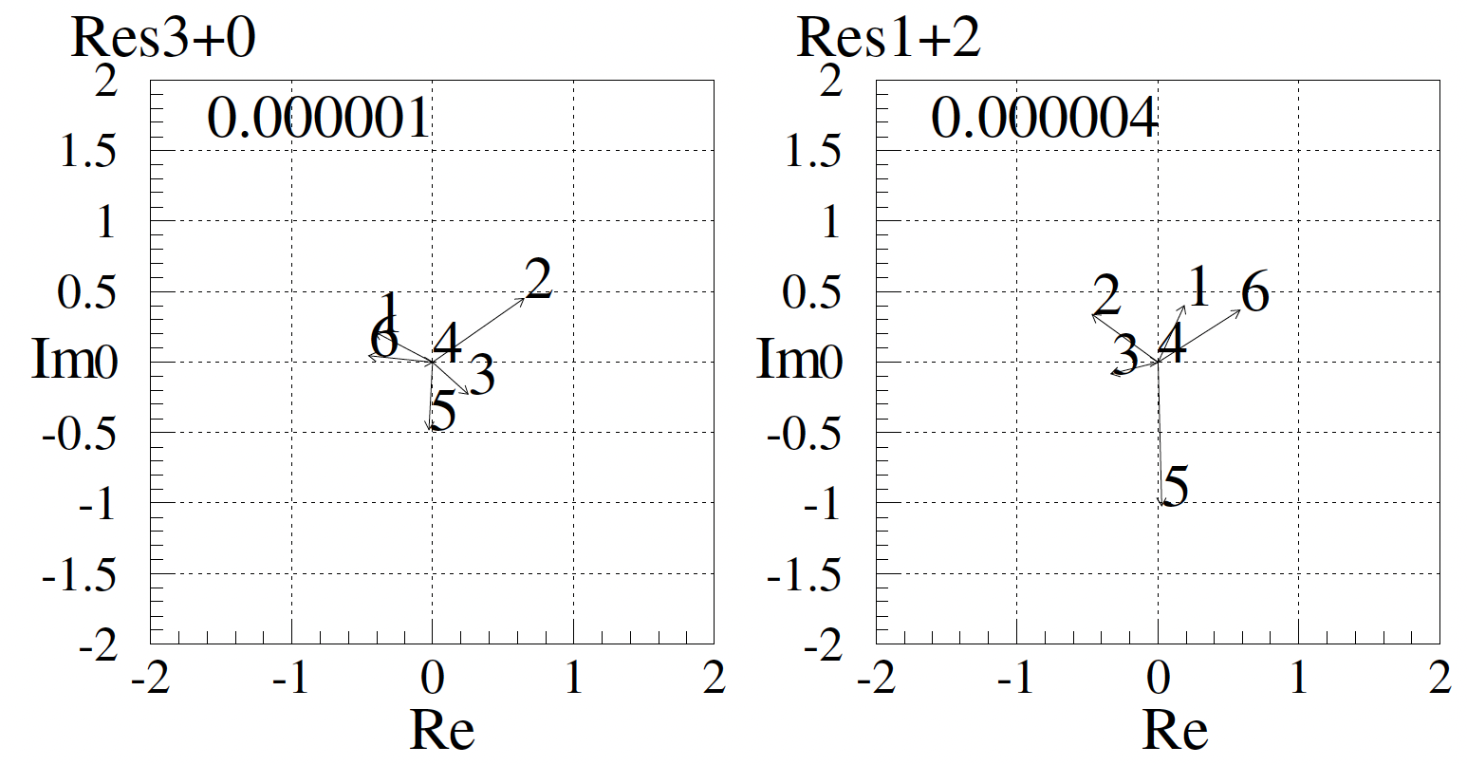
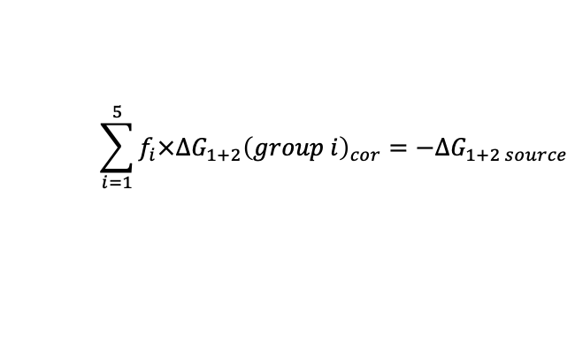
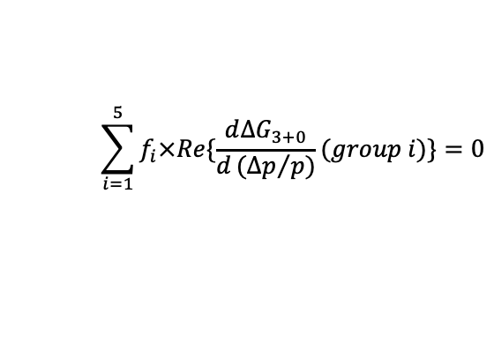
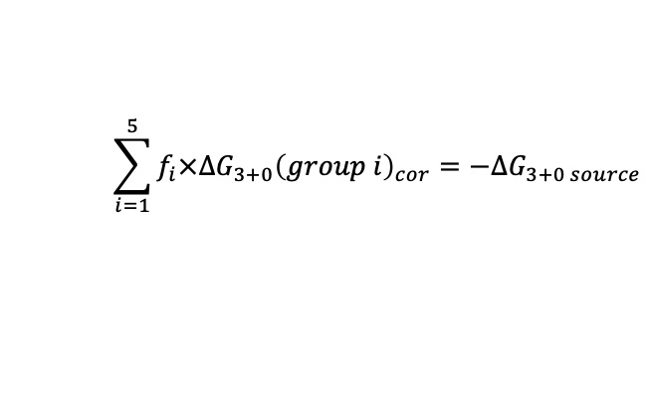
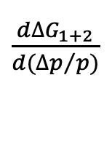
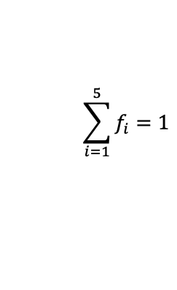
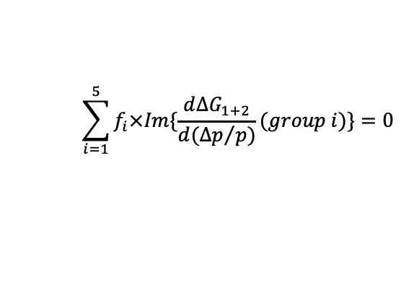
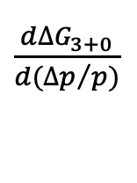
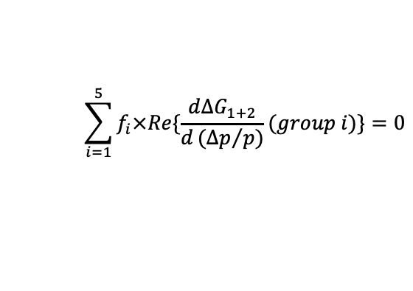
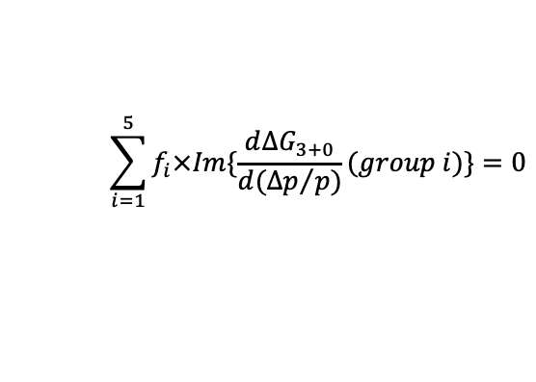
Resonance correction for off-momentum particles
Find the solution for the following simultaneous equations.
$$\sum_{i=1}^{5}{f_{i}×Re\{\frac{d∆G_{3+0}}{d{(∆p}/{p)}}(group i)\}}=0$$
$$\sum_{i=1}^{5}{f_{i}×Im\{\frac{d∆G_{3+0}}{d({∆p}/{p)}}(group i)\}}=0$$
$\frac{d∆G_{3+0}}{d{(∆p}/{p)}}$
$\frac{d∆G_{1+2}}{d{(∆p}/{p)}}$
$$\sum_{i=1}^{5}{f_{i}×Re\{\frac{d∆G_{1+2}}{d{(∆p}/{p)}}(group i)\}}=0$$
$$\sum_{i=1}^{5}{f_{i}×Im\{\frac{d∆G_{1+2}}{d({∆p}/{p)}}(group i)\}}=0$$
$$\sum_{i=1}^{5}{f_{i}}=1$$
$$\sum_{i=1}^{5}{f_{i}×∆G_{3+0}{\left(group i\right)}_{cor}}=−∆G_{3+0 source}$$
$$\sum_{i=1}^{5}{f_{i}×∆G_{1+2}{\left(group i\right)}_{cor}}=−∆G_{1+2 source}$$
SFA | ΔG₃₊₀ / (Δp/p) | ΔG₁₊₂ / (Δp/p) | factor: f
group 1 | 11.09 | 10.64 | -0.041718
group 2 | 3.25 | 2.36 | 0.242718
group 3 | 8.26 | 8.39 | 0.040839
group 4 | 10.22 | 11.83 | 0
group 5 | 0.71 | 1.52 | 0.671723
group 6 | 5.30 | 7.96 | 0.086440

Slide 9
Optics modulated by the space charge force
Optics is modulated by the space charge force.
It should be considered for the resonance corrections.
Initial test particles
81π
2Jy
2Jx
81π
Optics modulation by space charge force was approximately calculated.
Space charge tune shift is 0.06 for the 60π mm mrad particles.

Slide 10
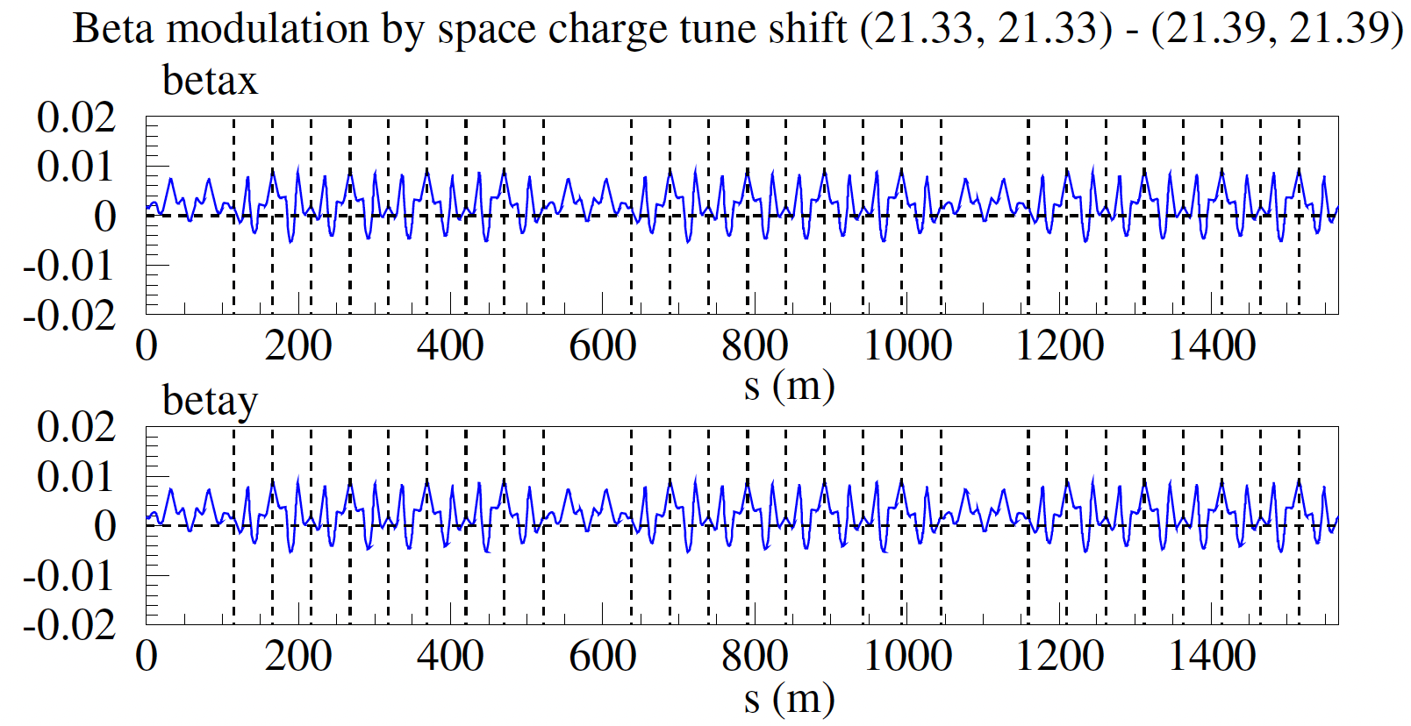
Beam optics modulated by the space charge force
For dp=0%, space charge tune shift = −0.06
  Start with the optics of (21.39, 21.39).
  Multiply the scale factor to K1 values for the tune (21.33, 21.33).
Same methods for the chromatic tune shifts of dp/p = ±0.2%, ±0.4%.

Slide 11
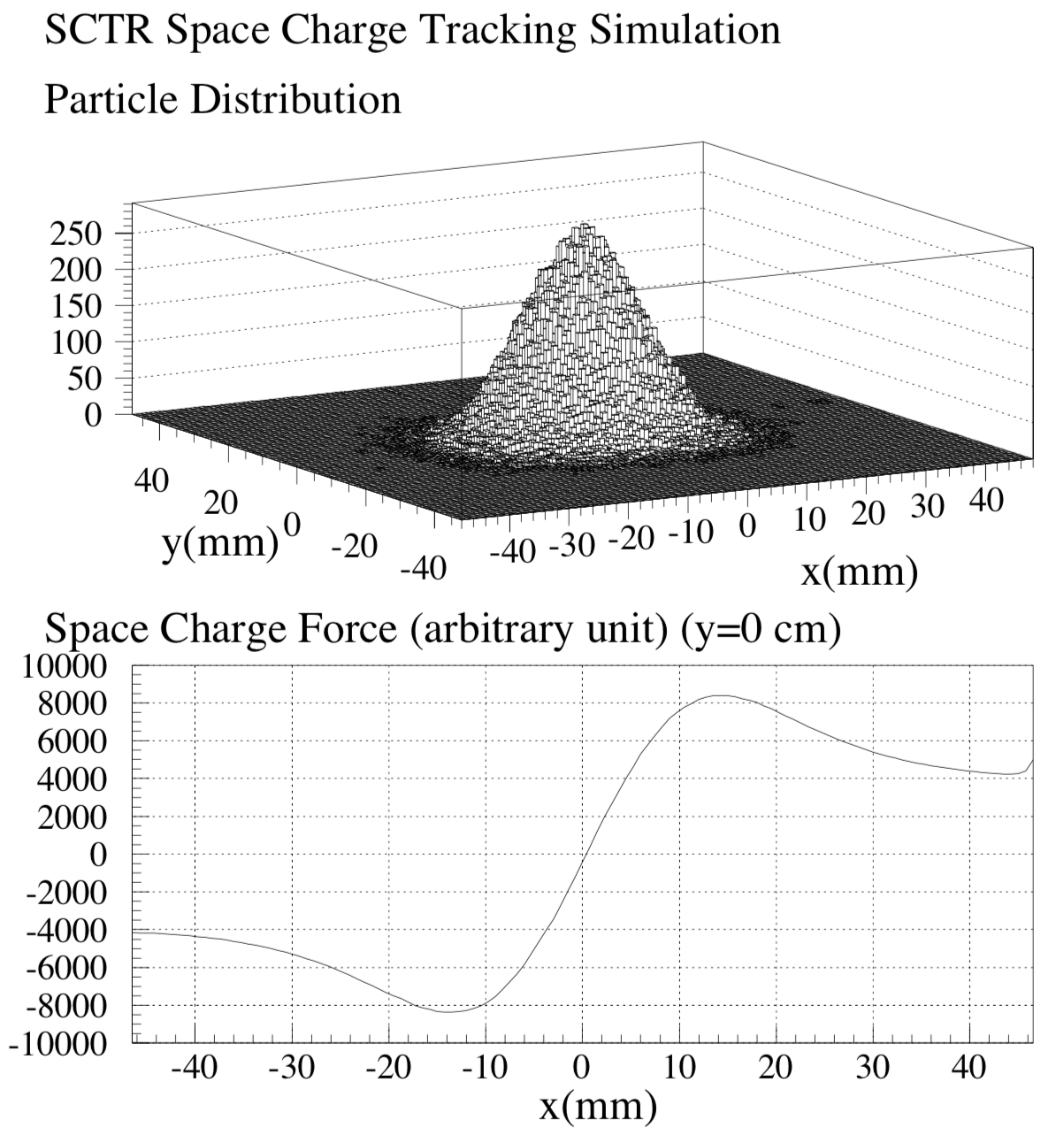
Space Charge Tracking Simulation
Space charge tracking simulation program SCTR was made for J-PARC MR by Ohmi san.
Particle in cell calculation
Space charge potentials and kicks are calculated about 1000 elements in the circumference.
Number of grid : 128×128×128
Grid size : 0.78 mm × 0.78 mm × 1 m
Number of Macro Particles : 200,000
Initial beam distribution
  Transverse Gaussian rms emittance : 4π mm mrad
  Longitudinal Bunching factor : 0.2

Slide 12
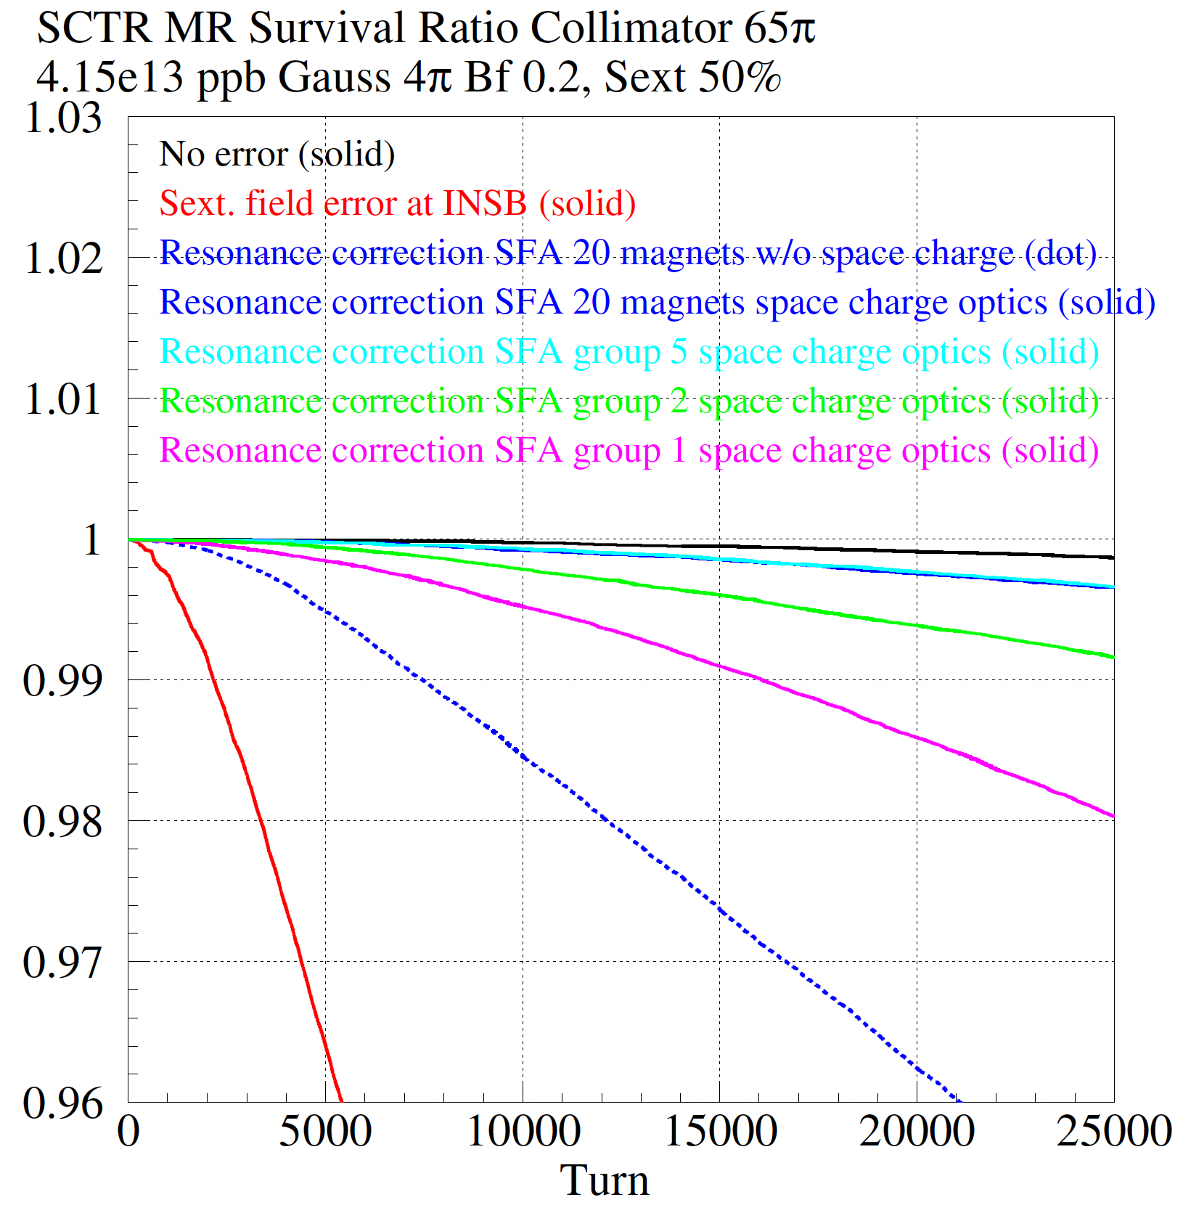
Simulation results
Beam survival
SFA | ΔG₃₊₀ / (Δp/p) | ΔG₁₊₂ / (Δp/p) | Beam Survival
group 1 | 11.09 | 10.64 | 0.9803
group 2 | 3.25 | 2.36 | 0.9916
group 3 | 8.26 | 8.39
group 4 | 10.22 | 11.83
group 5 | 0.71 | 1.52 | 0.9966
group 6 | 5.30 | 7.96
20 mags | 0 | 0 | 0.9966

Slide 13
Summary
Simulation study indicated that the beam loss was reduced by correcting third order resonances for both on-momentum and off-momentum particles.
The correction can be done with 5 groups of 4 sextupole magnets; total 20 sextupole magnets.
We must consider the beam optics modulated by the space charge effect for the resonance correction.
In this study we assume the error source. But…
  We should be able to apply this method even if the error source is not known.
  We should be able to measure the momentum deviation dependence of the resonance driving terms with the real beam.

