Slide 1


Impacts of Tune Asymmetry on the Space Charge Limit
J Appleby^{1,2}, E. Ahmadi¹, S. Machida¹, A. Oeftiger²
¹ISIS Neutron and Muon Source, RAL, UK
²John Adams Institute, University of Oxford, UK
Space Charge 2026, 30th September 2026, 11:50
Notes:
Hello everyone, I’m Josh Appleby, a second-year DPhil student at Oxford University working at ISIS Neutron & Muon Source.
I’m looking at whether the choice of transverse working point, in particular symmetric vs asymmetric tunes, can allow for an increase in intensity in the space-charge dominated regime.

Slide 2
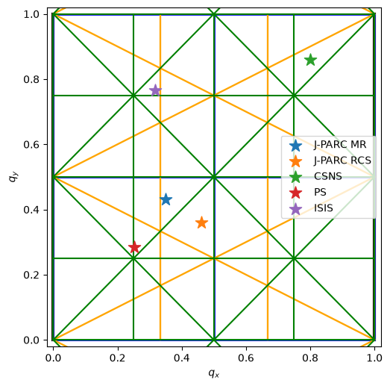
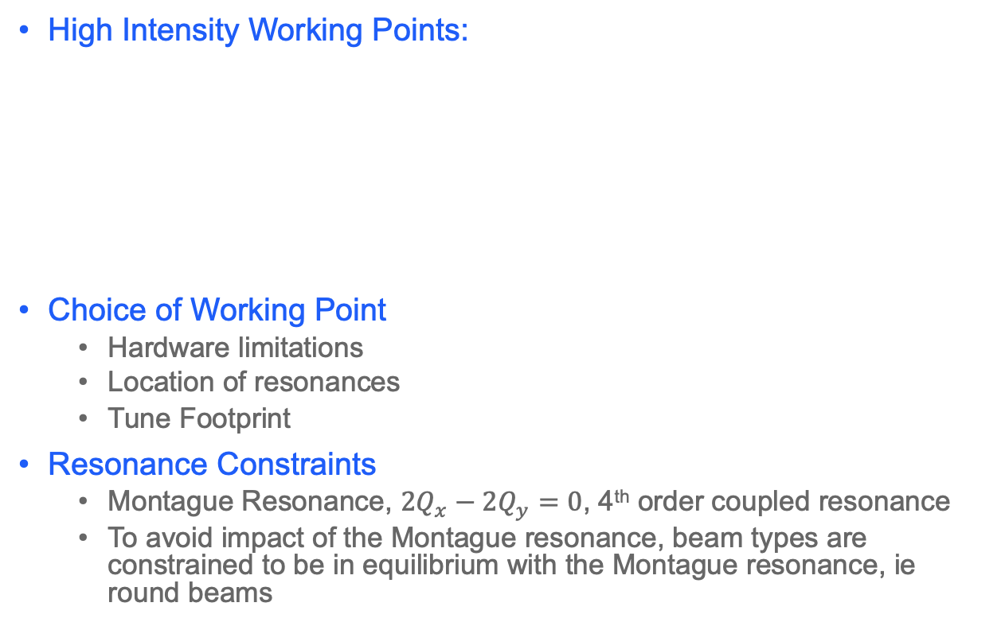
High Intensity Machines Often Operate Near-Equal Tunes
2
High Intensity Working Points:
Choice of Working Point
  Hardware limitations
  Location of resonances
  Tune Footprint
Resonance Constraints
  Montague Resonance, $2Q_{x}−2Q_{y}=0$, 4th order coupled resonance
  To avoid impact of the Montague resonance, beam types are constrained to be in equilibrium with the Montague resonance, ie round beams
Facility | Intensity | Working Point
J-PARC MR | 3.3e14 | (21.35, 21.43)
J-PARC RCS | 8.3e13 | (6.46, 6.36)
ISIS | 3e13 | (4.316, 3.765)
CSNS | 1.5e13 | (4.8, 4.86)
CERN PS | 8e12 | (6.252, 6.285)
Fractional working points for J-PARC MR, CSNS, PS & ISIS, with up to 4th order resonance lines.
Notes:
Many high intensity facilities such as J-PARC, CSNS & PS currently operate with near equal tunes. ISIS notably has split tunes.
ISIS notably splits its tunes by half an integer as a part of the lattice optimisation, balancing the optics, the quadrupole pole profiles and resonance and resistive wall instability constraints.
Direct Space charge causes amplitude and distribution dependent incoherent detuning, creating a tune footprint.
This means different particles will have a different tune, with the potential to satisfy different resonance conditions, and as such must be considered when selecting a working point.
The overall goal then, is to find an area in tune space where the number of resonances is minimised, and the destructive dynamics caused by unavoidable resonances are minimised.
But is confusing – many high intensity accelerators operate near equal tunes, which is where the Montague Resonance is.
It is a strong 4th order resonance, driven by space-charge along 2Qx – 2Qy = 0
It causes exchange between transverse planes, driving emittance growth that can cause beam loss.
So the question is, how does the choice of tune impact the maximum reachable intensity?

Slide 3
Does Tune Asymmetry Change the High-Intensity Limit?
3
Resonance Dynamics
  How does changing the integer or fractional working point change how a space-charge dominated beam interacts with a resonance?
    Resonance trapping, action exchange, tune modulation
Observable Consequences
  How does this dynamic appear and manifest?
    Emittance growth, emittance exchange, halo formation and beam loss
Intensity Limit
  Can tune asymmetry alter beam behaviour with resonances or increase the usable tune space, such that the beam intensity can be increased?
    Tune-space area and space-charge-driven tune spread
Are some accelerator types better suited for high intensity operations due to the tune space they naturally operate in?
Synchrotrons: Coupled transverse focusing favours similar tunes, so large tune separation can require more extreme optics
Fixed-Field Accelerators: Greater focusing flexibility allows lattices to be designed with strongly unequal tunes.
Notes:
This leads to several questions.
At the single particle level, does the choice of working point change the way that a particle interacts when a resonance condition is satisfied?
What effects does this cause when considering the collective beam? Do we see emittance growth or immediate beam loss?
Can these effects be understood and exploited to inform the choice of working point to increase the intensity
These lead naturally to a much longer-term question, whether different accelerator designs naturally favour configurations that are advantageous for high intensity operations? For example, synchrotron vs fixed field accelerator?

Slide 4
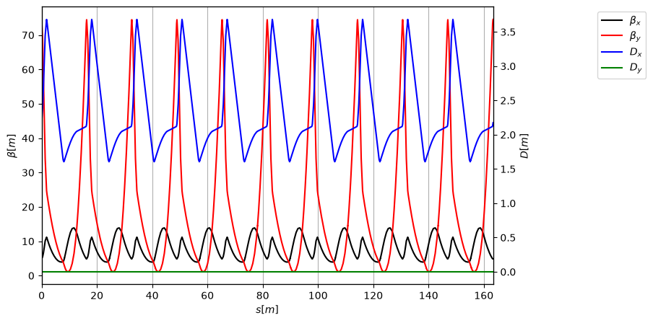
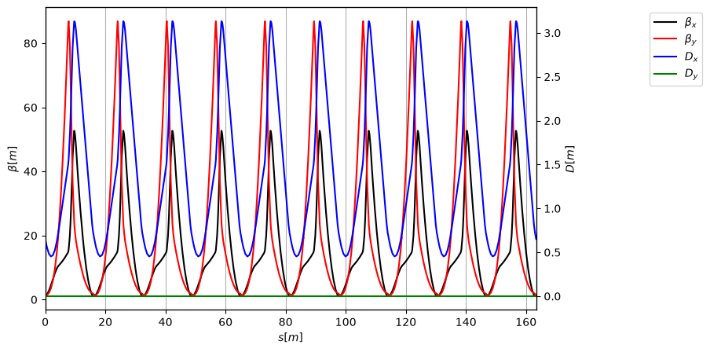
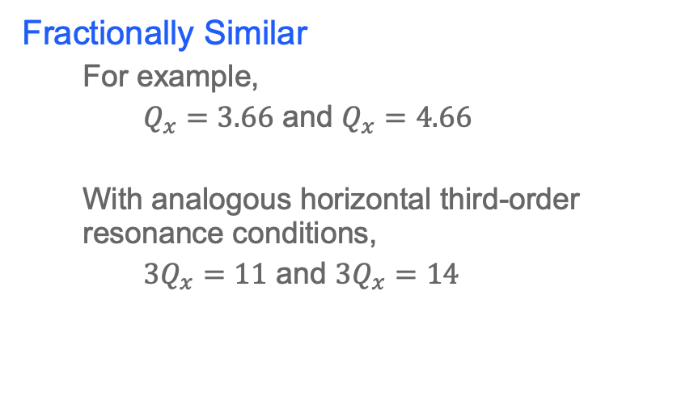
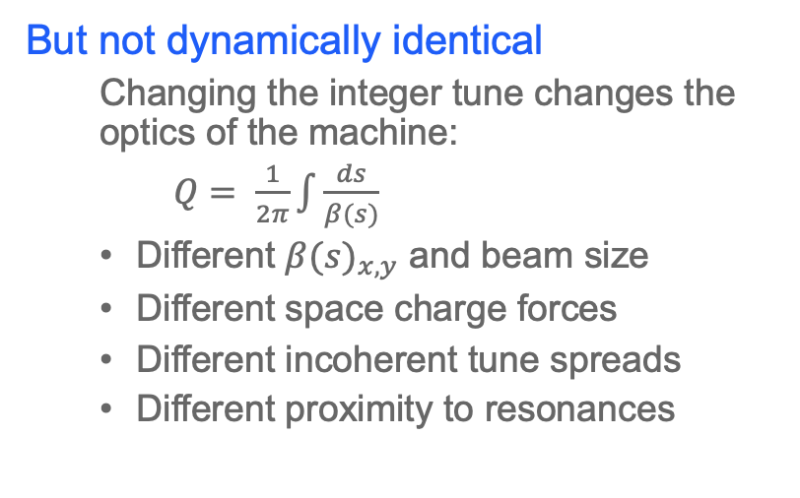
Comparisons with an identical fractional tune
4
Fractionally Similar
  For example,
  $Q_{x}=3.66$ and $Q_{x}=4.66$
  With analogous horizontal third-order resonance conditions,
  $3Q_{x}=11$ and $3Q_{x}=14$
But not dynamically identical
  Changing the integer tune changes the optics of the machine:
  $Q= \frac{1}{2π}\int{\frac{ds}{β(s)}}$
  Different ${β(s)}_{x, y}$ and beam size
  Different space charge forces
  Different incoherent tune spreads
  Different proximity to resonances
Therefore, a different integer tune may not produce the same beam response to resonances
Q = (3.666, 4.666)
Q = (4.666, 4.666)
Notes:
If we compare horizontal tunes 3.66 and 4.66, the fractional tune is the same, and we therefore are looking at the 3Qx=n resonance condition, albeit with different harmonics.
But physically they are very different working points, as to achieve such a different tune, the optics of the machine are altered significantly
This will result in a different betafunction and beam size which results in a different space charge force, incoherent tune spread and proximity to resonances.
Therefore, changing the integer tune should change the beam dynamics significantly, and if so, we should understand, characterise and utilise this to our advantage.

Slide 5
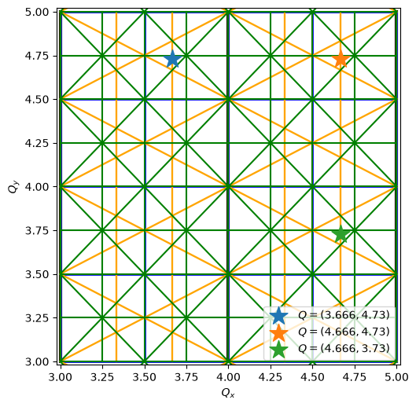
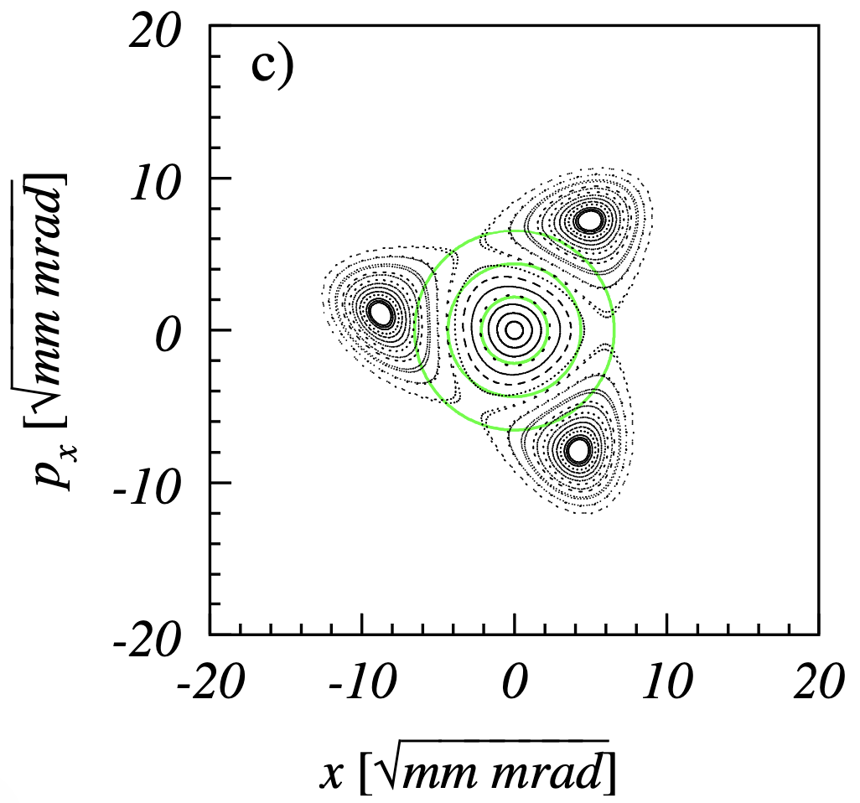
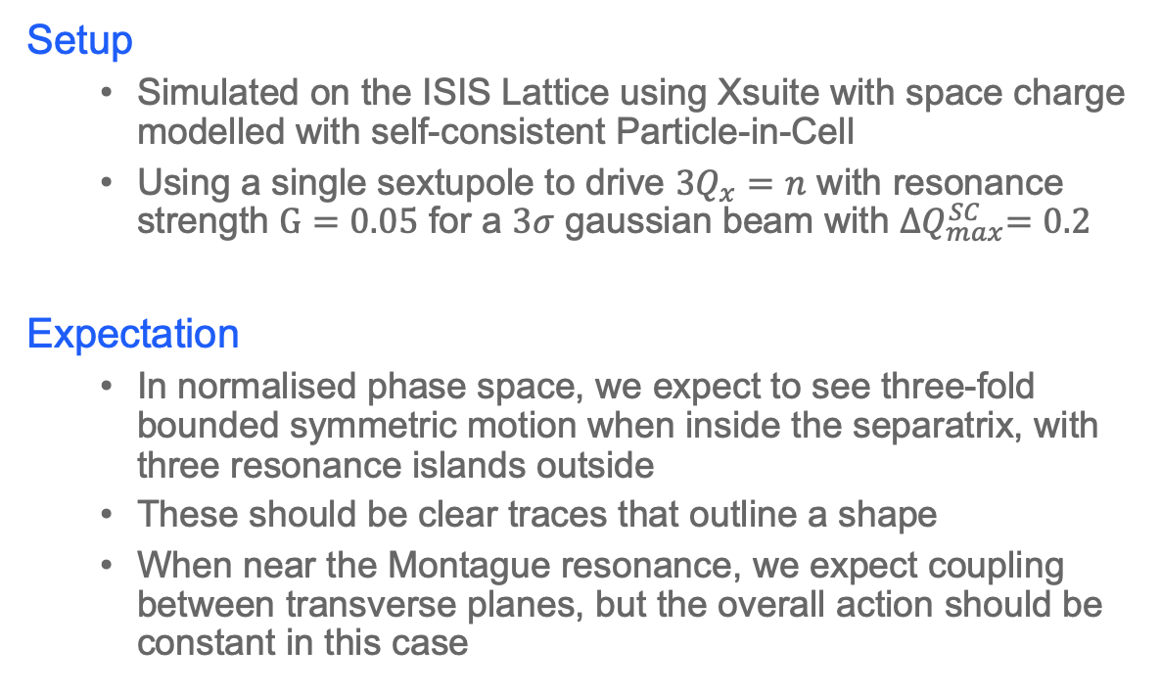
Investigating Integer Tunes Using Third-Order Resonances
5
Setup
  Simulated on the ISIS Lattice using Xsuite with space charge modelled with self-consistent Particle-in-Cell
  Using a single sextupole to drive $3Q_{x}=n$ with resonance strength $G=0.05$ for a $3σ$ gaussian beam with ${∆Q}_{max}^{SC}=0.2$
Expectation
  In normalised phase space, we expect to see three-fold bounded symmetric motion when inside the separatrix, with three resonance islands outside
  These should be clear traces that outline a shape
  When near the Montague resonance, we expect coupling between transverse planes, but the overall action should be constant in this case
Target interactions for ISIS, with up to 4th order resonance lines.
Third-Order Phase Space Portrait
Credit: G. Franchetti, at al.
Notes:
For this investigation, I am driving the 3Qx = n resonances, driven by a single sextupole in the ISIS lattice.
I choose working points that means that the tails of the tune footprint in the three quadrants will satisfy the resonance conditions 3QX=11 and 3QX=14.
Note: The lower (3, 3) integer quadrant is unreachable with ISIS, so is not included here.
This enables us to compare the horizontal third order dynamics at both 3 and 4 integer working points.
Expectation:
Third order resonance typically shows 1 SFP and 3 UFPs, producing a stable area that particle should traverse; however, space charge detuning adds an additional three SFPs as resonance islands.
We expect to see clear traces that outline a shape, but when near the Montague resonance, we expect that trace to get fuzzy because of coupling. This can be proven to be true if the total action is constant.

Slide 6
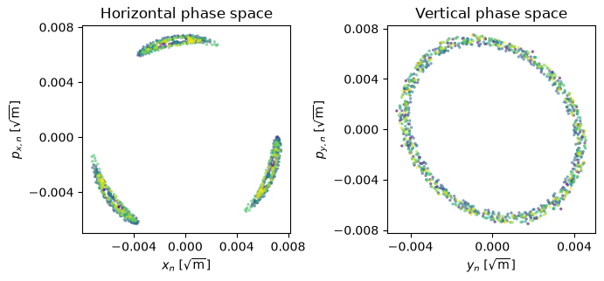
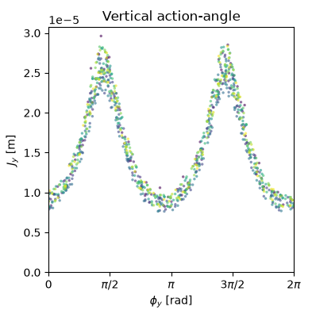
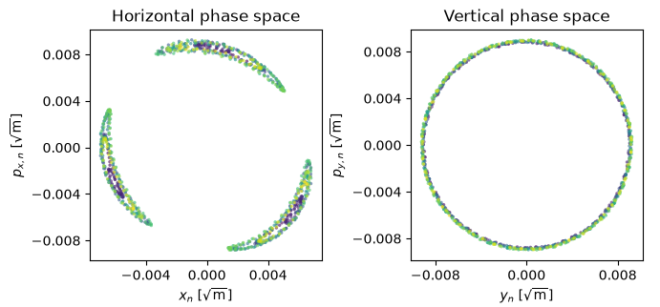
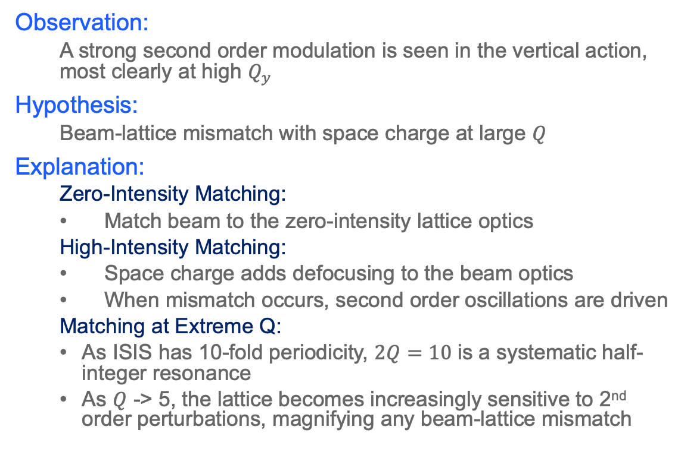
Initial Observations (Unequal Tunes)
Q = (3.666, 4.684)
6
Observation:
  A strong second order modulation is seen in the vertical action, most clearly at high $Q_{y}$
Hypothesis:
  Beam-lattice mismatch with space charge at large $Q$
Explanation:
  Zero-Intensity Matching:
  Match beam to the zero-intensity lattice optics
  High-Intensity Matching:
  Space charge adds defocusing to the beam optics
  When mismatch occurs, second order oscillations are driven
  Matching at Extreme Q:
  As ISIS has 10-fold periodicity, $2Q=10$ is a systematic half-integer resonance
  As $Q$ -> 5, the lattice becomes increasingly sensitive to 2nd order perturbations, magnifying any beam-lattice mismatch
Q = (4.666, 3.756)
Notes:
In both of these split tune cases, three resonance islands are seen, as expected.
We however also see a strong second-order modulation in the vertical action, which is more prominent as Q increases.
The hypothesis is currently that this is a matching effect.
At zero intensity, the beam is generated with the twiss parameters as found by the lattice optics at the location of initialisation.
When space charge is included, the beam optics change, meaning they do not match the zero-intensity lattice optics.
The distribution therefore has a mismatch which manifests as a second order oscillation.
As ISIS has 10-fold symmetry, at high Q, we are nearing the systematic resonance condition 2Q=10 . As we approach this, the betafunction grows rapidly, and becomes increasingly sensitive to other perturbations.
This ultimately exaggerates the strength of the quadrupolar oscillation caused by mismatch
The challenge is attempting to mitigate this, as it hides the subtlety of the single particle dynamics when this effect is so dominant.

Slide 7
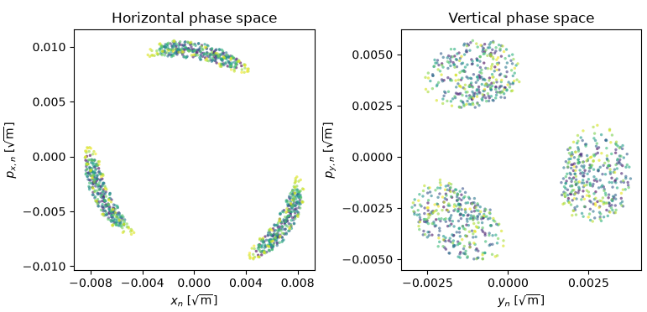
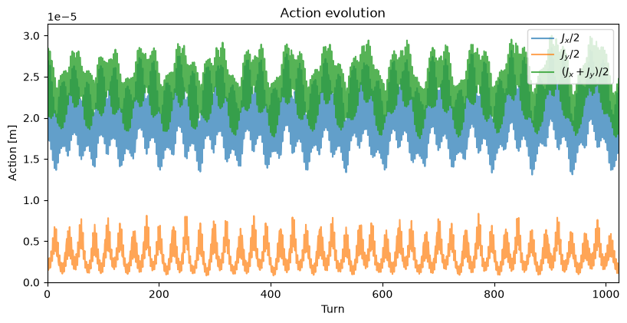
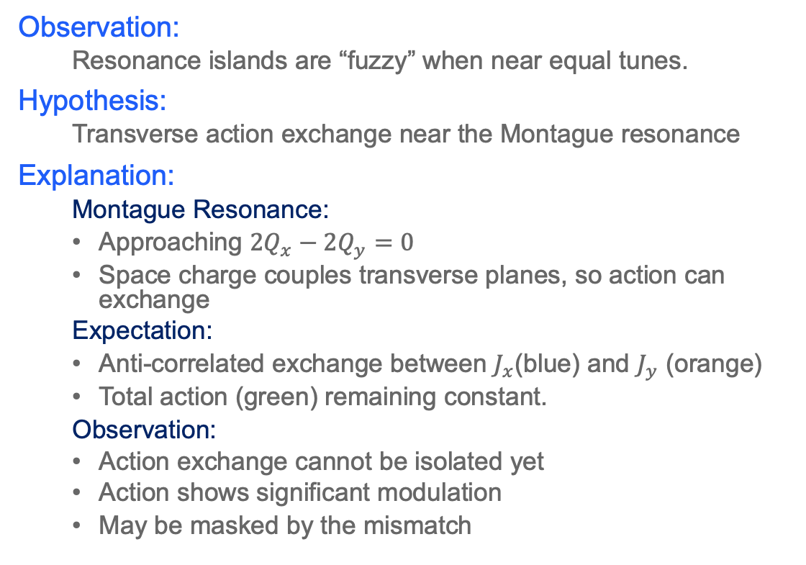
Initial Observations (Equal Tunes)
7
Q = (4.666, 4.666)
Observation:
  Resonance islands are “fuzzy” when near equal tunes.
Hypothesis:
  Transverse action exchange near the Montague resonance
Explanation:
  Montague Resonance:
  Approaching $2Q_{x}−2Q_{y}=0$
  Space charge couples transverse planes, so action can exchange
  Expectation:
  Anti-correlated exchange between $J_{x}$(blue) and $J_{y}$ (orange)
  Total action (green) remaining constant.
  Observation:
  Action exchange cannot be isolated yet
  Action shows significant modulation
  May be masked by the mismatch
Notes:
In the equal tunes case, the three resonance islands can be seen, but they don’t have distinct traces, but more of a “fuzzy” interior.
The theory is that this is transverse action exchange due to the Montague resonance.
If this is the explanation for this behaviour, then it should be clear to see with an anticorrelation in the horizontal and vertical actions as they exchange.
However, it is currently not clear if this is the case, which could be due to the dominant effects of the mismatch as discussed in the previous slide.
The immediate step is to control this mismatch, then to understand the mechanics shown here.

Slide 8
From Resonance Dynamics to the Space Charge Limit
8
Establishing the Underlying Motion
  Remove mismatch with beam matching
  Minimise structural optics contributions
Identify Coupling Mechanism
  Quantify action exchange near equal tunes
Compare Resonance Response
  Trapping, emittance growth, halo formation, beam loss
Compare the Space Charge Limits at different tunes
  Equal vs Unequal tunes
Are near-equal tunes intrinsically favourable at high intensity?
Notes:
The work is not yet at the stage where I can give definitive answers, but these initial studies have done is identify the physics that needs to be understood before that comparison is meaningful.
First, I need a clean description of the underlying single-particle motion, understanding where and how matching and structural resonances impact the results.
Second, I can establish an understand of how the Montague resonance manifests in these beams
Third, I can return to the main question; understanding the particle and beam dynamics that occur in these different tune regimes, and to build a better picture of the physics behind this.
Finally, this will answer if these differences translate into different intensity limits at different working points, and ultimately guide the design of future machines to be optimised for this purpose.
WANT TO DEVELOP THIS FOR A GENERAL CASE TO APPLY TO ANY ACCELERATOR

Slide 9
Thank you for listening
Any Questions?

Slide 10
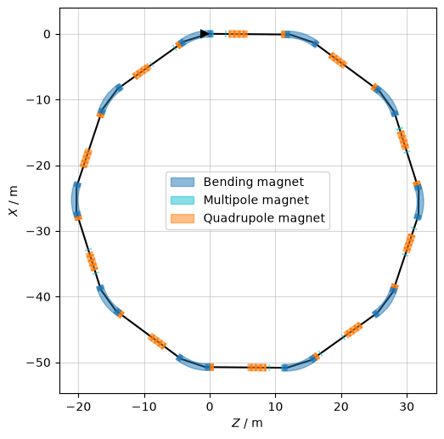
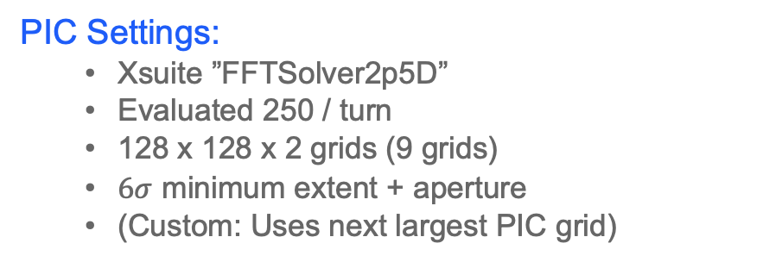
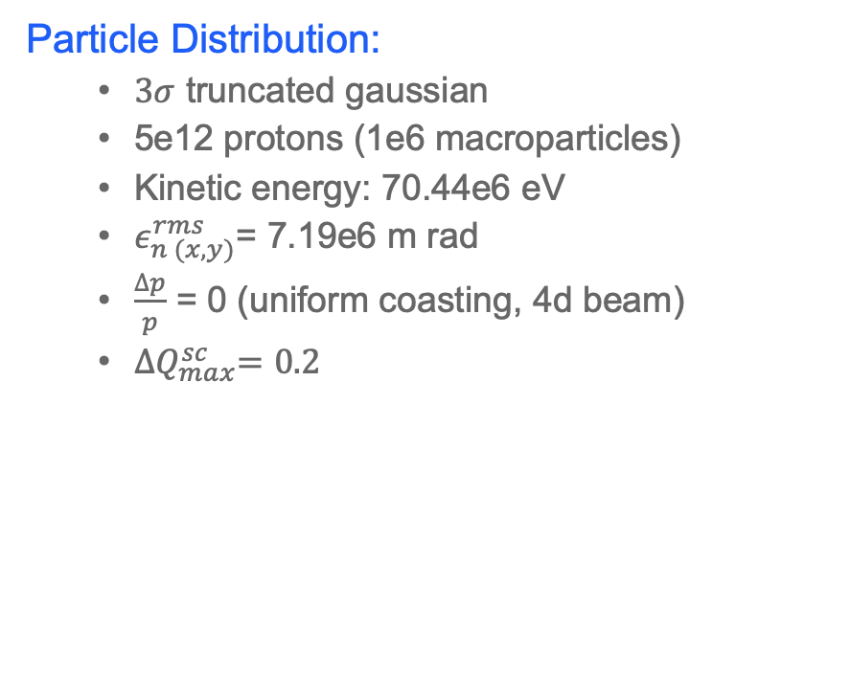
Appendix A: Xsuite Simulation Model
Particle Distribution:
  $3σ$ truncated gaussian
  5e12 protons (1e6 macroparticles)
  Kinetic energy: 70.44e6 eV
  $ε_{n (x, y)}^{rms}$= 7.19e6 m rad
  $\frac{∆p}{p}$ = 0 (uniform coasting, 4d beam)
  ${∆Q}_{max}^{sc}=0.2$
PIC Settings:
  Xsuite ”FFTSolver2p5D”
  Evaluated 250 / turn
  128 x 128 x 2 grids (9 grids)
  $6σ$ minimum extent + aperture
  (Custom: Uses next largest PIC grid)
Simulation Settings:
  1024 Turns

Slide 11
Appendix B: Equilibration Process
Match the particle distribution from the zero-intensity lattice twiss
Track over 6n turns, recalculating the beam distribution twiss each turn.
Calculate the mean twiss in each n sample window
Estimate the residual variation from double the final 4 windows
Equilibrium is reached when 6 consecutive windows are stable in both transverse planes
If not stable, track another n turns and repeat
If stable, average the twiss parameters over the full stable region
Match the particle distribution with these new high-intensity twiss values

Slide 12
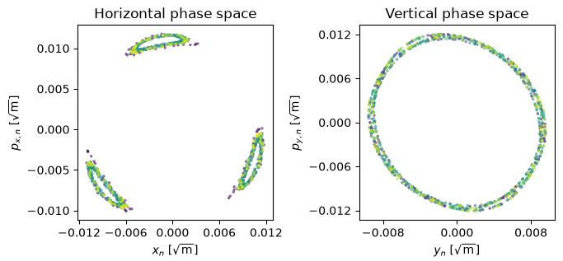
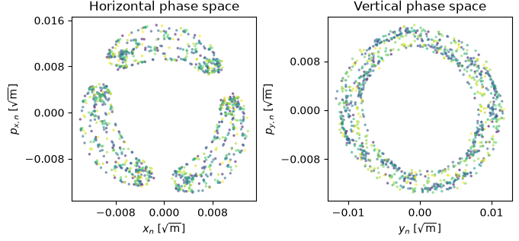
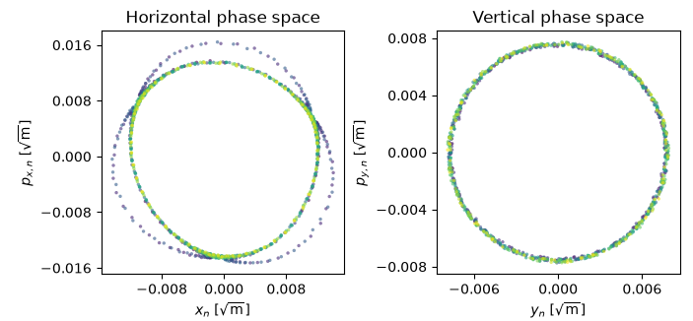
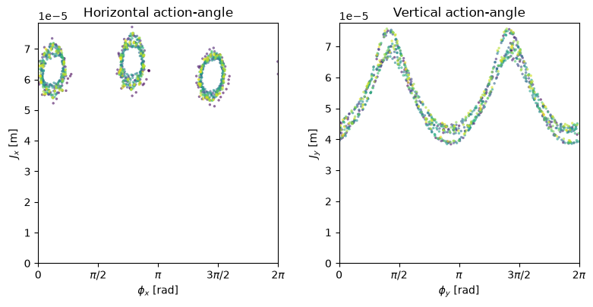
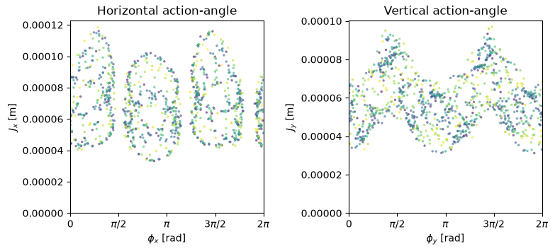
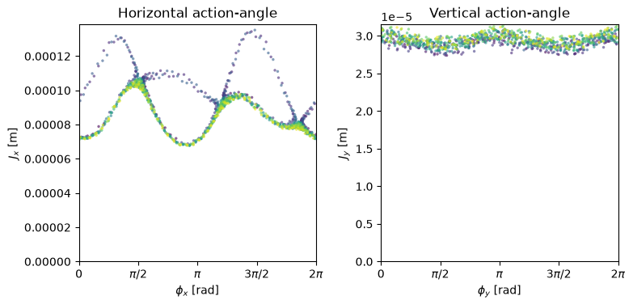
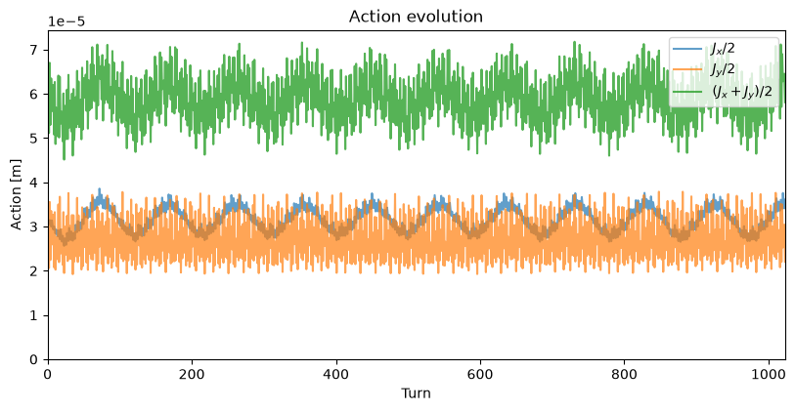
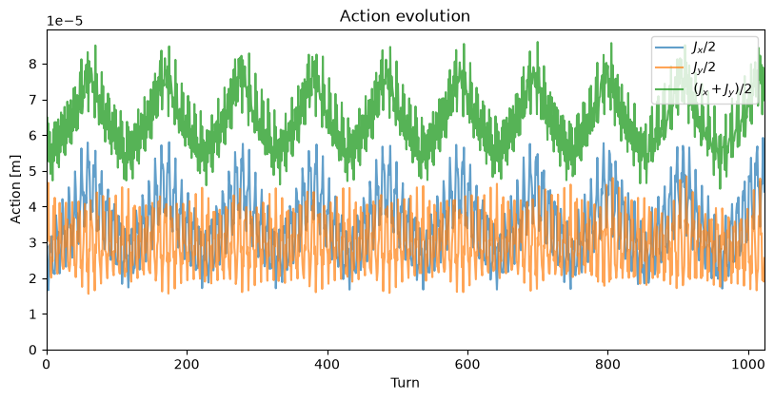
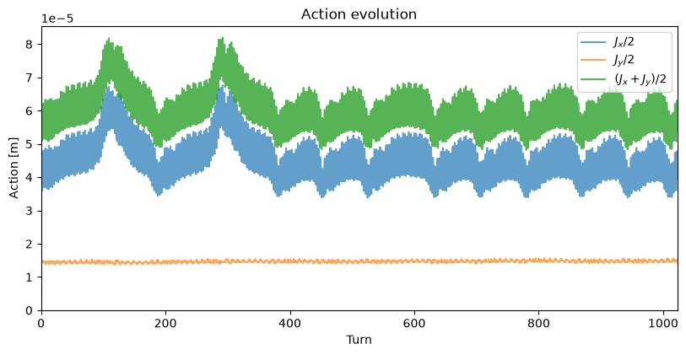
Appendix C: Additional Montague Coupling Examples
Additional examples as to show this isn’t numerical noise/clarify coupling evidence
Q = (3.666, 4.713)
Q = (4.666, 4.724)
Q = (4.663, 4.719)

