Slide 1
Welcome to the session on Benchmarking and Experiments!
Beam Dynamics in the SNS Linac and Beam Test Facility
Kiersten Ruisard, ORNL
Benchmarking PIC simulations against the SNS Beam Test Facility
Tony Wood, ORNL
Space-charge dynamics in bare IOTA: Benchmarking among simulations and experiment
Nilanjan Banarjee, FNAL
Benchmarking Experience with PTC-PyORBIT for High-Intensity Synchrotron Studies
Haroon Rafique, RAL
Space Charge Effects in the Alternating Gradient Synchrotron at injection energies
Yichao Jing, BNL

Slide 2
Beam Dynamics in the SNS Linac and Beam Test Facility
October 2, 2026 | Trinity College, Oxford
Kiersten Ruisard
Oak Ridge National Laboratory

Slide 3
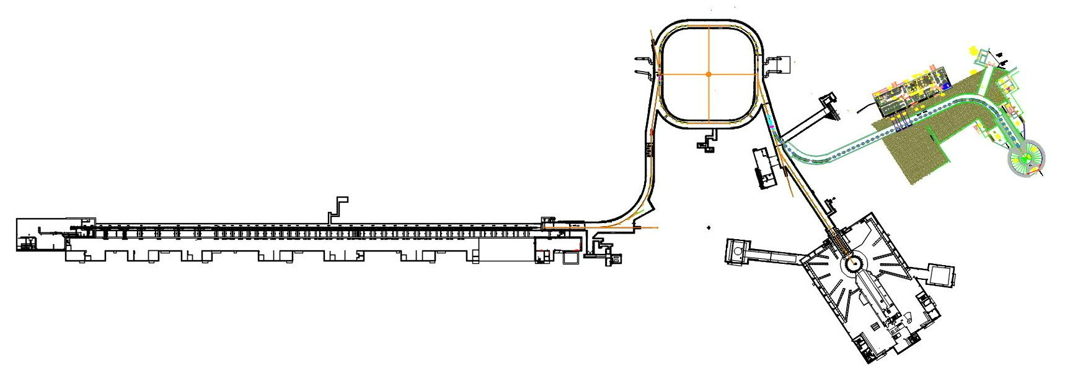
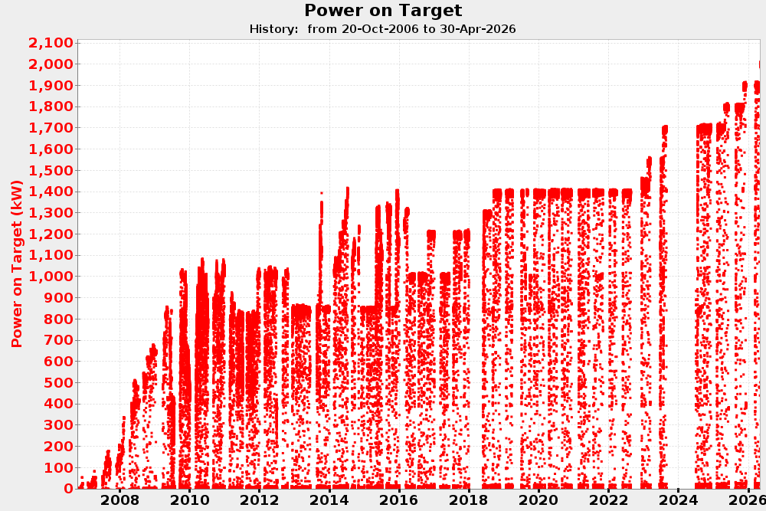


Spallation Neutron Source
2.5 MeV
186 MeV
1300 MeV
RFQ
DTL
CCL
SCL $β=0.61$
SCL $β=0.81$
0.7 MW to 2nd target station
2 MW
All new cavities installed
2 MW target
1.4 MW baseline design

Slide 4
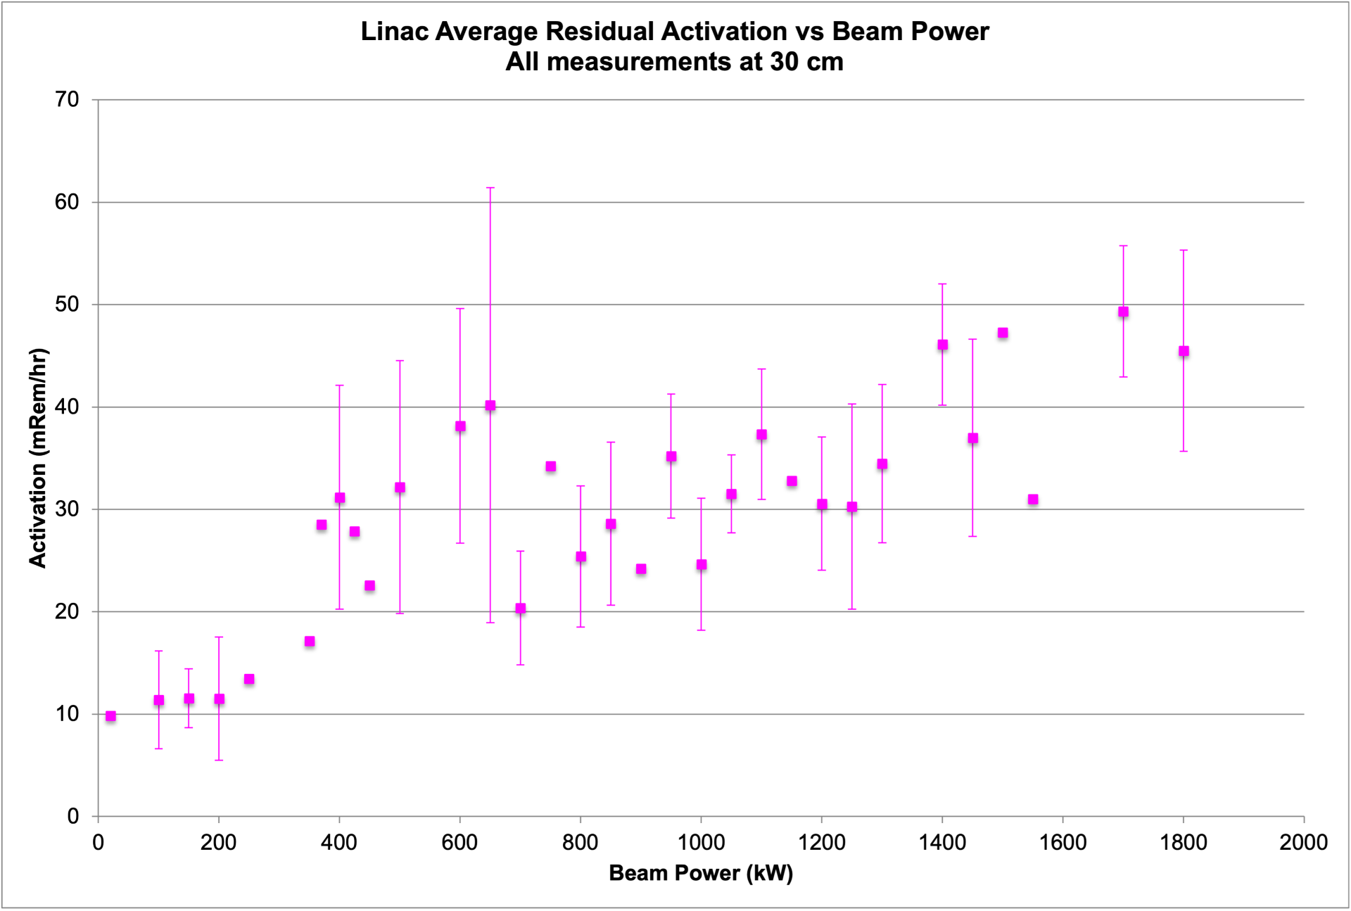
Increased beam loss at 2+ MW increases lost beam and radioactivation in tunnels

Slide 5
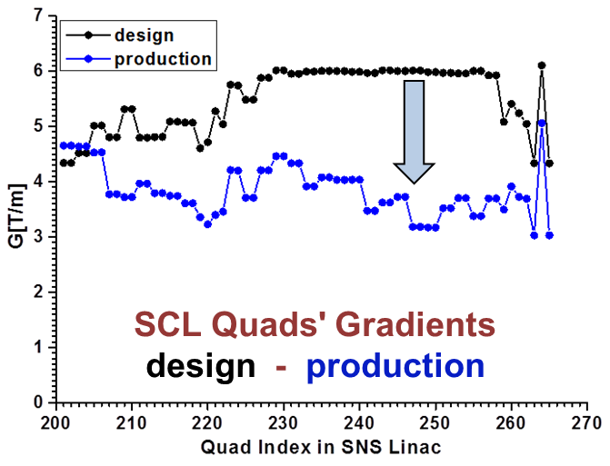
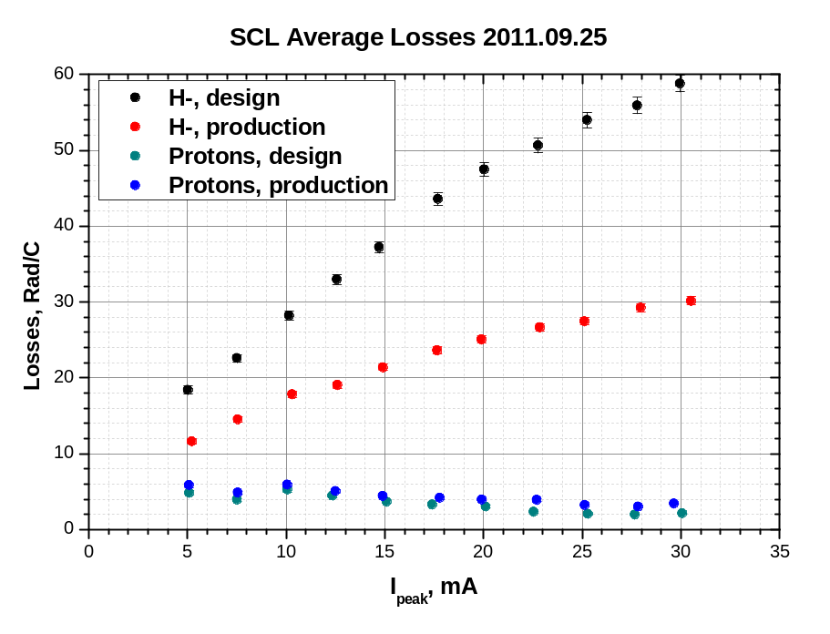




Intrabeam stripping loss was a major hiccup in initial commissioning of SNS
$$H^{−}$$
$$H^{−}$$
$$H^{0}$$
$$H^{−}$$
$$e$$
A. Shishlo, J. Galambos, A. Aleksandrov, V. Lebedev, and M. Plum, PRL 108, 1 (2012)

Slide 6
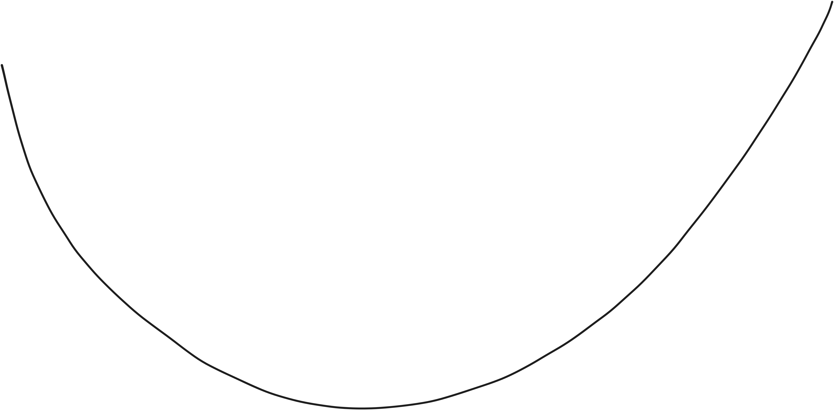
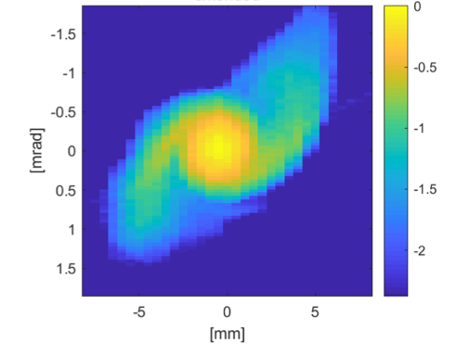




Beam dynamics mechanisms for LINAC beam loss
Dominated by
intrabeam stripping
Dominated by halo
$$H^{−}$$
$$H^{−}$$
Beam loss
$$H^{0}$$
$$H^{−}$$
Model prediction
$$e$$
design
Real operating point
Beam optics (~ bunch size)

Slide 7
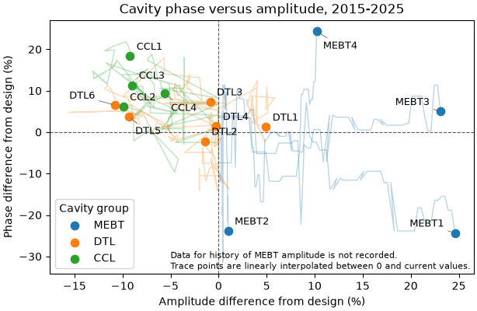
Production optics have been empirically tuned away from design
Settings for warm linac cavities from 2015-2025.
(MEBT cavity amplitude settings are approximated, due to missing data)

Slide 8
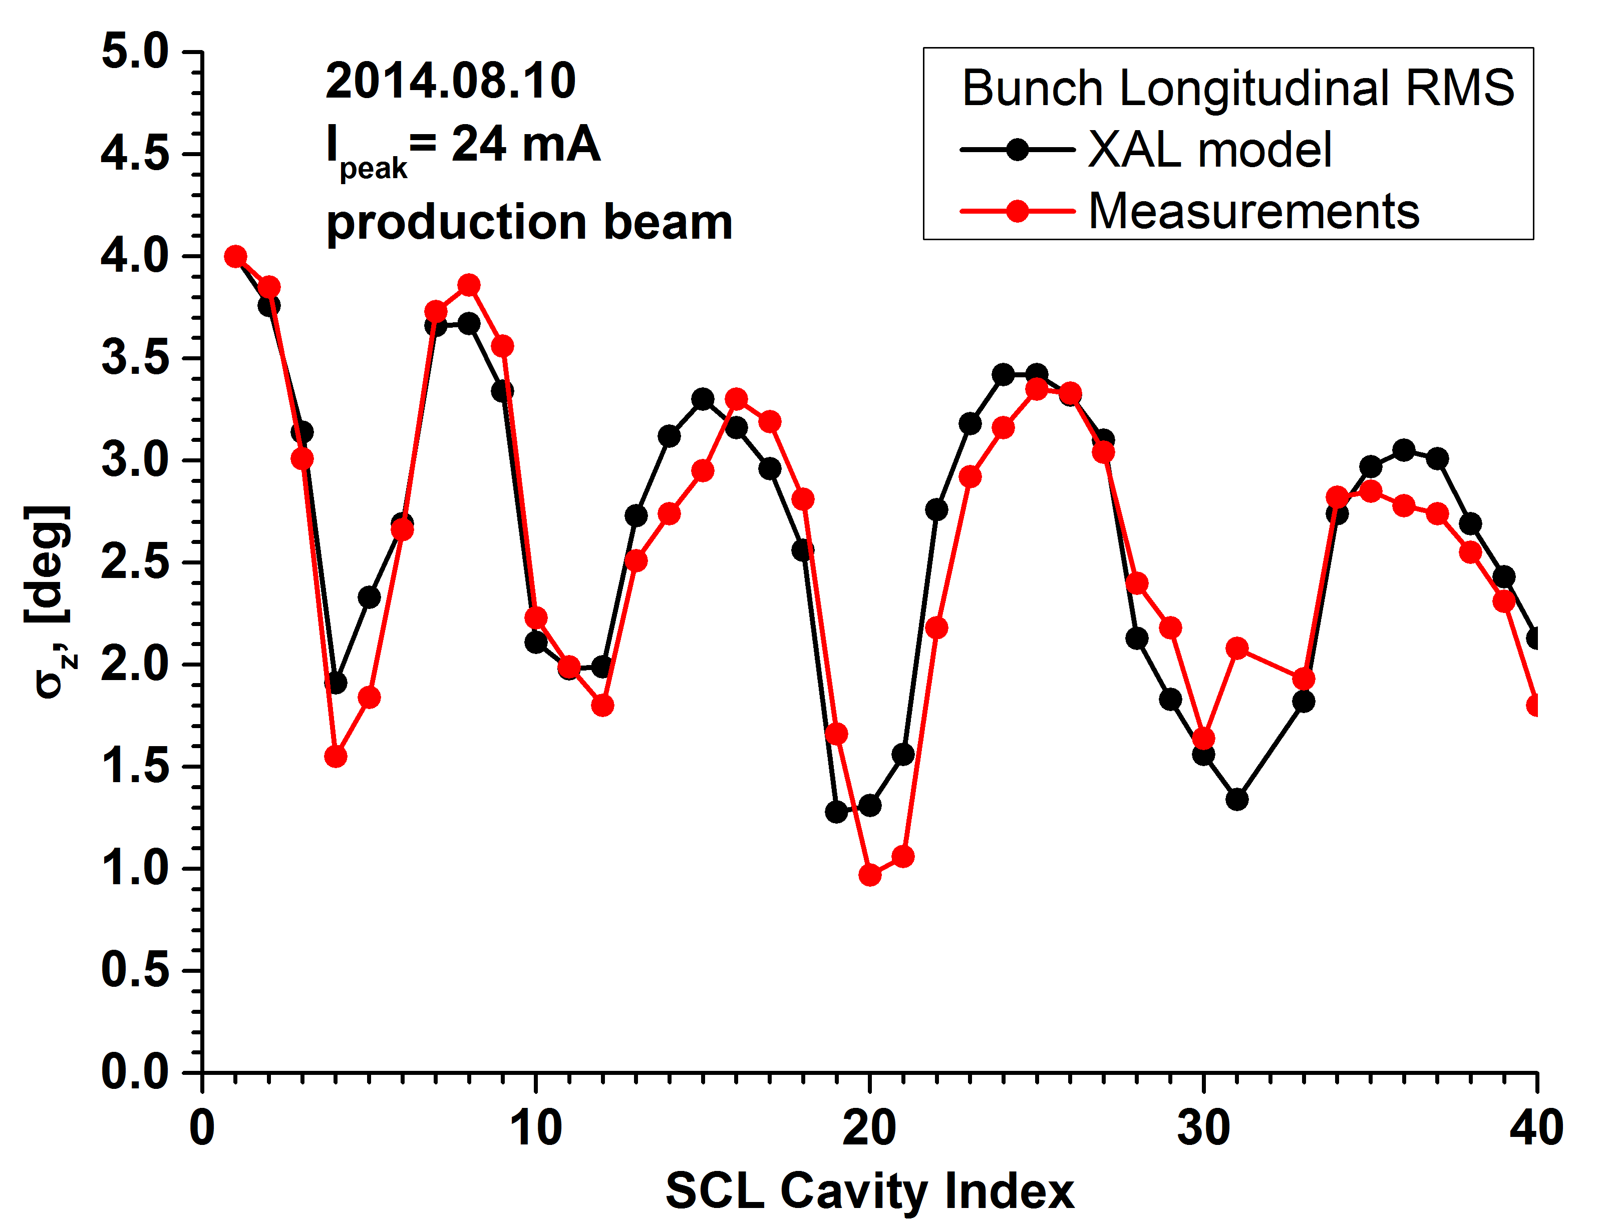
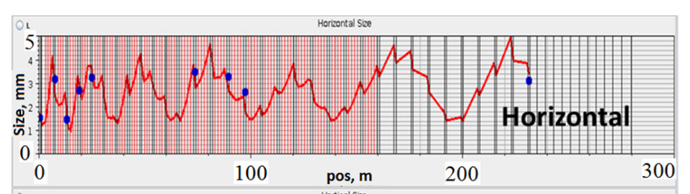
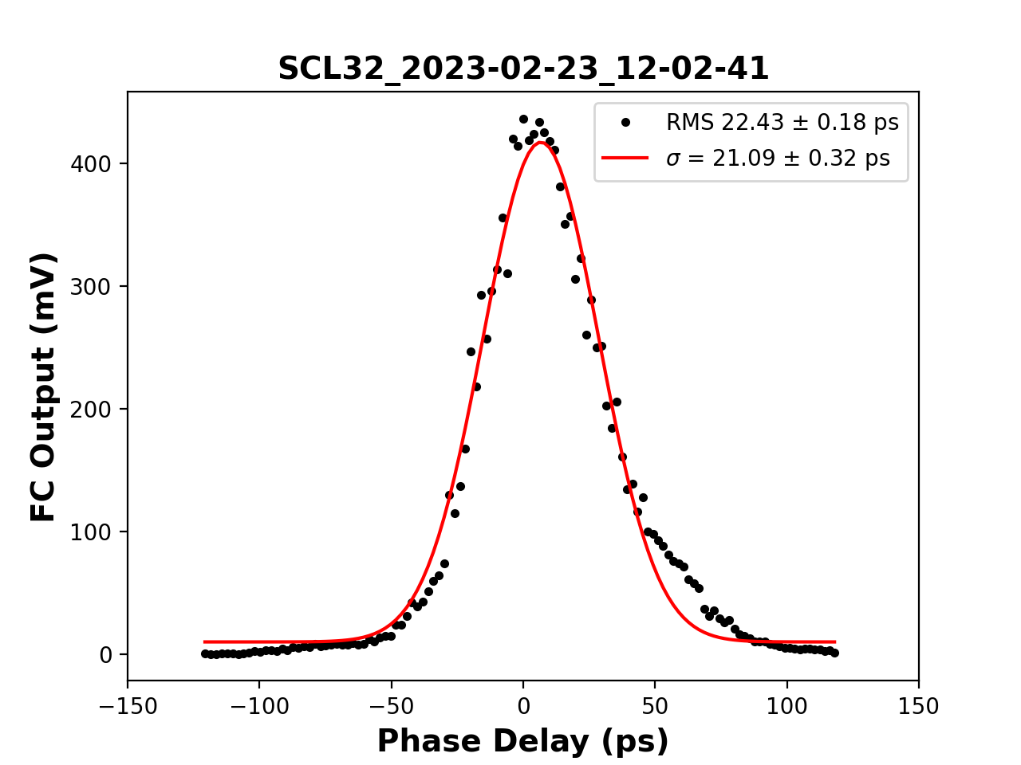
Beam is not matched!
Shishlo, LINAC2014
Transverse phase space at end of SCL
Beam Longitudinal Profile at End of SCL
Shishlo, 2023 HB

Slide 9
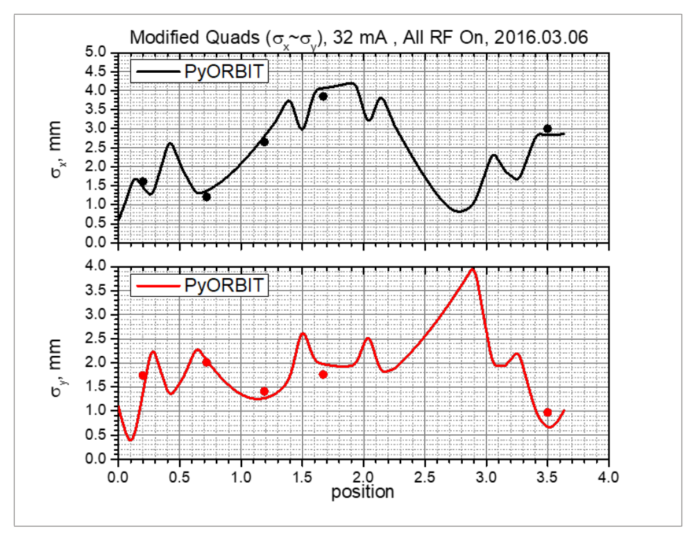
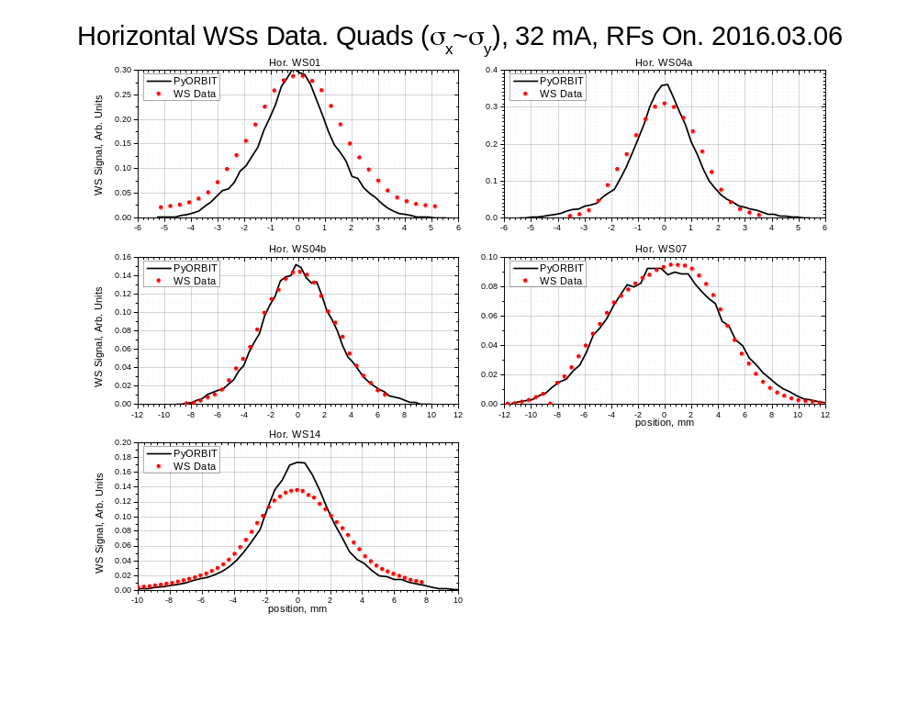
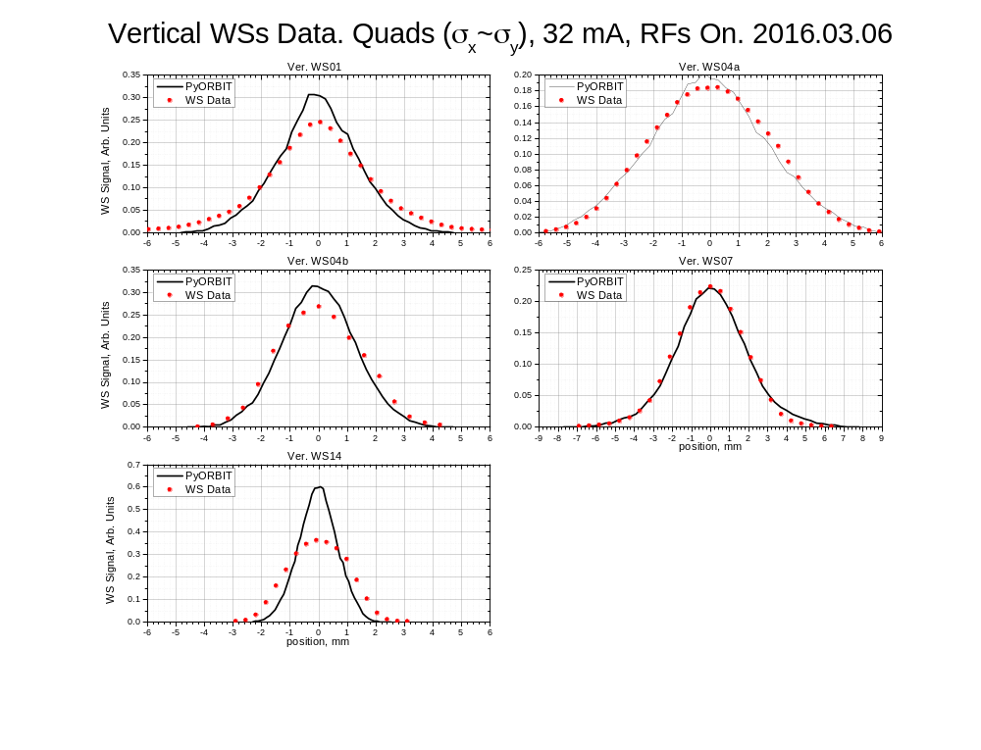
MEBT model is also benchmarked – we don’t understand the tails here either
Phase space diagnostic
Dots = wire scanner profile measurements

Slide 10
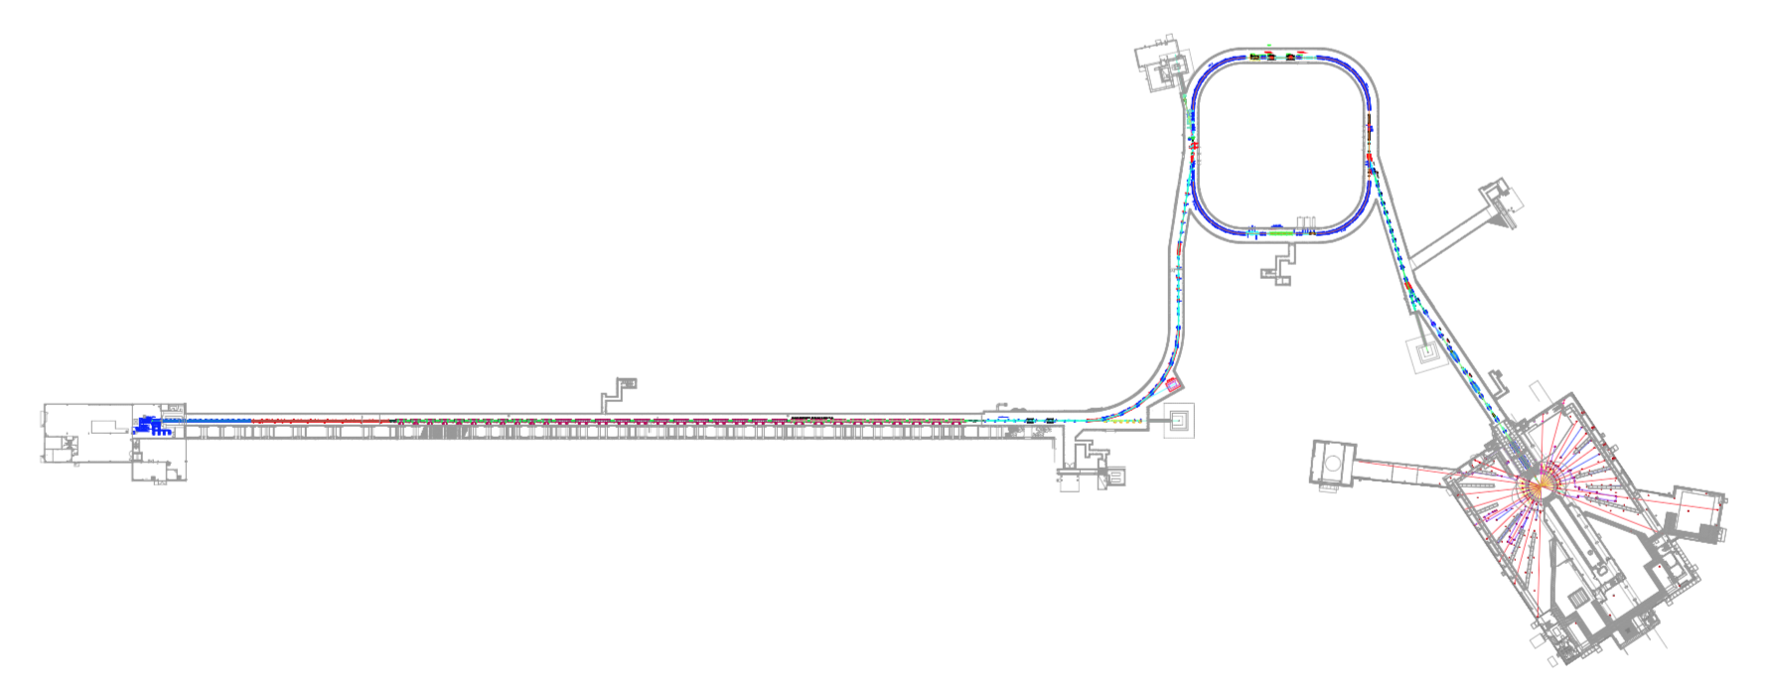
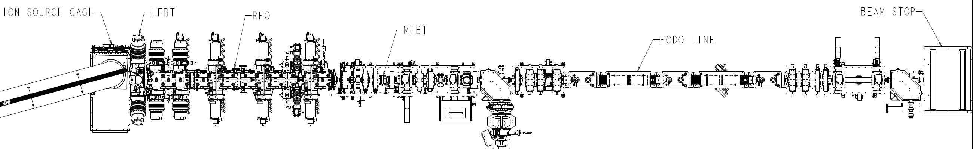
Spallation Neutron Source
320 m, 1.3 GeV H⁻
Beam Test Facility
13 m, 2.5 MeV H⁻
Ion source
LEBT
RFQ
beamstop
MEBT
FODO

Slide 11
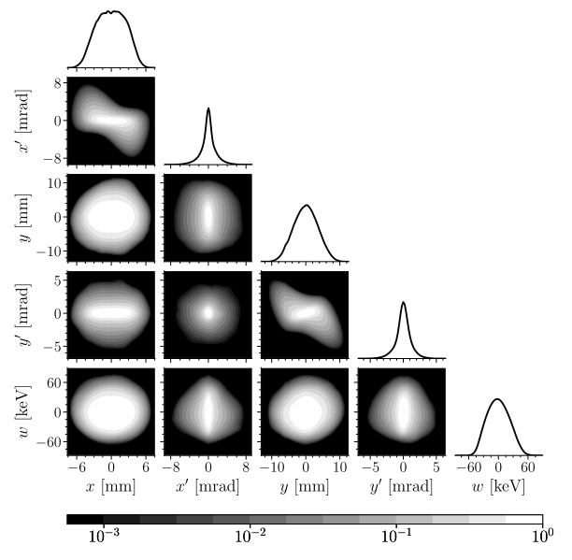
Extensive phase space diagnostics give detailed picture of initial bunch distribution
“input bunch”
2D high dynamic range
Up to 6D phase space
5D measurement of initial bunch
Hoover et. al (2023). PRAB 26, 064202

Slide 12
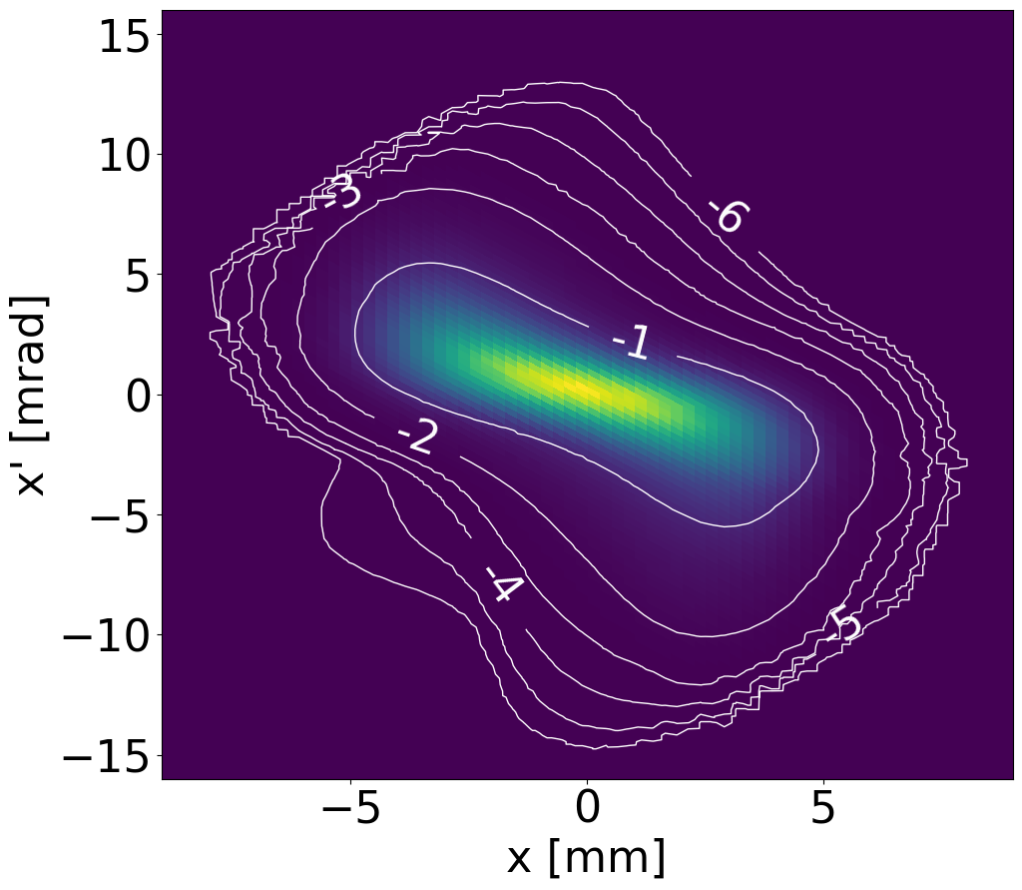
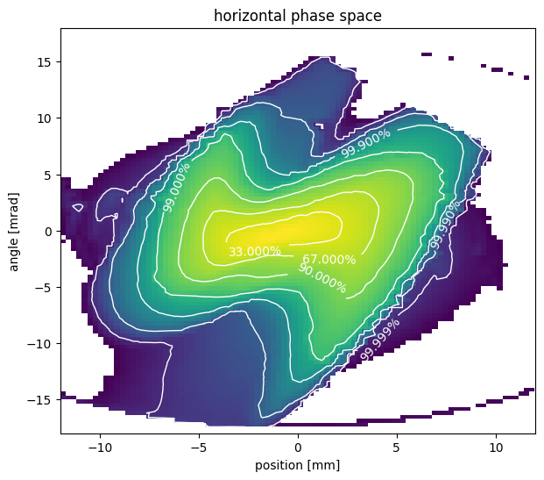


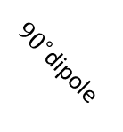
Extensive phase space diagnostics give detailed picture of initial bunch distribution
“output bunch”
“input bunch”
2D high dynamic range
2D high dynamic range
Up to 6D phase space
slit 1 $=x$
slit 2 $\sim x′$
${90}^{∘}$dipole
H⁺
H⁻ beam
0.95 m
2 cameras for range-stitching

Slide 13
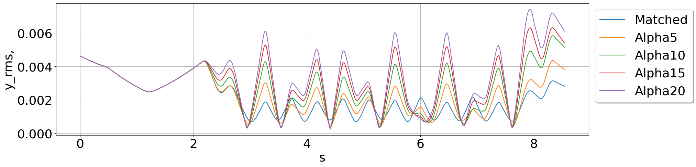
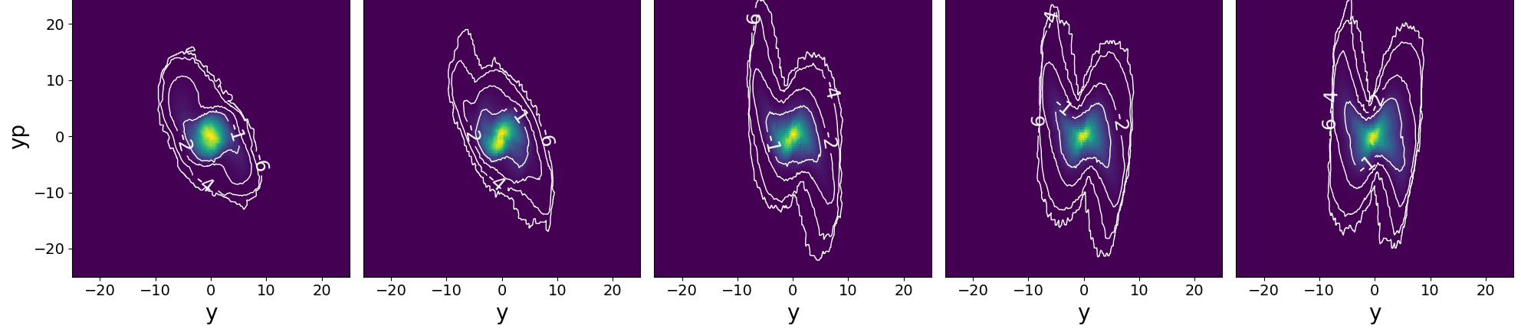
We are currently studying dependence of halo on mismatch and current density
“input bunch”
2D high dynamic range
Up to 6D phase space
Plot shows 5 optics cases with varying level of mismatch:
rms y [m]
s [m]
Increasing mismatch

Slide 14
Summary
2006 | 2007 | 2008 | 2009 | 2010 | 2011 | 2012 | 2013 | 2014 | 2015 | 2016 | 2017 | 2018 | 2019 | 2020 | 2021 | 2022 | 2023 | 2024 | 2025 | 2026
Reduce losses by matching
Reduce losses empirically
Reduce losses with model?
Development of better tools, diagnostics, PyORBIT
BTF beam dynamics project
SNS linac model has not been used to explain H⁻ losses
  There is no trusted global model
  We cannot predict or control losses using model (and we have not matched)
SNS Beam Test Facility can validate PIC model for bunch evolution
  Particularly on formation and transport of nonlinear tails and halo
  Some BTF diagnostics being implemented for SNS MEBT
Will better physics knowledge improve operations?

Slide 15
Thanks for your attention
Remaining slides show additional materials

Slide 16
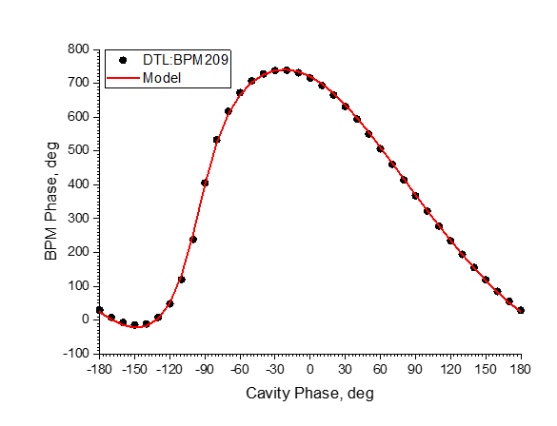


2.5 MeV
186 MeV
387 MeV
1300 MeV
RFQ
DTL
CCL
SCL $β=0.61$
SCL $β=0.81$
HEBT
402.5 MHz
805 MHz
Model for rms Twiss is useful in the HEBT
OpenXAL envelope model is online model
This model is useful for tuning and choosing operating point:
Transverse centroid model is benchmarked for whole linac, model-based orbit correction works (to within 0.1 mm)
Model-based tuning of cavity phases/amplitudes is fast and reproducible
  Re-scaling around tripped cavity achieves accuracy of 1.5 MeV (0.1%)
  Cavity phase/amplitudes known to within 1˚ / 1%
  Require only phase scans to calibrate energy, cavity phase, cavity amplitude
Phase scan of DTL1 fit with OpenXAL model

Slide 17
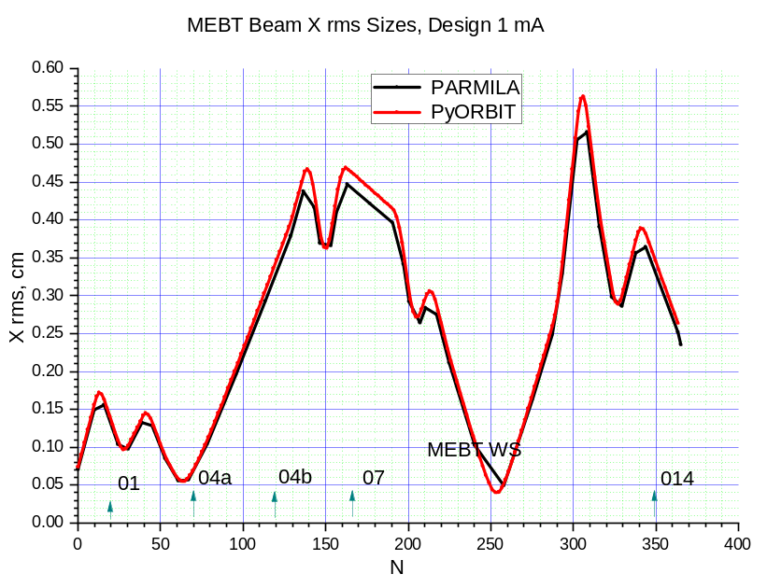
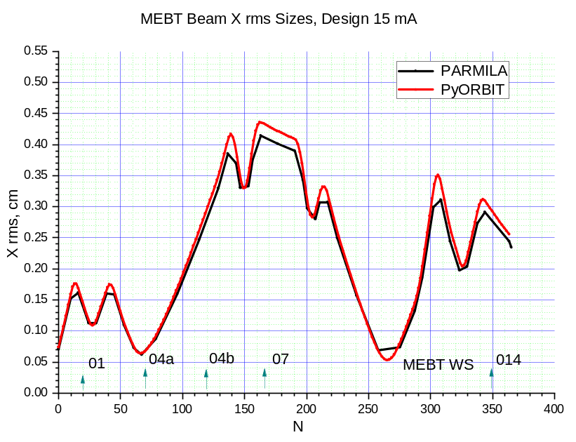
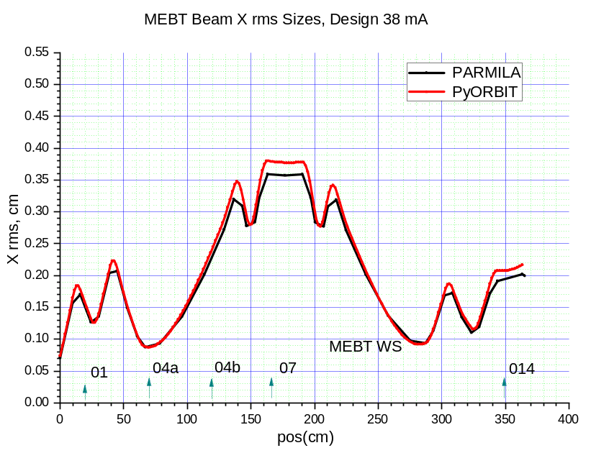
PARMILA – PyORBIT X RMS (3D Waterbag, 3D FFT SC)
1 mA
15 mA
38 mA
Horizontal RMS size

Slide 18
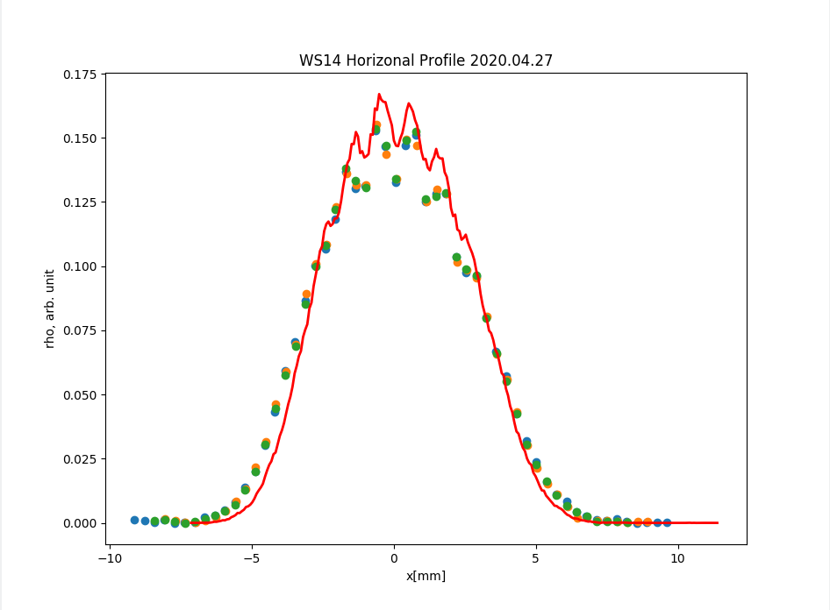
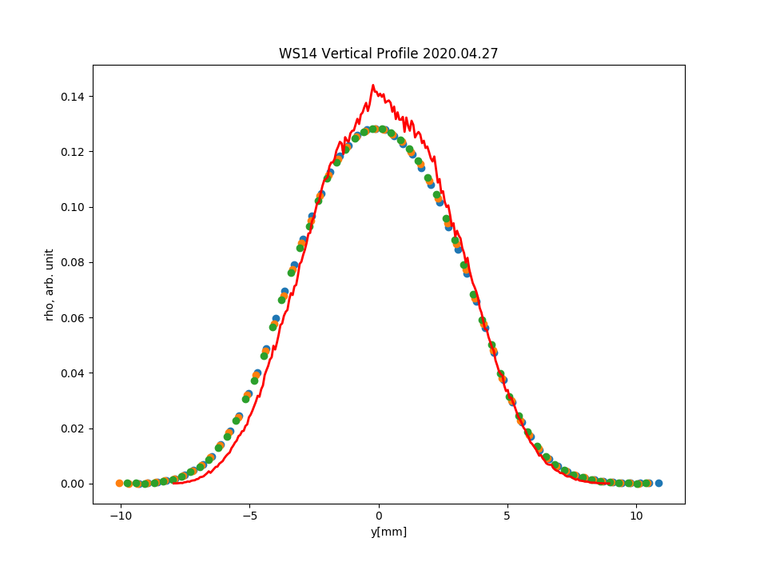
Transport to WS14 – 6 mA (No Quads – just Drift)
Horizontal
Vertical
Points – three times measurements of WS14 for all last 4 quads off
Red curve – PyORBIT emittance distribution tracking
Simulations show too narrow shapes

Slide 19
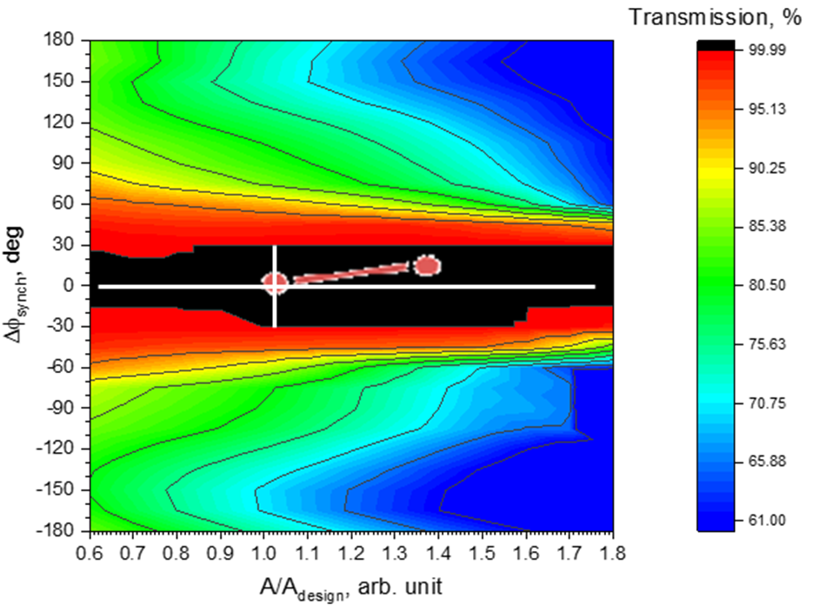
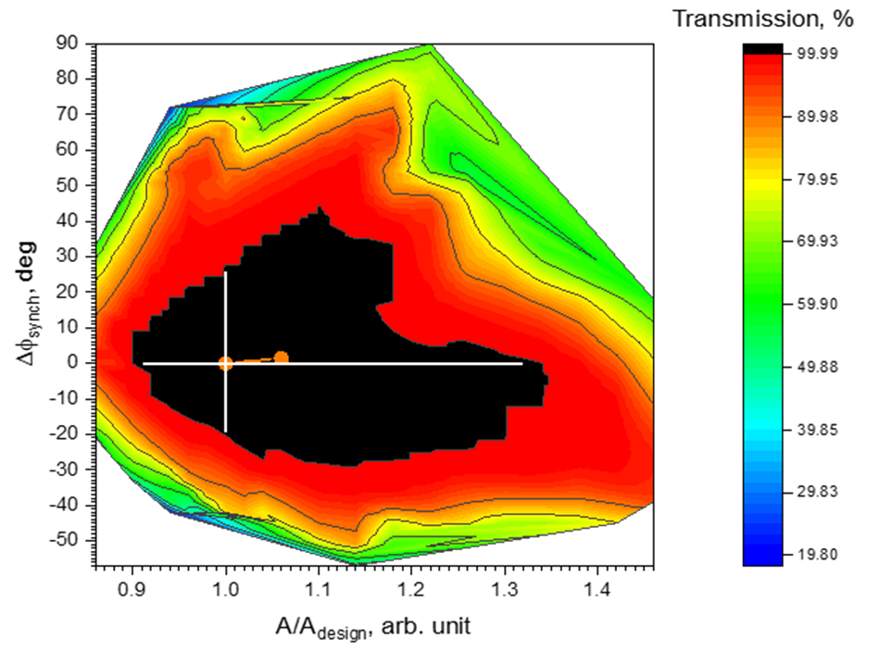
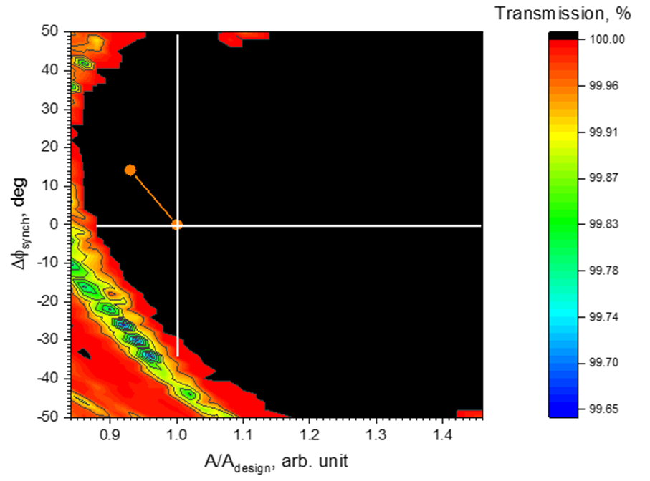
MEBT/DTL/CCL
MEBT1
DTL1
CCL1

Slide 20
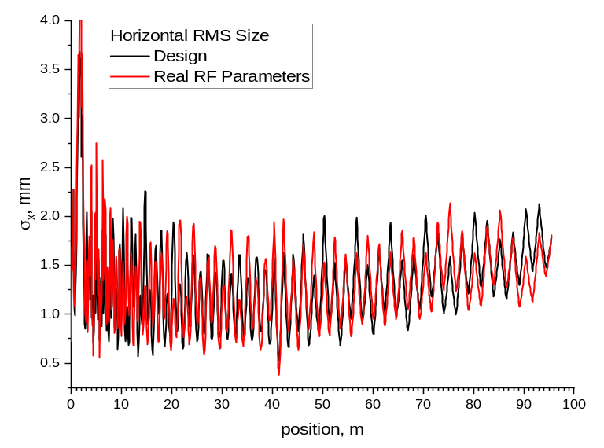
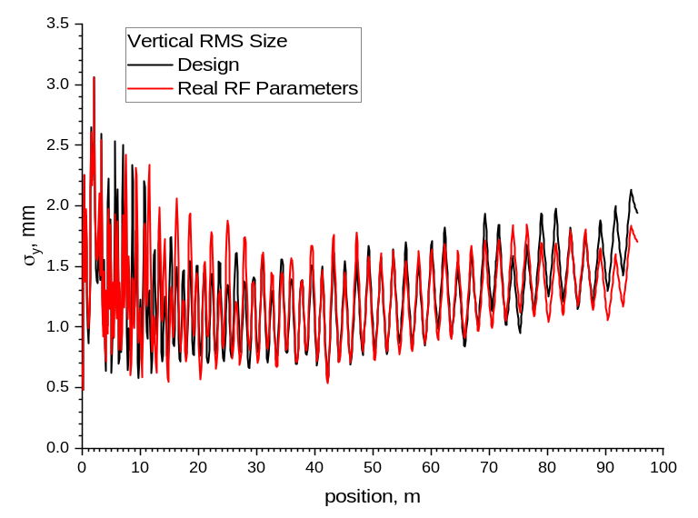
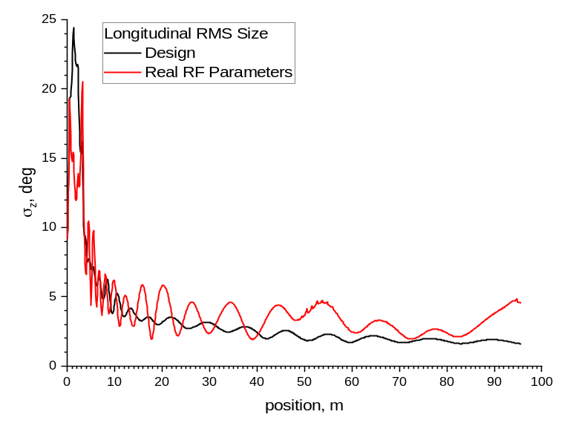
Simulations: Design vs. “Real” RF Settings (PyORBIT)
CCL1
near
end
Horizontal and Vertical RMS sizes do not show anything dramatic
Longitudinal RMS is awful at MEBT and in general
Beam loss started in CCL1

Slide 21
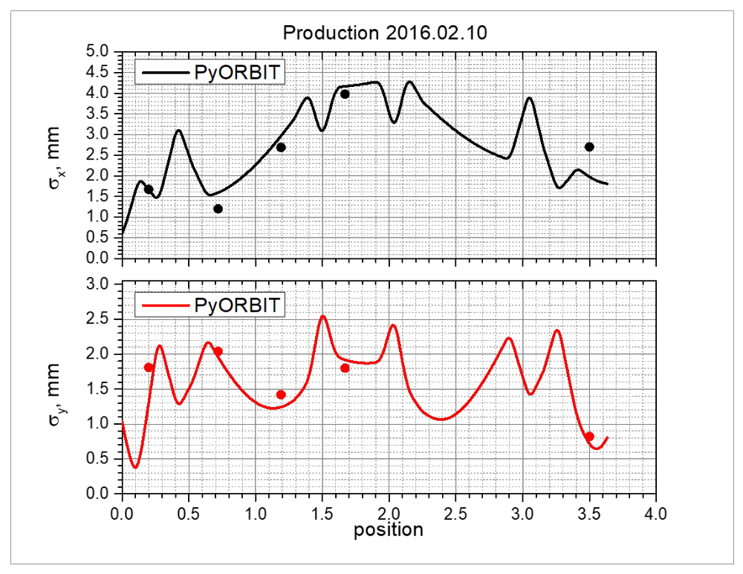
MEBT model is not consistent across cases/diagnostics
Phase space device
Phase space device
Dots = wire scanner profile measurements

Slide 22
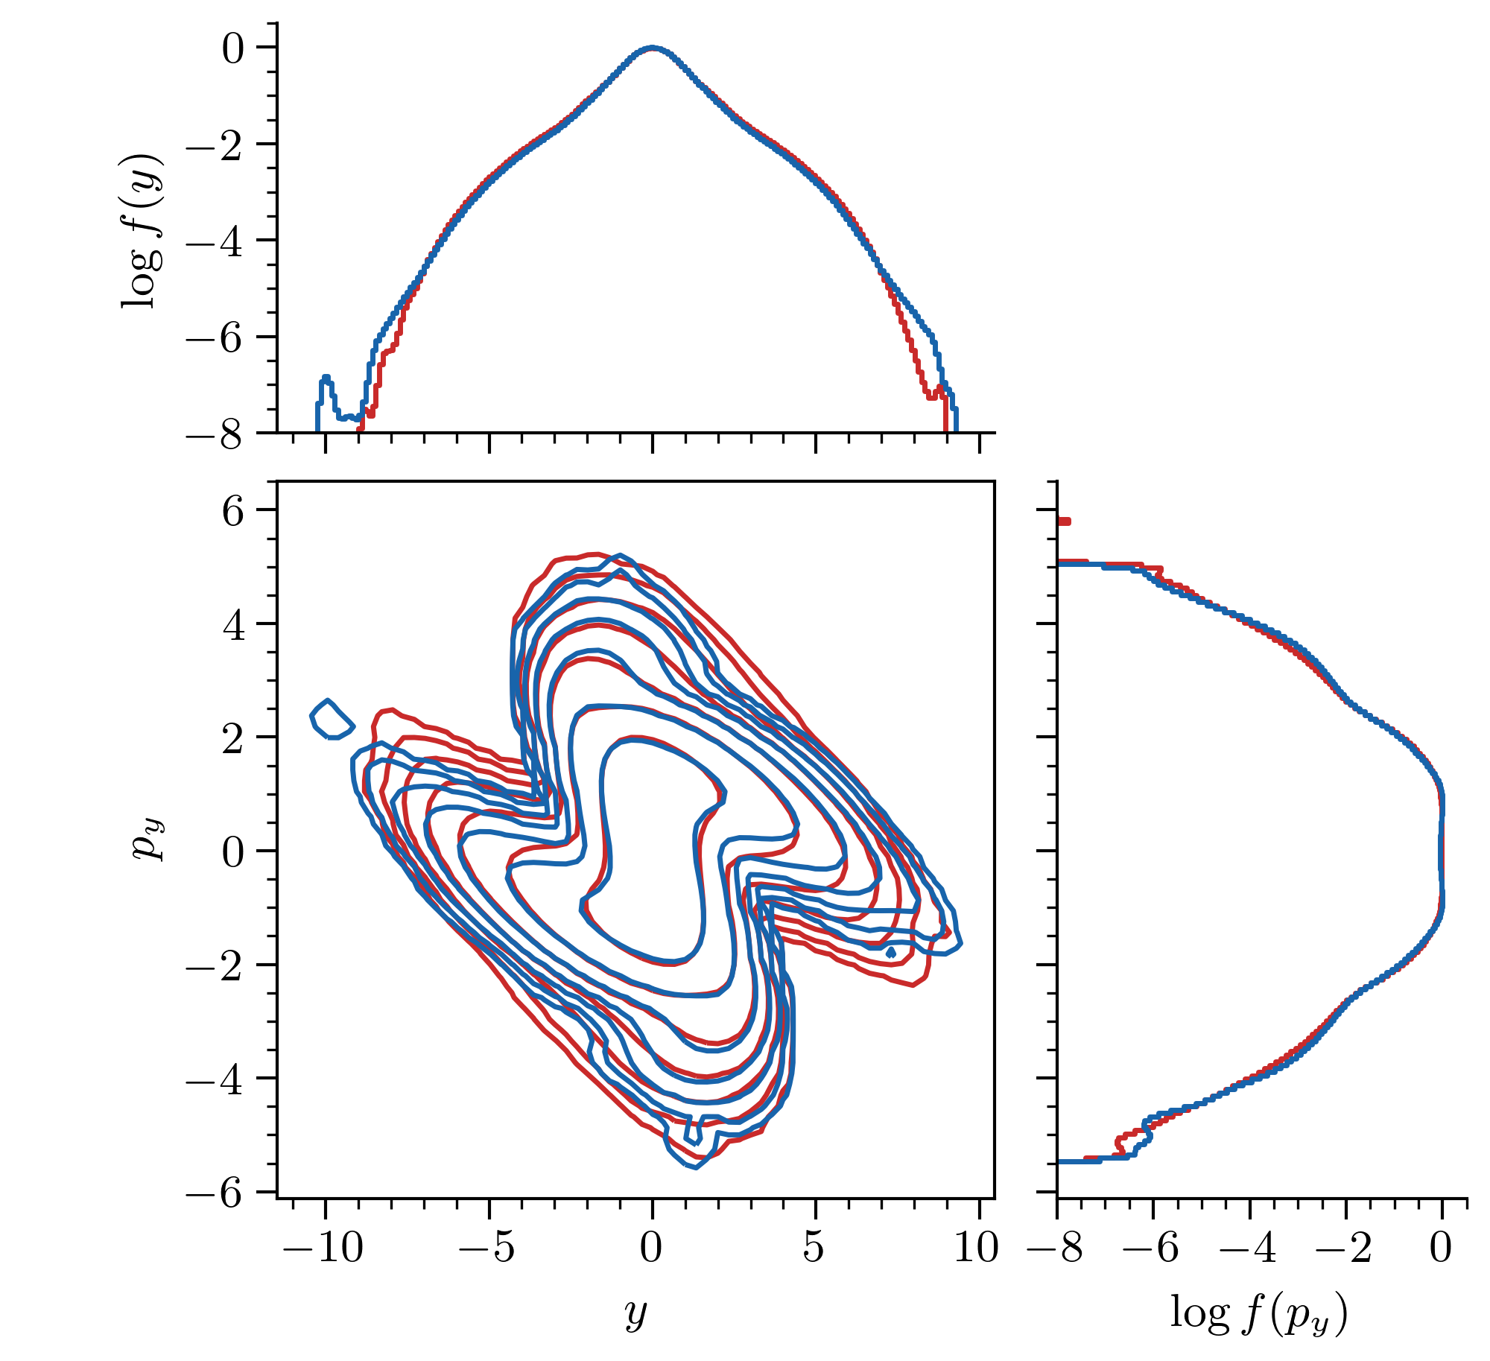
MEBT
6D phase space measurement
2D measurement, high dynamic range
simulate
compare
10⁻²
(~99%)
10⁻⁷ (~99.99999%)
Hoover et al, High Brightness Workshop, CERN (Oct 2023)

Slide 23
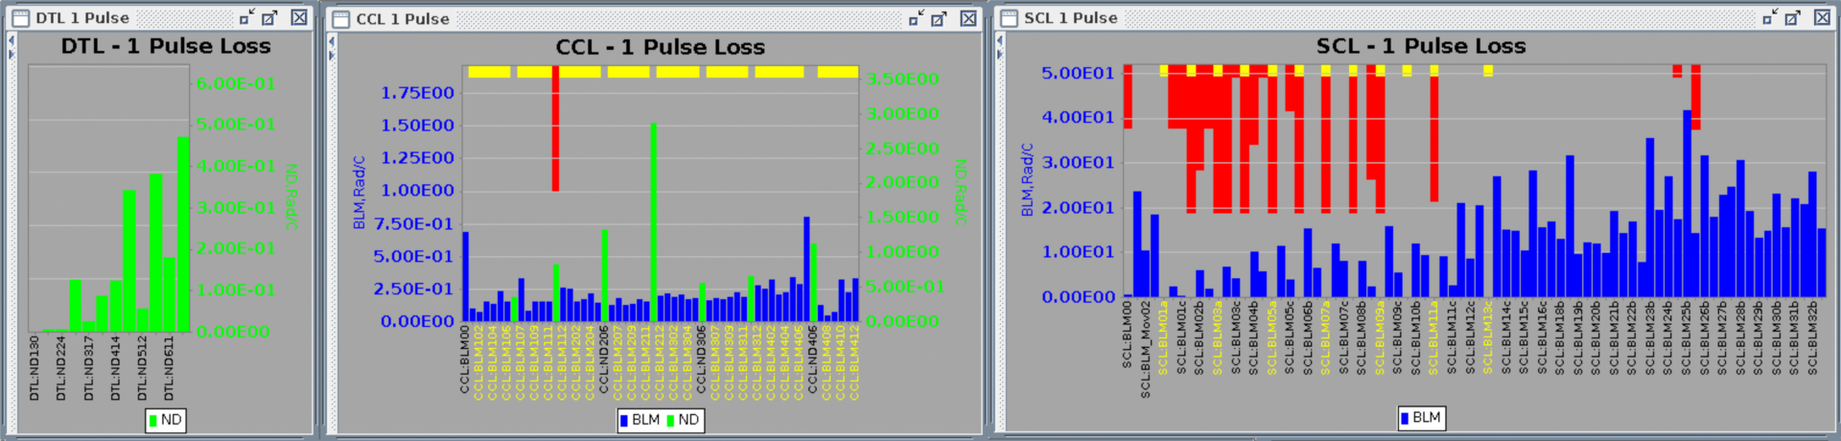
Predicting loss rates is only part-way to predicting detected losses or radiation
Signals of ionization and neutron detector loss monitors along linac:
BLM
BLM
BLM
Beam →

