Slide 1
Welcome to the session on Benchmarking and Experiments!
Beam Dynamics in the SNS Linac and Beam Test Facility
Kiersten Ruisard, ORNL
Benchmarking PIC simulations against the SNS Beam Test Facility
Tony Wood, ORNL
Space-charge dynamics in bare IOTA: Benchmarking among simulations and experiment
Nilanjan Banarjee, FNAL
Benchmarking Experience with PTC-PyORBIT for High-Intensity Synchrotron Studies
Haroon Rafique, RAL
Space Charge Effects in the Alternating Gradient Synchrotron at injection energies
Yichao Jing, BNL
Notes:
IOTA: 0.5 incoherent tune shift
ISIS: Injection painting
AGS: Xsuite. Emittance growth and sc tune shift. Increase injection energy?

Slide 2
Beam Dynamics in the SNS Linac and Beam Test Facility
October 2, 2026 | Trinity College, Oxford
Kiersten Ruisard
Oak Ridge National Laboratory
Notes:
Accessing Title Slide Options
The standard ORNL presentation template includes five branded title slide layouts:
Title | Standard. The preferred layout for lab-wide and general presentations. Features a default aerial photograph of the lab.
Title | Custom Image. Allows replacement of the default background with a custom full-slide image (16:9 or 4:3 landscape format).
Title | Custom Portrait Image. Supports inclusion of a custom 4:3 portrait image positioned next to the introductory text.
Title | Custom Landscape Image. Supports inclusion of a custom 16:9 landscape image positioned next to the introductory text.
Title | Text Only. Offers additional space for longer titles and multiple presenters.
Additional Lab-approved title slides specific to directorates and user facilities are available in PowerPoint under the following folders: Custom Title Slides and User Facility Templates, located in Presentation Templates.
Custom Title Slide Guidelines
Image Rights. Any custom images, graphics, or photography must be owned by ORNL or used with documented permission from the original creator or source.
Appropriate Image Use. Select images that work well with the layout. Ensure the focal point of the image is not obscured by the title text and white overlay box.
Relevance and Impact. Visuals are a key element of effective communication. Whenever possible, use imagery that enhances the message of your presentation and reflects ORNL’s mission and values.
Quality and Clarity. Use high-resolution images for clarity on large screens. Avoid overly complex or dark images that may conflict with the title text.
Text-Only Option. If no appropriate or approved imagery is available, or if imagery is not permitted for the subject matter, the Title | Text Only layout provides a clean, professional alternative.
Learn more about ORNL presentations
https://ornl.sharepoint.com/sites/Branding/SitePages/Presentations.aspx

Slide 3
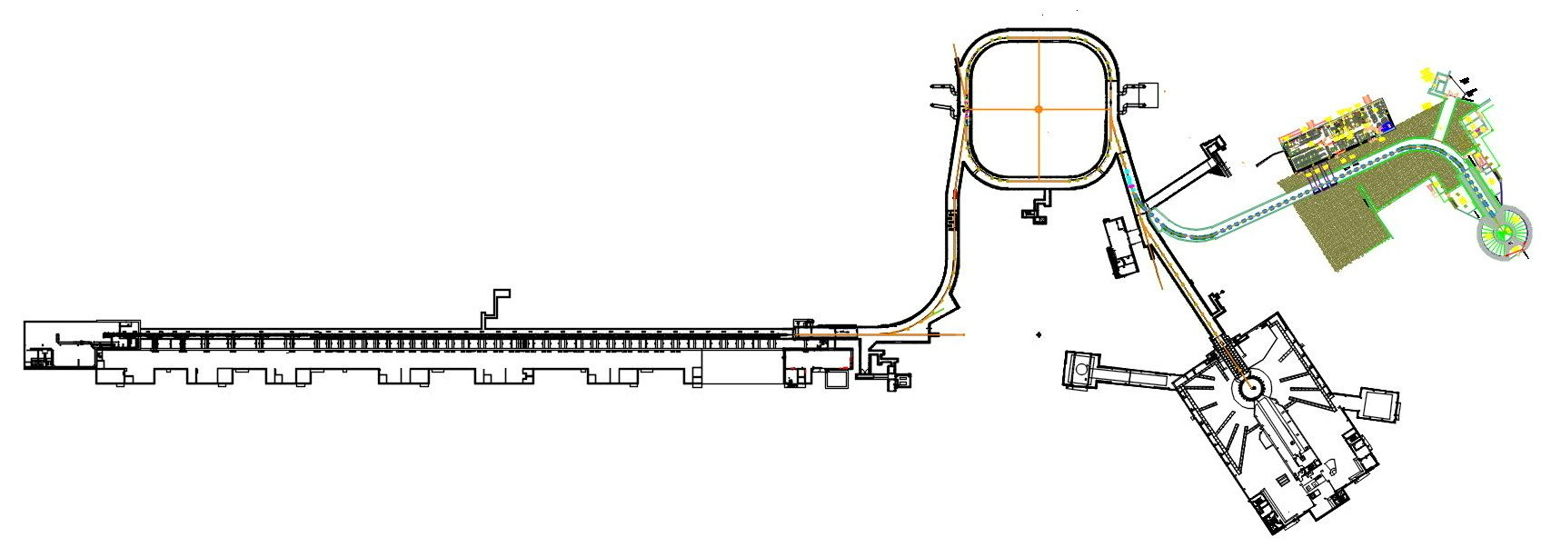
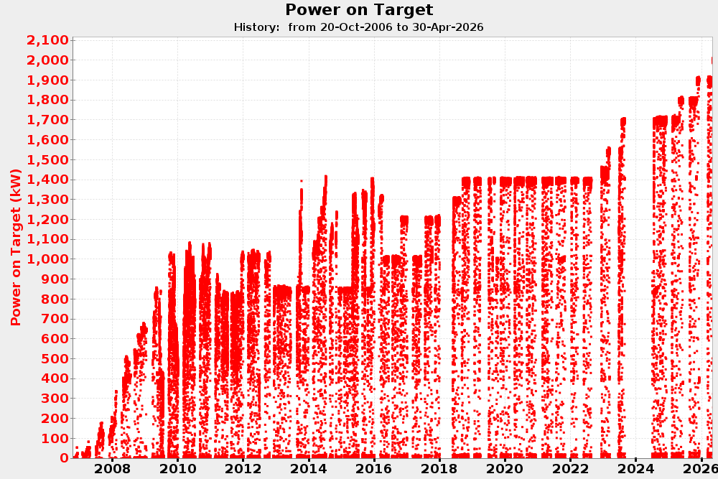


Spallation Neutron Source
2.5 MeV
186 MeV
1300 MeV
RFQ
DTL
CCL
SCL $β=0.61$
SCL $β=0.81$
0.7 MW to 2nd target station
2 MW
All new cavities installed
2 MW target
1.4 MW baseline design
Notes:
Dynamics in 2 very different machines
Introduce SNS
- One operational complexity of the SNS linac is BEAM LOSS.
-much more than protons
- We understand our losses very well empricically
-one gap is we don’t have a model that helps us understand the cause/effect relationships
How can beam test facility help?
Introduce
Built out beamline with advanced PS diagnostics and FODO section
Help better understand halo, a source of loss

Slide 4
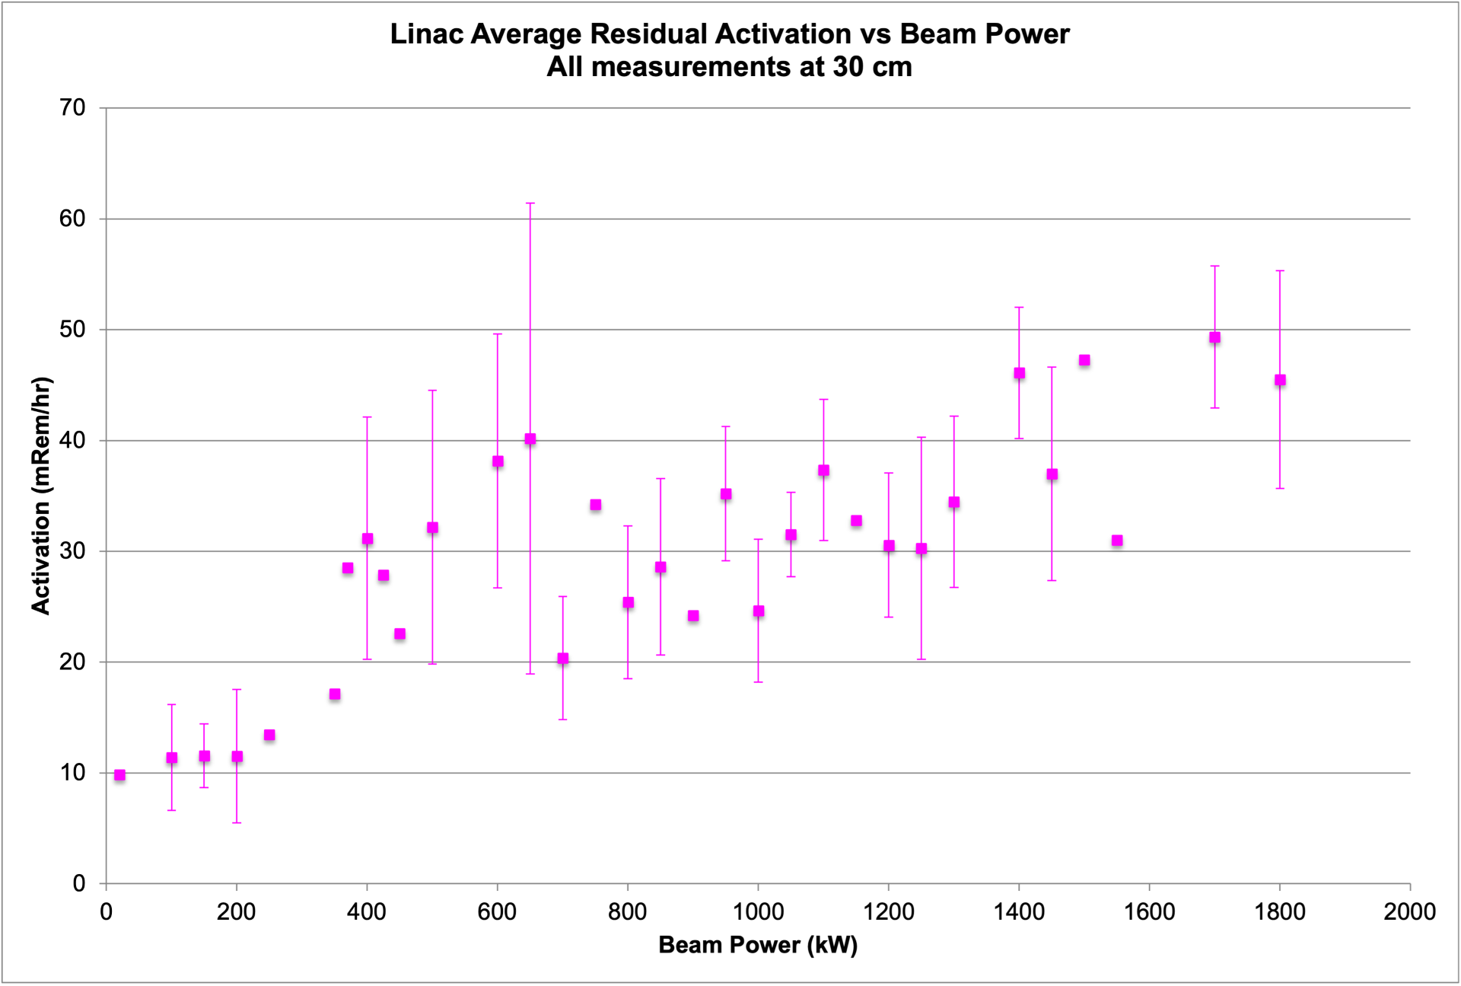
Increased beam loss at 2+ MW increases lost beam and radioactivation in tunnels
Notes:
With increased power, what do we expect from losses? We do not expect losses to exceed “safe limit,” but it will make our job of reliable operations harder
Historical beam loss plot
Limit is 100 mrem/hr at 30 cm after 4 hours, which is approximately the 1W/m limit
Extrapolating – we will stay below the limit!
(many confounding factors in this plot; cool-down time, success of loss tuning, length of shutdown)
(we are mostly short-lived isotopes that decay over ~45 days half life)
------------------------------------------------------
1 W/m ~ (100 mrem/hr at 30 cm after 4 hours)
Bring it back to beam loss…
Beam-loss induced problems in SCL/linac =
Higher activation, wear and tear
Beam-loss-induced degradation events
All components of tunnel suffer faster degradation with higher activation.
In SCL, beam loss could excite gas dynamics and increase the incidence rate of arcing and permanent cavity damage.
In anticipation we’re trying to maintain expertise in cavity refurbishment.
Other beam dynamics issues: (not related dto beam loss)
Beam loading reduces cavity reliability
Higher beam power – more loss when errant beam trips occur
Most likely “catastrophic” dynamics issue is e-p instability in the ring. This has been excluded to 2.6 MW empirically.
Activation plot – we recently changed time until RCT survey from few hours to 1 day. That affects activation plot.

Slide 5
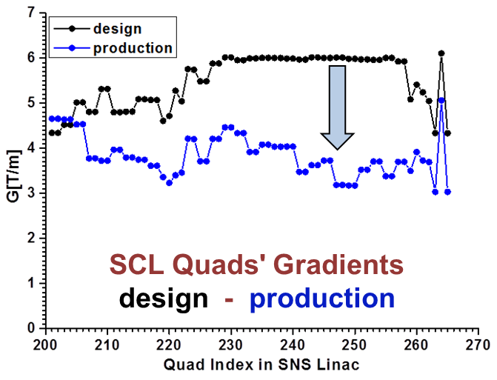
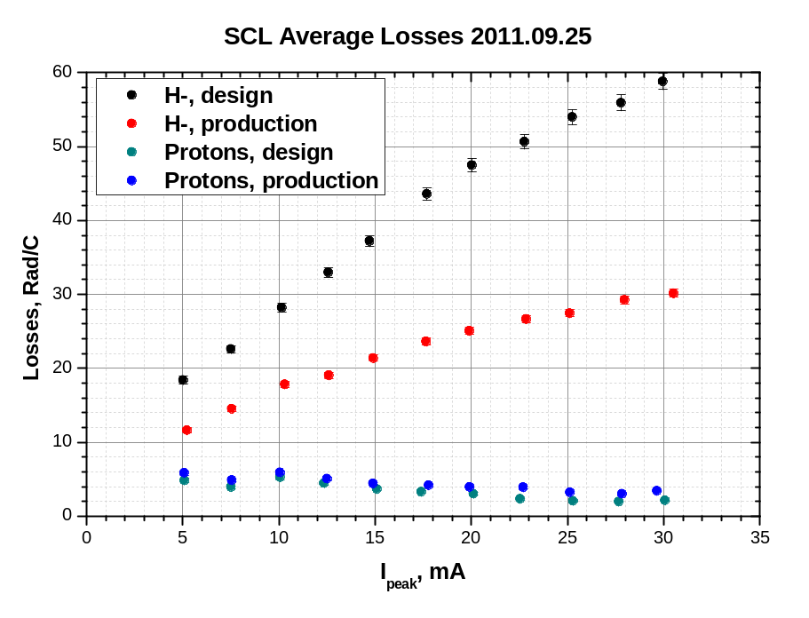




Intrabeam stripping loss was a major hiccup in initial commissioning of SNS
$$H^{−}$$
$$H^{−}$$
$$H^{0}$$
$$H^{−}$$
$$e$$
A. Shishlo, J. Galambos, A. Aleksandrov, V. Lebedev, and M. Plum, PRL 108, 1 (2012)
Notes:
We were able to tolerate this because of large aperture in SCL!

Slide 6
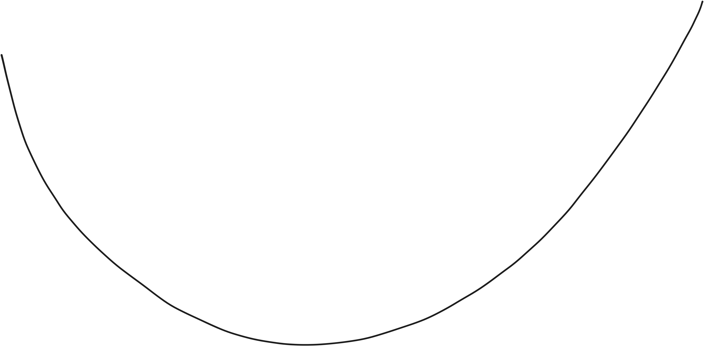
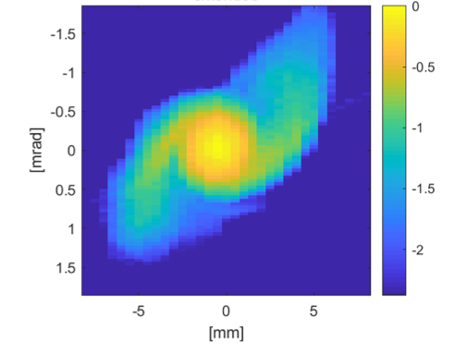



Beam dynamics mechanisms for LINAC beam loss
Dominated by
intrabeam stripping
Dominated by halo
$$H^{−}$$
$$H^{−}$$
Beam loss
$$H^{0}$$
$$H^{−}$$
Model prediction
$$e$$
design
Real operating point
Beam optics (~ bunch size)
Notes:
Model prediction : 0.5% loss at end of CCL (huge!); design Twiss at MEBT entrance and production settings on cavities
We believe through model-based and empirical interventions, we’re balancing these two points
Next I’ll talk about specific observations in the linac. A little bit piecemeal – many separate efforts over the years. Andrei Shishlo did many of these observations.
----------------------------------------------------------------------------
We’ve semi-empirically found a local minimum and we try to stay close to it.
1 W/meter goal. We are well below this. Highest region ~.2-.3 W/meter
30W total loss in SCL
Design: SNS was designed to be a “no loss” machine
Model: model does not agree that our real operating point is a good one
This is our current understanding! Based on what we’ve learned over the years
Other sources:
- Dark current
- proton component from ion source (easy to fix with dog leg)
dynamic aperture loss?
Plot is from HEBT phase space, at 1.4 MW, 1 GeV, with laser wire emittance scanner

Slide 7
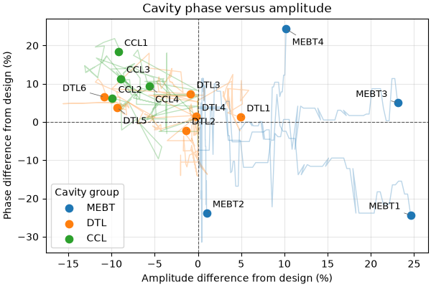
Production optics have been empirically tuned away from design
Settings for warm linac cavities from 2015-2025.
(MEBT cavity amplitude settings are approximated, due to missing data)
Notes:
This plot cost $4.47 with Codex Sol

Slide 8
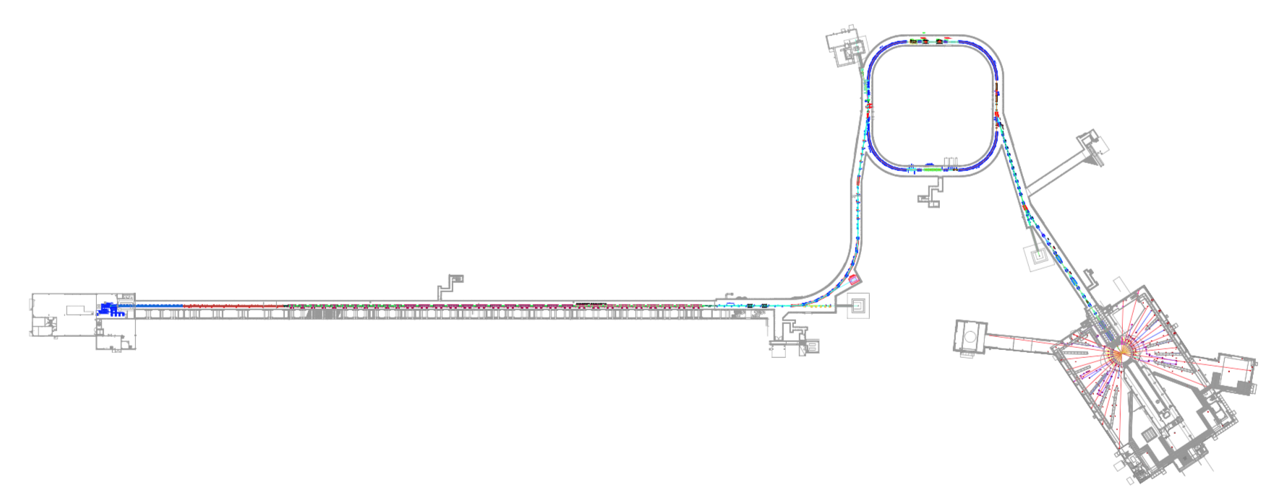
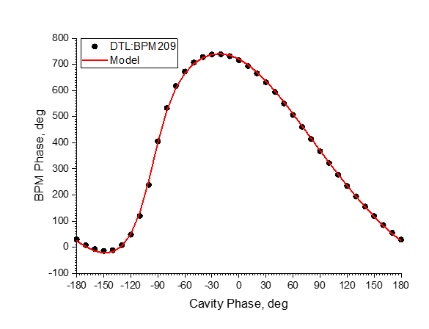


2.5 MeV
186 MeV
387 MeV
1300 MeV
RFQ
DTL
CCL
SCL $β=0.61$
SCL $β=0.81$
HEBT
402.5 MHz
805 MHz
Model for rms Twiss is useful in the HEBT
OpenXAL envelope model is online model
This model is useful for tuning and choosing operating point:
Transverse centroid model is benchmarked for whole linac, model-based orbit correction works (to within 0.1 mm)
Model-based tuning of cavity phases/amplitudes is fast and reproducible
  Re-scaling around tripped cavity achieves accuracy of 1.5 MeV (0.1%)
  Cavity phase/amplitudes known to within 1%
  Require only phase scans to fit energy, cavity phase, cavity amplitude
Phase scan of DTL1 fit with OpenXAL model
Notes:
4 wire scanners in HEBT, we can predict and use and reproduce longitudinal twiss.
OpenXAL envelope model has been defacto tool; We’re working to replace with PyORBIT

Slide 9
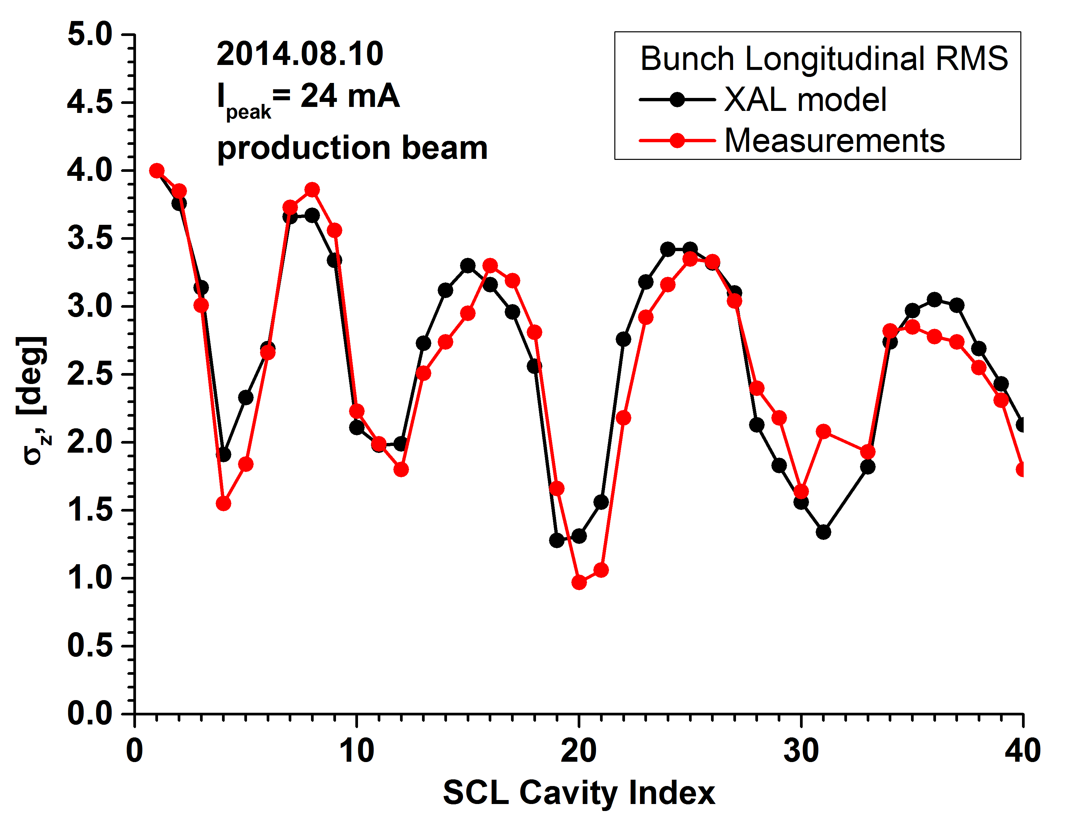
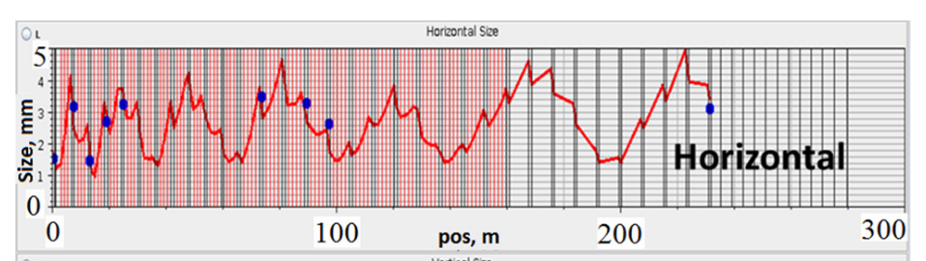
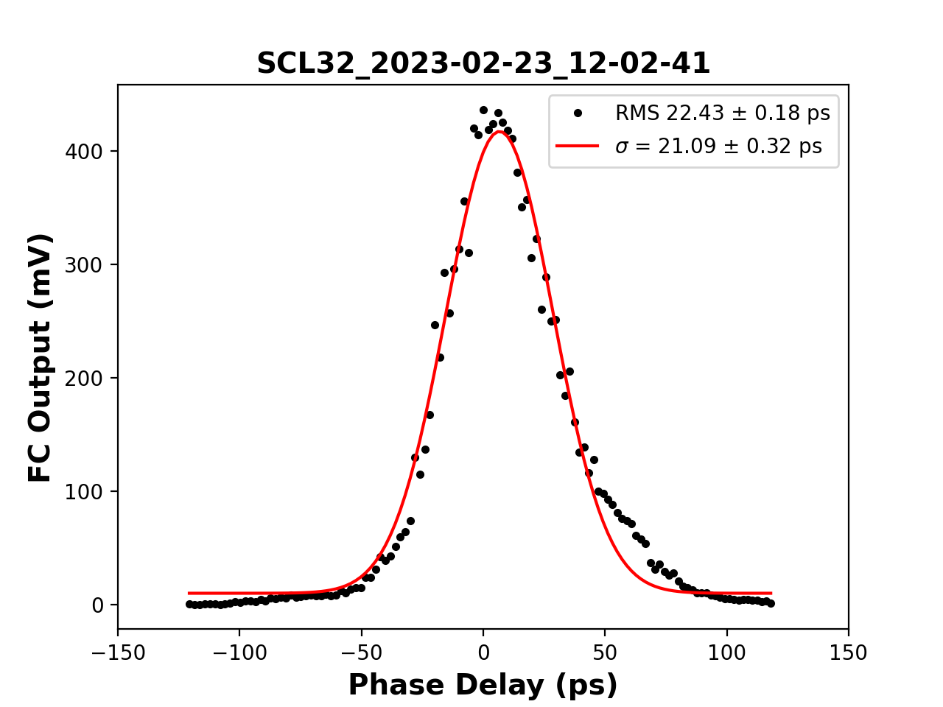
Beam is not matched!
Shishlo, LINAC2014
Transverse phase space at end of SCL
Beam Longitudinal Profile at End of SCL
Shishlo, 2023 HB
Notes:
We don’t use second order moments to choose our operating point!
Attempts to match sections of the linac have not improved losses. (but, we haven’t really tried – we always need to fine-tune losses)
These measurements are:
Longitudinal: gaussian assumption, PRSTAB 2013 method (RF cavity scan and BPM amplitude → rms size in degrees) 24 mA, only med-beta SCL
Transverse: 8 laser-wire stations, 38 mA
(caveat: For transverse measurements, SCL has laser wires (4 in med-beta, 4 in high-beta); difficult to use and can't use with production beam, need low power. Because of AFF, low power twiss might be different.)
Make the point that beam is very non-Gaussian;
Laser-wire measuremeents show large tails (Laser Wire “virtual slit” method was developed (by Yun Liu, SNS) to measure longitudinal profiles of beam in SCL)
New tool: MENT in HEBT can give more detailed view of phase space
Definitely raises questions about how to transport tails – we have no clue what beam outside of core is doing!
* longitudinal emittance is 2x design (from BSM and cavity scan/BPM measurements)

Slide 10
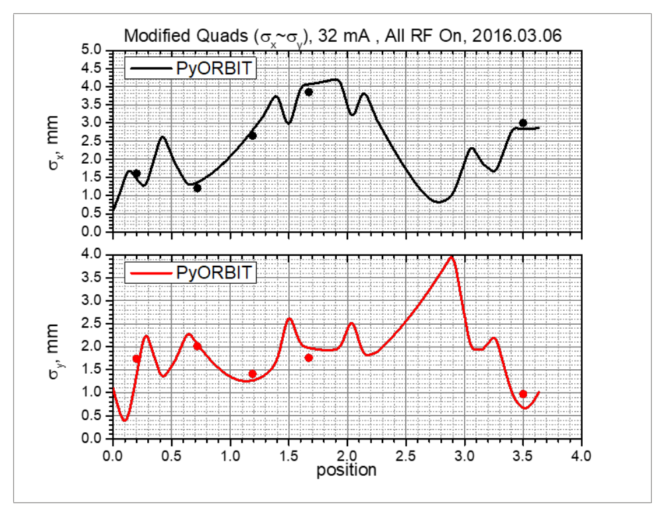
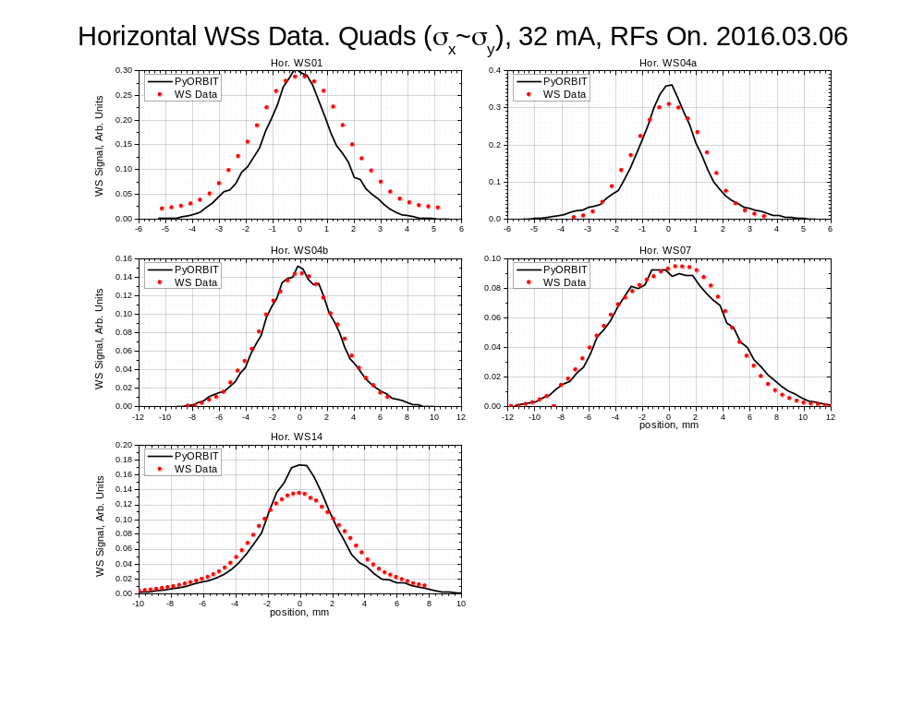
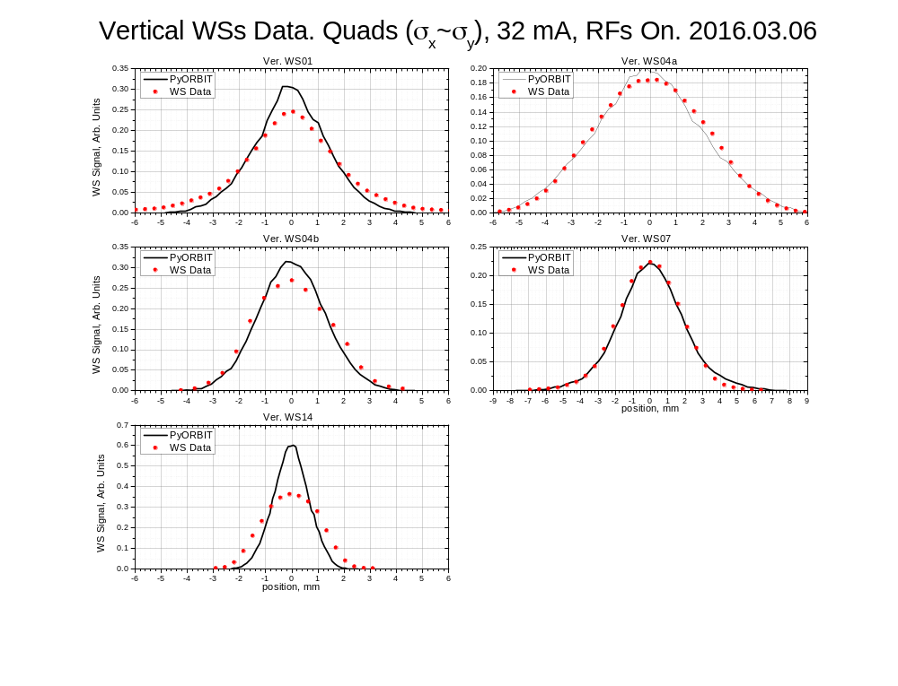
MEBT model is also benchmarked – we don’t understand the tails here either
Phase space diagnostic
Dots = wire scanner profile measurements

Slide 11
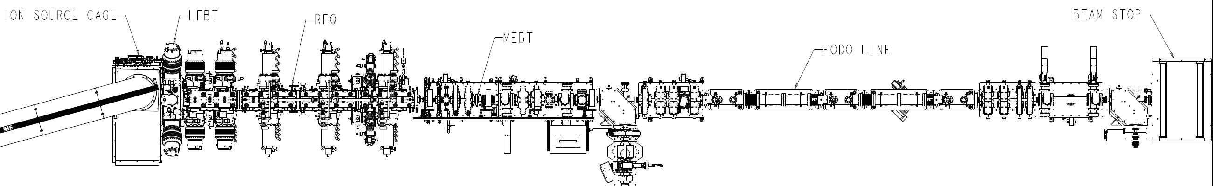
Spallation Neutron Source
320 m, 1.3 GeV H⁻
Beam Test Facility
13 m, 2.5 MeV H⁻
Ion source
LEBT
RFQ
beamstop
MEBT
FODO
Notes:
Dynamics in 2 very different machines
Introduce SNS
- One operational complexity of the SNS linac is BEAM LOSS.
-much more than protons
- We understand our losses very well empricically
-one gap is we don’t have a model that helps us understand the cause/effect relationships
How can beam test facility help?
Introduce
Built out beamline with advanced PS diagnostics and FODO section
Help better understand halo, a source of loss

Slide 12
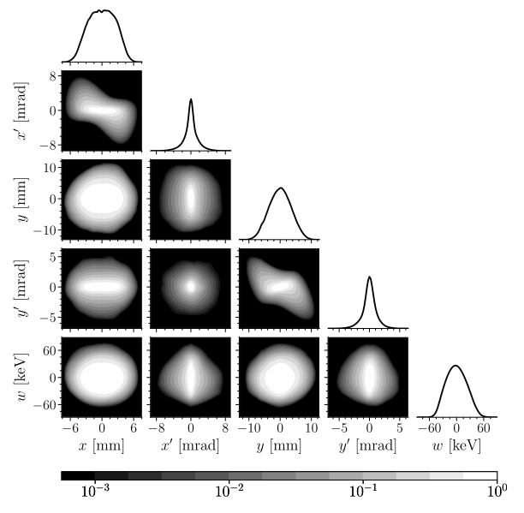
Extensive phase space diagnostics give detailed picture of initial bunch distribution
“input bunch”
2D high dynamic range
Up to 6D phase space
5D measurement of initial bunch
Hoover et. al (2023). PRAB 26, 064202

Slide 13
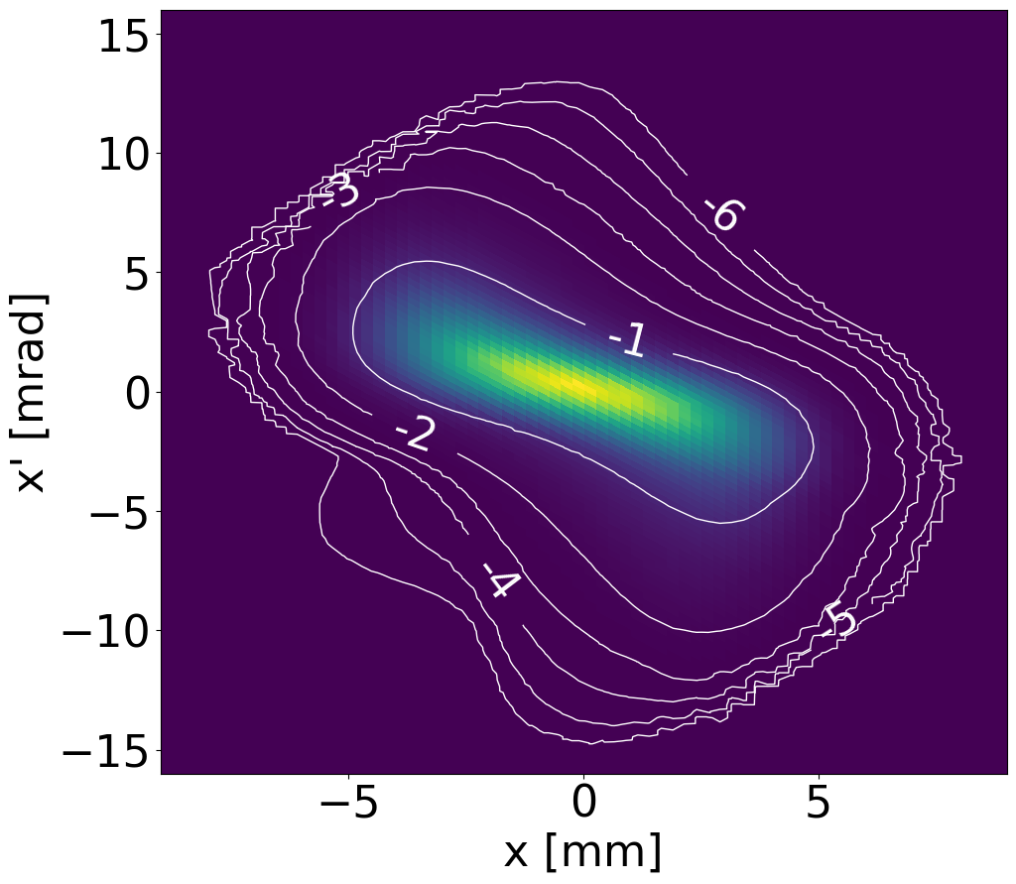
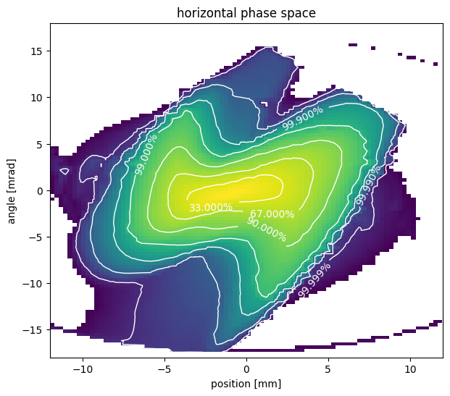



Extensive phase space diagnostics give detailed picture of initial bunch distribution
“output bunch”
“input bunch”
2D high dynamic range
2D high dynamic range
Up to 6D phase space
slit 1 $=x$
slit 2 $\sim x′$
${90}^{∘}$dipole
H⁺
H⁻ beam
0.95 m
2 cameras for range-stitching

Slide 14
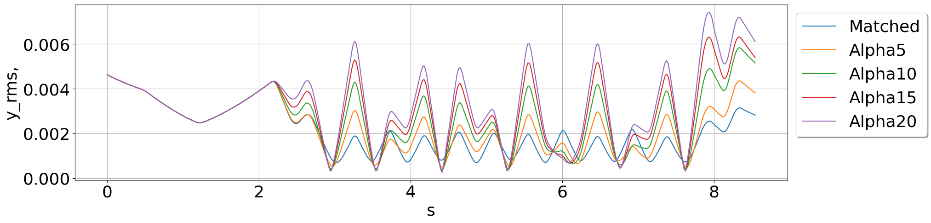
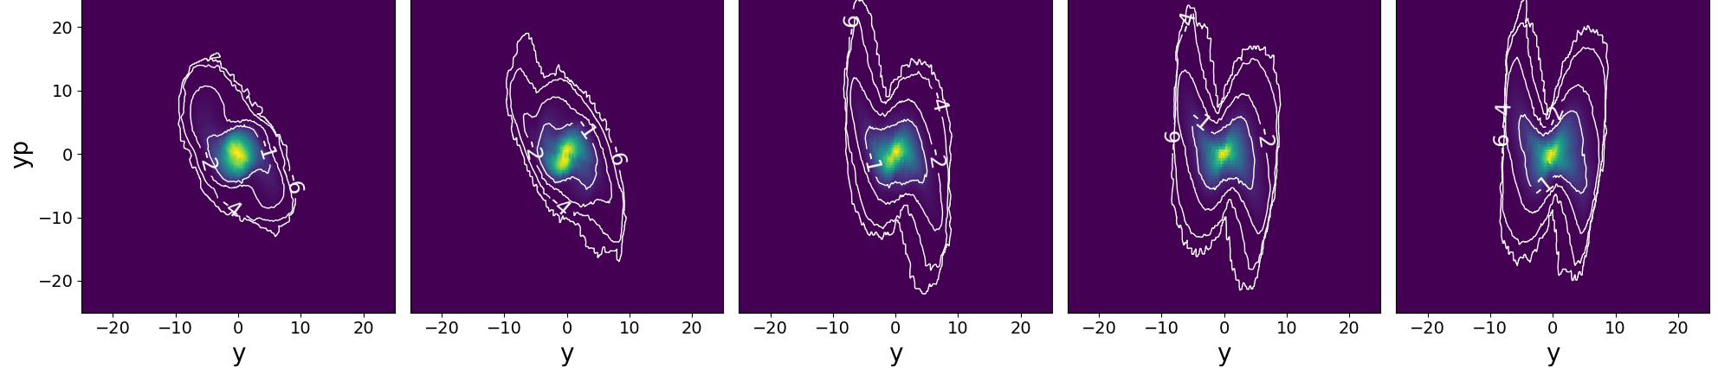
We are currently studying dependence of halo on mismatch and current density
“input bunch”
2D high dynamic range
Up to 6D phase space
Plot shows 5 optics cases with varying level of mismatch:
rms y [m]
s [m]
Increasing mismatch

Slide 15
Summary
2006 | 2007 | 2008 | 2009 | 2010 | 2011 | 2012 | 2013 | 2014 | 2015 | 2016 | 2017 | 2018 | 2019 | 2020 | 2021 | 2022 | 2023 | 2024 | 2025 | 2026
Reduce losses by matching
Reduce losses empirically
Reduce losses with model?
Development of better tools, diagnostics, PyORBIT
BTF beam dynamics project
SNS Linac model is not good enough to intentionally design optics
  There is no trusted global model
  We cannot predict or control losses using model (matching has not worked)
SNS Beam Test Facility can validate PIC model for bunch evolution
  Particularly on formation / transport of nonlinear tails / halo
  Some BTF diagnostics being implemented for SNS MEBT
Better physics knowledge can improve operations

Slide 16
Thanks for your attention
Remaining slides back-up

Slide 17
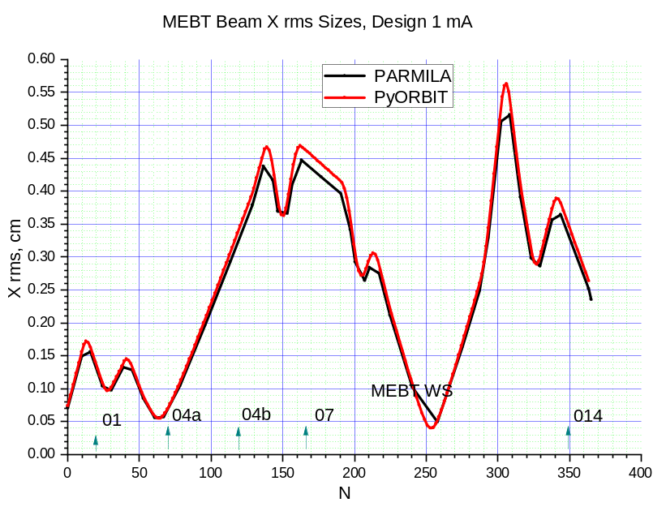
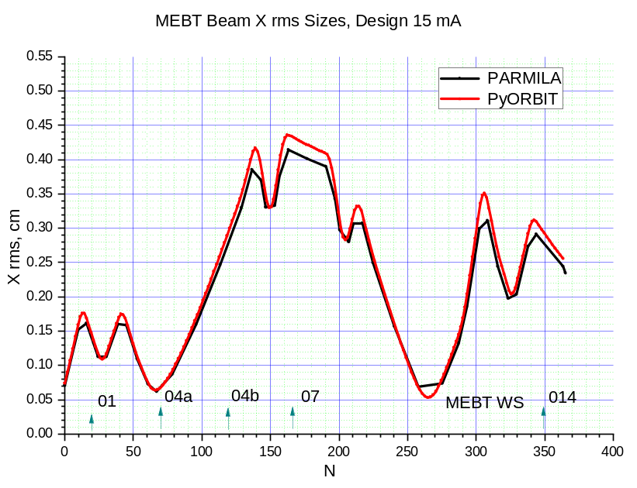
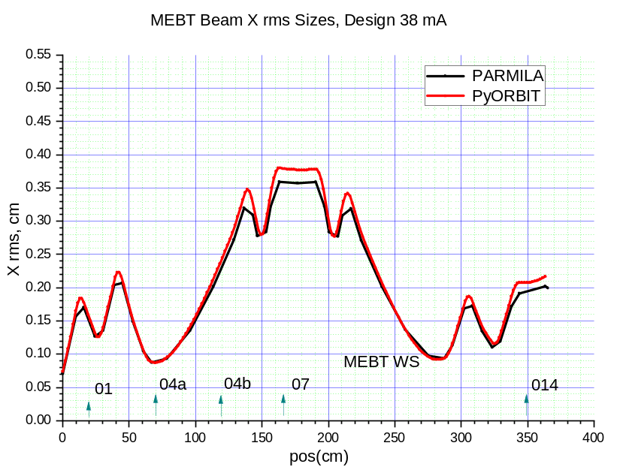
PARMILA – PyORBIT X RMS (3D Waterbag, 3D FFT SC)
1 mA
15 mA
38 mA
Horizontal RMS size

Slide 18
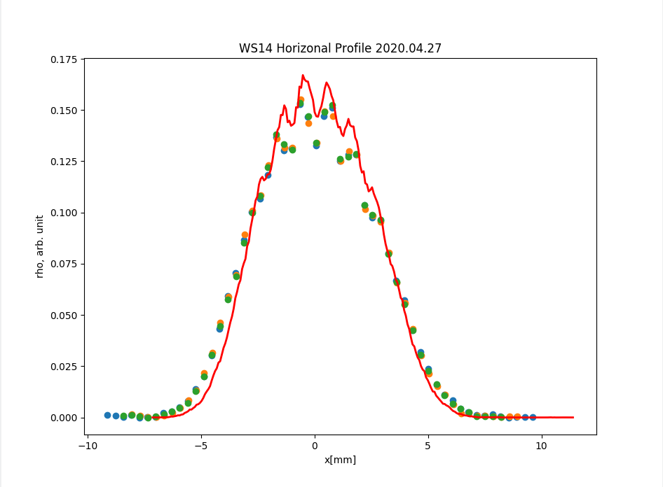
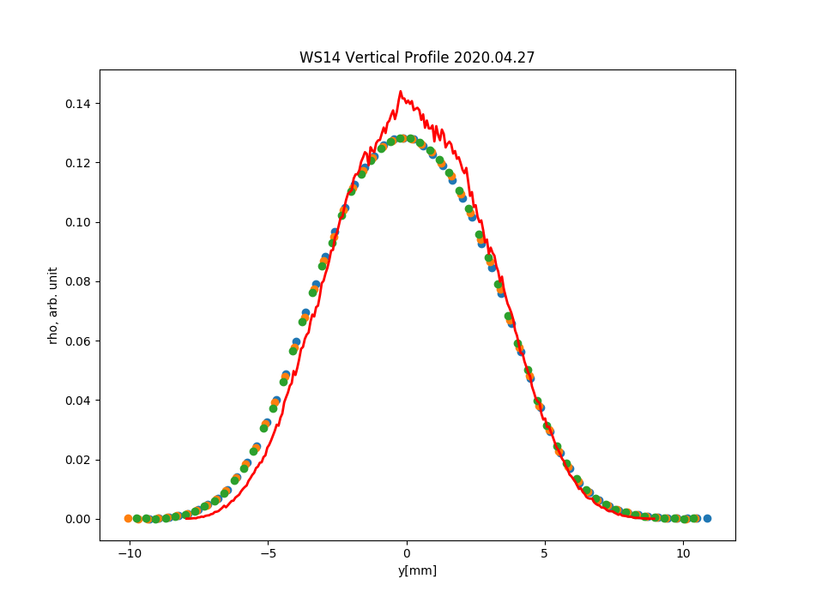
Transport to WS14 – 6 mA (No Quads – just Drift)
Horizontal
Vertical
Points – three times measurements of WS14 for all last 4 quads off
Red curve – PyORBIT emittance distribution tracking
Simulations show too narrow shapes
Notes:
Significantly simplified beamline: Simulations still show beam is too narrow at WS14!
Increasing emittance by 6-8 % helps
Increasing SC by x4 helps
- Pyorbit and parmila compare pretty well
Low current beam (attenuate from 30 to 6 mA)
High-resolution emittance scans
Soft-edged quad model in PyORBIT
All RF off, last 4 quads off

Slide 19
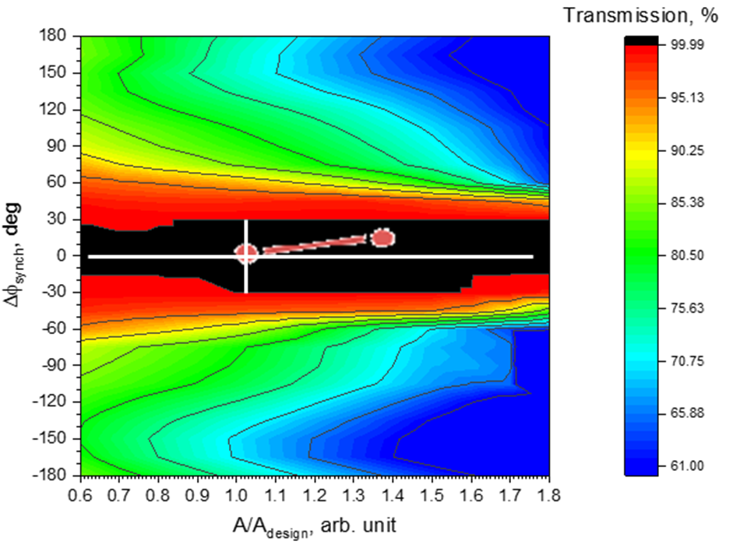
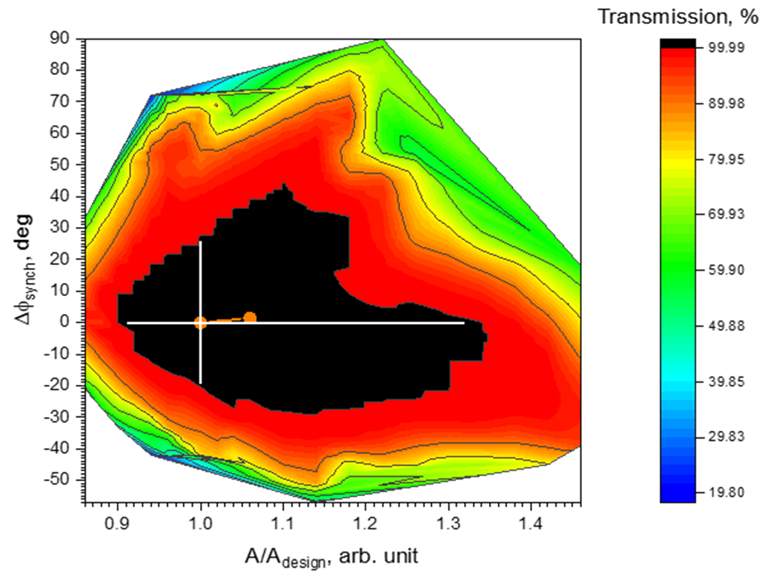
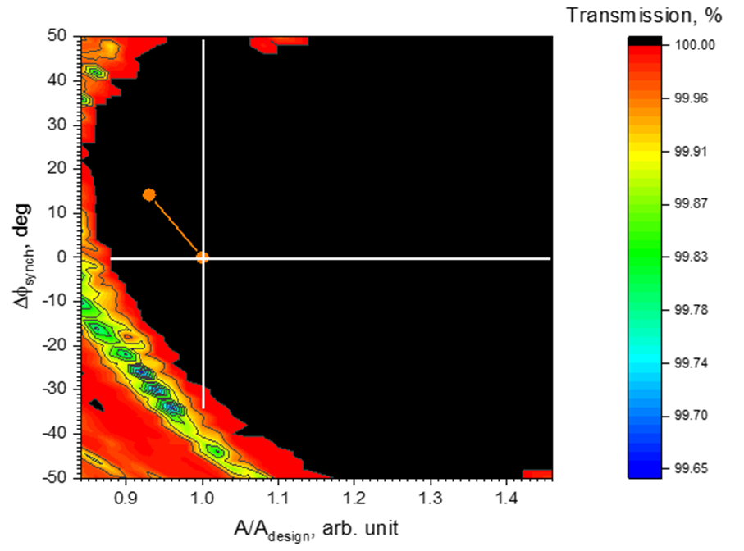
MEBT/DTL/CCL
MEBT1
DTL1
CCL1
Notes:
Simulation of Each cavity Phase & Amplitude 2D Scan
We changed amplitudes and phases 14 cavities one by one
For each cavity, all downstream ones were tuned according to design
100,000 macro-particles at the MEBT entrance with design Twiss
Transmission was simulated to the end of warm linac

Slide 20
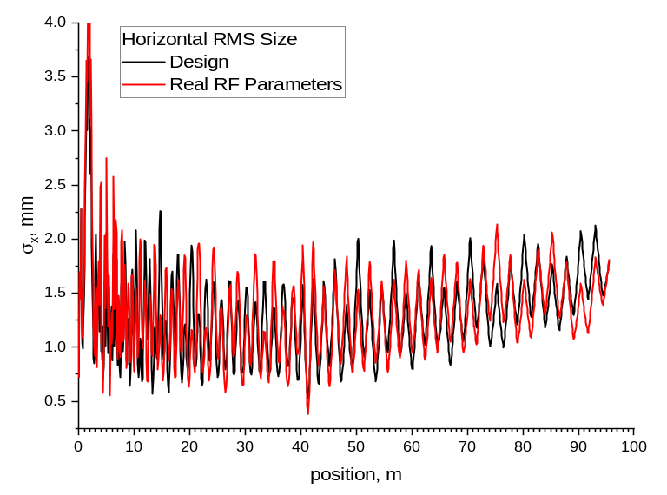
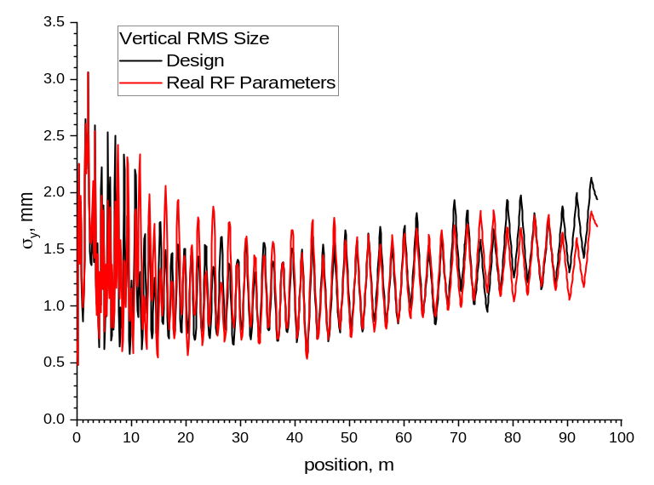
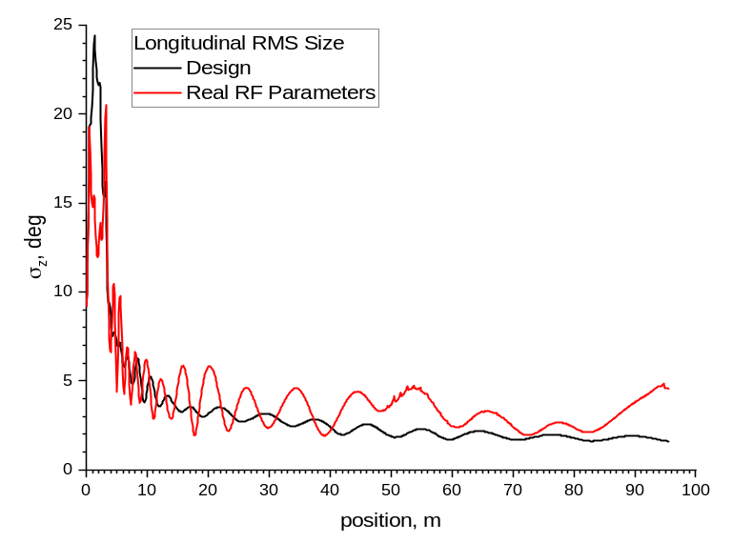
Simulations: Design vs. “Real” RF Settings (PyORBIT)
CCL1
near
end
Horizontal and Vertical RMS sizes do not show anything dramatic
Longitudinal RMS is awful at MEBT and in general
Beam loss started in CCL1

Slide 21
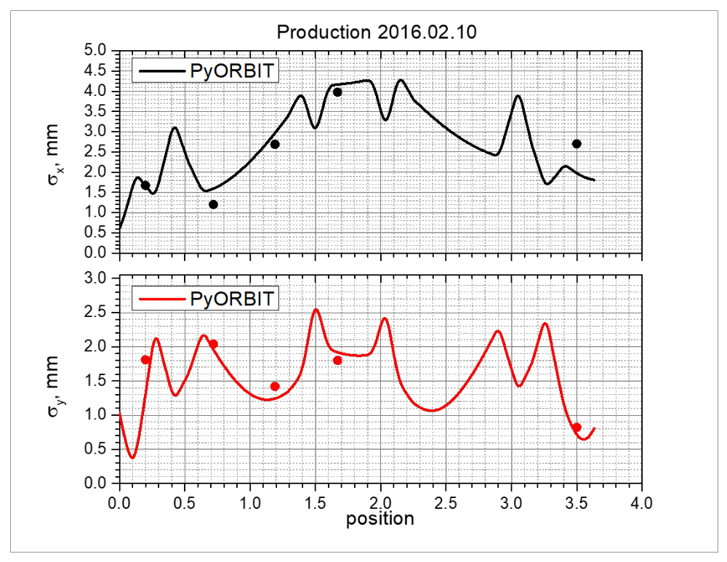
MEBT model is not consistent across cases/diagnostics
Phase space device
Phase space device
Dots = wire scanner profile measurements

Slide 22
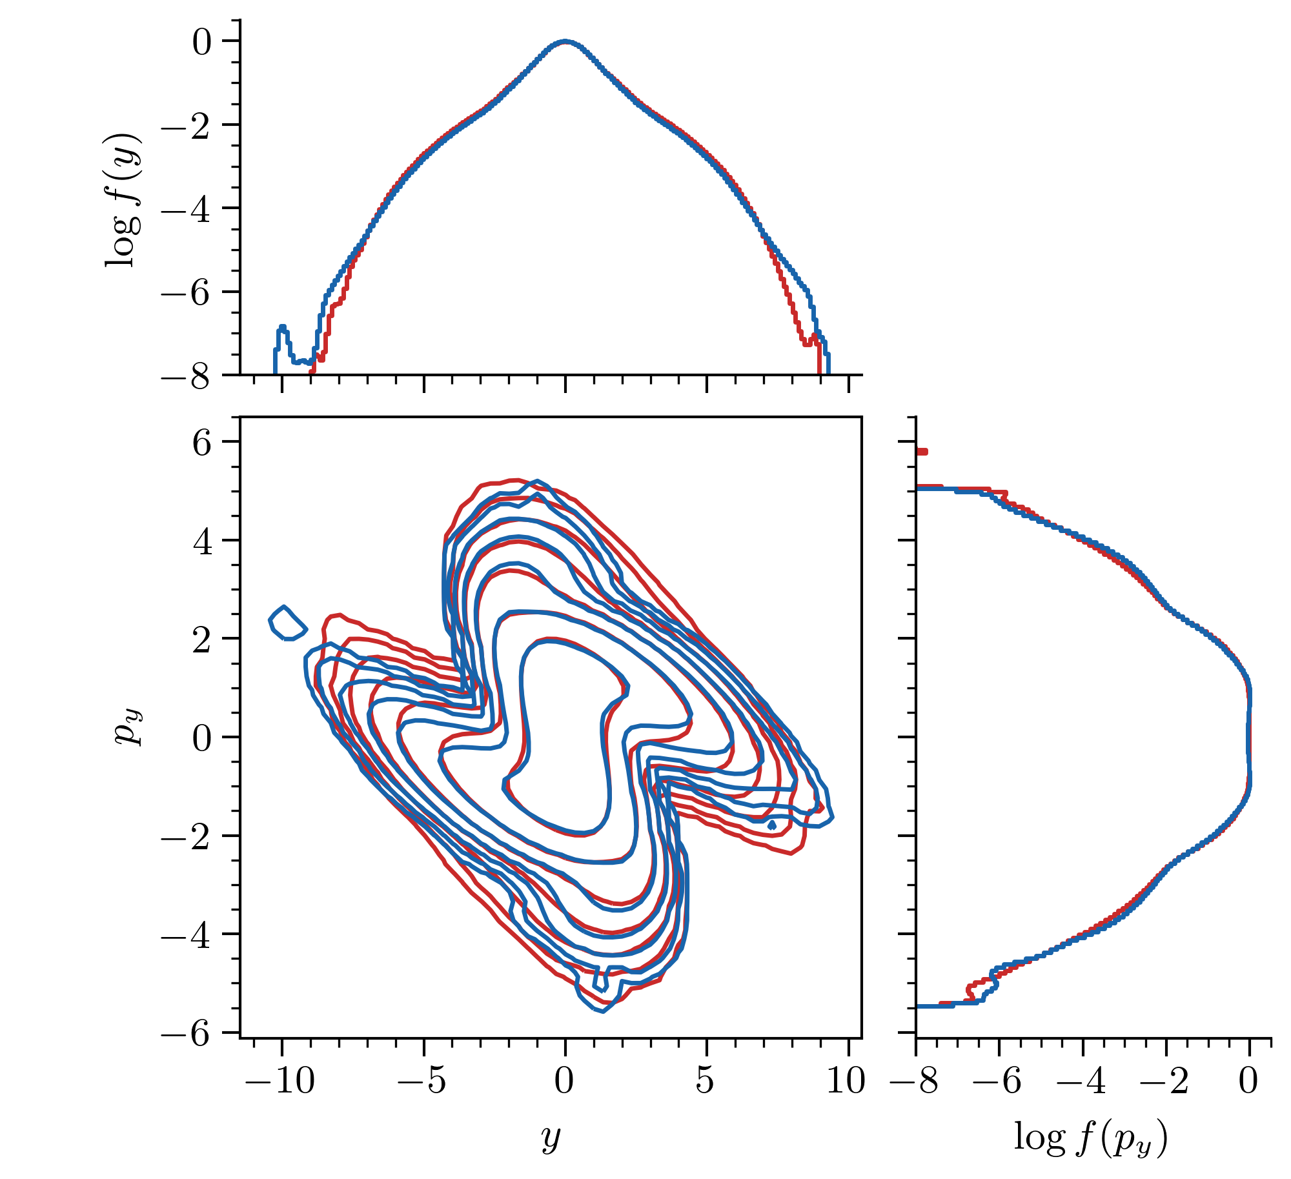
MEBT
6D phase space measurement
2D measurement, high dynamic range
simulate
compare
10⁻²
(~99%)
10⁻⁷ (~99.99999%)
Hoover et al, High Brightness Workshop, CERN (Oct 2023)
Notes:
How many particles?

Slide 23
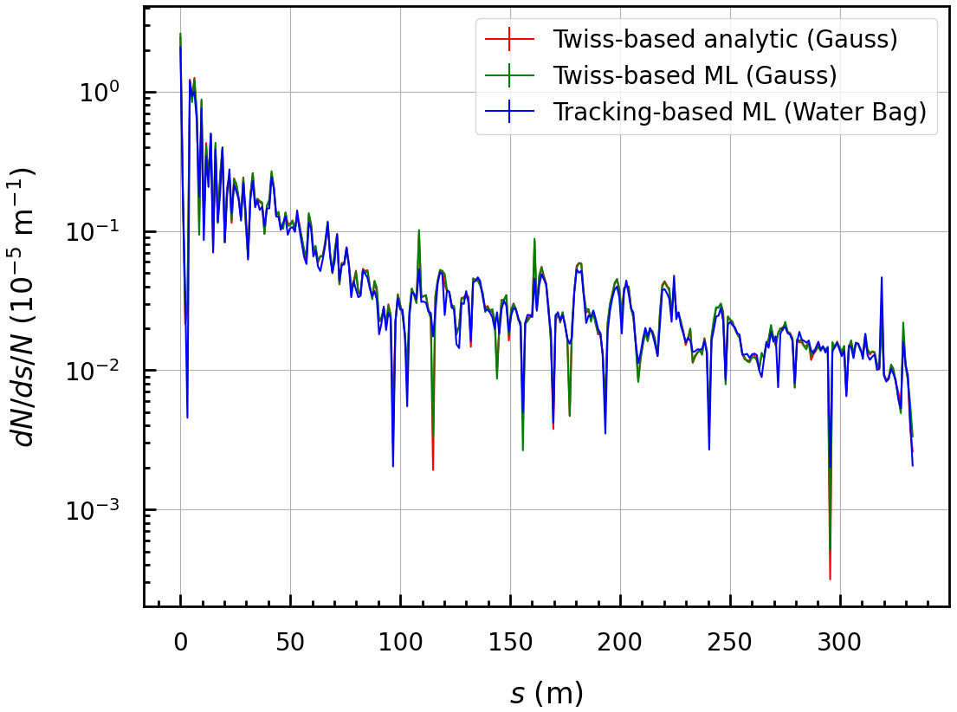


Distribution-based stripping calculation will also improve “realism” in model
Shivam Kakkar, flash / poster
IBSt loss modeling
$$H^{−}$$
$$H^{−}$$
$$H^{0}$$
$$H^{−}$$
$$e$$

Slide 24
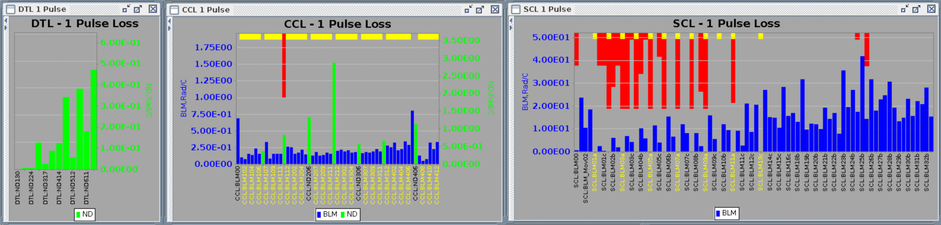
Predicting loss rates is only part-way to predicting detected losses or radiation
Signals of ionization and neutron detector loss monitors along linac:
BLM
BLM
BLM
Beam →

