Slide 1
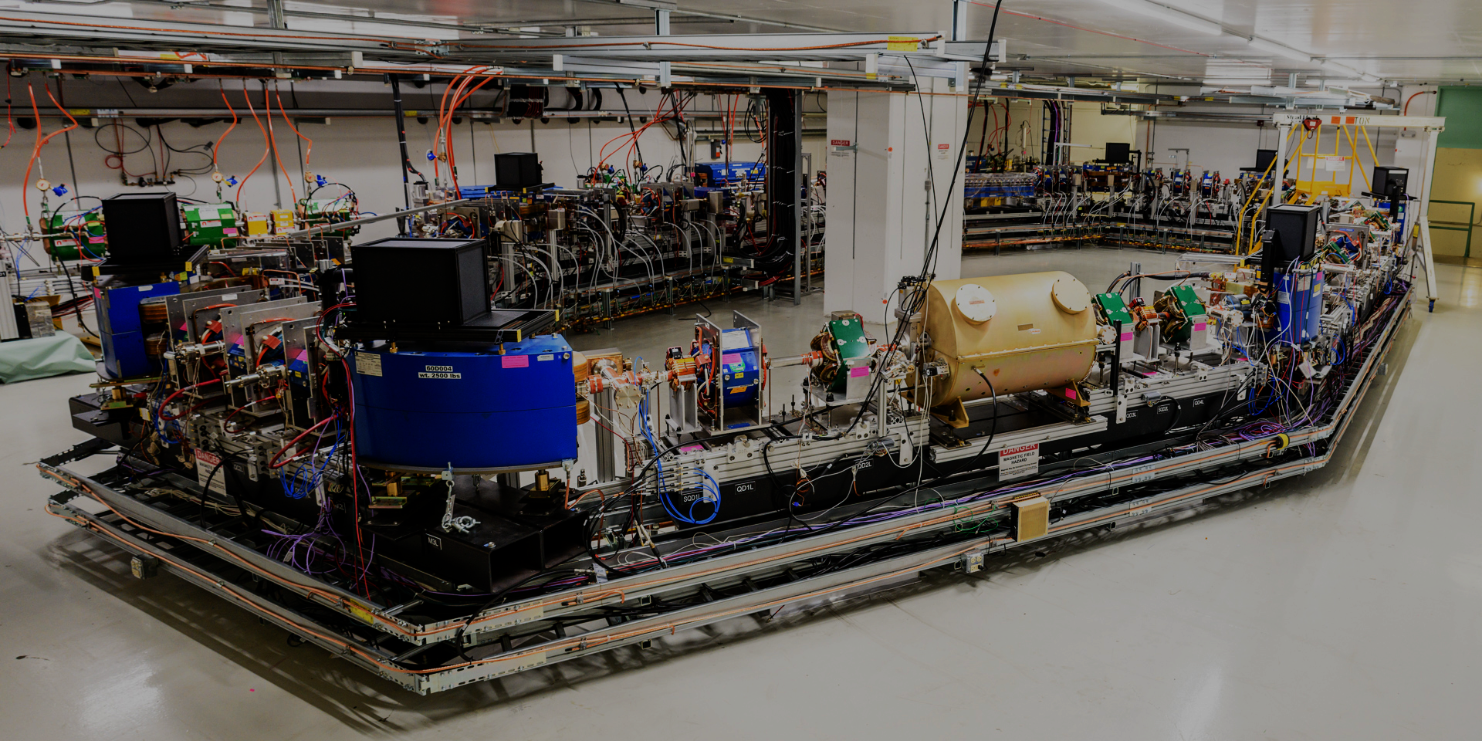
Space-charge dynamics in bare IOTA: Benchmarking among simulations and experiment
October 02, 2026
N. Banerjee, A. Romanov, E. Stern, FNAL
C. Mitchell, J. Qiang, LBNL
D. Shatilov, NIU
Notes:
Hello everyone! I want to start by acknowledging that I am presenting this ongoing work on behalf of my co-authors at Fermilab, Lawrence Berkeley National Lab, and Northern Illinois University.

Slide 2
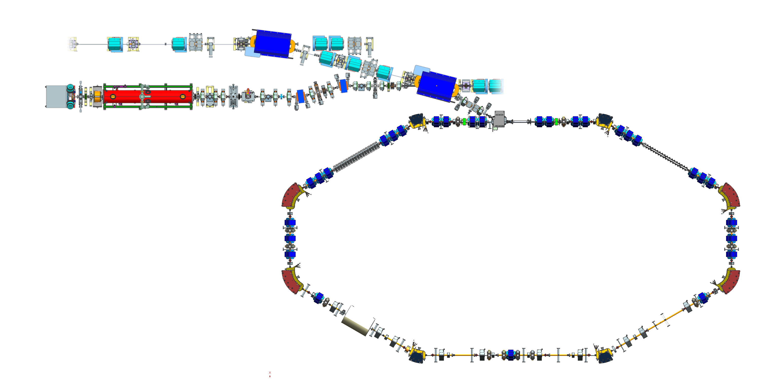
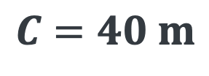
Overview: Fermilab Accelerator Science and Technology Facility
150 MeV e- from FAST linac
High-energy beamlines
2.5 MeV p+ from IOTA Proton Injector
01
02
Danilov-Nagaitsev Insert
Physics Goals
Benchmarking among simulation codes
IOTA storage ring
$$C=40 m$$
03
04
Benchmarking simulations
with experiments
Summary and Outlook
Notes:
Here’s a floor plan of our facility. The octagonal ring to the right is the Integrable Optics Test Accelerator with a circumference of 40 m. It circulated it’s first protons in January 2026. I will discuss some simulations and results related to space-charge dynamics in this machine.
Giulio Stancari already gave an extensive overview of our physics program on Monday. Let me re-iterate our short-term goals of the proton program.

Slide 3
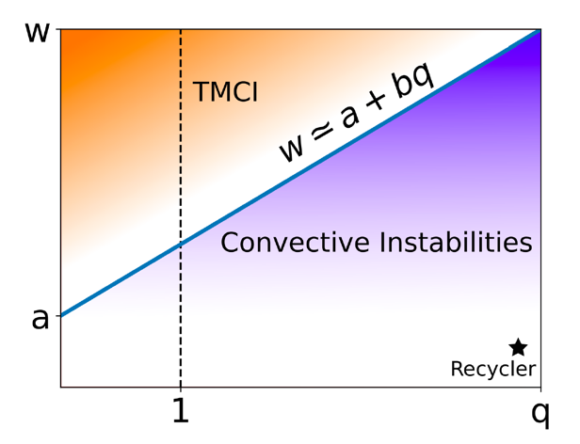
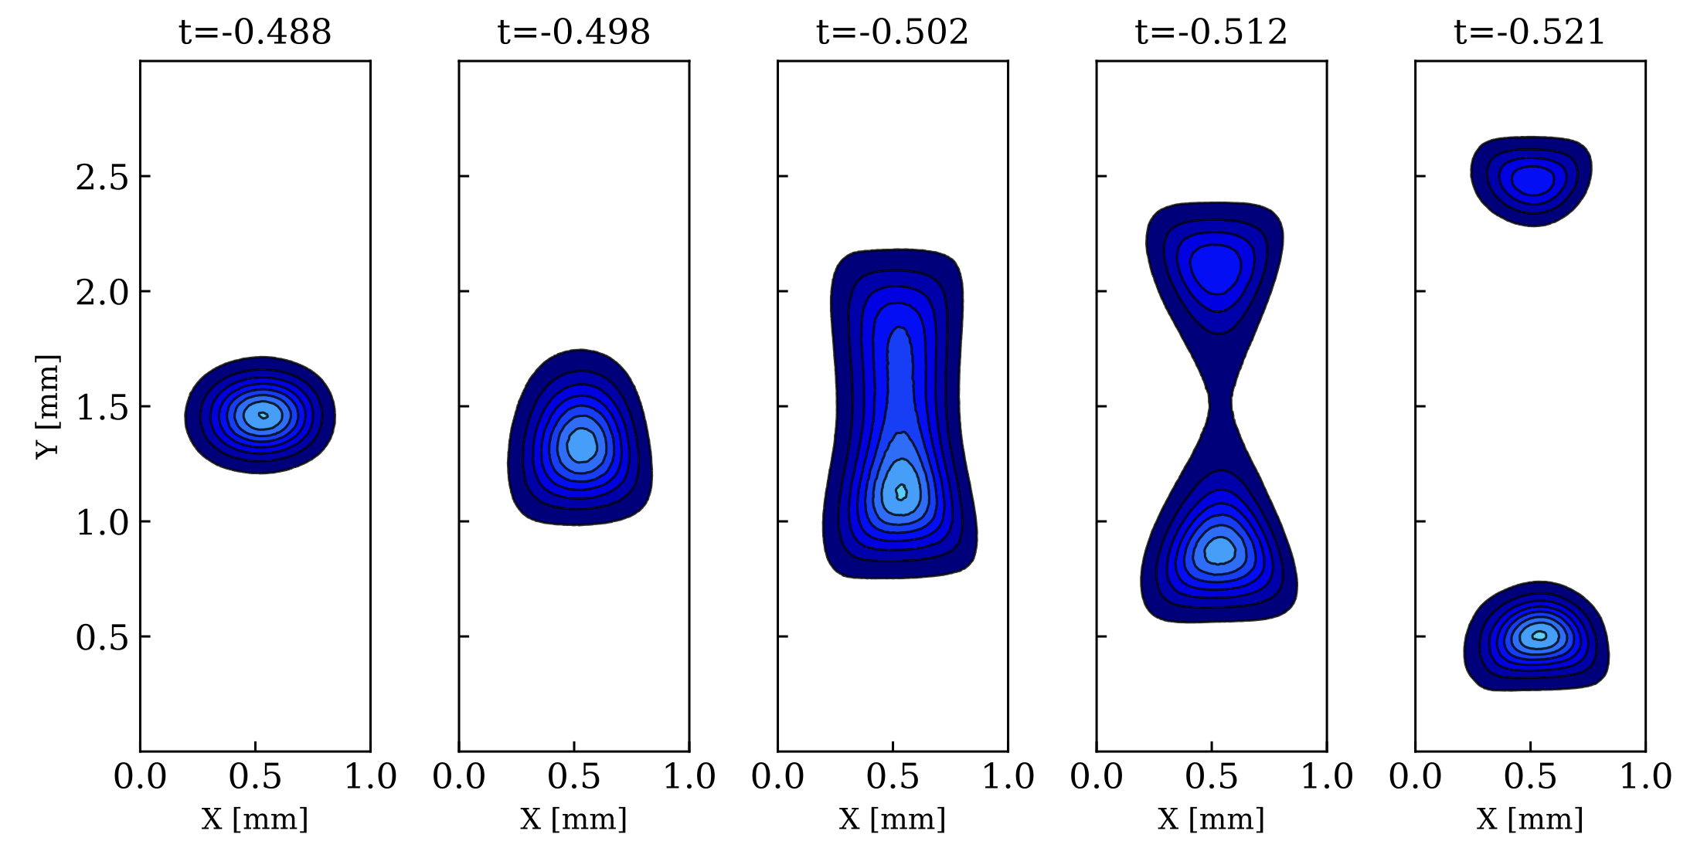
Advance high-intensity physics for hadron rings
Immediate goals guided by the US Department of Energy (DOE) Accelerator and Beam Physics (ABP) Roadmap and Fermilab's Intensity-Frontier priorities.
This Talk
Construct model of SC dynamics in bare IOTA
Model must reproduce measured emittance growth and beam loss as a function of intensity.
Explore interplay of impedance and intense SC
Model must reproduce instability growth rates seen in experiment.
Provide methods and insights applicable to the Fermilab Booster, Main Injector, and Recycler to help establish beam to the Deep Underground Neutrino Experiment by 2031.
Explore Non-linear Integrable Optics as a tool to increase intensity
Experiments must show increase of collective instability threshold and lower emittance growth.
Parameter space of instabilities
A. Burov, Phys. Rev. Accel. Beams 22, 034202, 2019.
C. Gonzalez-Ortiz et al., A/25, this workshop.
Wakefield
Amplitude (Waker)
SC Tune Shift
Synchrotron radiation images of 150 MeV beam passing through integer resonance with DN magnet.
J. Wieland et. al., arXiv:2607.21863, 2026.
Notes:
We have identified 3: constructing a high-fidelity model of space-charge which matches experiments, exploring the interplay of impedance and intense space charge–work already in progress at the Fermilab Recycler and presented at this workshop on Wednesday by Cristian Gonzalez-Ortiz. He will bring the waker experiment to IOTA in 2027. Our work towards these first 2 goals will hopefully provide methods and insights applicable to the Fermilab main complex and help us re-commission these machines in time to provide beam to the Deep Underground Neutrino Experiment (DUNE) by 2031, which is priority number one at Fermilab. The third goal is to demonstrate the use of Non-linear Integrable Optics to mitigate the effects of space-charge and instabilities. I will discuss goal 1 today.

Slide 4
Benchmarking among simulation codes
02
Notes:
First off, benchmarking among simulation codes.

Slide 5
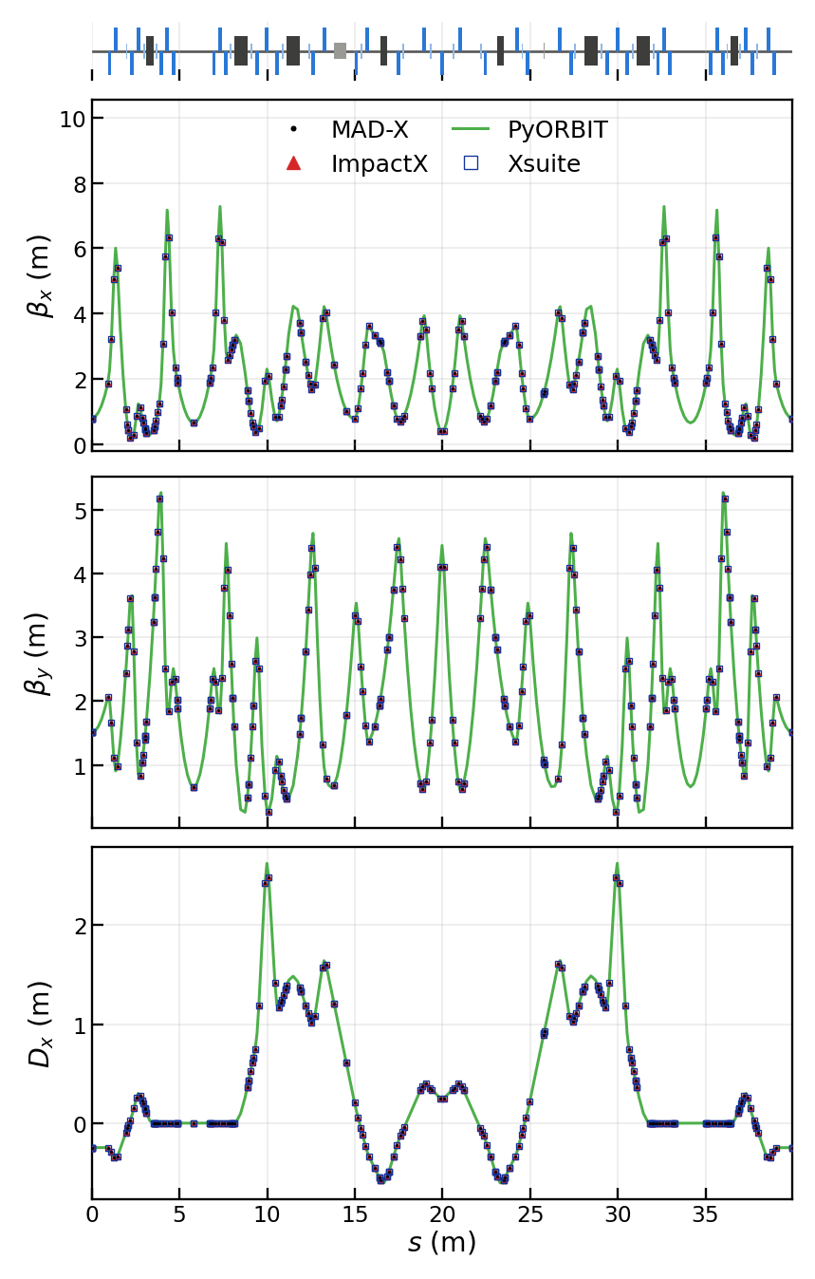
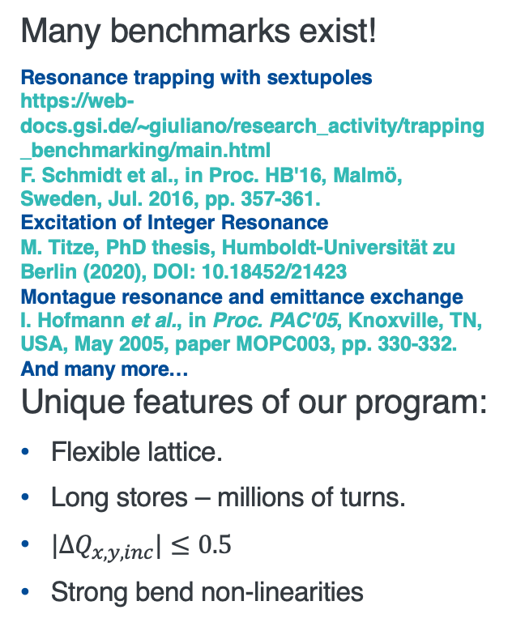
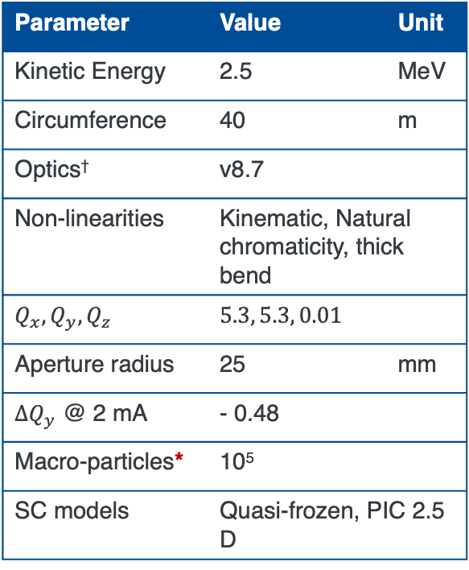
New benchmarking campaign specific to IOTA
Captures the unique feature set of our 2.5 MeV proton physics program.
Parameter | Value | Unit
Kinetic Energy | 2.5 | MeV
Circumference | 40 | m
Optics† | v8.7
Non-linearities | Kinematic, Natural chromaticity, thick bend
$$Q_{x}, Q_{y},Q_{z}$$ | $$5.3, 5.3, 0.01$$
Aperture radius | 25 | mm
$∆Q_{y}$ @ 2 mA | - 0.48
Macro-particles* | 10⁵
SC models | Quasi-frozen, PIC 2.5 D
Many benchmarks exist!
Resonance trapping with sextupoles
https://web-docs.gsi.de/~giuliano/research_activity/trapping_benchmarking/main.html
F. Schmidt et al., in Proc. HB'16, Malmö, Sweden, Jul. 2016, pp. 357-361.
Excitation of Integer Resonance
M. Titze, PhD thesis, Humboldt-Universität zu Berlin (2020), DOI: 10.18452/21423
Montague resonance and emittance exchange
I. Hofmann et al., in Proc. PAC'05, Knoxville, TN, USA, May 2005, paper MOPC003, pp. 330-332.
And many more…
Unique features of our program:
Flexible lattice.
Long stores – millions of turns.
$|∆Q_{x,y,inc}|≤0.5$
Strong bend non-linearities
NOT a detailed list!
†Dipoles and quadrupoles only. NIO, sextupoles, octupoles turned off.
*Same initial coords in all codes
Notes:
Many benchmarks for space-charge codes exist! Our campaign focuses on the unique features of IOTA: flexible lattice, easily store millions of turns, large tune shift, and strong bend non-linearities. For this benchmark, we will track bunched beam in an idealized lattice containing only drifts, dipoles, and quadrupoles with most non-linearities turned off. All codes will receive an injected beam of hundred-thousand macro-particles with the same initial coordinates.

Slide 6

Ran four codes and two types of models
Quasi-frozen models are not much faster than PIC 2.5 D for 10⁵ particles.
Processor: AMD EPYC 7543 32-Core Processor; the pod's cgroup quota is 32 CPUs and 20 GiB, shared.
GPU: NVIDIA A100 80GB PCIe, MIG slice 1g.10gb, of which 10.20 GB is usable.
*Modified and extended: https://github.com/bcathey-fnal/py-orbit-iota
†Measured on a different cluster
 | ImpactX A. Huebl et. al, in Proc. NAPAC’22, TUYE2, pp. 302-306, 2022. | Lifetrac D. N. Shatilov et al., in Proc. PAC'05, Knoxville, TN, USA, May 2005, paper TPAT084, pp. 4138-4140. | PyORBIT* A. Shishlo et al., Procedia Computer Science 51, pp. 1272-1281, 2015. | G. Iadarola et al., in Proc. HB'23, Geneva, Switzerland, Oct. 2023, pp. 73-80.
 | Processor, ms/turn | MPI ranks, ms/turn | MPI ranks, ms/turn | Processor, ms/turn
PIC 2.5 D | GPU, 562 | N/A | 8, 834 | GPU, 1127
Quasi-frozen | GPU, 642 | 64, 52.5† | 8, 2600 | GPU, 1083
Notes:
We used 4 codes: ImpactX, Lifetrac, an extended version of PyORBIT, and Xsuite in this benchmark. We compared the quasi-frozen model in all 4 codes, and the PIC 2.5 D model in ImpactX, PyORBIT, and Xsuite. Now let’s discuss the results of comparing these 7 models in total.

Slide 7
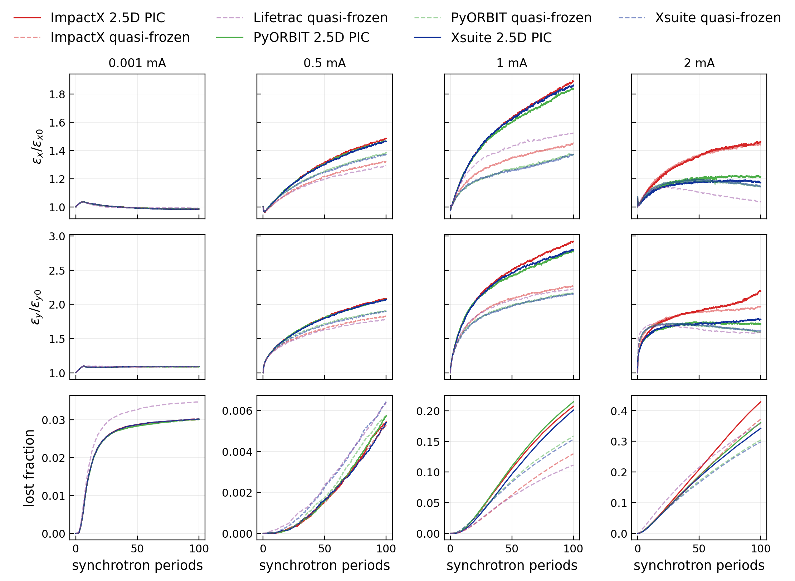
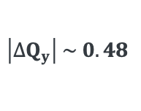
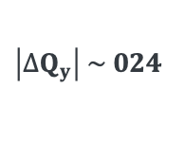
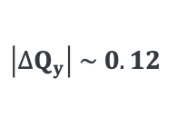
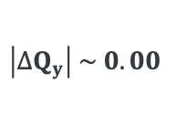
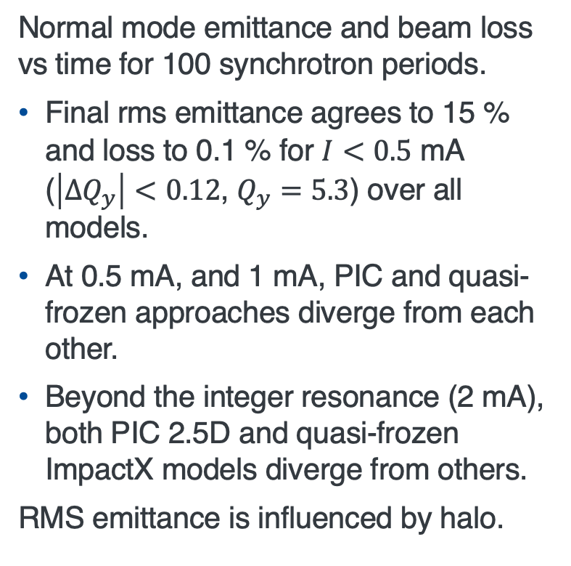
Codes generally agree with each other
But PIC and Quasi-frozen approaches diverge in rms emittance after crossing resonances.
Normal mode emittance and beam loss vs time for 100 synchrotron periods.
Final rms emittance agrees to 15 % and loss to 0.1 % for $I<0.5$ mA ($\left|∆Q_{y}\right|<0.12$, $Q_{y}=5.3$) over all models.
At 0.5 mA, and 1 mA, PIC and quasi-frozen approaches diverge from each other.
Beyond the integer resonance (2 mA), both PIC 2.5D and quasi-frozen ImpactX models diverge from others.
RMS emittance is influenced by halo.
$$\left|∆Q_{y}\right| \sim 0.00$$
$$\left|∆Q_{y}\right| \sim 0.12$$
$$\left|∆Q_{y}\right| \sim 024$$
$$\left|∆Q_{y}\right| \sim 0.48$$
Bare tunes: 5.3, 5.3
Notes:
The figure to the right summarizes the dynamics over 100 synchrotron periods, at 4 beam currents each occupying one column, with the corresponding incoherent tune shifts noted at the bottom. Since there’s a lot of detail, let me summarize. Firstly, the codes generally agree with each other, with loss agreement to better than 0.1 % up to a tune shift of 0.1. Beyond the integer resonance crossed at 2 mA, the rms emittance predicted by both the PIC 2.5 D and quasi-frozen models of ImpactX diverge from others. Now let’s look at the beam profiles.

Slide 8
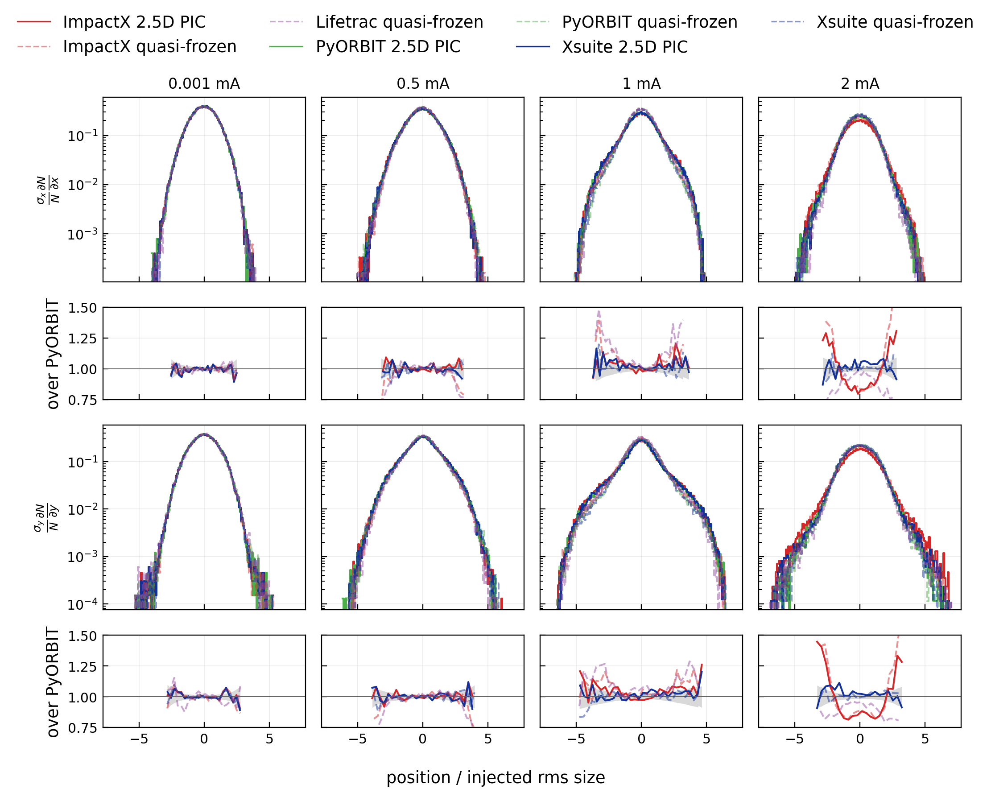
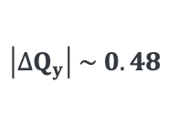
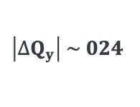
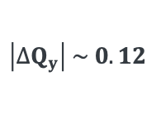
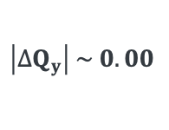
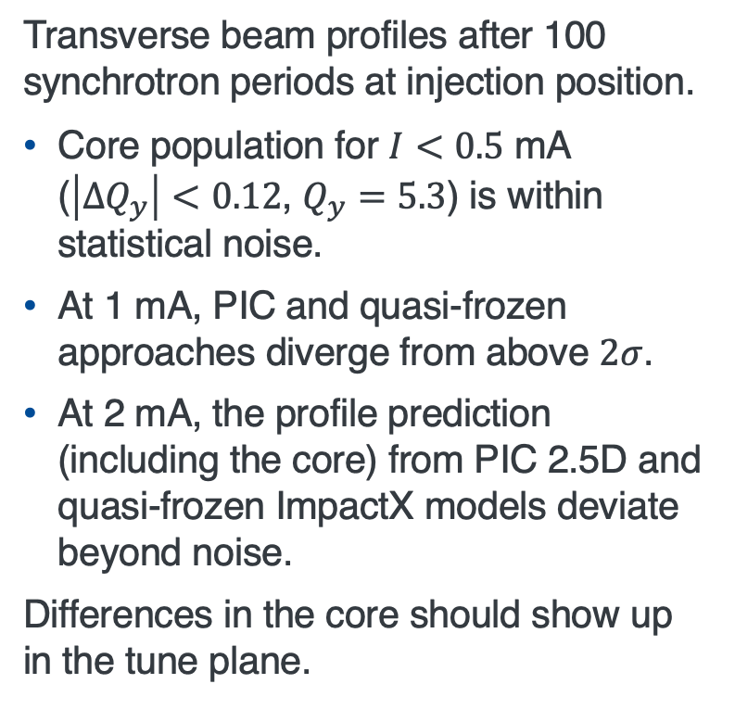
Difference in transverse beam profiles is subtle
Moderate differences only show up near or beyond the integer.
Transverse beam profiles after 100 synchrotron periods at injection position.
Core population for $I<0.5$ mA ($\left|∆Q_{y}\right|<0.12$, $Q_{y}=5.3$) is within statistical noise.
At 1 mA, PIC and quasi-frozen approaches diverge from above $2σ$.
At 2 mA, the profile prediction (including the core) from PIC 2.5D and quasi-frozen ImpactX models deviate beyond noise.
Differences in the core should show up in the tune plane.
$$\left|∆Q_{y}\right| \sim 0.00$$
$$\left|∆Q_{y}\right| \sim 0.12$$
$$\left|∆Q_{y}\right| \sim 024$$
$$\left|∆Q_{y}\right| \sim 0.48$$
Notes:
The figure to the right shows 1-D projections of the transverse beam profiles at the 4 beam currents after 100 synchrotron periods. Believe me that there are 7 lines in each of these 8 plots. Differences are quite subtle which is encouraging. You can see small differences beyond 2 sigma at 1 mA, and deviations at the core in both PIC 2.5 D and quasi-frozen models of ImpactX at 2 mA. The deviation in the core should also be visible in the tune plane.

Slide 9
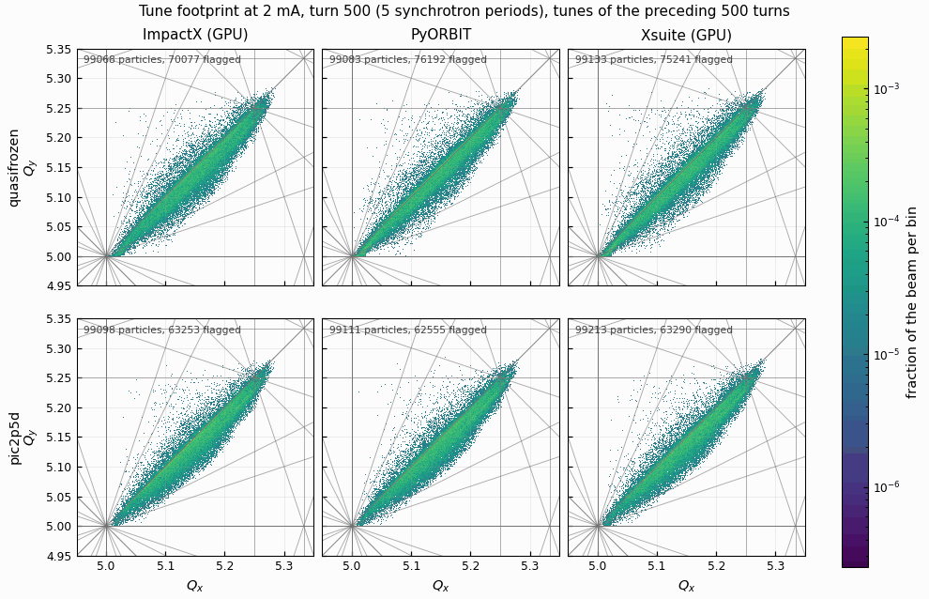
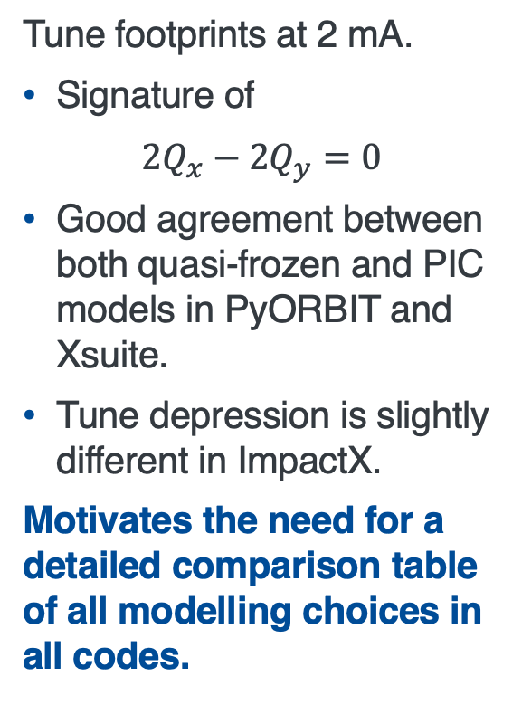
Tune footprints reveal the difference
Footprints differ in the size of the depressed tail.
Tune footprints at 2 mA.
Signature of
$$2Q_{x}−2Q_{y}=0$$
Good agreement between both quasi-frozen and PIC models in PyORBIT and Xsuite.
Tune depression is slightly different in ImpactX.
Motivates the need for a detailed comparison table of all modelling choices in all codes.
Notes:
The animation to the right shows the planes at 2 mA, as predicted by both the quasi-frozen models in the top row, and the PIC 2.5 D models in the bottom row. Remember, all the models start from identical initial conditions, and indeed the first frame of the animation shows identical tune planes in all 6 models. However, after 100 synchrotron periods, while PyORBIT and Xsuite agree quite well, you can see a clear difference in the depression in the tune planes predicted by ImpactX. I think these results motivate the need for the community to compile a detailed comparison table of all modelling choices in space-charge codes.

Slide 10
Benchmarking simulations with experiments
03
Notes:
Let’s move on to comparing simulation with experiments.

Slide 11
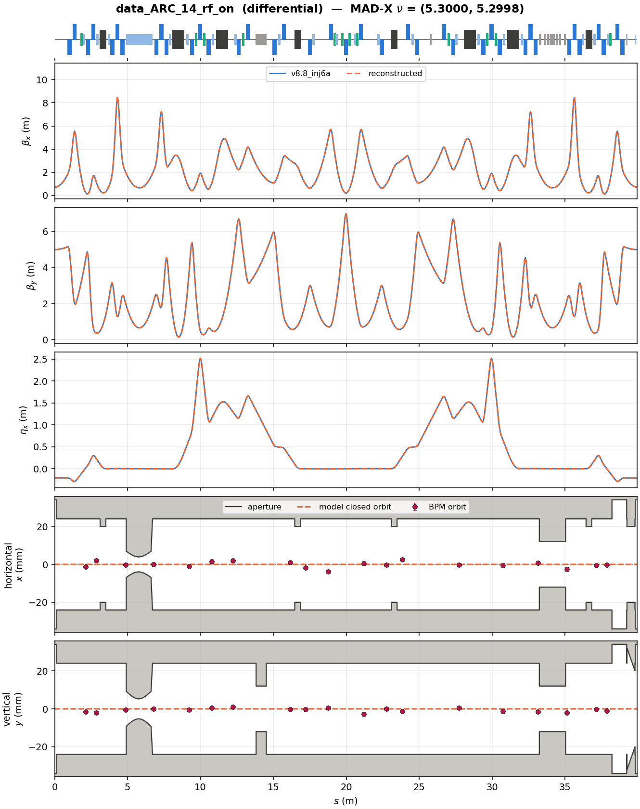
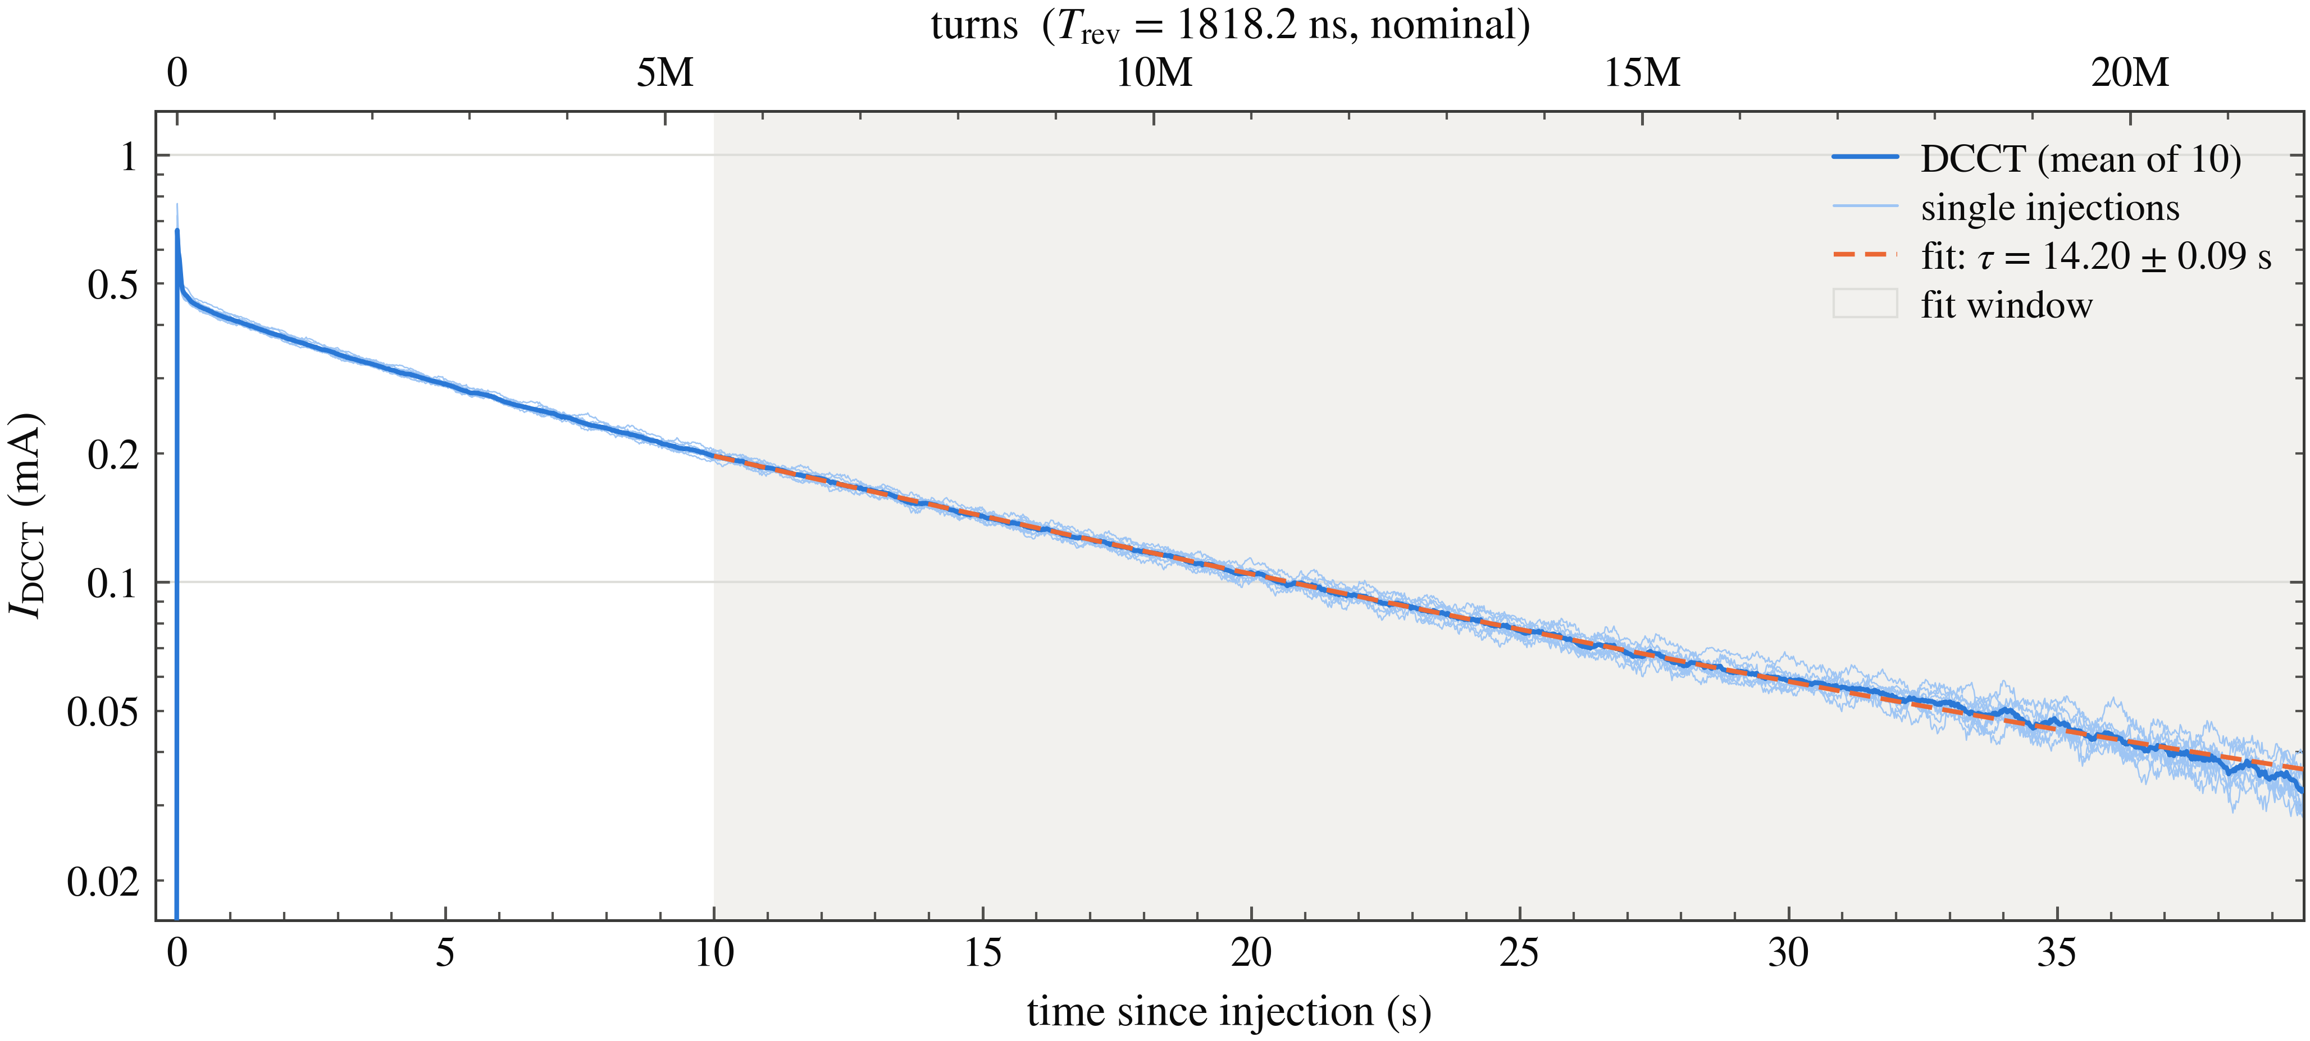
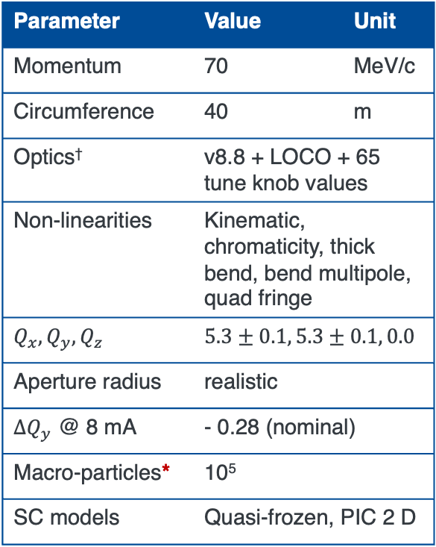
Compare loss with coasting beam
Captures the interplay of space-charge and magnet non-linearities.
Parameter | Value | Unit
Momentum | 70 | MeV/c
Circumference | 40 | m
Optics† | v8.8 + LOCO + 65 tune knob values
Non-linearities | Kinematic, chromaticity, thick bend, bend multipole, quad fringe
$$Q_{x}, Q_{y},Q_{z}$$ | $$5.3±0.1, 5.3±0.1, 0.0$$
Aperture radius | realistic
$∆Q_{y}$ @ 8 mA | - 0.28 (nominal)
Macro-particles* | 10⁵
SC models | Quasi-frozen, PIC 2 D
First protons circulated in January 2026.
Available diagnostics:
Beam Position Monitors
DC Current Transformer
Wall Current Monitor
Ionization Profile Monitor (Jan 2027)
* All turn-by-turn except DCCT
Only data from DCCT has been used in this benchmark.
NOT a detailed list!
†Dipoles and quadrupoles only. NIO, sextupoles, octupoles turned off.
*Same initial coords in all codes
H. Piekarz et al 2025 JINST 20 T10007
Notes:
The first 2.5 MeV protons were circulated in IOTA in January 2026. We currently have BPMs, DCCT for measuring current, and a Wall Current Monitor. Our IPM is scheduled for installation in January 2027.
Here’s a plot showing coasting beam current as a function of time over 20-million turns. Based on this plot, we see a beam lifetime of 14.2 seconds using our baseline lattice.
Our next benchmark will be comparing beam current as a function of time measured from this DCCT with simulations of coasting beam in a set of 65 realistic IOTA lattices with different working points, still with only drifts, dipoles, and quads, but now containing realistic apertures and parasitic non-linearities.
This time 3 codes will receive an injected coasting beam of hundred-thousand macro-particles with the same initial coordinates based on plausible beam parameters.

Slide 12
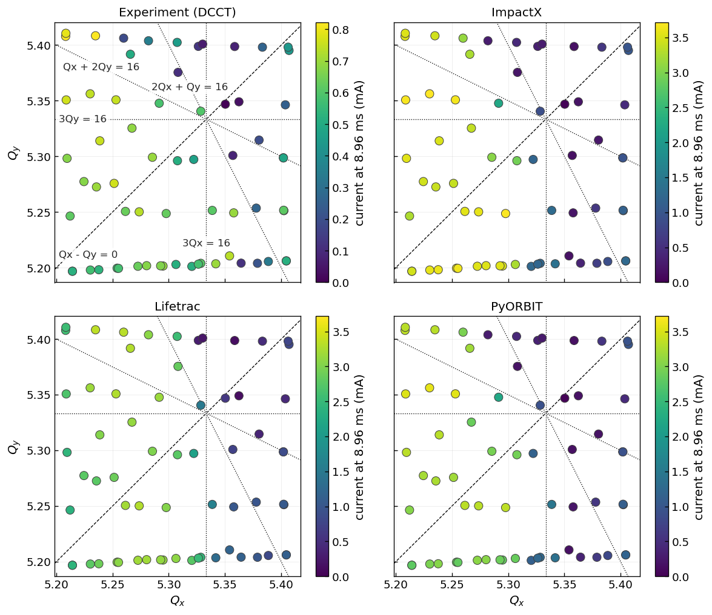
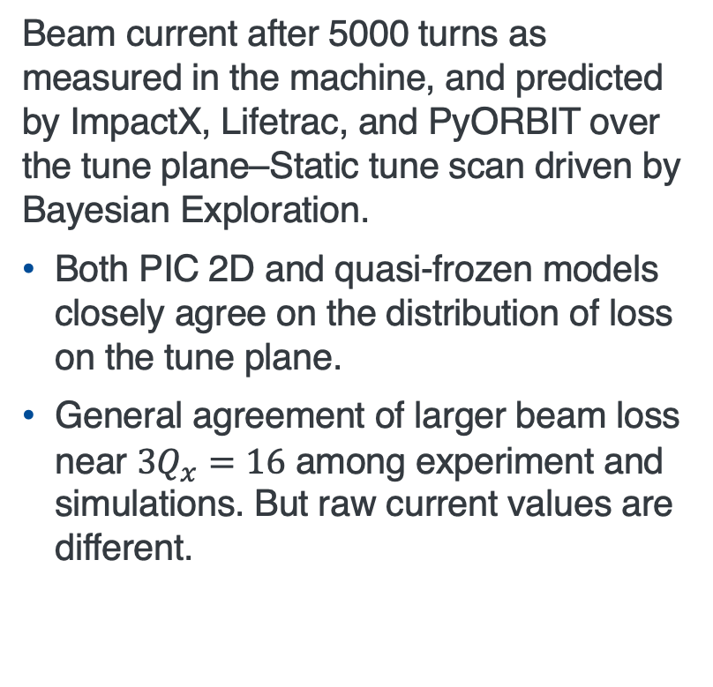
Models reproduce the general tune landscape
But a single loss figure hides temporal complexity.
Beam current after 5000 turns as measured in the machine, and predicted by ImpactX, Lifetrac, and PyORBIT over the tune plane–Static tune scan driven by Bayesian Exploration.
Both PIC 2D and quasi-frozen models closely agree on the distribution of loss on the tune plane.
General agreement of larger beam loss near $3Q_{x}=16$ among experiment and simulations. But raw current values are different.
Notes:
The plots to the right show beam current after 5000 turns as a function of working point of the lattice. The top left plot shows experimental data, the bottom shows simulation results from the quasi-frozen model in Lifetrac, while the two plots to the right use PIC 2D in ImpactX and PyORBIT. If you squint your eyes, the general loss landscape looks close qualitatively with a stop band near 3Qx = 16. But then notice that the color bar in experiment has a range of up to 0.8 mA, compared to the simulations which have a range up to 3.5 mA. What am I hiding?

Slide 13
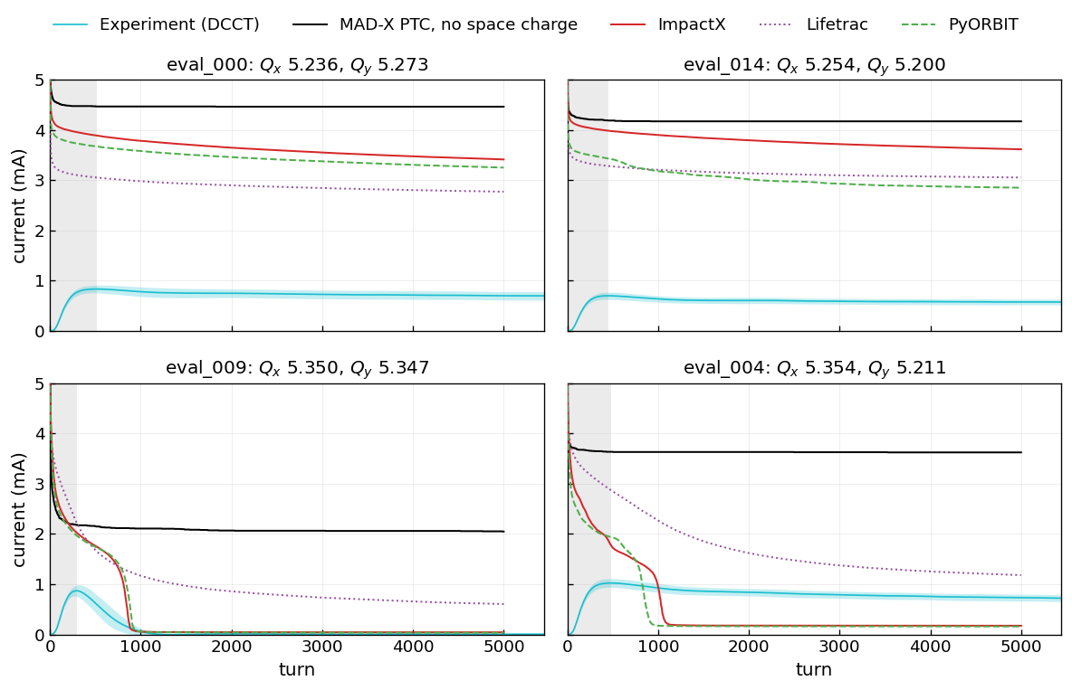
Space-charge generates steady beam loss
Models reproduce this effect qualitatively, but PIC 2D adds delayed loss unseen in experiment.
The simulated ring loses about 50% of the current within a few turns after injection due to scraping on the aperture.
Only space-charge simulations reproduce steady beam loss over 1000s of turns.
Simulations near 3Qx = 16 show delayed increase in beam loss not seen in experiment.
Opportunity to improve match by tuning beam parameters and multipole strength. – Model calibration
Notes:
The actual currents in the simulations are quite different from the experiment, although there is some correlation of where in the tune plane more beam is lost. For example, if you look at the bottom left plot, which is near the 3Qx = 16 stopband, the measured beam current shown in light blue quickly decays to 0 by turn 1000, so do self-consistent PIC simulations in ImpactX and PyORBIT shown in red and green respectively, but with an anomalous fast loss behavior seen after turn 900. The quasi-frozen model in Lifetrac seen as the dotted purple line, shows something different, and tracking in MAD-X PTC without space-charge shows almost no loss after turn 100. A large part of the differences is simply because we don’t know our initial beam parameters, and intrinsic lattice non-linearities exactly. Directly measuring them can be tedious or may not be possible in some machines. Hence, in my opinion, developing effective model calibration techniques which efficiently proposes measurements to improve fidelity of simulation outputs will be beneficial.

Slide 14
Summary and Outlook
04

Slide 15
Summary
The immediate goals of the IOTA proton research program will address these challenges in the context of hadron rings.
  Construct high-fidelity model of space-charge dynamics in bare IOTA.
  Explore the interplay of impedance and space-charge.
  Explore Non-linear Integrable Optics as a tool to increase intensity in future machines.
A new simulation benchmarking campaign specific to bunched proton beam in IOTA reveals differences among different codes, especially on crossing resonances.
A detailed comparison table of all modelling choices in all modern codes will help the field.
While simulations of loss with coasting beam qualitatively match experimental data, quantitative agreement will require extensive model calibration.
Improving model calibration techniques through targeted experiments will improve model fidelity.
Time-scale for goals: 2 proton runs
Notes:
To summarize, our short-term goals for the IOTA physics program include constructing a high-fidelity space-charge model which matches with experiments.
A new simulation benchmarking campaign specific to bunched beam reveals subtle differences in predictions, especially on crossing resonances.
We also compared measured loss in coasting beam with simulations achieving qualitative agreement, but going farther will require extensive model calibration.

Slide 16
Acknowledgements and an invitation
We would like to thank Rob Ainsworth, Sergey Antipov, Alexey Burov, Brandon Cathey, Valery Lebedev, Sergei Nagaitsev, Frank Schmidt, Tanaji Sen, Ben Simons, Giulio Stancari, Alexander Valishev, Mike Wallbank, and John Wieland for insightful discussions, for help with modeling and simulations, and for contributing to the definition of the IOTA proton physics program.
This work was produced by FermiForward Discovery Group, LLC under Contract No. 89243024CSC000002 with the U.S. Department of Energy, Office of Science, Office of High Energy Physics.
Visit us and run an experiment in IOTA! Our unique capabilities include having:
highly reconfigurable optics,
tolerance for large beam loss,
abundant beam time, and
capability of reaching an incoherent tune shift of 0.5 with 2.5 MeV protons.
Notes:
In the end, I want to acknowledge that many people have contributed to the IOTA physics program both inside and outside Fermilab. To help continue this, I want to re-iterate our invitation!... Thank you for listening.

Slide 17
Backup slides
05

Slide 18
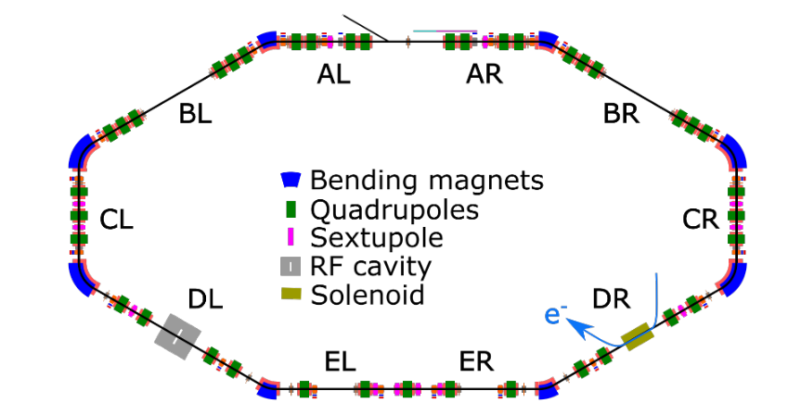
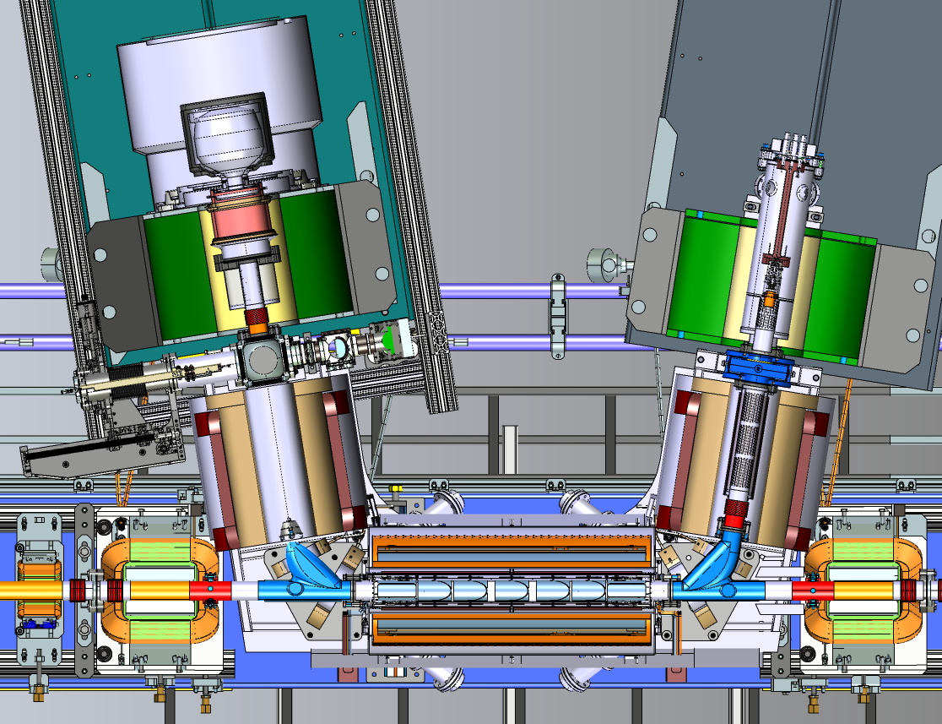
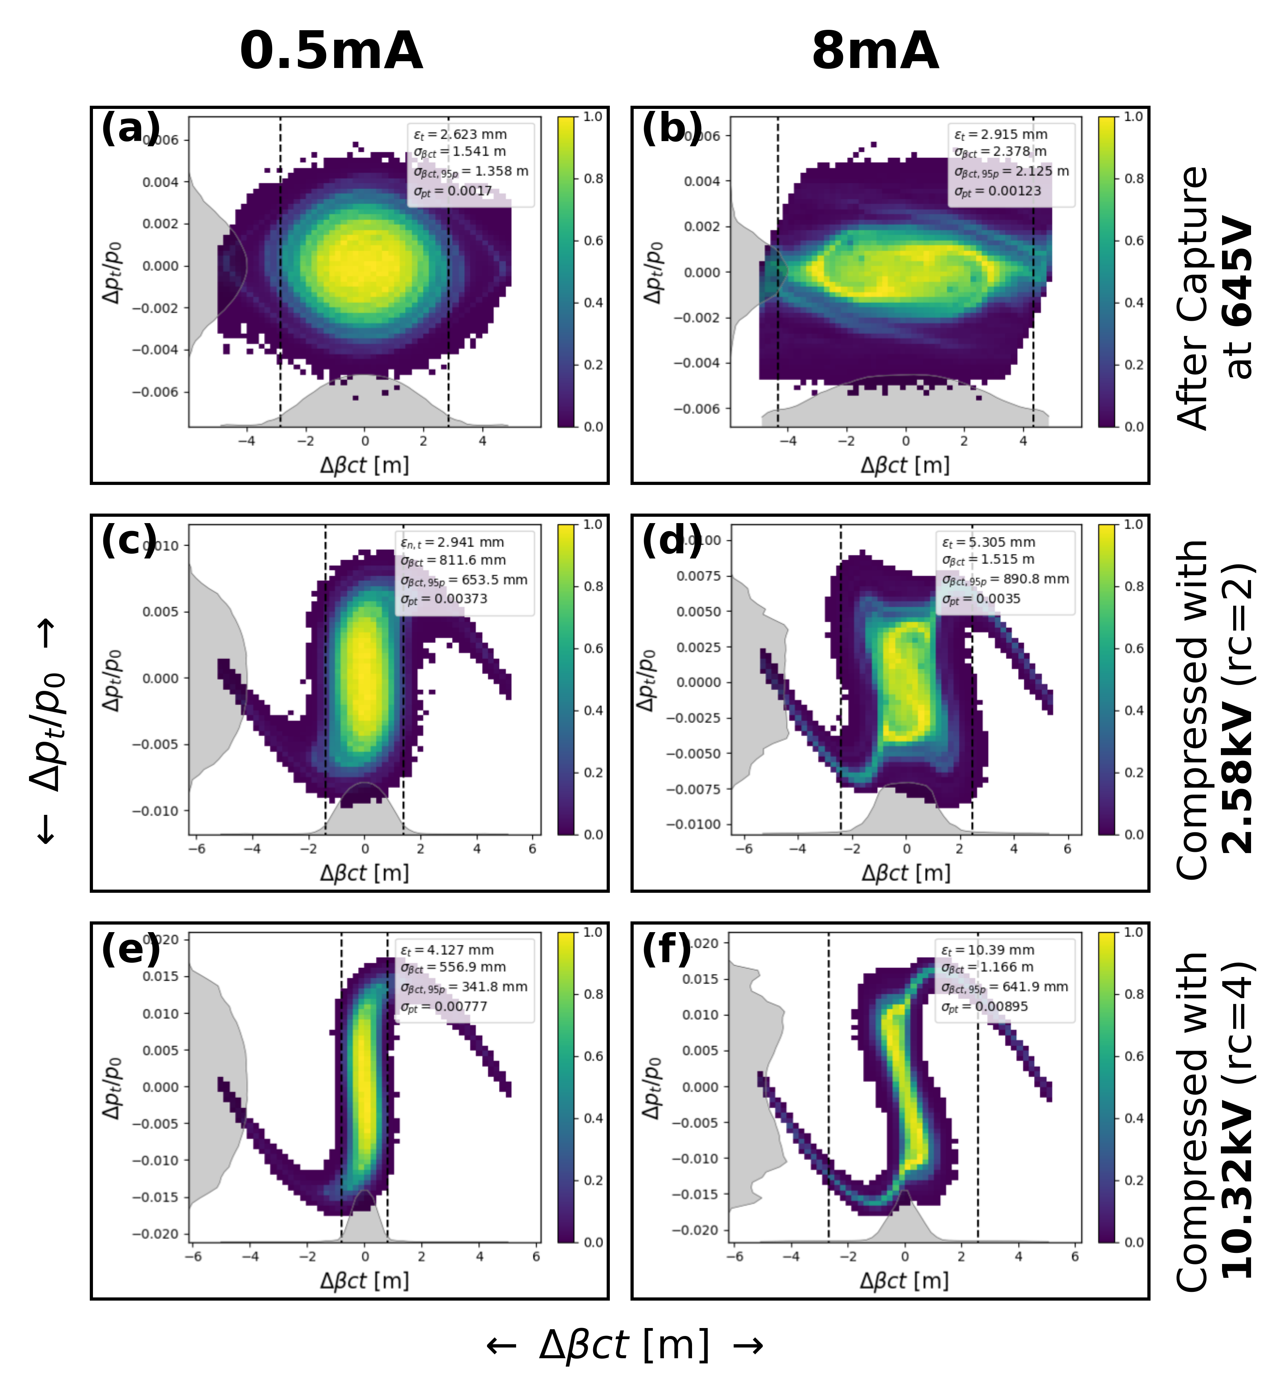
Appendix A: Future Goals: Demonstrate space-charge compensation, snap bunch rotation…
Space-charge resonance suppression
Adjusting multipoles.
Realize 2-fold periodicity.
Electron lens
Implementation of NIO using the McMillan and Gaussian electron lens.
Demonstration of space-charge compensation.
Electron Cooling to control equilibrium tune shift.
Snap bunch rotation
Needed for the muon collider proton driver.
e⁻ source
Proposed location of the electron lens in IOTA
G. Stancari et al, JINST 16 P05002, 2021.
e⁻ beam
Simulated longitudinal phase-space for a factor of 2 snap bunch rotation at 0.5 mA in IOTA.
B. Simons et al., Accepted for publication in JINST, 2026.
Relative momentum deviation
Longitudinal spatial coordinate

Slide 19
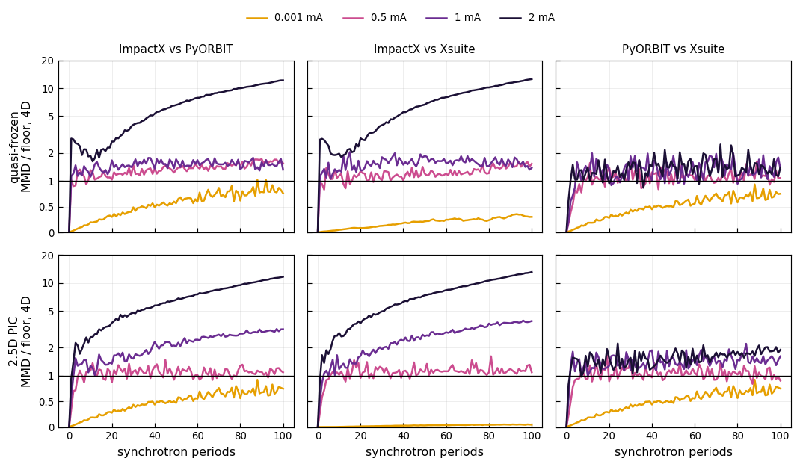
Appendix B: MMD quantifies the difference
Statistical measures can be used to track the deviation among different models
Maximum Mean Discrepancy (MMD) is a statistical measure of the distance between two probability distributions.
At 1 uA, the metric is below the sampling floor for all codes and models, but ImpactX and Xsuite are the best matched.
PyORBIT and Xsuite match within 1 -2 times the sampling floor at all currents, while ImpactX deviates.
C. Mitchell et al., Phys. Rev. E 106, 065302, 2022.

Slide 20
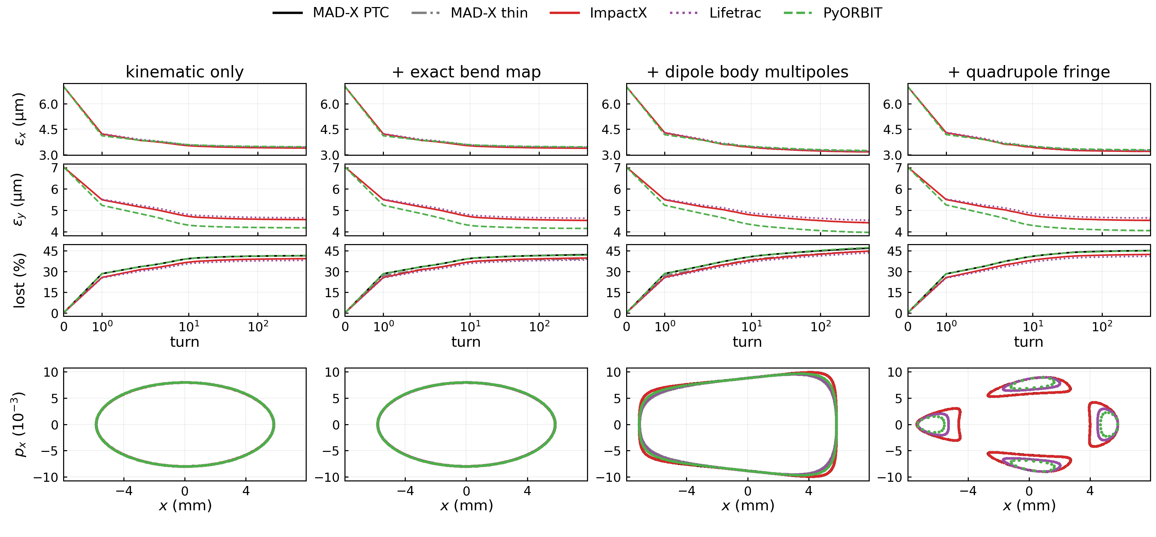
Appendix C: Single particle dynamics with lattice non-linearities

Slide 21
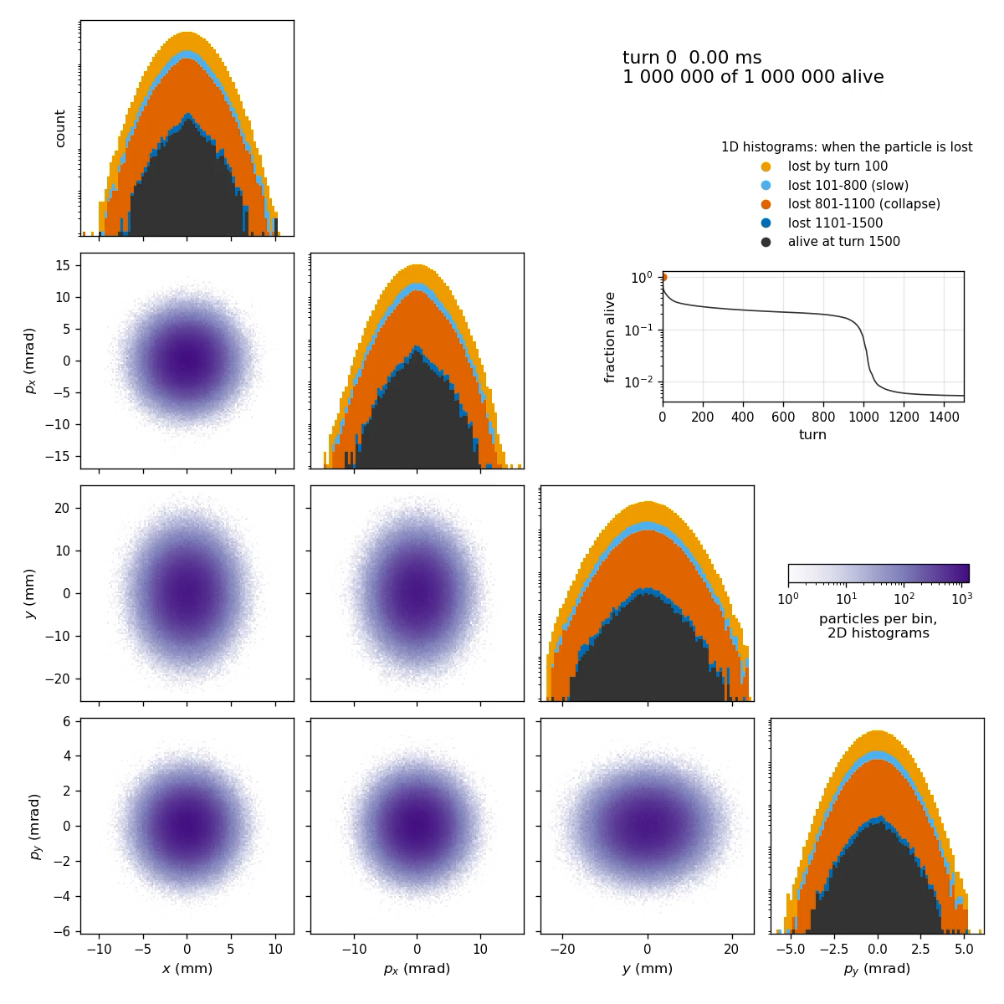
Appendix D: Delayed loss seen in simulations of coasting beam

