Slide 1
Parametric instabilities in actual high-intensity linear accelerators
Dong-O Jeon, Ji-Ho Jang
Institute for Basic Science
Space Charge 2026

Slide 2
Space-charge halo mechanisms
There are largely two families of space-charge mechanisms: particle resonances and parametric instabilities.
Their differences were well pointed out in references:
(particle) resonances: a.k.a. single particle resonances, resonances, incoherent resonances …
(parametric) instabilities: a.k.a. parametric resonances, structure resonances, coherent resonances, coherent instabilities, mode instabilities, instabilities …
This talk focuses on space charge of linear accelerators.
Jeon et al, NIM A 832, 43 (2016);
Jeon, J Korean Phys Soc 72, 1523 (2018)
2

Slide 3
Particle resonances in high-intensity linacs
In 2009, 4σ = 360° particle resonance was discovered in high-intensity linacs. [Jeon et al, PRST-AB 12, 054204 (2009)]
Confirmed by two experiments.
In 2015, 6σ = 720° particle resonance was discovered. [Jeon et al, PRL 114, 184802 (2015)]
In 2016, higher order particle resonances were discovered:
8σ = 1080° resonance, 10σ = 1440° resonance [Hofmann, HB2016]
σ : depressed phase advance per period
σ_{o} : zero current phase advance
3

Slide 4
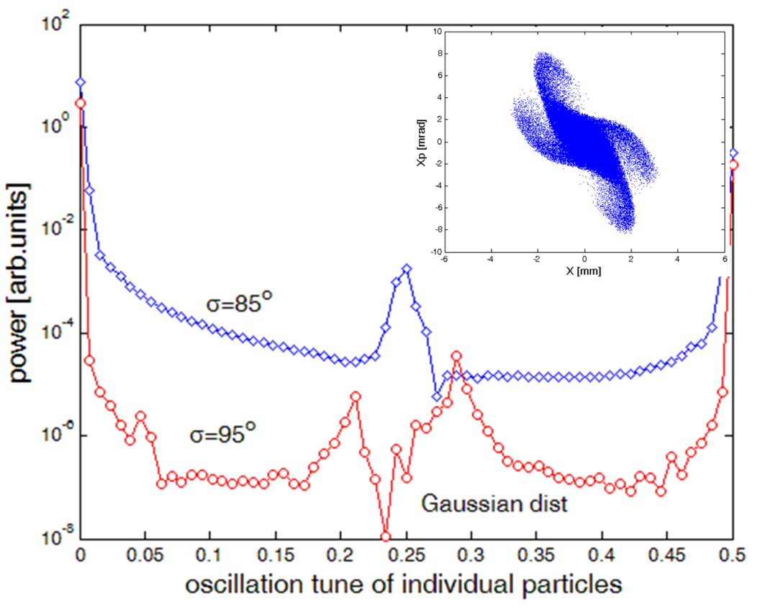
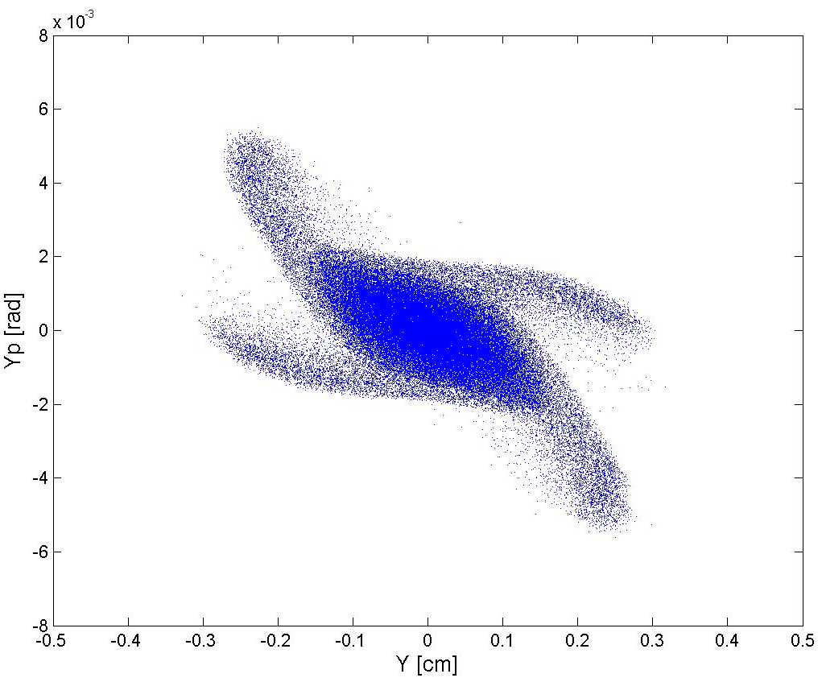
4th order particle resonance in high-intensity linacs
Jeon et al, PRST-AB 12, 054204 (2009)
Gaussian dist.
4σ = 360° particle resonance in high-intensity linacs discovered in simulations.
Resonance effect when σ < 90° and σ_{o} > 90°.
FFT resonance frequency peak at 1/4.
Confirmed by two experiments.
4

Slide 5
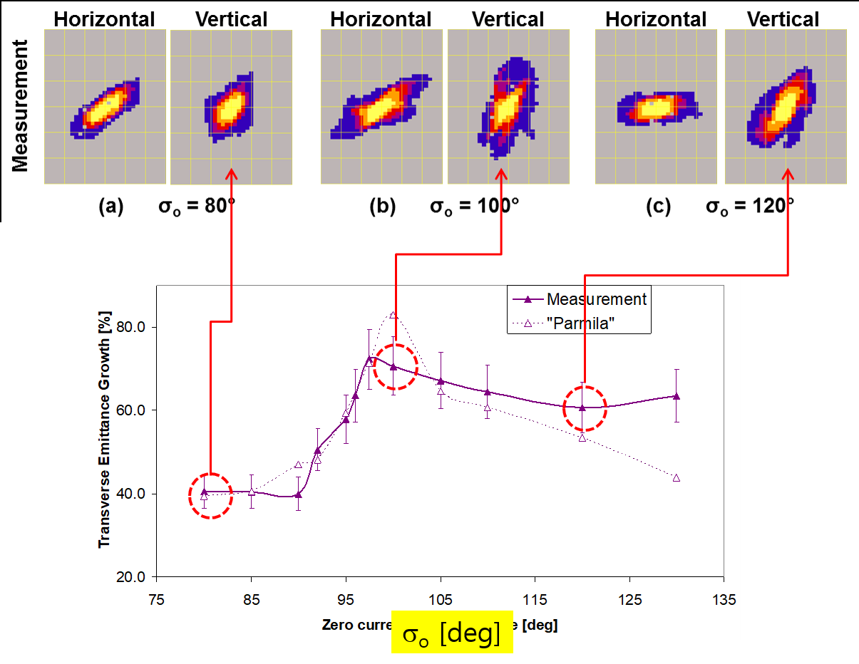
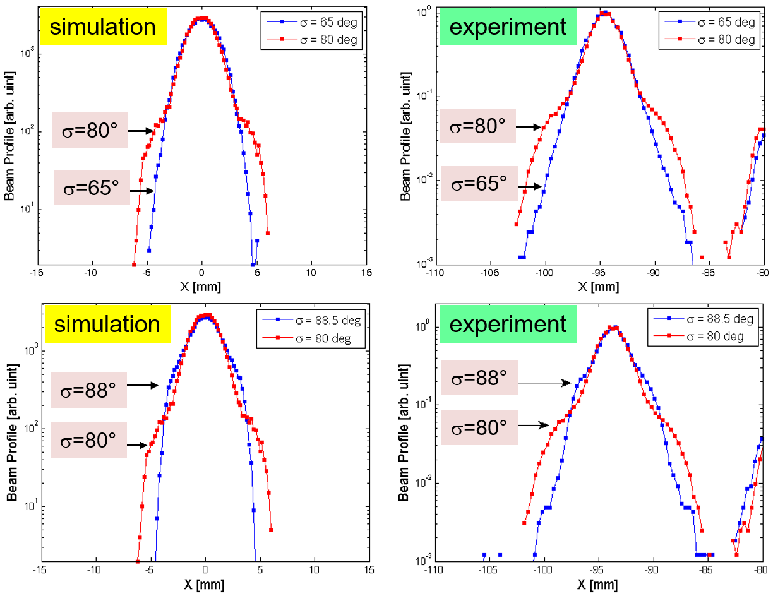
Experiment 1 & 2: 4th order resonance
Exp 1 @ GSI
Groening et al, PRL 102, 234801 (2009)
Exp 2 @ SNS
Jeon, PRAB 19, 010101 (2016)

Slide 6
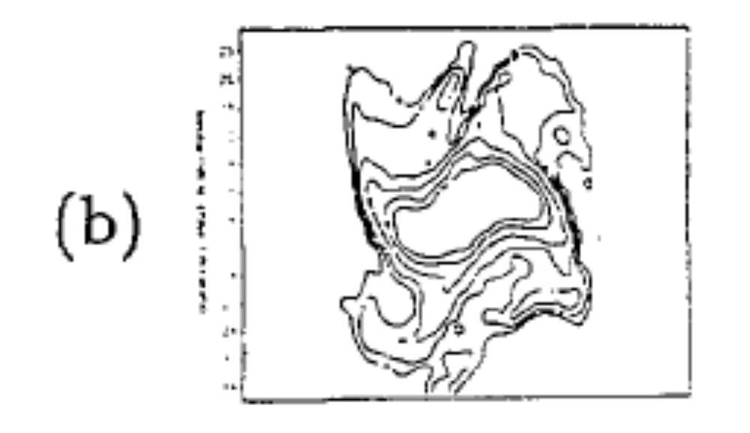
Tiefenback’s experiment (1986)
Tiefenback’s PhD thesis (1986) reported an experiment observation of “four-pointed structure” for the σ_{o}=98° lattice,
But, misidentified it as the 4th order parametric instability.
Rather, it was the fourth-order particle resonance.
σ_{o}=98° lattice
Figure 5.15 of Tiefenback’s thesis
6

Slide 7
Parametric instabilities observed in multiparticle simulations
4(σ_{o}-Δσcoh)
=180º
instability
waterbag
3(σ_{o}-Δσcoh)
=180º
instability
waterbag
σ=30°
σ=60°
σ=90°
σ=120°
σ=135°
4(σ_{o}-Δσcoh)
=180º
instability
KV
4(σ_{o}-Δσcoh)
=360º
instability
KV
envelope
instability
non-KV, KV
3rd and 4th order parametric instabilities have been observed for waterbag distribution, other than KV distribution.
7

Slide 8
Parametric instabilities in actual linacs?
3rd and 4th parametric instabilities are observed in multiparticle simulations for waterbag distribution beside KV;
But, not observed for Gaussian distribution. → indicating that these parametric instabilities are not observable in actual linacs.
We have claimed that high order instabilities are not observable in actual linear accelerators since 2018.
Jeon, J. Korean Phys. Soc. 72, 1523 (2018);
HB2018 and Space Charge 2019
Parametric instability | KV | waterbag | Gaussian
2nd order | Observed | Observed | Observed
3rd order, 4th order | Observed | Observed | Not observed
higher order | Observed | Not observed | Not observed
8

Slide 9
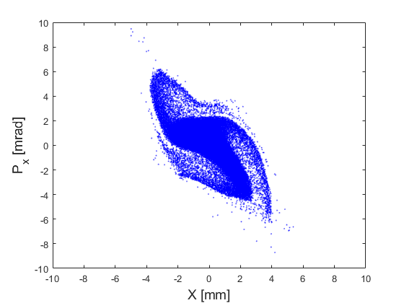


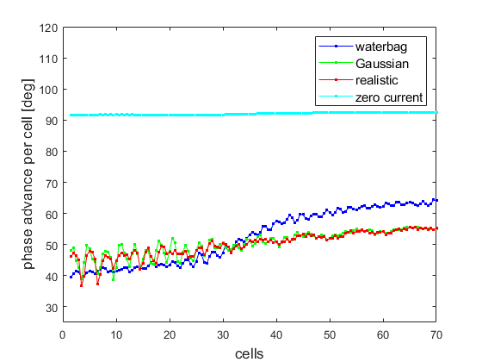
No 3rd order parametric instability for realistic beam
Jeon et al, Nucl. Eng. Technol. 58, 104379 (2026)
σ_{o}=92°, σ=40°, 80 mA
waterbag dist
Gaussian dist
realistic dist
σ_{ο}
3rd order parametric instability is not manifested for Gaussian or realistic distributions.
Realistic distribution from the emittance measurement of 35 mA SNS beam
σ

Slide 10
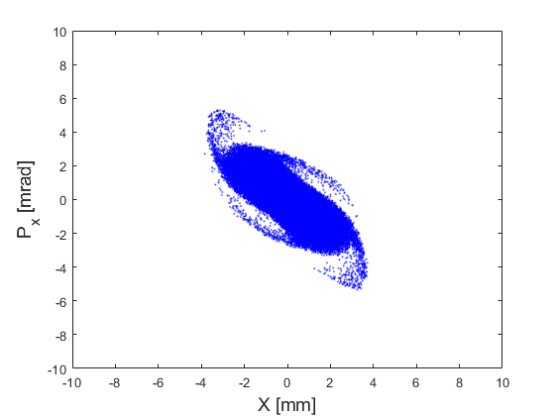


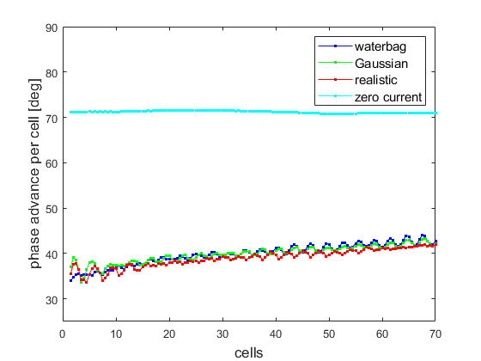
No 4th order parametric instability for realistic beam
Jeon et al, Nucl. Eng. Technol. 58, 104379 (2026)
σ_{o}=71°, σ=35°, 40 mA
waterbag dist
Gaussian dist
realistic dist
σ_{ο}
4th order parametric instability is not manifested for Gaussian or realistic distributions.
Realistic distribution from the emittance measurement of 35 mA SNS beam
σ

Slide 11
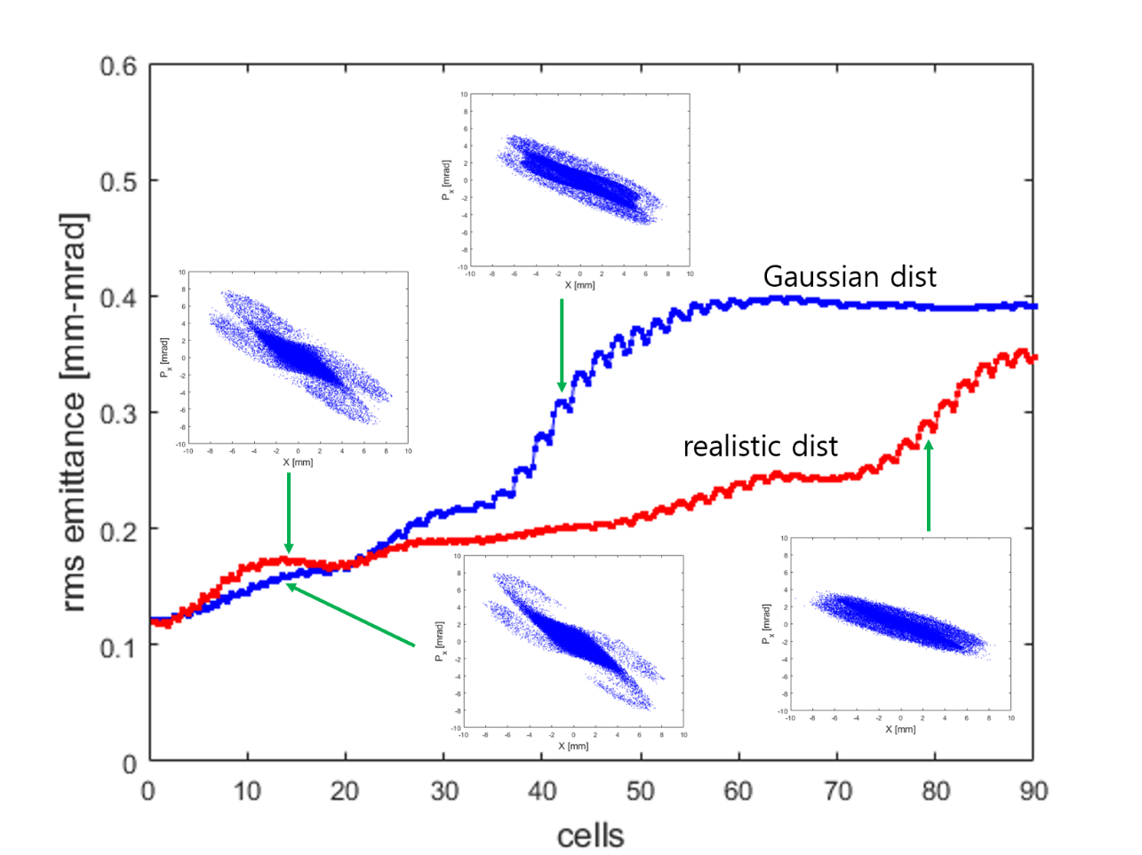
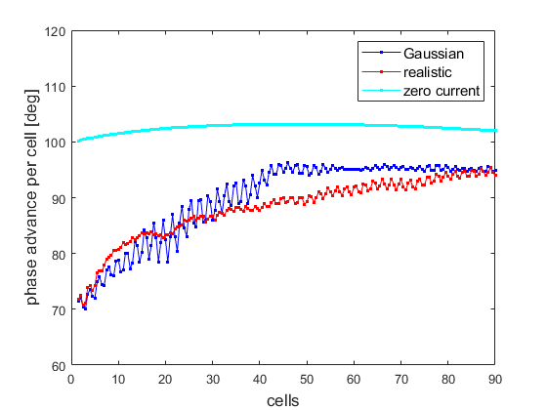
Envelope instability effect reduced for realistic distribution
Jeon et al, Nucl. Eng. Technol. 58, 104379 (2026)
σ_{ο}
Gaussian
realistic
σ=90°
σ
Realistic 35-mA beam
(SNS)
For realistic distribution, envelope instability onset is delayed, emittance growth reduced, but stronger 4th order particle resonance effect.
The envelope instability manifests in a linac when the 4th order resonance disappears (as σ goes above 90°).

Slide 12
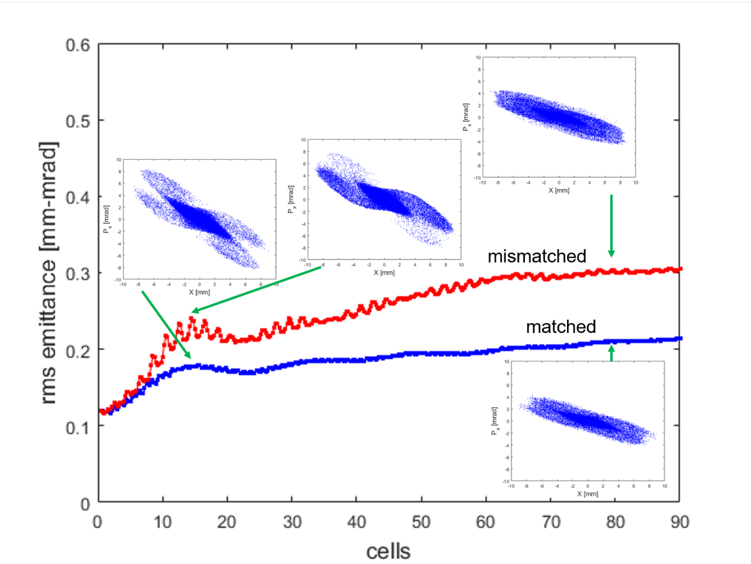
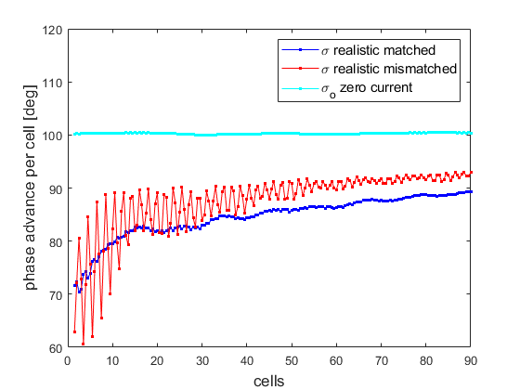
Mismatch effect for realistic distribution
σ_{ο}
mismatched
σ
matched
Initial mismatch does not excite the envelope instability, when σ stays below 90° (4th order resonance is active).
Mismatch by increasing β_{x} and β_{y} by 20%.

Slide 13
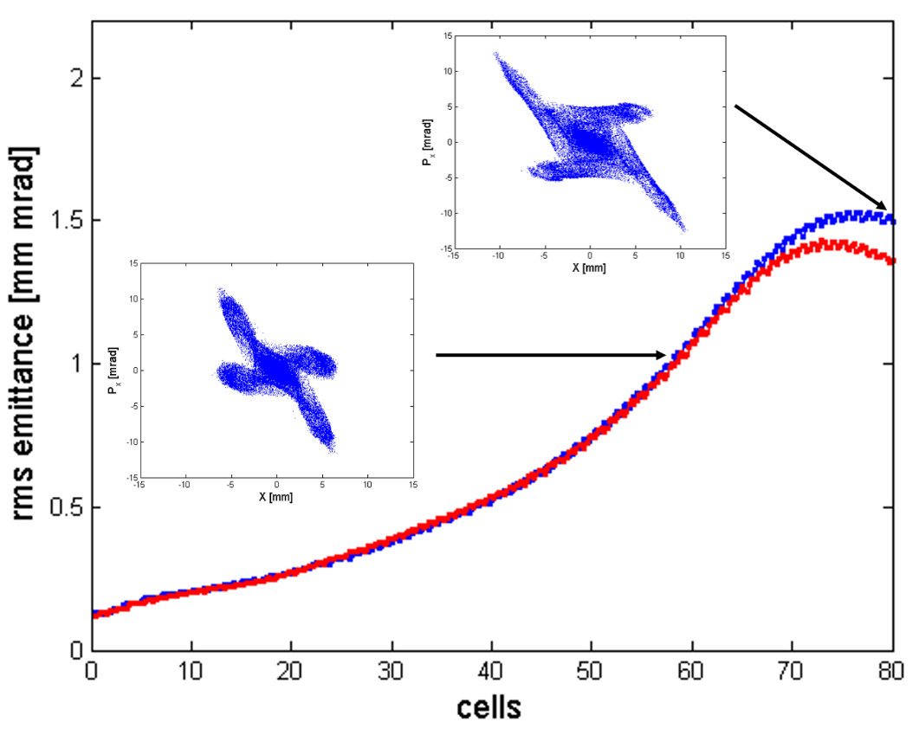
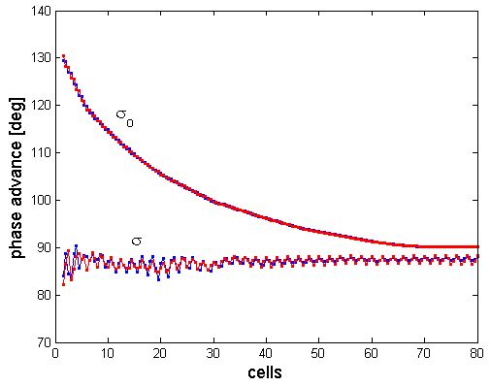
4th order particle resonance dominates over the envelope instability
σ = 87° linac
Gaussian distribution
The envelope instability is suppressed when 4th order resonance is active.
In circular accelerators, there are a web of resonances (lattice + space charge).
Is the envelope instability observable in 4ν=m resonance stopband?
13

Slide 14
In multi-particle simulations
4(σ_{o}-Δσcoh)
=180º
instability
waterbag
3(σ_{o}-Δσcoh)
=180º
instability
waterbag
4th order
resonance
non-KV
6th order
resonance
non-KV
8th, 10th order
resonance
non-KV
σ=30°
2
σ=60°
σ=90°
1
σ=120°
σ=135°
4(σ_{o}-Δσcoh)
=180º
instability
KV
4(σ_{o}-Δσcoh)
=360º
instability
KV
envelope
instability
non-KV, KV
In region , parametric instabilities of higher than 2nd order are not manifested for non-KV beams.
In region , parametric instabilities are manifested for waterbag beam, but not for Gaussian.
Envelope instability manifests when 4th order resonance disappears.
1
2
14

Slide 15
In actual linear accelerators
4th order
resonance
non-KV
6th order
resonance
non-KV
8th, 10th order
resonance
non-KV
σ=30°
σ=60°
σ=90°
σ=120°
σ=135°
envelope
instability
non-KV
Only particle resonances and the envelope instability are observable in actual linear accelerators.
High order parametric instabilities are like dragons in an imaginary world; they are not seen in real world.
15

Slide 16
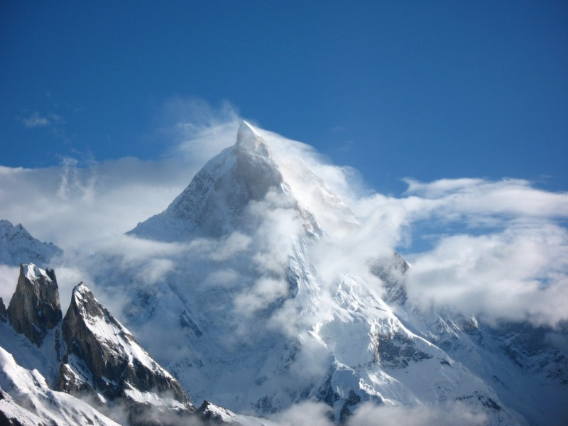
Thank you for your attention!

Slide 17
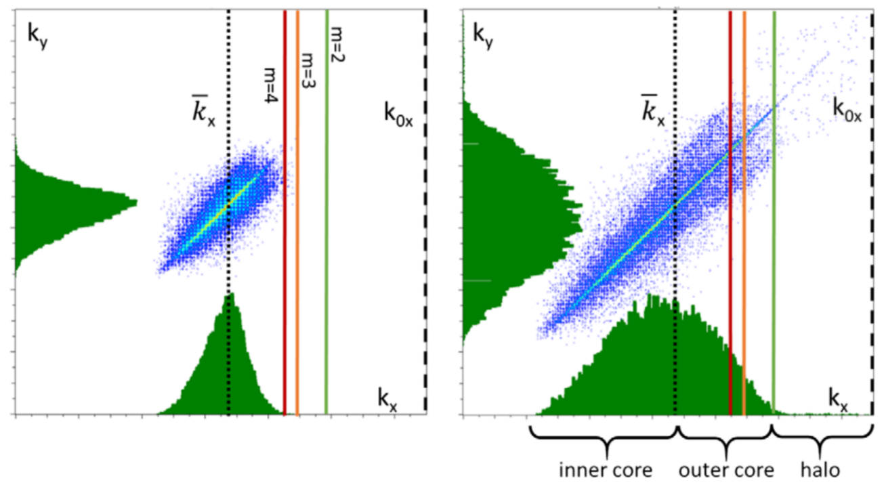
Parametric instabilities in actual linacs?
Landau damping suppresses most of parametric instabilities except the envelope instability for Gaussian distribution.
Only the envelope instability is observable in actual linacs.
Hofmann et al, PRAB 24, 024201 (2021)
Waterbag distribution
Gaussian distribution
17

Slide 18
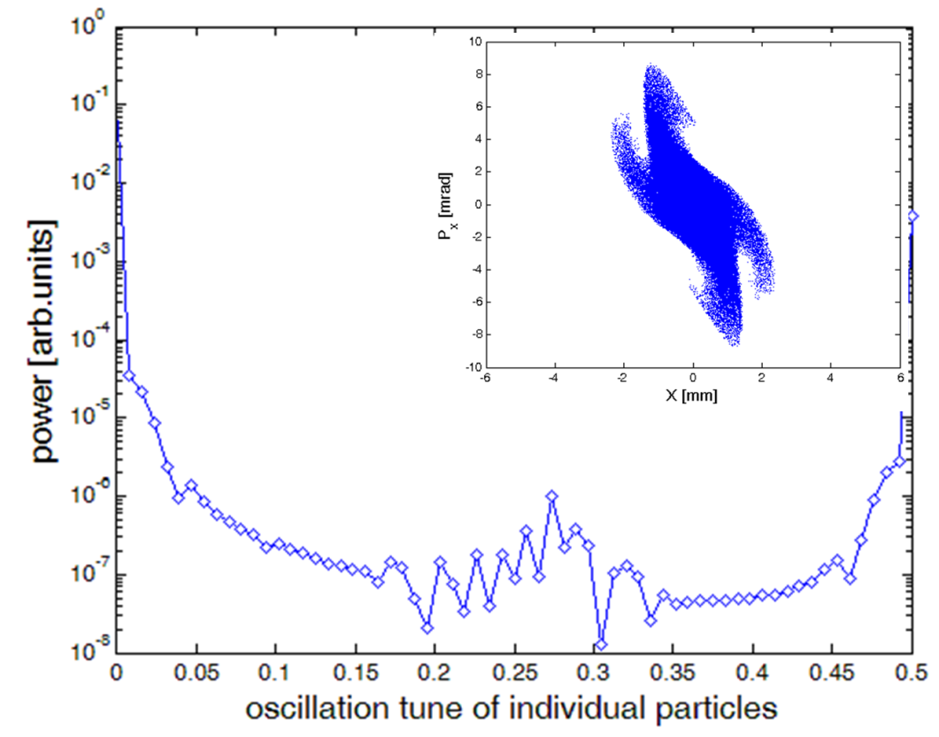
Parametric Instability vs Particle Resonance
Jeon, J Korean Phys Soc 72, 1523 (2018)
KV distribution
Gaussian dist.
σ_{o}=112°
σ=85°~93°
4(σ_{o}-Δσcoh)=360º
parametric instability
4σ=360º
particle resonance
FFT resonance frequency for the particle resonance.
No FFT resonance frequency for the parametric instability.

Slide 19
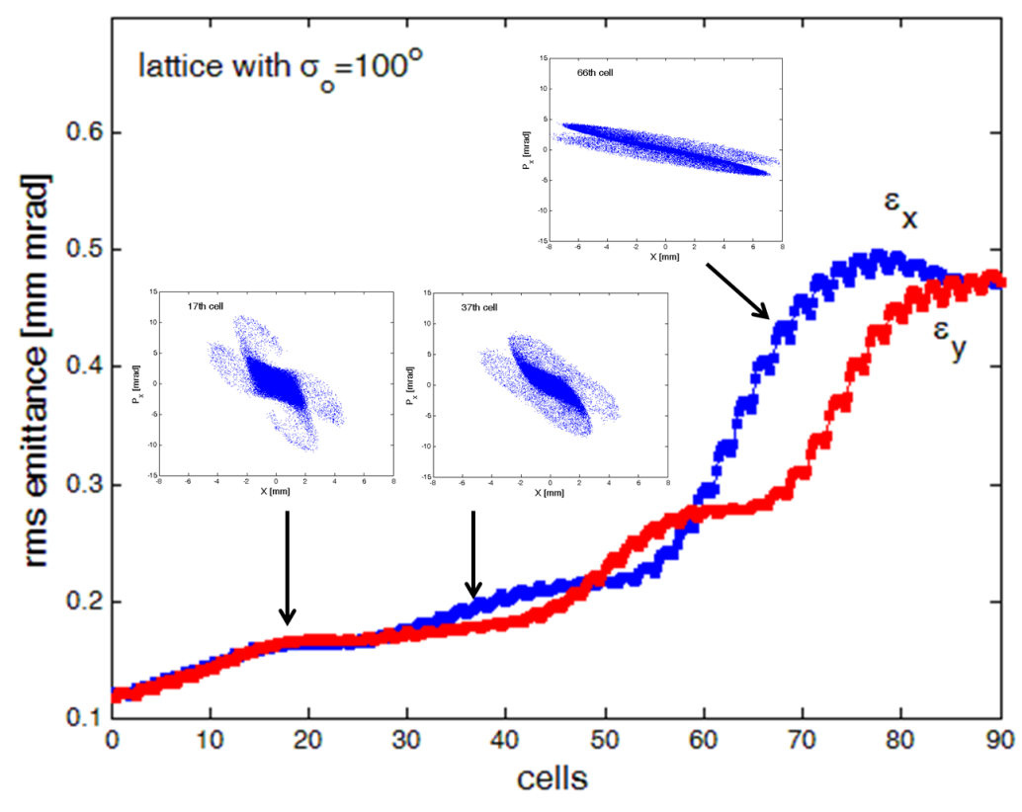
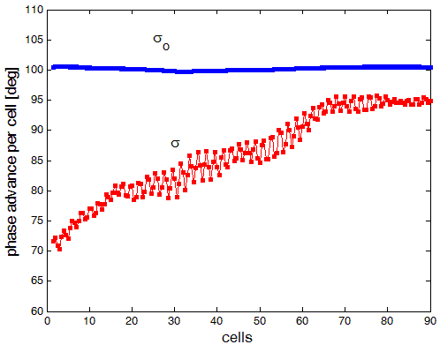
When does the envelope instability develop?
Jeon et al, NIM A 832, 43 (2016)
Gaussian dist.
σ_{o} = 100° linac
The envelope instability manifests in a linac when the 4th order resonance disappears (as σ goes near and above 90°).
The 4th order particle resonance is dominant over the envelope instability.
19

