Slide 1
Experimental and Simulation Studies of Non-linear Resonances in the ISIS Synchrotron
SPACE CHARGE 2026 · 7TH ICFA BD MINI-WORKSHOP
Esmaeil Ahmadi
Chris Warsop
Hayley Cavanagh
ISIS Neutron and Muon Source · STFC Rutherford Appleton Laboratory
Session A-4 · Beam Loss and Halo Dynamics · Oxford · 2 October 2026

Slide 2
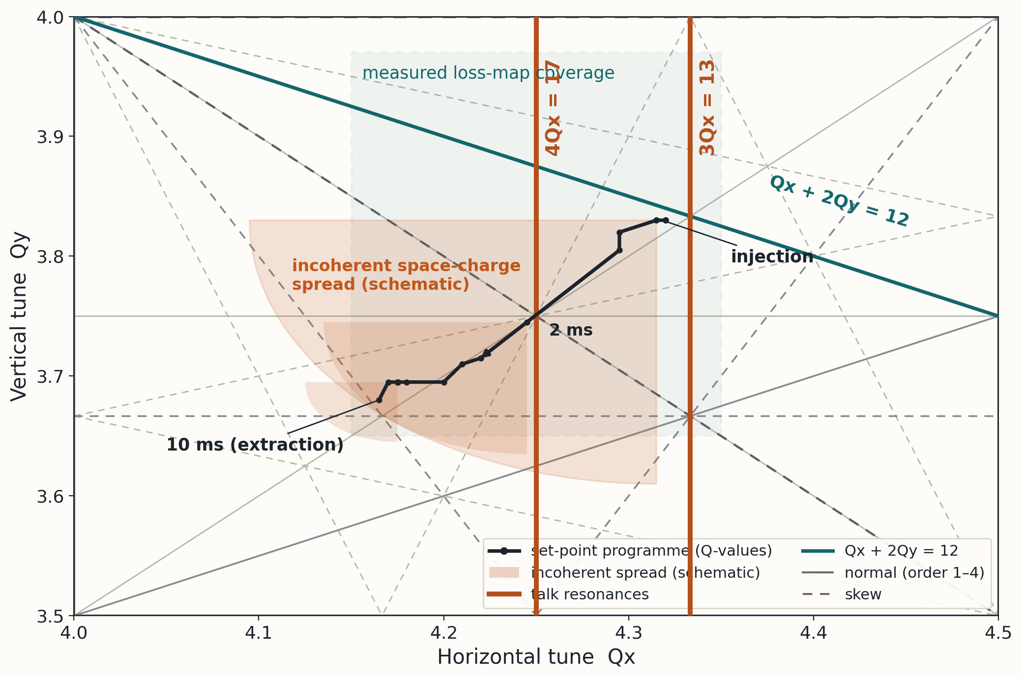
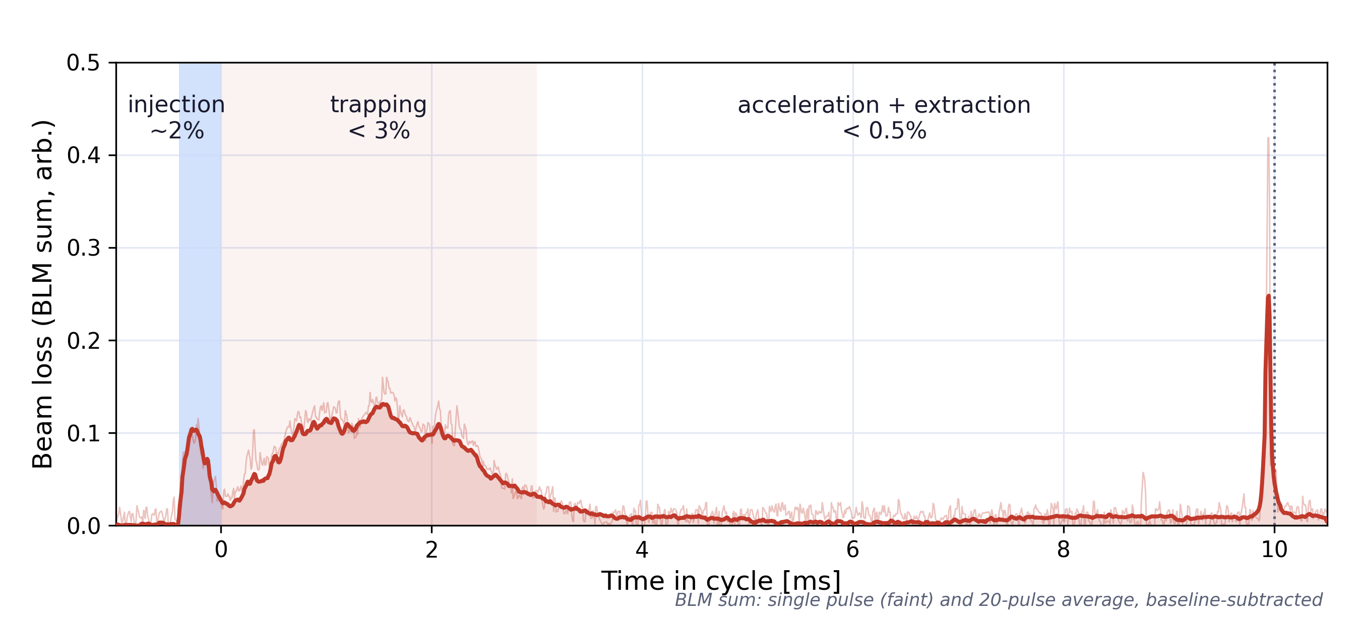
MOTIVATION
THE ISIS TUNE FOOTPRINT SAMPLES NON-LINEAR RESONANCES
The incoherent tune spread at injection is 0.4 to 0.5 — the footprint simply cannot avoid all the low-order lines
ISIS operation is not about avoiding these resonances — it's about choosing where the footprint sits and how fast particles sweep across the lines
Measurement-based setup on benchmarked models — we are measuring the machine in more detail than ever. Better models give a better basis for operations, improved understanding, and push the high-intensity limit
ISIS loss budget

Slide 3
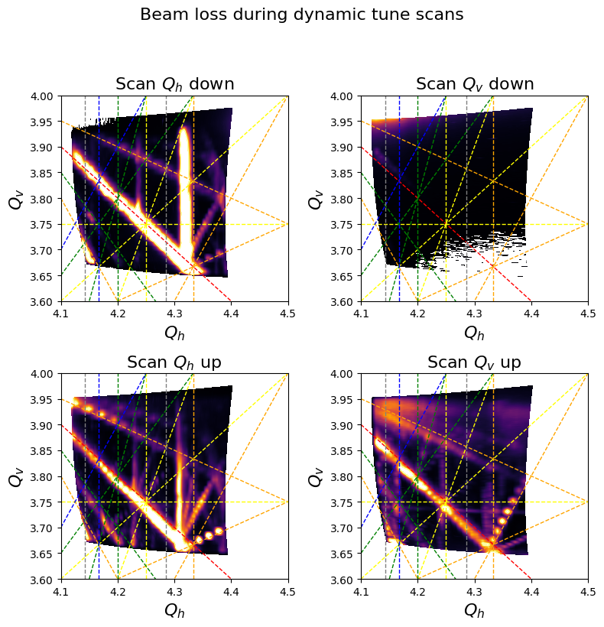
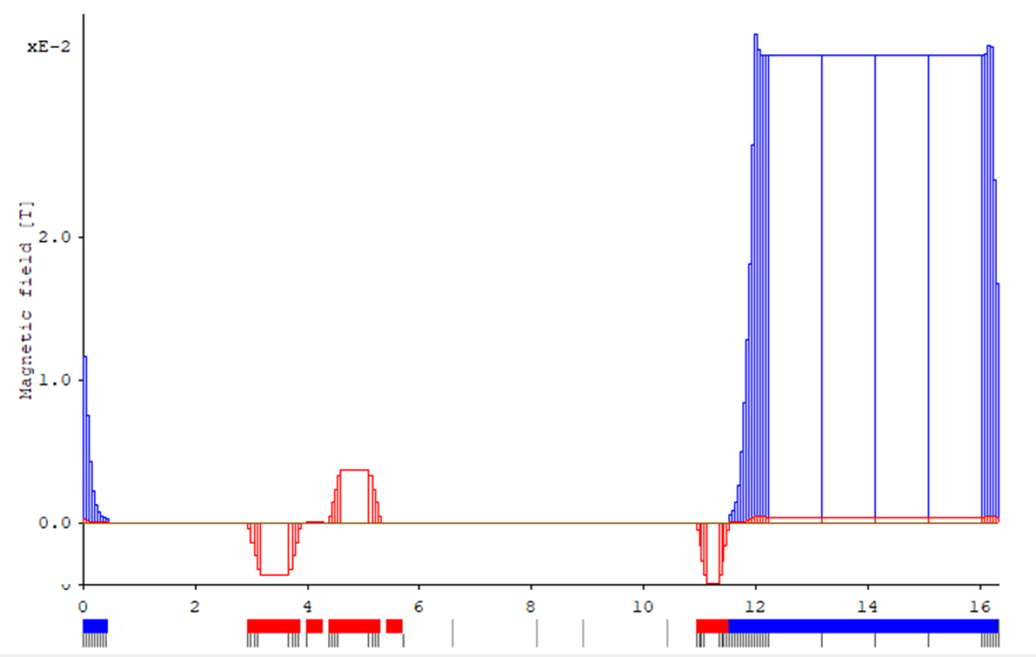
Measurement meets the model?
MEASUREMENTS
At ISIS the dipole bending radius is small and the aperture large — so fringe fields are strong.
How do we model the machine's nonlinearity?
Does the model reproduce the measurements?
Sliced model of the lattice
Dynamic tune scan:
A fingerprint of the machine's error content
Up/down crossing asymmetry
Stop band width

Slide 4
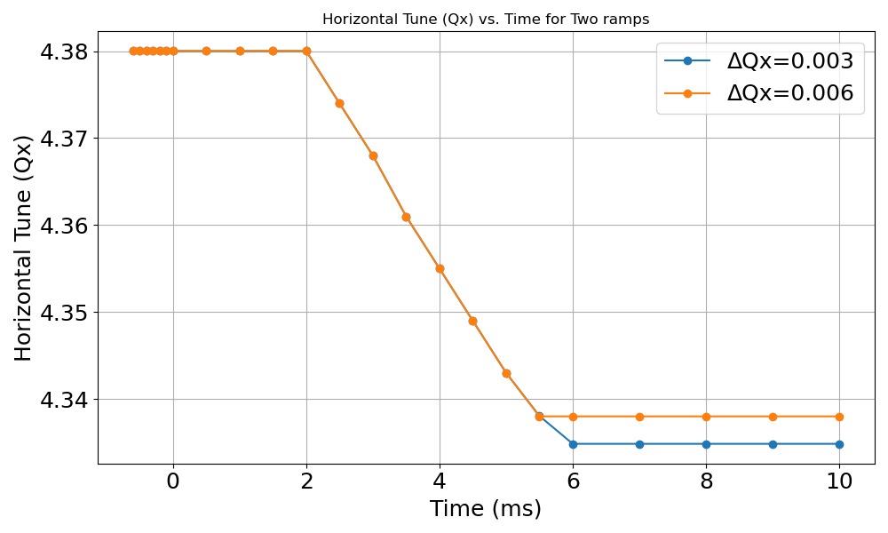
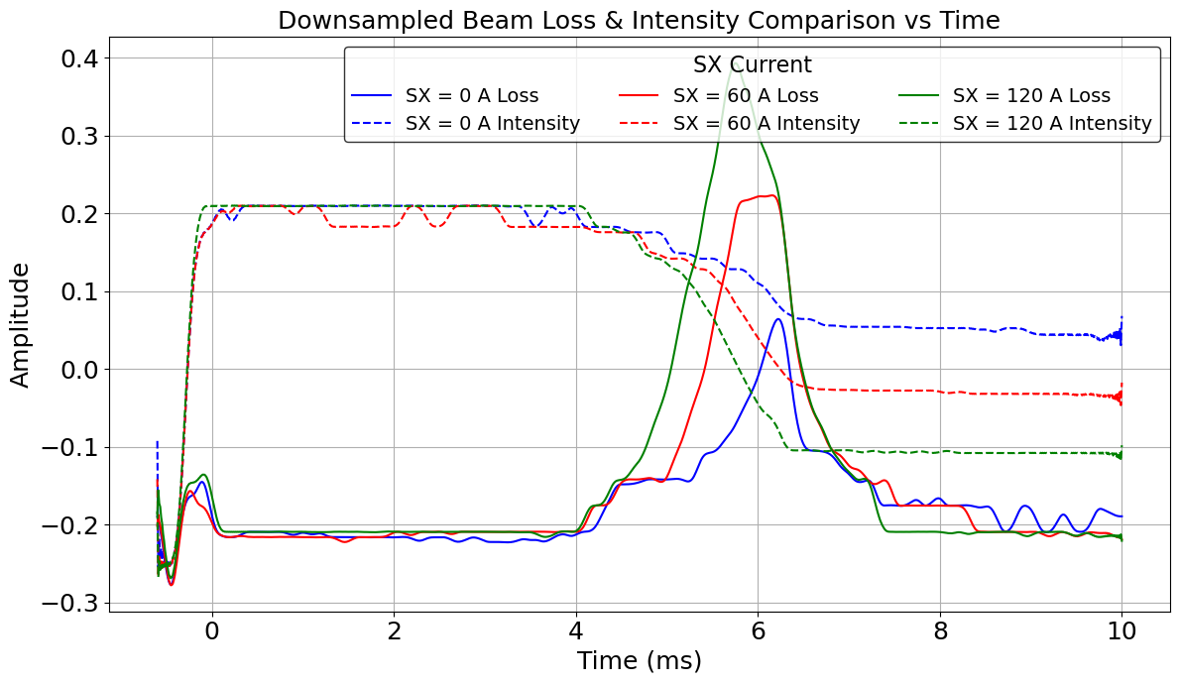
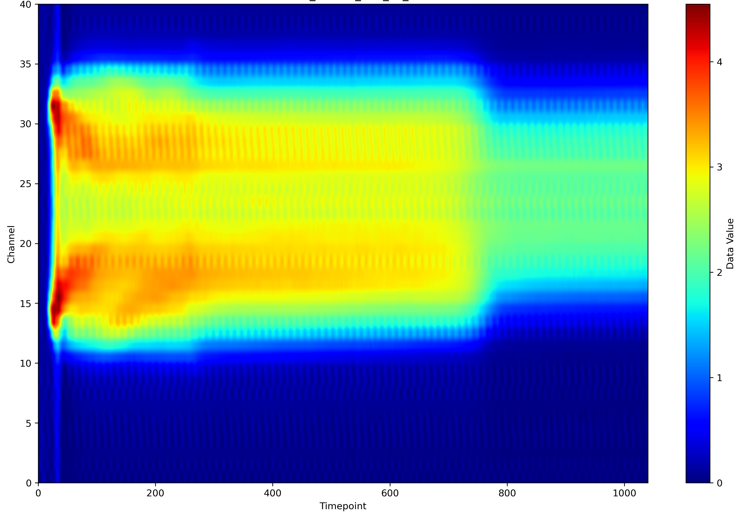
Ramp the tune, record everything, simulate the same ramp(Coasting beam, low intensity)
METHOD
1
2
3
4
Ramp the tune
Record the loss
Watch the halo
Simulate the ramp
Dynamic Qh and Qv ramps across the resonance, from below and from above; fiducial-corrected tunes
Ring-summed beam-loss monitors plus the intensity monitor, through the crossing
R6HPM1 / R6VPM2 profile monitors: tails and halo forming as the beam crosses
The identical dynamic tune ramp in Xsuite (two trim families) — not a static tune grid
Q ramp
Beam loss while approaching the resonance
Beam Profile (RGI)

Slide 5
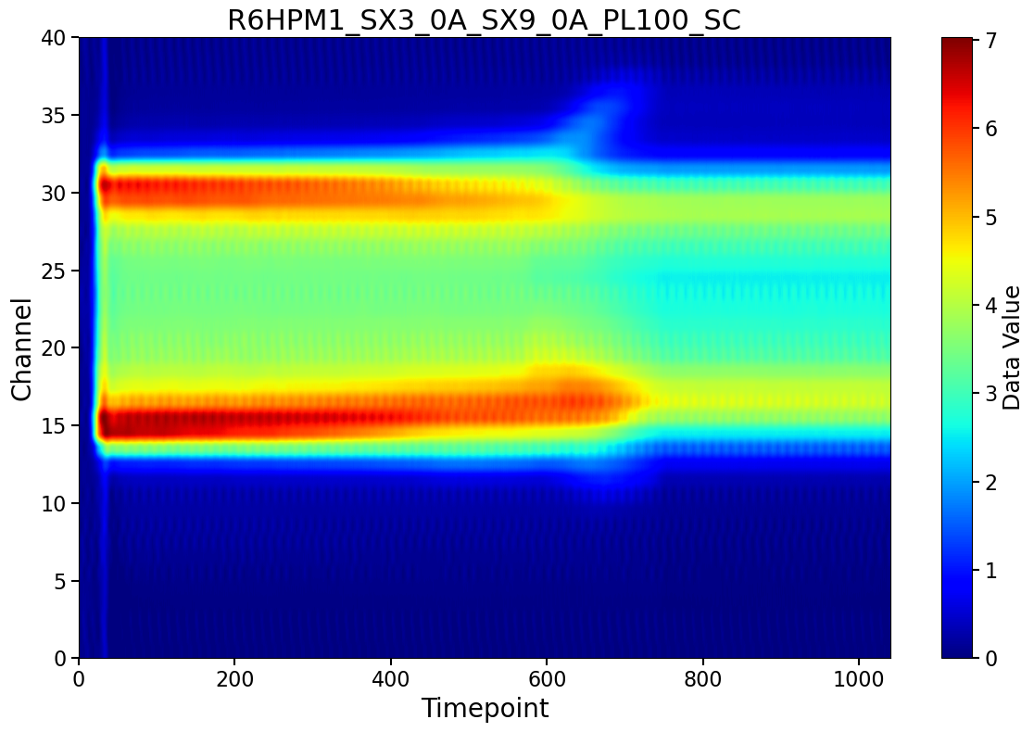
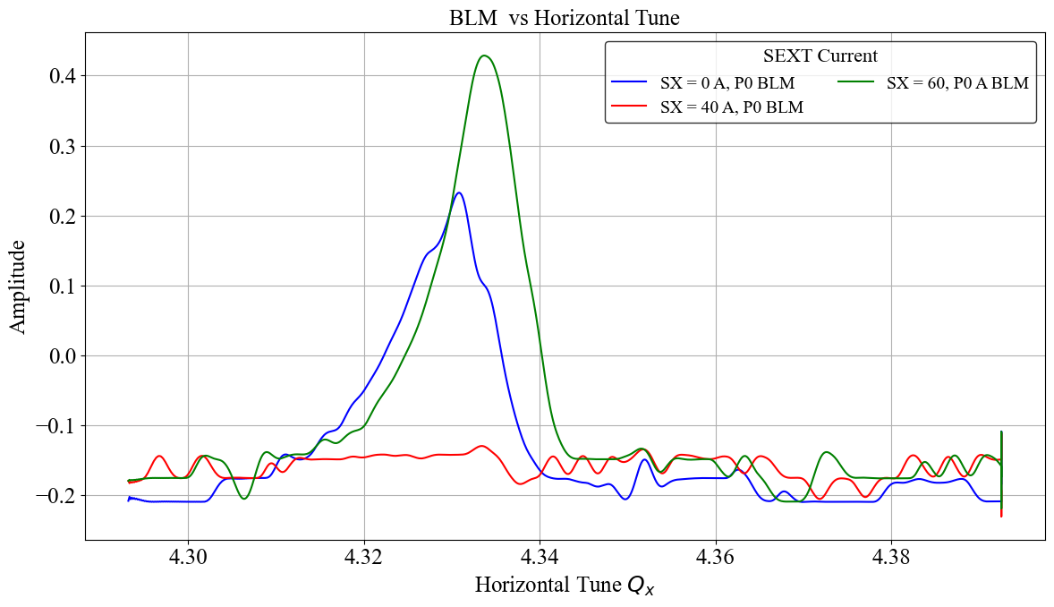
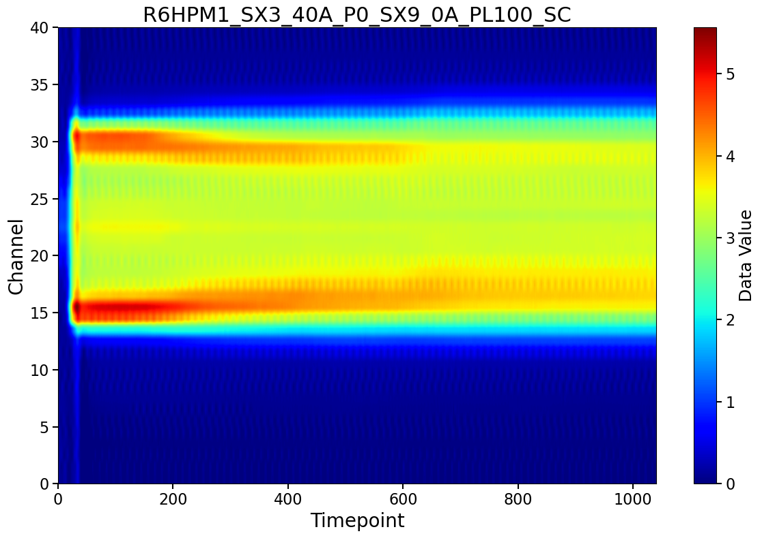

Nonlinear model calibration
Sextupole compensation of the residual 3Qₓ = 13 error
Qx=4.333
Beam loss vs Qx along the ramp
Beam profile with residual
Sextupole exciting 3Qx=13
Loss from residual sext error
Over drive with sextupole
Compensate by one DC sextupole
Beam profile after sextupole compensation
Tune ramp direction
3$Q_{x}$=13

Slide 6
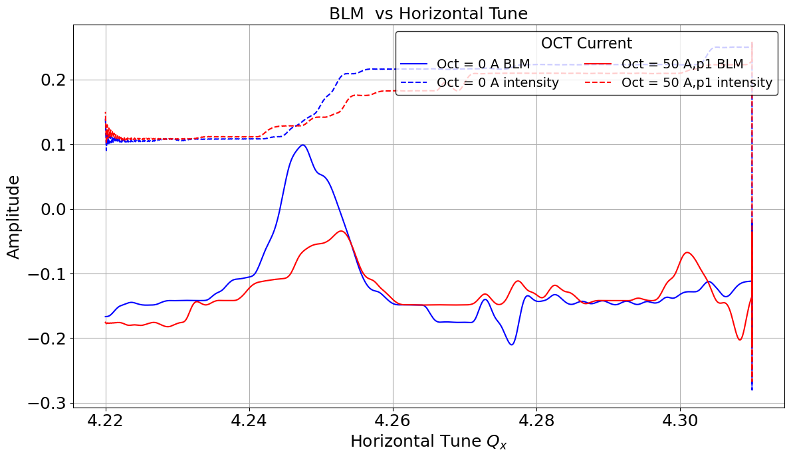
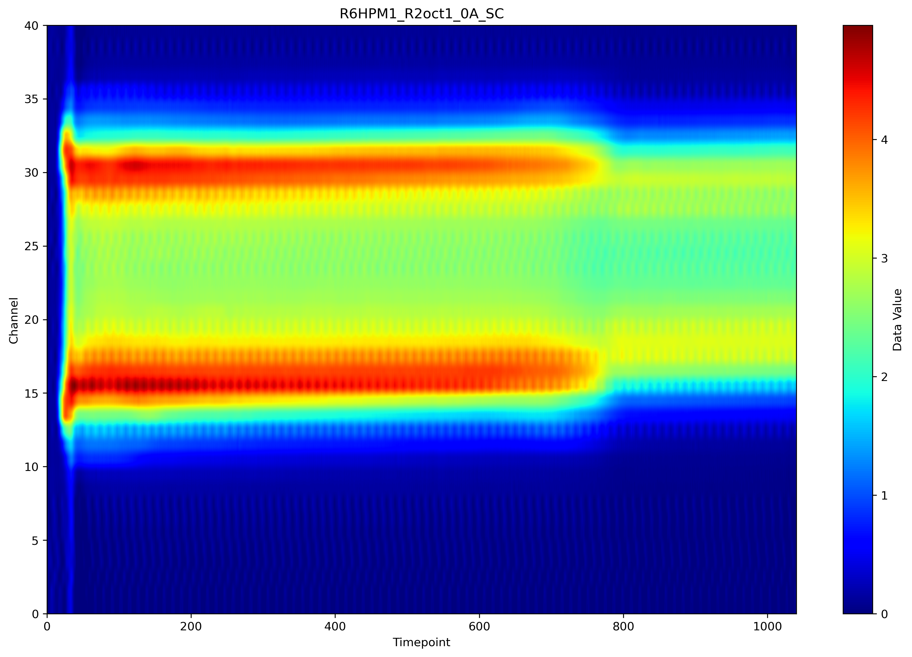
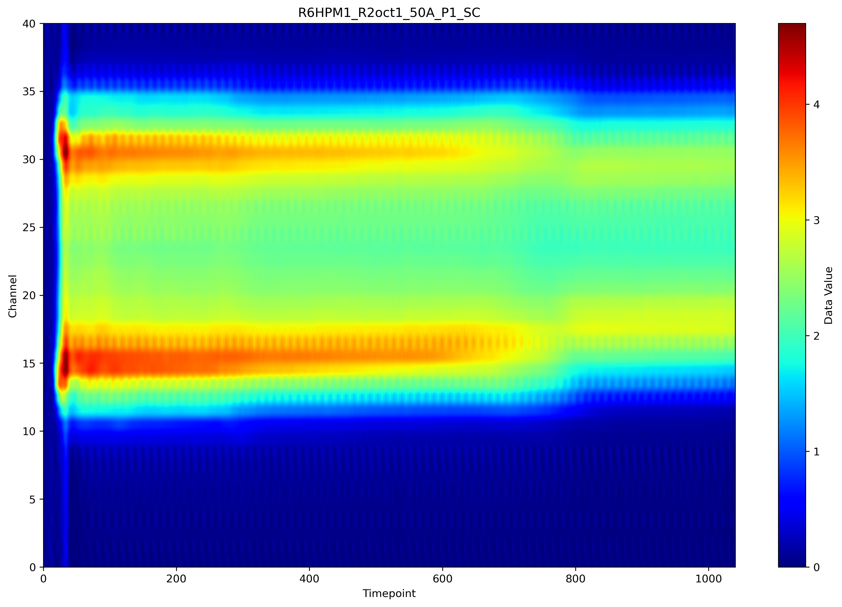

Nonlinear model calibration
Octupole compensation of the residual 4Qₓ = 17 resonance
Qx=4.25
BLM and intensity vs Qx across the 4Qx = 17 crossing
Beam profile with residual
octupole
Loss from residual octupole error
Tune ramp direction
4$Q_{x}$=17
Beam profile after octupole compensation
A single DC octupole at 50 A partially compensates the crossing — k₃L = 1.10 m⁻³ at the null (0.15701·I·L_eff / Bρ, L_eff = 0.1719 m)

Slide 7
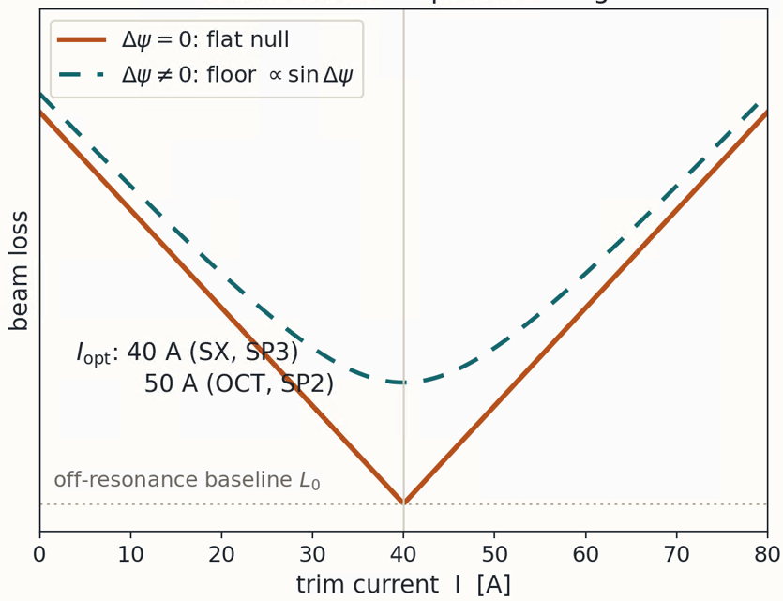
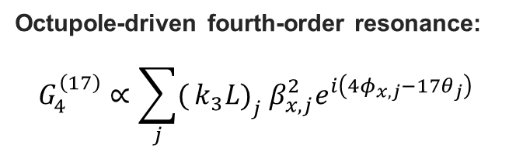
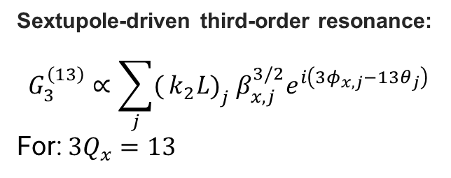
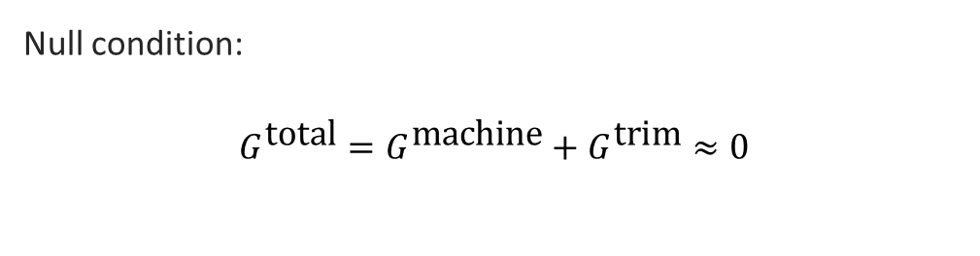
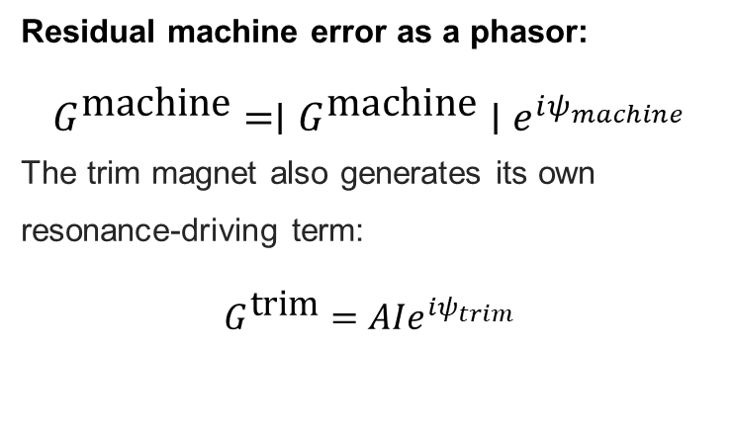
Compensation theory: one phasor per resonance
Null condition:
$$G^{\text{total}}=G^{\text{machine}}+G^{\text{trim}}≈0$$
Sextupole-driven third-order resonance:
$$G_{3}^{\left(13\right)}∝\sum_{j}{(}\left.k_{2}L{\left.)\right.}_{j} β_{x,j}^{3/2}e^{i\left(3φ_{x,j}−13θ_{j}\right)}\right.$$
For: $3Q_{x}=13$
Why one magnet is enough: 13 and 17 are not multiples of P = 10, so symmetric magnet families cancel at these harmonics — the residual is symmetry-breaking, and a single symmetry-breaking trim can null it
Octupole-driven fourth-order resonance:
$$G_{4}^{\left(17\right)}∝\sum_{j}{(}\left.k_{3}L{\left.)\right.}_{j} β_{x,j}^{2}e^{i\left(4φ_{x,j}−17θ_{j}\right)}\right.$$
Residual machine error as a phasor:
$$G^{\text{machine}}=∣G^{\text{machine}}∣e^{iψ_{machine}}$$
The trim magnet also generates its own resonance-driving term:
$$G^{\text{trim}}=AIe^{iψ_{trim}}$$

Slide 8
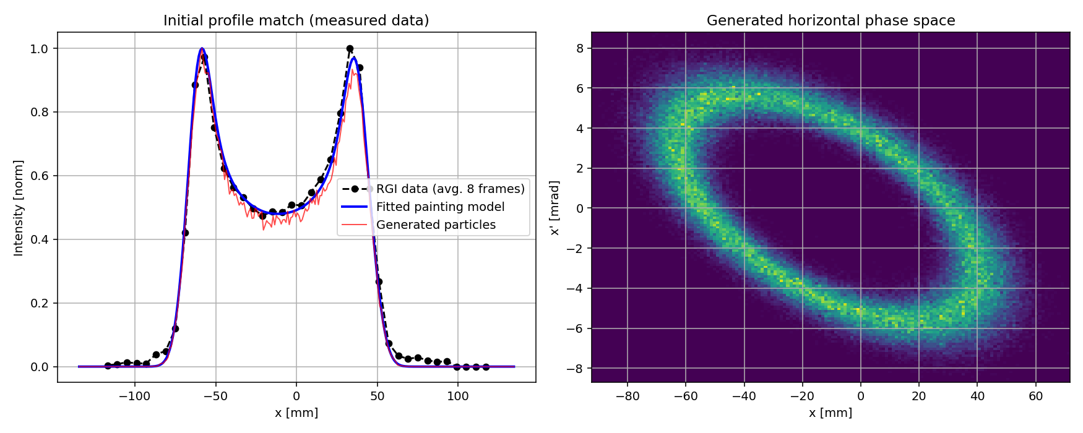
Modelling nonlinearity near resonance 3Qx=13
Initial distribution from fitting profile monitor data
The initial coasting beam is a hollow beam.

Slide 9
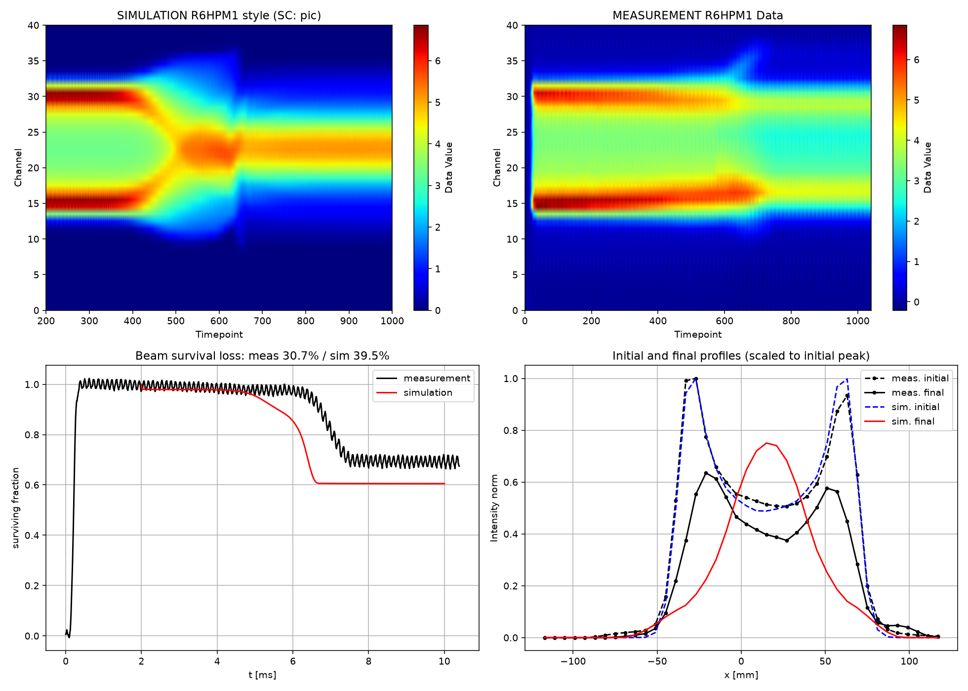
Modelling nonlinearity near resonance 3Qx=13
simulation
experiment
Only the compensating sextupole is included in the model.
Profile:
Intensity (N=8.5e11pp)effect included via PIC calculation
Initial distribution
Beam survival
Final distribution (Experiment and model)

Slide 10
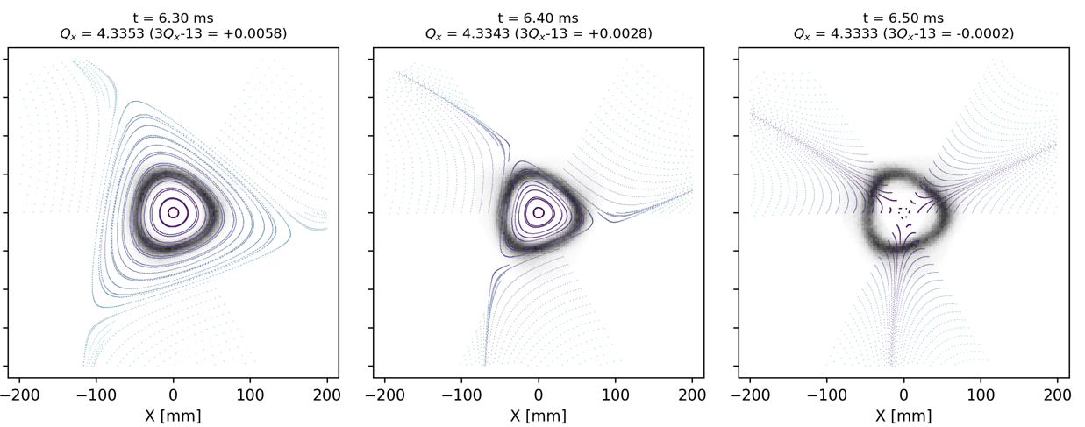
Modelling nonlinearity near resonance 3Qx=13
Phase space near resonance with only sextupole
The separatrix shrinks as the tune ramps — particles are peeled off along it.

Slide 11
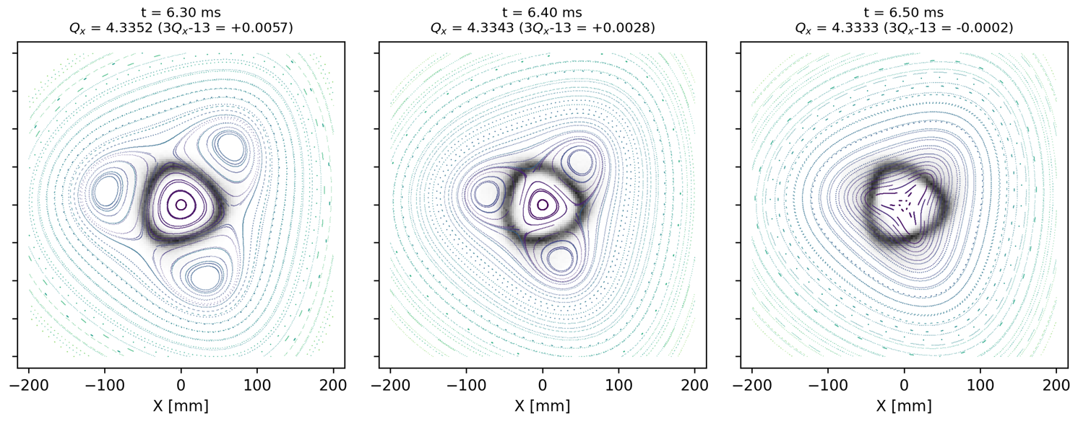
Modelling nonlinearity near resonance 3Qx=13
Additional fixed points appear when the octupole error is added
Appearing more fixed points by adding octupole error to the model

Slide 12
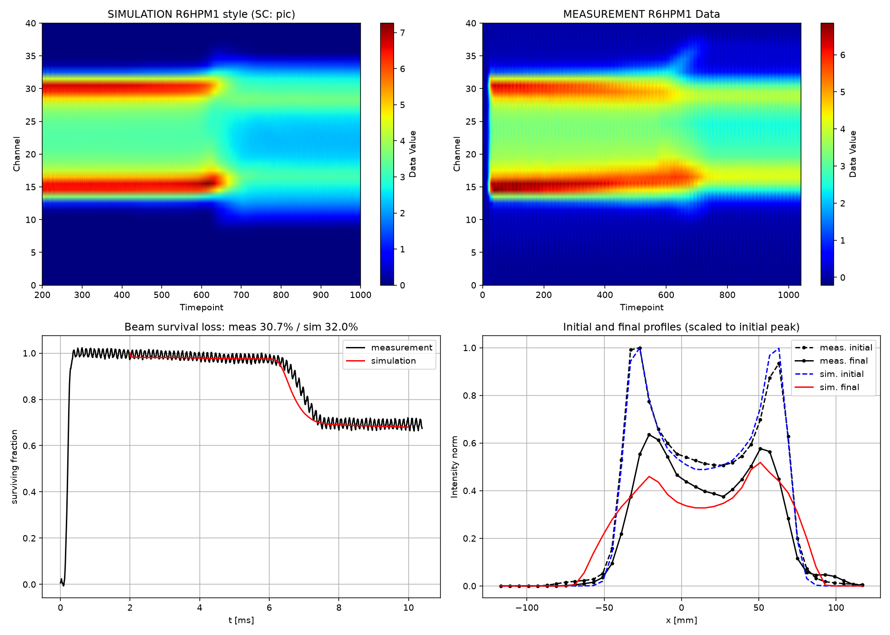
Modelling nonlinearity near resonance 3Qx=13
simulation
experiment
the predicted octupole error had to be increased by a factor of two to fit the model to experiment.

Slide 13
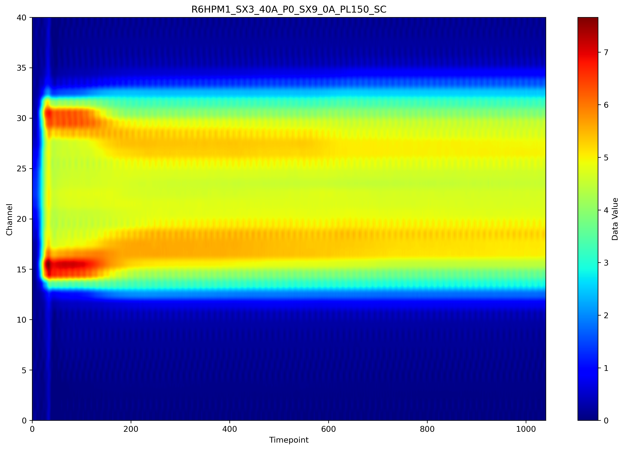
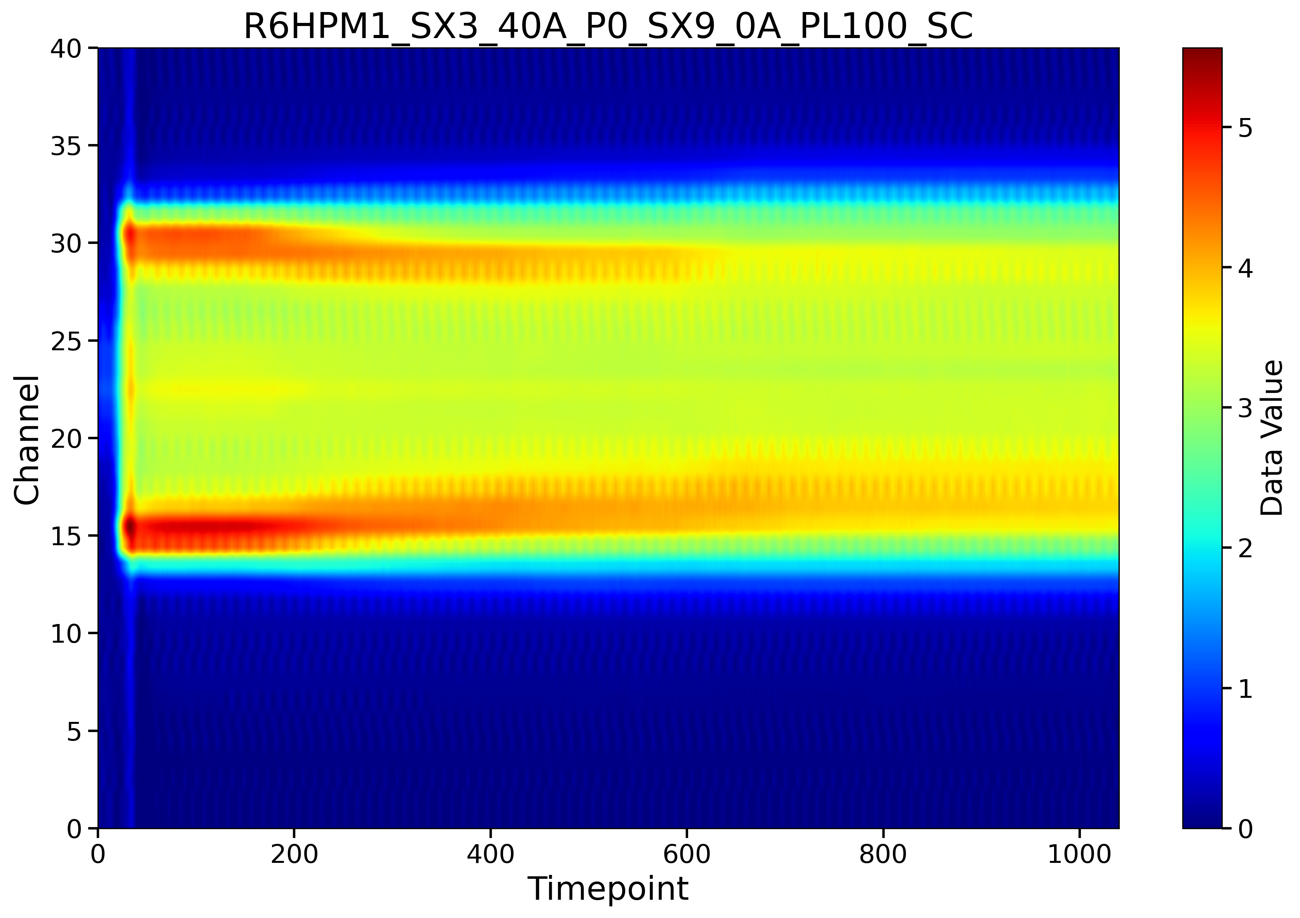
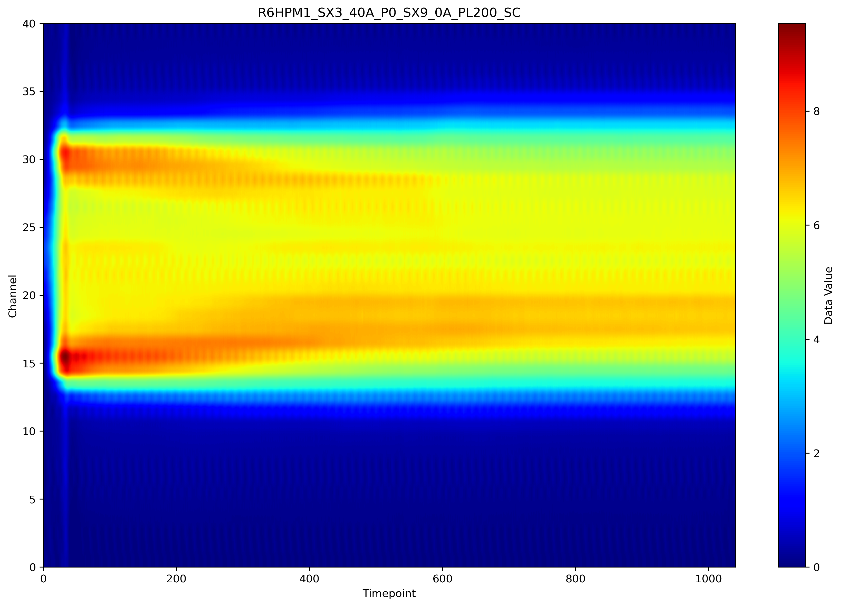
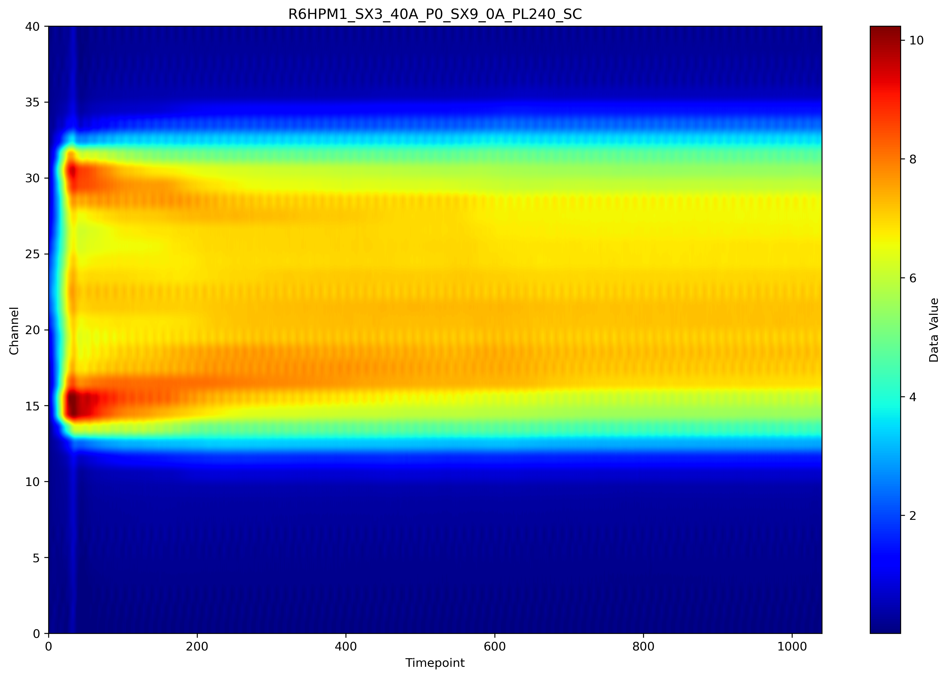
How 3Qx=13 compensation works with increasing beam intensity
N=8.0e11 ppp
N=1.5 e12 ppp
N=2.0 e12 ppp
N=3.3 e12 ppp

Slide 14
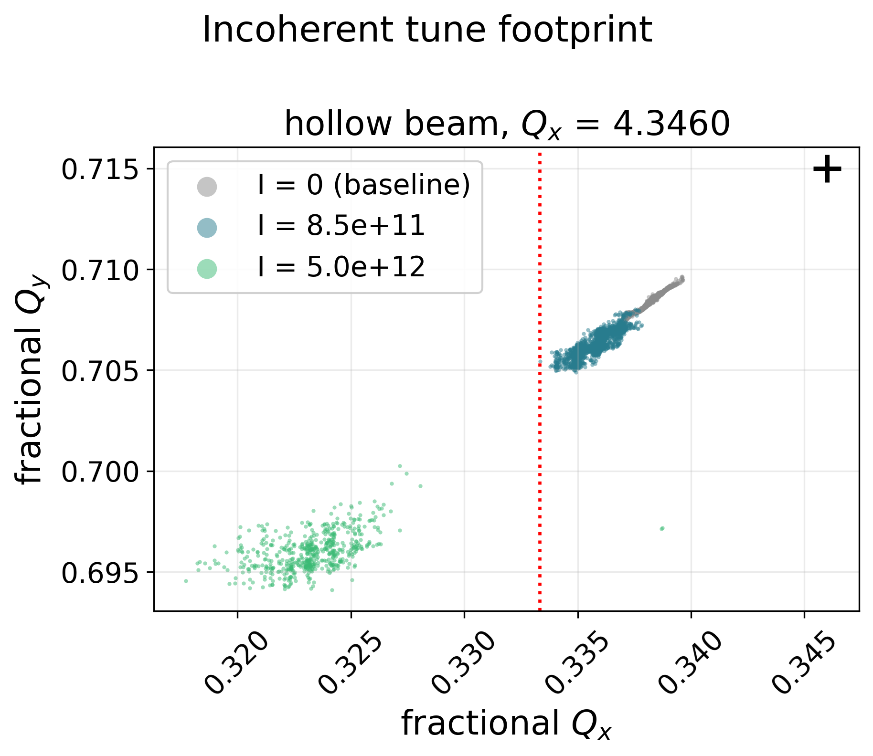
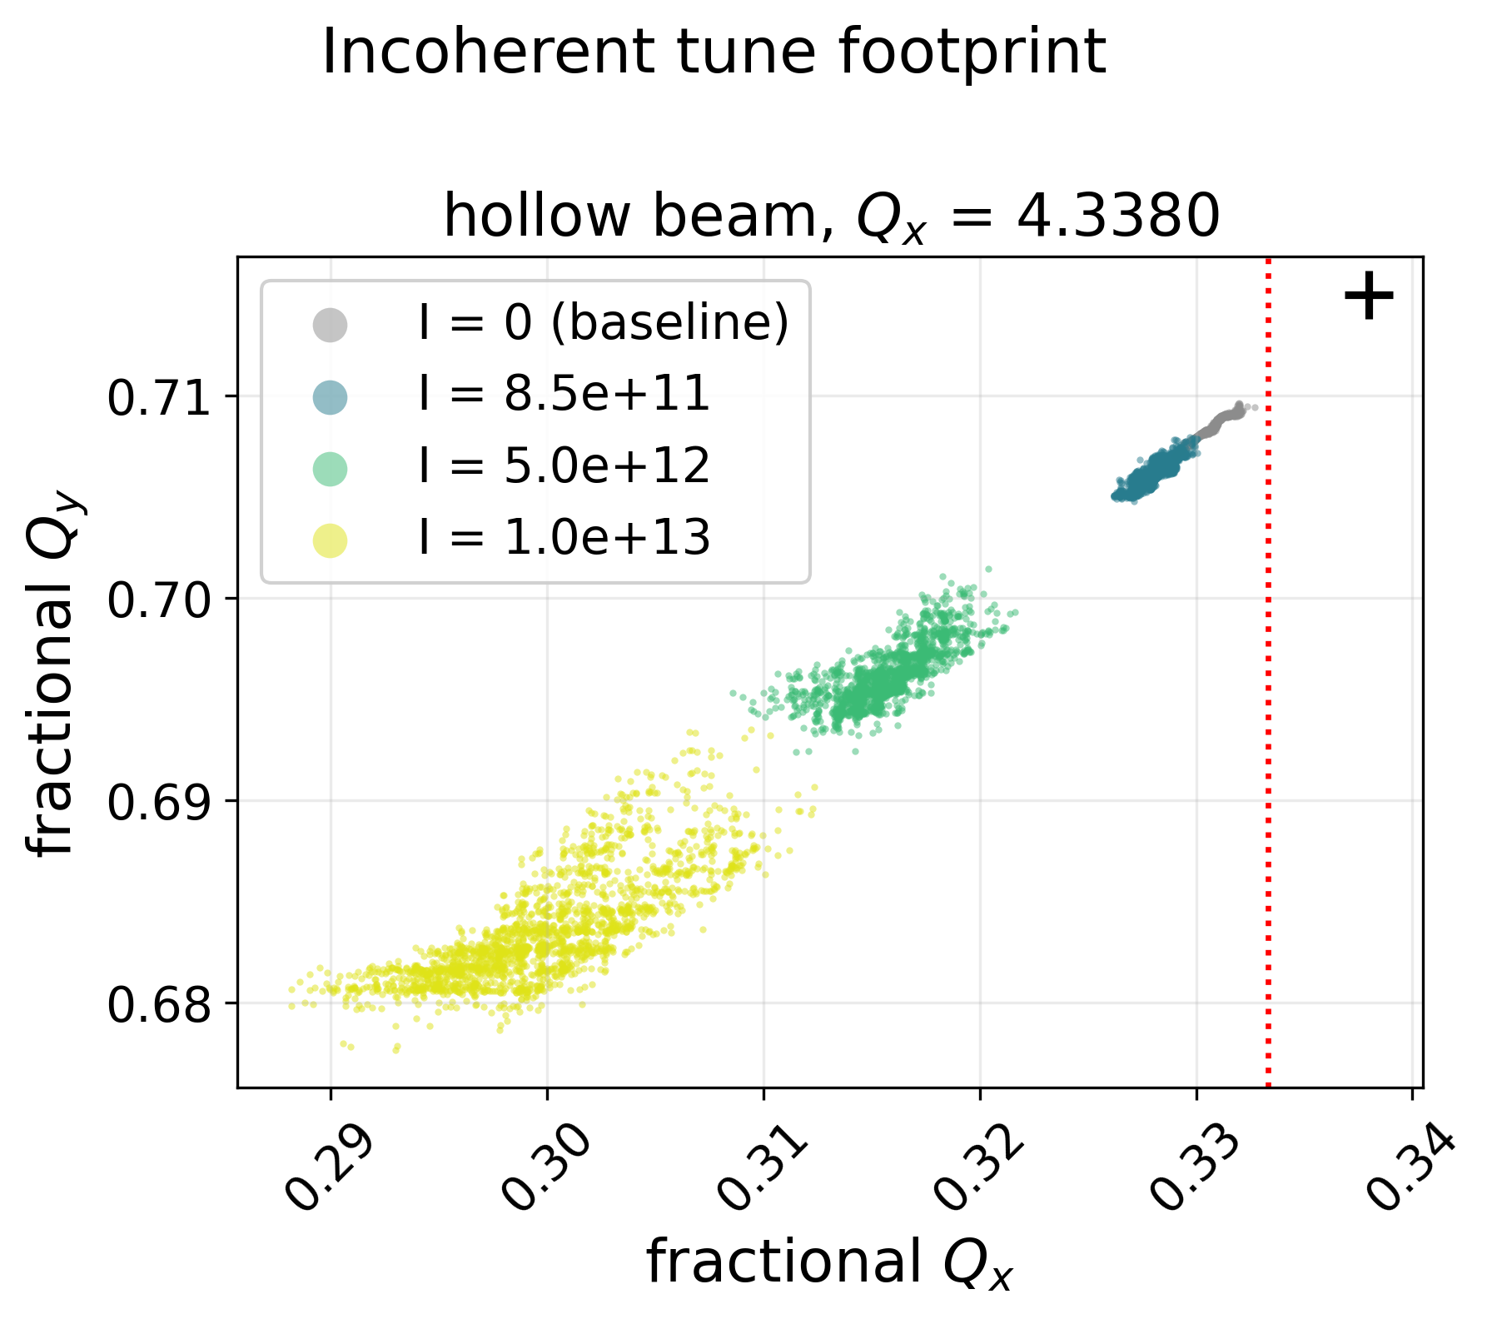
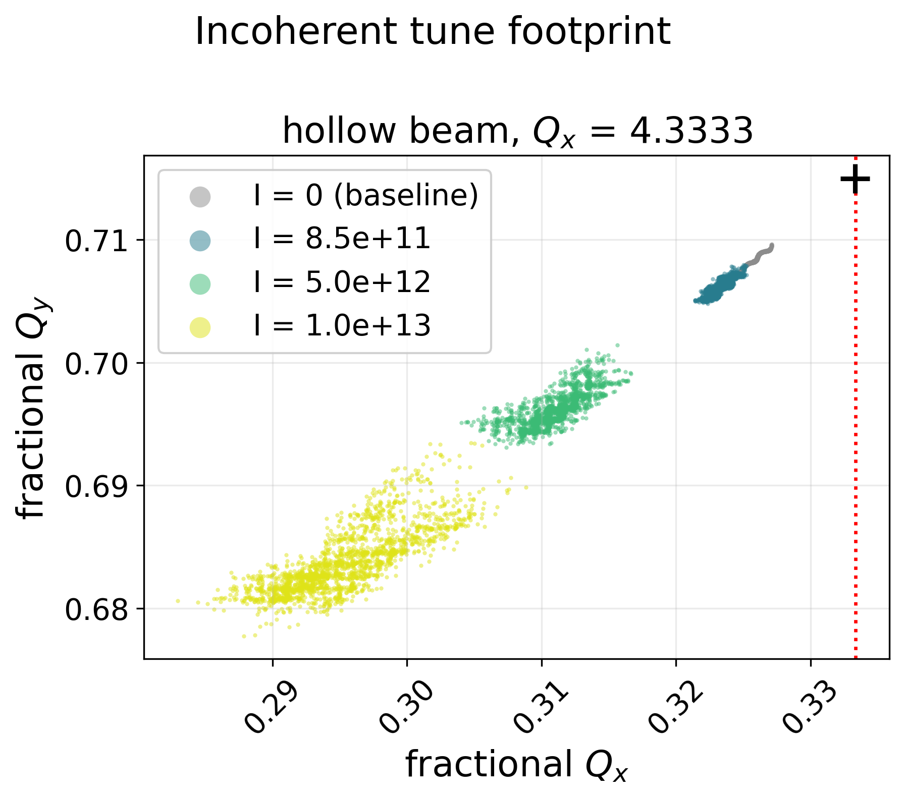
Tune footprints under space charge at different tune points
Set tune
The footprint touches 3Qx = 13 before the set point does, so the beam crosses a resonance the tune programme never does

Slide 15
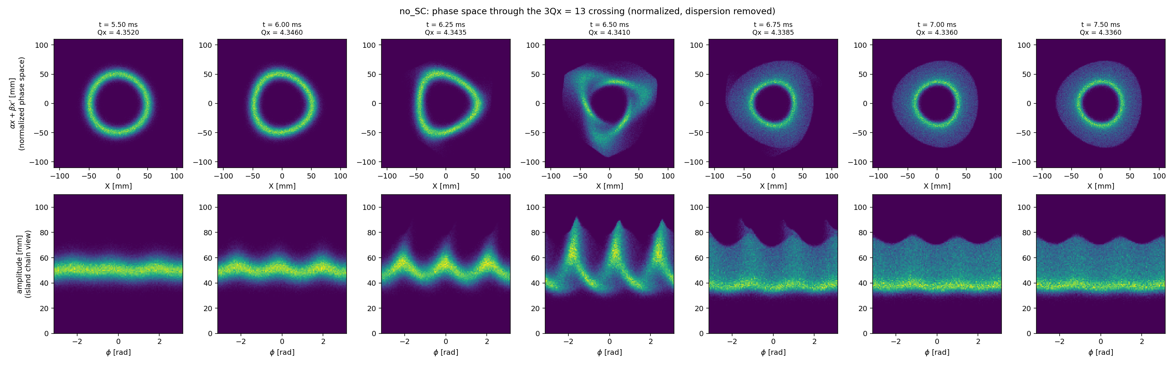
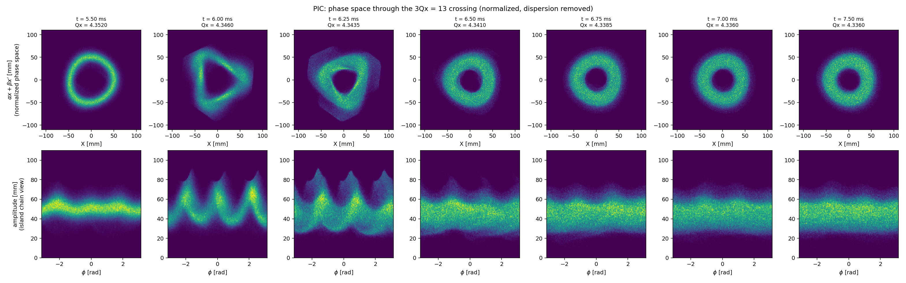
Phase space near resonance during tune ramp
Tune ramp direction
Zero intensity
Intensity = 8.5×10¹¹ ppp
3Qx = 13 island chain sweeps through the beam and transports trapped particles to large amplitude — with space charge the islands broaden and carry more of the core.

Slide 16
Summary and conclusion
Measured tune loss maps fingerprint the machine: loss concentrates on 3Qx = 13 and Qx + 2Qy = 12, with a strong up/down crossing asymmetry — the observable everything else must explain
One DC magnet per resonance: a single sextupole at 40 A flattens 3Qx = 13; a single octupole at 50 A nulls 4Qx = 17 — coasting beam, tunes held; |f₃₀₀₀|, |f₄₀₀₀| of the bare machine measured at the nulls
The residual error reproduces the crossing by chromatic selection — mechanism right, magnitude wrong: the same sextupole strength does not give the same loss in the simulation
Measurement-anchored PIC: the footprint reaches 3Qx = 13 before the set point does— redistribution starts early and ends in a flat halo plateau.
The mechanism is resonant trapping–transport: the beam deforms into the 3Qx = 13 triangle and trapped particles ride outward; space charge broadens and feeds the chain
Next: Study stopband position, coherent vs incoherent — a stability diagram to optimize the operational tune program.

Slide 17
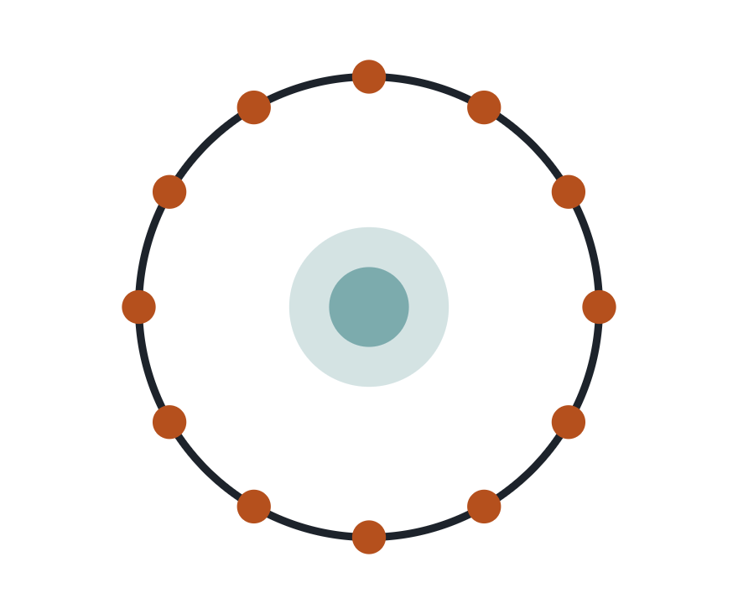
Add space charge: measurement-anchored PIC
Solver
Xsuite PIC on the same dynamic tune ramp · averaged 2.5D FFT solver · 200 space-charge interaction nodes · verified against internal deposition, field and kick tests
Beam, anchored to monitors
Horizontal: fitted painted annulus 48.5–63.2 mm (R6HPM1) · Vertical: fitted hollow profile (R6VPM2) · Bounded parabolic δ, edge 3.0×10⁻⁴, mean 1.55×10⁻³
Scan
Intensity 0 → 2.5×10¹² ppp across the 3Qx = 13 crossing, multi-seed ensembles
Self-consistent kicks distributed around the ring; core–halo charge density solved each pass

Slide 18
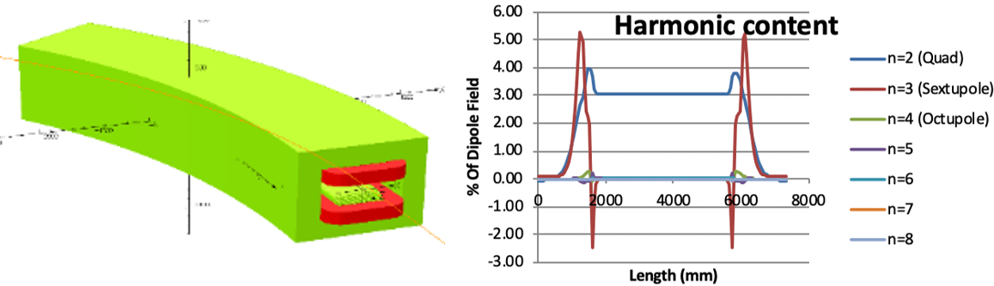
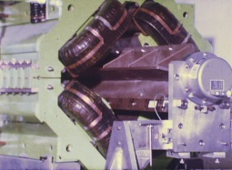
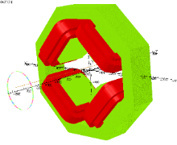
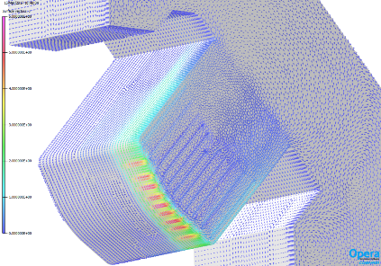
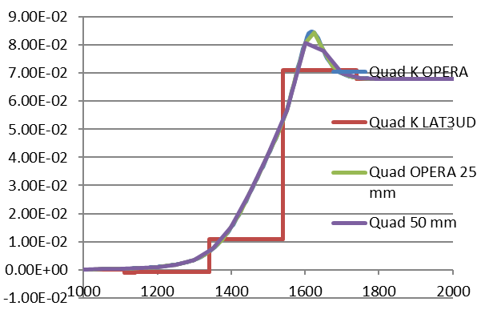
MAGNET MODELLING
Q QT Q QT RF Q BF (dipole)
One of 10 ISIS Super periods
Limited measurements available for ring magnets
Matched OPERA simulations to measurements
Produced models of each magnet type
Incorporating non-linear multipole components into simulations, including fringe fields
  Better TEAPOT/PTC PyORBIT models
ISIS Combined Function Dipole
ISIS Quadrupole
Improved fringe fields
Dean Adams, Iker Rodriguez, Steve Jago et al.

Slide 19
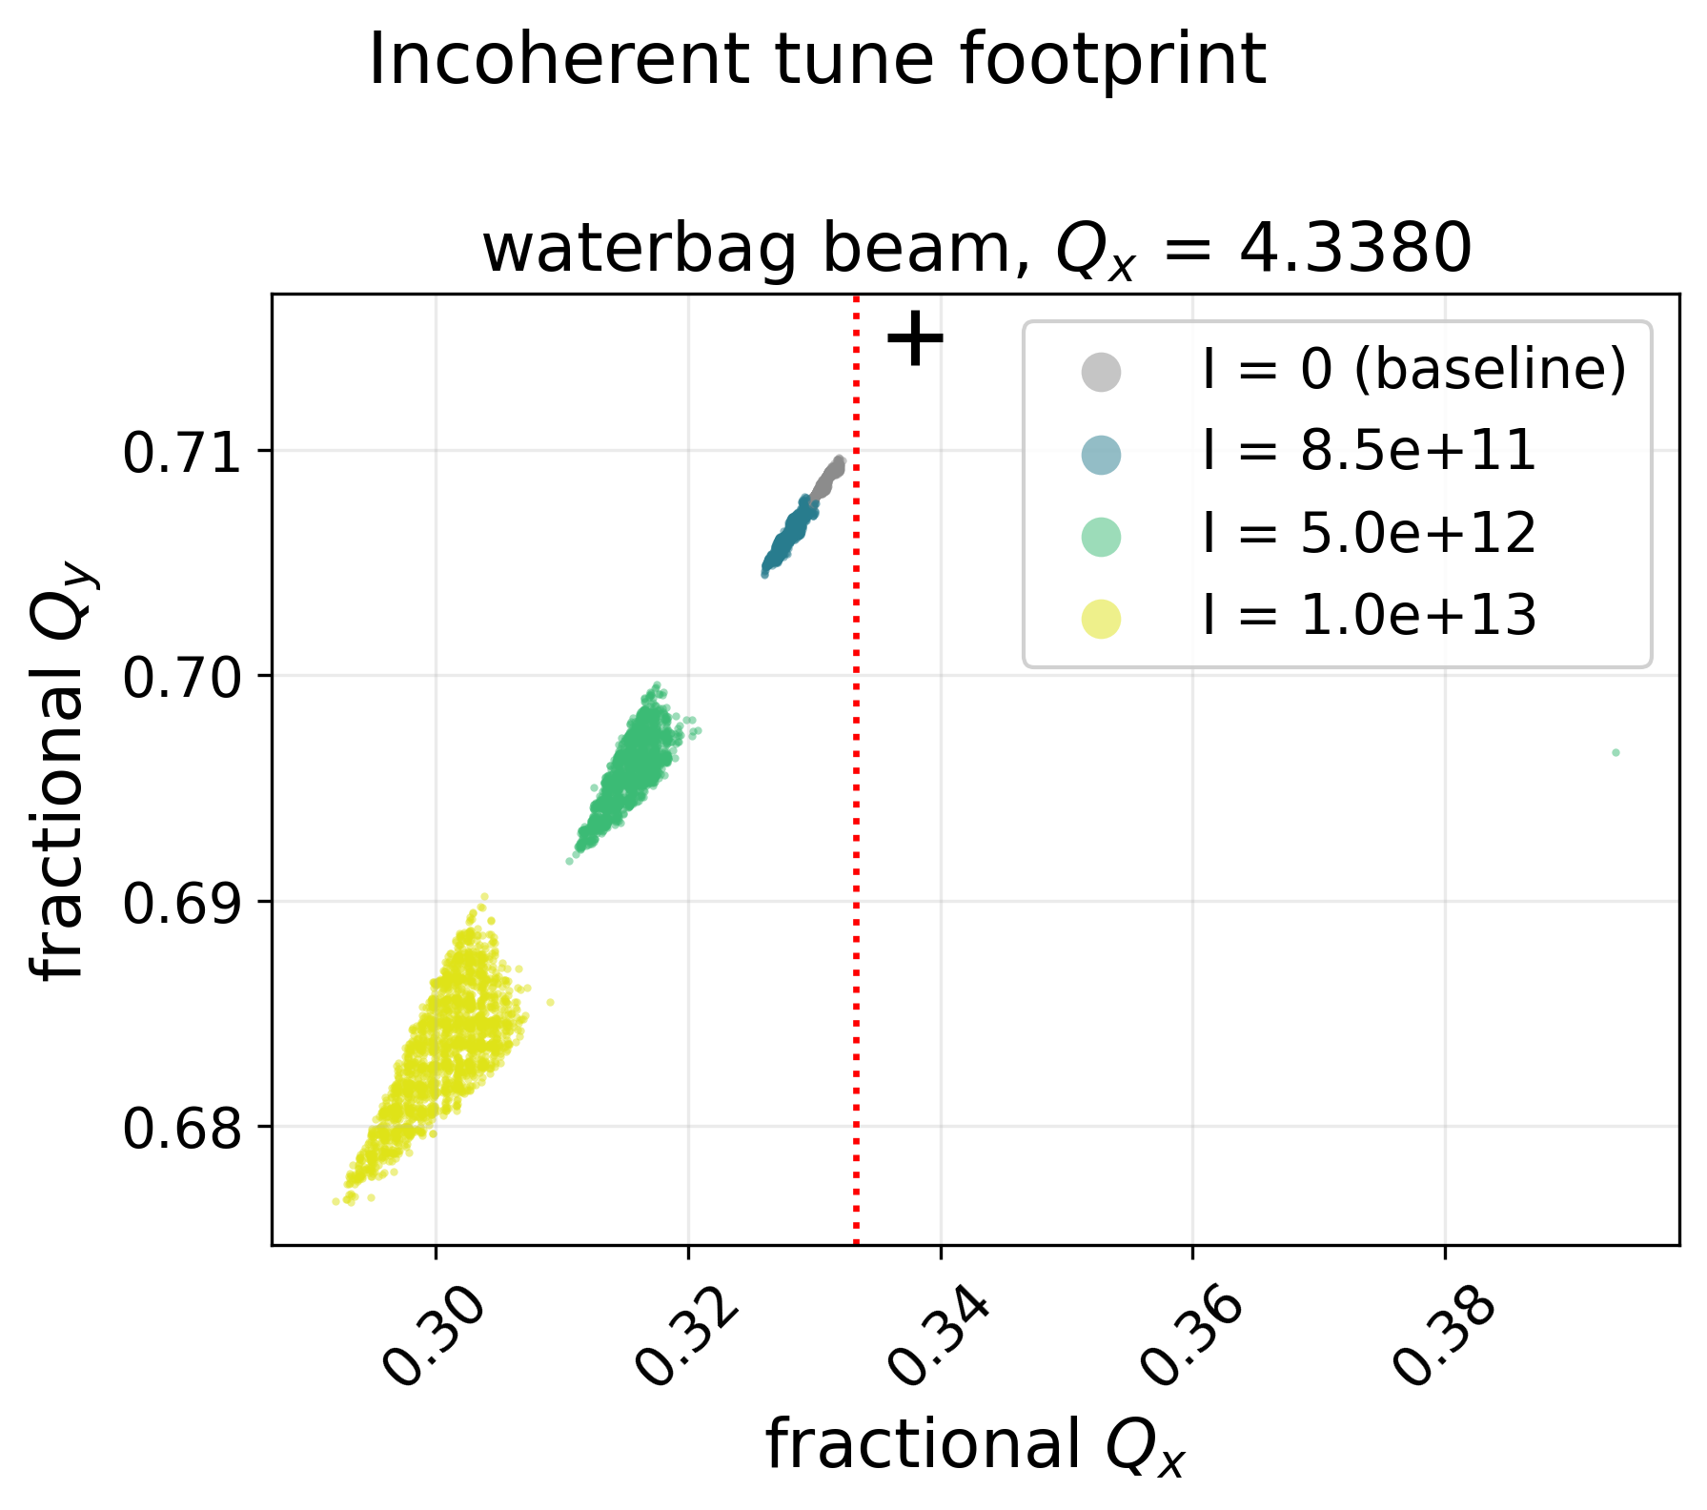
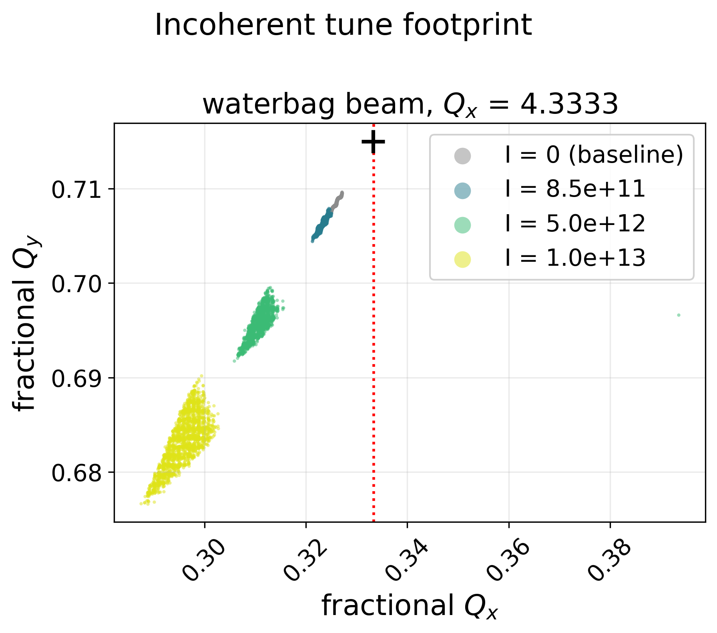
Space charge with waterbag distribution

