Slide 1

Observations of mismatch-driven halo in 2.5 MeV H- beam at the SNS Beam Test Facility
October 2, 2026 | Space Charge ‘26
Trent Thompson
The BTF Research Team
Oak Ridge National Laboratory, University of Tennessee - Knoxville
Notes:
On behalf of beam test facility project team

Slide 2
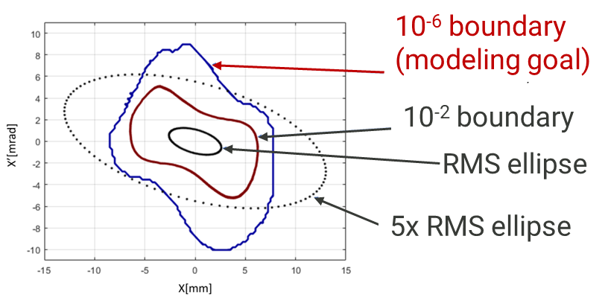
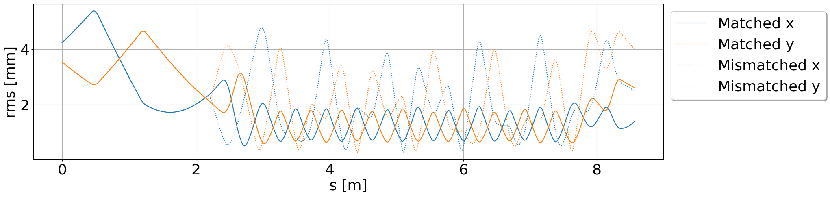
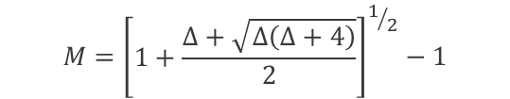


What are the beam dynamics influencing the growth of halo in FODO transport lines?
Halo:
  All beam occupying regions of particle density below 10⁻⁴ of peak particle density.
Mismatch:
  How does increasing mismatch effect halo formation?
  Degree of mismatch determined with the Mismatch Factor.
Space Charge:
  How does current density effect halo formation?
  Attenuators in the BTF allow easy modulation of current density.
$$M={\left[\begin{matrix}1+\frac{Δ+\sqrt{Δ\left(Δ+4\right)}}{2} \\ \end{matrix}\right]}^{1/2}−1$$
$$Δ={\left(Δα\right)}^{2}−ΔβΔγ$$
$$Δ\left(α,β,γ\right)=\left(α,β,γ\right)−(α_{m},β_{m},γ_{m})$$
T. P. Wangler, RF Linear Accelerators, Wiley-VCH Verlag GmbH & Co. KGaA,Weinheim (2008)
Notes:
Sentence or two about sns

Slide 3
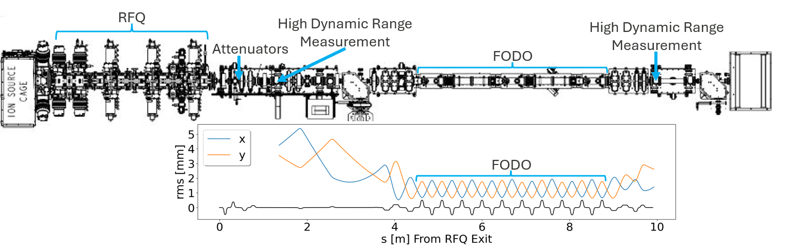
The Beam Test Facility (BTF) is a front-end replica of the SNS with a diagnostic heavy beam line
BTF Parameters
Energy | 2.5 MeV
Current | 50 mA
Magnets | Quads
 | Dipoles
 | Correctors

Slide 4
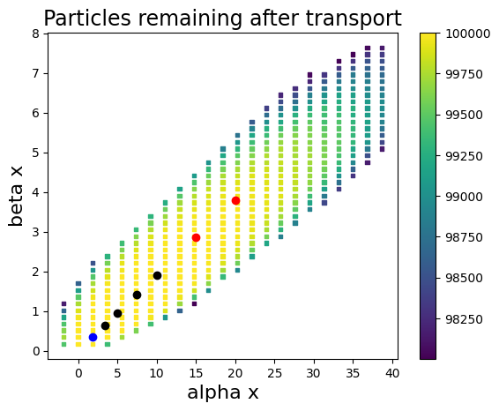
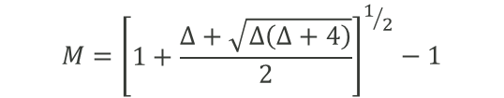
Step 1: Determine potential region of transportable mismatched beams using gaussian simulations
Legend:
Matched
Mismatched
Discarded
Define gaussian bunches with Twiss Parameters
  Alpha y = - Alpha x
  Beta y = Beta x
PyORBIT simulations of FODO line transport
Record number of particles lost to determine aperture acceptance
Select Twiss Parameters in acceptance region to create mismatched cases
Name | Alpha | Beta | Mismatch Factor
Matched | 1.83 | 0.34 | 0
M 0.37 | 3.4 | 0.64 | 0.37
M 0.67 | 5 | 0.94 | 0.67
M 1.05 | 7.5 | 1.42 | 1.05
M 1.37 | 10 | 1.90 | 1.36
M 1.90 | 15 | 2.86 | 1.90
M 2.35 | 20 | 3.80 | 2.34
$$M={\left[\begin{matrix}1+\frac{Δ+\sqrt{Δ\left(Δ+4\right)}}{2} \\ \end{matrix}\right]}^{1/2}−1$$
Notes:
Tie to Kiersten case
All these simulations have zero loss, but in measurement not
Design simulation of gaussian beam, does not include realistic tails
Stress using gaussian, with real beam the region shrinks

Slide 5
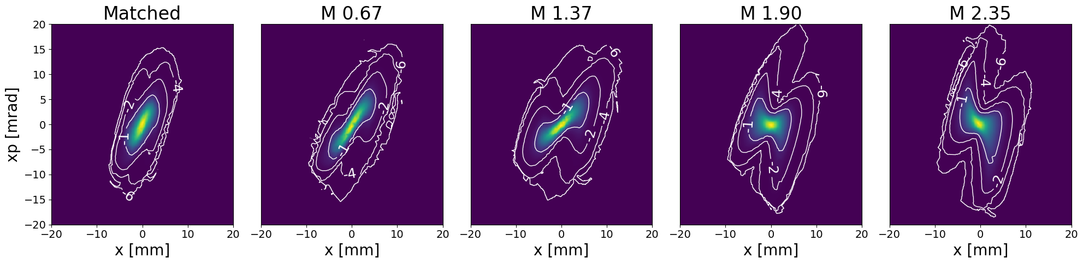
Step 2: Implement mismatch optics and measure output phase spaces with 6 degrees of dynamic range
T. E. Thompson et al., in Proc. NAPAC2025, Sacramento, CA, USA, Aug. 2025, pp. 926-931 doi:10.18429/JACoW-NAPAC2025-THYD03

Slide 6
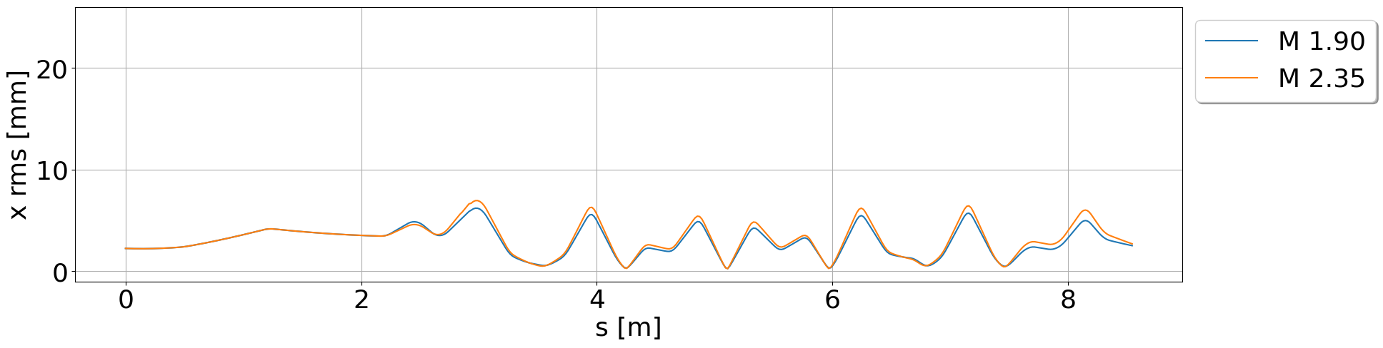
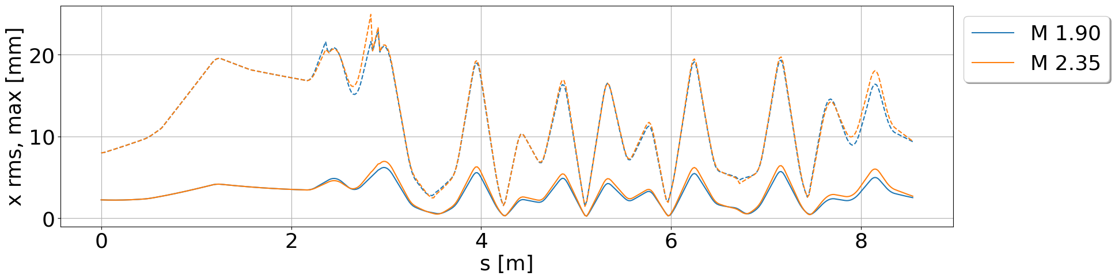
Step 3: Use improved knowledge of tails to determine scraping locations and guide optics re-optimization
 | Transmission
Matched | 95%
M 0.67 | 94%
M 1.37 | 93%
M 1.90 | 90%
M 2.35 | 86%
Aperture
Matching Section
FODO
Matching Section
FODO
 | Transmission
Matched | 97%
M 0.67 | 97%
M 1.37 | 96%
M 1.90 | Dropped
M 2.35 | Dropped
Aperture
Notes:
Do not say we have good transmission
How many particles actually lost
Talk about correctors here

Slide 7

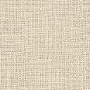
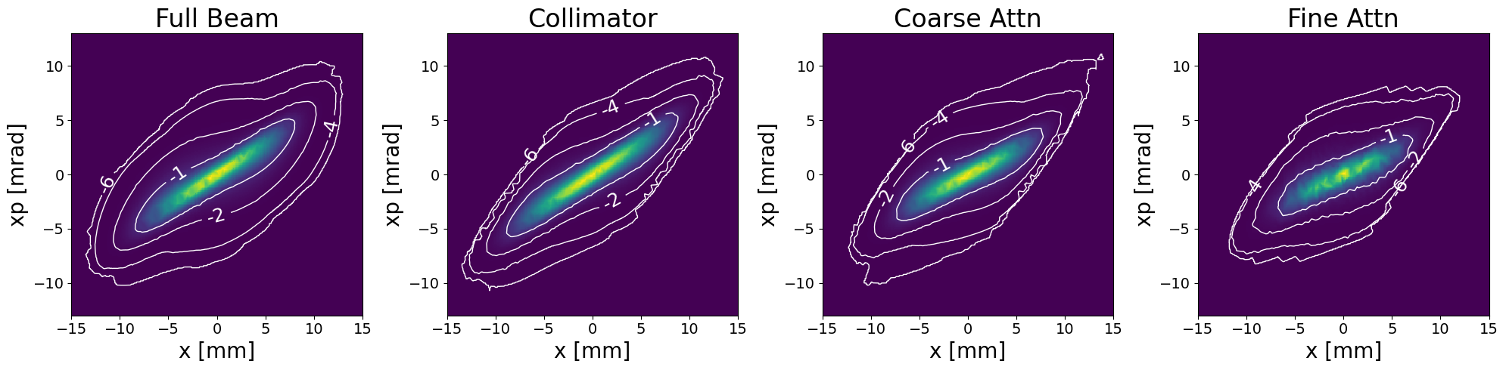
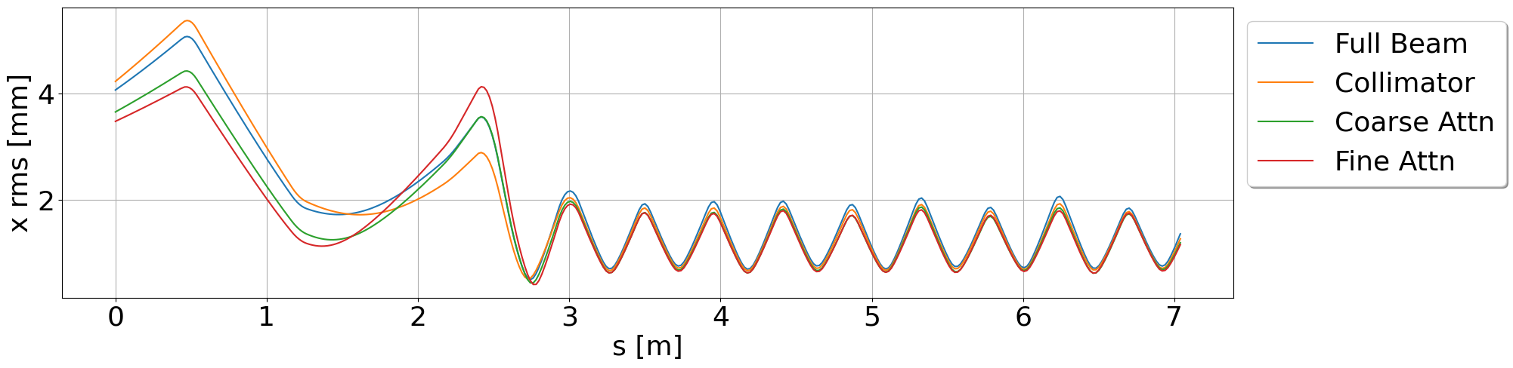
Step 4: Repeat measurements with new optics and extend study to include various current density distributions
Circular Collimator
Coarse Attenuator
Fine Attenuator
 | Current [mA] | Current Density %
Full Beam | 50.8 | 100%
Collimator | 42.5 | 100%
Coarse Attn | 18.9 | 44.5%
Fine Attn | 8.9 | 20.9%
Notes:
Under similar match conditions can we decrease halo formation with just adjusting current density
In the middle of redoing the study for these cases

Slide 8
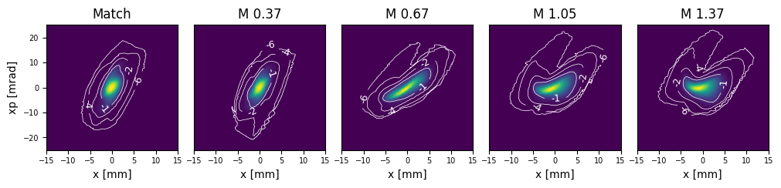
Current Step: Measure mismatched output phase spaces of each current density case (only collimator completed so far)
Notes:
Discuss steering upgrade with it to further lower losses
Growth in tails
Still wonky
Still scrapped

Slide 9
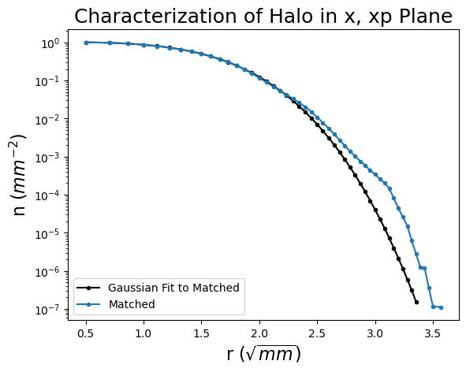
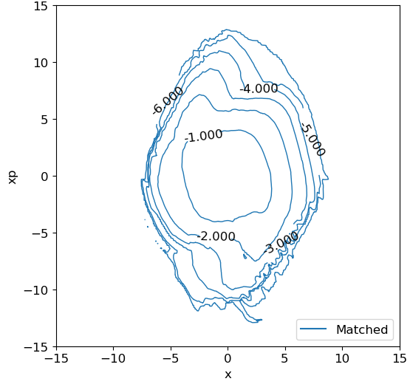
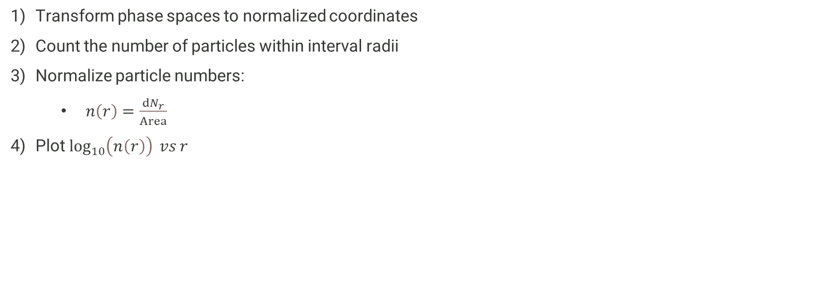
Next Step: Use phase density plots to evaluate the formation of halo and compare across cases
Transform phase spaces to normalized coordinates
Count the number of particles within interval radii
Normalize particle numbers:
  $n\left(r\right)=\frac{ⅆN_{r}}{Area}$
Plot $\log_{10}\left(n\left(r\right)\right) vs r$
Notes:
RMS equivalent gaussian

Slide 10
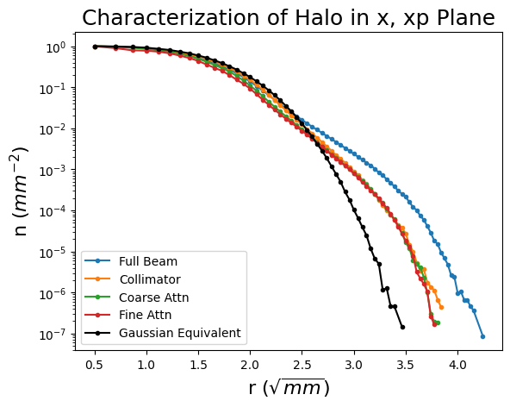
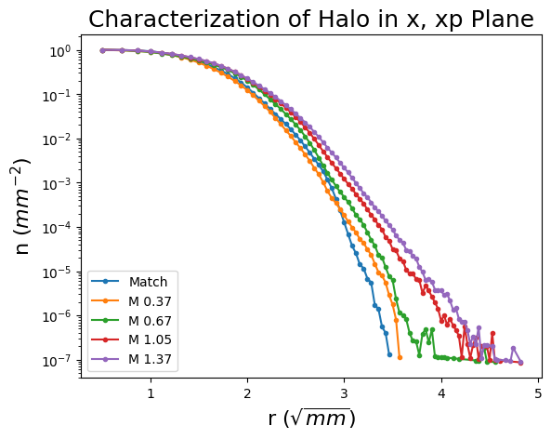
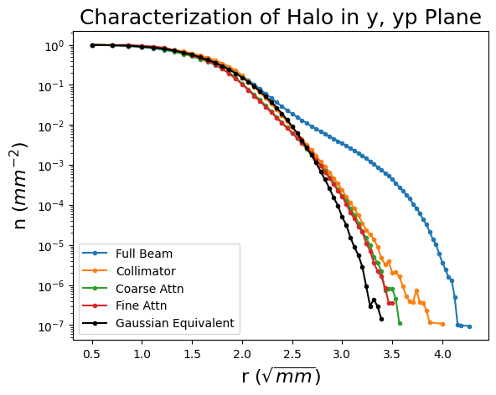
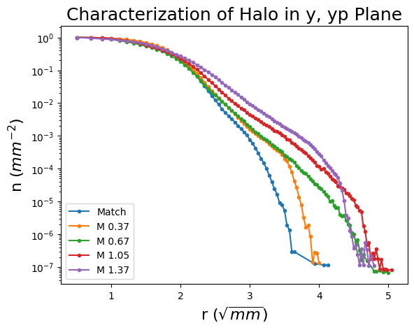
Current results provide insight into the relation between mismatch and halo
Input Phase Densities
Output Collimated Phase Densities
Collimation reduces initial halo
Mismatch increases halo formation

Slide 11
Research into halo formation at the BTF is ongoing with promising results so far
The first systematic high dynamic range study of the relation between mismatch and halo completed
  Large scraping motivated new optics
Improved knowledge of beam tail distribution used to improve transmission for future studies
  Caveat: Still losing more beam than desired
  Next Step: Addition of more correctors to improve orbit trajectory
Measurements of varying current density distributions at beginning of BTF taken
Measurements of mismatched beams for each current density distribution at end of BTF
  Only measurements of collimated beam completed
  Measurements for both attenuators are in progress
Formation of halo analyzed using phase density plots

Slide 12
Backup Slides
Notes:
Slide about steering correctiong
Add final summary slide

Slide 13
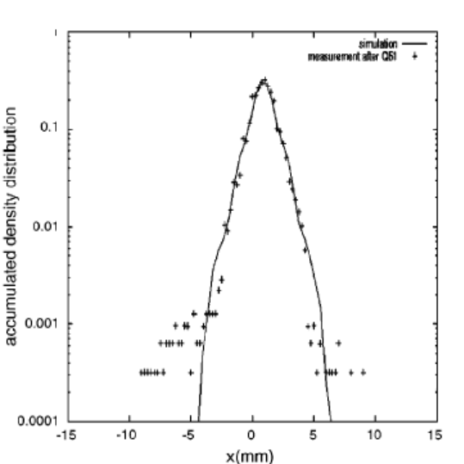
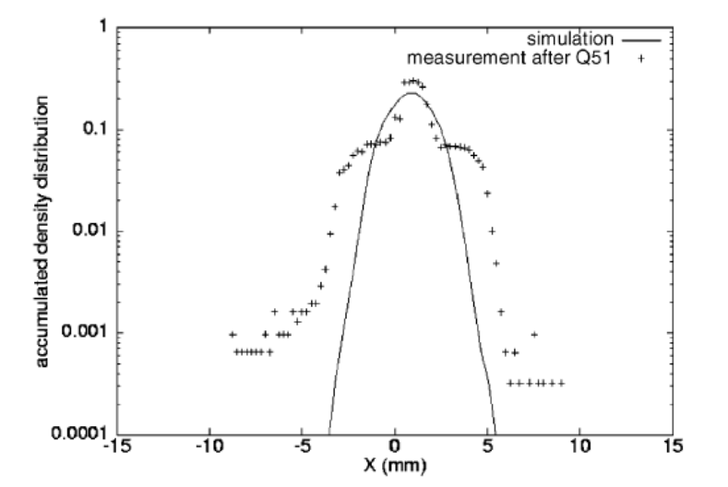
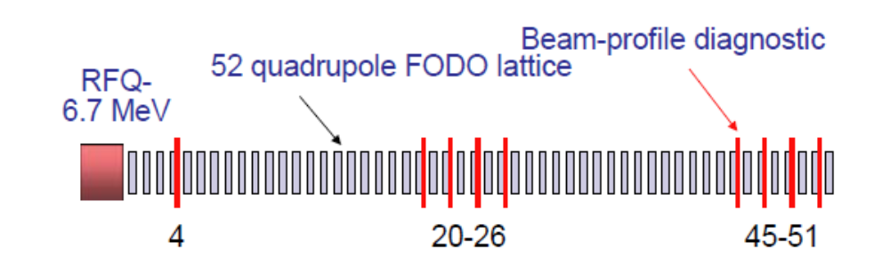
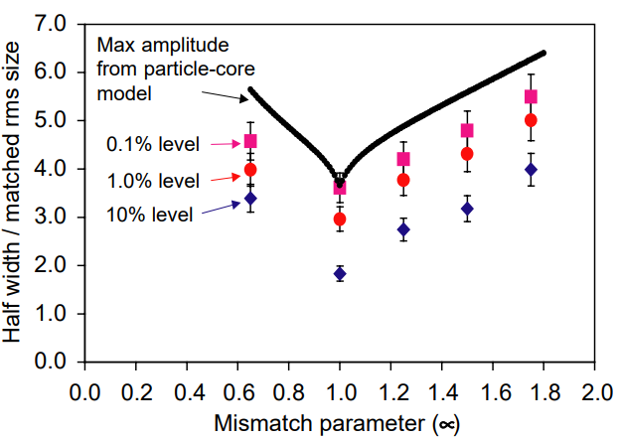
BTF follows earlier attempts to benchmark medium-energy beam evolution
Matched
Mismatched
LEDA @ LANL: extensive simulations aimed at benchmarking halo evolution measurements
Qiang, J., Colestock, P. L., Gilpatrick, D., Smith, H. V., Wangler, T. P., & Schulze, M. E. (2002). Macroparticle simulation studies of a proton beam halo experiment. Phys Rev ST-AB, 5(12), 35–47 .
Simulations of high-intensity ion front-ends benchmarked to RMS, generally do not reproduce tails/halo.
Goal: demonstrate modeling of front-end with PIC code down to loss-level (scraping of 1 part-per-million ions)
Notes:
Restate rms agreement statement, no one has ever benchmarked halo
Simulations do not agree at rms

Slide 14
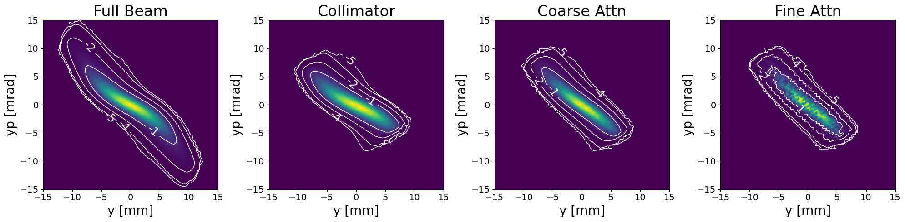
Input Measurements

Slide 15
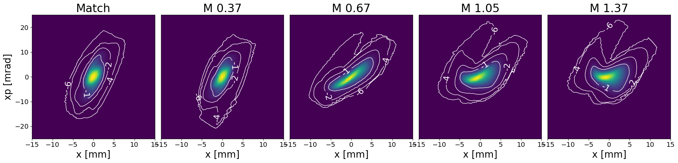
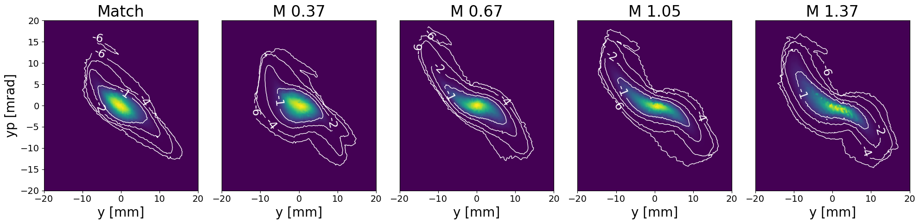
Collimated Output Measurements
Notes:
Use full beam transmission number
Move to optics redesign slide
Discuss steering upgrade with it to further lower losses

Slide 16
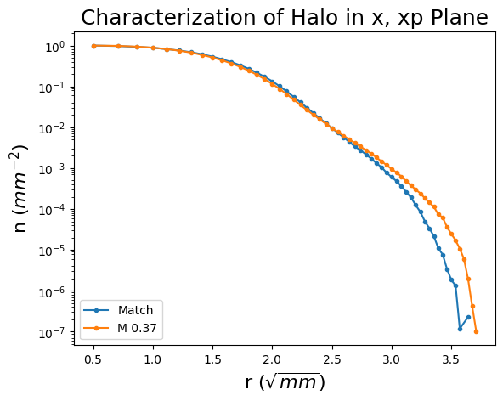
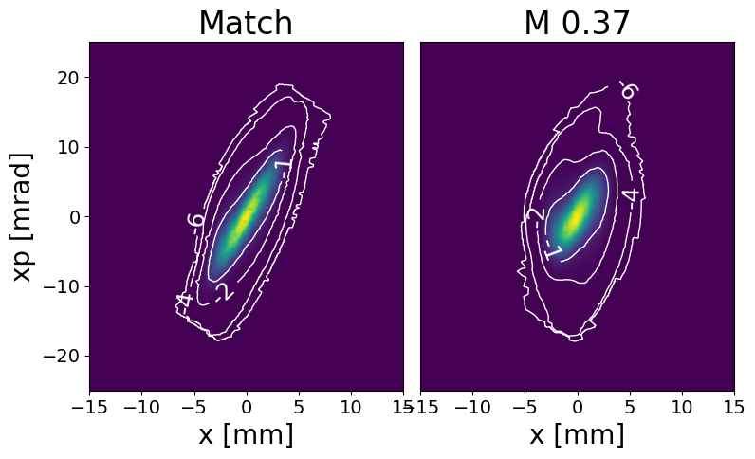
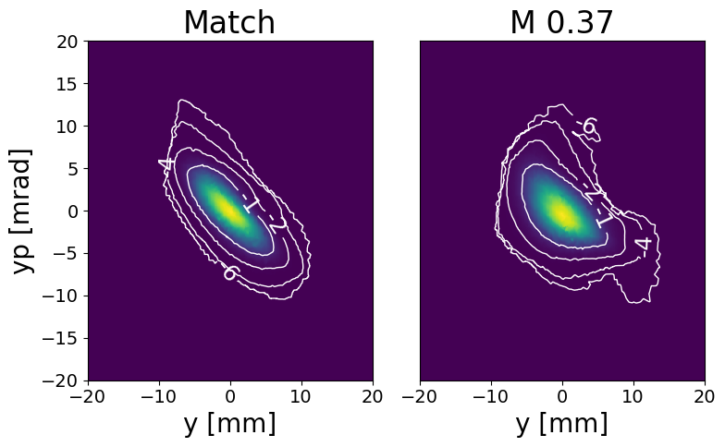
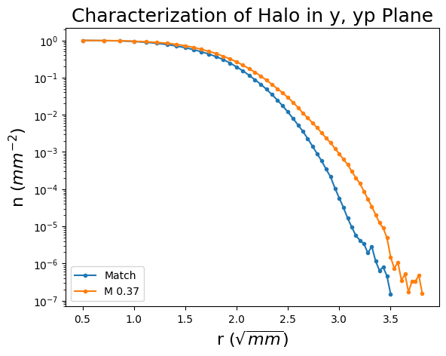
Coarse Attenuator Output Measurements
Notes:
Do not discuss tilted

Slide 17
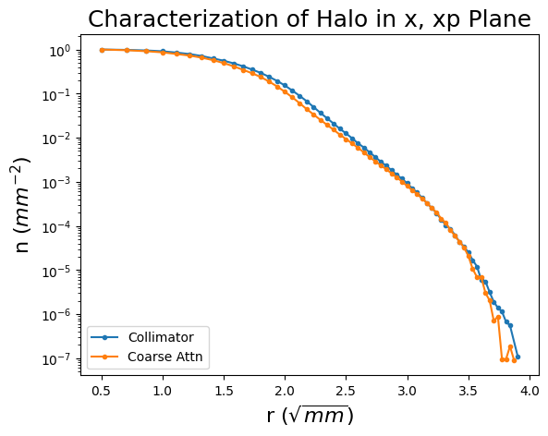
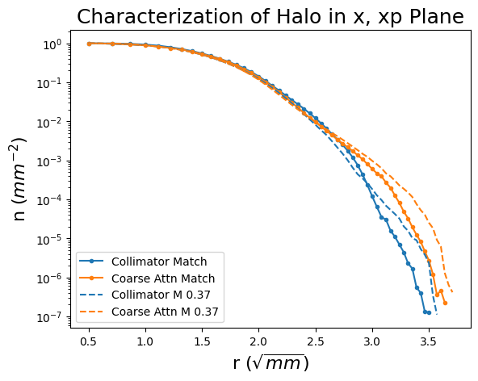
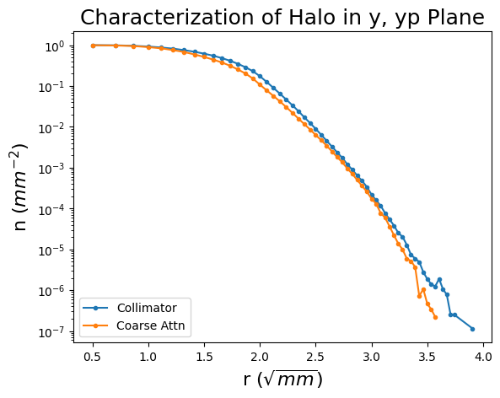
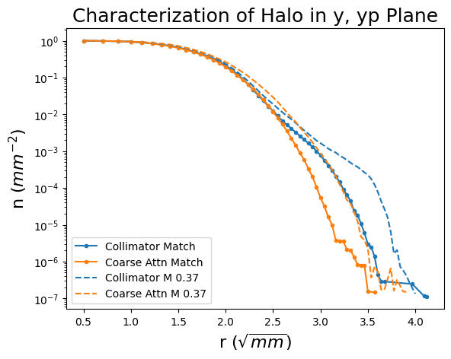
Comparing halo formation between the Collimator and Coarse Attenuator
Caveat to Data:
  Transport with the Collimator has far lower transmission than with the Coarse Attn
 | Collimator | Coarse Attn
Matched | 97.2% | 100%
M 0.37 | 96.0% | 99%

