Slide 1
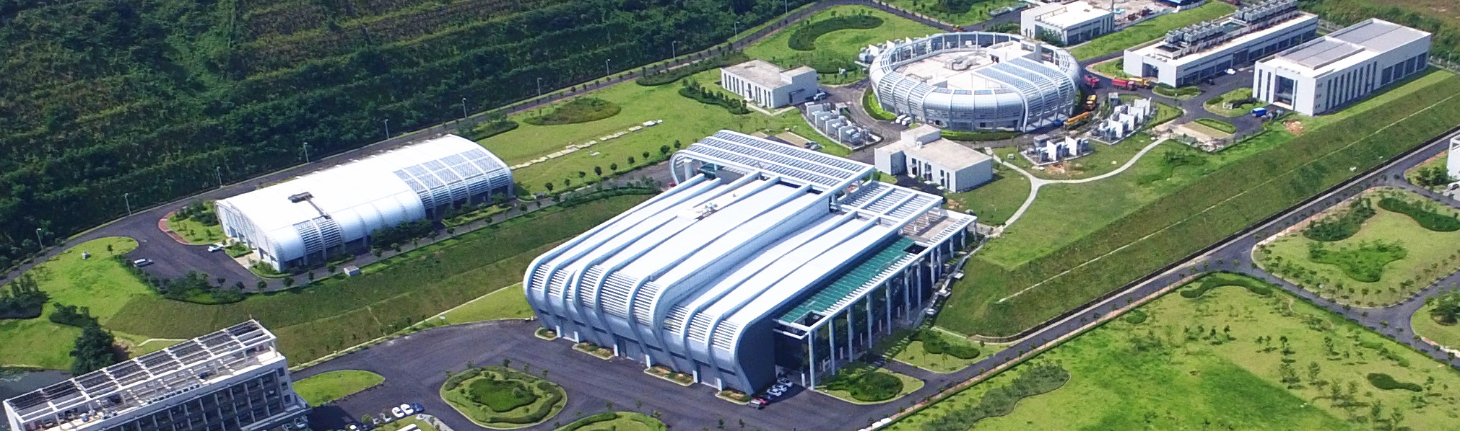

Space Charge Effect Simulation and Tune Optimization for Reducing Beam Loss at CSNS
Shouyan Xu
Spallation Neutron Source Science Centre, IHEP
University of Oxford Space Charge 2026

Slide 2
Contents
1
Introduction to CSNS/RCS
2
Challenges in high intensity commissioning
3
Space charge effect simulation at CSNS/RCS
4
Tune pattern optimization
5
Further power upgrade

Slide 3
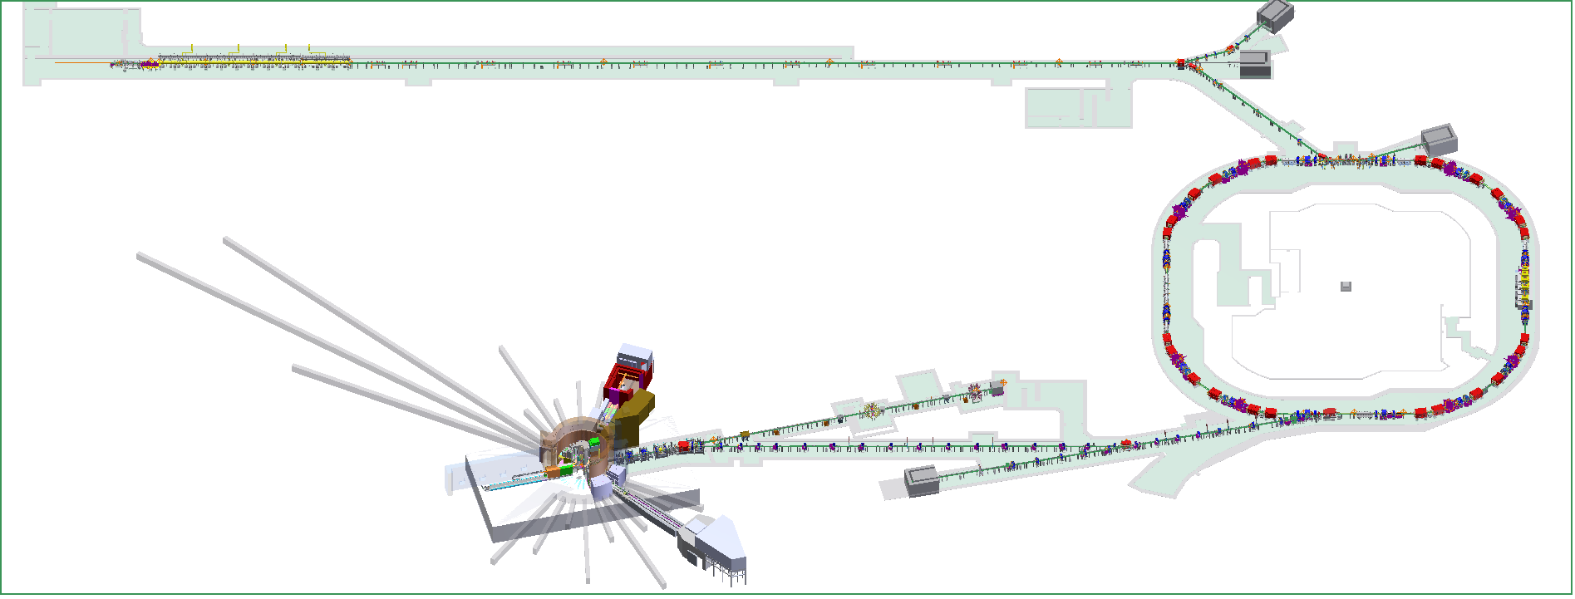
1: Introduction to CSNS/RCS
80MeV H⁻ linac
RCS，
1.6GeV, 25Hz
Target, Tungsten
100 kW

Slide 4
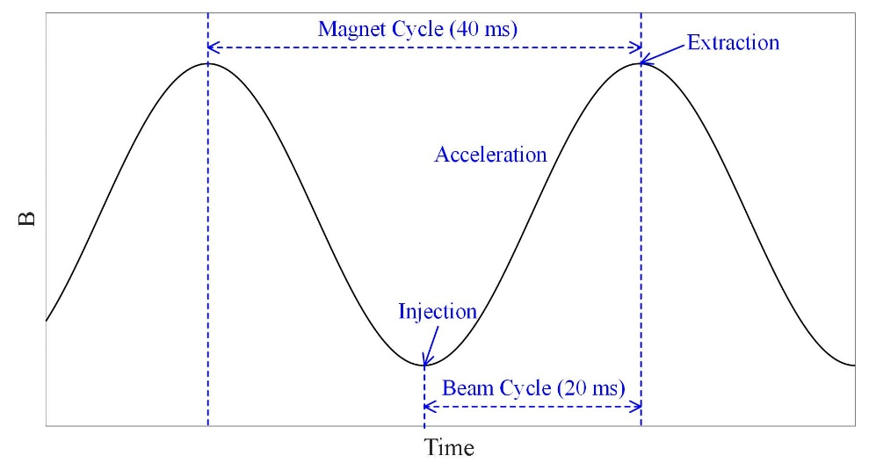
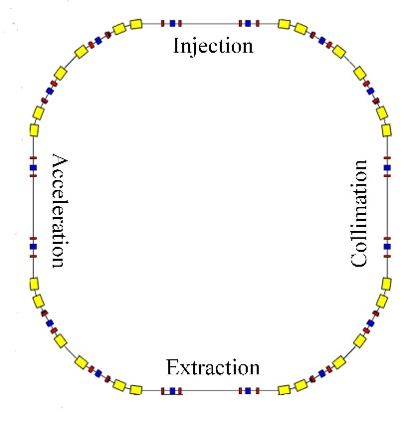
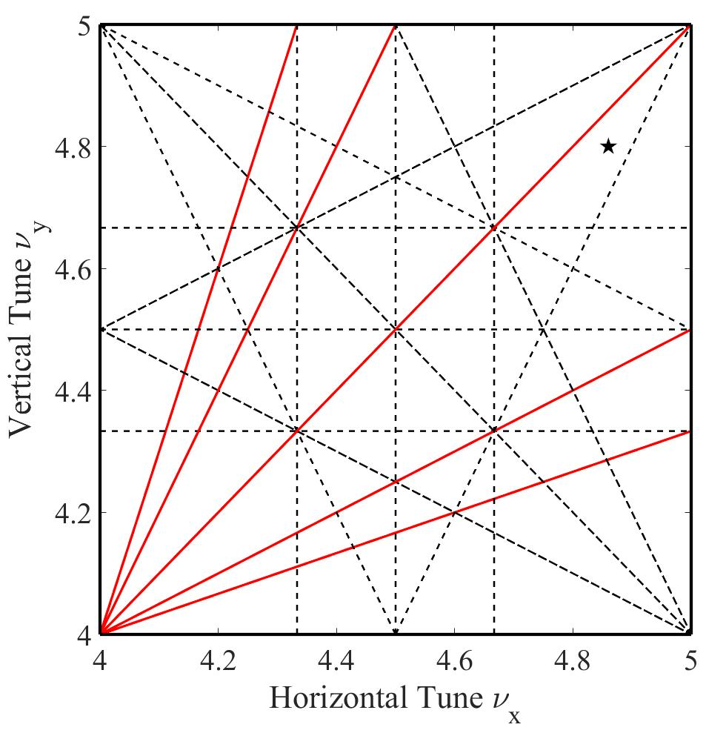
Output Beam Power [kW] | 100
Injection Energy [MeV] | 80
Extraction Energy [GeV] | 1.6
Pulse repetition rate [Hz] | 25
Ramping Pattern | Sinusoidal
Acceleration Time [ms] | 20
Circumference [m] | 227.92
Number of dipoles | 24
Number of quadrupoles | 48
Lattice Structure | Triplet
Nominal Betatron Tunes (H/V) | (4.86, 4.80)
Natural Chromaticity | -4.0/-8.2
Ring Acceptance [πmm-mrad] | 540
Harmonic Number | 2
Number of Particles per Pulse | 1.56×10¹³
Space-Charge Tune Shift | -0.28
The schematic diagram of the magnetic field waveform
The schematic layout of the RCS
The design tune location in the resonance map

Slide 5
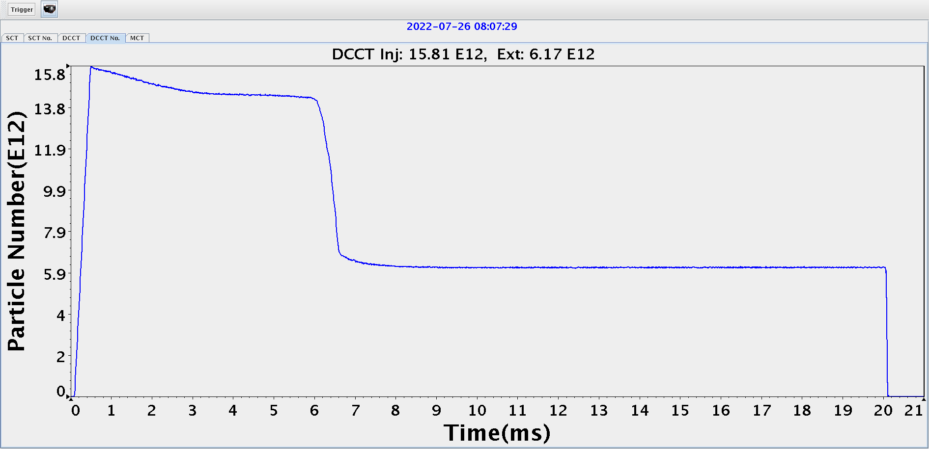
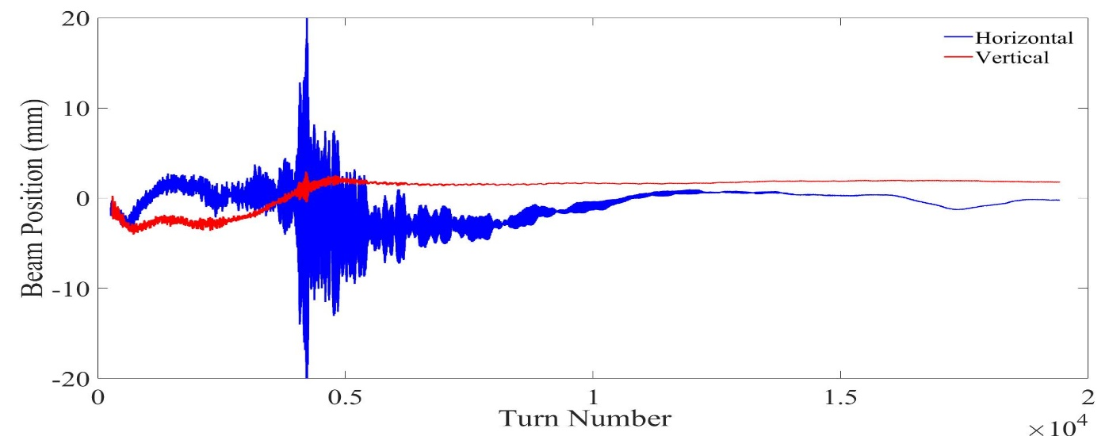
2: Challenges in high intensity commissioning
Space charge effects
Beam transmission
Beam instability
Beam positions over the acceleration process
The beam loss caused by space charge effects and beam instability hinders the achievement of higher power levels.

Slide 6
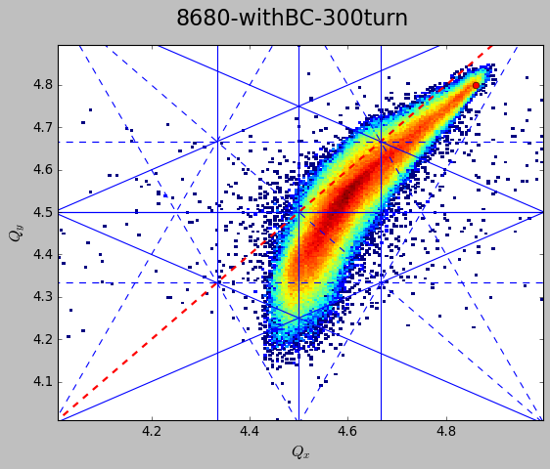
3: Space charge effect simulation at CSNS/RCS
With a tune below the integer value
The incoherent RMS tune shift approaches -0.28
Half integer resonance under space charge is a key beam loss mechanism

Slide 7
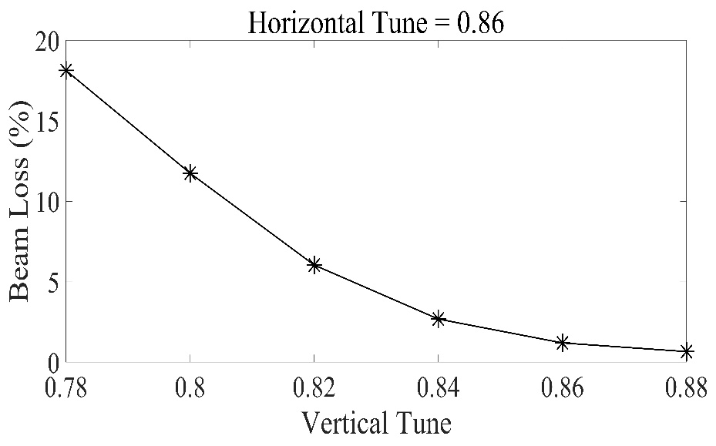
Beam transmission with the tune (4.86, 4.80)
Beam loss decreases as vertical tunes move up and away from half integer resonance lines.
The horizontal tune has a minor impact on the transmission rate
  Due to dispersion effects, space charge tune shift in horizontal plane is smaller.
  The horizontal natural chromaticity is smaller.
  A smaller horizontal tune spread induced by space charge and chromaticity

Slide 8
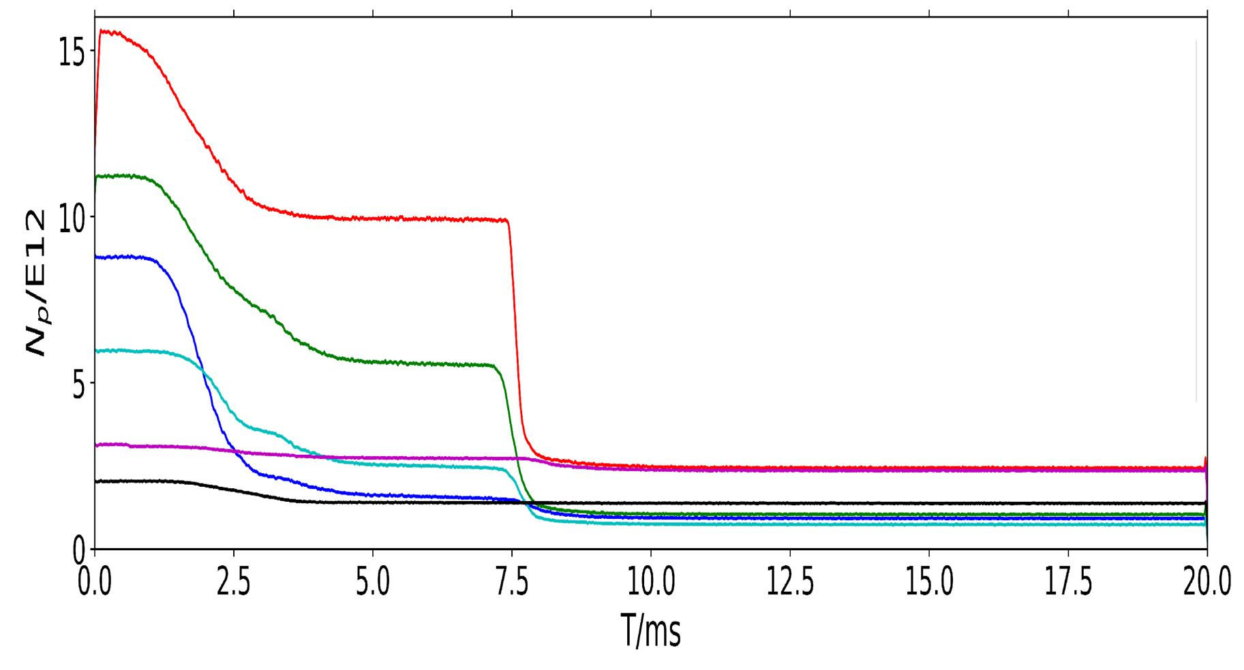
The greatest challenge we encountered in achieving higher intensity beam at CSNS/RCS was instability.
Even at a beam power of 30kW, instability can be observed with the design tune (4.86, 4.80) and natural chromaticity.
Beam positions for 100kW beam power
The correlation between beam instability and the number of stored particles

Slide 9
The influence of the chromaticity on instability
With the tune (4.86, 4.80)
  The instability is clearly changed with chromaticity.

Slide 10
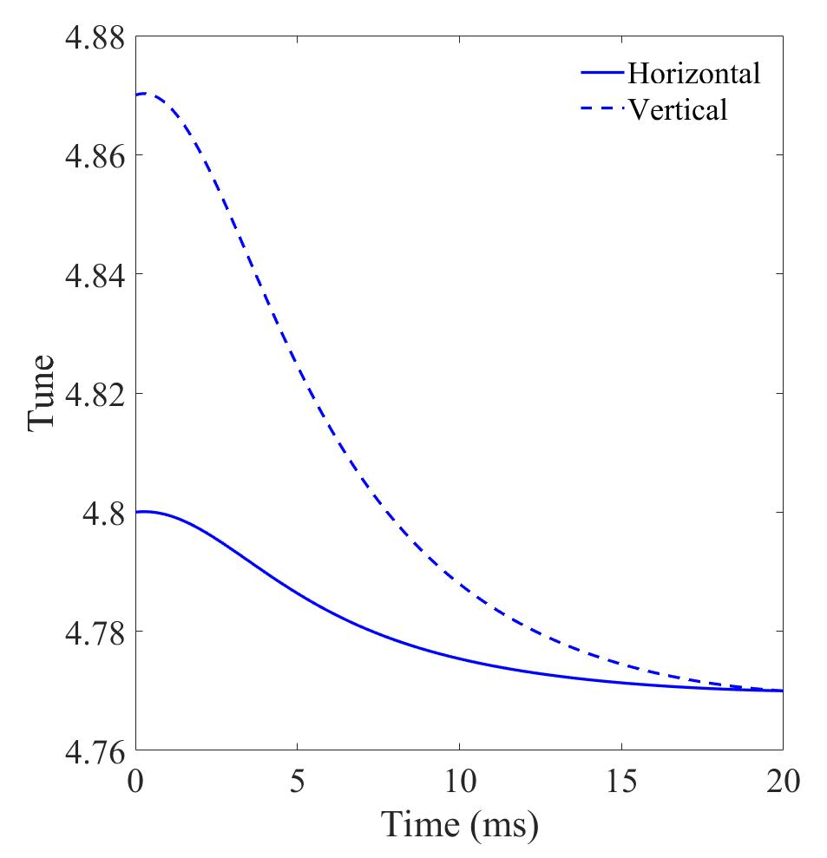
4: Tune pattern optimization
Alleviate space charge
Suppress instability
Instability
Space charge
Space charge induced beam loss decreases as tunes are moved up and away from half-integer resonance lines
Instability growth rates increase rapidly as the tune approaches integer
The tune requirements for reducing space charge induced beam loss and suppressing beam instability are different
We propose a pattern of tune variation: the tune varies depending on space charge effects and instability

Slide 11
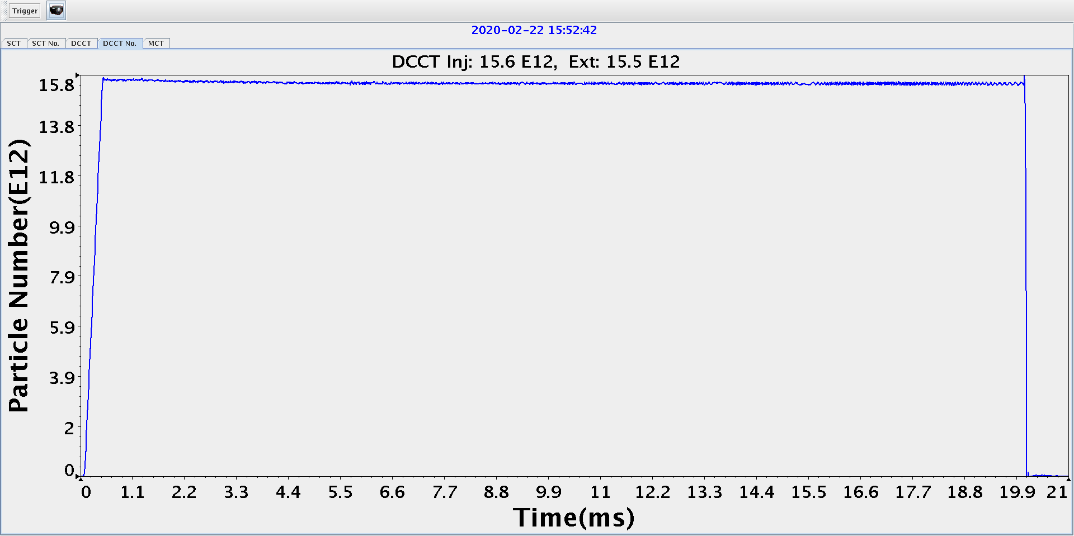
Space charge
Instability
By utilizing the optimized variable tune pattern, the beam transmission rate achieves a remarkable 99.5%.

Slide 12
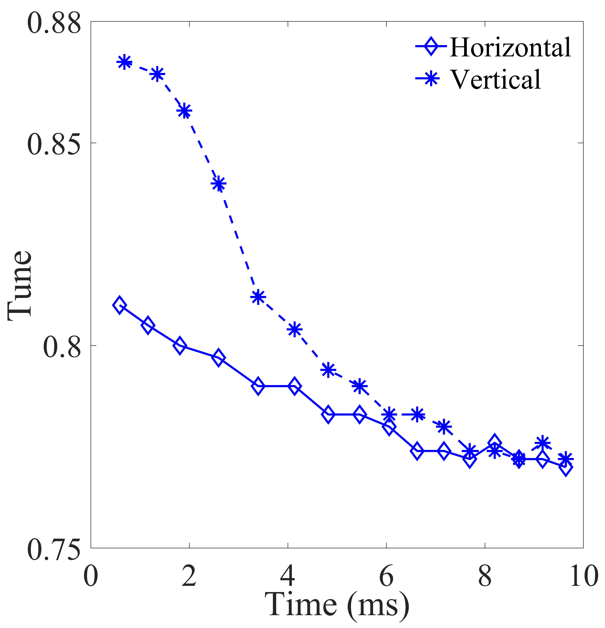
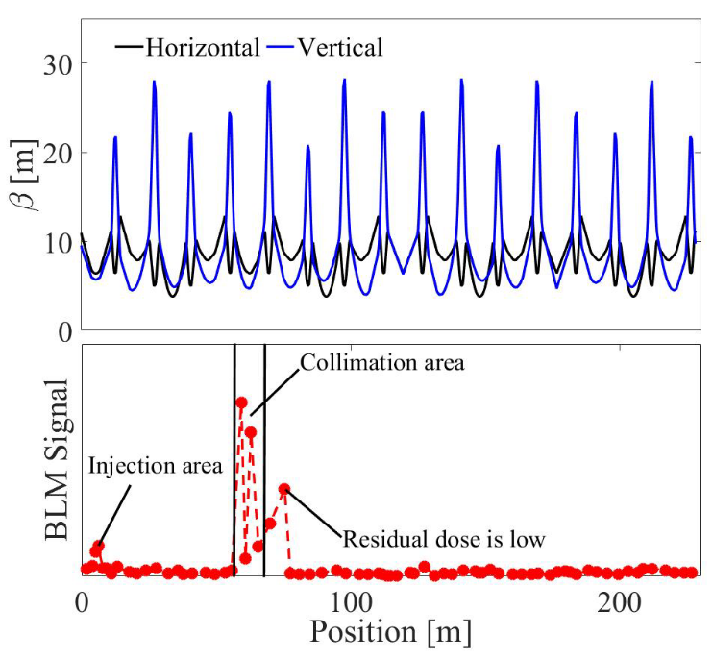
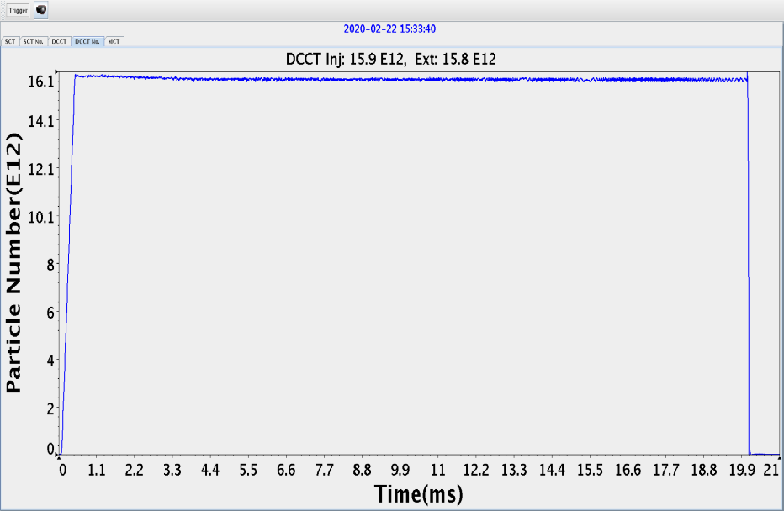
After the tune optimization, beam loss caused by space charge and beam instability was successfully controlled.
After collimation system optimization, beam loss was well localized at the collimator section.
The measured tune variations
after the tune optimization
Beam transmission with the optimized tune pattern
BLM signals along the RCS

Slide 13
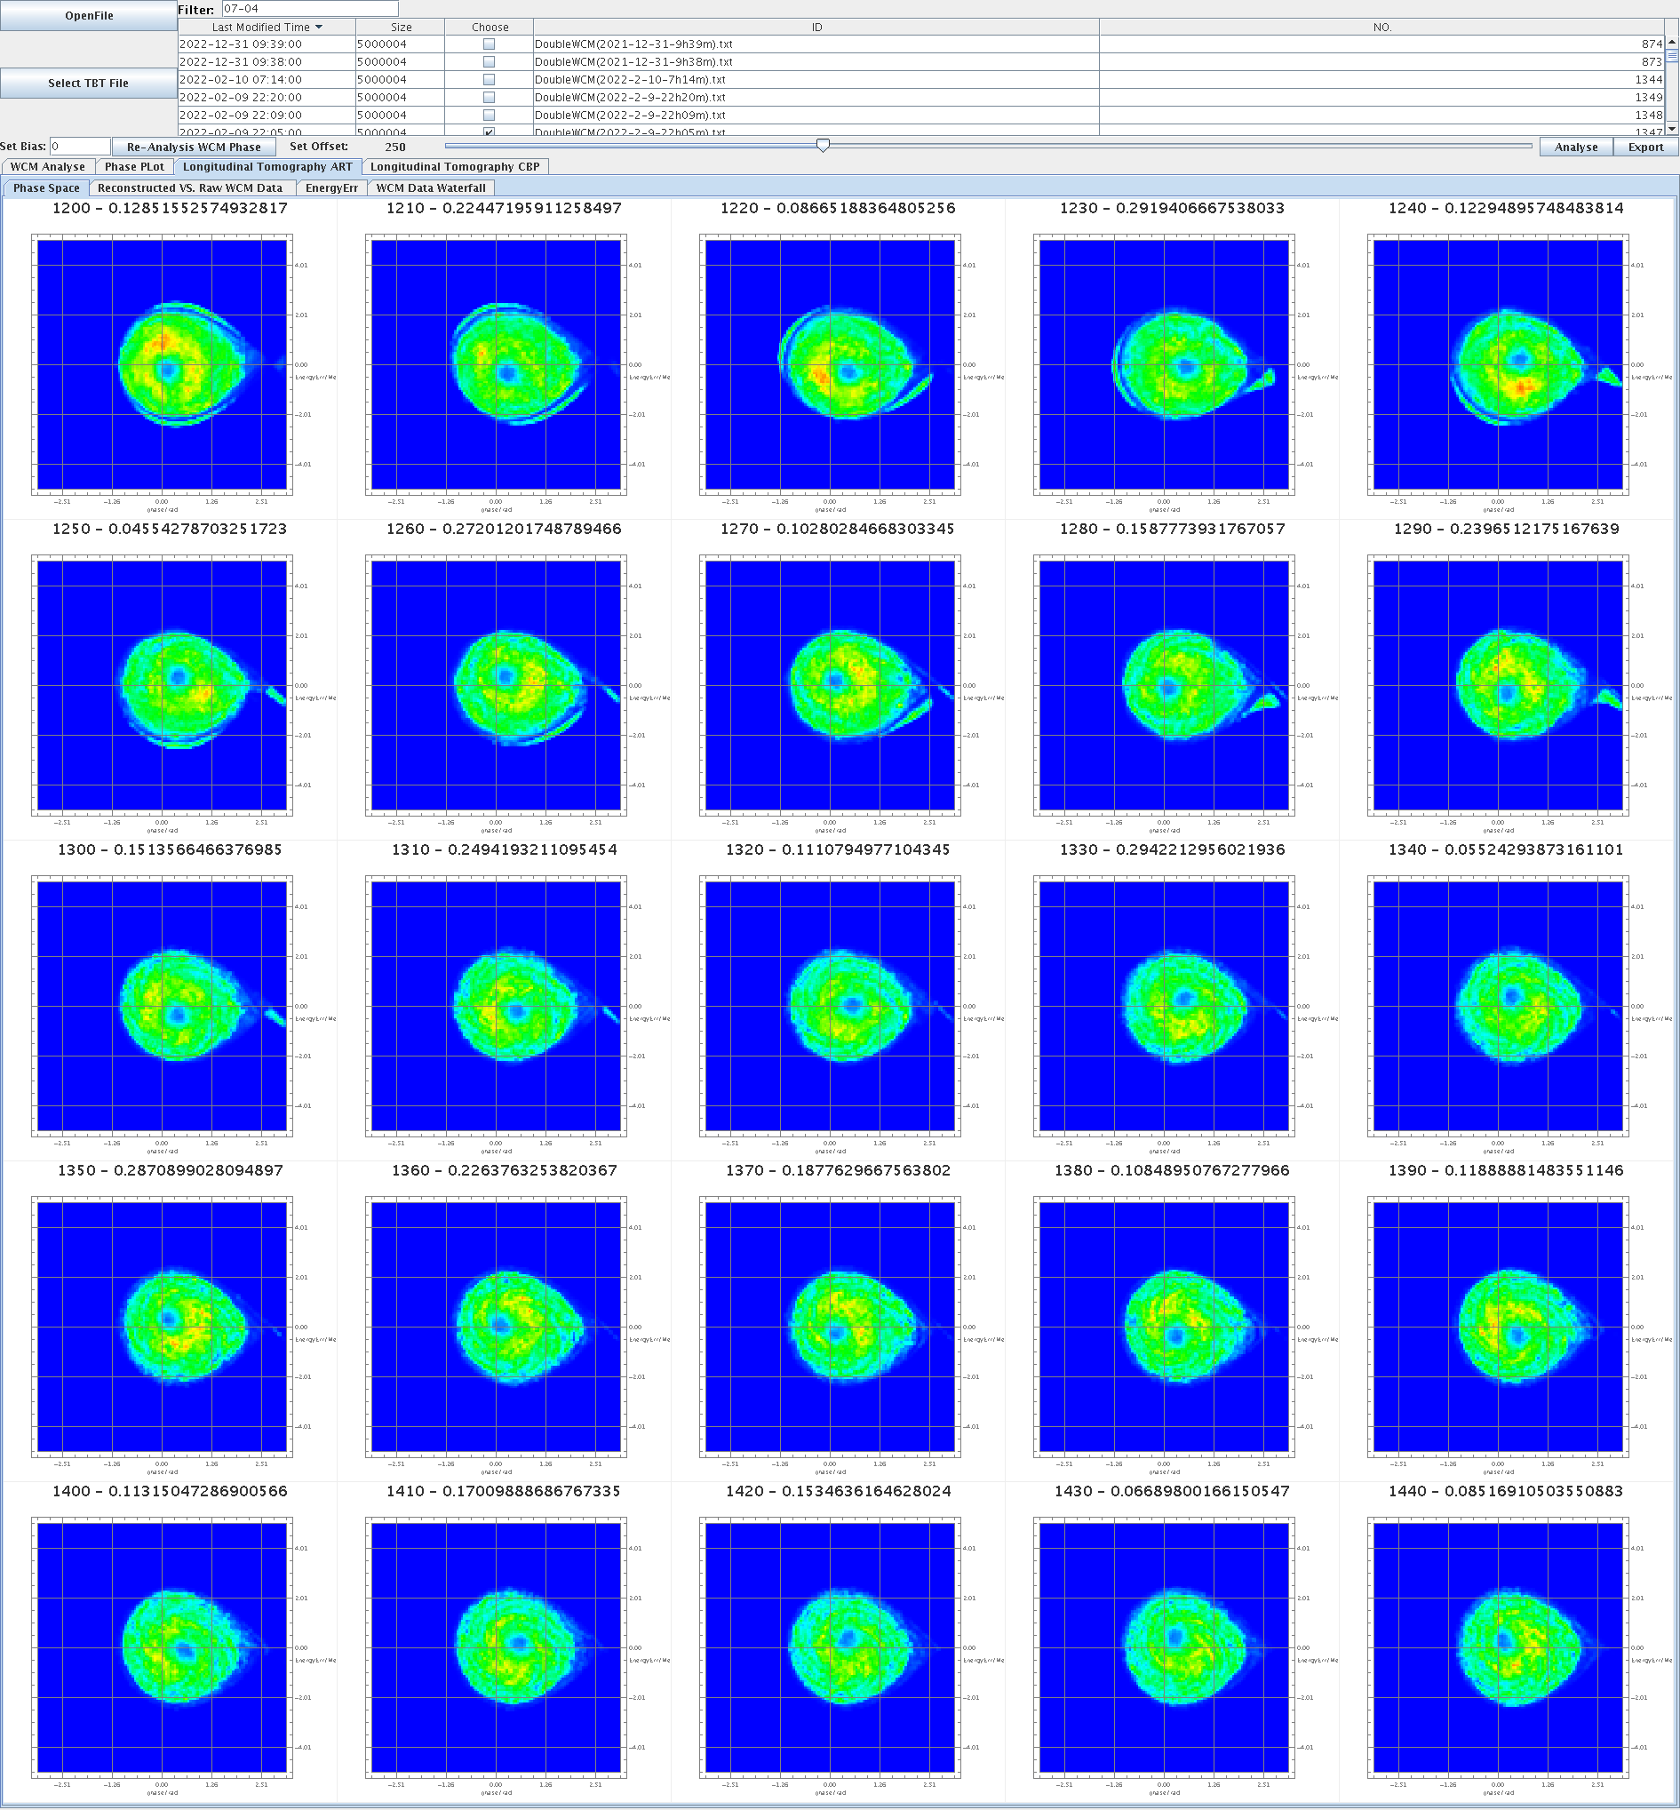
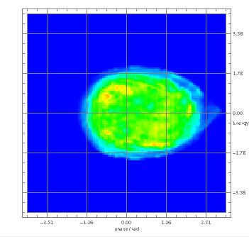
5: Further power upgrade
After the CSNS beam power reached 100 kW, pulsed correction quadrupoles, second-harmonic cavities, and a momentum collimator were installed in the RCS, with the aim of pushing the beam power up to 200 kW.
1. second-harmonic cavities have been installed at CSNS to increase the bunching factor, mitigate space charge effects, and thereby allow for more particles to be injected.

Slide 14
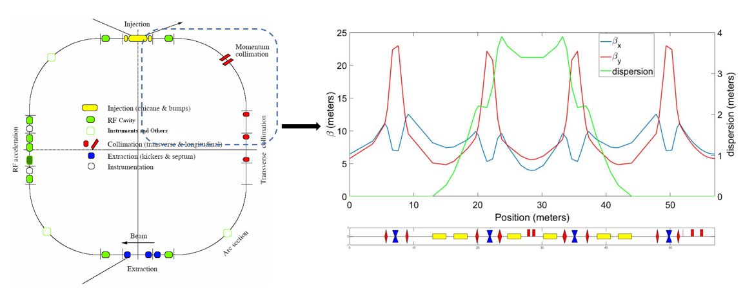
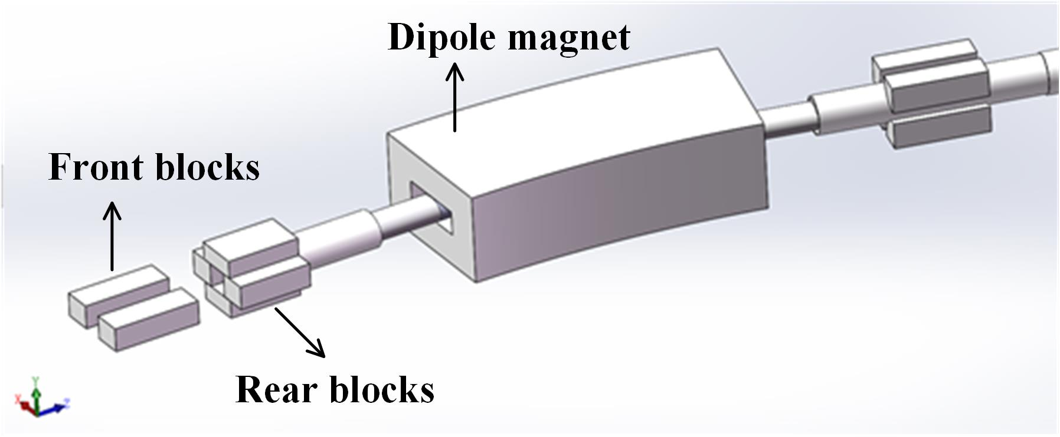
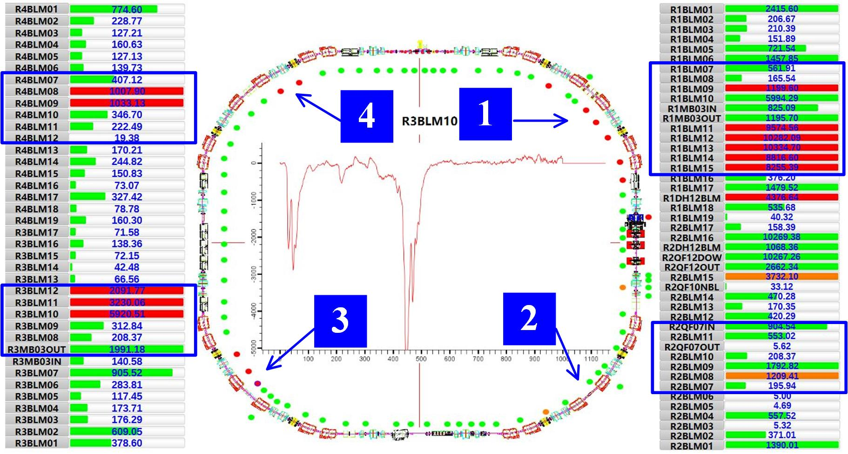
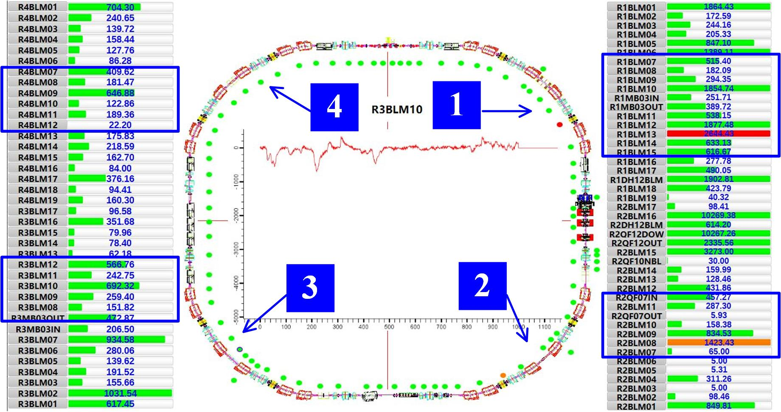
2. To address the issue of beam loss in the longitudinal plane induced by the dual-harmonic system and fast acceleration, a momentum collimator was designed and installed at CSNS.

Slide 15
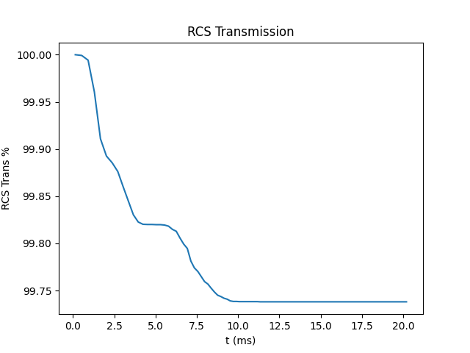
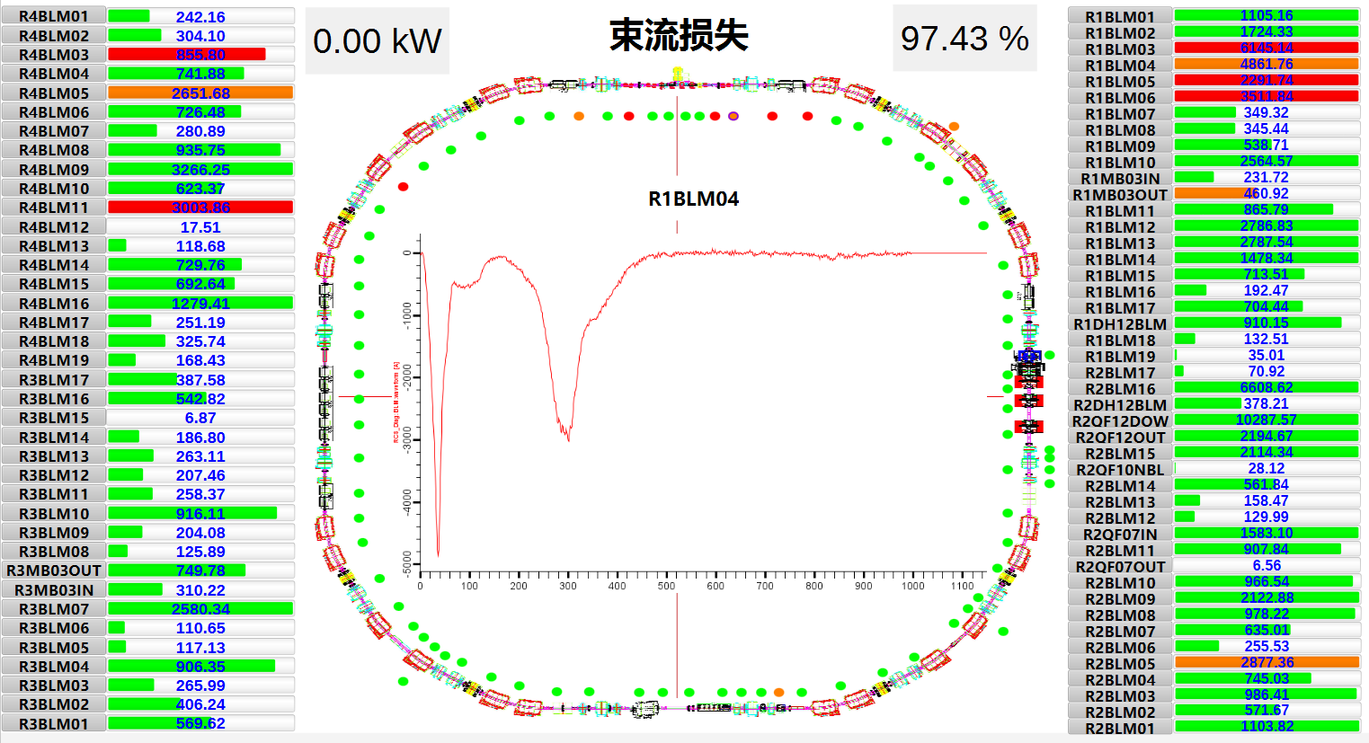
3. To mitigate the instability issue, an attempt was made to shift the tune above the integer resonance line. In 2026, the tune (4.42, 5.32) was tested. No beam instability was observed, and the beam power is expected to reach 200 kW.

Slide 16
Summary
1. During the high-intensity beam commissioning of CSNS RCS, severe beam instabilities were encountered. It was found that suppressing instability conflicts with the goal of mitigating space-charge-induced beam loss.
2. By adopting a time-varying tune during the acceleration process, beam instabilities were suppressed while space-charge-induced beam loss was reduced, allowing the beam power to reach the designed target of 100 kW.
3. To further upgrade the beam power, CSNS has installed second-harmonic cavities, a momentum collimator, and pulsed correction quadrupoles, and has shifted the tune above the integer resonance to suppress beam instability. The beam power is expected to reach 200 kW.

Slide 17
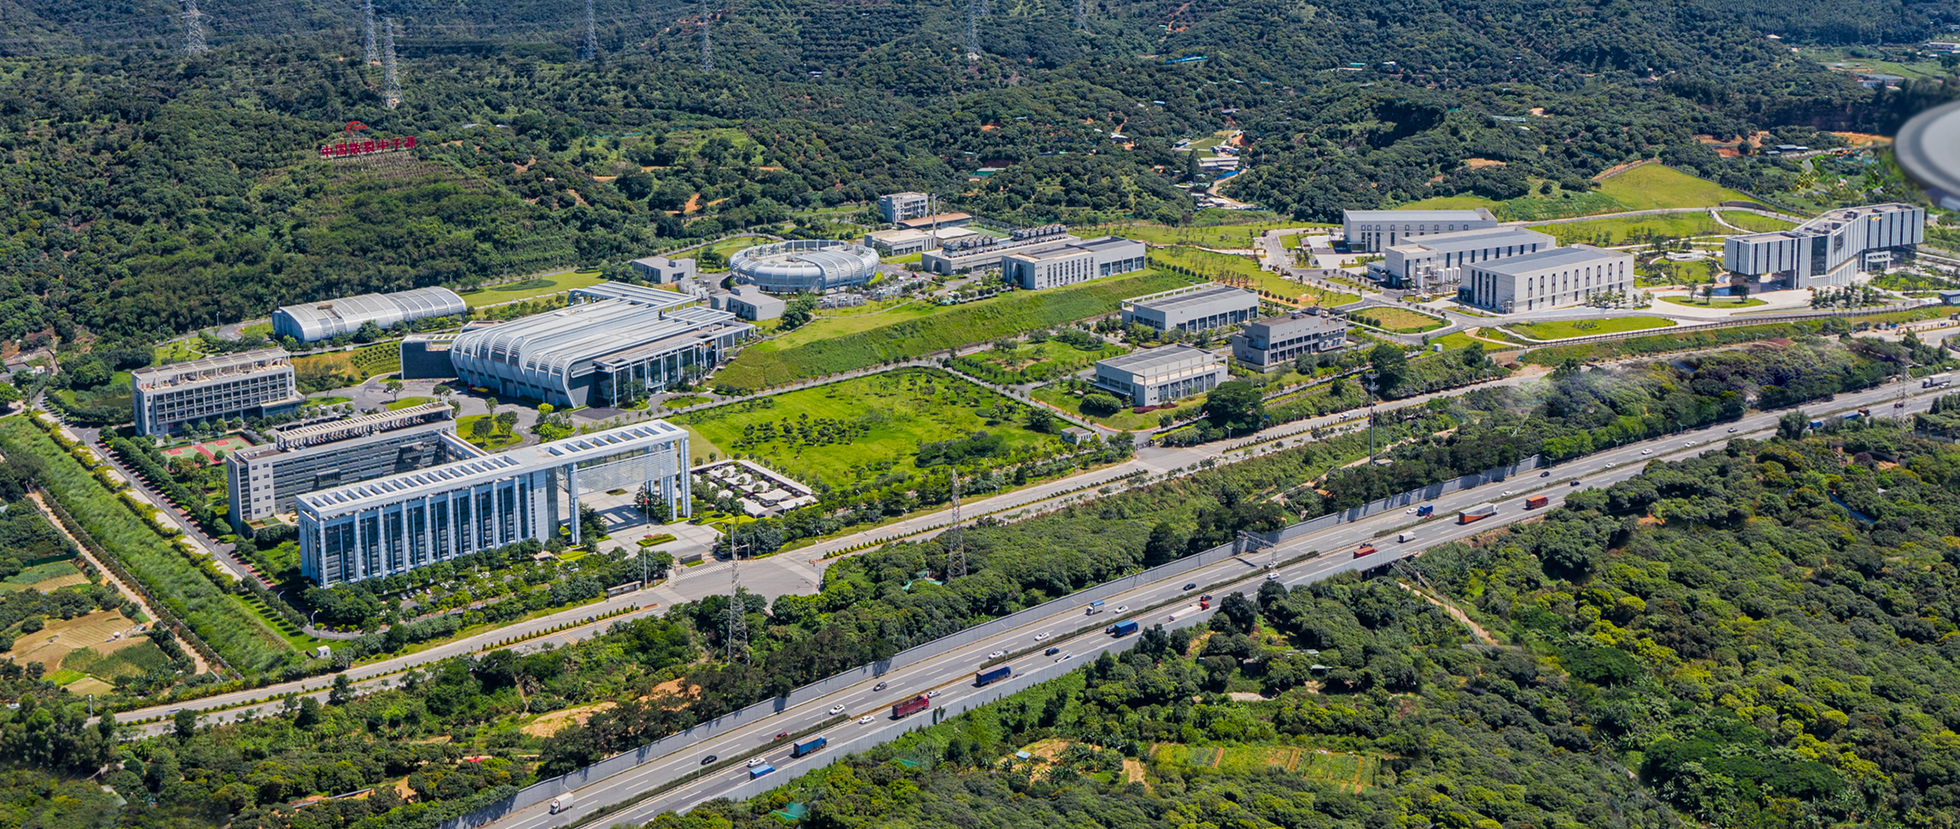
Thank you !

