Slide 1
Injection Studies for the ISIS Pre-Injector Upgrade
Bill Kyle
Space Charge Workshop 2026, Oxford, UK
01.10.26

Slide 2
Overview
Current ISIS Injection
01
Pre-Injector Upgrade Project
02
RF Programme Design
03
Working Point Optimisation
04
Stability Study
05
Summary
07
Longitudinal Painting Studies
06
2

Slide 3
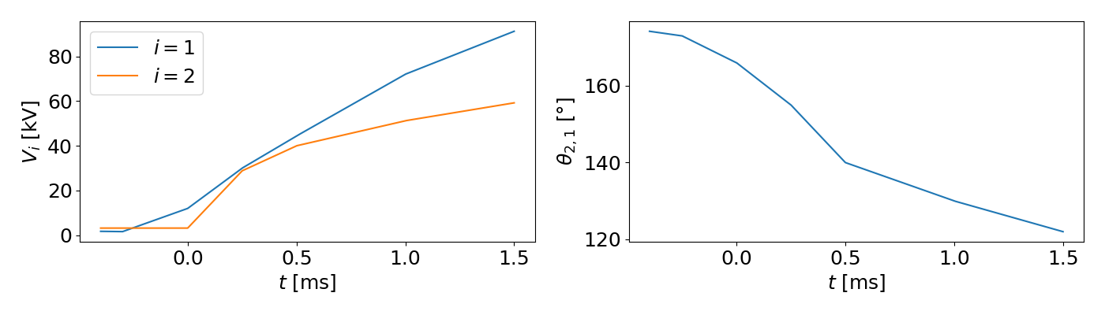
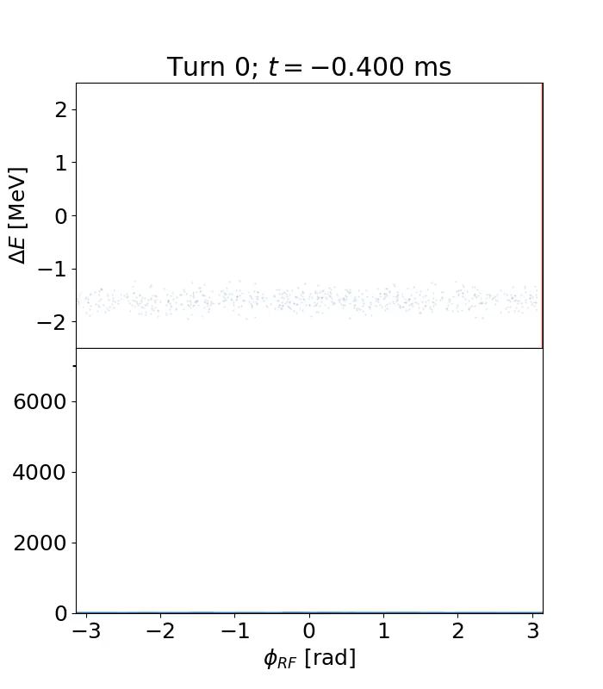
Current ISIS Injection
Coasting beam injection (~200-300 µs)
  70 MeV H⁻ beam
  0.15% momentum spread
Low initial ring RF voltage
Flat RF frequency
Falling main magnet field
  Dispersive horizontal painting
Voltage slowly increased for trapping
Low energy trapping losses
  2-3% total injection + trapping
  0.5% from non-adiabatic capture
  Acceptable but improvable
AC-coupled BPMs:
  No absolute measure of coasting beam position
Notes:
DHRF, 2nd harmonic operate with high delta over injection
Debuncher smears out 202.5 MHz bunched pulse train
Earlier losses particle outside bucket
Later losses driven by filamentation
Relative measurements possible, diagnostic HEDS chopper useful

Slide 4
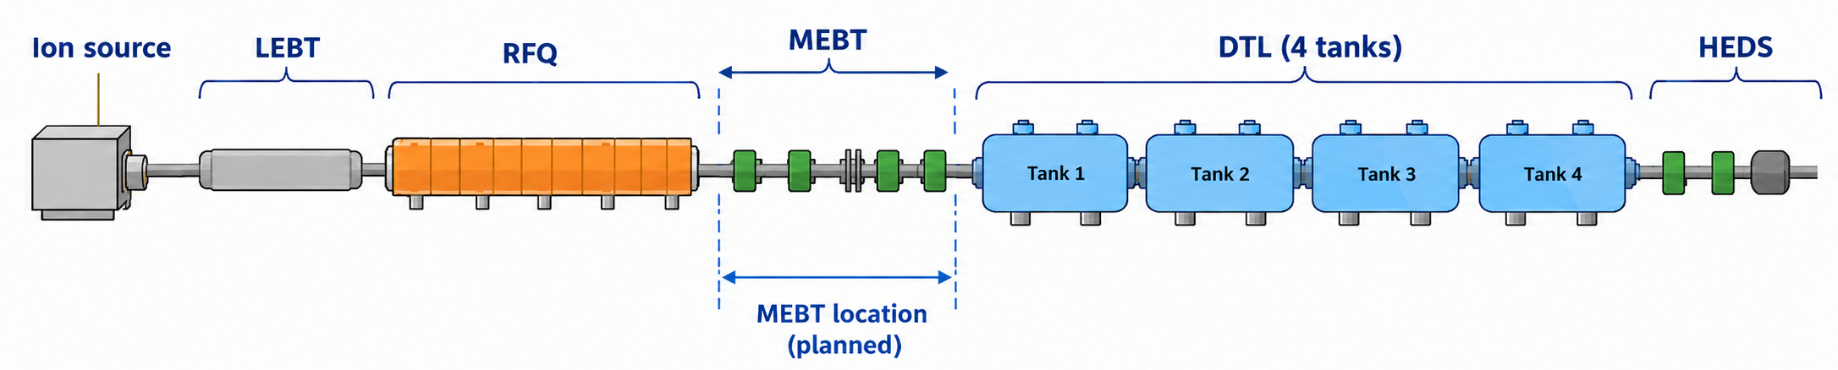
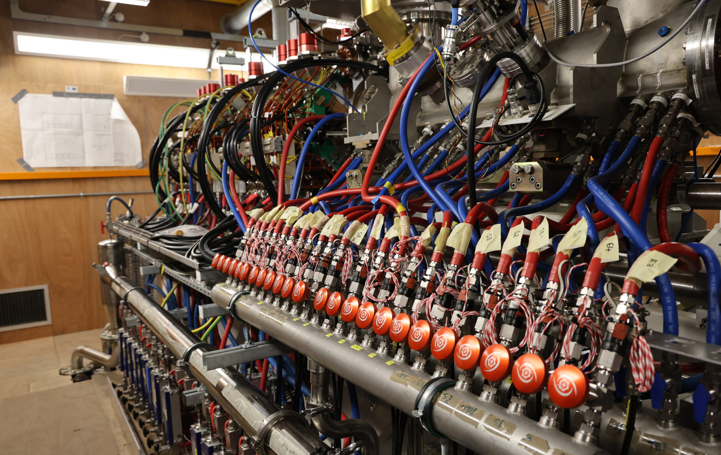
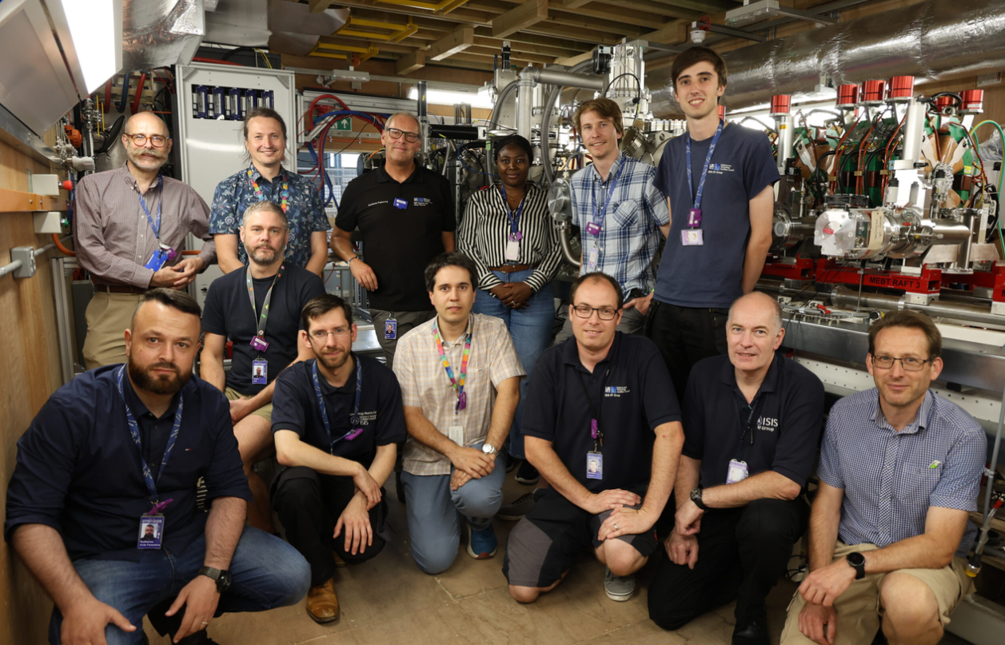
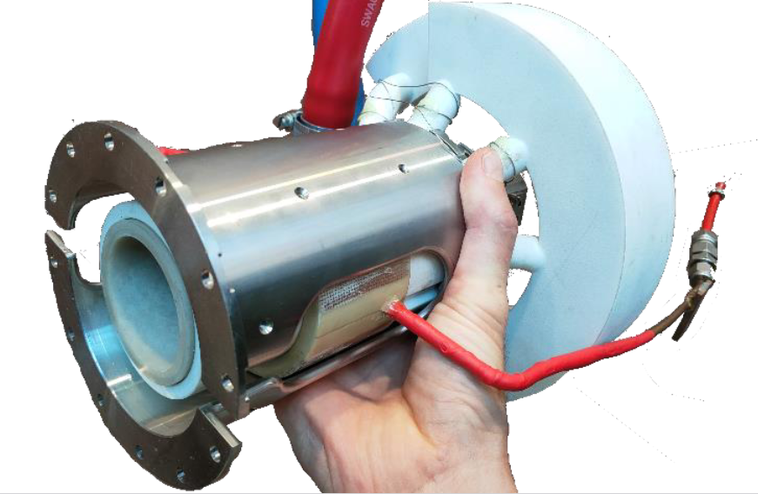
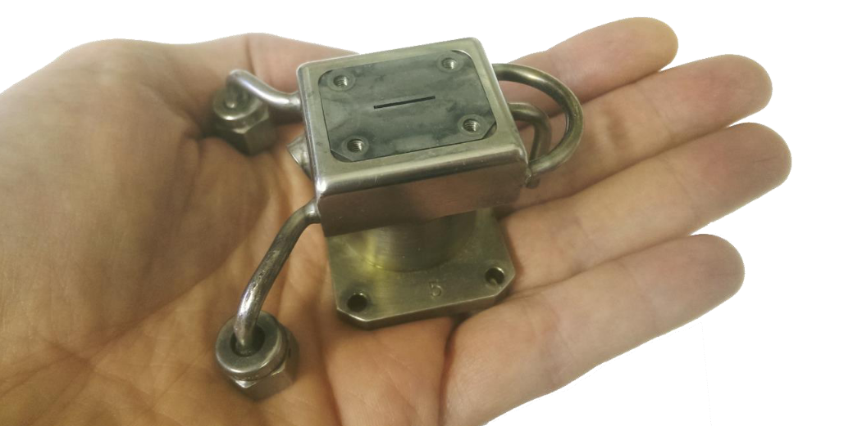
ISIS Pre-Injector Upgrade Project
Three pillars of project:
  RF H⁻ ion source.
    Increased reliability
    Better maintainability
    Longer operational lifetime
  Medium-Energy Beam Transport (MEBT)
    6-dimensional matching (q-poles and QWRs)
    Additional trajectory correction
    Additional diagnostics
  Electrostatic Chopper
    Installed in MEBT
    Synchronised to RCS RF
    Controlled low-energy losses (665 keV)
    Potential to mitigate transverse space charge effects
Images sourced from [1], [2]
Notes:
Typically need 2 ion sources per user-cycle – scheduled maintenance days
Fleet of 10 penning sources maintained
Synch’ed to fundamental RF
Bu

Slide 5
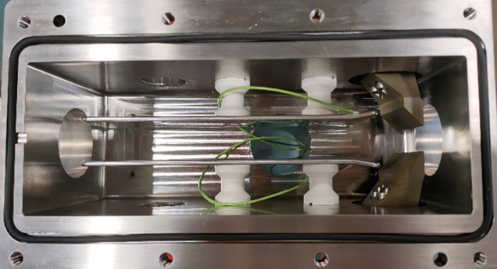
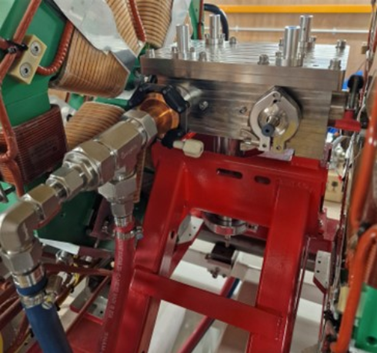
MEBT Chopper
243 mm electrostatic chopper^{[3]}
Aluminium electrodes (±7.5 kV)
Water-cooled tungsten beam dump
Removes first 100 µs of the injector pulse train^{[4]}
Chops at ring RF frequency (1.34 MHz)
Duty factor of up to 40%
Images sourced from [3], [4]
Notes:
Deflection of beam falling outside of RF system acceptance
Careful optics design and collim. required to avoid beam deposition on electrodes
Space-charge compensation

Slide 6
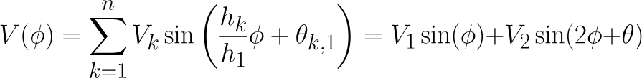
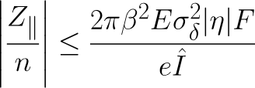
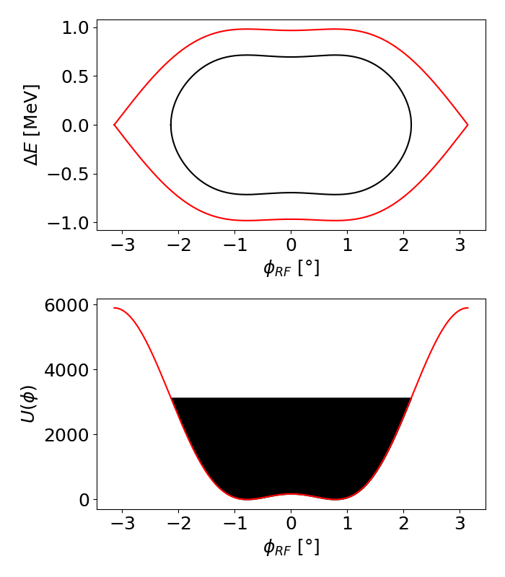
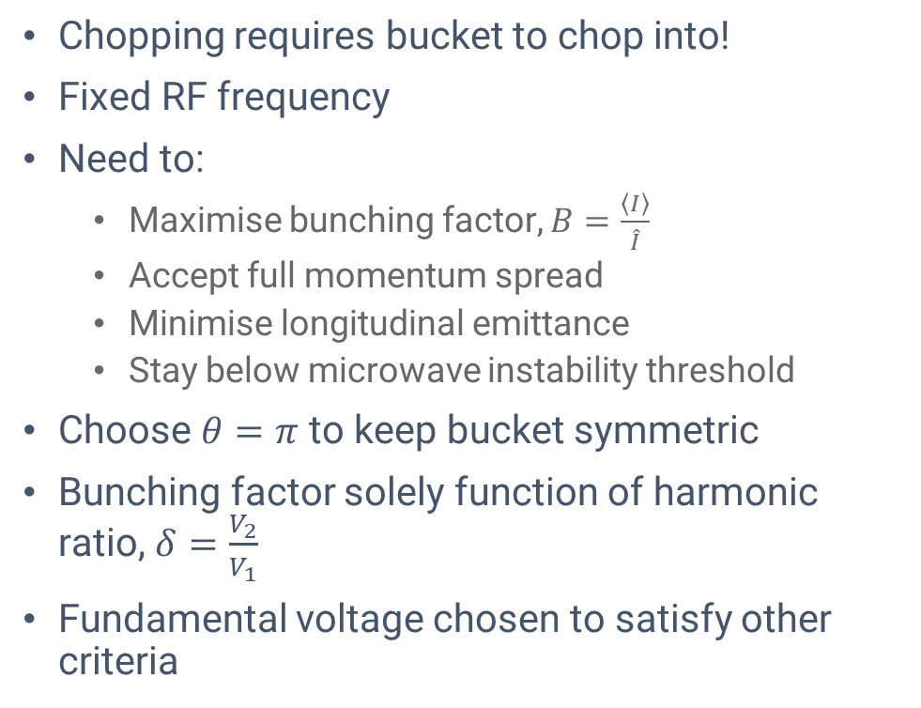
RF Voltage Programme
Chopping requires bucket to chop into!
Fixed RF frequency
Need to:
  Maximise bunching factor, $B=\frac{\left\langle I\right\rangle }{\hat{I}}$
  Accept full momentum spread
  Minimise longitudinal emittance
  Stay below microwave instability threshold
Choose $θ=π$ to keep bucket symmetric
Bunching factor solely function of harmonic ratio, $δ=\frac{V_{2}}{V_{1}}$
Fundamental voltage chosen to satisfy other criteria
^{[5]}
Notes:
Technically some acceleration, bucket not entirely stationary
Maximise BF and minimise long. Emit according to HP
Well below KSB criterion
Symm bucket maximises Bf

Slide 7
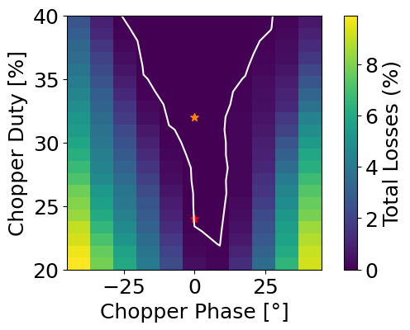
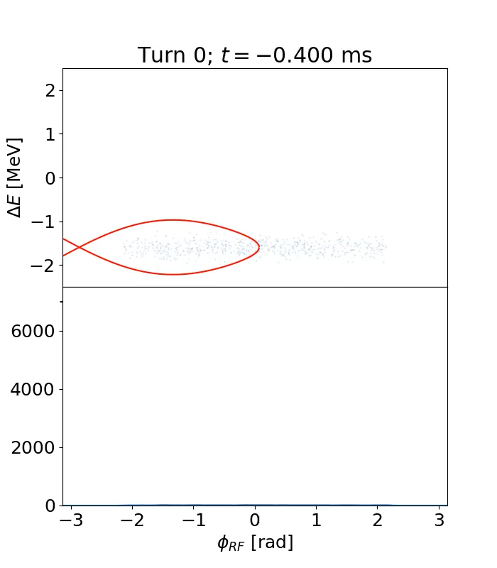
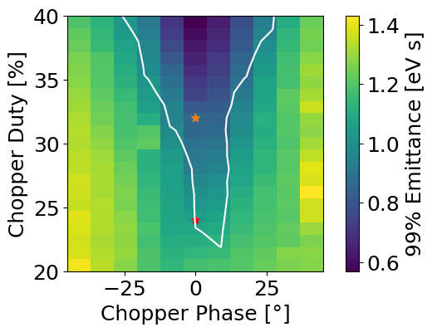
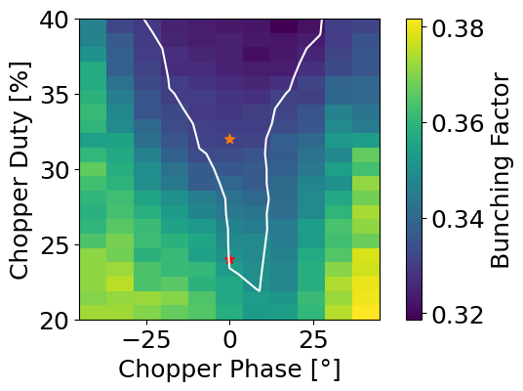
Chopper Working Point Optimisation
Need to determine working point of chopper
Goal intensity: 300 µA
Assume
  35 mA @ RFQ exit
  Perfect transmission through DTL
Scan chopper phase and duty factor
Optimisation criteria:
  0% loss
  Maximised bunching factor
  Minimised longitudinal emittance
Iterative process with voltage programme optimisation
WP found at 32% duty, 0° phase
Notes:
Bfac and emittance are in tension
Within previous spec

Slide 8
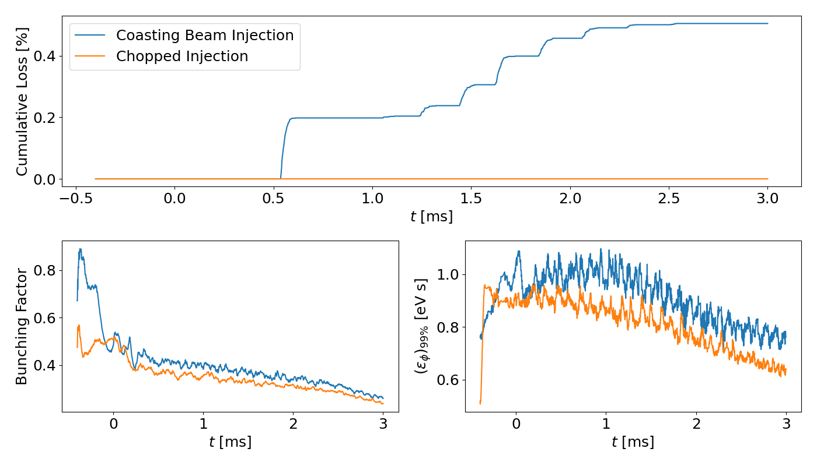
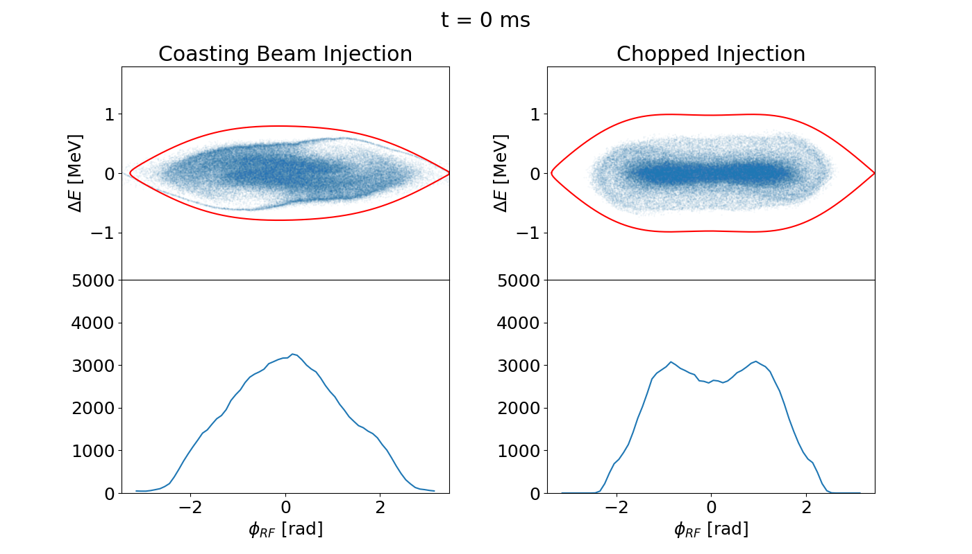
Comparison to Normal Operation
Clear improvement on beam losses
Small reduction in bunching factor as expected
Good improvement (~15%) in 99% emittance
Slight reduction in peak line density at low energies
Notes:
Longitudinal distribution shows dense core with diffuse halo – beneficial to rms long emittance as well

Slide 9
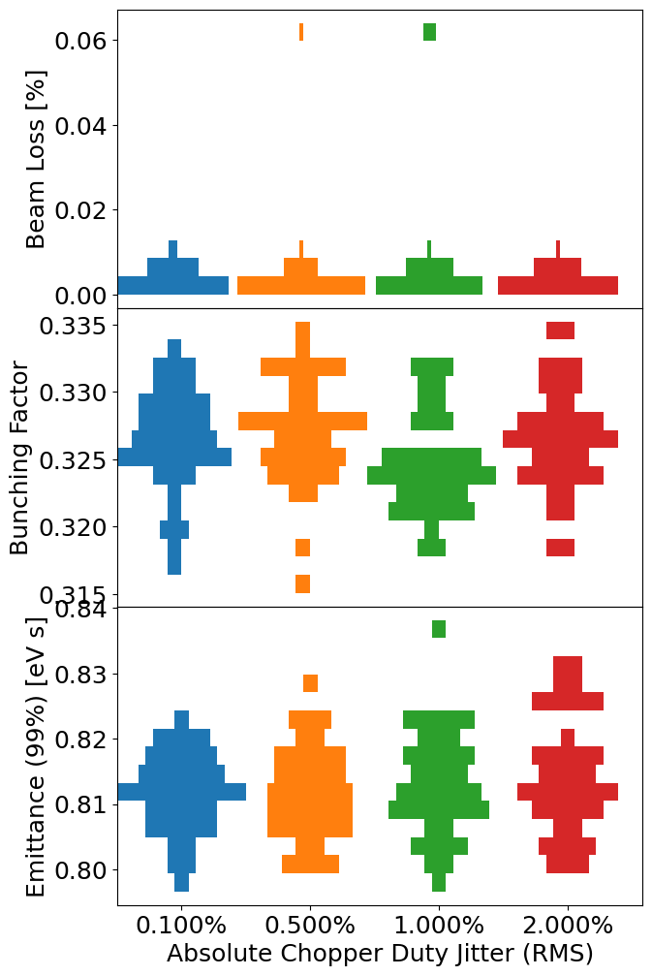
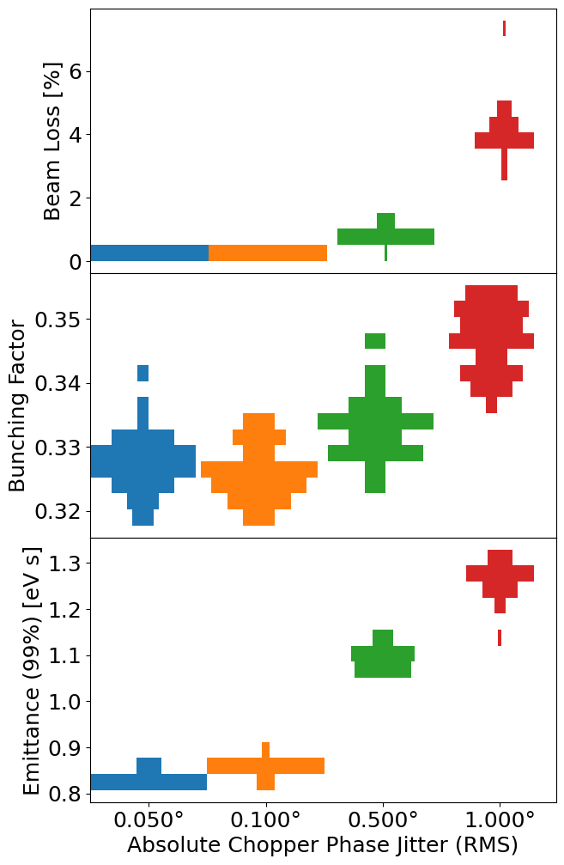
Chopper Working Point Stability
Need to define required chopper stability
Apply gaussian noise to chopper demand
Duty and phase noise investigated independently
40 repeats per noise level
Much more sensitive to phasing jitter
  Ideally < 0.05° (RMS)
Duty factor jitter < 0.5% (RMS)
Notes:
Turn-by-turn variation of chopper signals
Will continue running for additional statistics

Slide 10
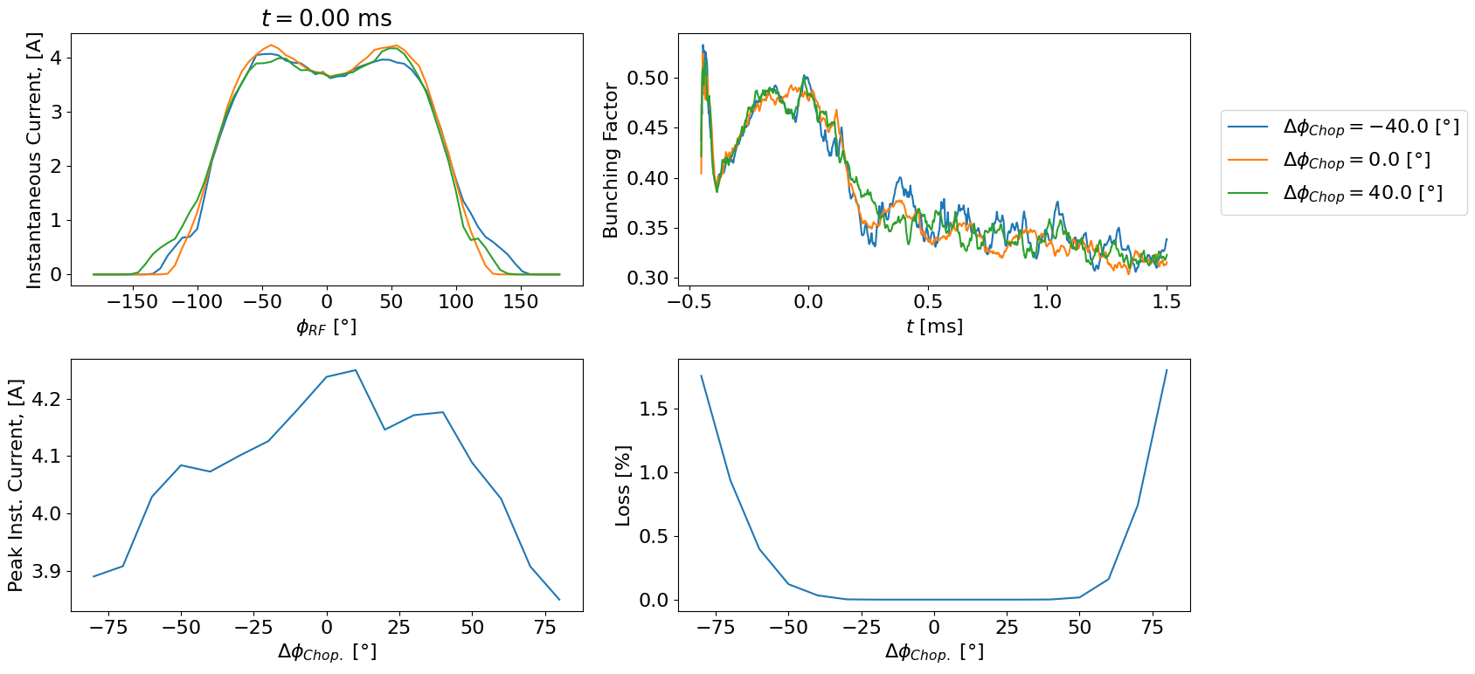
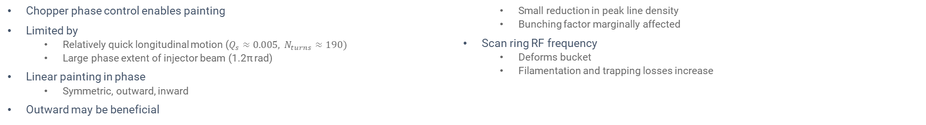
Longitudinal Painting Study
Chopper phase control enables painting
Limited by
  Relatively quick longitudinal motion ($Q_{s}≈0.005, N_{turns}≈190)$
  Large phase extent of injector beam (1.2π rad)
Linear painting in phase
  Symmetric, outward, inward
Outward may be beneficial
  Small reduction in peak line density
  Bunching factor marginally affected
Scan ring RF frequency
  Deforms bucket
  Filamentation and trapping losses increase
Notes:
One synchrotron revolution during injection period
Maximum chopper duty is 40% - required to achieve 300 uA in fairly short injection cycle
Pictured results from outward
Fr scan shifts phi-s, do have technically non-zero phi_s anyway, but makes worse

Slide 11
Summary
MEBT chopper will enable zero-loss injection into ISIS RCS
Voltage program developed for chopped injection mode
Working point determined
Operational stability analysis performed
Chopped injection results in smoother LPS distributions, with reduced longitudinal emittance
Small reduction in bunching factor expected, which may impact transverse space charge
Next Steps:
Investigate 2nd-harmonic phase sweeps (à la J-PARC RCS ^{[6]})
Non-linear chopper phase sweeps
Questions:
Any experience of bunch shaping using ring RF frequency rather than e.g. PIMS?
Successes with painting hollow beams and preserving them^{[7, 8]}?
Notes:
Tamura-san
Hollow beams – rf gymnastics (forte), radial loop (Oeftiger) somewhat unstable for general opration

Slide 12
Thank you for your attention!
Any questions?

Slide 13
References
[1] ISIS Neutron and Muon Source, “First Beam through Pre-Injector Test Stand”, 2026
[2] S. R. Lawrie, “External RF-Coil H⁻ Ion Source Commissioning”, presented at ICIS2021, Canada (2021)
[3] J. Speed, A. Avaroglu and I. Rodriguez, “Practical Design and Manufacturing of the New ISIS MEBT Chopper”, in proc. of IPAC24, USA (2024), doi: 10.18429/JACoW-IPAC2024-THPR19
[4] I. Rodriguez, S. Lawrie, and J. Speed, “DESIGN OF AN ELECTROSTATIC CHOPPER FOR THE NEW ISIS MEBT”, in proc. of IPAC23, Italy (2023), doi: 10.18429/JACoW-IPAC2023-TUPM016
[5] S. Y. Lee , “Accelerator Physics”, Singapore (1999), World Scientific, ISBN: 981-02-3709-X
[6] F. Tamura et al., “Longitudinal painting with large amplitude second harmonic rf voltages in the rapid cycling synchrotron of the Japan Proton Accelerator Research Complex”, in Phys. Rev. STAB, 12, 041001 (2009), doi: 10.1103/PhysRevSTAB.12.041001
[7] A. Oeftiger, S. Hancock and G. Rumolo, “Space Charge Mitigation with Longitudinally Hollow Bunches”, in proc. of HB2016, Sweden (2016), doi:10.18429/JACoW-HB2016-MOPR026
[8] V. Forte et al. “THE PSB OPERATIONAL SCENARIO WITH LONGITUDINAL PAINTING INJECTION IN THE POST-LIU ERA”, in proc. of IPAC17, WEPVA035, Denmark (2017), doi: 10.18429/JACoW-IPAC2017-WEPVA035

