Slide 1
Designing experiments to study beam dynamics at high space charge intensities in the SNS AR
Austin Hoover
7th ICFA Workshop on Space Charge | Oxford, UK
September 30, 2026

Slide 2
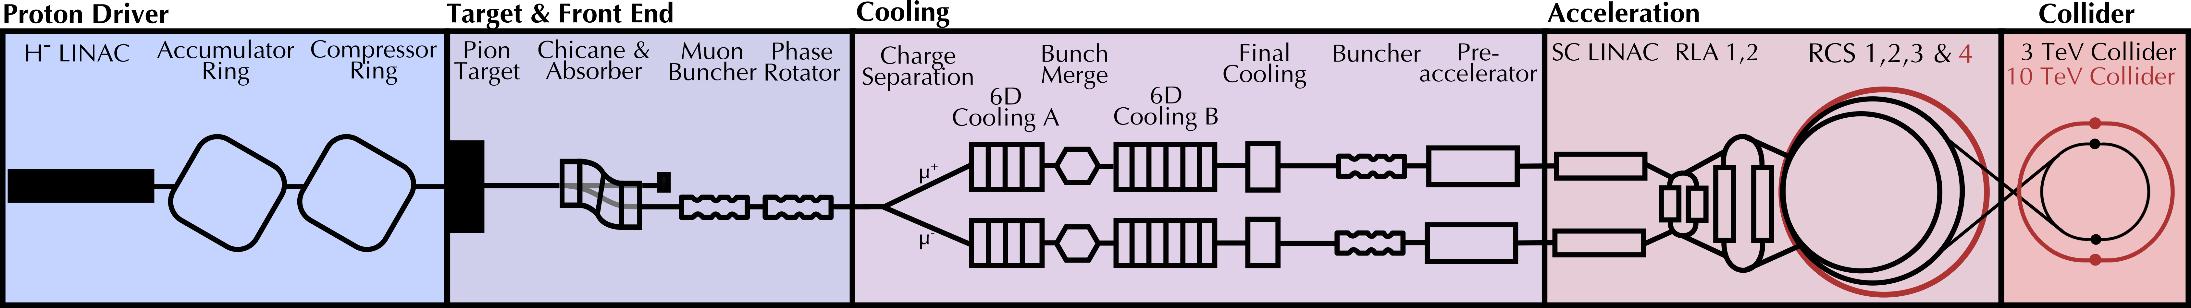
Space charge will play an important role in next-generation hadron accelerators
Muon Collider (MuC) would require strong bunch compression after accumulation.
Compression will create extreme space charge forces (albeit for a short time).
High power = strict loss requirements (< 1 W/m)
2-4 MW, 5-10 Hz, 1-3 ns

Slide 3
Some model predictions have not been directly observed in experiment
“Advances made over the past few years have helped to arrive at a more balanced understanding of these mechanisms and narrow the gap between highly idealized analytical models and multi-particle simulations—a trend that is encouraging and should be promoted. It cannot be overlooked, however, that systematic and clear experimental data on space charge physics processes is difficult to obtain in production accelerators and therefore still quite limited. This is to a large extent due to the challenges of having sufficient diagnostics and getting enough access to beam time on devices that are primarily user facilities. The impression of many workers in the field [that the gap between theory—including simulation—and the real world of operating accelerators is still considerable] is not misleading.” \cite{hofmann_space_2017}

Slide 4
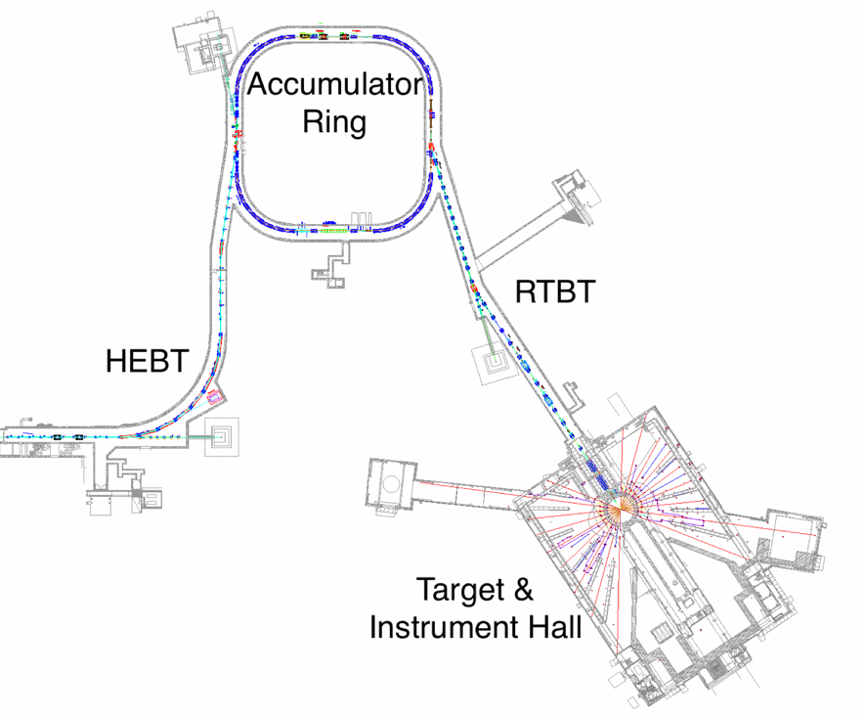


Experiments at SNS could provide valuable data
Accumulator ring compresses to 700 ns
Injection
Front-End forms 1-ms H- beam
Linac accelerates to 1.3 GeV
RF (h=1,2)
2.5 MeV
86.8 MeV
186 MeV
387 MeV
1300 MeV
RFQ
MEBT
DTL
CCL
SRF $β=0.61$
SRF $β=0.81$
Ion Source
Target 2.0 MW @ 60 Hz
Notes:
SNS is 20 years old now but was just recently upgraded. I don't think we've exploited all the physics in the machine.

Slide 5
Experiments at SNS could provide valuable data
Largest single-bunch intensity (2.25e+14 / 2.8 MW-equivalent)
Flexible energy range (1.3 → 0.8 GeV, gamma ratio 1.3, perveance ratio 2.5)
Beam shaping (painting + compression)
Detailed transverse diagnostics (MENT, e-scanner)

Slide 6
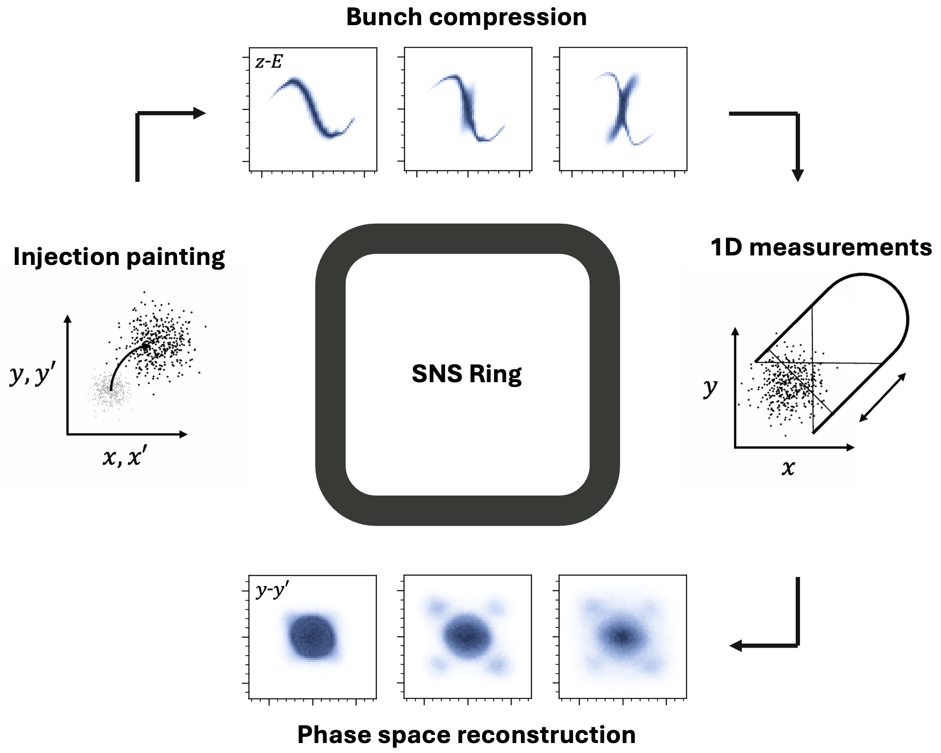
Summary of proposed research
Notes:
Use phase space painting to launch variety of initial distributions in SNS AR.
Use bunch compression to ramp space charge tune shifts beyond 0.5.
Measure 2D/4D phase space distributions as function of time.

Slide 7
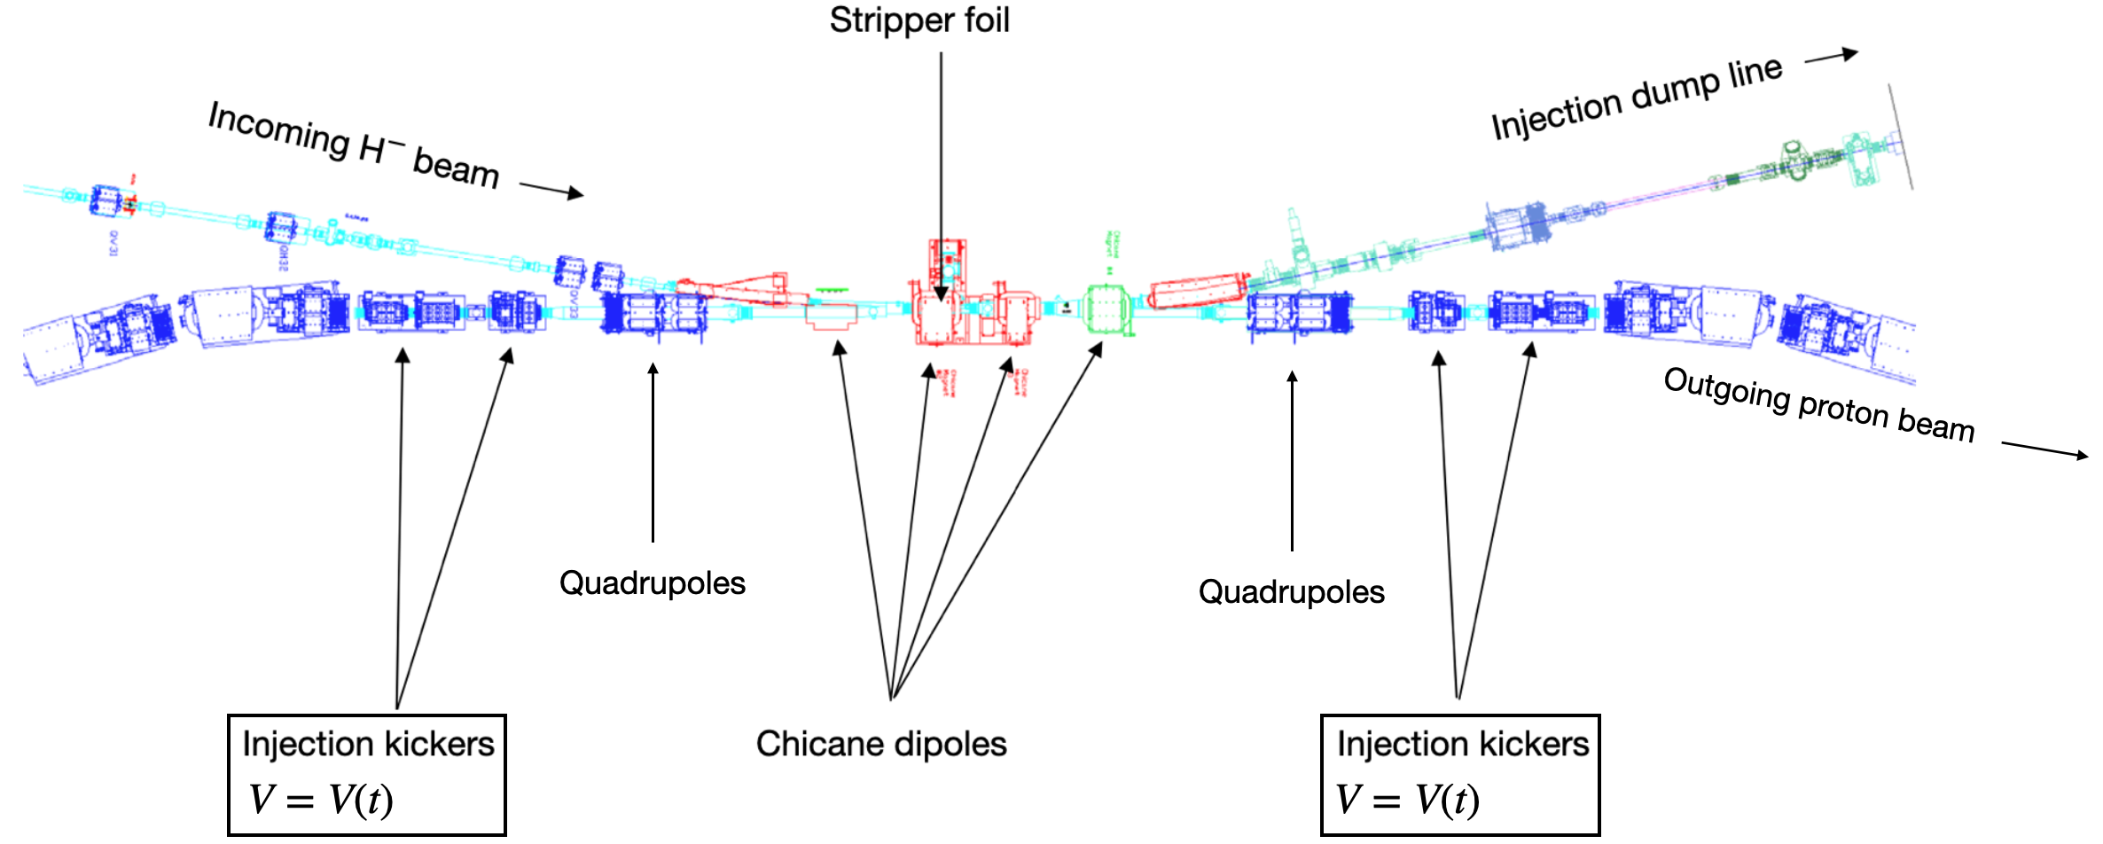
Painting waveforms could be modified to launch variety of initial distributions
Notes:
Much smaller beam possible by lowering energy.

Slide 8
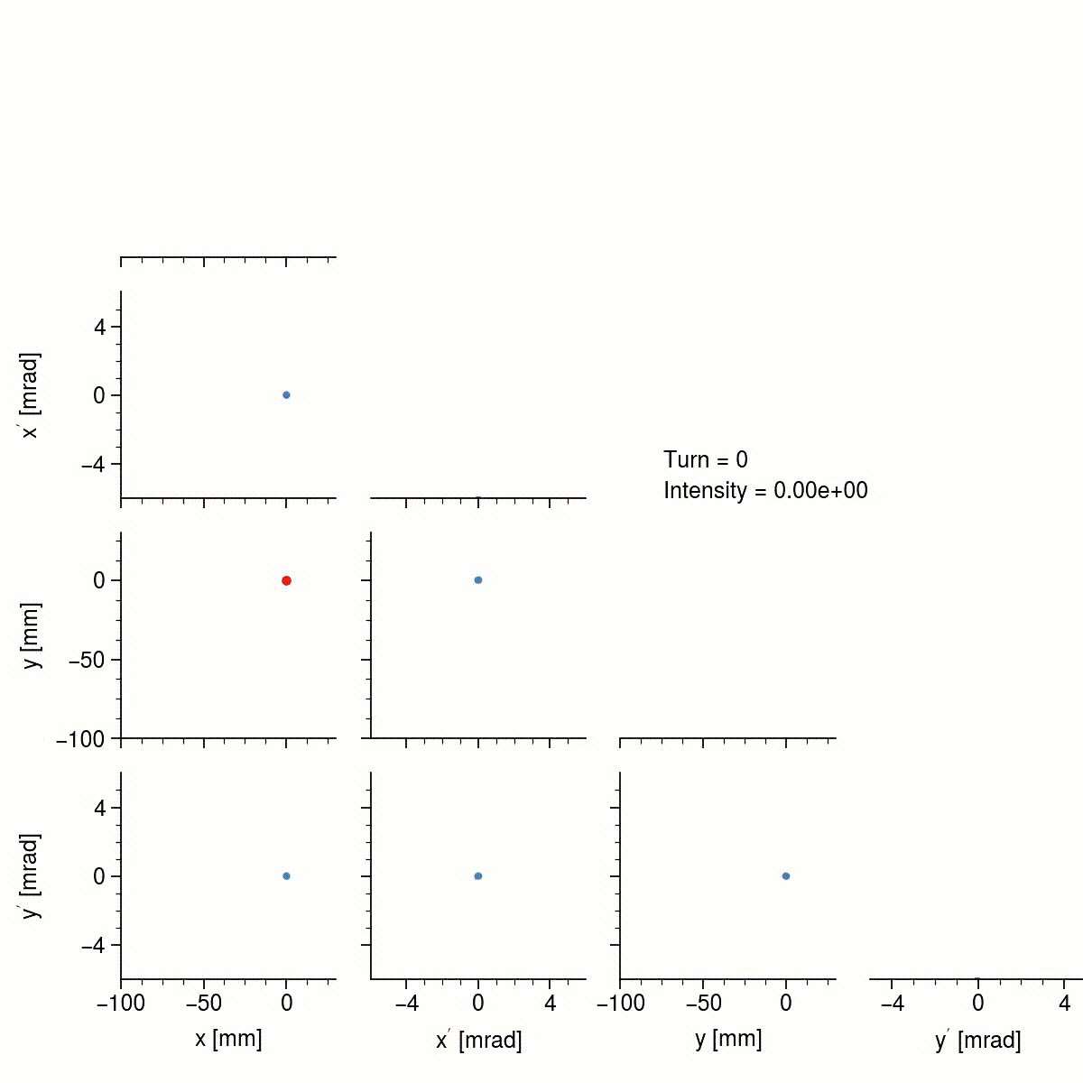
Painting waveforms could be modified to launch variety of initial distributions

Slide 9
Bunch compression experiments have begun using existing hardware/software
SNS has four RF cavities (h=1, h=1, h=2, h=2)
Each cavity can run at either harmonic.
Each cavity has operating limit of 10 kV. 18 kV tests (no beam) were performed during SNS commissioning.
Need to find optimal combination of voltage, phase, feedback, feedforward to maximize compression ratio + troubleshoot RF issues.
Notes:
Normally the RF reduces peak density — we want to do the opposite.

Slide 10
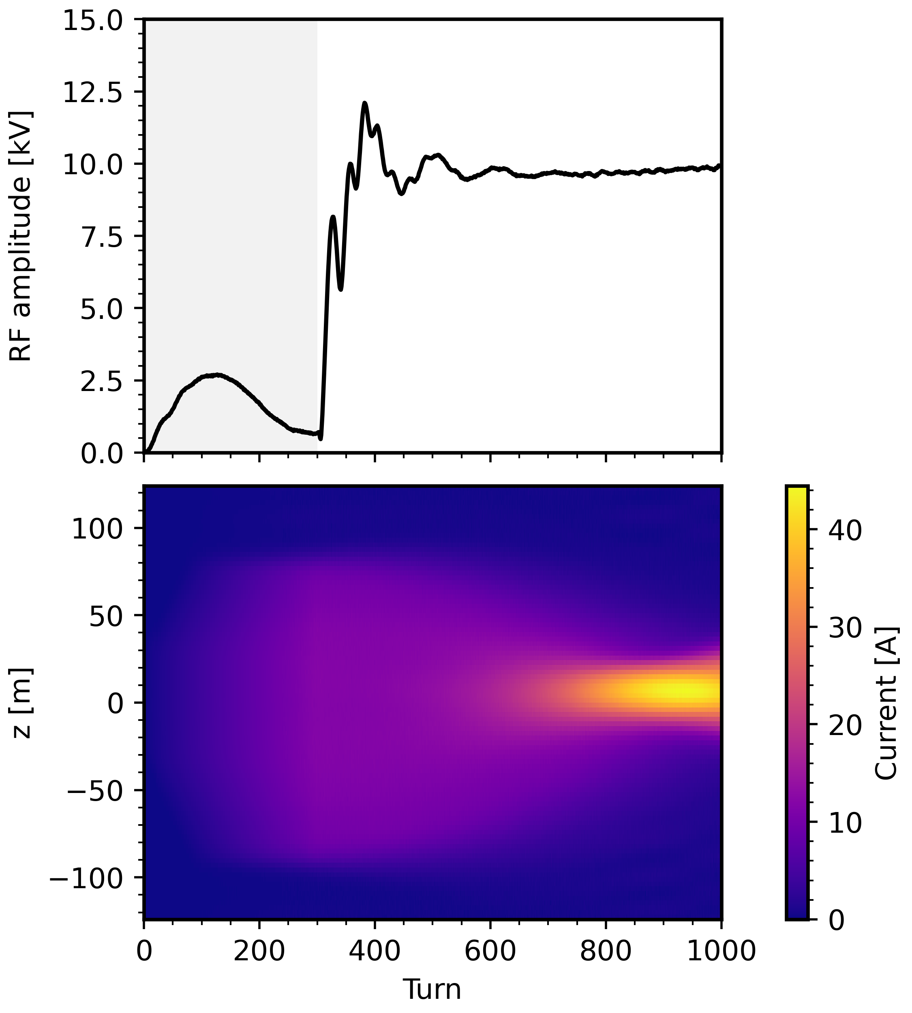
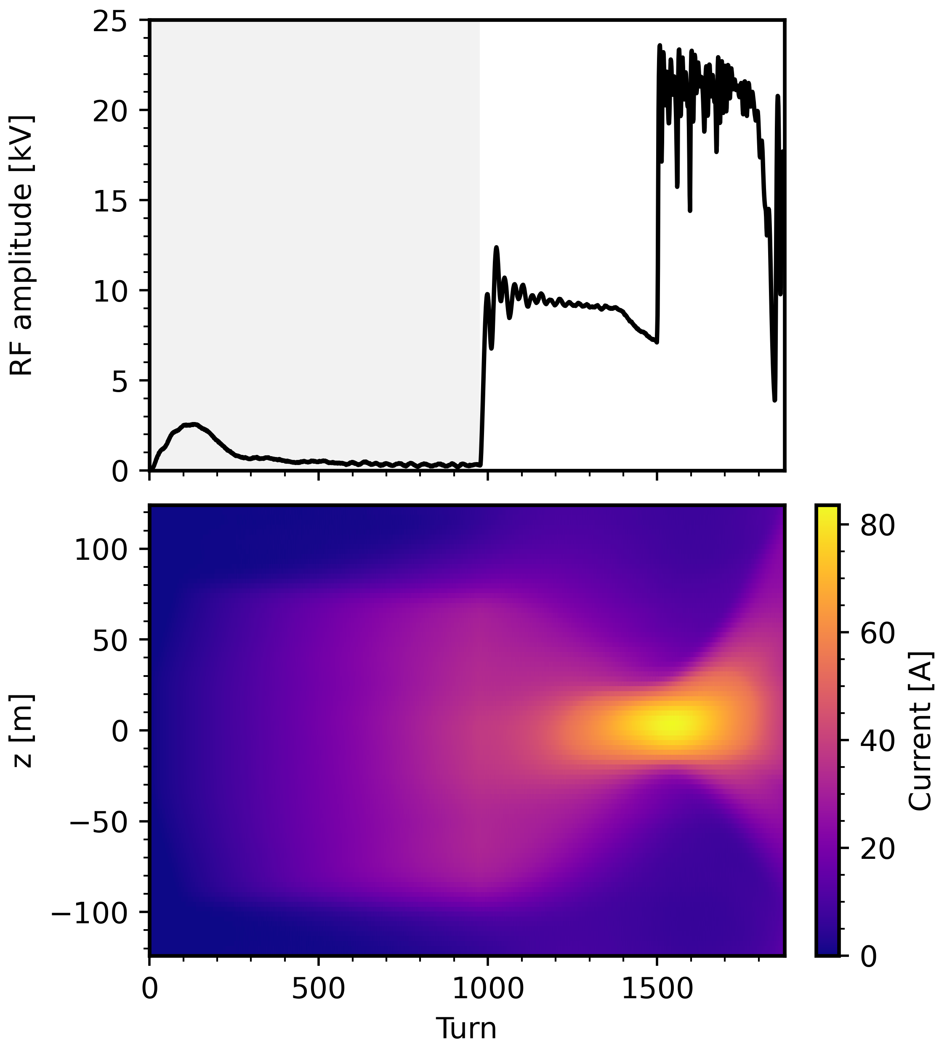
Initial experiments demonstrated 2.5x increase in peak density for 1.9 MW-equivalent beam
300-turn injection
1000-turn injection
Notes:
Used 2 cavities here

Slide 11
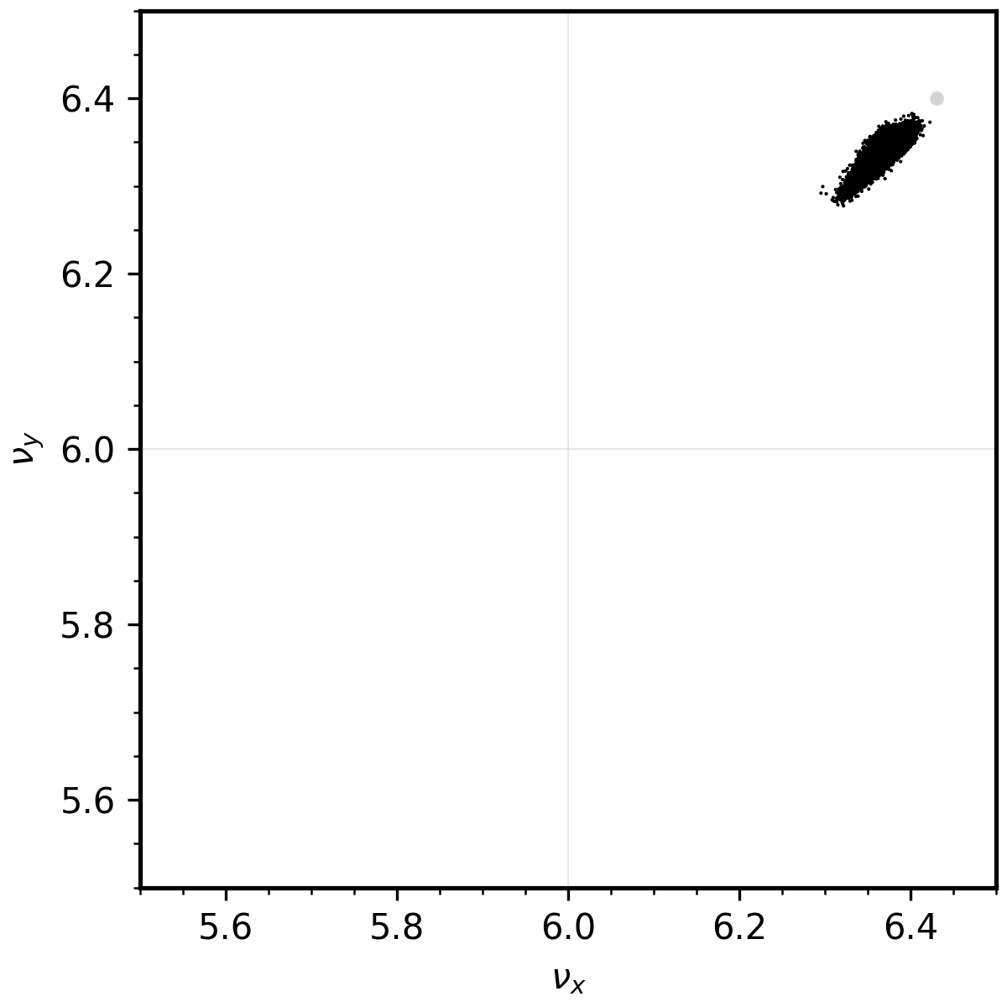
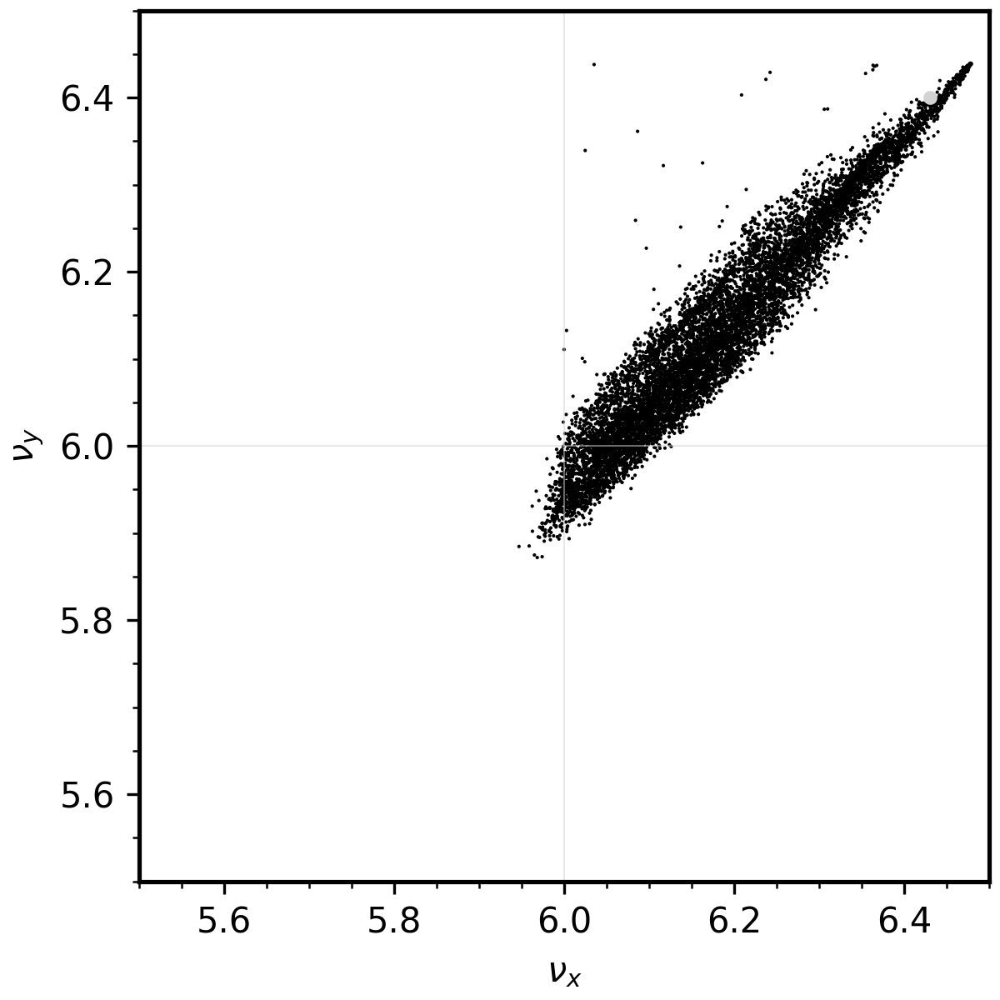
Large tune shifts/spreads possible with moderate compression ratios
Initial
Final
Gaussian, 1.3 GeV, 25 mm mrad
Notes:
RF = 10 x 4 kV
Initial distribution is RMS-matched, sigma dE = 1 MeV
Factor of ~4-5 compression

Slide 12
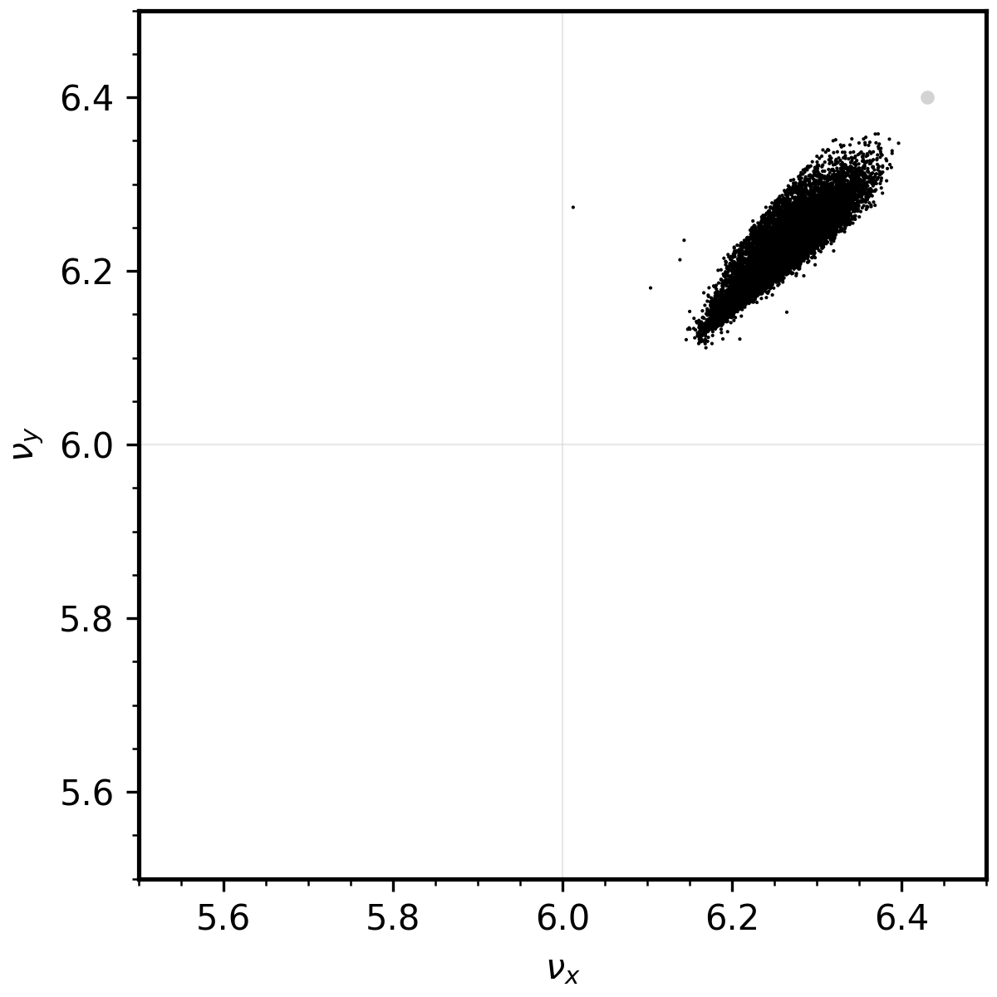
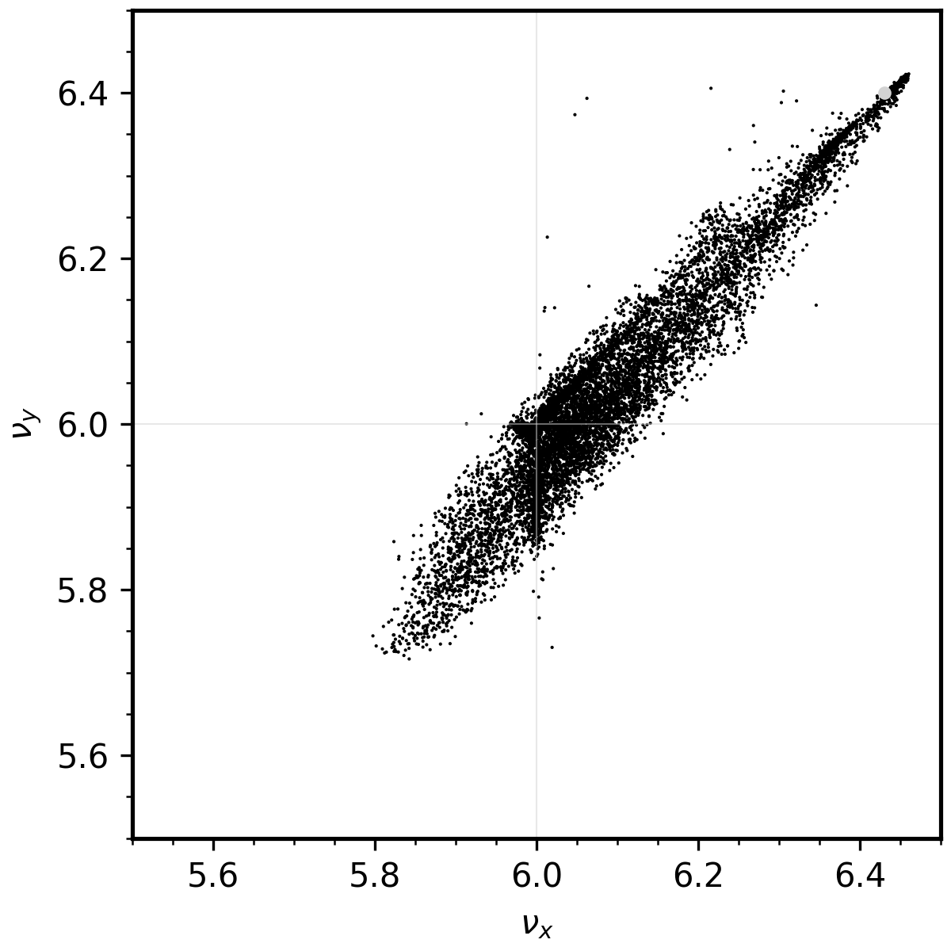
Large tune shifts/spreads possible with moderate compression ratios
Initial
Final
Gaussian, 0.8 GeV, 25 mm mrad

Slide 13
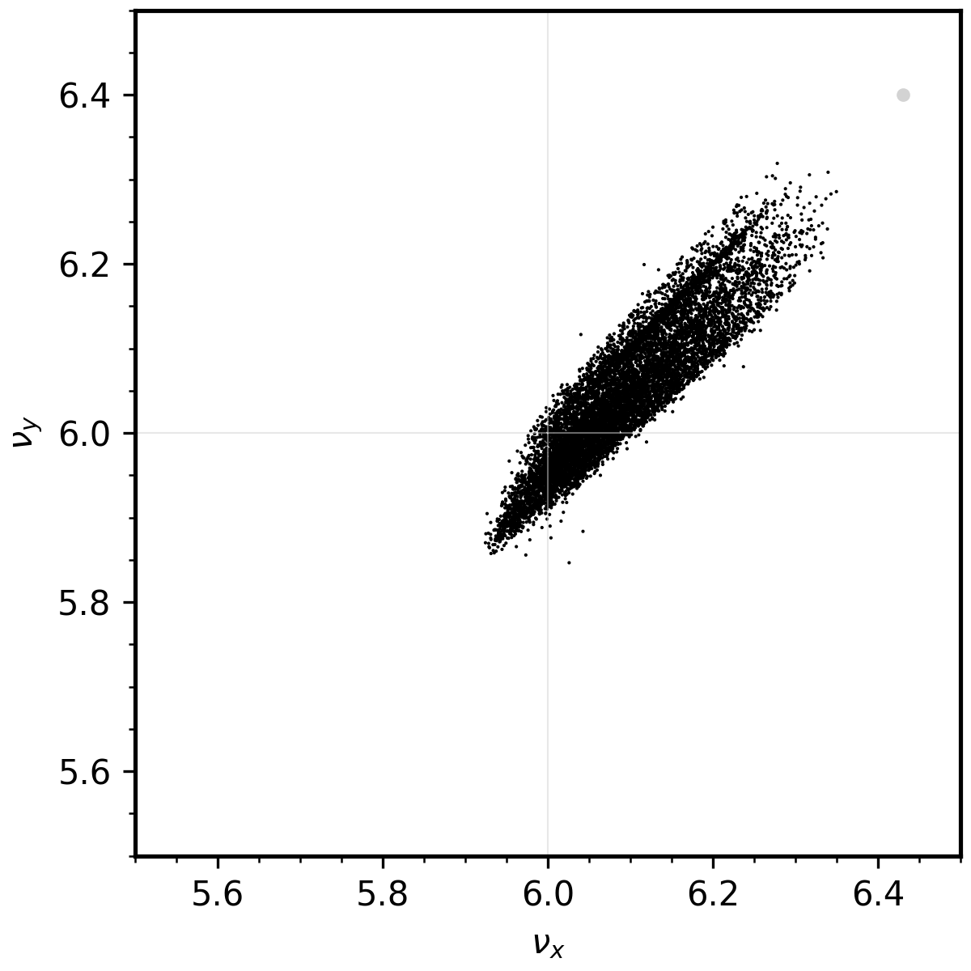
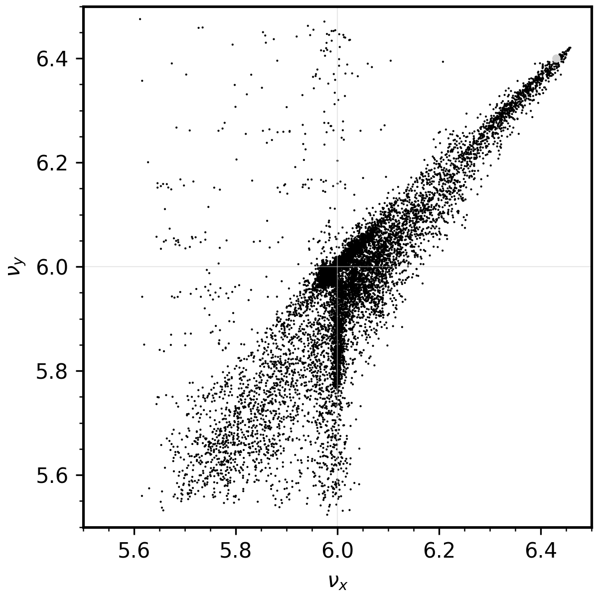
Large tune shifts/spreads possible with moderate compression ratios
Initial
Final
Gaussian, 0.8 GeV, 12 mm mrad

Slide 14
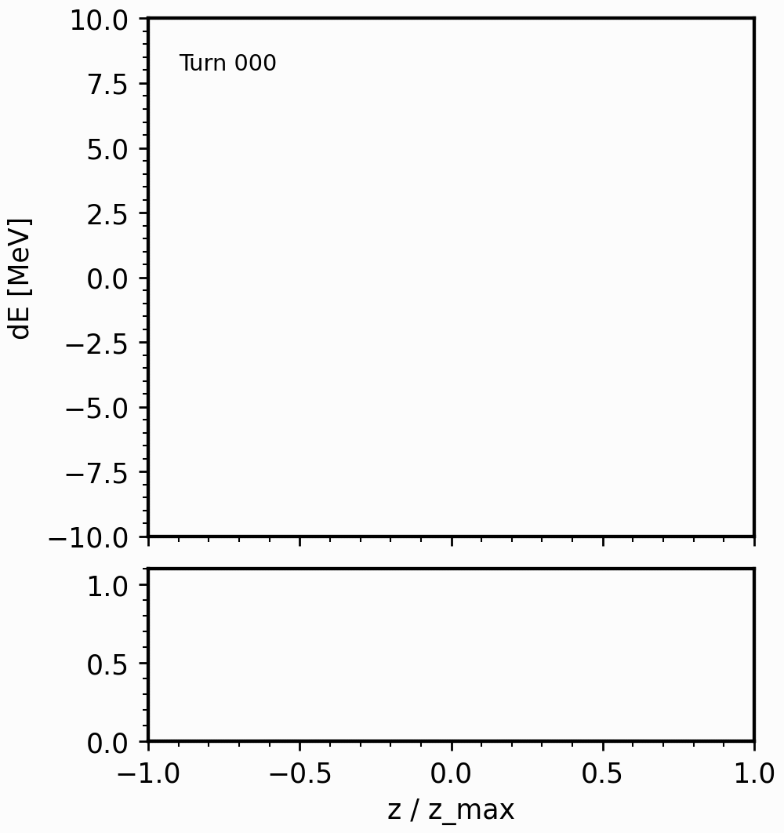

Longitudinal space charge expected to influence compression
1300 MeV
800 MeV

Slide 15
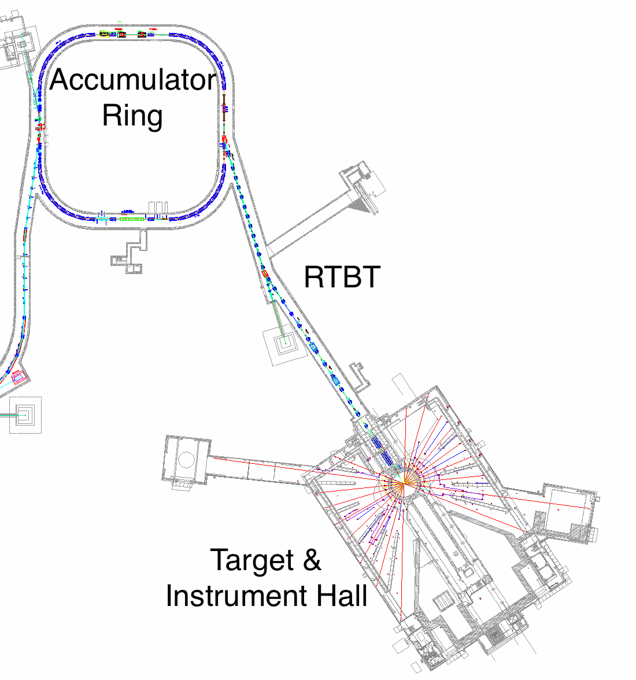
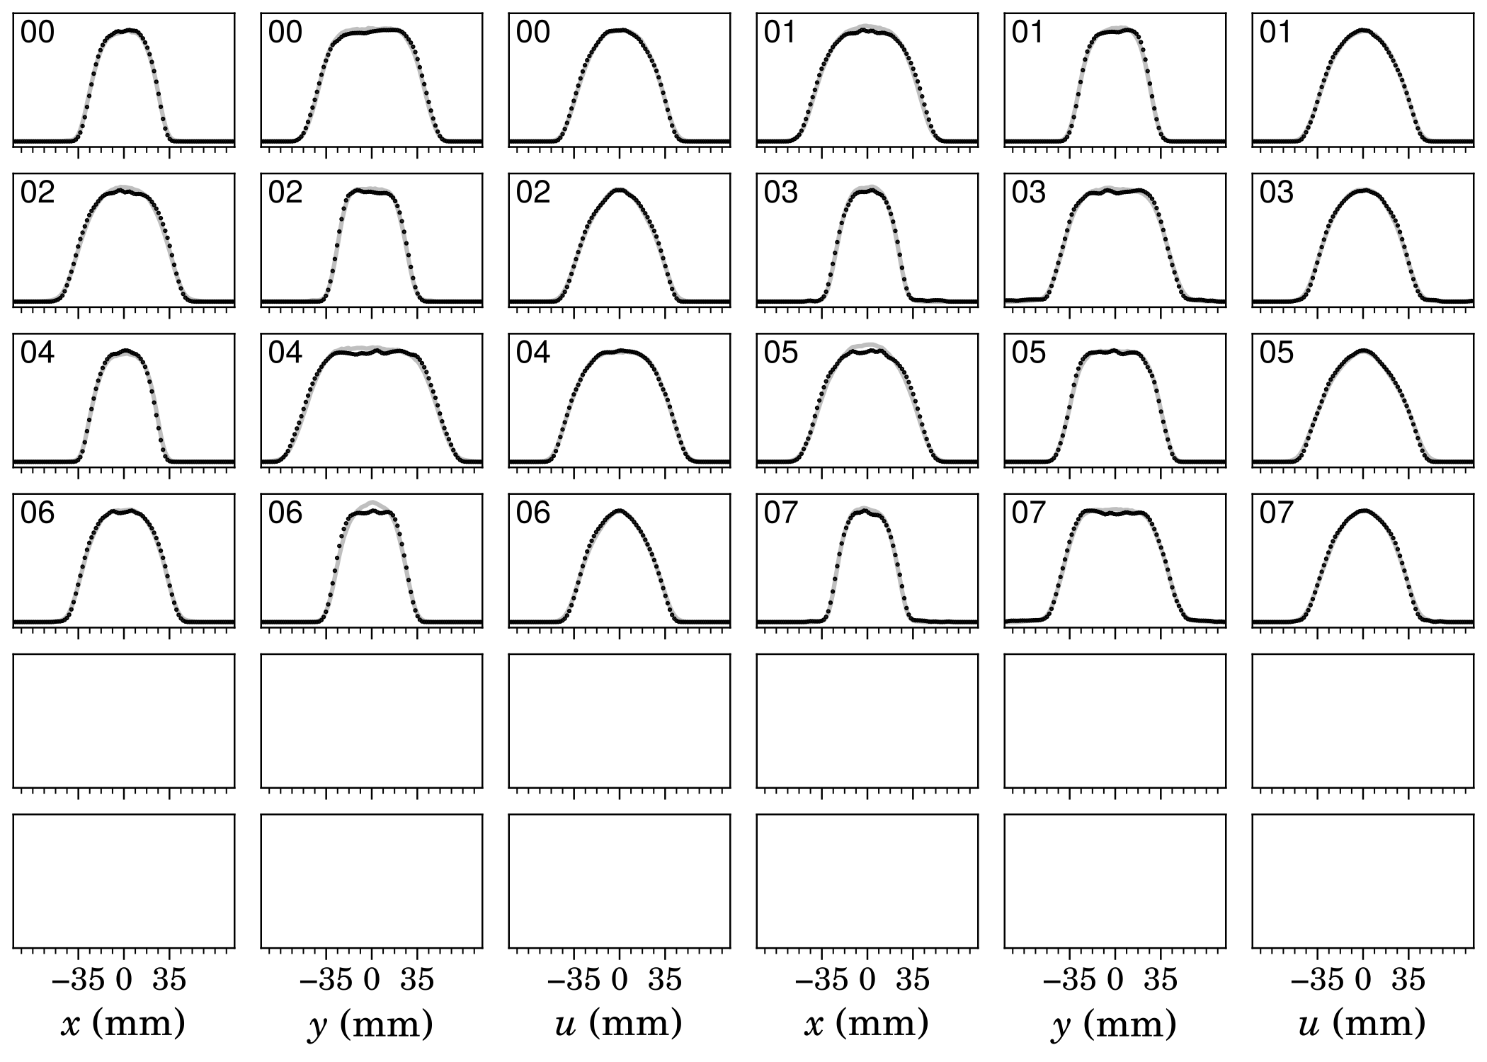
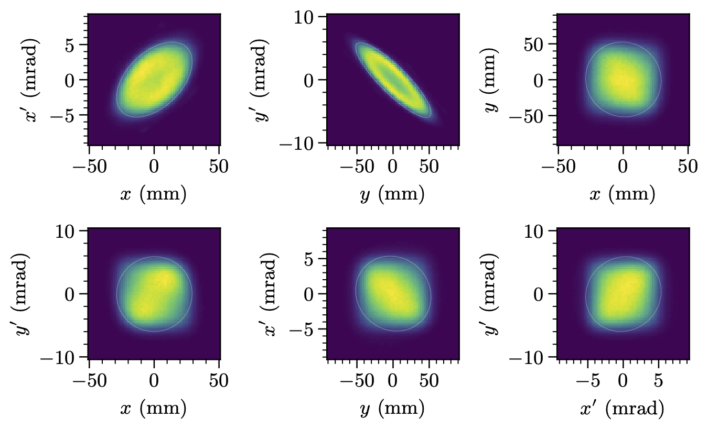


Wire scanners constrain phase space distribution of accumulated beam (2D/4D)
MENT
$x$-$x’$
$y$-$y’$

Slide 16
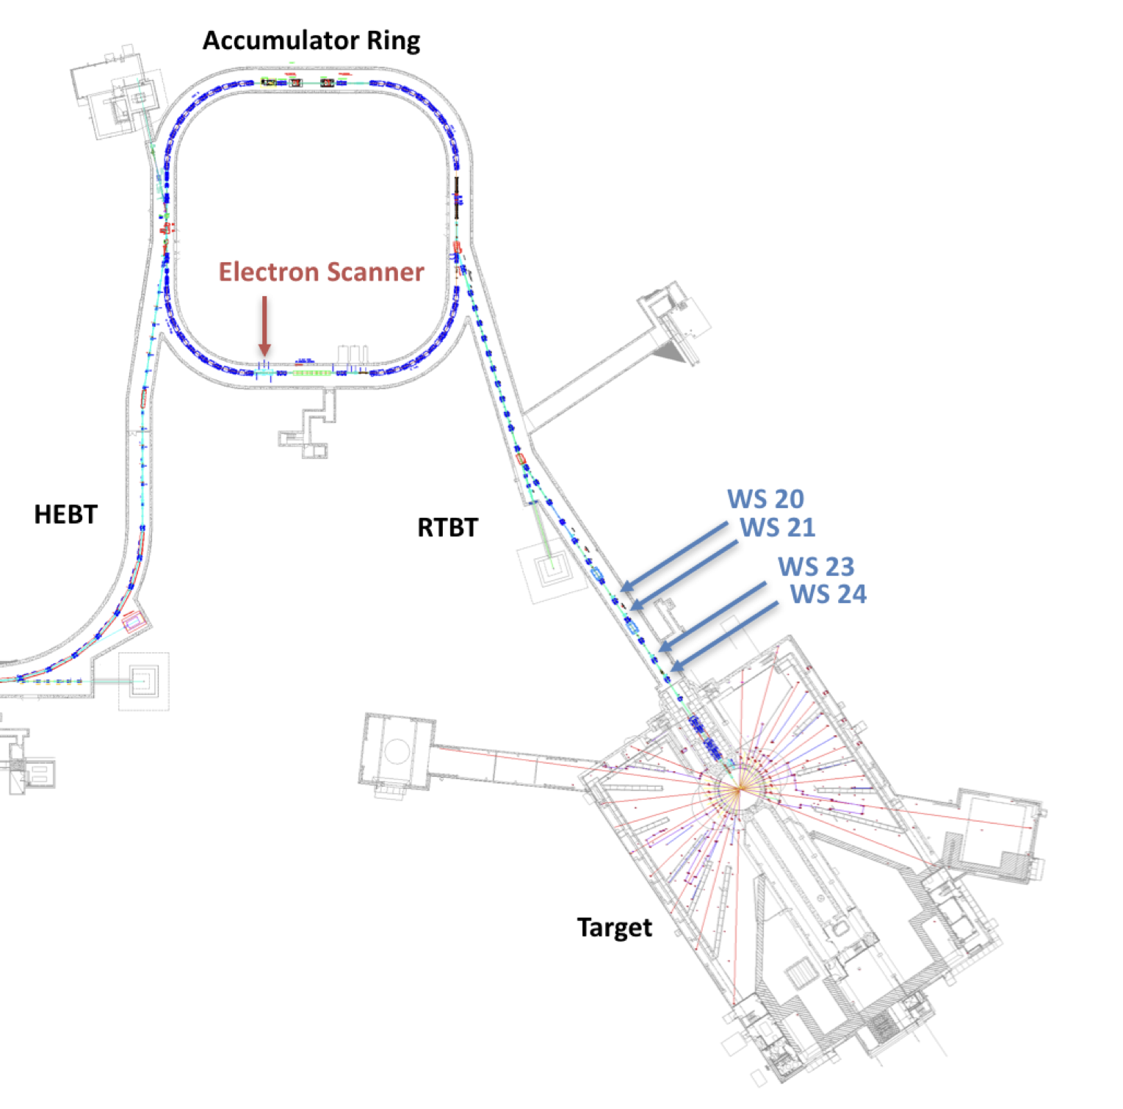
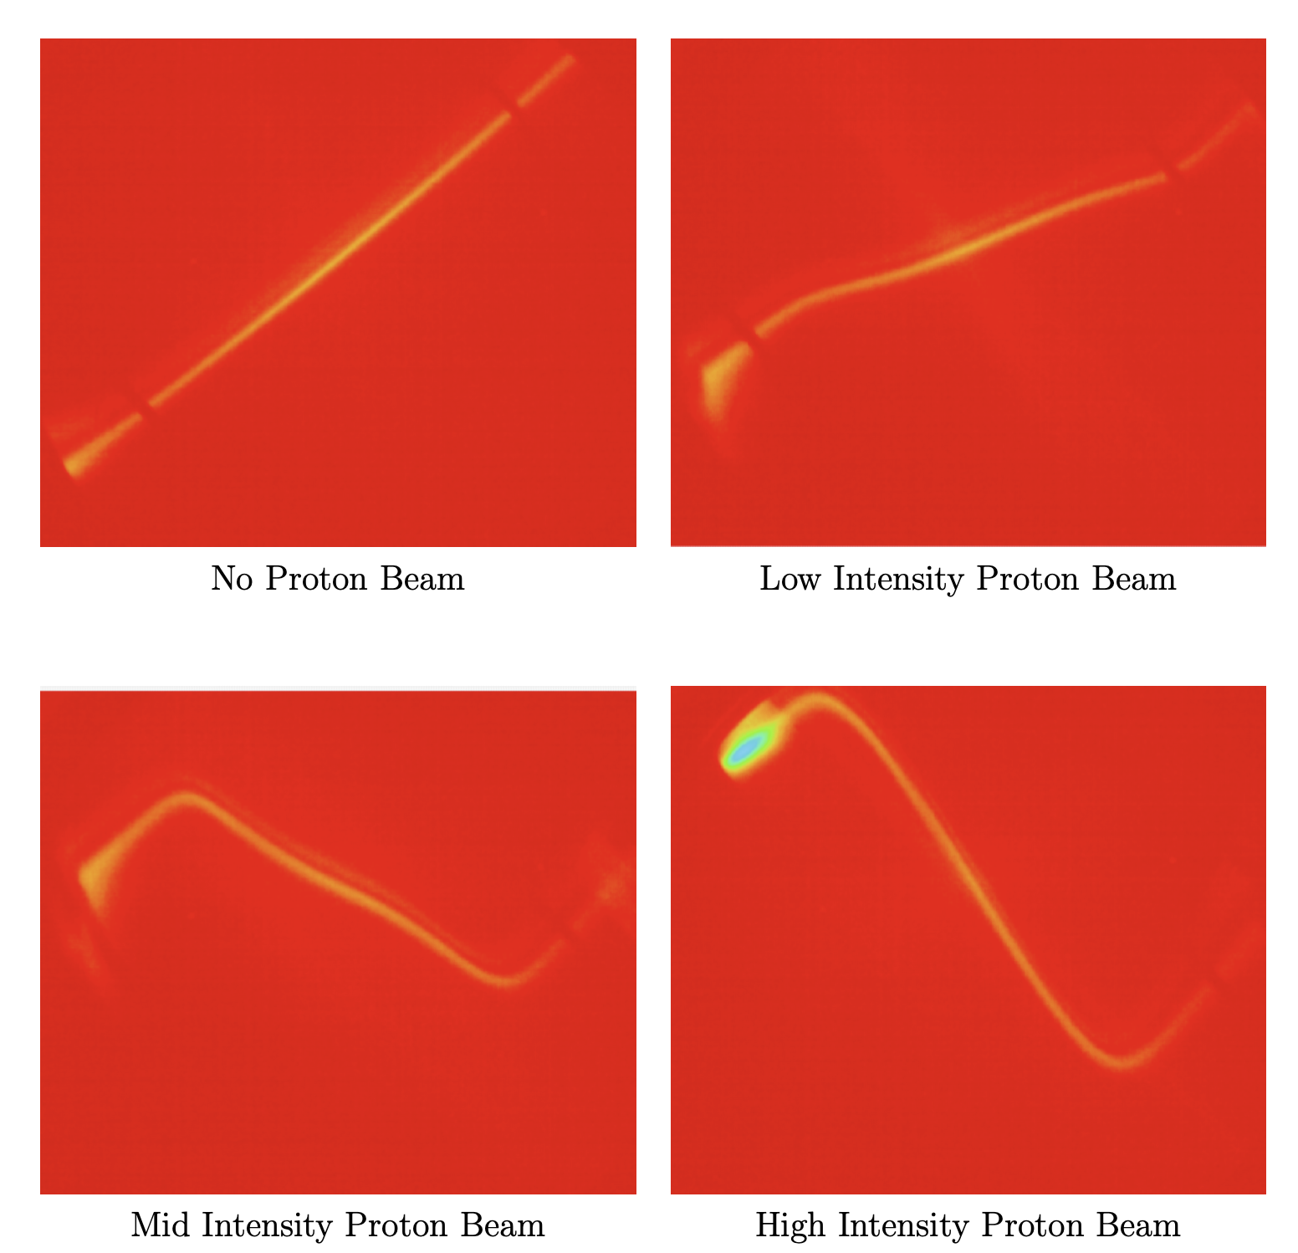
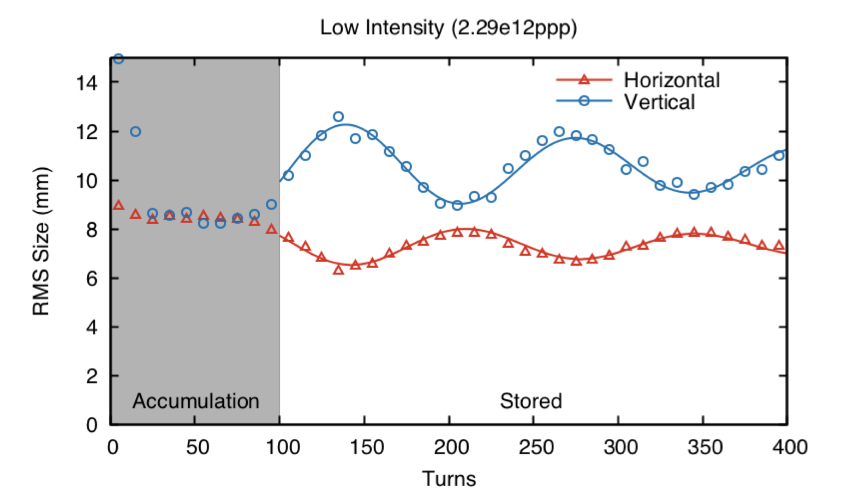
Electron scanner will provide turn-by-turn profiles
Source: R. Potts, "Exploration of Equal Tune Transverse Coupling in the Spallation Neutron Source Accumulator Ring." (2017).

Slide 17
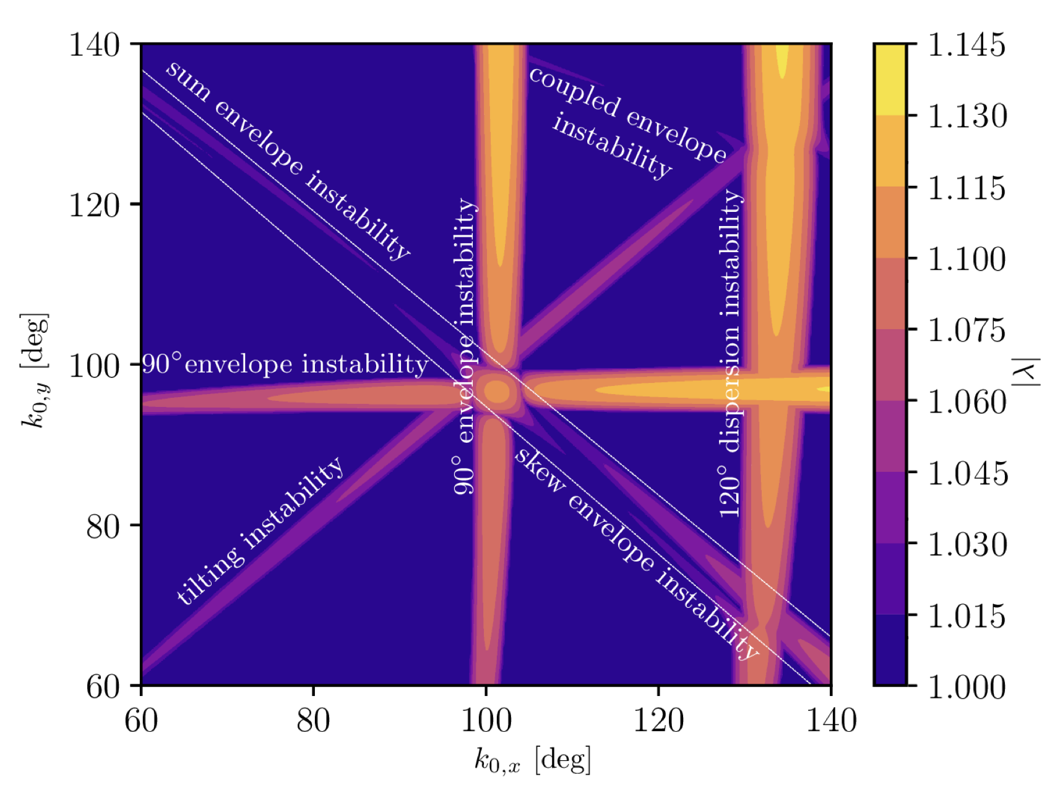
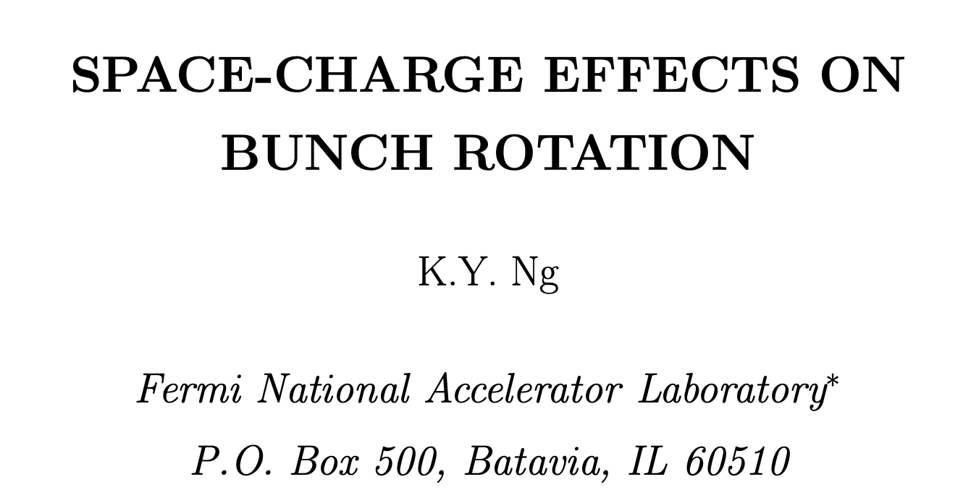
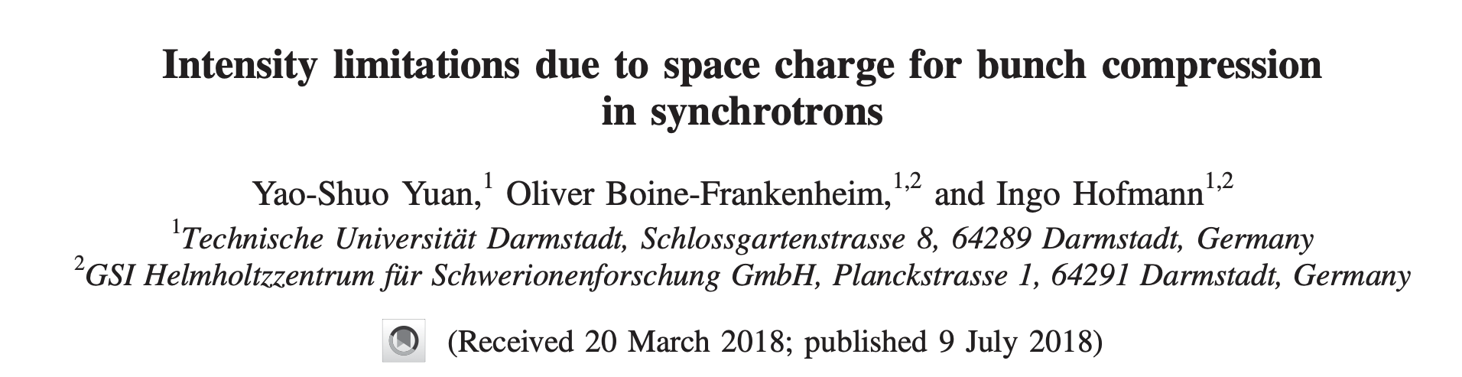
What could we measure?
SC resonance?
Envelope instability?
Longitudinal?
Notes:
4th order is clear from simulations; not sure what other effects we expect to see.

Slide 18
Conclusion
Proposal: leverage SNS lattice flexibility + painting + compression + diagnostics to generate high-quality benchmarks of space charge effects in rings.
Experiments could be relevant to next-generation facilities like MuC.
Thanks for listening!

Slide 19
Extra slides

Slide 20
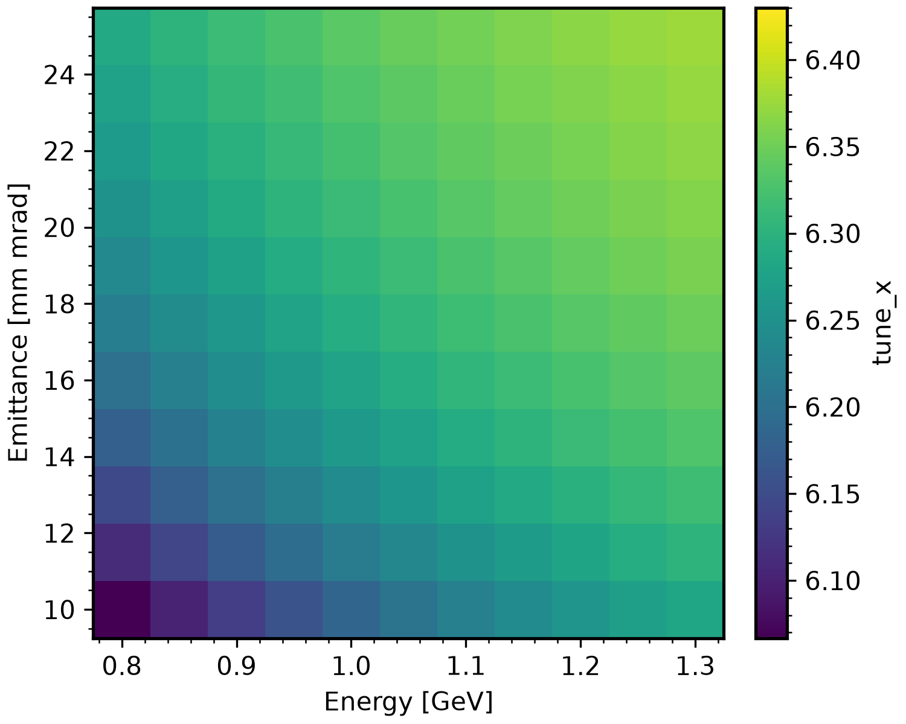


At reduced beam energy and painted emittance, KV tune shift approaches 0.4
$$ν_{x0}$$
$$ν_{x}$$
Notes:
2.8 MW intensity

Slide 21
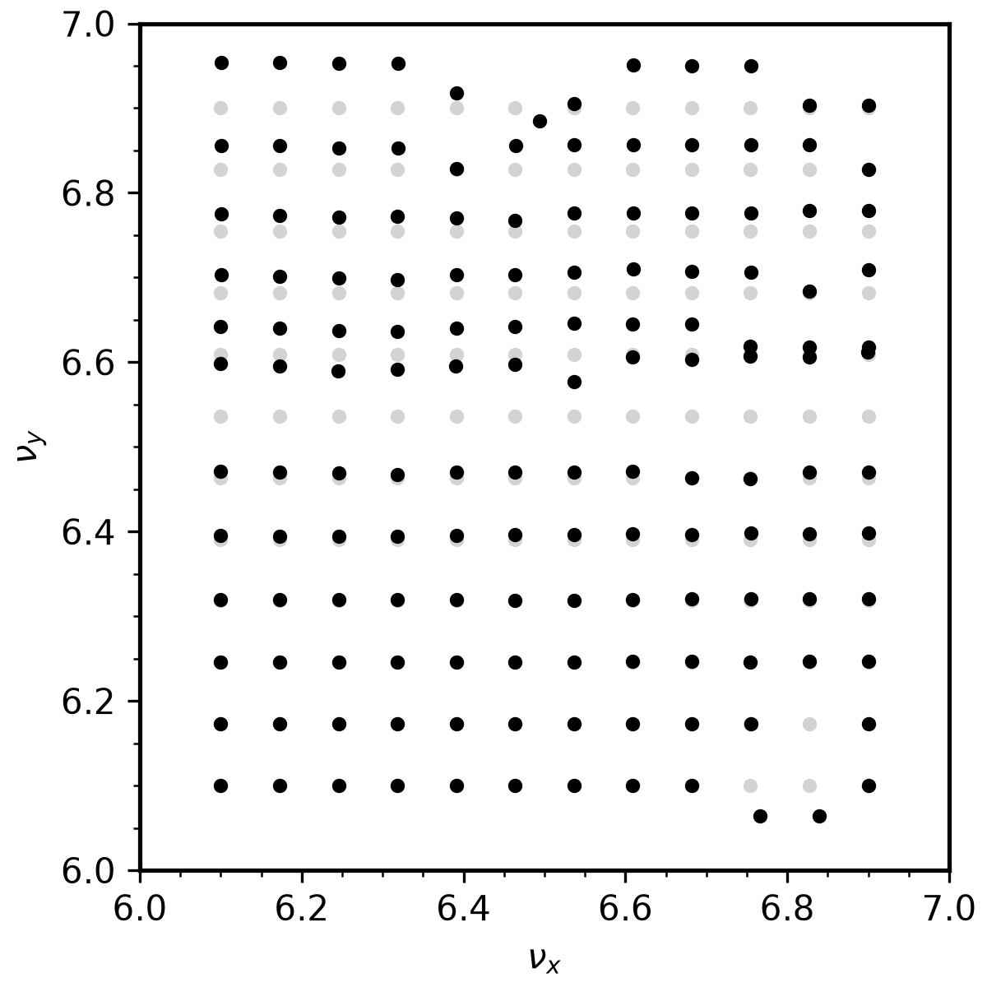
MAD-X model can access most tunes in the range [6, 7]

Slide 22
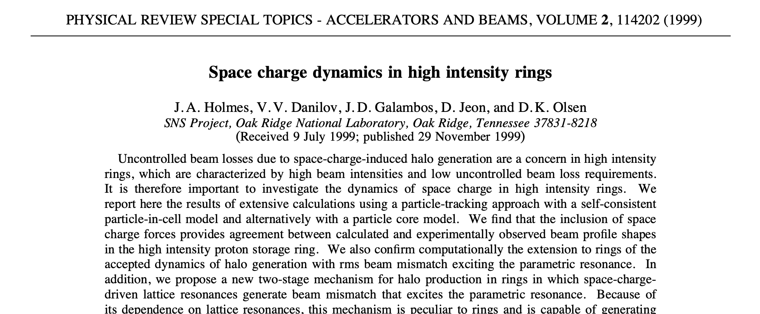
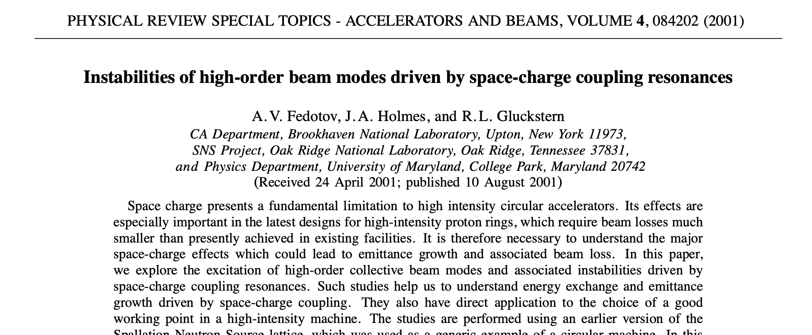
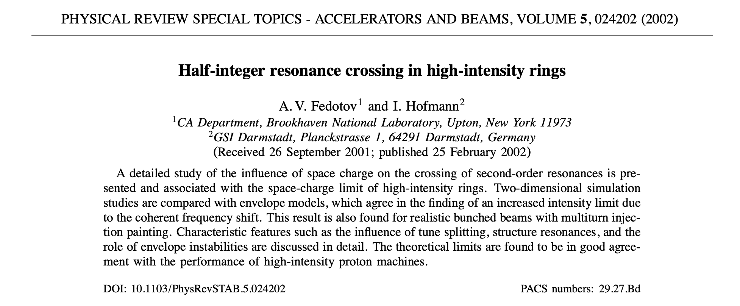
1999-2002: papers studied behavior of KV distribution in newly designed SNS AR

Slide 23
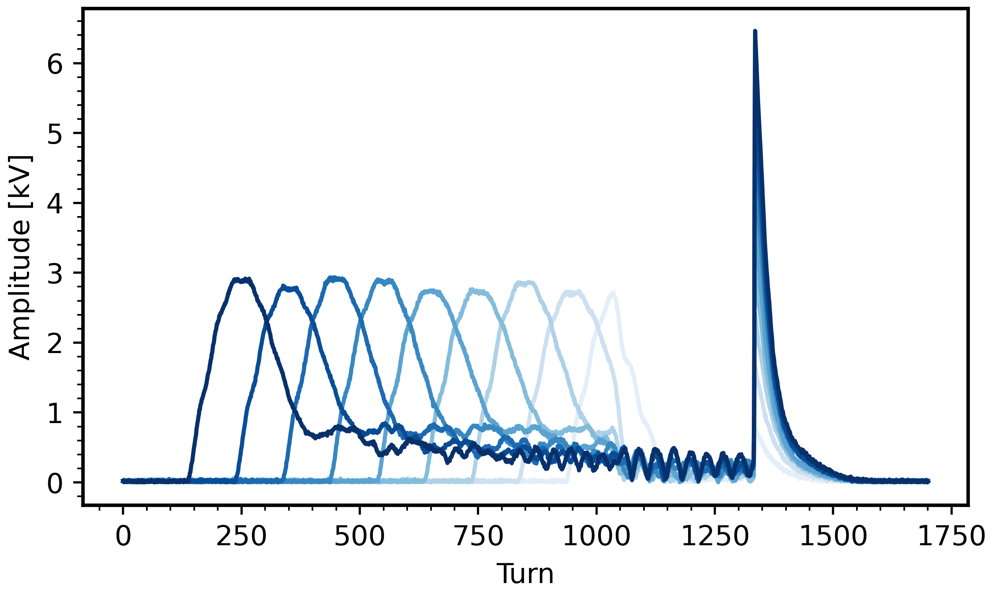
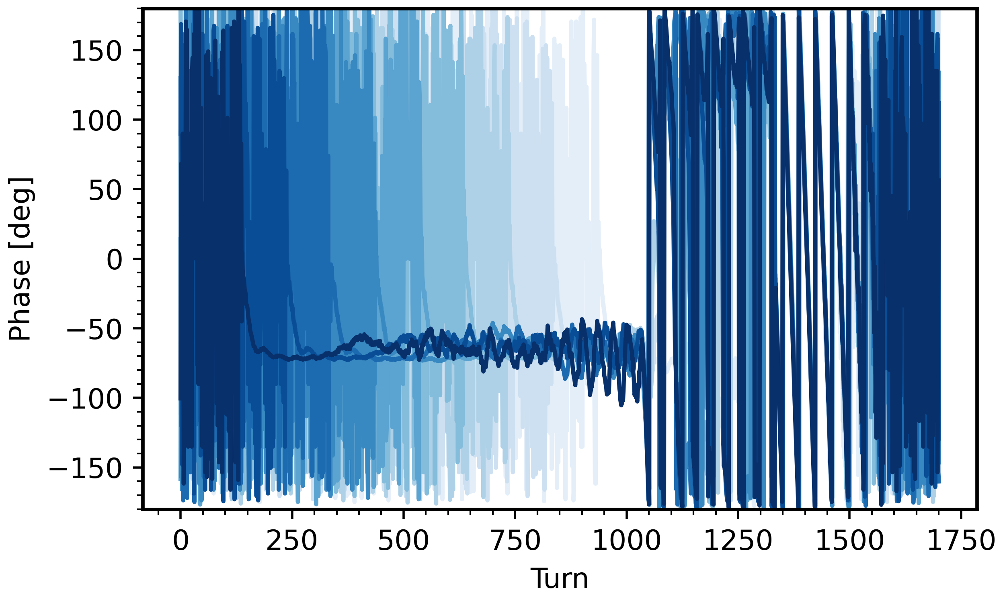
RF feedback loop can eventually offset most beam-induced voltage

Slide 24
SNS pulse structure
16.7 ms (1/60 Hz)
Macro-pulse
(ion source)
15.7ms
1ms
945 ns (1/1.059 MHz)
Mini-pulse
(chopper)
645 ns
300 ns
260 micro-pulses
Micro-pulse
(RFQ)
2.4845 ns (1/402.5 MHz)

Slide 25

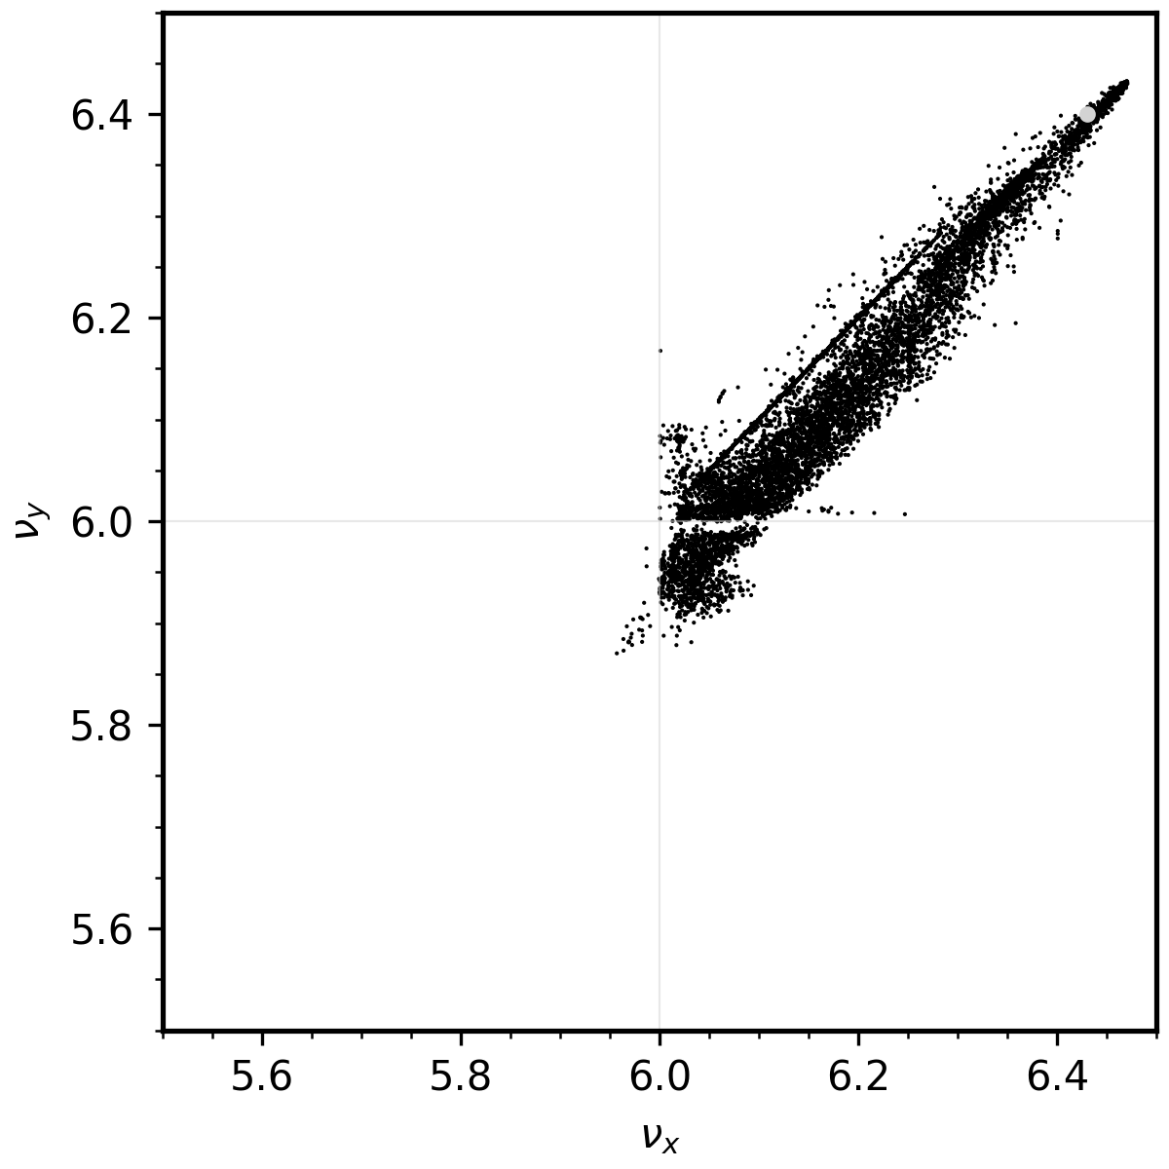
APA vs. NAFF tunes during compression
Initial
Final
APA (10 turns)
NAFF (100 turns)

Slide 26
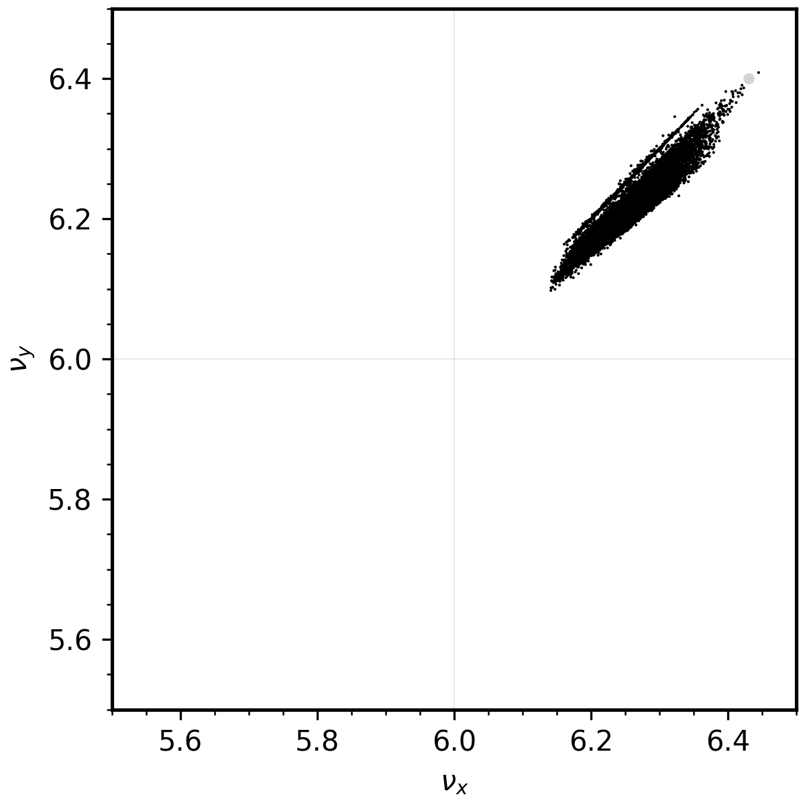
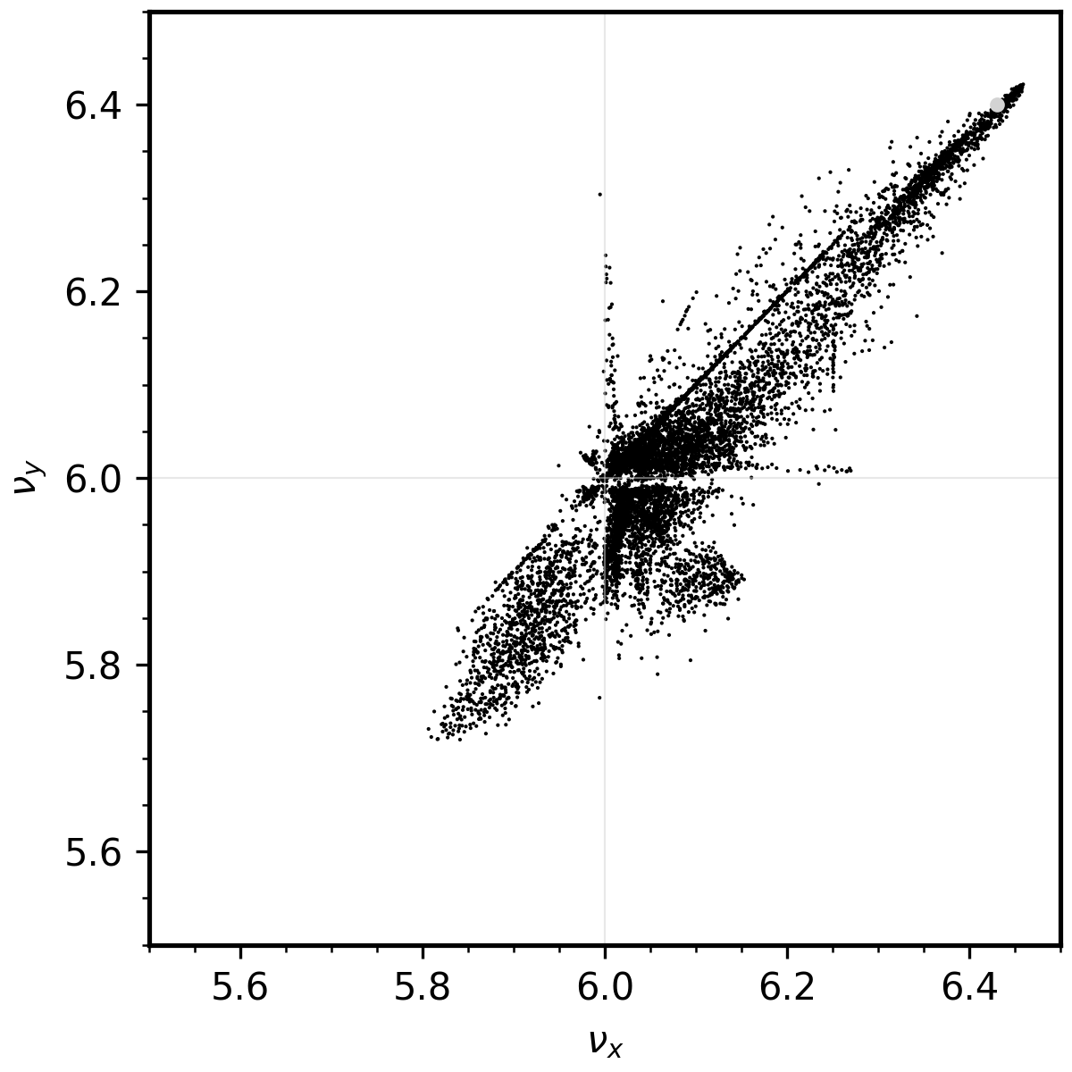
APA vs. NAFF tunes during compression
Initial
Final
APA (10 turns)
NAFF (100 turns)

Slide 27

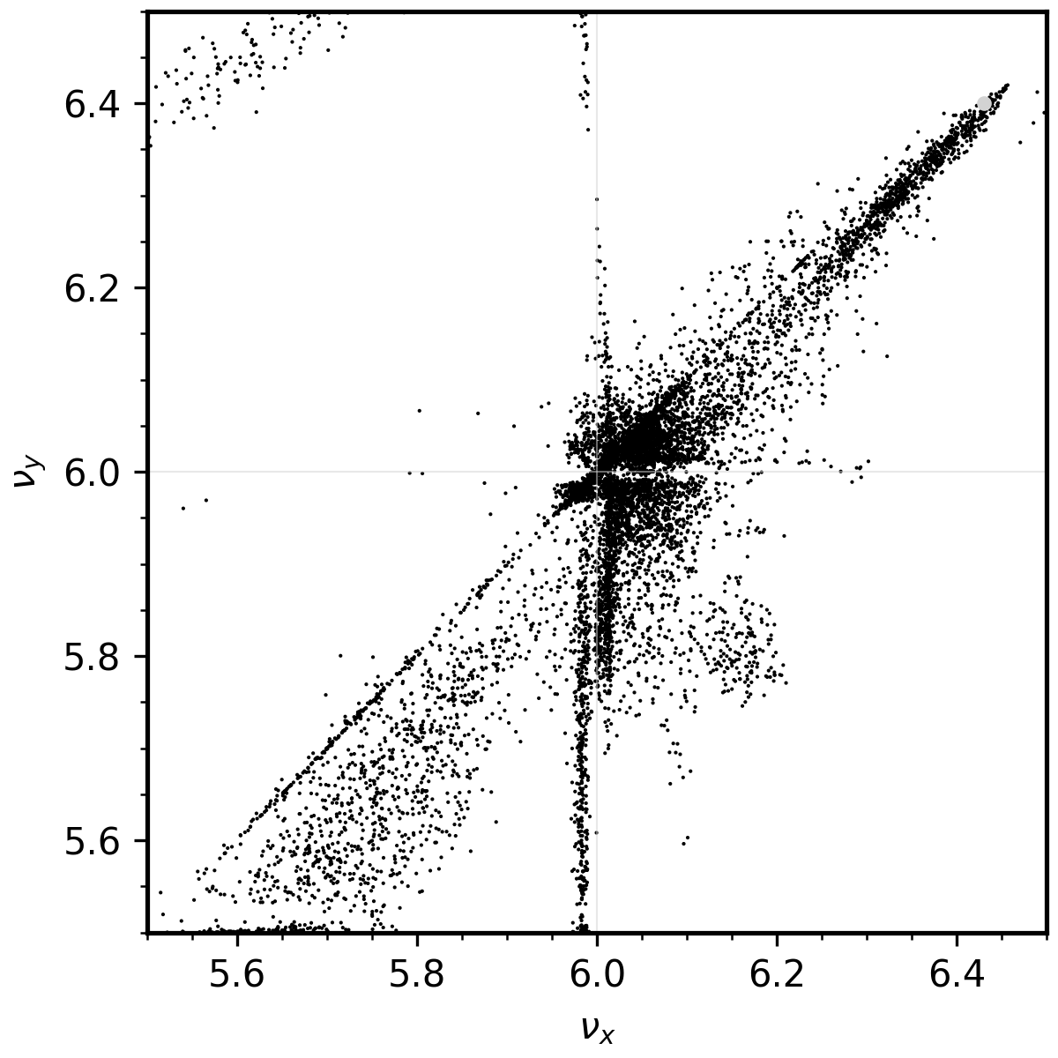
APA vs. NAFF tunes during compression
Initial
Final
APA (10 turns)
NAFF (100 turns)

Slide 28
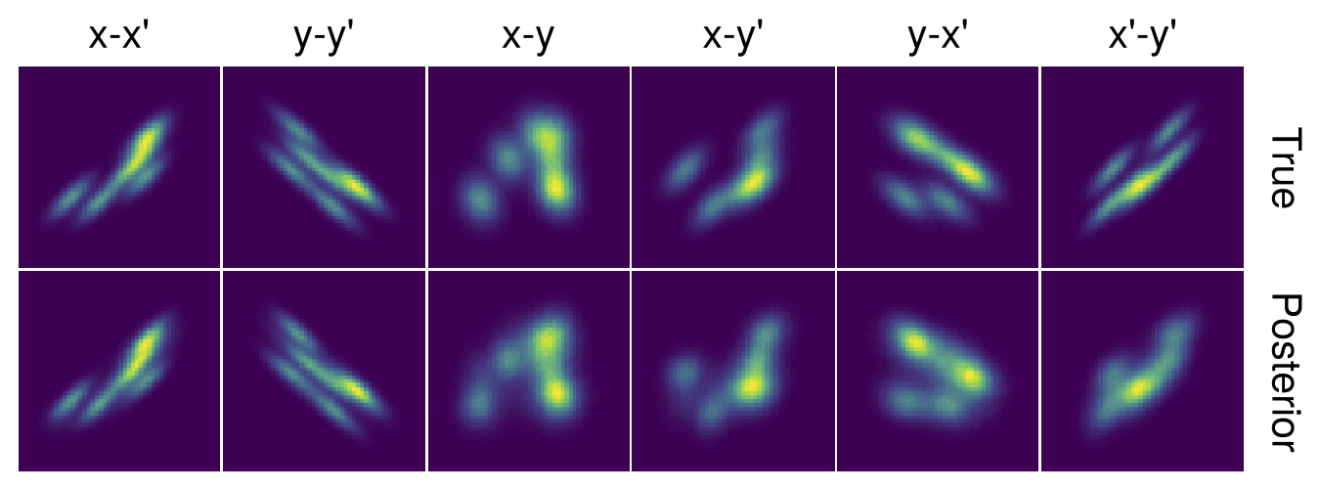
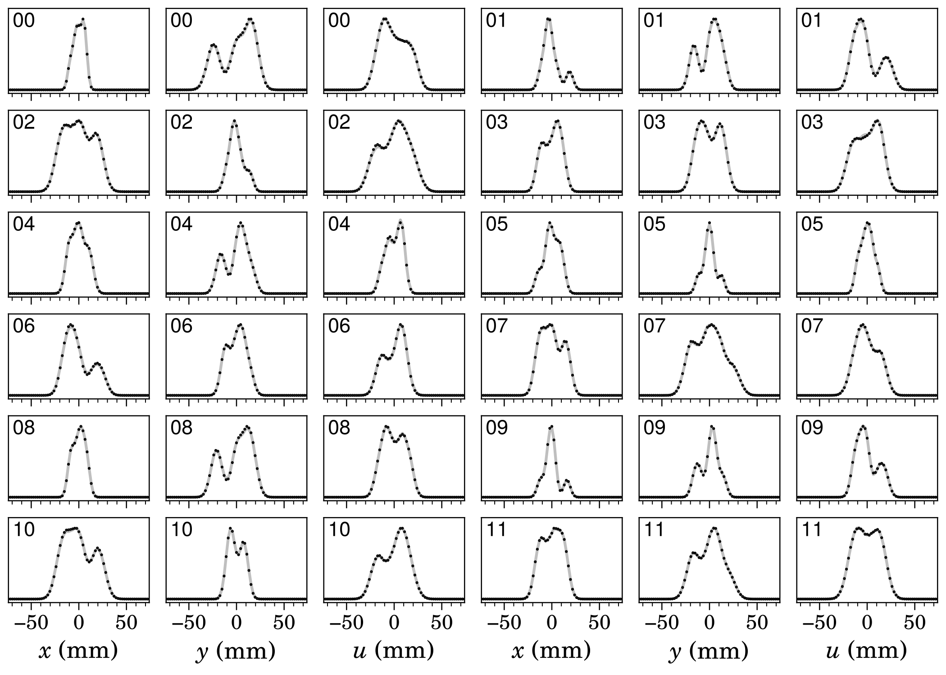
MENT reconstruction reproduces primary distribution features

Slide 29
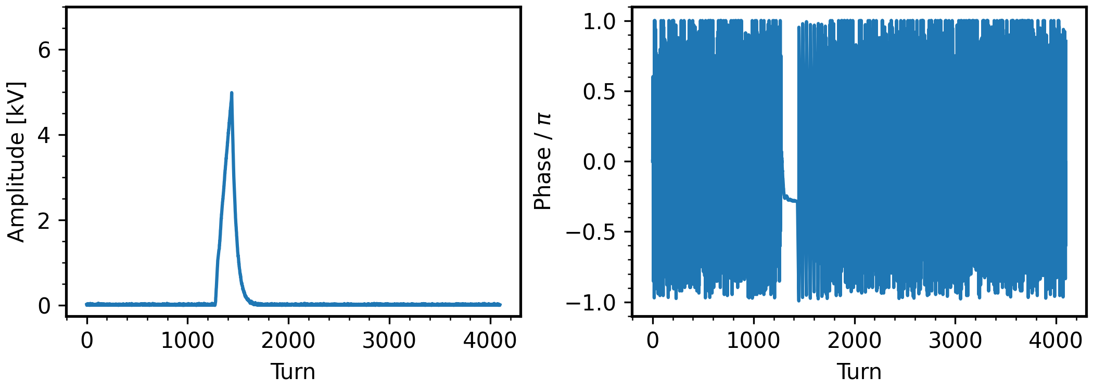
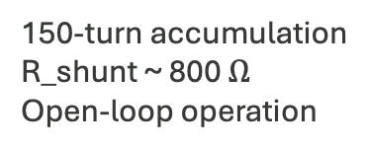
Accumulated beam induces voltage/phase shift in RF cavities
150-turn accumulation
R_shunt ~ 800 $Ω$
Open-loop operation

Slide 30
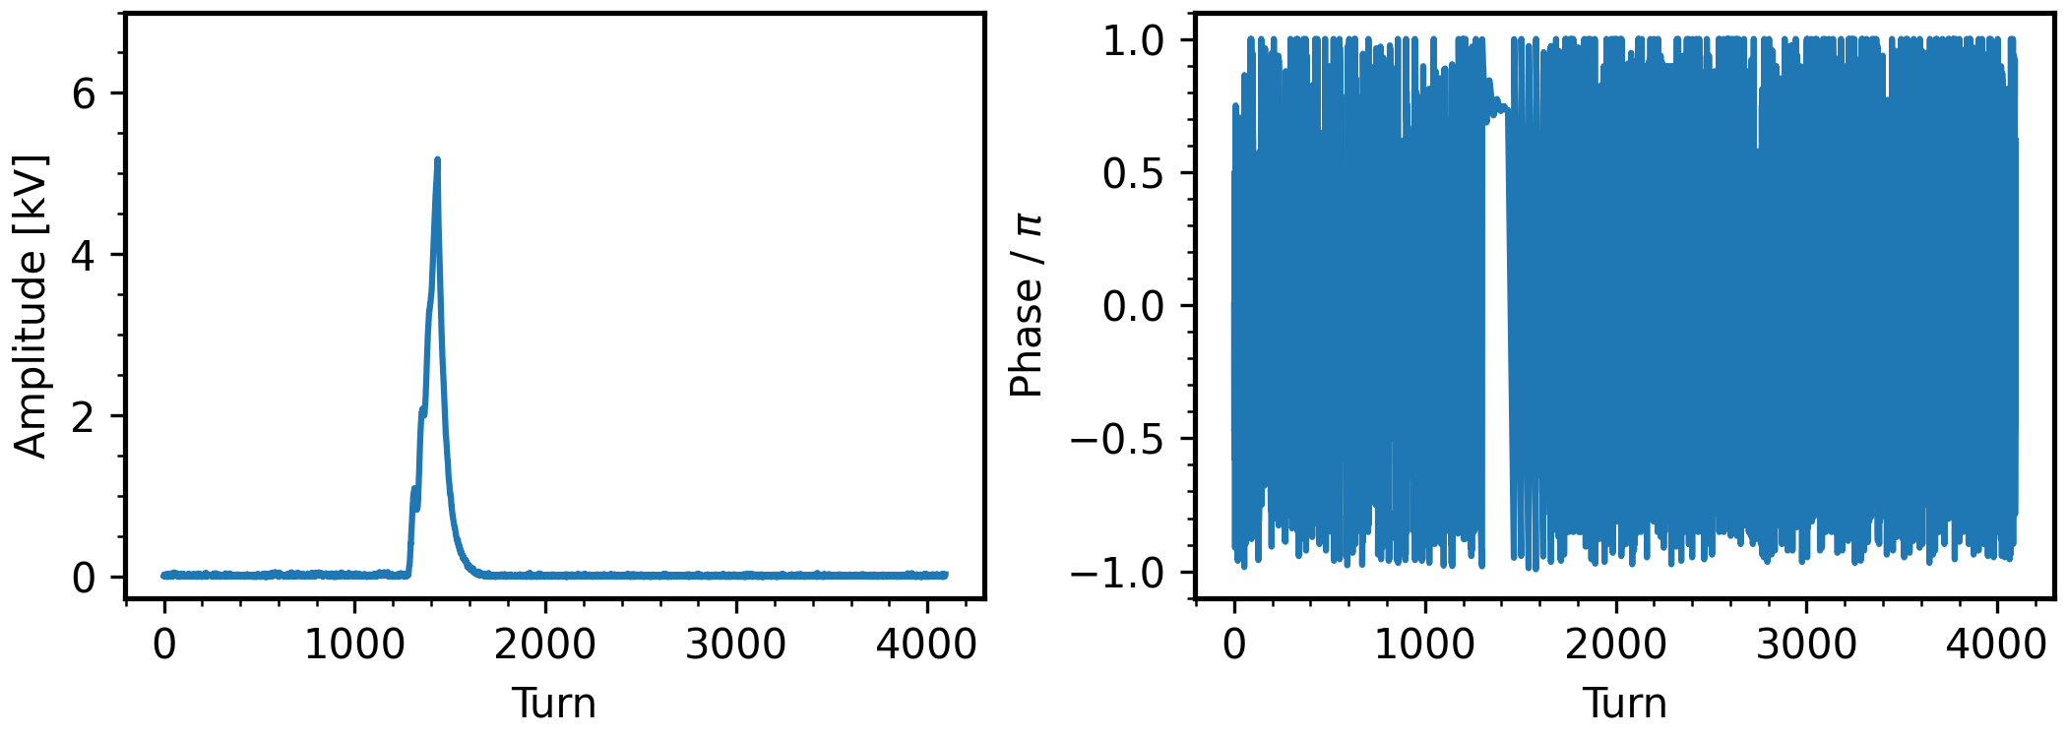
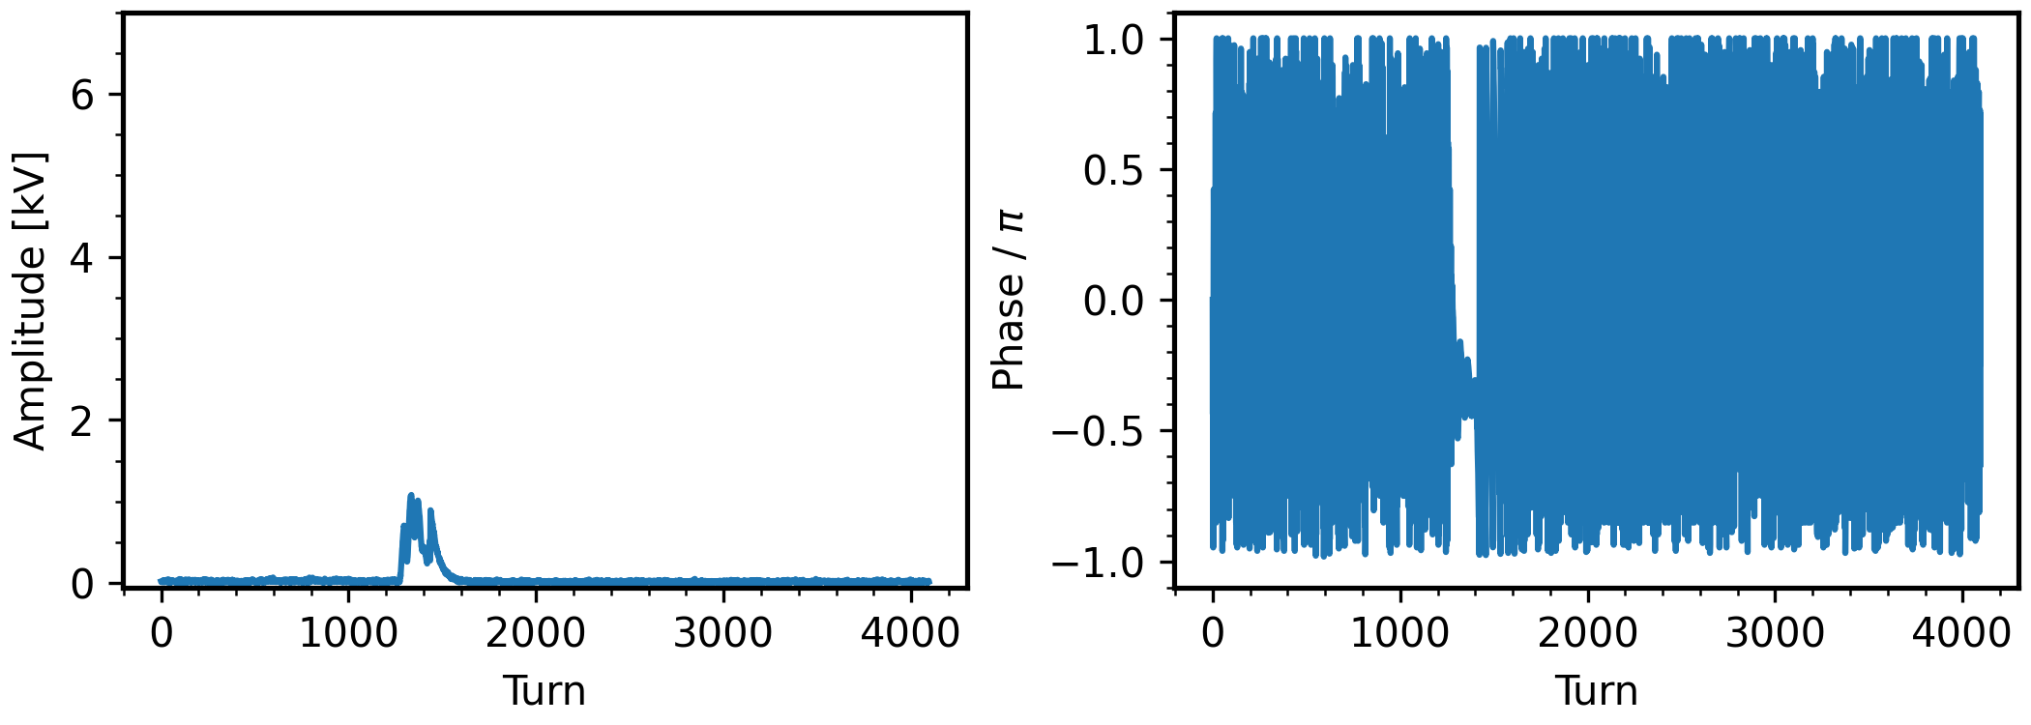
RF feedforward correction tested at low intensity
Beam-induced voltage
Feedforward waveform (shifted phase)
Combined waveform

Slide 31
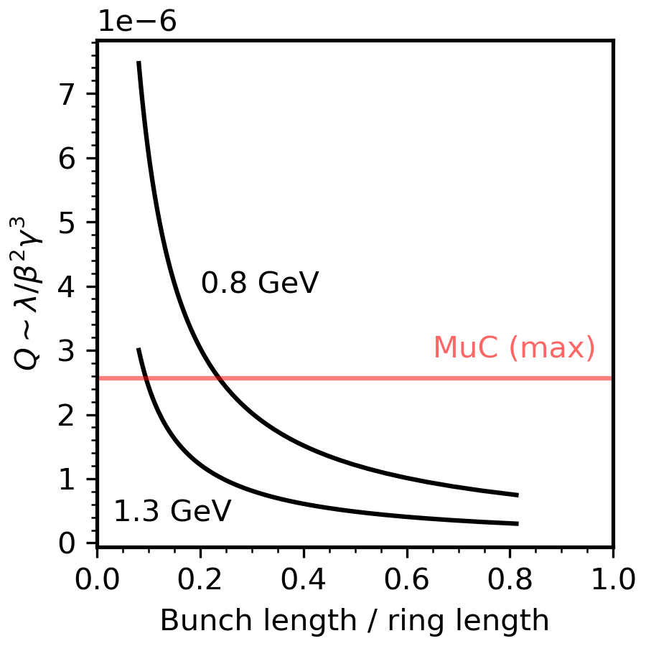
SNS space charge perveance could approach compressed bunch in MuC
MuC assumptions:
Power = 2.0 MW
Energy = 5 GeV
Rep. rate = 5 Hz
Bunch length (rms) = 2 ns
*Note that tune shift scales with emittance

Slide 32
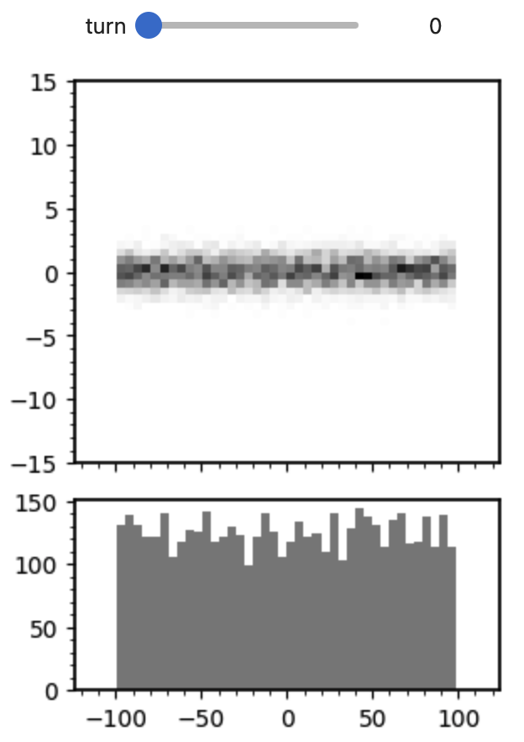
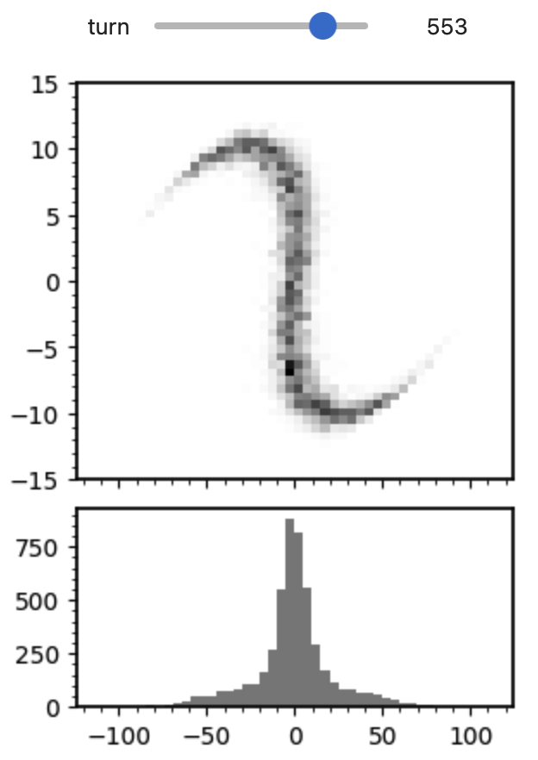
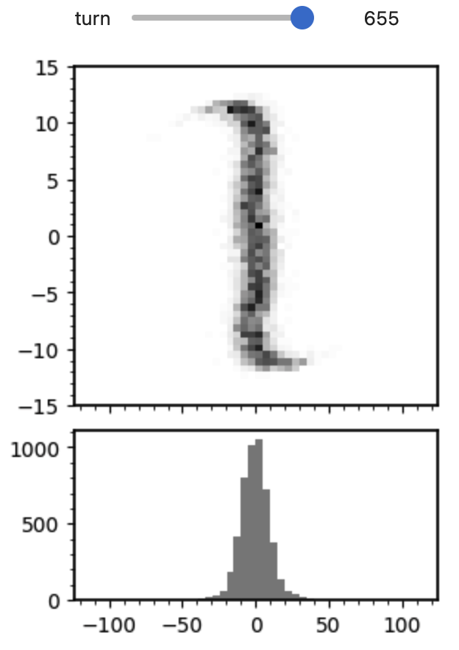


Second-harmonic cavities may help reduce tails in compressed bunch
Initial bunch
$$A_{2}=0$$
$$A_{2}=−A_{1}/4$$

