Slide 1
Emittance Growth under Space Charge Neutralization
Condition in LEBT
— Beam-Plasma Coupling Oscillation —
7th ICFA Mini-Workshop on Space Charge
30 Sep. - 2 Oct. 2026
Ippei YAMADA, Kunihiro KOJIMA, Motoki CHIMURA
J-PARC Center, Japan Atomic Energy Agency

Slide 2
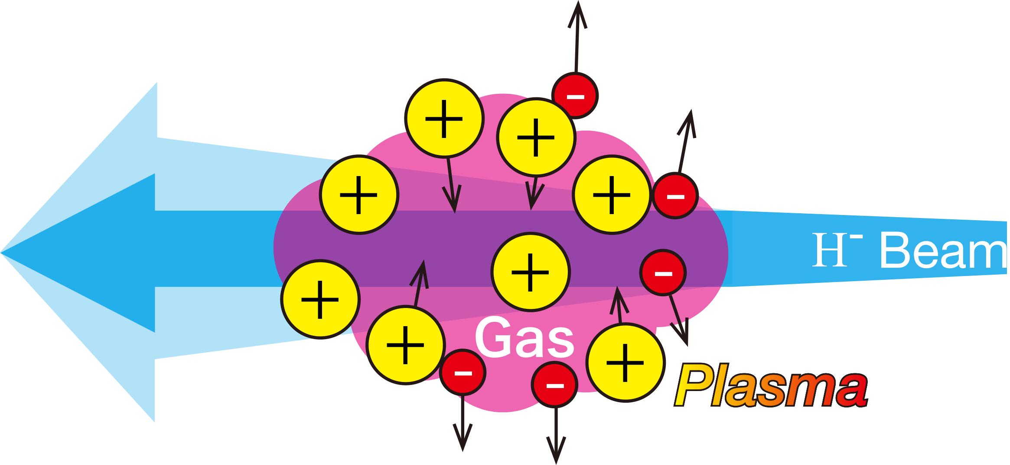
Introduction: Background of SCN/SCC
❖ Space charge neutralization/compensation is essential for beam transport in LEBT
but, still not completely under control or understood…
In some previous studies*,
plasma-like wave is observed in PIC simulation
However, details and its direct effect on beam quality are not well discussed (just on plasma loss)
>> We investigate “Beam-Plasma Coupling Oscillation” with numerical and analytical approaches
without Gas
with Gas
*B. John et al., JINST 20, C05024 (2025)
C. A. Valerio-Lizarraga et al., PR-ST AB 18, 080101 (2015)
I. Yamada et al., 7th ICFA Mini-Workshop on Space Charge, 30 Sep. — 2 Oct. 2026

Slide 3
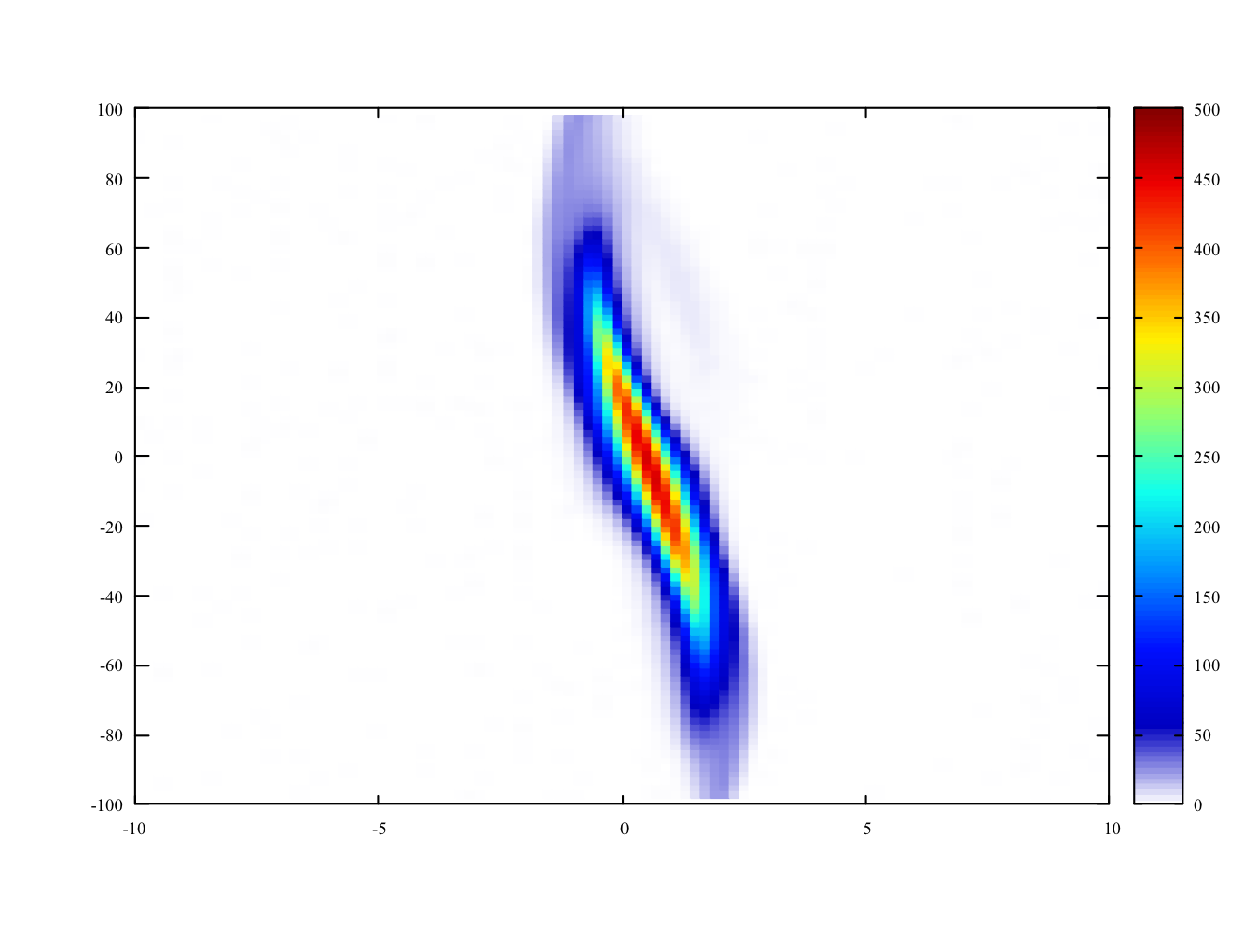
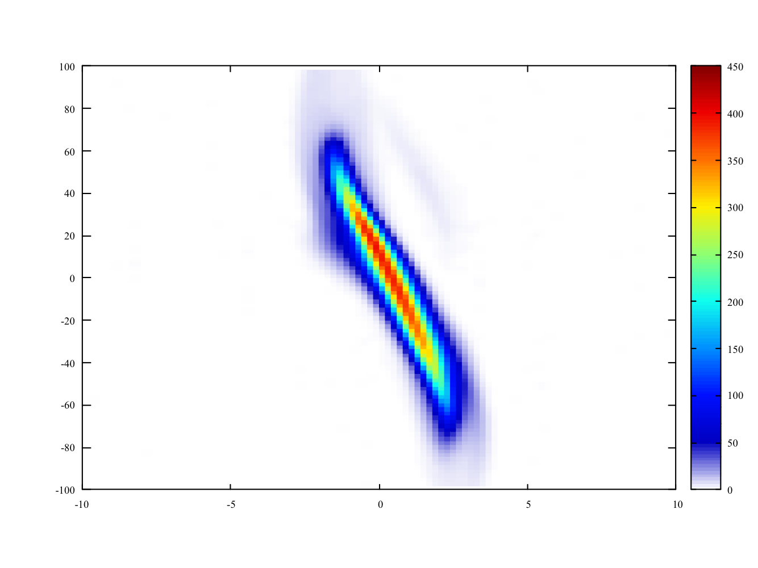
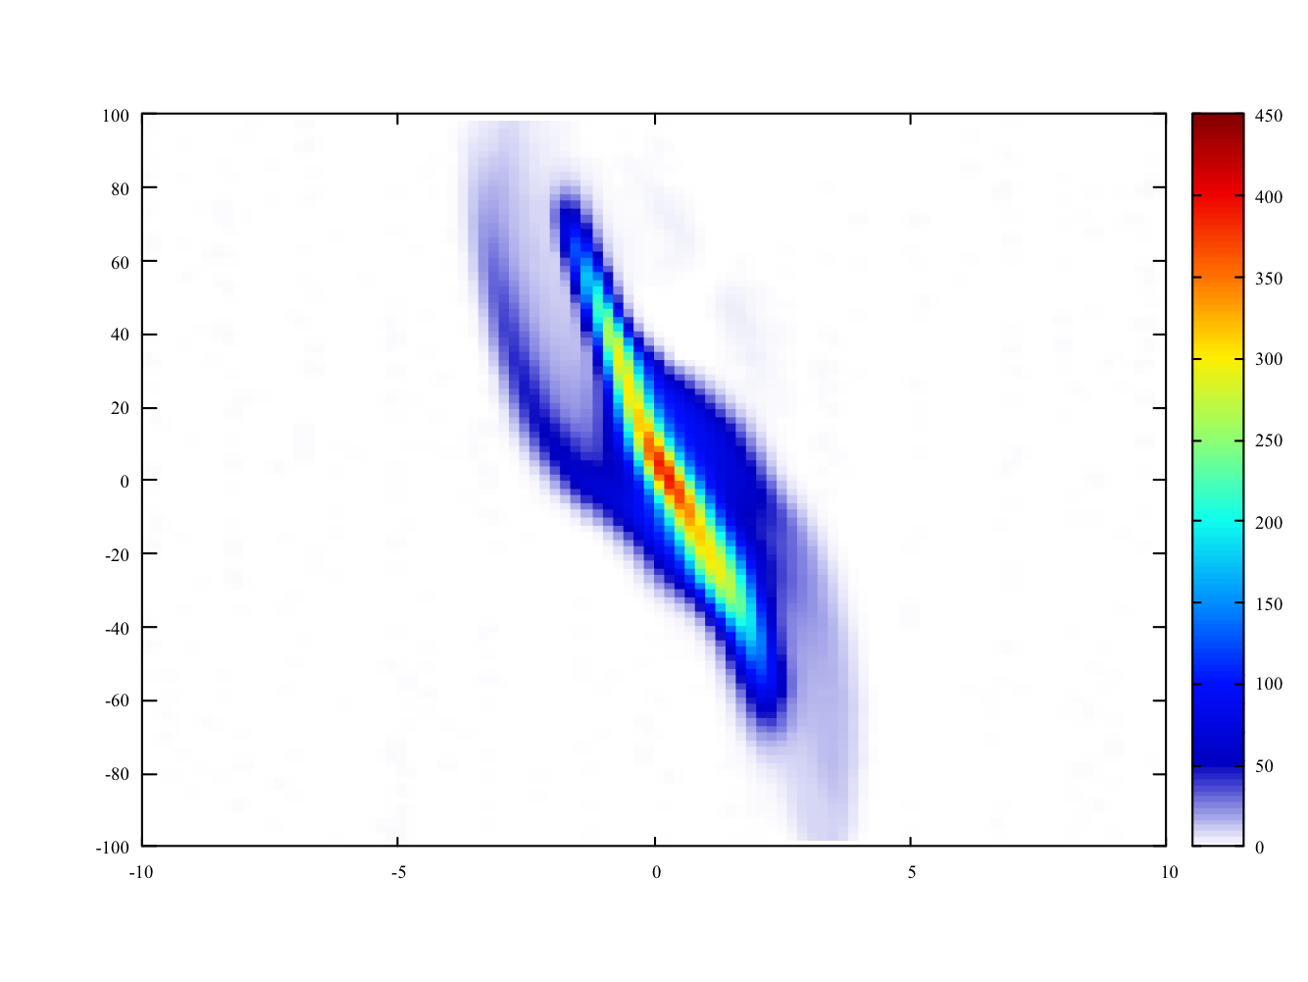
Introduction: Another Motivation
Measurement
Ave. in 300-500 us
❖ There still exists emittance growth even at enough neutralization
Dose coupling oscillation contribute to emittance growth?
20 mA
x-x’ plane
Solenoid
Solenoid
50 keV
500 us
Orifice
chamber
RFQ
H⁻ Ion
Source
30 mA
Double-slit
emittance monitor
at test stand
5 Pa
673 mm
$$τ=10ns$$
5 x10⁻³ Pa
$$τ=10μs$$
43 mA
8 x10⁻⁴ Pa
$$τ=60μs$$
Neutralization time constant：$τ=\frac{1}{σ_{ion}n_{gas}βc}$
3 x10⁻⁴ Pa
$$τ=150μs$$
H⁺ + H2 —> H⁺ + H2⁺ + e^{- :} $σ_{ion}=3×{10}^{-20}$ m²
User operation: 60 mA
I. Yamada et al., 7th ICFA Mini-Workshop on Space Charge, 30 Sep. — 2 Oct. 2026

Slide 4
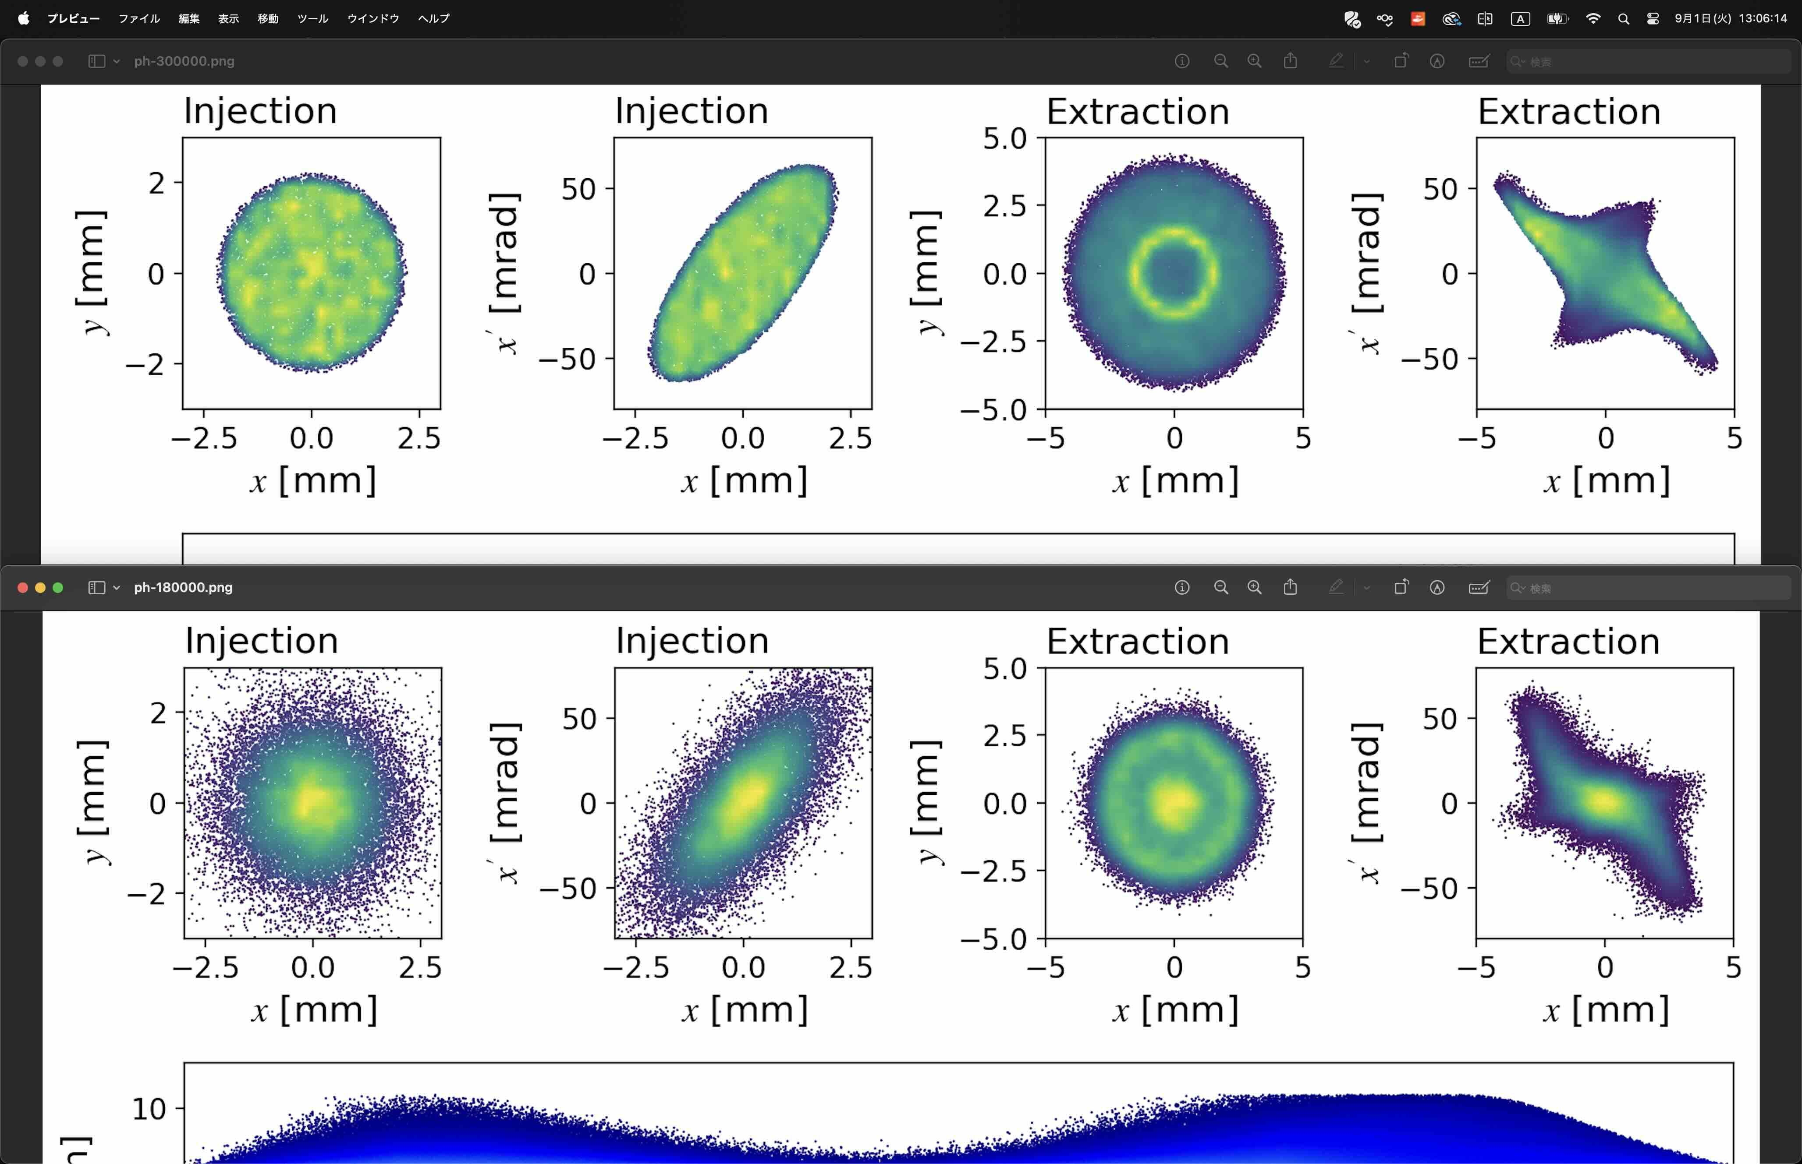
Numerical Approach: Validity of PIC code
❖ PIC simulation reproduces measured distribution
Code: WARP developed at LBNL
Plasma: ${H_{2}}^{+}$ in every step, ignore e⁻
Geometry: same as the reality
Initial condition: based on simulation in I.S.
ion source exit
KV
ion source exit
Gaussian
Consistent
Measurement
I. Yamada et al., 7th ICFA Mini-Workshop on Space Charge, 30 Sep. — 2 Oct. 2026

Slide 5
Numerical Approach: Simplification of Conditions
❖ Simplify conditions to compare PIC with analytical approach
Geometry:
- Cylindrical symmetry
Beam:
- KV distribution
Plasma:
- uniform gas distribution (and no orifice), H⁺
- w/o electrons
External field:
- uniform linear focusing force: $B_{θ}(r)=Cr$ for compensating divergence due to emittance
5 Pa
$$τ=10ns$$
5 x10⁻³ Pa
1 x10⁻³ Pa, $τ=50μs$
3 x10⁻⁴ Pa
8 x10⁻⁴ Pa
$$τ=150μs$$
simulation domain
I. Yamada et al., 7th ICFA Mini-Workshop on Space Charge, 30 Sep. — 2 Oct. 2026

Slide 6
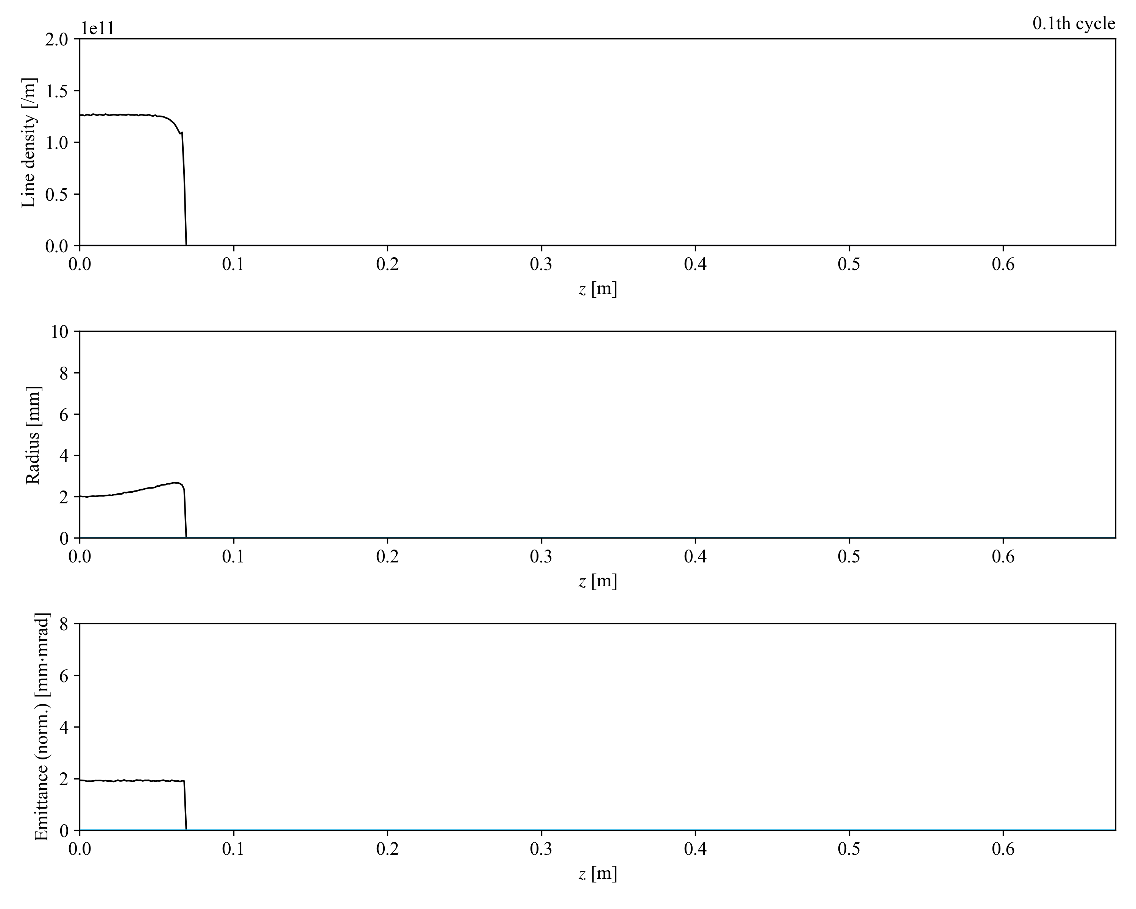
Numerical Result 1:
❖ PIC simulation showed oscillation on both beam and plasma >> coupling may occur
1 cycle = 0.673 us
Line density [1/m]
Beam
Plasma
Z [m]
Radius [mm]
Z [m]
Emittance [mm mrad]
Z [m]
I. Yamada et al., 7th ICFA Mini-Workshop on Space Charge, 30 Sep. — 2 Oct. 2026

Slide 7
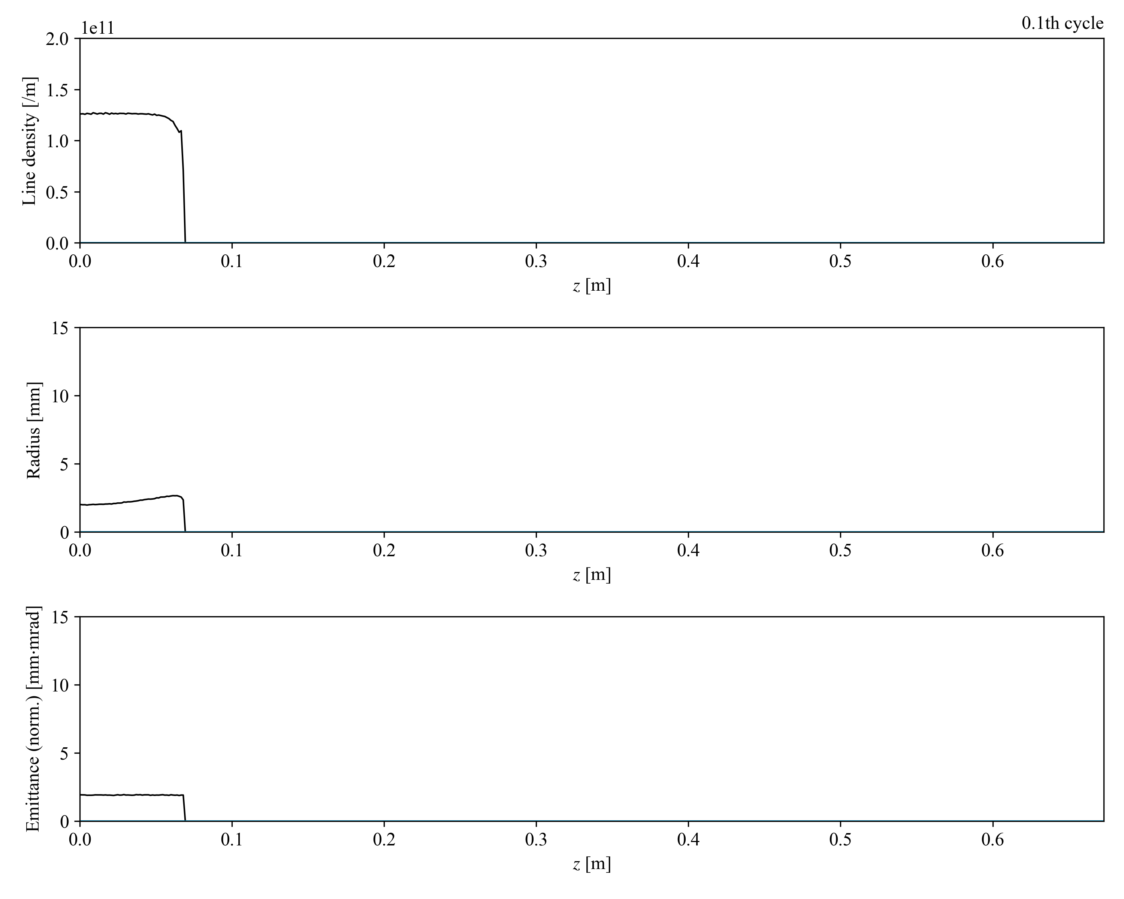
Numerical Result 1:
❖ PIC simulation showed oscillation on both beam and plasma >> coupling may occur
1 cycle = 0.673 us
Line density [1/m]
Beam
Plasma
Z [m]
Radius [mm]
Z [m]
Emittance [mm mrad]
Z [m]
I. Yamada et al., 7th ICFA Mini-Workshop on Space Charge, 30 Sep. — 2 Oct. 2026

Slide 8
Numerical Result 1:
❖ PIC simulation showed oscillation on both beam and plasma >> coupling may occur
1 cycle = 0.673 us
Beam
Plasma
Line density [1/m]
Z [m]
Radius [mm]
Z [m]
Emittance [mm mrad]
Z [m]
I. Yamada et al., 7th ICFA Mini-Workshop on Space Charge, 30 Sep. — 2 Oct. 2026

Slide 9
Analytical Approach: Linear Vlasov-Poisson System
❖ Linear Vlasov-Poisson analysis to clarify if coupling oscillation can be occur
Conditions:
- Distribution function: cylindrically symmetric uniform
- EB-field: with or without unperturbed field => linear focusing E-field
step func.
$$f(r,z,v_{r},v_{z})=\frac{1}{πa^{2}v_{⊥}}Θ(-r+a)Θ(-v_{r}+v_{⊥})δ(v_{z}-βc)$$
$$E_{r}=-qKr$$
$χ_{s}$: electric susceptibility
$ρ_{s}$: charge density
$η_{s}$: density ratio
$Z_{s}$: charge number
$A_{s}$: mass number
$k$ : wave number
$J_{l}$ : Bessel function
Vlasov-Poisson system reduces to an eigenvalue problem (dispersion relation):
Normalized formula
$$\frac{∂f_{s}}{∂t}+v⋅∇f_{s}-η_{s}\frac{Z_{s}}{A_{s}}∇ϕ⋅∇_{v}f_{s}=0$$
$$-∇^{2}ϕ=\underset{s}{∑}η_{s}Z_{s}ρ_{s}$$
$$\left(\begin{matrix}χ_{b}-1 & & χ_{b} \\ χ_{p} & & χ_{p}-1\end{matrix}\right)\left(\begin{aligned}ρ_{b} \\ ρ_{p}\end{aligned}\right)=0$$
$$χ_{s}=η_{s}\frac{{Z_{s}}^{2}}{A_{s}}\frac{1}{(ω-k_{z}β_{s}c)^{2}-(k_{r}v_{⊥,s})^{2}}$$
$$ω_{0,s}=\sqrt{\frac{qK}{m_{s}}}$$
without unperturbed field:
s: particle species, beam/plasma
$$χ_{s}=η_{s}\frac{{Z_{s}}^{2}}{A_{s}}\frac{1}{{k_{r}}^{2}+{k_{z}}^{2}}\overset{∞}{\underset{l=-∞}{∑}}\left\{-\frac{k_{r}J_{l}\left(J_{l+1}+J_{l-1}\right)}{ω-lω_{0}}+\frac{{k_{z}}^{2}v_{⊥,s}\left({J_{l}}^{2}-J_{l+1}J_{l-1}\right)}{(ω-lω_{0})^{2}}\right\}$$
with unperturbed field:
I. Yamada et al., 7th ICFA Mini-Workshop on Space Charge, 30 Sep. — 2 Oct. 2026

Slide 10
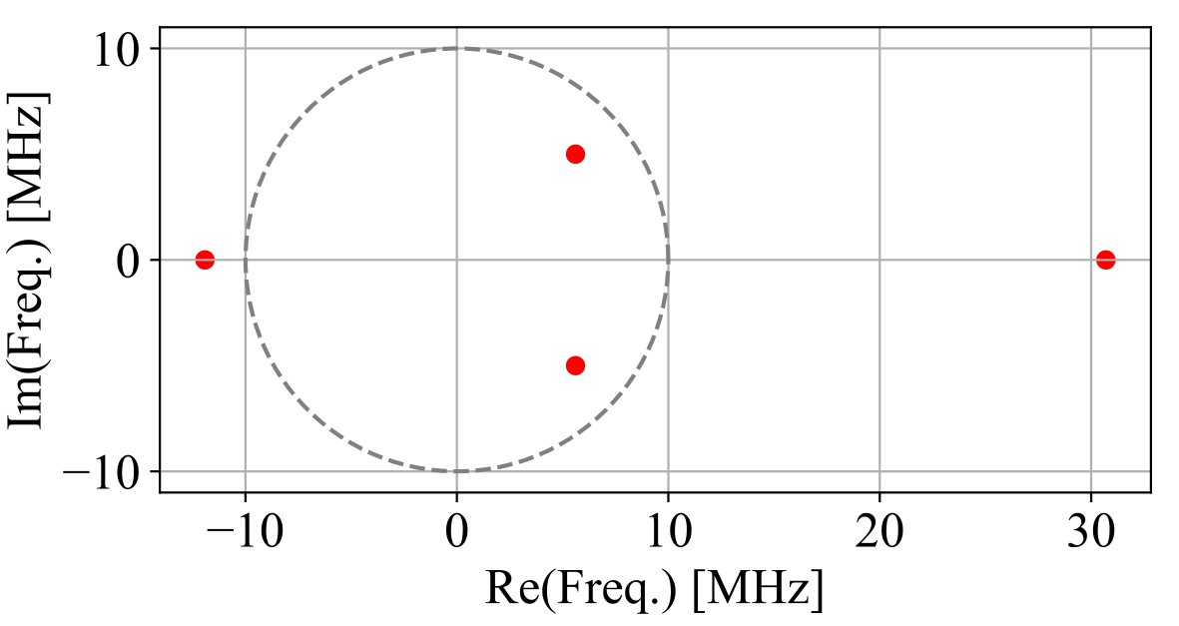
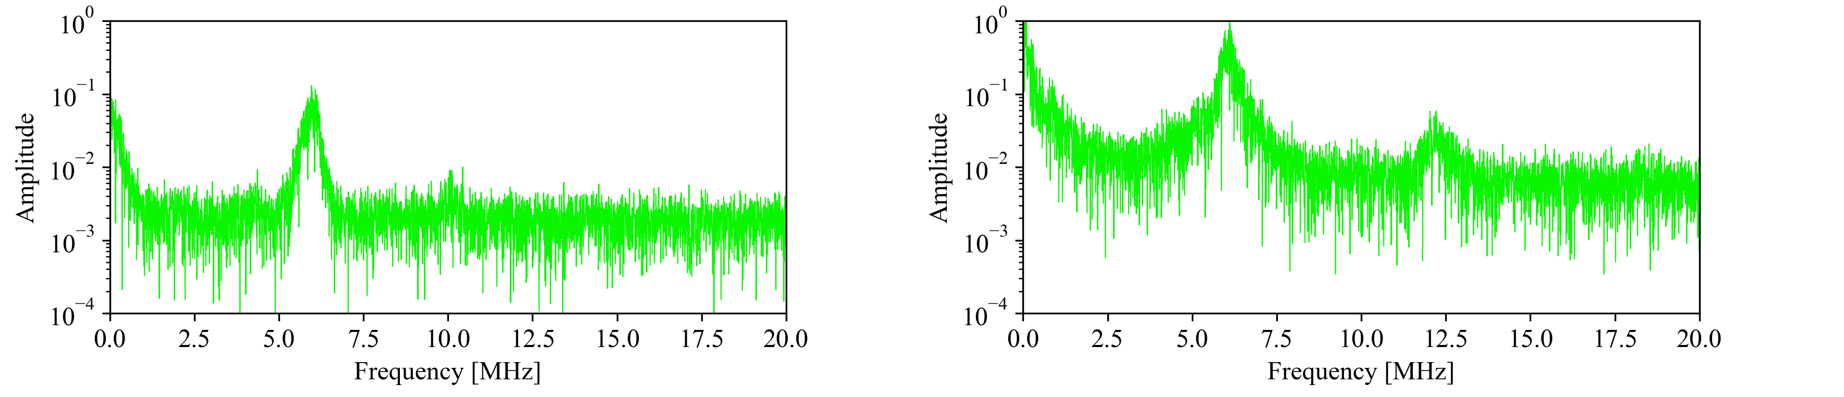
Analytical Result 1: without Unperturbed Field
❖ Vlasov-Poisson analysis is consistent with PIC and supports existence of coupling oscillation
Coupling degree is roughly evaluated from eigenvector ratio:
$ρ_{b}/ρ_{p}∼1$ => coupled
$ρ_{b}/ρ_{p}≪1,ρ_{b}/ρ_{p}≫1$ => uncoupled
Beam
Plasma
$$\left(\begin{matrix}χ_{b}-1 & & χ_{b} \\ χ_{p} & & χ_{p}-1\end{matrix}\right)\left(\begin{aligned}ρ_{b} \\ ρ_{p}\end{aligned}\right)=0$$
x-x’ plane
Conditions assumed from simulation result
$λ_{z}$ =0.2 m
SCN degree = 0.6
Beam radius = 3 mm
$v_{⊥,b}$ = 30 mrad
$v_{⊥,p}$ = 5 mrad
Freq [MHz] ${ρ_{b}}/{ρ_{p}}$ Mode
$6.0±j5.0$ 0.64 Coupled
13 0.22 ~Plasma
31 4.1 Beam
Radius [mm]
0.2 m
Z [m]
~6 MHz
Beam
Plasma
~10 MHz
Amplitude
Amplitude
~6 MHz
~12 MHz
Freq. [MHz]
Freq. [MHz]
I. Yamada et al., 7th ICFA Mini-Workshop on Space Charge, 30 Sep. — 2 Oct. 2026

Slide 11
Analytical Result 1: without Unperturbed Field
❖ Vlasov-Poisson analysis is consistent with PIC and supports existence of coupling oscillation
Coupling degree is roughly evaluated from eigenvector ratio:
$ρ_{b}/ρ_{p}∼1$ => coupled
$ρ_{b}/ρ_{p}≪1,ρ_{b}/ρ_{p}≫1$ => uncoupled
Beam
Plasma
$$\left(\begin{matrix}χ_{b}-1 & & χ_{b} \\ χ_{p} & & χ_{p}-1\end{matrix}\right)\left(\begin{aligned}ρ_{b} \\ ρ_{p}\end{aligned}\right)=0$$
Conditions assumed from simulation result
$λ_{z}$ =0.2 m
SCN degree = 0.5
Beam radius = 3 mm
$v_{⊥,b}$ = 30 mrad
$v_{⊥,p}$ = 5 mrad
x-x’ plane
Freq [MHz] ${ρ_{b}}/{ρ_{p}}$ Mode
$6.0±j5.0$ 0.64 Coupled
13 0.22 ~Plasma
31 4.1 Beam
Radius [mm]
0.2 m
Z [m]
~6 MHz
Beam
Plasma
~10 MHz
Amplitude
Amplitude
~6 MHz
~12 MHz
Freq. [MHz]
Freq. [MHz]
I. Yamada et al., 7th ICFA Mini-Workshop on Space Charge, 30 Sep. — 2 Oct. 2026

Slide 12
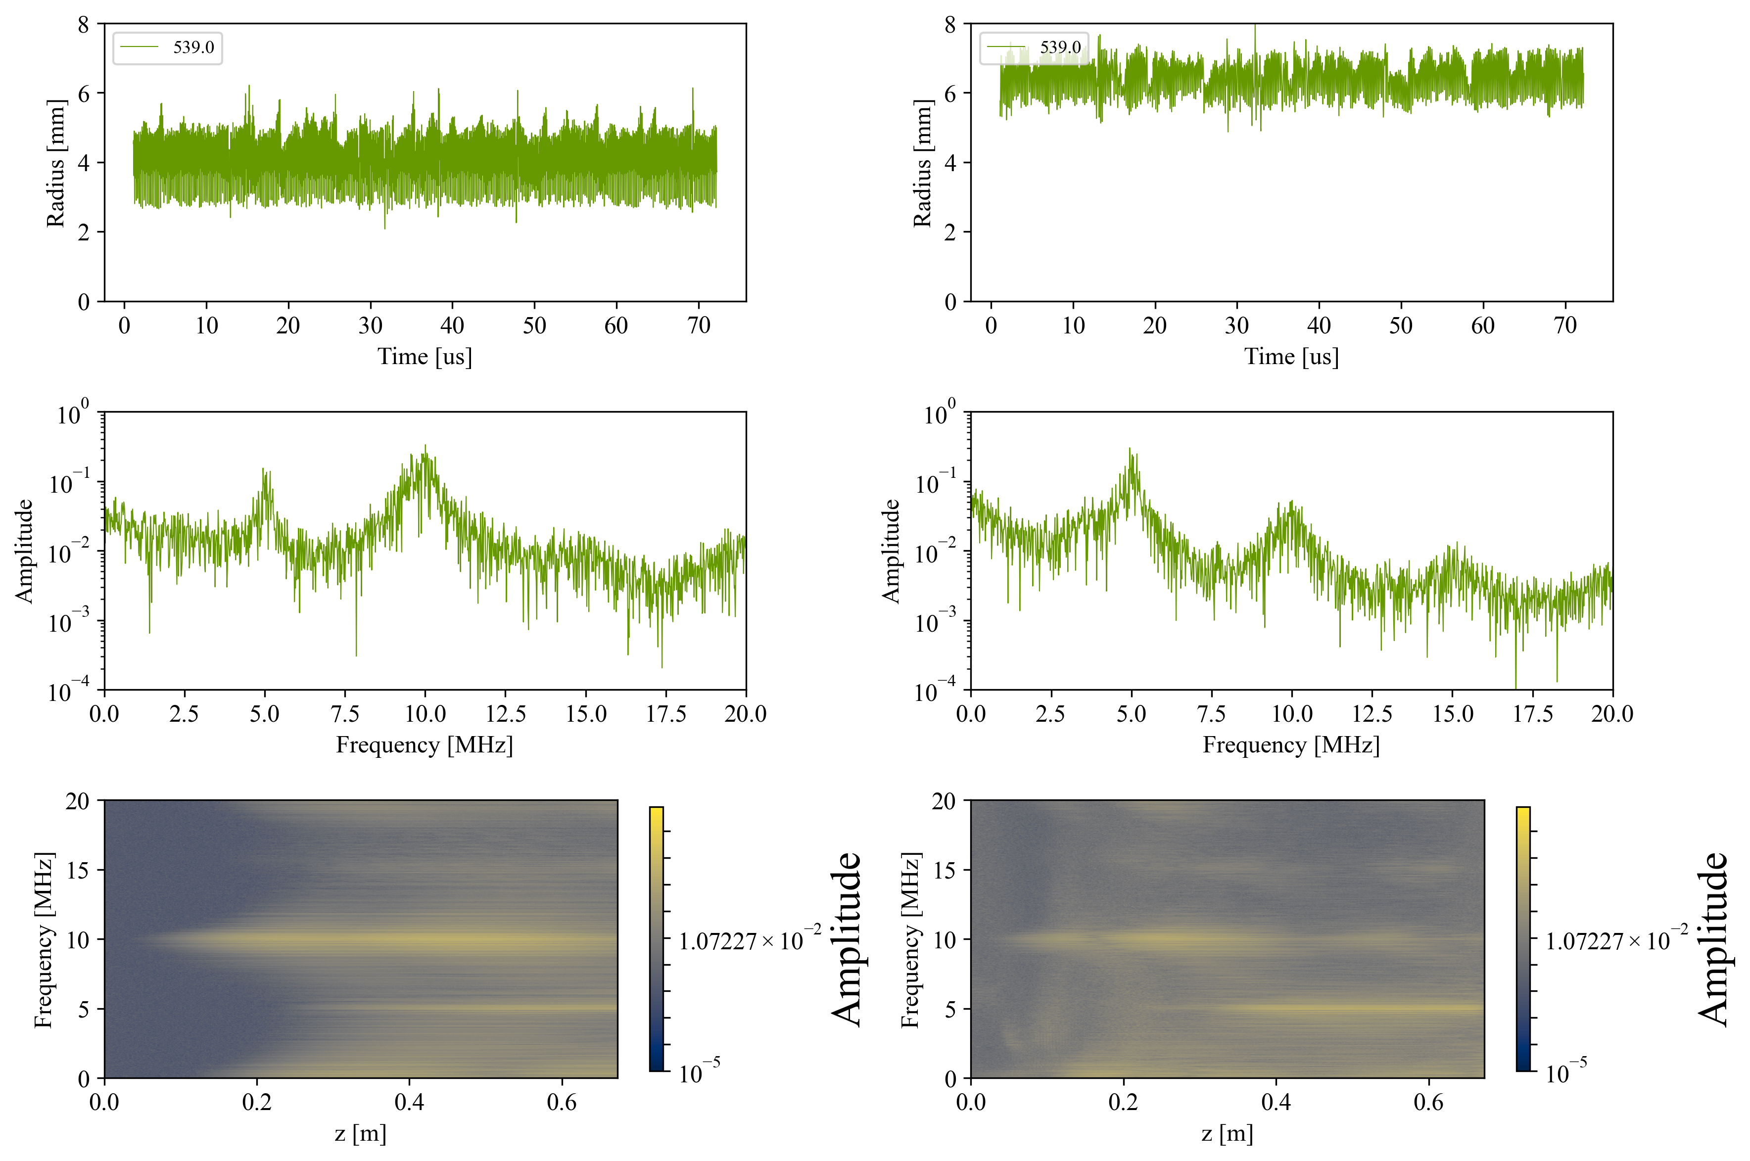
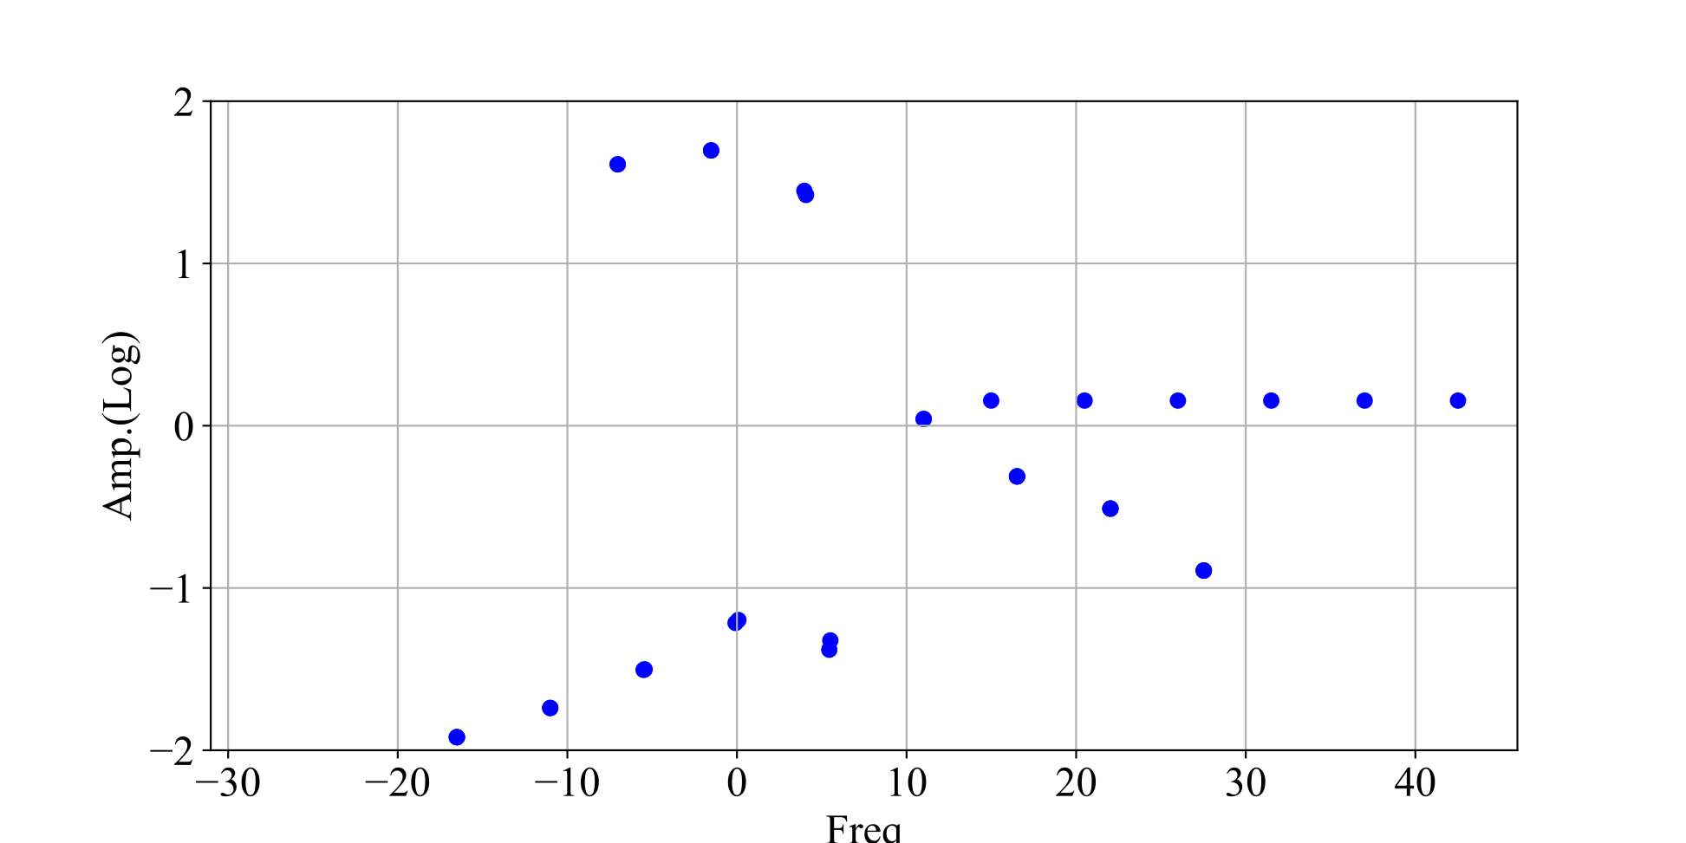
Analytical Result 2: with Unperturbed Field
❖ Vlasov-Poisson analysis is consistent with PIC and supports existence of coupling oscillation
At enough high gas pressure (10⁻¹ Pa, x100 as previous), the number of eigen-modes increased
=> it implies unperturbed field becomes important
Beam
$$χ_{s}=η_{s}\frac{1}{{k_{r}}^{2}+{k_{z}}^{2}}\frac{{Z_{s}}^{2}}{A_{s}}\overset{∞}{\underset{l=-∞}{∑}}\left\{-\frac{k_{r}J_{l}\left(J_{l+1}+J_{l-1}\right)}{ω-lω_{0}}+\frac{{k_{z}}^{2}v_{⊥,s}\left({J_{l}}^{2}-J_{l+1}J_{l-1}\right)}{(ω-lω_{0})^{2}}\right\}$$
~10 MHz
~15 MHz
Plasma
x2
Coupled mode
x0.5
~ 5 MHz
~20 MHz
All modes are in real
~5n MHz
Freq. [MHz]
I. Yamada et al., 7th ICFA Mini-Workshop on Space Charge, 30 Sep. — 2 Oct. 2026

Slide 13
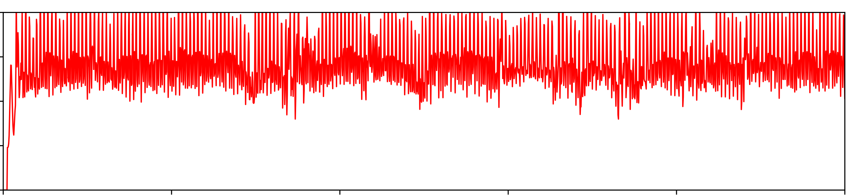
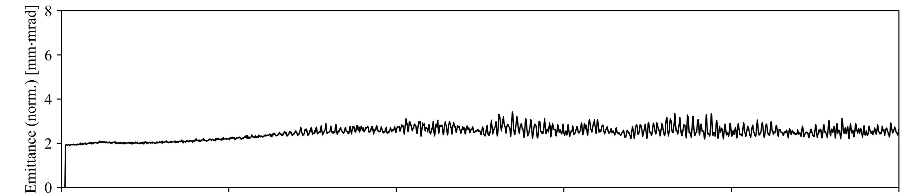
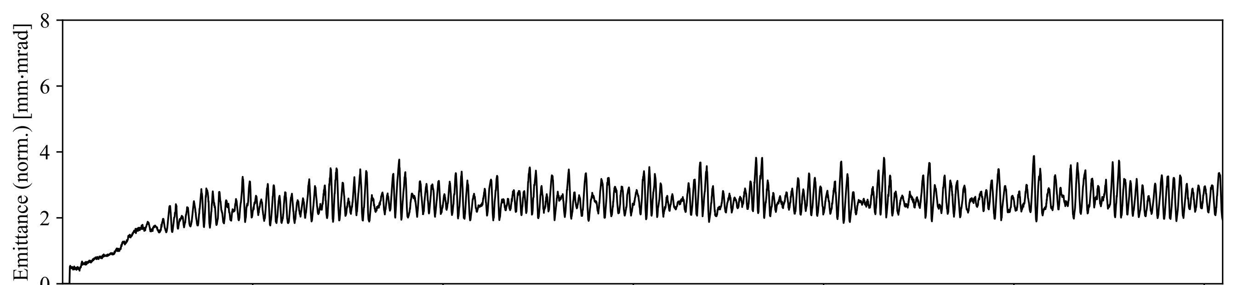
Numerical Result 2: Effect of Coupling on Beam Emittance
❖ Beam-plasma coupling oscillation induces emittance growth
Strong coupling oscillation could potentially occur in actual systems
coupling oscillation induces big growth
Simplified model
KV
H2 gas, uniform at 10⁻³ / 10⁻¹ Pa
uniform linear focusing
almost no plasma
with plasma, but no coupling oscillation => slight growth
Actual J-PARC LEBT model
Gaussian
H2 gas, strong z-dependance
in range of 1 - 10⁻⁴ Pa
2 solenoids focusing
(small emittance due to beam loss)
20
40
60
80
100
Time [us]
I. Yamada et al., 7th ICFA Mini-Workshop on Space Charge, 30 Sep. — 2 Oct. 2026

Slide 14
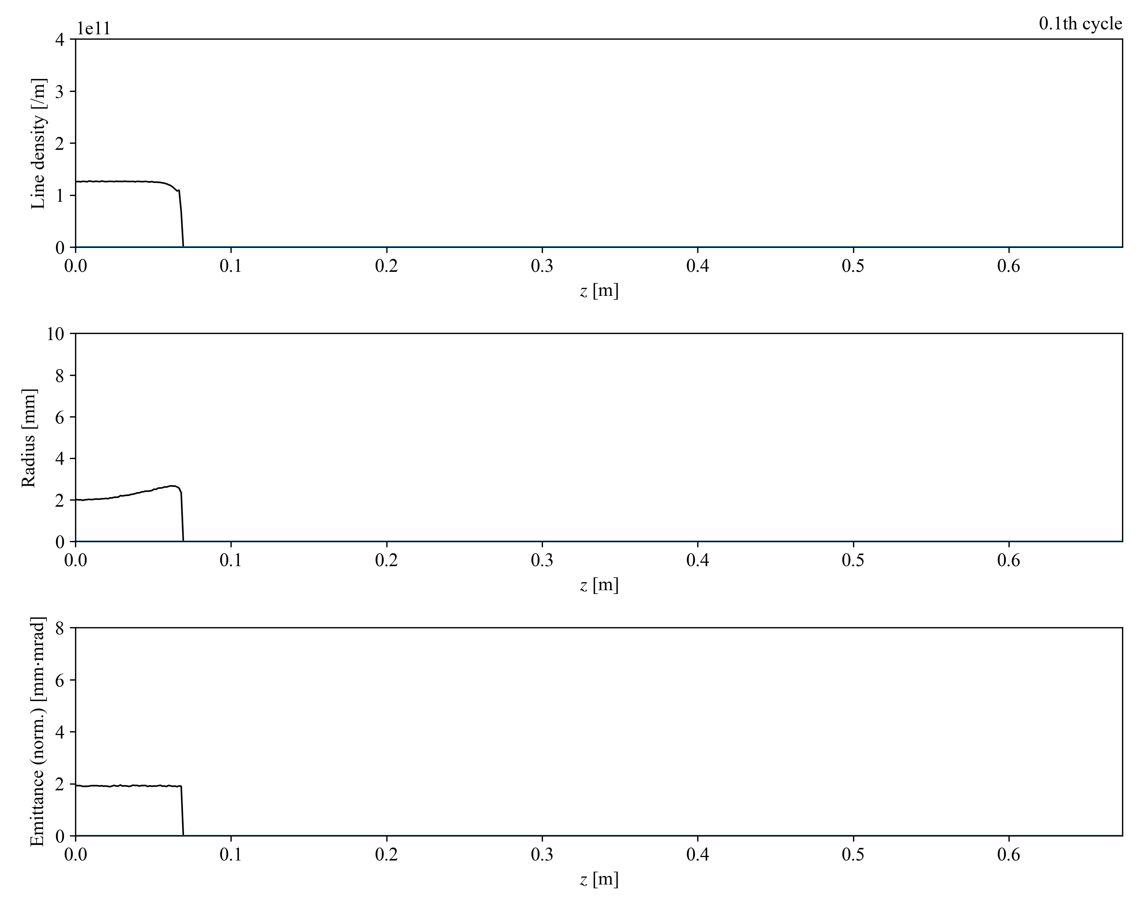
Summary
❖ Beam-Plasma coupling oscillation was studied with numerical and analytical approaches
>> Both approaches are consistent and support coupling oscillation
>> It was found coupling could potentially occur in actual systems
❖ Coupling oscillation could increase beam emittance
but it has not been confirmed that coupling contributes the measured growth
❖ Higher gas pressure induces stronger coupling and emittance growth
>> Coupling should be taken into consideration for gas injection
❖ We will try to measure the coupling effect
Beam
Plasma
high pressure: 0.1 Pa
$$\left(\begin{matrix}χ_{b}-1 & & χ_{b} \\ χ_{p} & & χ_{p}-1\end{matrix}\right)\left(\begin{aligned}ρ_{b} \\ ρ_{p}\end{aligned}\right)=0$$
w/o unperturbed field:
$$χ_{s}=η_{s}\frac{{Z_{s}}^{2}}{A_{s}}\frac{1}{(ω-k_{z}β_{s}c)^{2}-(k_{r}v_{⊥,s})^{2}}$$
$$χ_{s}=η_{s}\frac{1}{{k_{r}}^{2}+{k_{z}}^{2}}\frac{{Z_{s}}^{2}}{A_{s}}\overset{∞}{\underset{l=-∞}{∑}}\left\{-\frac{k_{r}J_{l}\left(J_{l+1}+J_{l-1}\right)}{ω-lω_{0}}+\frac{{k_{z}}^{2}v_{⊥,s}\left({J_{l}}^{2}-J_{l+1}J_{l-1}\right)}{(ω-lω_{0})^{2}}\right\}$$
with unperturbed field:
I. Yamada et al., 7th ICFA Mini-Workshop on Space Charge, 30 Sep. — 2 Oct. 2026

Slide 15
Summary
❖ Beam-Plasma coupling oscillation was studied with numerical and analytical approaches
>> Both approaches are consistent and support coupling oscillation
>> It was found coupling could potentially occur in actual systems
❖ Coupling oscillation could increase beam emittance
but it has not been confirmed that coupling contributes the measured growth
❖ Higher gas pressure induces stronger coupling and emittance growth
>> Coupling should be taken into consideration for gas injection
❖ We will try to measure the coupling effect
Beam
Plasma
$$\left(\begin{matrix}χ_{b}-1 & & χ_{b} \\ χ_{p} & & χ_{p}-1\end{matrix}\right)\left(\begin{aligned}ρ_{b} \\ ρ_{p}\end{aligned}\right)=0$$
w/o unperturbed field:
$$χ_{s}=η_{s}\frac{{Z_{s}}^{2}}{A_{s}}\frac{1}{(ω-k_{z}β_{s}c)^{2}-(k_{r}v_{⊥,s})^{2}}$$
$$χ_{s}=η_{s}\frac{1}{{k_{r}}^{2}+{k_{z}}^{2}}\frac{{Z_{s}}^{2}}{A_{s}}\overset{∞}{\underset{l=-∞}{∑}}\left\{-\frac{k_{r}J_{l}\left(J_{l+1}+J_{l-1}\right)}{ω-lω_{0}}+\frac{{k_{z}}^{2}v_{⊥,s}\left({J_{l}}^{2}-J_{l+1}J_{l-1}\right)}{(ω-lω_{0})^{2}}\right\}$$
with unperturbed field:
I. Yamada et al., 7th ICFA Mini-Workshop on Space Charge, 30 Sep. — 2 Oct. 2026

Slide 16
Animation at 0.1 Pa
❖ Gas density exceeds beam density because production rate is enough high
=> Unperturbed component becomes intense
I. Yamada et al., 7th ICFA Mini-Workshop on Space Charge, 30 Sep. — 2 Oct. 2026

Slide 17
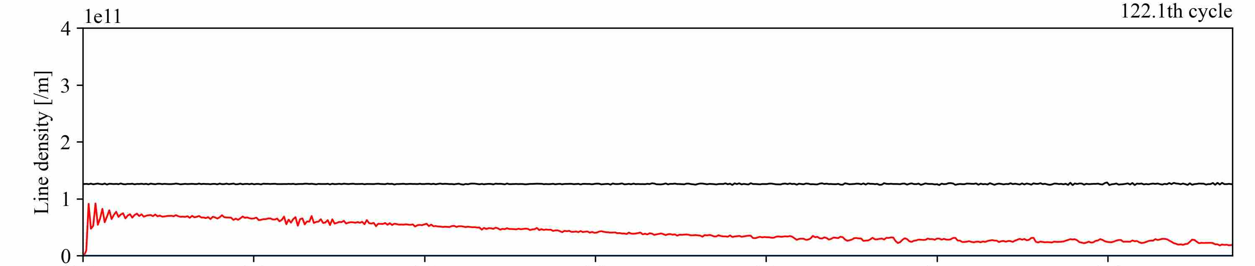
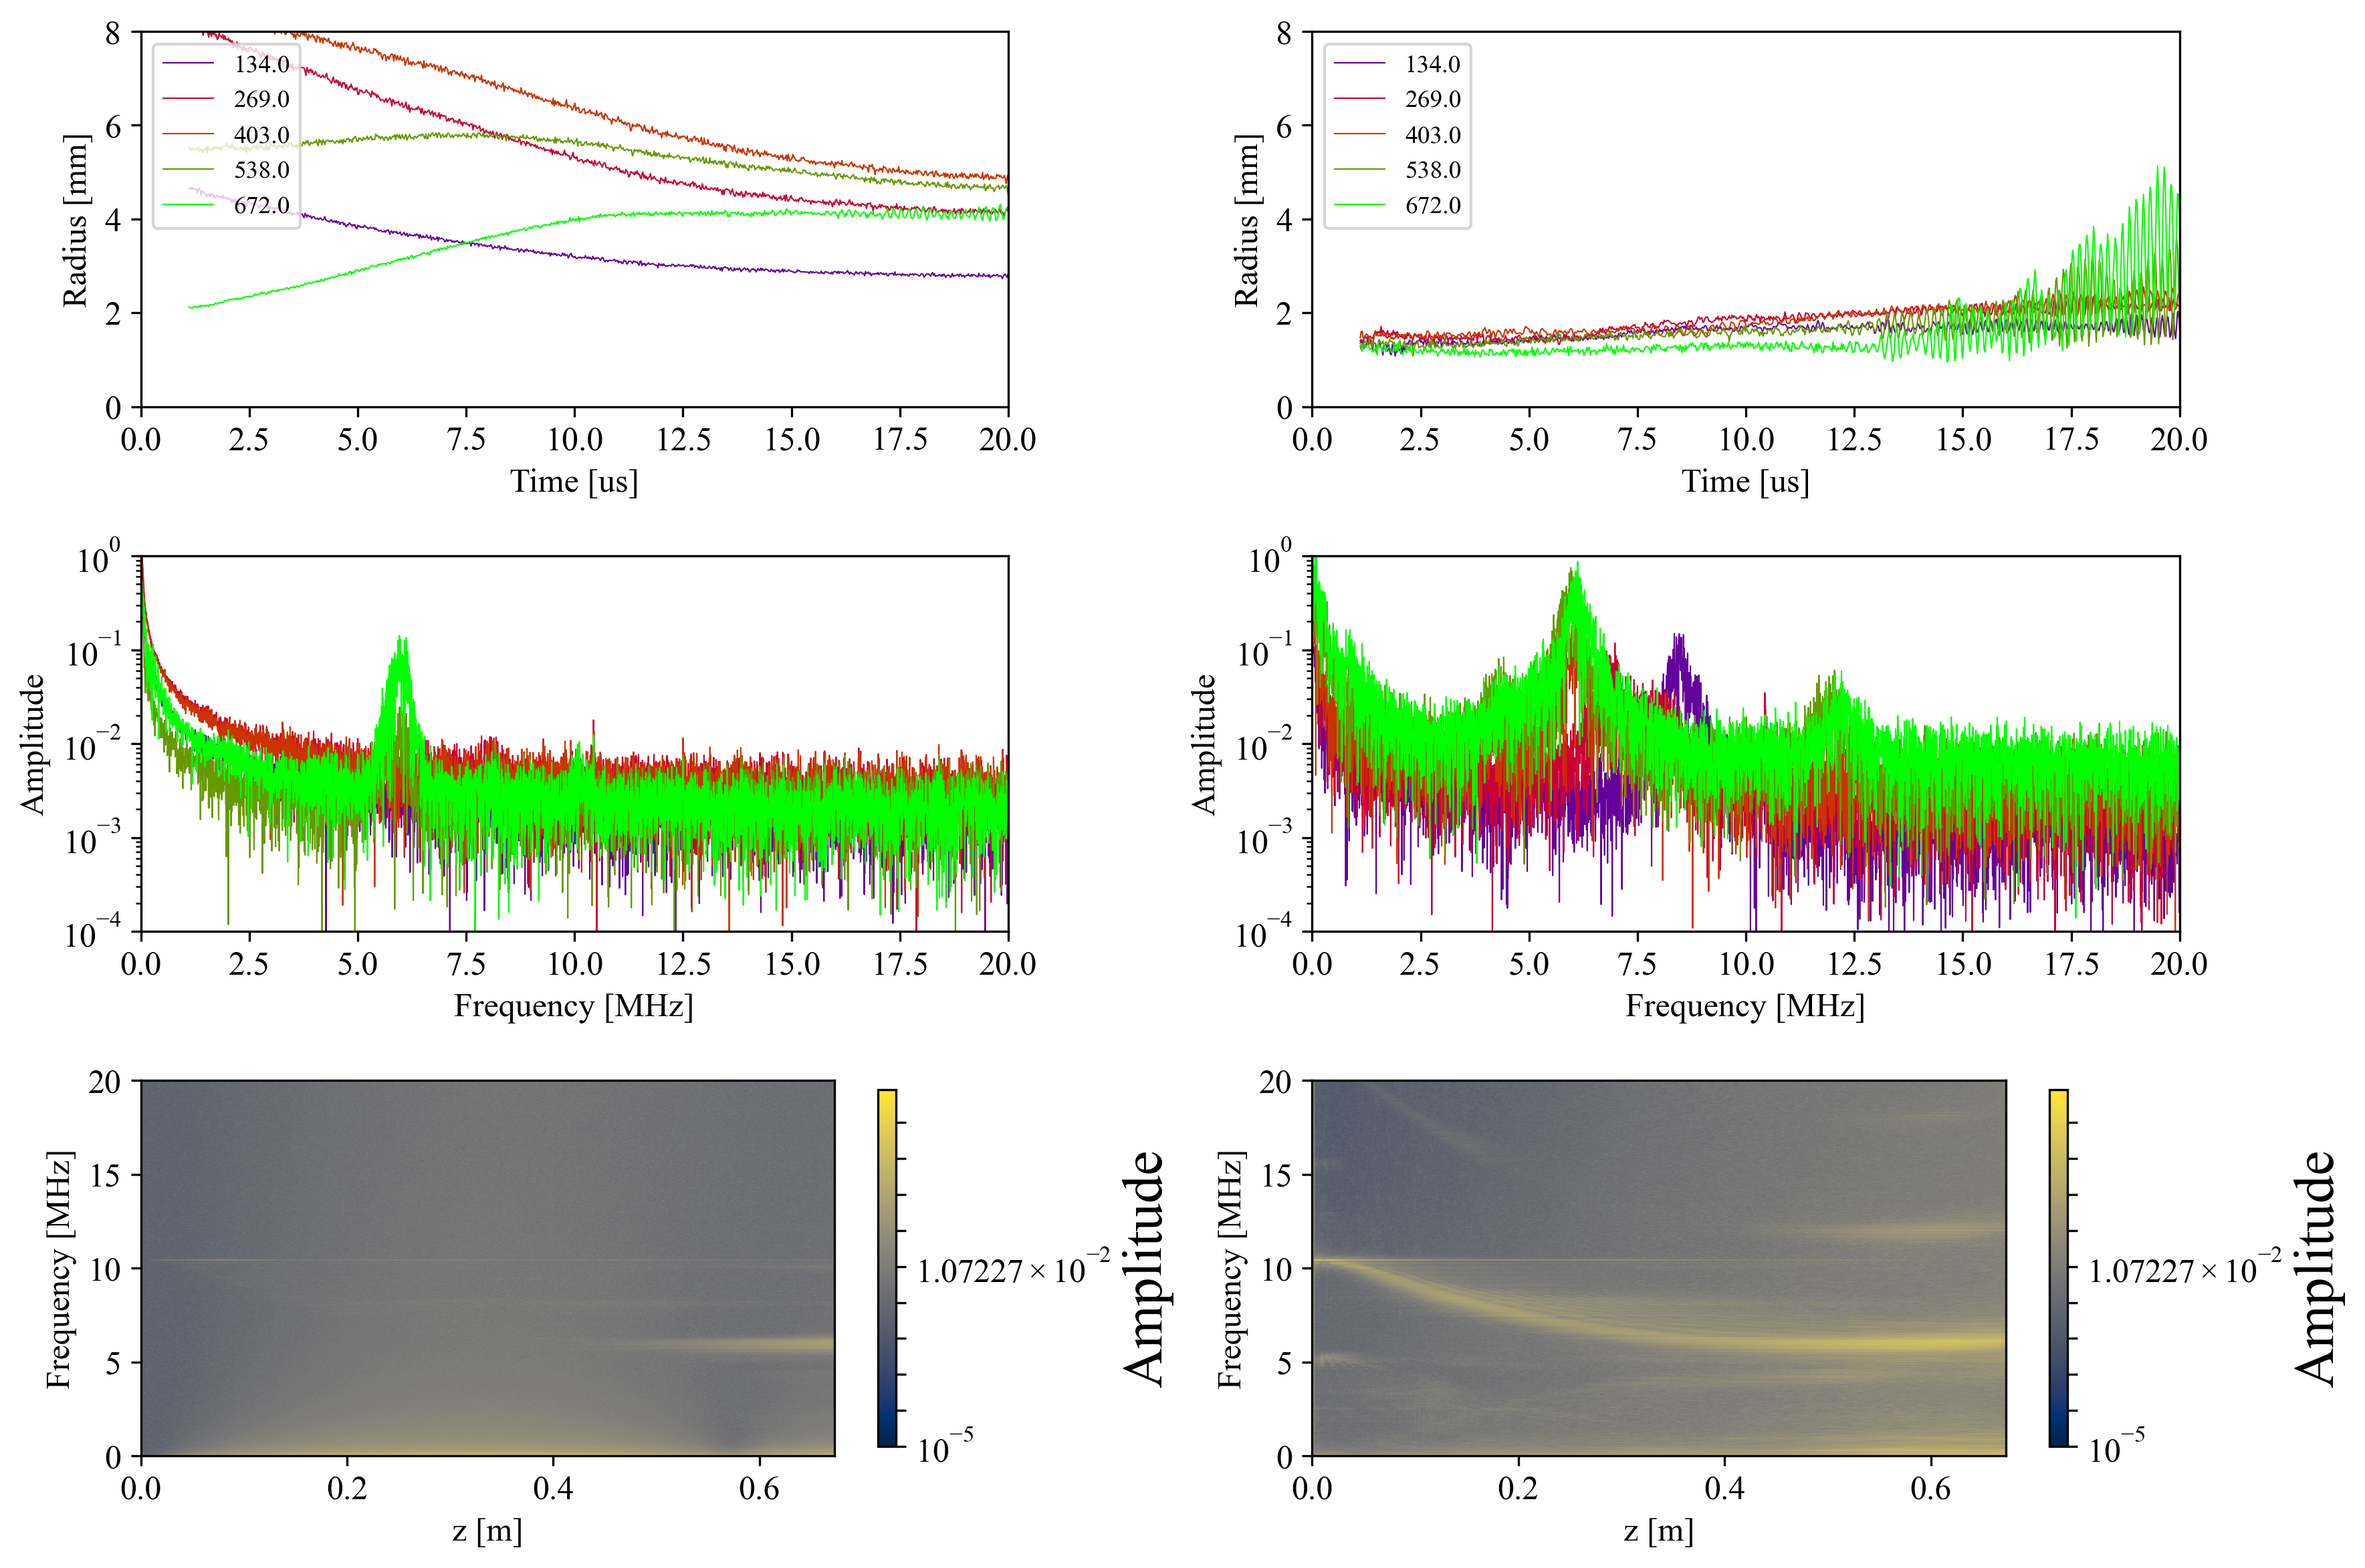
❖ Coupling may be induced by plasma
Plasma density in longitudinal direction makes plasma freq. change
=> Where plasma eigen-freq. corresponds to beam eigen-freq., coupling can be occur
Beam
$$ω∝\sqrt{n_{s}}$$
Plasma
I. Yamada et al., 7th ICFA Mini-Workshop on Space Charge, 30 Sep. — 2 Oct. 2026

Slide 18
あくまで「カップリングがgrowthを引き起こすか」
背景：プラズマ振動が生じるという話がある，LEBTは十分なガス圧があるのにgrowthがある
目的：カップリングでgrowthが説明できるか
ただし，実験できてないし，シミュレーションも振動中の分布はちゃんと確認してない
=> 課題となっているgrowthが説明できるか，ではなく，カップリングでgrowthが起こりうるか，を検証
手法：PICの紹介，PICで研究できることの妥当性
解析と比較するため，原因を絞るための簡略化
結果：PICにて，KVとTEでビーム・プラズマともに振動が確かに生じている => 本当に物理的意味のある振動か？
（上で実際の系での振動を見せているなら，簡略化では振動は消えてない）
解析的にカップリングが起こりうるかを検証
=> 実際に起こりうる，エミッタンスもカップリングの影響で振動・成長する
I. Yamada et al., 7th ICFA Mini-Workshop on Space Charge, 30 Sep. — 2 Oct. 2026

