Slide 1
High-Intensity Performance and Limits in the Fermilab Main Injector and Recycler
September 30, 2026
Rob Ainsworth
Scientist

Slide 2
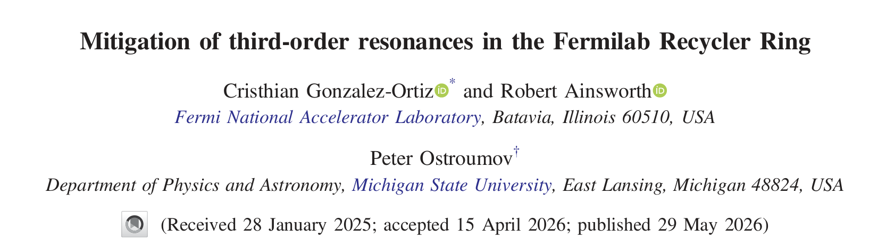
Outline
Introduction
Accelerator Complex
  Recycler
Slip-stacking
Space charge
PIP-II upgrades
Resonance correction efforts
Summary & Questions

Slide 3
Introduction
The FNAL Accelerator Complex delivers high intensity beam for Neutrino Experiments
Goal: As many protons as possible while keeping losses to acceptable levels

Slide 4
Fermilab Accelerators
H- linac
35 kV source, 750 kV RFQ, 400 MeV linac ~20mA
Booster synchrotron
H- stripping injection, ~16 turns to ~4.7E12 p
0.4 to 8 GeV at 15 Hz
h=84
Recycler
3.3 km (h=588) permanent magnet 8 GeV ring
Slip-stacking 12 Booster batches, ~56e12 p
Main Injector
8 to 120 GeV ramp in 1.067 s

Slide 5
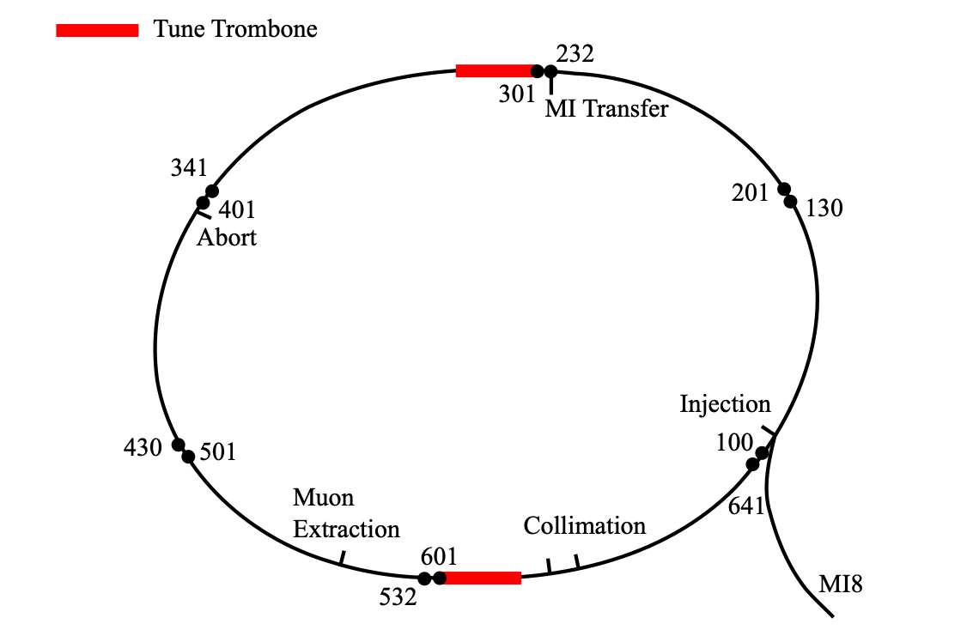
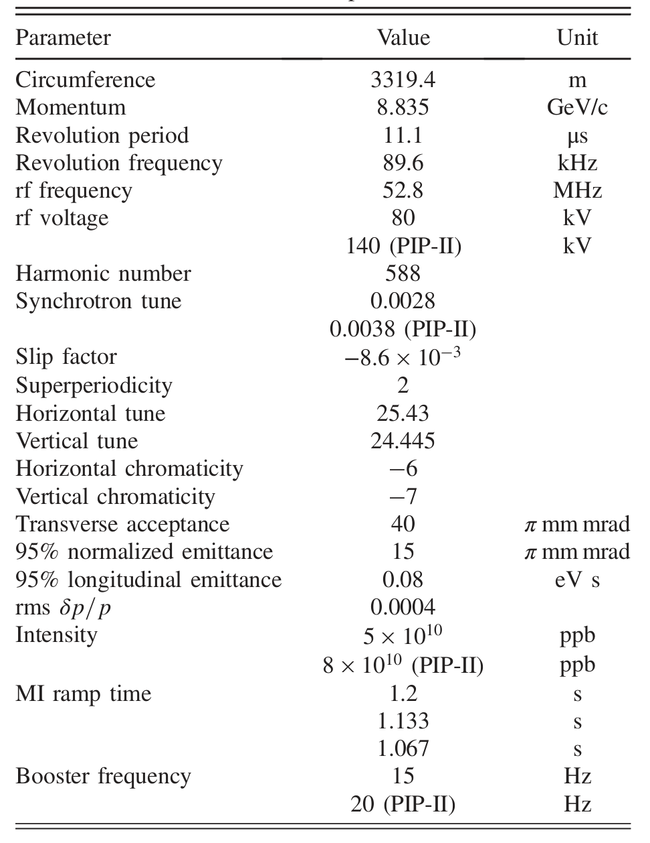
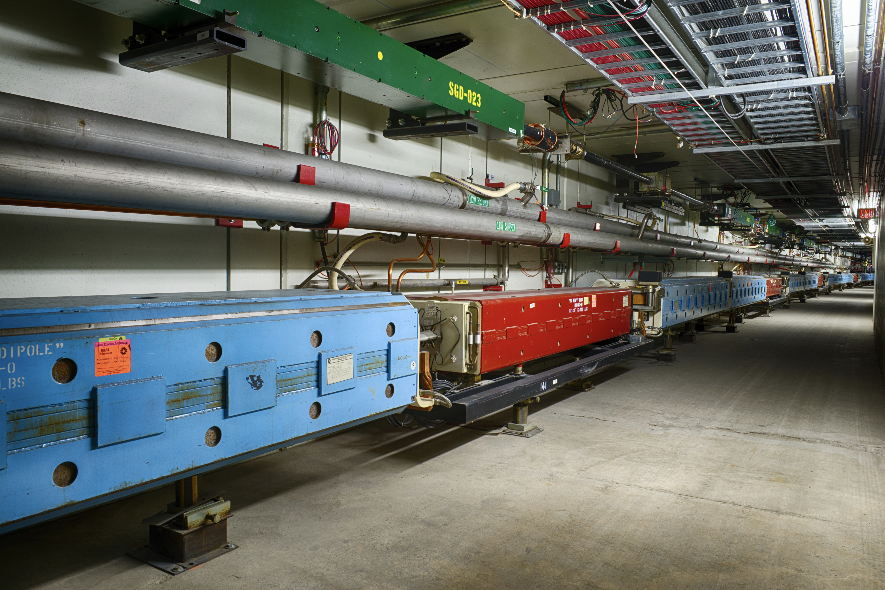
Recycler
Permanent magnet machine
Shares enclosure with Main Injector
Operates below transition
Bare machine has super periodicity of 2

Slide 6
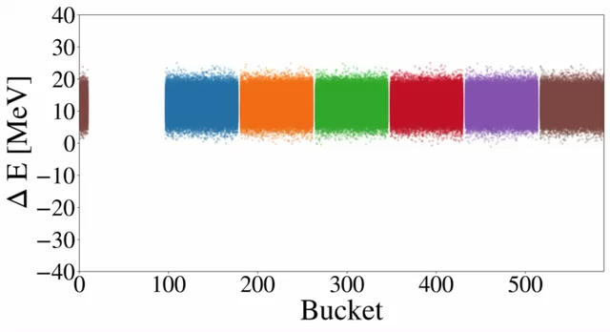
Slip-stacking
Separation between batches is set by Booster harmonic number 84 multiplied by Booster frequency
1260 Hz for 15 Hz -> 24 MeV

Slide 7
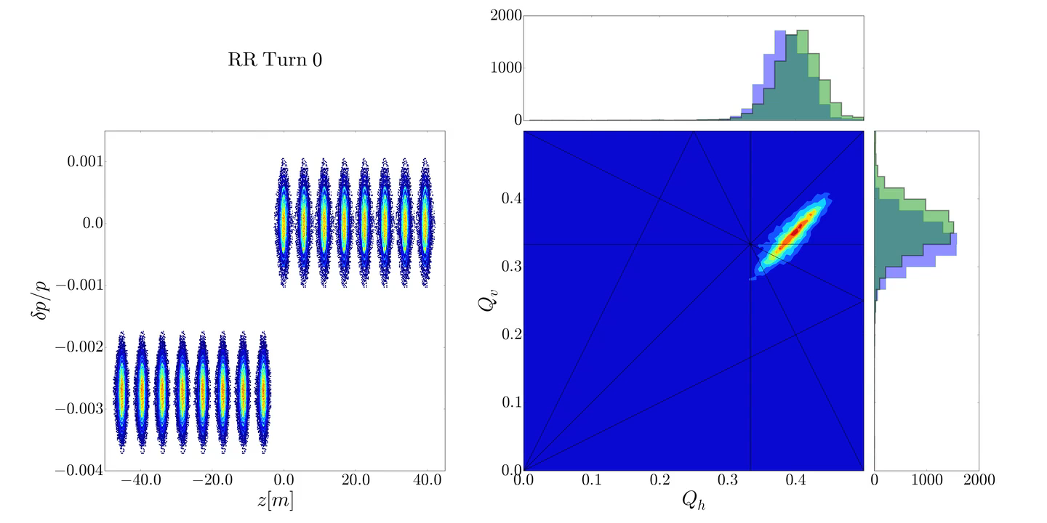
Tune footprint during slip-stacking

Slide 8
High intensity Slip-stacking operation
Modulating tune shift as bunches overlap
Two co-propagating beams means two footprints
  Differing momenta means footprints separated by linear chromatic tune shift
    Momenta are symmetric around 0 dp/p so quadratic terms cancels out
Operating chromaticity is -6,-7
  Footprints separated by ~0.02 Limited tune flexibility
  Tune trombones used to change tune in permanent magnet machine
Is Space charge currently limiting Recycler operations?

Slide 9
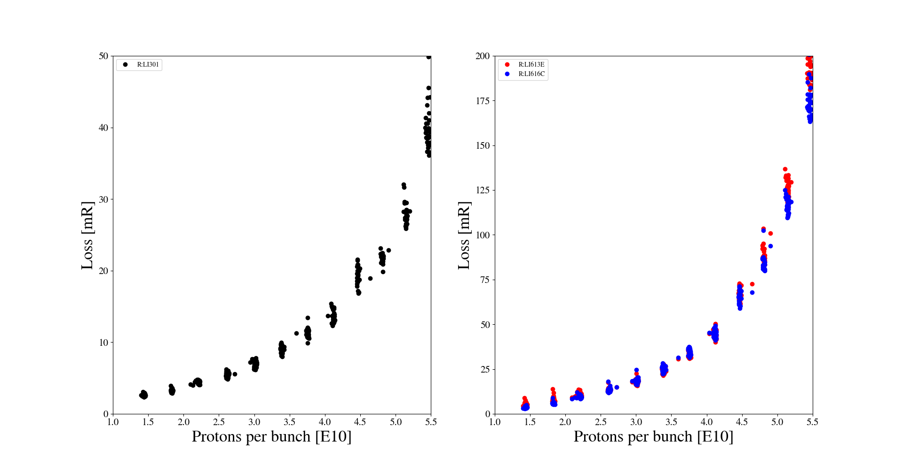
Beam loss is not linear

Slide 10
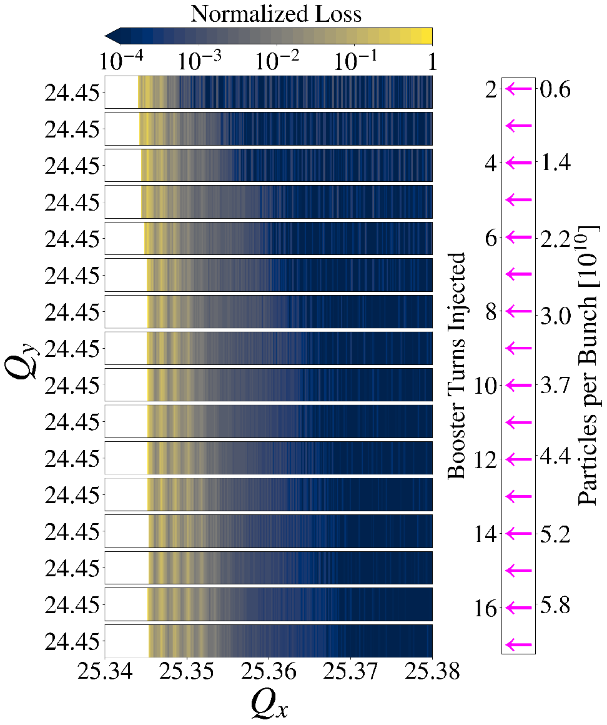
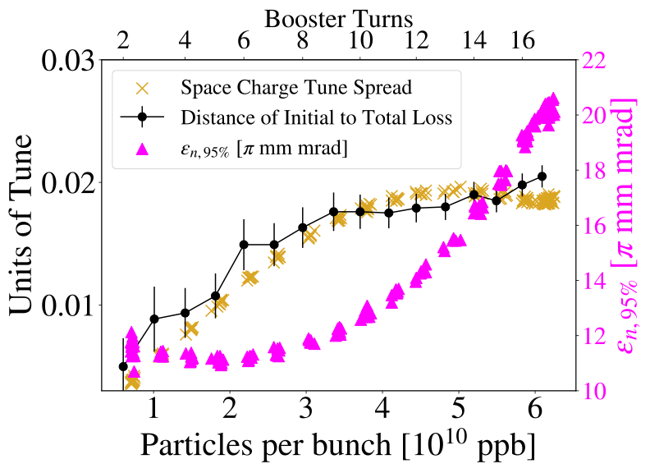
Injected emittance with intensity

Slide 11
PIP-II upgrades
We’re beginning the last high intensity run before a long shutdown
  PIP-II upgrades
New SRF linac
High injection energy into Booster (400 MeV -> 800 MeV)
Booster 15 Hz -> 20 Hz
  Bigger slip-stacking separation -> bigger footprint separation
50% more beam
Minimal upgrades for Recycler & Main Injector
Post upgrades, injected emittance could be smaller, intensities will be higher
- Need to be ready

Slide 12
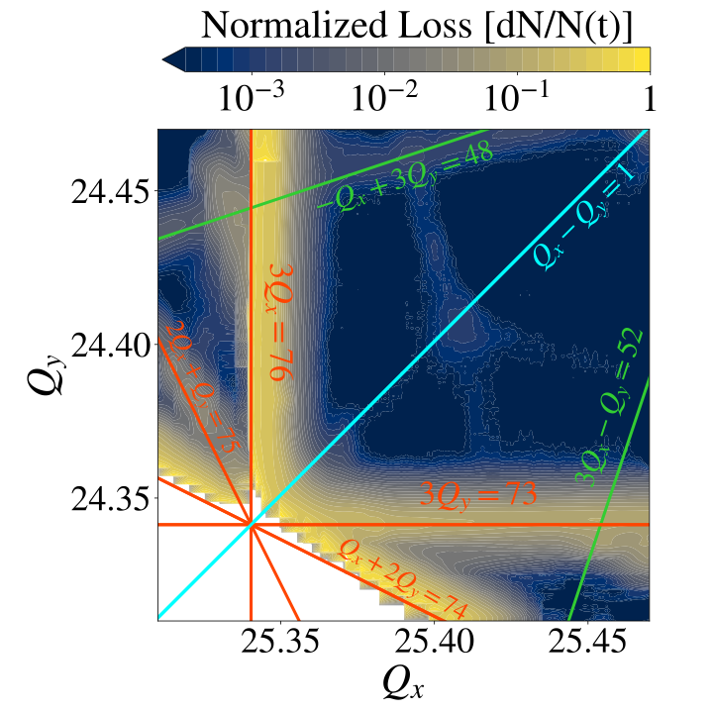
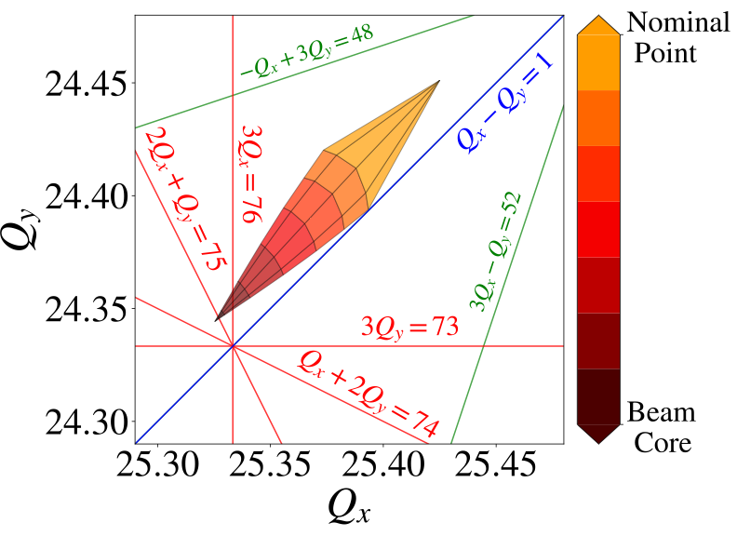
Space charge at PIP-II intensities

Slide 13
Resonance correction circuits
The Recycler has 60 sextupole correctors for chromaticity correction
We installed 8 sextupoles at 4 locations (0,90,180,270deg in phase advance) for 3Qx correction and 4 Skew sextupoles for 3Qy correction
  Since added an additional two sextupoles although have not commissioned yet
  Installed in straight sections to avoid chromatic effects
  At each location, sextupoles were placed next to each other as one sextupole was not strong enough
4 Skew quadrupoles already installed for linear coupling correction

Slide 14
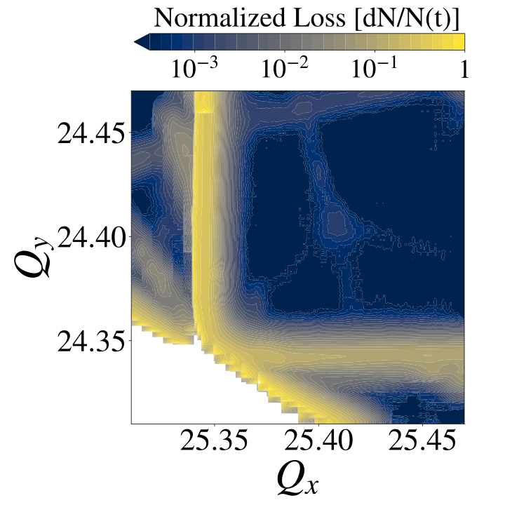
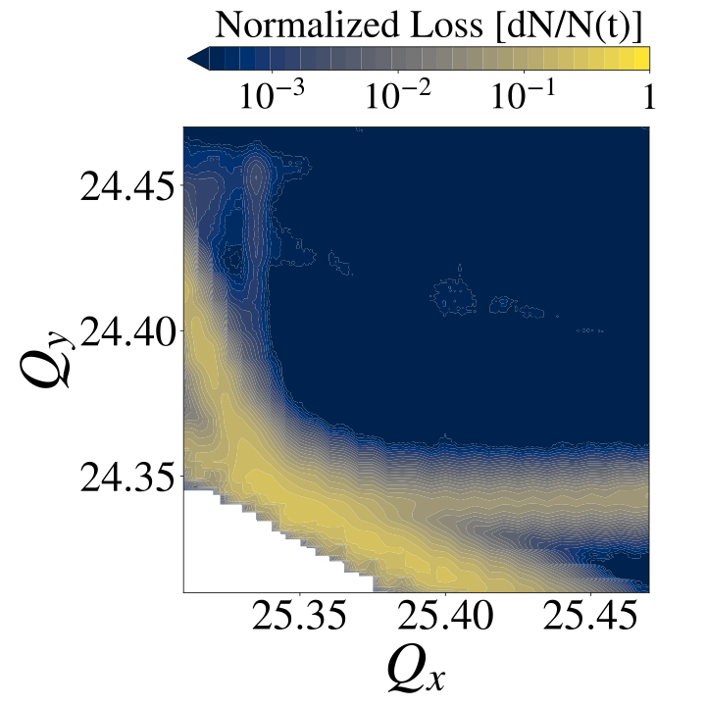
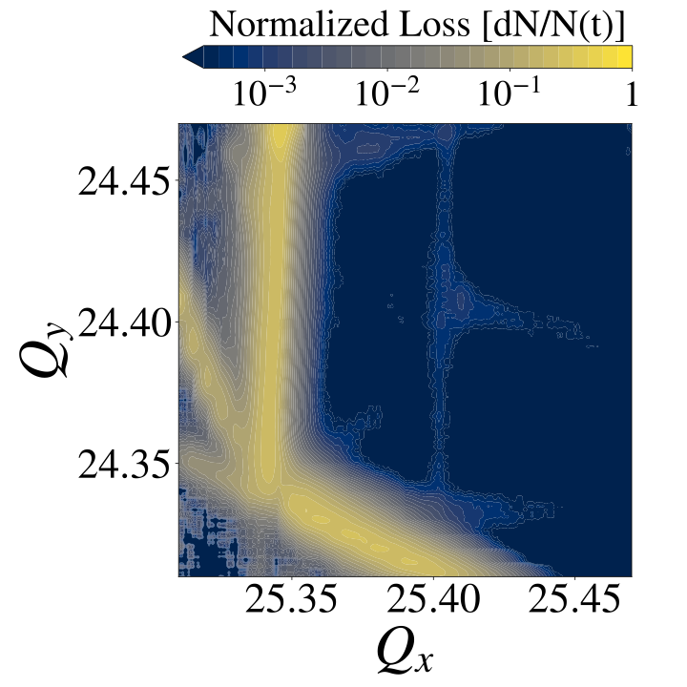
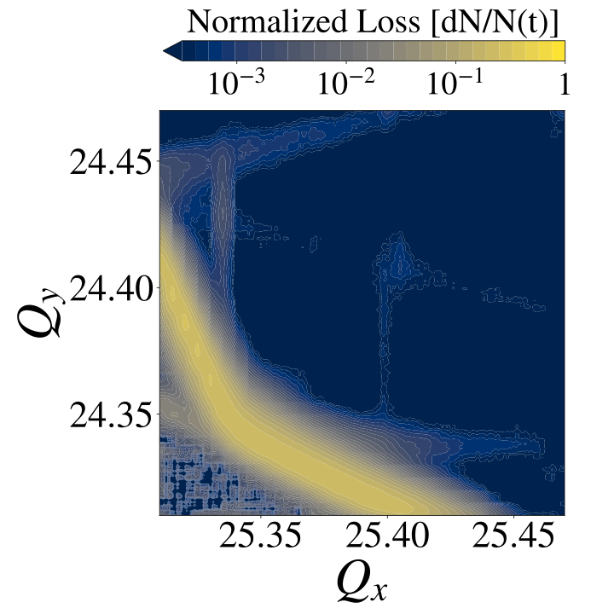
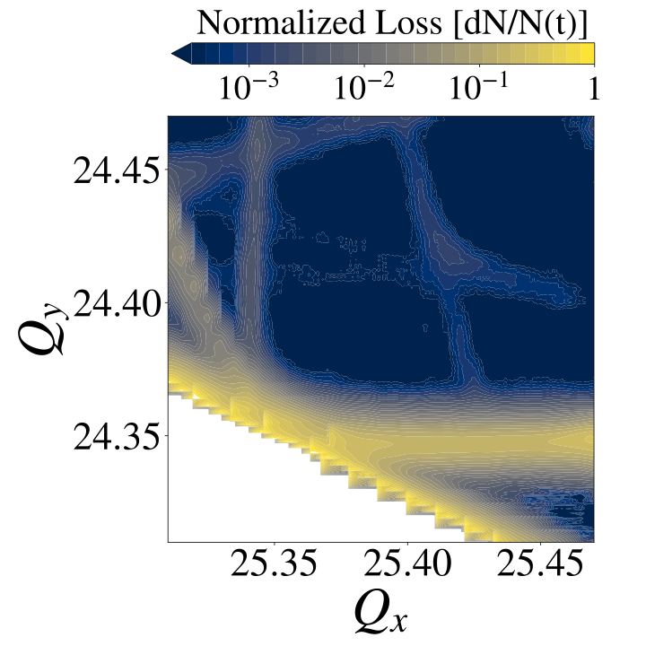
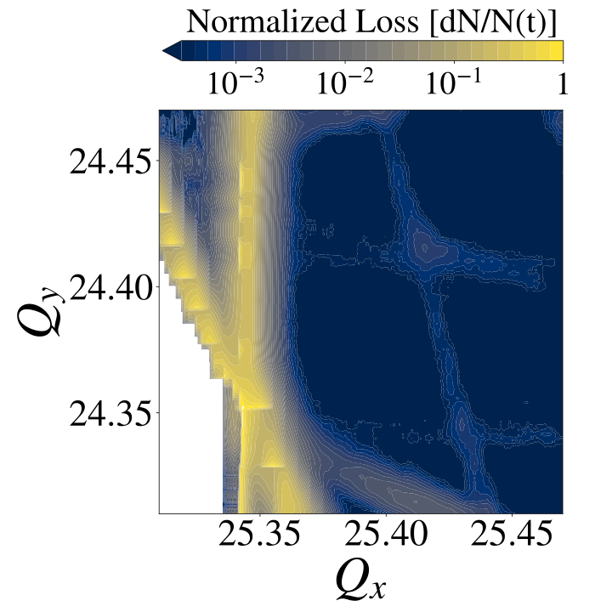
Resonance correction – measured tune space
3Qx
3Qy
3Qx & 3Qy
3Qy &
Qx + 2Qy
3Qx & 2Qx + Qy

Slide 15
Summary & Open Questions
The Recycler uses the slip-stacking process to double the beam intensity
  Modulating tune shift where two footprints are separated by non-zero linear chromatic tune shift
Space charge effects appear to saturate at current intensities/injected emittance
Resonance correction systems in place for post upgrades
Questions:
  In the past, Resonance correction was tuned up by minimizing RDT at low intensity and leaving same corrections for high intensity. With the increased use of optimization algorithms, are there better optimums out there?
  The 3rd Order correction circuit has sextupoles are 4 locations but doubled up, should we redistribute to 8 locations i.e. is it better to spread out the RDT corrections.

Slide 16
Thank you!

Slide 17
Backup Slides
02

Slide 18
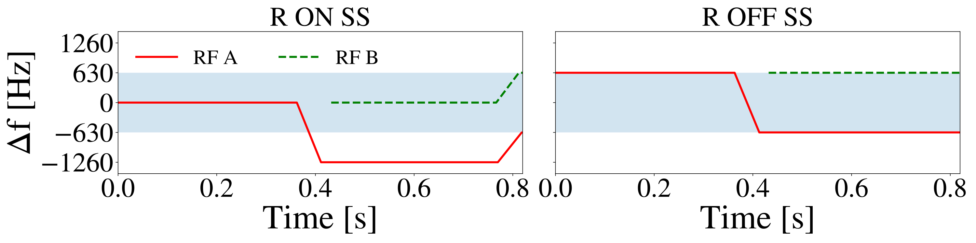
MI/RR challenges
Charge #4,6
To prepare for 20 Hz, Radial Offset slip-stacking implemented and operational since 2022
  Reduced losses in MI by factor of 3
PIP-II required a 1.2 s ramp in Main Injector
  Implemented since 2019
  Shortened further to 1.067 s allow 1 MW beam power record
New Collimators in injection line to RR from Booster

Slide 19
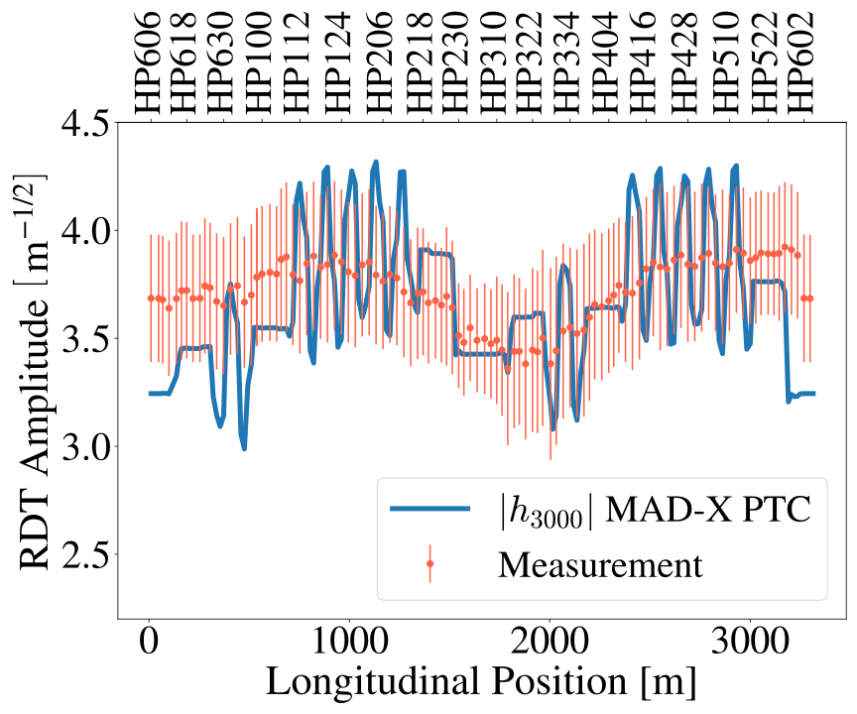
RDT measurement vs simulation

