Slide 1

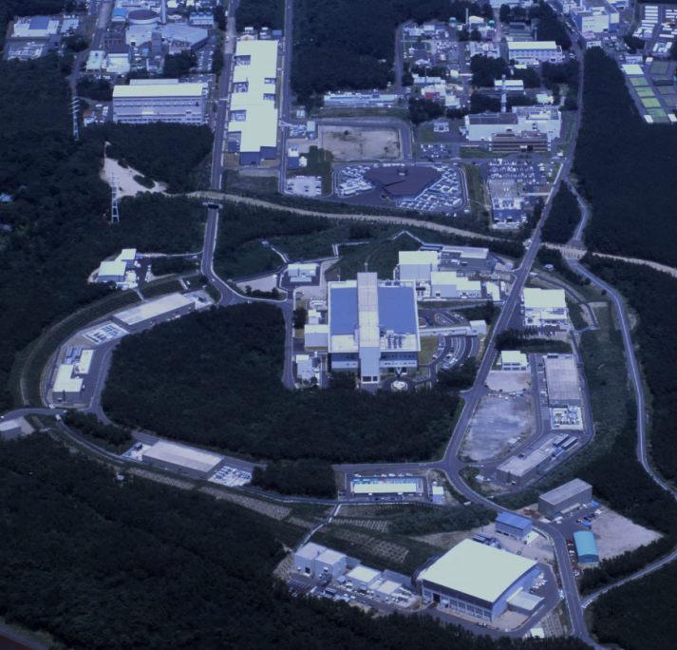
J-PARC Accelerators and Experimental facilities
J-PARC
(KEK & JAEA)
Beam loss Minimization by
well Mitigating the SC Effect
at 1.5 MW Beam Power
at J-PARC RCS
400 MeV H⁻ Linac
Foil
3 GeV Rapid Cycling Synchrotron (RCS)
Neutrino Beam Line to Kamiokande (NU)
Pranab SAHA
On behalf of RCS beam commissioning team
Space Charge Workshop 2026, Oxford, UK
2026/9/30
30 GeV Main Ring synchrotron (MR)
Material and Life Science Experimental Facility (MLF)
Hadron Expt. Hall (HD)

Slide 2
Outline:
Introduction and background
Key optimizations for beam loss mitigation
Results of beam loss minimization
Summary and Outlook

Slide 3
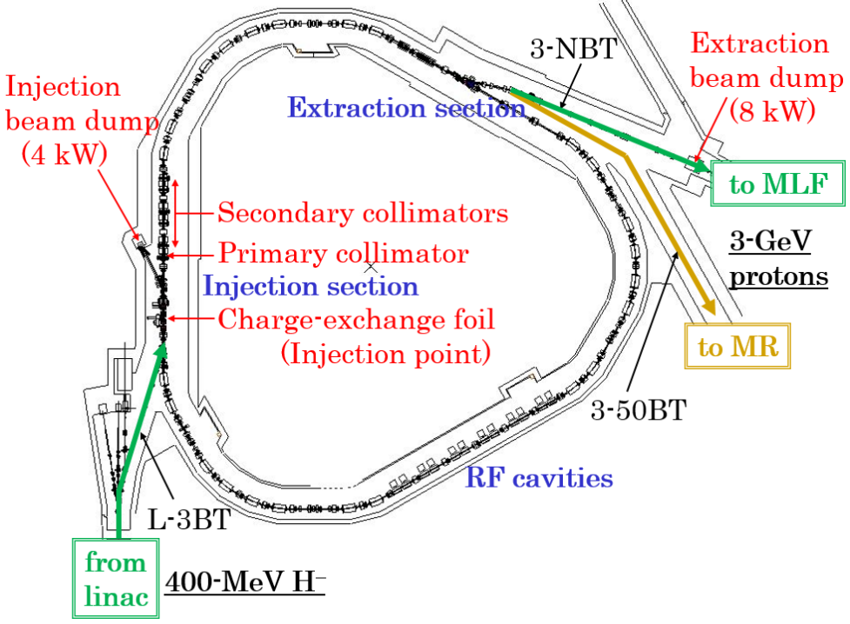
Brief introduction of the RCS
RCS key parameters
Circumference : 348.333 m
Superperiodicity : 3
Harmonic number : 2
Number of bunches : 2
Injection : H⁻ multi-turn
charge-exchange injection
Injection energy : 400 MeV
Injection period : 0.5 ms (307 turns)
Injection peak current : 50 mA
Extraction energy : 3 GeV
Repetition rate : 25 Hz
Particles per pulse : 8.33 x 10¹³
Beam power : 1 MW
Collimator capacity: 4 kW
RCS has two functions:
Proton driver for producing pulsed
muons and neutrons at the MLF.
Injector to the MR
Beam sharing between MLF and MR: 88 : 12 or 96:4
depending on MR cycle
Beam loss mitigation for beam operation to the MLF
is a high priority.

Slide 4
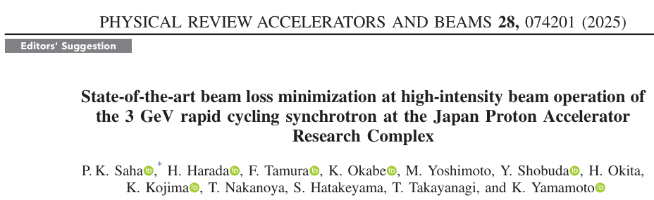
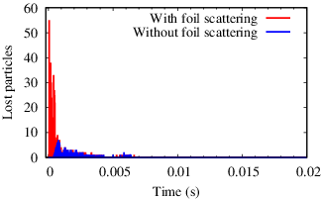
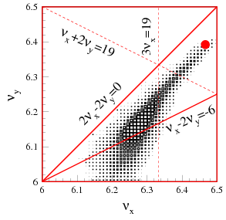
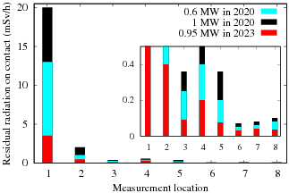
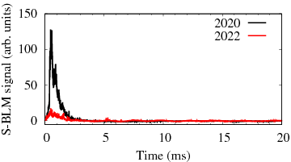
Background (1 MW beam tuning results)
Simulation w/ and w/o foil scattering
, H. Hotchi
Simulation:
Elimination of foil scattering
gives almost no beam loss!!
Implemented alternative ways of resonance corr.
and new ways for optimizing LP and TP.
The residual beam loss at 1 MW is < 0.1%.
Beam loss occurs only at lower energy localizing well
in the collimator section.
Beam loss is mostly caused by the foil scattering.
Loss power: < 0.1 kW << Collimator capacity (4 kW)!
We established reliable numerical simulation
and feedback to systematic beam tests to address
all considerable issues and practical solutions
for beam loss mitigation at 1 MW.
Residual dose
(On contact)
Similar procedures and further detail optimization of many parameters we have applied for beam loss mitigation at 1.5 MW.
Time structure of the
beam loss

Slide 5
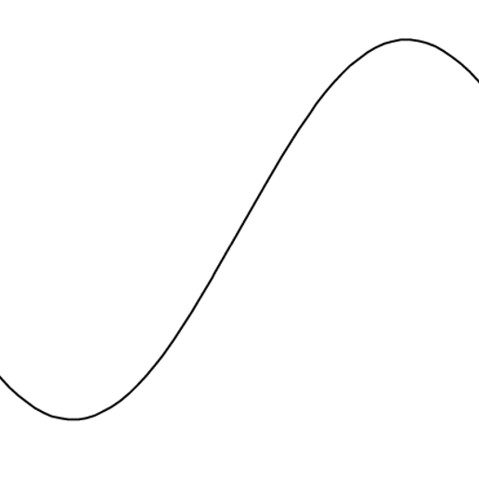
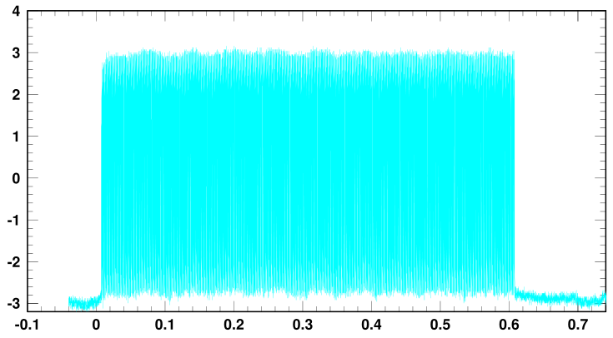
Basic parameters for 1.5 MW
BM field ramping
Beam extraction here
BM bottom
Bρ
t = 5.6 ms
0.8 GeV
Paint bump
T_{inj}=0.5 ms
Injection pulse
t = 20 ms
⇒ 1.0 MW
(8.33 x 10¹³ ppp)
3 GeV
I_{peak}=50 mA
T_{inj}=0.6 ms
RF trip
I_{peak} = 62 mA
⇒ 1.5 MW
(1.25 x 10¹⁴ ppp)
t = 0 ms
(BM bottom)
10
20
Time (ms)
Injection beam
Currently, acceleration is limited up to 0.8 GeV due io capacity of the RF anode power supply.
Installing new RF cavities and will be completed in 2028.
However, for beam loss study and its mitigation can be done as beam loss occurs only at lower beam energy for the first few ms.
62 mA
0.6 ms

Slide 6
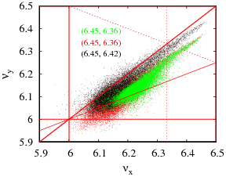
Optimization of the operating point
At 1 MW, the bare tune at injection is set at (6.46, 6.36).
However, further SC detuning at 1.5 MW forces the beam core
beyond ν_{y} = 6.
Simulation results shows a significant increase of the beam loss.
As a result, the operating point is optimized, especially the vertical
tune is moved to 6.42 setting the bare tune at (6.45, 6.42).
Then, next concern is ν_{x} –ν_{y} = 0 resonance, for which the
painting/beam emittance controlling is a key issue.
The ν_{x} – 2ν_{y} = -6 resonance correction is optimized according
change of beam intensity.
ν_{x} + 2ν_{y} = 19
3ν_{x} = 19
1 MW
1.5 MW
1.5 MW
2ν_{x} -2ν_{y} = 0
ν_{x} – 2ν_{y} = -6
Basically, we figured out almost all possible sources causing beam emittance
growth/beam halos and applied realistic counter measures.

Slide 7
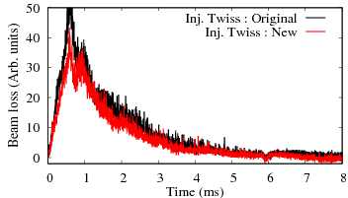
Optimization of injection twiss
In the latest beam test in 2025, we optimized the injection
beam parameters better than the previous study.
Measured injection twiss parameters at the foil
Run# Time | α_{x} | α_{y} | β_{x} [m] | β_{y} [m] | ε_{x} (rms) [π mm mrad] | ε_{y} (rms) [π mm mrad]
92 (March ’25) | -0.69 | -0.75 | 6.64 | 2.13 | 0.42 | 0.31
92 (Dec ‘24) | -0.55 | -0.11 | 6.33 | 1.93 | 0.47 | 0.31
Extraction
y’
Circulating
beam
Time structure of the beam loss taken by
a BLM at the collimator section.
Additional beam loss partly reduced.
Inj. beam
y
Improvement of injection beam emittance.
Injection α_{y} optimization towards matching to the ring.
Foil size limits a further optimization.
A bigger foil size increases foil scattering beam loss.

Slide 8
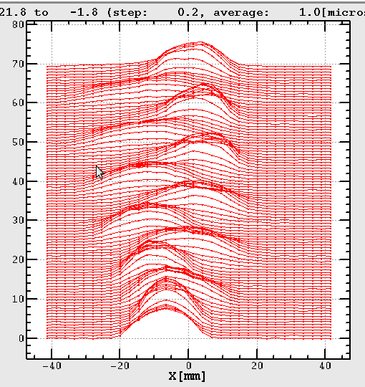
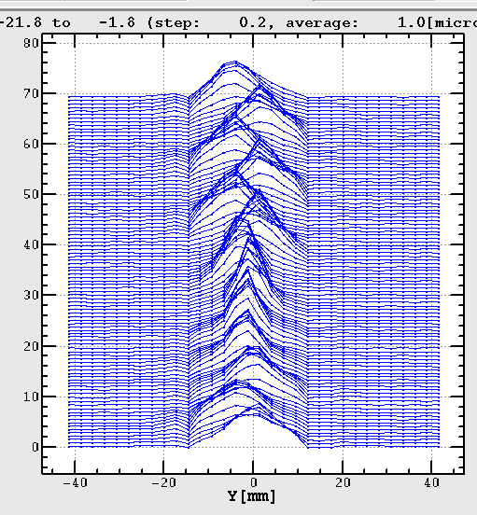
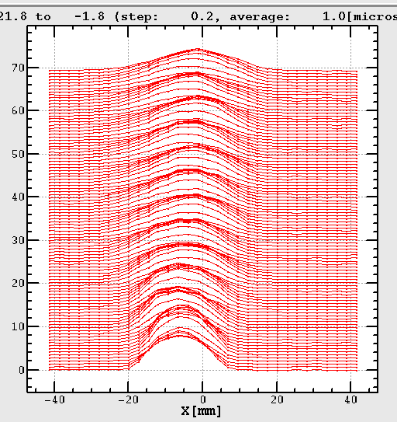
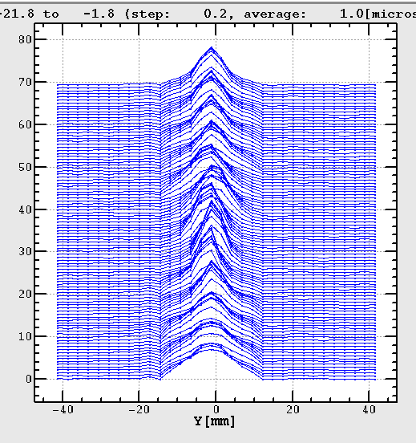
Injection error correction
Horizontal
Vertical
Injection
beam
Mismatch
Emittance
growth
Closed orbit
Injection bump
Injection errors causes beam emittance growth
beyond the painting emittance.
Injection orbit matching to the closed orbit was
done well by using IPM.

Slide 9
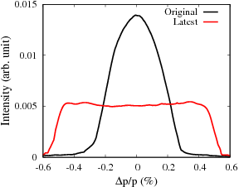
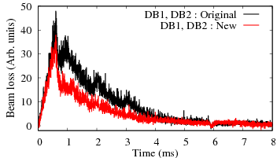
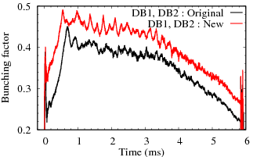
Application of wider injection energy spread
An extremely wider and uniform energy spread of the injection beam is used obtained
by huge change of amplitudes of last 2 RF cavities of the Linac called Debunchers.
We inject the beam at the bucket center instead of an offset injection.
Bunching factor is significantly improved.
The SC effect is reduced, and beam becomes more
stable in the longitudinal plane giving a significant
beam loss mitigation.
Bunching factor

Slide 10
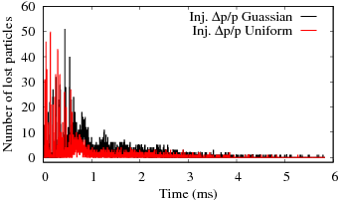
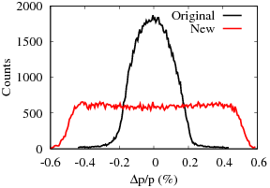
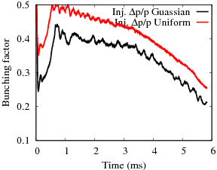
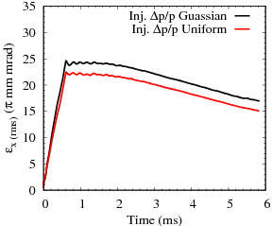
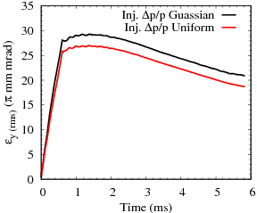
Numerical simulation using higher inj. energy spread
Measured data was incorporated
in the simulation
Bunching factor
Similar to the measurement, an application of higher
energy spread of the injection beam gives a significant
improvement of bunching factor.
The SC effect is reduced keeping a lower beam emittance.
The SC induced beam losses (except foil scattering ones)
are well mitigated.
Horizontal
Vertical
Unnormalized rms emittance

Slide 11
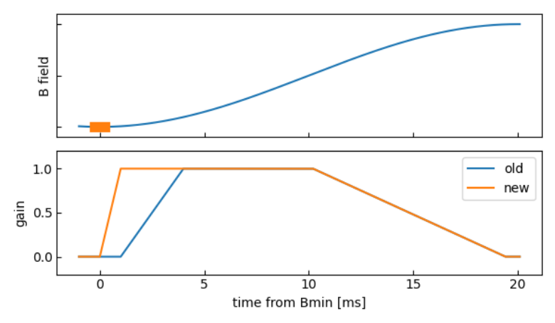
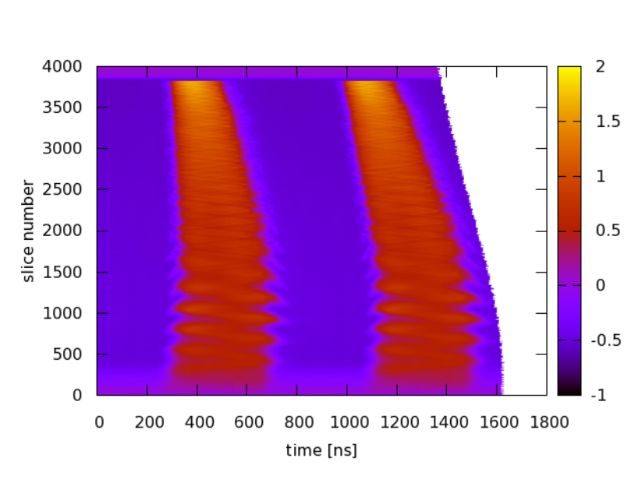
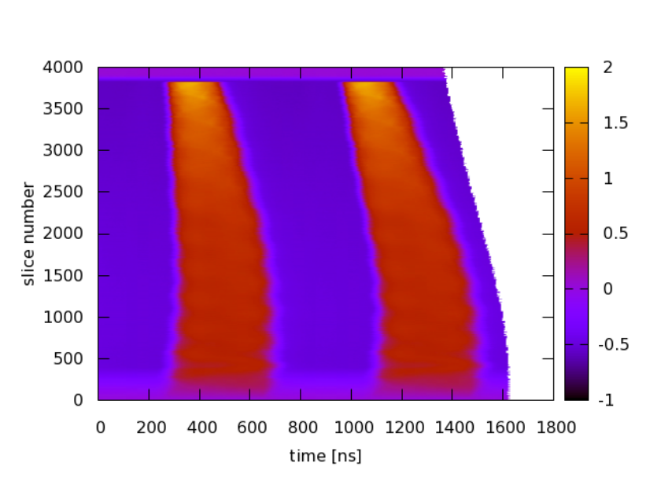
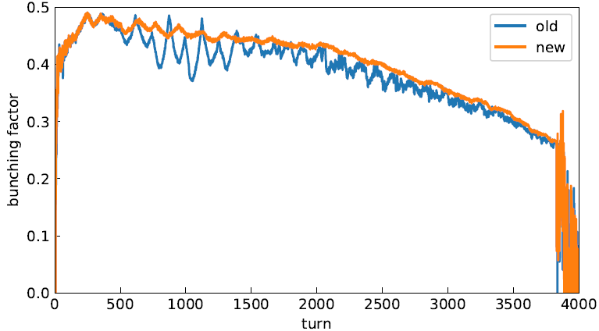
Optimization of the RF phase feedback pattern
B_{min}
RF PFB gain to max is done much faster to 1 ms from that of 4 ms so far.
Dipole oscillation is significantly suppressed.
Bunching factor is substantially improved.
Beam is well stabilized!
Bunching factor

Slide 12
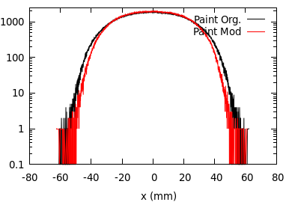
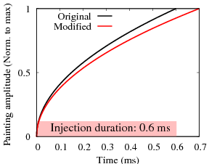


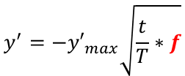
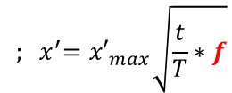
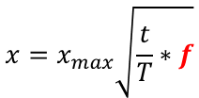
Optimization of Transverse painting: Simulation
We manipulate painting functions to produce as much as uniform beam
distributions for reducing the SC effect and keeping beam emittance smaller.
Horizontal beam profile
$$x=x_{max}\sqrt{\frac{t}{T}∗f}$$
$${ ; x}^{′}={x′}_{max}\sqrt{\frac{t}{T}∗f}$$
$$y^{′}={−y′}_{max}\sqrt{\frac{t}{T}∗f}$$
y$=0 ;$
Correlated painting
Max
Vertical beam profile
End of
painting
Vertical action
The unpainted area is
filled by the SC effect.
Simulated beam profiles at the end of injection
Beam distribution is improved reducing beam
halos and the corresponding beam loss.
0
0 Horizontal action Max

Slide 13
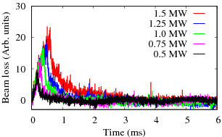
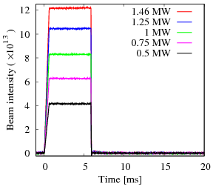
Results of beam loss mitigation in 2025
Injection
(0.4 GeV)
Extraction
(0.8 GeV)
3 GeV
Peak Current: 62 mA
& Injection pulse length
ー 0.2 ms (0.5 MW-eq.)
ー 0.3 ms
ー 0.4 ms
ー 0.5 ms
ー 0.6 ms (1.5 MW-eq.)
No beam intensity loss can be seen up to the
highest beam intensity of 1.5 MW.
Beam loss occurs only at lower energy and is just
proportional to the beam intensity (inj. Pulse length) corresponding to foil scattering of the circulating beam.
Circulating beam current measured
by the DCCT.

Slide 14
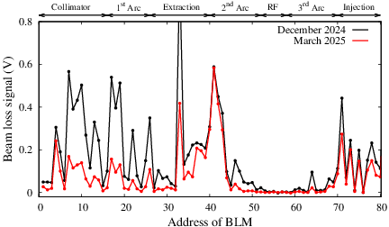
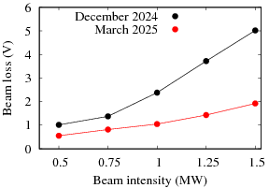
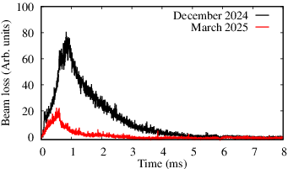
Estimation of the beam loss at 1.5 MW
Integrated beam loss at the collimator to 1st arc.
ID #35~45
From beam dump
50 mA 1 MW opr.
60%
reduced
Beam loss throughout the RCS integrated over inj. to exr.
Beam loss is significantly reduced in latest beam test.
Beam loss at 1.5 MW is <0.1%.
Corresponding beam loss power: < 0.1 kW !
<< Collimator capacity of 4 kW!
→ Beam loss is almost same as 1 MW opr. at present with 50 mA peak.
Residual radiation in the RCS at 1.5 MW operation can be
kept sufficiently lower level as the current 1 MW operation.
Extraction
Temporal structure of the beam loss at
the collimator.

Slide 15
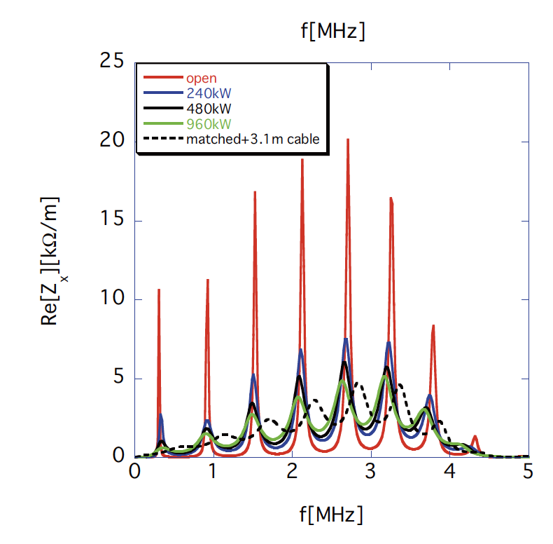
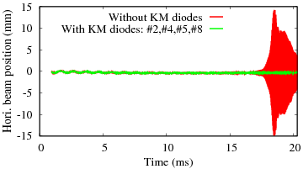
Beam instability at 1.5 MW
Transverse impedance of the extraction kicker magnets is the significant beam instability
source in the RCS. The beam instability occurs at higher beam energy.
Recently, we have installed impedance damper to 4 KMs out of 8 in total (Y. Shobuda et al., PRAB 26, 053501 (2023)).
The impedance is successfully reduced by half.
However, due to beam is accelerate up to 0.8 GeV (not to 3 GeV) for 1.5 MW, we can’t check yet the instability.
As a result, we checked the beam instability in the simulation.
The simulation can simulate realistic beam instability in the RCS (P.K. Saha et al., PRAB 23, 024203 (2018)).
We simulate 1.5 MW beam power with the given reduced impedance of the KMs.
We believe no beam instability occurs at 1.5 MW as with the present reduced impedance to half.
Kicker impedance (Y. Shobuda)

Slide 16
Summary and outlook
・In addition to the optimization applied for beam loss mitigation at 1 MW, we have further
tuned all possible sources of beam emittance growth by optimizing many parameters of the
Injection beam as well as in the RCS.
・Injection twiss was optimized and an extremely wider and uniform energy spread was applied.
・In the RCS, optimized betatron tune, injection error corrected perfectly and as well as
fine optimization of the RF phase FB was done.
・As a result, the beam loss at 1.5 MW has been well minimized in the latest beam test in 2025.
・The residual beam loss at 1.5 MW is estimated to be as low as < 0.1% and is mostly caused by
foil scattering of the circulating beam.
・The beam loss power is ~0.1 kW, which is kept far less than the collimator capacity of 4 kW.
・Similar to present 1 MW operation, the machine activation at 1.5 MW can be thus
kept to a lower level as to realize a sustainable operation.
・In the simulation, we have confirmed that no beam instability occurs as the kicker impedance
is reduced to half.
Next, we will try to use a further smaller size foil to reduced the foil scattering beam loss.
We are studying to correct nx = 6.5 and nx + ny = 13 for further tunability beyond 1 MW (K. Kojima).

Slide 17
Backups

Slide 18
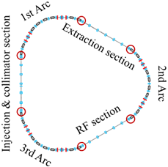
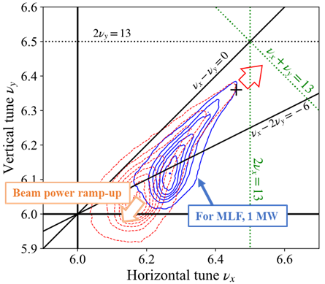
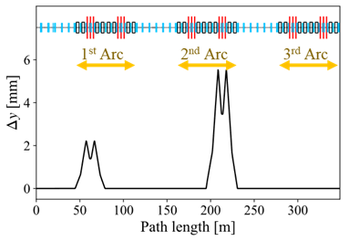
Study of ν_{x} = 6.5 & ν_{x}+ ν_{y} = 13 resonance corrections
K. Kojima, H. Harada
□ Bending
□ Sextupole
□ Quadrupole
The space charge effect pushes the tune spread toward the lower tune side.
The operating point should be shift to avoid the overlapping of structure resonance.
We are studying to correct ν_{x} = 6.5 and ν_{x}+ ν_{y} = 13 resonances to enhance the tunability.
ν_{x} = 6.5 can be corrected by the using trim quadrupoles (ATAC 2025)
ν_{x}+ ν_{y} = 13 correction → Tested for a low intensity beam:
(5 kW-eq. with Hori. & Vert. large amplitudes)
Trim quadrupole
Small orbit distortion
Sextupole field
Skew
quadrupole
Beam survival at (6.55, 6.45)
ν_{x}+ ν_{y} = 13 is
well corrected.

Slide 19
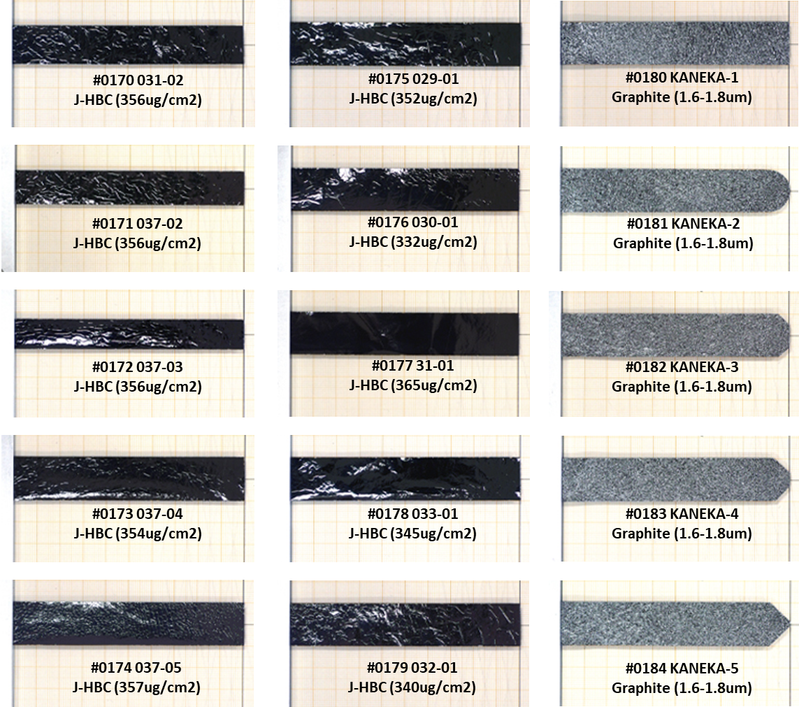
Possibility of further reducing vertical foil size
Inj. β_{y} = 8 m
Inj. beam
Inj. β_{y} = 2.2 m
Inj. β_{y} = < 2 m
20 mm
14 mm
12 mm
Since 2022
Test run from Feb. 18, 2026
Current Carbon foil in service has a satisfactory longer lifetime at high-intensity operation.
Ideally, almost no missing foil H- exists for the current vertical foil size of 14 mm.
Foil degradation becomes prominent when supporting fibers are broken.
We have a scope to reduce vertical size from 14 to 12 mm without any significant
increase of the missing H- component.
Foil scattering uncontrolled beam loss can be further 10% reduce.

Slide 20
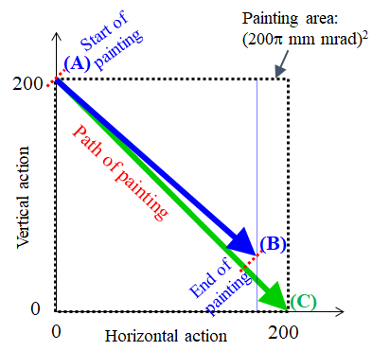
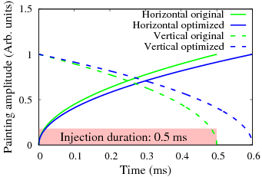
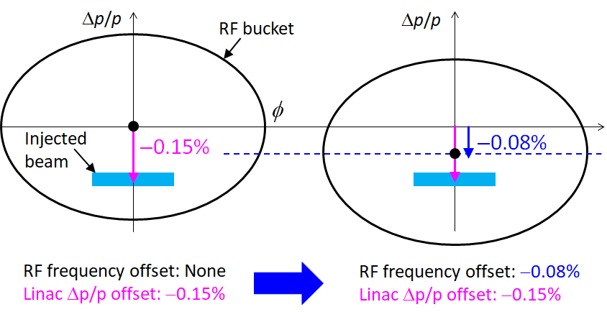
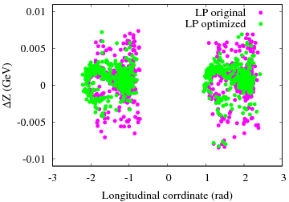
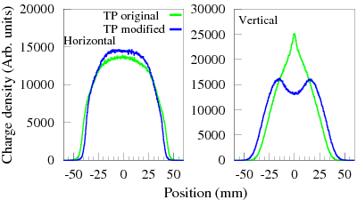
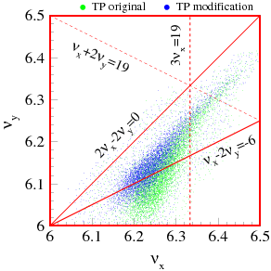
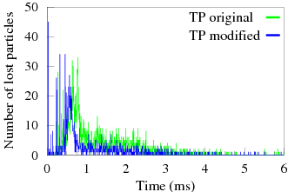




LP and TP optimization schemes at 1 MW
LP optimization:
TP optimization:
$$x=x_{max}\sqrt{\frac{t}{T}∗f}$$
$${; x}^{′}={x′}_{max}\sqrt{\frac{t}{T}∗f}$$
Emittance exchange
$$y^{′}={−y′}_{max}\sqrt{1−\frac{t}{T}∗f}$$
y$=0 ;$
AC→AB
Slow variation of painting
The unpainted area is filled by the SC effect
and emittance exchange
Simulation
Simulation
Time structure of
the beam loss
Beam loss occurred due to large Δp/p.
Reduced by LP optimization
・High spatial charge concentration. ・Asymmetric tune distribution.
→ More particles trapping on the resonance → Additional beam loss.
Well optimized by TP modification.

