Slide 1
Environmental neutron measurement and development of analysis techniques using nuclear emulsion detector
T. Shiraishi - Kanagawa Univ.
23 Feb. 2026 CYGNUS2026 @Kobe

Slide 2
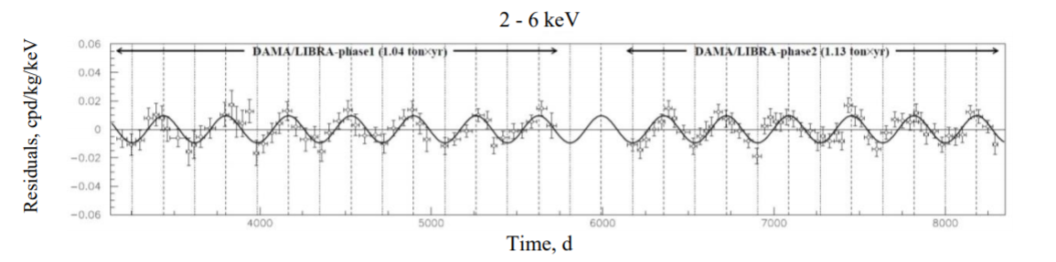
Motivation of Environmental Neutron Measurement
Background Study
Nuclear recoil by Neutron
→ background in direct WIMPs search
γ, p, α emission via nuclear reactions （e.g. ^{A}N + n → ^{A+1}N + γ）
→ background in rare event searches
Demonstration of low mass dark matter search (e.g. Boosted Dark Matter)
R. Bernabei et al., Nucl. Phys. At. Energy 19, 307 (2018)
DAMA/LIBRA signal : 2 – 6 keVee
n
> 22 years annual modulation
N
→ Assuming this signal as Na recoil by neutron, its energy corresponding to 80 – 250 keV
Neutron measurement over a wide energy range is necessary
(especially sub-MeV)

Slide 3
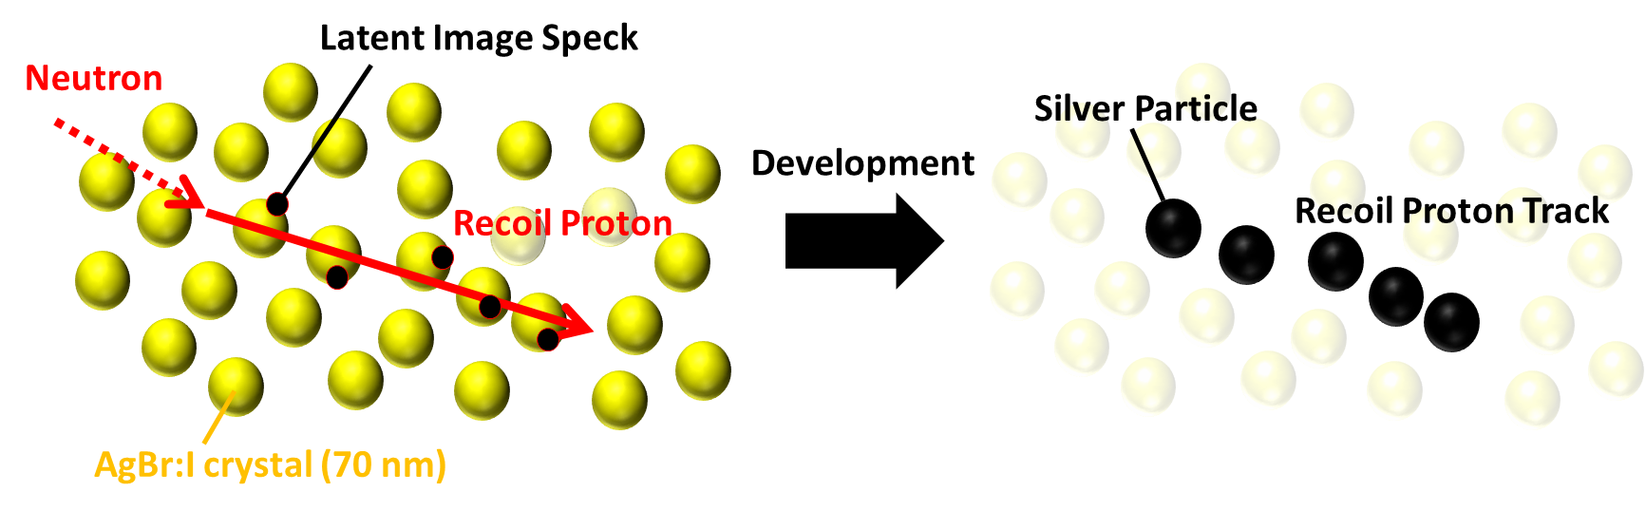
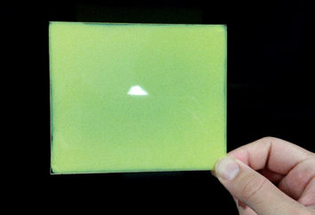
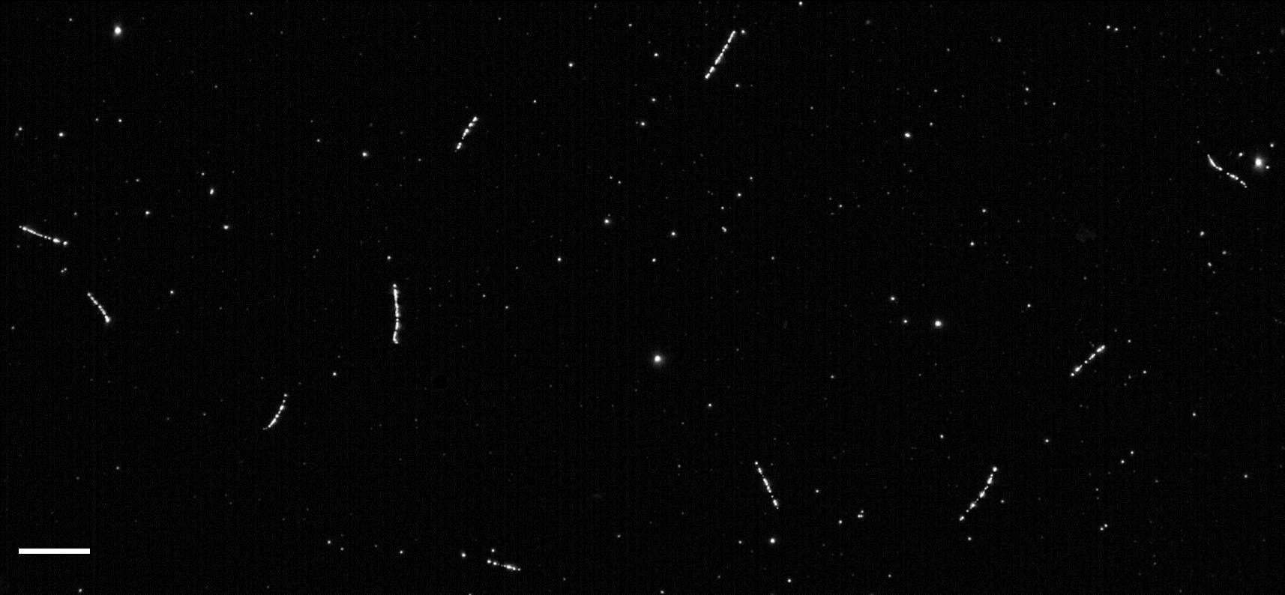

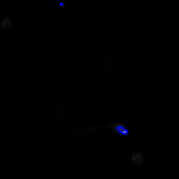
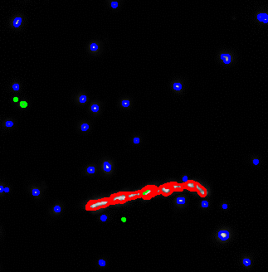
Neutron Detection Principle by Nano Imaging Tracker (NIT)
NIT film
H atomic fraction ~ 40%
Optical Microscope Image
880 keV Neutron
10 μm
5 μm
Sub-micrometric
3D tracking
Proton range
Neutron
θ
Ep ~ 600 keV
10 μm
T. Shiraishi, et al., PTEP 2021 4, 043H01 (2021)

Slide 4
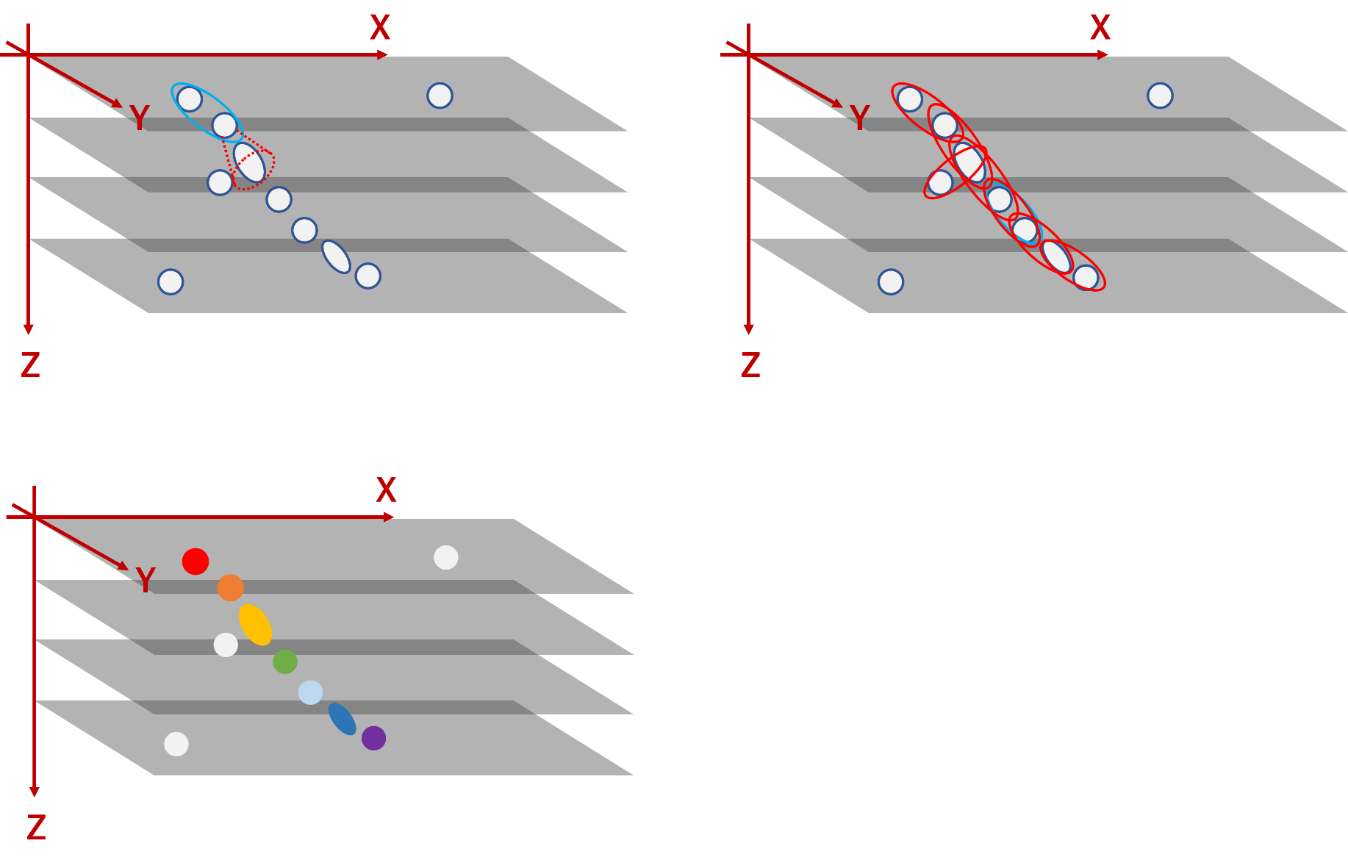
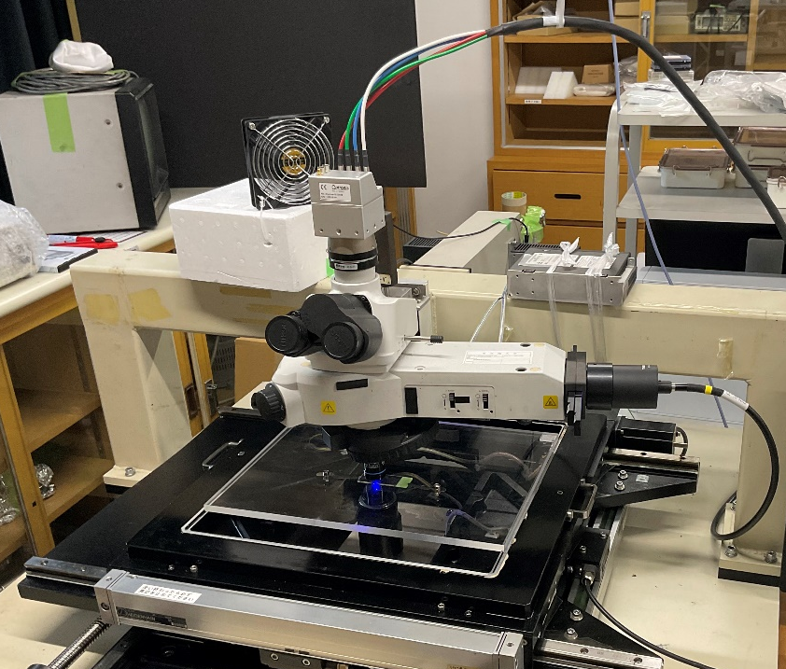
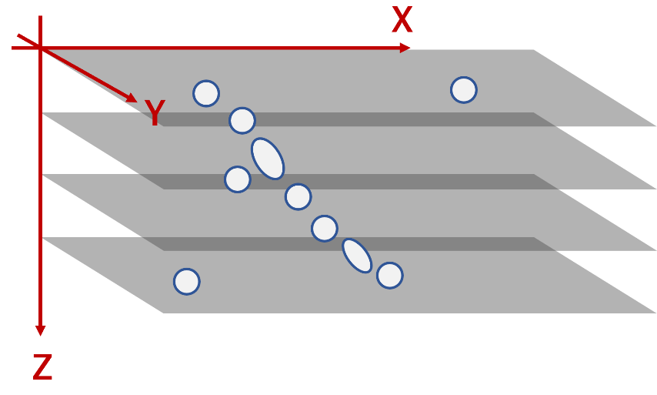
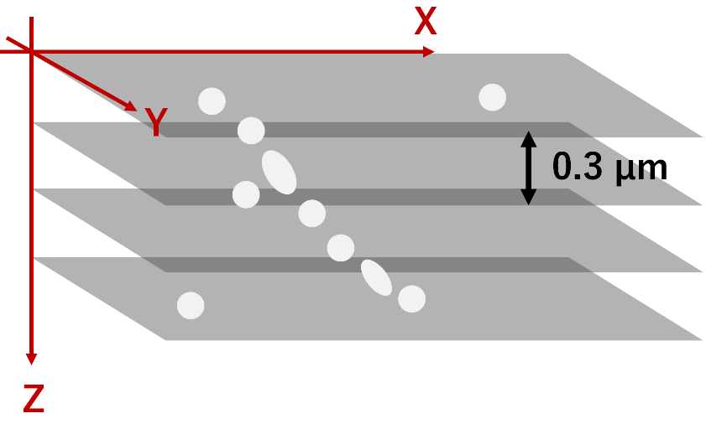
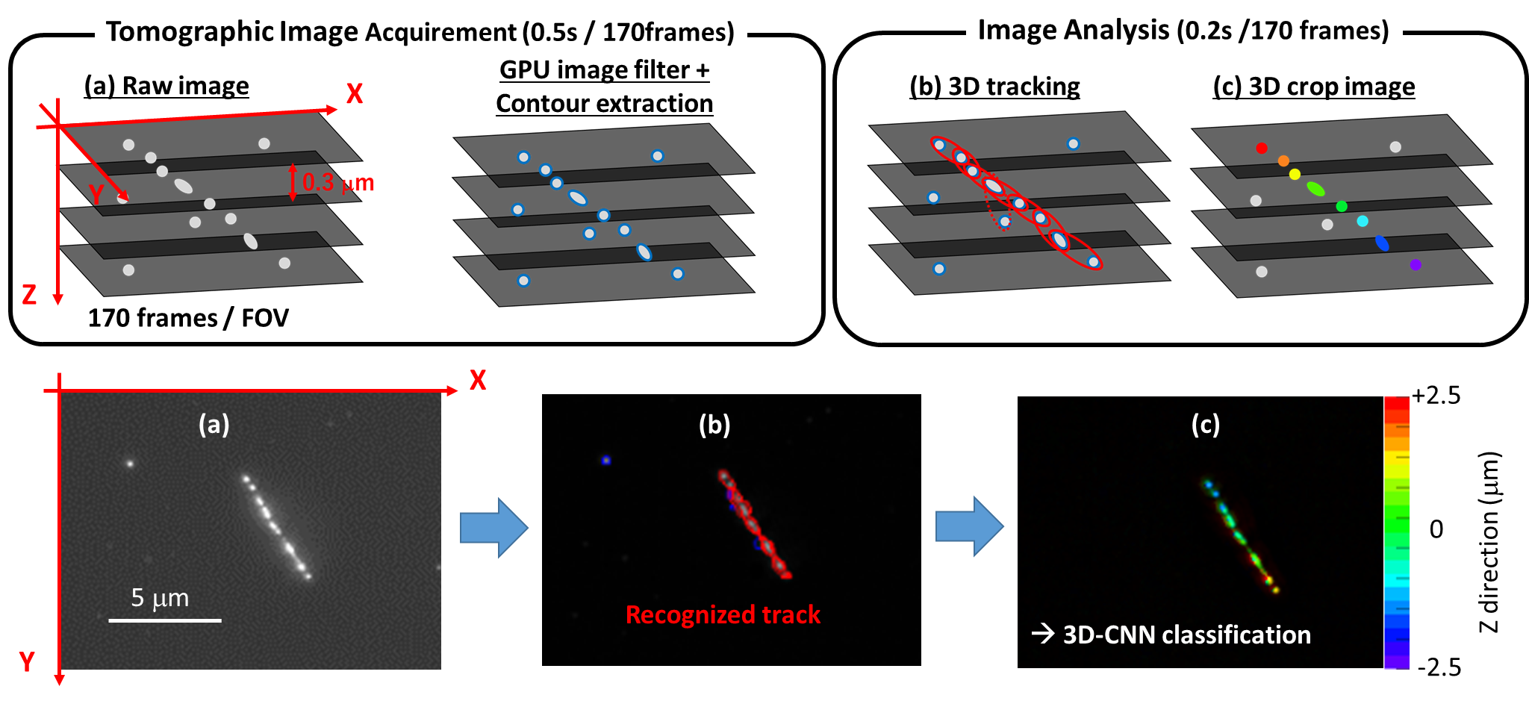
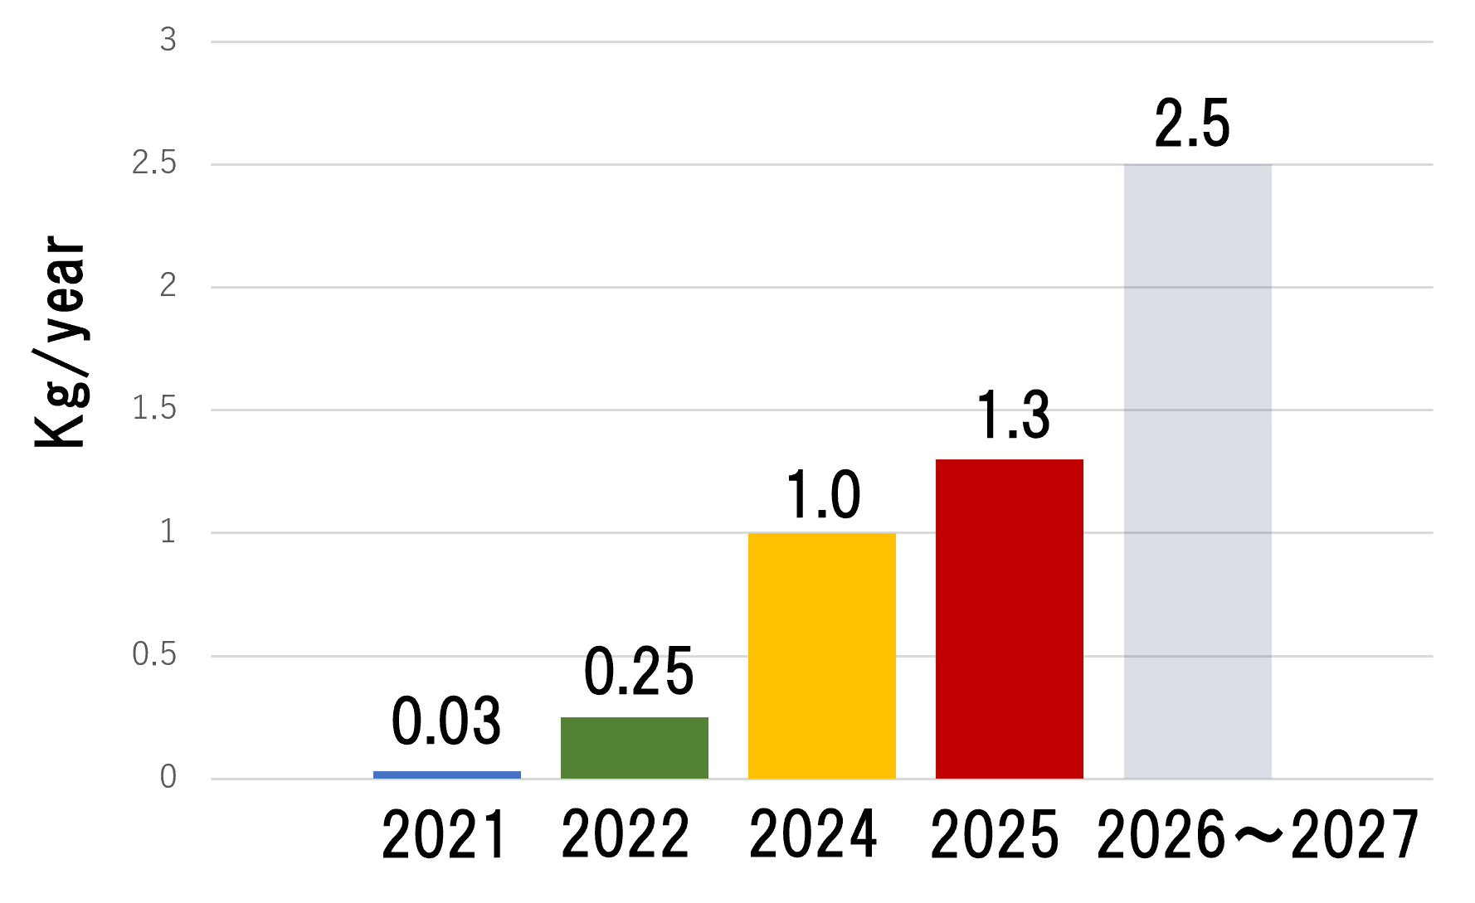
High-resolution Readout and 3-dimensional Tracking
Latest Analysis System (Kanagawa Univ.)
50 Gbps Image Acquiring
3D Tracking
5 Mpixels & 700 fps
(50 Gbps)
High-speed Camera
Z-drive
Epi-illumination microscope
Light guide
Objective lens
XY-drive
Improve analysis speed
T. Shiraishi, et al., Phys. Rev. C 107, 014608 (2023)
Achieve high speed (1.3 kg/year) while maintaining high resolution

Slide 5
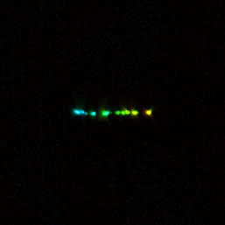
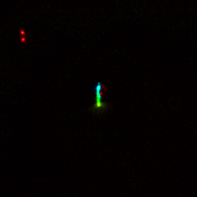
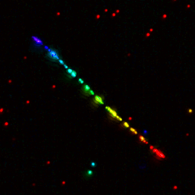
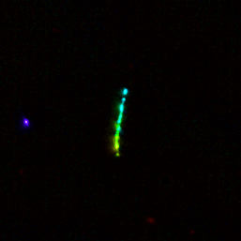
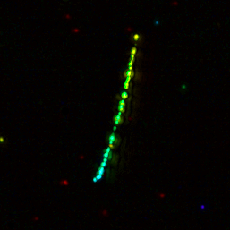

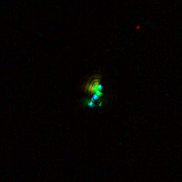
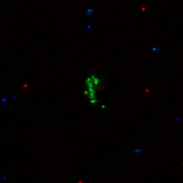
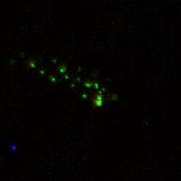
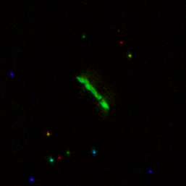
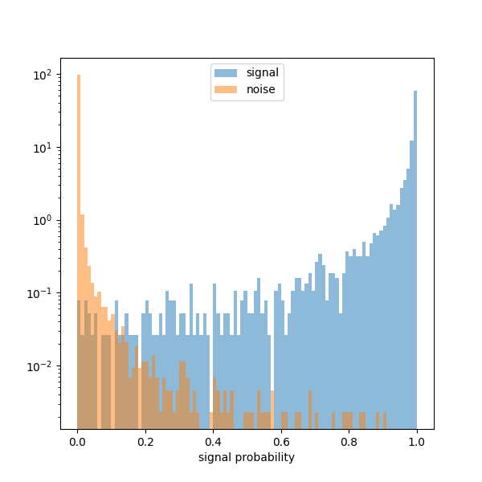
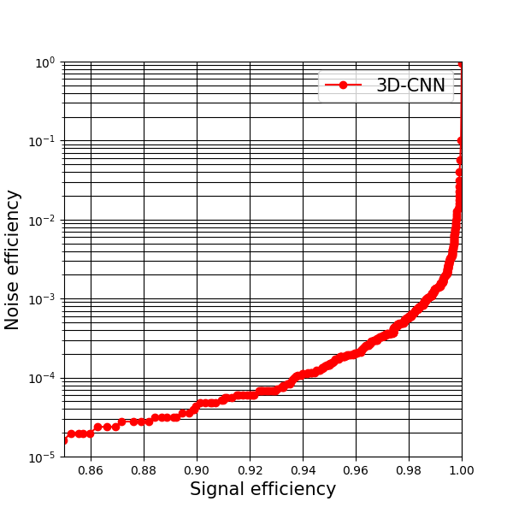
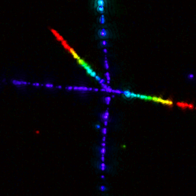
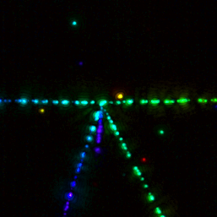
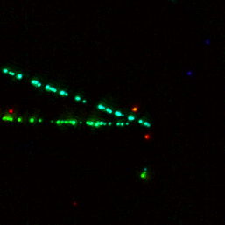
3D Convolutional Neural Network （3D-CNN）
Training Samples
Proton or alpha
1024
layers
256
layers
feature maps1
64 x 64 x 128
feature maps2
32 x 32 x 256
feature maps3
16 x 16 x 512
feature maps4
8 x 8 x 256
input image size
128 x 128 x 20
proton
dust
multi
Flattened
・・・
・・・
Dropout
0.2
Convolution &
Max-Pooling
Dropout
0.5
Dust
Convolution &
Max-Pooling
Convolution &
Max-Pooling
Convolution &
Max-Pooling
Noise
Signal
Reduce the noise by a factor of 10⁴ with 95% efficiency
Multi-prong

Slide 6
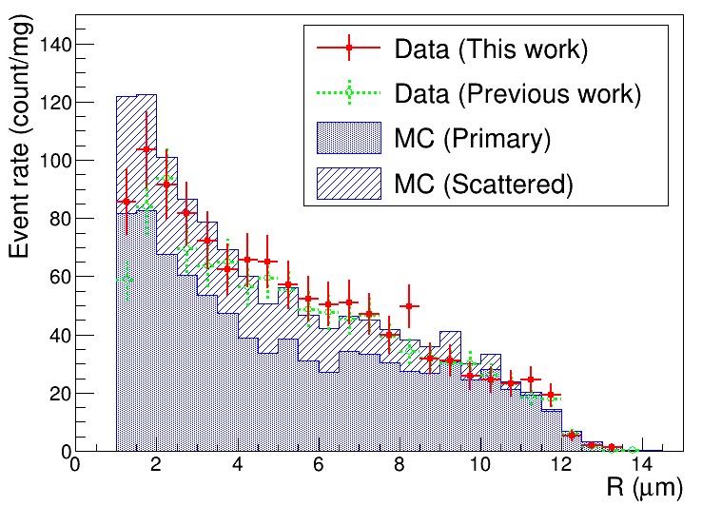
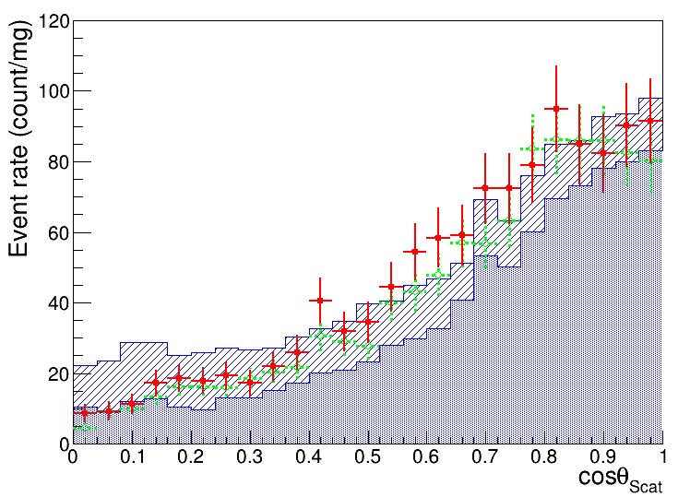
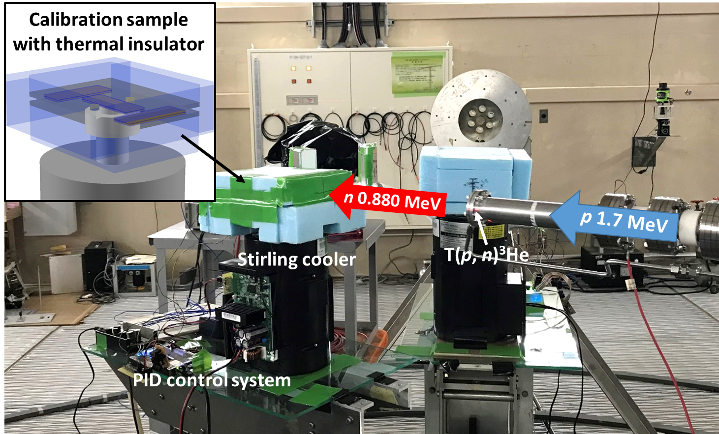
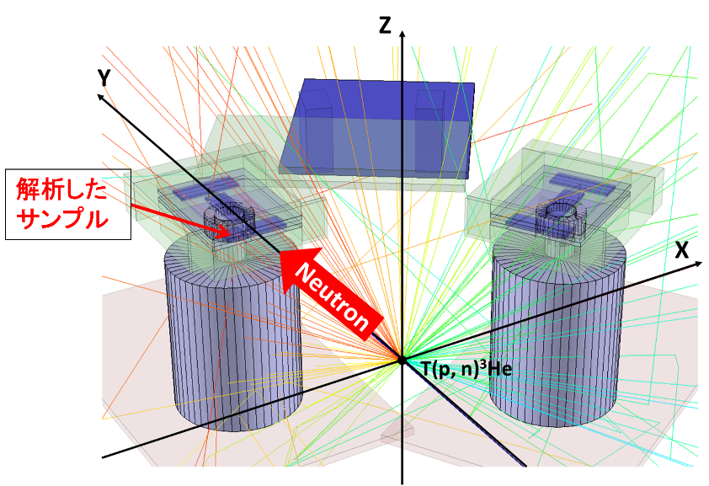
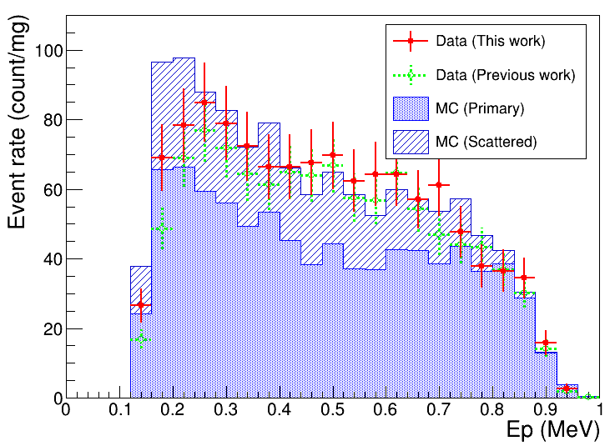
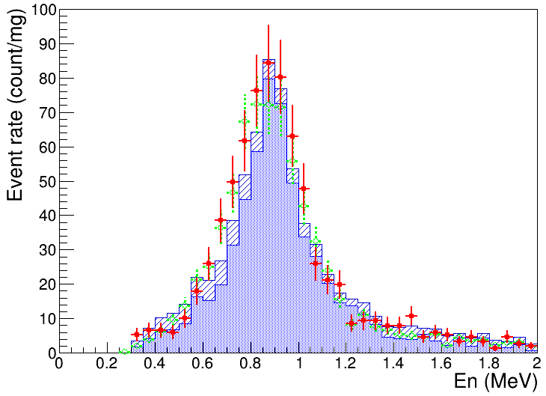

Evaluation using Monochromatic Fast Neutron Beam
Monochromatic 0.88 MeV neutron via T(p n)³He reaction @ AIST
Track Range
Scattering Angle
2025
2022
Geant4 simulation
Proton Energy
Reconstructed Neutron Energy
Beam Energy
(0.88±0.02) MeV
$$E_{n}=\frac{E_{p}}{\cos^{2}{θ}}$$

Slide 7
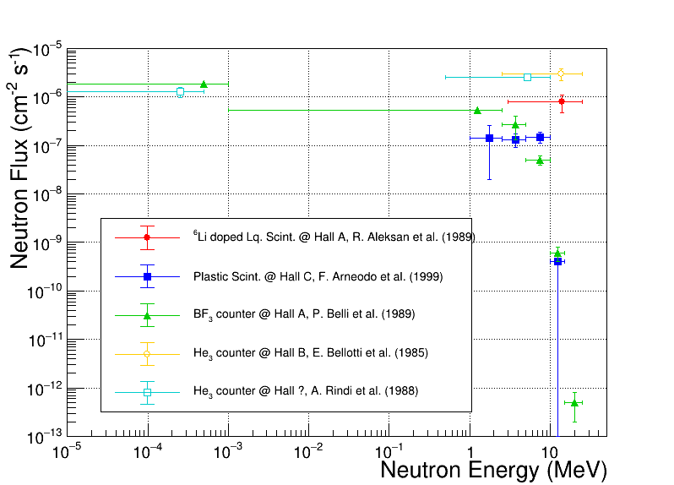
Environmental Neutron Measurement @LNGS
No spectrum and directional data in sub-MeV
Almost of measurements used moderators and thermal neutron captures.
No energy resolution
→ Uncertainty of moderations
Unknown angular distribution.
Neutron flux is different for each measurements.
→ Annual modulation of water content in the rock, or Location affects it?
H. Wulandari et al., Astropart. Phys. 22 (2004) 313.

Slide 8
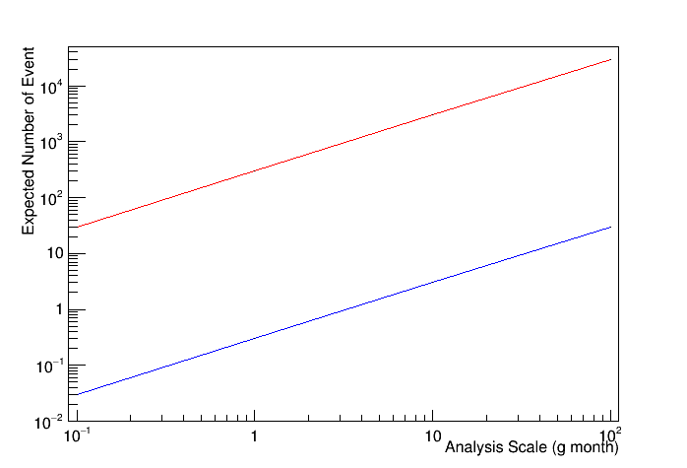
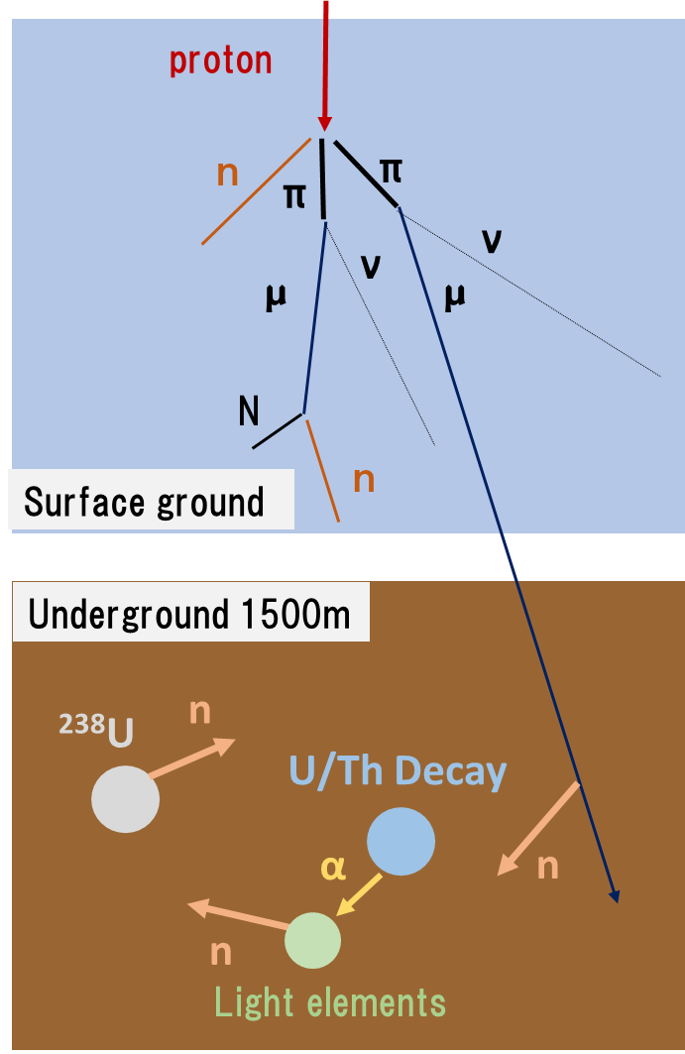
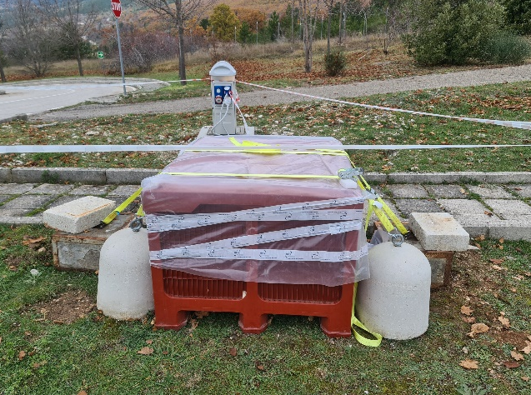
Environmental Neutron Measurement by NIT @ LNGS
n-Run2
(May 2022)
n-Run1
(Nov. 2021)
Surface ground
n-Run4
(Nov. 2023 )
*Radon reduction
n-Run3
(Jan. 2023)
Underground
Refrigerator Box
12cm
Sample2
Thermal
Insulator
10cm
Compressor
Without shielding!
because of no sensitivity to muon and gamma
Sample1
8

Slide 9
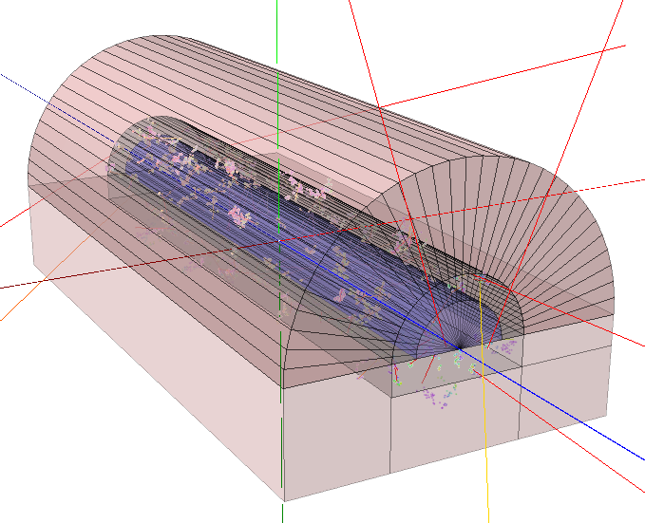
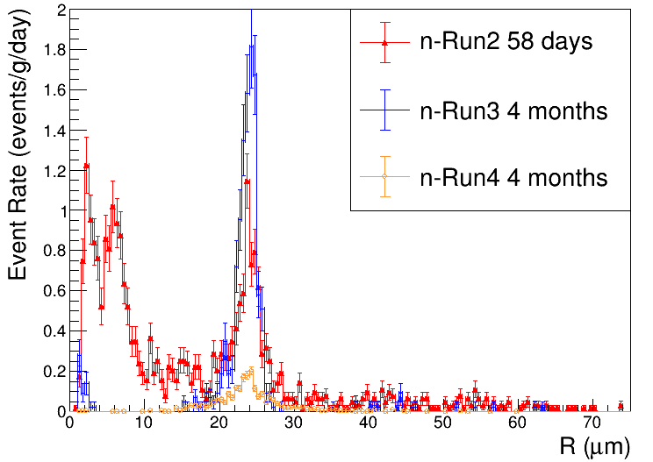
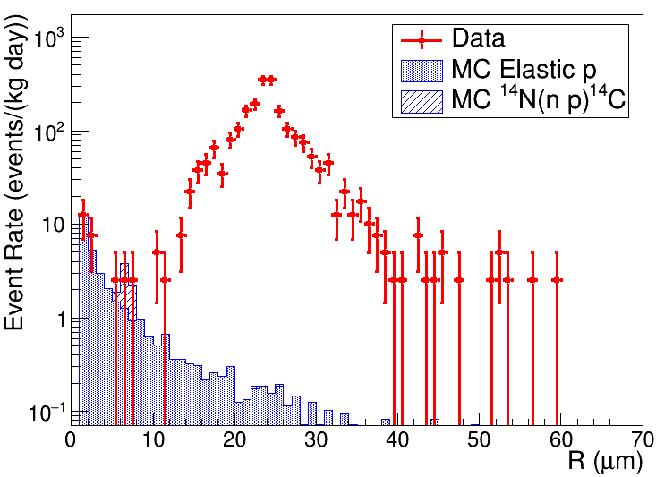
Results of Neutron Measurement
MC Simulation using NeuCBOT, PHITS, and GEANT4
sub-MeV
²¹⁰Po
Surface ground
(α n) reaction in the rock by ²³⁸U, ²³²Th
Spontaneous fission of ²³⁸U
* Assuming the water content in the concrete is 8%
Thermal n
¹⁴N(n p) ¹⁴C
H. Wulandari et al., Astropart. Phys., 22, 313-322 (2004)
Result of n-Run4 0.52 kg*day
Underground
²³⁴U, ²³⁰Th, ²²⁶Ra
²¹⁰Po
(n-Run4)
²³⁸U
sub-MeV
Preliminary
In sub-MeV region, both surface ground and underground measurements are consistent with predictions
Radon reduction is needed for MeV region

Slide 10
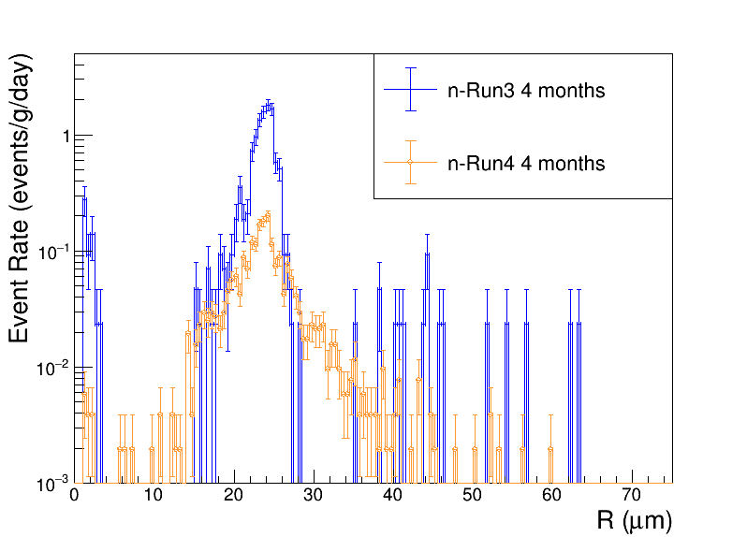
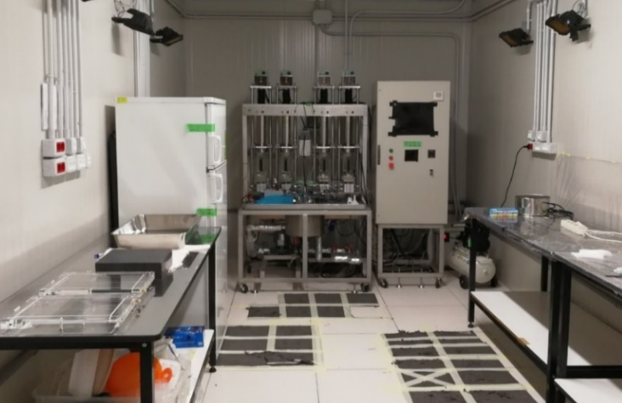
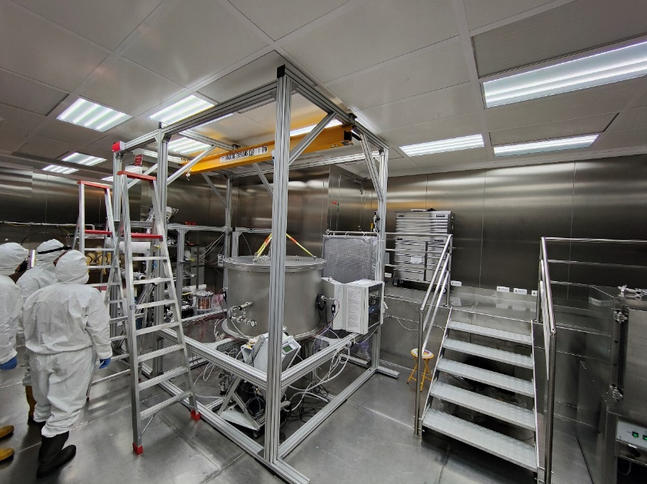
Effects of Radon Reduction in Air
²¹⁰Po
NEWSdm facility (@ Hall-F)
²³⁴U, ²³⁰Th, ²²⁶Ra
Rn Level ~ 100 Bq/m³
²³⁸U
n-Run3
²¹⁴Po
sub-MeV
Radon free room (CR1 @ Hall-C)
Rn Level ~ a few Bq/m³
n-Run4
α-ray background has decreased, however the energy resolution is worse than in the previous run (n-Run3)
→ Damage to the sample due to rapid drying at low humidity in CR1?
→ Further radon reduction and humidification are needed

Slide 11
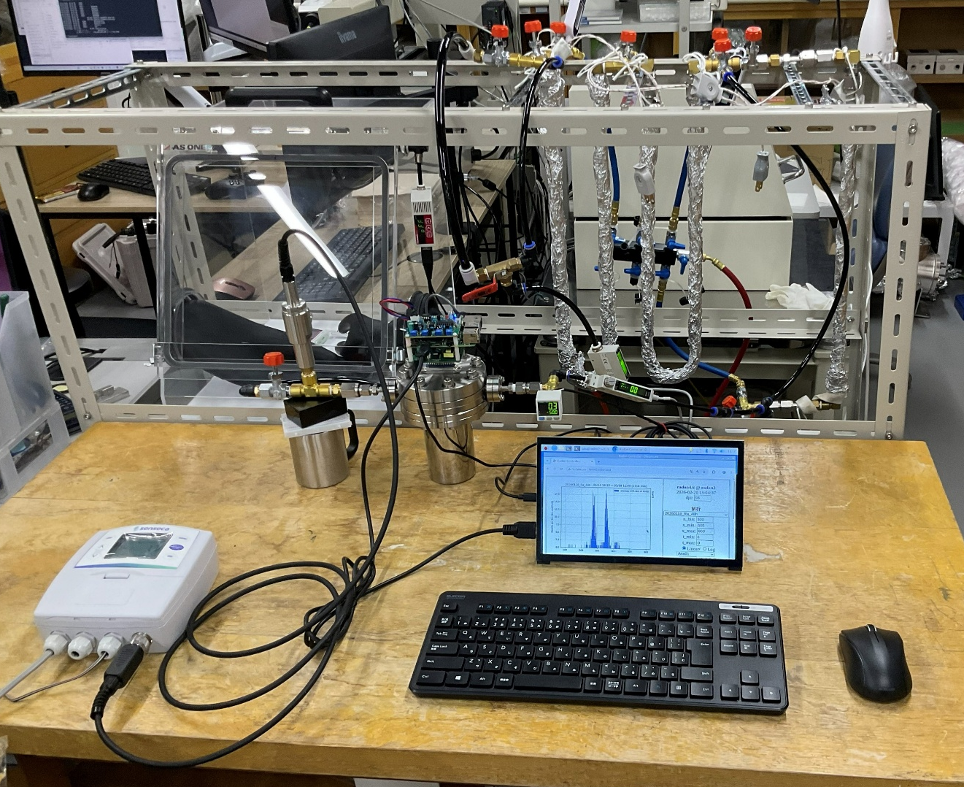
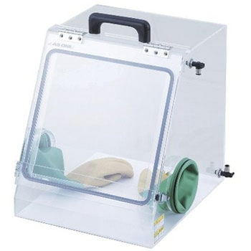

Radon Filtering System
*provided from Dr. Ogawa
4A type zeolite
(for water trap)
Ag-zeolite*
(for Radon trap)
Circulation
Gas circulation compressor
Radon Detector
−HV
α
PIN-PD
α
Globe box
²¹⁸Po⁺
²²²Rn
Humidification
+
NIT film preparation
MFC
GND
Now trying to reduce Rn in air…

Slide 12
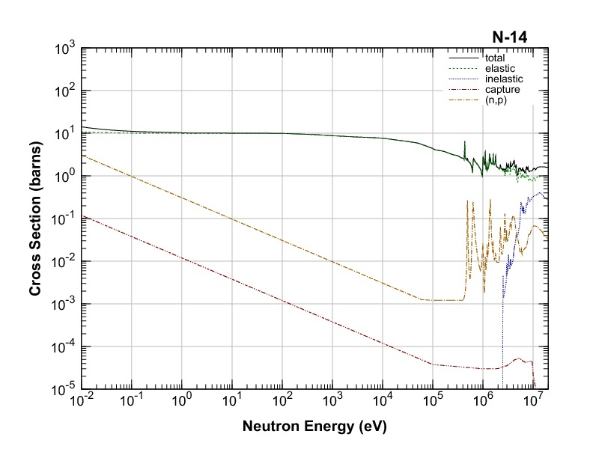
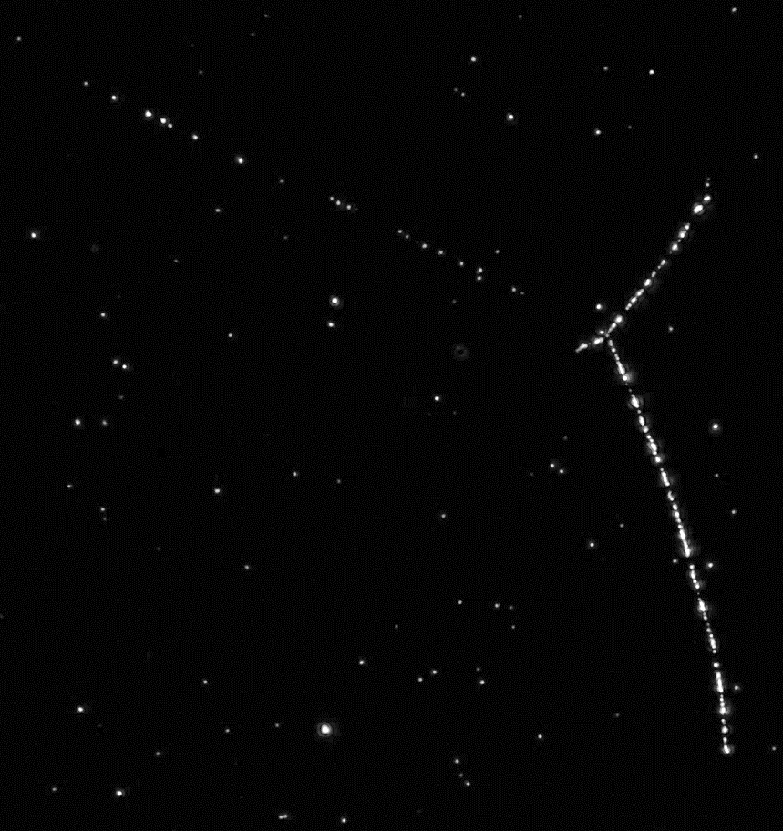
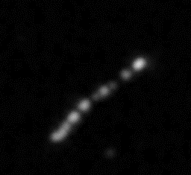
Neutron Detection Methods for Various Energies
Neutron Energy
meV (thermal neutron)
100 keV (~ 1 µm)
Sub-GeV −
Nuclear Reaction
Proton Elastic Scattering
Deep Inelastic Scattering
n + ¹⁴N → p + ¹⁴C + 0.62 MeV
0.88 MeV neutron
3 fragments
0.58 MeVproton
(Monochromatic)
σ_{N(n p)C} ~ 2 barn
@ 26meV
Recoil proton
θ
Nuclear recoil
6.5 µm
JENDL-4.0
10 µm
70 µm
N atomic fraction ~ 3.7% in NIT
Reconstruct 3D trajectory with sub-micron accuracy
→ can obtain position, energy and direction

Slide 13
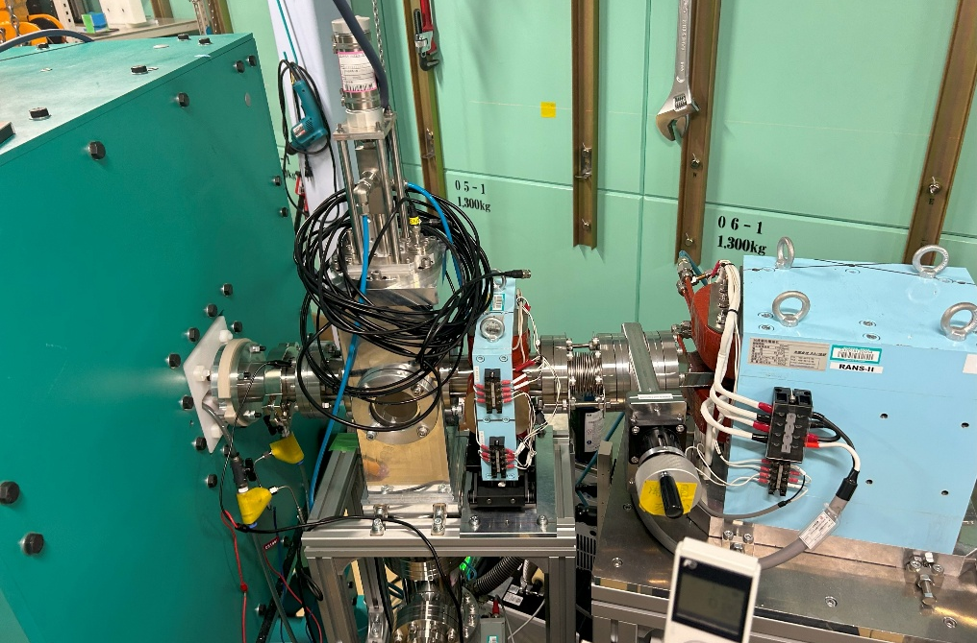
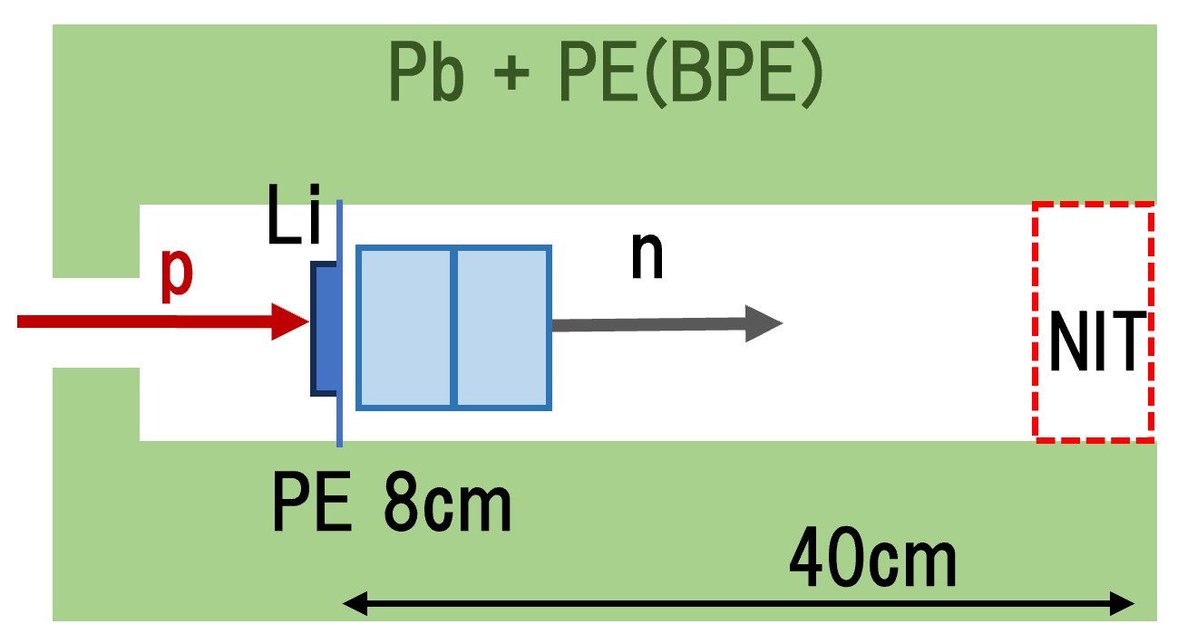
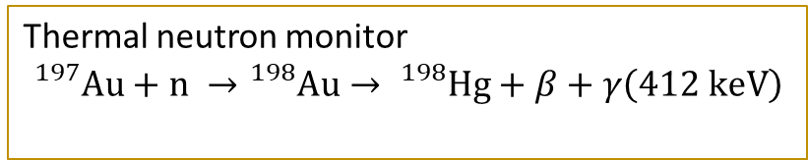

Demonstration of Thermal Neutron Detection
Thermal neutron monitor
$${}_{}^{197}{Au+n →{}_{}^{198}{Au}→ {}_{}^{198}{Hg}}+β+γ\left(412 keV\right)$$
Neutron source: RANS-Ⅱ beamline @ RIKEN
Measured by Ge detector
proton 2.49 MeV
Li
Gold foil
$$\text{7}\text{Li}\text{(}\text{p} \text{n}\text{)7}\text{Be}$$
PE moderators
⁷Li(p n)⁷Be
*Neutron energy is broad spectrum due to 100 µm thick of Li target
Proton signal created by
thermal neutrons via ¹⁴N(n p)¹⁴C
fast neutrons (elastic collision)

Slide 14


Confirmation of Thermal Neutron Signal
Neutron spectra expected by Geant4 simulation
Data (proton energy spectra)
w/o moderator
Thermal neutron signal
w/o moderator
Thermal neutron
Red (8cmPE) ×10 scale
Blue (14cmPE) ×100 scale
Fast neutron
Fast neutron
Confirmed the characteristic 0.584 MeV peak from the ¹⁴N(n p)¹⁴C reaction is enhanced by moderators

Slide 15



Data/MC Comparison of Thermal Neutron Signal
w/o moderator
PE 8cm
PE 14cm
Thermal neutron signal
Confirmed the expected sensitivity to thermal neutrons
→ Sensitive over a wide energy range

Slide 16




Luminescence and Track Formation in AgBr:I Crystal
NIT film
60keV C ion
Silver filament
0.5 µm
Microscope
Track formation
20 nm UNIT type
Luminescence
via Iodide
NIT type
Light yield ~ 40 photon/keV
@ 88K (²⁴¹Am γ-ray)
200 nm OPERA type
T. Shiraishi et al., Nucl. Inst. Meth. A 927 (2019) 202

Slide 17
Luminescence and Track Formation in AgBr:I Crystal
NIT film
60keV C ion
Silver filament
0.5 µm
Microscope
Track formation
sub-micron
track
Get BOTH responses
20 nm UNIT type
Luminescence
via Iodide
High-efficient
luminescence
NIT type
Light yield ~ 40 photon/keV
@ 88K (²⁴¹Am γ-ray)
200 nm OPERA type
T. Shiraishi et al., Nucl. Inst. Meth. A 927 (2019) 202

Slide 18

Luminescence and Track Formation in AgBr:I Crystal
NIT film
60keV C ion
Silver filament
0.5 µm
Microscope
Track formation
sub-micron
track
Get BOTH responses
20 nm UNIT type
Luminescence
via Iodide
High-efficient
luminescence
NIT type
Light yield ~ 40 photon/keV
@ 88K (²⁴¹Am γ-ray)
200 nm OPERA type
T. Shiraishi et al., Nucl. Inst. Meth. A 927 (2019) 202

Slide 19



Luminescence α – β Comparison @105K
Fast (540nm)
Averaged Waveforms
50 < total p.e. < 200
Slow (560nm)
²⁴¹Am 70 Bq
⁶⁰Co 30 Bq
T. Shiraishi et al., Nucl. Inst. Meth. A 927 (2019) 202
T. Shiraishi, Doctor Thesis (2019), Nagoya Univ.

Slide 20


Temperature dependency
Slow component drastically quenched by arising temperature
Fast component is comparable even at RT.

Slide 21

Luminescence Study with Ion Implantation System at Cryogenic Temperature
Now, upgrade and measurement on going

Slide 22
Summary
→ T. Shiraishi et al., PTEP 2021 4, 043H01 (2021)
3D sub-micrometric tracking technique has been developed for NIT analysis
Achieved analysis speed of 1.3 kg/year/machine with 1 µm (→ p 100keV) threshold
Neutron run in Gran Sasso
Surface ground run (n-Run1, nRun2)
Succeeded to measure neutron spectrum and direction in sub-MeV region
Thermal neutron signal was indicated
Confirmed using RANS-Ⅱ beamline @ RIKEN
Underground run (n-Run3, nRun4)
Environmental neutron signal in sub-MeV region has been observed with 0.52 kg*day scale analysis
More scaling up is available, but Radon background contamination also observed in MeV region with current scale
→ Constructing Radon filtering system using Ag-zeolite
Luminescence of NIT
Luminescence characteristics are studying using Ion implantation system
→ T. Shiraishi et al., Phys. Rev. C 107, 014608 (2023)

Slide 23
Backup

Slide 24

For the Verification of DAMA Signal
DAMA claims signal around 2 – 6 keVee
Many experiments agree that quenching factor of Na is ~20%
22 years annual modulation
R. Bernabei et al., Nucl. Phys. At. Energy 19, 307 (2018)
D. Cintas et al, J. Phys.: Conf. Ser. 2156, 012065 (2021)
Assuming DAMA signal as neutron background, its energy corresponding to 80 – 250 keV
→ Neutron spectrum measurement including sub-MeV region is needed to verify the DAMA signal!

Slide 25















Establishment of Neutron Energy Reconstruction
0.88 MeV neutron
Neutron direction is “known”
Neutron direction is “unknown”
$$E_{n}′$$
10 µm
Predict original $E_{n}$ distribution from observed $E_{p}$ distribution using Unfolding Method
$$n$$
Ep = 0.31 MeV, cosθ = 0.60
→ En = 0.86 MeV
$$E_{n}$$
$$p$$
$$θ$$
Used spontaneous fission of ²⁵²Cf
$$E_{p}$$
Response function
$$E_{n}≃\frac{E_{p}}{\cos^{2}{θ}}$$
Ep = 0.59 MeV, cosθ = 0.86
→ En = 0.80 MeV
Data
Original Energy
Ep = 0.85 MeV, cosθ = 0.98
→ En = 0.89 MeV
$${g(E}_{p})=\int{R\left(E_{p} | E_{n}\right)∙f(E_{n})ⅆE_{n}}$$
Neutron Energy
Neutron energies can be reconstructed event by event
$$\frac{ΔE_{n, FWHM}}{E_{n}}≅0.31$$

Slide 26

Establishment of Neutron Energy Reconstruction
0.88 MeV neutron
Neutron direction is “known”
Neutron direction is “unknown”
$$E_{n}′$$
10 µm
Predict original $E_{n}$ distribution from observed $E_{p}$ distribution using Unfolding Method
$$n$$
Ep = 0.31 MeV, cosθ = 0.60
→ En = 0.86 MeV
$$E_{n}$$
$$p$$
$$θ$$
Used spontaneous fission of ²⁵²Cf
$$E_{p}$$
Response function
$$E_{n}≃\frac{E_{p}}{\cos^{2}{θ}}$$
Ep = 0.59 MeV, cosθ = 0.86
→ En = 0.80 MeV
Data
Original Energy
Ep = 0.85 MeV, cosθ = 0.98
→ En = 0.89 MeV
$${g(E}_{p})=\int{R\left(E_{p} | E_{n}\right)∙f(E_{n})ⅆE_{n}}$$
Neutron Energy
Neutron energies can be reconstructed event by event
$$\frac{ΔE_{n, FWHM}}{E_{n}}≅0.31$$

Slide 27
Luminescence

Slide 28




Event discrimination by using multi-signals
CDMS Experiment (Charge + Phonon)
XENON Experiment (Photon + Charge)
S. Fallows, Univ. of Minnesota Doctor Thesis, Dec 2014
XENON Collaboration, E. Aprile et al, Phys. Rev. D 97, (2018) 092007

Slide 29

Cryostat and DAQ
T. Shiraishi, et al., Nucl. Inst. Meth. A 927 (2019) 202
T. Shiraishi, Doctor Thesis (2019), Nagoya Univ.
Cryostat
²⁴¹Am 66 Bq
Two-photon coincidence method
MPPC measure intensity and decay time
PMT & Monochromator measure spectrum
Spectrum and waveform analysis with ultra-low noise at photon counting levels

Slide 30


Cryostat and DAQ
T. Shiraishi, et al., Nucl. Inst. Meth. A 927 (2019) 202
T. Shiraishi, Doctor Thesis (2019), Nagoya Univ.
Cryostat
MPPC signal at α-ray exposed
²⁴¹Am 66 Bq
Two-photon coincidence method
MPPC measure intensity and decay time
PMT & Monochromator measure spectrum
Spectrum and waveform analysis with ultra-low noise at photon counting levels
→ First observation of AgBr:I luminescence for charged particles

Slide 31



Results of AgBr:I luminescence study so far
Comparison of light yield with ²⁴¹Am γ
Spectrum
Decay Time
405nm LED
α-ray
Light yield at liquid nitrogen temperatures is comparable to NaI:Tl scintillators
These differences probably come from excitation density between alpha rays and photoexcitation
Capable of application as a scintillation detector, giving time resolution, and so on…
Possibility of particle identification from luminescence characteristics
Understanding electronic properties under high-density excitation
T. Shiraishi, et al., Nucl. Inst. Meth. A 927 (2019) 202
T. Shiraishi, Doctor Thesis (2019), Nagoya Univ.

Slide 32


Luminescence
Comparison of α – photo excitation
Current understanding
NIT
There is no doubt that iodine acts as an isoelectronic trap for holes
Slow components are tunneling recombination between shallow trapped electrons and trapped holes
Fast components are predicted as direct recombination between conduction electrons and trapped holes (high-density excited states in α-rays)
NIT
Wavelength shift is observed
Decay time is quite different
Fast/Slow ratio depends on excitation density?

Slide 33




Why can indirect transition-type AgBr luminous?
E
Excitation
Luminescence
E
Wavenumber space
Conduction band
k
Electrons
I⁻ trap
Surface defects
Ag⁺
Energy
Luminescence
(Recombination)
Ag core
Hole trap
(Iodide)
Potential for electron in GaP:N
Valence band
Holes
Bohr radius
Iodide acts as isoelectronic trap
If hole is trapped
Localized to Iodide
Hole can spread in wavenumber space because of the uncertainty principle
Hole is captured by difference in electron affinity between Br and I
Very short range potential same order of Bohr radius
→ Hole is localized very close to Iodide
Before, luminescence of emulsion was reported only by photo-excitation

Slide 34

Combined detection may be possible?
Setup Example
MPPC Array
X axis
NIT
Y axis
Locate the recorded track position in emulsion with mm accuracy
Dust and fog don’t luminescent
Identify particle property from luminescence information (intensity, life time, spectrum, …)

Slide 35



Energy deposition of low-velocity nuclear recoil
Energy deposition of low velocity nuclear recoil (β~10⁻³, ≈ fermi velocity of electrons) in solid is very complex
The nucleus becomes neutral covered with electrons, no longer a simple ionization loss
Rutherford scattering (Nuclear Stopping Power, NSP)
Lattice defect generation
Collision cascade
Molecular orbital formation (Velocity Matching)
…
Ga (15keV)
 | ESP in AgBr:I crystal (keV/μm) | NSP in AgBr:I crystal (keV/μm)
30keV C＋ | 240 | 130
10keV β線 | 6.5 | 0
1MeV β線 | 0.5 | 0
Lattice defect of potassium iodide
Proceedings of the Royal Society, A 332, 167 (1973)

Slide 36




Luminescence Study with Ion Implantation System at Cryogenic Temperature

Slide 37




Accelerators in our laboratory
Low Velocity Ion Implantation
Acceleration Voltage : 5 ~ 200 kV
Temperature : –196 ~ 1000℃
Ion : H, He, B, C, N, O, F, Si, P, Ar, Ti, Fe, Co, Ge, Kr, Xe, CO, CD₄, ...
Valence : 1, 2, 3, (4)
Beam size : φ 10 cm (max.)
Beam density : 10⁶ ~ 10¹³ ion/cm²
1MV Tandem Pelletron Ion Accelerator
Acceleration Voltage : 0.5 - 1 MV
Ion : He⁺⁺, H, Li, B, C, O, Si, Ni, Cu, ...
Valence : 1, 2, ???
Detector : Si semiconductor detector x 2
Analysis : RBS-channeling, PIXE, Nuclear Reaction, ERDA

Slide 39






Comparison of Nuclear Emulsion
OPERA type
Nano Imaging Tracker (NIT) type
AgBr:I crystal (SEM)
AgBr:I crystal (SEM)
200nm crystal
44nm crystal
500nm
500nm
Optical microscope image
Optical microscope image
Ion
Ion
Range ~ 200nm
1 µm
1 µm
100μm
100μm
500MeV/n Fe ion
60keV C ion
500MeV/n Fe ion
60keV C ion

Slide 40

High Energy Ion Track in NIT
C 290 MeV/n
Ar 500 MeV/n
Fe 500 MeV/n
Xe 150 GeV
Pb 150 GeV

Slide 41
Environmental neutron measurement

Slide 42

1st Surface Run (n-Run1) for Environmental Neutron Measurement @ LNGS
n-Run1 Setup
Motivation
Demonstration of spectrum measurement for environmental neutron and CR-DM search
There is no detailed data in the sub-MeV region even on the surface
Refrigerator Box
12cm
Sample2
Thermal
Insulator
10cm
Compressor
Sample1
* Recoil protons are accumulated O(2) events /(g month) on the surface

Slide 43



Event Classification
External α-rays are excluded by fiducial volume cut, then events are topologically classified to Single-prong and Multi-prong
Unfortunately, n-Run1 samples accumulated a lot of Radon daughters, we focused on sub-MeV region (2~14μm → 0.25~1MeV) of Single-prong event to analyze with background free

Slide 44


Single-prong Analysis Result (n-Run1)
Detectable neutron spectrum with 2 < R < 14 μm
(0.25 < Ep < 1 MeV)
Range spectrum of Single-prong signal
¹⁴N(n p)¹⁴C reaction
(Q = 0.62 MeV)
0.25 < En < 10 MeV
9.0 x 10⁻³ cm⁻² s⁻¹ @ LNGS surface
Observed signal increase consistent with environmental neutron signal
Assumed neutron spectrum expected by PARMA model
T. Sato, PLOS ONE 10, e0144679 (2015)
T. Sato, PLOS ONE 11, e0160390 (2016)

Slide 45



Data/MC Comparison (n-Run1)
Proton Energy
Plane Angle
Zenith (= Z)
θ_{Zenith}
φ
X
Horizontal sample
Zenith Angle
Number of Events
MC : 11.9±0.5 event/g/day
Data : 11.1 ± 0.6(stat.) ± 2.4(sys.) event/g/day
Neutron Flux [0.25 ~ 10 MeV]
PARMA model : 9.0 x 10⁻³ cm⁻² s⁻¹
Data : (8.4±1.8) x 10⁻³ cm⁻² s⁻¹
→ Due to low efficiency for vertical
T. Shiraishi, et al., Phys. Rev. C 107, 014608 (2023)

Slide 46


MeV Region (n-Run1)
Proton Energy
Track Range
²¹⁴Po
n-Run1
²¹⁰Po
sub-MeV
²¹⁴Po
(short life-time)
Sub-MeV

Slide 47
Reduction of ²¹⁴Po Contamination at Drying
Hall F (NEWSdm facility)
Proton Energy
²¹⁴Po
n-Run2, n-Run3
(climatic chamber)
n-Run1
²¹⁰Po
sub-MeV
1 order
n-Run1
(granite table)
more 2 order
n-Run4
(Radon free room, CR1 @ Hall C)

Slide 48


n-Run1 and n-Run2 Result
Sub-MeV region
Track Range
¹⁴N + n → p 584keV + ¹⁴C 42keV
track range ~ 6.5μm
Sub-MeV
²¹⁰Po
(Long life-time)
¹⁴N(n p)¹⁴C
Q=626keV
²¹⁴Po
(short life-time)
As expected
sub-MeV signal increase
²¹⁰Po-alpha increase
Offset background in MeV decrease
Thermal neutron signal can be seen significantly
Thermalized due to surrounding materials?
or attenuation by water contained in rock was suppressed?

Slide 49


n-Run1 and n-Run2 Result
Sub-MeV region
Track Range
¹⁴N + n → p 584keV + ¹⁴C 42keV
track range ~ 6.5μm
Sub-MeV
²¹⁰Po
(Long life-time)
¹⁴N(n p)¹⁴C
Q=626keV
²¹⁴Po
(short life-time)
As expected
sub-MeV signal increase
²¹⁰Po-alpha increase
Offset background in MeV decrease
Thermal neutron signal can be seen significantly
Thermalized due to surrounding materials?
or attenuation by water contained in rock was suppressed?

Slide 50


Surface Run Result (*after reference subtraction)
Proton energy spectrum (linear scale)
(log scale)
¹⁴N(n p)¹⁴C
²¹⁰Po
²¹⁴Po
Reduced offset background makes MeV spectrum similar to the simulation

Slide 51
2nd Surface Neutron Run (n-Run2)
 | Condition | Exposure Time on Surface (day) | Analyzed Mass (g) | Average Rainfall in Assergi (mm/day)
n-Run1 (Run start from 24 Nov. 2021) | Dried on granite table Run @ -20℃ | 2 | 0.65 | 4 **
 |  | 29 | 1.35 | 4 **
n-Run2 (Run start from 25 May 2022) | Dried in chamber Run @ -15℃ | 0 | 0.95 | ---
 |  | 58 | 1.08 | 1.4
** Estimation from Nov. – Dec. 2022 data

Slide 52



Neutron Flux
Log
Angle-integrated neutron flux on LNGS surface with water fraction in rock = 20%
Linear
PARMA model take into account the neutron reflection by surface ground
Especially, epi-thermal neutrons flux depends on water fraction in rock
*Expected by PARMA model
thermal
epi-thermal
fast

Slide 53


Underground Neutron Sources
(α n) reaction in the rock by ²³⁸U, ²³²Th(, ²³⁵U)
Spontaneous fission of ²³⁸U
μ spallation
Negligible in <10MeV region at LNGS underground
H. Wulandari et al., Astropart. Phys., 22, 313-322 (2004)
ρ = 2.71 g/cm³
Estimate myself using NeuCBOT and GEANT4 simulation

Slide 54



Neutron Spectrum at LNGS Underground
Tunnel structure by GEANT4
Attenuation
n
Original
After attenuation
Neutrons attenuated by water contained concrete
→Spectrum spread to thermal region

Slide 55

μ spallation
J.M. Carmona et al., Astropart.Phys. 21 (2004) 523-533
Underground muon rate is about 6 order less than Surface
Almost negligible

Slide 56
Monochromatic Neutron Calibration

Slide 57


Calibration with Monochromatic Sub-MeV Neutron
Monochromatic 880 keV neutron exposure from T(p n)³He reaction at AIST
Data of recoil proton
Exposed 7.9 hours with a stable temperature at -26℃
Range cut (1 μm)
En cos²θ

Slide 58




Simulation of Neutron Exposure
Considering energy and fluence for each angle
Color corresponding to neutron energy
Energy
Fluence

Slide 59


Correlation of Proton Energy and Range in NIT (GEANT4)
NIT density : 3.2 g/cm³
E ≈ 60.68 + 553.16 $\sqrt{R}$ - 474.59 $\sqrt[3]{R}$ (keV)

Slide 60
Calibration of α-ray detection

Slide 61


Calibration of alpha-ray Energy (E_{α}) by Th star
Th Decay Chain
Suggested by Valeri
²²⁸Th (6±1) mBq/kg
(Ge Detector)
→ 15 events/(g 28day)
Th star event is useful for calibration of run condition, such as brightness or E-R relation
It should be accumulated during run, and 5 prong event can be identified as ²²⁸Th to ²⁰⁸Pb
5.423, 5.685, 6.288, 6.779, [8.785 or 6.051] MeV
~64%
10 μm
~36%
2002年アイソトープ手帳

Slide 62



α-energy calibration with Th star
²¹²Po (64%)
n-Run1 Sample 2 & 3
²¹⁶Po
²²⁰Rn
²¹²Bi (36%)
²²⁴Ra
²²⁸Th
$$E_{α, fit}≈−2.111+1.511×\sqrt{R_{α}} \left(MeV\right)$$
ΔE_{α,FWHM} / E_{α} ~ 5%
Geant4 Simulation

Slide 63


Concerning the excess in MeV region - Understanding for ²¹⁰Po contamination -
²²⁸Th (6±1) mBq/kg
(Ge Detector)
Multiplicity of α in 1event | Expected number of event (31day * 0.71g) | Number of event from Data
5 (²²⁸Th to ²⁰⁸Pb via ²¹²Po) | 6.4 (Ge) | 5
5 (²²⁸Th to ²⁰⁸Pb via ²⁰⁸Tl) | 3.6 (Ge) | 3
4 (²²⁴Ra to ²⁰⁸Pb via ²¹²Po or ²⁰⁸Tl) | ~1 (Ge) | 1
4 (²²⁶Ra to ²¹⁴Bi) | 1.5 (Ge) | 2
3 (²²²Rn to ²¹⁴Bi) | ~0.1 (Ge) +²²²Rn contaminated | 3
1 (²³⁸U, ²³⁴U, ²³⁰Th) | respectively 1.5 (Ge) | Respectively < 3
1 (²¹⁰Po) | 1.5 (Ge) +²²²Rn contaminated | 80?
²²⁶Ra 0.8 mBq/kg (Ge)
Contaminated from air

Slide 64


Eα Spectrum
U decay chain
²¹⁴Po peak (7.687MeV) ???
→ ²¹⁴Po should be 3prong!
No time dependence excess
→ Short life time alpha decay?
Can this seem as
internal 1prong???
²¹⁰Po peak (5.304MeV) have time dependence
→ Accumulate during the Run
2002年アイソトープ手帳

Slide 65
Intrinsic Activity (Chamber dry & Underground)
n-Run3 4 month sample
α source | Energy (MeV) | Event Rate (events/g/4month) | Total Activity (mBq/kg)
²¹⁸Po, ²¹⁴Po (Rn short decay) | 6.003, 7.687 | 50 +- 12
²¹⁰Po (Rn long decay) | 5.304 | 1138 +- 56 | 10.97 +- 0.54
²³⁴U, ²³⁰Th, ²²⁶Ra | 4.775, 4.668, 4.784 | 103 +- 17 | 10.0 +-1.6
²³⁸U | 4.198 | 33 +- 10 | 3.2 +- 0.9
Confirmed to be 2 orders less by CR1 dry
Contaminated from air
Accumulated during Run
These activities are almost 3.3 mBq/kg respectively
According to Fabio’s paper (Astropart. Phys. A 80, 16 (2016)),
²²⁶Ra activity is 2.4 mBq/(1kg high deionized gelatin) → 0.8 mBq/(1kg NIT)
Because of radiative equilibrium, ²³⁴U, ²³⁰Th, ²²⁶Ra, ²³⁸U should be same activity

